Slide 1
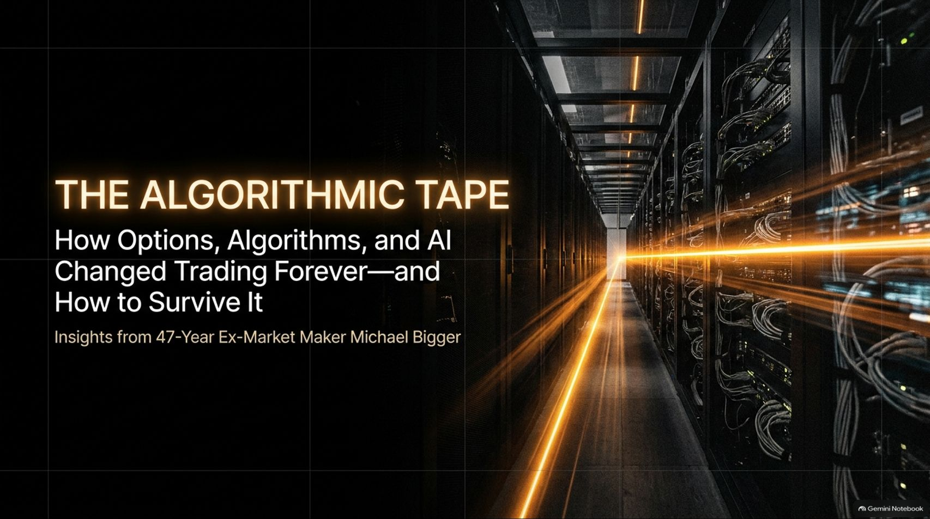
Notes:
Target Speaking Time: ~3–4 Minutes
Speaker Script:
"Welcome, everyone. Today we are tackling a critical topic: The Algorithmic Tape: How Options, Algorithms, and AI Changed Trading Forever—and How to Survive It.
Drawing from decades of frontline market-making experience, our core premise today is straightforward: the rules of engagement in global financial markets have been entirely rewritten. Human intuition and speed can no longer compete with automated infrastructure.
Over the next 16 slides, we will deconstruct how options dealers hedge, why algorithmic feedback loops dictate intraday price action, and how you can forge an unyielding survival framework using modern AI and disciplined risk management."
Ex-Market Maker: Algorithms Changed Trading FOREVER... It’s About To Happen AGAIN!
https://www.youtube.com/watch?v=weEaVmcTN08

Slide 2
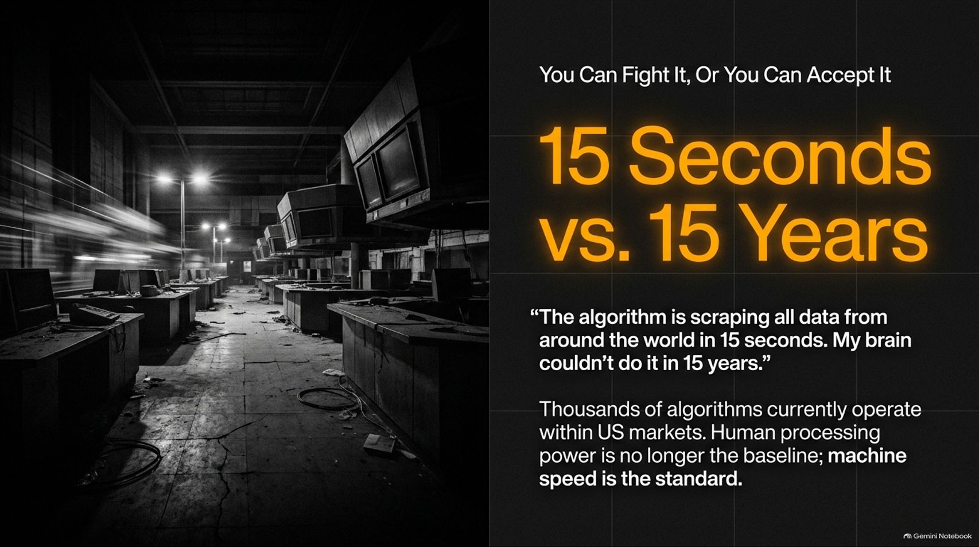

Slide 3
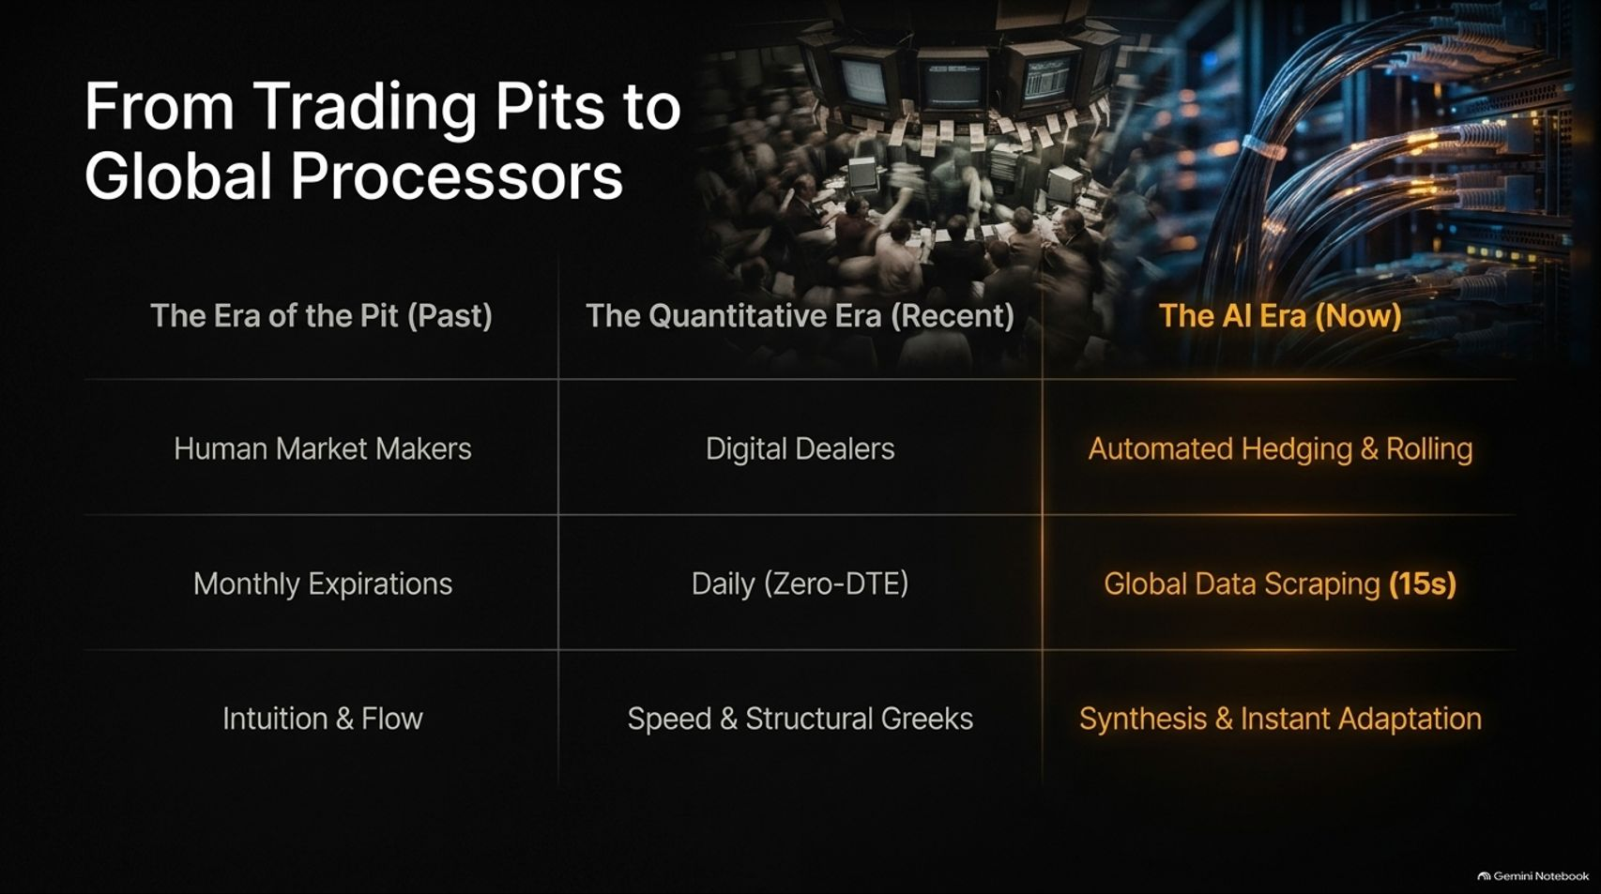
Notes:
Target Speaking Time: ~4–5 Minutes
Speaker Script:
"To understand where we are, let's look at the evolution of market structure across three distinct eras:
The Era of the Pit (Past): Characterized by human market makers shouting bids in physical pits, monthly options expirations, and trading driven by human intuition and order flow.
The Quantitative Era (Recent): Brought digital dealers, daily or short-term expirations, and a focus on speed and structural option Greeks.
The AI Era (Now): Automated hedging and rolling, global data scraping occurring every 15 seconds, and real-time synthesis and instant adaptation.
The modern market is an automated organism. Your strategy must reflect this reality."

Slide 4
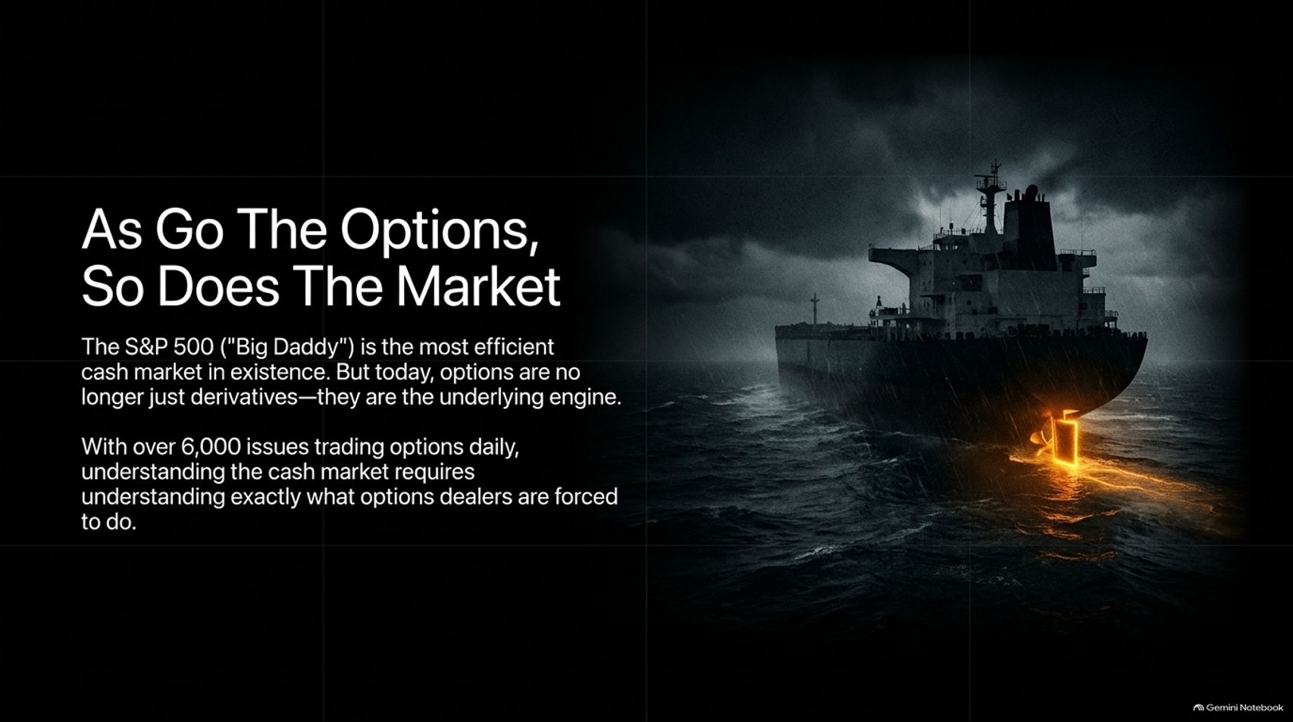
Notes:
Target Speaking Time: ~4 Minutes
Speaker Script:
"Why do options dictate cash market movements? Because the S&P 500—often called 'Big Daddy'—is the most efficient cash market in existence. But today, options are no longer just passive derivative side-bets; they are the underlying engine driving the cash market.
With over 6,000 issues trading options daily, understanding the cash market requires understanding exactly what options dealers are forced to do to stay delta-neutral. The tail wags the dog every single day."

Slide 5
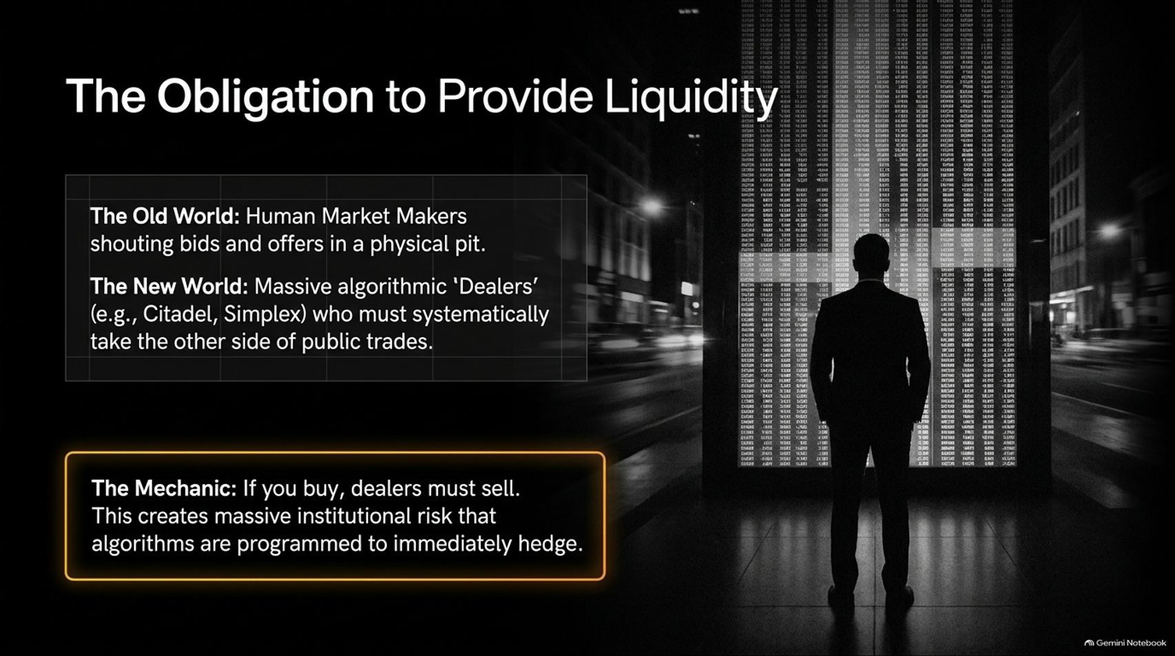
Notes:
Target Speaking Time: ~4–5 Minutes
Speaker Script:
"Let’s examine the mechanical engine: The Obligation to Provide Liquidity.
In the old world, human market makers shouted bids and offers in physical pits. In the new world, massive algorithmic dealers—firms like Citadel or Simplex—must systematically take the other side of public trades.
The Mechanic: If you buy, dealers must sell. This creates massive institutional risk that algorithms are programmed to immediately and aggressively hedge. When retail buys call options en masse, dealers are short calls and must buy the underlying stock to remain neutral."

Slide 6
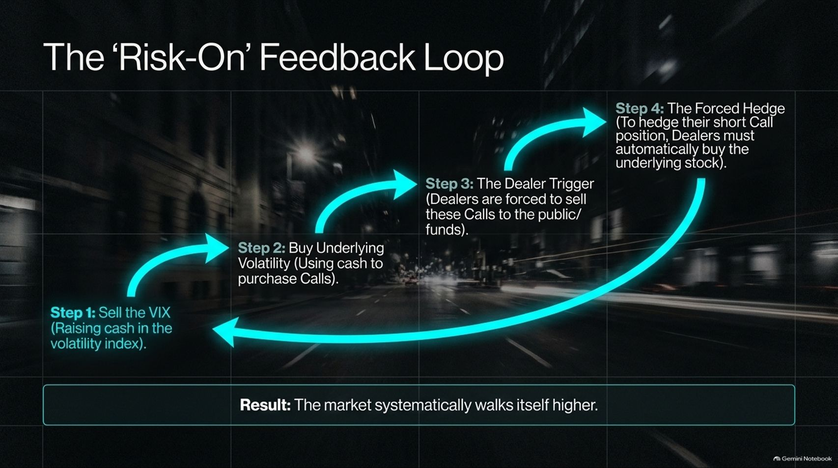
Notes:
Target Speaking Time: ~4–5 Minutes
Speaker Script:
"When these forces align, they create a powerful 'Risk-On' Feedback Loop:
Step 1: Market participants sell the VIX, raising cash in the volatility index.
Step 2: They buy underlying volatility using cash to purchase call options.
Step 3: Dealers are forced to sell these calls to the public and funds, leaving them short gamma.
Step 4 (The Forced Hedge): To hedge their short call positions, dealers must automatically buy the underlying stock.
Result: The market systematically walks itself higher, driven not by fundamental earnings news, but by dealer delta-hedging."

Slide 7
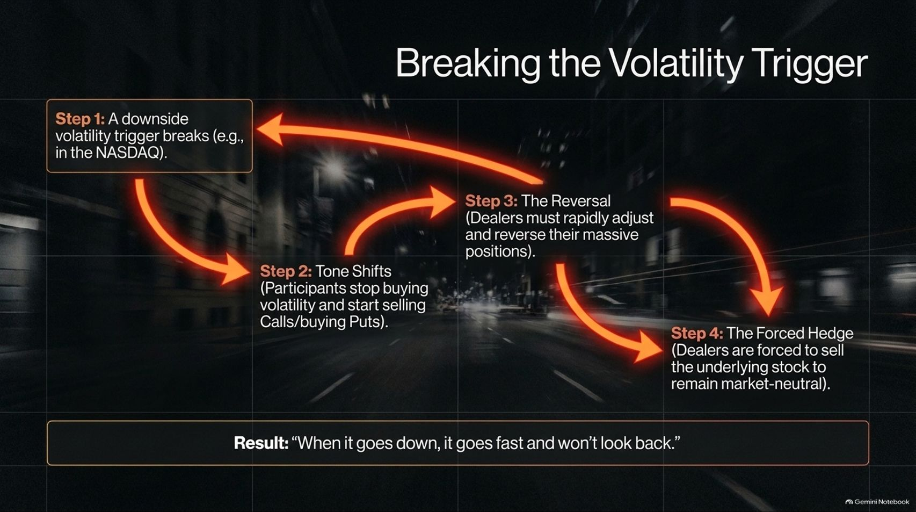

Slide 8
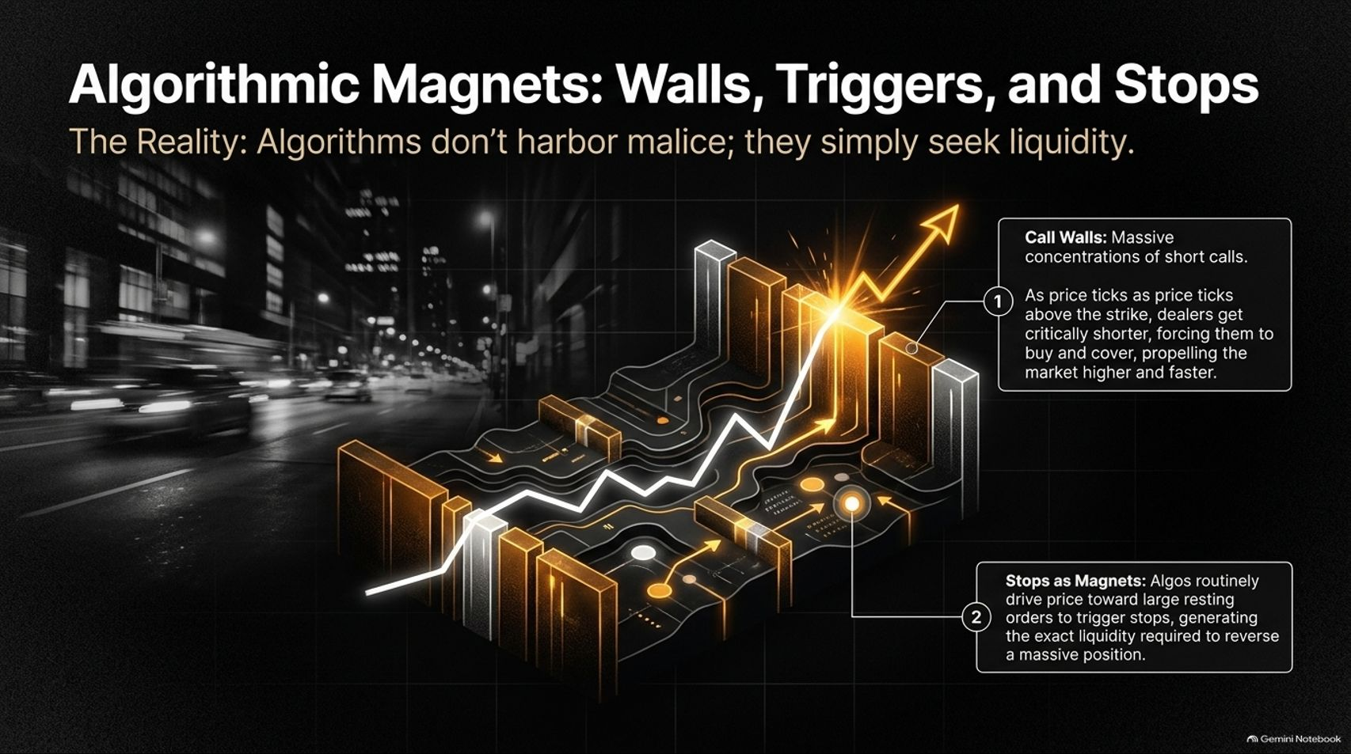
Notes:
Target Speaking Time: ~4–5 Minutes
Speaker Script:
"Algorithms don’t harbor malice or personal vendettas against retail accounts; they simply seek liquidity.
Notice two key structures on the tape:
Call Walls: Massive concentrations of short calls. As price ticks above the strike, dealers get critically shorter, forcing them to buy and cover rapidly, propelling the market higher and faster.
Stops as Magnets: Algorithms routinely drive price toward large resting orders to trigger stops, generating the exact liquidity required to unwind massive institutional positions."

Slide 9
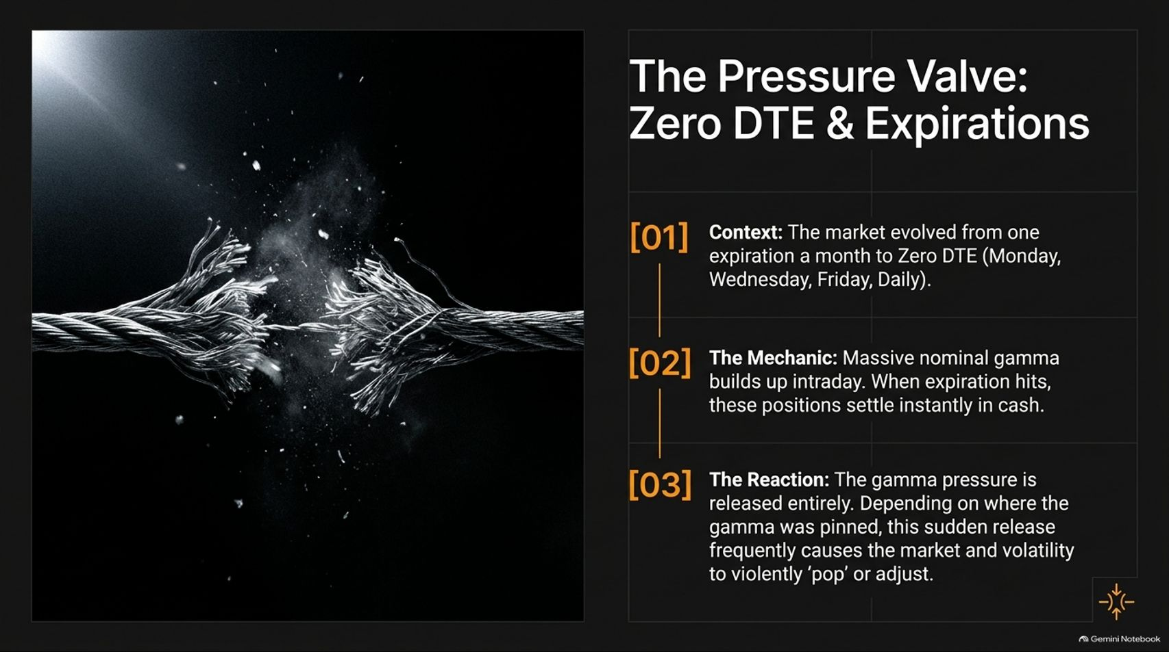
Notes:
Target Speaking Time: ~4 Minutes
Speaker Script:
"The modern market’s pressure valve is Zero DTE (Zero Days to Expiration) Options.
Context: The market evolved from monthly expirations to daily Zero DTE contracts spanning Monday through Friday.
The Mechanic: Massive nominal gamma builds up intraday. When expiration hits, these positions settle instantly in cash.
The Reaction: Gamma pressure is released entirely. Depending on where gamma was pinned, this sudden release frequently causes the market and volatility to violently 'pop' or adjust at expiration crosses."

Slide 10
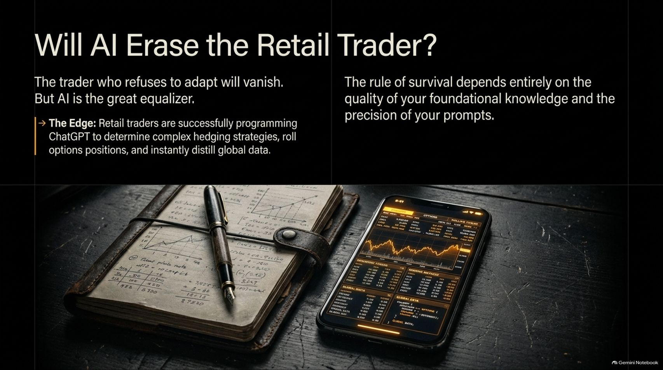
Notes:
Target Speaking Time: ~4–5 Minutes
Speaker Script:
"A common fear is whether AI will completely erase the retail trader. The truth is: the trader who refuses to adapt will vanish. But AI is also the great equalizer.
The Edge: Today, retail traders are successfully programming and prompting AI tools like ChatGPT to determine complex hedging strategies, roll options positions, and instantly distill global data feeds.
The rule of survival depends entirely on the quality of your foundational knowledge and the precision of your prompts."

Slide 11
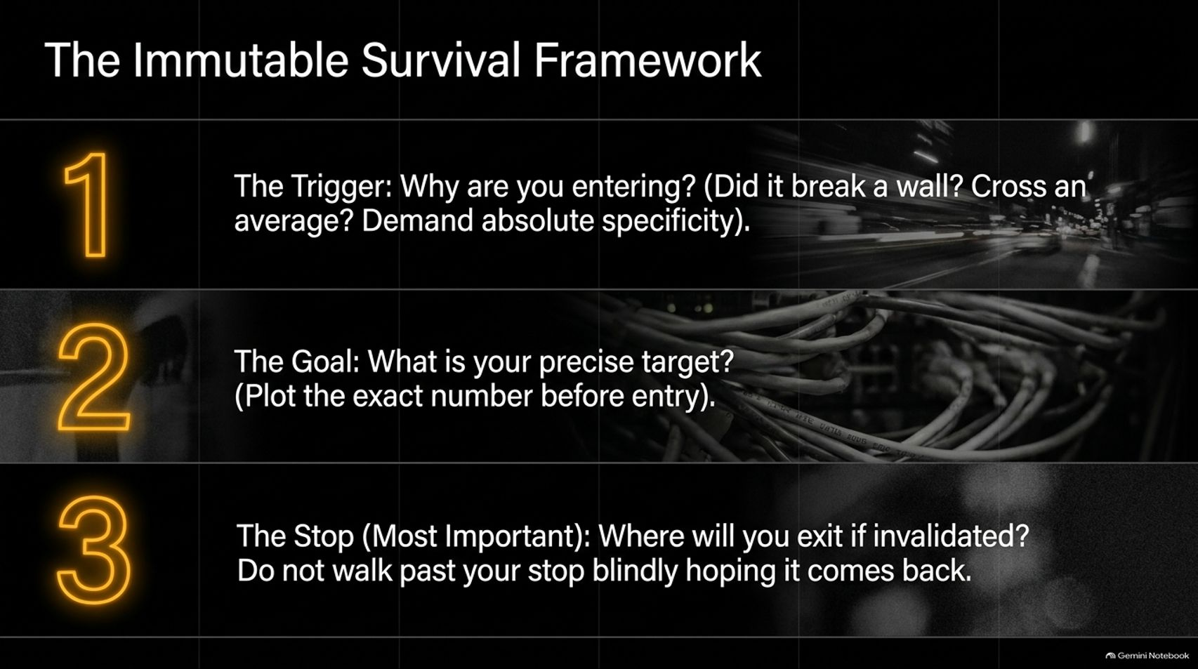

Slide 12
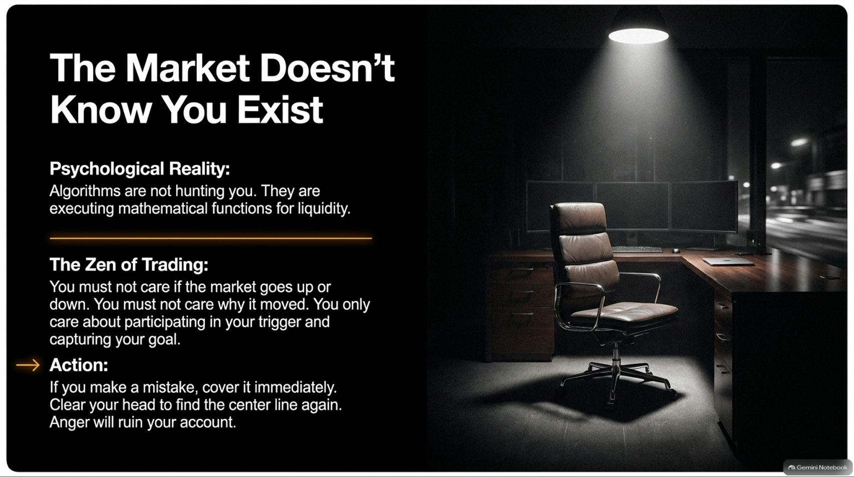
Notes:
Target Speaking Time: ~4 Minutes
Speaker Script:
"Psychological mastery is non-negotiable. Remember: The Market Doesn't Know You Exist.
Algorithms are not hunting your specific stop loss; they are executing mathematical functions for liquidity.
The Zen of Trading: You must not care if the market goes up or down. You must not care why it moved. You only care about participating in your trigger and capturing your goal. If you make a mistake, cover it immediately. Clear your head. Anger and revenge trading will ruin your account."

Slide 13
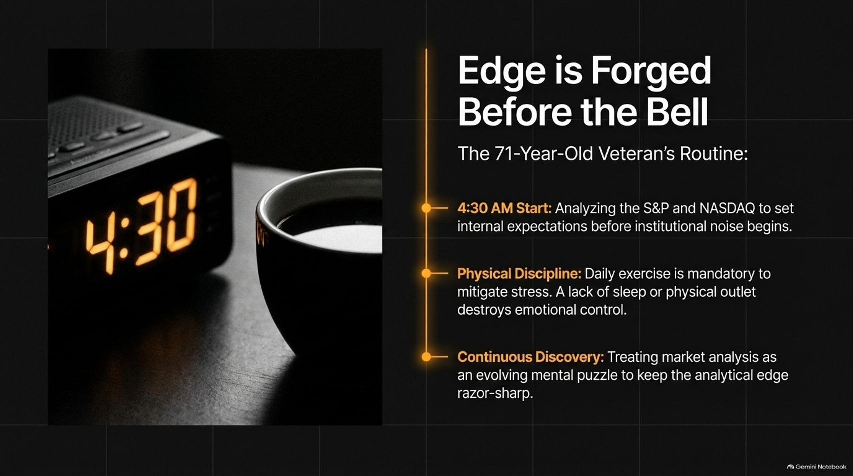
Notes:
Target Speaking Time: ~4–5 Minutes
Speaker Script:
"Edge isn't found during the chaotic frenzy of the trading day; Edge is Forged Before the Bell.
Look at the routine of veteran market makers:
4:30 AM Start: Analyzing S&P and Nasdaq structures to set internal expectations before institutional noise begins.
Physical Discipline: Daily exercise is mandatory to mitigate stress. A lack of sleep or physical outlet destroys emotional control.
Continuous Discovery: Treating market analysis as an evolving mental puzzle to keep the analytical edge razor-sharp."

Slide 14
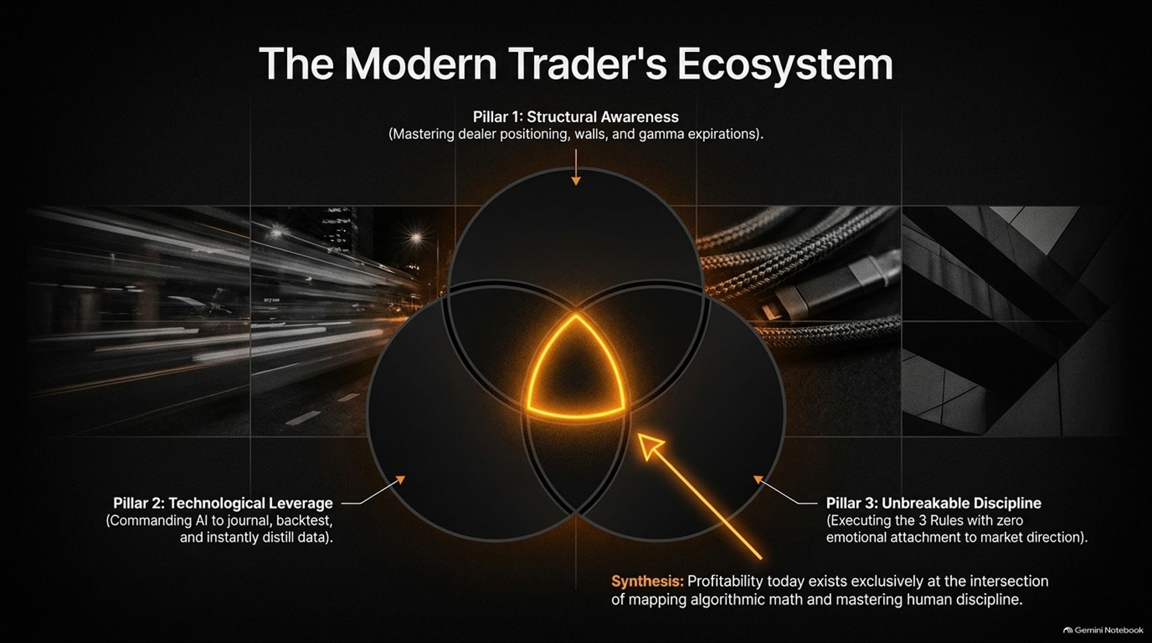
Notes:
Target Speaking Time: ~4 Minutes
Speaker Script:
"True profitability today exists at the exact intersection of three core pillars forming The Modern Trader's Ecosystem:
Pillar 1 (Structural Awareness): Mastering dealer positioning, walls, and gamma expirations.
Pillar 2 (Technological Leverage): Commanding AI to journal, backtest, and instantly distill global data.
Pillar 3 (Unbreakable Discipline): Executing your rules with zero emotional attachment to market direction.
Master all three, and you possess a durable professional edge."

Slide 15
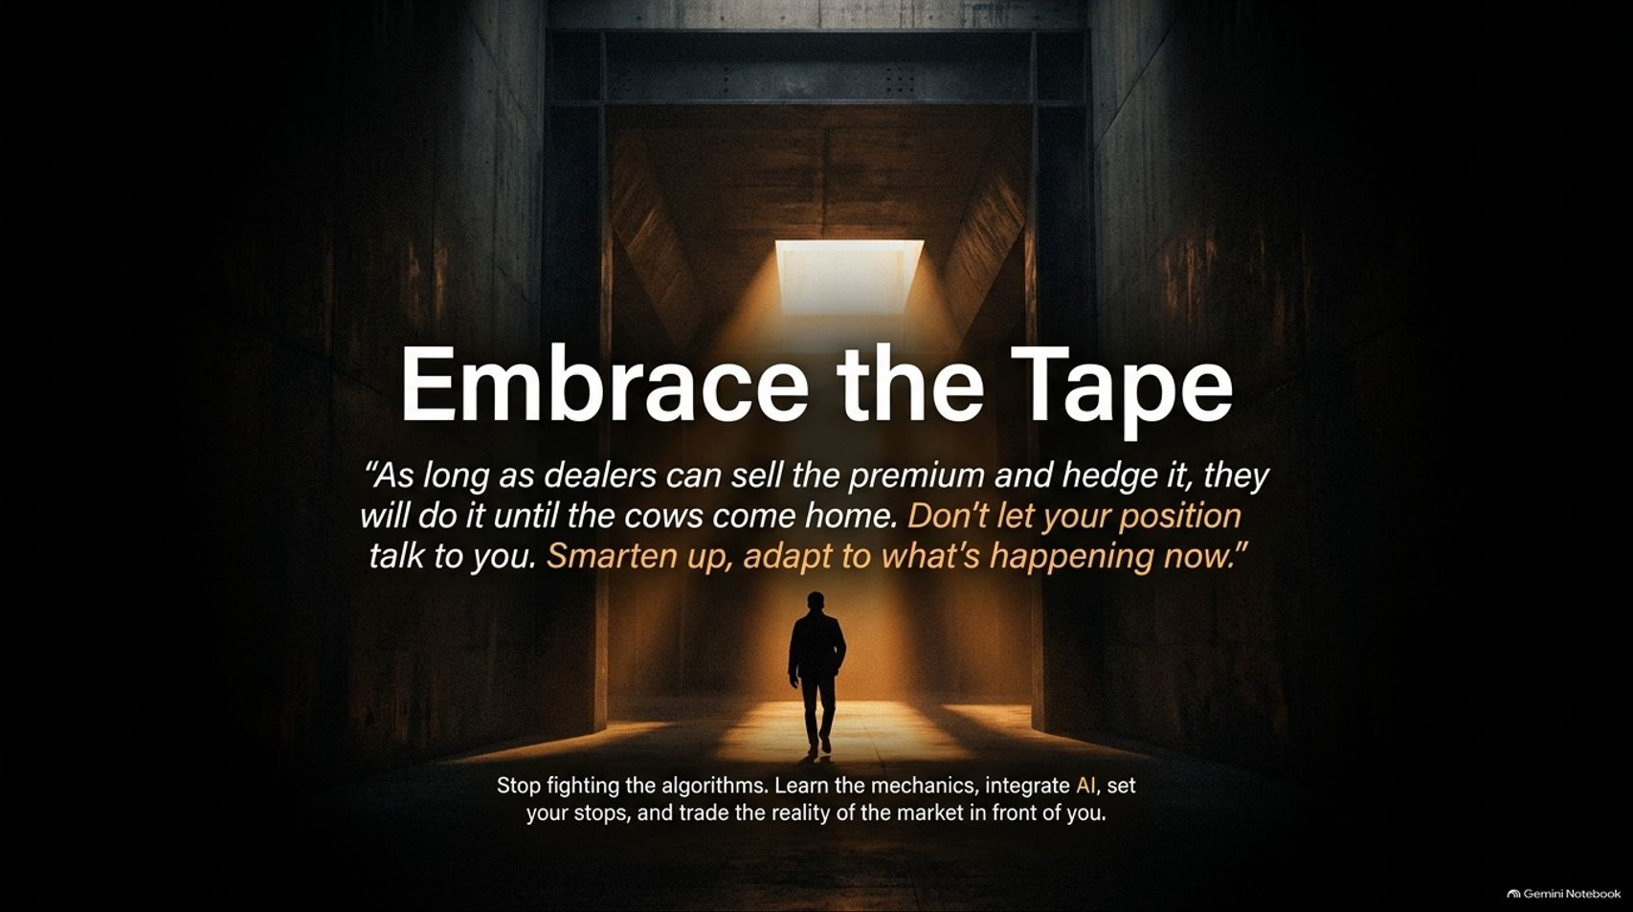
Notes:
Target Speaking Time: ~3–4 Minutes
Speaker Script:
"To wrap up our core philosophy: Embrace the Tape.
As our veteran market maker reminds us: 'As long as dealers can sell the premium and hedge it, they will do it until the cows come home. Don't let your position talk to you. Smarten up, adapt to what's happening now.'
Stop fighting the algorithms. Learn the mechanics, integrate AI into your workflow, set your stops, and trade the objective reality of the market in front of you."

Slide 16
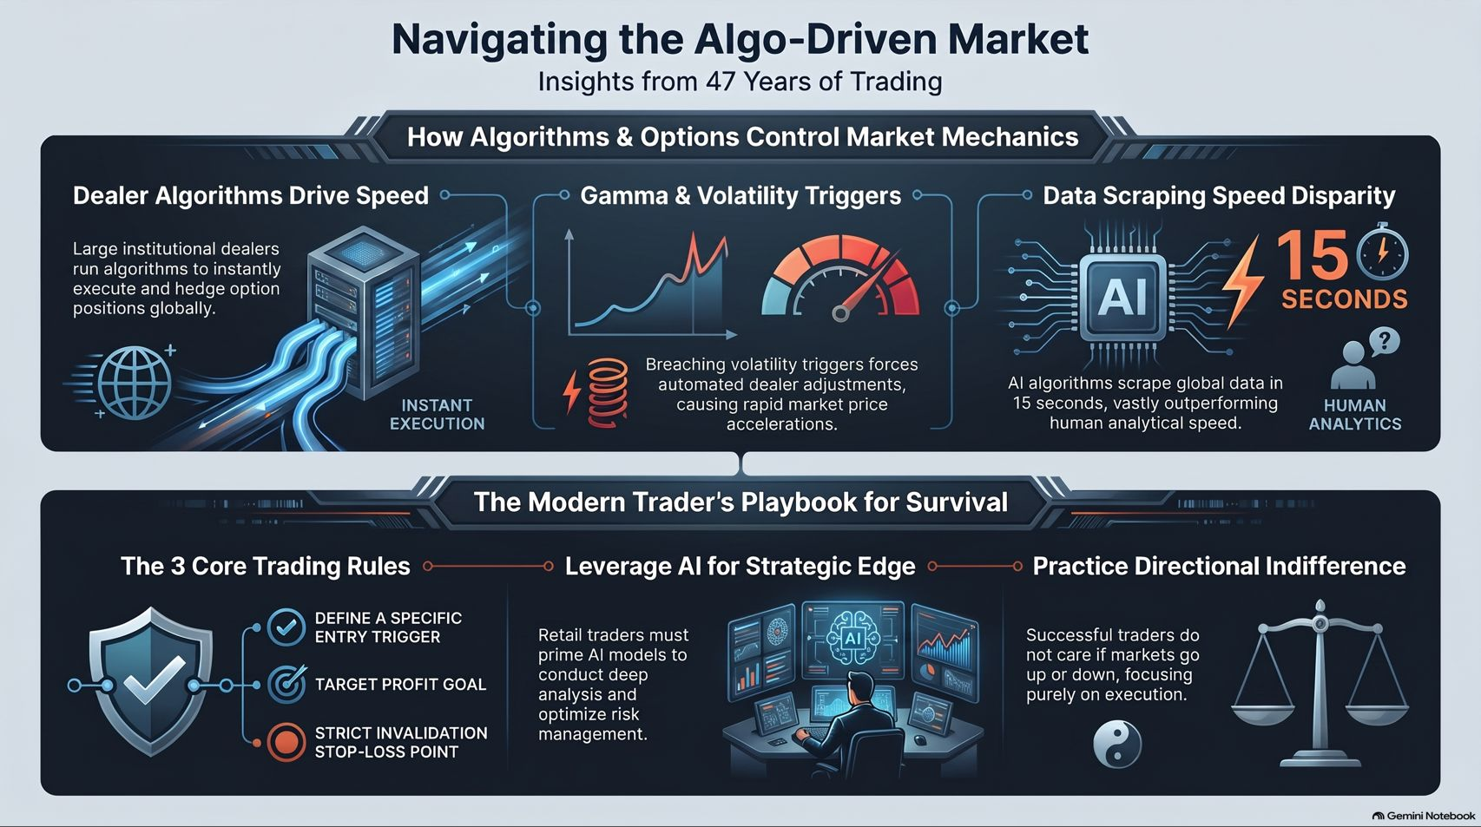
Notes:
Target Speaking Time: ~4–5 Minutes
Speaker Script:
"Our concluding dashboard brings together everything we've covered:
On the top half, we recognize how dealer algorithms drive speed, gamma triggers accelerate downside, and AI data scraping outpaces human analysis in 15 seconds.
On the bottom half, our playbook responds: enforce the 3 core trading rules, leverage AI for strategic edge, and practice absolute directional indifference.
Thank you for your time, and let’s open the floor to questions."

