Slide 1
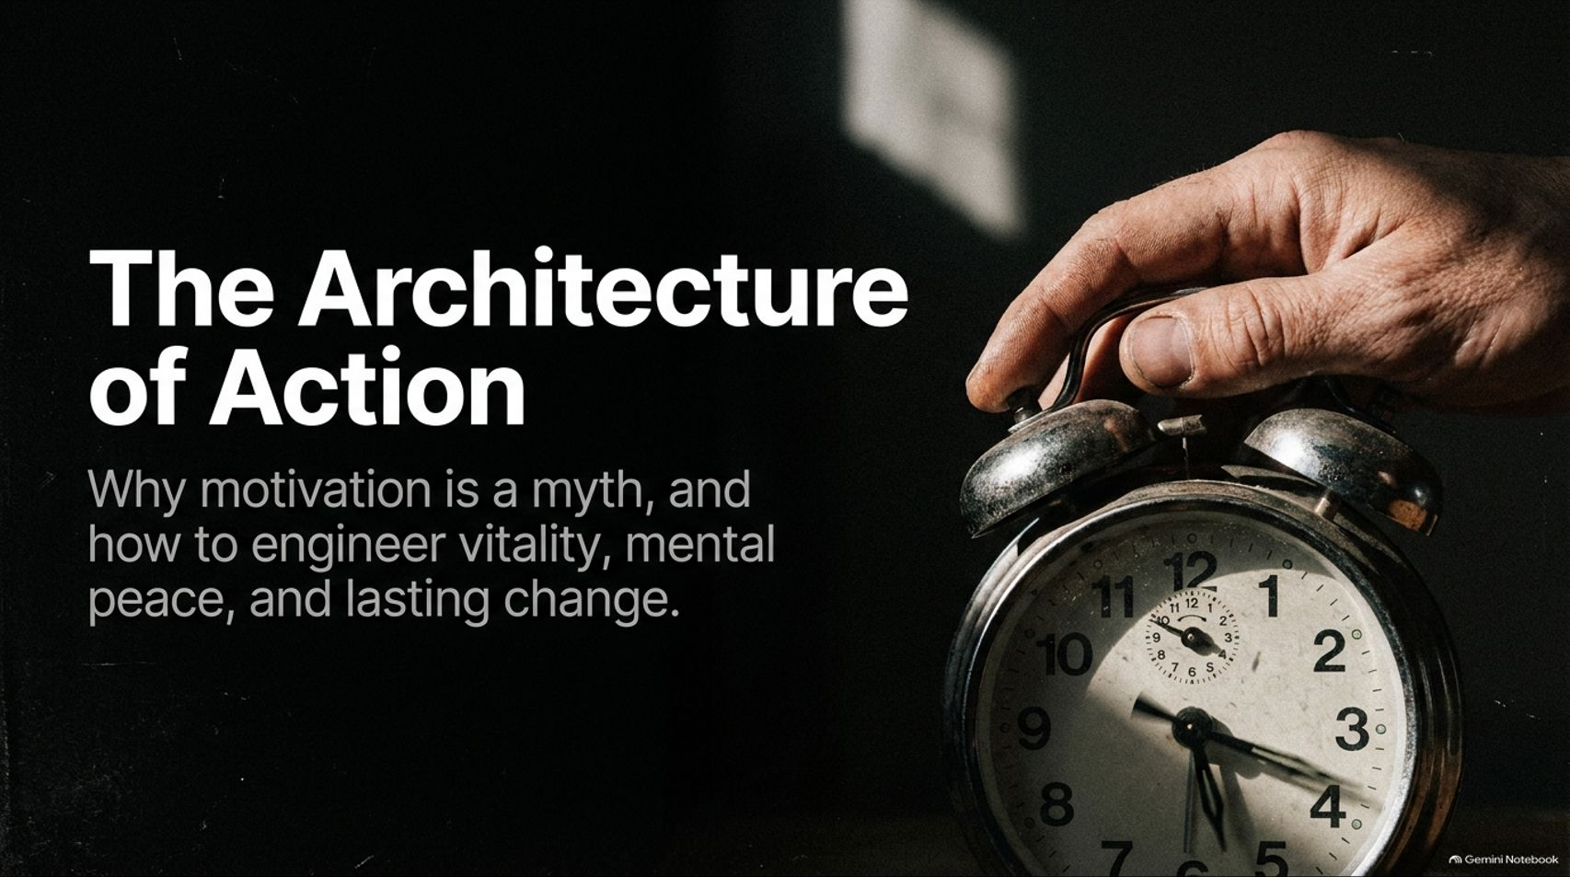
Notes:
Target Speaking Time: ~3–4 Minutes
Speaker Script:
"Welcome, everyone. Today we are tackling a critical topic: The Architecture of Action: Why motivation is a myth, and how to engineer vitality, mental peace, and lasting change.
Drawing from the powerful insights shared by Mark Hyman and Mel Robbins, our core premise today is straightforward: human beings have been sold a dangerous lie. We spend our entire lives waiting around to feel ready before we act, waiting for motivation to strike like lightning. But as you're going to see today, motivation is fleeting, unreliable, and entirely unnecessary.
Over the next 16 slides, we will deconstruct the neurological trap of hesitation, learn how to hijack our environment, master our mental boundaries using the 'Let Them / Let Me' framework, and engineer a lifelong upward physical spiral. Let's dive in."
Mel Robbins: The Real Reason You Can't Stick to Healthy Habits (And How to Fix It)
https://www.youtube.com/watch?v=5MDvPFrAsGM

Slide 2
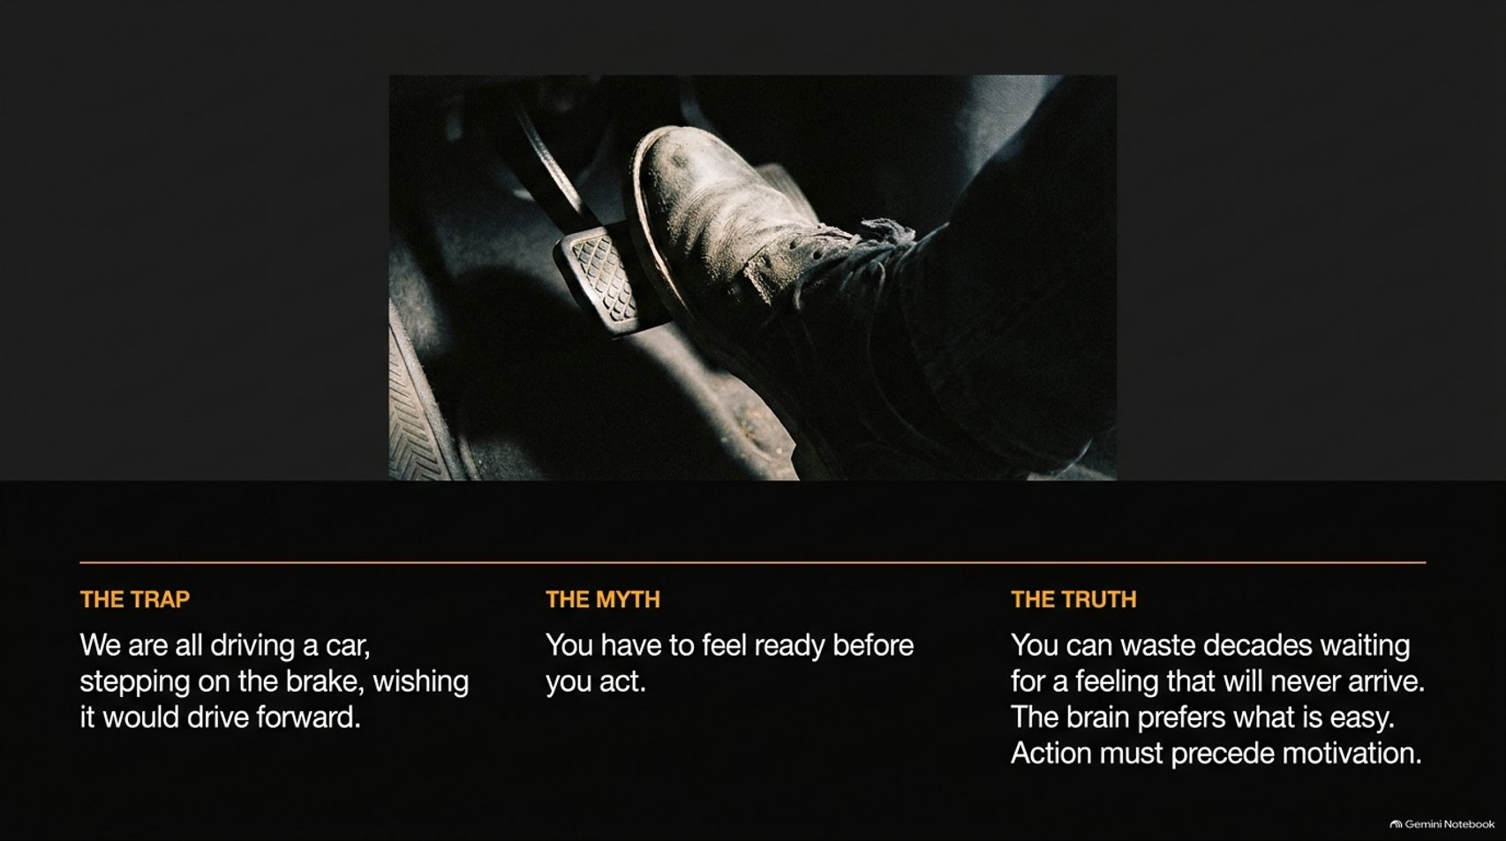

Slide 3
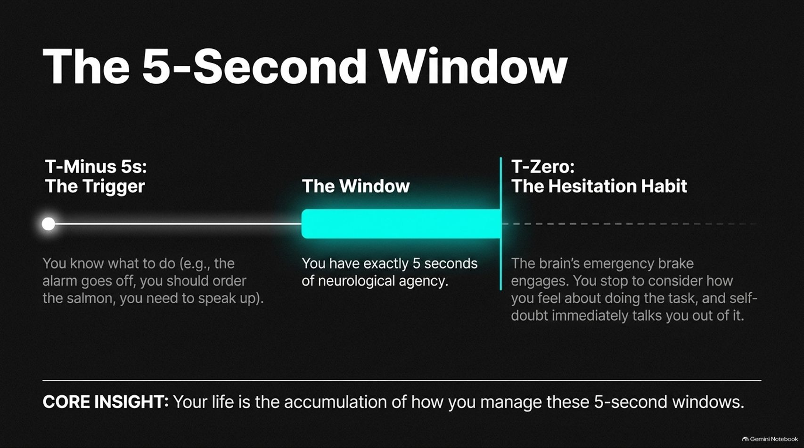
Notes:
Target Speaking Time: ~4–5 Minutes
Speaker Script:
"So, what actually happens inside our brains during those critical moments of choice? We enter The 5-Second Window.
At T-Minus 5s (The Trigger): You know exactly what you need to do. The alarm goes off, you know you should order the salmon instead of the burger, or you know you need to speak up in a meeting.
The Window: You have exactly 5 seconds of neurological agency before your brain takes over.
At T-Zero (The Hesitation Habit): The brain’s emergency brake engages. You stop to consider how you feel about doing the task. Because change feels uncomfortable, self-doubt immediately talks you out of it.
Core Insight: Your entire life is simply the accumulation of how you manage these 5-second windows."

Slide 4
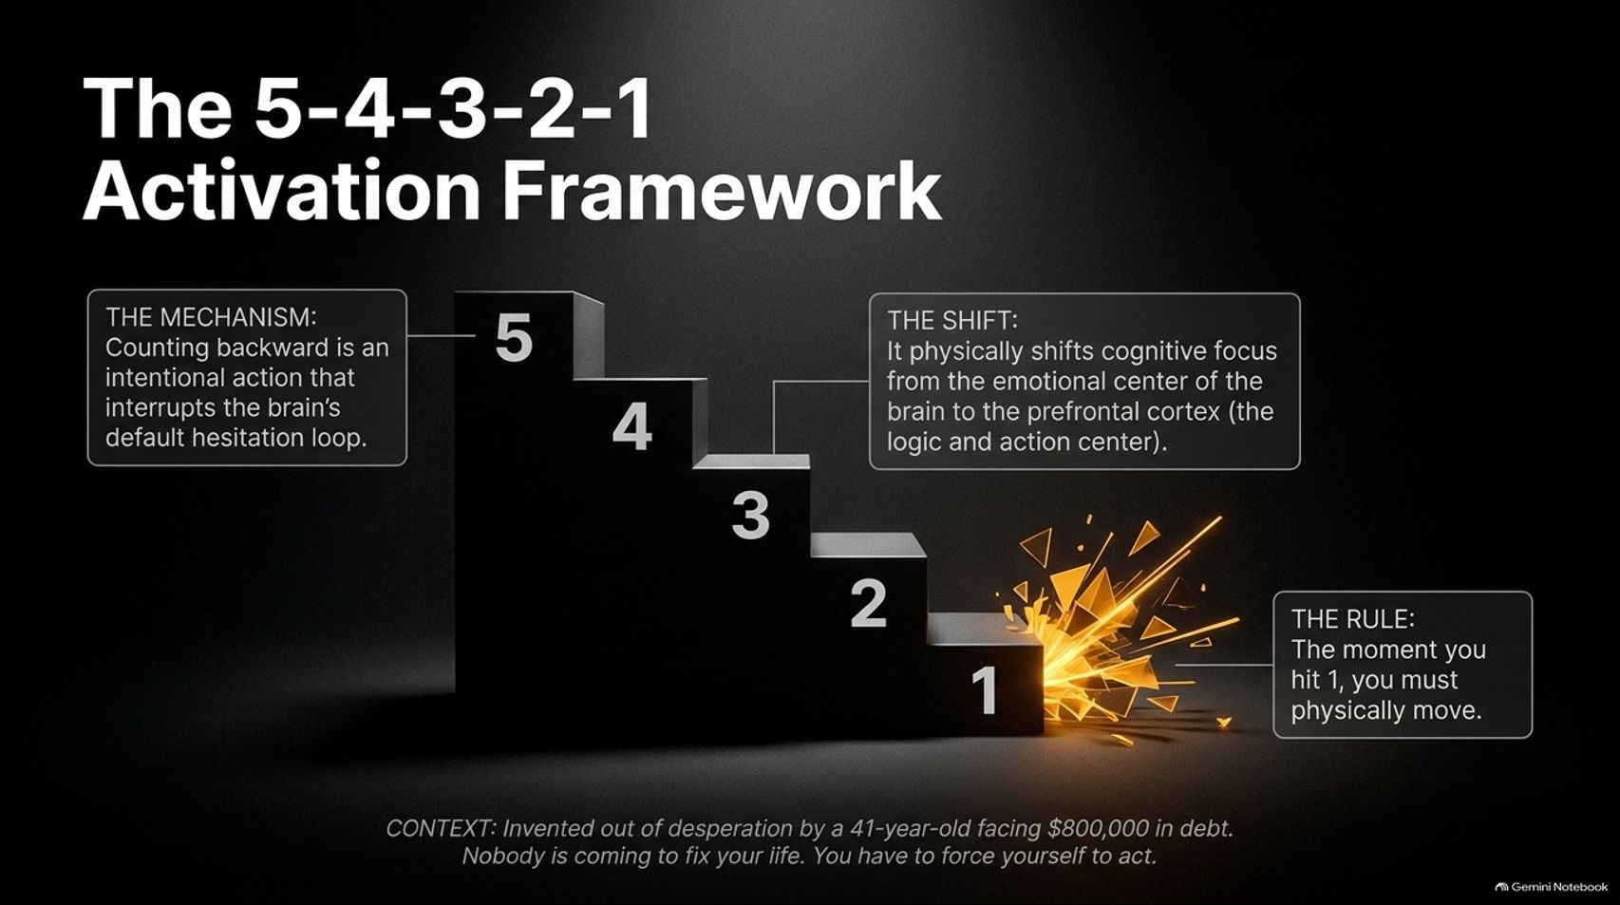
Notes:
Target Speaking Time: ~4–5 Minutes
Speaker Script:
"How do we beat the hesitation habit? Enter The 5-4-3-2-1 Activation Framework.
The Context: This tool wasn't born in a sterile academic laboratory; it was invented out of sheer desperation by a 41-year-old Mel Robbins who was $800,000 in debt, facing foreclosure, and struggling with severe personal and professional burnout. She realized a fundamental truth: Nobody is coming to save you. You have to force yourself to act.
The Mechanism: Counting backward from 5 to 1 is an intentional metacognitive action that interrupts the brain's default hesitation loop.
The Shift: Counting backward physically shifts your cognitive focus away from the emotional center of the brain (the limbic system) and activates the prefrontal cortex—your logic and action center.
The Rule: The moment you hit 1, you must physically move. No exceptions."

Slide 5
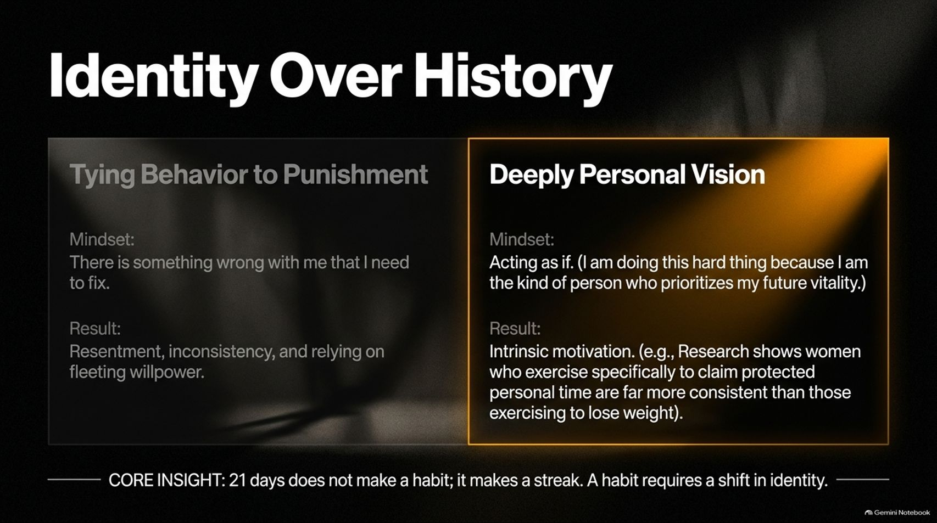
Notes:
Target Speaking Time: ~4–5 Minutes
Speaker Script:
"Moving past a single moment of action requires shifting how we view ourselves. This brings us to Identity Over History.
On the left, we see the trap of Tying Behavior to Punishment: Operating under the mindset that 'There is something fundamentally wrong with me that I need to fix.' The result? Chronic resentment, inconsistency, and relying entirely on fleeting willpower.
On the right, we embrace a Deeply Personal Vision: Acting as if—operating from the identity of someone who prioritizes future vitality.
Consider the research: Studies show that women who exercise specifically to claim protected personal time for themselves are far more consistent than those exercising solely for weight loss.
Core Insight: 21 days does not make a habit; it makes a streak. A true habit requires a fundamental shift in identity."

Slide 6


Slide 7
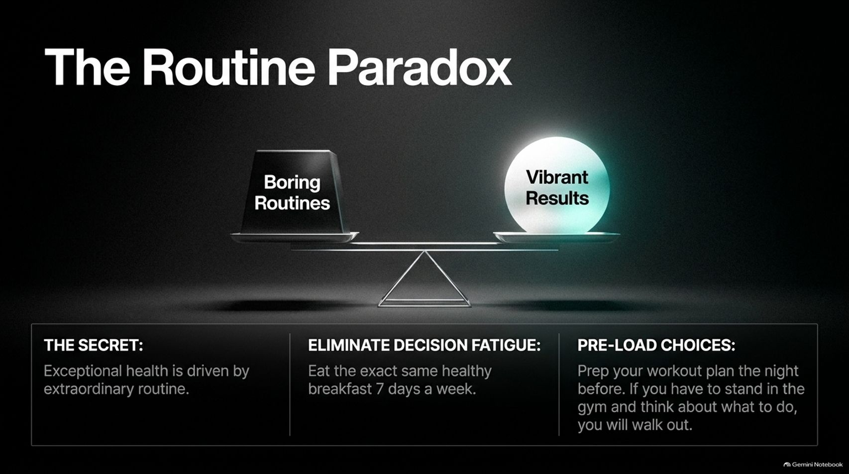
Notes:
Target Speaking Time: ~4–5 Minutes
Speaker Script:
"Next, let's examine The Routine Paradox.
The Secret: Exceptional health and long-term vitality are not born from chaotic bursts of inspiration; they are driven by extraordinary routine.
Eliminate Decision Fatigue: Dr. Hyman and Mel Robbins both share that they eat the exact same healthy breakfast day after day. Why? Because every decision you make drains your mental battery. Eliminate trivial choices.
Pre-Load Choices: Prep your workout plan and lay out your clothes the night before. If you walk into the gym and have to stand around wondering what exercises to do, cognitive fatigue will take over, and you will walk right back out the door."

Slide 8
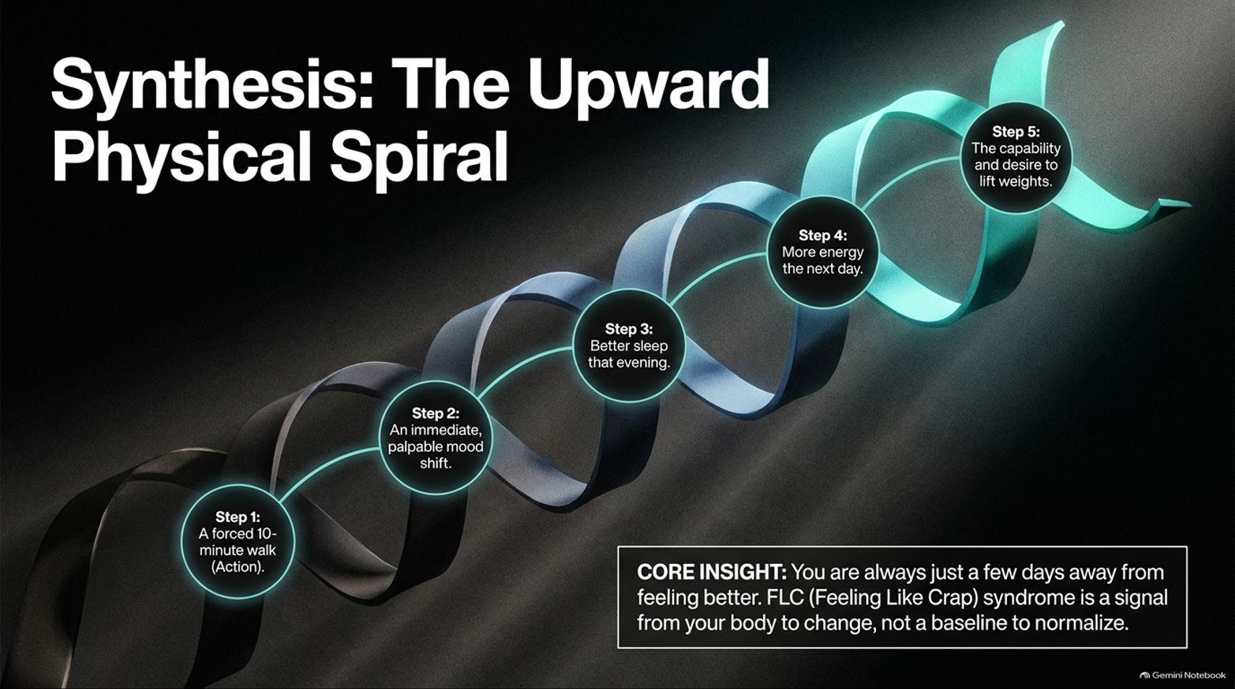
Notes:
Target Speaking Time: ~4–5 Minutes
Speaker Script:
"When you string these actions together, you create The Upward Physical Spiral:
Step 1: A forced 10-minute walk (Action).
Step 2: An immediate, palpable mood and energy shift.
Step 3: Better sleep that same evening.
Step 4: Increased baseline energy the next day.
Step 5: The genuine capability and renewed desire to lift weights and expand your physical limits.
Core Insight: You are always just a few days away from feeling better. FLC (Feeling Like Crap) syndrome is a biological signal from your body telling you to change, not a miserable baseline to normalize."

Slide 9


Slide 10
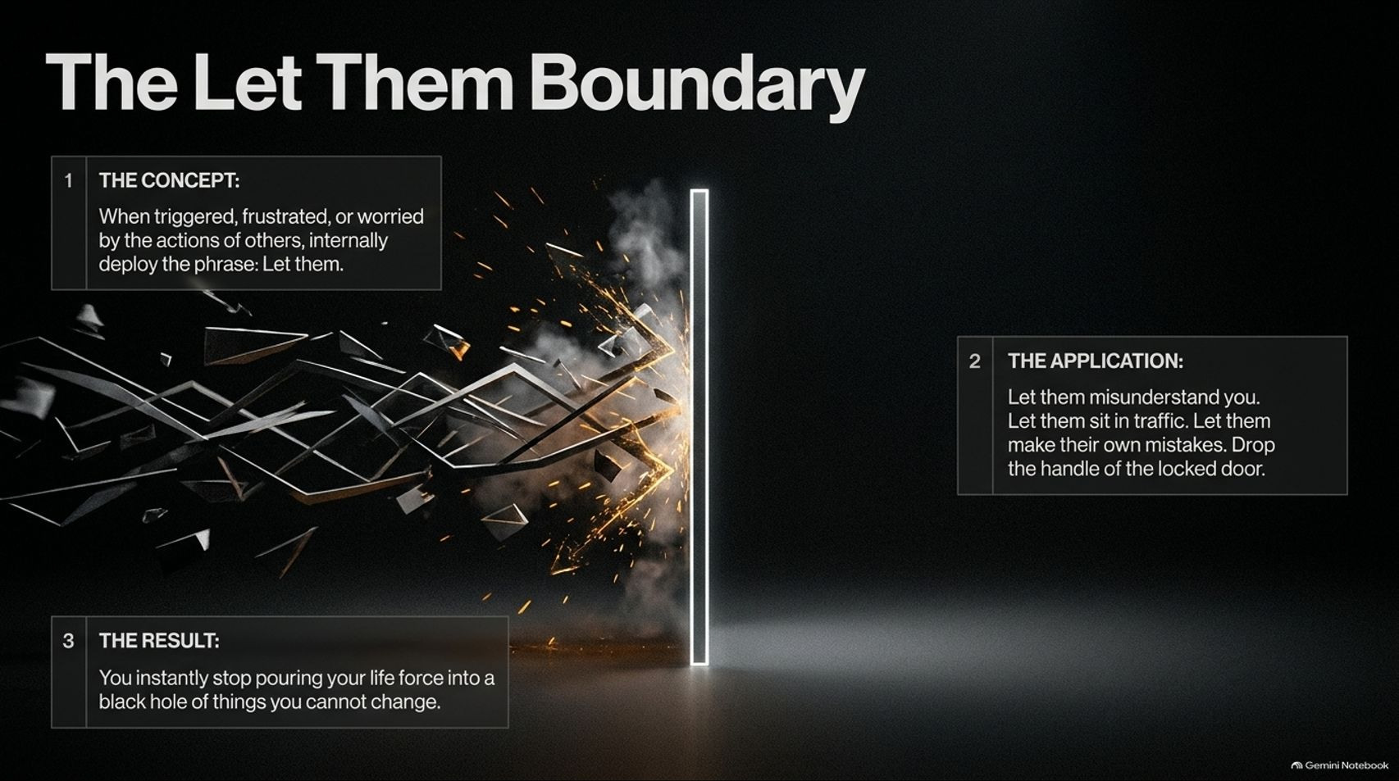
Notes:
Target Speaking Time: ~4–5 Minutes
Speaker Script:
"How do we stop fighting reality? We deploy The Let Them Boundary.
1. The Concept: Whenever you feel triggered, frustrated, or worried by the actions of others, internally deploy four powerful words: 'Let them.'
2. The Application: Let them misunderstand you. Let them sit in traffic. Let them make their own mistakes. Drop the handle of the locked door you've been pulling on for years.
3. The Result: You instantly stop pouring your precious life force into a bottomless black hole of things you cannot change. You establish a rock-solid mental boundary."

Slide 11
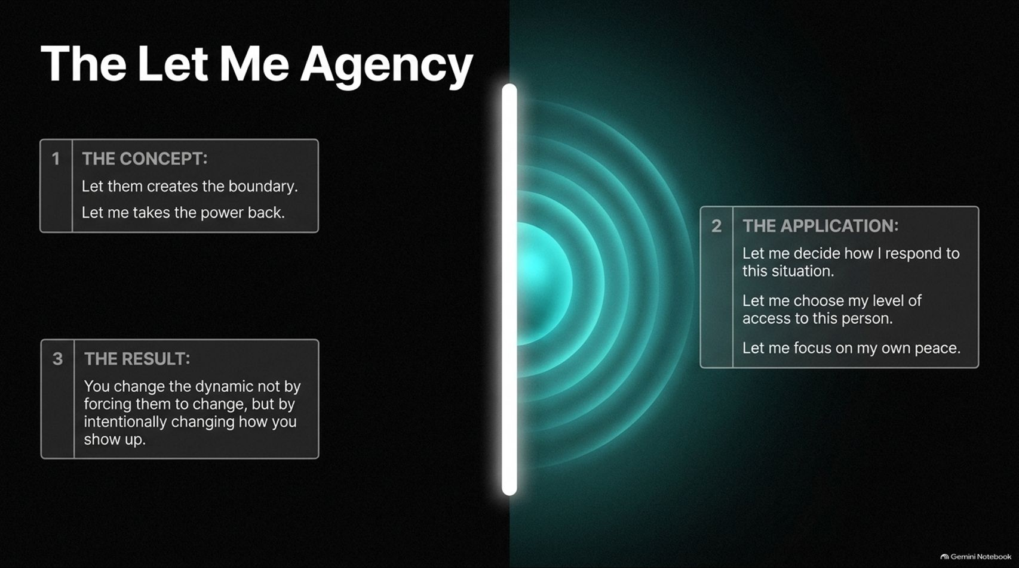
Notes:
Target Speaking Time: ~4–5 Minutes
Speaker Script:
"Saying 'Let them' is only half of the equation. To regain true power, you must pair it with The Let Me Agency.
1. The Concept: 'Let them' creates the outer boundary; 'Let me' takes your personal power back.
2. The Application: 'Let me' decide how I respond to this situation. 'Let me' choose my level of access to this person. 'Let me' focus entirely on my own inner peace.
3. The Result: You transform difficult dynamics not by forcing other people to bend to your will, but by intentionally changing how you show up in every room."

Slide 12
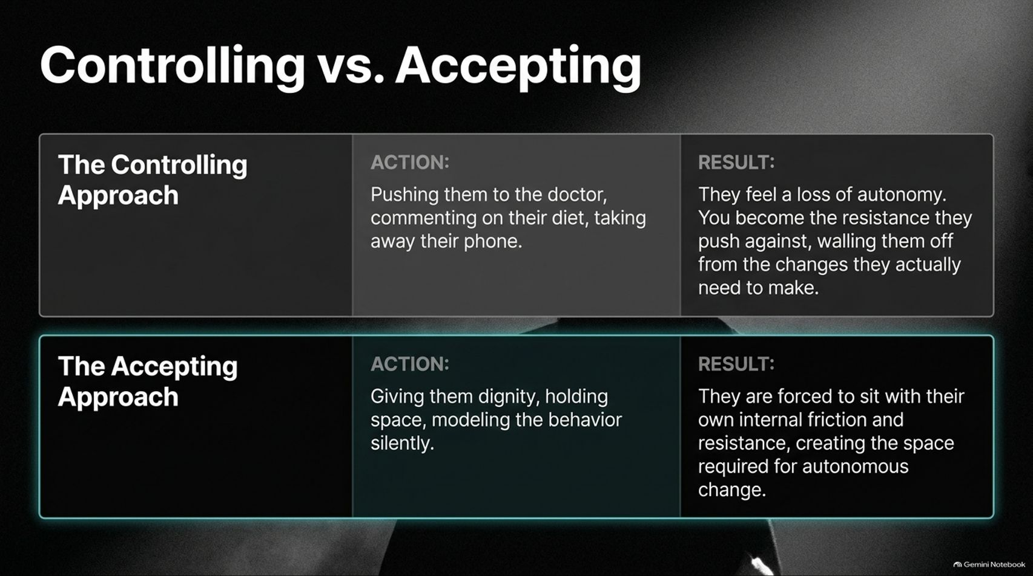
Notes:
Target Speaking Time: ~4–5 Minutes
Speaker Script:
"Let’s look at the direct contrast between The Controlling Approach and The Accepting Approach in our relationships.
The Controlling Approach: Pushing your partner to see a doctor, constantly criticizing their diet, or policing their habits.
Result: They feel a profound loss of autonomy. You become the exact resistance they push against, walling them off from the healthy changes they actually need to make.
The Accepting Approach: Giving them dignity, holding supportive space, and modeling the desired behavior silently.
Result: They are forced to sit with their own internal friction and resistance, which creates the vital psychological space required for autonomous, lasting change."

Slide 13
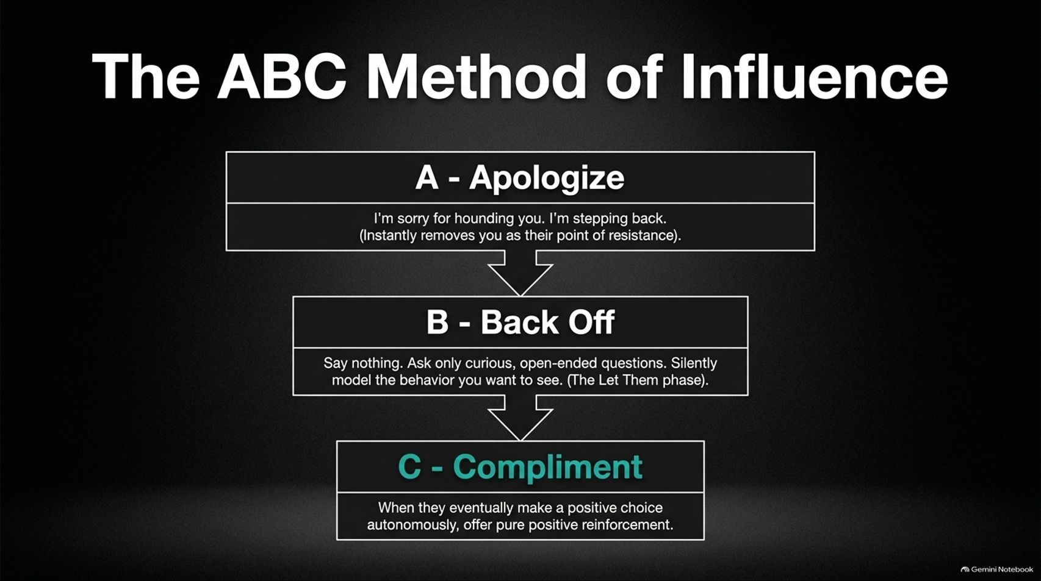
Notes:
Target Speaking Time: ~4–5 Minutes
Speaker Script:
"Drawing on the research of neuroscientist Dr. Tally Sharot, Mel Robbins outlines The ABC Method of Influence for encouraging loved ones without nagging:
A - Apologize: Acknowledge your past pressure. Say, 'I'm sorry for hounding you about your health. I'm stepping back.' This instantly disarms them and removes the point of resistance.
B - Back Off: Stop lecturing. Ask curious, open-ended questions instead. Silently model the healthy behaviors you want to see.
C - Compliment: When they eventually make a positive choice autonomously, offer pure, uncritical positive reinforcement."

Slide 14
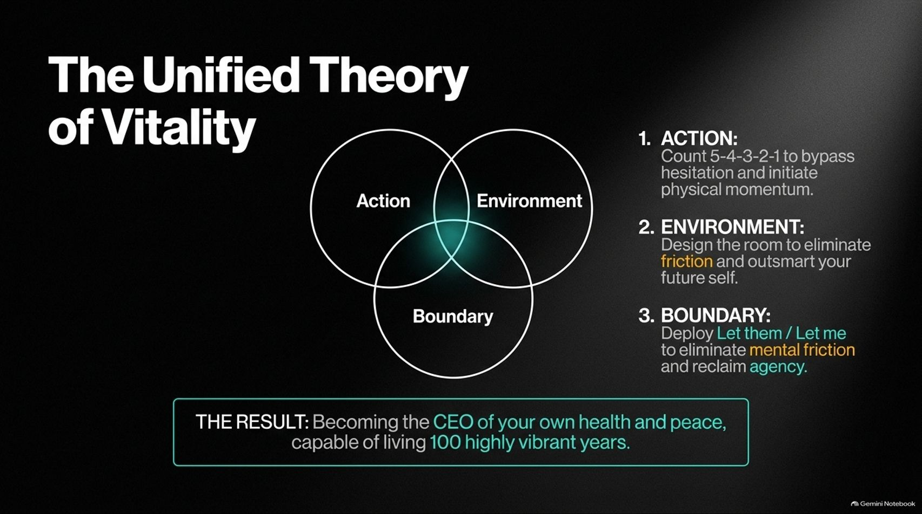
Notes:
Target Speaking Time: ~4–5 Minutes
Speaker Script:
"When we synthesize everything we’ve discussed, we arrive at The Unified Theory of Vitality, which sits at the intersection of three pillars:
Action: Using the 5-4-3-2-1 rule to bypass hesitation and initiate physical momentum.
Environment: Designing your physical surroundings to eliminate friction and outsmart your future self.
Boundary: Deploying 'Let them / Let me' to eliminate mental friction and reclaim personal agency.
The Result: You become the CEO of your own health and peace of mind, fully capable of living 100 highly vibrant years."

Slide 15
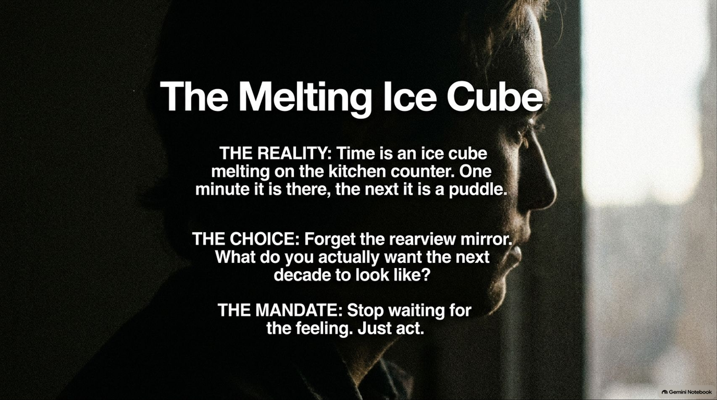
Notes:
Target Speaking Time: ~3–4 Minutes
Speaker Script:
"As we near the end of our journey, remember the metaphor of The Melting Ice Cube.
The Reality: Time is an ice cube melting on a warm kitchen counter. One minute it is whole, and the next it is a puddle.
The Choice: Stop looking in the rearview mirror filled with regrets or past failures. Ask yourself honestly: What do you actually want the next decade of your life to look like?
The Mandate: Stop waiting to 'feel ready.' Stop waiting for motivation. Just act."

Slide 16

Notes:
Target Speaking Time: ~4–5 Minutes
Speaker Script:
"Our concluding dashboard brings together the complete blueprint for physical vitality and habit change:
On the upper path, we see that action precedes motivation, environment engineering builds consistency, and physiological adaptation remains possible at any age—whether you are 50, 67, or 92.
On the lower path, we master the mindset framework: releasing external control with 'Let them' and owning our power with 'Let me.'
Remember: You have one life. Grab it by the horns, take control of your health, and start building your future today. Thank you."

