Slide 1

Notes:
Target Speaking Time: ~3–4 Minutes
Speaker Script:
"Welcome, everyone. Today we are exploring The Architecture of Impact: Markets, Resilience, and the Ultimate Asymmetric Bet, featuring distilled insights from legendary investor Bill Ackman.
Over his decades leading Pershing Square, Ackman has built a reputation for high-conviction value investing, navigating market panics, and orchestrating complex corporate transformations. But as we'll see today, the principles that allow an investor to generate compounding returns in public markets are the exact same principles required to navigate technological disruption and conquer profound personal tragedy.
Across these 14 slides, we will unpack Pershing Square's core investment engine, deconstruct the anatomy of billion-dollar equity bets like Netflix, analyze the structural advantage of permanent capital, and examine how Ackman applied the investor’s toolkit to medical innovation following a catastrophic personal crisis. Let's begin."
Bill Ackman: People are Going to Lose a Lot of Money
https://www.youtube.com/watch?v=Cpq8y5HpcF4

Slide 2
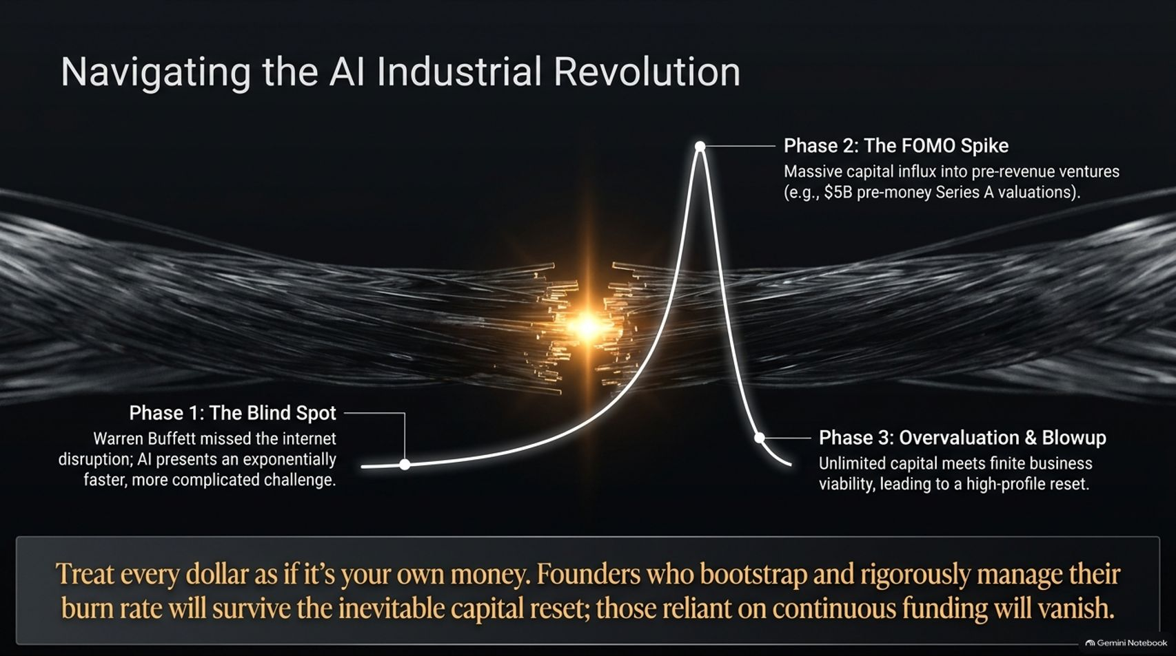
Notes:
Target Speaking Time: ~4–5 Minutes
Speaker Script:
"We begin by examining the current macroeconomic climate and the ongoing AI Industrial Revolution through the lens of market cycles.
Phase 1 (The Blind Spot): History shows that even the greatest investors can miss transformative paradigm shifts. Warren Buffett famously missed the early internet disruption; AI represents an exponentially faster and more complex challenge.
Phase 2 (The FOMO Spike): We are currently witnessing an unprecedented capital influx into pre-revenue ventures. Companies are securing $5 billion pre-money Series A valuations within weeks of founding, driven purely by the Fear Of Missing Out.
Phase 3 (Overvaluation & Blowup): As Ackman warns, when unlimited venture capital meets finite business viability, a high-profile market reset is inevitable.
Key Takeaway: Founders and investors must treat every dollar as if it’s their own money. Those who bootstrap, manage burn rates, and focus on unit economics will survive the capital reset; those reliant on continuous external funding will vanish."

Slide 3
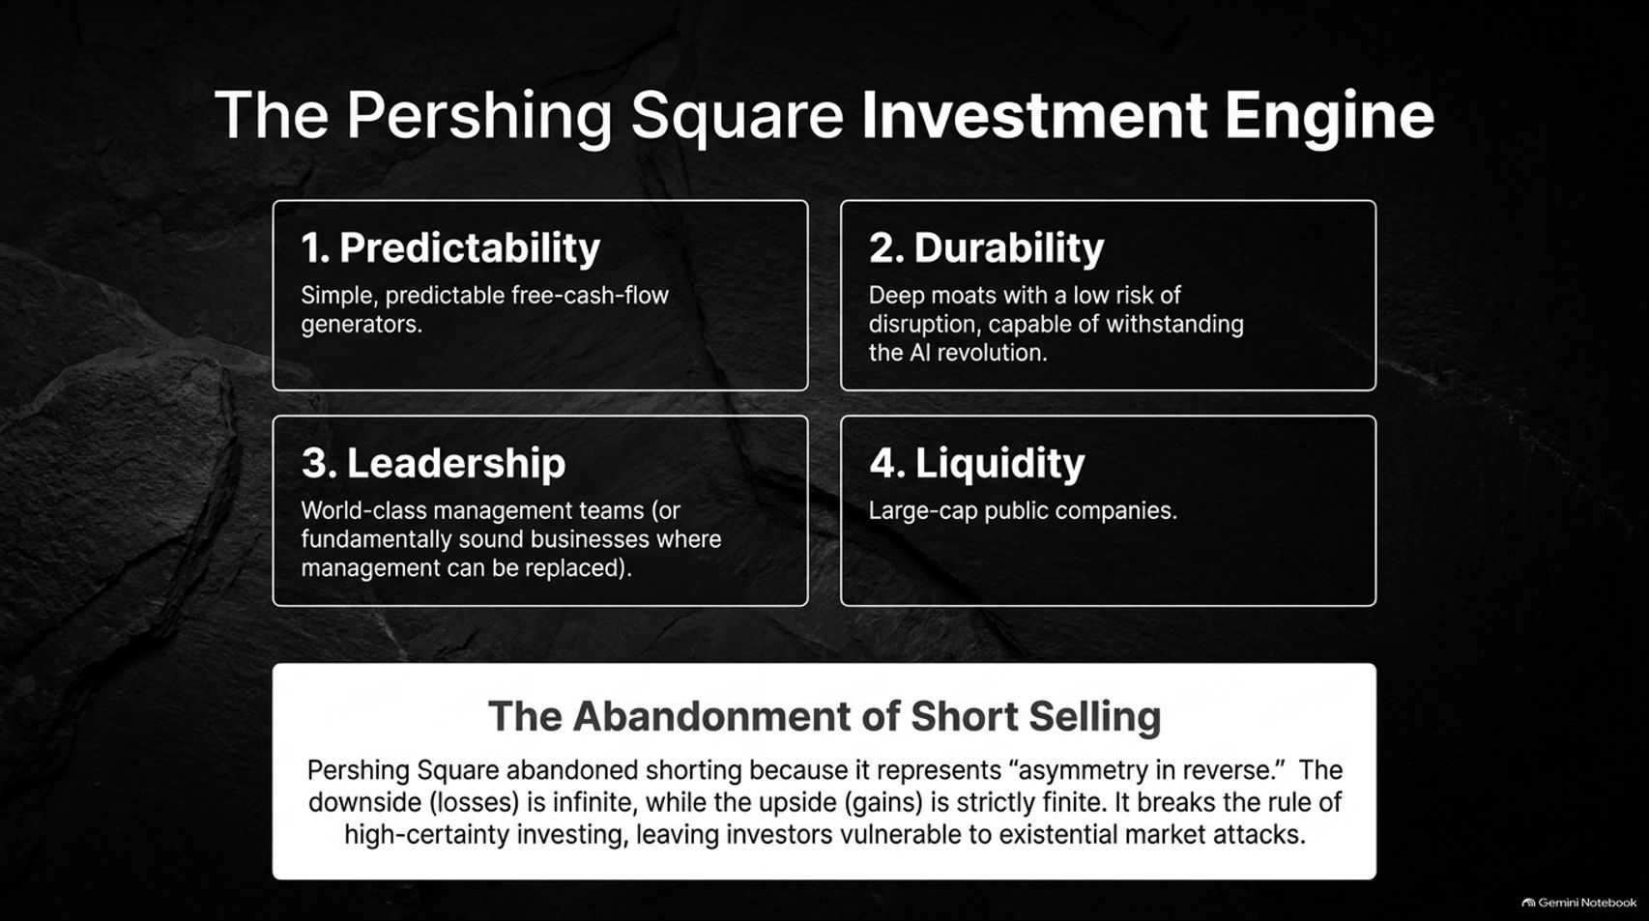
Notes:
Target Speaking Time: ~4–5 Minutes
Speaker Script:
"How does Pershing Square navigate market noise and achieve long-term outperformance? By adhering strictly to four non-negotiable investment criteria:
Predictability: Simple, predictable free-cash-flow generators. If a business cannot be forecasted with high certainty over a multi-year horizon, it is immediately discarded.
Durability: Deep competitive moats with a low risk of technological obsolescence, capable of withstanding the AI revolution.
Leadership: World-class management teams—or fundamentally sound, high-quality businesses where underperforming management can be replaced.
Liquidity: Large-cap public companies that provide structural flexibility.
The Abandonment of Short Selling: Notice the critical strategic shift at the bottom of the slide. Pershing Square officially abandoned short selling because it represents 'asymmetry in reverse.' In a short bet, your upside is strictly capped at 100%, while your downside losses are theoretically infinite. It breaks the rule of high-certainty investing and leaves funds vulnerable to short squeezes and market attacks."

Slide 4
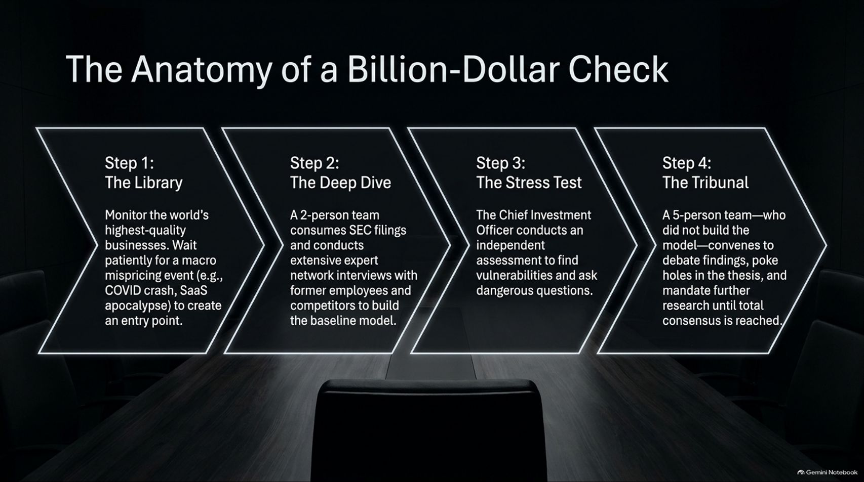
Notes:
Target Speaking Time: ~4–5 Minutes
Speaker Script:
"Before Pershing Square deploys a billion dollars into a single position, the idea must pass through an institutional research gauntlet:
Step 1 (The Library): The firm continuously monitors the world's highest-quality businesses, waiting patiently for a macro mispricing event—such as the 2020 COVID crash or a sector panic—to create an attractive entry point.
Step 2 (The Deep Dive): A tiny 2-person deal team consumes years of SEC filings, industry reports, and conducts extensive expert network interviews with former employees and competitors to build the baseline model.
Step 3 (The Stress Test): The Chief Investment Officer conducts an independent assessment, intentionally playing devil's advocate to find vulnerabilities and stress-test every assumption.
Step 4 (The Tribunal): A 5-person team—who did not build the original financial model—convenes to debate the findings, poke holes in the thesis, and mandate further research until complete consensus is reached."

Slide 5
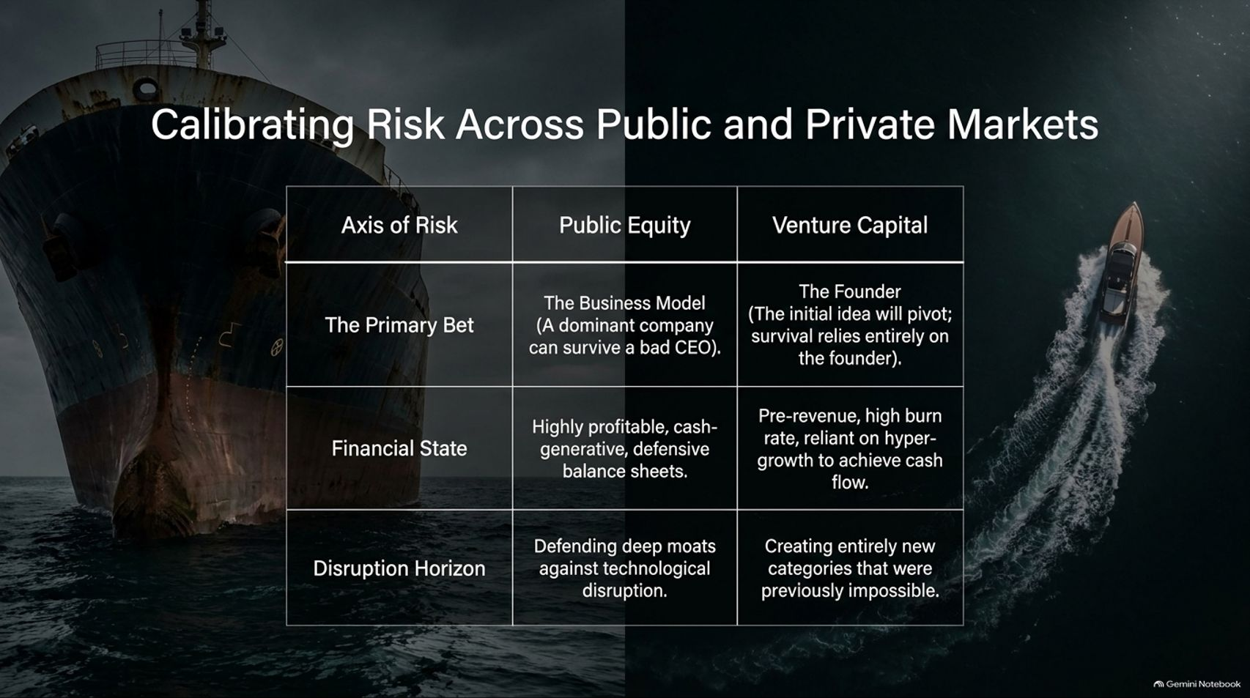
Notes:
Target Speaking Time: ~4–5 Minutes
Speaker Script:
"To understand risk allocation, we must contrast how capital is evaluated in Public Equity versus Venture Capital.
The Primary Bet: In public markets, your primary bet is on the Business Model. A dominant business with a wide moat can survive an average CEO. In venture capital, your primary bet is on the Founder, because the initial business idea will almost certainly pivot. (Ackman references backing Coupang in South Korea despite hating the original business model, purely because of the founder's brilliance).
Financial State: Public holdings are highly profitable, cash-generative, and hold defensive balance sheets. VC holdings are pre-revenue, high-burn, and reliant on hyper-growth.
Disruption Horizon: Public companies defend deep existing moats, whereas venture startups attempt to create entirely new categories."

Slide 6
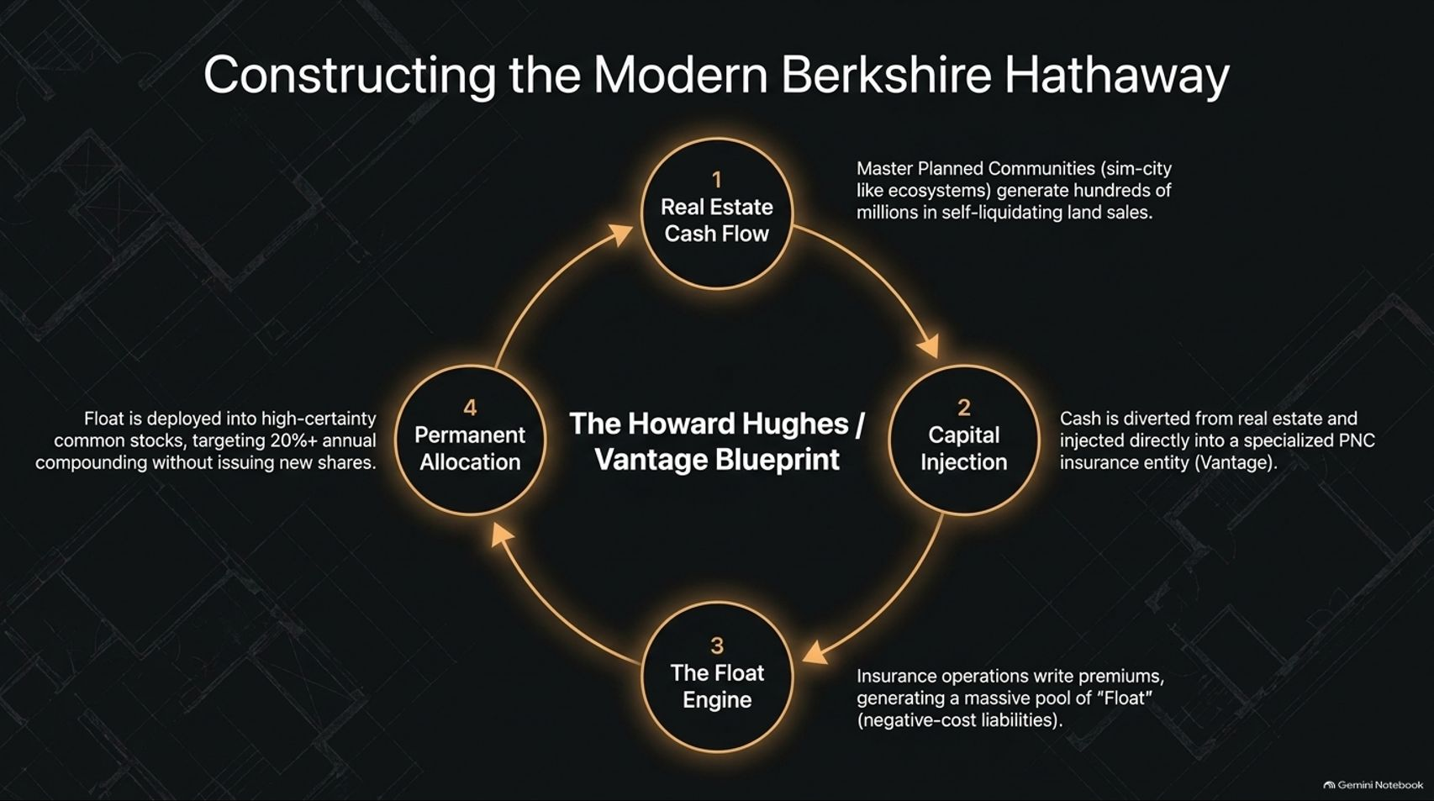
Notes:
Target Speaking Time: ~5–6 Minutes
Speaker Script:
"One of the most fascinating structural architectures in modern finance is Pershing Square's playbook for building the 'Modern Berkshire Hathaway' through Howard Hughes Holdings and Vantage.
1. Real Estate Cash Flow: Howard Hughes operates Master Planned Communities (sim-city-like ecosystems such as Summerlin, Nevada). It sells residential land to homebuilders, generating hundreds of millions in self-liquidating cash flows.
2. Capital Injection: Instead of distributing dividends, cash is diverted from real estate and injected directly into a specialized property & casualty insurance entity (Vantage).
3. The Float Engine: The insurance operations write policies and collect premiums upfront, generating a massive pool of 'Float'—which is essentially negative-cost capital.
4. Permanent Allocation: That float is handed to Pershing Square to invest in high-certainty public common stocks targeting 20%+ annual compounding, creating a perpetual compound interest machine without diluting equity."

Slide 7
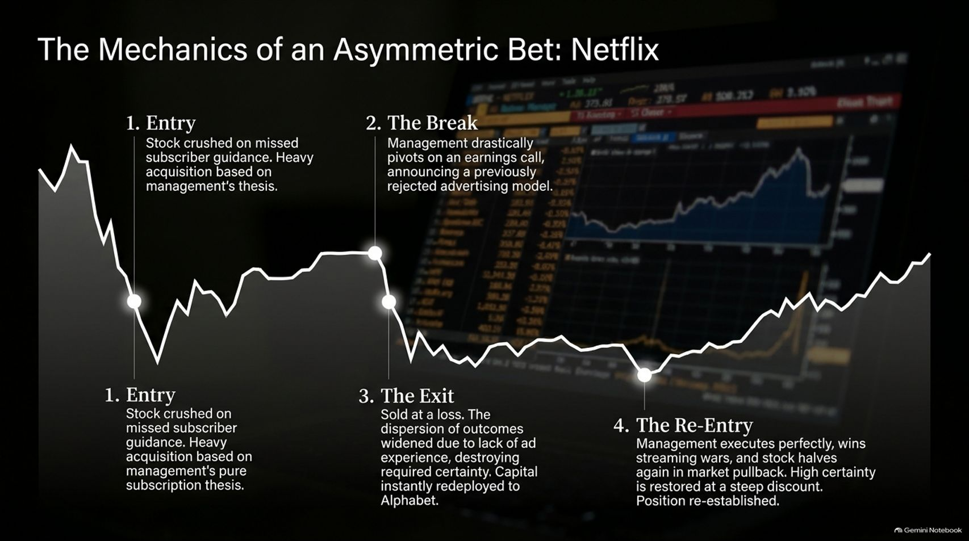
Notes:
Target Speaking Time: ~5–6 Minutes
Speaker Script:
"This slide illustrates the anatomy of Pershing Square's famous high-conviction trade in Netflix—and the intellectual honesty required to execute it.
1. Entry: Pershing Square acquired a massive stake in Netflix after the stock was crushed due to a temporary quarterly miss in subscriber guidance. The thesis was based on pure, predictable subscription growth.
2. The Break: Months later on an earnings call, management drastically pivoted, announcing plans to introduce an ad-supported tier—a model they had previously rejected for years.
3. The Exit: Ackman immediately sold the entire position at a loss. Why? Because an ad-supported model altered the dispersion of outcomes. Pershing Square lacked expertise in advertising, destroying the high-certainty thesis. Capital was immediately redeployed into Alphabet (Google).
4. The Re-Entry: After Netflix proved its execution, won the streaming wars, and offered a clear valuation discount during a broader market pullback, high certainty was restored, and the position was re-established."

Slide 8
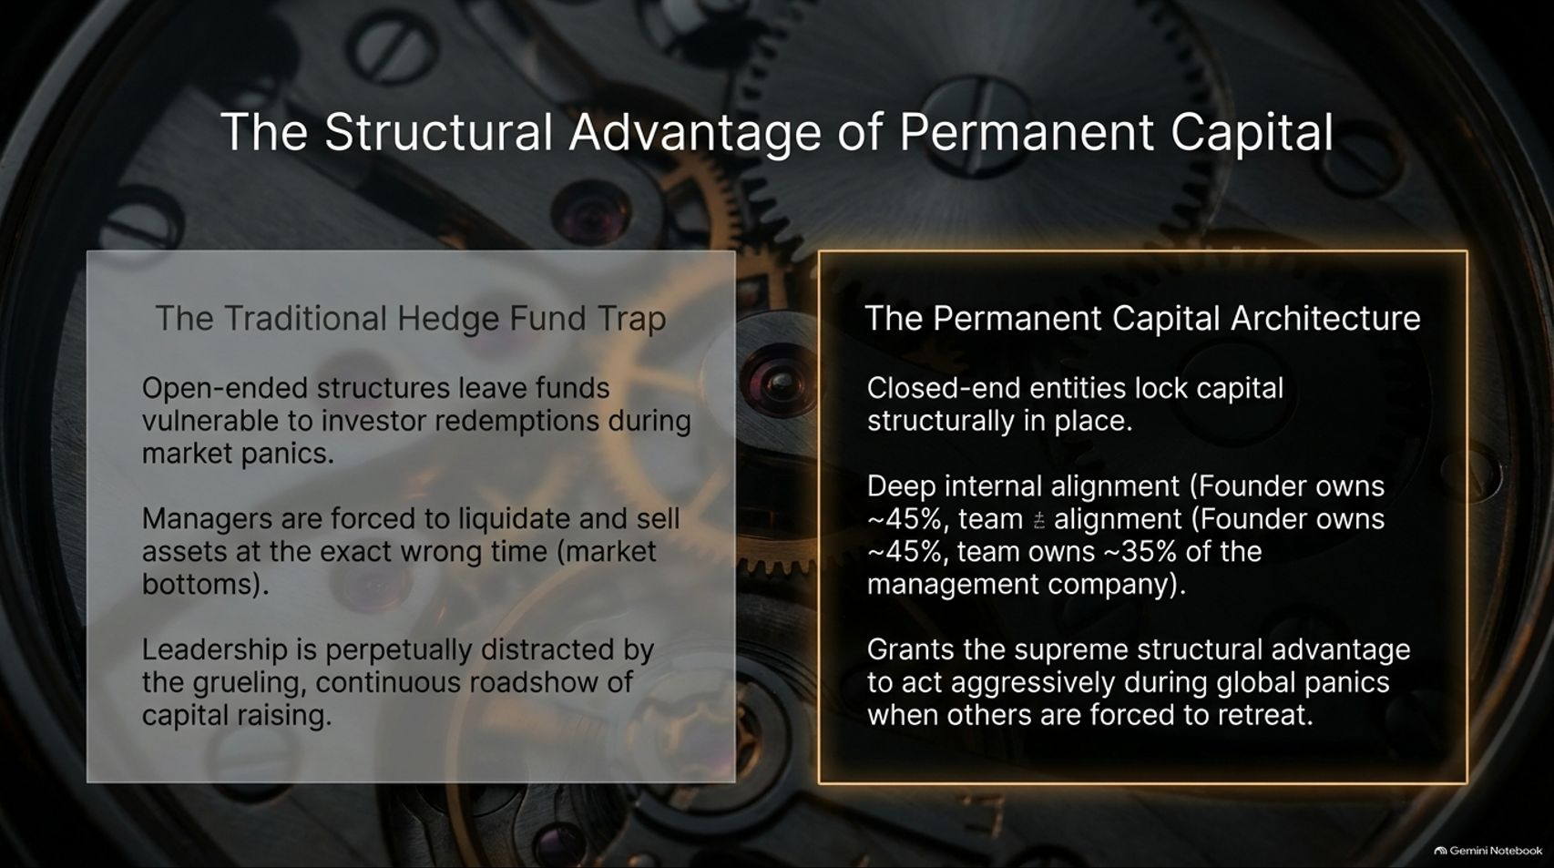
Notes:
Target Speaking Time: ~4–5 Minutes
Speaker Script:
"In institutional investing, structure dictates strategy. This slide contrasts The Traditional Hedge Fund Trap with The Permanent Capital Architecture.
Traditional open-ended hedge funds live under constant threat. When markets crash, nervous investors demand redemptions. Fund managers are forced to sell their best assets at the exact bottom of the market just to pay out cash, while leadership is perpetually distracted by fundraising roadshows.
Pershing Square restructured into a closed-end permanent capital entity. Capital is locked in structurally. Furthermore, deep internal alignment exists: Ackman and his team own ~45% of the entity and ~35% of the management company. This grants the supreme structural advantage: the ability to act aggressively as a buyer during global panics when everyone else is forced to panic-sell."

Slide 9
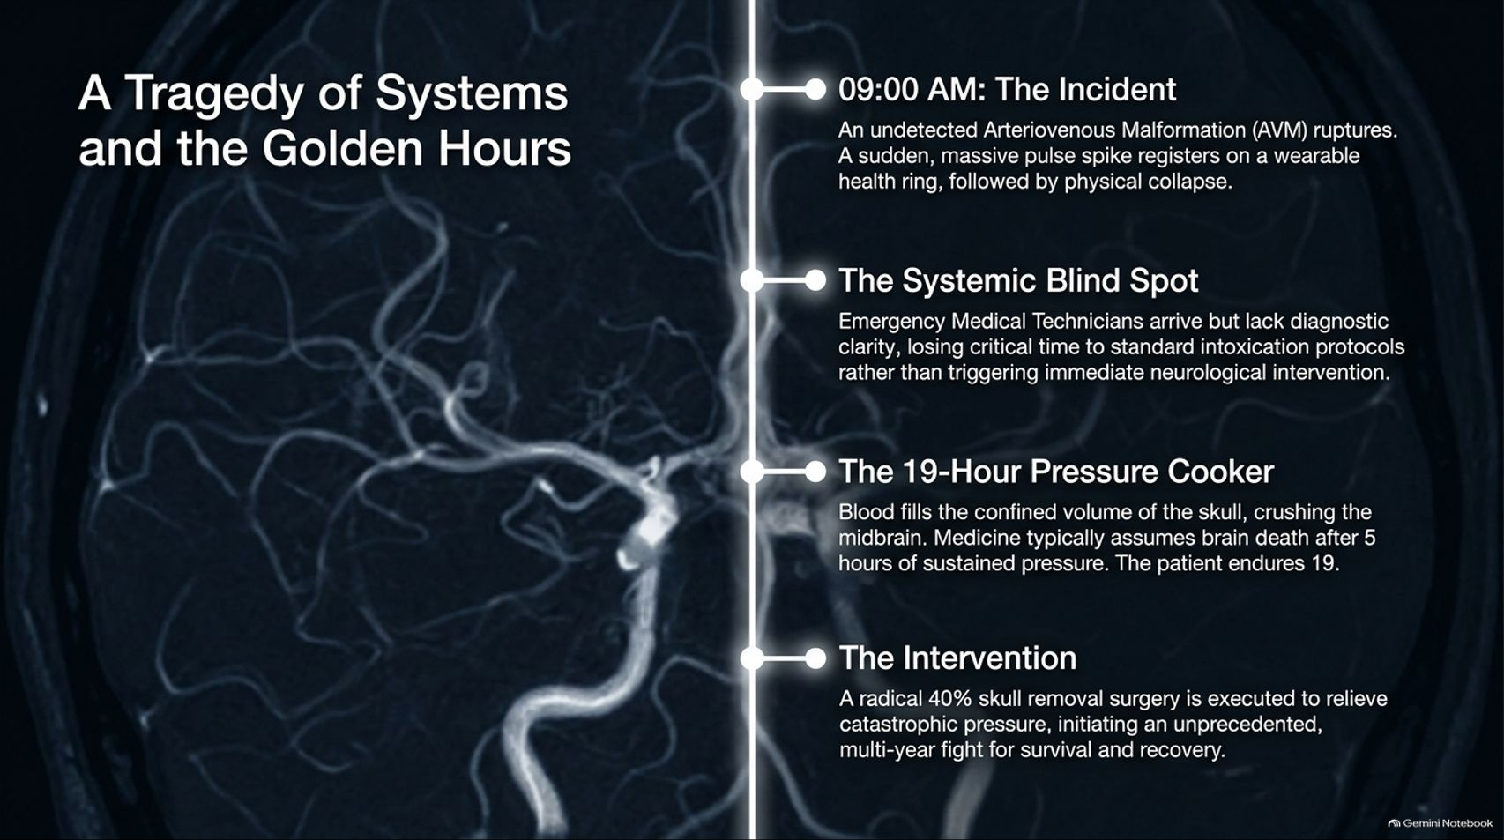
Notes:
Target Speaking Time: ~5–6 Minutes
Speaker Script:
"We now transition from financial markets to a profound personal crucible that redefined Ackman's life.
09:00 AM (The Incident): Ackman's daughter suffered a sudden rupture of an undetected Arteriovenous Malformation (AVM) in her brain. A wearable health ring registered a catastrophic pulse spike, followed by immediate physical collapse.
The Systemic Blind Spot: Emergency medical technicians arrived but lacked diagnostic clarity. Critical time in the 'Golden Hour' was lost to standard intoxication protocols rather than triggering immediate neurological intervention.
The 19-Hour Pressure Cooker: Arterial blood filled the confined space of the skull, crushing the midbrain. Standard medical literature assumes brain death occurs after 5 hours of sustained pressure. She endured 19 hours before emergency surgery.
The Intervention: A radical 40% skull removal surgery (decompressive craniectomy) was performed to relieve pressure, saving her life and sparking a multi-year fight for recovery."

Slide 10
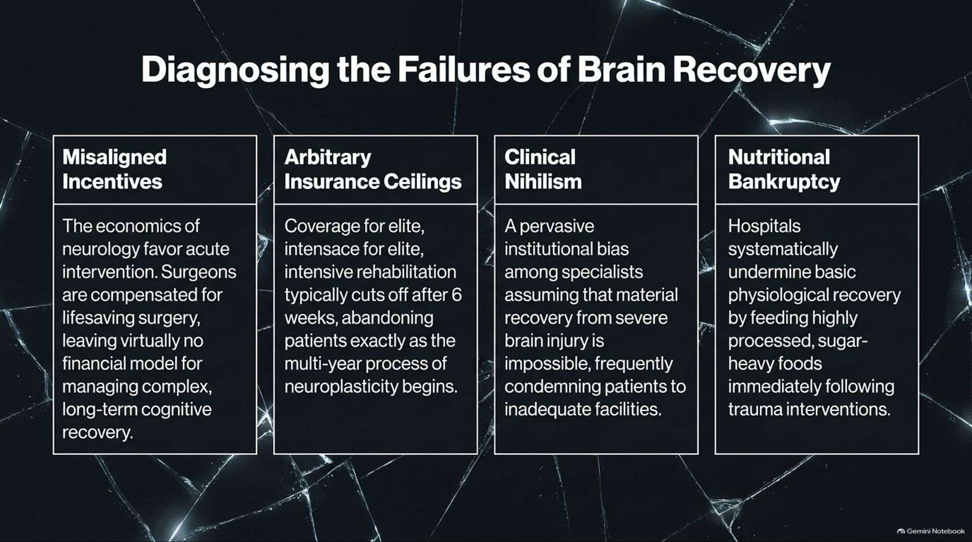
Notes:
Target Speaking Time: ~4–5 Minutes
Speaker Script:
"Navigating his daughter's rehabilitation, Ackman applied his investor mindset to audit the healthcare system, identifying four systemic failure points in brain injury recovery:
Misaligned Incentives: The economics of neurology heavily favor acute surgical intervention. Surgeons are compensated for saving lives in the OR, but virtually no financial model exists for managing complex, long-term cognitive recovery.
Arbitrary Insurance Ceilings: Insurance coverage for intensive rehabilitation typically cuts off after 6 weeks—abandoning patients exactly as neuroplasticity begins to take hold.
Clinical Nihilism: A pervasive institutional bias exists among specialists who assume material recovery from severe brain injury is impossible, frequently pushing families toward long-term care facilities.
Nutritional Bankruptcy: Traumatized brains require metabolic repair, yet hospital facilities systematically feed brain-injured patients highly processed, sugar-heavy foods."

Slide 11
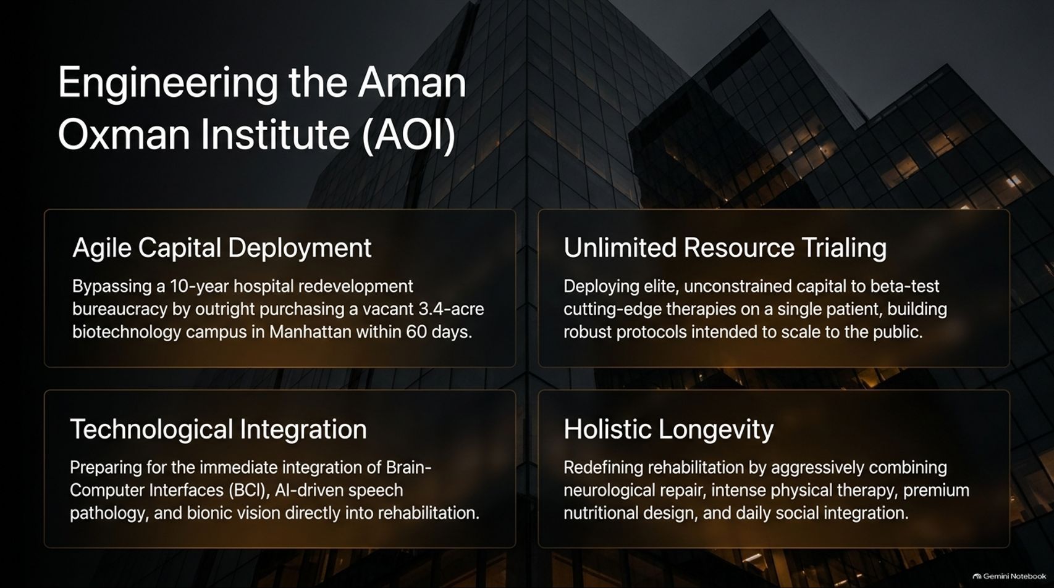
Notes:
Target Speaking Time: ~5–6 Minutes
Speaker Script:
"Refusing to accept the status quo, Ackman applied private equity speed and capital to launch the Aman Oxman Institute (AOI) for brain recovery:
Agile Capital Deployment: Bypassing a typical 10-year hospital redevelopment bureaucracy, Ackman purchased a vacant 3.4-acre biotechnology campus in Manhattan within 60 days.
Unlimited Resource Trialing: Deploying capital to beta-test cutting-edge, experimental therapies on his daughter, creating a rigorous, data-driven protocol designed to scale globally to the public.
Technological Integration: Integrating Brain-Computer Interfaces (BCI), AI-driven speech pathology, and bionic vision directly into daily rehabilitation.
Holistic Longevity: Redefining recovery by combining neurological repair, intense physical therapy, metabolic nutritional design, and daily social integration under one roof."

Slide 12
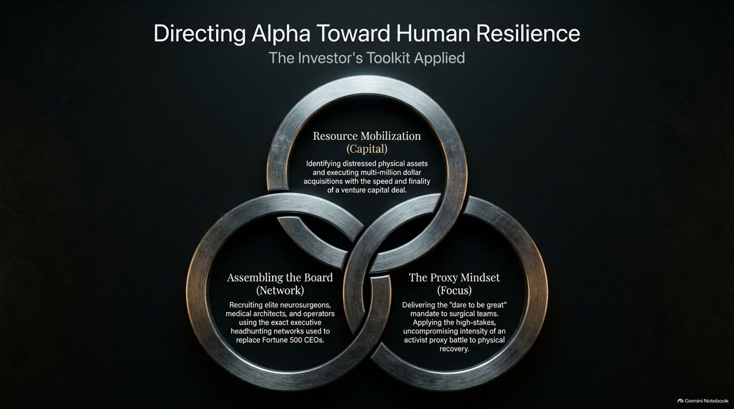
Notes:
Target Speaking Time: ~4–5 Minutes
Speaker Script:
"This slide illustrates how Ackman applied his exact investor’s toolkit to tackle medical science through three intersecting rings:
Resource Mobilization (Capital): Identifying distressed physical assets (like the Manhattan biotech campus) and executing multi-million dollar acquisitions with the speed and finality of a venture capital buyout.
Assembling the Board (Network): Recruiting world-class neurosurgeons, medical architects, and operators using the executive headhunting networks typically reserved for replacing Fortune 500 CEOs.
The Proxy Mindset (Focus): Delivering a 'dare to be great' mandate to medical teams. Ackman brought the high-stakes, uncompromising intensity of an activist proxy battle directly into the operating room and rehab clinic."

Slide 13
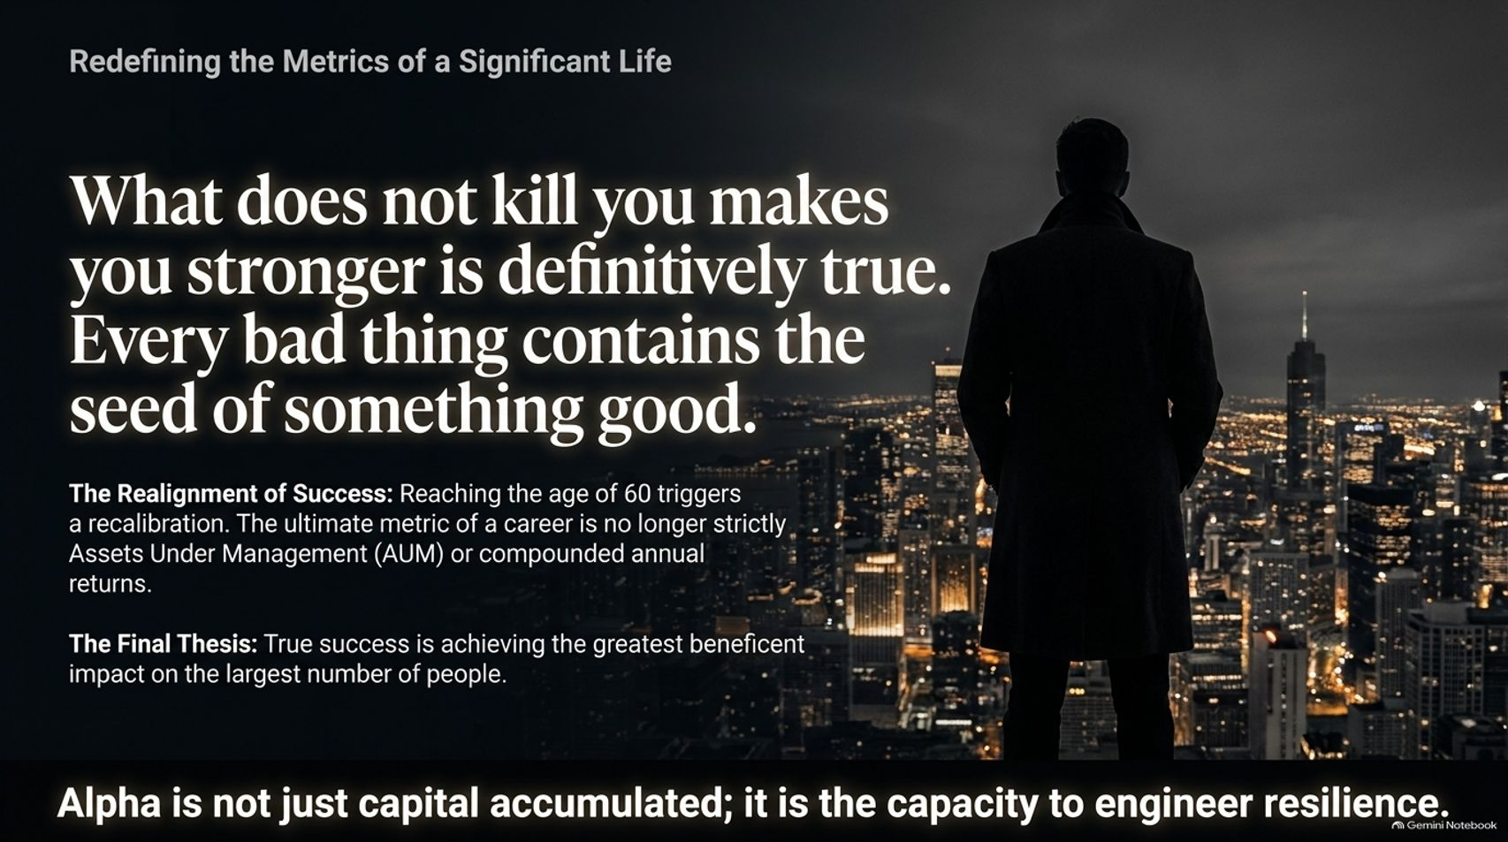
Notes:
Target Speaking Time: ~4–5 Minutes
Speaker Script:
"As Ackman approached the age of 60, surviving market battles and personal tragedy triggered a fundamental recalibration of what it means to lead a successful life.
Friedrich Nietzsche’s classic phrase—'What does not kill you makes you stronger'—is definitively true. Every setback, crash, or crisis contains the seed of an equivalent or greater benefit if you have the resilience to extract it.
The Realignment of Success: The ultimate metric of a career is no longer strictly Assets Under Management (AUM), compounded annual returns, or placement on financial leaderboards.
The Final Thesis: True success is achieving the greatest beneficent impact on the largest number of people. Alpha is not merely capital accumulated on a balance sheet; it is the capacity to engineer human resilience."

Slide 14
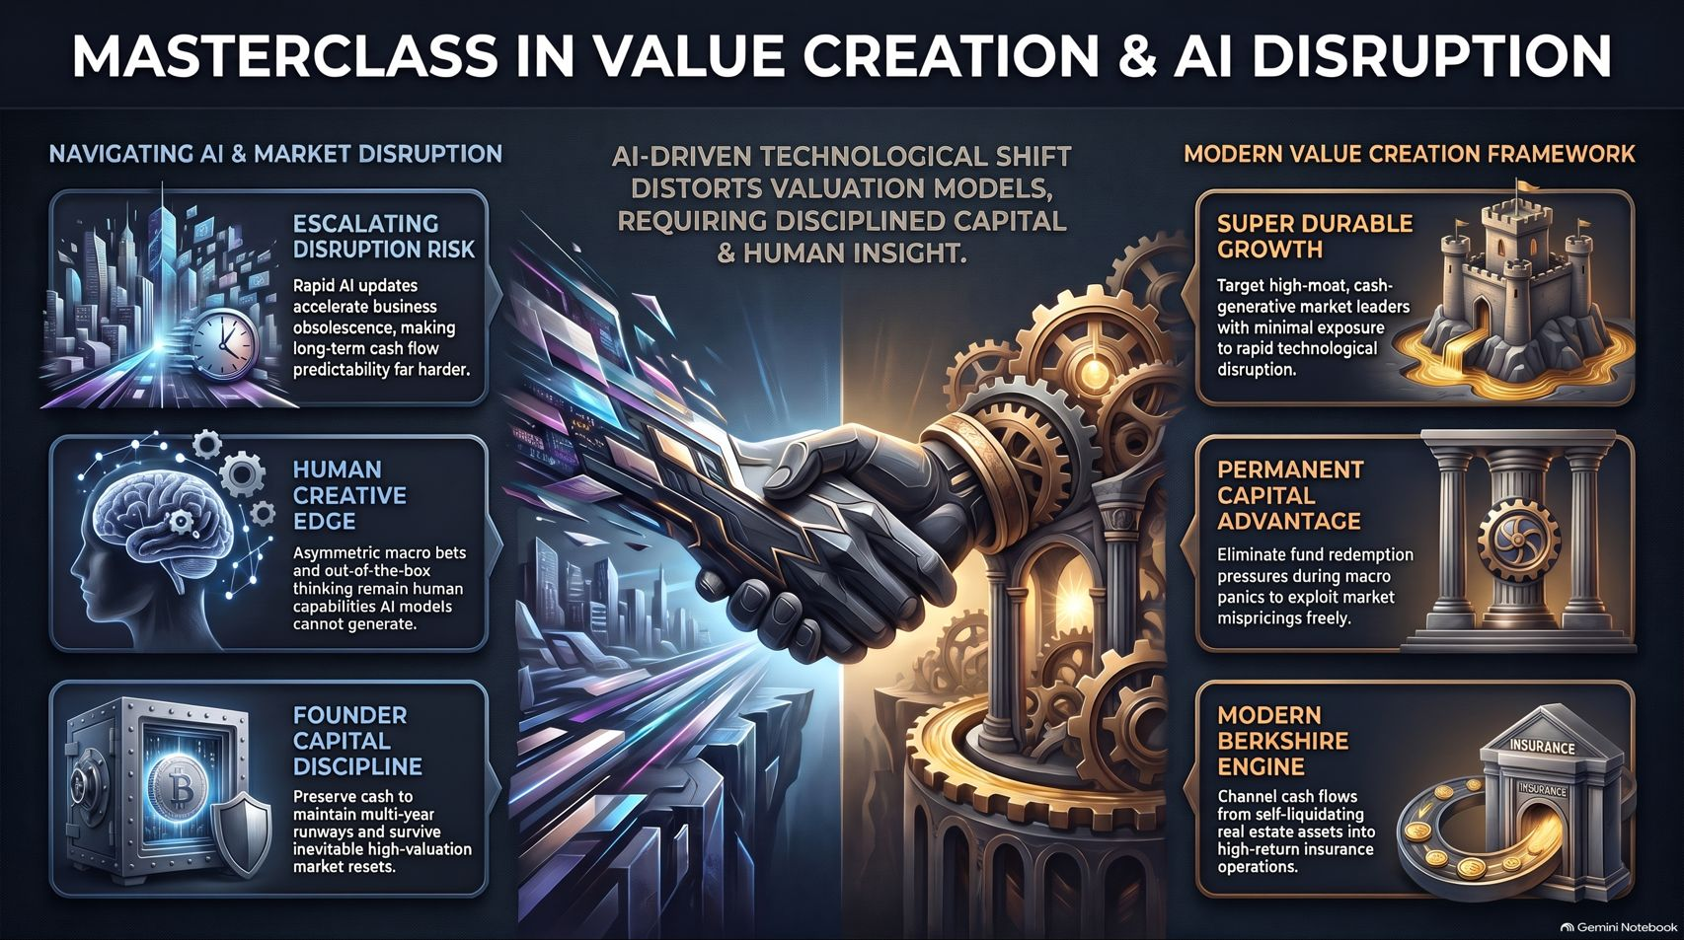
Notes:
Target Speaking Time: ~4–5 Minutes
Speaker Script:
"Our final synthesis slide brings together the entire masterclass:
On the left side, we navigate AI & Market Disruption: acknowledging escalating disruption risks, preserving founder capital discipline, and recognizing that human creative edge—out-of-the-box thinking and asymmetric bets—remains a domain AI cannot replicate.
On the right side, we deploy the Modern Value Creation Framework: targeting super durable growth with deep moats, locking in permanent capital advantages to exploit market panics, and building self-funding compounding engines.
Whether managing billions in capital or fighting for human life, success requires discipline, clarity, and an unwavering commitment to long-term impact. Thank you."

