Slide 1

Notes:
Target Speaking Time: ~3–4 Minutes
Speaker Script:
"Welcome, everyone. Today we are tackling a fundamental question that separates amateur market participants from professional systematic operators: The Architecture of Profit: What Actually Makes a Trading System Profitable?
Too many traders confuse a lucky bull market or a handful of great trades with actual skill. They believe they 'know how to trade' because their account went up during favorable conditions, only to watch their profits vanish the moment the market turns hostile.
Across the next 15 slides—drawing from over 16 years of market experience—we are going to move away from guessing and emotion, and instead deconstruct the exact mathematical architecture required to build a permanent, repeatable edge. Let’s begin."
From ONE WIN To CONSISTENT Profits @jlawstock2
https://www.youtube.com/watch?v=OVhjvIBwzCY

Slide 2
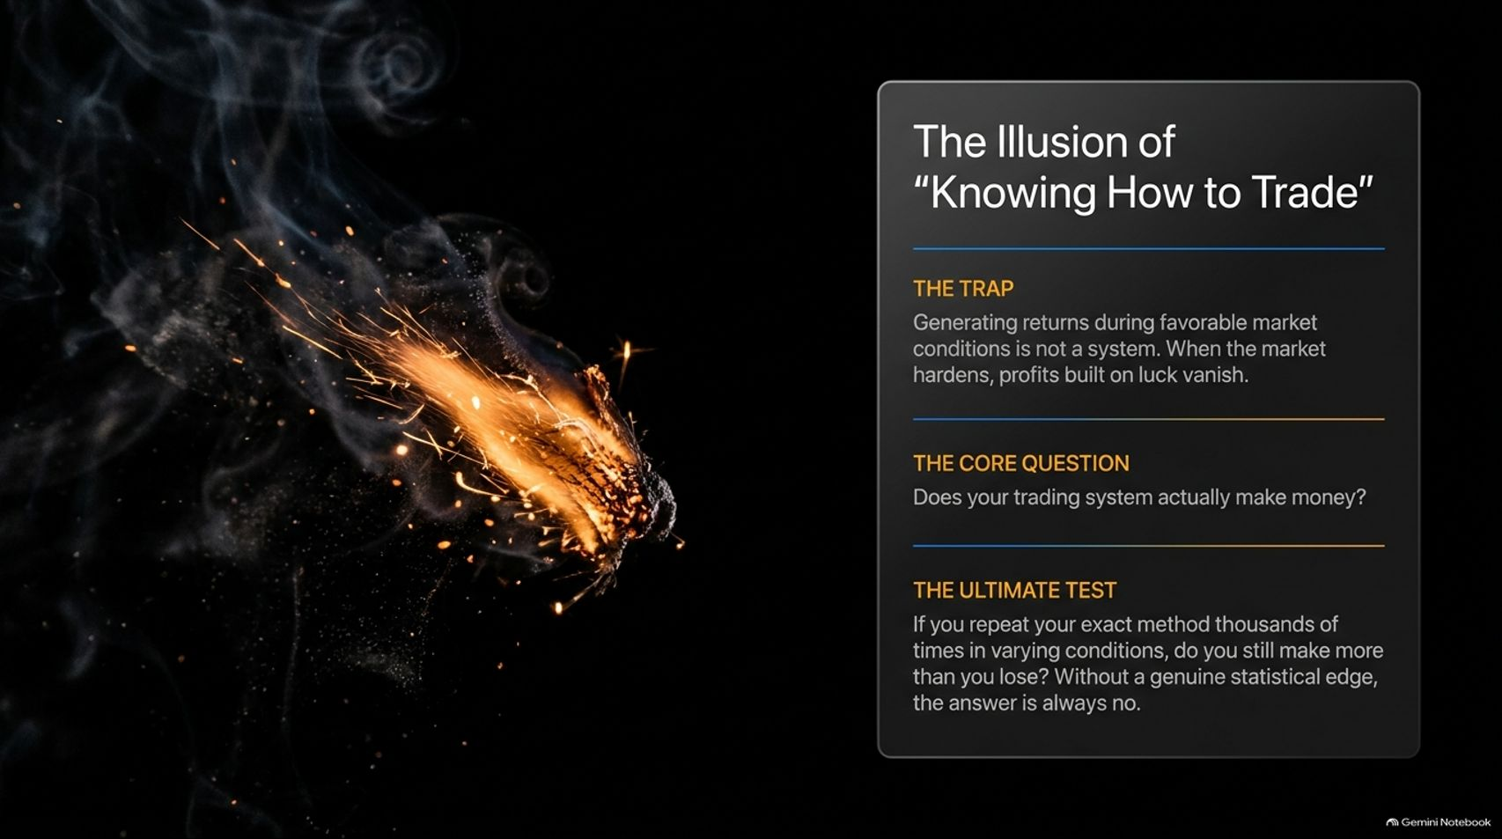
Notes:
Target Speaking Time: ~4–5 Minutes
Speaker Script:
"Let’s start with a hard truth captured on Slide 2: The Illusion of 'Knowing How to Trade'.
The Trap: Generating returns during a strong, favorable market environment is not a system. When the market hardens, profits built purely on luck evaporate.
The Core Question: Does your trading system actually make money independent of market tailwinds?
The Ultimate Test: If you were forced to repeat your exact trading method thousands of times in varying, difficult conditions, would you still make more than you lose? If your answer relies on catching 'one big stock' or 'good market timing,' the answer is no. Without a genuine statistical edge, you are just gambling."

Slide 3
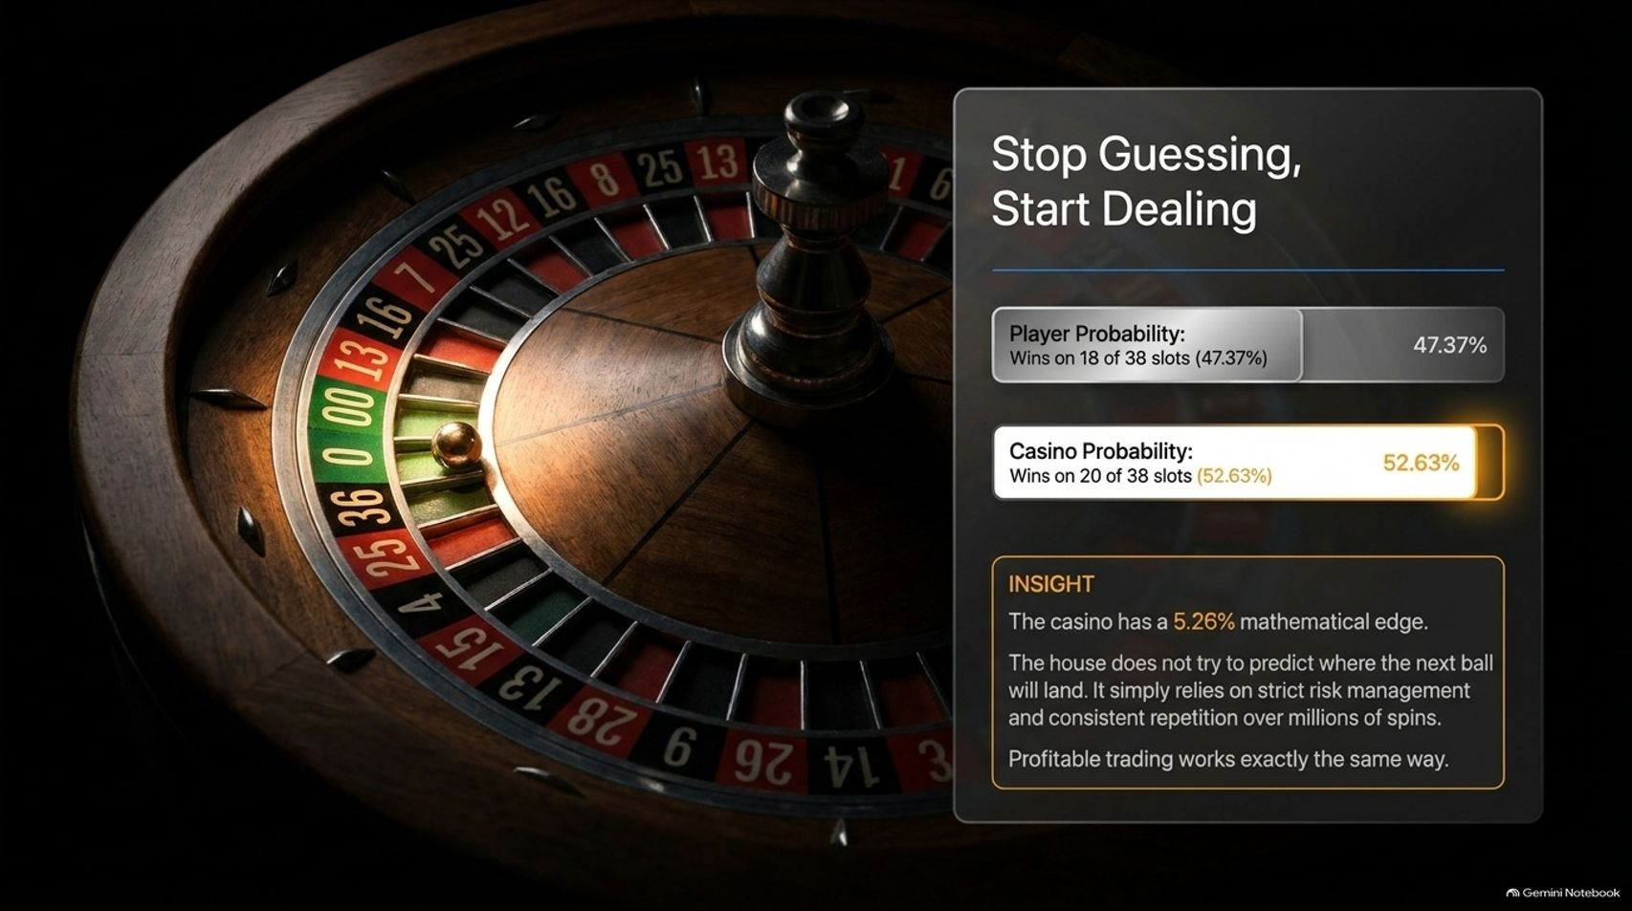
Notes:
Target Speaking Time: ~4–5 Minutes
Speaker Script:
"To understand how professionals approach the markets, let's look at the ultimate mathematical baseline: The Casino.
Look at the roulette wheel statistics on your screen: An American roulette wheel has 38 slots (numbers 1 through 36, plus 0 and 00). A player betting on red wins on 18 of those 38 slots, giving them a 47.37% probability of winning. The casino wins on the remaining 20 slots, giving it a 52.63% probability.
The Insight: The casino holds a mathematical edge of 5.26%. Crucially, the house does not try to predict where the next ball will land. It doesn't stress over short-term outcomes. It simply relies on strict risk management and consistent repetition over millions of spins. Profitable trading works in the exact same way."

Slide 4
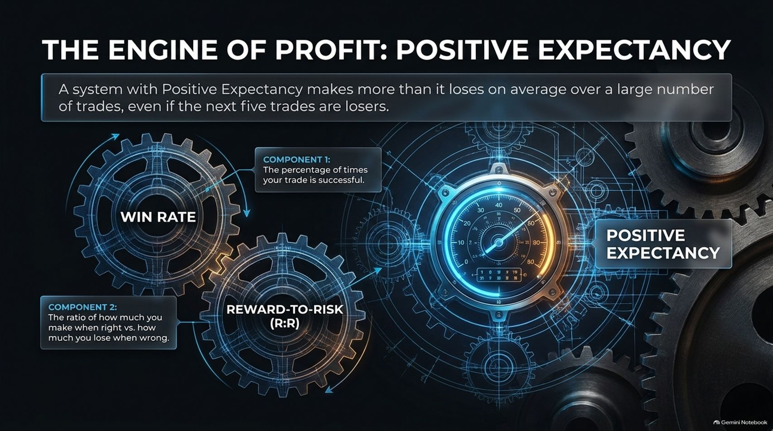
Notes:
Target Speaking Time: ~4–5 Minutes
Speaker Script:
"What powers this mechanical engine? Positive Expectancy.
A system with positive expectancy makes more than it loses on average over a large sample of trades, even if the next five trades in a row are total losers.
Positive expectancy is driven by two vital gears working together:
Win Rate: The percentage of times your trade hits its target and is successful.
Reward-to-Risk Ratio (R:R): The mathematical proportion of how much you make when you're right versus how much you lose when you're wrong.
When these two components are properly calibrated, your system generates positive statistical value per play."

Slide 5
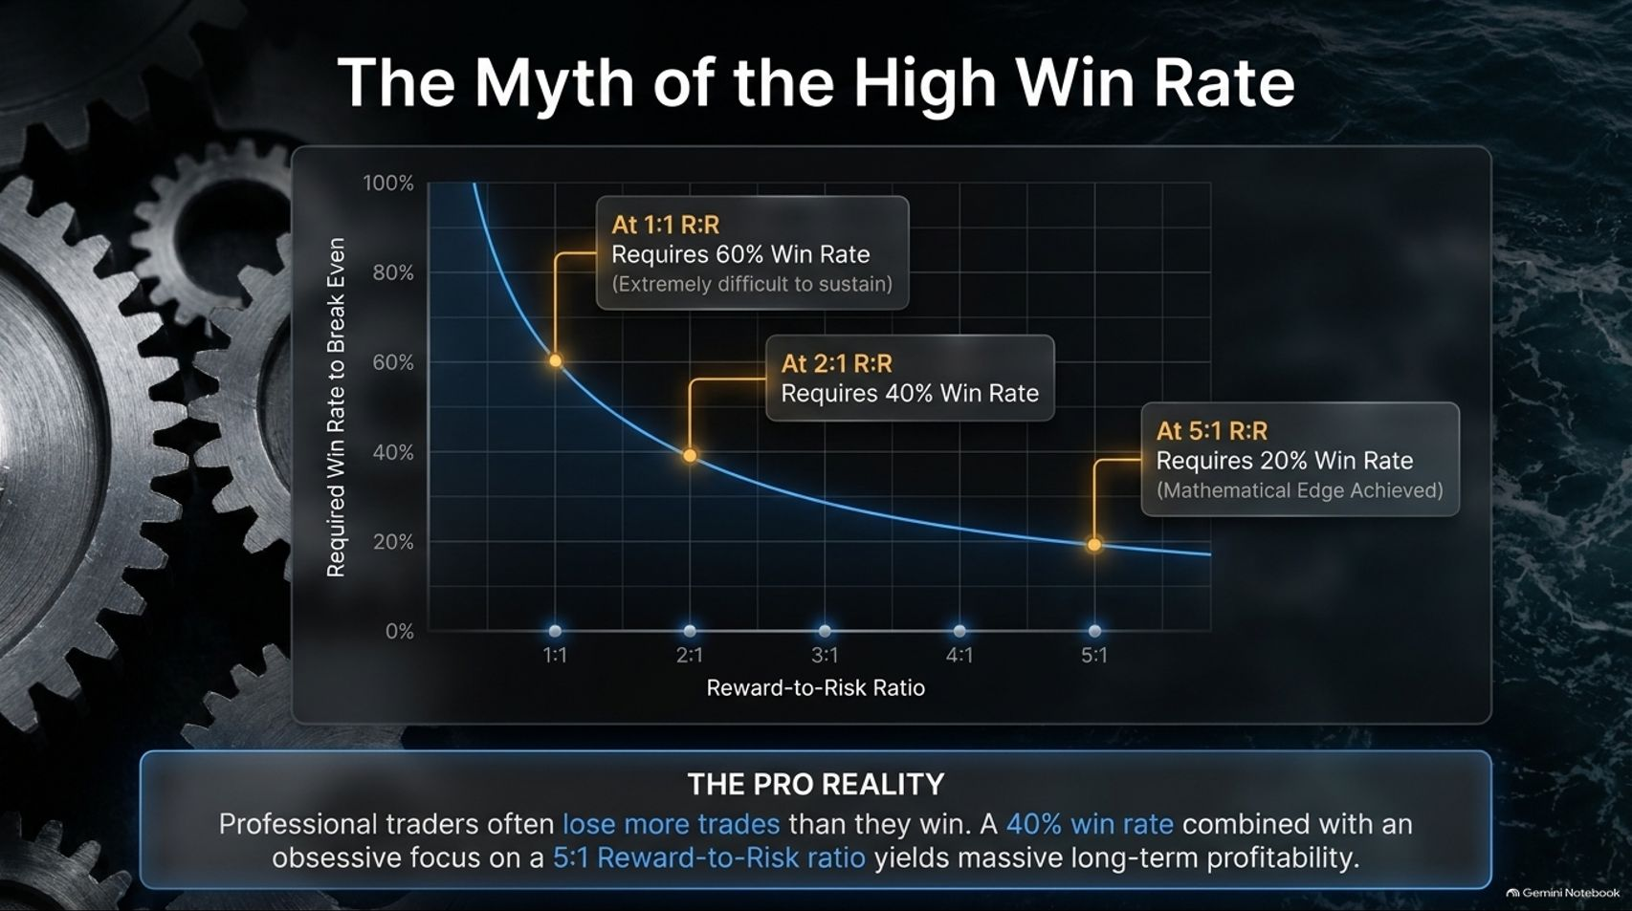
Notes:
Target Speaking Time: ~4–5 Minutes
Speaker Script:
"One of the most destructive myths in retail trading is the obsession with achieving an 80% or 90% win rate. Look at the mathematical curve on Slide 5:
At a 1:1 Reward-to-Risk ratio, you require a 60% win rate just to break even—which is extraordinarily difficult to sustain long-term.
At a 2:1 Reward-to-Risk ratio, you require a 40% win rate.
At an elite 5:1 Reward-to-Risk ratio, your required win rate drops to just 20% to achieve mathematical edge.
The Pro Reality: Professional traders routinely lose more trades than they win. A 40% win rate combined with an obsessive focus on a 5:1 reward-to-risk structure yields massive, compounding long-term profitability."

Slide 6
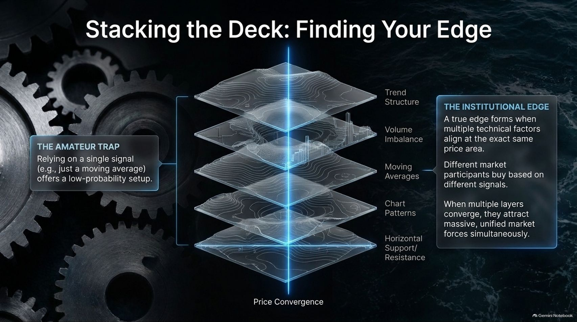
Notes:
Target Speaking Time: ~4–5 Minutes
Speaker Script:
"Amateurs look for a single technical indicator—like a cross on a moving average—and wonder why their trade fails. That is The Amateur Trap.
The Institutional Edge: A true technical edge forms only when multiple independent factors converge at the exact same price area.
Think of it like geological strata:
Trend Structure
Volume Imbalance
Moving Average Alignment
Chart Patterns
Horizontal Support/Resistance
Different market participants trade off different signals. When multiple layers converge into a single price zone, they attract massive, unified institutional buying or selling pressure simultaneously."

Slide 7
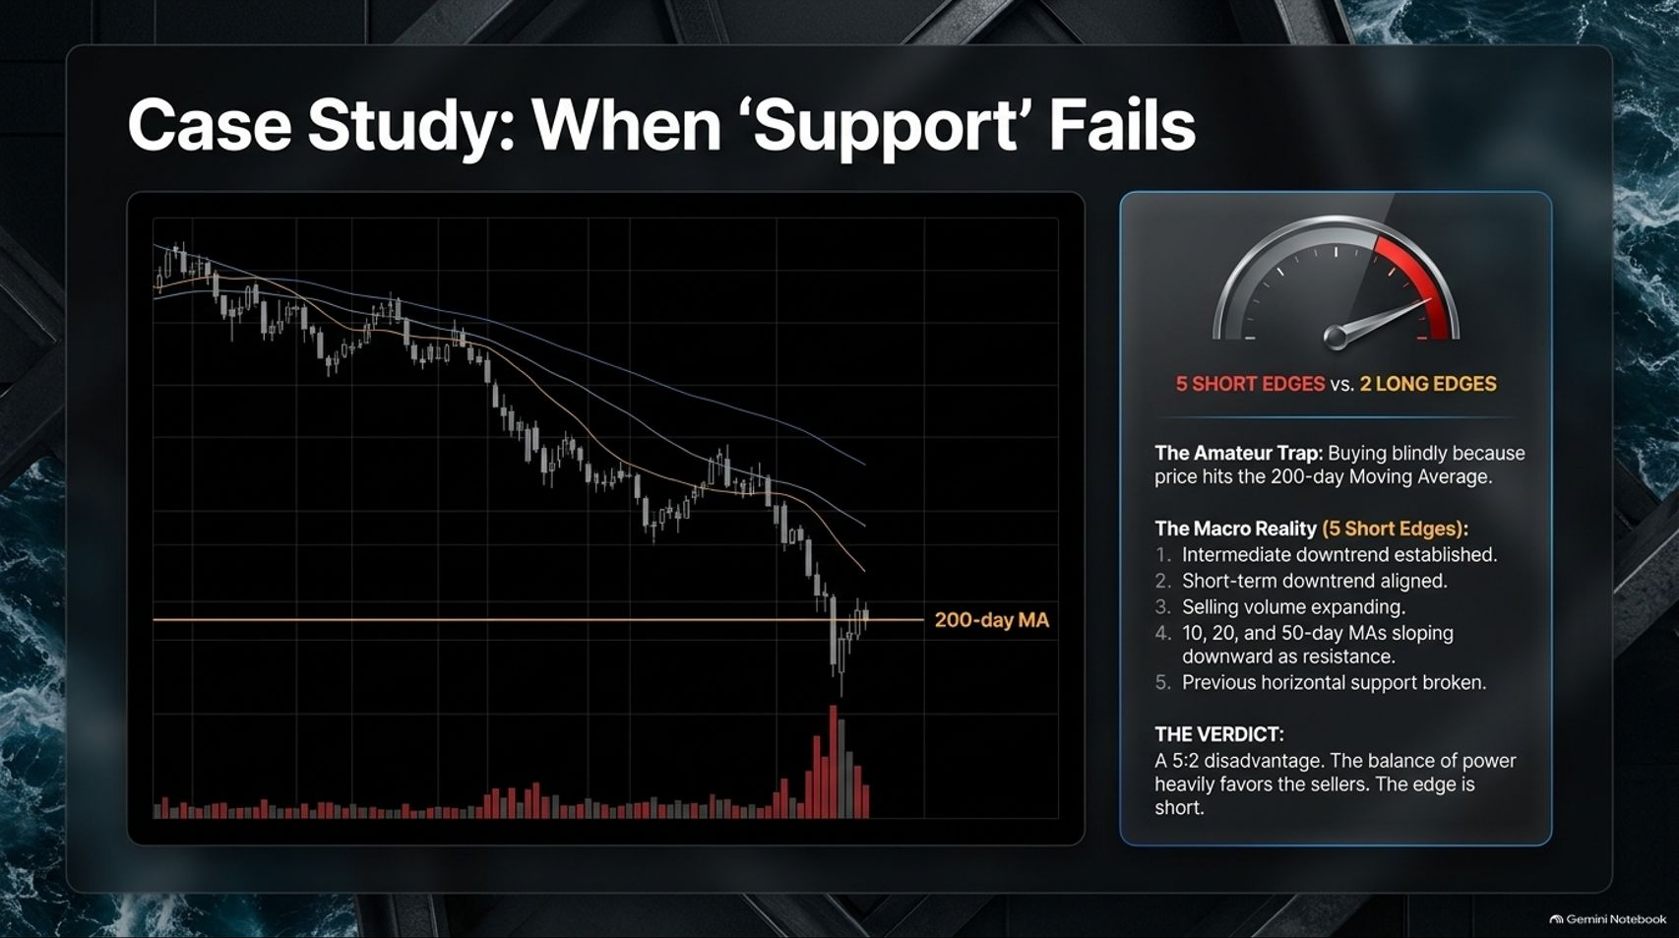
Notes:
Target Speaking Time: ~4–5 Minutes
Speaker Script:
"Let's look at a concrete case study: When 'Support' Fails.
On this chart, a stock pulls back to the famous 200-day Moving Average. The amateur trader blindly buys simply because price touches the moving average, walking straight into a trap.
The Macro Reality (5 Short Edges vs. 2 Long Edges):
Intermediate-term downtrend is firmly established (lower highs and lower lows).
Short-term downtrend is aligned.
Selling volume is actively expanding on down days.
10, 20, and 50-day MAs are sloping downward, acting as heavy overhead resistance.
Previous horizontal support has already been broken.
The Verdict: A 5:2 disadvantage. The balance of power heavily favors sellers. Buying here is financial suicide."

Slide 8
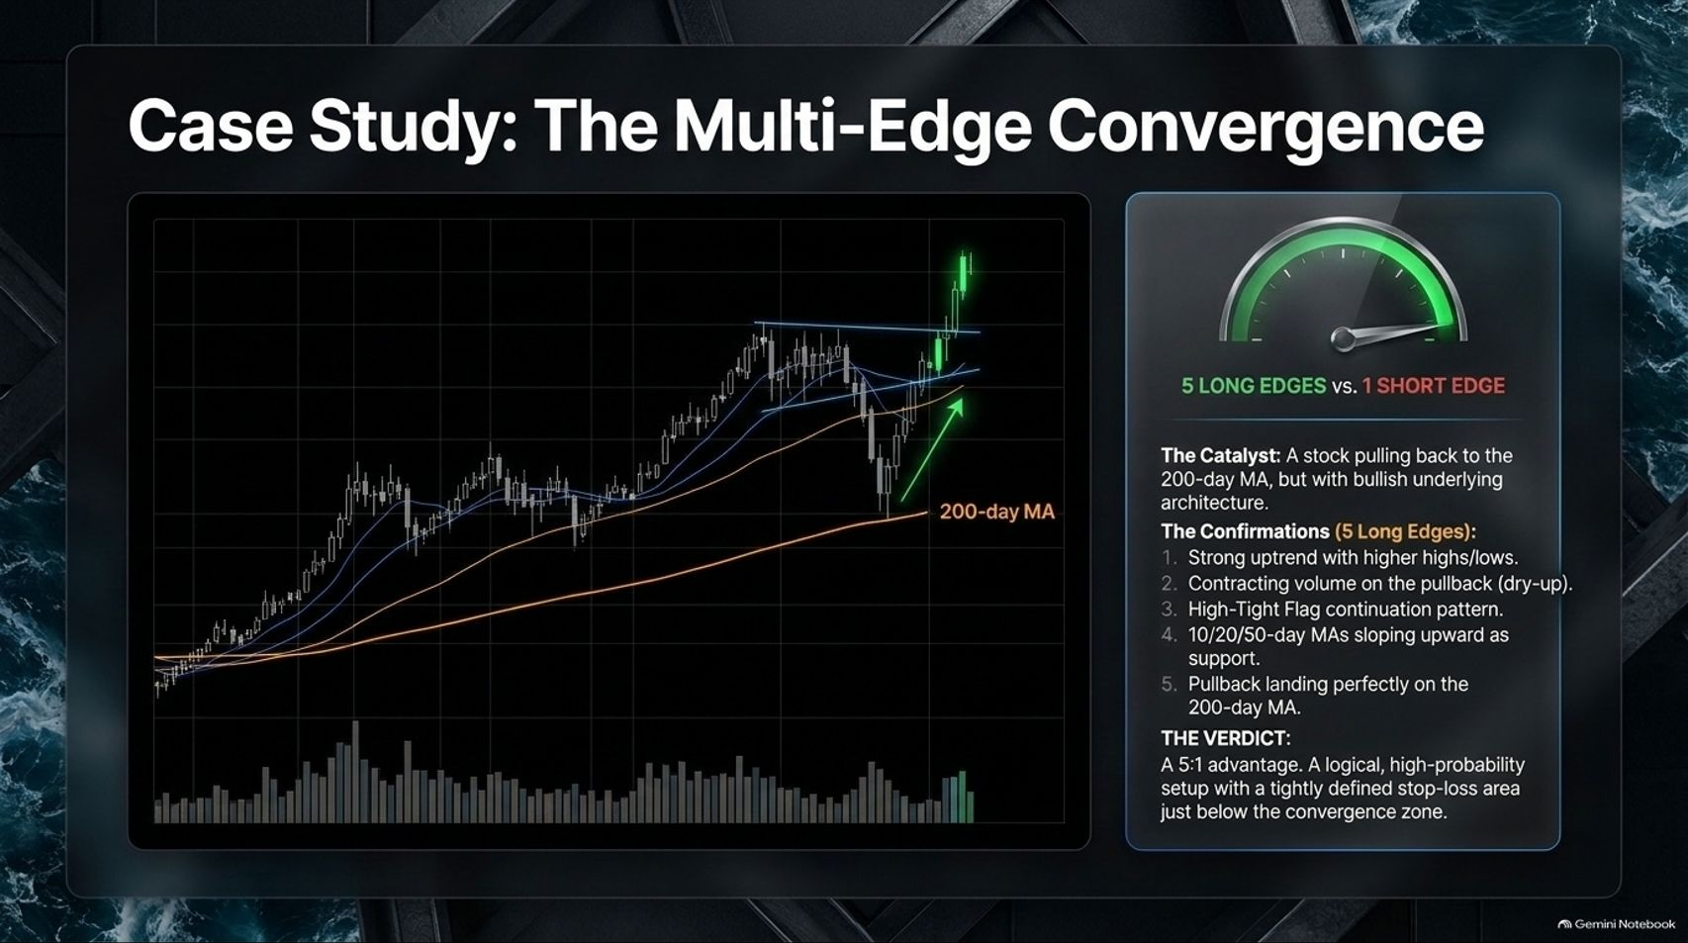
Notes:
Target Speaking Time: ~4–5 Minutes
Speaker Script:
"Now let's examine the exact opposite scenario: The Multi-Edge Convergence.
Here, a stock pulls back to the 200-day moving average, but the underlying architecture tells a completely different story.
The Confirmations (5 Long Edges vs. 1 Short Edge):
Strong primary uptrend with higher highs and higher lows.
Volume contracts sharply on the pullback (supply is drying up).
Forming a classic High-Tight Flag continuation pattern.
10/20/50-day MAs are sloping upward and acting as dynamic support.
The pullback lands perfectly on the 200-day MA confluence zone.
The Verdict: A 5:1 advantage. This is a high-probability setup allowing for a tightly defined stop-loss just below the convergence zone."

Slide 9
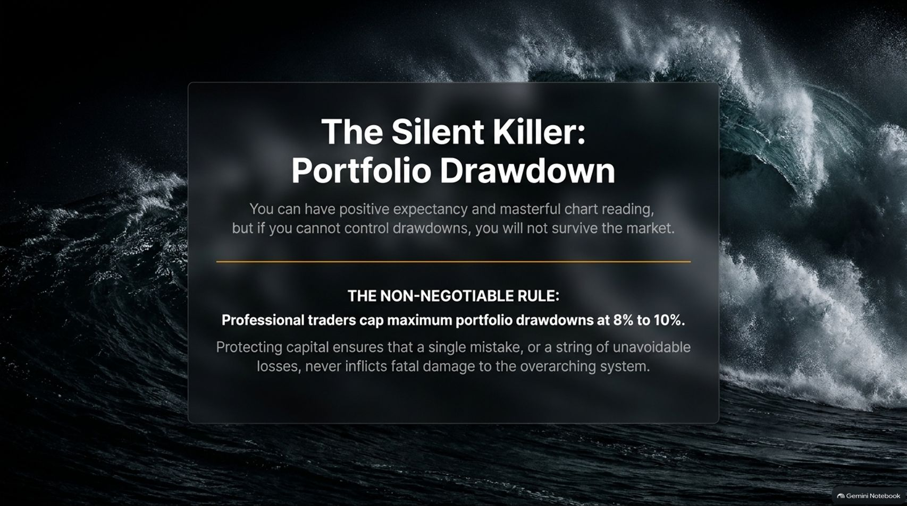
Notes:
Target Speaking Time: ~4–5 Minutes
Speaker Script:
"You can have a brilliant mathematical expectancy and masterful chart-reading skills, but if you cannot control drawdowns, you will not survive the markets. Drawdowns are The Silent Killer.
The Non-Negotiable Rule: Professional traders cap maximum portfolio drawdowns at 8% to 10%.
Protecting your capital ensures that a single bad mistake, or a string of unavoidable losing trades, never inflicts fatal damage to your overarching system. Survival is the prerequisite to compounding."

Slide 10
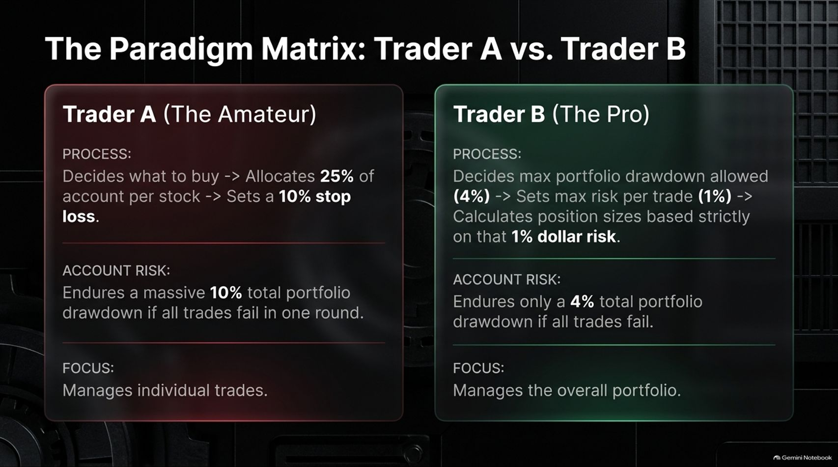
Notes:
Target Speaking Time: ~5–6 Minutes
Speaker Script:
"Let's look at how risk management changes everything through The Paradigm Matrix comparing two traders who experience identical market conditions:
Trader A (The Amateur): Decides what stock to buy, allocates a massive 25% of total account capital per stock, and sets a 10% stop-loss. If all trades fail, Trader A suffers a devastating 10% portfolio drawdown in a single round. Trader A focuses exclusively on individual trades.
Trader B (The Pro): Works backward. Trader B first defines maximum allowable portfolio drawdown (e.g., 4%), sets max risk per trade at 1%, and calculates position sizes strictly based on that dollar risk. If all trades fail, Trader B's drawdown is capped at 4%. Trader B manages the overall portfolio."

Slide 11
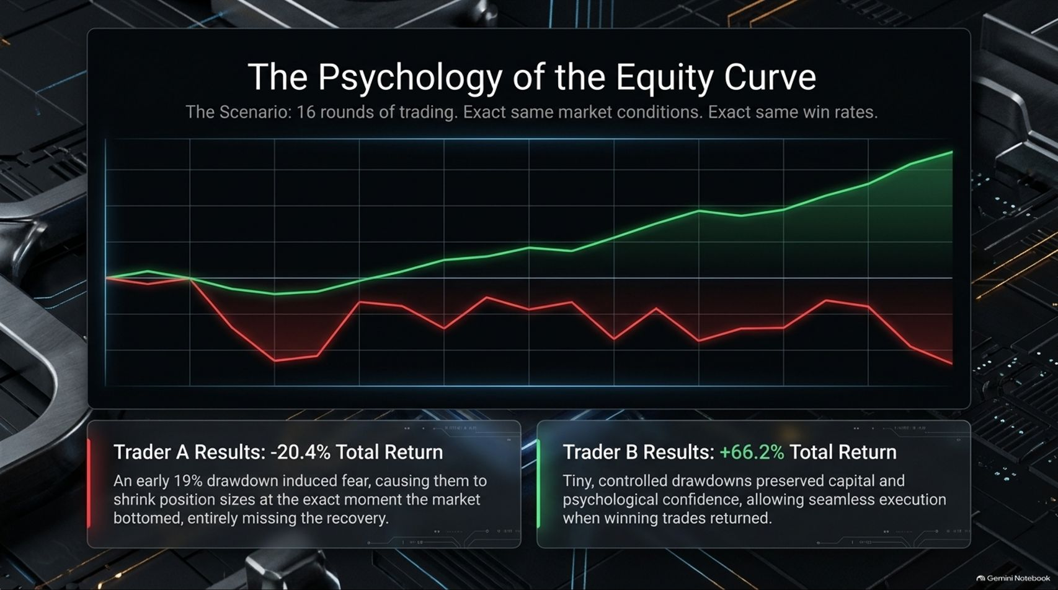
Notes:
Target Speaking Time: ~4–5 Minutes
Speaker Script:
"How does risk management impact psychology and long-term results? Look at The Psychology of the Equity Curve across 16 rounds of trading with identical market conditions and win rates:
Trader A Results (-20.4% Total Return): An early 19% drawdown induced intense fear. Trader A panicked and shrank position sizes at the exact moment the market bottomed, entirely missing the subsequent recovery rally.
Trader B Results (+66.2% Total Return): Tiny, controlled drawdowns preserved capital and psychological confidence. This allowed seamless, emotion-free execution when winning trades returned."

Slide 12
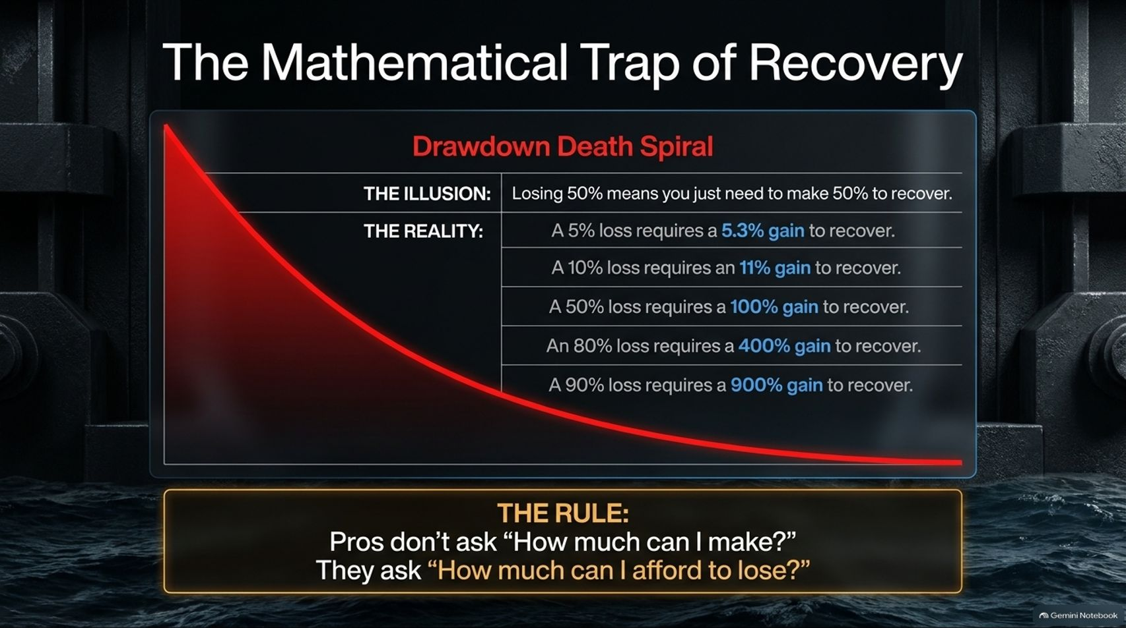
Notes:
Target Speaking Time: ~4–5 Minutes
Speaker Script:
"Why is drawdown control so vital? Because of The Mathematical Trap of Recovery.
Amateurs operate under the illusion that losing 50% means they just need a 50% gain to recover. The math is brutally punishing:
A 5% loss requires a 5.3% gain to recover.
A 10% loss requires an 11% gain.
A 50% loss requires a 100% gain just to break even.
An 80% loss requires a 400% gain.
The Rule: Amateurs ask, 'How much can I make?' Professionals ask, 'How much can I afford to lose?'"

Slide 13
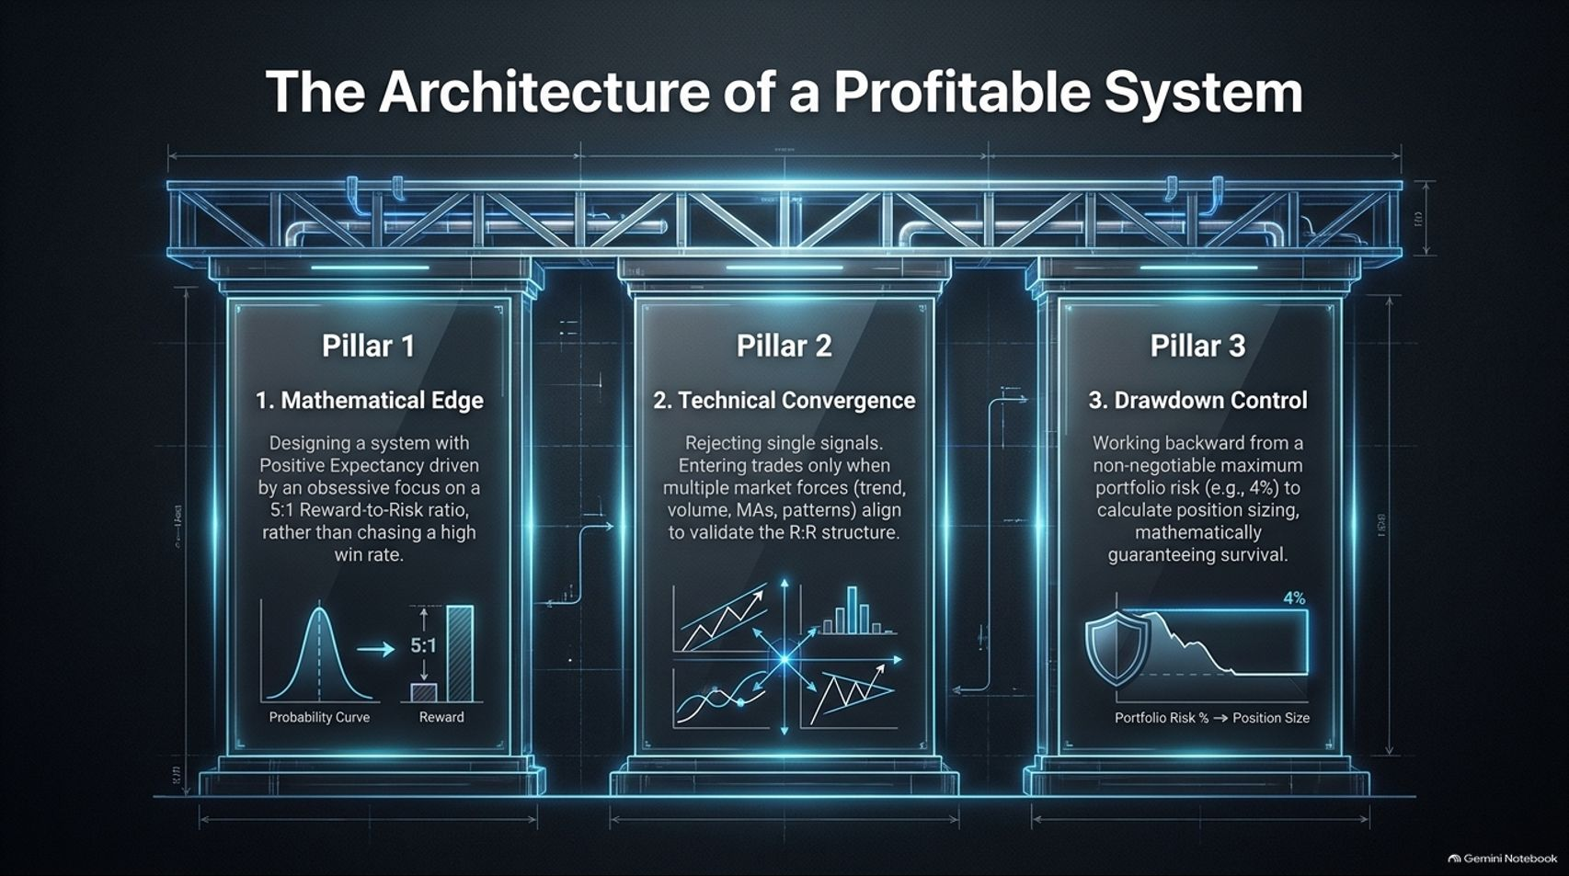
Notes:
Target Speaking Time: ~4–5 Minutes
Speaker Script:
"To summarize, The Architecture of a Profitable System rests on three unshakeable pillars:
Mathematical Edge (Pillar 1): Designing a system with positive expectancy driven by an obsessive focus on a high reward-to-risk ratio (e.g., 5:1), rather than chasing an ego-driven win rate.
Technical Convergence (Pillar 2): Rejecting single indicators. Entering trades only when multiple market forces—trend, volume, moving averages, and chart patterns—align to validate the thesis.
Drawdown Control (Pillar 3): Working backward from a non-negotiable maximum portfolio risk limit to calculate position sizing, mathematically guaranteeing survival."

Slide 14
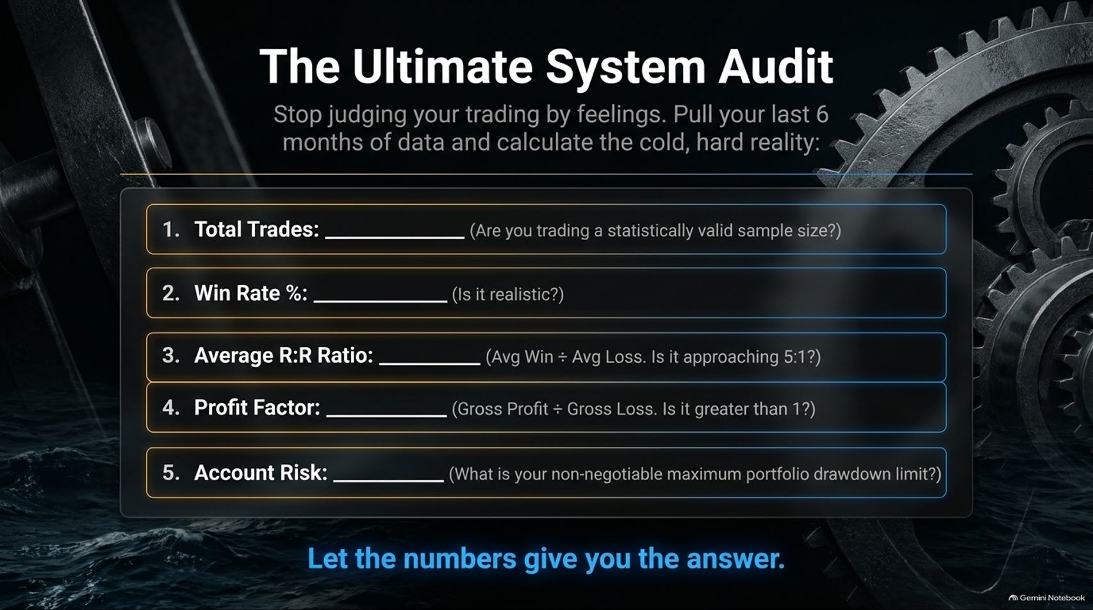
Notes:
Target Speaking Time: ~4–5 Minutes
Speaker Script:
"Stop judging your trading performance by your temporary feelings or emotional highs. Pull your last 6 months of execution data and conduct The Ultimate System Audit:
Total Trades: Are you trading a statistically valid sample size (e.g., 100+ trades)?
Win Rate %: Is it realistic and accounted for?
Average R:R Ratio: Average Win divided by Average Loss. Is it approaching 5:1?
Profit Factor: Gross Profit divided by Gross Loss. Is it cleanly greater than 1.0?
Account Risk: What is your non-negotiable maximum portfolio drawdown limit?
Let the numbers give you the answer."

Slide 15
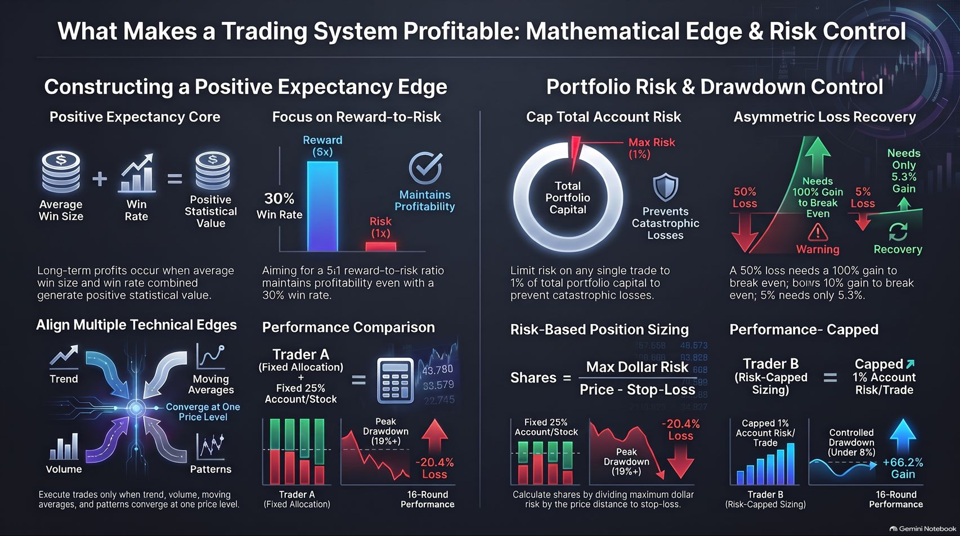
Notes:
Target Speaking Time: ~4–5 Minutes
Speaker Script:
"Our concluding synthesis dashboard brings together everything we have mastered today:
On the left, we anchor our core Positive Expectancy Edge, combining average win size, win rate, and multi-edge technical convergence to ensure our setups possess genuine statistical value.
On the right, we enforce strict Portfolio Risk & Drawdown Control, capping account risk at 1% per trade to bypass the mathematical death spiral of deep drawdowns.
Remember: The real winners in the market are not the ones who try to get rich overnight with oversized bets. They are the systematic operators who survive, manage risk, and let compounding do the heavy lifting over thousands of repetitions. Thank you."

