Slide 1
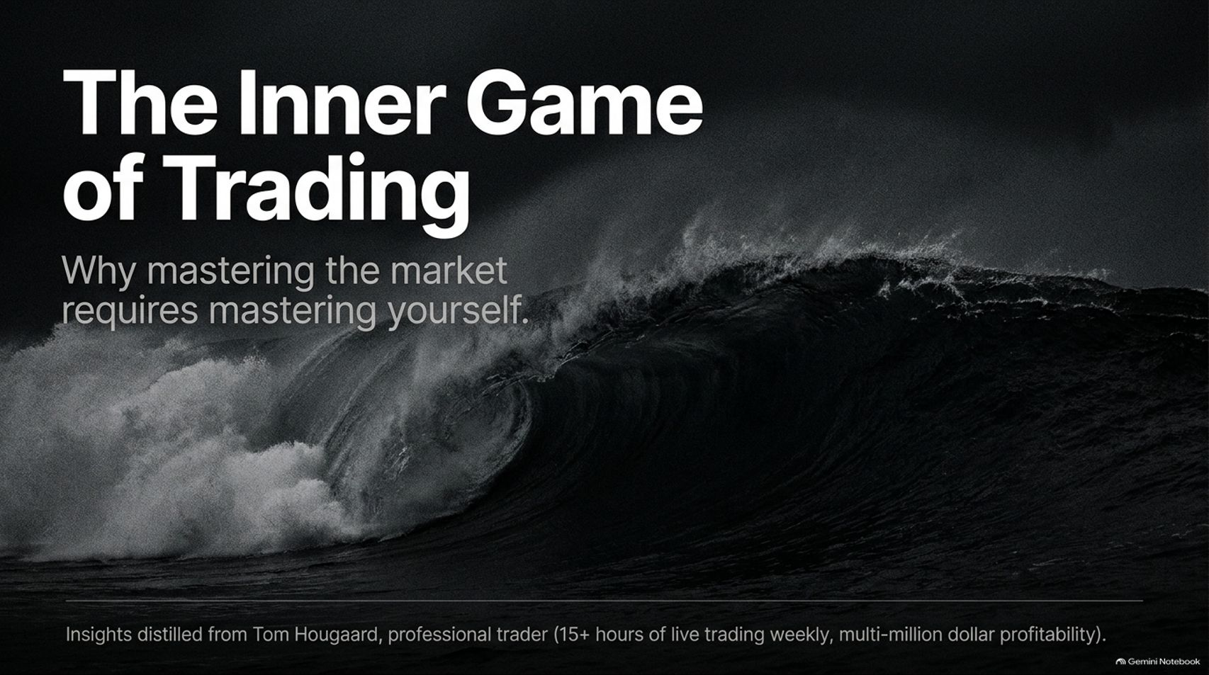
Notes:
Target Speaking Time: ~3–4 Minutes
Speaker Script:
"Welcome, everyone. Today we are tackling a profound topic that separates amateur market participants from professional systematic operators: The Inner Game of Trading: Why mastering the market requires mastering yourself.
As Tom Hougaard notes in his live masterclasses, many traders spend years chasing indicators, YouTube gurus, and secret strategies, only to realize that their account performance remains stagnant or negative. Why? Because trading is not an outer intellectual test; it is an intense, unyielding mirror of the human psyche.
Across these 15 slides, we will deconstruct the exact behavioral architecture, risk parameters, and emotional discipline required to build a permanent, repeatable trading edge. Let’s dive in."
Tom Hougaard: This Is Why Most Traders Fail (Best Loser Wins Full Speech)
https://www.youtube.com/watch?v=h-y60kyhO3I

Slide 2
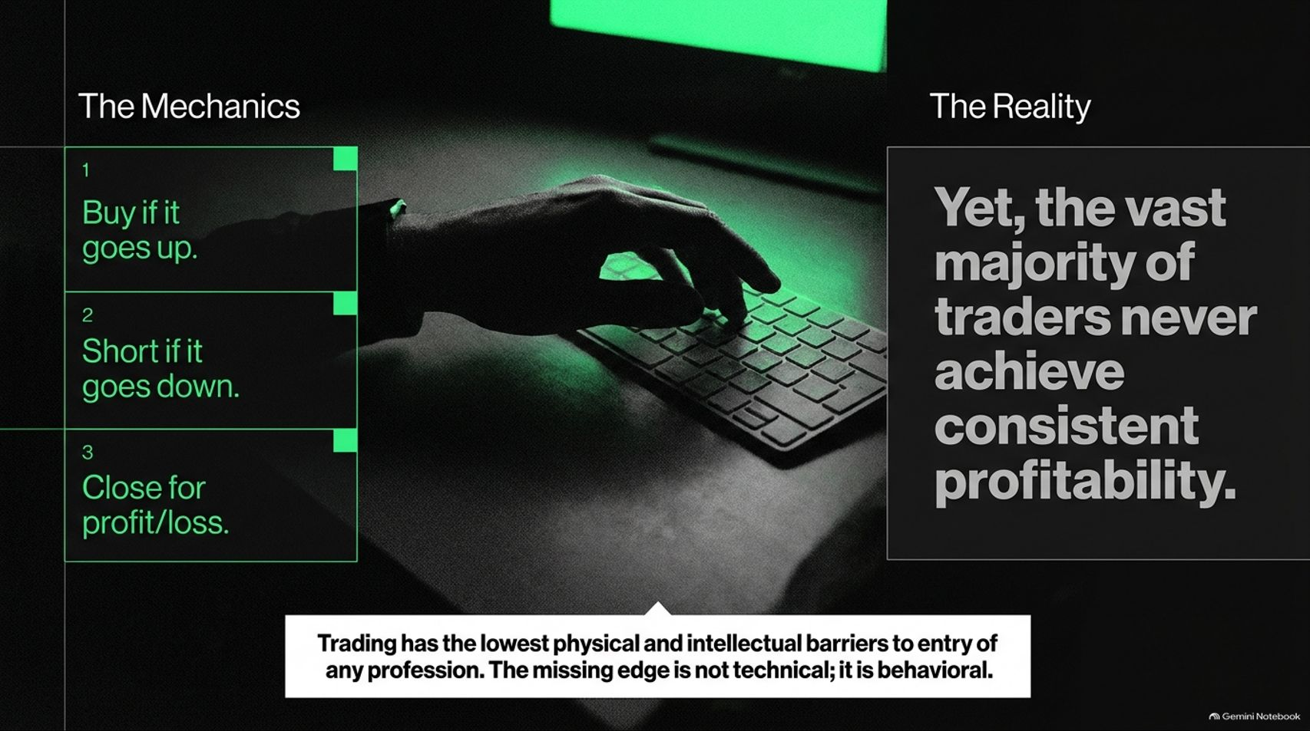
Notes:
Target Speaking Time: ~4–5 Minutes
Speaker Script:
"Let’s look at Slide 2: The Mechanics vs. The Reality.
At its core, trading is deceptively simple. The mechanics require only three fundamental actions:
Buy if it goes up.
Short if it goes down.
Close for profit or loss.
The Reality: Despite having the lowest physical and intellectual barriers to entry of any profession—requiring nothing more than a computer, an internet connection, and some capital—the vast majority of traders never achieve consistent profitability.
As Tom highlights, the missing edge is never technical; it is entirely behavioral."

Slide 3
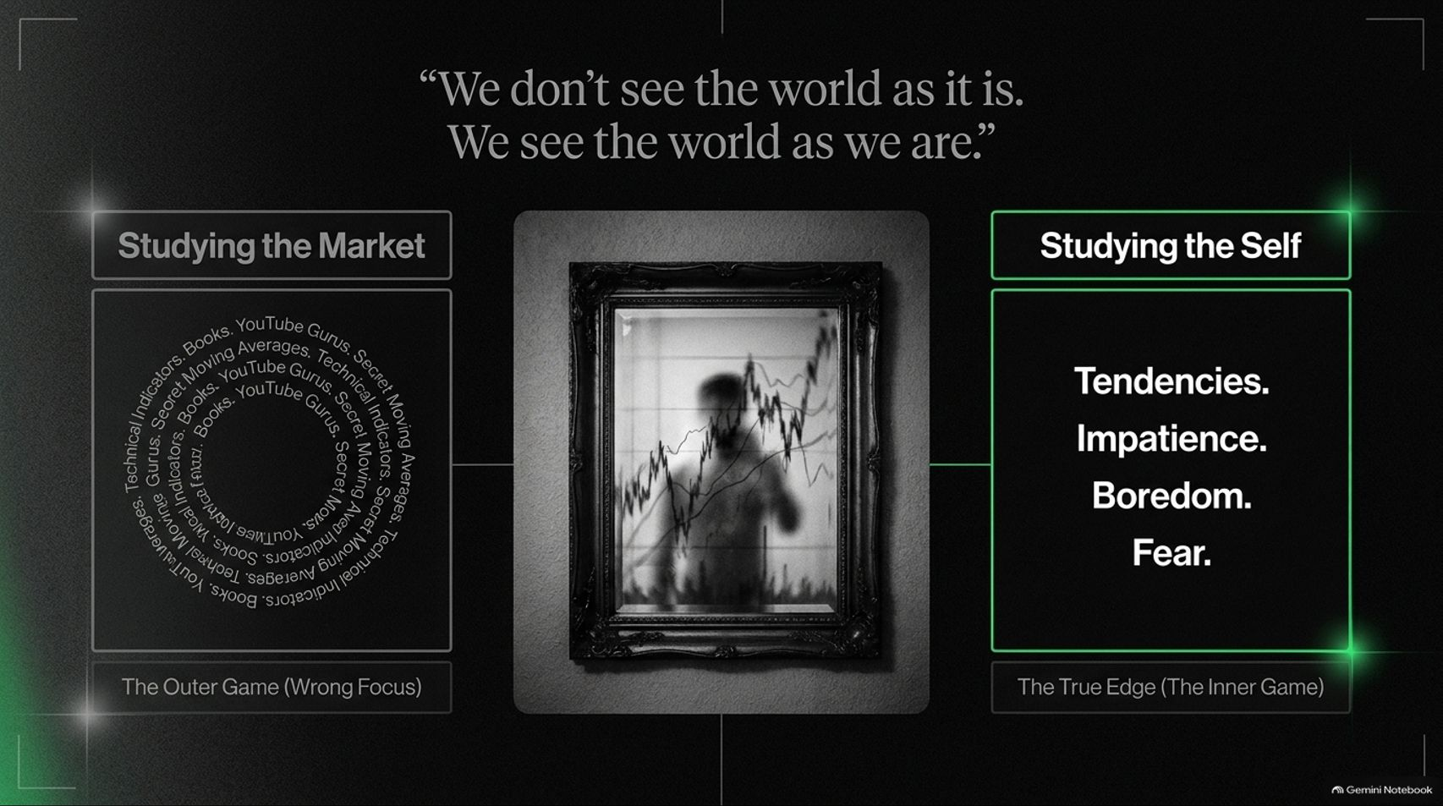
Notes:
Target Speaking Time: ~4–5 Minutes
Speaker Script:
"To quote a timeless axiom: 'We don’t see the world as it is; we see the world as we are.'
The Outer Game (Wrong Focus): Most struggling traders trap themselves in an infinite loop of studying technical indicators, books, secret moving averages, and YouTube gurus. They look outward for a magical holy grail that will fix their trading equation.
The True Edge (The Inner Game): Professional performance requires shifting focus inward to Study the Self. You must confront your raw tendencies—your impatience, your boredom, your ego, and your fear. Until you master your inner state, no technical system can save you."

Slide 4
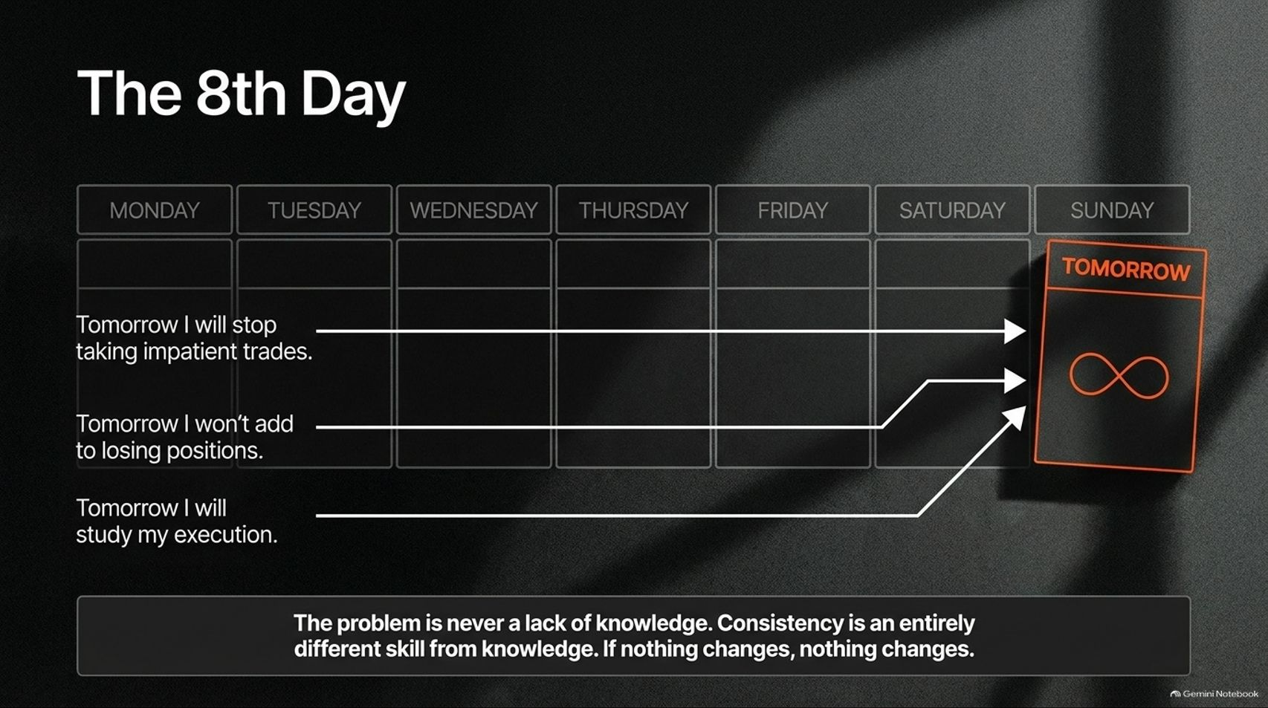
Notes:
Target Speaking Time: ~4–5 Minutes
Speaker Script:
"Slide 4 exposes a psychological trap that binds millions of people worldwide: The 8th Day.
Most human beings operate on an 8-day week: Monday through Sunday, plus 'Tomorrow'.
'Tomorrow I will stop taking impatient trades.'
'Tomorrow I won’t add to losing positions.'
'Tomorrow I will study my execution.'
The Reality: Tomorrow is the day that never comes. As Tom emphasizes, the problem is never a lack of knowledge. Consistency is an entirely different skill from knowledge. If nothing changes in your daily behavioral framework, nothing changes in your account balance."

Slide 5
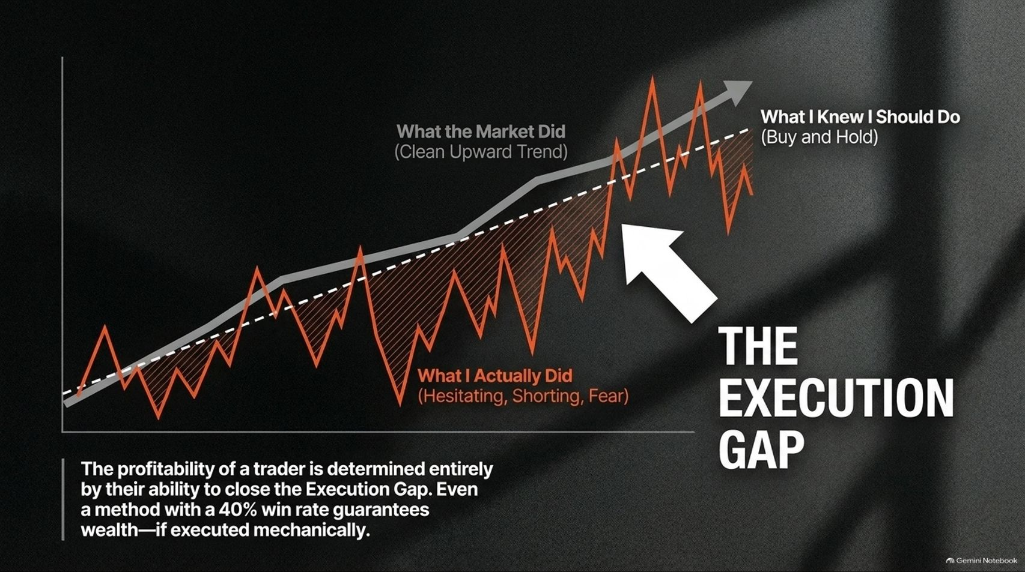
Notes:
Target Speaking Time: ~4–5 Minutes
Speaker Script:
"Look closely at Slide 5: The Execution Gap.
The market charts a clean upward trend (what you knew you should do: buy and hold). Yet, what the trader actually did was oscillate wildly between hesitation, shorting out of fear, and emotional panic.
The Core Lesson: The profitability of a trader is determined entirely by their ability to close the Execution Gap. Even a straightforward method with a modest 40% win rate guarantees massive wealth generation—if and only if it is executed with cold, mechanical consistency."

Slide 6
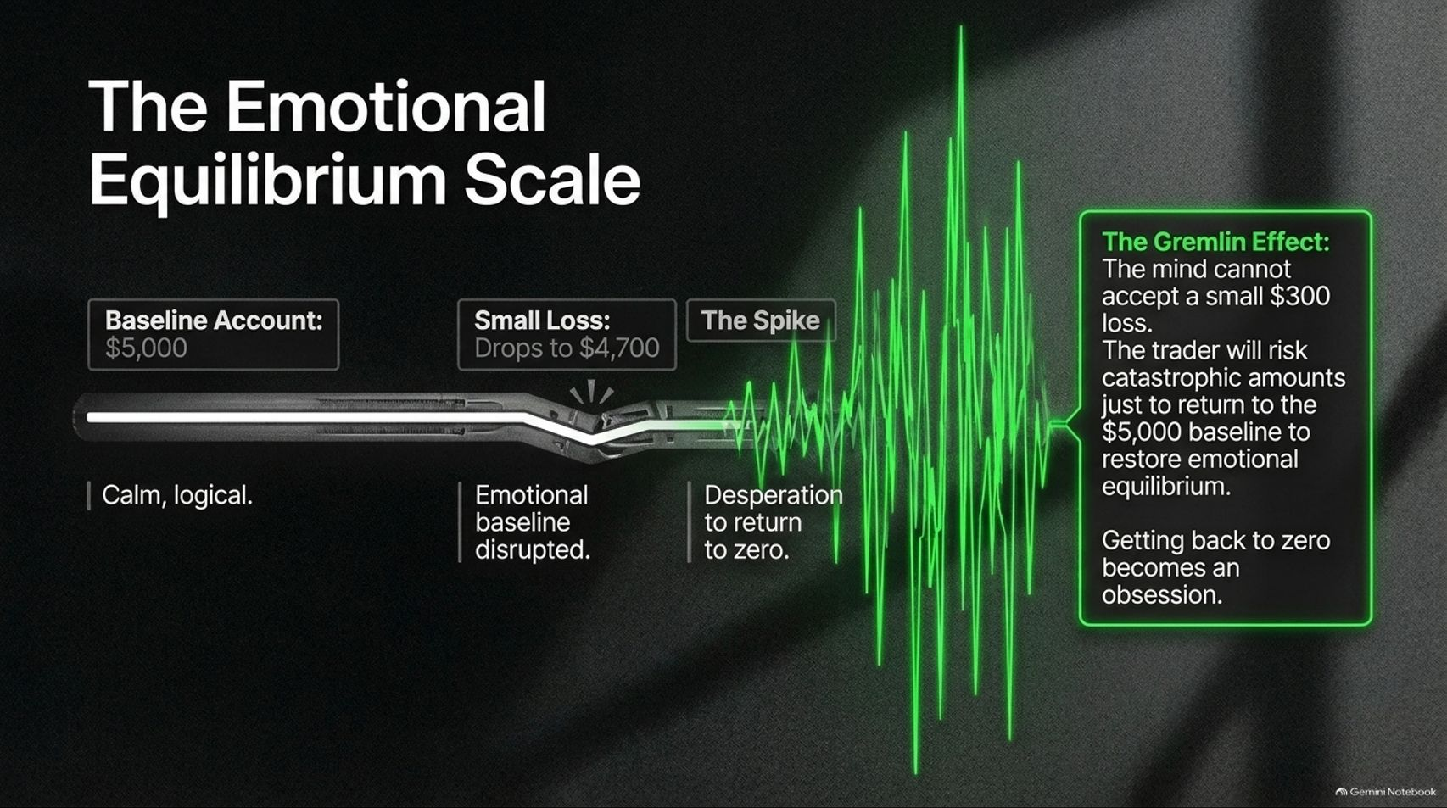
Notes:
Target Speaking Time: ~4–5 Minutes
Speaker Script:
"Slide 6 illustrates The Emotional Equilibrium Scale and the psychological monster Tom calls 'The Gremlin Effect'.
Imagine starting your day with a calm, logical baseline account of $5,000. The first trade hits a small loss, dropping your balance to $4,700.
The Gremlin Effect: Your primitive mind cannot accept a minor $300 loss. An internal panic spikes, triggering desperate behavior. The trader will risk catastrophic, account-destroying amounts just to return to the $5,000 baseline and restore emotional equilibrium. Getting back to zero becomes a toxic, blinding obsession."

Slide 7
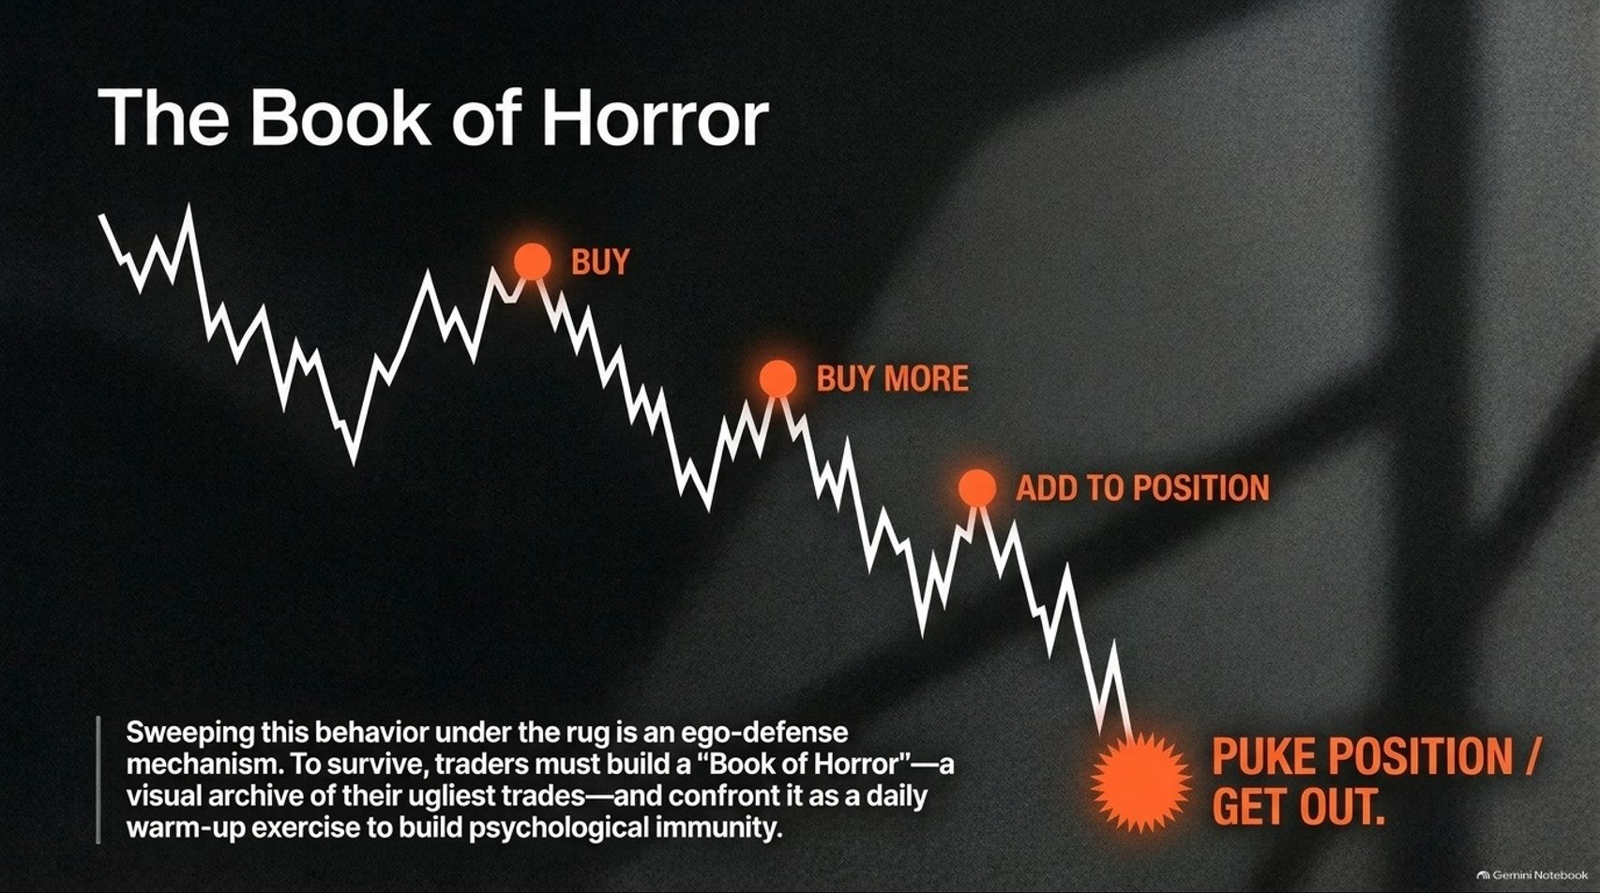
Notes:
Target Speaking Time: ~4–5 Minutes
Speaker Script:
"To break destructive habits, traders must confront their worst moments. Slide 7 introduces The Book of Horror.
Picture a persistent downtrend where an amateur buys at the top, buys more halfway down, adds further to the position as it bleeds, and finally 'pukes' the position out in complete despair at the absolute bottom.
The Solution: Sweeping this ugly behavior under the rug is an ego-defense mechanism. To survive, you must build a 'Book of Horror'—a visual archive of your worst trades—and confront it daily as a warm-up exercise to build psychological immunity."

Slide 8
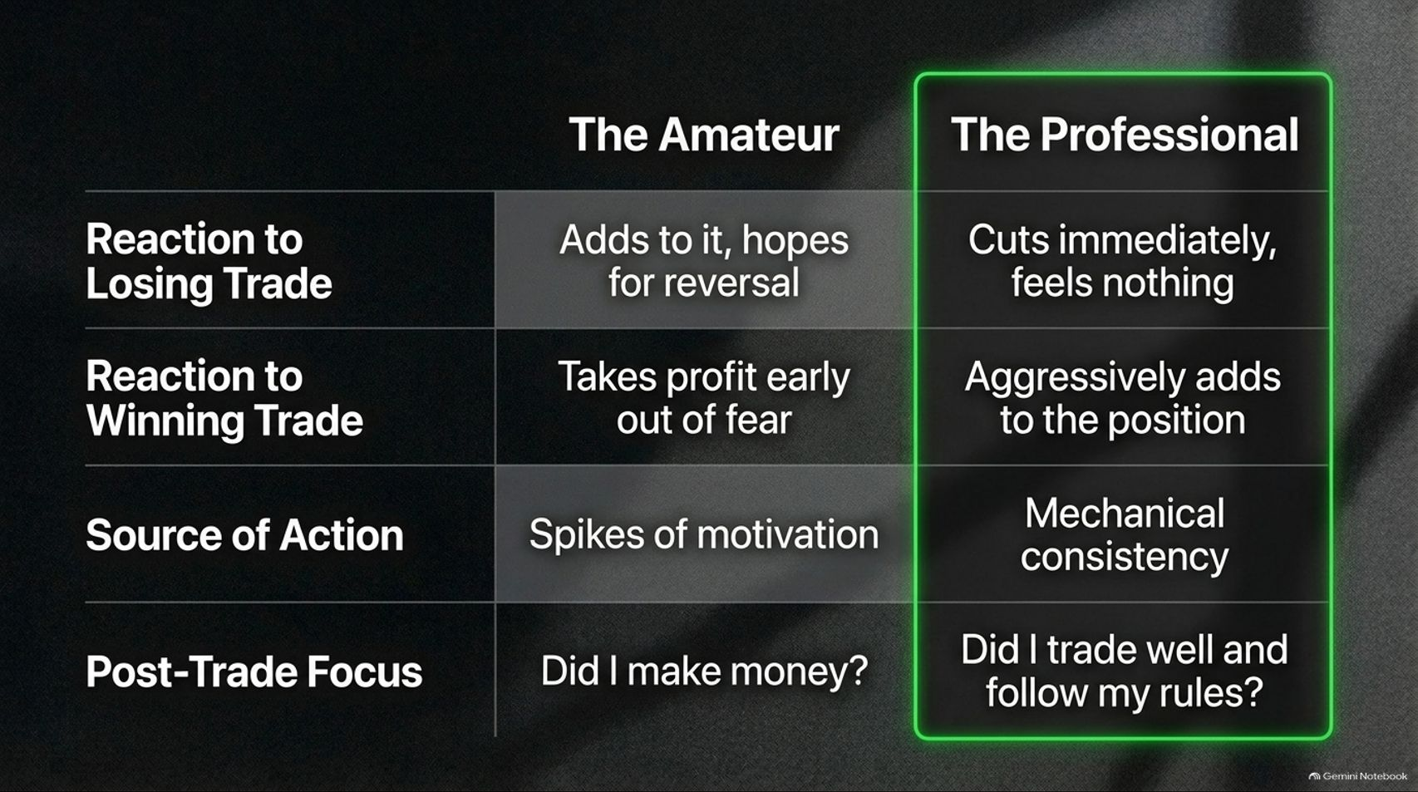
Notes:
Target Speaking Time: ~4–5 Minutes
Speaker Script:
"Slide 8 provides a direct comparative matrix between The Amateur and The Professional:
Dimension
The Amateur
The Professional
Reaction to Losing Trade
Adds to it, hoping for a market reversal.
Cuts immediately, feels zero emotional attachment.
Reaction to Winning Trade
Takes profit early out of fear of losing gains.
Aggressively adds to the winning position.
Source of Action
Driven by fleeting emotional spikes and motivation.
Driven by unyielding mechanical consistency.
Post-Trade Focus
'Did I make money?' (Outcome-focused).
'Did I trade well and follow my rules?' (Process-focused).

Slide 9
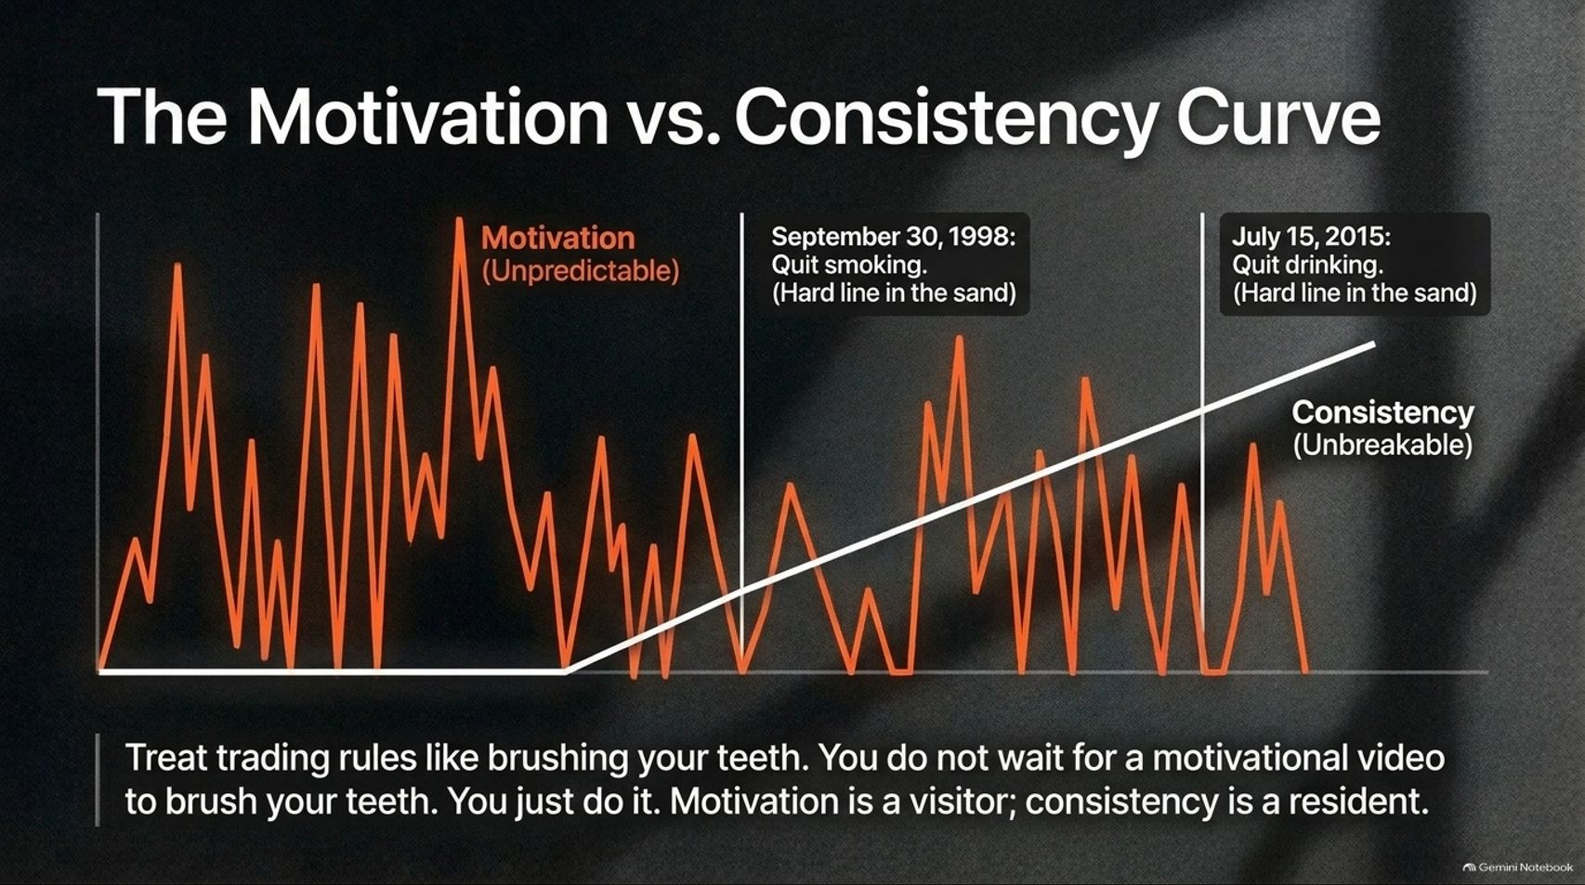
Notes:
Target Speaking Time: ~4–5 Minutes
Speaker Script:
"Slide 9 deconstructs The Motivation vs. Consistency Curve.
Motivation is erratic, unpredictable, and spikes wildly like an unstable chart. If your trading discipline relies on waiting to 'feel motivated,' you will fail.
The Dental Analogy: Treat your trading rules like brushing your teeth. You don't wait for a motivational video or an emotional breakthrough to brush your teeth—you simply do it because it is a non-negotiable hygiene habit. Motivation is a temporary visitor; consistency must become a permanent resident."

Slide 10
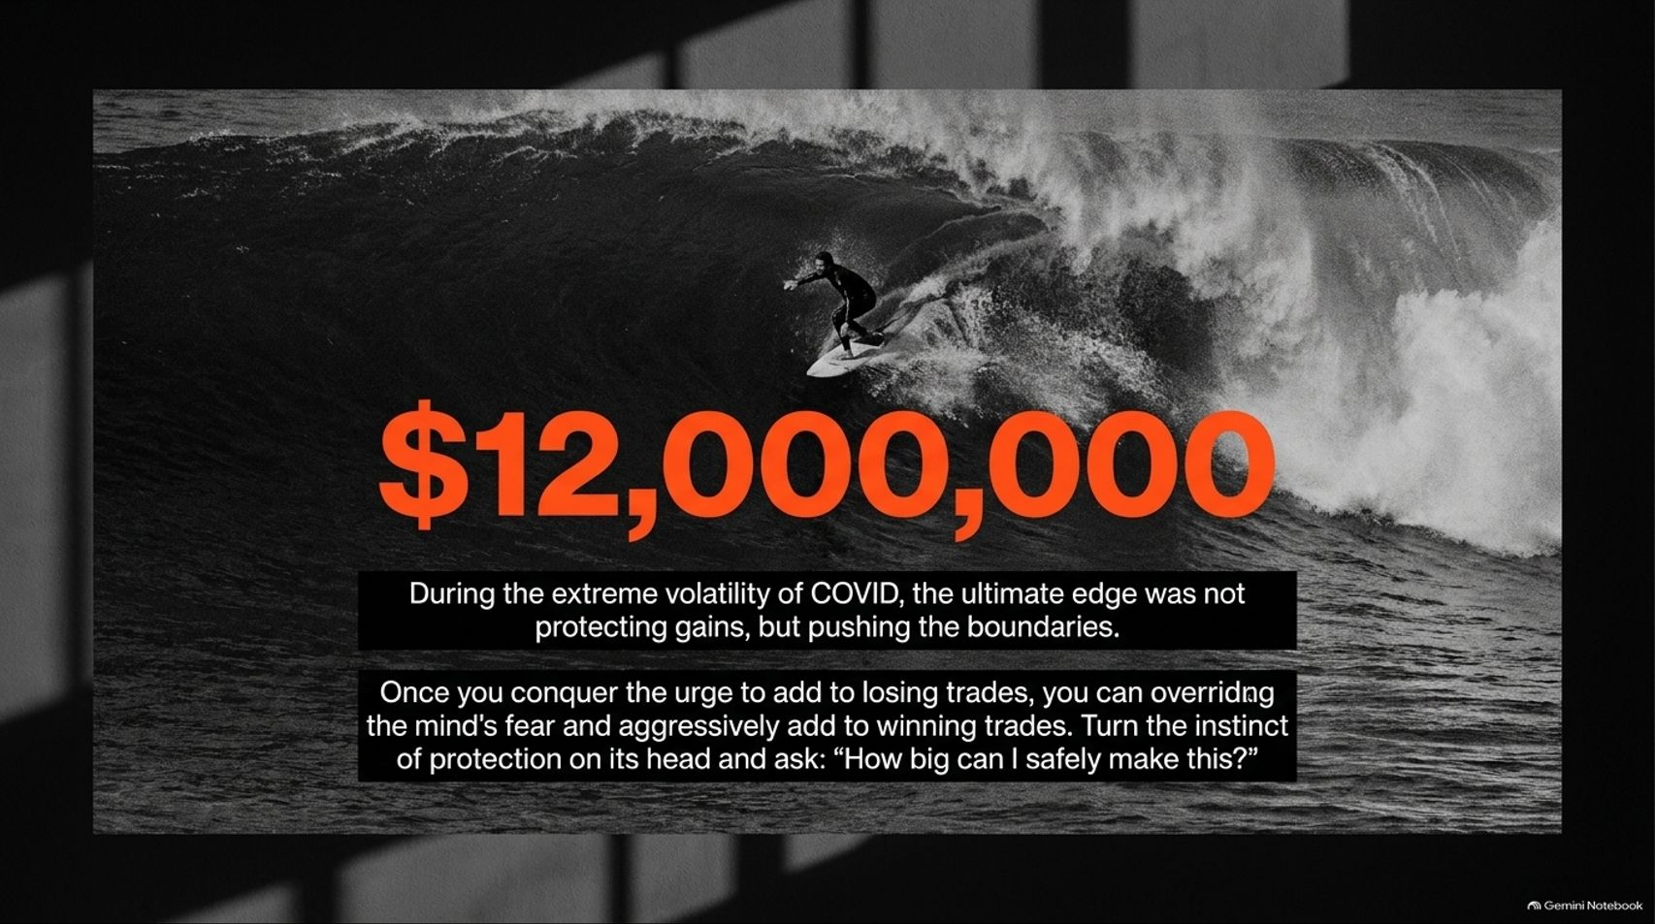
Notes:
Target Speaking Time: ~4–5 Minutes
Speaker Script:
"Slide 10 highlights Tom’s personal breakthrough during the extreme market volatility of COVID-19, where he generated close to $12,000,000.
The Paradigm Shift: Most traders, upon making a large sum of money, instantly become protective and shrink their size out of fear of giving it back.
The ultimate edge during historic market opportunities was not being defensive, but pushing the boundaries. Once you conquer the urge to add to losing trades, you can override fear and aggressively add to winning trades. Turn your protective instinct on its head and ask: 'How big can I safely make this?'"

Slide 11
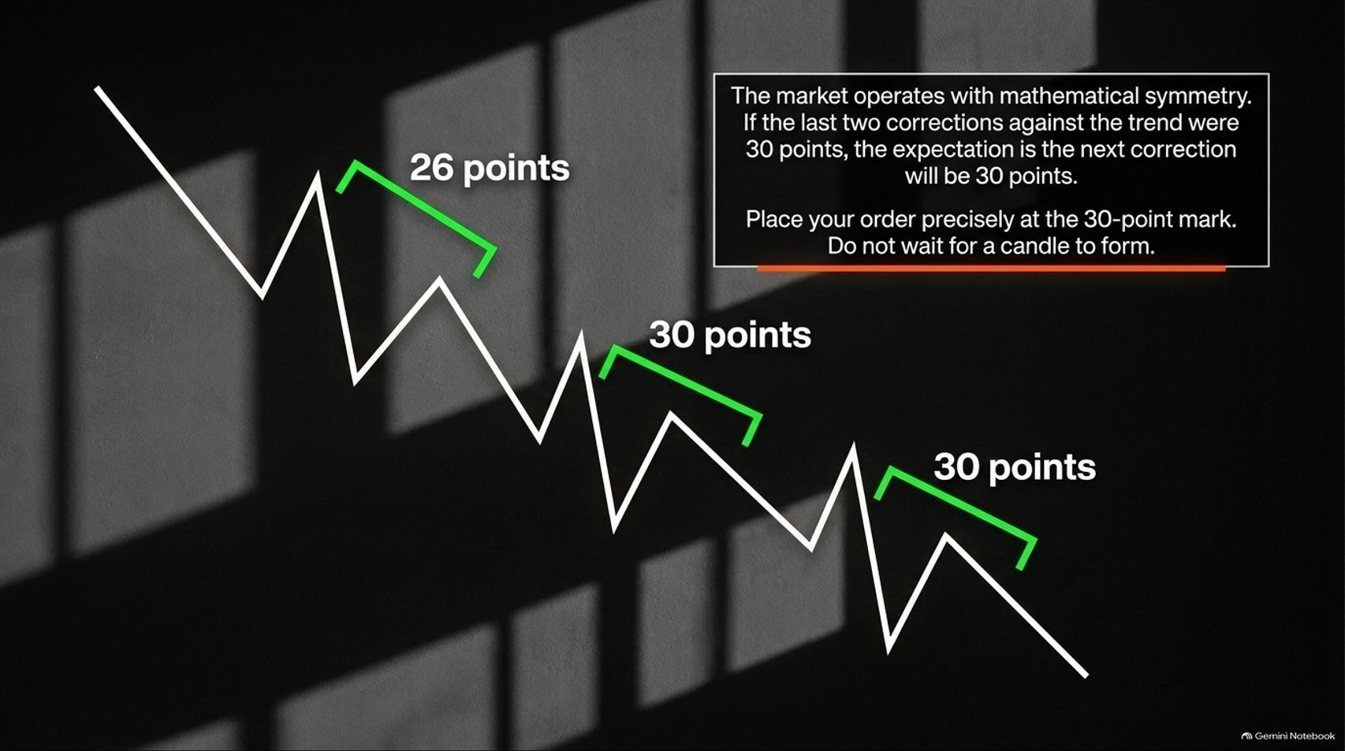
Notes:
Target Speaking Time: ~4–5 Minutes
Speaker Script:
"Slide 11 shifts into Tom’s practical charting methodology: Precision Wave Point Counting.
The market operates with strict mathematical symmetry. If historical corrections against a trend measure 26 points, then 30 points, and then 30 points, the statistical expectation is that the next correction will also respect that 30-point boundary.
Execution Rule: Place your order precisely at the mathematical 30-point mark. Do not wait for a candlestick to form or hesitate in real-time; let objective numerical structure dictate your entries."

Slide 12
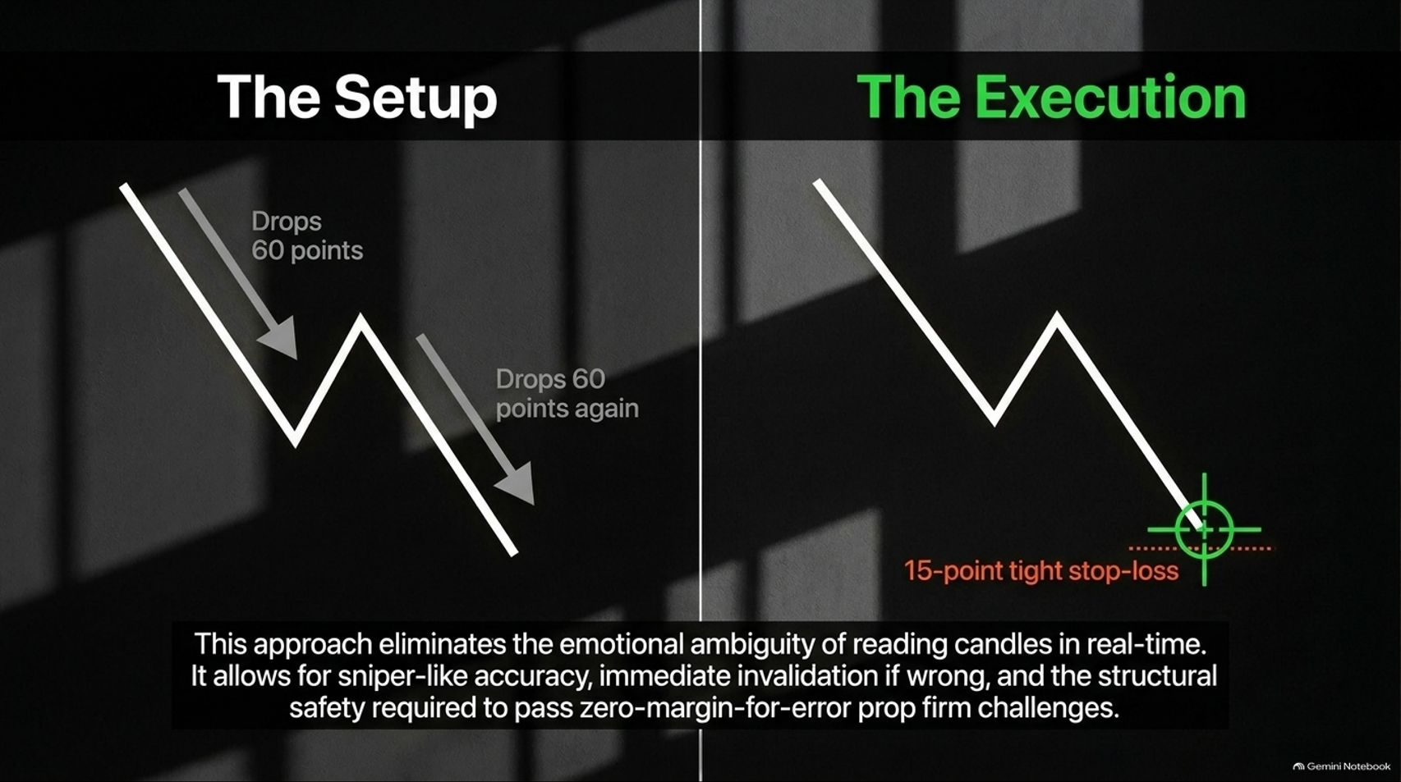
Notes:
Target Speaking Time: ~4–5 Minutes
Speaker Script:
"Slide 12 contrasts The Setup with The Execution.
When a market structure repeats a 60-point drop twice, the third wave provides a pristine mathematical blueprint.
The Advantage: This approach entirely eliminates the emotional ambiguity of reading candles in real-time. It allows for sniper-like accuracy, immediate invalidation if your math is proven wrong (e.g., a tight 15-point stop-loss), and the structural risk control required to successfully pass zero-margin-for-error prop firm challenges."

Slide 13
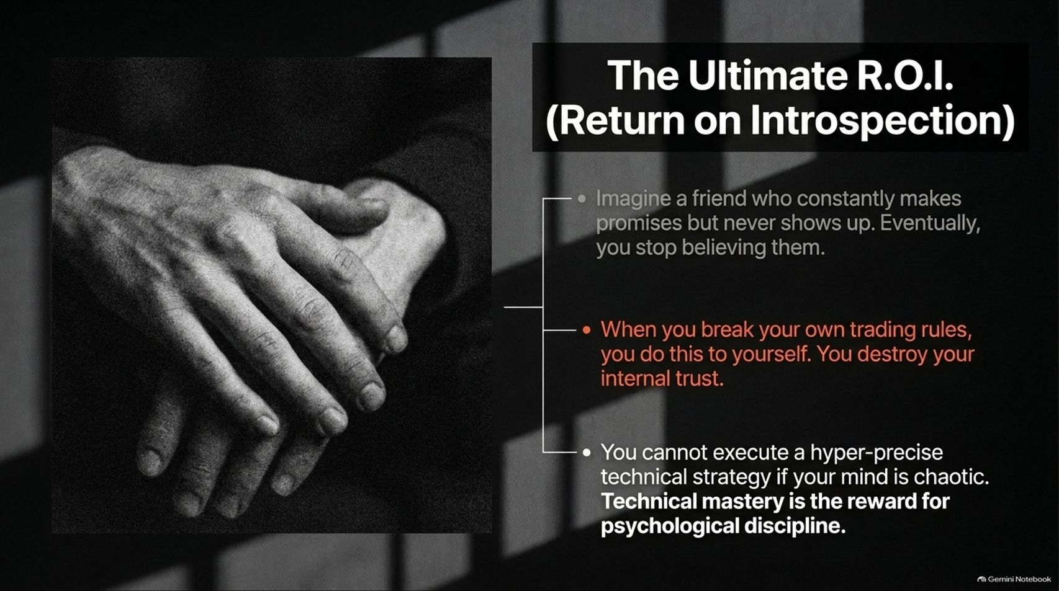
Notes:
Target Speaking Time: ~4–5 Minutes
Speaker Script:
"Slide 13 delivers the deepest philosophical takeaway of the presentation: The Ultimate R.O.I. (Return on Introspection).
Imagine a friend who constantly makes promises but never shows up; eventually, you stop believing them.
Self-Betrayal: When you break your own trading rules, you do this exact thing to yourself—you systematically destroy your internal self-trust. You cannot execute a hyper-precise technical strategy if your mind is in chaos. Technical mastery is not a starting point; it is the natural reward for psychological discipline."

Slide 14
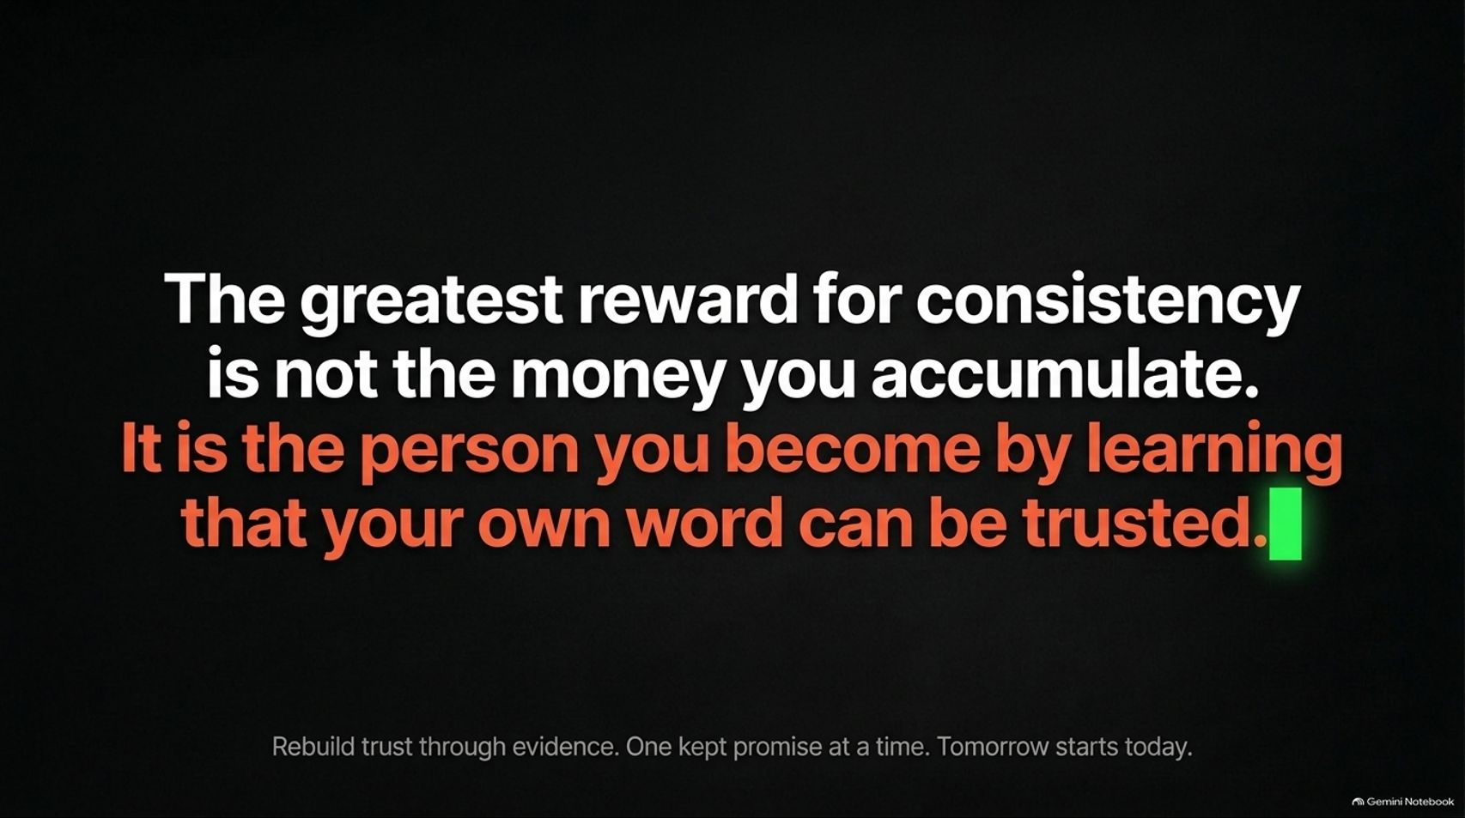
Notes:
Target Speaking Time: ~4–5 Minutes
Speaker Script:
"Slide 14 captures the culmination of the journey:
'The greatest reward for consistency is not the money you accumulate. It is the person you become by learning that your own word can be trusted.'
How to Rebuild Trust: You cannot fix broken self-trust with empty positive affirmations or loud motivational mantras. You rebuild trust strictly through evidence—one kept promise at a time. Honor your risk limits on your very next trade, follow your review routine today, and let concrete actions restore your psychological integrity."

Slide 15
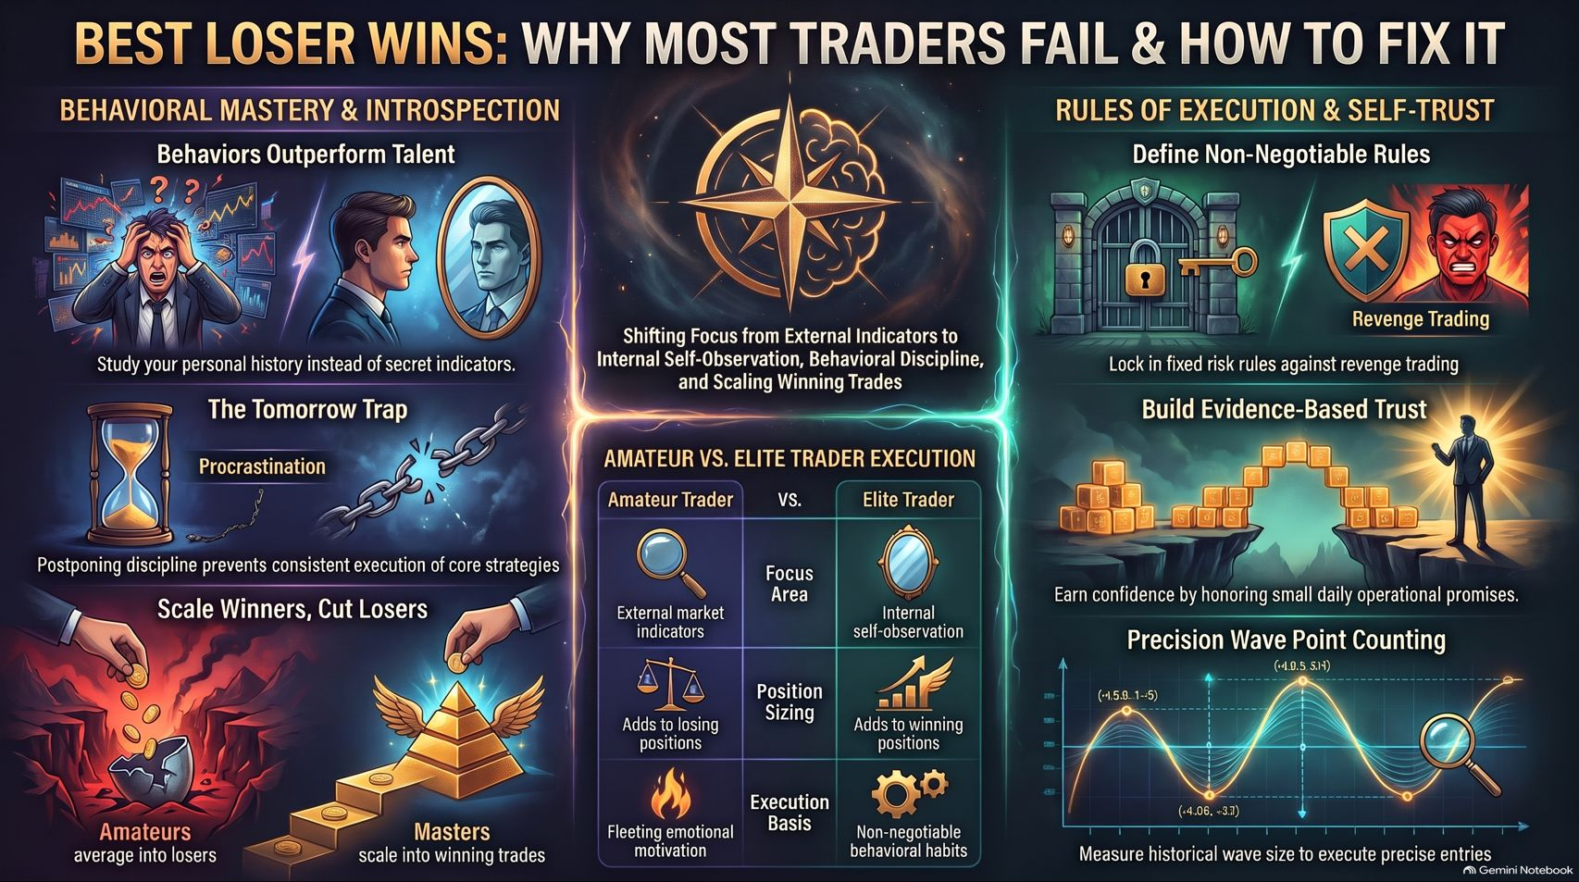
Notes:
Target Speaking Time: ~4–5 Minutes
Speaker Script:
"Our concluding synthesis on Slide 15 pulls together the entire architectural framework:
Behavioral Mastery: Study your personal trading history and behavioral data rather than chasing secret indicators.
Shift Focus: Move away from external market noise and toward internal self-observation, strict risk control, and scaling winning positions.
Rules of Execution: Lock in non-negotiable risk rules, eliminate revenge trading, and earn unshakeable self-trust through disciplined daily execution.
Remember: The winners in this game are not the ones who get lucky once, but the resilient operators who survive, adapt, and master the inner game. Thank you."

