Slide 1
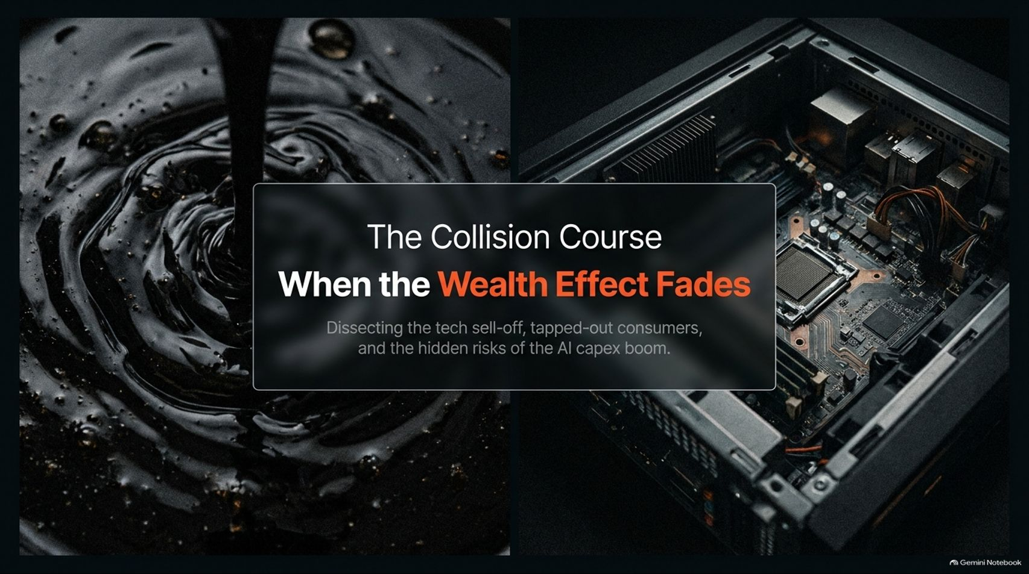
Notes:
Target Speaking Time: ~3–4 Minutes
Speaker Script:
"Welcome, everyone. Today we are dissecting a critical juncture in the global financial landscape: The Collision Course: When the Wealth Effect Fades.
As explored in recent market analysis with macro experts Bob Elliot and Ahan Haque, the current market narrative rests heavily on a fragile tug-of-war: sticky structural inflation on one side, and extreme, uninterrupted growth extrapolation in artificial intelligence on the other.
Across these 15 slides, we will examine why consumer spending has decoupled from stagnant wages, how disavings are propping up the economy, and the hidden systemic risks of tech pseudo-credit. Let's dive into the data."
Tech is Selling Off. Spending Is Outrunning Wages. What Happens When the Wealth Effect Fades?
https://www.youtube.com/watch?v=Cp5xnh4COXg

Slide 2
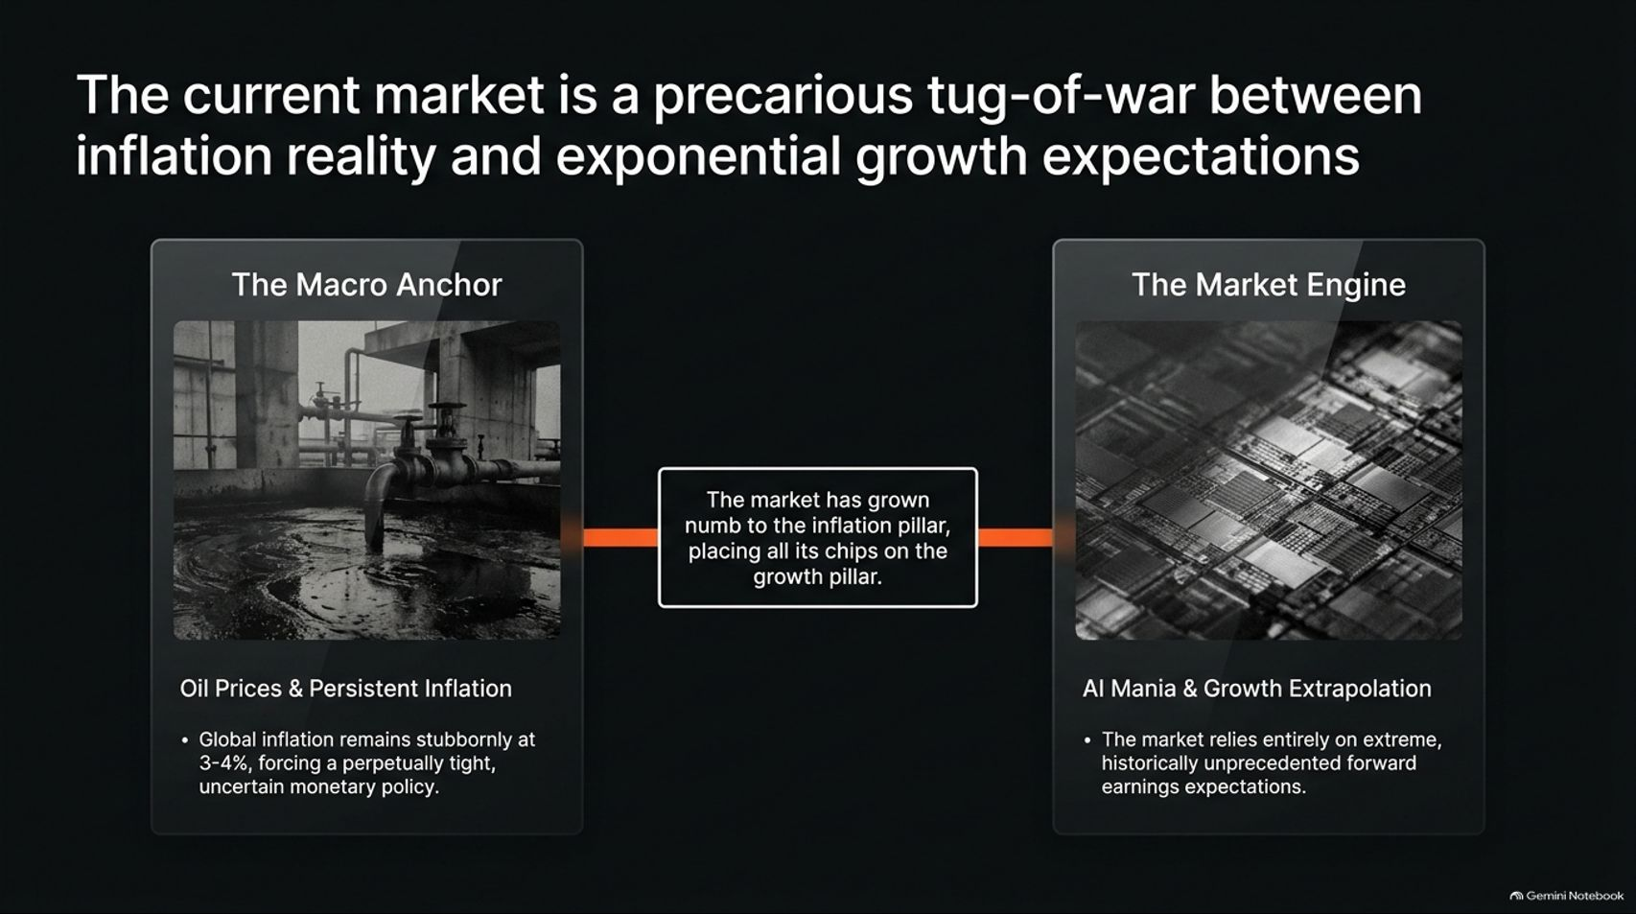
Notes:
Target Speaking Time: ~4–5 Minutes
Speaker Script:
"Let’s look at Slide 2: The Macro Anchor vs. The Market Engine.
The Macro Anchor: Global inflation remains stubbornly anchored at 3% to 4%, largely driven by energy dynamics and persistent oil price pressures. Central banks are forced into a perpetually tight monetary stance.
The Market Engine: Conversely, the market has grown completely numb to this inflation pillar, placing all its chips on exponential growth expectations centered around the AI mania.
The Disconnect: Market pricing relies entirely on historically unprecedented forward earnings expectations while ignoring foundational macroeconomic constraints."

Slide 3
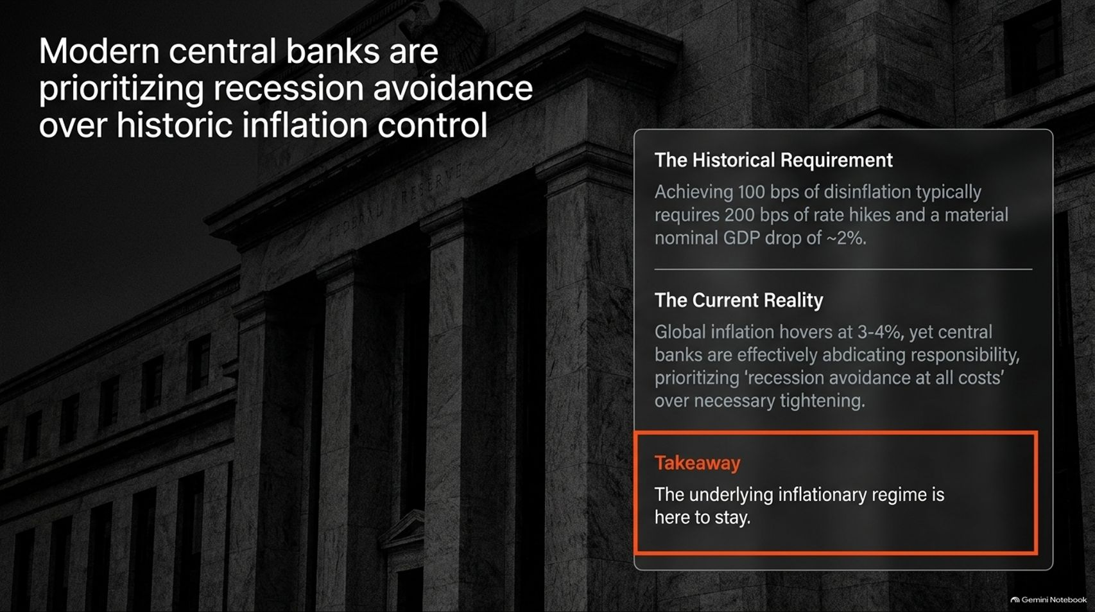
Notes:
Target Speaking Time: ~4–5 Minutes
Speaker Script:
"Slide 3 addresses a profound shift in monetary policy: Modern central banks are prioritizing recession avoidance over historic inflation control.
The Historical Requirement: Achieving 100 basis points of disinflation traditionally requires roughly 200 basis points of aggressive rate hikes and a material nominal GDP contraction of about 2%.
The Current Reality: Even with inflation hovering at 3-4%, central banks across the developed world are effectively abdicating responsibility, prioritizing 'recession avoidance at all costs' over necessary tightening.
Takeaway: The underlying inflationary regime is structural and here to stay."

Slide 4
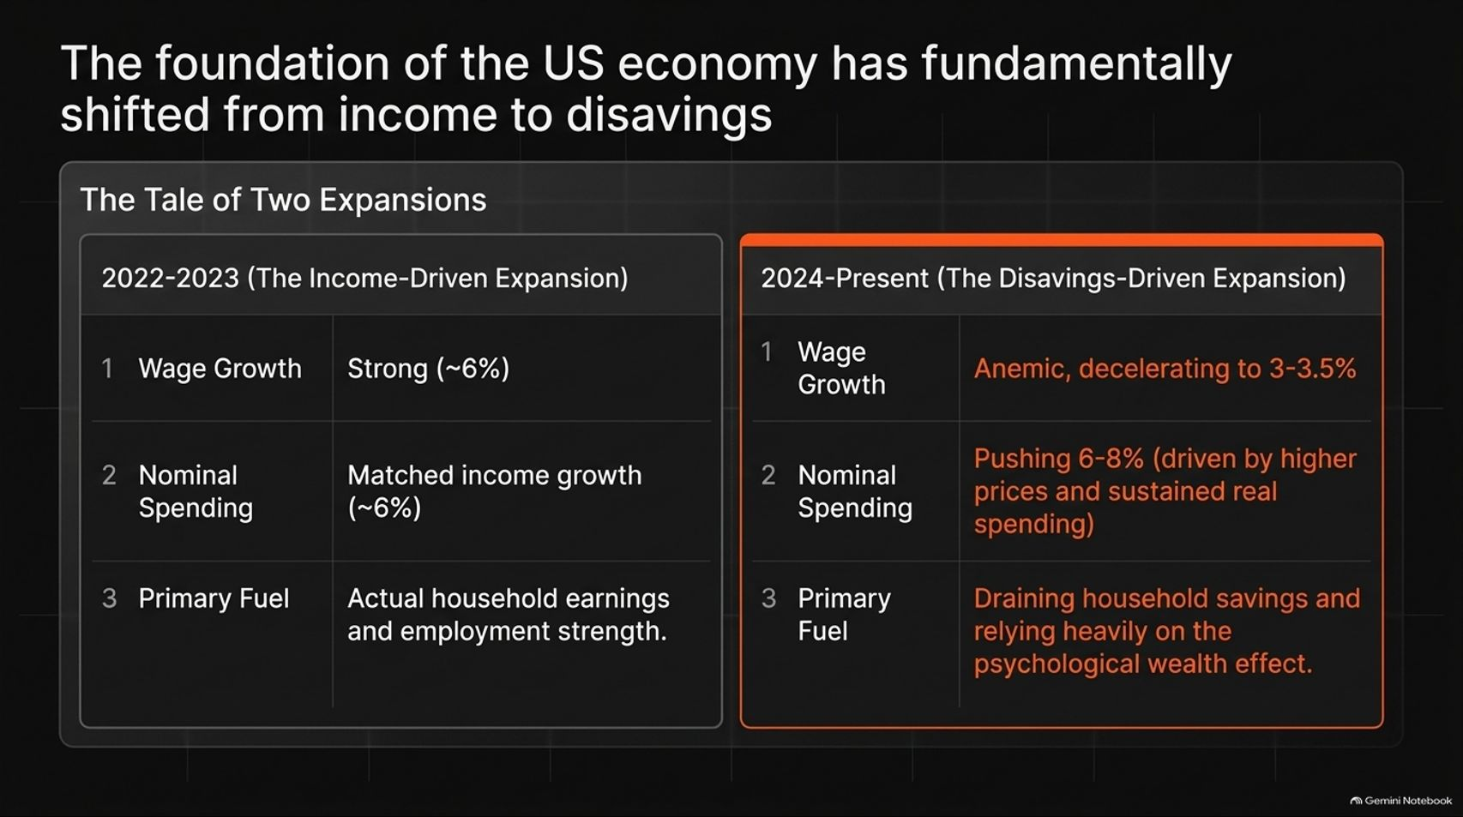
Notes:
Target Speaking Time: ~4–5 Minutes
Speaker Script:
"Slide 4 highlights a fundamental structural mutation in the US economy: The foundation has shifted from income to disavings.
2022–2023 (The Income-Driven Expansion): Wage growth ran strong at ~6%, perfectly matching nominal spending. Growth was fueled by actual employment strength.
2024–Present (The Disavings-Driven Expansion): Wage growth has decelerated to an anemic 3–3.5%. Yet, nominal spending pushes higher at 6–8%.
The Primary Fuel: Consumers are aggressively draining household savings and relying entirely on the psychological wealth effect of rising asset prices to fund consumption."

Slide 5
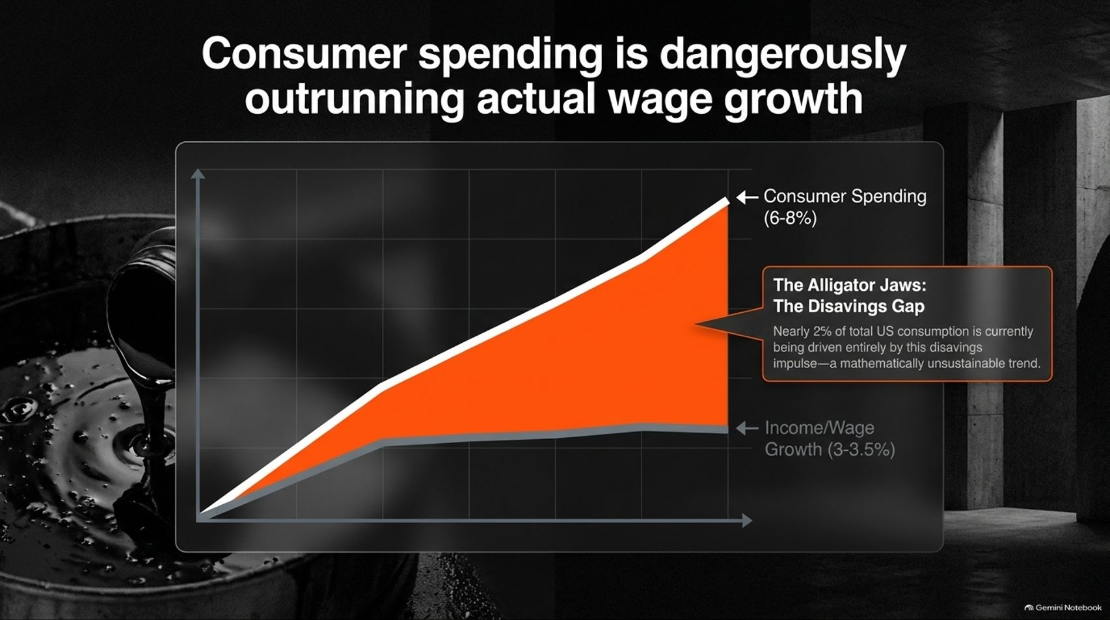
Notes:
Target Speaking Time: ~4–5 Minutes
Speaker Script:
"Look closely at Slide 5: Consumer spending is dangerously outrunning actual wage growth.
The divergence between consumer spending (growing at 6–8%) and wage/income growth (lagging at 3–3.5%) forms what we call The Alligator Jaws.
The Disavings Gap: Nearly 2% of total US consumption is currently being driven entirely by this disavings impulse. As Bob Elliot notes, when energy and living costs remain high for months, households eventually exhaust their buffers. This mathematical trajectory is fundamentally unsustainable."

Slide 6
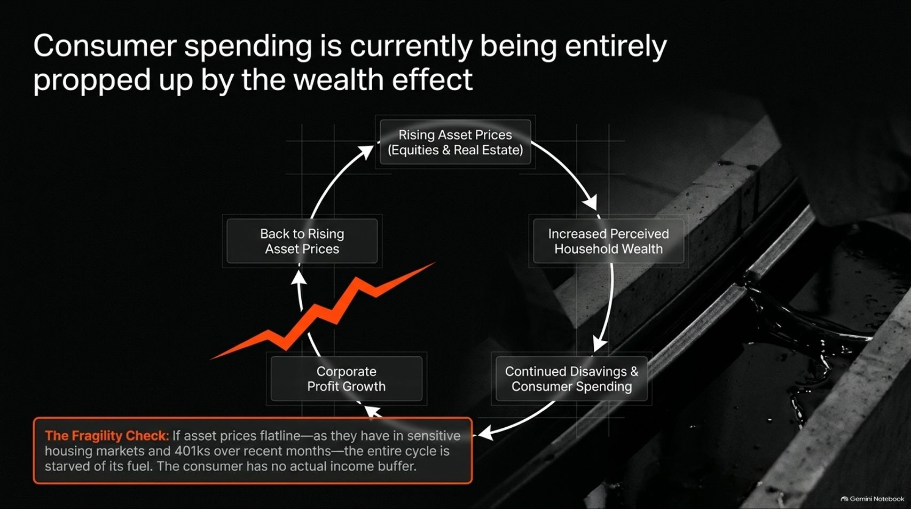
Notes:
Target Speaking Time: ~4–5 Minutes
Speaker Script:
"Slide 6 maps out The Wealth Effect Feedback Loop:
Rising Asset Prices (Equities & Real Estate) $\rightarrow$
Increased Perceived Household Wealth $\rightarrow$
Continued Disavings & Consumer Spending $\rightarrow$
Corporate Profit Growth $\rightarrow$
Back to Rising Asset Prices.
The Fragility Check: If asset prices flatline—as they have in sensitive housing markets and stagnant 401(k)s over recent months—the entire self-reinforcing cycle is starved of its fuel. Because the consumer has no actual income buffer, any stall in asset markets triggers an immediate spending slowdown."

Slide 7
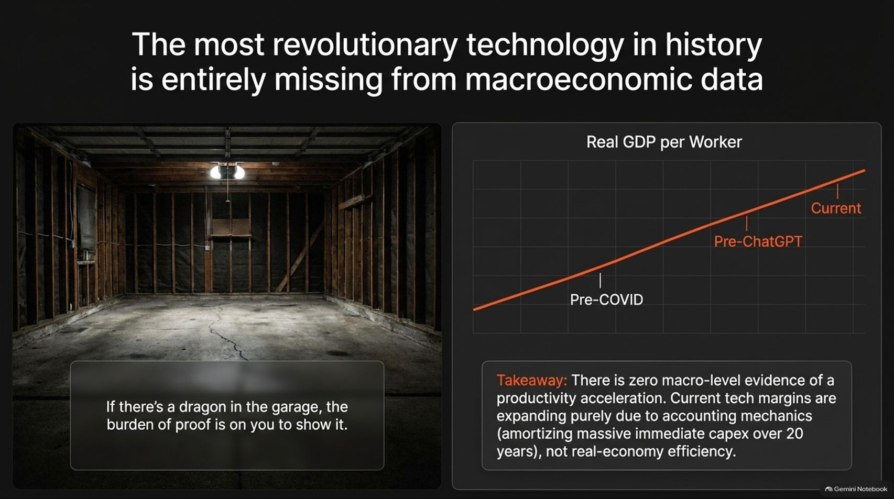
Notes:
Target Speaking Time: ~4–5 Minutes
Speaker Script:
"Slide 7 tackles a glaring paradox: The most revolutionary technology in history is entirely missing from macroeconomic data.
As Carl Sagan's 'dragon in the garage' metaphor suggests: if you claim a revolutionary productivity boom is underway, the burden of proof is in the macro data.
Real GDP per Worker: Holding steady precisely along pre-COVID and pre-ChatGPT historical trend lines.
Takeaway: There is zero macro-level evidence of a productivity acceleration. Current tech margins are expanding purely due to accounting mechanics—amortizing massive immediate capex over 20 years—rather than real-economy efficiency."

Slide 8
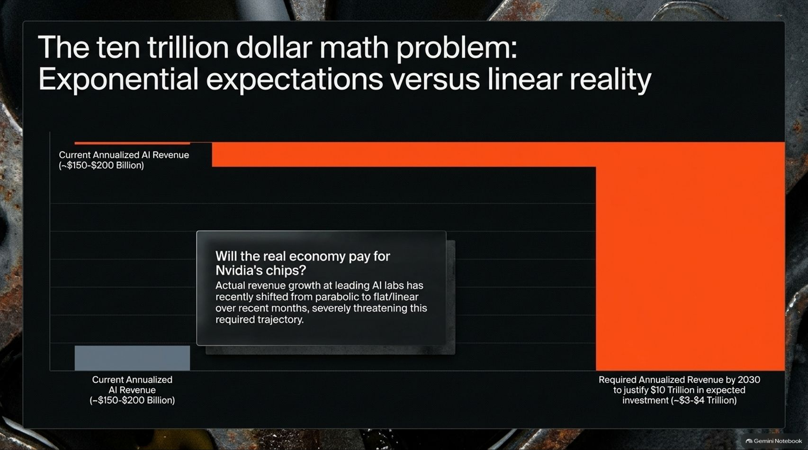
Notes:
Target Speaking Time: ~4–5 Minutes
Speaker Script:
"Slide 8 illustrates The Ten Trillion Dollar Math Problem: Exponential expectations versus linear reality.
Cumulative industry investments in AI and infrastructure buildout are projected to reach roughly $10 Trillion by 2030. To justify that capital expenditure, leading AI labs and hyperscalers require approximately $3 to $4 Trillion in annualized revenue.
The Gap: Current annualized AI revenue sits at roughly $150–$200 Billion. Furthermore, revenue growth at leading AI adoption nodes has recently shifted from parabolic to flat/linear over recent months, severely threatening the required exponential trajectory."

Slide 9
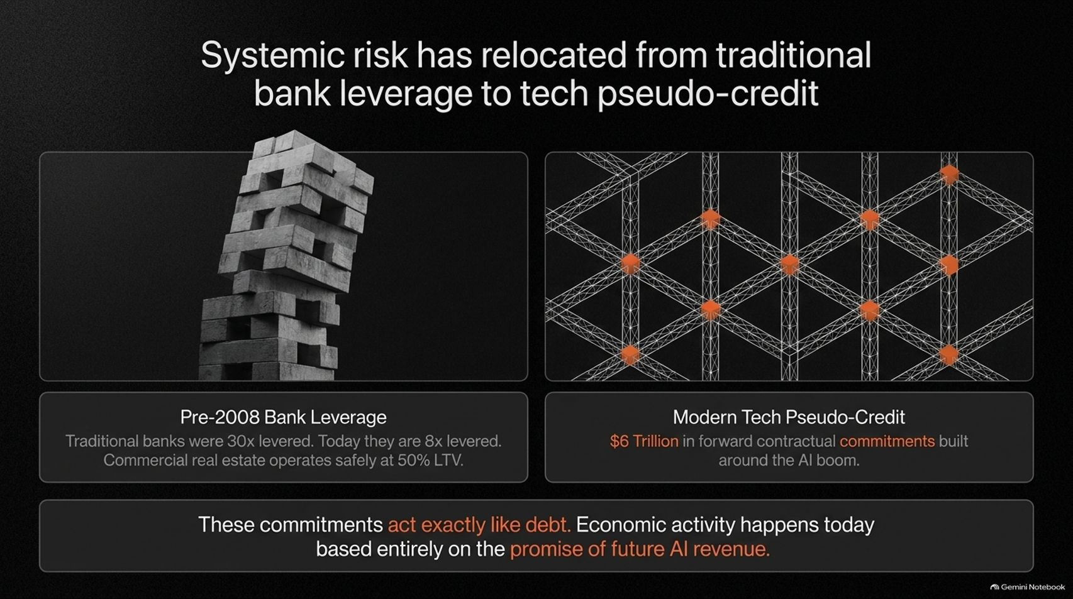
Notes:
Target Speaking Time: ~4–5 Minutes
Speaker Script:
"Slide 9 highlights how financial risk has evolved: Systemic risk has relocated from traditional bank leverage to tech pseudo-credit.
Pre-2008 Bank Leverage: Traditional banks were 30x levered (today they operate at a much safer 8x, with commercial real estate at 50% LTV).
Modern Tech Pseudo-Credit: Built around $6 Trillion in forward contractual commitments tied to the AI boom.
The Risk: These contractual commitments act exactly like debt. Economic activity and hardware procurement happen today based entirely on the promise of future AI revenue that may never materialize."

Slide 10
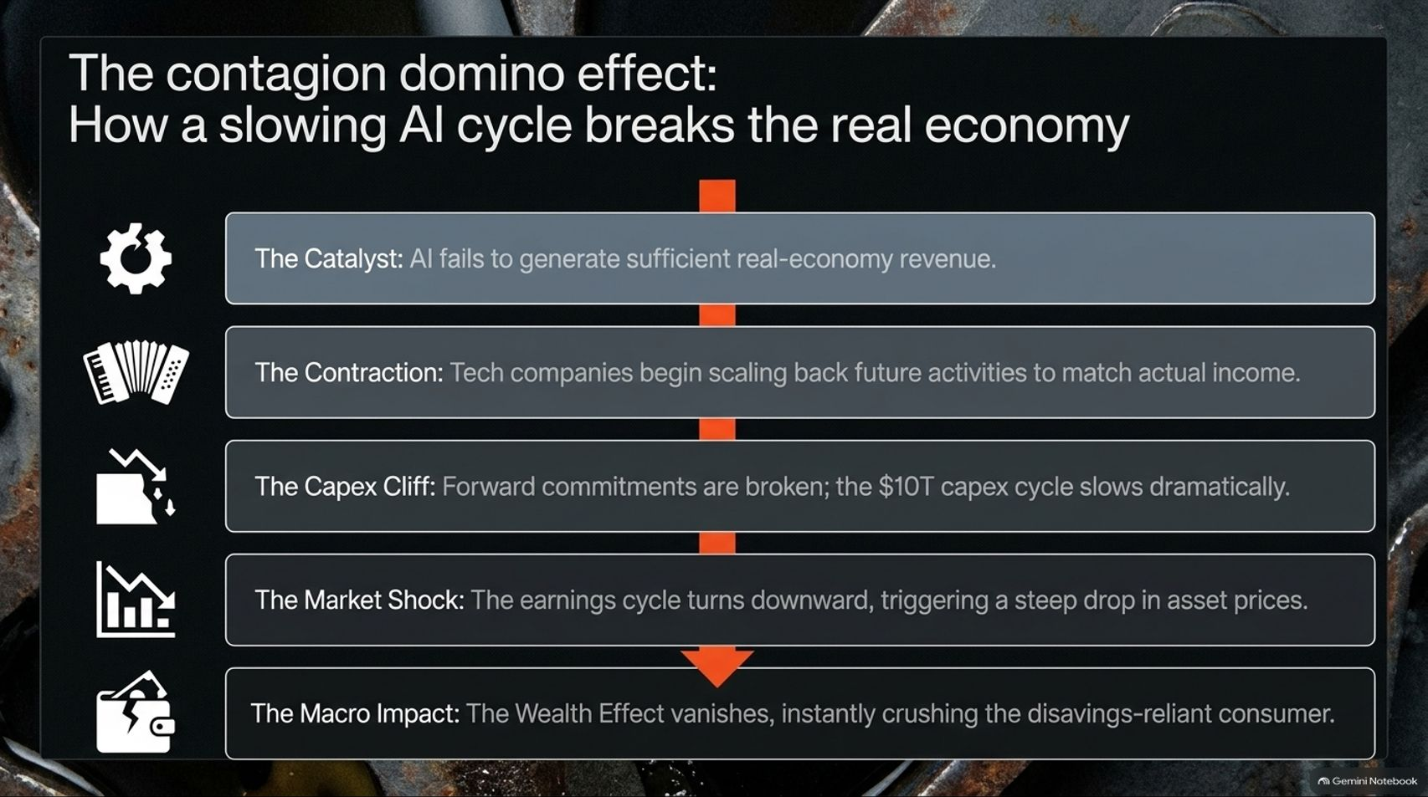
Notes:
Target Speaking Time: ~4–5 Minutes
Speaker Script:
"Slide 10 outlines The Contagion Domino Effect: How a slowing AI cycle breaks the real economy:
The Catalyst: AI fails to generate sufficient real-economy revenue to justify buildout costs.
The Contraction: Tech companies begin scaling back future activities to match actual income.
The Capex Cliff: Forward contractual commitments are broken; the $10T capex cycle slows dramatically.
The Market Shock: The tech earnings cycle turns downward, triggering a steep correction in asset prices.
The Macro Impact: The psychological wealth effect vanishes, instantly crushing the disavings-reliant consumer."

Slide 11
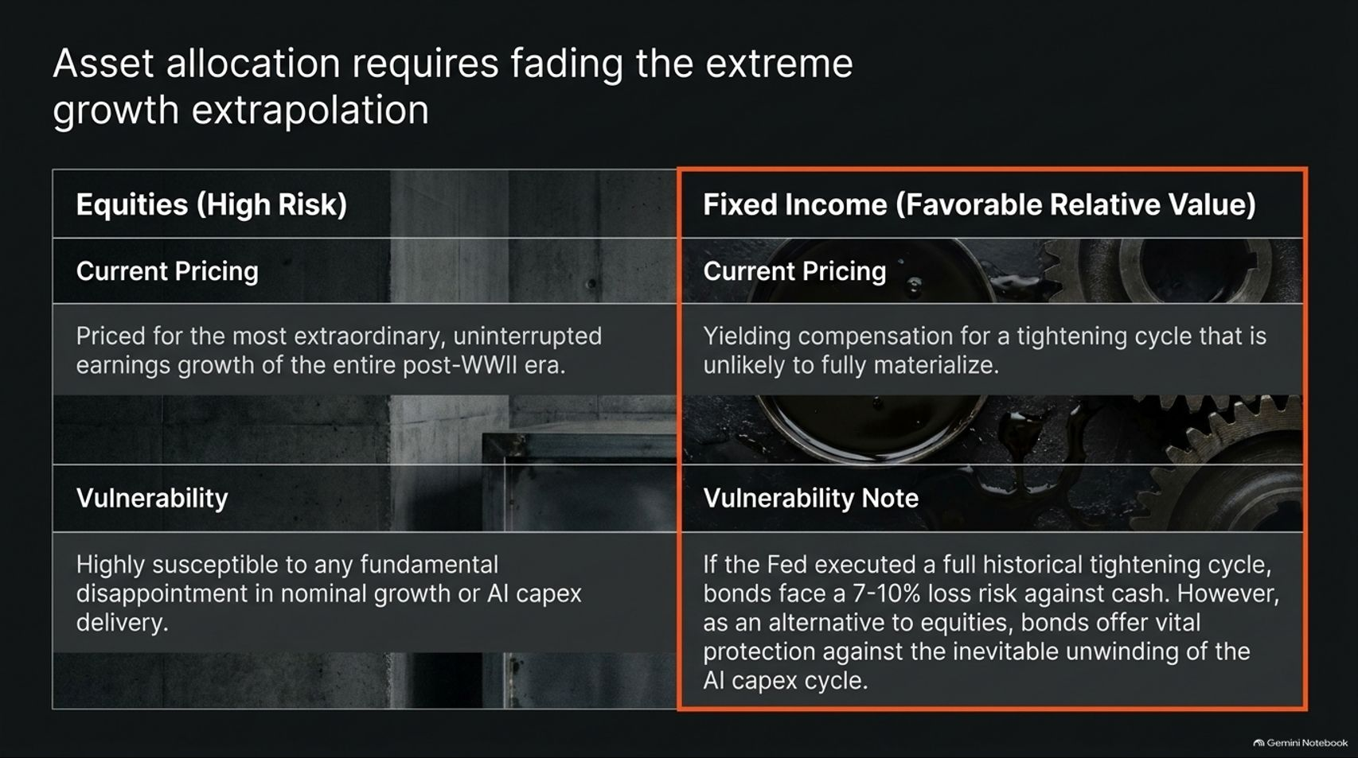
Notes:
Target Speaking Time: ~4–5 Minutes
Speaker Script:
"Slide 11 guides tactical asset allocation: Fading extreme growth extrapolation.
Equities (High Risk): Currently priced for the most extraordinary, uninterrupted earnings growth of the entire post-WWII era. Highly susceptible to any fundamental disappointment in nominal growth or AI delivery.
Fixed Income (Favorable Relative Value): Yielding compensation for a tightening cycle that is unlikely to fully materialize. While bonds carry modest duration risk if the Fed fully tightens, they offer vital capital protection against the inevitable unwinding of the AI capex cycle."

Slide 12
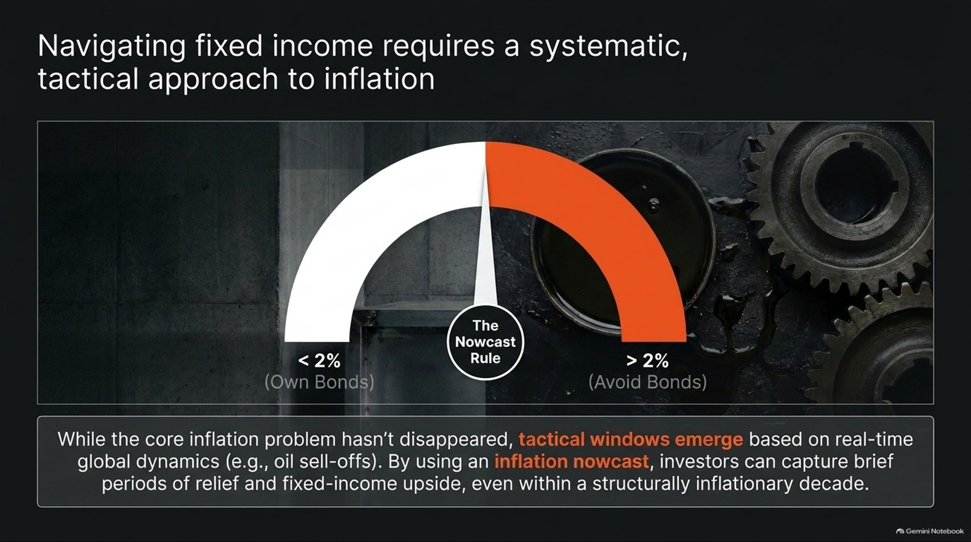
Notes:
Target Speaking Time: ~4–5 Minutes
Speaker Script:
"Slide 12 focuses on timing: Navigating fixed income requires a systematic, tactical approach to inflation.
Using an Inflation Nowcast model tied to real-time commodity and oil dynamics:
Nowcast < 2%: Tactical window to own bonds and capture capital appreciation.
Nowcast > 2%: Avoid bonds and maintain defensive positioning.
Takeaway: While structural inflation remains present, tactical windows emerge during commodity sell-offs, allowing investors to capture fixed-income upside even within a structurally inflationary decade."

Slide 13
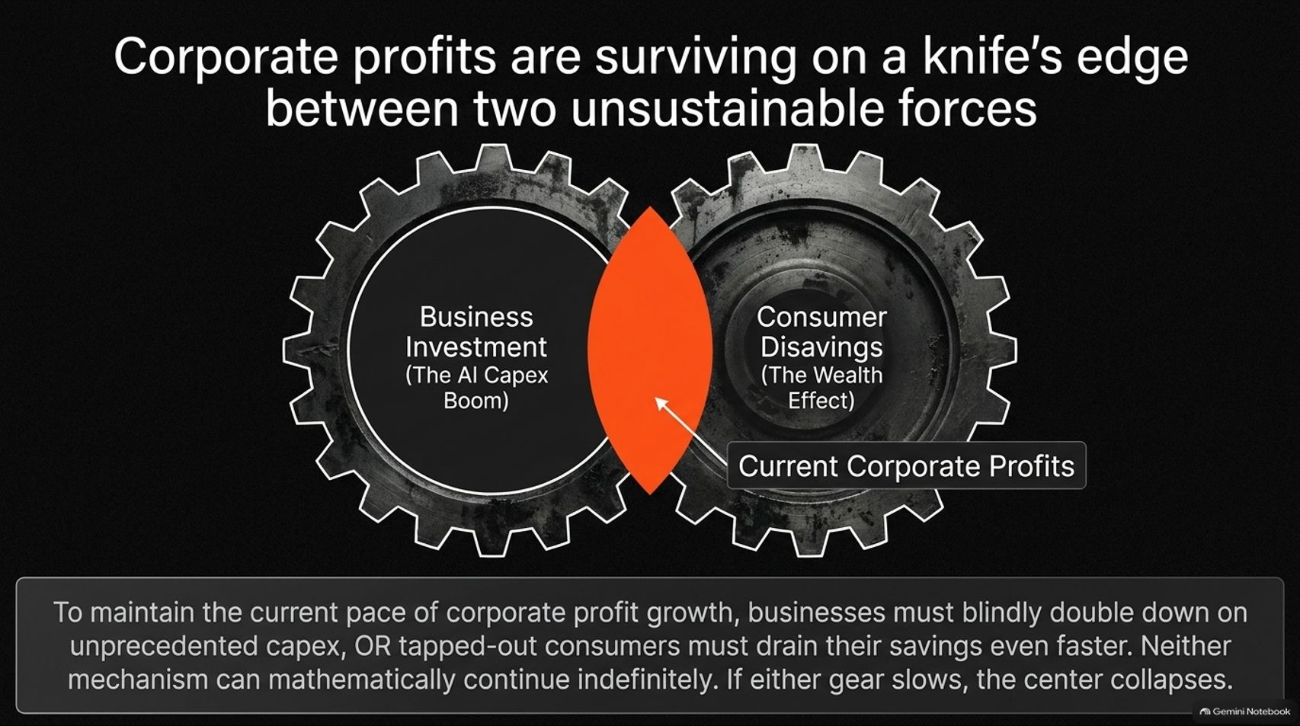
Notes:
Target Speaking Time: ~4–5 Minutes
Speaker Script:
"Slide 13 encapsulates the macro dilemma: Corporate profits are surviving on a knife's edge between two unsustainable forces:
Gear 1: Business Investment (The AI Capex Boom).
Gear 2: Consumer Disavings (The Psychological Wealth Effect).
The Core Conflict: To maintain current profit growth, businesses must blindly double down on unprecedented capex, OR tapped-out consumers must drain their savings even faster. Neither mechanism can continue indefinitely. If either gear slows, corporate earnings collapse."

Slide 14
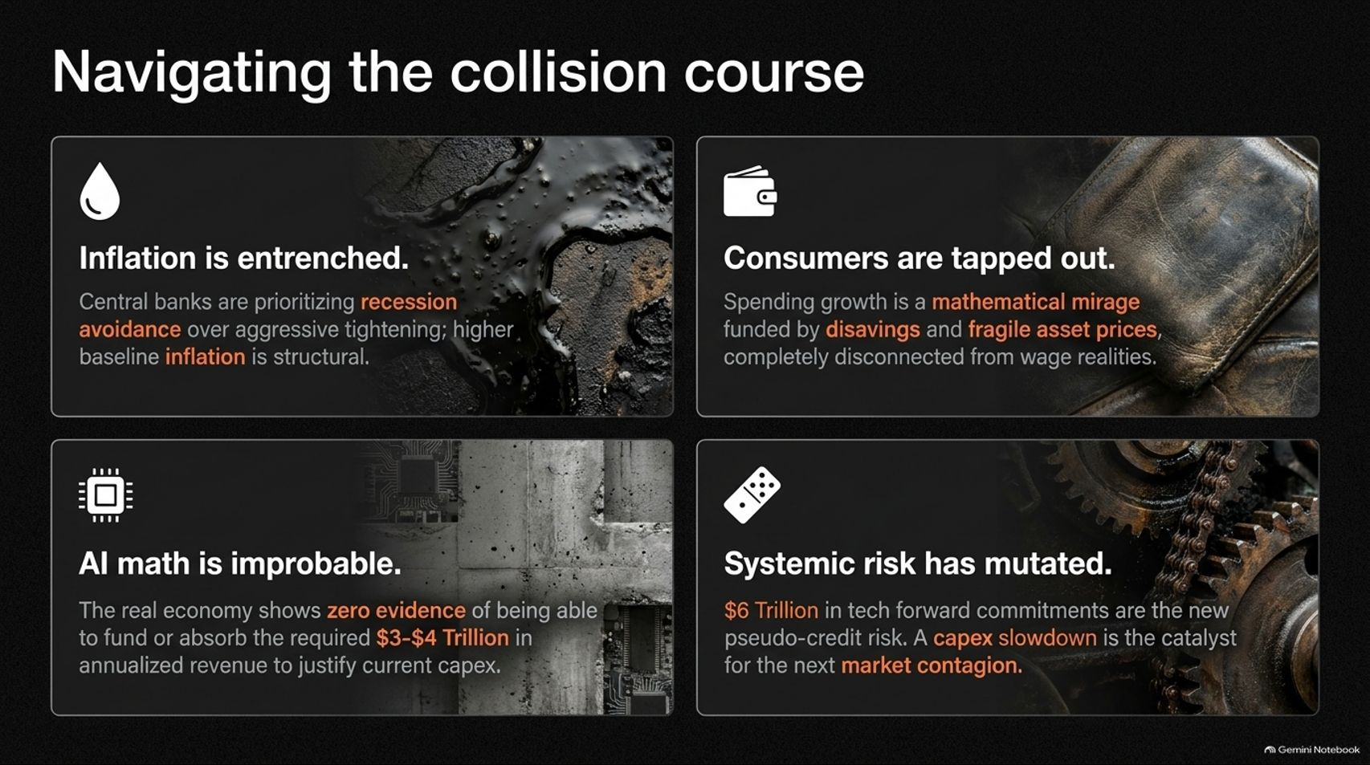
Notes:
Target Speaking Time: ~4–5 Minutes
Speaker Script:
"Slide 14 provides our four-pillar executive summary for navigating this collision course:
Inflation is Entrenched: Central banks prioritize recession avoidance over tightening; structural inflation is here to stay.
Consumers are Tapped Out: Spending growth is a mathematical mirage funded by disavings and fragile asset prices.
AI Math is Improbable: The real economy shows zero evidence of absorbing the $3–$4T in annualized revenue required to justify current capex.
Systemic Risk has Mutated: $6 Trillion in forward tech commitments represent pseudo-credit risk; a capex slowdown is the catalyst for contagion."

Slide 15
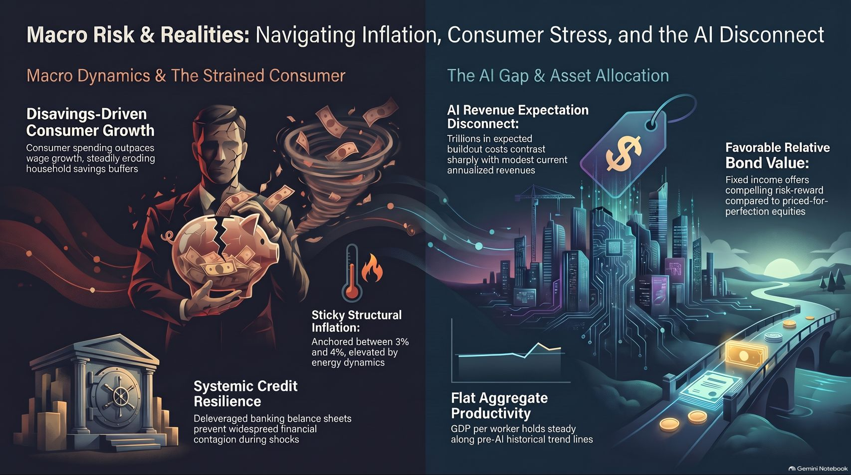
Notes:
Target Speaking Time: ~4–5 Minutes
Speaker Script:
"Our concluding synthesis on Slide 15 bridges macro dynamics with portfolio action:
On the left, we recognize the strained consumer facing disavings-driven spending, sticky structural inflation, and resilient but leveraged banking fundamentals.
On the right, we navigate the AI gap—contrasting soaring buildout costs against flat aggregate productivity and highlighting fixed income as a compelling hedge against priced-for-perfection equities.
By respecting these macro collisions rather than extrapolating linear trends into infinity, we position portfolios to survive and capitalize on the next regime shift. Thank you."

