Slide 1
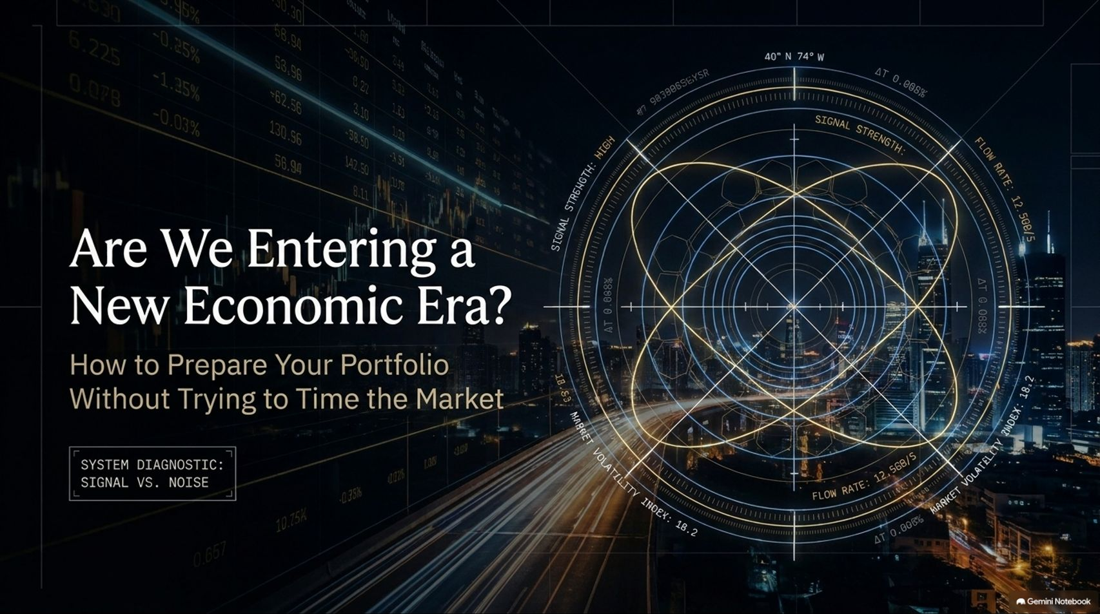
Notes:
Target Speaking Time: ~3–4 Minutes
Speaker Script:
"Welcome, everyone. Today we are unpacking a critical diagnostic of our current financial landscape: Are We Entering a New Economic Era? How to Prepare Your Portfolio Without Trying to Time the Market.
As explored in recent market analysis with macro experts and quantitative strategists—including insights from Brent Cachuba on options dealer flows, Ben Hunt on common knowledge moments, and Bob Elliot and Ahan Haque on the macro economy—the market is caught in a high-stakes tug-of-war.
We are transitioning from fundamental-driven investing to an environment governed by algorithmic dealer flows, negative gamma, physical energy chokepoints, and extreme financialization. Over the next 16 slides, we will break down what is signal, what is noise, and how to build portfolio resilience."
Blue Wave Sell-Off. Four Market Experts on What Comes Next
https://www.youtube.com/watch?v=aUzDuI94tjs

Slide 2
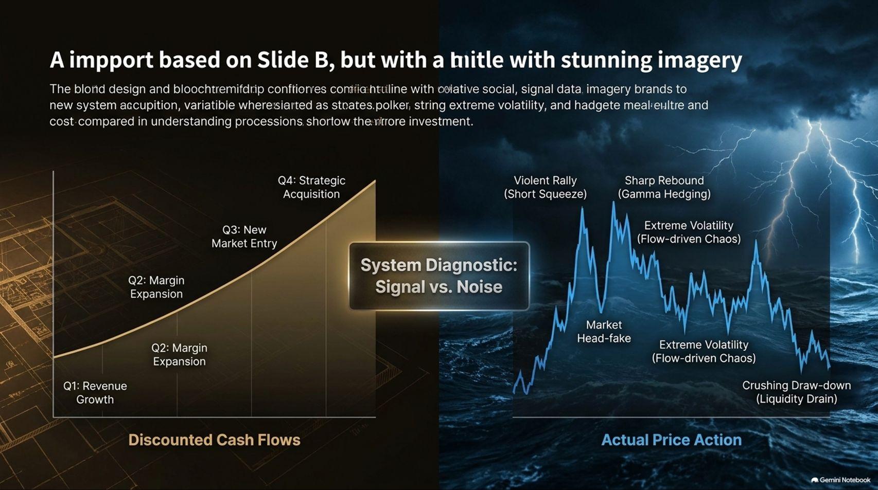
Notes:
Target Speaking Time: ~3–5 Minutes
Speaker Script:
"Slide 2 establishes our core framework: Signal vs. Noise.
On the left side, traditional investors look at discounted cash flows, P/E ratios, and linear quarterly earnings growth—assuming markets are driven by rational, fundamental business performance.
On the right side, we see the actual price action: violent rallies, short squeezes, flow-driven chaos, gamma hedging, and crushing drawdowns driven by liquidity drains.
The Takeaway: If you are trading the left side while ignoring the right side, you are trading human emotion against algorithmic forced liquidation. Understanding market mechanics is no longer optional; it is survival."

Slide 3
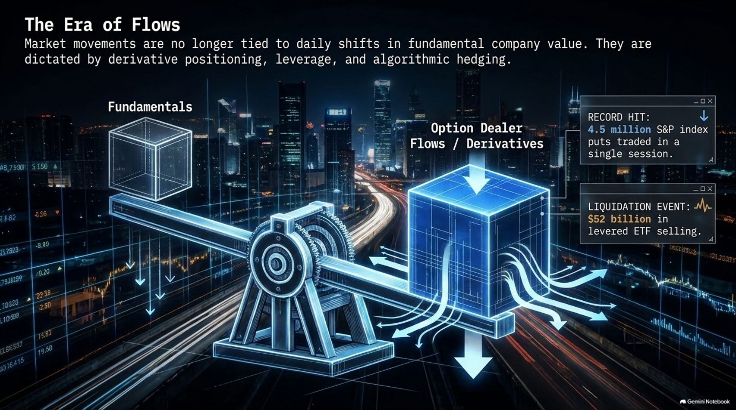
Notes:
Target Speaking Time: ~3–5 Minutes
Speaker Script:
"Let’s turn to Slide 3: The Era of Flows.
Market movements are no longer tethered primarily to daily shifts in fundamental company value. Instead, they are dictated by derivative positioning, leverage, and algorithmic hedging.
Data Readout:
We recently witnessed 4.5 million S&P index puts traded in a single session—an all-time record.
Concurrently, levered ETF selling triggered a staggering $52 billion liquidation event in a single window.
The Lesson: When options dealer hedging and passive leverage outweigh fundamental inflows, equity prices behave less like corporate ownership stakes and more like high-frequency volatility instruments."

Slide 4
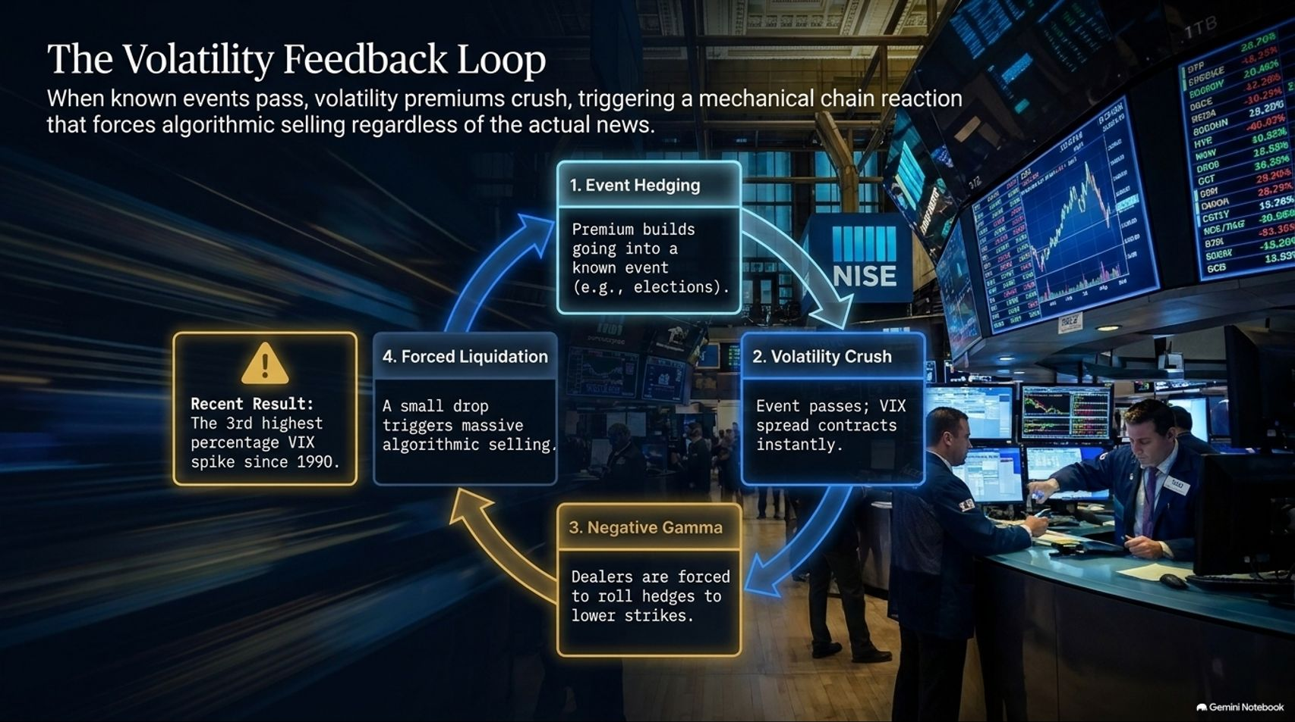
Notes:
Target Speaking Time: ~4–5 Minutes
Speaker Script:
"Slide 4 maps out The Volatility Feedback Loop—the exact mechanical chain reaction that occurs when known events pass:
Event Hedging: Implied volatility premiums build aggressively going into major catalysts (e.g., elections or earnings).
Volatility Crush: Once the event passes, VIX spreads contract instantly as option premium is monetized.
Negative Gamma: Dealers who are short gamma are forced to roll hedges to lower strikes, exacerbating downside pressure.
Forced Liquidation: Even a small market drop triggers massive algorithmic selling.
Recent Result: This mechanical loop recently drove the 3rd highest percentage VIX spike since 1990, proving that volatility events are structurally engineered, not just emotional reactions."

Slide 5
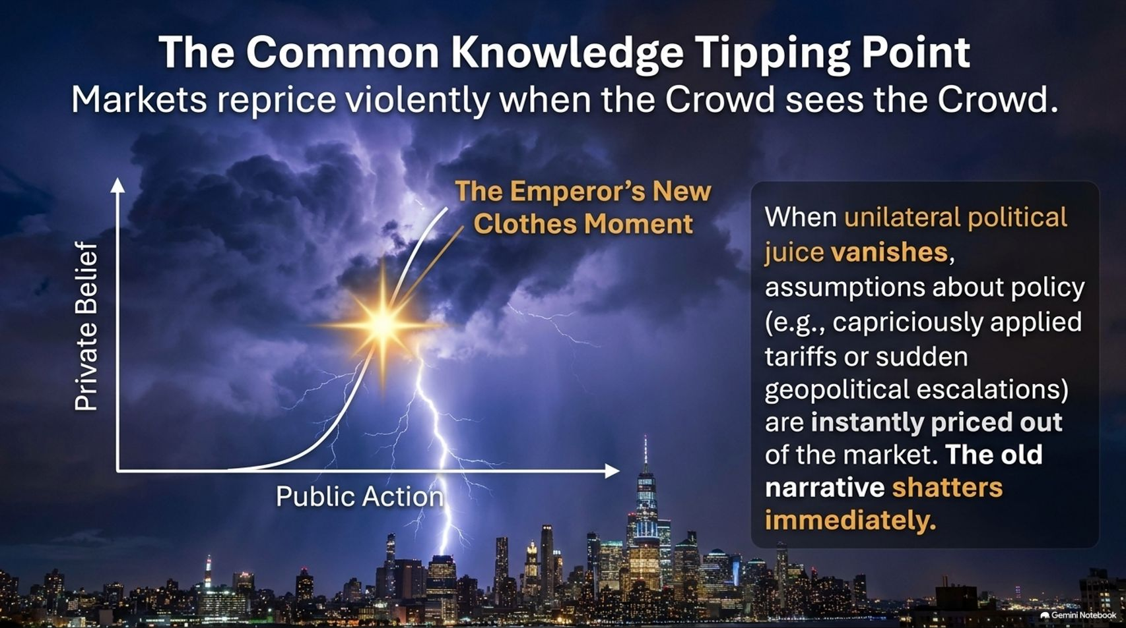
Notes:
Target Speaking Time: ~4–5 Minutes
Speaker Script:
"Slide 5 introduces Ben Hunt’s concept of The Common Knowledge Tipping Point—where markets reprice violently when 'the crowd sees the crowd' (the Emperor’s New Clothes moment).
When private disbelief suddenly aligns into public action, the old narrative shatters immediately.
Market Implication: Whether applied to political shifts—such as the rapid erosion of unilateral executive authority or capriciously applied tariff policies—or structural economic consensus, when the illusion breaks, markets do not gently adjust. They reprice instantaneously. You cannot negotiate with a common knowledge moment; you can only position ahead of it."

Slide 6
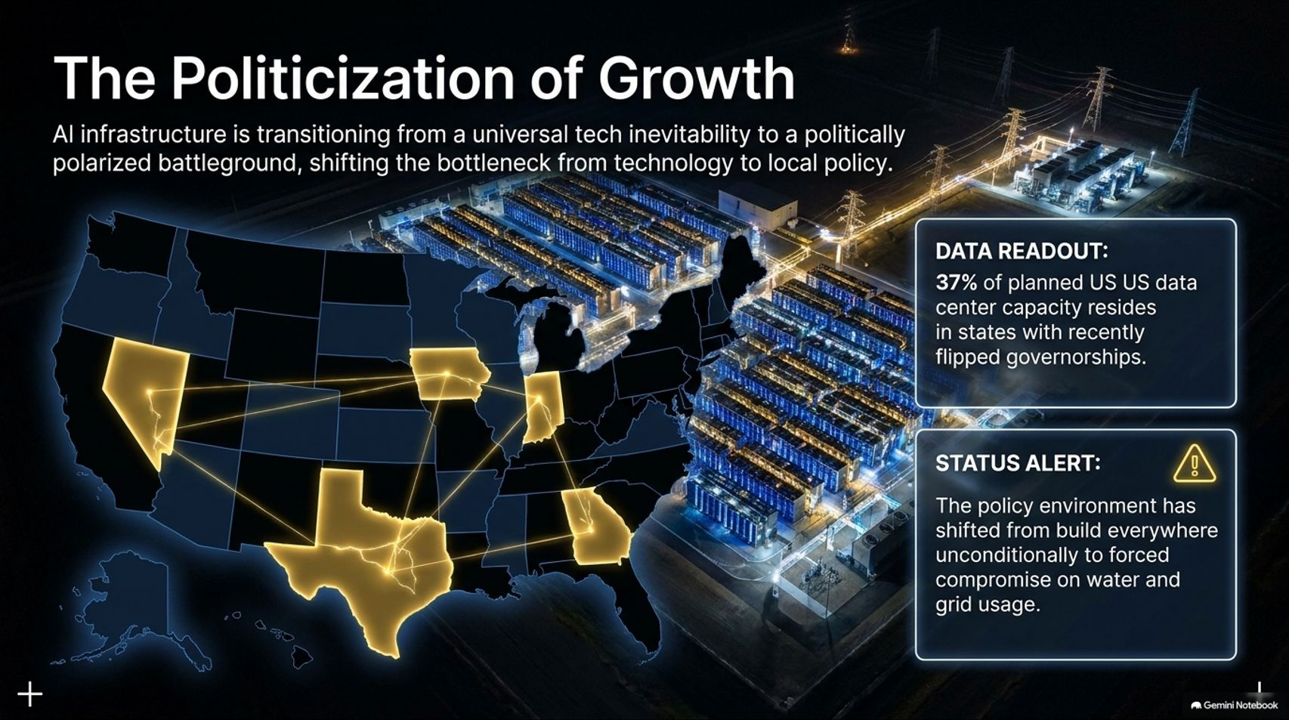
Notes:
Target Speaking Time: ~3–5 Minutes
Speaker Script:
"Slide 6 examines The Politicization of Growth—how AI infrastructure is transitioning from a universal tech inevitability to a politically polarized battleground.
Data Readout:
37% of planned US data center capacity now resides in states with recently flipped governorships.
The policy environment has decisively shifted from 'build everywhere unconditionally' to forced compromise on local water usage, community impact, and regional grid capacity.
Takeaway: The primary bottleneck for AI infrastructure has shifted from semiconductor technology to local and regional energy politics."

Slide 7
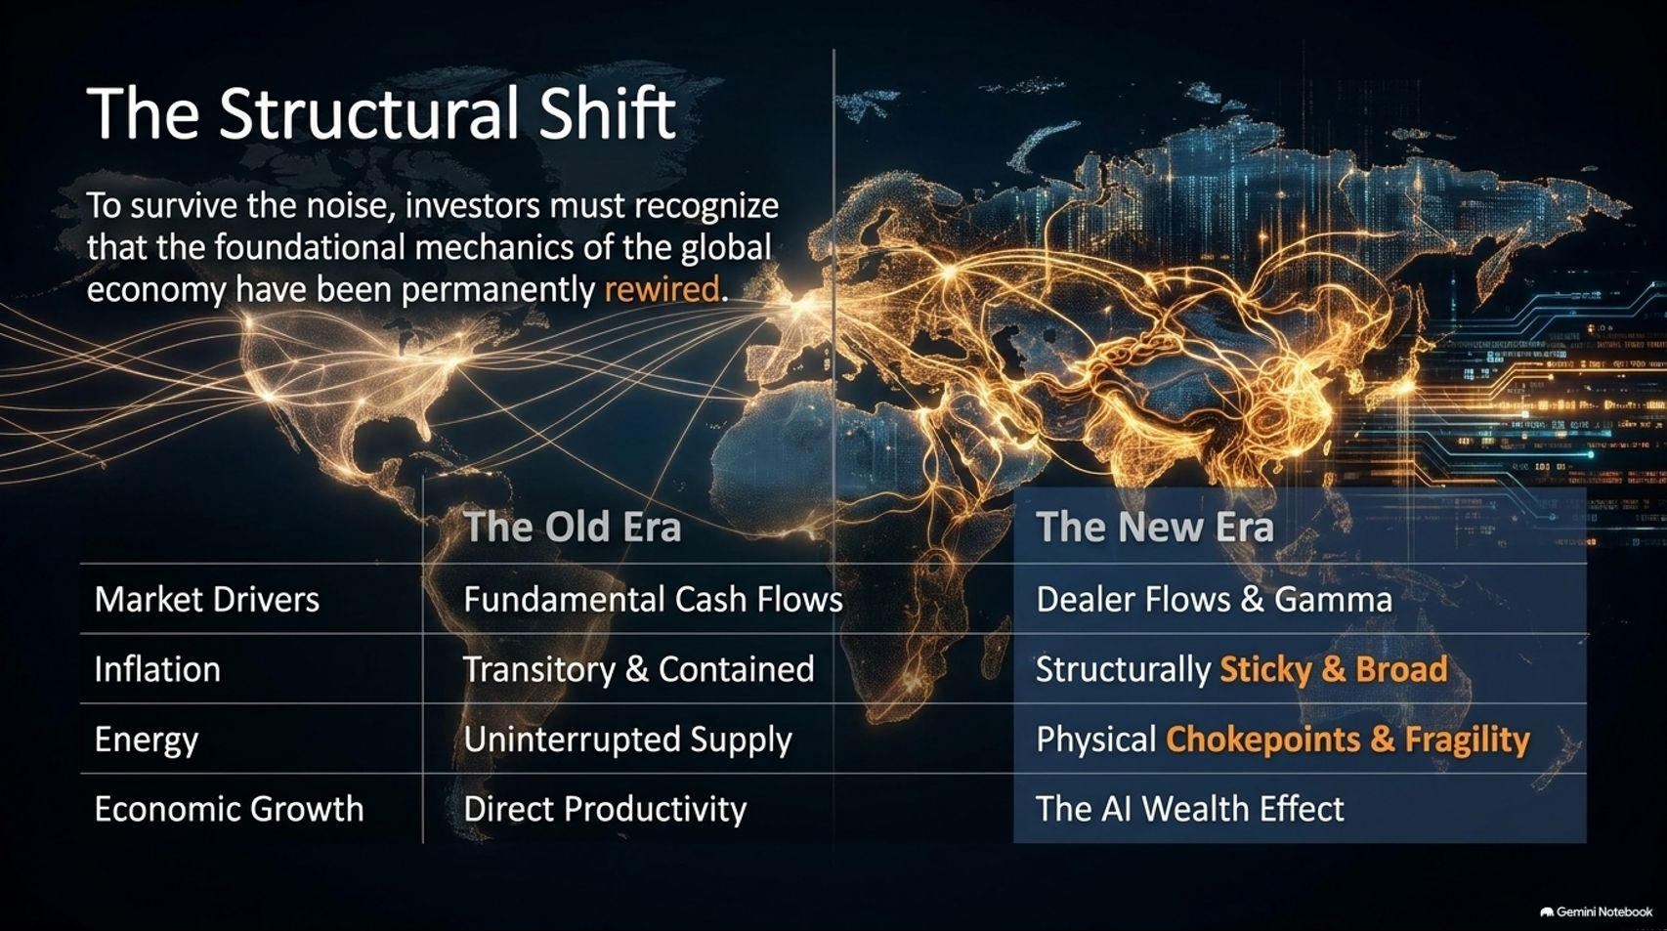
Notes:
Target Speaking Time: ~4–5 Minutes
Speaker Script:
"Slide 7 provides our master comparison table: The Structural Shift.
| Economic Pillar | The Old Era | The New Era | | :--- | :--- | :--- | | Market Drivers | Fundamental Cash Flows | Dealer Flows & Gamma | | Inflation | Transitory & Contained | Structurally Sticky & Broad | | Energy | Uninterrupted Supply | Physical Chokepoints & Fragility | | Economic Growth | Direct Productivity | The AI Wealth Effect |
Takeaway: To survive the noise, investors must recognize that the foundational mechanics of the global economy have been permanently rewired."

Slide 8
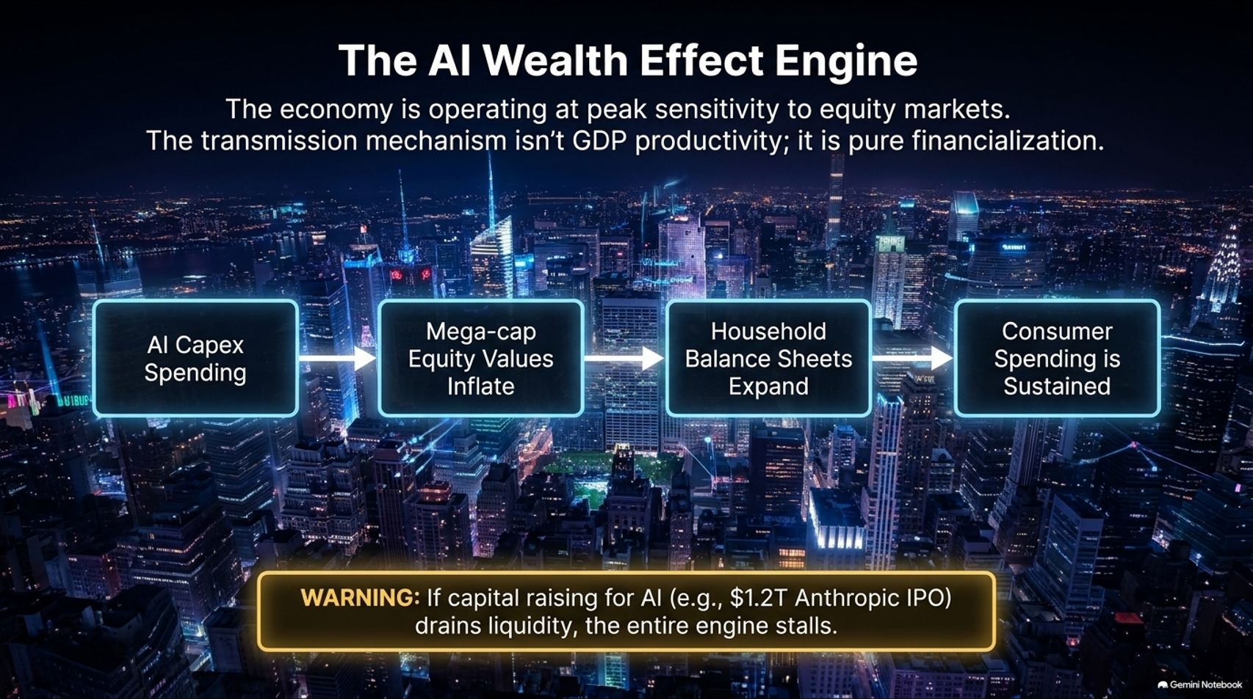
Notes:
Target Speaking Time: ~4–5 Minutes
Speaker Script:
"Let’s look at Slide 8: The AI Wealth Effect Engine.
The modern US economy is operating at peak sensitivity to equity markets. The transmission mechanism is not traditional GDP productivity growth; it is pure financialization.
The Chain: AI Capex Spending $\rightarrow$ Mega-cap Equity Values Inflate $\rightarrow$ Household Balance Sheets Expand (via 401ks and real estate) $\rightarrow$ Consumer Spending is Sustained.
The Warning: If capital raising or liquidity constraints for AI infrastructure (such as massive upcoming tech IPOs or funding drains) lock up liquidity, the entire engine stalls, threatening consumer spending that relies on asset appreciation."

Slide 9
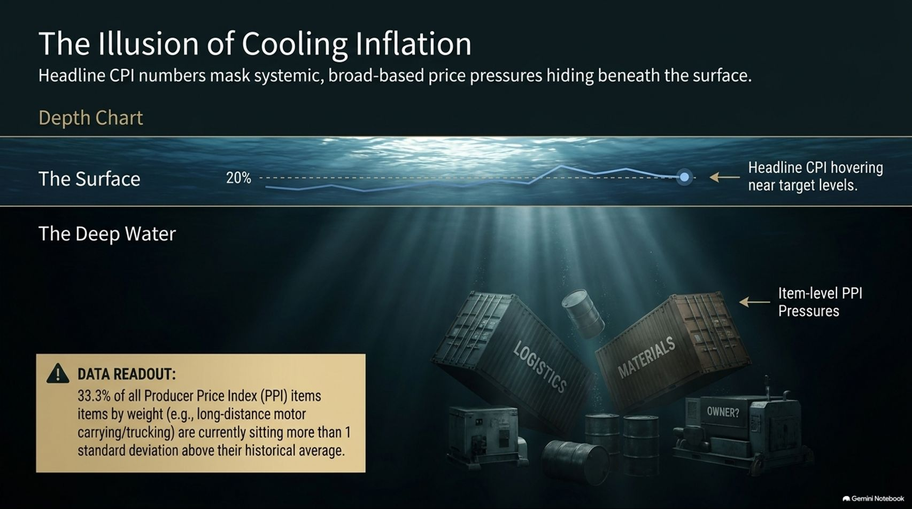
Notes:
Target Speaking Time: ~3–5 Minutes
Speaker Script:
"Slide 9 uncovers The Illusion of Cooling Inflation.
While headline CPI numbers hover comfortably near target levels (creating the surface appearance of victory), systemic, broad-based price pressures are hiding deep beneath the surface.
Data Readout: Over 33% of all Producer Price Index (PPI) items by weight—specifically logistics, materials, and long-distance motor transport—are currently sitting more than 1 standard deviation above their historical averages.
Takeaway: Input-level producer inflation is broadening, meaning margin compression or delayed consumer price shocks remain a latent danger."

Slide 10
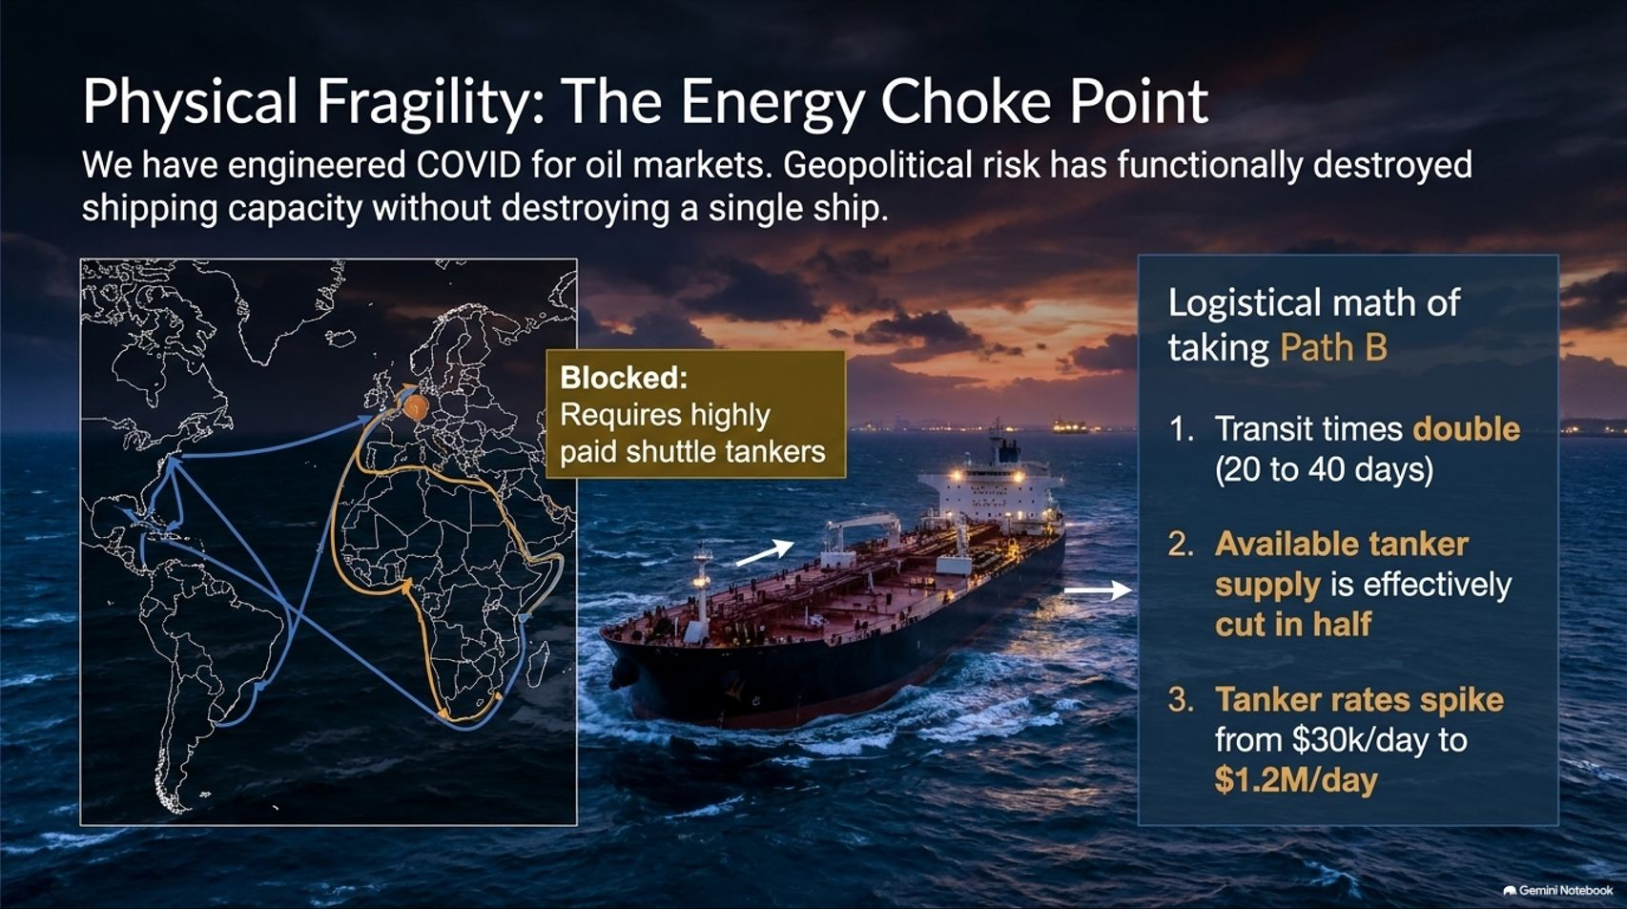
Notes:
Target Speaking Time: ~4–5 Minutes
Speaker Script:
"Slide 10 details Physical Fragility: The Energy Chokepoint.
As Eric Pacman highlights, geopolitical conflict and maritime security risks have effectively engineered a COVID-like shock for global oil logistics without destroying a single ship.
The Logistical Math (Path B):
Transit times double from 20 to 40 days around physical detours.
Available crude tanker supply is effectively cut in half.
Tanker shipping rates have spiked from normal levels of $20k–$30k/day to $1.2M/day.
Takeaway: Energy markets are handcuffed by severe physical transportation bottlenecks, keeping structural oil and transportation costs elevated."

Slide 11
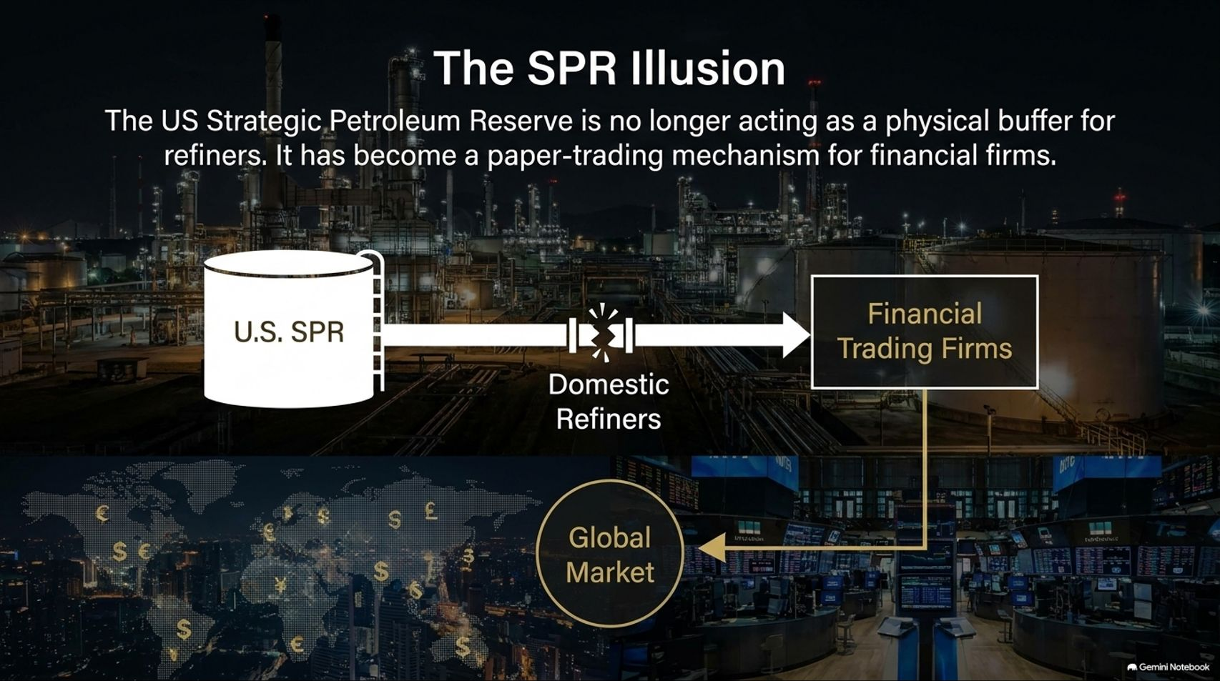
Notes:
Target Speaking Time: ~3–5 Minutes
Speaker Script:
"Slide 11 examines The SPR Illusion.
The US Strategic Petroleum Reserve is no longer functioning as a physical buffer for domestic refiners during supply crunches. Instead, recent government loan releases have converted it into a paper-trading mechanism for financial trading firms.
The Mechanics: Financial trading firms subscribe to crude loan releases, locking in backwardation arbitrage profits on day one through global paper markets, while actual physical barrels flow straight out to global export markets rather than domestic refiners.
Takeaway: This financialization of emergency reserves leaves the domestic refining complex vulnerable if physical supply shocks intensify."

Slide 12
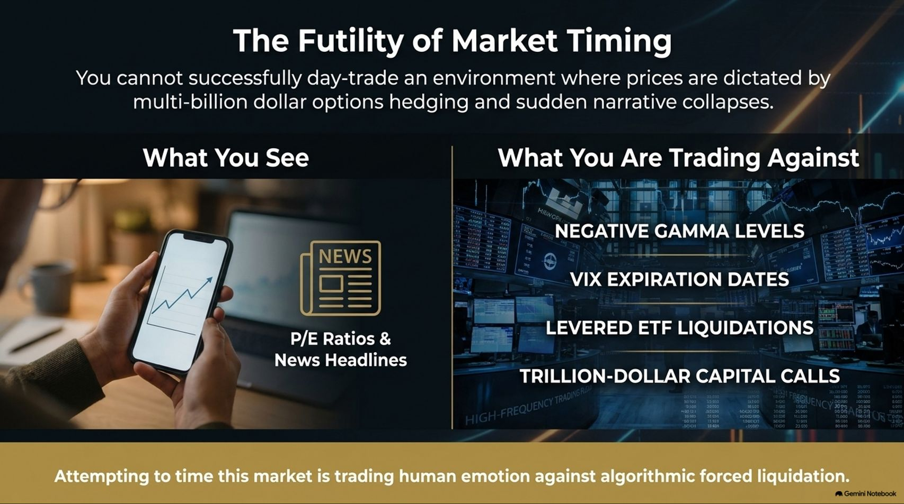
Notes:
Target Speaking Time: ~3–5 Minutes
Speaker Script:
"Slide 12 emphasizes The Futility of Market Timing.
You cannot successfully day-trade or swing-trade an environment where daily prices are dictated by multi-billion dollar options hedging, VIX expiration dates, levered ETF liquidations, and trillion-dollar capital calls.
What You See: News headlines, P/E ratios, and daily fundamental commentary. What You Are Trading Against: Negative gamma levels, VIX expiration squeezes, and algorithmic forced liquidations.
Conclusion: Attempting to time this market is trading human emotion against automated forced selling. You will lose."

Slide 13
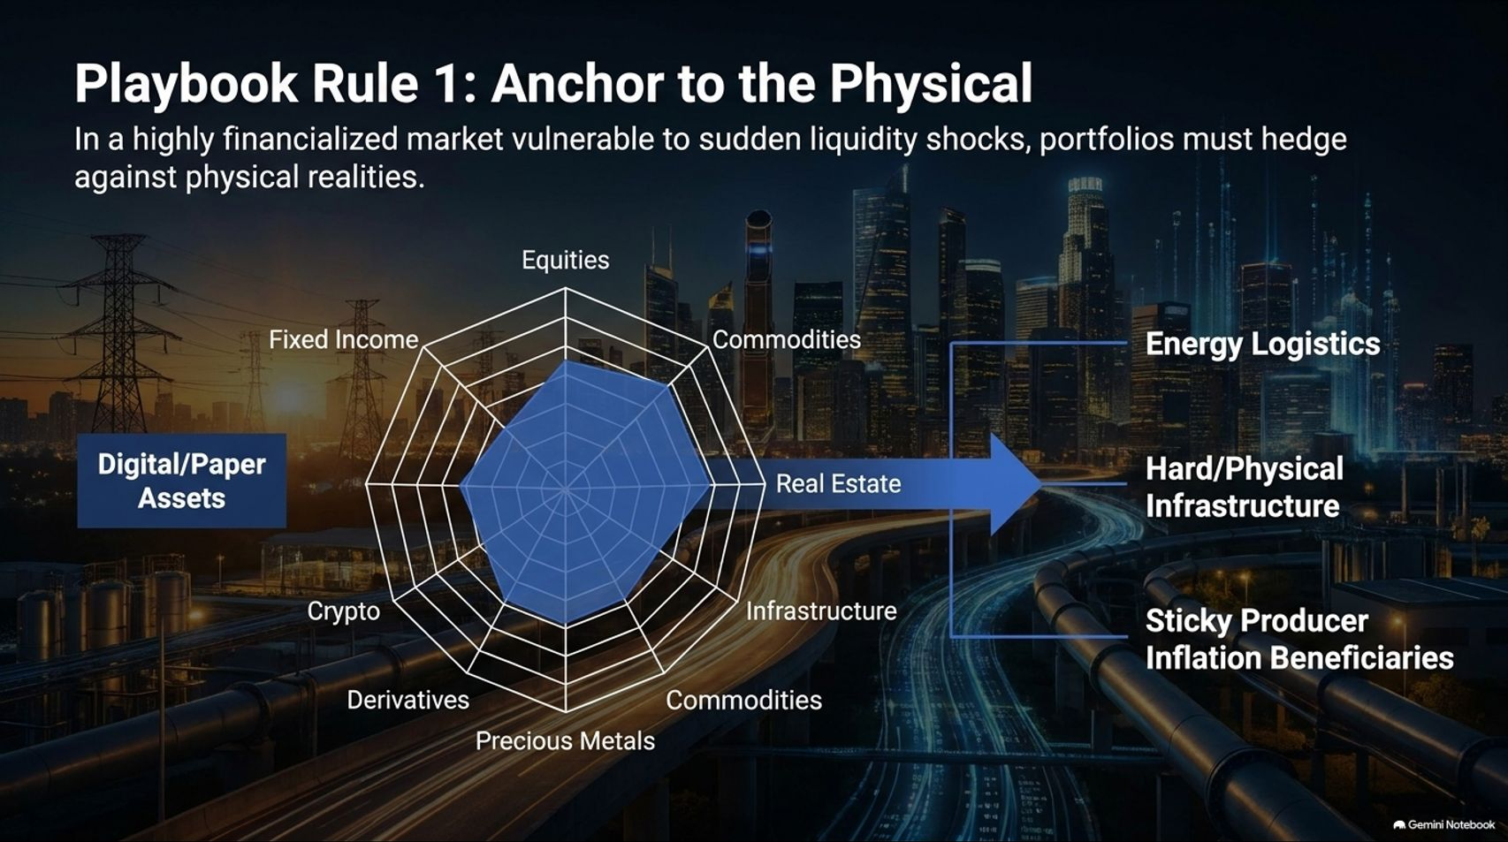
Notes:
Target Speaking Time: ~4–5 Minutes
Speaker Script:
"Slide 13 outlines Playbook Rule 1: Anchor to the Physical.
In a highly financialized market acutely vulnerable to sudden liquidity shocks and paper-asset sell-offs, portfolios must establish structural hedges against physical realities.
Actionable Allocations:
Overweight Energy Logistics & Hard Infrastructure.
Target Sticky Producer Inflation Beneficiaries and tangible commodities.
Underweight unhedged, purely digital/paper speculative assets during periods of extreme gamma instability."

Slide 14
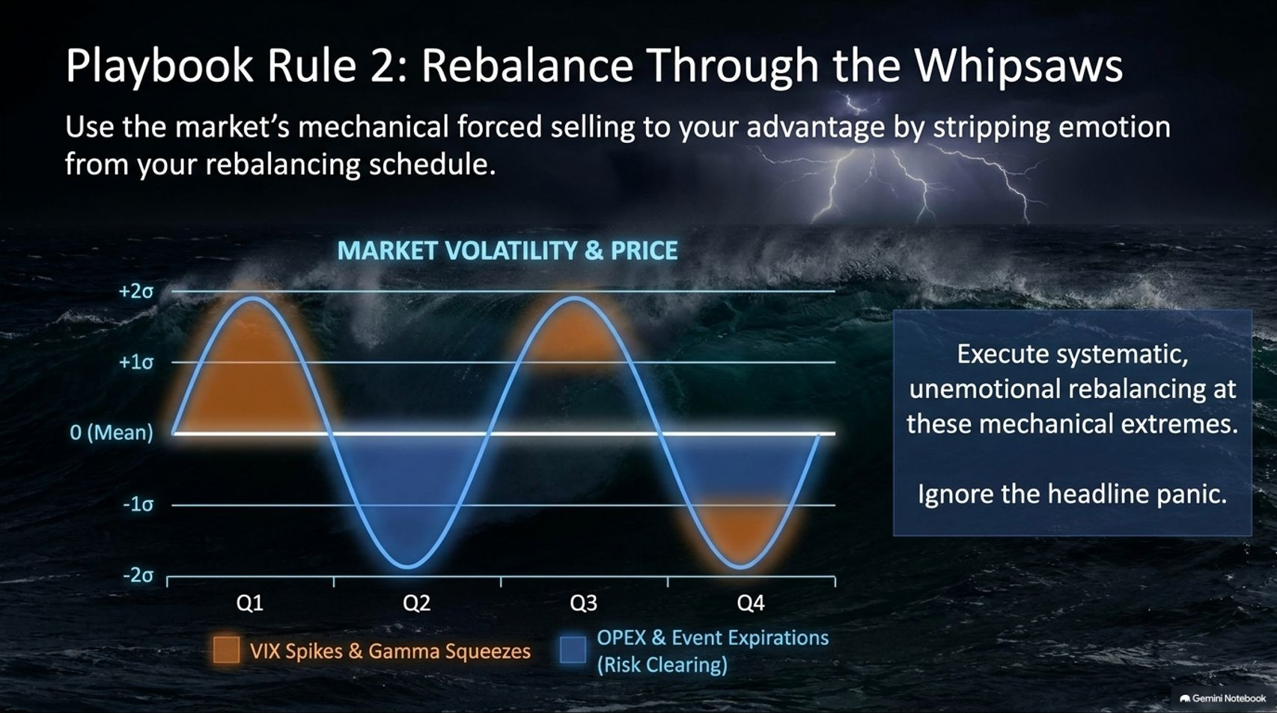
Notes:
Target Speaking Time: ~4–5 Minutes
Speaker Script:
"Slide 14 outlines Playbook Rule 2: Rebalance Through the Whipsaws.
Use the market's mechanical forced selling to your absolute advantage by stripping emotion from your rebalancing schedule.
Execution:
When VIX spikes and gamma squeezes push asset prices to extreme deviations (+2σ or -2σ), ignore the media panic.
Execute systematic, unemotional rebalancing into risk-clearing expirations (Opex).
Takeaway: Volatility is no longer just a risk metric; for the disciplined investor, mechanical volatility is an inventory-clearing discount window."

Slide 15
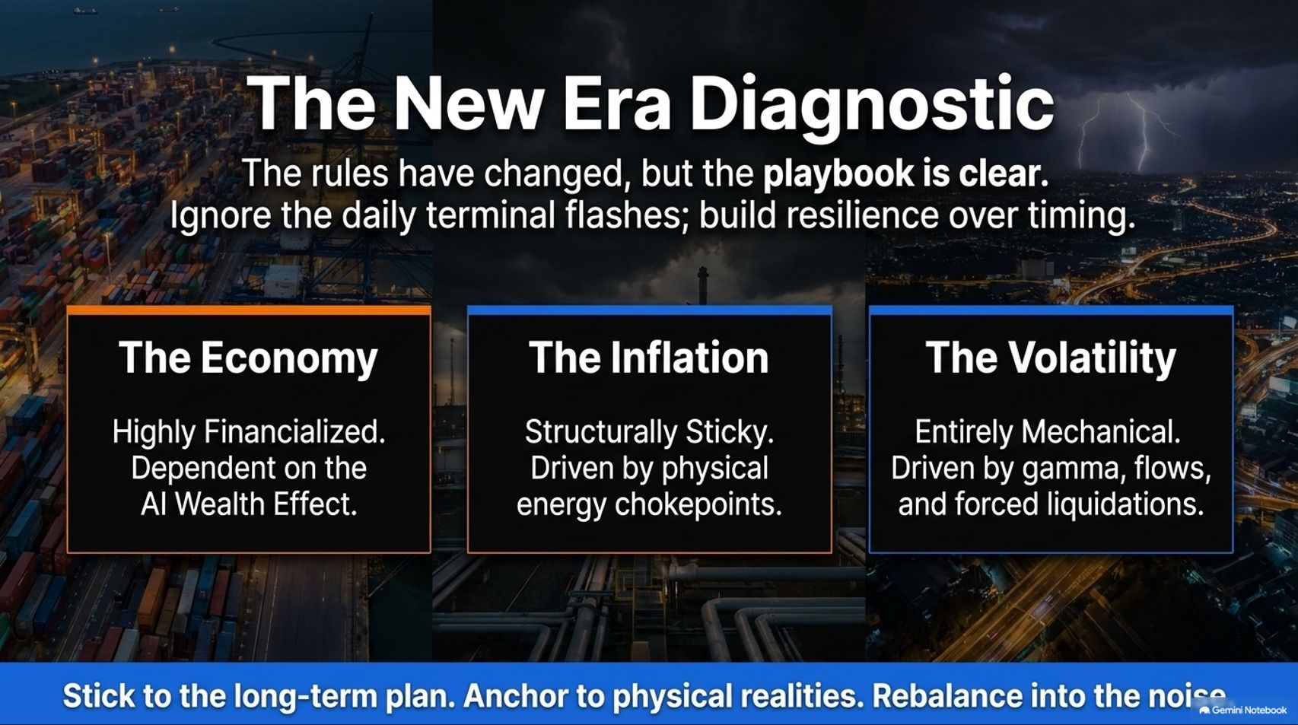
Notes:
Target Speaking Time: ~3–4 Minutes
Speaker Script:
"Slide 15 summarizes our three diagnostic pillars for the New Era:
The Economy: Highly financialized and dangerously dependent on the AI wealth effect.
The Inflation: Structurally sticky, driven by physical energy chokepoints and broad producer cost pressures.
The Volatility: Entirely mechanical, driven by gamma, dealer flows, and cascading liquidations.
Core Motto: Stick to the long-term plan. Anchor to physical realities. Rebalance into the noise."

Slide 16
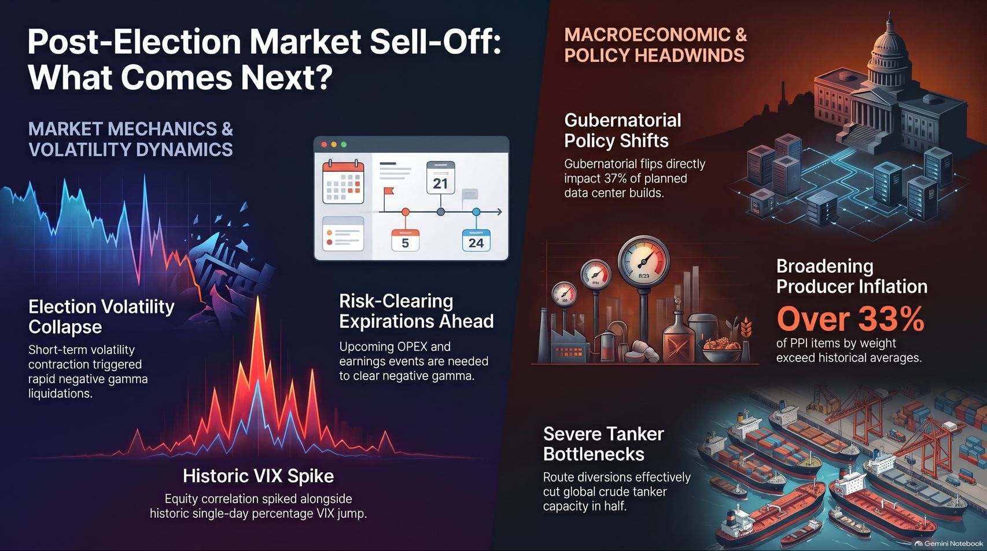
Notes:
Target Speaking Time: ~3–5 Minutes
Speaker Script:
"Finally, Slide 16 synthesizes our concluding market outlook: Post-Election Market Sell-Off & What Comes Next.
We have navigated a classic post-election volatility storm: short-term volatility contraction triggering rapid negative gamma liquidations, historic VIX percentage spikes, and cross-asset correlation breakdowns.
Macro & Policy Headwinds: Gubernatorial and state policy shifts impacting 37% of planned data center builds, broadening producer inflation exceeding 30%, and severe tanker logistics bottlenecks continue to pressure the tape.
Final Word: As risk-clearing expirations and upcoming tech earnings approach, do not get shaken out by terminal flashes. Maintain your physical anchors, execute systematic rebalancing, and navigate the noise with discipline. Thank you."

