Slide 1
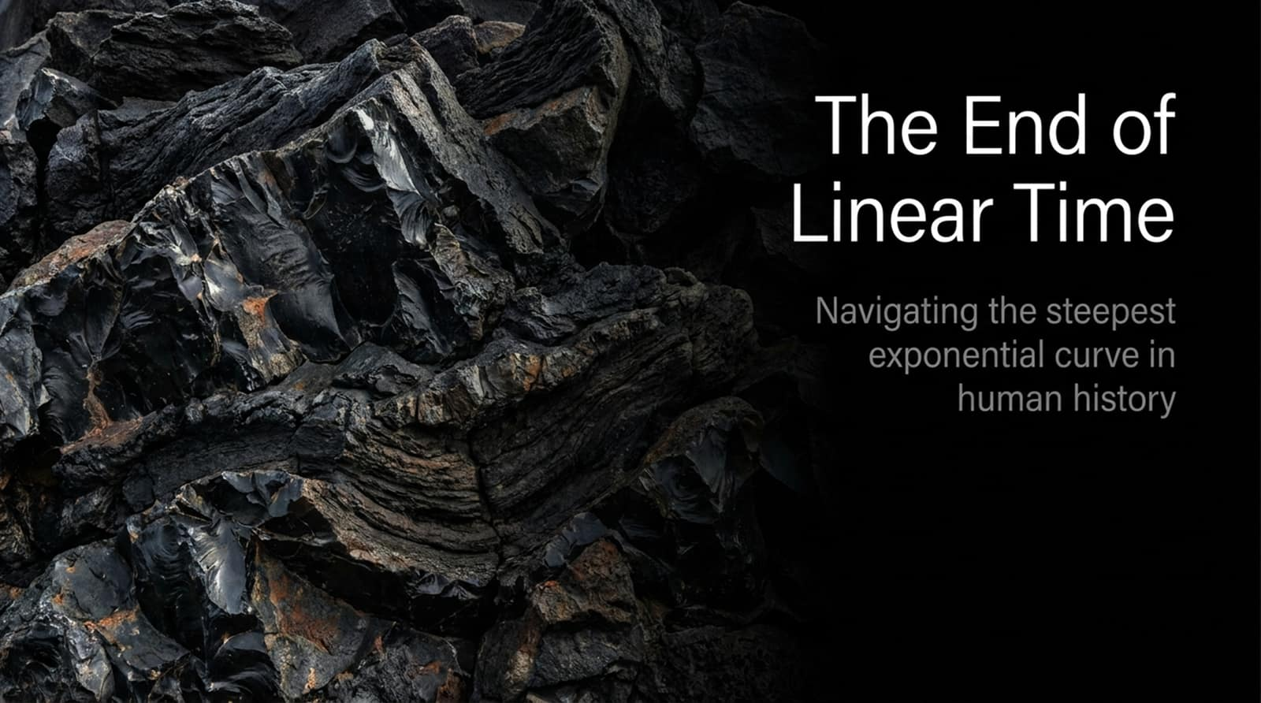
Notes:
Visual Reference: Title slide featuring rugged dark rock strata and the title: "The End of Linear Time: Navigating the steepest exponential curve in human history."
Speaker Notes:
Opening Hook: Welcome everyone. The title of this presentation—and the core premise of our discussion today—is borrowed from a famous sentiment by modern neuroscience pioneer Santiago Ramón y Cajal. But rather than looking inward at the brain, we are looking outward at the macro-trajectory of human civilization and technology.
Setting the Mindset: To get into the right psychological mindset, imagine standing on a plot of global progress and GDP over time. If you look back across human history, it feels entirely natural to assume that the future will resemble a linear extrapolation of the present. Most of us live our daily lives assuming that next year, and the decade after, will look fundamentally similar to today with minor incremental updates.
The Core Thesis: The purpose of this presentation is to violently disrupt that assumption. We are not on a linear trajectory; we are standing on a steep exponential curve, and our human intuition—optimized for linear survival—is failing us. AI is in the process of transforming the global landscape in ways that will make the next few years unrecognizable compared to the past. If you believe this reality, it must fundamentally change how you plan your career, your research, and your long-term choices.
2026 Conference on Physics and AI: Jascha Sohl-Dickstein
https://www.youtube.com/watch?v=3LZN2UUxDos

Slide 2
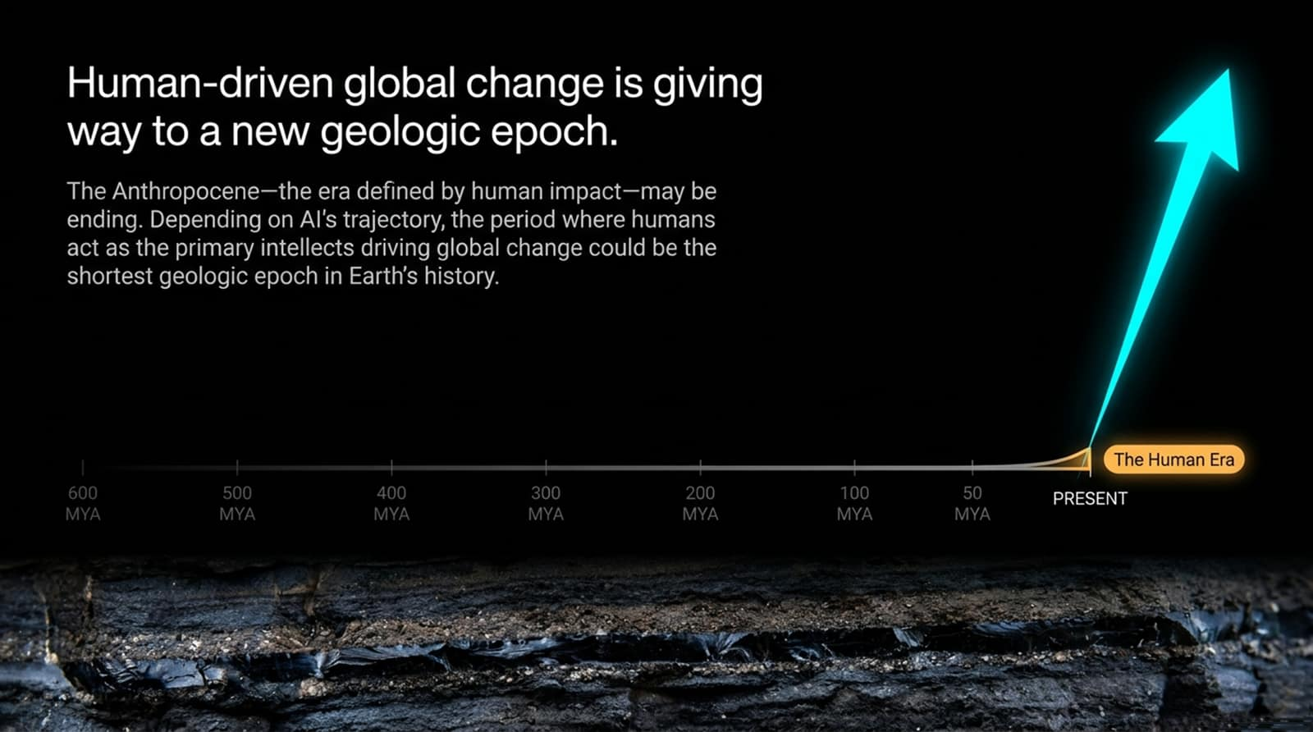
Notes:
Visual Reference: Timeline graphic illustrating deep geological time (600 MYA to Present) transitioning sharply into an abrupt vertical spike labeled "The Human Era."
Speaker Notes:
Deep Time Context: Let’s start by looking at geologic epochs—the vast markers of deep time defined by major shifts in climate, life forms, and planetary processes visible in rock strata. For a long time, nature drove these changes. But humans have begun leaving a permanent scar on the Earth—from the sixth mass extinction to radioisotopes from mid-century nuclear tests locked into future rock strata.
The Anthropocene's Short Span: Scientists have proposed naming our current era the Anthropocene—the epoch defined by human impact. But here is the central paradox: depending on the trajectory of Artificial Intelligence, the period where humans act as the primary intellects driving global change could turn out to be a microscopic footnote in Earth's history.
Transitioning the Driver: If AGI and artificial superintelligence emerge, human-driven planetary change gives way to machine-driven acceleration. The Anthropocene may well be the shortest geologic epoch in the history of our planet because intelligence itself is escaping biological limits.

Slide 3
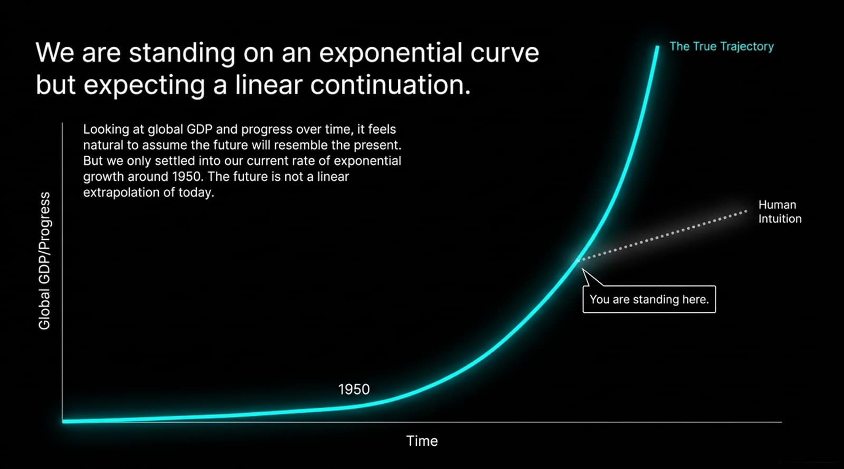
Notes:
Visual Reference: A graph tracking Global GDP/Progress against Time, showing a flat baseline skyrocketing upward post-1950, contrasted against a dotted line labeled "Human Intuition."
Speaker Notes:
Deconstructing the Graph: Look closely at this graph. If you plot global GDP or technological progress over the grand sweep of human history, it looks dead flat until very recently. In fact, humanity did not settle into our current compounding rate of exponential growth until roughly 1950.
The Failure of Human Intuition: Notice the two lines diverging on the right side of the screen. The dotted line represents human intuition—our gut feeling that progress is steady, manageable, and linear. The solid cyan line represents the true trajectory.
Where We Stand: "You are standing here" right at the knee of the curve. Because the curve has been relatively gentle up to now, our brains have been trained to extrapolate a linear future. But linear extrapolation on an exponential curve guarantees catastrophic underestimation. The future is not a smooth extension of today; it is an incoming wall of compounding acceleration.

Slide 4
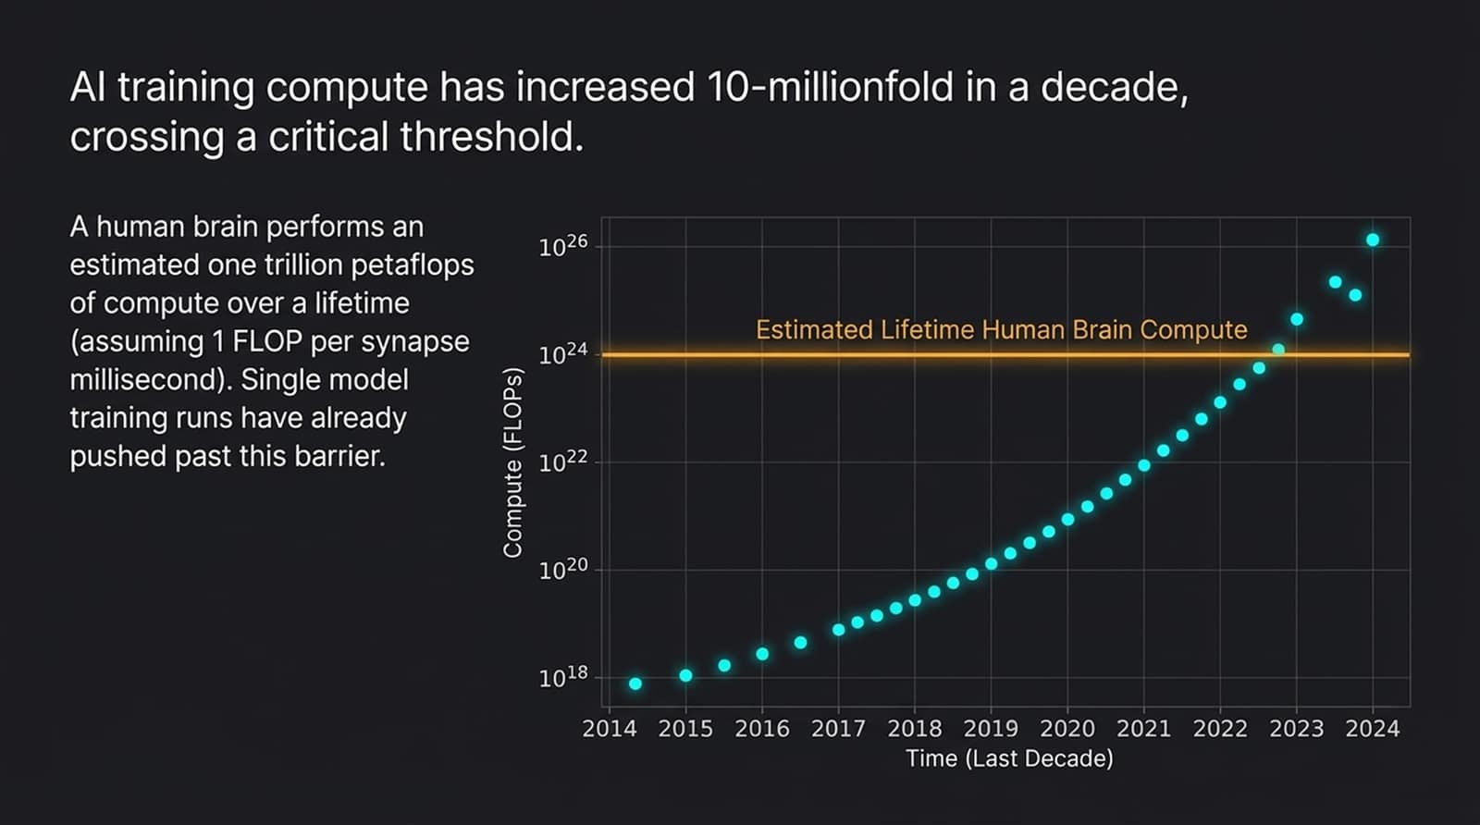
Notes:
Visual Reference: A logarithmic scatter plot showing compute (FLOPs) scaling exponentially from $10^{18}$ to $10^{26}$ between 2014 and 2024, crossing a horizontal line representing "Estimated Lifetime Human Brain Compute."
Speaker Notes:
The Engine of Scale: What is driving this exponential curve? Compute. This logarithmic plot tracks the compute used to train notable AI models over the last decade. Every single tick on the y-axis is two orders of magnitude larger than the one below it.
The 10-Millionfold Leap: In just ten years, AI training compute has increased roughly 10 millionfold. To put that in perspective, look at the horizontal orange line near the top: that represents a back-of-the-envelope estimate of the total compute a human brain performs over an entire lifetime—roughly one trillion petaflops, assuming about one FLOP per synapse millisecond.
Crossing the Biological Barrier: Single, modern model training runs have already pushed past this biological barrier. While raw compute scale is not identical to biological architecture, matching or exceeding the lifetime compute of a human brain across a single training run makes historical human-level cognitive comparisons entirely obsolete. We are playing in a completely different computational tier.

Slide 5
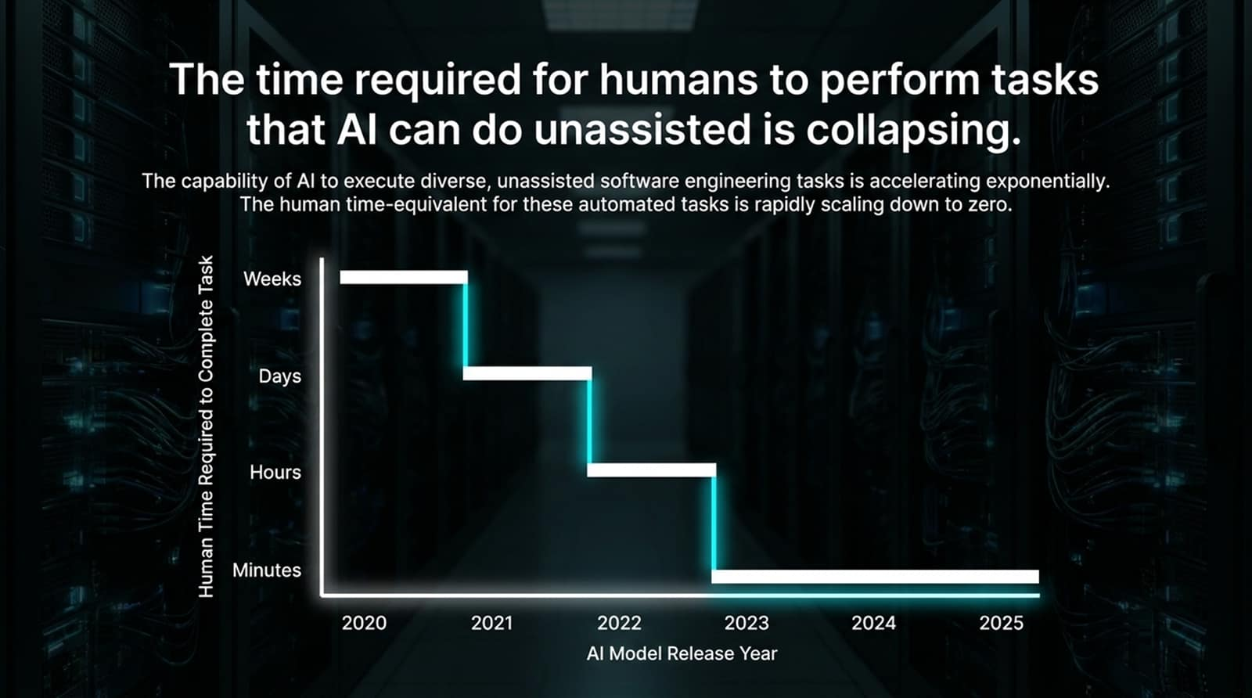
Notes:
Visual Reference: A step-down bar chart showing the human time-equivalent for automated AI software engineering tasks dropping from weeks/days down to hours and minutes between 2020 and 2025.
Speaker Notes:
Beyond Compute to Capabilities: It isn’t just raw compute that is scaling; practical capability is collapsing time barriers. This chart, based on data tracking unassisted software engineering tasks, measures how long it takes a human professional to complete a task that an AI model can now execute successfully.
The Compression of Human Labor: Notice the step-function collapse. A few years ago, tasks that took human engineers weeks or days were entirely out of reach for AI. By 2023, that window compressed to hours. Today, models routinely execute complex coding and execution tasks in minutes.
The Trend Line to Zero: The human time-equivalent for automated tasks is aggressively scaling down to zero. If you evaluate AI progress by looking at what it couldn't do yesterday, you will constantly miss what it is effortlessly mastering today.

Slide 6
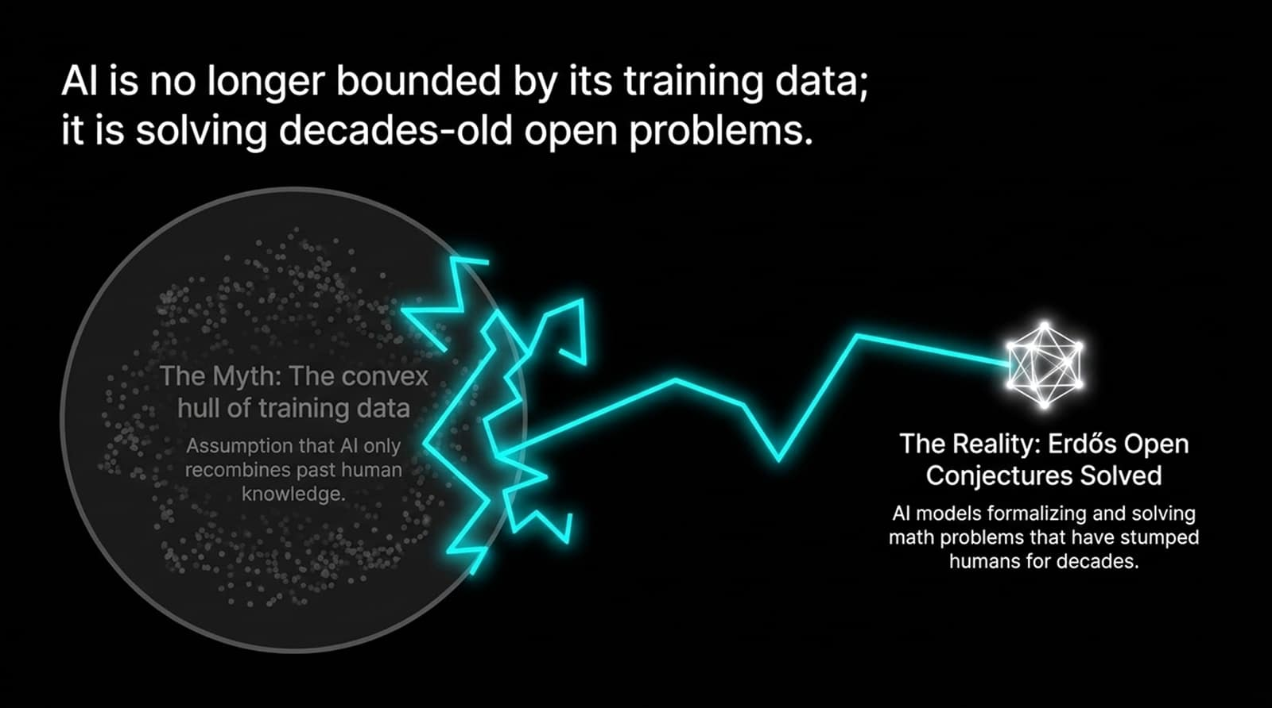
Notes:
Visual Reference: An illustration contrasting "The Myth: The convex hull of training data" (a confined cloud of past human knowledge) with "The Reality: Erdős Open Conjectures Solved" (an AI breaking past boundaries to solve decades-old math problems).
Speaker Notes:
Dispelling the Memorization Myth: A common pushback from skeptics is that AI can only regurgitate patterns found in its training data—that it’s merely a glorified autocomplete trapped inside a "convex hull" of past human thought.
True Generalization: Mathematically, the moment you type a novel prompt into an LLM, you are generating text outside the strict training distribution, meaning all inference is generalization. But more importantly, models have crossed a threshold where they are actively pushing past the boundaries of known human knowledge.
Conquering Open Math Problems: Look at Paul Erdős’s legendary open mathematical conjectures—unsolved problems that stumped brilliant human mathematicians for decades. In recent months, AI models have begun formalizing and solving these exact open problems. AI is no longer just mirroring human history; it is actively expanding the frontier of human discovery.

Slide 7
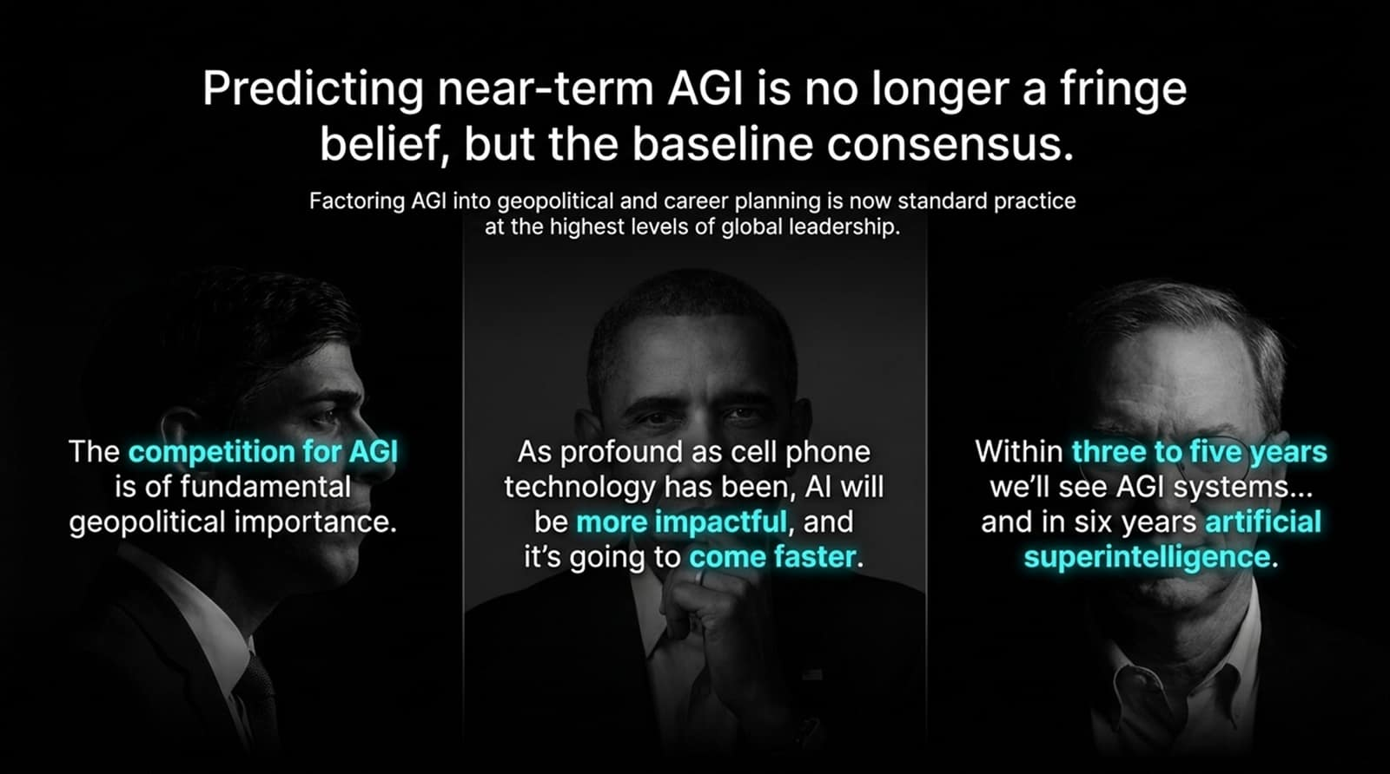
Notes:
Visual Reference: Three monochromatic portraits of global figures (Rishi Sunak, Barack Obama, Eric Schmidt) with highlighted quotes on the geopolitical and societal impact of AGI.
Speaker Notes:
Breaking the Overton Window: When academics or researchers talk about near-term Artificial General Intelligence, critics often dismiss it as "crazy" or outside the acceptable political spectrum—what political scientists call the Overton window. But that reluctance to speak plainly is evaporating.
The Global Leadership Consensus: Predicting near-term AGI is no longer a fringe belief held by techno-optimists in Silicon Valley basements; it is the baseline consensus among high-level global leaders and institution builders:
Former UK Prime Minister Rishi Sunak noted that the competition for AGI is of fundamental geopolitical importance.
Barack Obama observed that AI will be more impactful than cell phones, and arriving much faster.
Eric Schmidt famously projected AGI systems within 3 to 5 years, and artificial superintelligence shortly thereafter.
Permission to Take It Seriously: You do not need to censor your concerns or treat AGI as science fiction. The world’s most pragmatic, respected institutions are already factoring near-term AGI into their national security and strategic planning.

Slide 8
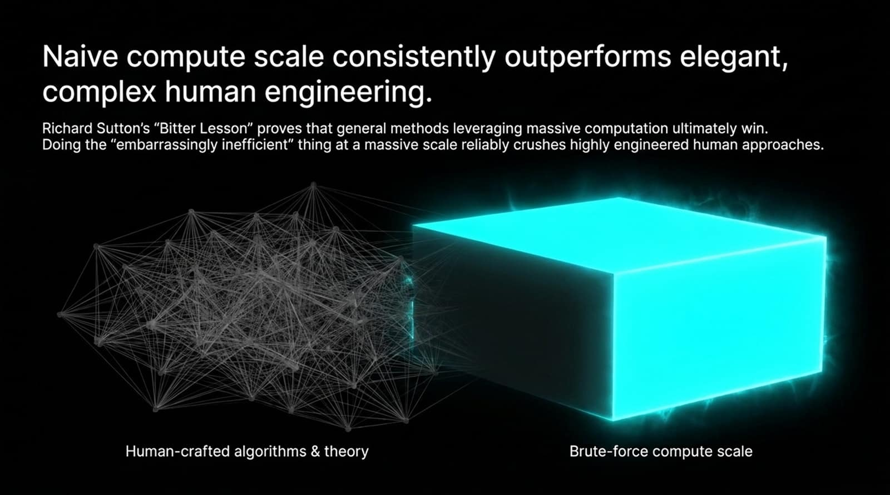
Notes:
Visual Reference: An abstract comparison between an intricate, web-like network labeled "Human-crafted algorithms & theory" and a massive glowing block labeled "Brute-force compute scale."
Speaker Notes:
The Bitter Lesson: In 2019, computer scientist Richard Sutton published a legendary essay titled "The Bitter Lesson". His observation shook the AI research community to its core: general methods that leverage massive computation ultimately win out over human-engineered cleverness every single time.
Brute Force vs. Elegance: As humans, we love elegant, handcrafted algorithms, bespoke heuristics, and theoretical elegance. But doing the "embarrassingly inefficient" thing at a massive, planetary compute scale reliably crushes highly engineered human approaches.
The Lesson for Researchers: Fighting compute scale with clever theoretical constraints is a losing battle. If your research methodology relies on bypassing scale rather than embracing it, you are building a sandcastle against a tidal wave.

Slide 9
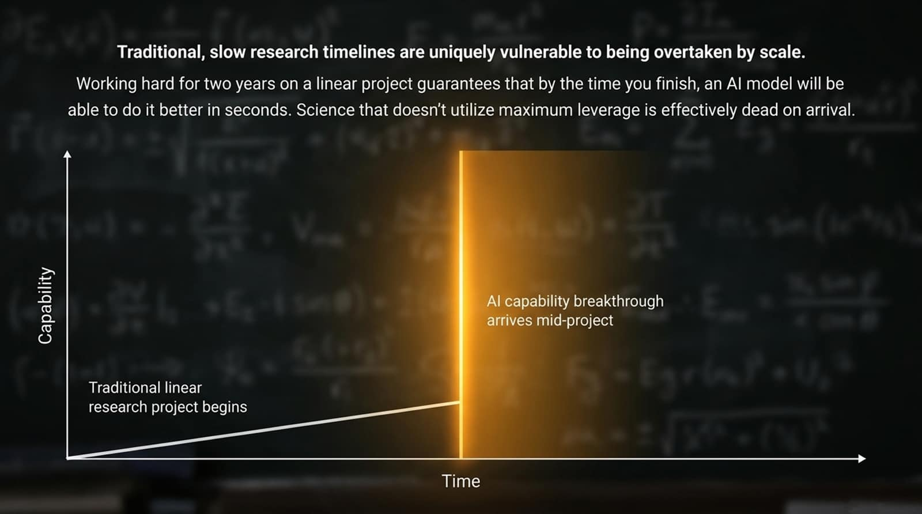
Notes:
Visual Reference: A graph tracking Capability over Time, featuring a glowing orange vertical band representing an "AI capability breakthrough arriving mid-project" that eclipses a traditional linear research trajectory.
Speaker Notes:
The Trap of Multi-Year Projects: Traditional academic and corporate research timelines are built for a linear world. If you embark on a traditional, slow research project—toiling away manually for two years on a linear timeline—you face a brutal trap.
Dead on Arrival: By the time you finish your painstaking work, an advancing AI model will be able to accomplish the exact same outcome in seconds.
Leveraging Maximum Leverage: Science that does not utilize maximum leverage is effectively dead on arrival. Researchers must adapt their workflows so that their projects compound alongside AI progress rather than getting steamrolled by it mid-stride.

Slide 10
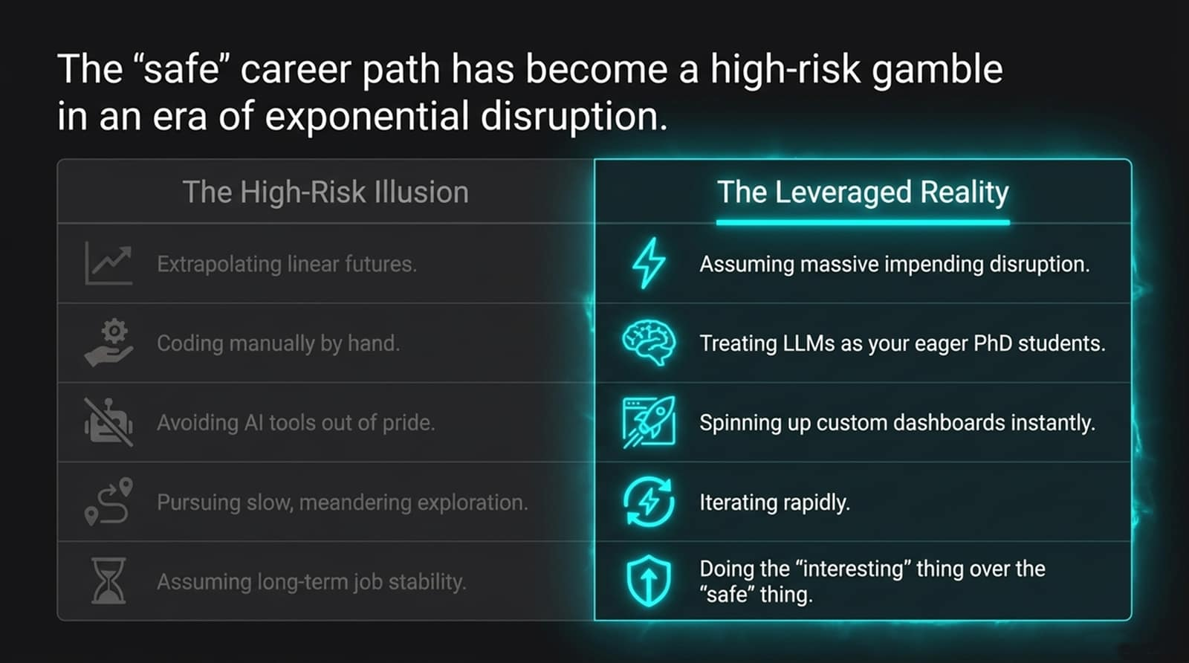
Notes:
Visual Reference: A side-by-side comparison table contrasting "The High-Risk Illusion" (extrapolating linear futures, coding manually, avoiding AI) with "The Leveraged Reality" (assuming disruption, treating LLMs as PhD students, iterating rapidly).
Speaker Notes:
Revisiting Risk and Reward: When people make life and career decisions, they naturally try to balance risk and reward, often choosing the "safe," conventional option. But in an era of exponential disruption, that traditional calculation is completely inverted.
The Illusion of Safety: Sticking to manual coding, avoiding AI tools out of professional pride, or pursuing slow, meandering exploration feels safe—but it is a high-risk illusion. Because a baseline level of disruption is now unavoidable, choosing the "safe path" doesn't buy you safety; it merely sacrifices your potential reward.
Embracing Intelligent Risk: You need to treat LLMs like eager, tireless PhD students, spin up custom dashboards instantly, and choose the interesting thing over the safe thing. In exponential times, caution is the riskiest stance you can take.

Slide 11
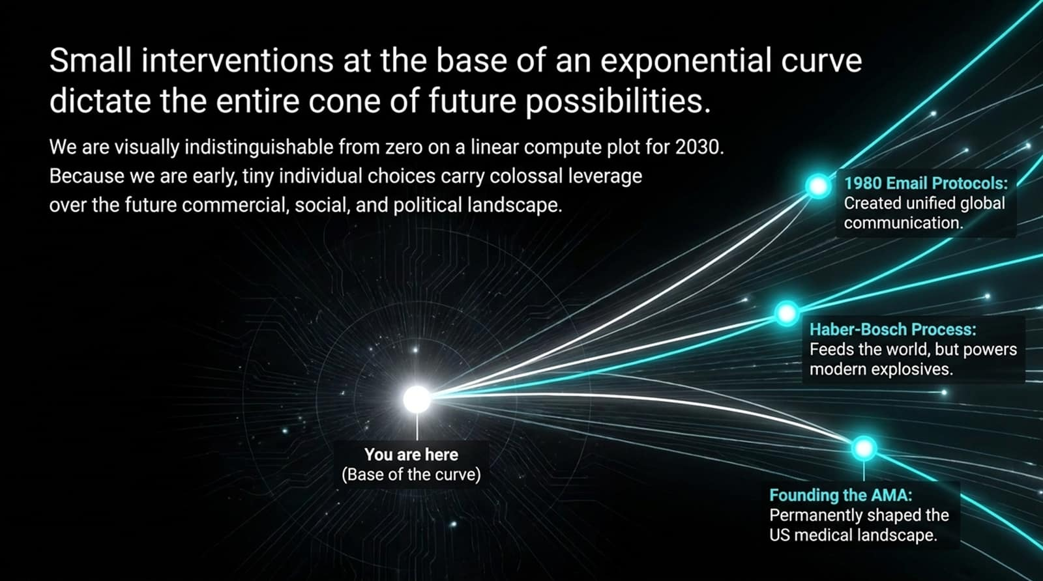
Notes:
Visual Reference: A network node graphic showing "You are here (Base of the curve)" splitting into multiple branching historical pathways, such as 1980 Email Protocols and the Haber-Bosch Process.
Speaker Notes:
We Are Still at Zero: Look at our current position on the timeline. Visually, on a linear compute plot for 2030, our present state looks indistinguishable from zero. Because we are right at the very beginning of the exponential curve, tiny individual choices carry colossal leverage.
Historical Precedents of Leverage: Think back to past technological inflections:
In 1980, two scientists proposed a simple standardized protocol for exchanging emails, creating unified global communication.
The Haber-Bosch nitrogen fixation process enabled humanity to feed billions, while also powering modern explosives.
Early organizational choices like founding the AMA permanently shaped the US medical landscape.
Your Power Today: Small decisions made today—the research problems you choose, the ethical stances you take, the architectures you champion—will dictate the entire commercial, social, and political cone of future possibilities.

Slide 12
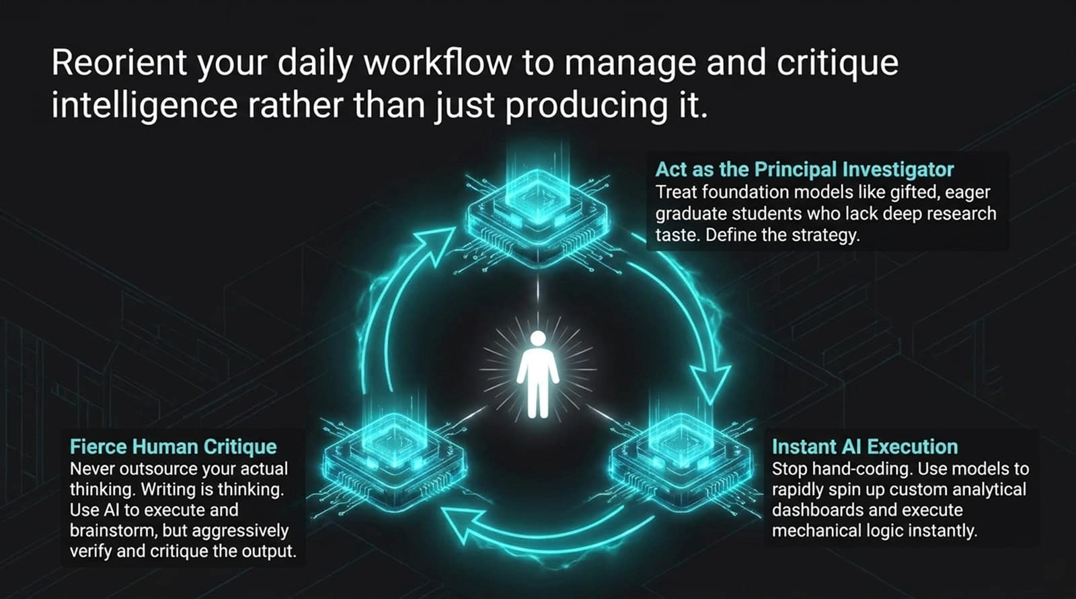
Notes:
Visual Reference: A triangular workflow diagram centering a human figure surrounded by foundation model nodes, highlighting "Act as the Principal Investigator," "Instant AI Execution," and "Fierce Human Critique."
Speaker Notes:
The PI Workflow: How should you structure your daily work in this new era? Reorient your workflow to manage and critique intelligence rather than manually grinding out raw production.
Three Pillars of Modern Execution:
Act as the Principal Investigator: Treat foundation models like gifted, eager graduate students who lack deep research taste; you define the strategy and scope.
Instant AI Execution: Stop hand-coding every mechanical line. Use models to spin up custom analytical dashboards and execute mechanical logic instantly.
Fierce Human Critique: Never outsource your actual thinking. Writing is thinking. Use AI to execute and brainstorm, but aggressively verify, stress-test, and critique the output.

Slide 13
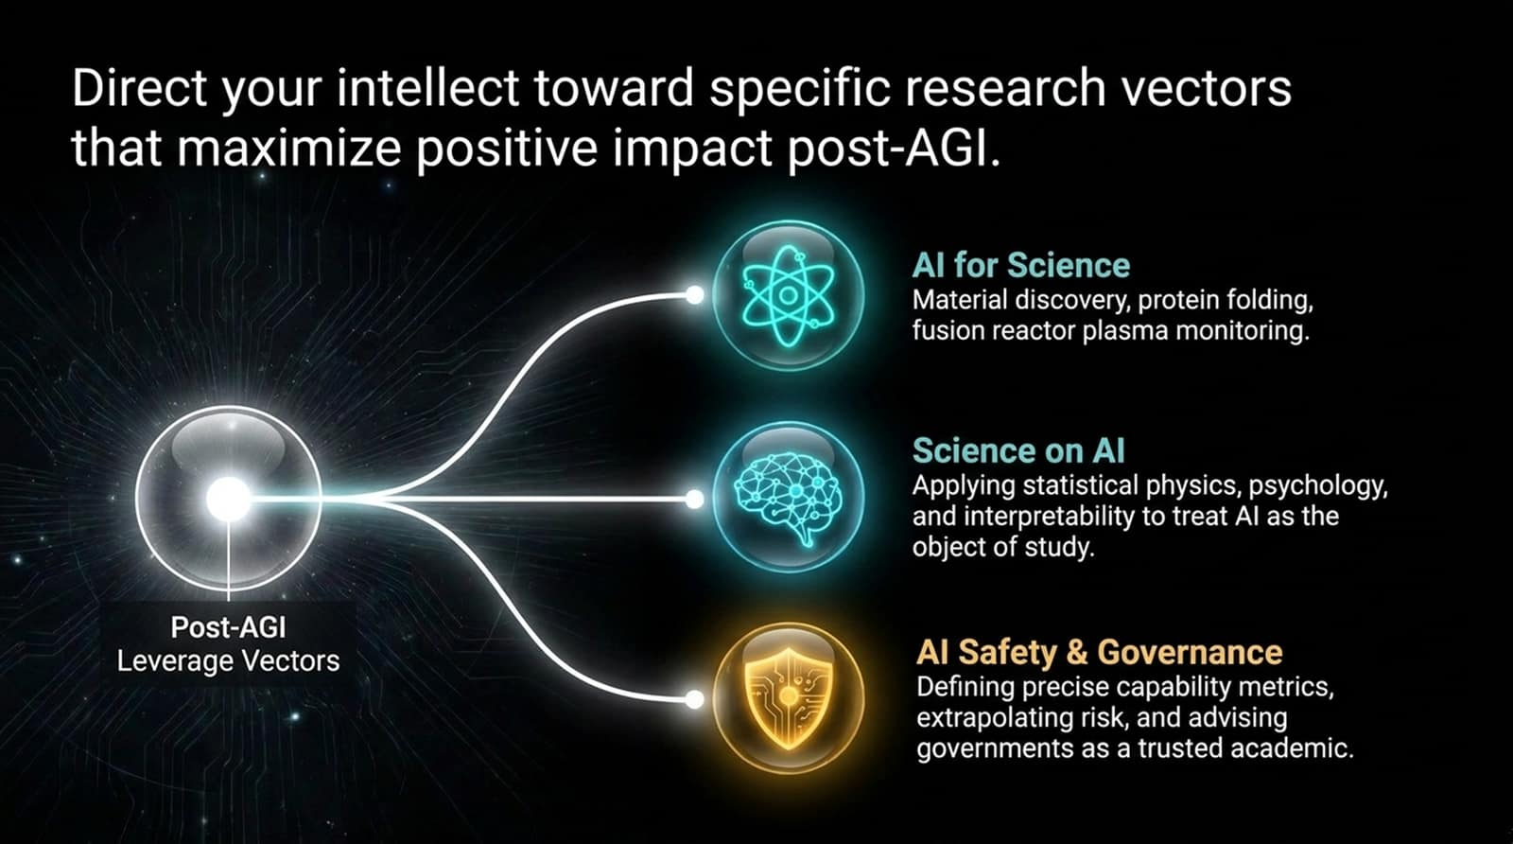
Notes:
Visual Reference: Three glowing thematic icons branching outward from a central post-AGI nexus: AI for Science, Science on AI, and AI Safety & Governance.
Speaker Notes:
Targeting High-Impact Vectors: If you have limited time and high stakes, where should you direct your intellect? We need to focus on specific research vectors that maximize positive impact in a post-AGI world.
The Three Critical Domains:
AI for Science: Accelerating material discovery, protein folding, and fusion reactor plasma monitoring. Understanding the physical world better is unambiguously positive.
Science on AI: Applying statistical physics, psychology, and interpretability to treat AI itself as the primary object of study (doing neuroscience on neural networks).
AI Safety & Governance: Defining precise capability metrics, extrapolating risk, and advising governments as trusted, technically competent academics. Governments are crying out for technical guidance.

Slide 14
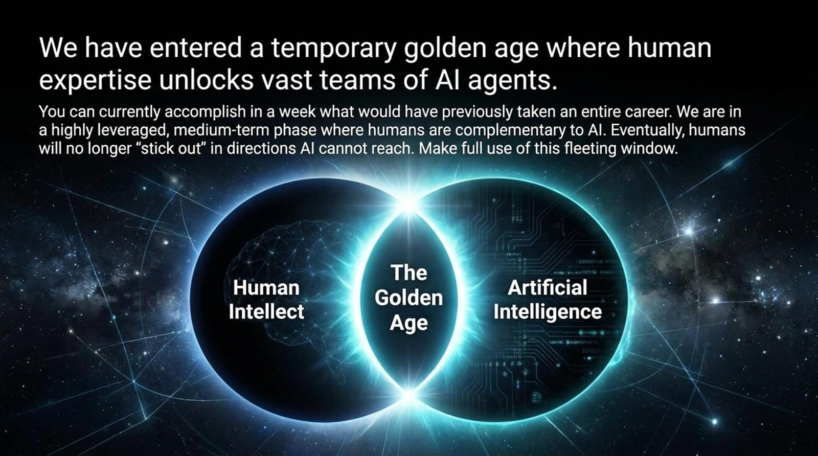
Notes:
Visual Reference: A dual-hemisphere Venn diagram intersecting "Human Intellect" and "Artificial Intelligence" to form a glowing central zone labeled "The Golden Age."
Speaker Notes:
The Fleeting Window: We have entered a temporary, highly leveraged golden age. Right now, human expertise acts as the master key that unlocks vast teams of AI agents.
Unprecedented Leverage: You can currently accomplish in a single week what would have previously consumed an entire human career. We are in a medium-term phase where humans are deeply complementary to AI.
Make Full Use of It: This is a fleeting window. Eventually, automated intelligence will span domains where human cognitive bottlenecks no longer stick out. Make full use of this golden age while human guidance commands absolute leverage.

Slide 15
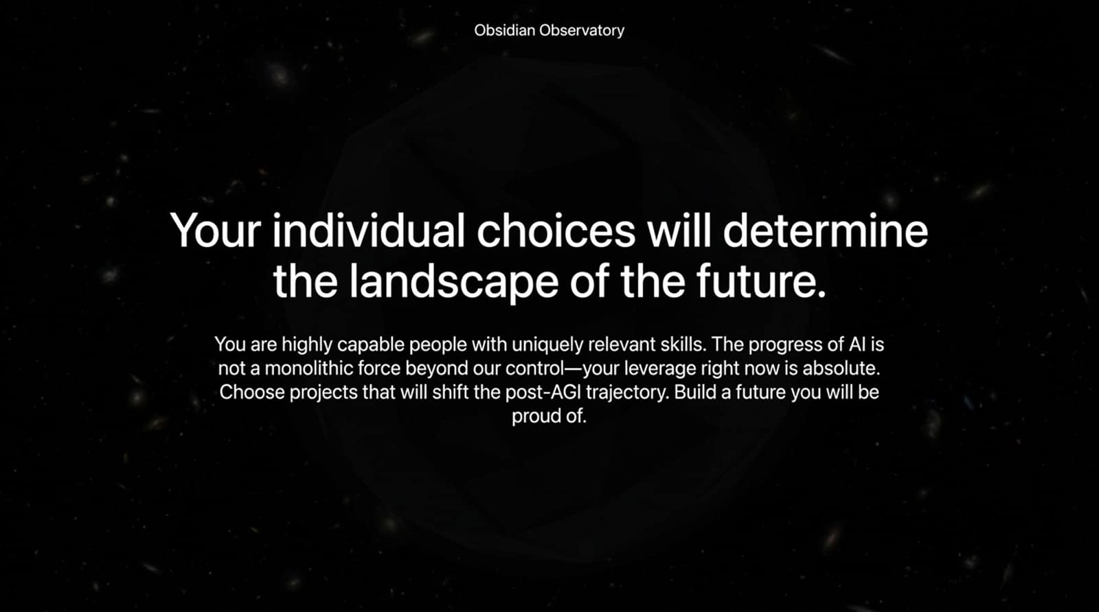
Notes:
Visual Reference: A deep cosmic background framed by the Obsidian Observatory logo, featuring the core call to action: "Your individual choices will determine the landscape of the future."
Speaker Notes:
Rejecting Fatalism: It is easy to look at the massive scale of AI development and feel a sense of helpless fatalism—to believe that progress is a monolithic force completely beyond our individual control. That is entirely false.
Absolute Agency: You in this room are highly capable people with uniquely relevant skills. Your leverage right now is absolute.
The Final Charge: Choose projects that will actively shift the post-AGI trajectory toward flourishing. Do not drift into the future passively—build a future you will be proud of when you look back.

Slide 16
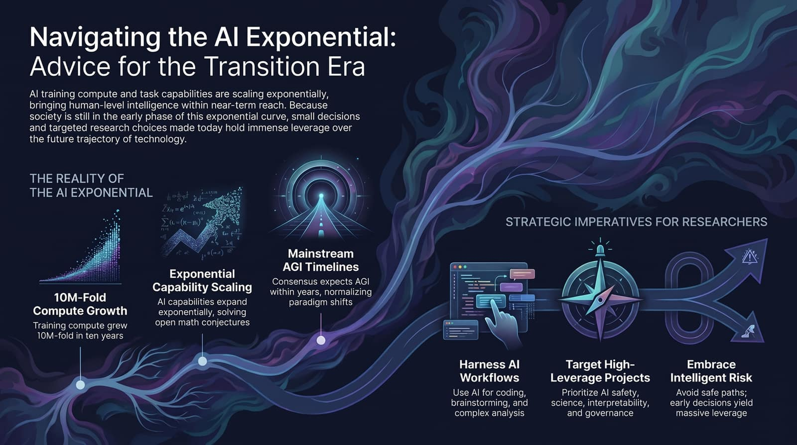
Notes:
Visual Reference: A comprehensive summary slide combining the exponential compute growth curve, mainstream AGI timelines, and the three strategic imperatives (Harness AI Workflows, Target High-Leverage Projects, Embrace Intelligent Risk).
Speaker Notes:
Synthesizing the Journey: Let’s bring everything together. As we’ve explored across this deck and anchored in the data from the Stanford HAI lecture:
The Reality: Training compute has scaled 10-millionfold in a decade, unassisted task capabilities are doubling exponentially, and mainstream AGI timelines are converging on years, not generations.
Harness AI Workflows: Stop coding manually and start acting as a Principal Investigator who directs, scopes, and fiercely critiques AI output.
Target High-Leverage Projects: Focus your intellect where it matters most—AI safety, interpretability, scientific discovery, and governance.
Embrace Intelligent Risk: Abandon safe, linear career paths that lead to obsolescence. Early decisions yield massive leverage.
Closing Remark: The linear era is over. The exponential era is here. The rest of the story is up to you. Thank you.

Slide 17
