Slide 1

Notes:
A Big Talk about Small Talk 🗣️ (with Ray Addam) Improve your Speaking Skills in English
https://www.youtube.com/watch?v=uSOZaWMVv8c

Slide 2
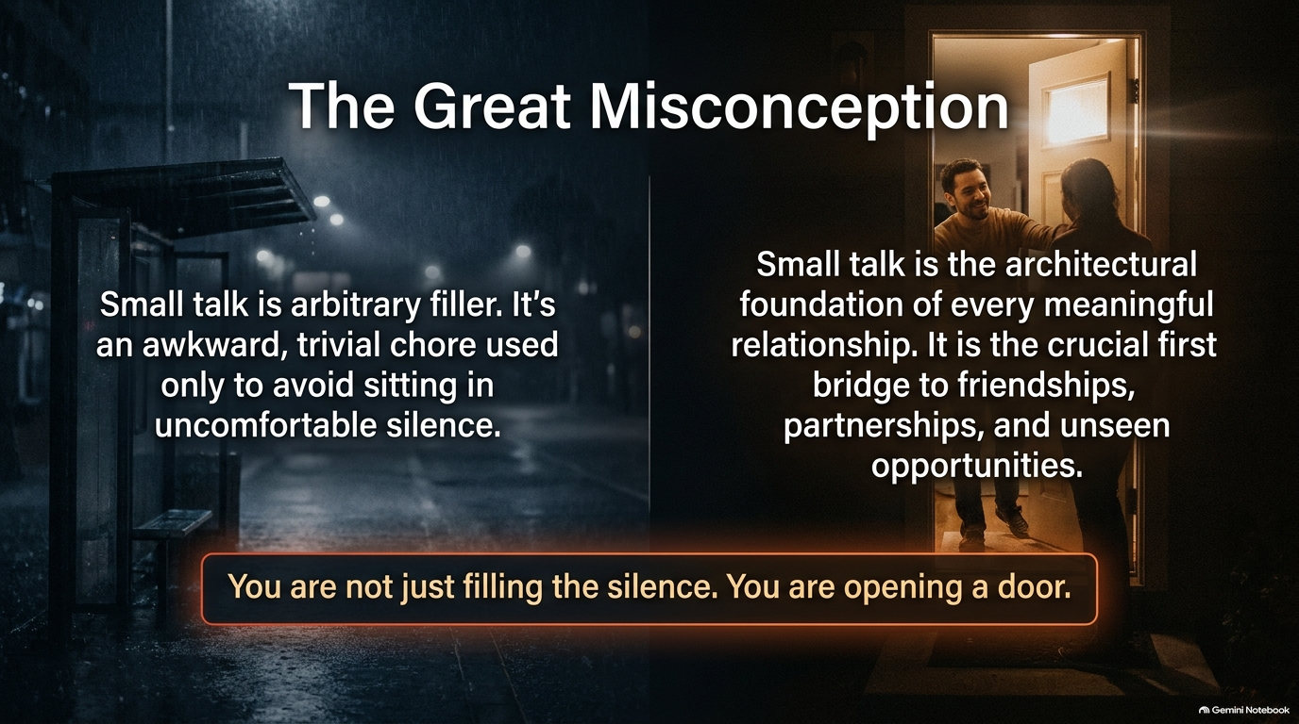

Slide 3
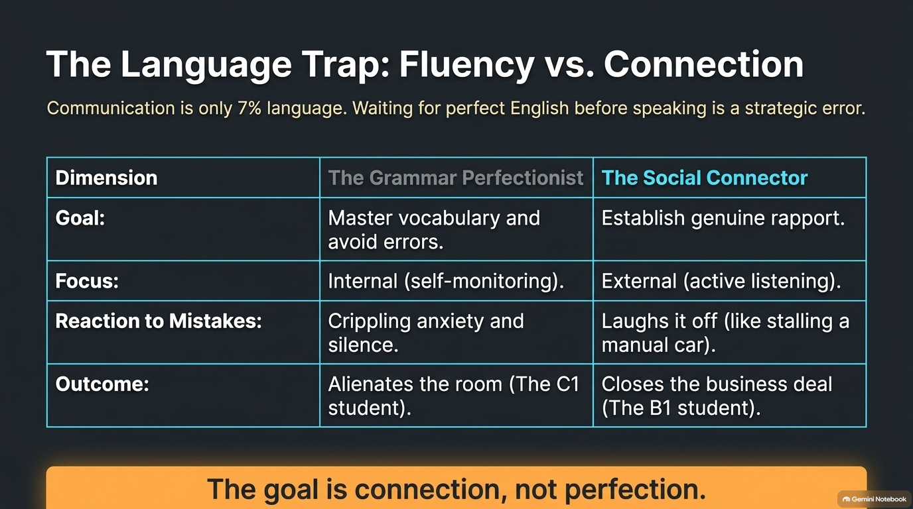

Slide 4
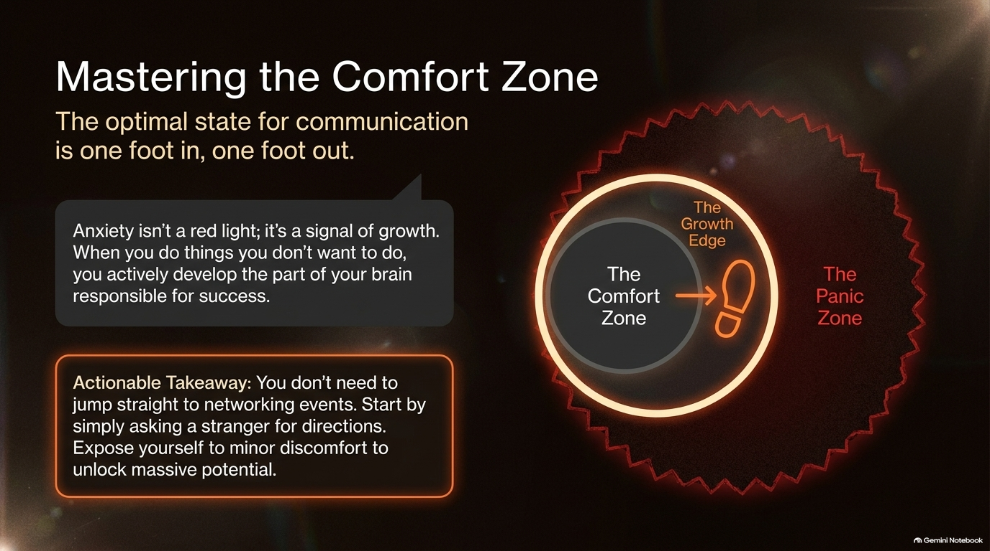

Slide 5
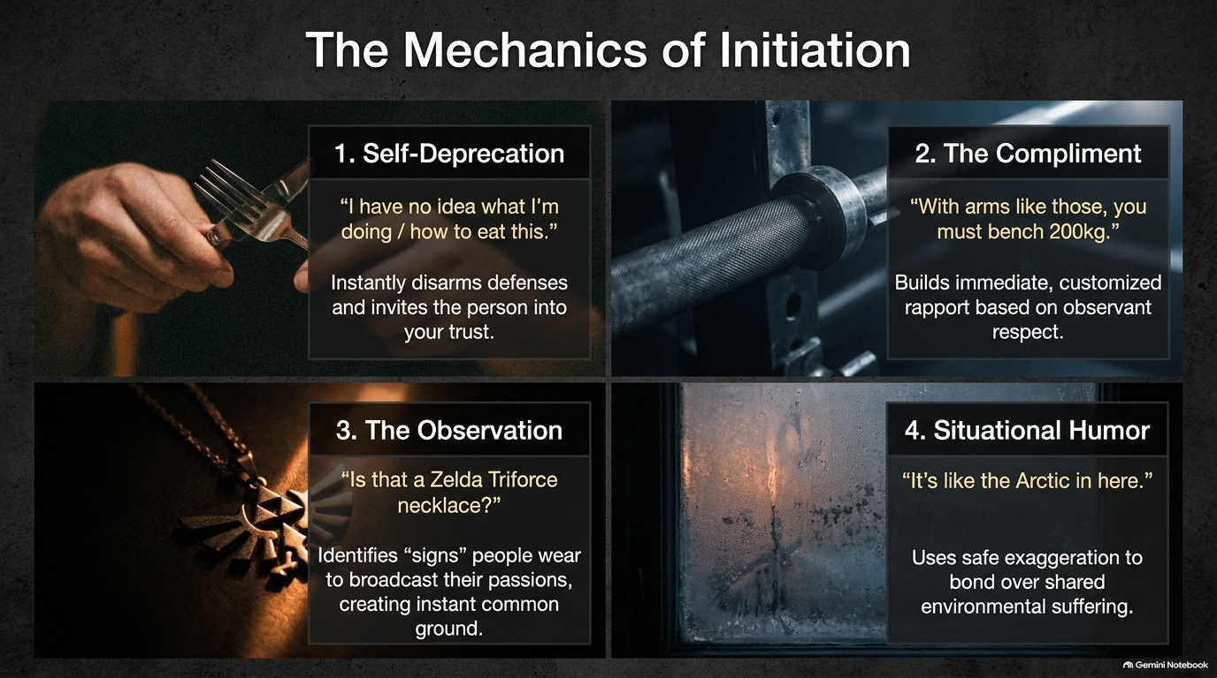

Slide 6
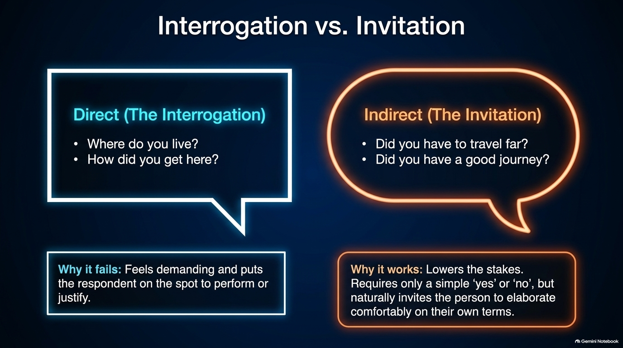

Slide 7
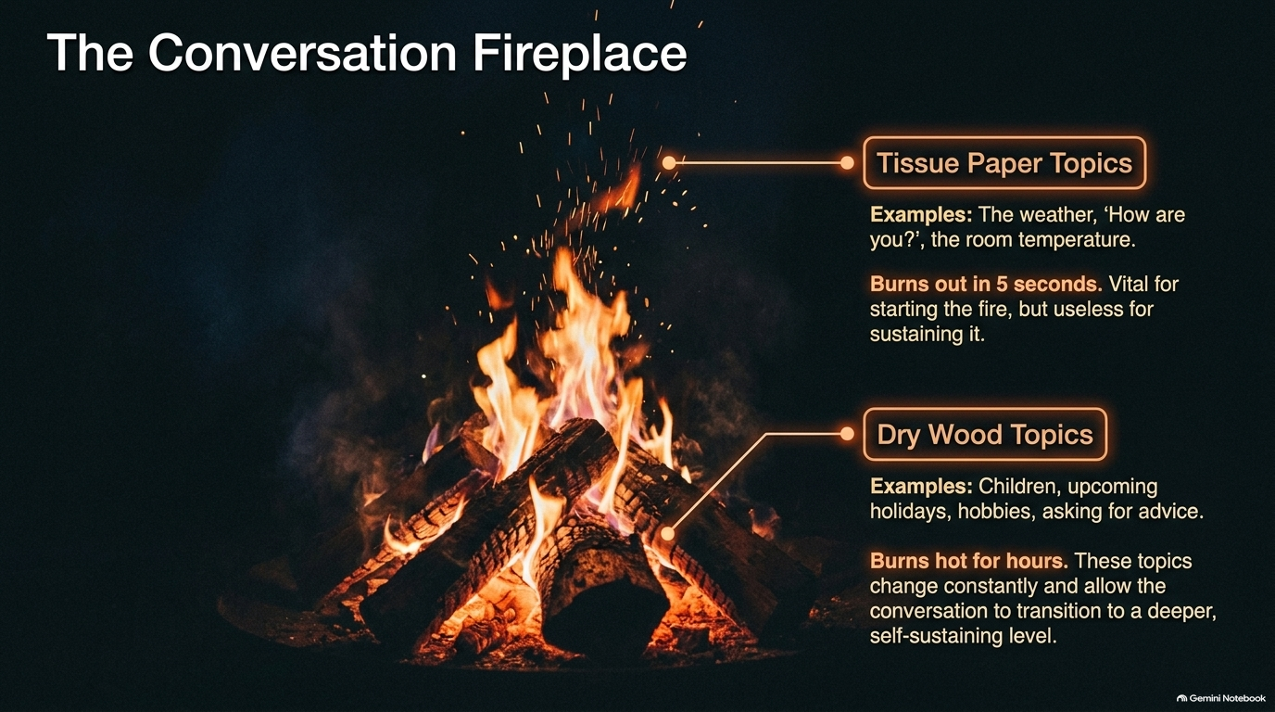

Slide 8
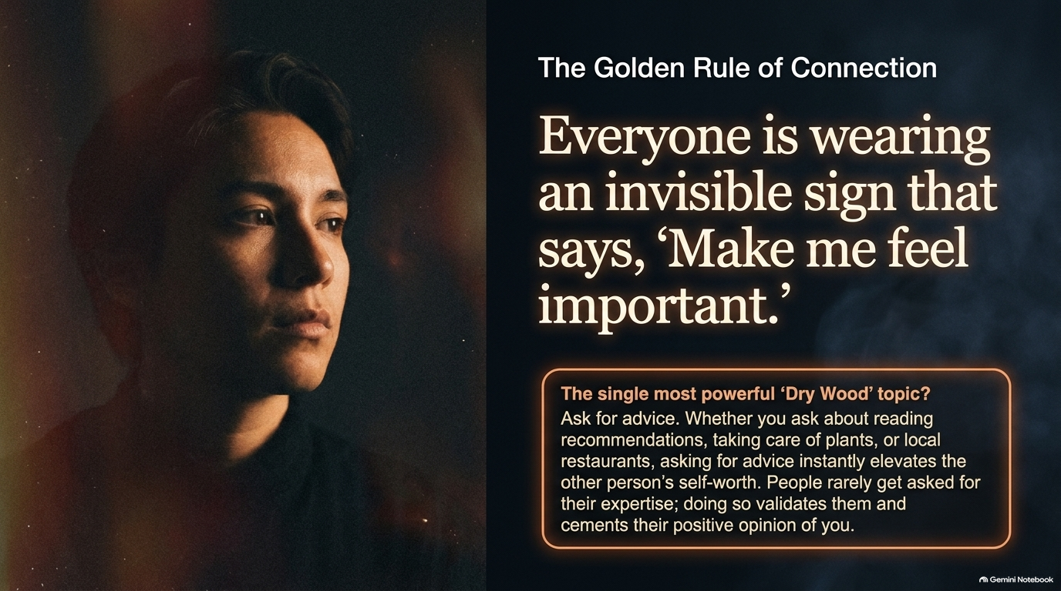

Slide 9
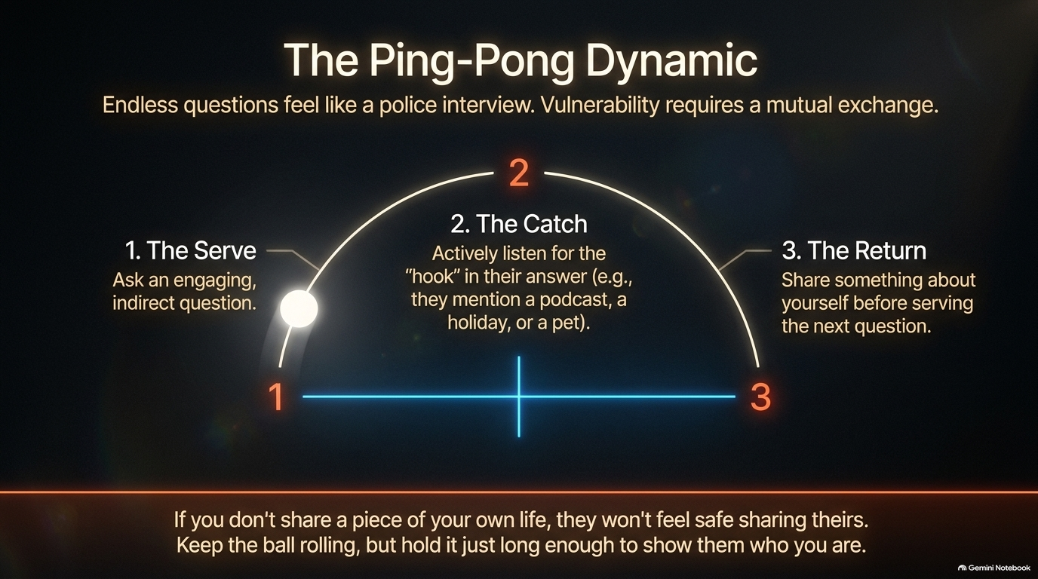

Slide 10


Slide 11


Slide 12


Slide 13
