Slide 1
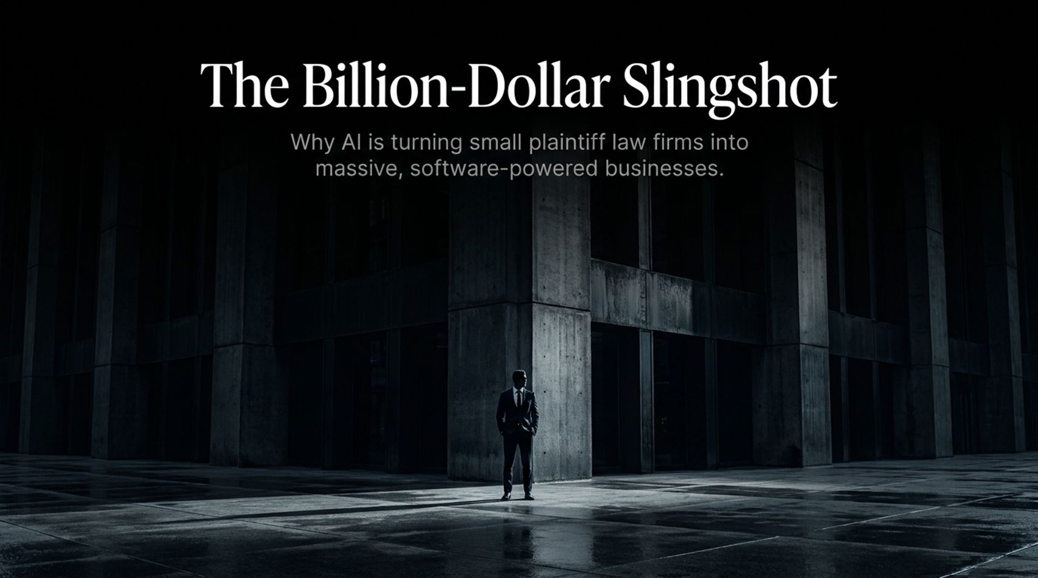
Notes:
Estimated Presentation Time: 3 minutes
Key Theme: Introduction to the AI Revolution in Plaintiff Law
Speaker Notes:
"Good morning, everyone. Today, we’re exploring how artificial intelligence isn't just cutting costs or automating repetitive tasks—it is fundamentally transforming small law firms into high-growth, billion-dollar businesses.
Most tech conversations around legal AI focus on large corporate firms or defense teams. But the real blue-ocean opportunity lies in plaintiff law. Historically, plaintiff firms operated under extreme labor constraints, relying on minimal software. Today, with vertical AI platforms like Eve, we are handing small contingency firms a 'slingshot' powerful enough to level the playing field against corporate Goliath-level defense entities. Over the next 15 slides, we’ll analyze how AI breaks economic bottlenecks, expands total addressable market (TAM), and scales law firms into software-like margins."
What Happens When Both Sides of a Case Use AI?
https://www.youtube.com/watch?v=iRMmPjunm3Q

Slide 2
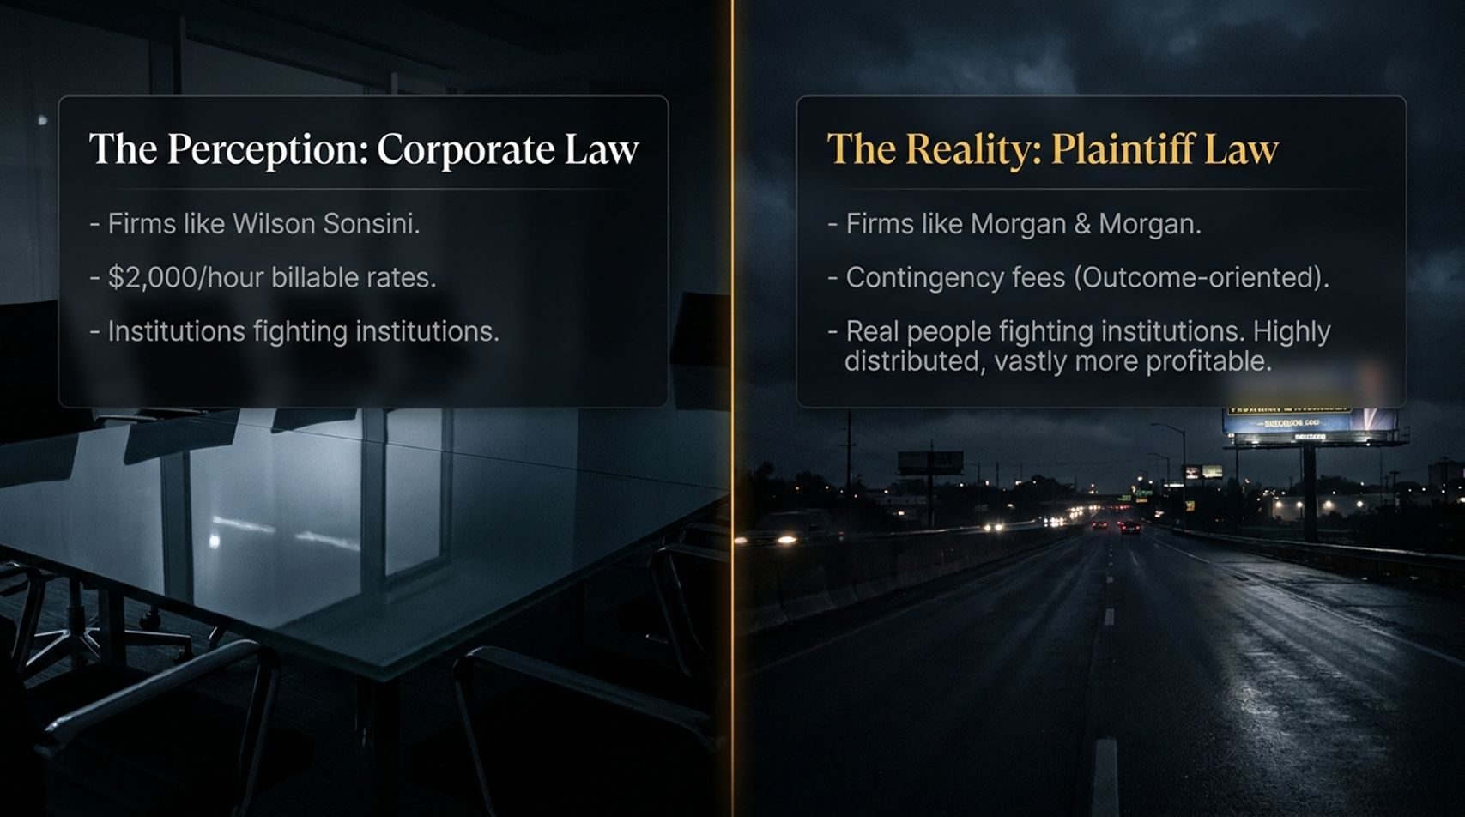
Notes:
Estimated Presentation Time: 3 minutes
Key Theme: Corporate Law vs. Plaintiff Law Dynamics
Speaker Notes:
"To understand this shift, we have to contrast the two distinct halves of the legal world. On one side, you have white-shoe corporate firms billing $1,000 to $2,000 an hour on a blank check. They monetize lawyer hours—the more hours spent, the higher their revenue.
On the other side is plaintiff law—the law of real people dealing with personal injury, labor disputes, or accidents. Plaintiff firms operate on contingency: they only get paid when they win. While corporate firms are well-funded, plaintiff law is far more distributed and holds massive untapped potential. However, because everyday people cannot afford $500/hour retainers, contingency law is the only vehicle delivering legal access—yet it has historically been bottlenecked by human labor capacity."

Slide 3
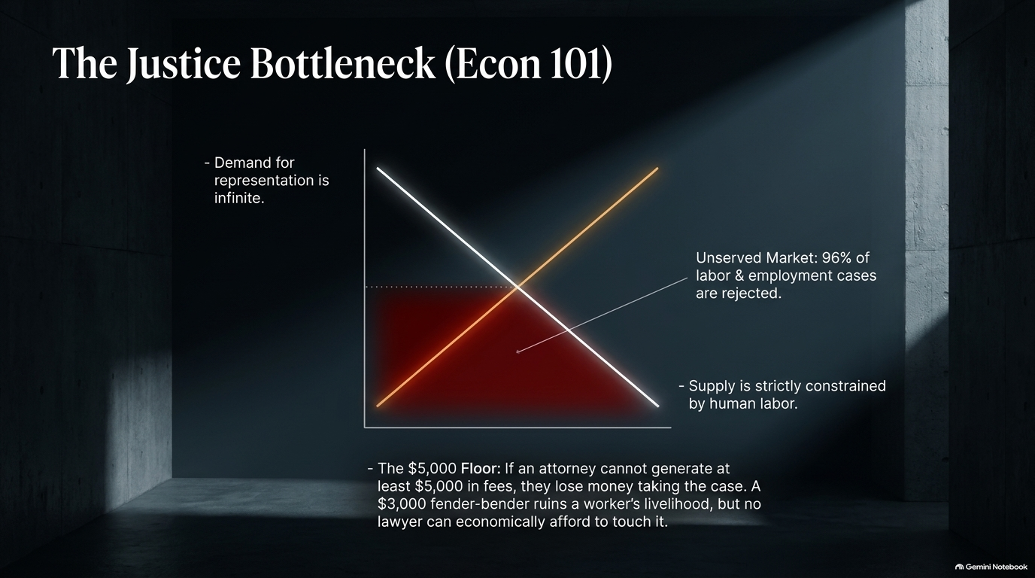
Notes:
Estimated Presentation Time: 4 minutes
Key Theme: Supply, Demand, and the $5,000 Fee Threshold
Speaker Notes:
"Let's view this through standard economic theory. In contingency law, demand from clients needing help is practically infinite. However, the supply curve is constrained by lawyer and paralegal labor hours.
Currently, if a case cannot yield at least $5,000 in attorney fees, a law firm will almost always reject it. Why? Because conducting 10 hours of initial research, intake, and legal analysis on a $1,000 or $3,000 damages claim means the firm loses money carrying the case—even if they win! As a result, 96% of labor and employment inquiries get turned away. AI liberates this market failure by bringing incremental labor costs down near zero, allowing firms to capture massive latent demand."

Slide 4
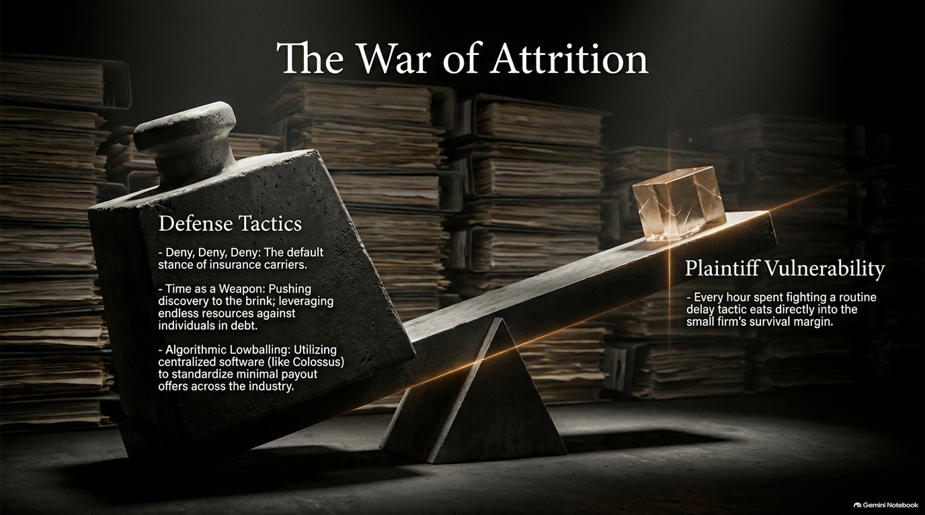
Notes:
Estimated Presentation Time: 4 minutes
Key Theme: Reframing AI's Value Proposition in Law
Speaker Notes:
"When most people think of AI, they assume it’s about downsizing teams and trimming overhead. But in plaintiff law, AI is a revenue expansion engine.
Because contingency firms are supply-constrained (by labor) rather than demand-constrained, firing people misses the point. By deploying AI agents, a firm doesn't just reduce labor hours—it unlocks the ability to take on 3x to 5x more cases without expanding headcount. As trial attorneys realize, AI doesn't cut their budget; it dramatically increases the top-line cash flow of the firm."

Slide 5
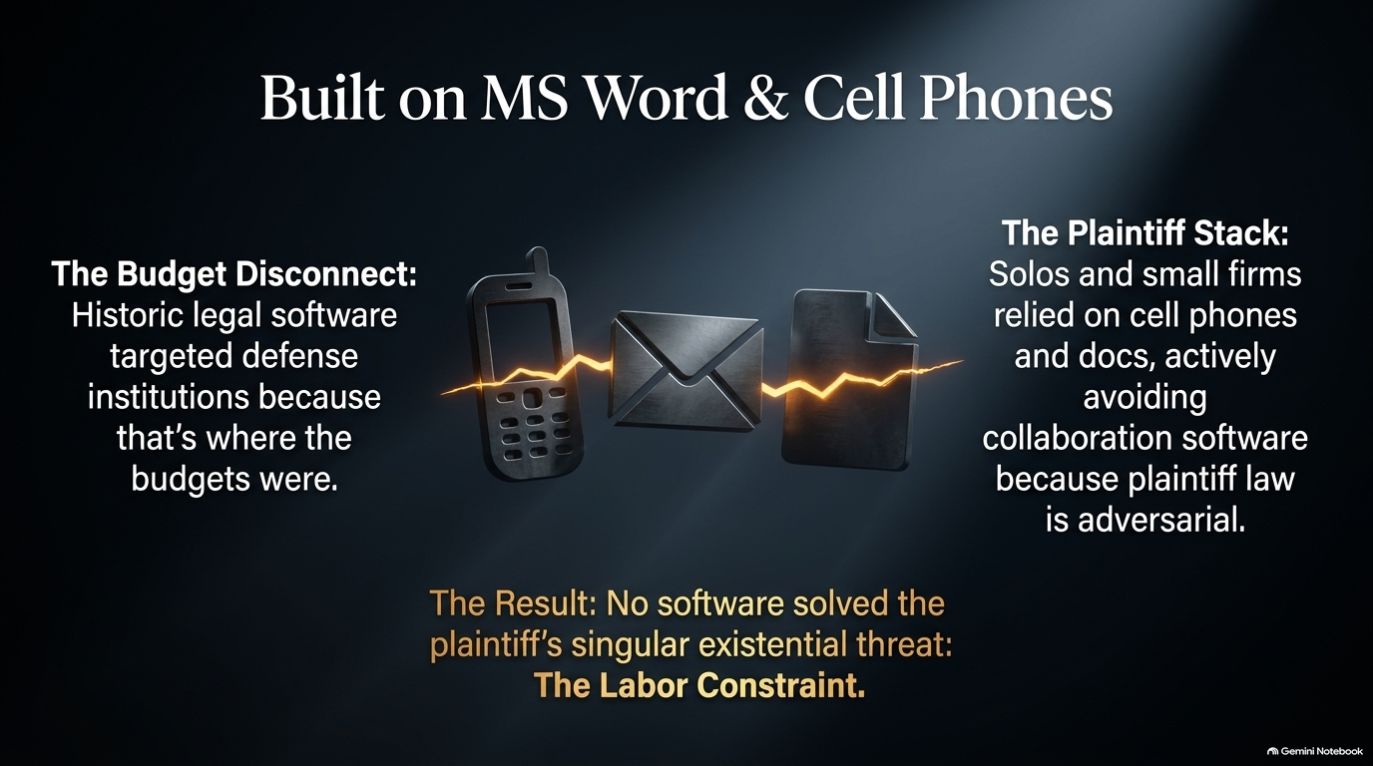
Notes:
Estimated Presentation Time: 5 minutes
Key Theme: Operational Transformation in Los Angeles
Speaker Notes:
"Let’s look at a concrete real-world example. A prominent plaintiff firm in Los Angeles integrated Eve into its end-to-end workflow. Prior to AI adoption, their attorneys managed an average capacity of 100 clients per lawyer.
After embedding AI agents across intake, case qualification, document review, and settlement brief generation, their capacity soared to 500 clients per attorney—a 500% increase in operational throughput! This wasn't achieved by working 80-hour weeks; it was achieved by shifting the lawyer's role from manual paperwork processor to strategic oversight and high-value trial advocacy."

Slide 6
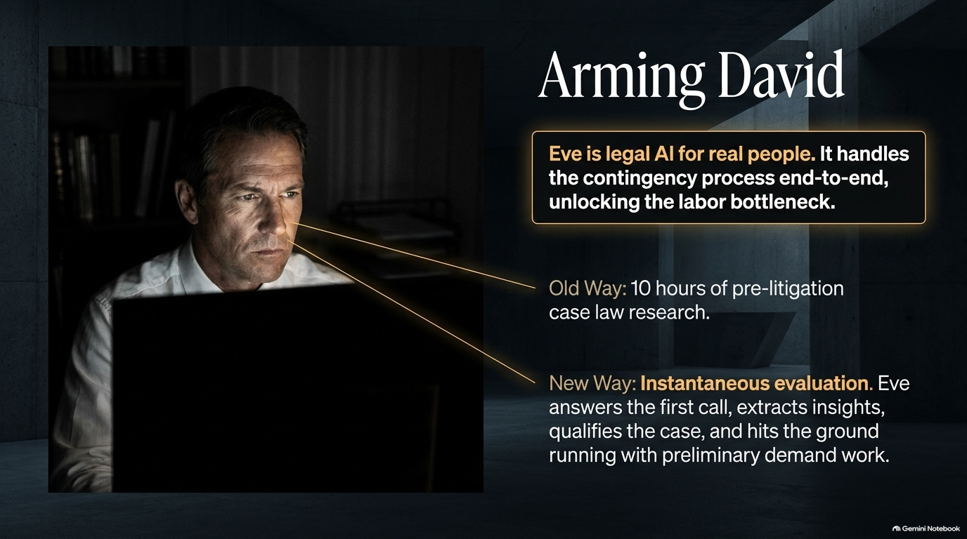
Notes:
Estimated Presentation Time: 5 minutes
Key Theme: Navigating Long-Horizon Workflows
Speaker Notes:
"Why is legal work so difficult to automate with generic AI models? Because a single personal injury or employment case isn't a one-shot prompt; it spans 6 to 12 months and involves over 10,000 discrete back-and-forth interactions.
Consider the lifecycle: inbound phone intake, medical record retrieval from reluctant healthcare providers, insurance carrier communications, cause-of-action evaluations, discovery requests, mediator briefs, and settlement negotiations. Executing this demands long-horizon agentic orchestration capable of maintaining context across thousands of steps with near-zero error tolerance."

Slide 7
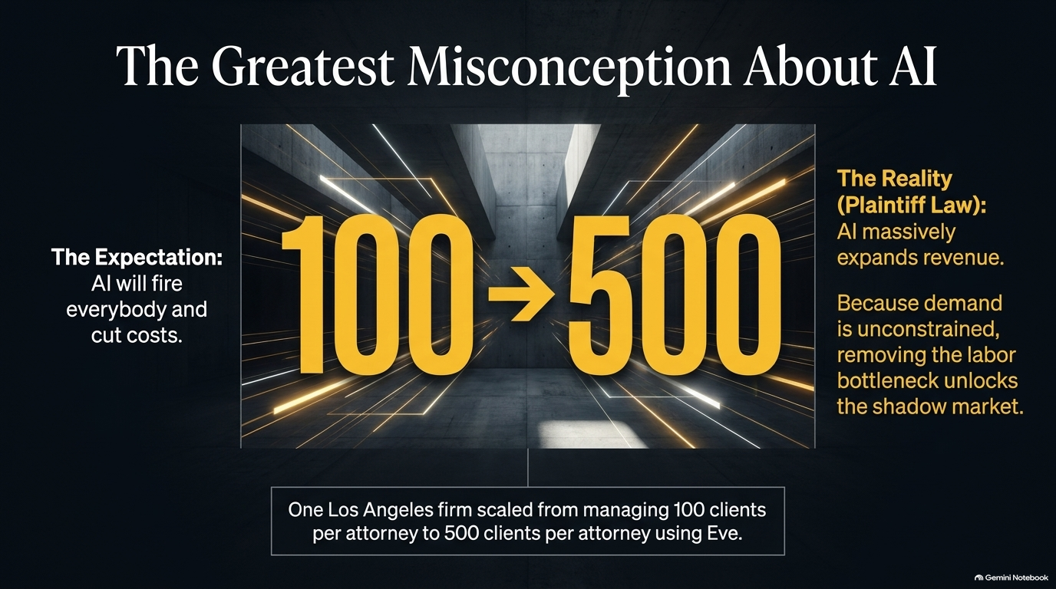
Notes:
Estimated Presentation Time: 4 minutes
Key Theme: Domain Context, Local Knowledge, and Non-Scrapable Data
Speaker Notes:
"A common question founders and investors ask is: 'Why can't a law firm just use raw GPT-4 or Claude?' Jay Kumar uses a brilliant analogy: If you drop Albert Einstein into a law firm tomorrow morning, he won't be productive for a long time.
Why? Because legal efficacy requires deep, hyper-local context. In plaintiff law, 99% of outcomes settle pre-trial and are non-scrapable. Public case law doesn't tell you how a specific insurance adjuster at Geico in a specific county negotiates soft-tissue claims. Vertical AI platforms win because they capture private structural data and multi-attribute local dynamics that generic LLMs can never see."

Slide 8
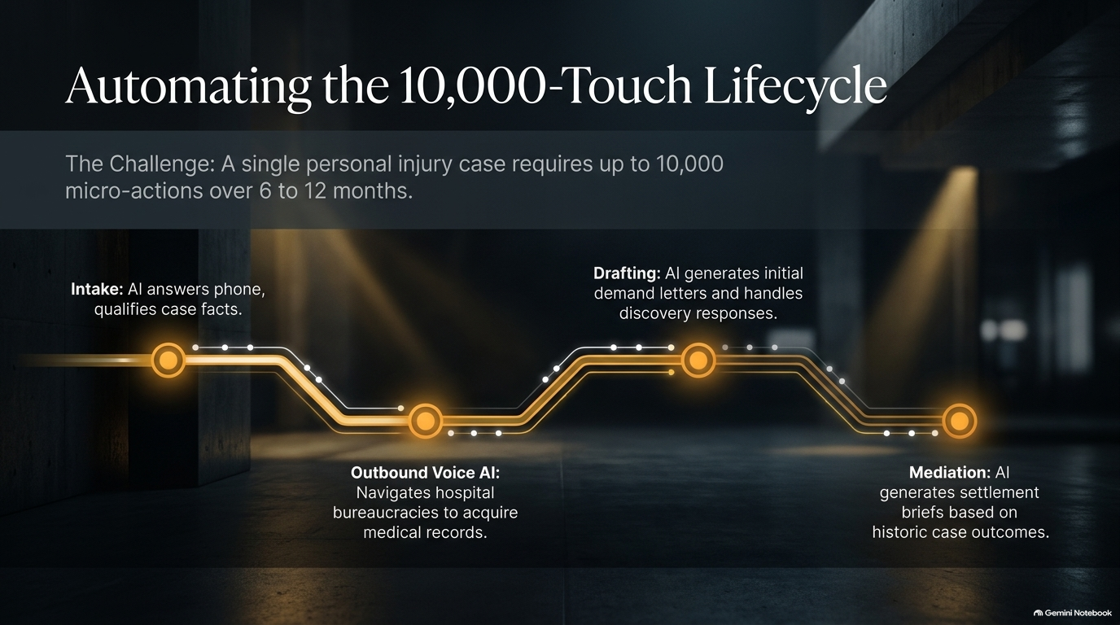
Notes:
Estimated Presentation Time: 4 minutes
Key Theme: Proprietary Settlement Databases and Systemic Defense Tactics
Speaker Notes:
"Insurance carriers have long held an asymmetric advantage over small law firms. Institutional defense side entities use ominous, centralized software databases (like Colossus) to systematically price out injuries, lowball claims, and delay proceedings.
Individually, small plaintiff firms lack the data visibility to know every move insurance companies make. Vertical AI bridges this gap by organizing cross-case learnings, tracking carrier patterns, and ensuring every missed detail, cause of action, or medical expense is surfaced instantly through automated auditing tools."

Slide 9
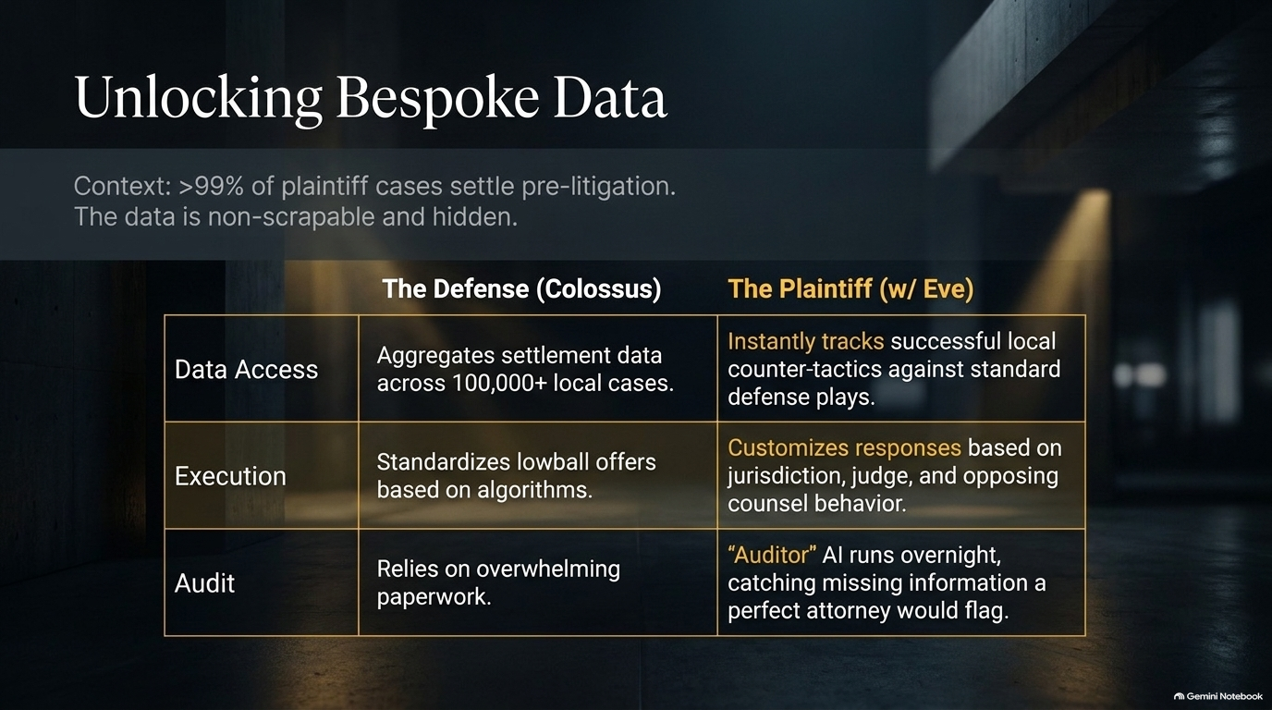
Notes:
Estimated Presentation Time: 4 minutes
Key Theme: Neutralizing "Holiday Discovery" Games
Speaker Notes:
"As AI enters litigation, we are seeing the emergence of Agent-vs-Agent interaction. Here is a remarkable example: Defense firms historically used stalling tactics, such as serving complex discovery requests on the afternoon before Thanksgiving, hoping to catch small firms off-guard or force rushed, poor-quality responses.
Using specialized legal agents, a plaintiff firm set up automated triggers that ingested the incoming holiday discovery request, cross-referenced case files, generated comprehensive response drafts, and served them back to defense counsel on the exact same day! Defense counsel was left stunned—the legacy games no longer work when software works 24/7."

Slide 10
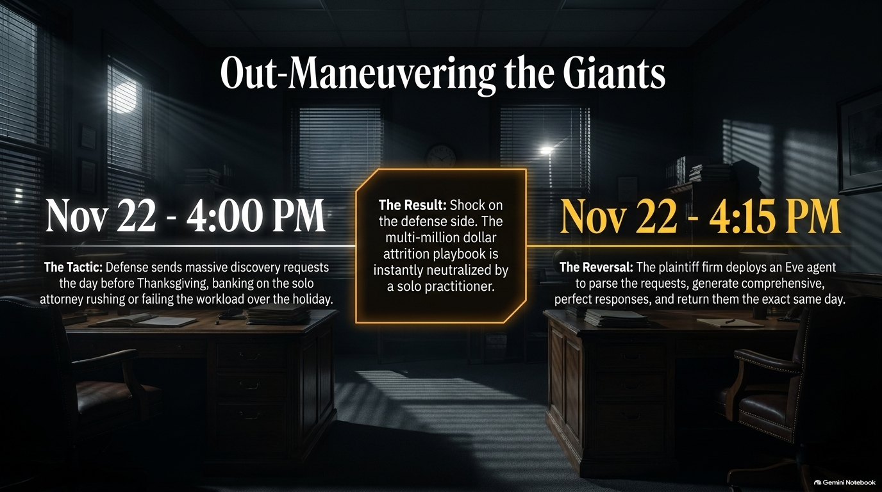
Notes:
Estimated Presentation Time: 3 minutes
Key Theme: Capturing Software Spend in $100B+ Outcome Markets
Speaker Notes:
"Legacy Venture Capitalists historically underestimated the legal tech market because they looked at software budgets. Small law firms traditionally bought nothing more than Microsoft Word and an email account. Software spend appeared tiny—a few billion dollars annually.
However, plaintiff law delivers hundreds of billions of dollars in annual case outcomes. Because these firms are labor-constrained, legal AI software isn't competing with IT budgets; it is competing with labor budgets. Vertical AI acts as a shadow labor workforce, capturing value from the multi-billion-dollar legal labor market."

Slide 11
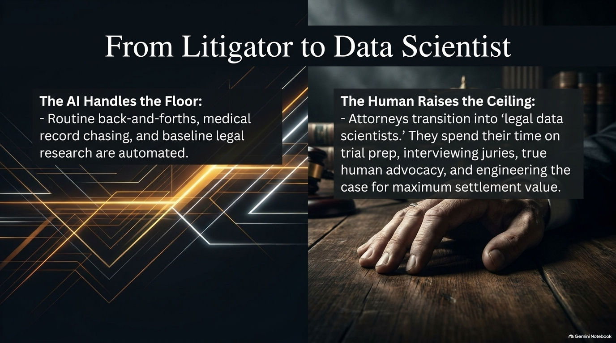
Notes:
Estimated Presentation Time: 4 minutes
Key Theme: From Per-Seat SaaS to Value-Based Economics
Speaker Notes:
"The broader software industry is undergoing a shift from seat-based SaaS ($99/user/month) to outcome-oriented pricing. Plaintiff law was actually decades ahead of tech because its entire model has always been outcome-based.
For legal AI platforms, charging per seat makes no sense when the software actively reduces the need for added seats while dramatically expanding case volume. By tying pricing to compute utilized, cases processed, and successful outcomes delivered, legal AI aligns directly with the business incentives of the firm."

Slide 12
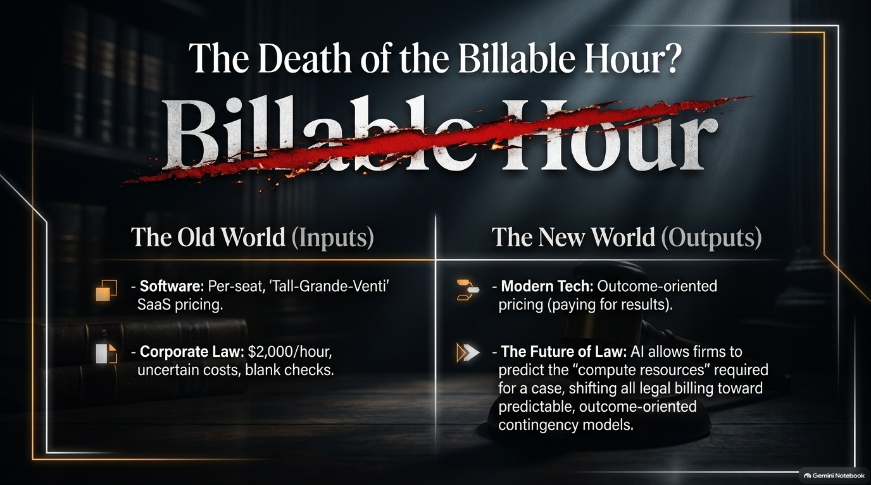
Notes:
Estimated Presentation Time: 4 minutes
Key Theme: The Paradigm Shift in Firm Operations
Speaker Notes:
"So, what does the successful attorney of the next decade look like? They won't be buried in administrative paperwork or hunting down medical records.
Instead, top attorneys will operate more like data scientists and system engineers. They will tune specialized AI workflows, analyze firm-specific case datasets, and leverage AI insights to dictate trial tactics and settlement levers. Software lifts the administrative floor, leaving lawyers to focus 100% on high-value human strategy, jury interaction, and true client advocacy."

Slide 13
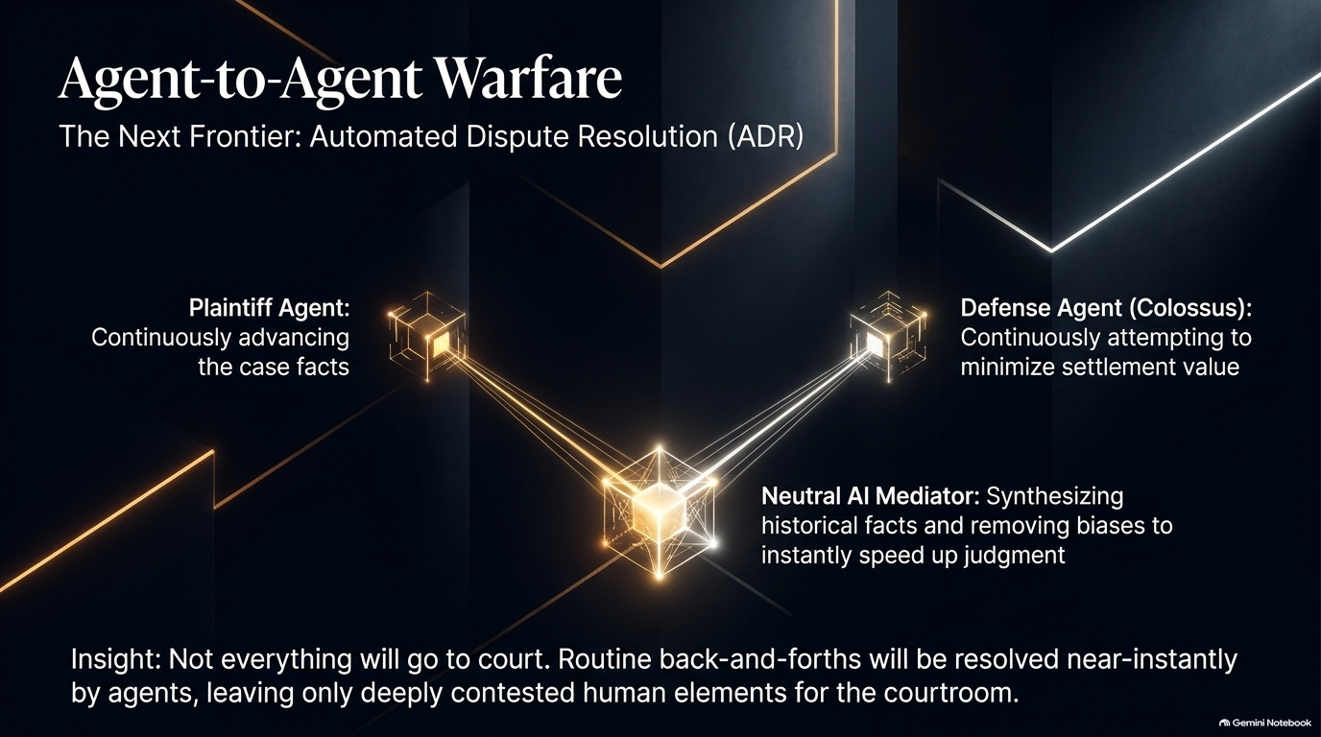
Notes:
Estimated Presentation Time: 4 minutes
Key Theme: How Small Firms Scale to $1B Businesses
Speaker Notes:
"How exactly does a small mom-and-pop law firm scale into a billion-dollar entity? Through two primary vectors:
Nationwide Micro-Specialization: Instead of being a general local lawyer, a 5-person firm can leverage proprietary datasets and AI efficiency to master a hyper-specific case type (e.g., specialized medical claims or niche labor violations) and acquire clients nationally at lower cost.
Accelerated M&A Roll-Ups: Large mega-firms are actively buying up smaller practices. Historically, integrating acquired firms was operational hell. Powered by AI platforms like Eve, acquiring firms can instantly standardize workflows, bypass administrative onboarding, and scale returns rapidly."

Slide 14
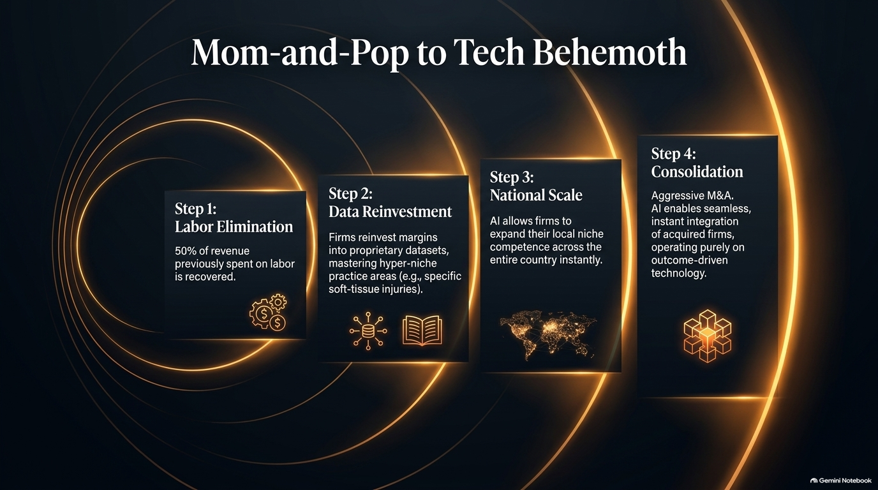
Notes:
Estimated Presentation Time: 5 minutes
Key Theme: 5-Year Outlook on the Broader Justice System
Speaker Notes:
"Looking ahead over the next 3 to 5 years, how does the wider judicial system adapt when millions of previously unrepresented citizens can suddenly file viable cases?
Courts cannot physically hold trials for every claim. As a result, the industry will naturally evolve toward Automated Dispute Resolution (ADR). Neutral AI-assisted mediators will analyze objective factual histories, historical regional settlement data, and evidence packages to provide rapid, unbiased settlement determinations—bypassing years of court gridlock and drastically lowering friction for both sides."

Slide 15
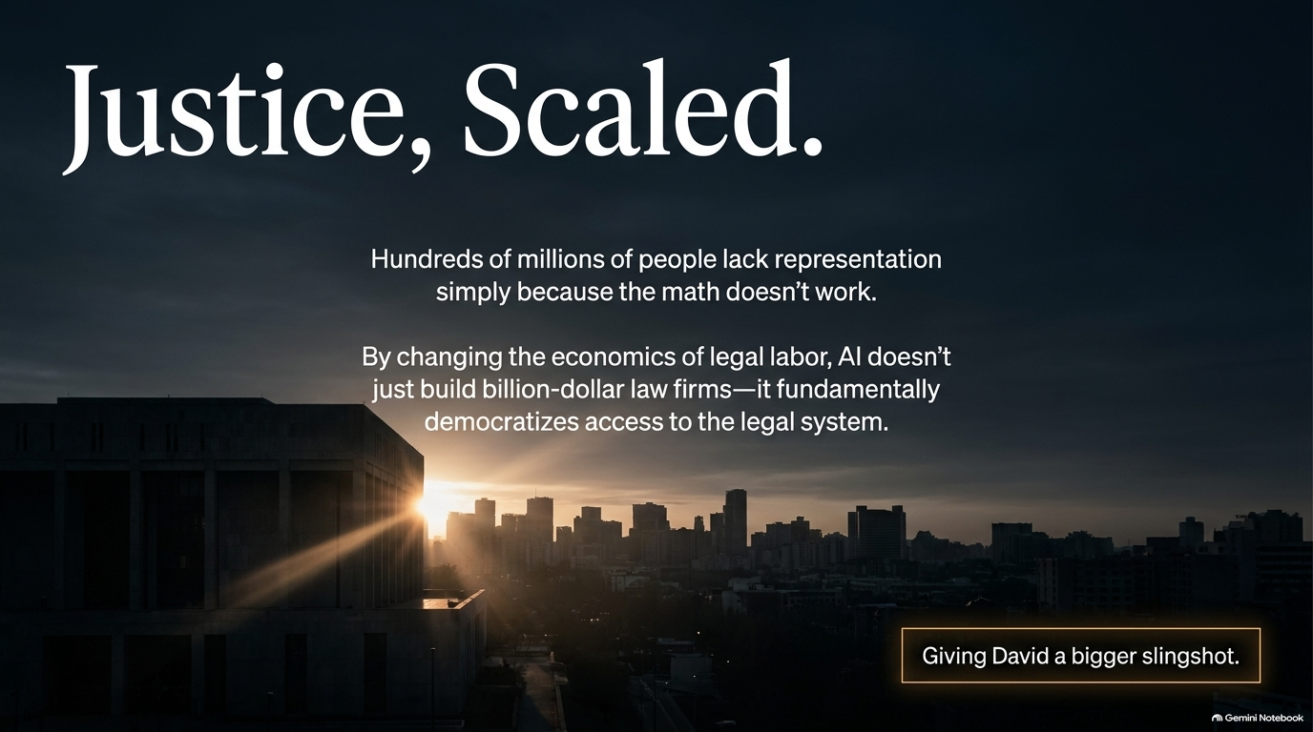
Notes:
Estimated Presentation Time: 3 minutes
Key Theme: The Human Element and Social Impact
Speaker Notes:
"At its core, the transformation of plaintiff law is about democratizing justice. Every day, thousands of workers experiencing harassment, injured drivers with small deductibles, or tenants facing illegal lease breaches are denied legal help simply because the economics don't work for traditional firms.
By removing the cost floor of legal labor, AI empowers small firms to represent everyday people whose backs are against the wall. It transforms legal representation from an expensive privilege for institutions into an accessible right for everyone."

Slide 16
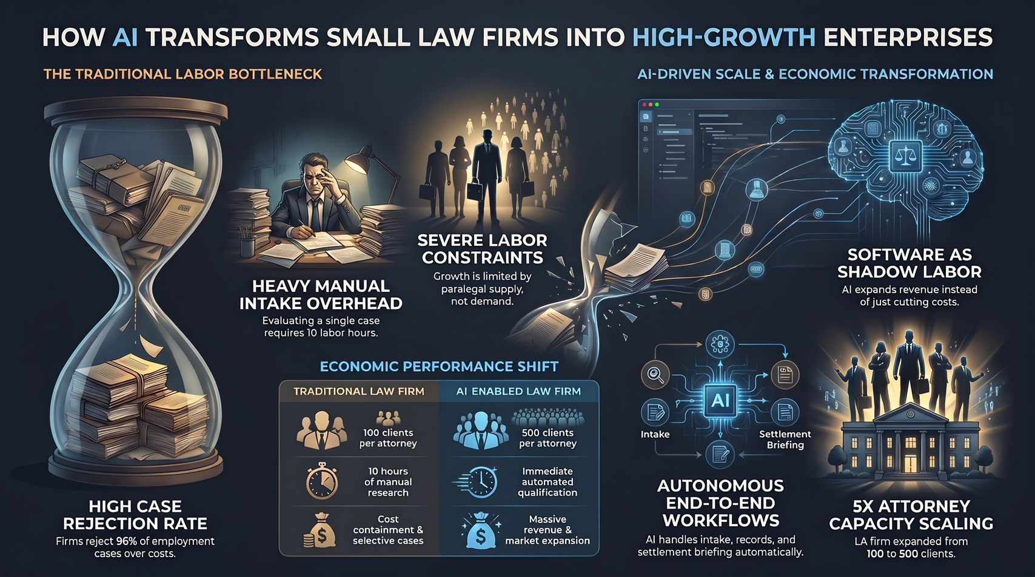
Notes:
Estimated Presentation Time: 2 minutes
Key Theme: Final Wrap-Up
Speaker Notes:
"To summarize our discussion:
Plaintiff law is labor-constrained, not demand-constrained.
AI drives revenue expansion, allowing attorneys to scale from 100 to 500+ cases.
Domain context and private pre-trial settlement data create defensible moats against generic LLMs.
Small law firms are evolving into high-margin software-like enterprises.
Thank you for your time. I welcome any questions from the floor."

