Slide 1
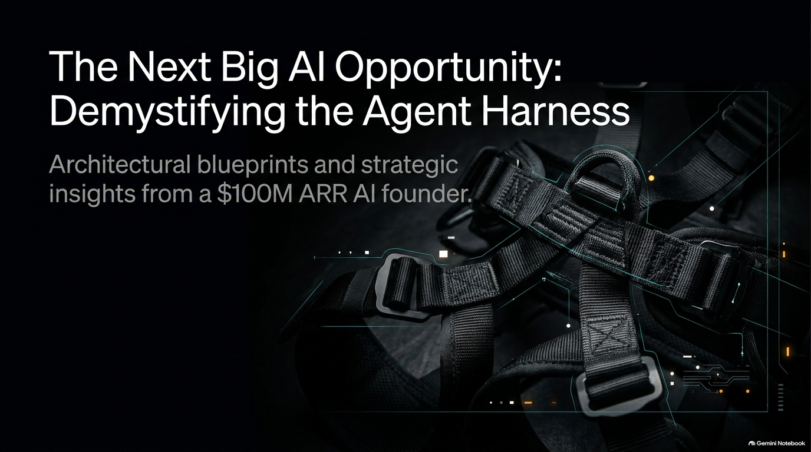
Notes:
Recommended Pacing: 2 – 3 minutes
Speaker Notes:
Welcome the audience and introduce the core premise: we are currently in the middle of a massive paradigm shift from simple, string-of-thought LLM calls to robust Agent Harnesses.
Mention that an agent harness isn’t just a thin wrapper around a foundation model; it is the entire operational environment—the tools, sandboxes, file inspectors, and human-in-the-loop validation loops—that turns an unpredictable AI model into a dependable, production-grade product.
Reference Gamma's evolution: moving from standalone API text generation in 2020/2023 to orchestrating hundreds of parallel model calls in a modern visual communication agent.
Podcast Anchor Reference: Demystifying what an agent harness looks like in practice.
$100M ARR Founder: The Next Big AI Opportunity
https://www.youtube.com/watch?v=st61aKW8P5A

Slide 2
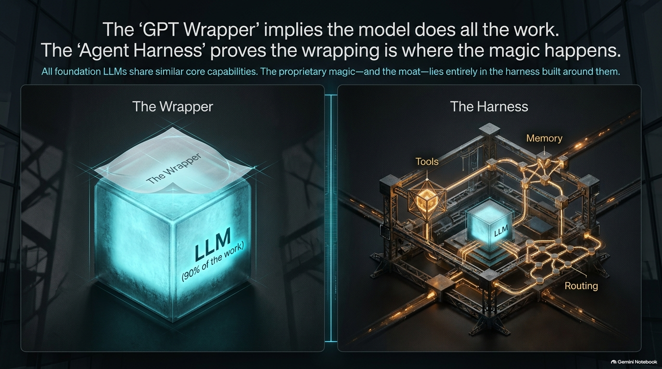
Notes:
Recommended Pacing: 3 – 4 minutes
Speaker Notes:
Break down the definition explicitly into its two components: the Agent (the core reasoning engine/LLM) and the Harness (the surrounding scaffolding).
Explain how a harness equips the agent with capabilities to execute tasks in a specific environment, inspect its own work, and solicit user preferences [02:35].
Compare coding agents (like Claude Code, which inspects file systems and runs tests) with creative agents (like Gamma, which evaluate visual style, layout, and storytelling arcs) [02:54].
Address the elephant in the room: Are agent harnesses just the "new GPT wrappers"? Argue that the wrapping is the vast majority of the work required to build a real product [04:04].

Slide 3

Notes:
Recommended Pacing: 4 – 5 minutes
Speaker Notes:
Walk the audience through the real-time choreography that occurs the second a user types a prompt (e.g., pasting messy notes to generate a 20-slide presentation).
Detail the architecture:
Sandboxing: Spinning up an isolated cloud computer for file and prompt context [04:56].
Generative UI / Clarification: Triggering forms or calling connectors (Slack, Notion, Linear) to source missing user intent and context [05:20].
Outline & Style Sourcing: Utilizing vision models, embeddings, and vector search across thousands of templates to pick and customize a visual style [06:07].
Highlight the sheer scale of the operation: a single generation workflow touches roughly 10 to 15 different models and makes 100 to 200 distinct model calls in parallel to ensure speed [07:02].

Slide 4
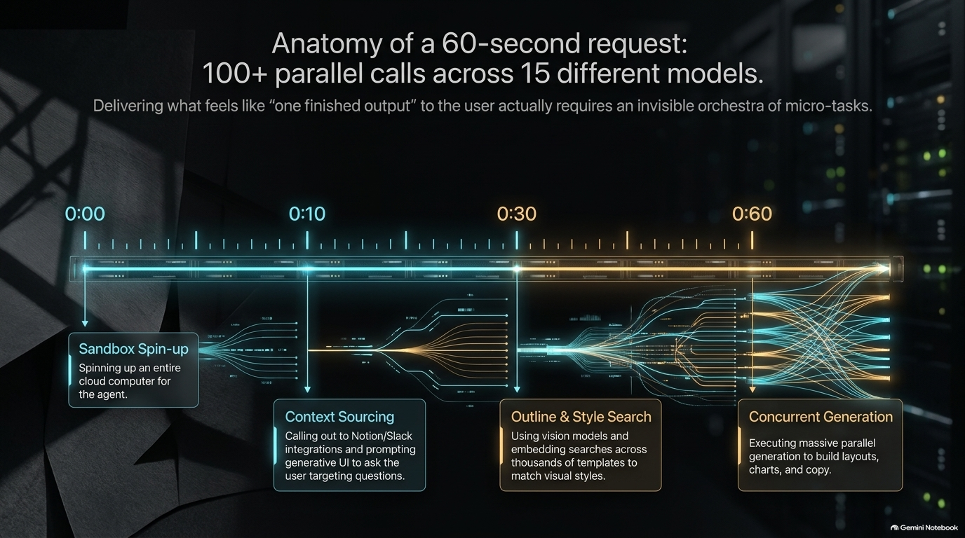
Notes:
Recommended Pacing: 3 – 5 minutes
Speaker Notes:
Emphasize that generation is only half the battle; the real magic of a mature harness lies in inspection and correction.
Describe how Gamma uses specialized AI vision models to review every single generated slide for human-like design flaws—such as misaligned text, clipped headshots in images, poor contrast, or incorrect padding [07:40].
Explain the multi-round self-healing cycle: the agent flags defects, runs automated fixes, and repeats the QA process before the user ever sees the first draft [08:06].
Podcast Anchor Reference: [07:51] - Catching visual errors that even a human eye might miss without a designer's background.

Slide 5
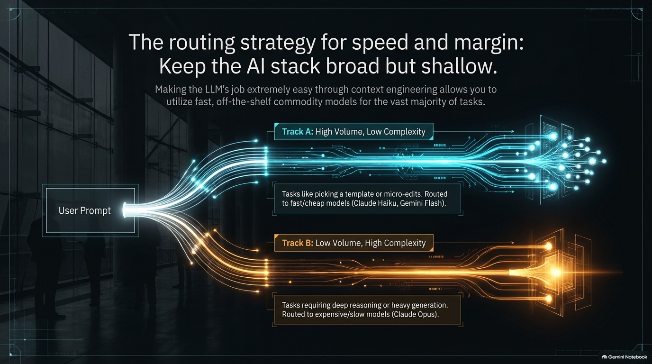
Notes:
Recommended Pacing: 3 – 4 minutes
Speaker Notes:
Discuss where founders should look for untapped agent harness opportunities outside of standard software engineering.
Define the two primary traits that make a niche ideal for a custom harness:
Subjectivity: Where there is no single "correct" answer, and human judgment calls and preferences are paramount [09:09].
User Investment: Where the end-user deeply cares about the specific nuances and output quality.
Share illustrative concepts like the "personal video game" (vibe-coding 3D worlds where non-technical users actively shape gameplay preferences) [09:37].
Podcast Anchor Reference: [09:04] - Why subjective problem spaces require a custom agent harness with a human-in-the-loop.

Slide 6
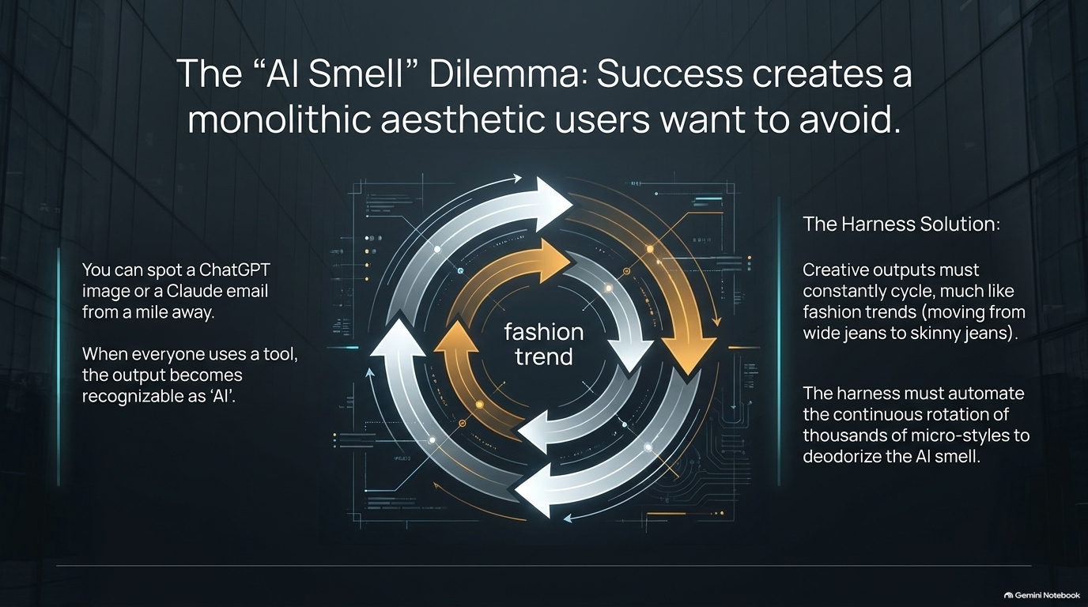
Notes:
Recommended Pacing: 3 – 4 minutes
Speaker Notes:
Address the reality of the copycat market: as soon as you find product-market fit, competitors will attempt to replicate your feature set (usually copying where you were 3 to 6 months ago) [10:36].
Outline how founders build a sustainable moat:
A Distinct Worldview: Moving faster toward an original thesis that others aren't prioritizing [11:19].
Proprietary Data: Leveraging unique datasets gathered from an existing platform footprint [11:29].
Beyond Pure Software: Integrating AI into physical services, real-life workflows, or heavy data-blocking verticals (like legal or medical tech) [11:40].

Slide 7
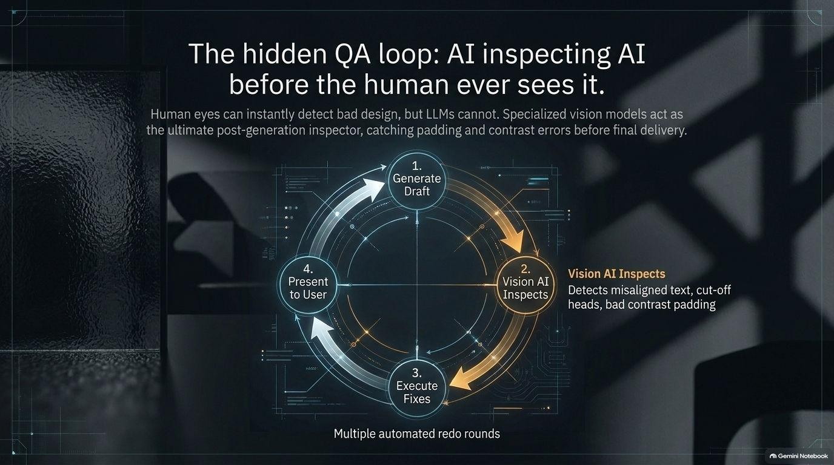
Notes:
Recommended Pacing: 3 – 5 minutes
Speaker Notes:
Introduce the concept of "AI smell"—the distinct, homogeneous stylistic footprint that instantly signals when something was generated by AI (e.g., cliché phrasing in writing or hyper-stylized templates in design) [14:10].
Discuss how early success can backfire if your product's output becomes so ubiquitous that everything starts looking identical [14:53].
Pivot to the solution: treating product design like fashion. Just as fashion cycles through trends (from wide jeans to skinny jeans), an agent harness must maintain an automated system that continuously cycles through diverse creative looks, expanding one AI smell into a thousand unique aesthetic pockets [15:13].

Slide 8
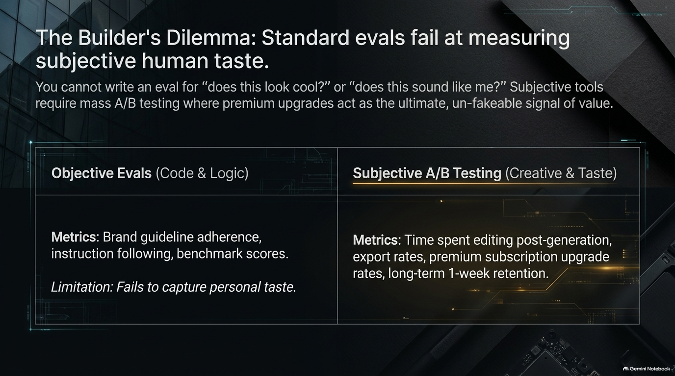
Notes:
Recommended Pacing: 4 – 6 minutes
Speaker Notes:
Define what an eval (evaluation) is: a hard-coded software test used to score model performance or prompt changes against objective criteria [16:04].
Explain the limitation of evals in creative or subjective domains: there is no single objective metric for whether a slide "looks cool" or sounds authentically like you [16:51].
Share how Gamma balances this: using objective evals for hard rules (like strict brand guideline adherence) [17:09], but heavily relying on large-scale A/B testing across a diverse user base to measure subjective success [17:52].
Detail North Star metrics: post-generation edit time, export/sharing rates, paid subscription upgrades, and 7-day/30-day retention [18:09].

Slide 9
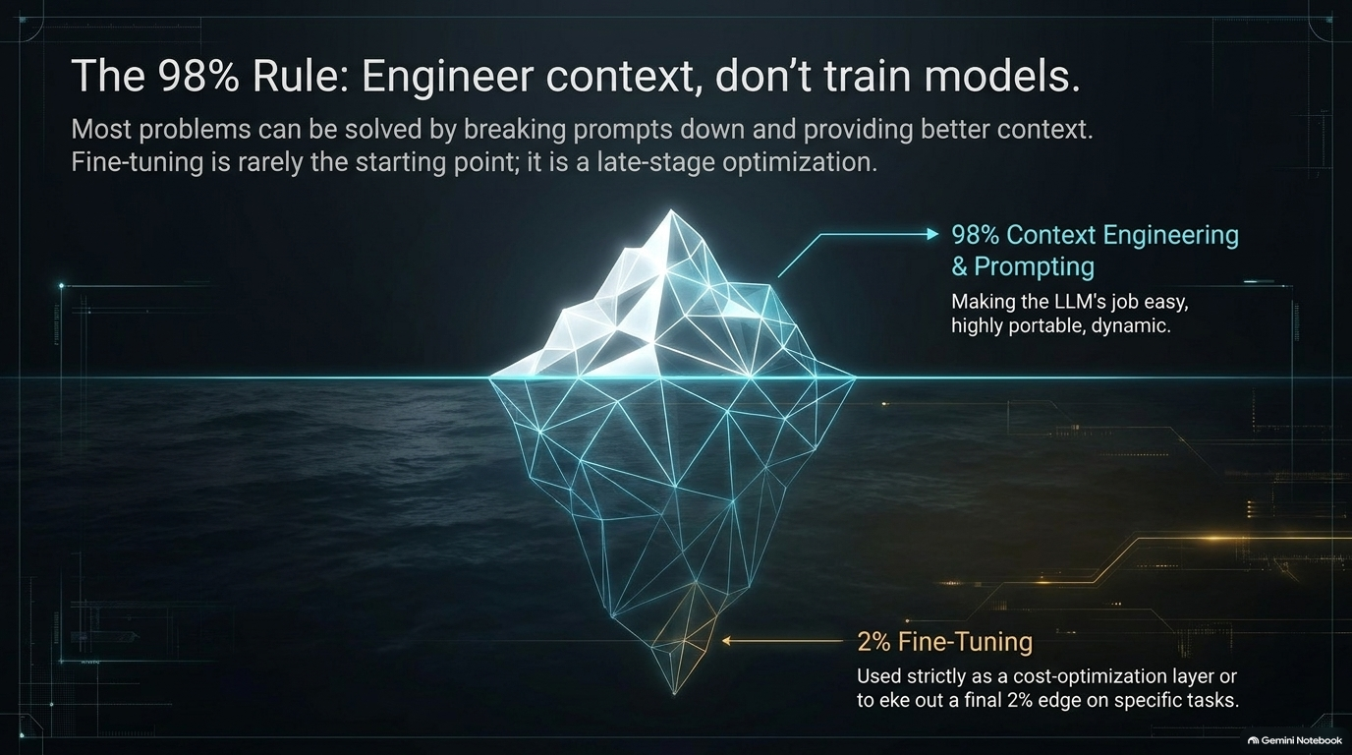
Notes:
Recommended Pacing: 3 – 4 minutes
Speaker Notes:
Analyze recent industry data regarding consumer spending on AI tools versus professional software budgets.
Contrast consumer fatigue toward subscription apps with the robust, enduring health of B2B prosumer spending (the exact model that powered the traditional SaaS boom over the last decade) [19:18].
Highlight the strategy of targeting professional consumers (proumers) who derive clear economic value from their work tools, making enterprise-grade reliability and workflow integration essential [19:34].

Slide 10
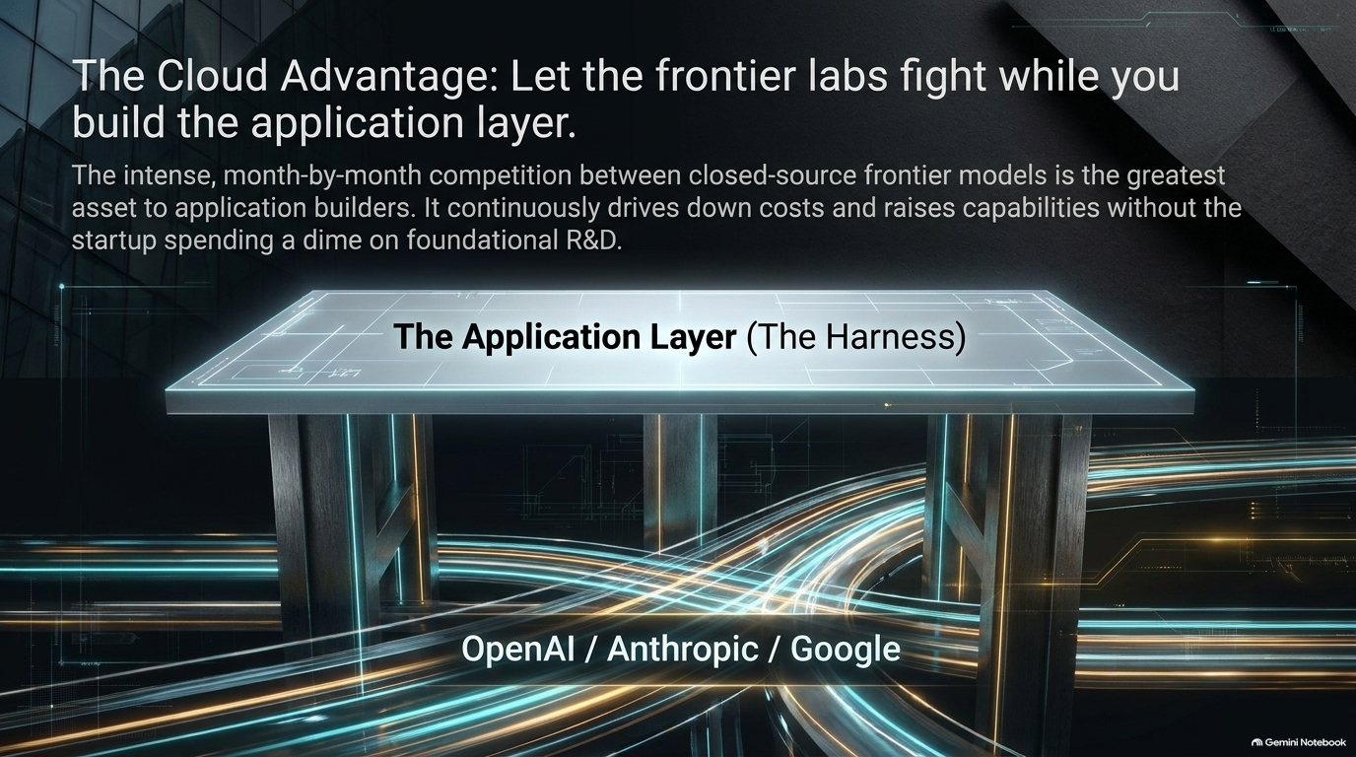
Notes:
Recommended Pacing: 3 – 4 minutes
Speaker Notes:
Challenge the common dogma that early-stage startups must train or fine-tune their own foundation models from day one [22:17].
Argue that for early-stage teams, the capital required to train custom frontier models is impractical, and competing directly against leading labs is a losing battle [22:33].
Outline the phased approach: use off-the-shelf frontier models (Anthropic, OpenAI, Google) to rapidly acquire usage and validate product-market fit. Once usage scales, fine-tune smaller models to cut costs, optimize personalization, or solve hyper-specific edge tasks (like visual QA) [22:49].

Slide 11
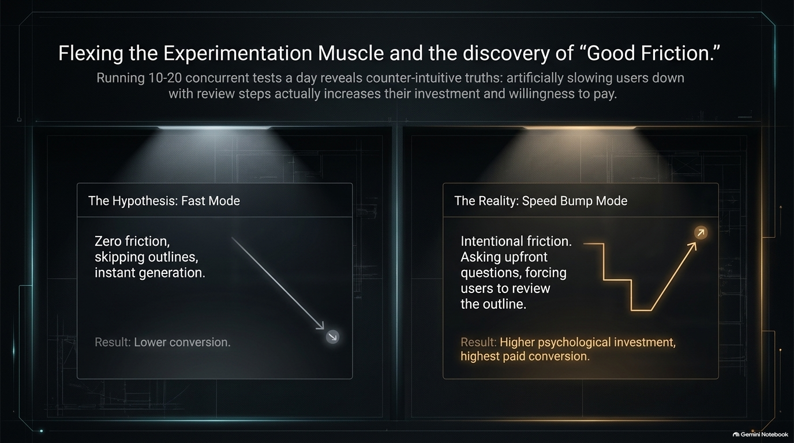
Notes:
Recommended Pacing: 3 – 4 minutes
Speaker Notes:
Unpack the concept of a "broad and shallow" AI stack: utilizing a wide array of different models, but applying them in clean, straightforward ways through prompt and context engineering rather than overly complex local architectures [24:26].
Emphasize context engineering as the core competitive discipline: structuring user intent, historical data, and environmental parameters so perfectly that any off-the-shelf model can return exceptional results [24:36].
Reiterate the preference for prompts over fine-tuning (98% of value comes from prompt structure, with fine-tuning reserved for cost reduction and fine-margins optimization) [25:02].

Slide 12
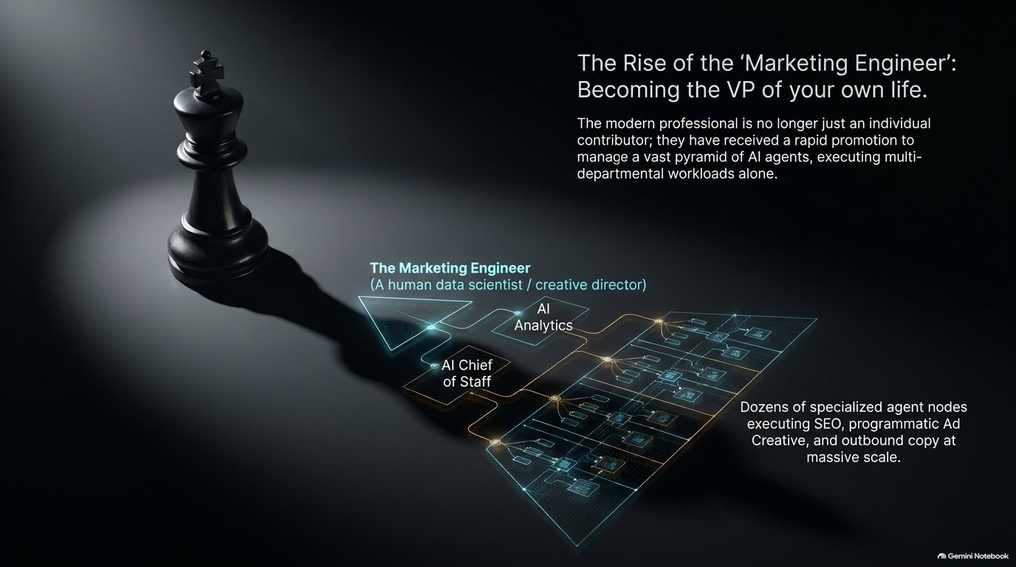
Notes:
Recommended Pacing: 4 – 5 minutes
Speaker Notes:
Detail the operational rhythm of a high-performance AI company: running 10 to 20 parallel experiments simultaneously, with many cycles lasting less than a day [26:55].
Share a real-world example: firing off experiments within an hour of a new model release (such as Claude Haiku updates) to test micro-edits and outline generation [27:12].
Discuss counter-intuitive experiment findings, such as testing a "fast mode" (removing friction like outlining questions) only to discover that necessary speed bumps actually lead to higher user satisfaction and higher conversion rates [28:13].
Podcast Anchor Reference: [28:34] - Why user friction and review steps can build emotional investment and improve final output quality.

Slide 13
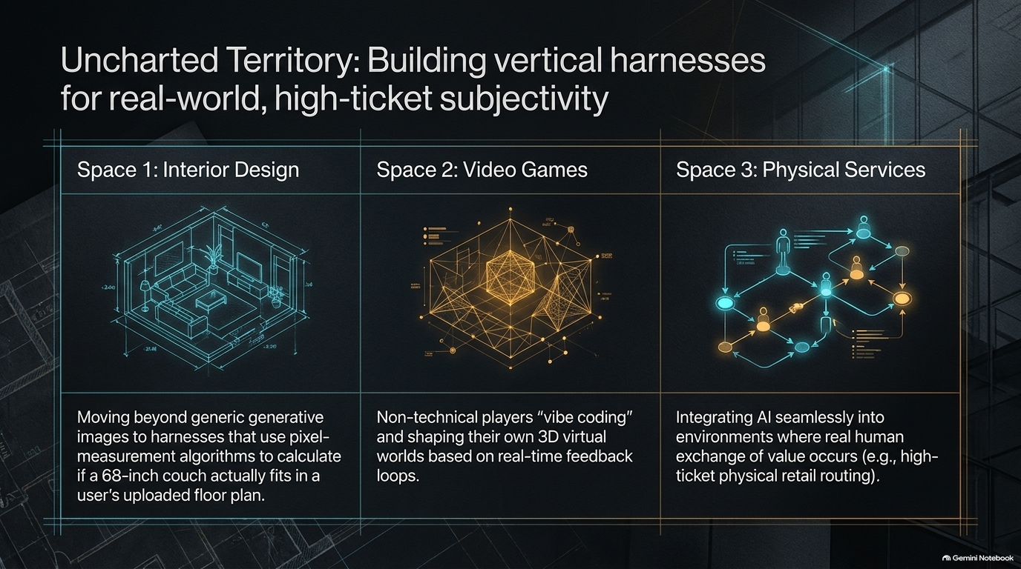
Notes:
Recommended Pacing: 3 – 5 minutes
Speaker Notes:
Introduce the evolution of marketing roles—from the Mad Men era of annual commercials, to digital marketing, growth hacking, and now the Marketing Engineer [29:17].
Define the modern marketing engineer: a hybrid operator running dozens of automated experiments daily by leveraging fleets of AI agents across SEO, GEO, social content, and paid acquisition [29:52].
Discuss how individual contributors have been promoted through layers of management, shifting from hands-on creation to supervising autonomous agent workforces [35:19].

Slide 14
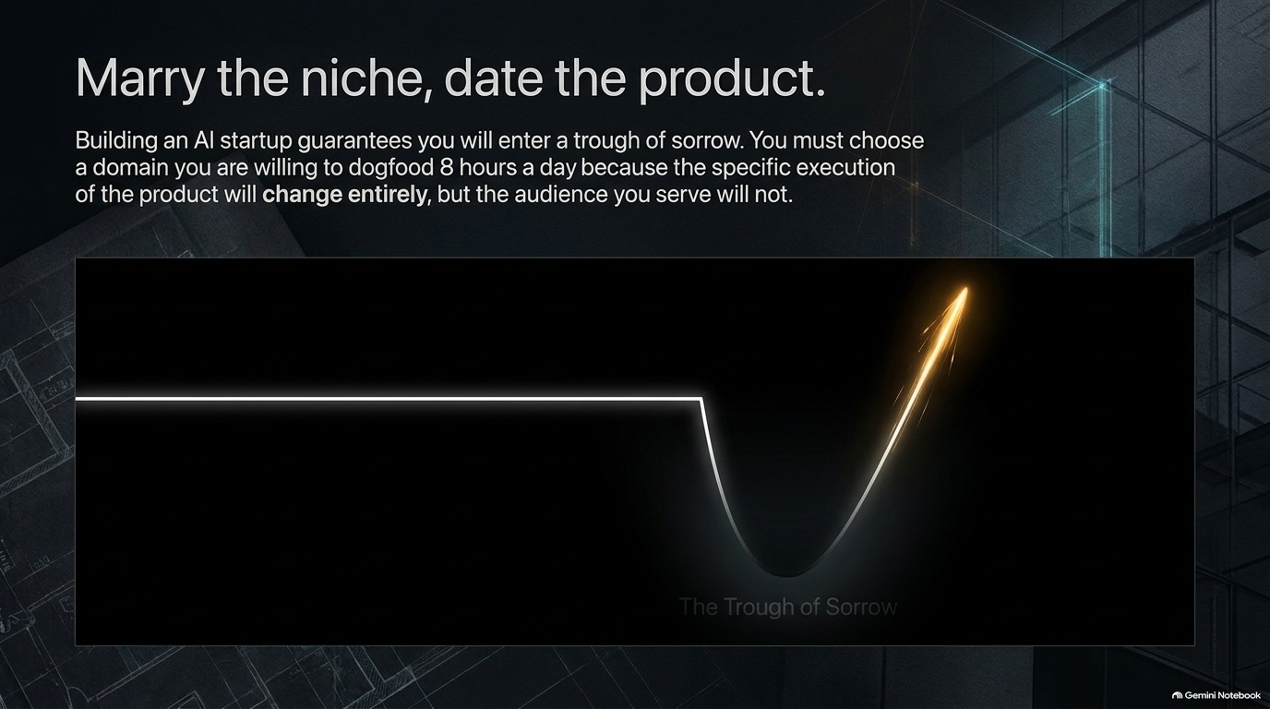
Notes:
Recommended Pacing: 3 – 4 minutes
Speaker Notes:
Draw parallels between physical fitness training and building experimentation muscles in business [37:35].
Acknowledge the inevitable "trough of sorrow"—the difficult phase where initial tests fail, cold outreach falls flat, and your first attempts don't yield a six-pack of results [38:02].
Emphasize that long-term success in building agent harnesses or scaling growth comes down to sheer numbers of at-bats, showing up consistently, and swimming through the trough [37:14].

Slide 15
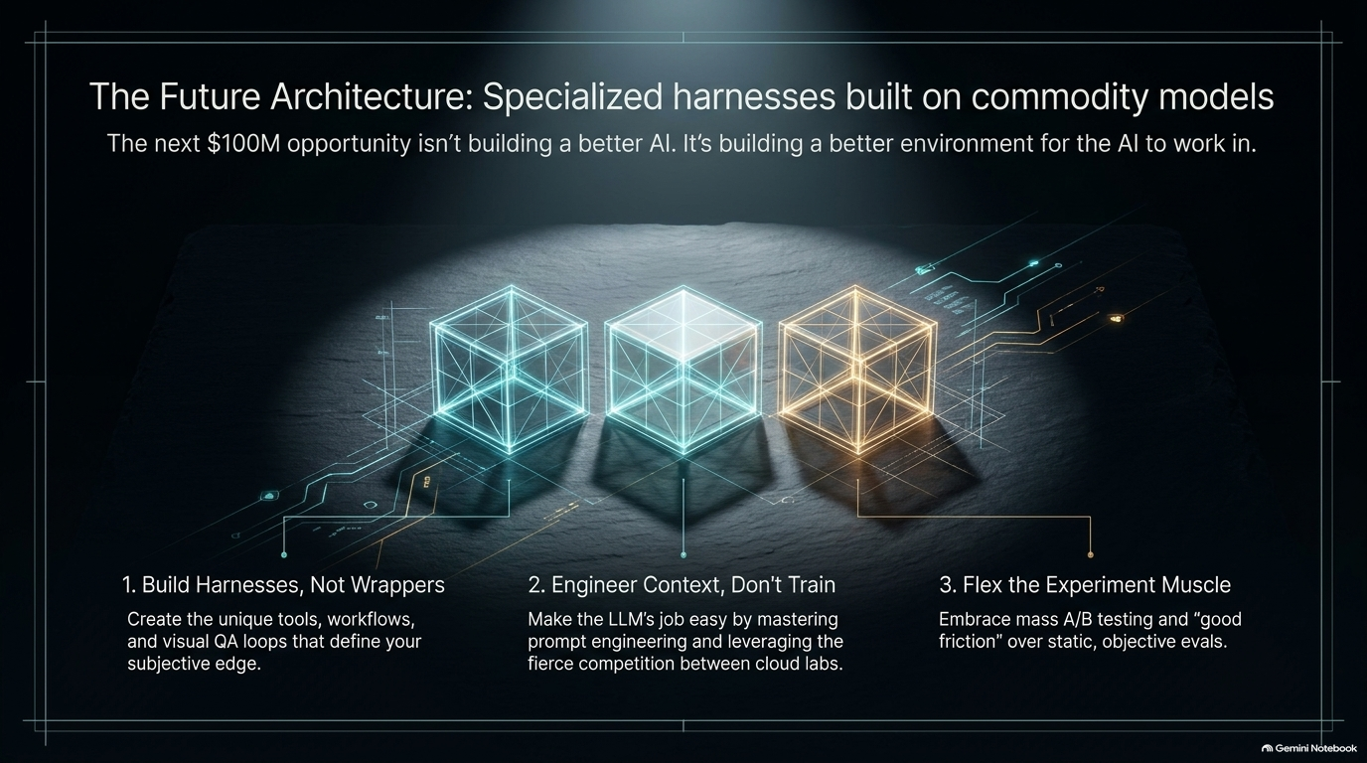
Notes:
Recommended Pacing: 3 – 4 minutes
Speaker Notes:
Highlight areas of technology that are currently underhyped, pointing specifically to mature AI image models [28:48].
Argue that because image models have gotten so good and stopped breaking, people stopped talking about them as bleeding-edge tech, relegating them to basic logo generation or menu mockups [38:53].
Showcase unexplored commercial and creative applications—such as generating complex structural diagrams, infographics, custom textures, physical interior design layouts, and dimensional measurements [39:55].

Slide 16
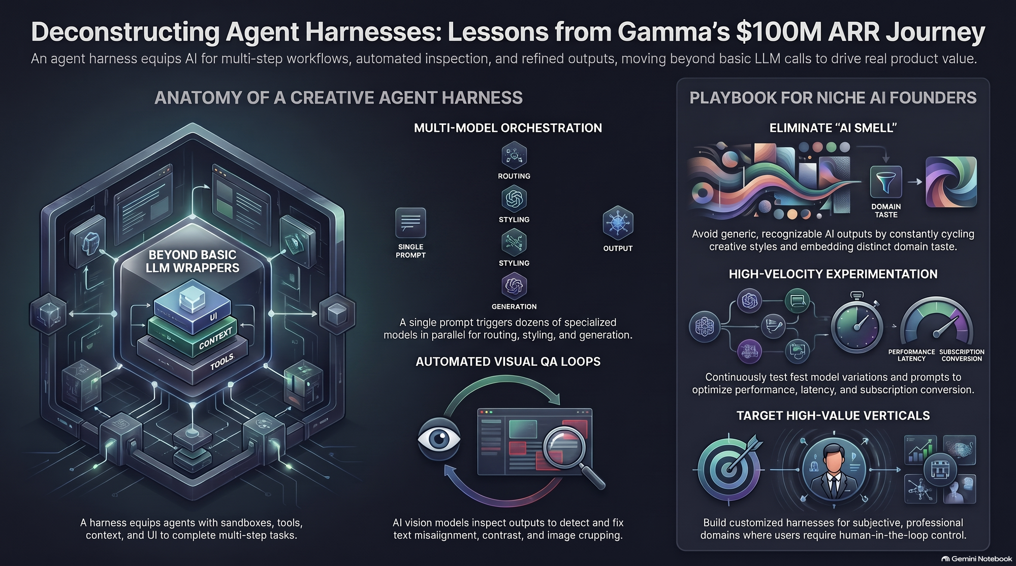
Notes:
Recommended Pacing: 3 – 5 minutes
Speaker Notes:
Leave the audience with guiding principles for starting an AI venture:
Marry the niche, date the product: Fall deeply in love with the specific audience and problem space you are serving, knowing that your software product will iterate and change shape constantly [38:39].
Be stubborn on vision, flexible in details: Maintain a clear North Star while adapting rapidly to market feedback [39:12].
Close with a personal note on founder alignment: choose a problem you are so passionate about that you want to spend 8 hours a day working on it—because building an agent harness and navigating the startup journey requires nothing less [47:36].
Would you like to expand any of these specific slide notes into a deeper script or extract additional themes from the presentation deck?

