Slide 1
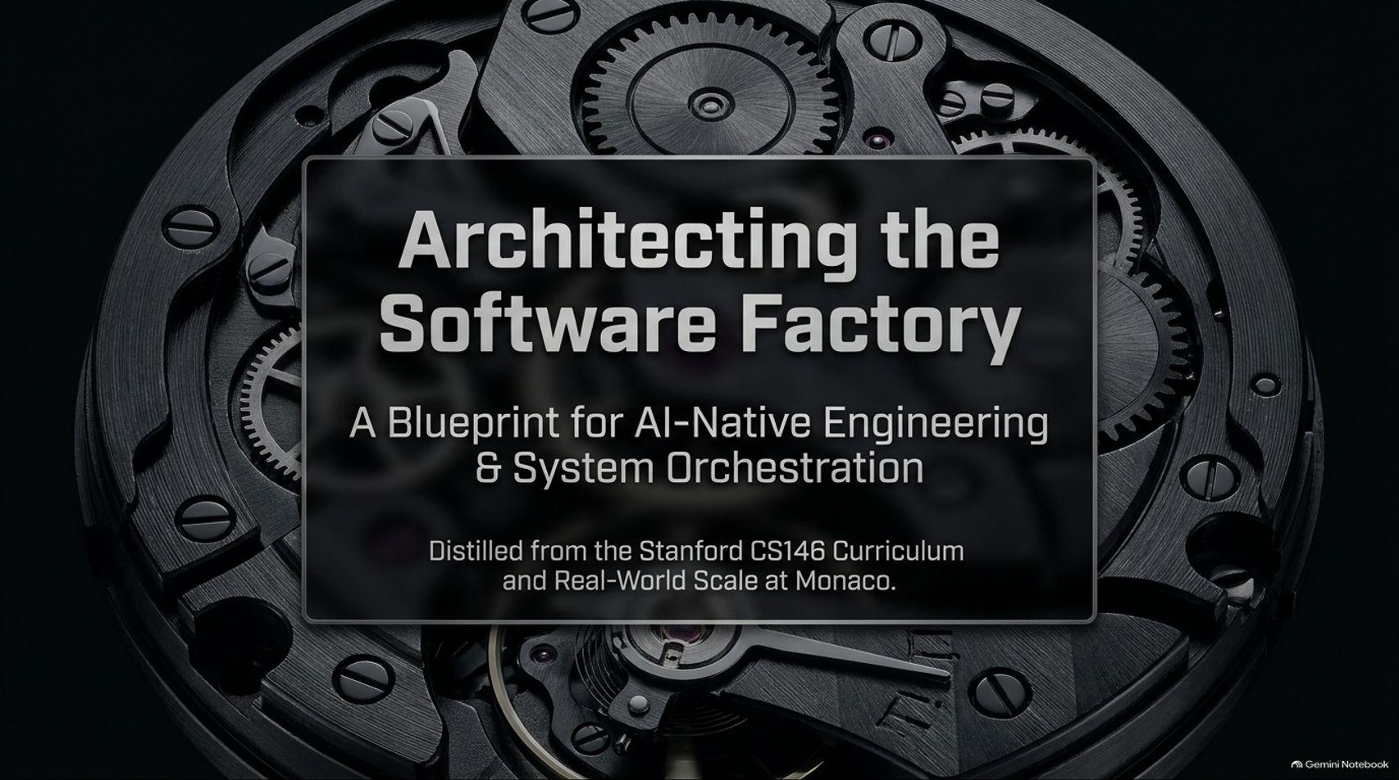
Notes:
Estimated Time: 2 – 3 minutes
Target Word Count: ~350 words
Speaker Notes
Welcome, everyone. Today we are discussing one of the most fundamental shifts in computer science education and software engineering since the advent of the cloud: Architecting the Software Factory.
This presentation is distilled directly from the curriculum of Stanford CS146—"The Modern Software Developer"—and real-world, large-scale implementation at Monaco.
Over the past two to three years, the industry has undergone a massive transformation. We have moved from simple code completion in the IDE to building autonomous, multi-agent software factories. The old paradigms of software development—where an engineer spends 80% of their day writing syntax, fixing typos, or hand-crafting pull requests line by line—are rapidly becoming obsolete.
In this session, we will break down what it actually takes to build an AI-native engineering organization. We are going to look under the hood of state-of-the-art coding agent harnesses, examine the shift from basic prompting to context engineering, and diagnose how to prepare legacy codebases for autonomous execution. We will also cover real-world lessons from Monaco, including how to handle the security attack surface of AI autonomy, how to orchestrate background AI-SREs, and how to maintain human control over critical system constraints.
Whether you are a software architect, a team lead, or an engineer preparing for the next decade of modern engineering, this deck serves as your blueprint for transitioning from artisanal software craft to high-throughput system orchestration. Let’s dive in.
[One Million AI Engineer Special] How Stanford Teaches AI-Native Engineering — Mihail Eric, Monaco
https://www.youtube.com/watch?v=dpY7YzZo4kE

Slide 2
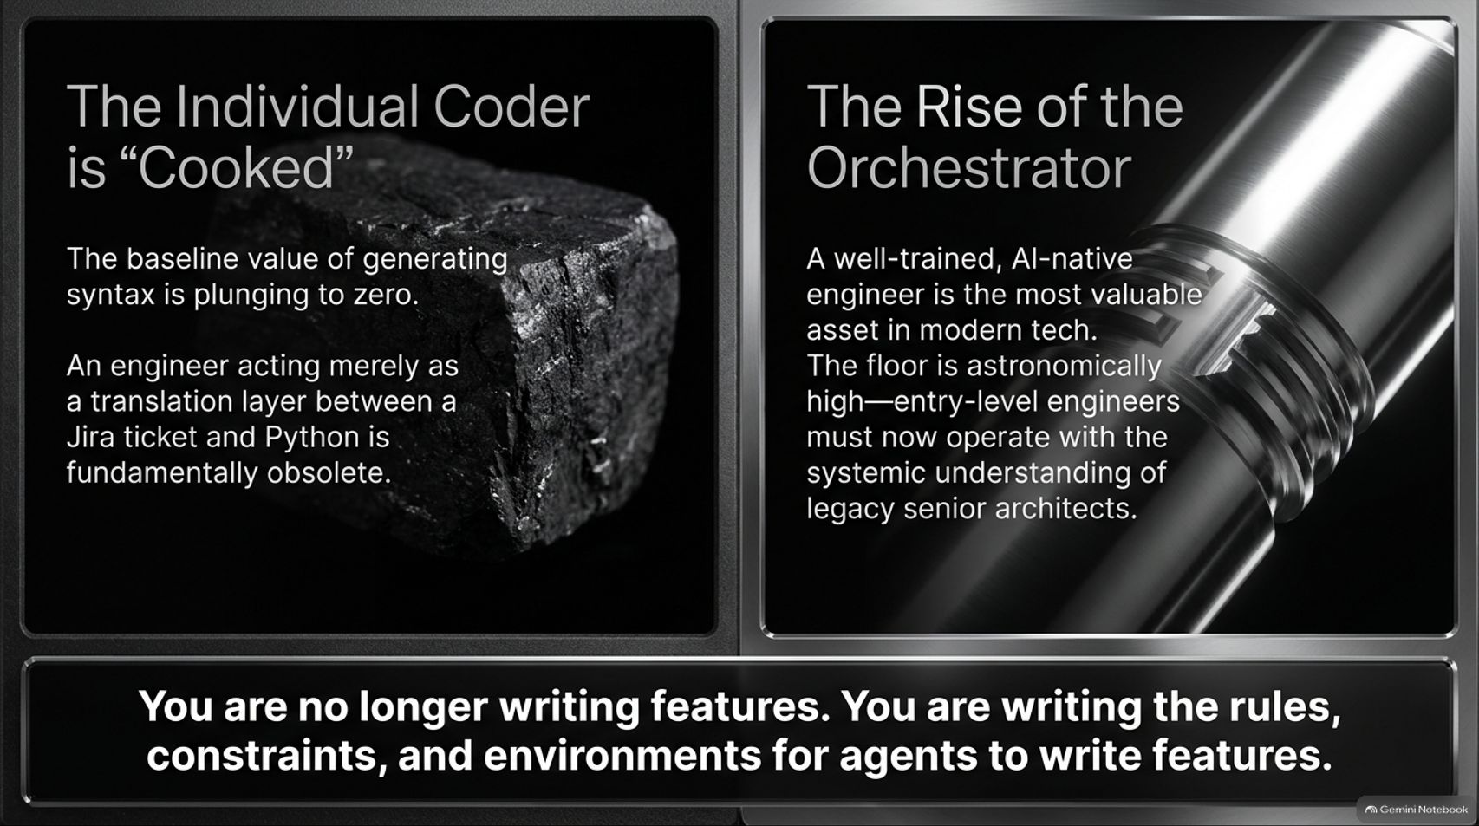
Notes:
Estimated Time: 4 – 5 minutes
Target Word Count: ~550 words
Speaker Notes
Let's talk bluntly about the market reality for software engineers today. As we state at the top of Slide 2: The individual coder is "cooked" if their primary value proposition is translating requirements into syntax.
For decades, standard entry-level engineering involved taking a Jira ticket, writing a feature branch in Python or TypeScript, creating tests, and pushing a pull request. If your sole job is acting as an expensive human translation layer between a task spec and executable syntax, LLMs are rendering that function obsolete at an exponential rate. The baseline value of generating raw syntax is approaching zero.
However, this does not mean software engineers are obsolete. In fact, the floor for what constitutes an entry-level engineer has risen astronomically. A modern, AI-native engineer—the Orchestrator—is among the most valuable assets in tech today. New graduates and junior devs can no longer operate with an L3 execution mindset; they are expected to demonstrate the systemic understanding and architectural taste of legacy senior staff engineers from day one.
Why? Because you are no longer writing features. You are writing the rules, constraints, evaluations, and execution environments for agents to write features.
Instead of writing a sorting function or a basic CRUD endpoint, you are designing the system prompt, configuring the sandboxed environment, providing context boundaries, and adjudicating between competing solution proposals generated by background agents. The shift is from mechanic to factory supervisor. If you master this transition, your leverage as an individual engineer grows by orders of magnitude.

Slide 3
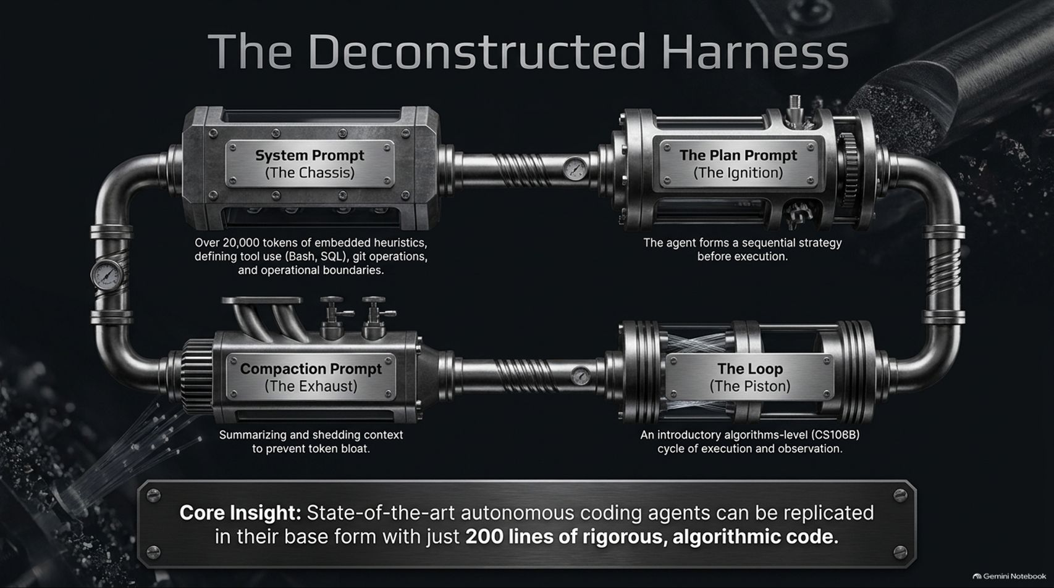
Notes:
Estimated Time: 5 – 6 minutes
Target Word Count: ~700 words
Speaker Notes
When people look at high-performing coding tools or enterprise agents, they often assume there is deep, mysterious magic under the hood. On Slide 3, we deconstruct the core engine: The Agent Harness.
The single most important takeaway here is our core insight: State-of-the-art autonomous coding agents can be replicated in their base form with just ~200 lines of rigorous, algorithmic code.
At Stanford CS146, students build this exact 200-line harness to understand the fundamental components of an agentic loop. Let's break down the four main components shown in the diagram:
System Prompt (The Chassis): This is the foundation. It contains up to 20,000+ tokens of embedded heuristics, operational guardrails, and tool specifications (Bash execution, SQL queries, Git workflows). It dictates how the agent interacts with its world.
The Plan Prompt (The Ignition): Before touching code, the agent is instructed to form a sequential, step-by-step strategy. It forces the model into deliberate, system-2 reasoning before invoking tools.
The Loop (The Piston): This is the heart of the engine—a straightforward execution-observation cycle reminiscent of introductory CS algorithms (CS106B). The agent issues a tool call (e.g., run a test, read a file), receives standard output/error, updates its state, and decides the next step.
Compaction Prompt (The Exhaust): As the loop runs, the context window fills up quickly with verbose logs and stack traces. The compaction prompt continuously summarizes and sheds historical context to prevent token bloat and context degradation.
Understanding this pipeline strips away the hype. Agents aren't magic; they are structured state machines driving LLMs through bounded loops.

Slide 4
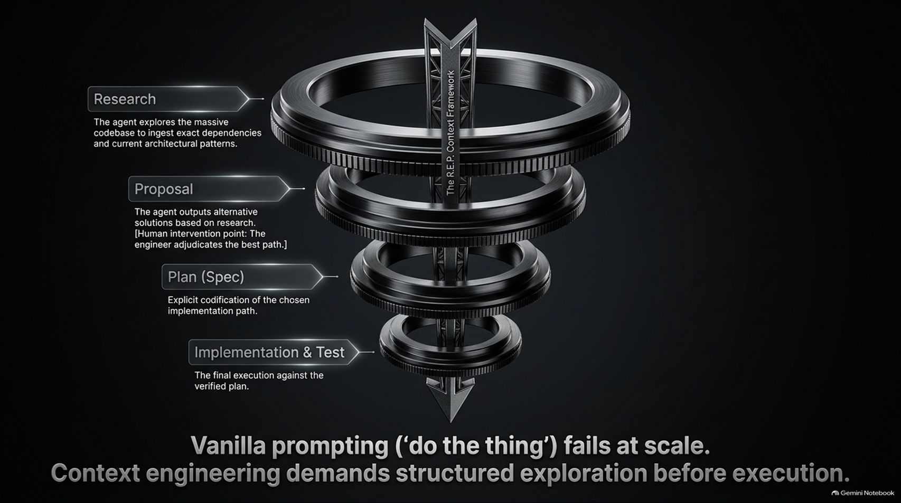
Notes:
Estimated Time: 4 – 5 minutes
Target Word Count: ~600 words
Speaker Notes
One of the most common points of failure in AI engineering is relying on "vanilla prompting"—simply typing "build this feature" into a chat interface and expecting clean code. Vanilla prompting inevitably fails at scale.
To build reliable agents, we use The R.E.P. Context Framework (Research, Proposal, Plan, Implementation & Test). Context engineering demands structured exploration before execution.
Let's walk down the funnel on Slide 4:
Stage 1: Research. The agent begins by reading the codebase. It ingests exact dependency trees, maps existing architectural patterns, and inspects signatures. It does not write a single line of code here.
Stage 2: Proposal. Based on its research, the agent formulates multiple alternative technical approaches. This is a critical human intervention point: the engineer reviews the options and adjudicates the best path based on business constraints or technical taste.
Stage 3: Plan (Spec). Once a solution is selected, the agent codifies an explicit, verifiable specification. This spec outlines every file to modify, function signatures to add, and edge cases to cover.
Stage 4: Implementation & Test. Only after the spec is verified does the agent enter the execution loop, running tests continuously to validate output.
By enforcing this funnel, you eliminate hallucinated architectures and prevent context window pollution early in the generation cycle.

Slide 5
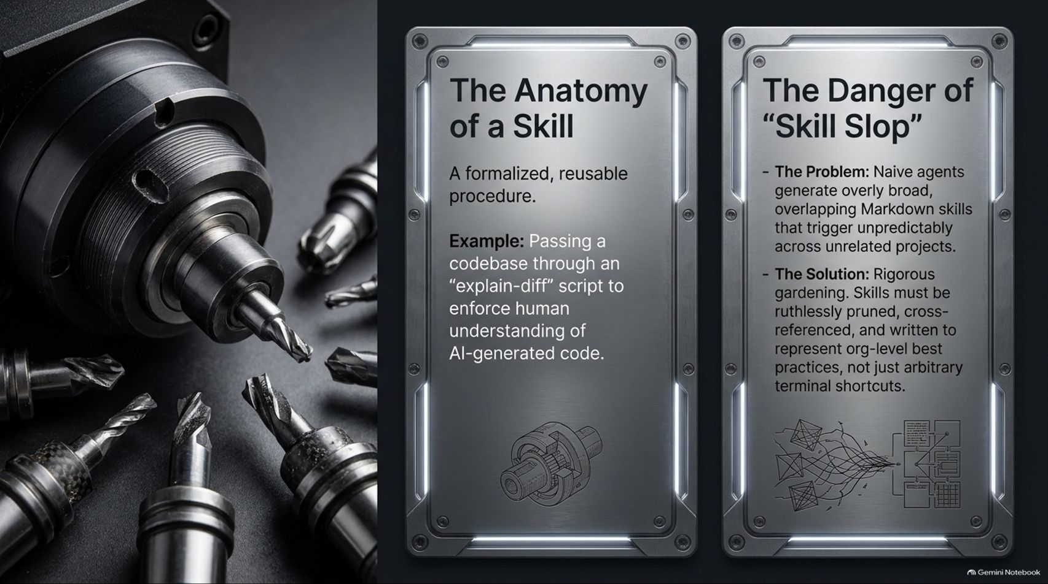
Notes:
Estimated Time: 4 – 5 minutes
Target Word Count: ~550 words
Speaker Notes
Slide 5 addresses how we extend agent behavior through modular procedural files, known as Skills. A Skill is a formalized, reusable procedure written in structured Markdown or code that teaches an agent how to execute complex, multi-step workflows.
For example, an "explain-diff" skill might mandate that after generating code, the agent must run a script breaking down architectural side-effects to enforce human comprehension before PR creation.
However, adding skills introduces a major operational challenge: "Skill Slop."
The Problem: When developers create hundreds of naive, overlapping Markdown skill files, the agent's routing logic degrades. Unclear triggering conditions cause irrelevant skills to fire unexpectedly across unrelated projects, polluting the context window and causing logic loops.
The Solution: Rigorous skill maintenance. Skills must be ruthlessly pruned, cross-referenced, and standardized across the organization. They should represent enterprise-level best practices, not just personal terminal shortcuts. Treat your agent's skill library with the same engineering rigor as your core SDK.

Slide 6
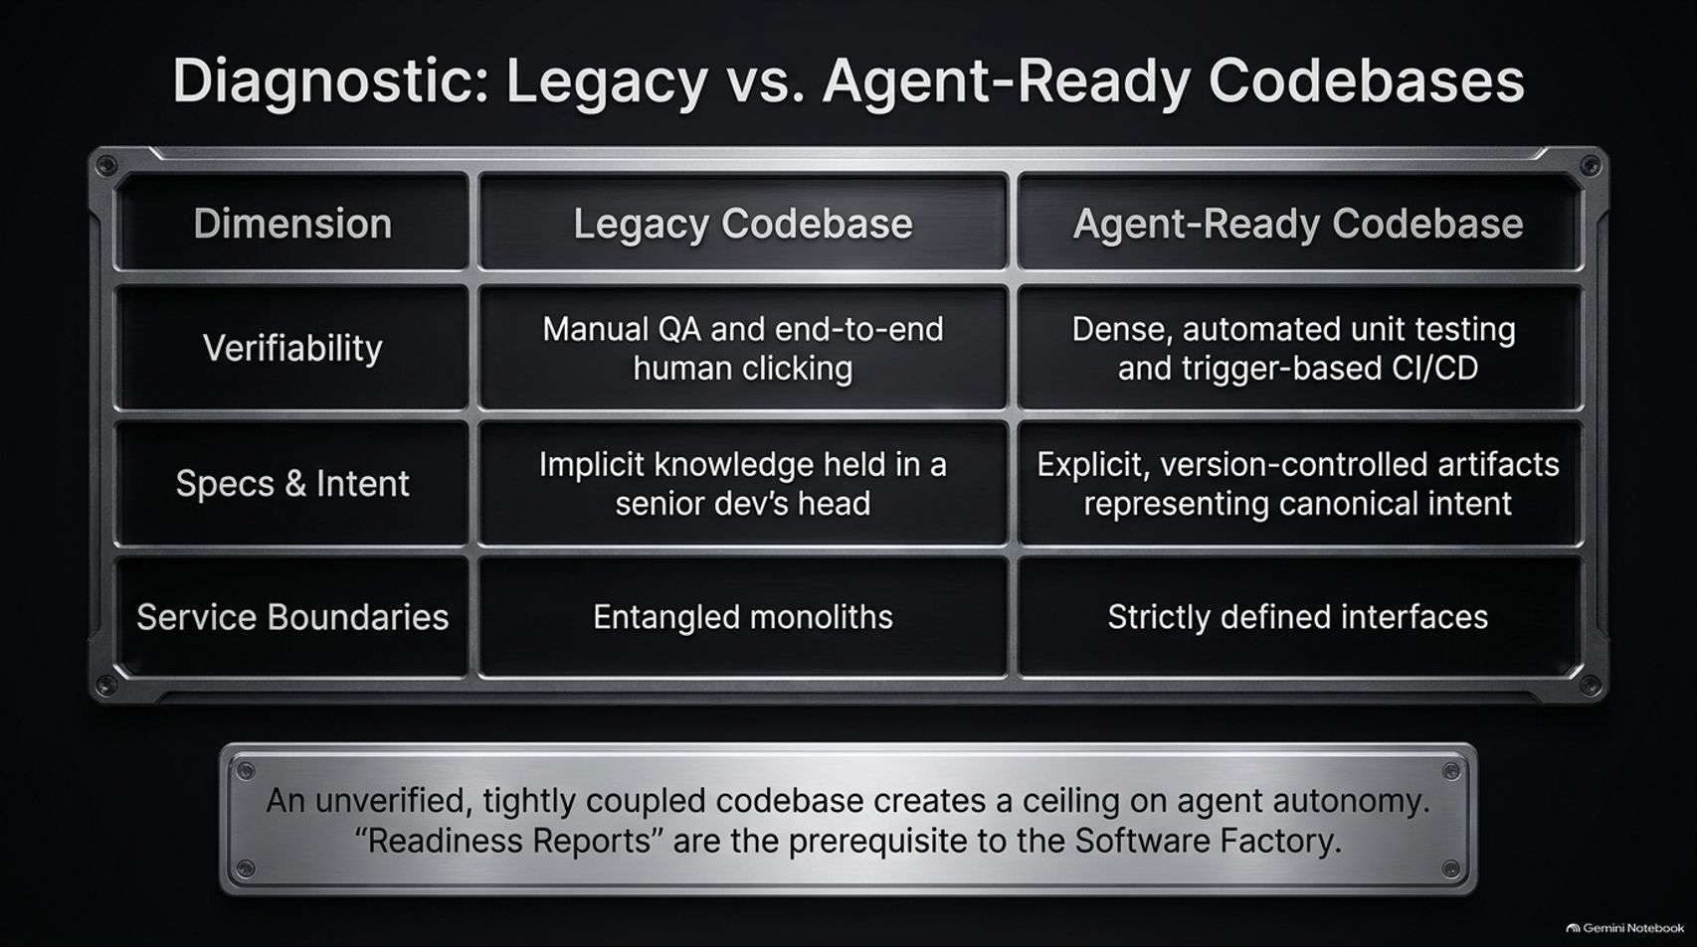
Notes:
Estimated Time: 4 – 5 minutes
Target Word Count: ~600 words
Speaker Notes
You cannot deploy autonomous agents into a messy, unverified codebase and expect miraculous productivity gains. On Slide 6, we present a diagnostic matrix comparing Legacy Codebases against Agent-Ready Codebases.
Let's evaluate the three core dimensions:
Verifiability: Legacy codebases rely on manual QA, visual inspection, and human end-to-end clicking. An agent cannot effectively evaluate if its code worked without instant programmatic feedback. Agent-ready codebases feature dense, automated unit test suites and trigger-based CI/CD pipelines that provide immediate, machine-readable pass/fail feedback.
Specs & Intent: In legacy setups, business rules live implicitly in a senior developer's head. Agents cannot read minds. Agent-ready codebases maintain explicit, version-controlled artifacts (specs, architectural decision records) that serve as canonical ground truth.
Service Boundaries: Entangled monoliths with circular dependencies break agent reasoning contexts. Agent-ready codebases strictly define modular interfaces and clear service contracts.
Bottom line: An unverified, tightly coupled codebase creates a hard ceiling on agent autonomy. Conducting a "Readiness Report" is the mandatory prerequisite step before deploying a Software Factory.

Slide 7
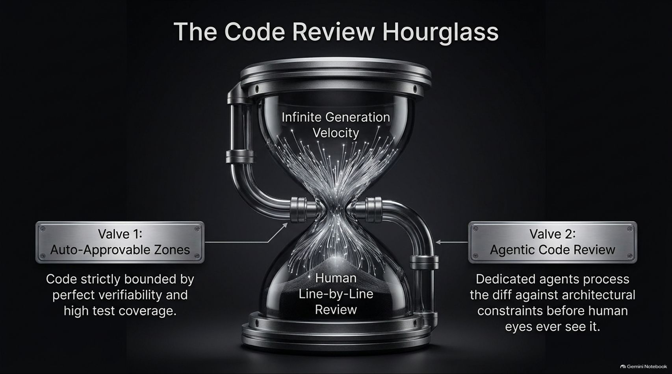
Notes:
Estimated Time: 4 – 5 minutes
Target Word Count: ~550 words
Speaker Notes
As coding agents increase engineering throughput by 10x or 100x, the primary bottleneck in the software lifecycle shifts dramatically from writing code to reviewing code. We call this The Code Review Hourglass.
At the top of the hourglass, you have infinite generation velocity. At the bottom, you have human engineers drowning in PR line-by-line code reviews. To prevent organizational paralysis, we must implement two critical control valves:
Valve 1: Auto-Approvable Zones. Code modifications that fall within strictly bounded, highly verifiable parameters—such as high test coverage zones or routine dependency upgrades—bypass human review entirely and auto-merge upon passing CI/CD tests.
Valve 2: Agentic Code Review. For more complex changes, dedicated background review agents process the diff against architectural constraints, security rules, and style guidelines before human reviewers are tagged.
By filtering pull requests through these two valves, human engineers focus exclusively on high-level architectural approval and domain logic, preserving overall delivery speed.

Slide 8
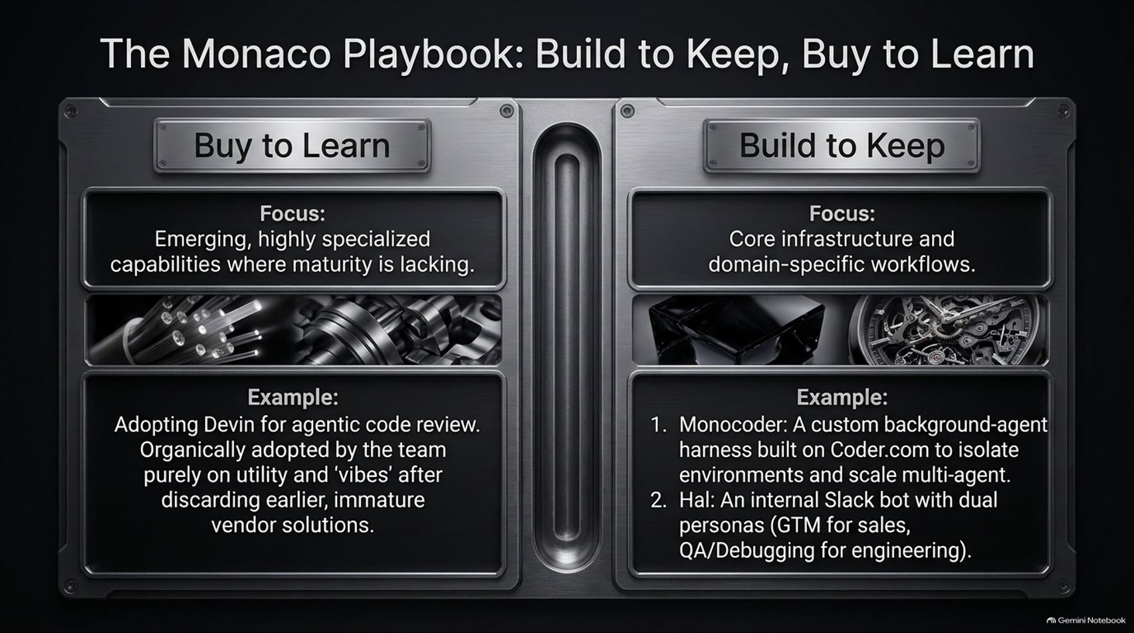
Notes:
Estimated Time: 5 – 6 minutes
Target Word Count: ~650 words
Speaker Notes
How should an enterprise build its AI tooling stack? Slide 8 illustrates The Monaco Playbook: a strategic framework based on "Build to Keep, Buy to Learn."
In a rapidly changing AI landscape, trying to build every agentic component from scratch leads to wasted engineering cycles. Conversely, relying entirely on off-the-shelf vendor tools leaves you without core IP differentiation.
Buy to Learn: Adopt emerging, highly specialized external tooling for capabilities where vendor maturity is still evolving. For example, Monaco adopted Devin for agentic code review. The engineering team adopted it organically based purely on utility and "vibes," allowing the team to learn operational agent dynamics without spending months building an in-house reviewer from scratch.
Build to Keep: Focus internal engineering resources on core infrastructure and domain-specific orchestrations.
Monocoder: Monaco built a custom background-agent harness on top of Coder.com to isolate environments and scale multi-agent execution safely.
Hal: An internal Slack bot featuring dual personas—one for GTM/sales operations and another for technical QA/debugging.
Use external tools to learn fast, but build in-house where custom workflow orchestration provides a durable moat.

Slide 9
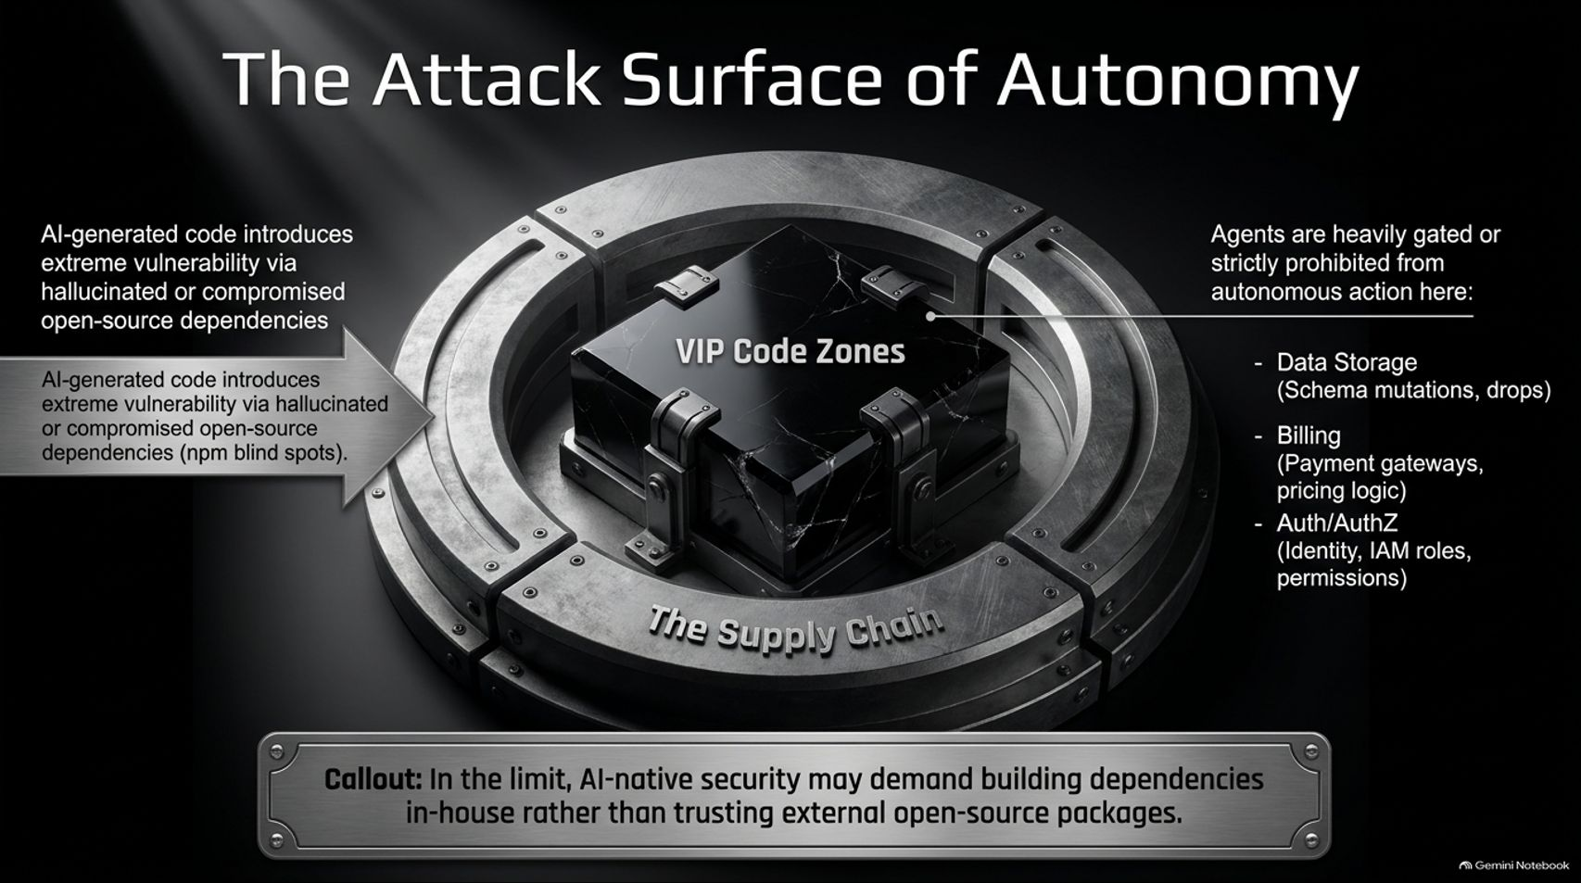
Notes:
Estimated Time: 4 – 5 minutes
Target Word Count: ~600 words
Speaker Notes
Granting autonomous agents write access to repository trees introduces major security risks. Slide 9 maps The Attack Surface of Autonomy.
There are two major attack vectors to govern:
Supply Chain Vulnerabilities: LLMs are susceptible to package hallucination—recommending non-existent or compromised open-source npm/PyPI packages. Autonomous agents can inadvertently import malicious dependencies if supply chain gates are not tightly enforced. In extreme scenarios, AI-native security may mandate bringing critical open-source dependencies in-house.
VIP Code Zones: Agents must be heavily gated or strictly prohibited from taking autonomous actions in critical system layers:
Data Storage: Schema mutations, raw database migrations, or table drops.
Billing Infrastructure: Payment gateway integrations, pricing logic modifications.
Auth/AuthZ: Identity providers, IAM roles, and core permission logic.
Autonomy requires sandboxing. Agents operate freely within bounded feature branches, but core structural zones demand mandatory multi-party human clearance.

Slide 10
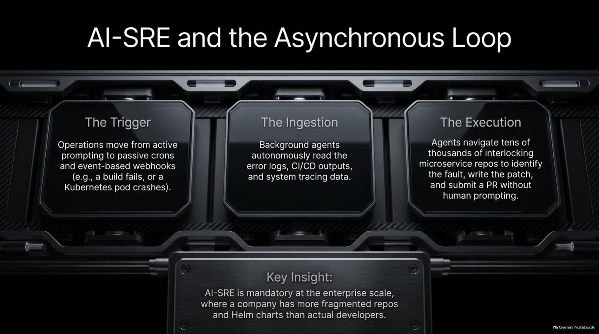
Notes:
Estimated Time: 4 – 5 minutes
Target Word Count: ~550 words
Speaker Notes
The ultimate expression of the software factory goes beyond synchronous coding assistants in an IDE—it moves to Asynchronous Background Execution. Slide 10 outlines the operational loop of an AI-SRE (Site Reliability Engineer).
The AI-SRE operates continuously across three asynchronous phases:
The Trigger: Operations shift away from manual human prompting toward passive cron jobs and webhook events. For example, a CI/CD build fails or a Kubernetes pod crashes in staging.
The Ingestion: Background agents autonomously pull error logs, stack traces, CI/CD outputs, and distributed tracing data to diagnose root causes.
The Execution: Agents navigate across thousands of microservice repositories, pinpoint the bug, generate a surgical fix, run regression tests, and open a PR with detailed diagnostic documentation—all without human prompting.
At enterprise scale—where companies maintain more fragmented repositories and Helm charts than active developers—AI-SRE systems become mandatory to keep operational overhead manageable.

Slide 11
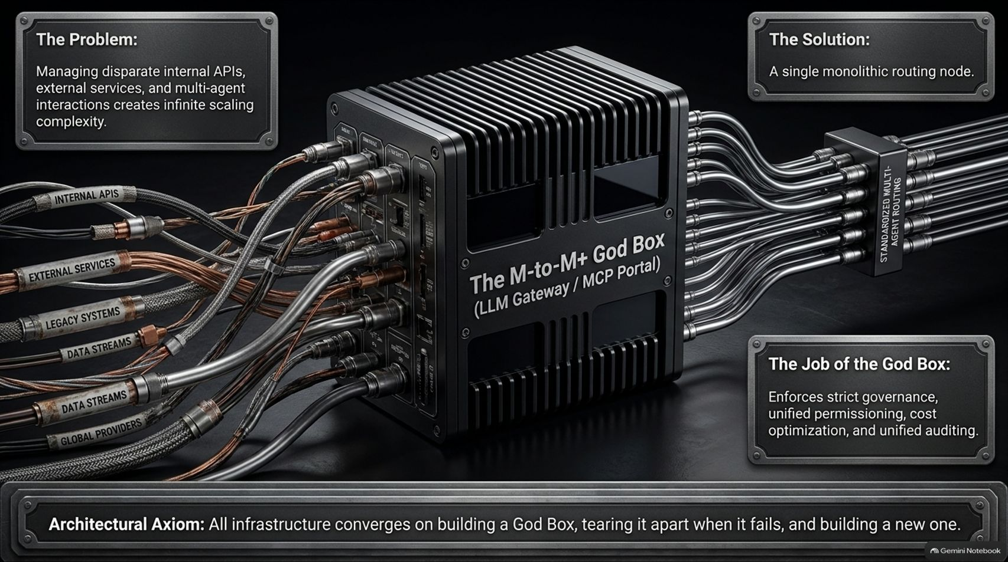
Notes:
Estimated Time: 5 – 6 minutes
Target Word Count: ~650 words
Speaker Notes
As an enterprise deploys dozens of specialized agents across multiple internal APIs and third-party LLM providers, architectural complexity explodes. Slide 11 illustrates the pattern for managing this chaos: The M-to-M+ God Box (LLM Gateway / MCP Portal).
The Problem: Routing disparate internal APIs, external services, legacy data streams, and multi-agent interactions directly to individual LLMs creates an unmaintainable spiderweb of custom integrations.
The Solution: A centralized, monolithic routing node. The "God Box" acts as a unified gateway using standardized protocols (such as Model Context Protocol / MCP).
The primary responsibilities of the God Box include:
Strict Governance & Permissibility: Unified IAM role enforcement across all agent tool calls.
Cost & Token Optimization: Centralized caching, prompt routing to lower-cost models, and context trimming.
Unified Auditing: Comprehensive telemetry and logging for compliance and debugging.
Architectural Axiom: Infrastructure engineering follows a predictable cycle—all infrastructure converges on building a God Box, tearing it apart when it hits scaling limits, and building a more refined next-generation version.

Slide 12
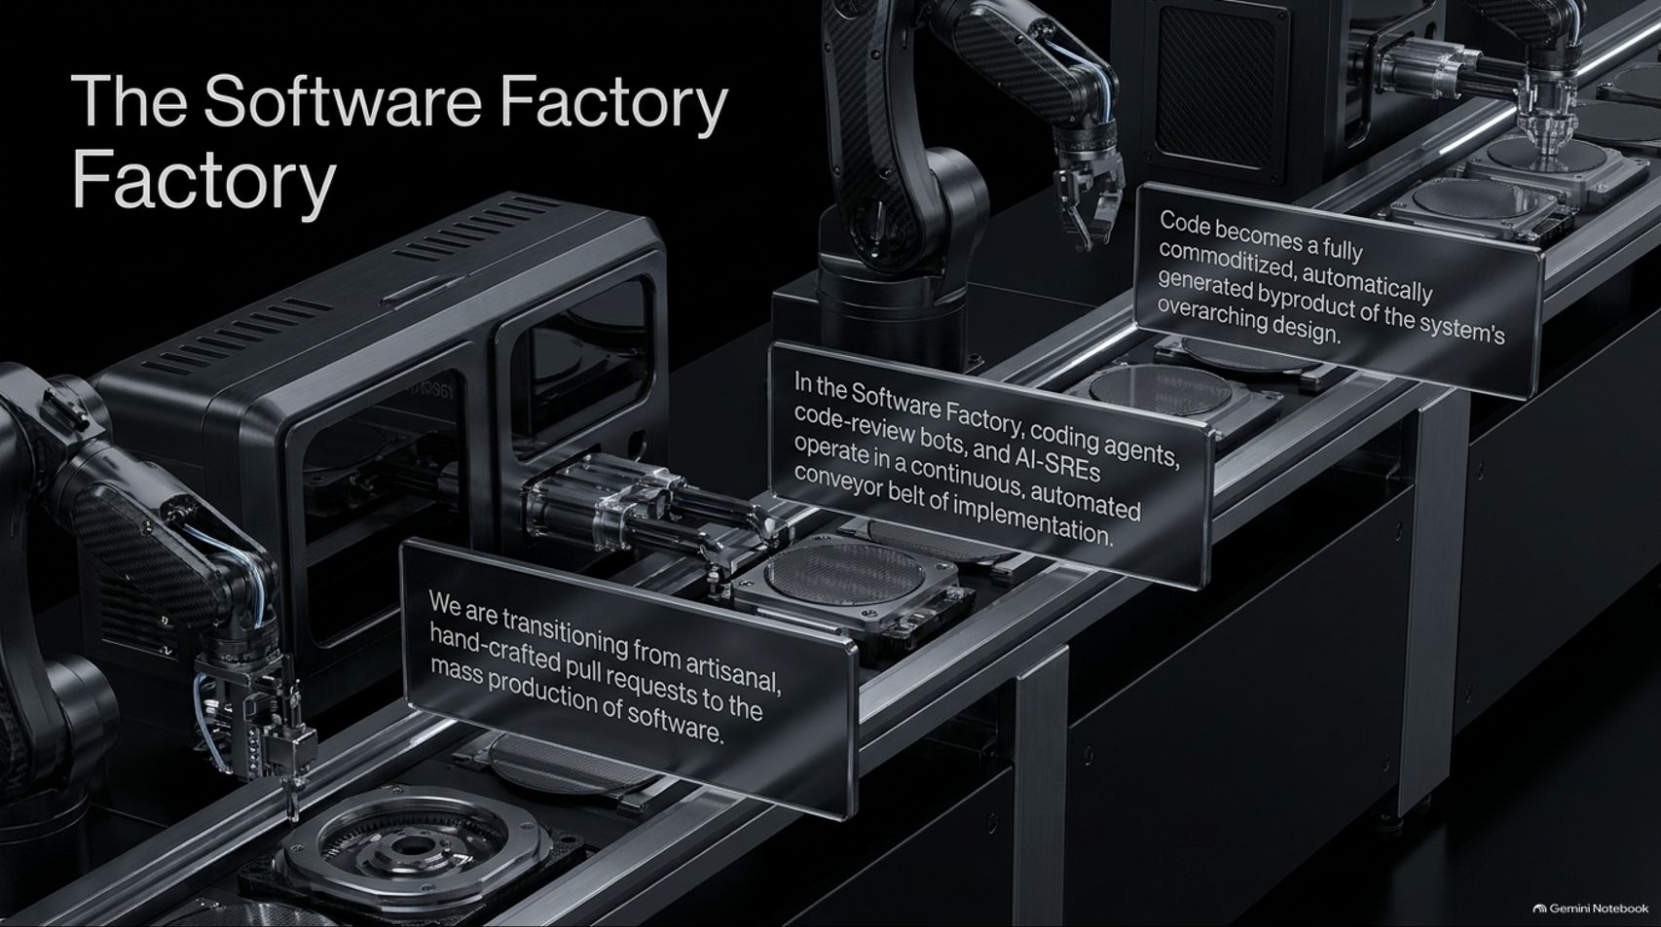
Notes:
Estimated Time: 4 – 5 minutes
Target Word Count: ~550 words
Speaker Notes
Slide 12 brings our core concept to life visually: The Software Factory Factory.
We are witnessing a historical industrial shift in computer engineering. We are transitioning from artisanal, hand-crafted software development to the mass automated production of software.
In this model:
Coding agents, automated code-review bots, and AI-SREs operate as continuous, interconnected assembly lines.
Raw requirements enter one side of the factory pipeline; tested, verified, and benchmarked code emerges from the other.
Code itself becomes a commoditized, automatically generated byproduct of the system's overarching architectural design.
As systems architects, your job is no longer to manually assemble individual gears (lines of code). Your job is to design, calibrate, and maintain the industrial assembly line that manufactures those gears automatically.

Slide 13
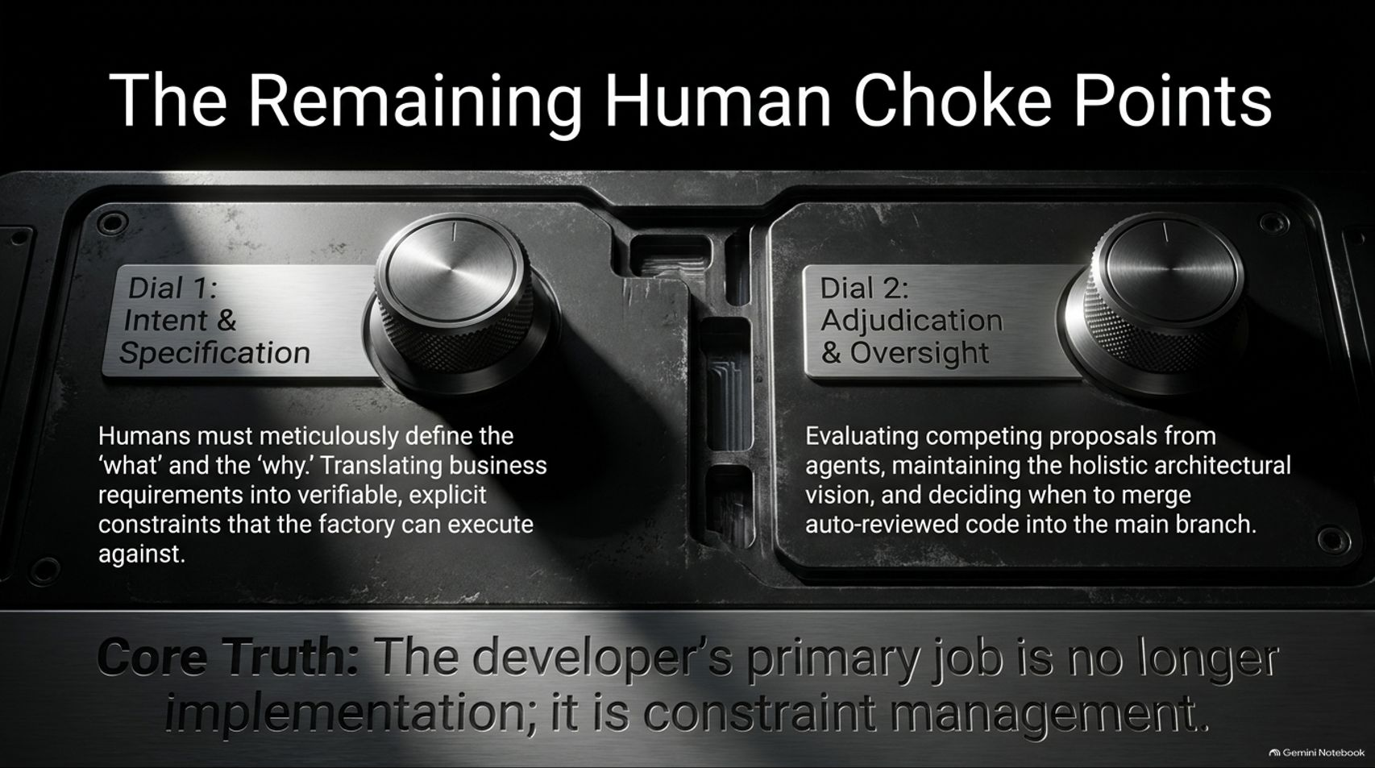
Notes:
Estimated Time: 4 – 5 minutes
Target Word Count: ~600 words
Speaker Notes
If agents are generating syntax, running tests, and managing basic operations, what remains for the human developer? Slide 13 highlights The Remaining Human Choke Points.
Human control is concentrated into two primary control dials:
Dial 1: Intent & Specification. Humans meticulously define the "what" and the "why." This involves translating ambiguous business requirements into explicit, verifiable constraints and specs that the software factory can execute against. If your spec is vague, the factory generates slop. Precision in specification is the ultimate high-leverage skill.
Dial 2: Adjudication & Oversight. Humans evaluate competing implementation proposals generated by agents. You maintain overall architectural coherence, uphold engineering taste, and make final merging decisions for core systems.
Core Truth: The developer's primary job is no longer implementation; it is constraint management.

Slide 14
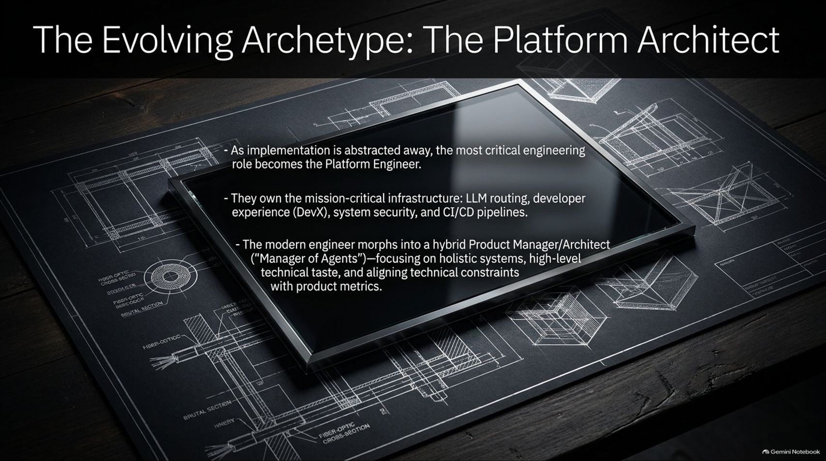
Notes:
Estimated Time: 4 – 5 minutes
Target Word Count: ~550 words
Speaker Notes
As task implementation is abstracted away, how do job titles and engineering roles evolve? Slide 14 defines The Evolving Archetype: The Platform Architect.
As code generation becomes commoditized, the Platform Engineer becomes the most critical role within the tech organization. These engineers own mission-critical platform infrastructure: LLM routing gateways, Developer Experience (DevX) tooling, security boundary enforcement, and automated CI/CD pipelines.
The modern software developer morphs into a hybrid Product Manager / Systems Architect ("Manager of Agents"). Key focus areas shift to:
Holistic System Design: Structuring how multi-agent networks interact safely.
Technical Taste & Standards: Establishing organization-wide benchmarks, evaluations, and quality baselines.
Product & Constraint Alignment: Ensuring technical constraints directly track business metrics.
Engineers who master this hybrid archetype become force multipliers across their organizations.

Slide 15
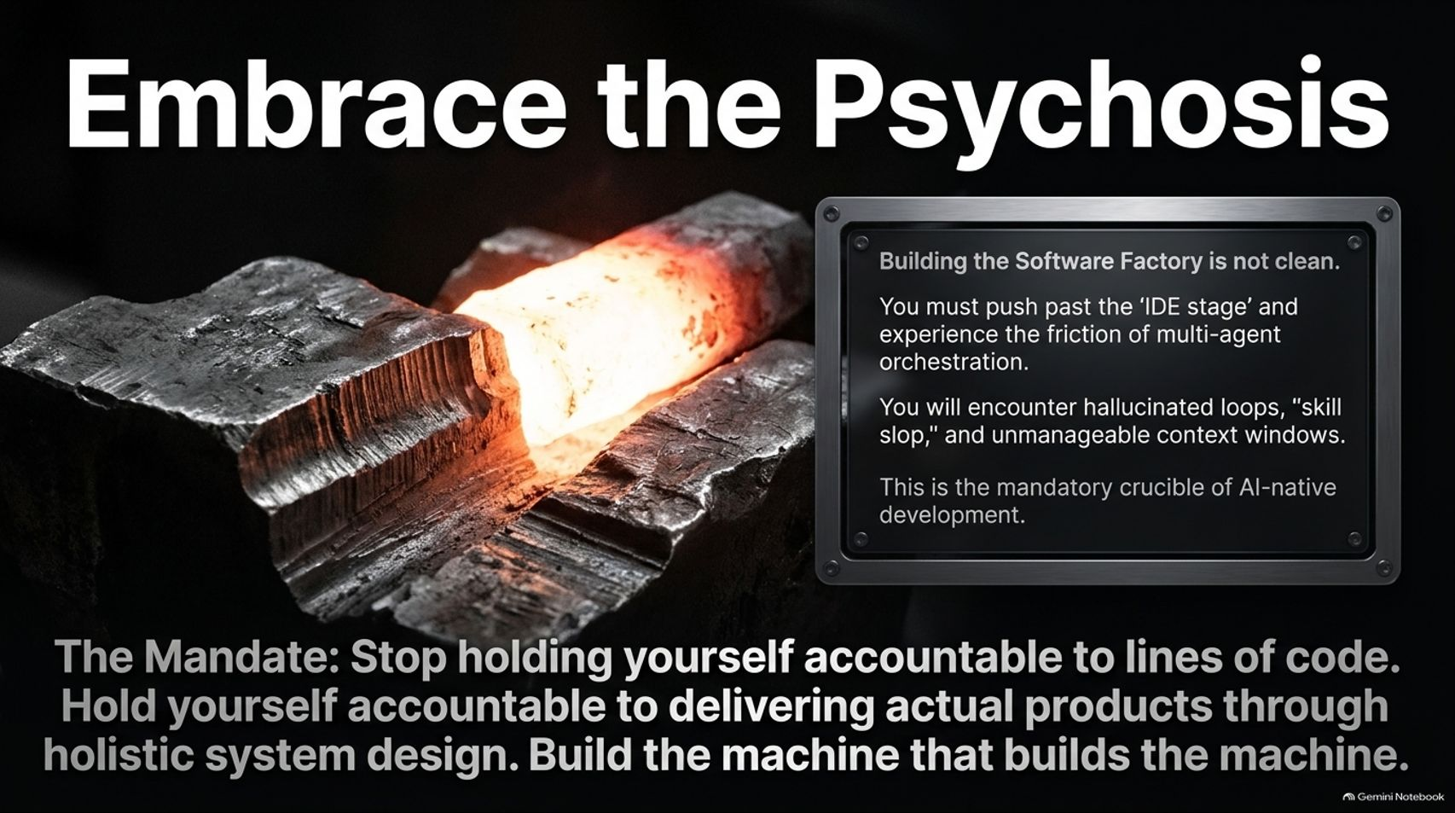
Notes:
Estimated Time: 3 – 4 minutes
Target Word Count: ~500 words
Speaker Notes
Slide 15 captures the cultural and psychological shift required to build in this new paradigm: Embrace the Psychosis.
Building an AI-native software factory is messy and non-deterministic. You must move beyond the safety of standard IDE autocompletion and experience the raw friction of multi-agent orchestration.
In the early stages, you will encounter hallucinated loops, skill slop, unmanageable context windows, and non-deterministic failures. This chaos is not a reason to retreat to manual coding—it is the mandatory crucible of AI-native development.
The Mandate: Stop holding yourself accountable to lines of code written. Hold yourself accountable to delivering actual products through holistic system design. Build the machine that builds the machine.

Slide 16
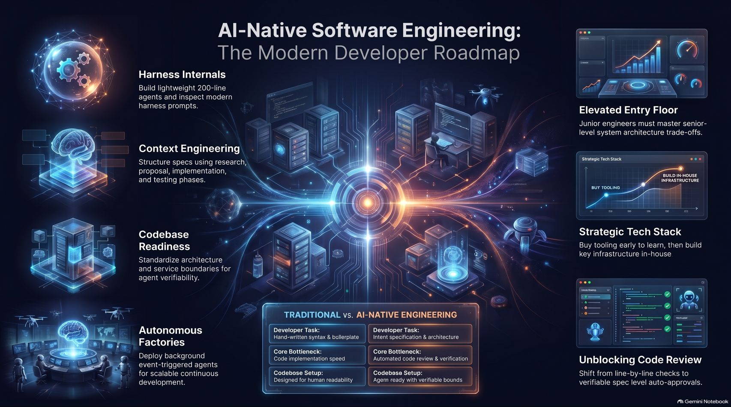
Notes:
Estimated Time: 4 – 5 minutes
Target Word Count: ~600 words
Speaker Notes
To wrap up our presentation, Slide 16 provides the complete AI-Native Software Engineering Roadmap, synthesizing everything we have covered today.
Let's review the journey across our key pillars:
Harness Internals: Build light, algorithmic 200-line agent harnesses to master tool execution, compaction, and loop dynamics.
Context Engineering: Structure problem-solving into clear phases—Research, Proposal, Spec, and Implementation—avoiding raw vanilla prompting.
Codebase Readiness: Standardize architecture, decouple monolithic dependencies, and implement dense, automated testing to make codebases verifiably agent-ready.
Autonomous Factories: Deploy event-triggered background agents (AI-SREs) for continuous execution and asynchronous maintenance.
Elevated Entry Floor: Shift junior developer training toward senior-level system trade-offs, architecture, and eval creation.
Strategic Tech Stack: Follow "Build to Keep, Buy to Learn"—leveraging specialized external tools early while constructing core routing infrastructure in-house.
Unblocking Code Review: Transition from manual line-by-line PR reviews to spec-level auto-approvals and agentic code reviews.
Thank you for your time. The future of engineering isn't about writing code faster—it's about building better software factories. I'm happy to open the floor to Q&A.

