Slide 1
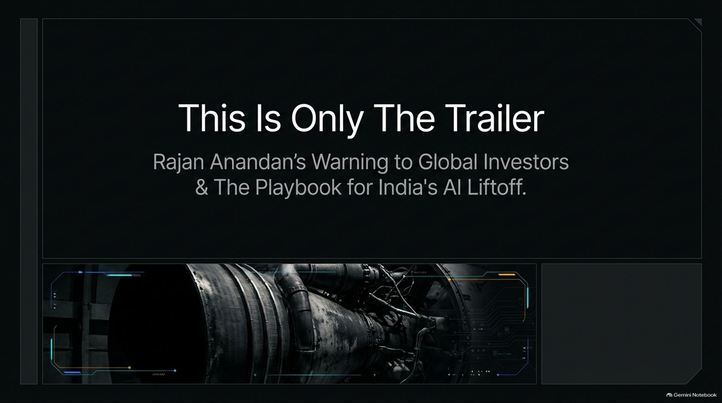
Notes:
Estimated Time: 2 – 3 minutes
Target Word Count: ~350 words
Speaker Notes
Welcome, everyone. Today we are unpacking one of the most critical structural shifts in global technology and venture capital: India's AI Liftoff.
This presentation is framed around the core thesis and warning delivered by Rajan Anandan, Managing Director at Peak XV, regarding where India stands in the global AI race.
For years, global public market investors have looked at Indian indices and dismissed them as the "anti-AI trade" due to a lack of local, pure-play foundation model giants. But as Anandan warns, anyone waiting for a global AI market correction to write off India is missing the forest for the trees. What we are seeing today in the public markets is only the trailer. The real movie is playing out in the private markets, where an explosive structural transformation is underway.
Over the next 16 slides, we will examine how India is bypassing Western paradigms, scaling its compute infrastructure by 10x, engineering ultra-affordable population-scale models, and rapidly building deep tech powerhouses in space, semiconductors, and advanced manufacturing. Let's dive into the private market reality.
“This Is Only The Trailer”: Rajan Anandan’s AI Warning for Investors
https://www.youtube.com/watch?v=-sD6Lsyy0a8

Slide 2

Notes:
Estimated Time: 4 – 5 minutes
Target Word Count: ~550 words
Speaker Notes
Let's address the elephant in the room right away on Slide 2: The Public Market Myth versus The Private Market Reality.
If you talk to foreign institutional investors, their narrative is clear: India has no publicly traded, pure-play native AI companies, foundation model builders, or AI hardware giants. Consequently, billions of foreign capital have flown past Indian indices into Taiwan, South Korea, and the US. That public market narrative is entirely true. Aside from niche neo-clouds like E2E Networks playing in AI compute, the public exchange lacks native AI bellwethers.
However, the private market story couldn't be further from the truth. 2026 is the watershed year where India officially entered the global AI race. The absence of public listings severely masks a massive structural explosion happening right now behind closed doors in early and growth-stage private ecosystems.
While public market investors look for immediate ticker symbols, private venture funds are backing founders who are building the foundational infrastructure for a nation of 1.4 billion people. The disconnect between public skepticism and private velocity creates one of the greatest investment arbitrage opportunities of our decade.

Slide 3
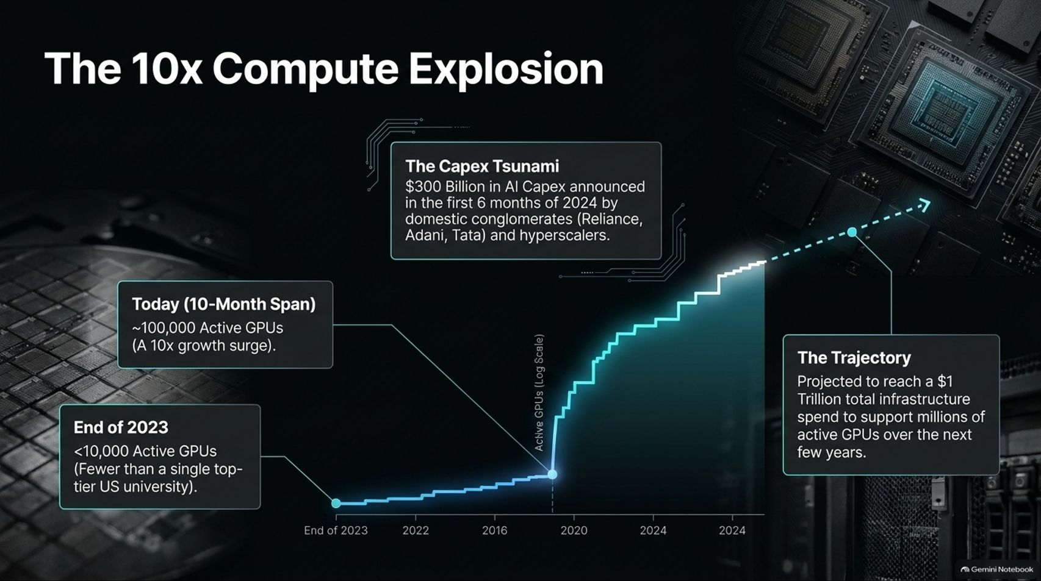
Notes:
Estimated Time: 5 – 6 minutes
Target Word Count: ~650 words
Speaker Notes
You cannot talk about artificial intelligence without talking about compute. On Slide 3, we analyze The 10x Compute Explosion.
Let’s look at the baseline data highlighted by Rajan Anandan: at the end of 2025, India as an entire nation had fewer than 10,000 active GPUs. To put that into perspective, single top-tier US universities possessed more compute power than the entire Indian economy. Without compute, model training and inference are impossible.
Look at how fast that narrative flipped:
The Capex Tsunami: In the first six months of 2024 alone, domestic conglomerates—specifically Reliance, Adani, and the Tata Group—alongside hyperscalers like AWS and GCP, announced over $300 billion in AI infrastructure capex. Indian neo-clouds like Yotta and Neysa are scaling rapidly.
The 10-Month Surge: Over an 8 to 10-month span, active GPU counts surged past 100,000, representing an explosive 10x growth curve.
The Trajectory: India is locked into a multi-year trajectory heading toward a $1 trillion total infrastructure spend, supporting millions of active GPUs in the coming years.
Without this massive physical foundation being laid right now, none of the application layers or sovereign AI models we will discuss would be possible. The compute bottleneck is rapidly breaking.

Slide 4
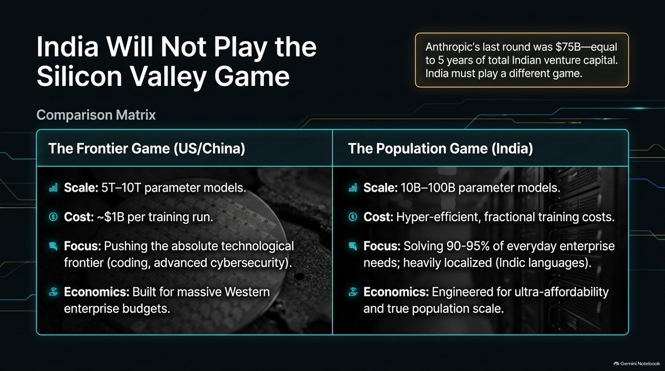
Notes:
Estimated Time: 5 – 6 minutes
Target Word Count: ~700 words
Speaker Notes
A common critique from global observers is that India cannot possibly compete with Western labs when Anthropic raises single venture rounds of $75 billion—an amount equal to five full years of total venture capital invested across all of India.
On Slide 4, our core strategic insight is simple: India will not play the Silicon Valley game because it cannot afford to, and it doesn't need to.
Let’s compare the two paradigms:
The Frontier Game (US / China): Focused on multi-trillion parameter models (5T–10T parameters), costing upwards of $1 billion per training run. Their economic model is built for massive Western enterprise budgets and absolute technological dominance in coding and advanced cybersecurity.
The Population Game (India): Focused on hyper-efficient, highly targeted 30B to 100B parameter models. These models solve 90% to 95% of everyday enterprise and consumer needs at a fraction of the cost, heavily localized for Indic languages.
As Anandan points out, if a large Indian financial institution wants to build an accounts payable agent for 300,000 field agents, it doesn't need a 5-trillion parameter model. A tightly optimized 30-billion parameter model does the job exceptionally well, with hyper-efficient training costs that make mass commercial deployment actually viable.

Slide 5
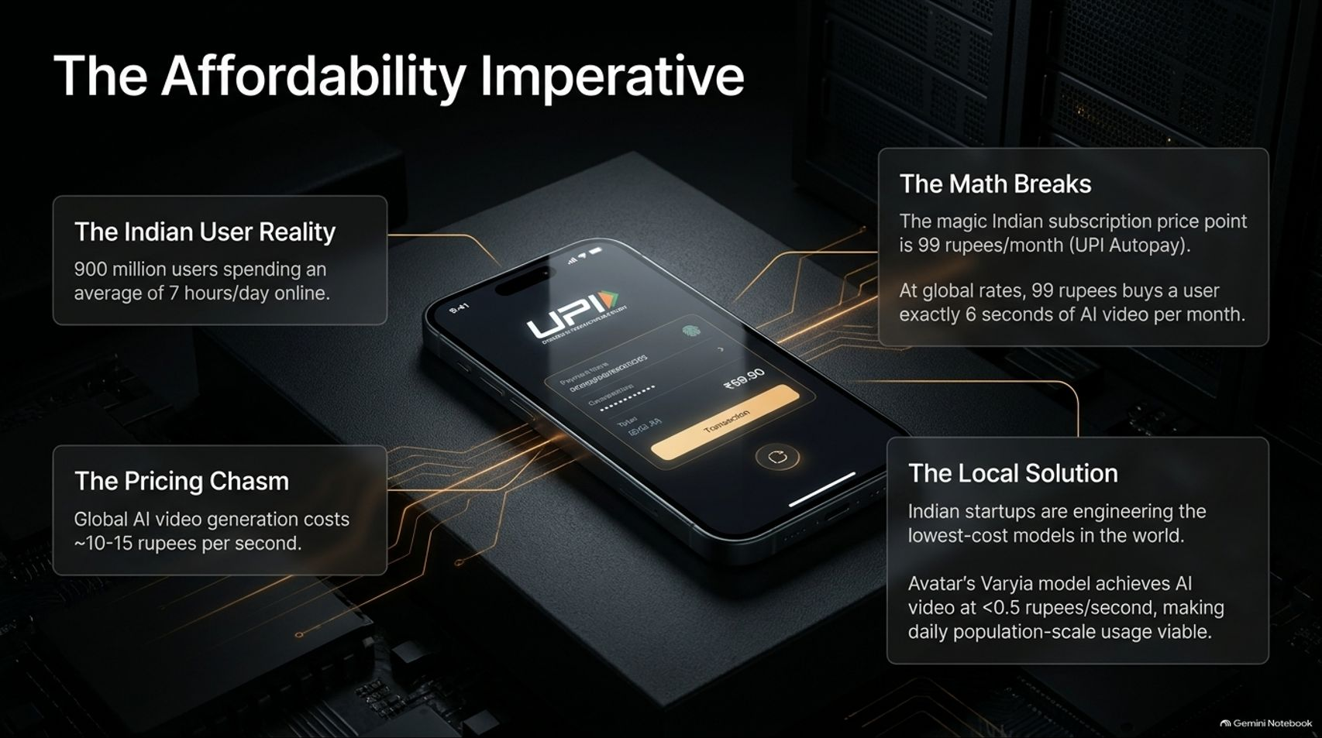
Notes:
Estimated Time: 4 – 5 minutes
Target Word Count: ~600 words
Speaker Notes
Why must Indian AI engineering be hyper-affordable? Slide 5 answers this through The Affordability Imperative.
Consider the Indian user reality: 900 million internet users spend an average of 7 hours online every single day. However, the economic reality of monetization dictates strict price ceilings:
The Pricing Chasm: Global AI video generation models currently cost around 10 to 15 rupees per second to run.
The Math Breaks: The magic mass-market subscription price point in India is ₹99 per month via UPI Autopay. At global compute rates, ₹99 buys a user a staggering 6 seconds of AI video per month. That product is dead on arrival; no user will pay ₹99 for six seconds of video.
The Local Solution: Indian startups are engineering the lowest-cost models in the world. For instance, Bangalore-based startup Avatar and its Varyia model have driven AI video generation costs down to under 0.5 rupees per second, making daily, population-scale usage economically viable.
Affordability isn't a feature in India; it is the entire business model.

Slide 6
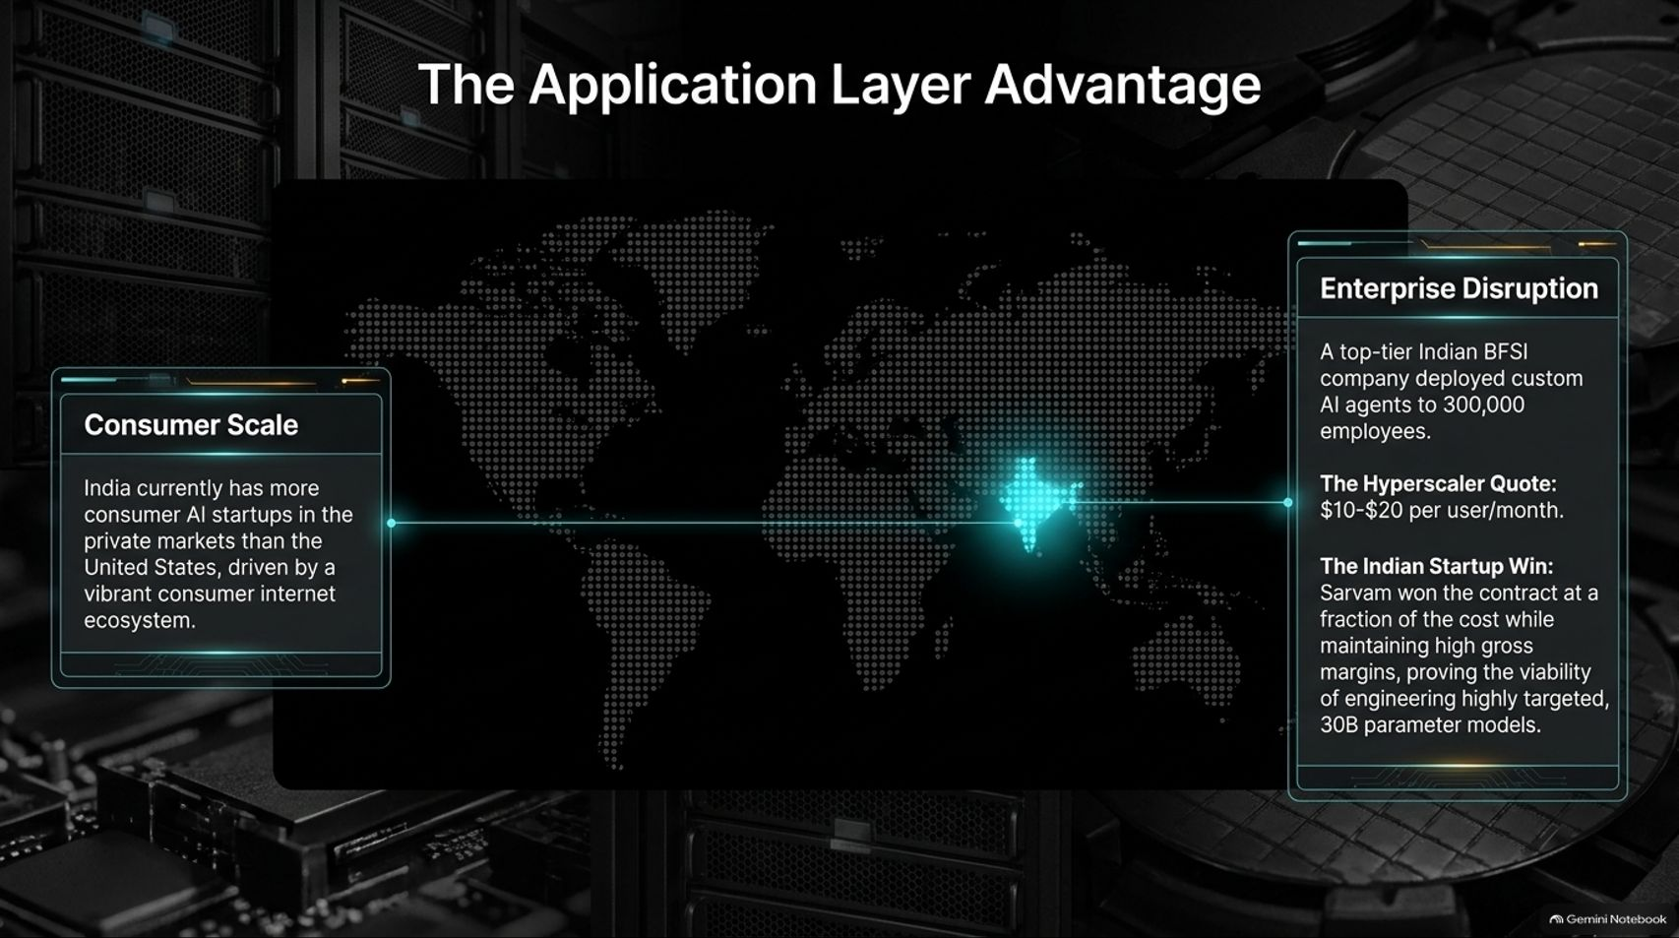
Notes:
Estimated Time: 4 – 5 minutes
Target Word Count: ~550 words
Speaker Notes
While the West obsesses over foundational model parameter counts, India is winning where it matters most: The Application Layer.
Slide 6 highlights two massive advantages:
Consumer Scale: Driven by a vibrant consumer internet ecosystem, India currently boasts more consumer AI startups operating in the private markets than the United States.
Enterprise Disruption: Consider a real-world deployment cited in our playbook. A top-tier Indian BFSI (Banking, Financial Services, and Insurance) enterprise wanted to deploy custom AI agents across 300,000 employees. While US hyperscalers and frontier model labs quoted $10 to $20 per user per month, Indian sovereign AI startup Sarvam won the contract at a fraction of that cost while maintaining exceptionally healthy gross margins.
This proves the viability of engineering highly targeted, highly localized 30-parameter models that undercut global software pricing while dominating domestic enterprise adoption.

Slide 7
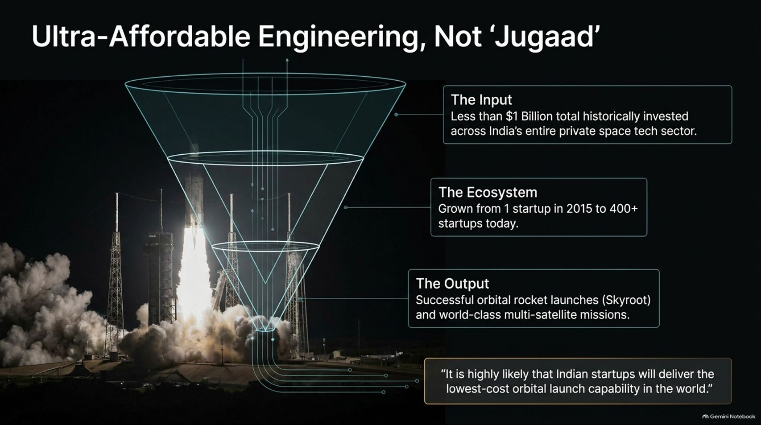
Notes:
Estimated Time: 4 – 5 minutes
Target Word Count: ~550 words
Speaker Notes
When Western observers look at how frugally Indian tech companies build world-class products, they often dismiss it as "Jugaad"—improvisational shortcuts or makeshift fixes. On Slide 7, we reject that label entirely: This is ultra-affordable, world-class engineering.
Let’s look at the proof point in India’s burgeoning SpaceTech sector:
The Input: Less than $1 billion in total historical capital has been invested across India's entire private space tech sector.
The Ecosystem: Driven by elite engineering talent, the private space ecosystem has grown from just 1 startup in 2015 to over 400 startups today.
The Output: Successful orbital rocket launches by companies like Skyroot Aerospace and world-class multi-satellite missions delivered at a fraction of NASA's or SpaceX's per-launch budgets.
As industry experts note: It is highly likely that Indian startups will deliver the lowest-cost orbital launch capability in the world. Frugality is a disciplined engineering choice, not a compromise on quality.

Slide 8
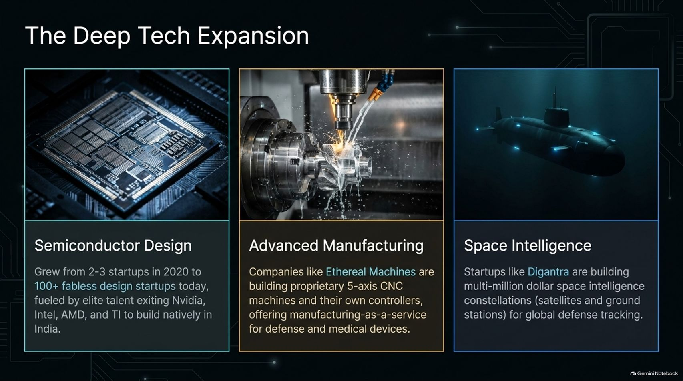
Notes:
Estimated Time: 5 – 6 minutes
Target Word Count: ~650 words
Speaker Notes
India's startup narrative has expanded far beyond consumer fintech and e-commerce. Slide 8 maps out The Deep Tech Expansion across three heavy engineering pillars:
Semiconductor Design: Fueled by elite engineering talent exiting Nvidia, AMD, Intel, and Texas Instruments to build natively in India, fabless semiconductor design startups have exploded from 2–3 companies in 2020 to over 100 startups today. Companies like Agnitio are building inference-specific GPUs, while others like C2I power chips have achieved multi-thousand-crore acquisitions shortly after founding.
Advanced Manufacturing: Companies like Ethereal Machines are building proprietary 5-axis CNC machines and custom controllers, offering manufacturing-as-a-service for defense, aerospace, and precision medical devices.
Space Intelligence: Startups like Digantra are building multi-million-dollar space intelligence constellations (combining low-Earth-orbit satellites and ground stations) for global defense tracking and space situational awareness.
India is building hard intellectual property from the silicon up.

Slide 9
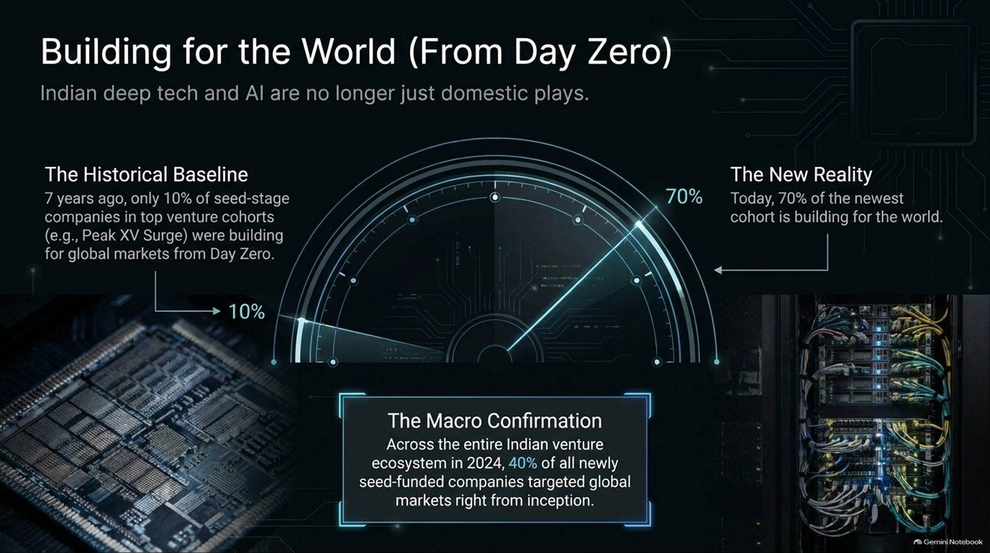
Notes:
Estimated Time: 4 – 5 minutes
Target Word Count: ~550 words
Speaker Notes
A decade ago, the universal critique of Indian tech was that it was inward-looking—solving domestic problems without global applicability. Slide 9 proves that narrative is dead: Indian deep tech and AI are building for the world from Day Zero.
Let’s examine the massive macro shift:
The Historical Baseline: Seven years ago, when early venture cohorts like Peak XV’s Surge program kicked off, only 10% of seed-stage portfolio companies were building for global markets from inception.
The New Reality: Today, 70% of the newest Surge cohort is building explicitly for global markets.
Macro Confirmation: Across the broader Indian venture ecosystem, 40% of all newly seed-funded companies targeted global markets right from day zero.
When you combine Indian engineering talent with global go-to-market strategies, you unlock massive scale. Take space tech startup Ulook in Bangalore: its co-founders bring experience from 15 successful satellite missions, building radio frequency satellite constellations to compete with elite global players like France's Unforeseen Labs.

Slide 10
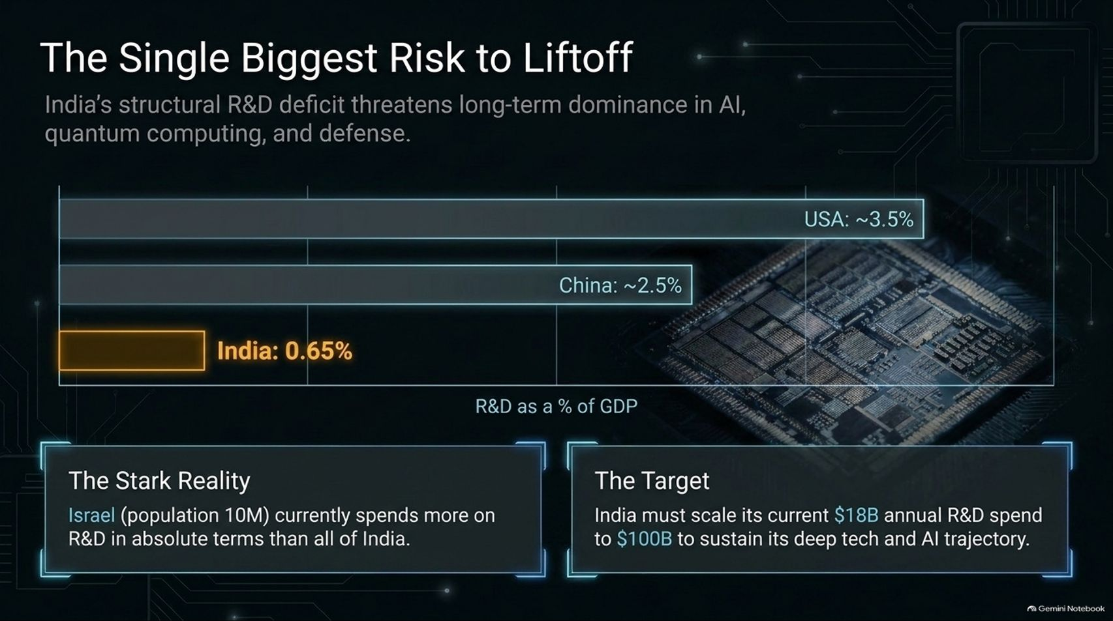
Notes:
Estimated Time: 5 – 6 minutes
Target Word Count: ~650 words
Speaker Notes
Every liftoff faces gravitational pull. On Slide 10, we confront The Single Biggest Risk to Liftoff: India's Structural R&D Deficit.
If India wants to maintain long-term dominance in AI, quantum computing, semiconductors, and advanced defense, it has a glaring structural hurdle to clear:
The Stark Reality: India currently spends roughly 0.65% of its GDP on R&D (~$18 billion annually). By comparison, China invests around 2.5%, and the United States invests 3.5%.
To put that in perspective: Israel—with a population of just 10 million—currently spends more on R&D in absolute dollar terms than all of India.
The Target: To sustain its deep tech trajectory, India must scale its annual R&D spend from $18 billion to $100 billion.
Without a massive step-change in R&D investment—funded jointly by public policy and private enterprise—India risks hitting an innovation ceiling in capital-intensive deep tech domains.

Slide 11
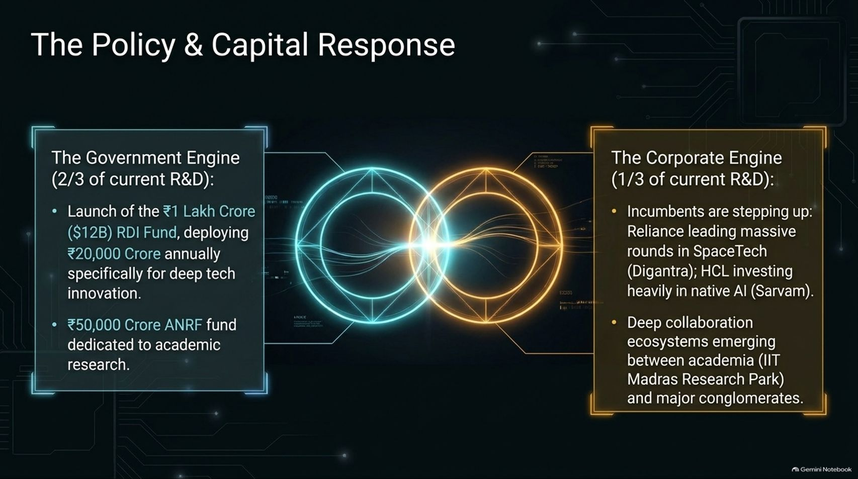
Notes:
Estimated Time: 4 – 5 minutes
Target Word Count: ~550 words
Speaker Notes
How is India responding to this R&D deficit? Slide 11 breaks down The Policy & Capital Response, driven by a powerful twin-engine model:
The Government Engine (Two-Thirds of Current R&D):
The RDI Fund: Launch of the ₹1 Lakh Crore ($12B) Research, Development, and Innovation Fund, deploying ₹20,000 crores annually specifically for deep tech and private sector innovation (including a ₹7,000 crore deep tech fund-of-funds approval).
The ANRF: A ₹50,000 crore Anusandhan National Research Foundation fund dedicated to ramping up academic research across premier institutions.
The Corporate Engine (One-Third of Current R&D):
India's largest conglomerates are stepping up. Reliance is leading massive funding rounds in SpaceTech (Digantra), while HCL is investing heavily in native AI foundation builders (Sarvam).
Deep academic-corporate collaboration ecosystems are flourishing, such as the IIT Madras Research Park, where major corporations house dedicated R&D units right next to student incubators.
Public policy and private capital are finally aligning to fund India's deep tech future.

Slide 12
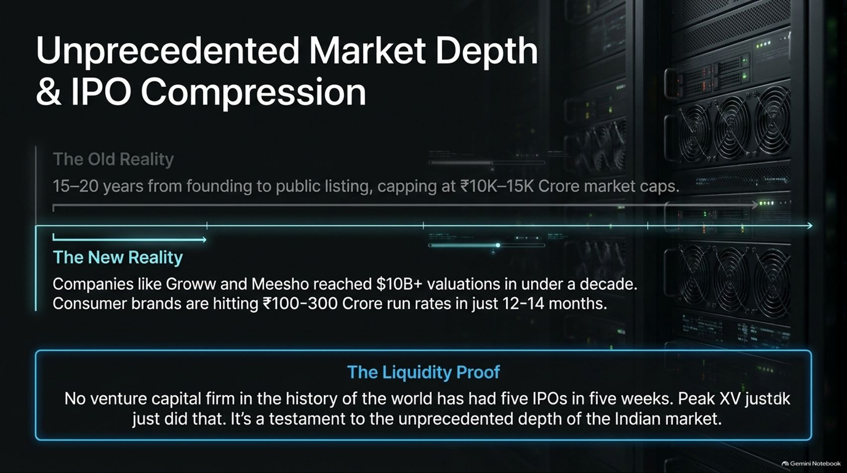
Notes:
Estimated Time: 4 – 5 minutes
Target Word Count: ~600 words
Speaker Notes
One of the most dramatic changes in the Indian financial ecosystem is how fast startups mature from an idea into publicly listed giants. Slide 12 analyzes Unprecedented Market Depth & IPO Compression.
The Old Reality: Historically, it took 15 to 20 years from founding to public listing, usually capping out at modest market caps of ₹10,000 to ₹15,000 Crores.
The New Reality: Companies like Groww and Meesho achieved $10 billion+ valuations in under a decade. Consumer brands are hitting ₹100–300 Crore revenue run rates in a mere 12 to 14 months.
The Liquidity Proof: As Rajan Anandan highlights, no venture capital firm in the history of the world had ever achieved five IPOs in five consecutive weeks. Peak XV just did that.
This unprecedented velocity is a testament to the immense depth and maturity of the Indian domestic capital markets, which are ready and eager to absorb high-growth tech listings.

Slide 13
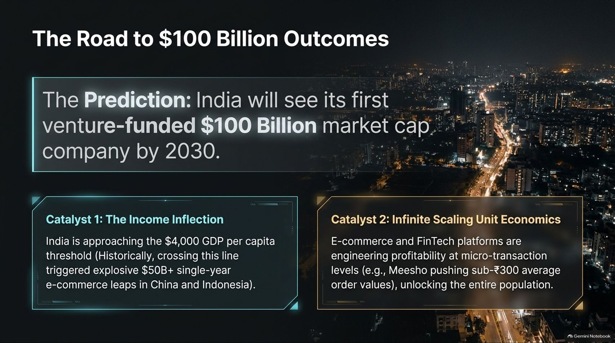
Notes:
Estimated Time: 4 – 5 minutes
Target Word Count: ~600 words
Speaker Notes
Slide 13 looks toward the horizon with a bold prediction: India will see its first venture-funded $100 Billion market cap company by 2030.
This trajectory is being propelled by two massive economic catalysts:
The Income Inflection: India is rapidly approaching the $4,000 GDP per capita threshold. Historically, crossing this line triggered explosive single-year e-commerce leaps of over $50 billion in China and Indonesia. As Indian household incomes rise, consumer spending velocity will double.
Infinite Scaling Unit Economics: Platforms like Meesho and Eternal (Zomato) are engineering profitability at micro-transaction levels (with average order values pushed sub-₹300), unlocking the purchasing power of the entire population.
With contenders spanning fintech (Groww, PhonePe) and e-commerce, India’s centicorn era is well within reach before the decade is out.

Slide 14
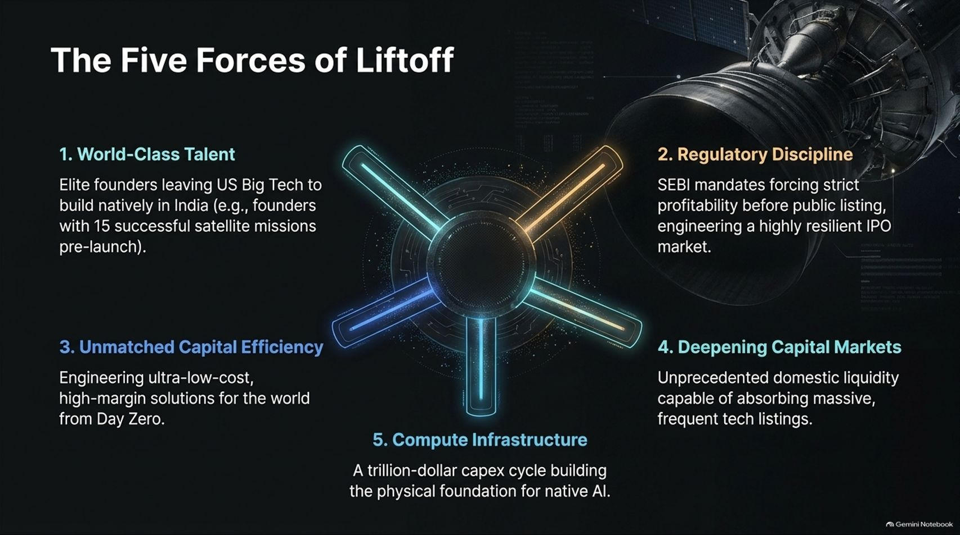
Notes:
Estimated Time: 4 – 5 minutes
Target Word Count: ~550 words
Speaker Notes
Slide 14 synthesizes our entire thesis into The Five Forces of Liftoff driving India's technological revolution:
World-Class Talent: Elite founders leaving US Big Tech to build natively in India—bringing world-class domain expertise (e.g., space founders with 15 successful missions pre-launch).
Regulatory Discipline: SEBI mandates enforcing strict profitability baselines before public listing, engineering an exceptionally resilient and trusted IPO market.
Unmatched Capital Efficiency: Engineering ultra-low-cost, high-margin solutions designed for population scale from Day Zero.
Deepening Capital Markets: Unprecedented domestic retail and institutional liquidity capable of absorbing frequent, multi-billion-dollar tech listings.
Compute Infrastructure: A trillion-dollar capex cycle building the physical GPU foundation required for sovereign AI.
When these five forces align simultaneously, national economic transformation is inevitable.

Slide 15

Notes:
Estimated Time: 3 – 4 minutes
Target Word Count: ~450 words
Speaker Notes
Slide 15 examines the macro financial impact of this shift on India's public indices.
Currently, venture-funded companies make up only about 4% of India's total public market capitalization. Over the next decade, as the broader Indian market expands from its current base toward $10T to $15T, that venture-backed share is projected to surge to 15%.
This represents a wholesale transformation of a national index. As Anandan reiterates: if global investors are sitting on the sidelines waiting for a global AI market correction to write off India, they fail to realize that what we are seeing today is only the trailer. The main feature film is just beginning.

Slide 16
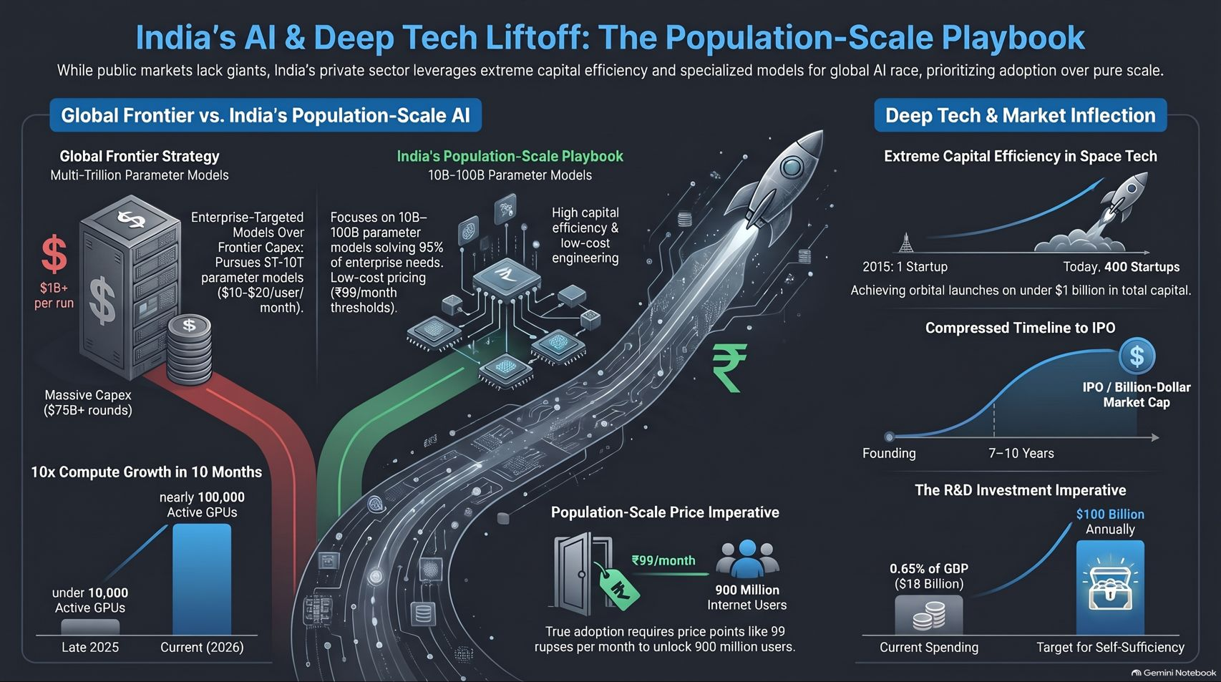
Notes:
Estimated Time: 4 – 5 minutes
Target Word Count: ~600 words
Speaker Notes
To conclude our presentation, Slide 16 summarizes The Population-Scale Playbook for India's AI Liftoff:
Beyond Frontier Scale: Rejecting bloated $1B training runs in favor of hyper-efficient 30B–100B parameter models built for 95% of enterprise needs at ₹99/month pricing tiers.
Deep Tech Dominance: Scaling capital-efficient startups in space tech (400+ startups on <$1B capital), advanced manufacturing, and fabless chip design.
Global Ambition: Shifting from 10% global orientation at inception to 70% of new deep-tech cohorts building for the world from Day Zero.
Closing the R&D Gap: Scaling national R&D from $18 billion toward $100 billion annually through combined government RDI funds and corporate conglomerate backing.
India's tech ecosystem is no longer catching up—it is writing a brand-new playbook for population-scale innovation. Thank you for your time, and I am happy to open the floor to Q&A.

