Slide 1
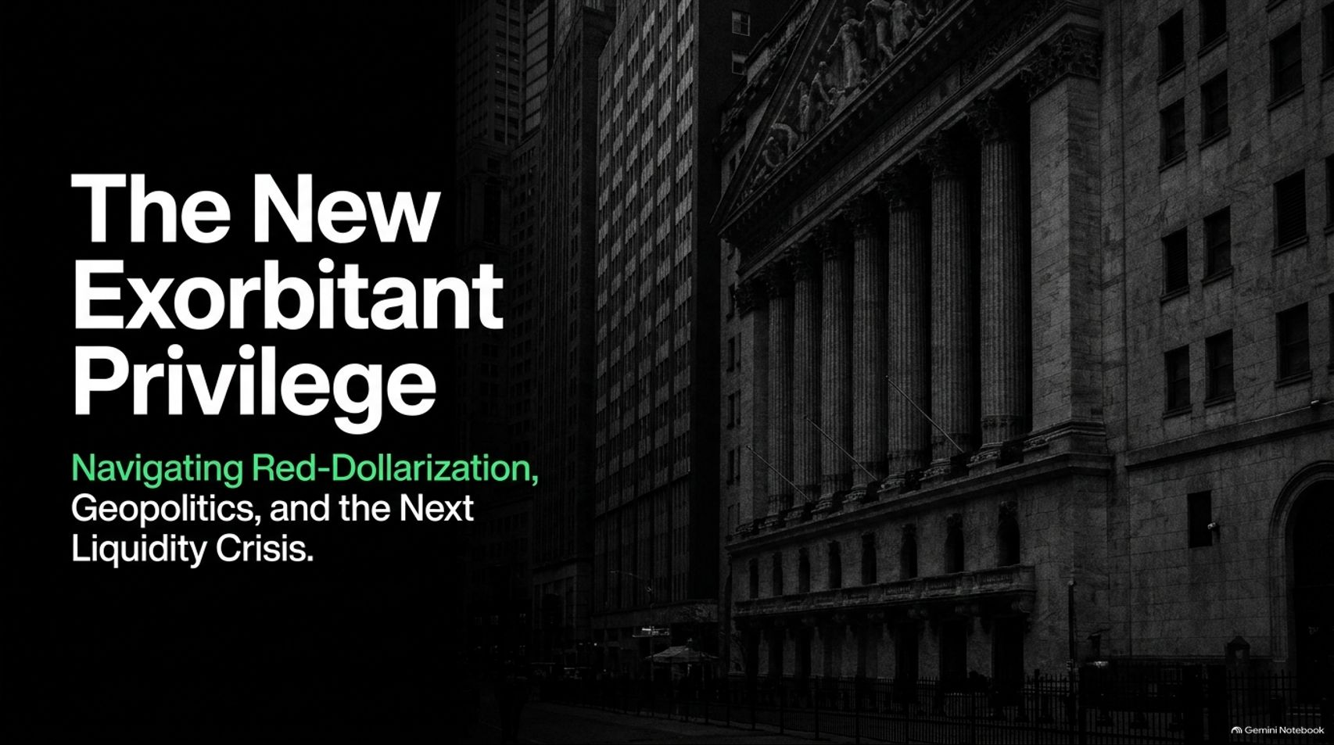
Notes:
Estimated Time: 2 – 3 minutes
Target Word Count: ~350 words
Speaker Notes
Welcome, everyone. Today we are addressing one of the most critical and misunderstood macroeconomic dynamics of our decade: The New Exorbitant Privilege: Navigating Red-Dollarization, Geopolitics, and the Next Liquidity Crisis.
For generations, economists talked about the US dollar's "exorbitant privilege"—its ability to print the world's reserve currency while running persistent deficits. But that privilege has evolved. Today, we are entering a radically more assertive, weaponized, and structurally fortified era of dollar dominance.
In this session, we are going to dissect why traditional narratives of de-dollarization are missing the mark. Instead of the world moving away from the dollar, we are witnessing a phenomenon we call "Red-Dollarization"—a system where the United States leverages digital currency rails, stablecoins, AI compute infrastructure, and energy tollbooths to tighten its grip on global capital flows.
We will also examine the dangerous threshold of the DXY index, why a surging dollar acts as a global wrecking ball, how foreign nations suffer a "slow shave" under dual carry trades, and—most importantly—what defensive playbook you must adopt before the next indiscriminate liquidity cascade hits. Let's unpack the macro landscape.
"Bad Things" To Happen As US Dollar Strengthens | Brent Johnson
https://www.youtube.com/watch?v=cAm1EdSngHc

Slide 2
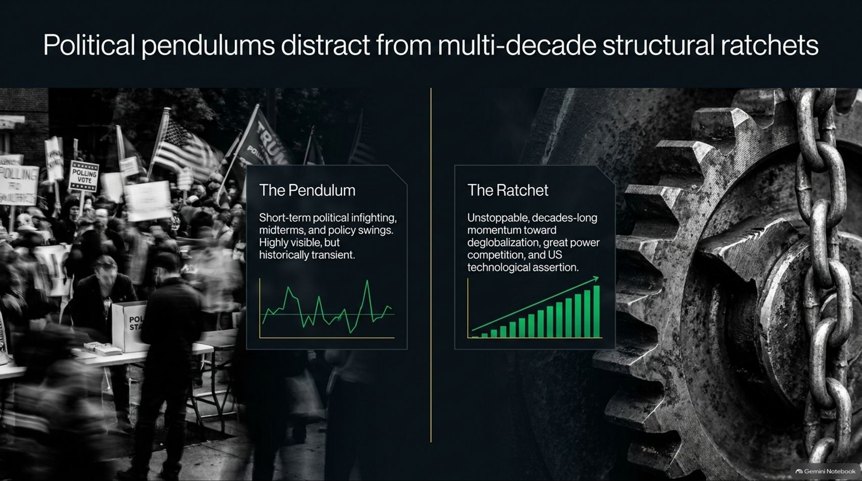
Notes:
Estimated Time: 4 – 5 minutes
Target Word Count: ~550 words
Speaker Notes
When looking at global markets, the human brain is naturally drawn to daily noise. On Slide 2, we highlight a fundamental distinction: Political pendulums distract from multi-decade structural ratchets.
The Pendulum: This is what dominates financial news networks—short-term political infighting, midterm elections, shifting administrations, and transient policy swings. While highly visible and emotionally charged, political pendulums swing back and forth, historically leaving long-term structural trends intact.
The Ratchet: This is the force that actually drives asset prices and geopolitical reality over decades. It is the unstoppable, structural momentum toward deglobalization, intense great power competition, resource nationalism, and aggressive US technological assertion.
If you manage your portfolio based purely on the political pendulum—reacting to every headline or election cycle—you will get whipped around. True macro positioning requires investing for the ratchet. The structural trends of sovereign fragmentation, supply chain re-shoring, and financial weaponization are not reversing; they are ratcheting tighter year after year.

Slide 3
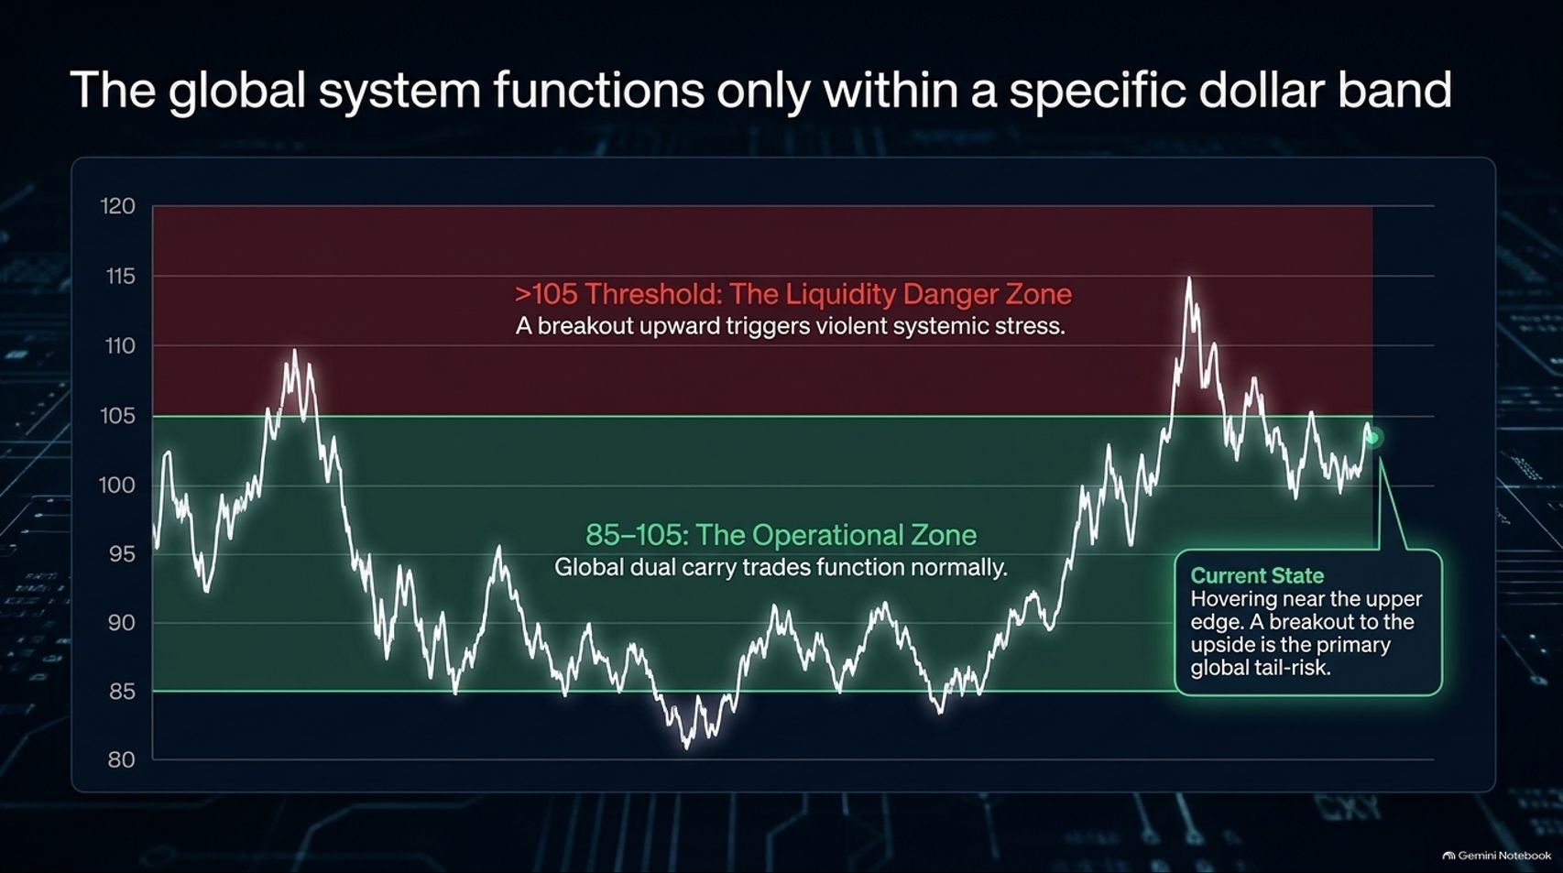
Notes:
Estimated Time: 4 – 5 minutes
Target Word Count: ~600 words
Speaker Notes
Global financial stability is not a continuous state; it operates within strict operational bounds. Slide 3 maps out the macro reality: The global system functions only within a specific dollar band.
Let’s look at the DXY (US Dollar Index) structural thresholds mapped here:
The Operational Zone (85–105): Within this historical band, global trade flows, emerging market debt servicing, and international dual carry trades function with relative normalcy. Central banks can manage currency fluctuations without triggering systemic breakdowns.
The Liquidity Danger Zone (>105): When the DXY breaks decisively upward past the 105 threshold, it ceases to be just a strong currency story—it transforms into a systemic wrecking ball.
As Brent Johnson notes regarding dollar strength, when the greenback grinds toward the upper edge of its historical range and threatens an upside breakout, severe liquidity stress is triggered globally. A surging dollar sucks liquidity out of every foreign banking system, creating margin pressure, forcing foreign debt defaults, and setting the stage for a violent global dash for cash. Right now, hovering near that upper edge, a dollar breakout is the primary unpriced tail-risk in global markets.

Slide 4
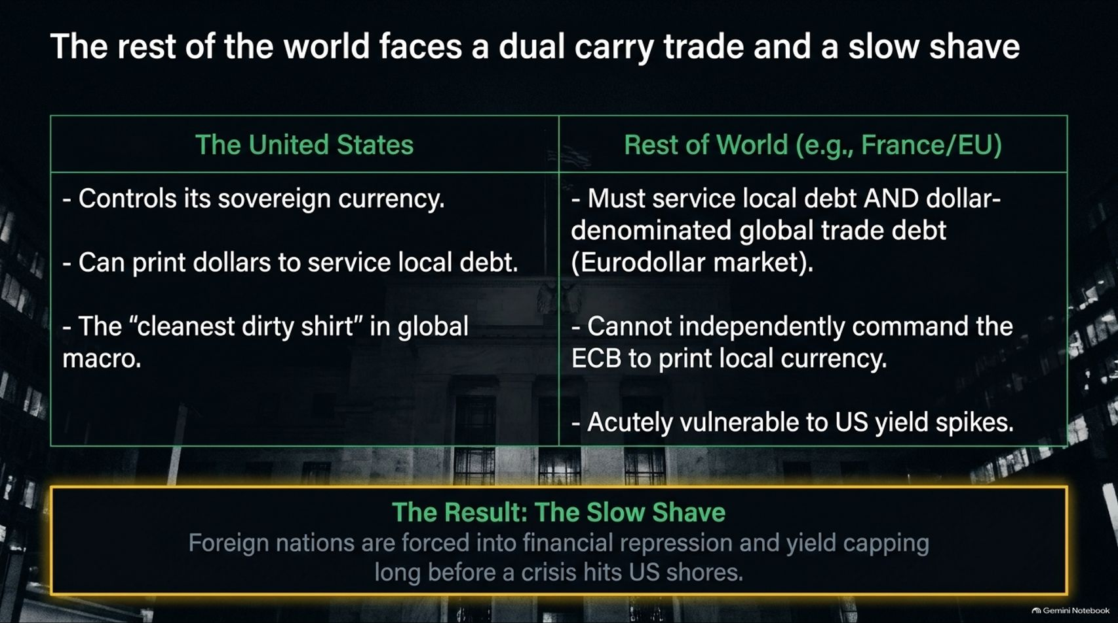
Notes:
Estimated Time: 5 – 6 minutes
Target Word Count: ~650 words
Speaker Notes
Why does a strong US dollar inflict such disproportionate pain outside American borders? Slide 4 breaks down the asymmetric mechanics between the United States and the Rest of the World (using Europe and France as prime examples).
The United States: Controls its own sovereign fiat currency, prints dollars to service domestic debt, and acts as the "cleanest dirty shirt" in global macro. When stress hits, capital naturally flows inward to US sanctuaries.
The Rest of the World: Foreign corporations and governments must service local economic debt and massive dollar-denominated global trade debt housed in the Eurodollar market. They cannot independently command the European Central Bank or foreign central banks to print rescue dollars at will, leaving them acutely vulnerable to US yield spikes.
The Result: The "Slow Shave." Foreign nations are forced into perpetual financial repression, yield-capping, and currency debasement long before an acute crisis ever hits US shores. Their standard of living gets slowly shaved away to service external dollar liabilities, widening the economic divergence between the US core and the foreign periphery.

Slide 5
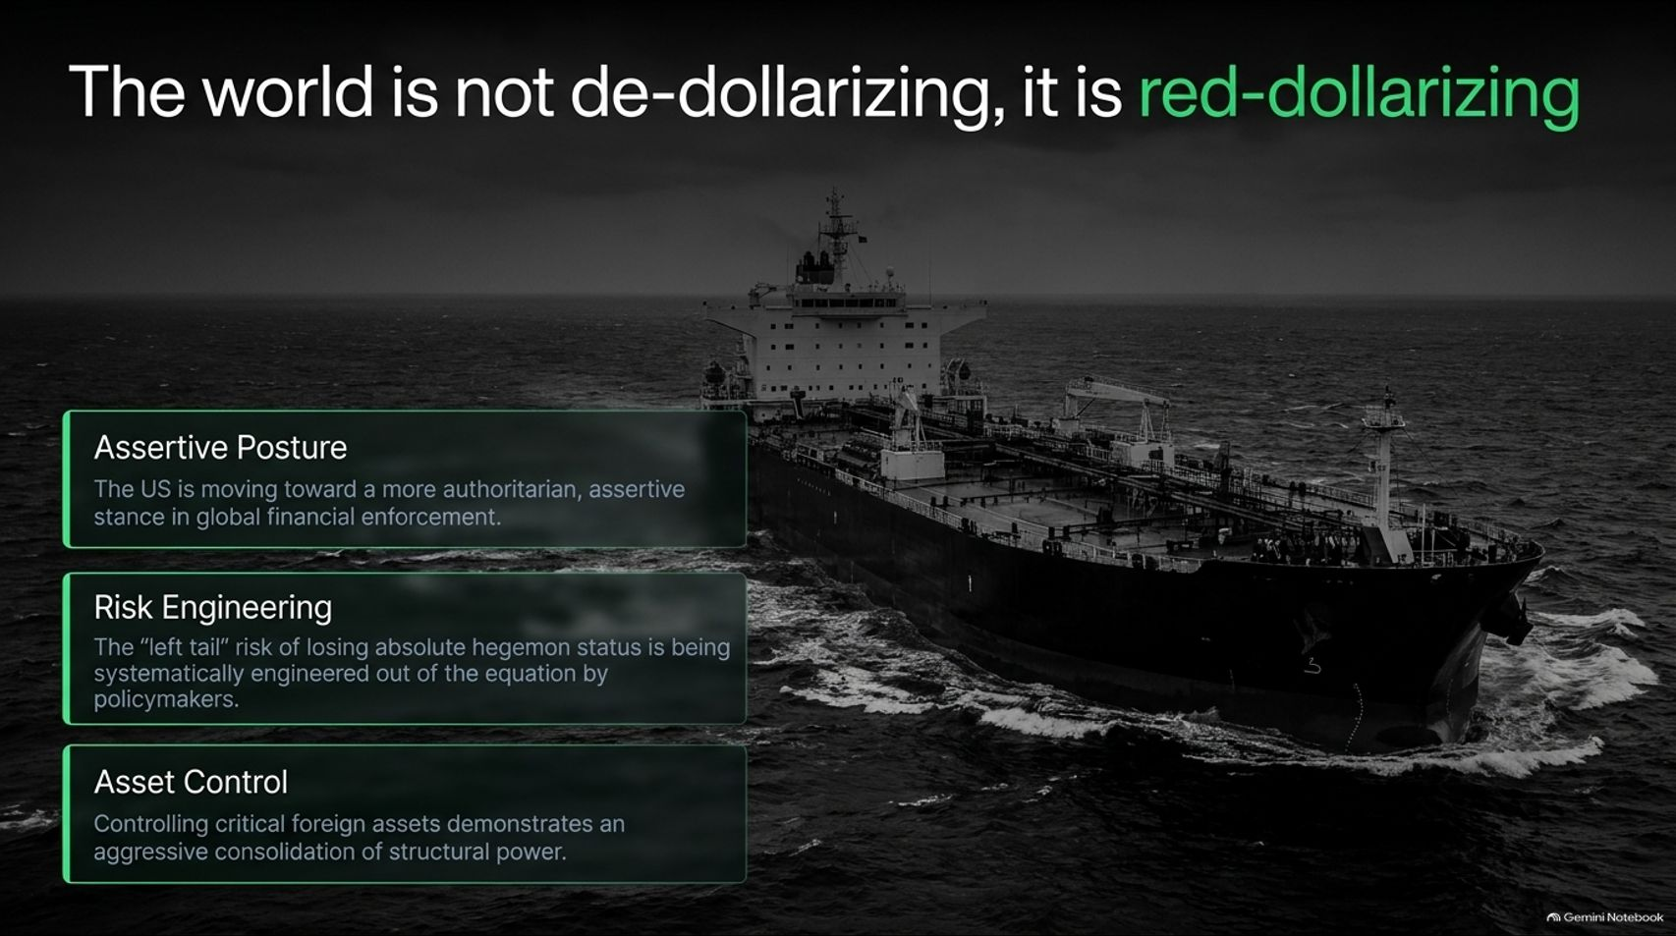
Notes:
Estimated Time: 4 – 5 minutes
Target Word Count: ~600 words
Speaker Notes
For the past three years, financial media has been saturated with breathless headlines about "de-dollarization"—the narrative that BRICS nations and alternative blocs are successfully dethroning the greenback. Slide 5 refutes this narrative directly: The world is not de-dollarizing; it is red-dollarizing.
True de-dollarization would mean foreign actors are replacing dollar dependency with an organic, trusted alternative. What is actually happening is a consolidation of American financial hegemony through three mechanisms:
Assertive Posture: The US is shifting toward a much more assertive, unapologetic stance in global financial enforcement, wielding sanctions and Swift exclusions as primary diplomatic tools.
Risk Engineering: The "left tail" risk of the US losing absolute global reserve status is being systematically engineered out of the equation by policymakers who recognize that no other nation possesses the legal depth, military security umbrella, or capital market liquidity to replace it.
Asset Control: Seizing or controlling critical foreign financial assets demonstrates an aggressive consolidation of structural power rather than a retreat from globalization.
The world isn't escaping the dollar; it is being forced to adapt to a tighter, more heavily monitored, and aggressively enforced digital dollar empire.

Slide 6
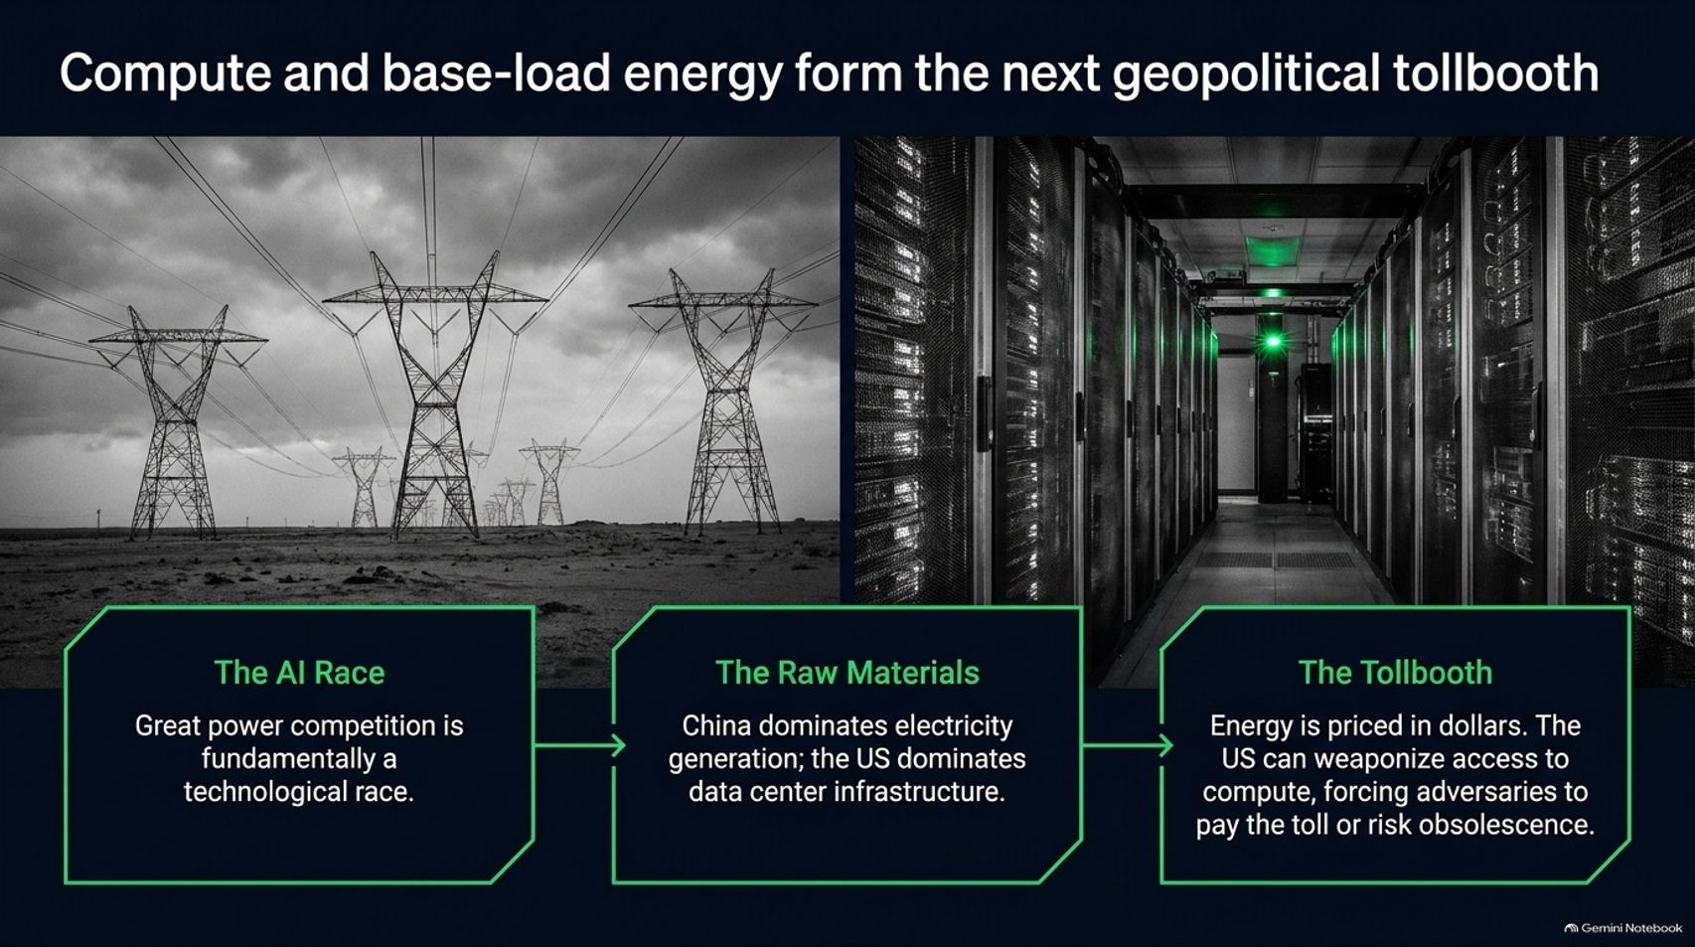
Notes:
Estimated Time: 5 – 6 minutes
Target Word Count: ~700 words
Speaker Notes
To understand where modern superpower conflict is heading, we must look beyond traditional banking ledgers to physical infrastructure. Slide 6 illustrates how Compute and base-load energy form the next geopolitical tollbooth.
Great power competition is fundamentally a technological race centered on Artificial Intelligence and advanced computing. However, this race relies on a stark bifurcation of resources:
The Raw Materials & Energy: China and various emerging regions dominate primary electricity generation and base-load energy capacity.
The Data Center Infrastructure: The United States and its allies dominate the cutting-edge semiconductor design, advanced GPUs, and hyperscale data center architecture.
The Tollbooth Mechanics: Global energy and compute are ultimately priced and settled in US dollars. By controlling access to the underlying silicon, software stacks, and cloud architectures, the US can weaponize access to compute. Adversaries are forced to pay the toll in dollar-denominated rails or risk total technological obsolescence. You cannot win the AI race without compute, and you cannot control compute without plugging into the dollar-denominated financial grid.

Slide 7
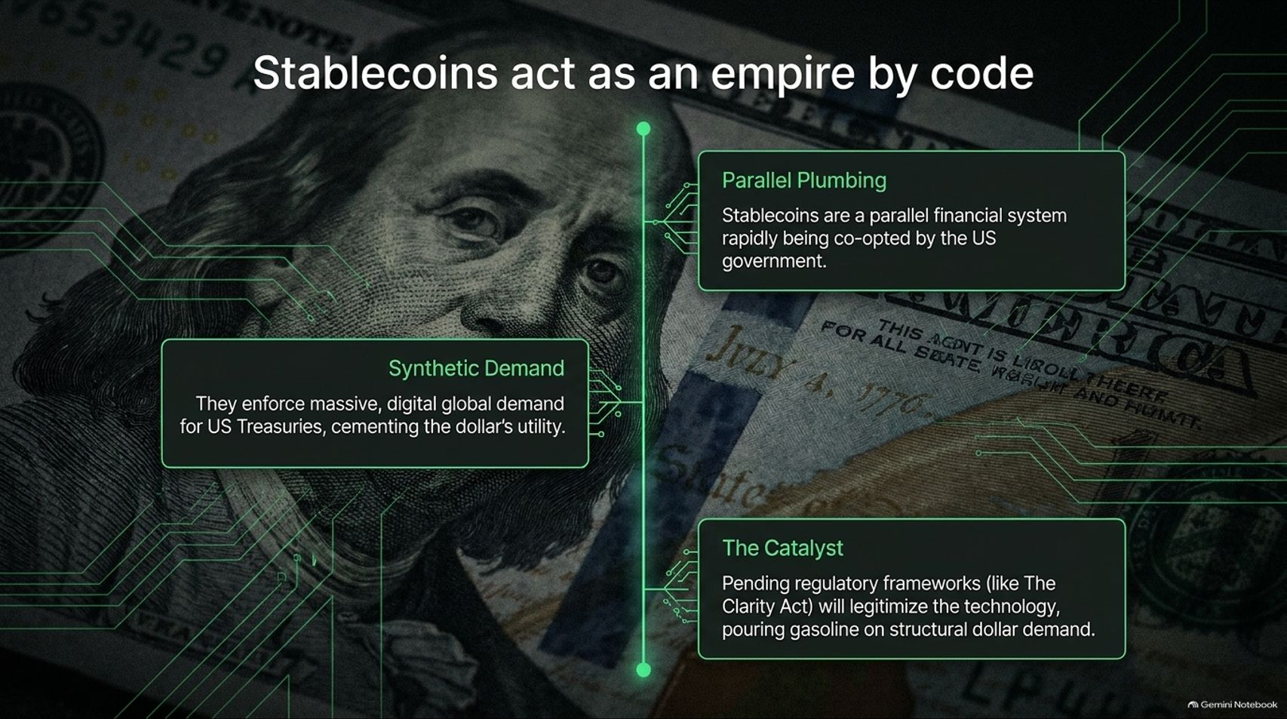
Notes:
Estimated Time: 4 – 5 minutes
Target Word Count: ~600 words
Speaker Notes
While critics view cryptocurrency as a threat to fiat supremacy, the United States financial establishment has pulled off a masterclass in regulatory capture. Slide 7 explains why Stablecoins act as an empire by code.
Instead of destroying the dollar, private-sector stablecoins (which are overwhelmingly pegged 1:1 to the US dollar and backed by short-term Treasuries) are expanding the dollar's reach into every corner of the global digital economy:
Parallel Plumbing: Stablecoins provide a lightning-fast, borderless financial settlement layer that is rapidly being co-opted and institutionalized by the US government.
Synthetic Demand: Every digital dollar token minted overseas requires the backing of physical US Treasuries. This enforces massive, organic, digital global demand for US sovereign debt, cementing the dollar's utility across unbanked and hyper-inflationary emerging markets.
The Regulatory Catalyst: Pending regulatory frameworks (such as digital asset clarity acts) will fully legitimize the technology, pouring institutional gasoline on structural dollar demand.
Crypto isn't replacing the dollar empire; it is upgrading its operating system.

Slide 8
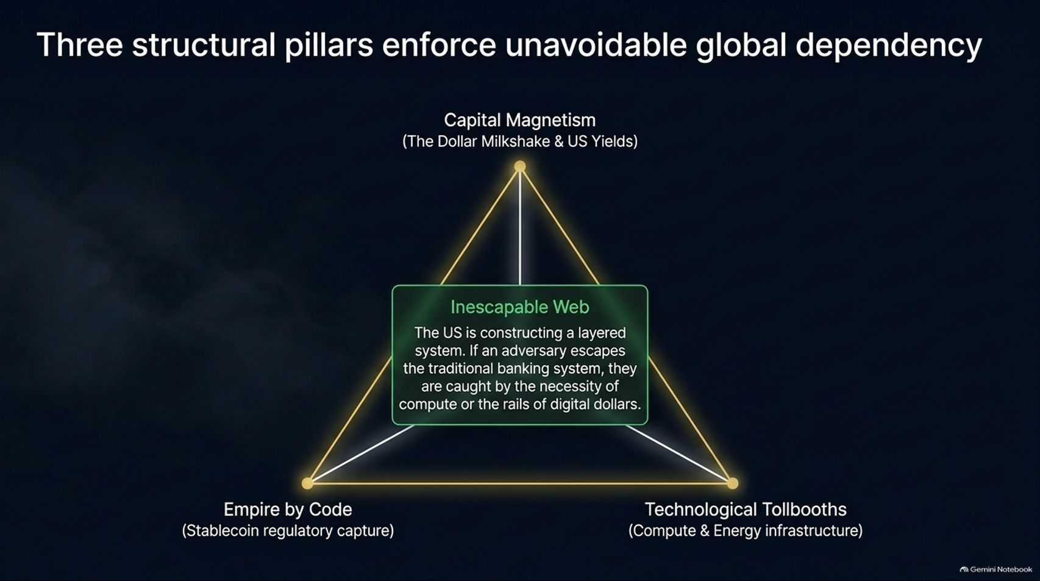
Notes:
Estimated Time: 4 – 5 minutes
Target Word Count: ~550 words
Speaker Notes
When you tie together the macro forces we have examined, you realize the US has constructed an Inescapable Web underpinned by three interlocking pillars (Slide 8):
Capital Magnetism (The Dollar Milkshake & US Yields): The sheer gravity of US capital markets pulls global liquidity inward, starving foreign economies of organic cash flow.
Empire by Code (Stablecoin Regulatory Capture): The proliferation of digital dollar rails ensures that even decentralized or underground cross-border transactions settle back into US sovereign debt instruments.
Technological Tollbooths (Compute & Energy Infrastructure): The physical necessity of AI chips, cloud infrastructure, and energy pricing enforces compliance at the hardware level.
The Inescapable Web: If a foreign adversary or corporate entity attempts to escape the traditional Western banking system to evade sanctions, they are immediately caught by the physical necessity of AI compute or the digital rails of dollar-pegged stablecoins. There is no outside.

Slide 9
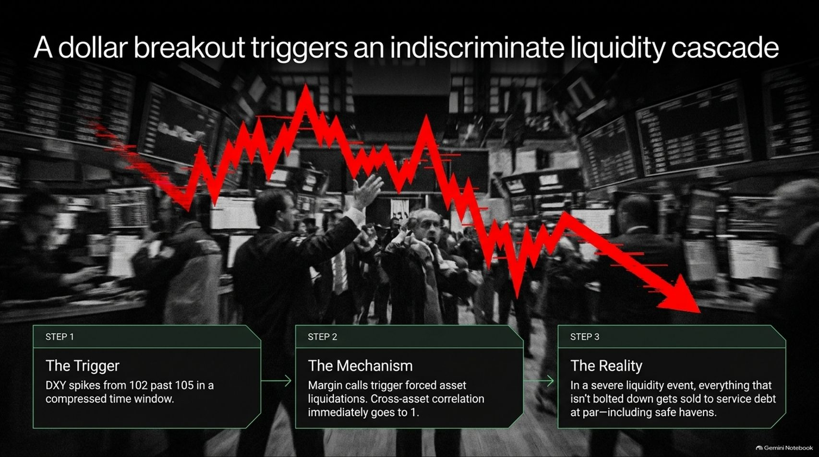
Notes:
Estimated Time: 5 – 6 minutes
Target Word Count: ~650 words
Speaker Notes
What happens when this coiled spring lets go? Slide 10 maps the mechanics of the next major market shock: A dollar breakout triggers an indiscriminate liquidity cascade.
Let's step through the transmission mechanism:
Step 1 (The Trigger): The DXY index violently spikes past the 105 level in a compressed time window, driven by a sudden global shortage of dollar liquidity.
Step 2 (The Mechanism): Foreign entities, hedge funds, and leveraged institutions face immediate margin calls. To cover US dollar-denominated debts, they are forced into indiscriminate asset liquidations. In a true panic, cross-asset correlation goes immediately to 1—everything gets sold, regardless of fundamental quality.
Step 3 (The Reality): In a severe liquidity event, solvency supersedes valuation. Anything that isn't bolted down gets sold to service debt at par—including traditional safe havens and high-grade equities.
This is why passive investors get crushed during liquidity crunches: cash is king, and forced sellers have zero negotiating power.

Slide 10
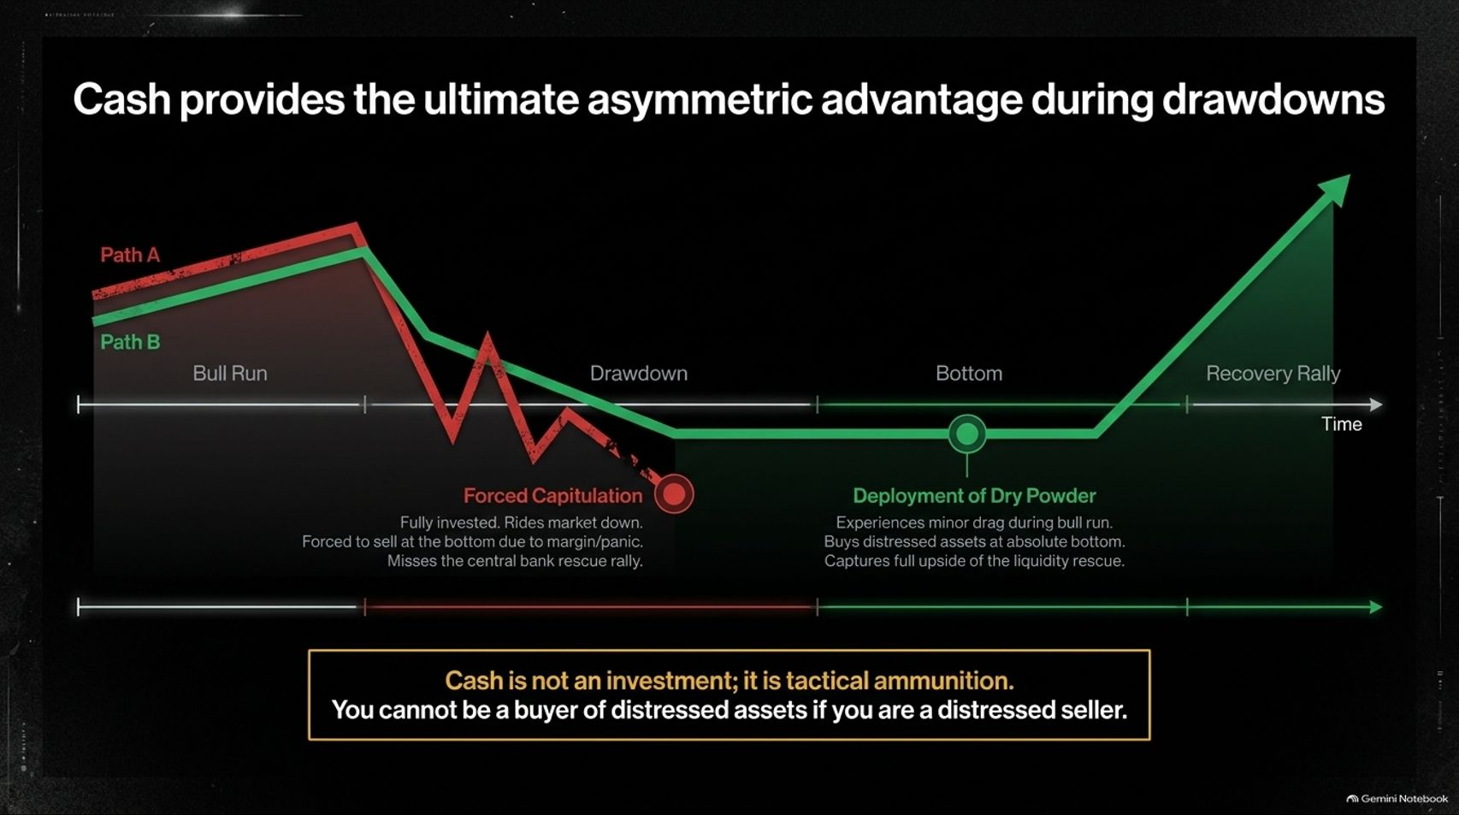
Notes:
Estimated Time: 5 – 6 minutes
Target Word Count: ~650 words
Speaker Notes
Wall Street loves to preach "stay fully invested all the time." Slide 10 exposes the fatal flaw in that dogma: Cash provides the ultimate asymmetric advantage during drawdowns.
Look at the two paths modeled on this slide:
Path A (Forced Capitulation): The investor remains 100% invested through a bull run, rides the market down into the drawdown, faces margin pressure, and is forced to sell at absolute panic bottoms—completely missing the subsequent central bank rescue rally.
Path B (Deployment of Dry Powder): The investor maintains tactical cash and short-term paper, experiencing only minor opportunity drag during late-stage bull blow-offs. When the liquidity cascade hits and asset prices detach from reality, they deploy dry powder to buy distressed assets at absolute bottom valuations, capturing the full upside of the eventual rescue rally.
The Core Takeaway: Cash is not a stagnant investment yield drag; cash is tactical ammunition. You cannot act as a buyer of distressed assets if you are a distressed seller yourself.

Slide 11
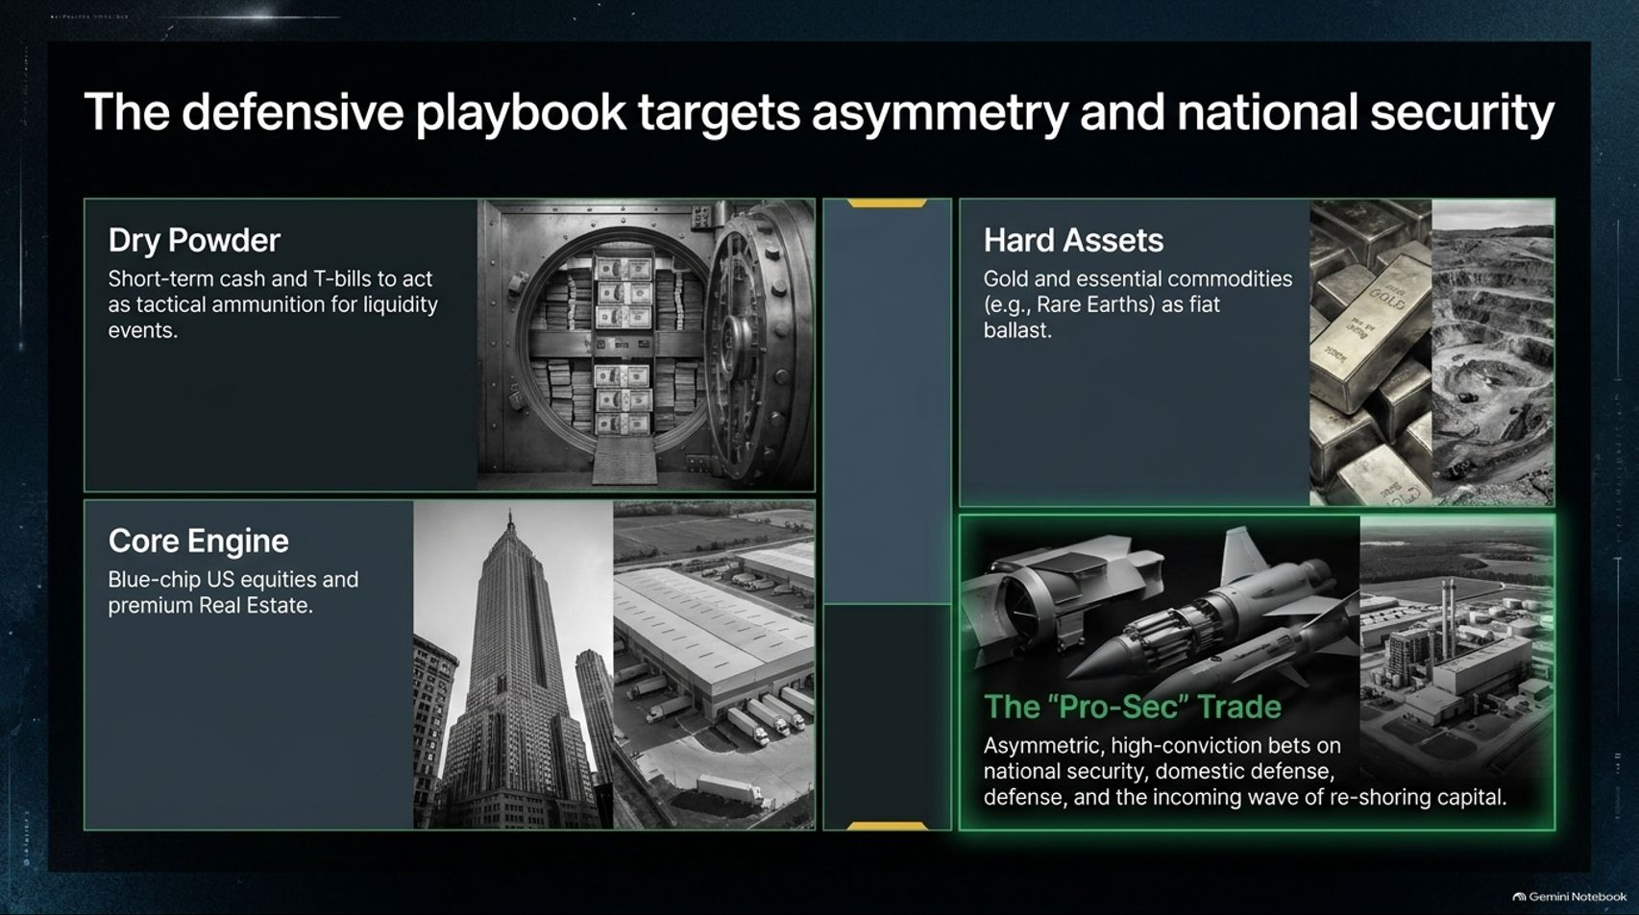
Notes:
Estimated Time: 4 – 5 minutes
Target Word Count: ~600 words
Speaker Notes
How do we position our portfolios for this environment? Slide 11 outlines The Defensive Playbook, built around four core asset pillars:
Dry Powder: Short-term cash equivalents and Treasury bills acting as tactical ammunition for upcoming liquidity events.
Hard Assets: Physical gold, silver, and essential commodities (such as rare earths) serving as foundational fiat ballast against currency debasement.
Core Engine: Blue-chip US equities with bulletproof balance sheets and premium real estate.
The "Pro-Sec" Trade: Asymmetric, high-conviction allocations targeting national security, domestic defense manufacturing, energy independence, and the multi-year structural wave of capital re-shoring.
By structuring your portfolio around national security tailwinds and dry powder reserves, you insulate your capital from systemic shock while remaining agile enough to capitalize on forced liquidations.

Slide 12
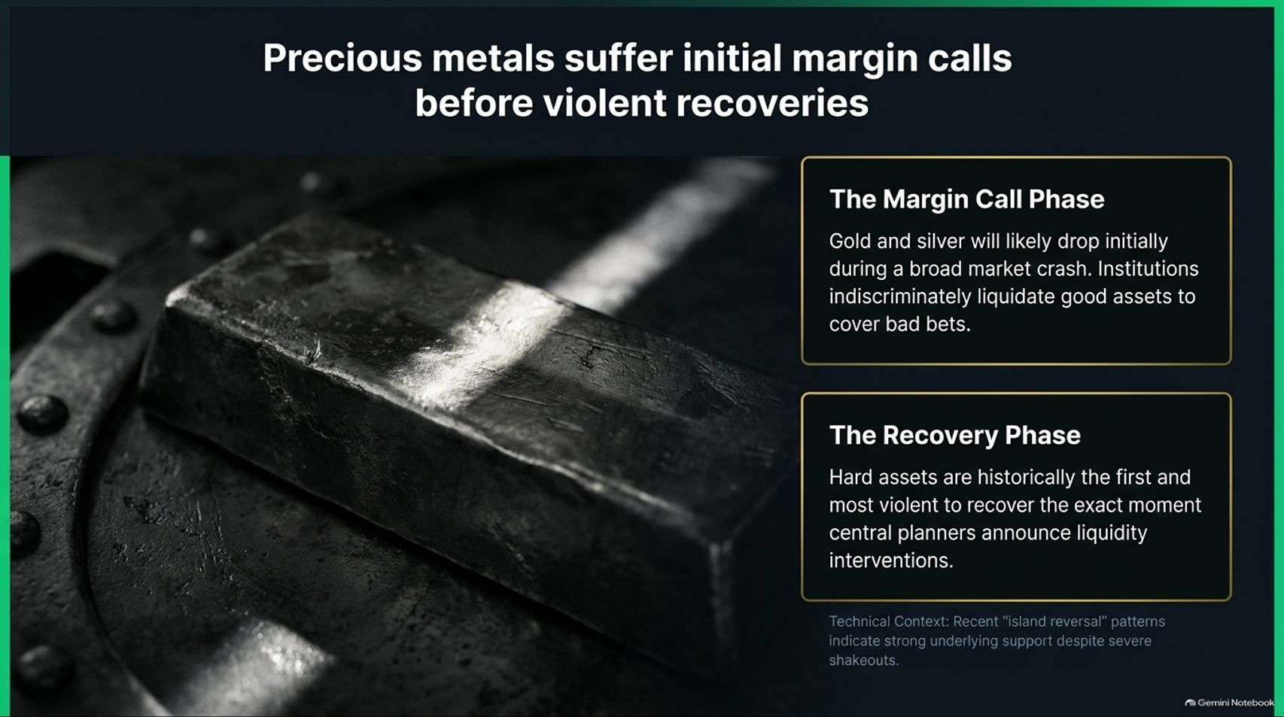
Notes:
Estimated Time: 4 – 5 minutes
Target Word Count: ~550 words
Speaker Notes
Investors often assume gold and silver are bulletproof shields that only go up during crises. Slide 12 issues a vital warning: Precious metals suffer initial margin calls before violent recoveries.
The Margin Call Phase: During the initial phase of a broad market crash or liquidity crunch, gold and silver will likely drop alongside everything else. Why? Because over-leveraged institutions facing margin calls will indiscriminately liquidate their best, most liquid assets—including precious metals—to cover bad bets elsewhere.
The Recovery Phase: However, this washout is short-lived. Hard assets are historically the first and most violent asset classes to recover the exact moment central planners announce emergency liquidity interventions or rate cuts.
Technical indicators like recent "island reversal" patterns signal strong underlying institutional support beneath the surface, proving that shakeouts are designed to separate weak hands from hard assets before the next monetary expansion leg.

Slide 13
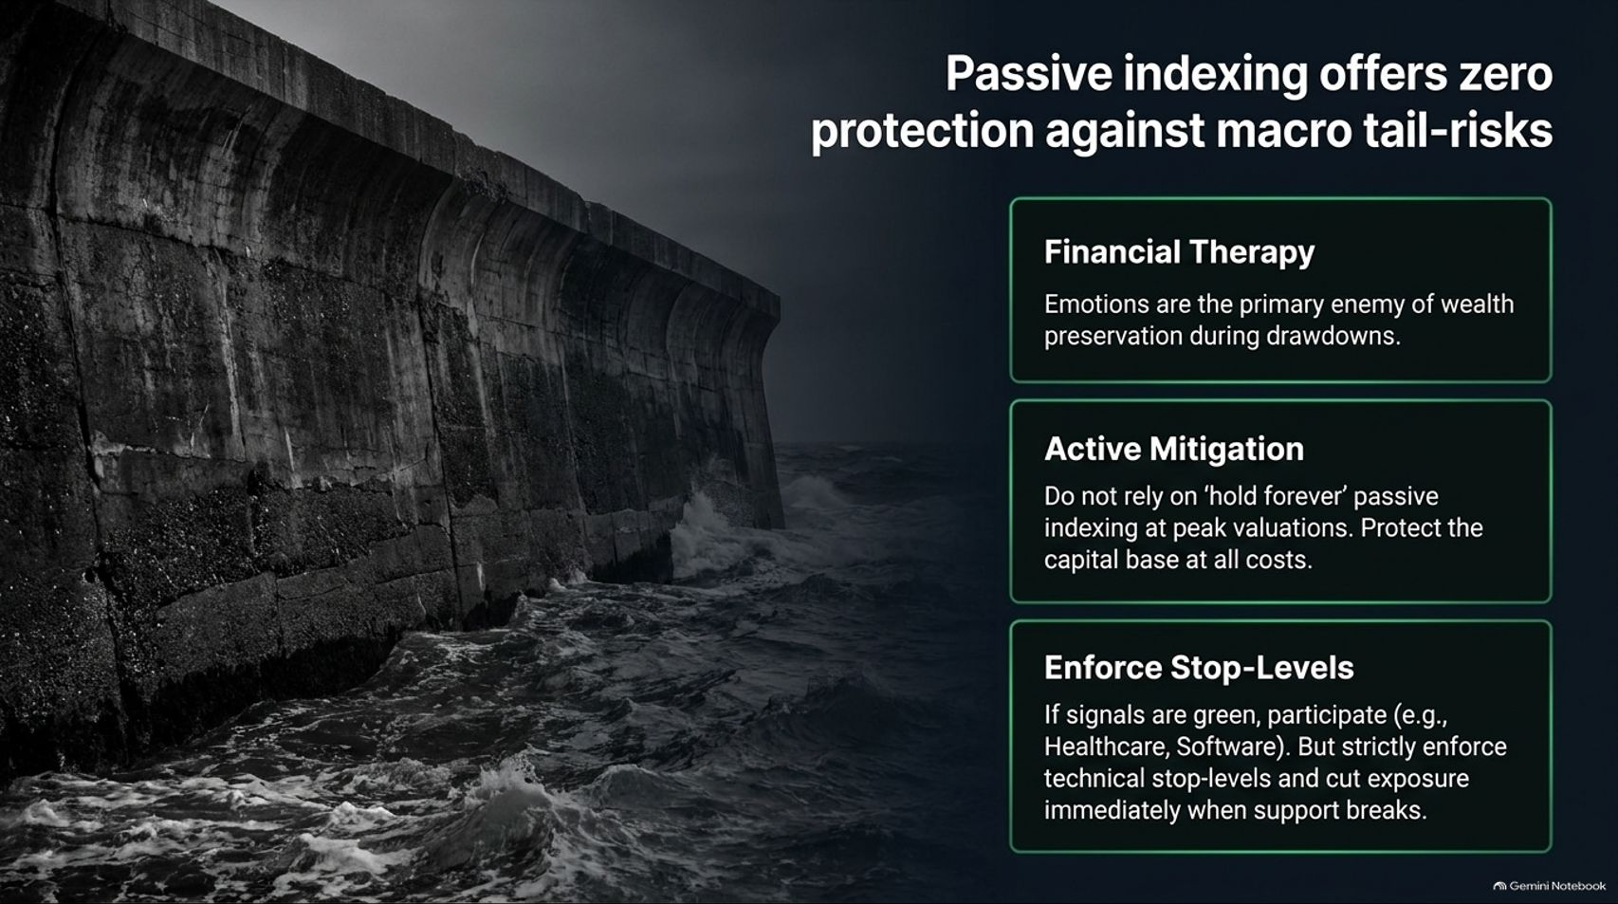
Notes:
Estimated Time: 4 – 5 minutes
Target Word Count: ~550 words
Speaker Notes
For the past fifteen years, passive indexing ("buy the S&P 500 and forget it") has been the default winning strategy. Slide 13 issues a stark caution: Passive indexing offers zero protection against macro tail-risks.
To survive macro regime shifts, you must manage both your portfolio and your psychology:
Financial Therapy: Emotions—panic, greed, and recency bias—are the primary enemies of wealth preservation during major market drawdowns.
Active Mitigation: Do not blindly rely on a "hold forever" passive indexing mindset when markets are sitting at historical peak valuations and structural liquidity is tightening. Protect your capital base at all costs.
Enforce Stop-Levels: When market signals are green, participate aggressively in leading sectors like healthcare and software. But strictly enforce technical stop-levels and cut exposure immediately when structural support breaks. Hope is not an investment strategy.

Slide 14
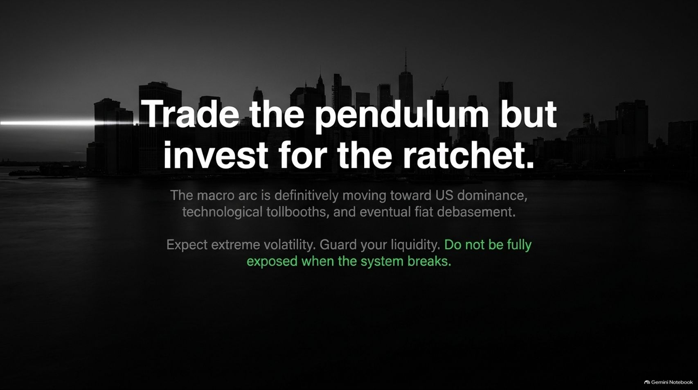
Notes:
Estimated Time: 3 – 4 minutes
Target Word Count: ~400 words
Speaker Notes
As we reach the conclusion of our deck on Slide 14, we summarize our guiding philosophy into one core maxim: Trade the pendulum, but invest for the ratchet.
The macro arc of our global economy is definitively moving toward American financial dominance, technological tollbooths, and inevitable long-term fiat debasement. You can trade the short-term noise of the political pendulum if you have the appetite, but your long-term capital allocation must respect the multi-decade structural ratchet.
Expect extreme volatility ahead. Guard your liquidity like your life depends on it, because when the system breaks, liquidity is the only currency that matters. Do not be fully exposed when the music stops.

Slide 15
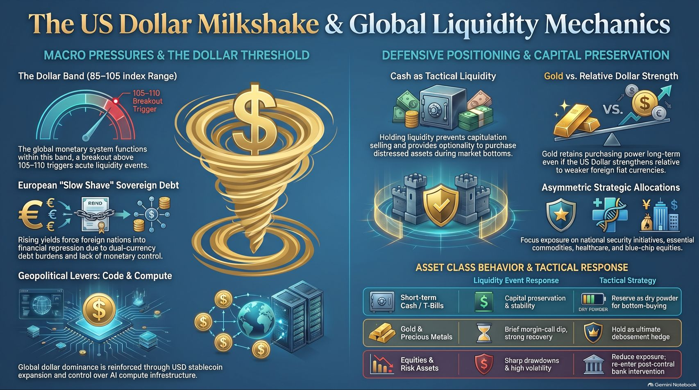
Notes:
Estimated Time: 4 – 5 minutes
Target Word Count: ~600 words
Speaker Notes
To wrap up our entire blueprint, Slide 15 provides the master summary framework of The US Dollar Milkshake & Global Liquidity Mechanics:
Macro Pressures: Monitoring the critical 105 DXY breakout threshold, navigating European sovereign debt "slow shaves," and recognizing how code and compute serve as modern geopolitical levers.
Defensive Positioning: Maintaining short-term T-bills as dry powder, holding physical gold as an ultimate debasement hedge, and tilting allocations toward national security and defense plays.
Tactical Response Matrix: Anticipating initial margin call dips in hard assets before violent monetary recoveries, while actively reducing risk exposure in high-beta equities ahead of systemic liquidity crunches.
Thank you for your time. The next liquidity crisis will punish complacency and reward preparation. Protect your dry powder, respect the dollar milkshake dynamics, and position your portfolio for the structural ratchet. I am happy to open the floor to Q&A.
For a deeper audio-video breakdown of these exact global liquidity mechanics and dollar strength warning signs, you can watch this analysis: Brent Johnson on Dollar Strength Risks. This video provides critical context on why an upside breakout in the US dollar index acts as a primary catalyst for global financial tightening and market drawdowns.

