Slide 1

Notes:
Estimated Time: 2 – 3 minutes
Target Word Count: ~350 words
Speaker Notes
Welcome, everyone. Today we are diving into a masterclass on market mechanics, discipline, and technical execution: The Tape Tells All: Trading Lessons from over 60 years in the market, based on the Stan Weinstein Playbook.
Stan Weinstein is a market legend, the author of the seminal book Secrets for Profiting in Bull and Bear Markets, and the creator of the world-renowned Stage Analysis system. Over his decades-long career, Weinstein has navigated everything from the 1987 crash to the dot-com bubble and the 2008 financial crisis.
In this session, we aren't just looking at historical theory; we are examining how market psychology, supply and demand, and multi-timeframe moving averages form the bedrock of professional trading. We will explore the four major stages of a stock’s lifecycle, deconstruct the anatomy of a perfect breakout, examine sector rotation through the "Forest for the Trees" approach, and contrast amateur emotional baggage with professional execution.
Whether you are trading a roaring bull market or navigating a brutal transitional correction, mastering the tape is the ultimate survival skill. Let's jump in.
60+ Years of Trading Lessons from Stan Weinstein | Stage Analysis Inventor
https://www.youtube.com/watch?v=PRRNI5SrUWY

Slide 2
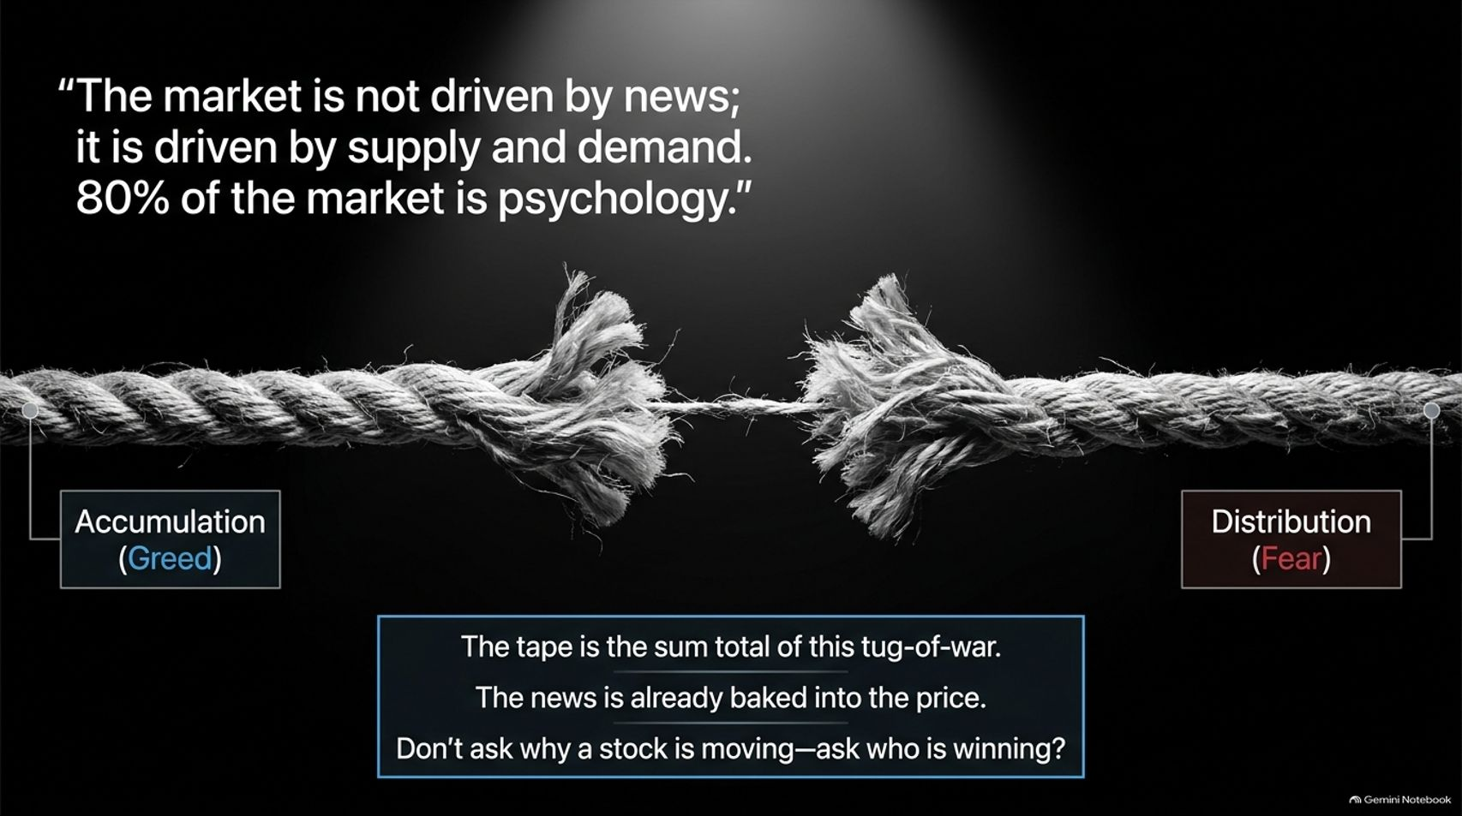
Notes:
Estimated Time: 4 – 5 minutes
Target Word Count: ~550 words
Speaker Notes
Let’s start with the foundational philosophy that drives every chart on Wall Street. As Weinstein famously points out: "The market is not driven by news; it is driven by supply and demand. 80% of the market is psychology."
Most retail traders make the fatal mistake of acting like amateur economists. They watch financial news networks, read earnings reports, and try to rationalize why a stock is moving. But by the time news hits the public domain, it is already baked into the price. The tape is the pure, unfiltered sum total of a constant tug-of-war between two psychological extremes: Accumulation driven by greed and Distribution driven by fear.
Think of the market as the greatest manic-depressive entity in history. One month, Wall Street is wildly infatuated with semiconductors, bidding them up to the moon; the next month, sentiment flips instantly to absolute panic.
Therefore, the golden rule of tape reading is this: Don't ask why a stock is moving—ask who is winning. When buying pressure overwhelms selling pressure, the stock goes up regardless of macroeconomic headlines. Stop arguing with the price action. Learn to read the scoreboard.

Slide 3
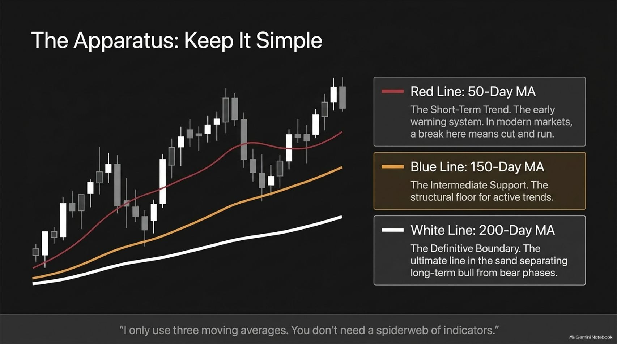
Notes:
Estimated Time: 4 – 5 minutes
Target Word Count: ~600 words
Speaker Notes
When you look at the computer screens of struggling traders, they often resemble a chaotic spiderweb of MACD histograms, RSI oscillators, Bollinger bands, and a dozen overlapping moving averages. On Slide 3, we emphasize Weinstein’s core mantra: Keep it simple (KISS).
Stan Weinstein relies exclusively on three moving averages on a daily and weekly chart:
The Red Line (50-Day Moving Average): This represents the short-term trend and serves as your early warning system. In modern, fast-moving algorithmic markets, a violation of the 50-day MA is an immediate yellow light—often a cue to tighten stops or reduce exposure.
The Blue Line (150-Day Moving Average): This acts as intermediate support and the structural floor for active trend campaigns.
The White Line (200-Day Moving Average): This is the definitive boundary—the ultimate line in the sand separating a long-term bull market phase from a bear market phase.
As Weinstein notes, you don't need a hundred indicators to be profitable; you need absolute clarity. When price respects these key moving averages, you stay in the trade. When the structural boundaries break, you step aside.

Slide 4
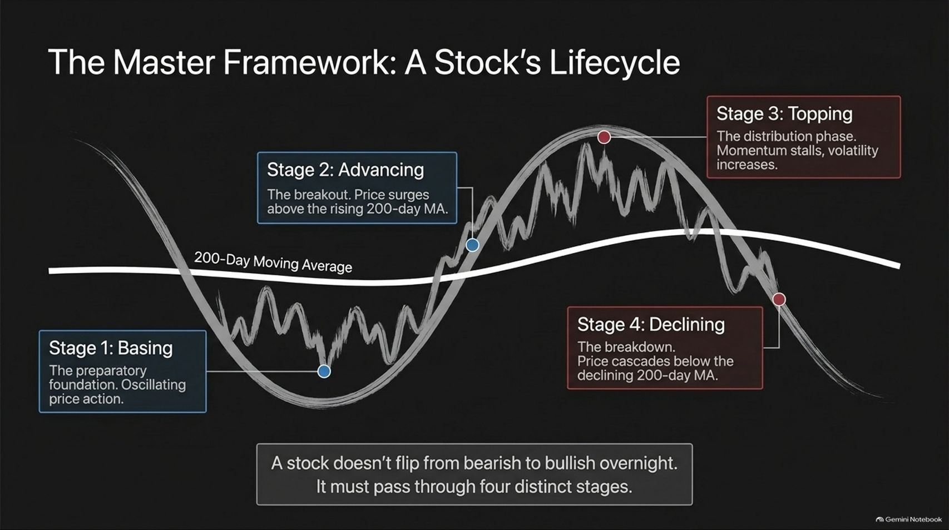
Notes:
Estimated Time: 5 – 6 minutes
Target Word Count: ~700 words
Speaker Notes
Slide 4 introduces the crown jewel of Weinstein’s methodology: The Master Framework of a Stock’s Lifecycle.
A stock does not simply flip from bearish to bullish overnight. It must transition through four distinct stages, governed by the slope of the 200-day moving average:
Stage 1: Basing (Accumulation): The preparatory foundation. Price moves sideways in a tight range while the 200-day moving average flattens out. Institutions and "smart money" quietly accumulate shares from bored or despairing retail sellers.
Stage 2: Advancing (The Uptrend): The breakout. Price surges above horizontal resistance and punches decisively above a rising 200-day moving average. This is where institutional sponsorship kicks in, and it is the prime zone for low-risk, high-reward entries.
Stage 3: Topping (Distribution): The transition phase. Momentum stalls, price action becomes wildly volatile and whipsawing, and the 200-day MA flattens. Smart money begins offloading shares to late-coming retail buyers.
Stage 4: Declining (The Downtrend): The breakdown. Price cascades below a now-declining 200-day moving average. Institutional sponsorship evaporates, leaving the stock stranded in a chronic downtrend.
Understanding which stage a stock occupies prevents you from buying falling knives in Stage 4 or holding past tops in Stage 3.

Slide 5
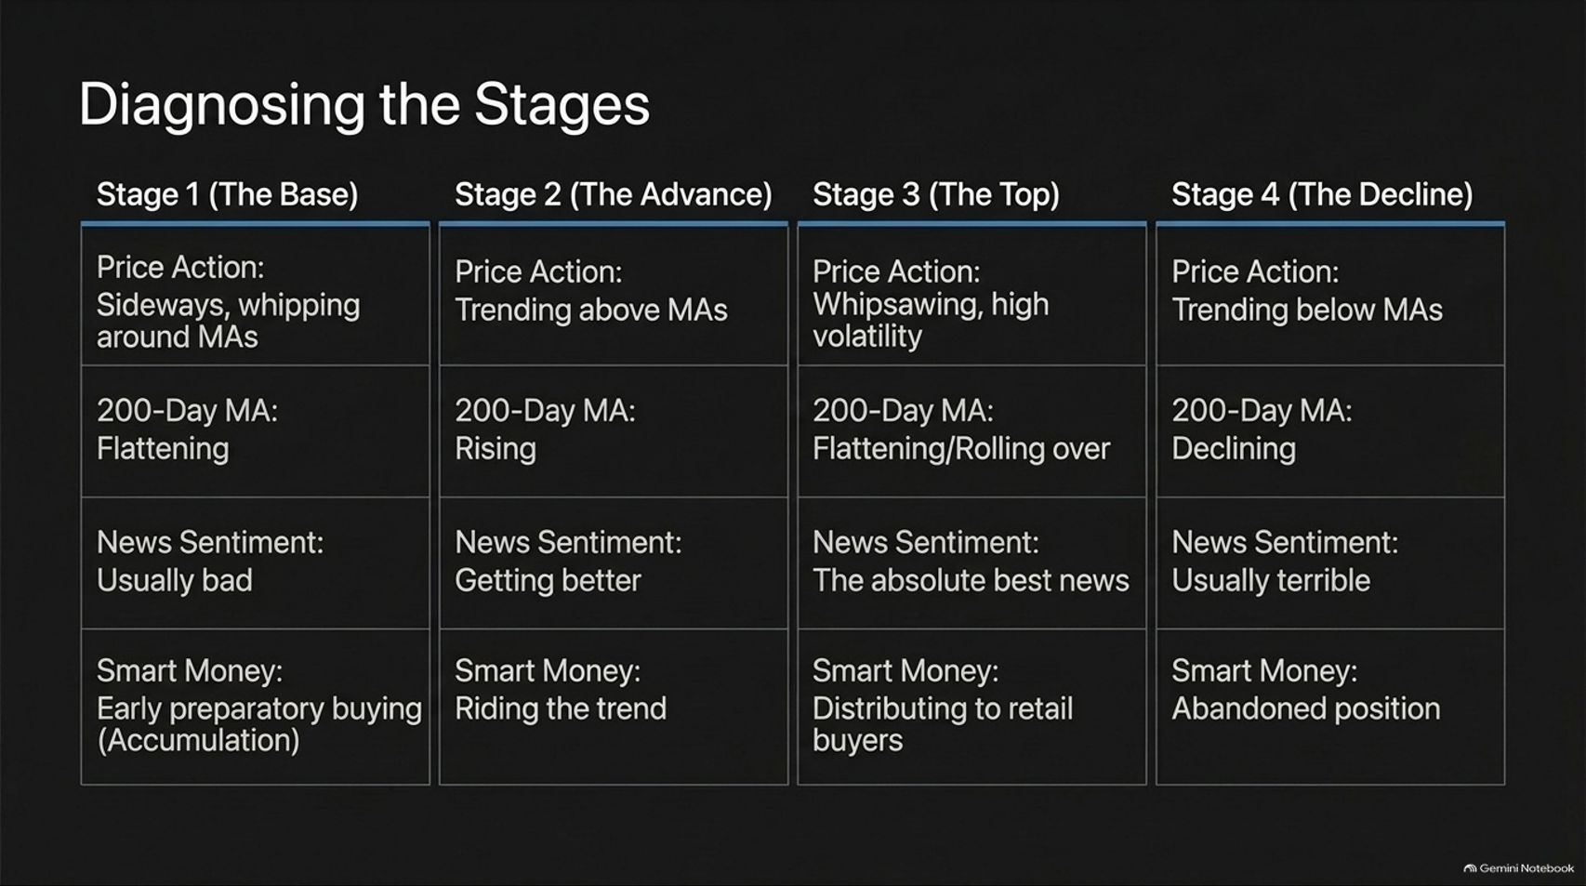
Notes:
Estimated Time: 4 – 5 minutes
Target Word Count: ~600 words
Speaker Notes
To make Stage Analysis actionable, Slide 5 breaks down a diagnostic matrix comparing price action, moving averages, news sentiment, and smart money behavior across all four stages:
Stage 1 (The Base): Sideways price action whipping around a flattening 200-day MA. News sentiment is usually terrible—there is always a glaring reason why the stock is beaten down. Behind the scenes, smart money is engaged in early preparatory accumulation.
Stage 2 (The Advance): Price trends cleanly above rising moving averages. News sentiment begins turning positive as earnings improve. Smart money is fully committed, riding the primary trend.
Stage 3 (The Top): Wild whipsawing and high volatility. The 200-day MA rolls over and flattens. Crucially, news sentiment reaches absolute perfection—front-page headlines herald record profits, which is precisely when smart money distributes shares to retail FOMO buyers.
Stage 4 (The Decline): Price trends relentlessly below declining moving averages. News sentiment is abysmal, and smart money has entirely abandoned the position.
Recognizing that peak good news often coincides with Stage 3 distribution is one of the most profitable realizations a trader can have.

Slide 6
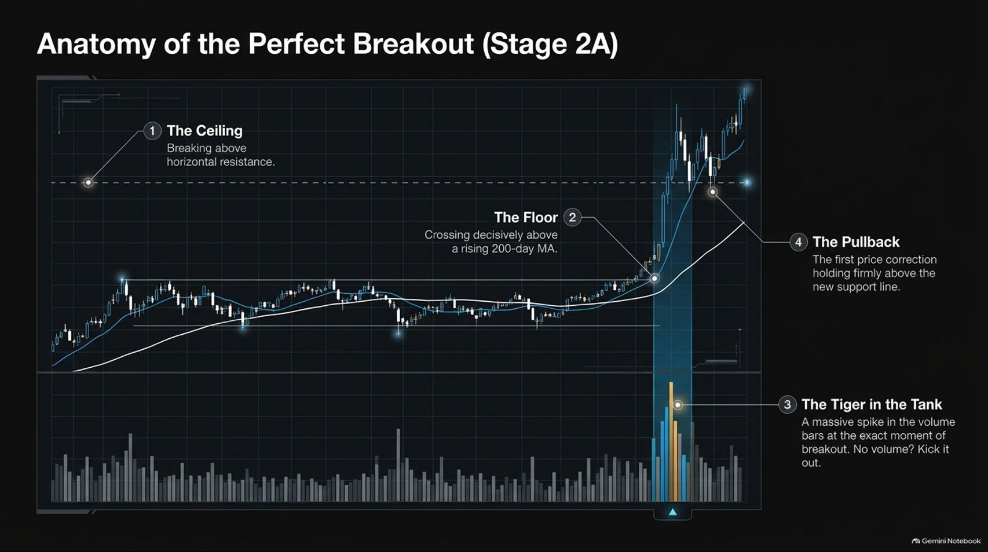
Notes:
Estimated Time: 5 – 6 minutes
Target Word Count: ~650 words
Speaker Notes
When scanning for new trade ideas, you aren't looking for just any breakout; you are hunting for the pristine Stage 2A Breakout. Slide 6 details its four vital anatomical components:
The Ceiling (1): The stock shatters through horizontal resistance established during the Stage 1 basing period.
The Floor (2): Price crosses decisively above a rising 200-day moving average, confirming that the long-term trend has officially shifted to bullish.
The Tiger in the Tank (3): Volume. As Weinstein emphasizes, all breakouts are not created equal. If a stock breaks resistance on anemic volume, kick it out. You want to see a massive, explosive spike in volume bars on the exact day of the breakout. That volume spike proves institutional sponsorship—the "tiger in the tank".
The Pullback (4): After the initial thrust, the stock undergoes a mild price correction that holds firmly above the breakout level. If it plunges all the way back into the old base, "Houston, we have a problem". If it holds shallow, it offers a pristine secondary add-on entry.

Slide 7
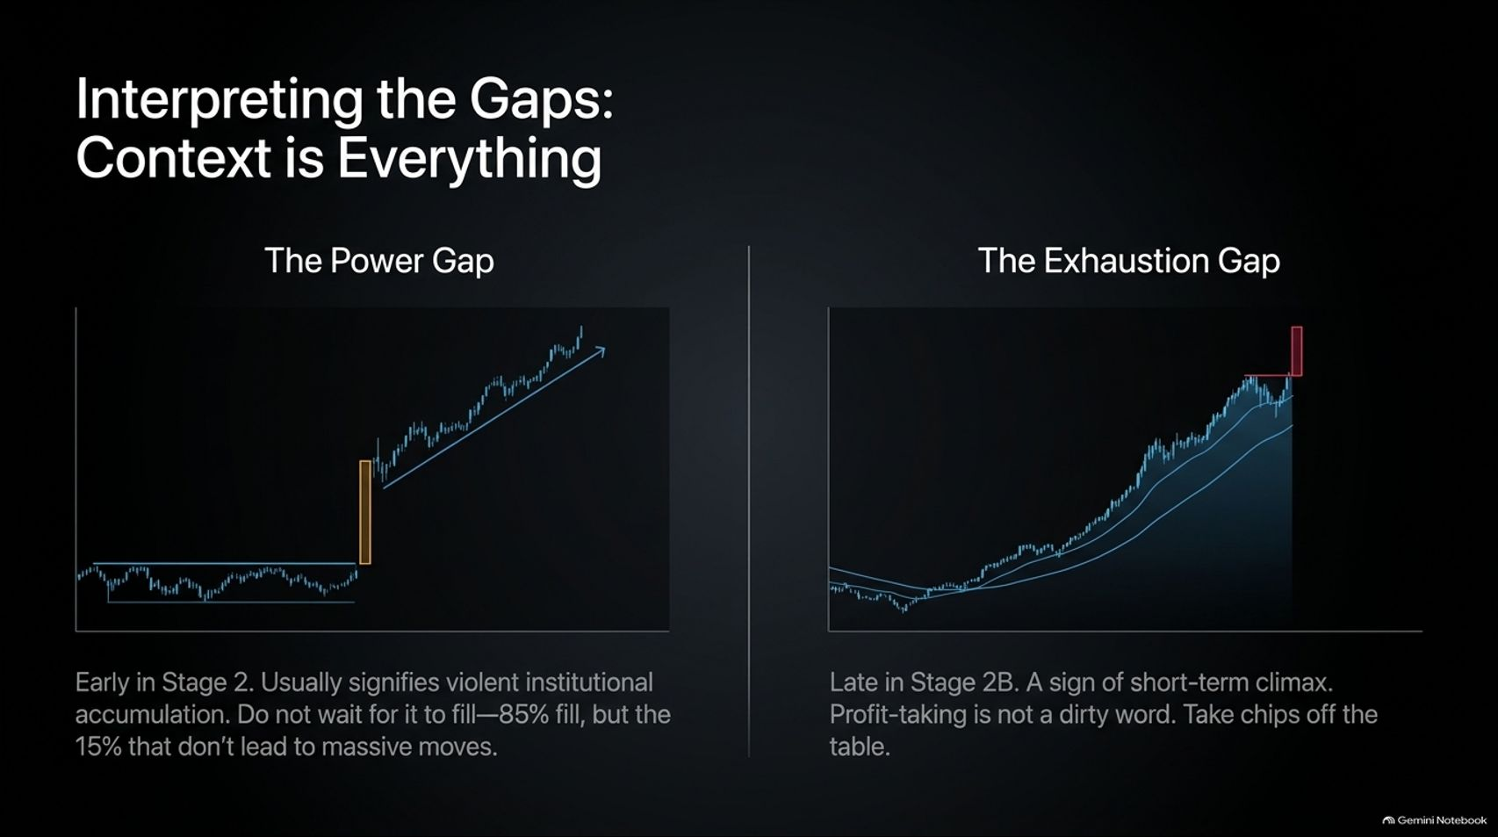
Notes:
Estimated Time: 4 – 5 minutes
Target Word Count: ~550 words
Speaker Notes
Price gaps are powerful signals on a chart, but their meaning depends entirely on where they occur in a stock’s lifecycle. Slide 7 contrasts The Power Gap against The Exhaustion Gap:
The Power Gap: This occurs early in Stage 2, right as a stock breaks out of its base. It usually signifies violent, aggressive institutional accumulation. Traders often make the mistake of waiting for gaps to fill; as Weinstein notes, while 85% of ordinary gaps fill over time, the 15% that don't fill are the monster breakout stocks that never look back. Do not miss out waiting for a 100% fill.
The Exhaustion Gap: This occurs late in Stage 2B after a protracted, multi-month advance. It represents a climatic blow-off top where retail euphoria peaks. Profit-taking is never a dirty word here. When you see an exhaustion gap after an extended run, take chips off the table.

Slide 8

Notes:
Estimated Time: 4 – 5 minutes
Target Word Count: ~600 words
Speaker Notes
A common question Stan Weinstein receives is: “You wrote your book in 1988; does Stage Analysis still work in today's algorithmic market?” The answer is a resounding yes, but with one major caveat: The rules of fear and greed haven't changed, but the speed of the market has accelerated exponentially.
Algorithmic Dominance: In past decades, market makers and human specialists maintained an orderly order book. Today, institutional flows are driven by high-frequency trading programs and programmatic button-presses that can swing markets in hours.
Speed of Failure: Black clouds form much faster today. Previously, a violation of the 50-day moving average was a signal to merely reduce position size. In modern markets, a violent break of the 50-day MA means you must cut exposure immediately, step aside, and live to fight another day.
The core principles of supply and demand remain bulletproof, but your execution must be faster and more disciplined than your father's generation.

Slide 9
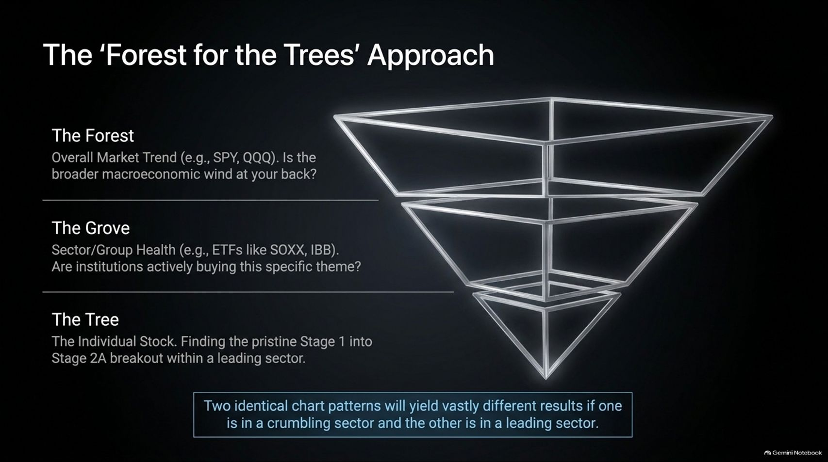
Notes:
Estimated Time: 4 – 5 minutes
Target Word Count: ~600 words
Speaker Notes
To consistently pick winning stocks, you must adopt a top-down analytical framework known as The 'Forest for the Trees' Approach (Slide 9).
The Forest (The Overall Market): Look at major market indices like SPY or QQQ. Is the broader macroeconomic wind at your back, or are indices breaking down into Stage 3 and Stage 4? Never fight the primary market tide.
The Grove (Sector & Group Health): Inspect industry ETFs like SOXX (semiconductors), IBB (biotech), or XRT (retail). Are institutions actively accumulating this specific theme, or is capital fleeing?
The Tree (The Individual Stock): Only after confirming the Forest and Grove are healthy do you drill down to find pristine Stage 1-to-2A breakouts within leading sectors.
Core Takeaway: Two identical chart patterns will yield vastly different results if one is in a crumbling, hated sector and the other is leading a surging bull group. Always align yourself with sector strength.

Slide 10
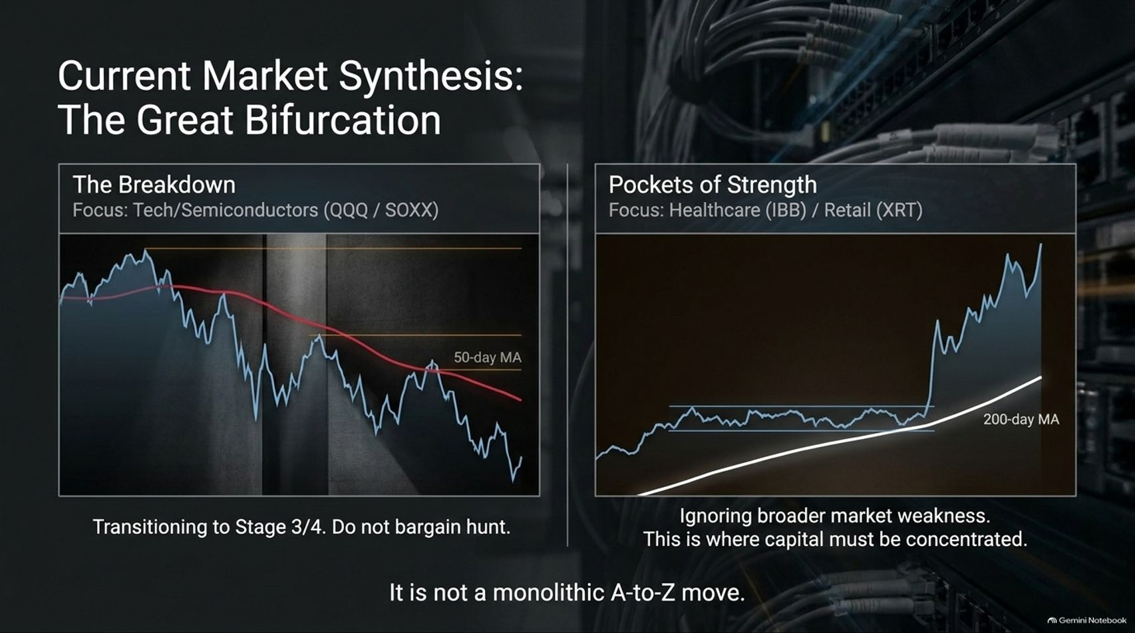
Notes:
Estimated Time: 5 – 6 minutes
Target Word Count: ~650 words
Speaker Notes
Markets are rarely monolithic. Slide 10 highlights a critical market dynamic: The Great Bifurcation.
During transitional market environments, you cannot treat the market as a single asset class. We often witness stark divergences across sectors:
The Breakdown (e.g., Tech / Semiconductors - QQQ / SOXX): Indices or leading groups rolling over into Stage 3 distribution and crossing below their 50-day and 200-day moving averages. When a dominant group transitions into Stage 3/4, do not bargain hunt.
Pockets of Strength (e.g., Healthcare - IBB / Retail - XRT): Simultaneously, defensive or rotation sectors may be quietly forming massive Stage 1 bases and breaking out into pristine Stage 2 uptrends, completely ignoring broader market weakness.
This is where institutional capital rotates. Your job as a trader is to exit breaking sectors immediately and concentrate your capital entirely in these emerging Pockets of Strength.

Slide 11
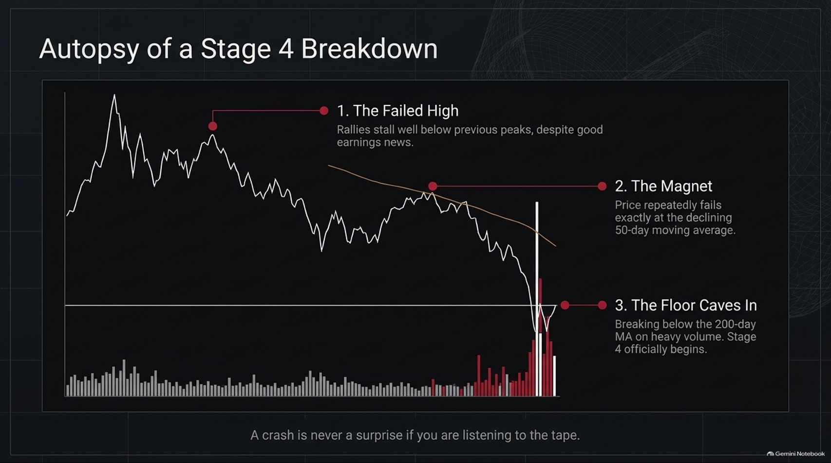
Notes:
Estimated Time: 4 – 5 minutes
Target Word Count: ~550 words
Speaker Notes
To protect your capital, you must recognize how bull markets die. Slide 11 provides a post-mortem: Autopsy of a Stage 4 Breakdown.
Let's trace the fatal trajectory step-by-step:
The Failed High: Rallies begin stalling well below previous cyclical peaks, even in the face of seemingly positive earnings reports or company news. The momentum is quietly draining out.
The Magnet: Price repeatedly fails exactly at a downward-sloping 50-day moving average, which acts like a ceiling or gravitational magnet pulling the stock lower.
The Floor Caves In: Finally, the stock breaks decisively below its long-term 200-day moving average on heavy liquidation volume. Stage 4 official breakdown.
As Weinstein emphasizes: A crash is never a surprise if you are listening to the tape. The moving averages and lower highs flashed warning signals weeks in advance.

Slide 12
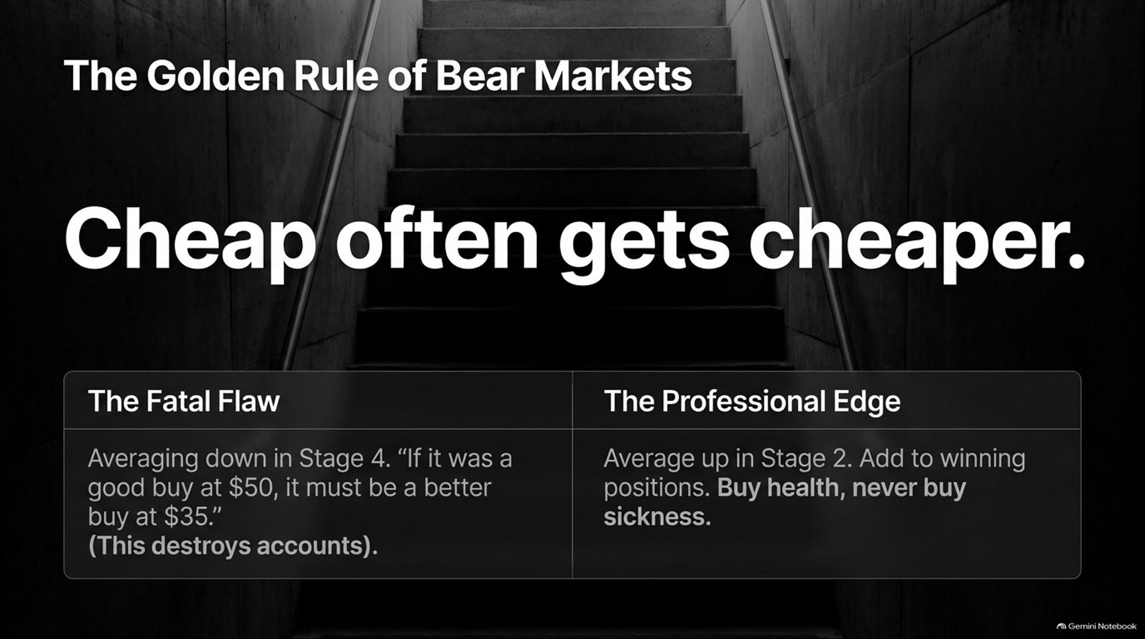
Notes:
Estimated Time: 4 – 5 minutes
Target Word Count: ~600 words
Speaker Notes
One of the most destructive psychological traps in investing is captured on Slide 12: Cheap often gets cheaper.
The Fatal Flaw: Amateurs love to average down in Stage 4. They look at a stock that dropped from $50 to $35 and convince themselves: “If it was a good buy at $50, it must be an absolute bargain at $35!” This psychological fallacy destroys trading accounts. Stocks in Stage 4 are fundamentally broken; they are cheap for a reason.
The Professional Edge: Professionals never average down in sickness. They average up in Stage 2, adding exposure to winning positions as they prove their strength.
Buy health, never buy sickness. Let institutional sponsorship validate your capital allocation.

Slide 13
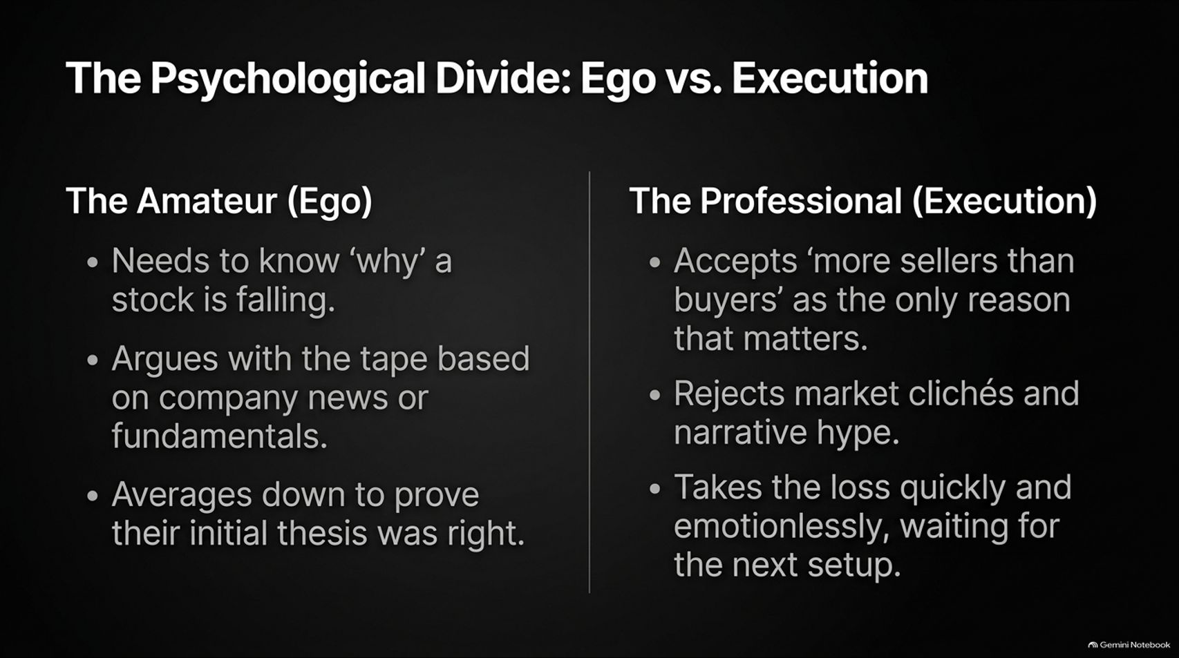
Notes:
Estimated Time: 4 – 5 minutes
Target Word Count: ~600 words
Speaker Notes
Trading success is 20% mechanics and 80% psychology. Slide 13 highlights The Psychological Divide between Amateurs (Ego) and Professionals (Execution):
The Amateur (Driven by Ego):
Needs to know why a stock is falling, constantly arguing with the tape based on company press releases or fundamental metrics.
Refuses to admit error, averaging down to prove their initial investment thesis was right.
The Professional (Driven by Execution):
Accepts "more sellers than buyers" as the only fundamental reason that matters.
Rejects market clichés, media hype, and broker opinions.
Cuts losing positions quickly and emotionlessly, clearing their mind to wait for the next pristine setup.
Your ego is your portfolio's worst enemy. Leave it at the door.

Slide 14
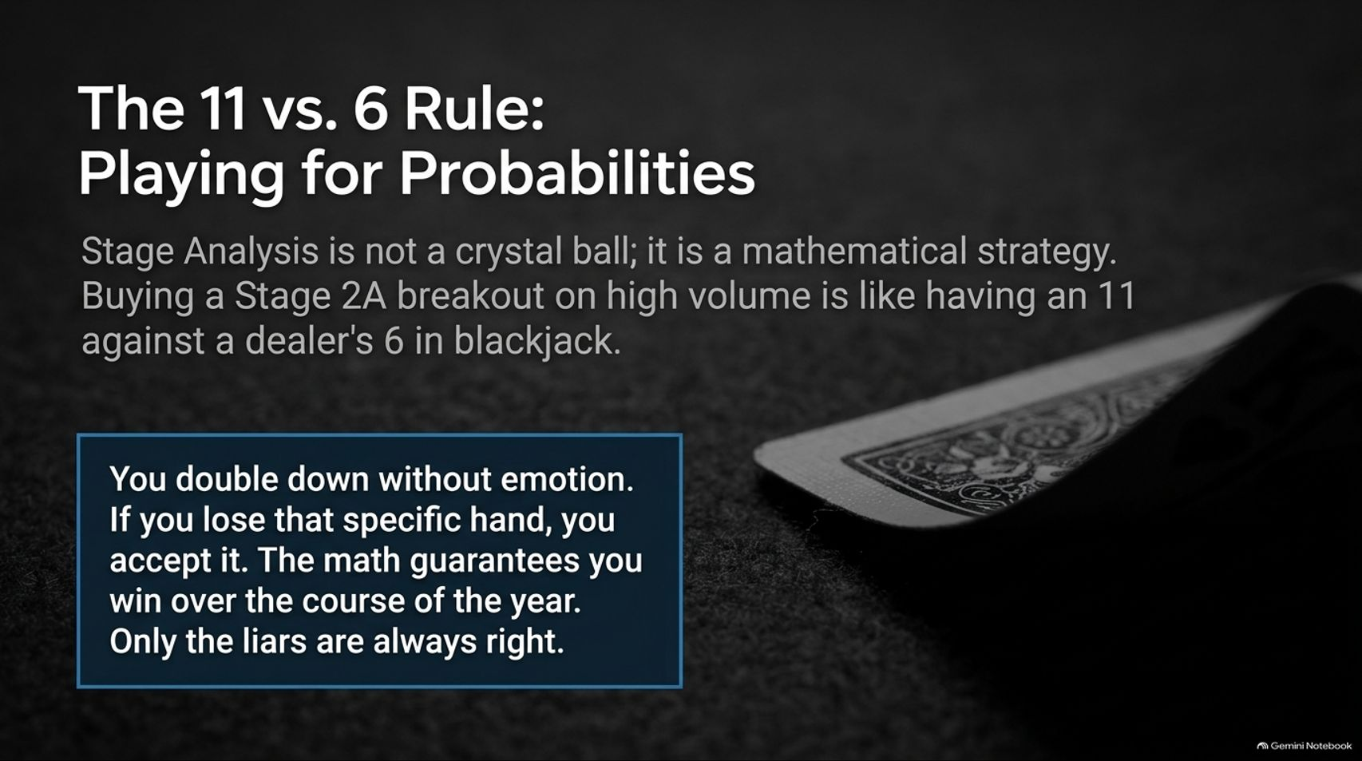
Notes:
Estimated Time: 4 – 5 minutes
Target Word Count: ~550 words
Speaker Notes
Stage Analysis is not a crystal ball; it is a mathematical edge based on probabilities. Slide 14 frames this using a casino analogy: Buying a Stage 2A breakout on heavy volume is like having an 11 against a dealer's 6 in blackjack.
In blackjack, holding an 11 against a 6 is the ultimate statistical double-down spot. You don't hesitate, and you don't let emotions dictate your bet size. You double down because the math heavily favors your victory over the long run.
Even if the dealer pulls a 21 and you lose that specific hand, you don't cry or abandon strategy—you accept it as statistical variance. Stage Analysis works exactly the same way. Follow your rules mechanically, take your 11-vs-6 setups every single time, and the law of large numbers guarantees profitability over the course of the year. Only the liars are always right.

Slide 15
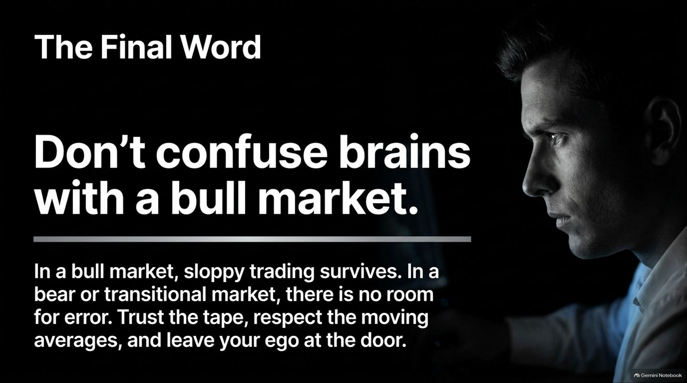
Notes:
Estimated Time: 3 – 4 minutes
Target Word Count: ~400 words
Speaker Notes
As we reach the conclusion of our deck on Slide 15, Stan Weinstein delivers his final guiding maxim: Don't confuse brains with a bull market.
In a roaring bull market, sloppy trading, poor risk management, and undisciplined entries can survive because rising tides lift all boats. But in a bear market or a volatile transitional market, there is zero room for error. Sloppy execution will drive traders out of business.
Trust the tape, respect your moving averages, and leave your ego at the door. Bear markets are brutal, but they always pave the way for the next great bull market cycle for those who preserve their capital.

Slide 16
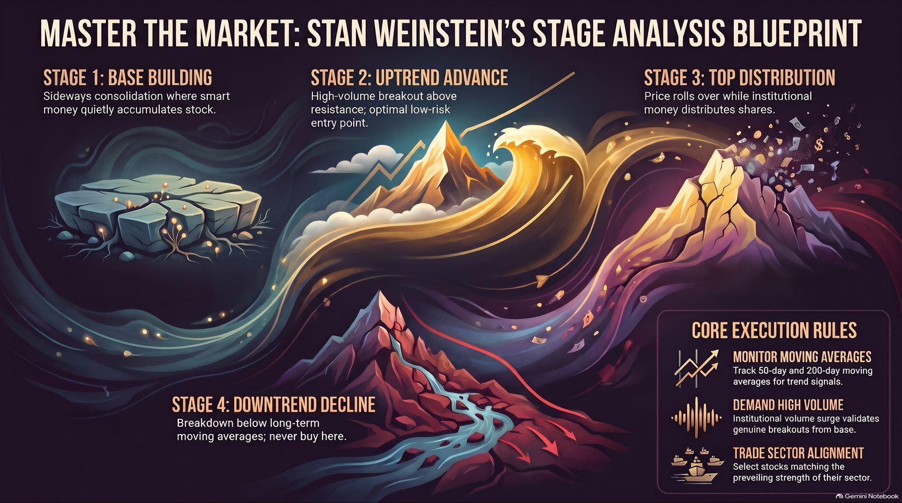
Notes:
Estimated Time: 4 – 5 minutes
Target Word Count: ~600 words
Speaker Notes
To wrap up our entire presentation, Slide 16 provides the master summary blueprint of Stan Weinstein’s Stage Analysis System:
Master the Four Stages: Accumulate in Stage 1 bases, ride the trend in Stage 2 breakouts, distribute into strength in Stage 3 tops, and strictly avoid or short Stage 4 downtrends.
Core Execution Rules:
Monitor Moving Averages: Track the 50-day and 200-day MAs for structural trend signals.
Demand High Volume: Require institutional volume spikes ("the tiger in the tank") to validate genuine breakouts.
Trade Sector Alignment: Use top-down analysis to select stocks matching the prevailing strength of leading industry groups.
Thank you for your time. Respect the tape, manage your risk like a professional, and happy trading. I am happy to open the floor to Q&A.
For a deeper video walkthrough of these exact stage analysis principles, historical market autopsies, and current chart case studies directly from Stan Weinstein, you can watch the complete interview here: Trading Lessons from 60+ Years in the Market | Exclusive with Stan Weinstein on TraderLion.

