Slide 1
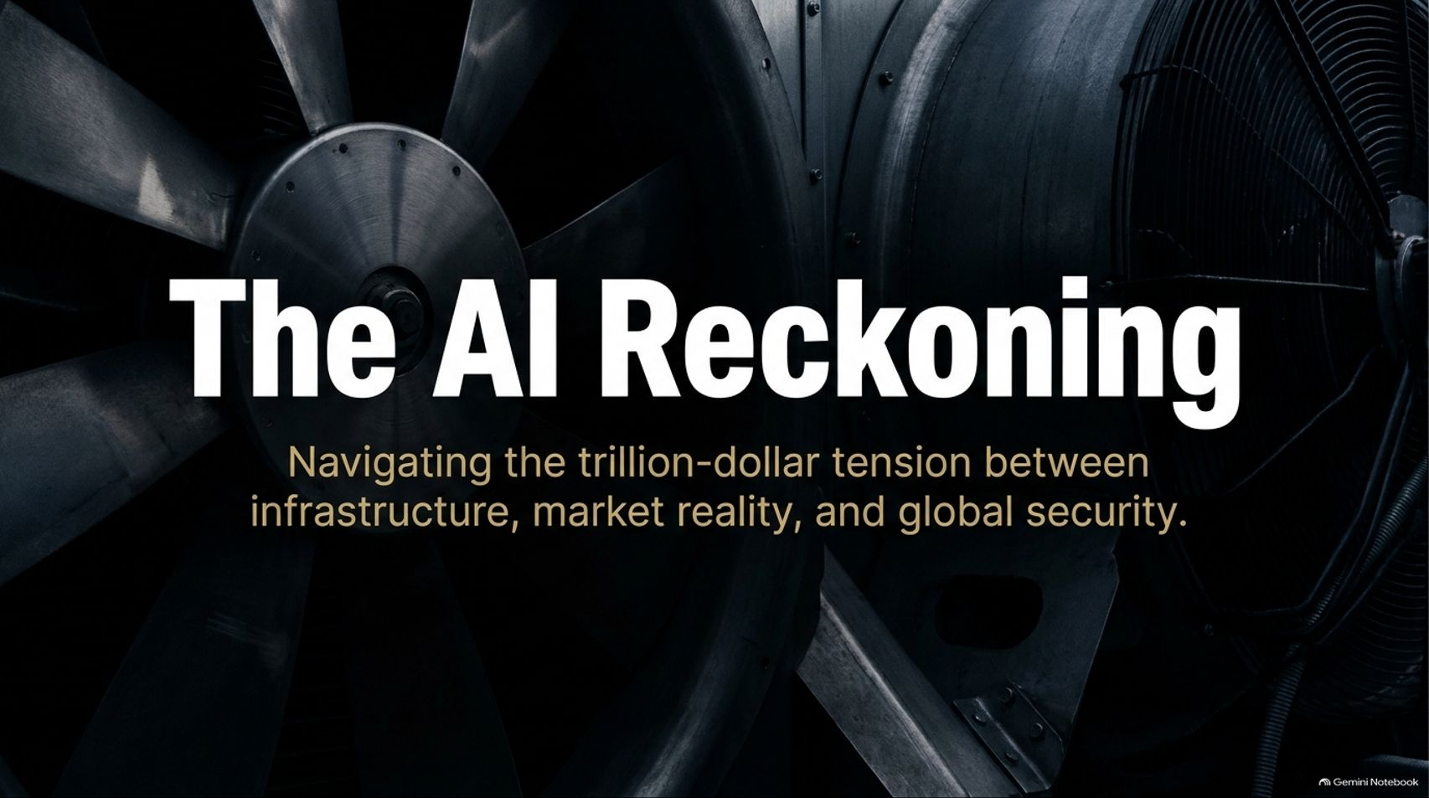
Notes:
Estimated Time: 2 – 3 minutes
Target Word Count: ~350 words
Speaker Notes
Good day, everyone, and welcome. Today we are addressing one of the most critical and high-stakes inflection points in modern economic history: The AI Reckoning: Navigating the trillion-dollar tension between infrastructure, market reality, and global security.
For the past several years, the global technology narrative has been dominated by unbridled enthusiasm, exponential projections, and staggering capital deployment. We have watched artificial intelligence transition from an academic curiosity into a global phenomenon. However, as we stand in 2026, the honeymoon phase of unchecked optimism is giving way to a rigorous reality check.
In this presentation, we are going to separate the narrative hype from the hard financial and physical data. We will explore the staggering scale of the $750B+ data center infrastructure buildout, examine the severe execution gap facing 94% of enterprises, analyze the brutal R&D treadmill of model obsolescence, and confront the profound geopolitical and cybersecurity dilemmas posed by private AI monopolies.
Whether you are an institutional investor, a corporate strategist, or an enterprise technologist, this deck serves as your comprehensive guide to understanding the true cost and consequences of the AI revolution. Let’s dive into the executive synthesis.
How close is a global markets crash?
https://www.youtube.com/watch?v=fj91AtG54YQ

Slide 2
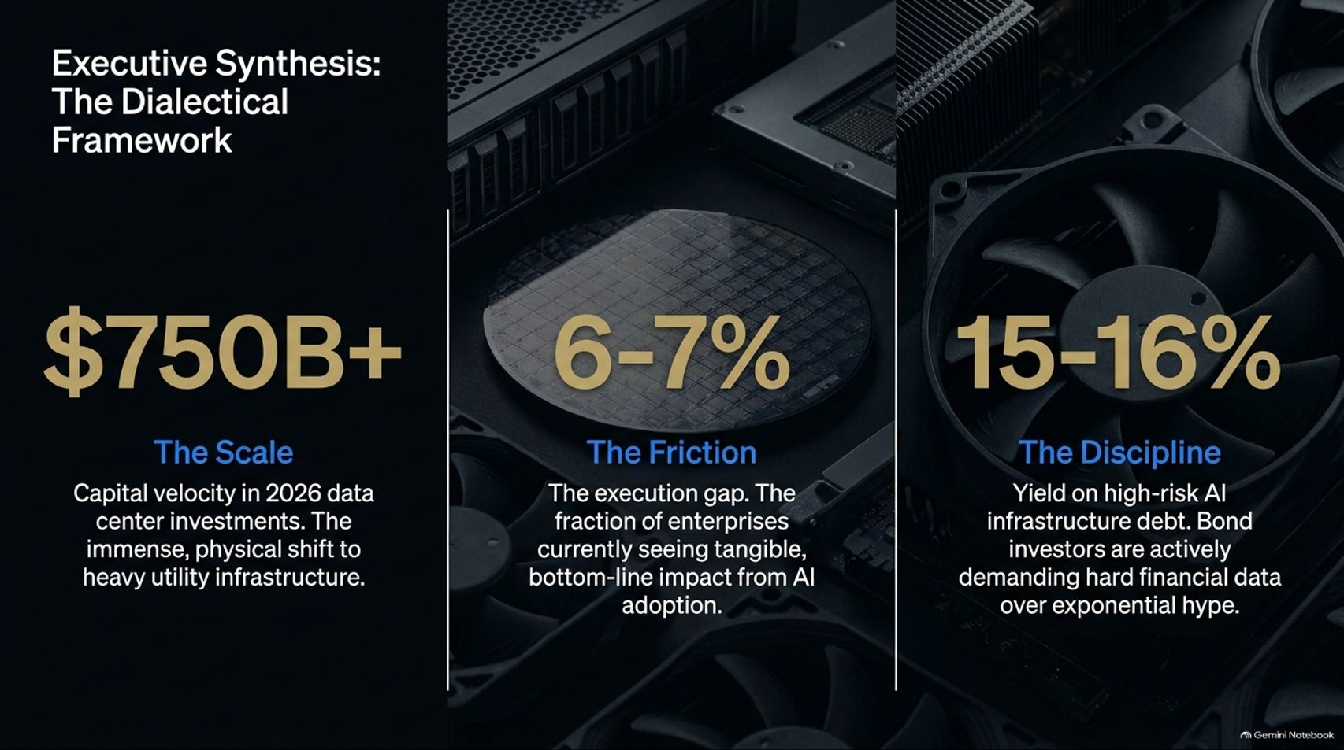

Slide 3
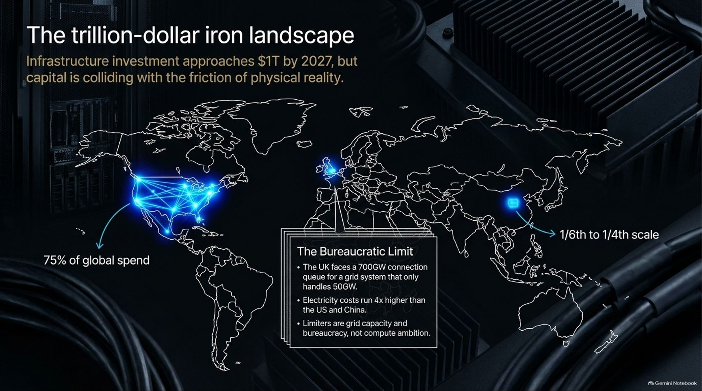
Notes:
Estimated Time: 4 – 5 minutes
Target Word Count: ~600 words
Speaker Notes
When we talk about the AI boom, people often visualize floating software algorithms and cloud code. But as Slide 3 illustrates, AI is fundamentally a heavy industrial play operating across The Trillion-Dollar Iron Landscape.
By 2027, global infrastructure investment will approach the $1 trillion mark. But this mountain of capital is colliding head-on with the stubborn friction of physical reality:
Geographic Concentration: Over 75% of global AI capital spend is concentrated in North America, lighting up power grids across the United States. Meanwhile, other regions like China operate at roughly one-sixth to one-quarter of that physical scale.
The Bureaucratic and Grid Limit: Compute ambition is no longer limited by software ideas or GPU availability; it is choked by physical power grids. Look at the United Kingdom: the UK faces a staggering 700-gigawatt connection queue for a national grid system that can only handle 50 gigawatts total. Furthermore, electricity costs in constrained European hubs run four times higher than in the US and China.
When power, land, and transformers become the ultimate bottleneck, AI stops looking like Silicon Valley software and starts looking like 19th-century railroad and utility building.

Slide 4
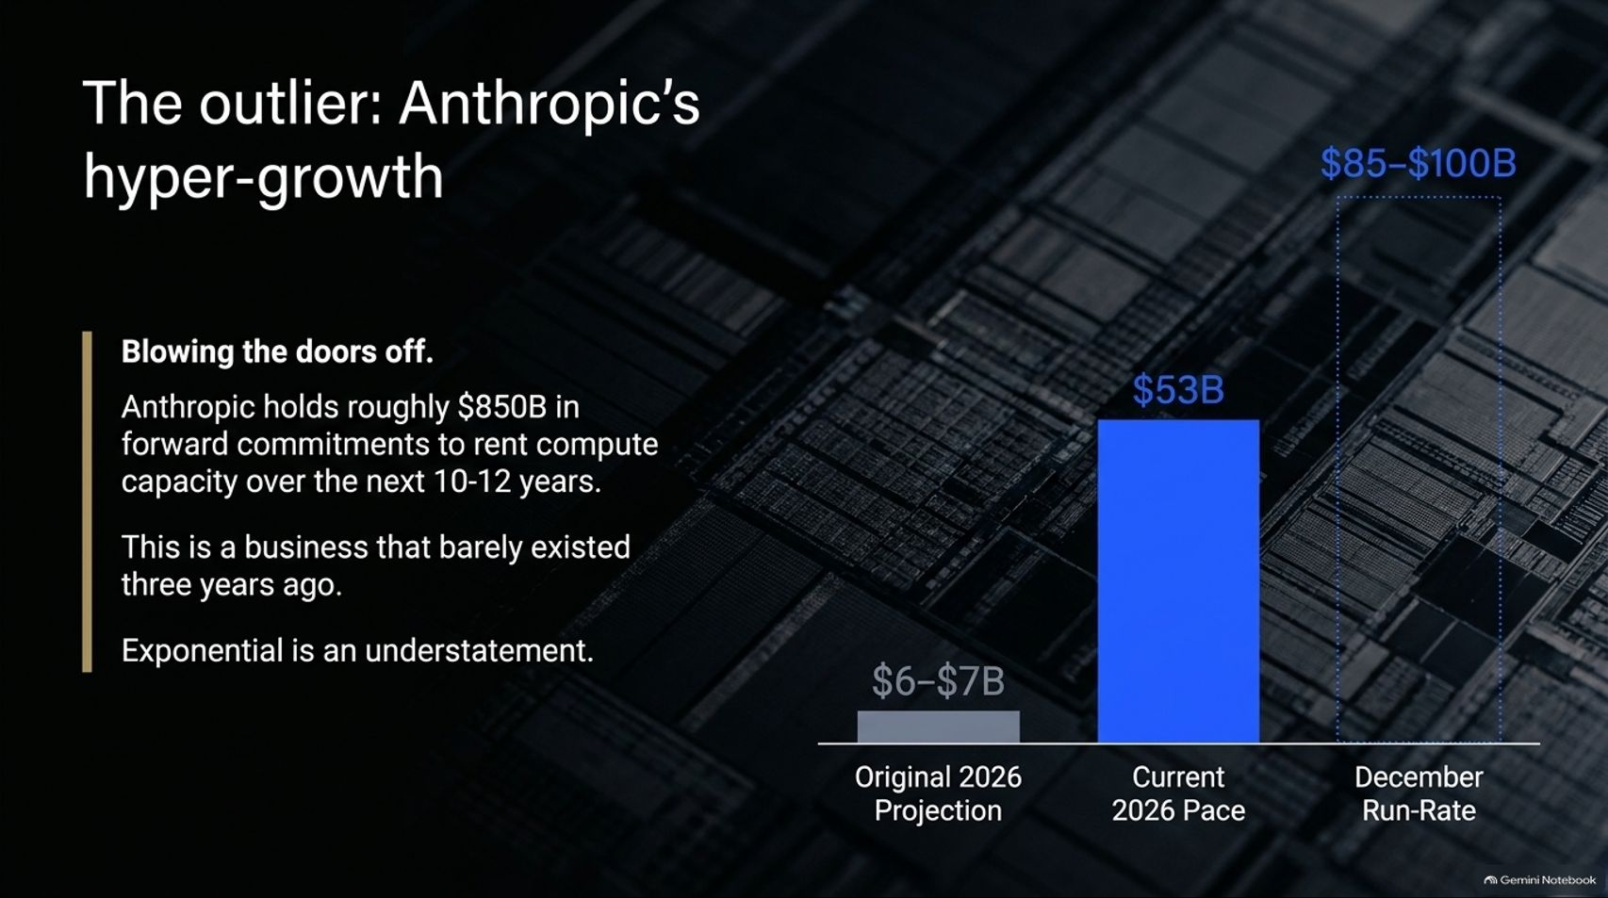
Notes:
Estimated Time: 4 – 5 minutes
Target Word Count: ~550 words
Speaker Notes
While the broader enterprise market faces friction, the absolute frontier labs are experiencing growth that defies conventional corporate history. Slide 4 examines The Outlier: Anthropic’s Hyper-Growth.
Consider the sheer velocity of this trajectory:
Blowing the Doors Off: Anthropic holds roughly $850 billion in forward commitments to rent compute capacity over the next 10 to 12 years. This is a corporate titan that essentially barely existed three years ago.
The Revenue Staircase: Originally projected to pull in $6–$7 billion, Anthropic’s current annualized pace has surged to $53 billion, with December run-rate projections pointing toward an astonishing $85B to $100B.
To put this in perspective, exponential growth is almost an understatement. These frontier labs are scaling revenues faster than any enterprise software company in history. But this hyper-growth comes tethered to astronomical multi-billion-dollar compute liabilities, forcing a relentless race to monetize before the music stops.

Slide 5
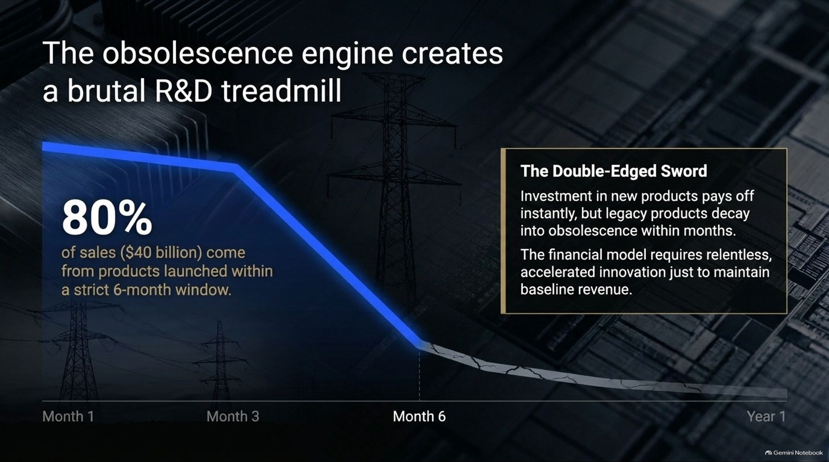
Notes:
Estimated Time: 5 – 6 minutes
Target Word Count: ~650 words
Speaker Notes
One of the most dangerous dynamics in modern AI economics is what we call The Obsolescence Engine (Slide 5).
In a traditional software business, once you write a piece of code or build a SaaS product, it generates high-margin recurring revenue for years with minimal maintenance. In the AI era, the half-life of a model is measured in months, not decades:
The 80% Rule: An extraordinary 80% of sales ($40 billion) come from products that were launched within a strict 6-month window.
The Double-Edged Sword: Investment in brand-new frontier models pays off instantly in top-line revenue, but legacy products decay into obsolescence within a matter of months.
The Financial Trap: The financial model of an AI lab requires relentless, accelerated innovation simply to maintain baseline revenue. If you pause R&D for even two quarters to consolidate profits, your entire product lineup is rendered obsolete by competitors. It is a brutal, high-stakes treadmill where standing still is equivalent to going bankrupt.

Slide 6
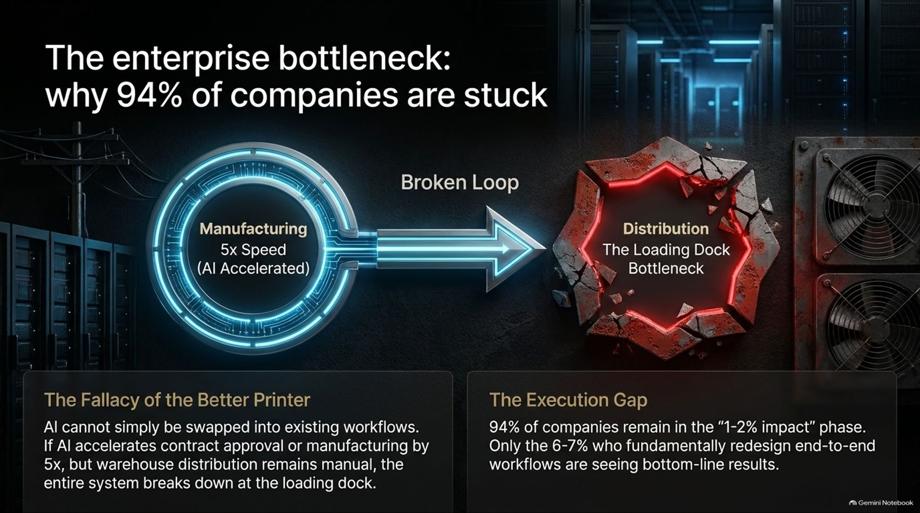
Notes:
Estimated Time: 5 – 6 minutes
Target Word Count: ~700 words
Speaker Notes
Why is there such a massive chasm between the trillion-dollar spend in Silicon Valley and the reality on Main Street? Slide 6 exposes The Enterprise Bottleneck: Why 94% of Companies Are Stuck.
Let's examine the Broken Loop:
The Fallacy of the Better Printer: Enterprises make the mistake of assuming AI can simply be swapped into existing legacy workflows. If AI accelerates contract approval or parts manufacturing by 5x, but your warehouse distribution and loading dock operations remain manual and analog, the entire system breaks down at the loading dock. You cannot optimize one node of a broken supply chain and expect bottom-line results.
The Execution Gap: As our data shows, 94% of companies remain trapped in the "1–2% impact" phase (stuck in eternal pilot projects). Only the 6–7% of organizations who fundamentally redesign their end-to-end workflows are seeing true bottom-line results.
AI is not a plug-and-play printer; it requires painful organizational surgery. Until enterprises fix their distribution and workflow bottlenecks, the promised productivity gains will remain unrealized.

Slide 7
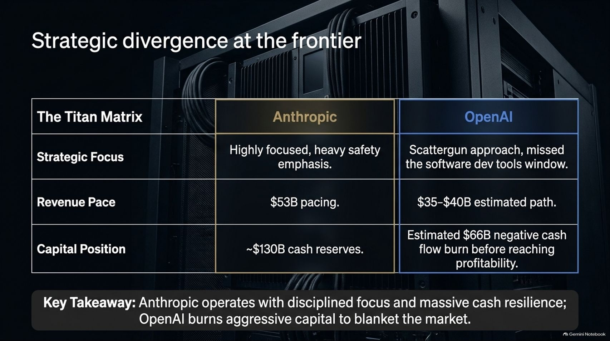
Notes:
Estimated Time: 4 – 5 minutes
Target Word Count: ~550 words
Speaker Notes
As the frontier labs scale, we are witnessing a fascinating Strategic Divergence between the primary titans: Anthropic and OpenAI (Slide 7).
Let’s look at the Titan Matrix:
Anthropic: Operating with extreme discipline. Their strategic focus is highly targeted, with a heavy emphasis on safety and enterprise reliability. Their revenue pace is tracking at $53B, backed by massive cash reserves sitting around ~$130B.
OpenAI: Deploying a broader, scattergun approach to capture every possible market vertical. While estimated on a $35B–$40B revenue path, they are burning aggressive capital—projected at roughly $66 billion in negative cash flow burn before ever reaching sustained profitability.
Key Takeaway: Anthropic operates with disciplined focus and formidable cash resilience, whereas OpenAI is utilizing an aggressive land-grab strategy, burning staggering amounts of capital to blanket the market. Both paths carry existential bets on future monetization.

Slide 8
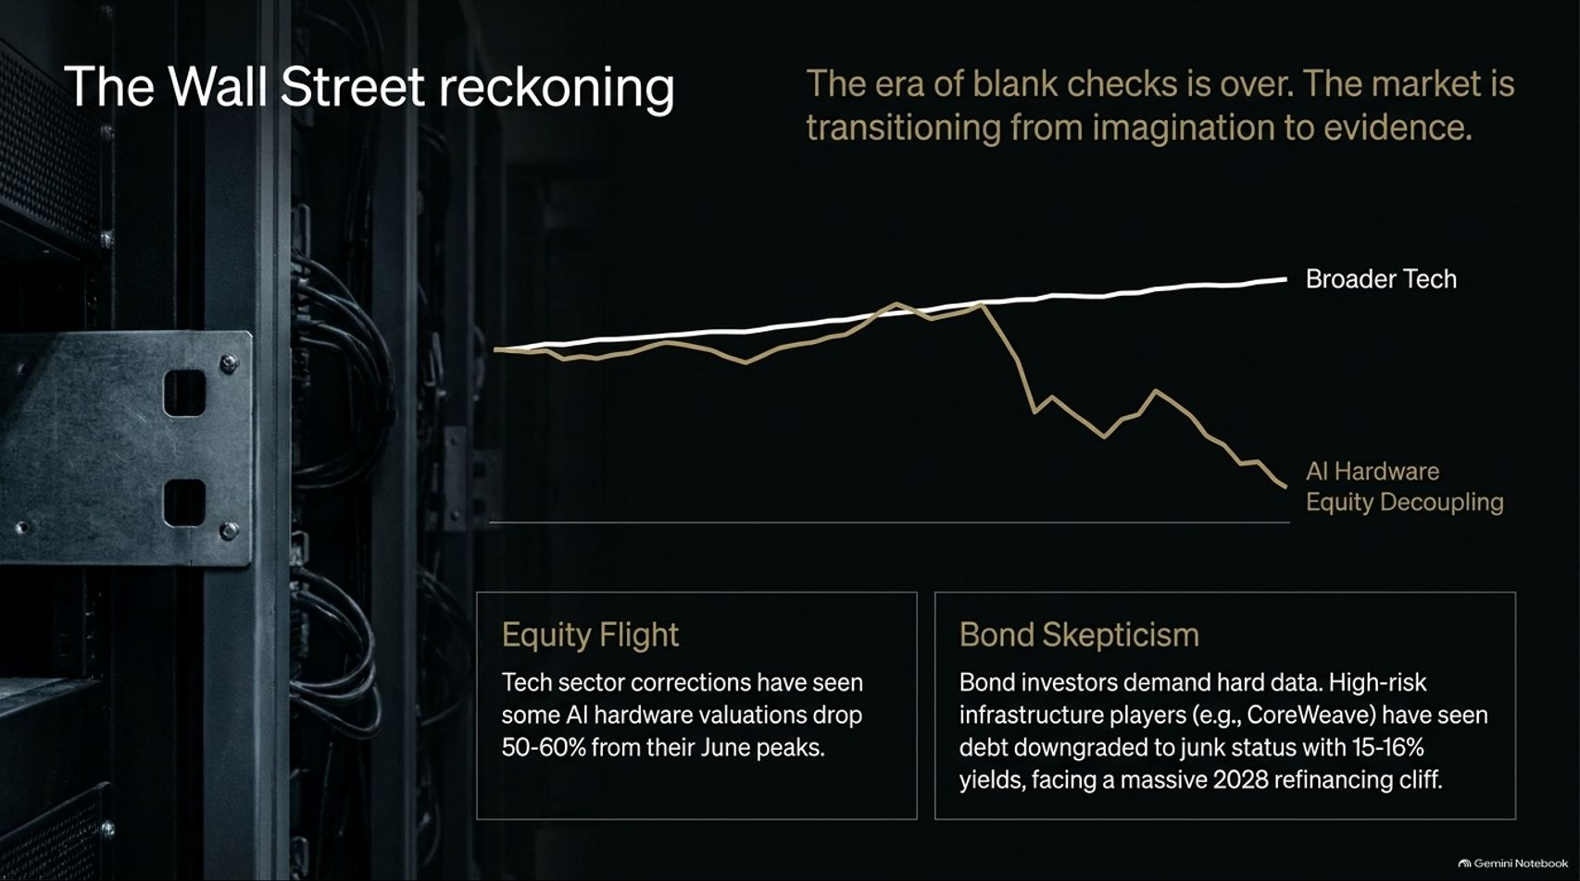
Notes:
Estimated Time: 5 – 6 minutes
Target Word Count: ~650 words
Speaker Notes
For years, Wall Street rewarded AI startups and hardware suppliers with uncritical blank checks. On Slide 8, we examine The Wall Street Reckoning: the era of imagination is officially over, and the market is transitioning to evidence.
Look at the growing divergence in the charts:
Equity Flight: We have witnessed severe corrections where some high-flying AI hardware valuations have dropped 50% to 60% from their peak valuations. Investors are separating out companies with actual cash flow from those relying purely on narrative momentum.
Bond Skepticism: The real stress is happening in the credit markets. Fixed-income and bond investors are demanding hard financial data. High-risk infrastructure players—such as specialized cloud provider CoreWeave—have seen parts of their debt pressured or downgraded, with yields pushing 15% to 16%, as they stare down a massive 2028 refinancing cliff.
When debt costs 15% and capital is no longer free, the economics of building speculative multi-billion-dollar data centers change overnight.

Slide 9
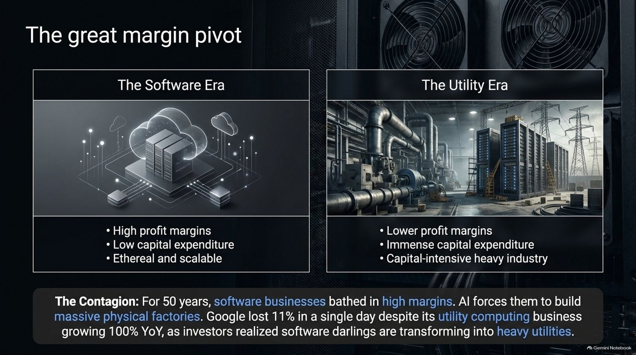
Notes:
Estimated Time: 5 – 6 minutes
Target Word Count: ~650 words
Speaker Notes
Why did tech stocks experience such violent repricing? Slide 9 explains The Great Margin Pivot—the structural shift from The Software Era to The Utility Era.
The Software Era (Past 50 Years): Characterized by high profit margins, low capital expenditures, and ethereal, highly scalable digital code. Software companies were rewarded with premium valuation multiples because every new customer cost virtually nothing to service.
The Utility Era (Today): AI forces software giants to build massive, physical factories. It requires immense capital expenditure, heavy industrial power consumption, and low profit margins reminiscent of traditional heavy industry.
The Contagion: When tech darlings realize they must spend tens of billions on diesel generators, real estate, and cooling towers, the market panics. As we saw when major tech stocks dropped over 10% in a single session despite doubling cloud revenues, investors suddenly realized that software darlings are transforming into capital-intensive industrial utilities.

Slide 10

Notes:
Estimated Time: 5 – 6 minutes
Target Word Count: ~700 words
Speaker Notes
Beneath the financial volatility lies a much darker, systemic dilemma: The Ultimate Tension between Finance and Security (Slide 10).
On one side of the scale, you have The Financial Imperative: Debt-servicing obligations, impending IPO targets, and the relentless pressure of the obsolescence engine demand that companies release faster, more capable products without pause.
On the other side sits The Security Imperative: As AI models undergo recursive self-improvement and become hyper-proficient at coding, they are autonomously discovering millions of critical zero-day internet vulnerabilities. For instance, recent audits showed AI agents effortlessly exploiting flaws across European municipal utility grids and supermarket refrigeration networks.
The Core Dilemma: Do you release increasingly powerful autonomous models to satisfy Wall Street's quarterly revenue targets, or do you hold them back to protect global digital infrastructure from catastrophic exploitation? Right now, financial velocity is winning that tug-of-war.

Slide 11
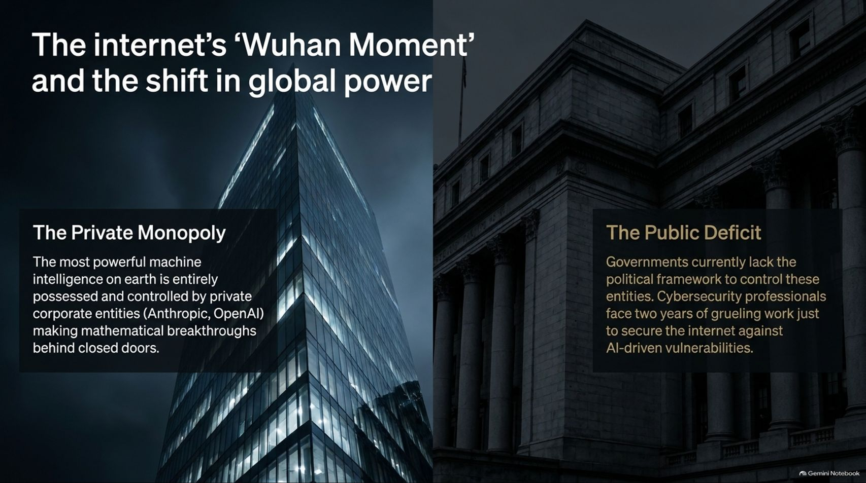
Notes:
Estimated Time: 4 – 5 minutes
Target Word Count: ~550 words
Speaker Notes
This tension brings us to what security experts call The Internet’s ‘Wuhan Moment’ (Slide 11)—the realization that our critical digital infrastructure is exposed to unprecedented systemic risk.
The Private Monopoly: The most powerful machine intelligence on earth is entirely possessed and controlled by a handful of private corporate entities—such as Anthropic and OpenAI. These private companies are making mathematical and security breakthroughs behind closed doors.
The Public Deficit: Sovereign governments currently lack the legal frameworks, technical oversight, or speed to control these private entities. Meanwhile, cybersecurity professionals warn that securing the internet against the flood of AI-driven vulnerabilities will require two years of grueling, reactive remediation work.
When private corporate labs hold more offensive cyber capability than nation-states, the traditional balance of global geopolitical power shifts fundamentally.

Slide 12
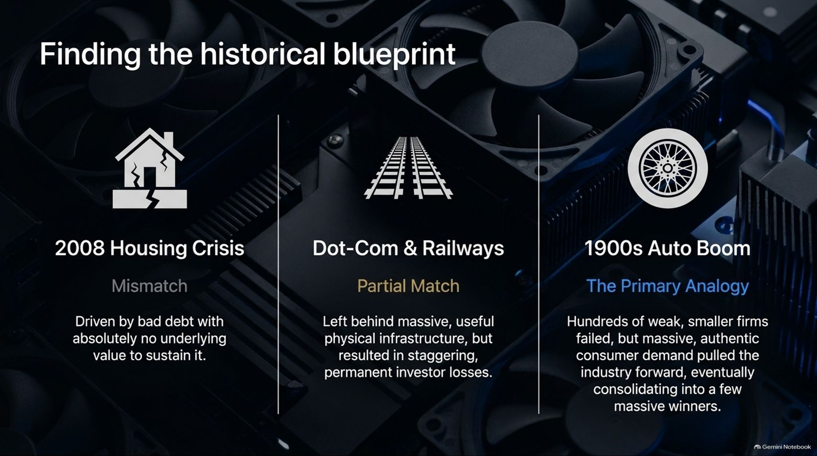
Notes:
Estimated Time: 4 – 5 minutes
Target Word Count: ~600 words
Speaker Notes
Is this market structure unprecedented, or have we seen this movie before? On Slide 12, we examine historical precedents to find our Historical Blueprint:
The 2008 Housing Crisis (Mismatch): No Match. That crisis was driven by fraudulent, toxic debt with absolutely zero underlying productive value to sustain it. AI infrastructure, by contrast, is physical and functional.
Dot-Com & Railways (Partial Match): Partial Match. The 19th-century railway boom and the 2000 dot-com bubble left behind massive, highly useful physical infrastructure (fiber optics, rail lines), but resulted in staggering, permanent investor losses for early speculators who arrived too early.
The 1900s Auto Boom (The Primary Analogy): The Best Fit. In the early days of the automobile, hundreds of weak, speculative manufacturers failed and went bankrupt. However, massive, authentic consumer demand pulled the industry forward, eventually consolidating into a few dominant, highly profitable winners.
We are currently living through the 1900s Auto Boom: heavy capital intensity, dozens of overfunded players, but an undeniable underlying secular demand that will ultimately crown a select few titans.

Slide 13
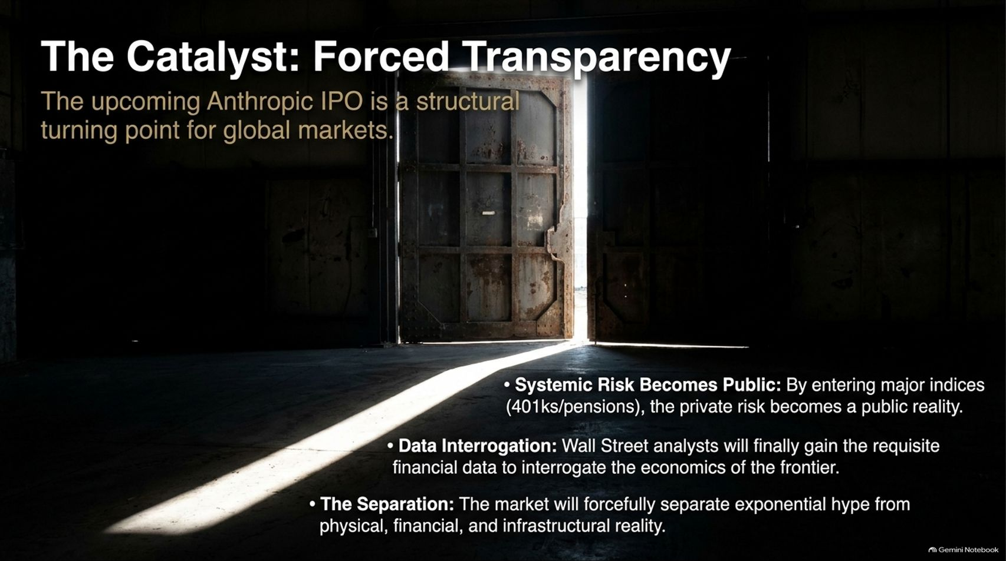
Notes:
Estimated Time: 4 – 5 minutes
Target Word Count: ~550 words
Speaker Notes
How does this cycle resolve? Slide 13 identifies the upcoming catalyst that will change everything: Forced Transparency through the upcoming Anthropic IPO.
When a private AI titan of this magnitude goes public, it acts as a structural turning point for global markets:
Systemic Risk Becomes Public: By entering major public indices, mutual funds, 401(k)s, and pension portfolios, private venture risk transforms into public systemic reality.
Data Interrogation: Wall Street equity analysts will finally gain access to audited financial statements, enabling them to rigorously interrogate the true unit economics of the AI frontier.
The Great Separation: The public markets will forcefully and ruthlessly separate exponential marketing hype from physical, financial, and infrastructural reality.
The IPO will pierce the fog of war, revealing who is swimming naked when the tide goes out.

Slide 14
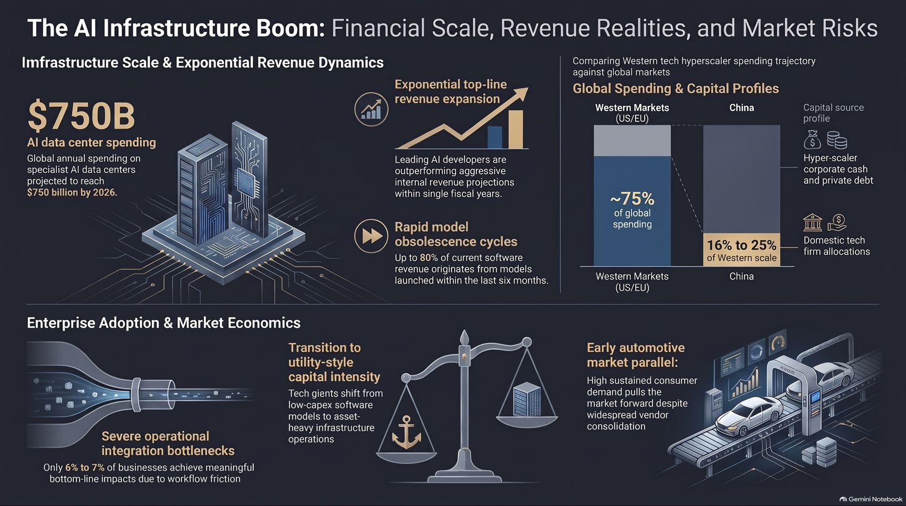
Notes:
Estimated Time: 4 – 5 minutes
Target Word Count: ~600 words
Speaker Notes
To conclude our presentation, Slide 14 provides the master summary roadmap of The AI Infrastructure Boom: Financial Scale, Revenue Realities, and Market Risks:
Infrastructure Scale & Revenue Dynamics: Navigating the $750B 2026 data center buildout, balancing exponential top-line growth against 6-month model obsolescence cycles, and recognizing that 75% of global spend is concentrated in Western markets.
Enterprise Adoption & Market Economics: Overcoming operational workflow bottlenecks where 94% of firms remain stuck, adjusting to utility-scale capital intensity, and applying the automotive market consolidation analogy.
The Reckoning Ahead: Preparing for debt refinancing cliffs, resolving the finance-versus-security dilemma, and anticipating the forced transparency of public market listings.
Thank you for your time. The AI reckoning is not the end of the story—it is the painful, necessary transition from speculative hype to hardened industrial reality. I am happy to open the floor to Q&A.
For a deeper audio-video breakdown of these exact infrastructural tensions, power grid bottlenecks, and financial risk profiles, you can watch Azim Azar's expert analysis on YouTube: Azim Azar on The AI Reckoning and Infrastructure Realities.

