Slide 1
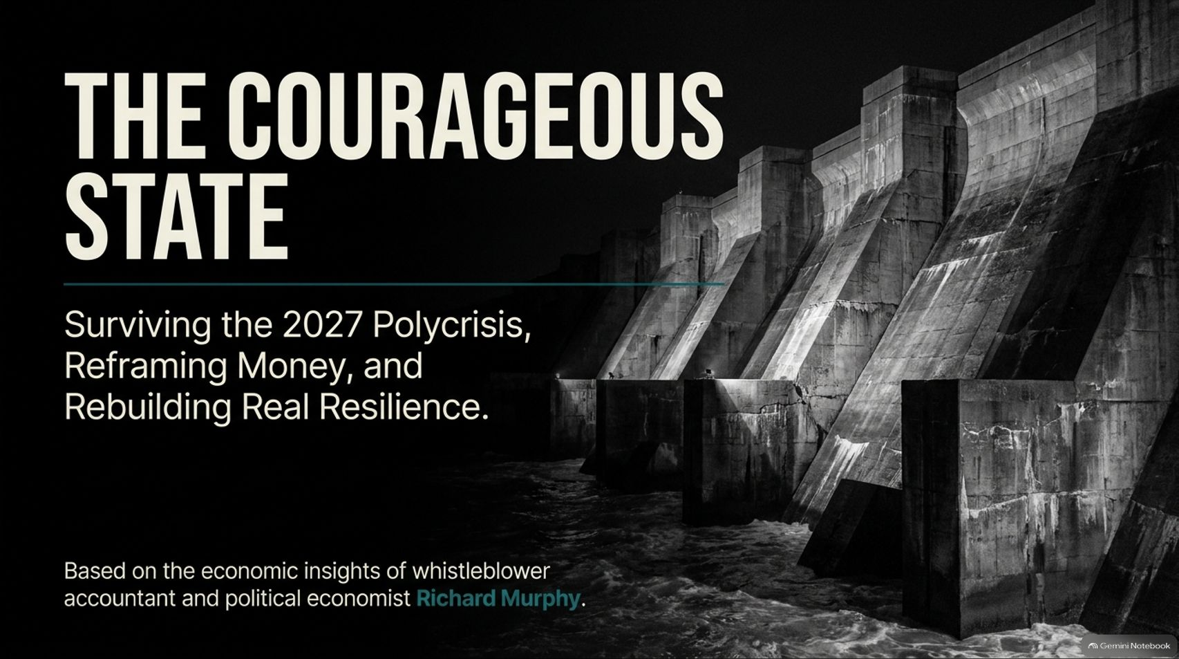
Notes:
Estimated Time: 2 – 3 minutes
Target Word Count: ~350 words
Speaker Notes
Welcome, everyone. Today we are exploring a radical and urgent roadmap for our economic future: The Courageous State: Surviving the 2027 Polycrisis, Reframing Money, and Rebuilding Real Resilience.
This presentation is built upon the piercing economic insights of whistleblower accountant, political economist, and Tax Justice Network co-founder Richard Murphy. As Murphy warns, we are sleepwalking toward a convergence of systemic risks in 2027 that will dwarf the 2008 financial crash.
For decades, we have allowed neoliberal dogma to shrink the state, hollow out our physical infrastructure, and prioritize financial extraction over human well-being. But money is not a scarce household budget item; it is an accounting ledger. The physical resources, skills, and energy exist to build a thriving society—what is missing is not money, but the political courage to plan our real productive capacity. Let’s examine how we got here and how we chart a new course.
Whistleblower Accountant: ‘I Predicted 2008, This Will Be WORSE’ | Aaron Meets Richard Murphy
https://www.youtube.com/watch?v=oMhT6qw8KGE

Slide 2
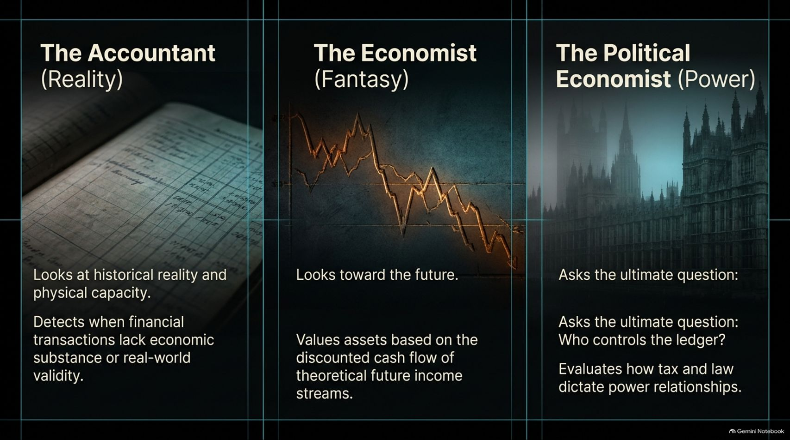

Slide 3
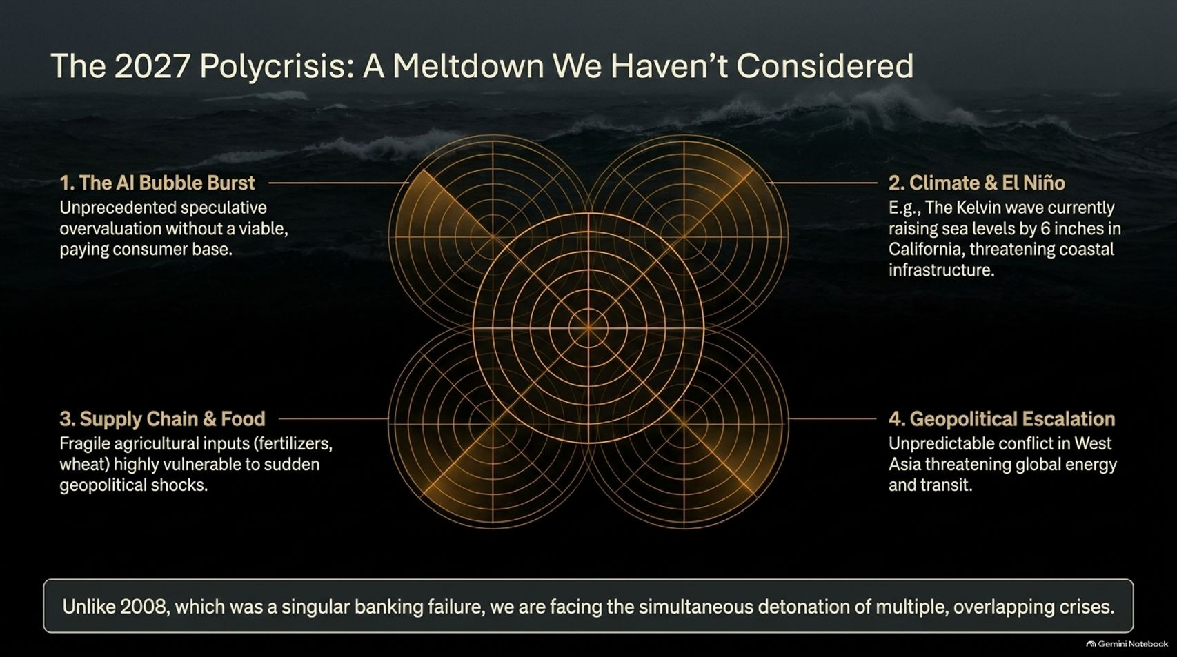
Notes:
Estimated Time: 5 – 6 minutes
Target Word Count: ~700 words
Speaker Notes
Why is 2027 shaping up to be such a critical inflection point? Slide 3 maps out The 2027 Polycrisis—the simultaneous detonation of multiple, overlapping systemic shocks:
1. The AI Bubble Burst: Unprecedented speculative overvaluation in artificial intelligence infrastructure, driven by massive forward commitments with little underlying paying consumer base.
2. Climate & El Niño: Accelerating environmental stress—such as thermal Kelvin waves raising sea levels and threatening vital coastal infrastructure.
3. Supply Chain & Food Disruptions: Fragile agricultural inputs, such as synthetic fertilizers and wheat supply chains, left acutely vulnerable to sudden geopolitical shocks.
4. Geopolitical Escalation: Volatile conflicts in West Asia threatening global energy corridors and maritime transit.
Unlike 2008, which was primarily a singular banking liquidity failure, we are facing an interconnected polycrisis. When AI capital flight collides with energy shocks and climate disruptions, fragile neoliberal systems will shatter.

Slide 4
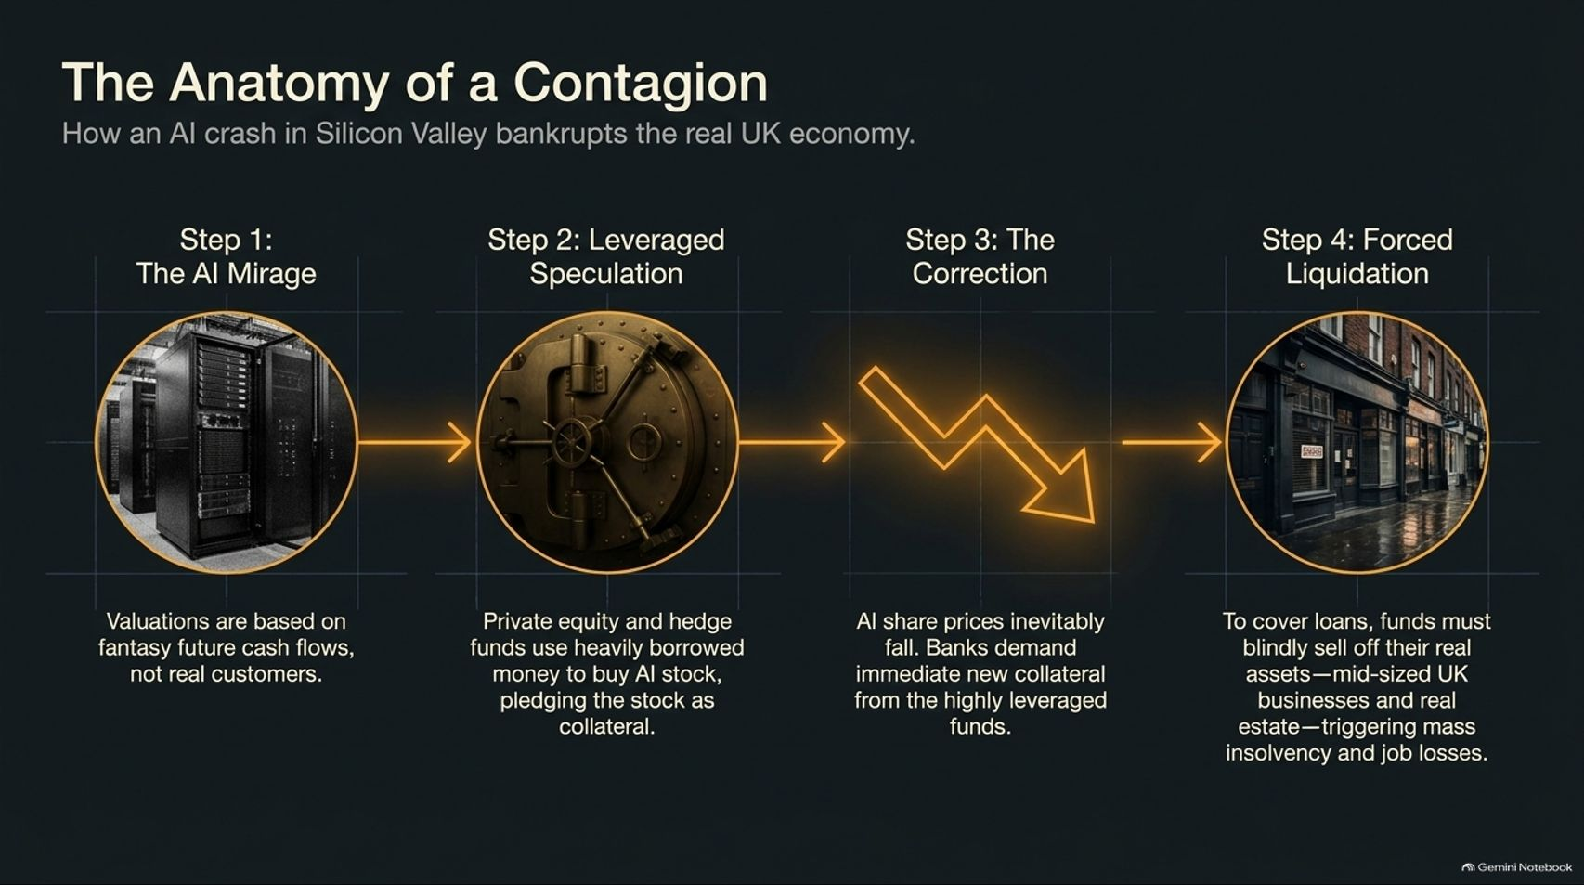
Notes:
Estimated Time: 5 – 6 minutes
Target Word Count: ~650 words
Speaker Notes
How does a speculative tech crash in California end up bankrupting a local business or real estate firm in the UK? Slide 4 traces The Anatomy of a Contagion:
Step 1: The AI Mirage: Valuations in tech are built on speculative future cash flows rather than real, cash-generative customers.
Step 2: Leveraged Speculation: Private equity funds and leveraged hedge funds borrow heavily against these overinflated tech stocks, pledging them as collateral.
Step 3: The Correction: When AI share prices inevitably correct, banking institutions demand immediate new collateral from these over-leveraged funds.
Step 4: Forced Liquidation: To cover margin calls and loans, funds are forced to blindly sell off their liquid real assets—including mid-sized UK businesses, commercial real estate, and infrastructure—triggering mass insolvencies, unemployment, and real-economy contagion.

Slide 5
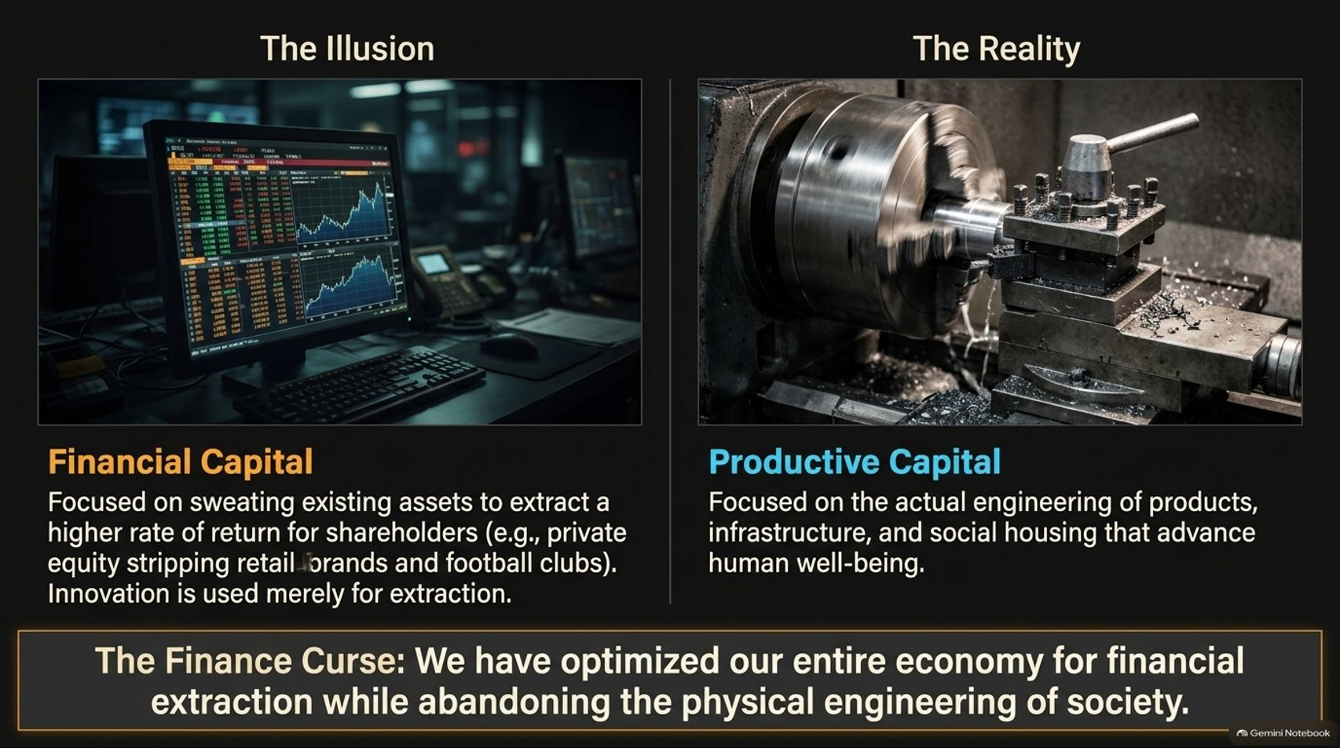
Notes:
Estimated Time: 4 – 5 minutes
Target Word Count: ~600 words
Speaker Notes
At the heart of our economic malaise is a fundamental perversion of capitalism. Slide 5 contrasts Financial Capital against Productive Capital:
Financial Capital (The Illusion): Focused entirely on sweating existing assets to extract higher returns for shareholders. Think of private equity stripping retail brands, utilities, and public infrastructure. Innovation is treated merely as a tool for financial extraction.
Productive Capital (The Reality): Focused on the actual engineering of goods, physical infrastructure, energy grids, and social housing that advance human well-being.
As Richard Murphy calls it, this is The Finance Curse: we have optimized our entire national economy for financial extraction while starving the physical engineering of society.

Slide 6
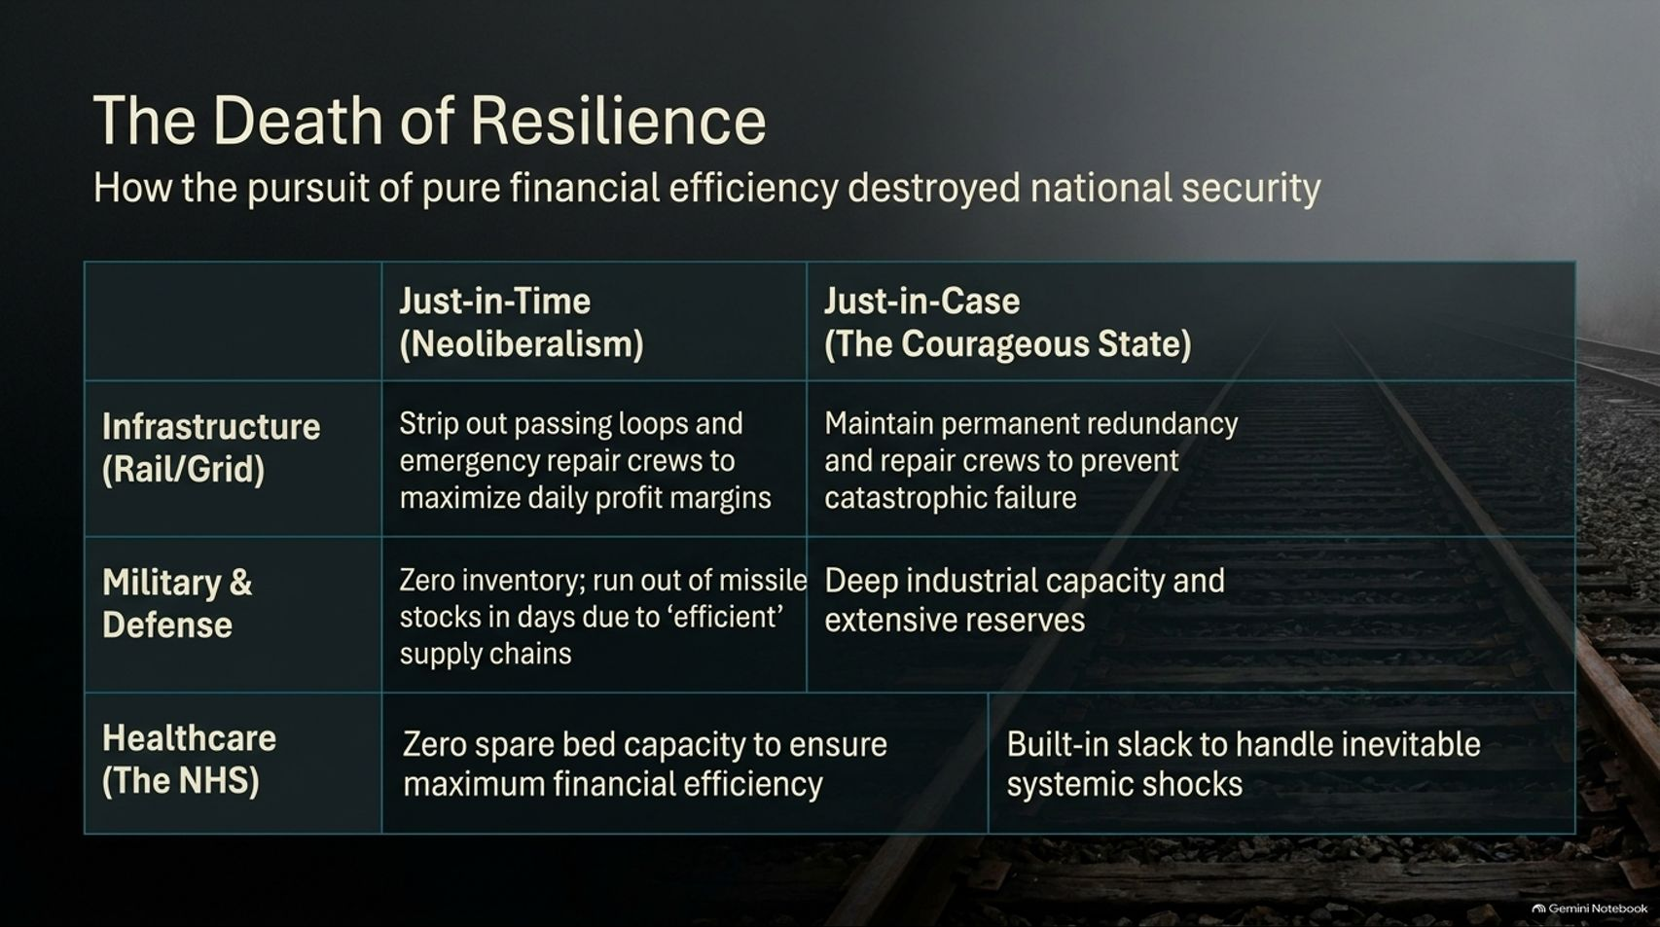
Notes:
Estimated Time: 4 – 5 minutes
Target Word Count: ~600 words
Speaker Notes
Decades of neoliberal governance have worshipped at the altar of pure financial efficiency. Slide 6 shows how this dogma destroyed our national security through The Death of Resilience:
Infrastructure (Rail/Grid): Neoliberalism strips out passing loops, maintenance budgets, and emergency repair crews to maximize daily profit margins. The Courageous State maintains permanent redundancy and repair crews to prevent catastrophic cascading failures.
Military & Defense: Running zero-inventory models means exhausting missile and munitions stocks in days during a conflict. True security requires deep domestic industrial capacity and extensive reserves.
Healthcare (The NHS): Operating with zero spare bed capacity to achieve "efficiency" guarantees that any seasonal flu or public health shock overwhelms the system. Built-in operational slack is not waste; it is insurance.

Slide 7
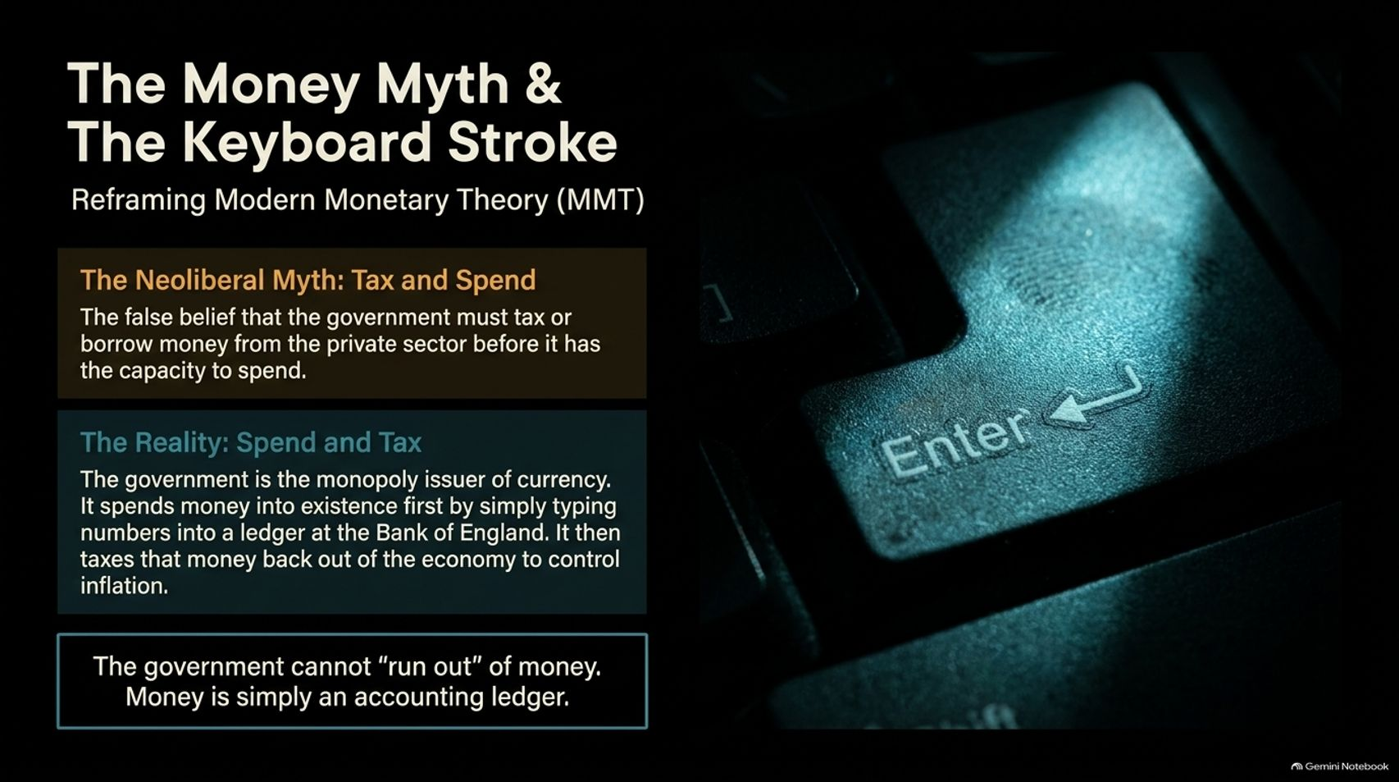
Notes:
Estimated Time: 5 – 6 minutes
Target Word Count: ~700 words
Speaker Notes
One of Richard Murphy's most vital contributions is debunking the household budget myth of government finance, drawing from Modern Monetary Theory (MMT) (Slide 7):
The Neoliberal Myth (Tax and Spend): The persistent, false political claim that a sovereign government must first collect taxes or borrow from the private sector before it has the financial capacity to spend.
The Reality (Spend and Tax): A currency-issuing government is the monopoly issuer of its own money. It spends money into existence first by simply typing numbers into a ledger at the central bank. It then taxes money back out of the economy primarily to control inflation and drive demand for the currency.
The Takeaway: The government cannot "run out" of money. Currency is an accounting ledger, not a piggy bank.

Slide 8
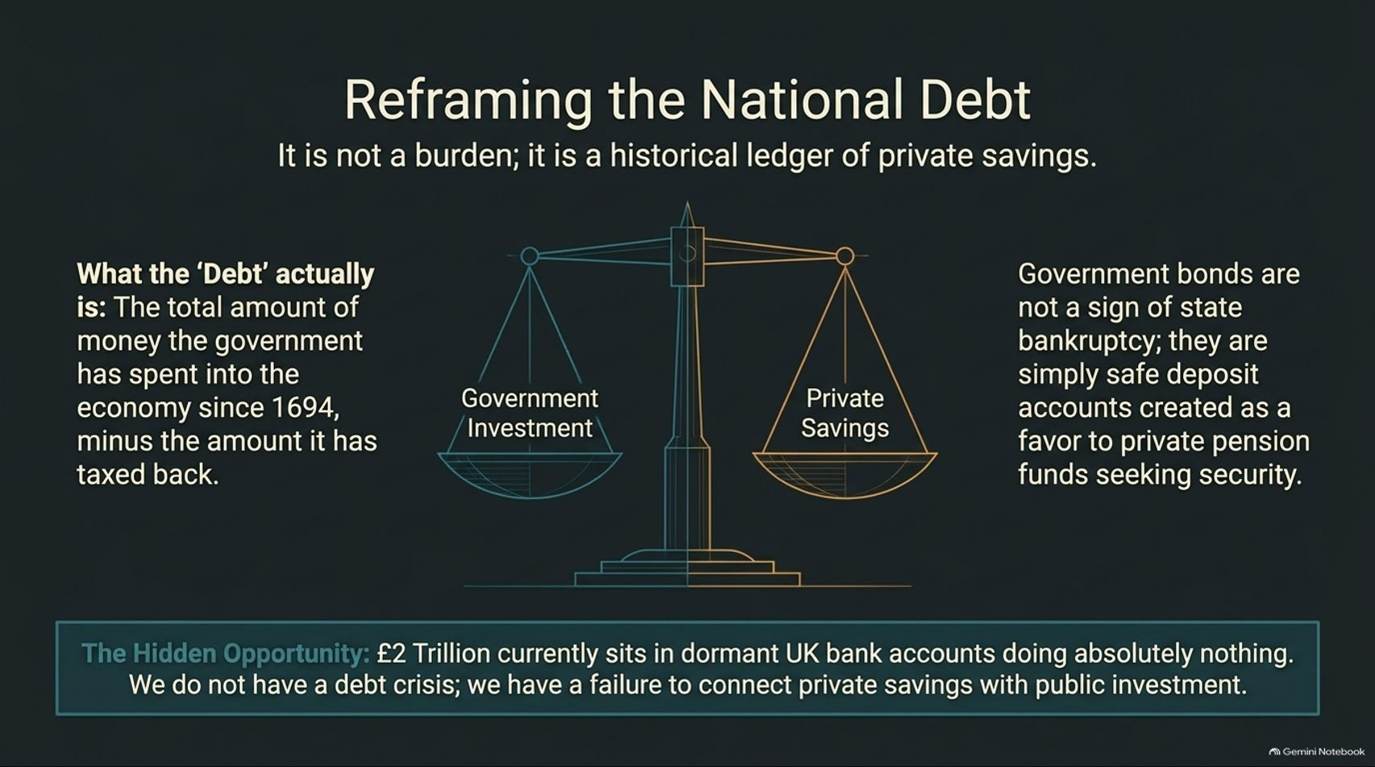
Notes:
Estimated Time: 4 – 5 minutes
Target Word Count: ~600 words
Speaker Notes
We are constantly told that the national debt is a crushing burden on our grandchildren. Slide 8 completely reframes this narrative:
What the "Debt" Actually Is: It is simply the total net amount of money the government has spent into the economy since 1694, minus the amount it has taxed back.
Government Bonds: National debt is not a sign of state bankruptcy; government bonds are safe deposit accounts created by the state as a secure refuge for institutional investors, pension funds, and savers seeking safety.
The Hidden Opportunity: There is currently over £2 trillion sitting in dormant UK bank accounts and passive funds doing nothing for the real economy. We do not have a national debt crisis; we have a failure to connect private savings with public investment.

Slide 9
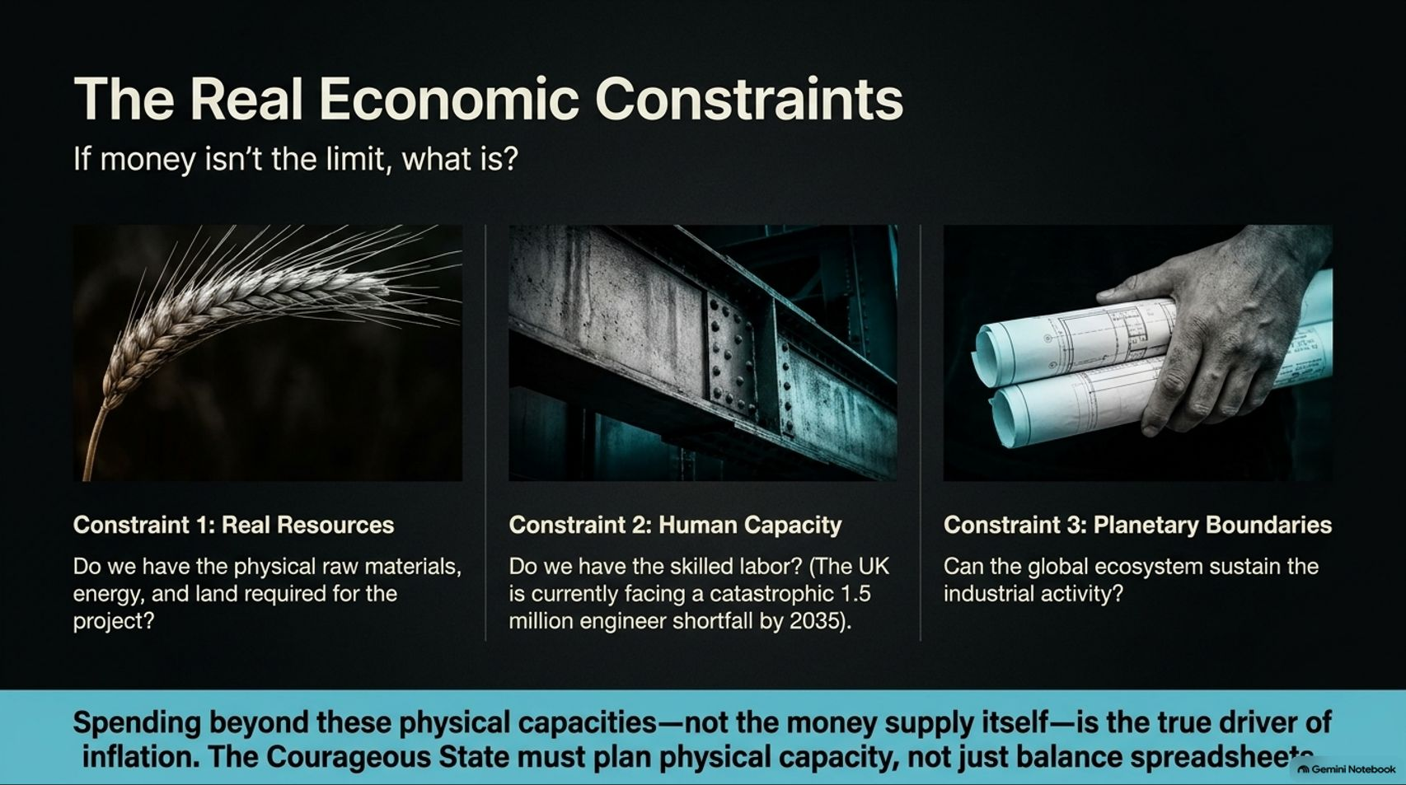
Notes:
Estimated Time: 5 – 6 minutes
Target Word Count: ~650 words
Speaker Notes
If money isn't the limit, what actually constrains a sovereign government? Slide 9 outlines the Three Real Economic Constraints:
Constraint 1: Real Resources: Do we have the physical raw materials, energy, and land required to execute a project?
Constraint 2: Human Capacity: Do we possess the skilled labor? For instance, the UK currently faces a catastrophic 1.5 million engineer shortfall projected by 2035.
Constraint 3: Planetary Boundaries: Can the global ecosystem sustain the industrial activity and carbon footprint of our plans?
The Core Lesson: Spending beyond these physical capacities—not exceeding an arbitrary money supply figure—is the true driver of inflation. The Courageous State must plan physical capacity, not just balance spreadsheets.

Slide 10
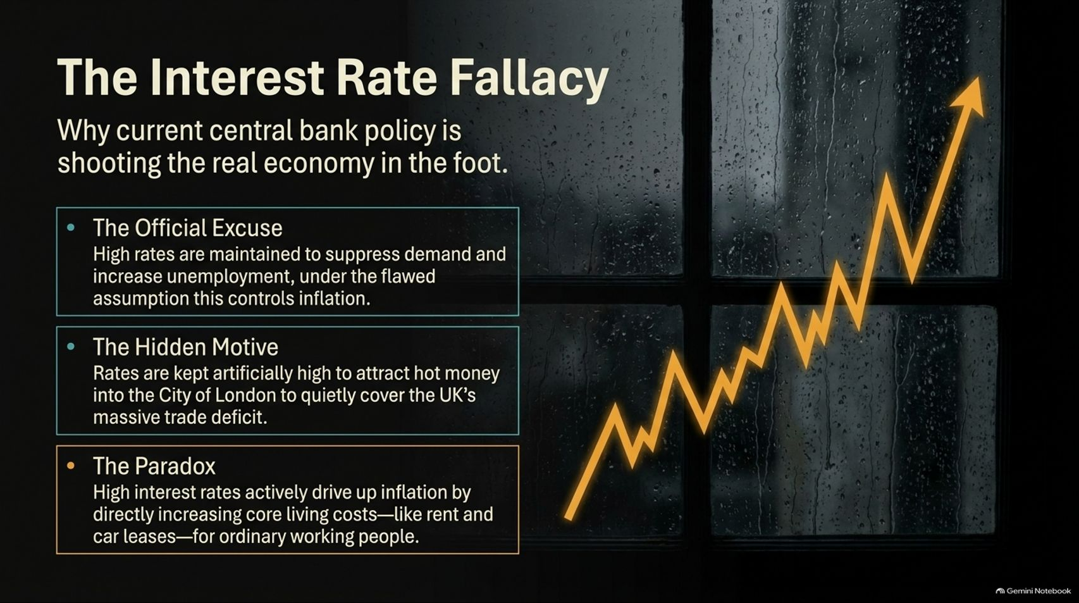
Notes:
Estimated Time: 4 – 5 minutes
Target Word Count: ~600 words
Speaker Notes
Central banks across the West rely on a blunt, destructive tool: raising interest rates to combat inflation. Slide 10 exposes The Interest Rate Fallacy:
The Official Excuse: Central banks claim high rates suppress aggregate demand and increase unemployment to cool inflation.
The Hidden Motive: In reality, rates are often kept artificially high to attract "hot money" inflows into financial centers like the City of London, helping to artificially cover chronic trade deficits.
The Paradox: In today's economy, high interest rates actually drive up inflation by directly increasing core living costs—such as mortgage resets, commercial rents, and business loan servicing costs—which businesses pass directly onto consumers.

Slide 11
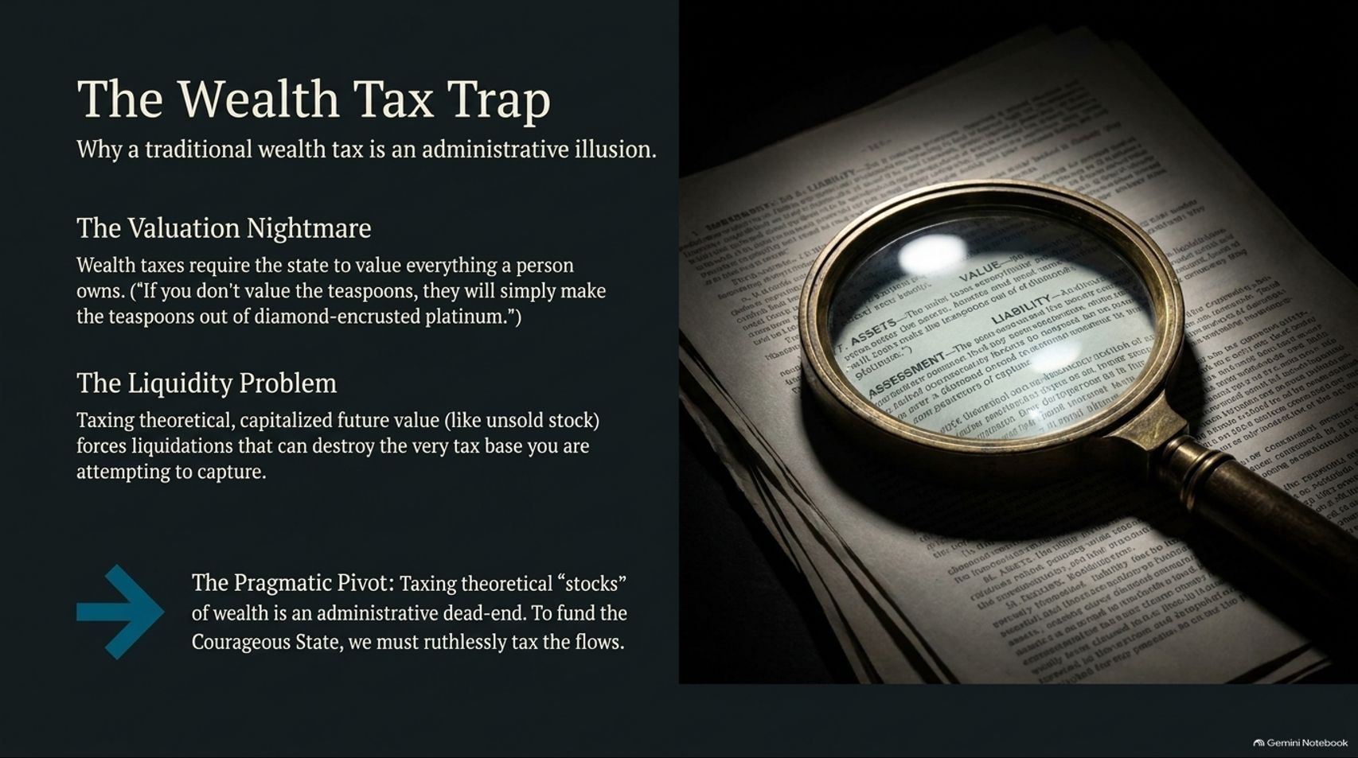
Notes:
Estimated Time: 5 – 6 minutes
Target Word Count: ~650 words
Speaker Notes
While wealth inequality is staggering, Slide 11 examines why Richard Murphy cautions against traditional wealth taxes, calling them The Wealth Tax Trap:
The Valuation Nightmare: Wealth taxes require the state to value everything a billionaire owns. As Murphy notes: "If you don't value the teaspoons, they will simply make the teaspoons out of diamond-encrusted platinum."
The Liquidity Problem: Taxing theoretical, capitalized future value—such as founder stock or paper wealth—forces premature liquidations that can destabilize companies and destroy the very tax base you are trying to capture.
The Pragmatic Pivot: Taxing theoretical stocks of wealth is an administrative dead-end. To fund the Courageous State, we must ruthlessly tax economic flows (income, rents, and financial transactions) rather than unliquidated paper stocks.

Slide 12
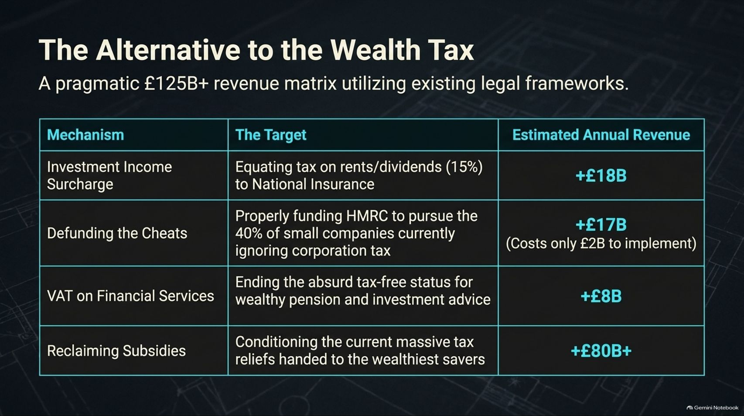
Notes:
Estimated Time: 5 – 6 minutes
Target Word Count: ~650 words
Speaker Notes
How do we fund public investment without falling into the wealth tax trap? Slide 12 presents a pragmatic £125B+ Revenue Matrix utilizing existing legal frameworks:
Investment Income Surcharge (+£18B): Equating tax rates on passive rents and dividends with active earned income (National Insurance).
Defunding the Cheats (+£17B): Properly funding tax authorities (like HMRC) to crack down on the 40% of small companies currently dodging corporation tax—yielding massive returns for a modest £2B enforcement investment.
VAT on Financial Services (+£8B): Ending the absurd, historic tax-free status enjoyed by wealthy pension and investment advisory services.
Reclaiming Subsidies (+£80B+): Reconditioning the massive tax reliefs currently handed out to wealthy savers.
This matrix proves the money is there; it’s simply parked in unproductive tax shelters.

Slide 13
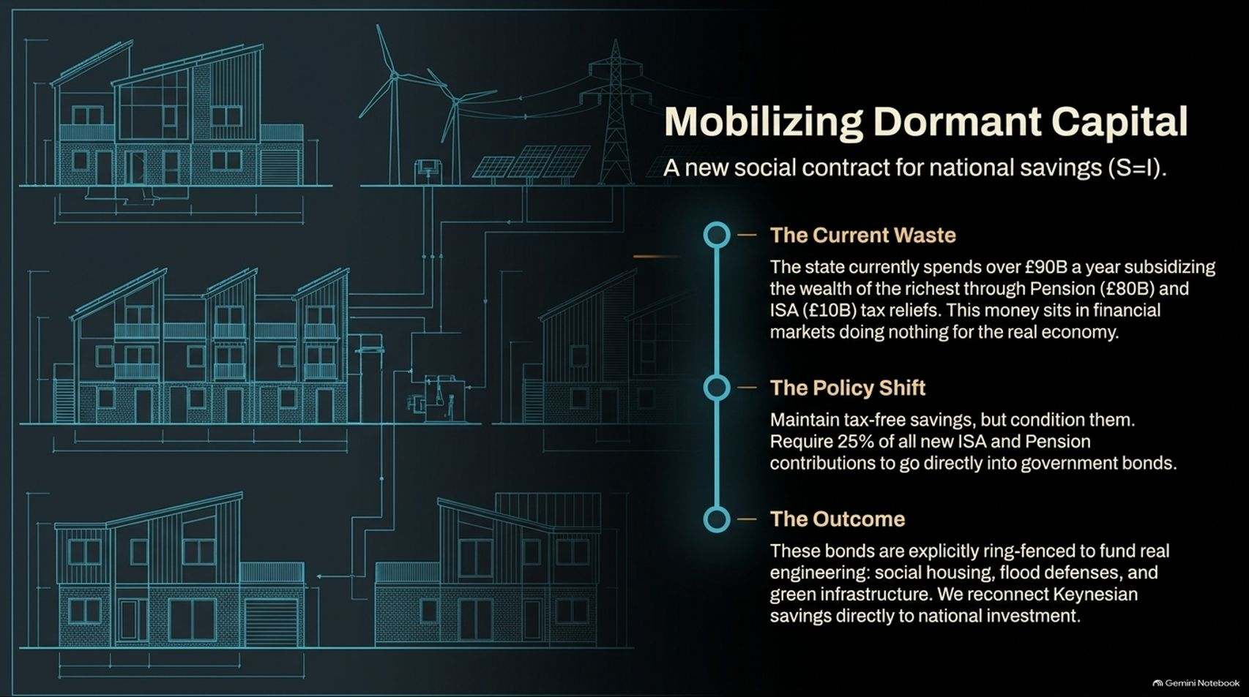

Slide 14
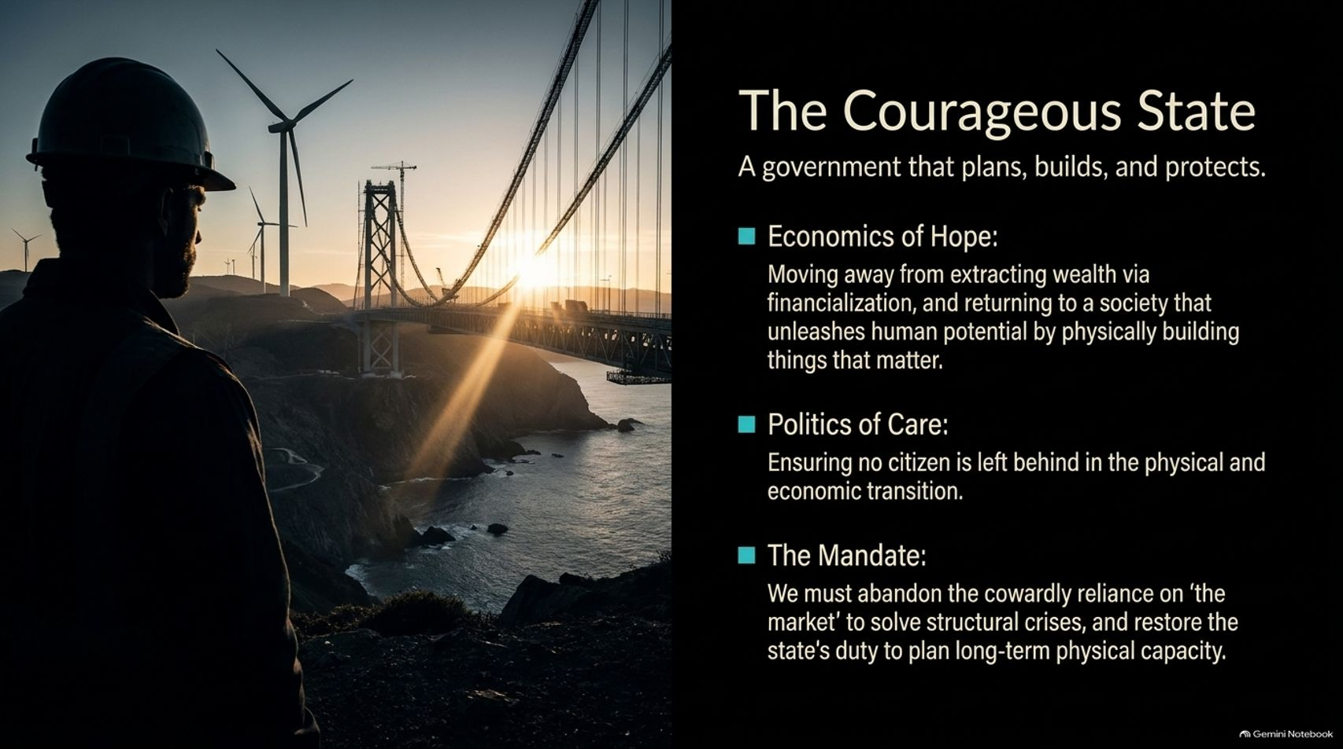
Notes:
Estimated Time: 4 – 5 minutes
Target Word Count: ~550 words
Speaker Notes
What does this new paradigm look like in practice? Slide 14 defines The Courageous State across three pillars:
Economics of Hope: Moving away from extracting wealth via financialization, and returning to a society that unleashes human potential by physically building things that matter.
Politics of Care: Ensuring no citizen is left behind in the industrial and green economic transition.
The Mandate: We must abandon our cowardly reliance on "the market" to solve structural crises, restoring the state's sovereign duty to plan long-term physical capacity.

Slide 15
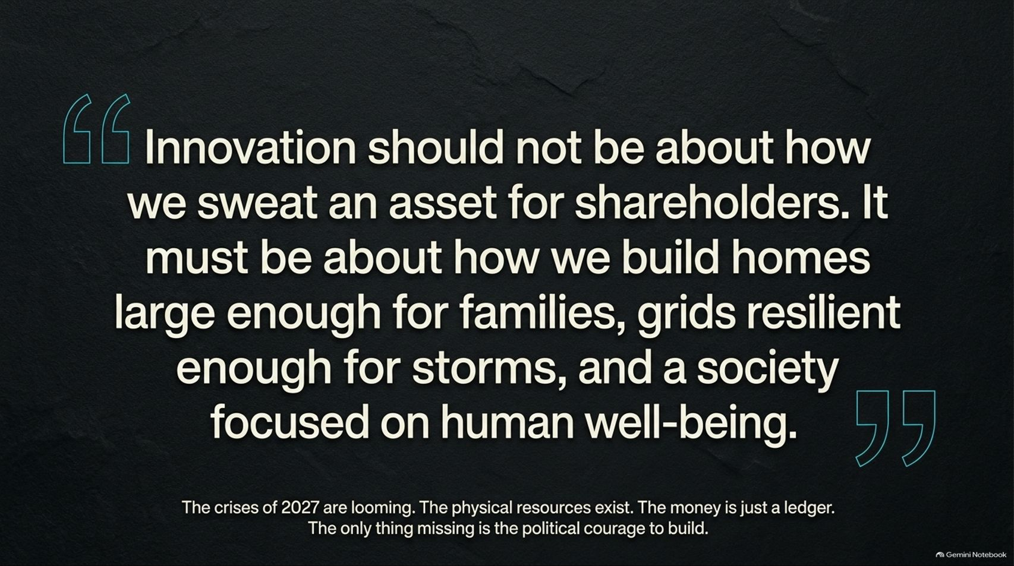
Notes:
Estimated Time: 3 – 4 minutes
Target Word Count: ~400 words
Speaker Notes
Slide 15 captures the moral core of Richard Murphy’s thesis in a single quote:
"Innovation should not be about how we sweat an asset for shareholders. It must be about how we build homes large enough for families, grids resilient enough for storms, and a society focused on human well-being."
As we face the compounding crises of 2027, remember this: the physical resources, the energy, and the technical skills exist. Money is simply an accounting ledger. The only thing missing is the political courage to build.

Slide 16
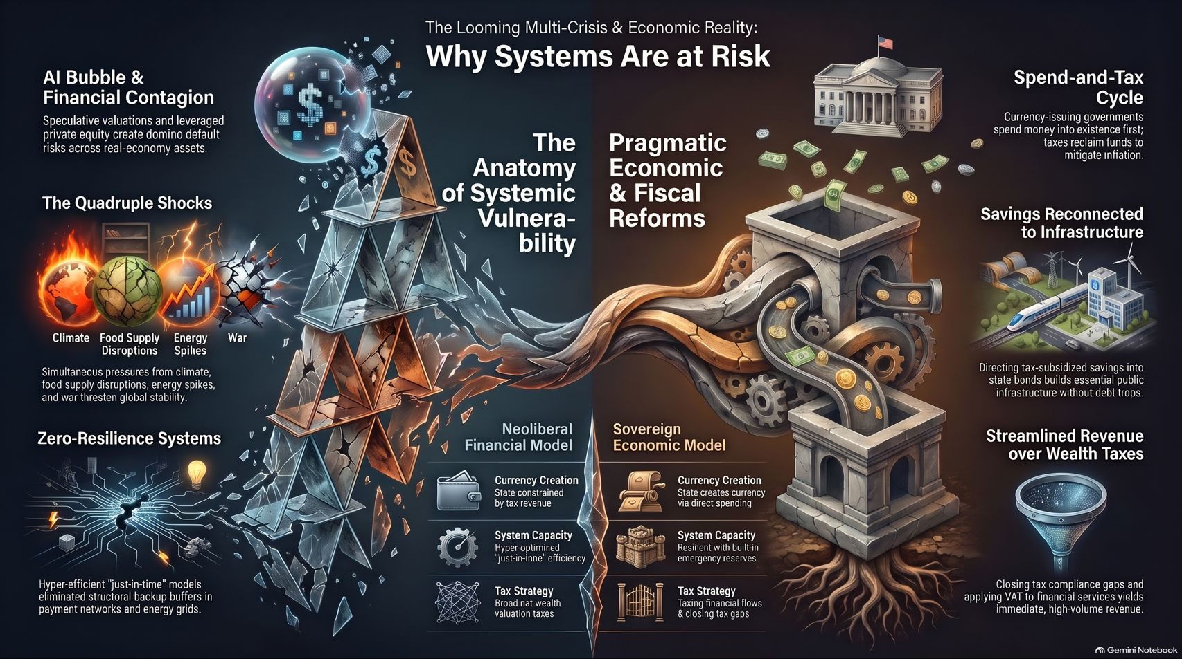
Notes:
Estimated Time: 4 – 5 minutes
Target Word Count: ~600 words
Speaker Notes
To conclude our presentation, Slide 16 provides the master summary roadmap of The Courageous State:
The Looming Multi-Crisis: Recognizing the 2027 polycrisis (AI contagion, climate shocks, supply chains) and rejecting fragile, zero-resilience neoliberal models.
Pragmatic Economic & Fiscal Reforms: Adopting sovereign MMT realities (spend-and-tax), redirecting dormant private savings into public infrastructure bonds, and replacing unworkable wealth taxes with robust tax-flow compliance.
Rebuilding Real Resilience: Focusing on physical capacity, human capital, planetary boundaries, and a state that actively plans, builds, and protects its citizens.
Thank you for your time. For a deeper, comprehensive discussion on these economic principles, you can watch Richard Murphy's full interview on Downstream: Whistleblower Accountant: ‘I Predicted 2008, This Will Be WORSE’ on Novara Media.

