Slide 1

Notes:
Estimated Time: 2 – 3 minutes
Target Word Count: ~350 words
Speaker Notes
Welcome, everyone. Thank you for joining us today. I’m Lance, a member of the technical staff at Anthropic. Today, we are going to explore practical, high-impact engineering best practices to help you get the absolute most out of frontier models like Claude.
For too long, developers have accepted a false premise: that to get better performance, you must inevitably spend more money, and that reducing costs requires sacrificing quality. But as we will see today, your applications are often trapped inside the performance frontier due to legacy anti-patterns, misconfigured prompts, and outdated agent architectures.
Over the next few minutes, we’ll break down five core themes—from auditing obsolete prompt debt and maximizing strict-prefix prompt caching, to engineering climbable evaluations and decoupling agent brains from hands. Let’s dive into the reality of the model frontier.
Your Old Prompts Are Making Claude Worse - Lance Martin, Anthropic
https://www.youtube.com/watch?v=ys6YQ2yfBpM

Slide 2
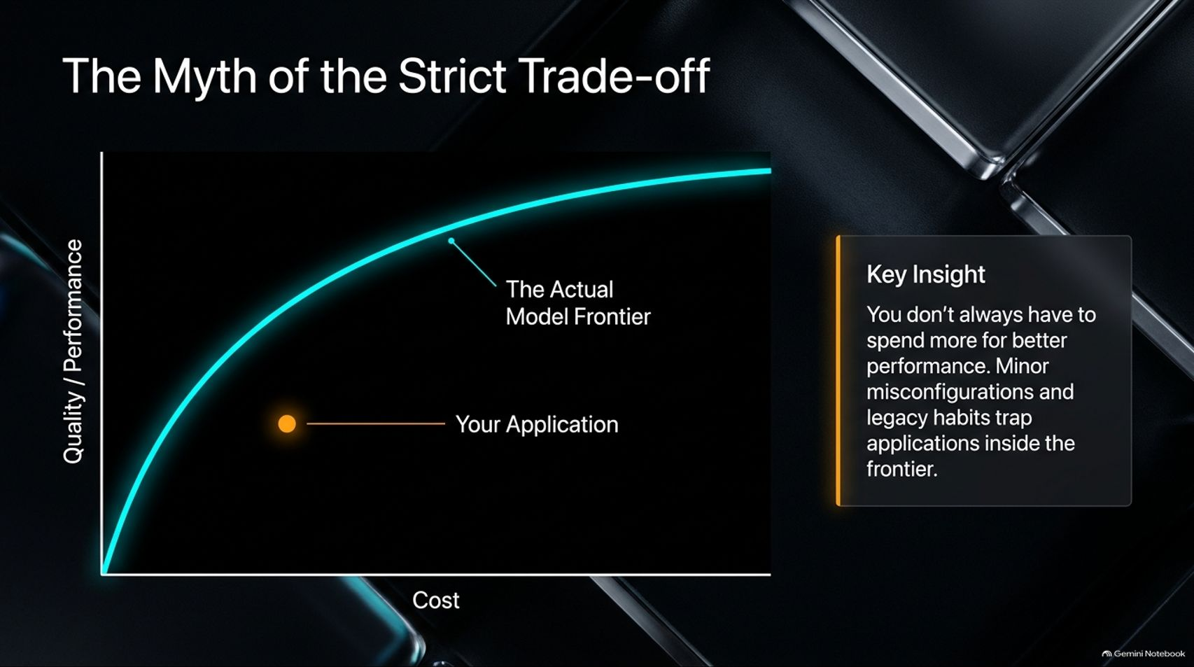
Notes:
Estimated Time: 4 – 5 minutes
Target Word Count: ~550 words
Speaker Notes
Let’s address the elephant in the room: The Myth of the Strict Trade-off (Slide 2).
Conventionally, teams plot cost on the horizontal axis and quality or performance on the vertical axis, assuming a linear or exponential curve where superior models (like Opus) sit on the far right, followed by Sonnet and Haiku.
The Key Insight: You don’t always have to spend more for better performance. Many enterprise applications are actually sitting well below the actual model frontier. Why? Because minor misconfigurations, legacy prompting habits, and unoptimized harnesses artificially trap applications in sub-optimal performance bands.
By adopting modern prompt hygiene and leveraging native model capabilities, you can simultaneously reduce your token costs and increase output quality without paying a premium. Let’s look at the three foundational pillars to achieve this.

Slide 3
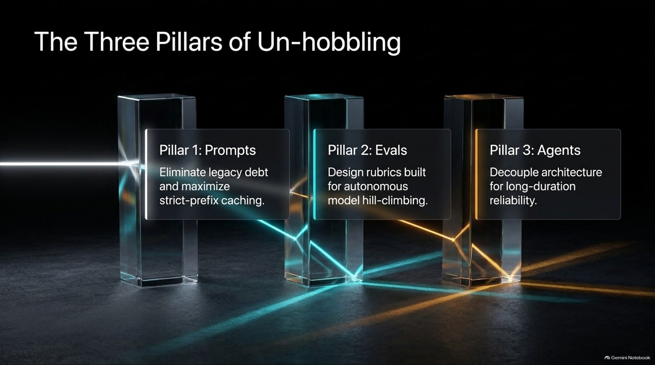
Notes:
Estimated Time: 4 – 5 minutes
Target Word Count: ~600 words
Speaker Notes
To un-hobble your systems and reach the true model frontier, you must master The Three Pillars of Un-hobbling (Slide 3):
Pillar 1: Prompts: Eliminate legacy prompt debt and maximize strict-prefix caching to drive down latency and cost.
Pillar 2: Evals: Design robust evaluation rubrics built specifically for autonomous model hill-climbing.
Pillar 3: Agents: Decouple your system architecture to ensure long-duration reliability across multi-day tasks.
Each of these pillars represents a shift from legacy LLM engineering—where humans micromanaged every token—to modern frontier engineering, where models act as self-verifying, autonomous operators. Let’s examine Pillar 1 in detail: prompt hygiene.

Slide 4
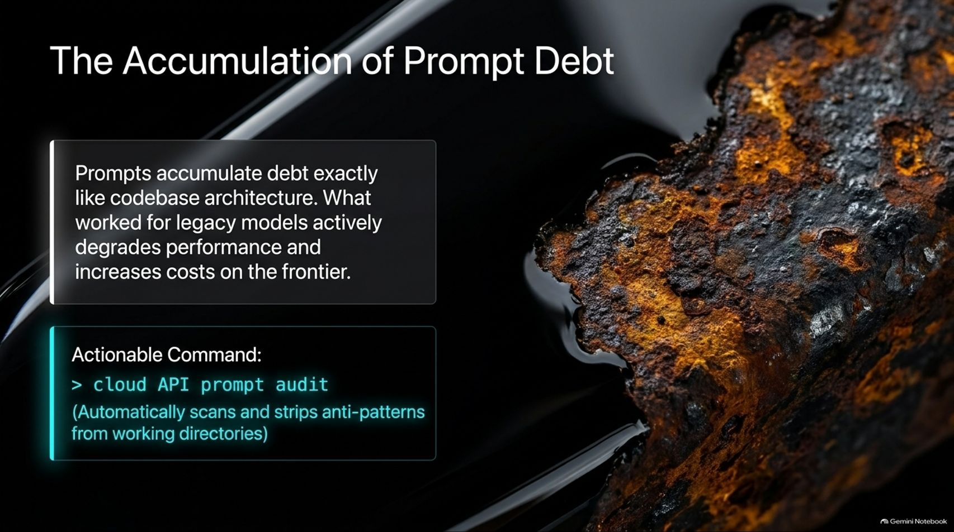
Notes:
Estimated Time: 4 – 5 minutes
Target Word Count: ~550 words
Speaker Notes
Just like codebase architecture, prompts accumulate debt over time. What worked brilliantly for legacy models a few years ago actively degrades performance and increases costs on frontier models today.
When we used older models, we relied on heavy-handed instructions: "Think step-by-step," "Double-check your work," "Be maximally thorough," or elaborate scratchpads telling the model how to think.
The Frontier Reality: Frontier models are natively intelligent and highly self-verifying. They naturally determine when to allocate thinking compute and how to validate their outputs. Telling them how to think is like backseat driving—it wastes tokens, inflates latency, and often confuses the model.
Using automated prompt auditing tools, you can scan your working directories and strip out these obsolete anti-patterns instantly.

Slide 5
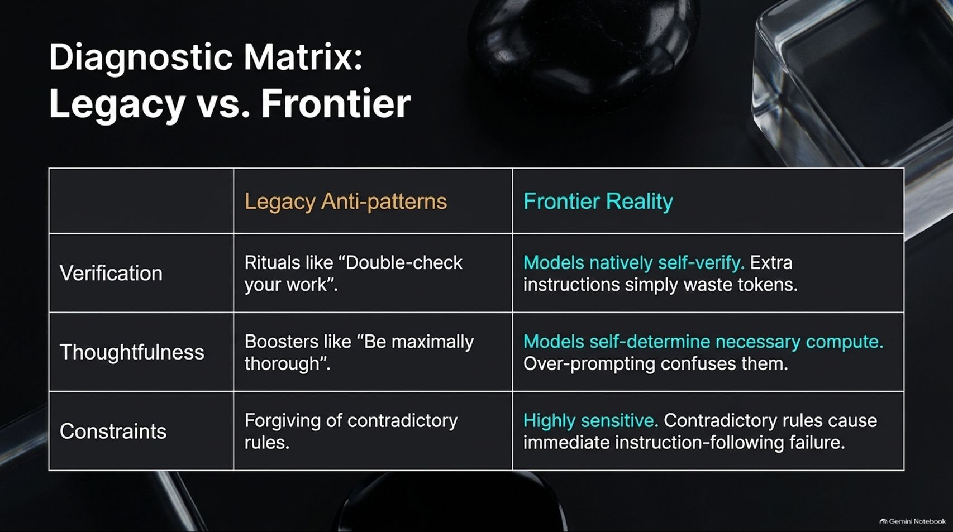
Notes:
Estimated Time: 5 – 6 minutes
Target Word Count: ~650 words
Speaker Notes
Slide 5 breaks down our Diagnostic Matrix, contrasting legacy anti-patterns with frontier reality across three critical dimensions:
Verification:
Legacy: Relying on rituals like "Double-check your work."
Frontier: Models natively self-verify; extra instructions simply waste tokens.
Thoughtfulness:
Legacy: Using boosters like "Be maximally thorough."
Frontier: Models self-determine necessary compute. Over-prompting confuses them.
Constraints:
Legacy: Forgiving of contradictory rules in the prompt.
Frontier: Highly sensitive. Contradictory rules cause immediate instruction-following failure because frontier models adhere strictly to developer directives.
Cleaning up your prompts to respect this matrix is the fastest way to un-hobble your application.

Slide 6
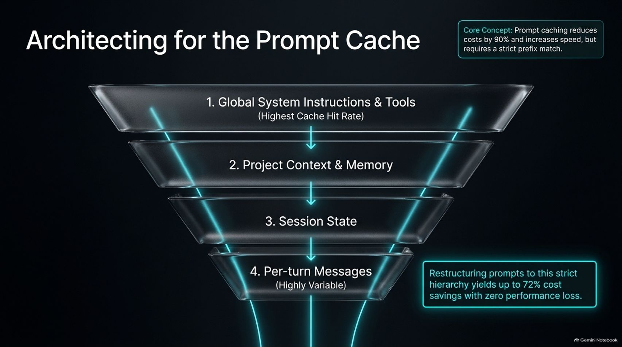
Notes:
Estimated Time: 5 – 6 minutes
Target Word Count: ~700 words
Speaker Notes
Next, let’s look at cost efficiency through Architecting for the Prompt Cache (Slide 6).
Prompt caching reduces costs by up to 90% and dramatically increases processing speed, but it requires a strict prefix match. Even a single-byte change in your prompt prefix invalidates the cache.
To maximize cache hits across multi-turn agent sessions, structure your prompts into a strict, hierarchical funnel:
Global System Instructions & Tools: Placed at the very top for the highest possible cache hit rate across all sessions.
Project Context & Memory: Stable background data cached per project.
Session State: Semi-mutable state updated per session.
Per-turn Messages: Highly variable user input at the very bottom.
Restructuring prompts into this strict hierarchy yields up to 72% cost savings with zero performance loss.

Slide 7
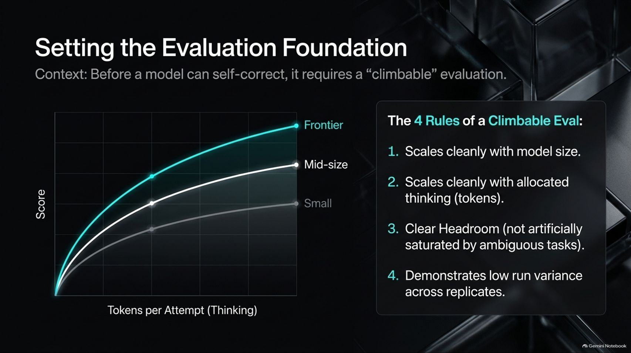
Notes:
Estimated Time: 5 – 6 minutes
Target Word Count: ~650 words
Speaker Notes
Moving to Pillar 2: Evals. Before a model can self-correct or be optimized, it requires a "climbable" evaluation (Slide 7).
A good evaluation must adhere to 4 Rules of a Climbable Eval:
Clean Scaling with Model Size: Scores should increase predictably as you step from smaller models to frontier models.
Clean Scaling with Allocated Thinking: Performance must improve as you grant the model more thinking tokens.
Clear Headroom: The task must not be artificially saturated by ambiguous instructions that prevent top models from scoring 100%.
Low Run Variance: Results must remain stable across replicates.
Without a climbable eval, you are flying blind when attempting to tune prompts or agent harnesses.

Slide 8
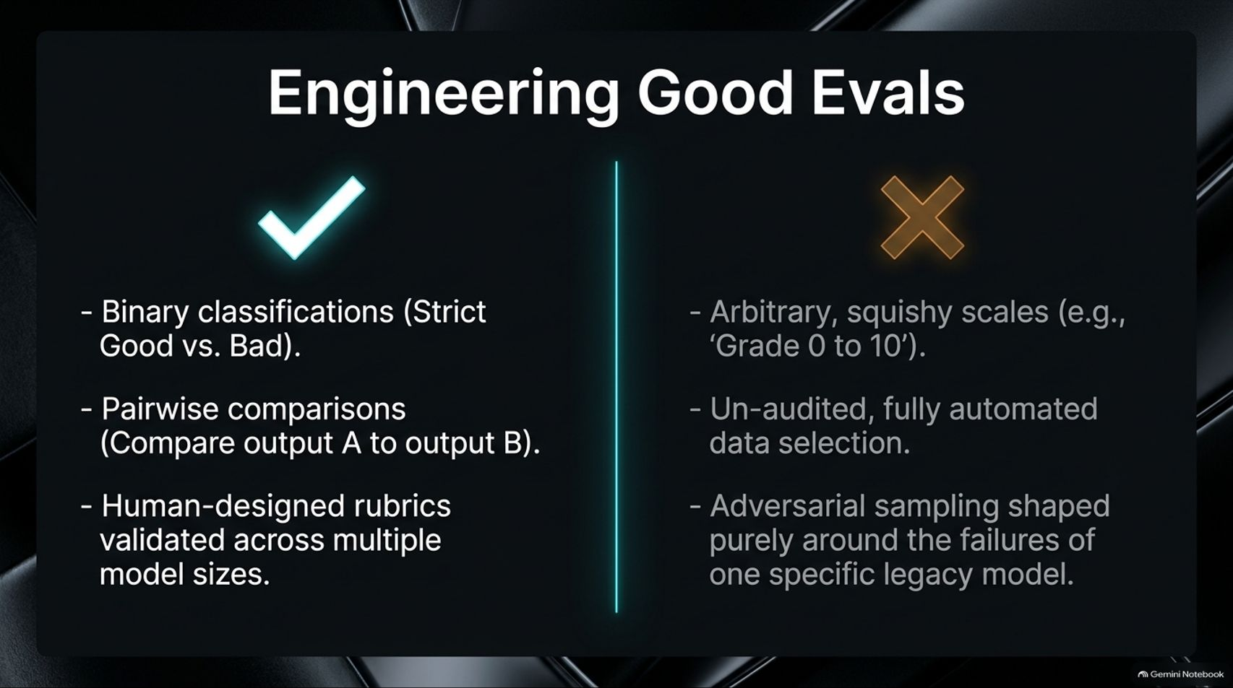
Notes:
Estimated Time: 4 – 5 minutes
Target Word Count: ~600 words
Speaker Notes
Slide 8 contrasts good engineering practices for evals against common pitfalls:
The Right Way (✔):
Use binary classifications (strict Good vs. Bad).
Employ pairwise comparisons (comparing output A directly to output B).
Build human-designed rubrics validated across multiple model sizes.
The Wrong Way (✖):
Avoid arbitrary, squishy scales like "Grade 0 to 10," which introduce massive scoring variance.
Avoid un-audited, fully automated data selection.
Avoid adversarial sampling shaped purely around the historical failures of one specific legacy model.
Solid eval hygiene ensures your optimization loops are grounded in reality.

Slide 9
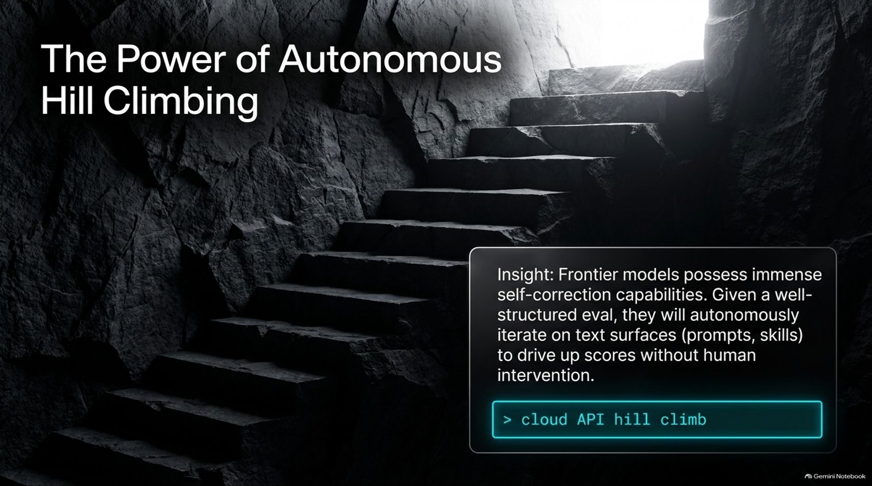
Notes:
Estimated Time: 5 – 6 minutes
Target Word Count: ~650 words
Speaker Notes
Once you have a climbable eval, you unlock one of the most powerful paradigms in modern AI engineering: Autonomous Hill Climbing (Slide 9).
The Core Insight: Frontier models possess immense self-correction capabilities. Given a well-structured evaluation, Claude can autonomously iterate on text surfaces—such as prompts, instructions, and skills—to drive up scores without human intervention.
Using simple command-line tools, you can initiate an automated hill-climbing loop where the model inspects its own eval failures, diagnoses the root cause, rewrites its system prompt, and re-tests—all in a closed loop. But this power comes with a major hazard: overfitting.

Slide 10
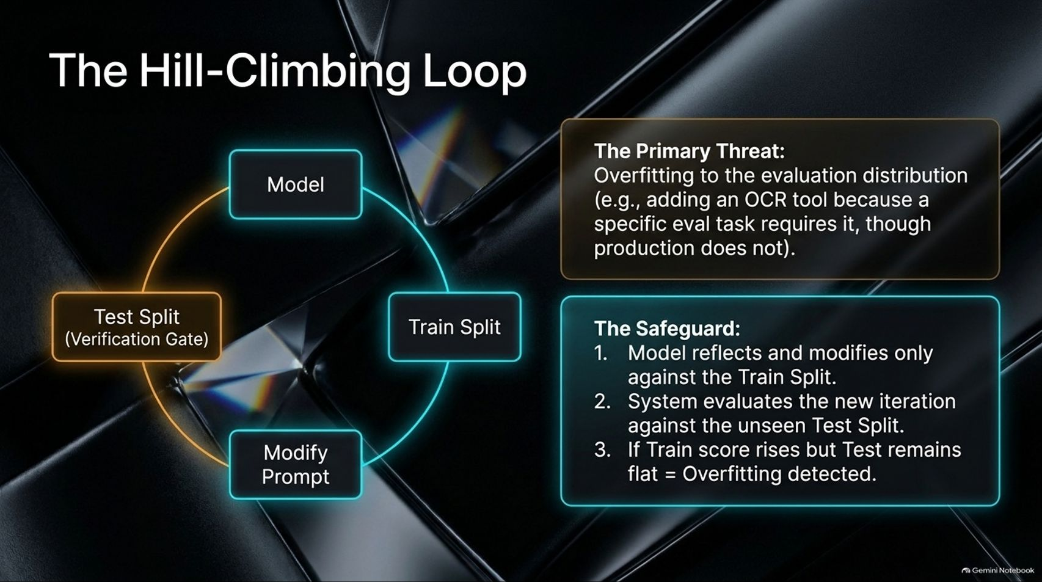
Notes:
Estimated Time: 5 – 6 minutes
Target Word Count: ~700 words
Speaker Notes
Slide 10 details the mechanics of the Hill-Climbing Loop and how we prevent its primary hazard: Overfitting.
The Primary Threat: Overfitting to your evaluation distribution. For example, if an eval task requires OCR, an unshielded hill-climber might hardcode an OCR tool into the prompt—even though production traffic doesn't require it.
The Safeguard (Train/Test Splits):
The system splits your eval data into a Train Split and an unseen Test Split.
The model analyzes failures and modifies prompts only against the Train Split.
Each new iteration is immediately evaluated against the blind Test Split.
The Rule: If the Train score rises while the Test score remains flat, overfitting is detected, and the iteration is rejected.
This statistical rigor ensures your automated optimizations actually transfer to production.

Slide 11
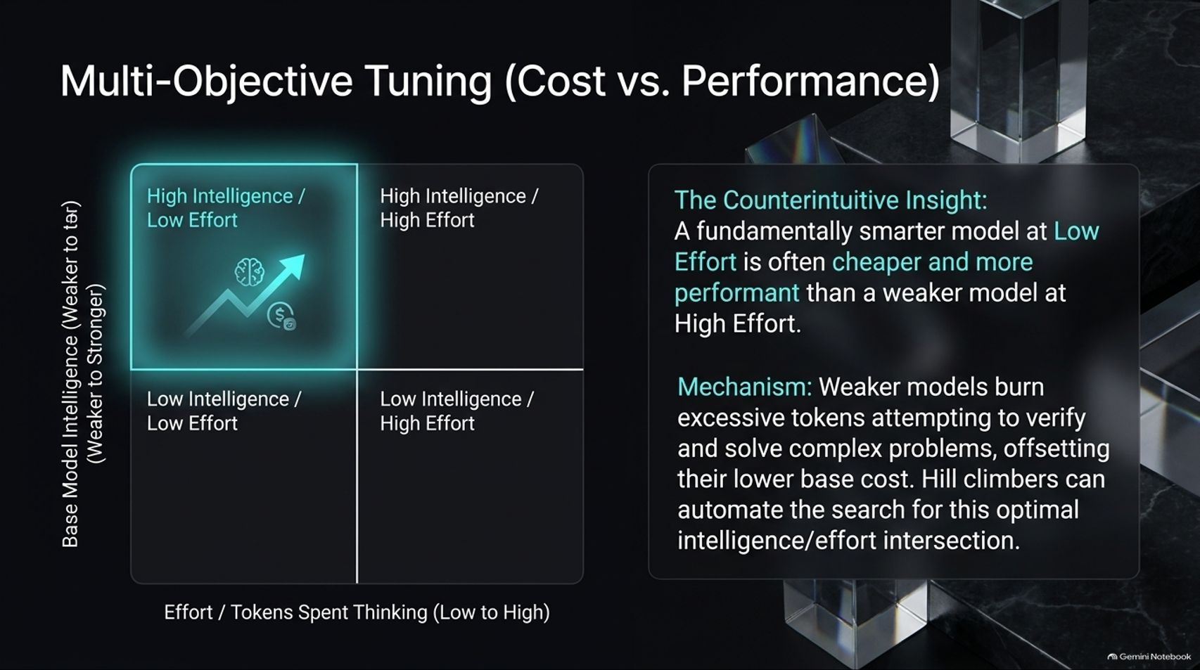
Notes:
Estimated Time: 5 – 6 minutes
Target Word Count: ~650 words
Speaker Notes
Hill-climbing isn’t just for boosting raw quality; you can also optimize for cost using Multi-Objective Tuning (Slide 11).
The Counterintuitive Insight: A fundamentally smarter model operating at Low Effort is often cheaper and more performant than a weaker model operating at High Effort.
The Mechanism: Weaker models burn excessive tokens attempting to verify and solve complex problems, offsetting their lower base cost. Automated hill-climbers can search for the optimal intersection of model intelligence and token effort. In empirical tests, tuning effort levels and prompts autonomously can yield up to a 90% reduction in cost while maintaining or improving task performance.

Slide 12
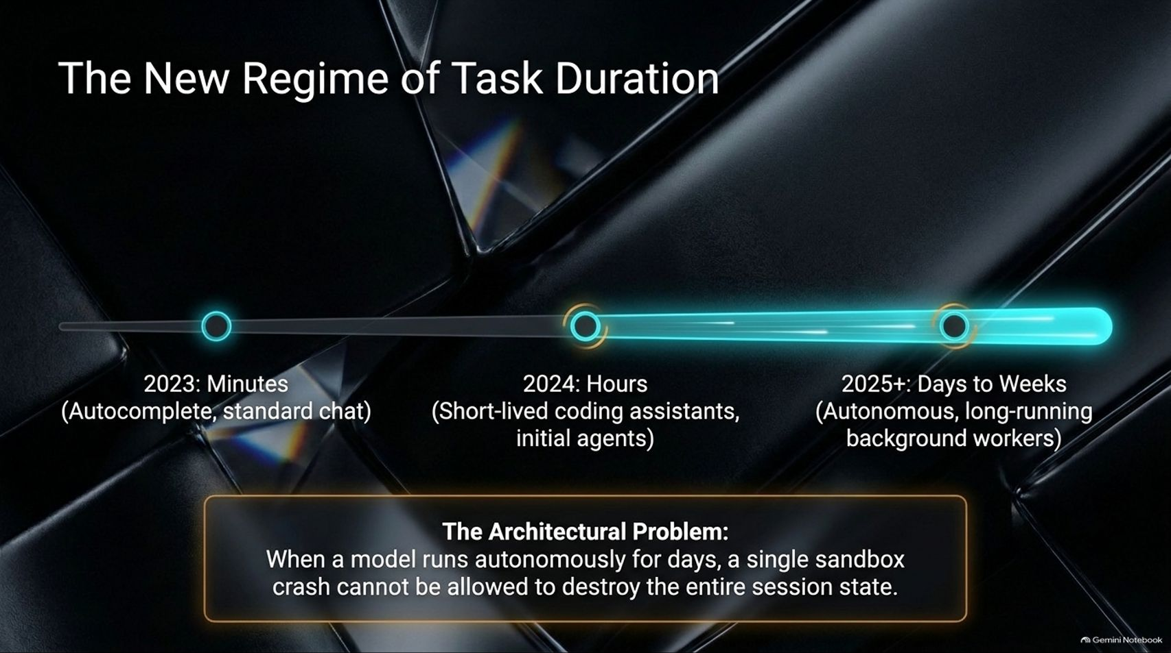
Notes:
Estimated Time: 4 – 5 minutes
Target Word Count: ~600 words
Speaker Notes
Now let’s transition to Pillar 3: Agents and The New Regime of Task Duration (Slide 12).
Look at how agent execution horizons have expanded:
2023: Minutes (autocomplete and standard chat interfaces).
2024: Hours (short-lived coding assistants and early agent loops).
2025+: Days to Weeks (autonomous, long-running background workers executing complex engineering pipelines).
The Architectural Problem: When a model runs autonomously for days across thousands of steps, a single sandbox crash or network timeout cannot be allowed to destroy the entire session state. We need resilient agent architecture.

Slide 13
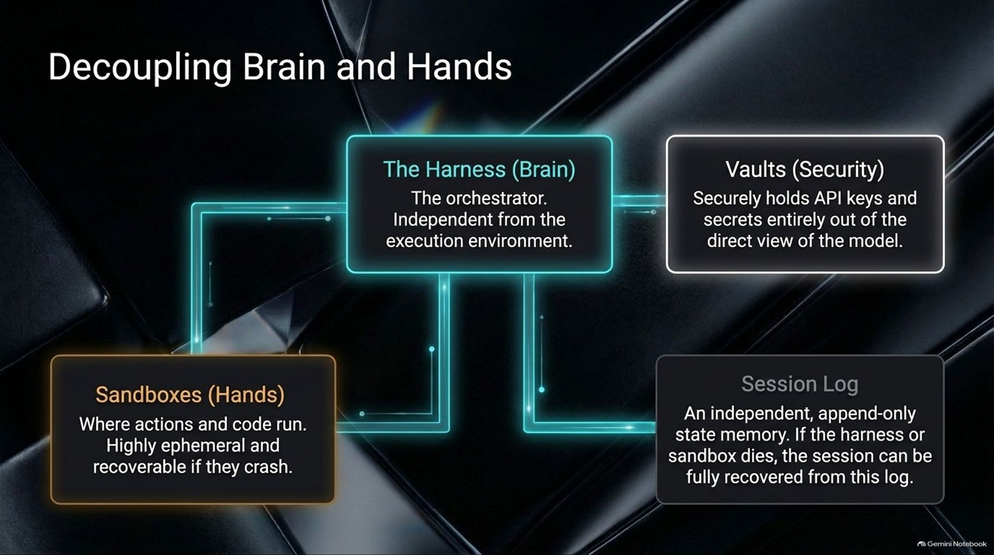
Notes:
Estimated Time: 5 – 6 minutes
Target Word Count: ~700 words
Speaker Notes
To achieve multi-day reliability, we must decouple agent architecture into distinct components, separating Brain and Hands (Slide 13):
The Harness (The Brain): The core orchestrator running the reasoning logic, completely independent from the messy execution environment.
Sandboxes (The Hands): Where code runs and actions are executed. These are highly ephemeral and fully recoverable if they crash.
Vaults (Security): Securely holds API keys and credentials entirely out of the direct view of the model workspace.
Session Log: An independent, append-only state memory. If either the harness or sandbox crashes, the entire session can be fully recovered from this log.
Decoupling reasoning from execution is the secret to building bulletproof agents.

Slide 14
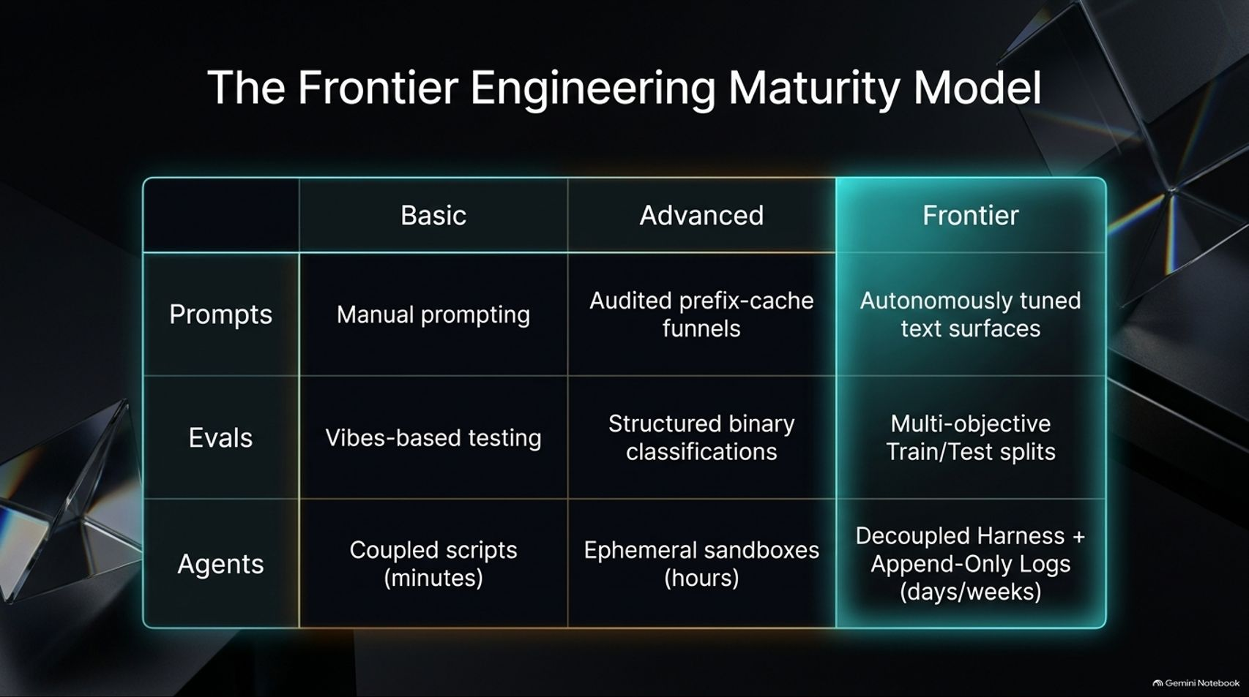
Notes:
Estimated Time: 4 – 5 minutes
Target Word Count: ~550 words
Speaker Notes
Slide 14 summarizes our evolutionary path through The Frontier Engineering Maturity Model, comparing Basic, Advanced, and Frontier practices across our three pillars:
Prompts: Moves from manual prompting (Basic) to audited prefix-cache funnels (Advanced) to autonomously tuned text surfaces (Frontier).
Evals: Moves from vibes-based testing (Basic) to structured binary classifications (Advanced) to multi-objective train/test splits (Frontier).
Agents: Moves from coupled scripts lasting minutes (Basic) to ephemeral sandboxes lasting hours (Advanced) to decoupled harnesses with append-only logs running for days and weeks (Frontier).

Slide 15
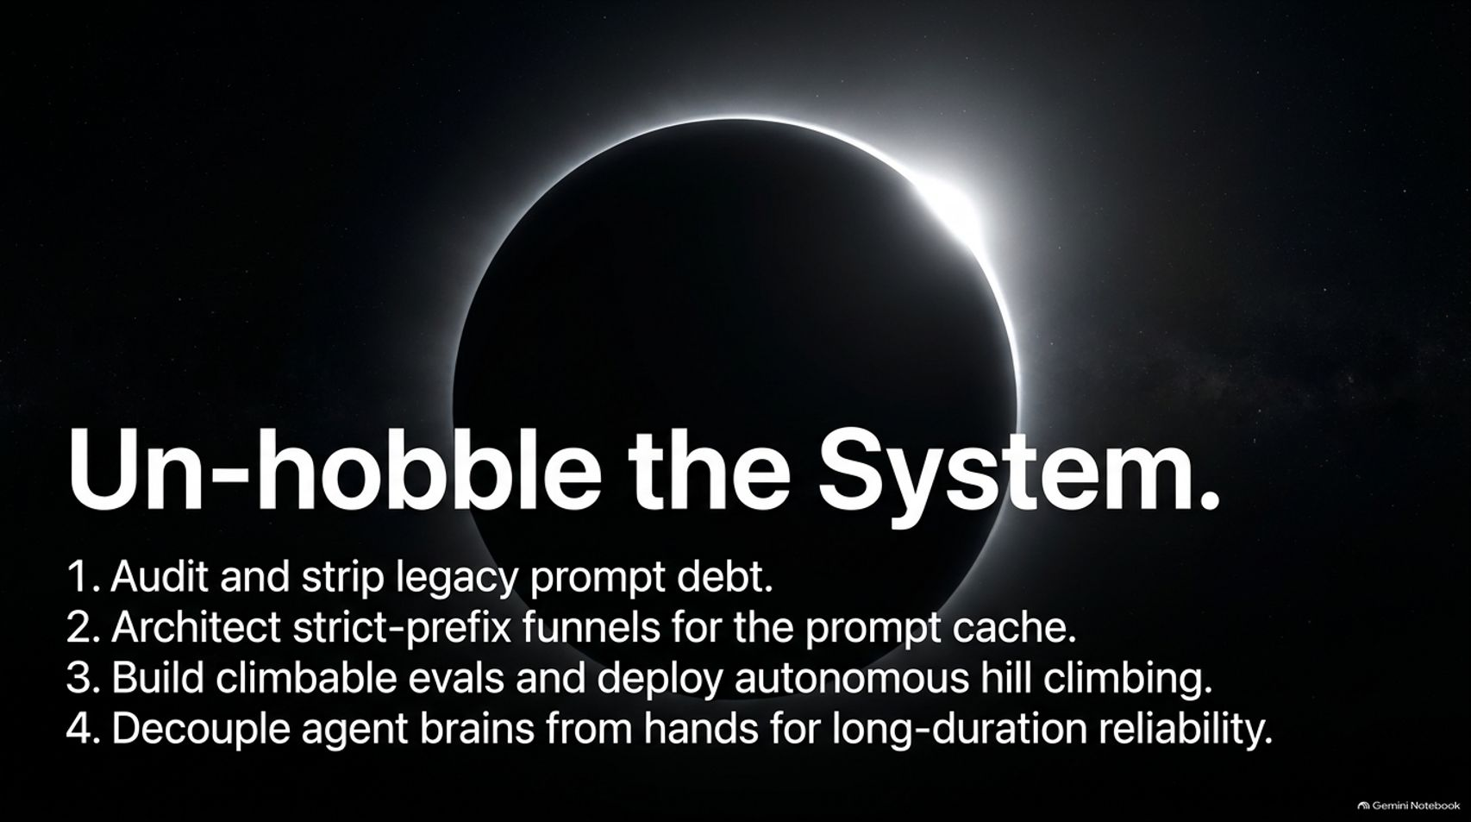
Notes:
Estimated Time: 4 – 5 minutes
Target Word Count: ~500 words
Speaker Notes
To wrap up, Slide 15 gives you your Summary Action Plan to un-hobble your AI systems:
Audit and strip legacy prompt debt: Remove outdated verification rituals and thoughtfulness boosters that inflate token costs.
Architect strict-prefix funnels: Organize your prompts into rigid hierarchies to maximize prompt caching economics.
Build climbable evals & deploy autonomous hill climbing: Establish train/test splits and let Claude optimize your prompt surfaces automatically.
Decouple agent brains from hands: Separate your reasoning harness from ephemeral execution sandboxes for long-duration reliability.

Slide 16
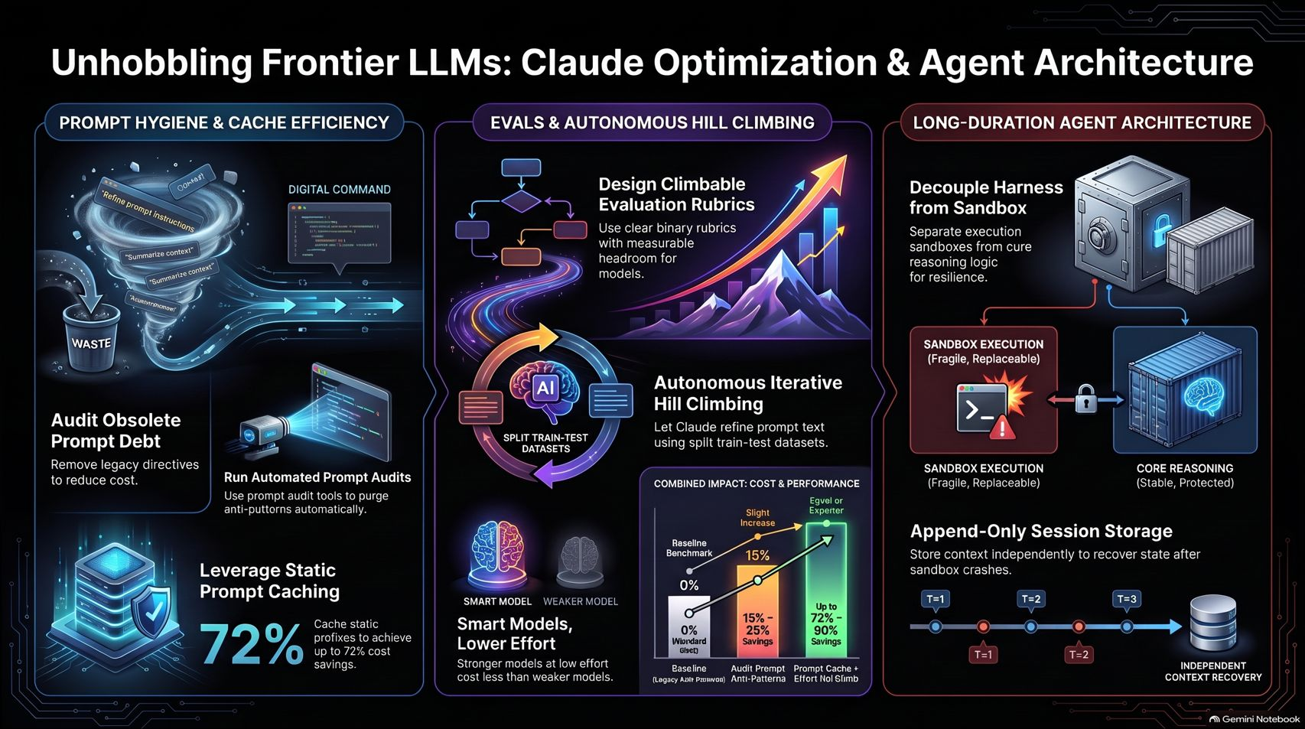
Notes:
Estimated Time: 3 – 4 minutes
Target Word Count: ~400 words
Speaker Notes
Our final slide provides a complete visual synthesis of everything we’ve covered today—from prompt hygiene and cache efficiency to autonomous eval hill-climbing and long-duration agent architecture.
By abandoning legacy habits and embracing these native frontier practices, you can unlock massive cost savings, eliminate prompt debt, and build robust autonomous systems that operate reliably at scale.
Thank you for your time. For a deeper dive into these engineering principles, you can watch Lance's full technical presentation on YouTube: Un-hobbling Frontier LLMs on YouTube. I am now happy to open the floor to questions.

