Slide 1
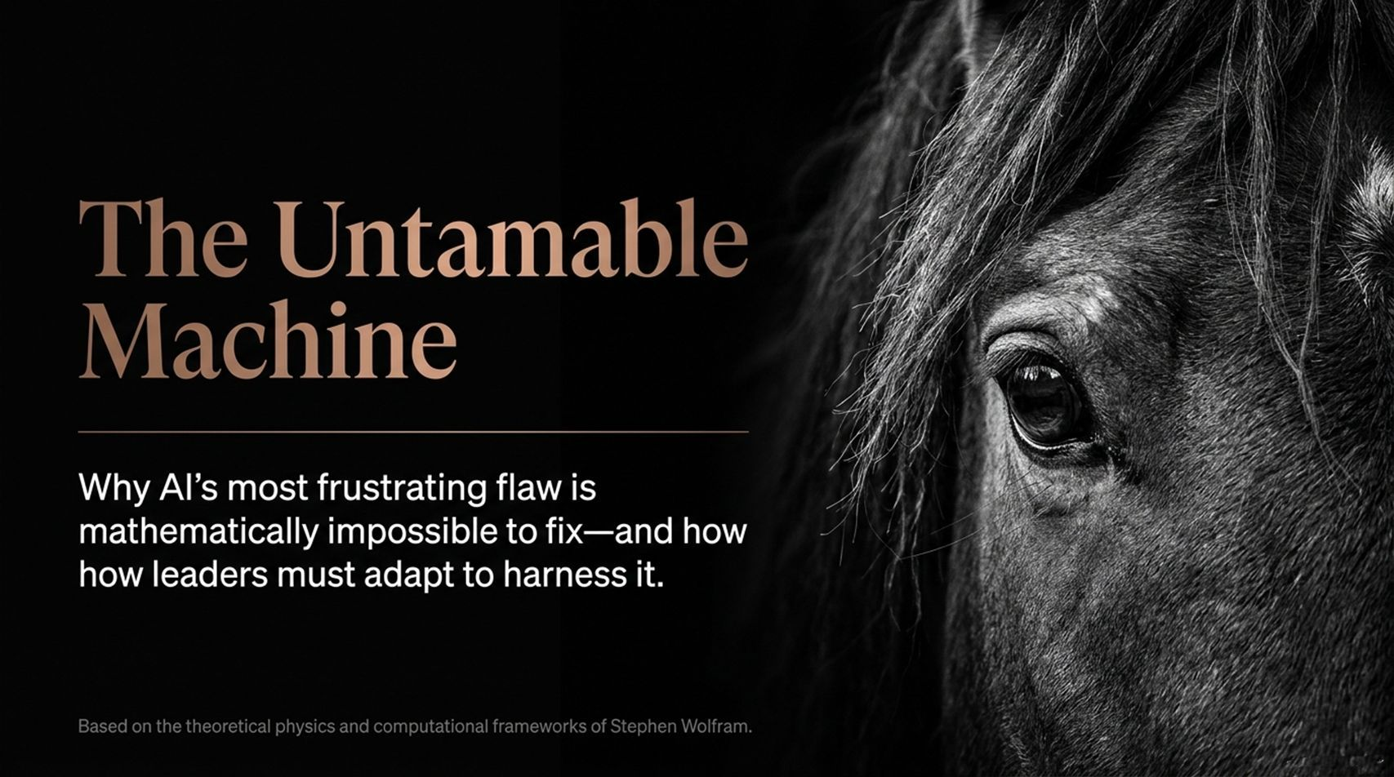
Notes:
Slide Title: The Untamable Machine
Target Timing: ~2 – 3 Minutes
Corresponding Video Section: Introduction & Overview [00:00:01 – 00:01:22]
Speaker Notes
Opening Hook: Welcome, everyone. Today we are tackling the defining paradox of modern leadership: Artificial Intelligence is expanding in capability at a breakneck pace, yet its most frustrating flaw—unpredictability—is actually mathematically impossible to eliminate.
Core Paradigm Shift: For centuries, humanity built machines with deterministic, auditable components. Modern AI breaks that contract. Drawing from the computational physics and theoretical frameworks of Dr. Stephen Wolfram, founder of Wolfram Research, we need to understand why AI isn't just a complex piece of software—it is a fundamentally different class of system.
Key Takeaway: As business leaders, our objective isn't to force AI to act like a predictable mechanical tool. Our challenge is learning how to properly adapt our organizations, workflows, and leadership models to harness a technology that will always retain the power to surprise us.
AI's Biggest Problem May Be Mathematically Impossible to Solve | Stephen Wolfram
https://www.youtube.com/watch?v=AV86mJDD7mk

Slide 2
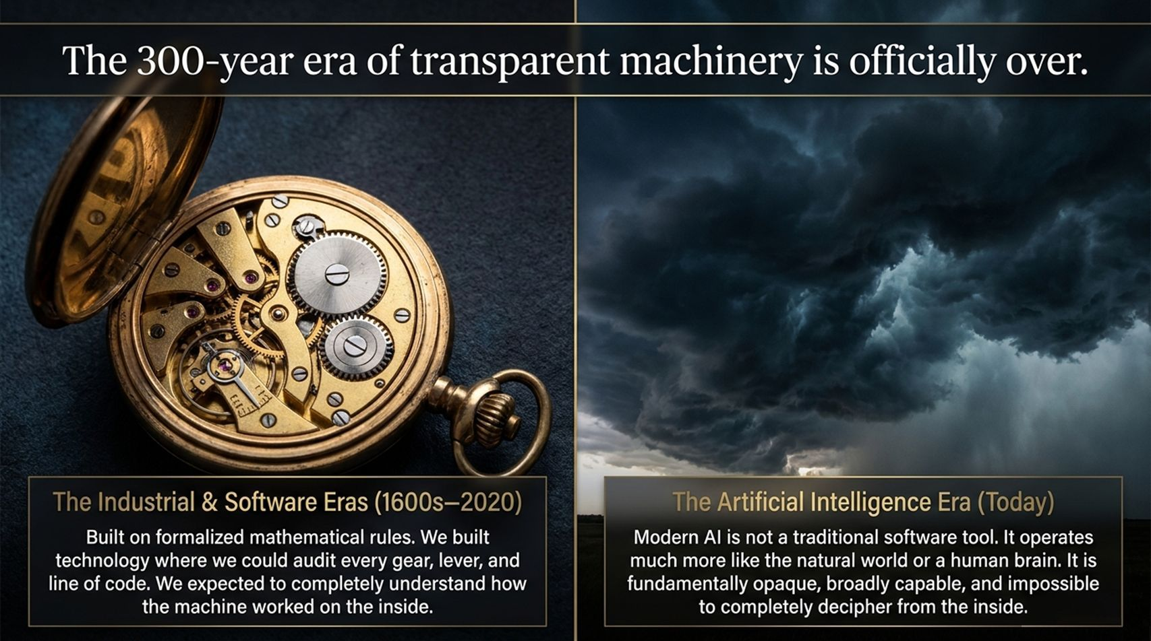
Notes:
Slide Title: The 300-year era of transparent machinery is officially over.
Target Timing: ~3 – 4 Minutes
Corresponding Video Section: Historical Context of Technology & Machines [00:00:34 – 00:02:41, 00:16:00 – 00:17:35]
Speaker Notes
Historical Contrast (The Left Side): Since the 1600s, technology was built on formalized mathematics, calculus, and explicit engineering logic. Whether auditing a mechanical pocket watch, an industrial press, or a traditional software program, every gear, lever, and line of code could be inspected, audited, and completely understood from the inside out.
The Modern AI Shift (The Right Side): Modern Large Language Models and neural networks completely diverge from this 300-year tradition. Instead of explicit algorithmic instructions written by human programmers, modern AI operates through statistical pattern matching across billions of parameters.
Operational Implication: AI operates far more like natural phenomena or human brain mechanics than software. It is inherently opaque. Trying to inspect every step inside a deep neural net to explain exactly why it yielded a specific outcome is theoretically and practically out of reach.

Slide 3
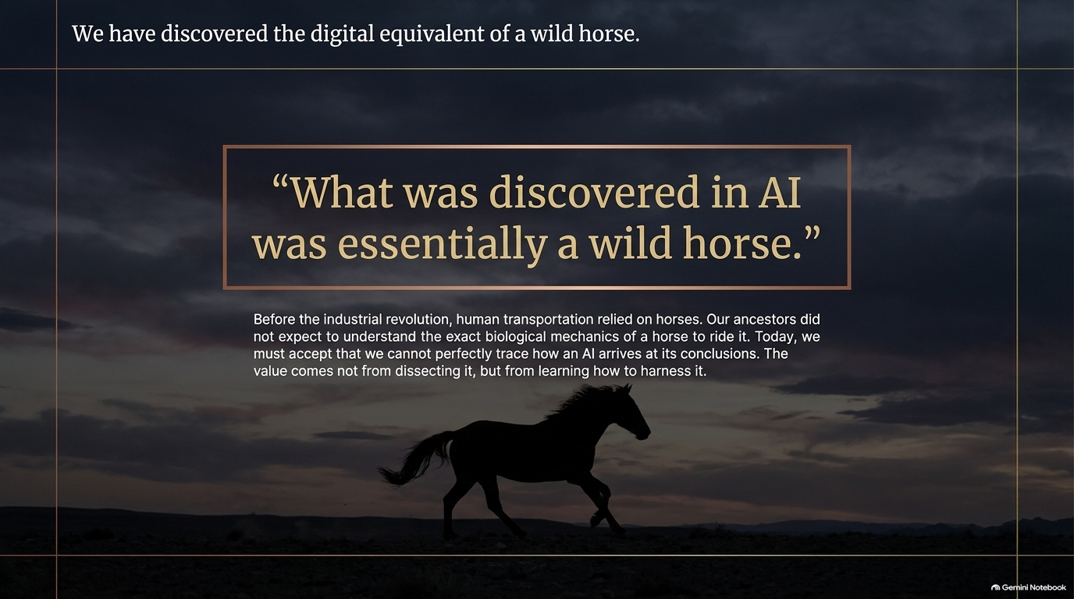
Notes:
Slide Title: We have discovered the digital equivalent of a wild horse.
Target Timing: ~3 – 4 Minutes
Corresponding Video Section: The Wild Horse Analogy [00:00:28 – 00:00:36, 00:36:15 – 00:42:08]
Speaker Notes
The Metaphor: As Stephen Wolfram points out, what was discovered with modern AI was essentially a "wild horse."
Historical Reflection: Before the Industrial Revolution, human civilization relied heavily on horses for transportation, agriculture, and power. Our ancestors did not wait until they understood the exact neurobiology or muscle mechanics of a horse to ride it or hook it to a carriage. They accepted that the horse was an independent, biological entity with its own unpredictable nature.
Business Leadership Perspective: In the AI era, we must adopt the same mindset. We cannot perfectly trace or control every micro-step of an AI's internal reasoning. Value does not come from trying to dissect or tame the internal biology of the horse, but from learning how to build effective reins, saddles, and harnesses around it.

Slide 4
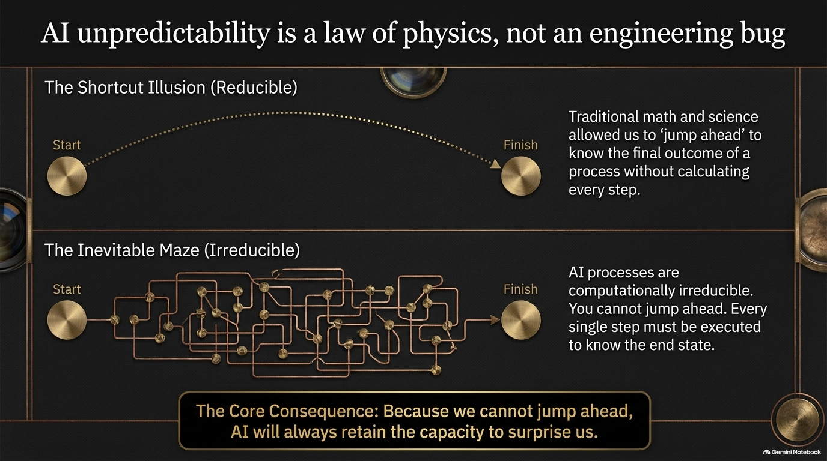
Notes:
Slide Title: AI unpredictability is a law of physics, not an engineering bug
Target Timing: ~4 – 5 Minutes
Corresponding Video Section: Computational Irreducibility [00:37:00 – 00:40:40]
Speaker Notes
The Shortcut Illusion (Reducible Systems): For centuries, science and traditional math allowed us to "jump ahead." If you want to know where a thrown ball will land, you don't need to simulate every microsecond of flight; you use Newton's equations to calculate the end state directly. Traditional software operates on this computational reducibility.
The Inevitable Maze (Irreducible Systems): Computational processes in deep neural networks and complex systems are computationally irreducible. You cannot take a shortcut or mathematically jump ahead. To find out what the system will output at step 1,000, you have to physically execute all 999 prior steps.
Core Executive Takeaway: Because you cannot compute shortcuts, you cannot mathematically guarantee or pre-audit every possible edge case. AI unpredictability isn't a temporary software bug that the next update will fix—it is bound by fundamental computational physics. AI will always retain the capacity to surprise us.

Slide 5
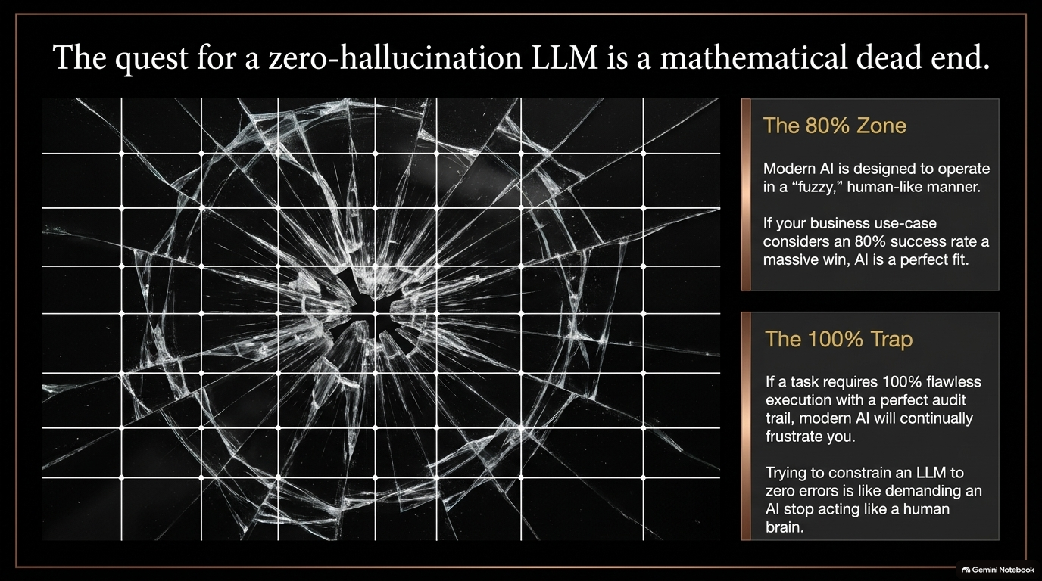
Notes:
Slide Title: The quest for a zero-hallucination LLM is a mathematical dead end.
Target Timing: ~3 – 4 Minutes
Corresponding Video Section: Limits of LLMs & Hallucinations [00:06:47 – 00:07:08, 00:21:15 – 00:22:00]
Speaker Notes
The 80% Zone: Modern LLMs are designed to mimic fuzzy human thinking, language patterns, and intuition. They excel in tasks where an 80%–90% success rate delivers enormous value—such as creative writing, brainstorming, summarization, or initial draft generation.
The 100% Trap: Many enterprises make the mistake of attempting to force LLMs into 100% deterministic, zero-error environments (like accounting, structural engineering, or legal compliance).
The Myth of Zero Hallucination: Asking an LLM to never hallucinate or err is a contradiction in terms. The very mechanism that gives AI its human-like creativity and fluid linguistic ability is what creates hallucinations. Expecting 100% flawless execution from an un-harnessed LLM is like demanding an AI stop acting like a human brain.

Slide 6
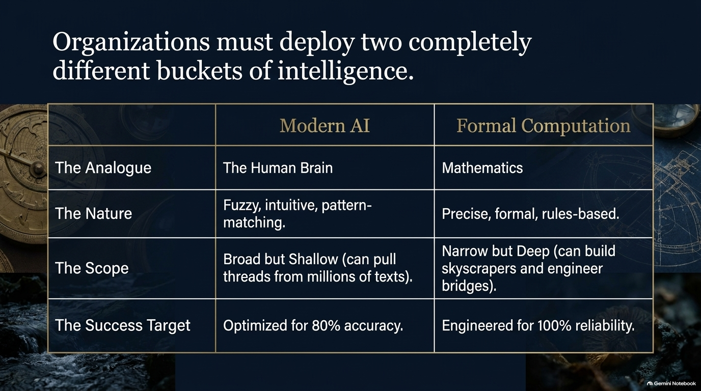
Notes:
Slide Title: Organizations must deploy two completely different buckets of intelligence.
Target Timing: ~4 – 5 Minutes
Corresponding Video Section: Fuzzy AI vs. Formal Computation [00:17:35 – 00:22:00]
Speaker Notes
Comparing the Two Buckets: Enterprise architecture requires recognizing that we have two distinct computational tools at our disposal:
Modern AI (The Human Brain Analogue): Fuzzy, intuitive, pattern-matching. Broad but shallow. It can pull threads across millions of texts in seconds, synthesize themes, and handle natural language.
Formal Computation (Mathematics & Rules): Precise, formal, rules-based. Narrow but deep. It is built for absolute exactness—calculating orbits, engineering bridges, or handling financial ledger integrity.
Strategic Alignment: Misalignment happens when leaders use the wrong tool for the job. Don't ask an LLM to perform complex multi-step math in its head; use AI for broad synthesis, and pass formal rules to computational engines built for 100% reliability.

Slide 7
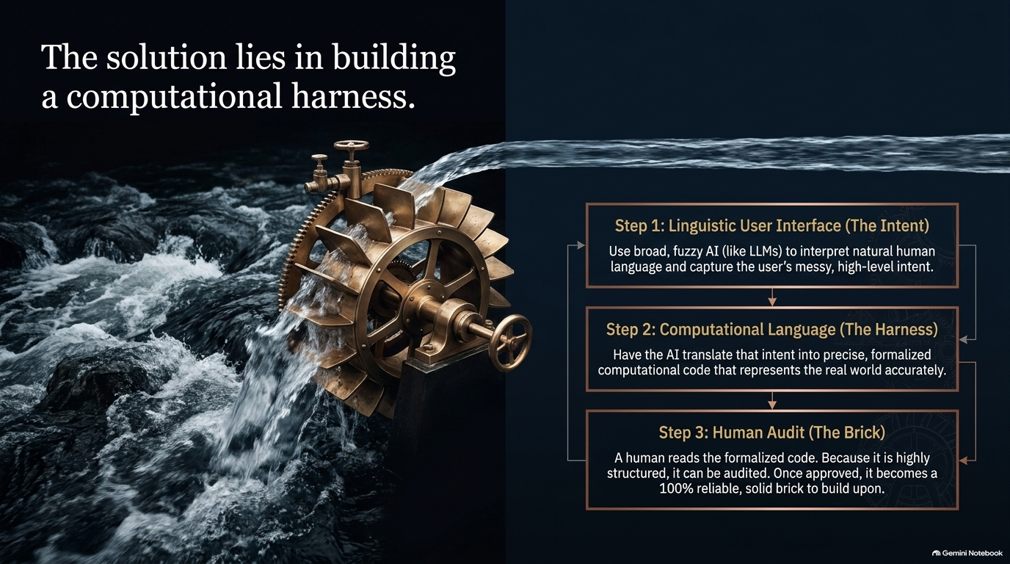
Notes:
Slide Title: The solution lies in building a computational harness.
Target Timing: ~4 – 5 Minutes
Corresponding Video Section: Hybrid Development & Wolfram Language [00:07:33 – 00:08:40, 00:22:00 – 00:22:38, 00:28:38 – 00:29:04]
Speaker Notes
The Architecture: To safely operationalize AI, organizations must construct a "computational harness" that bridges fuzzy intent with rigorous execution.
Step 1 — Linguistic User Interface (The Intent): Natural language acts as the user interface. The user describes messy, high-level intent, and the LLM interprets the request.
Step 2 — Computational Language (The Harness): Instead of executing raw actions directly, the LLM translates human intent into structured, human-readable computational code (e.g., Wolfram Language or formalized logic).
Step 3 — Human Audit & Execution (The Brick): Because the output is structured computational code, a human can easily inspect it. Once audited and validated, that code executes with 100% precision, becoming a reliable building block ("brick") for enterprise systems.

Slide 8
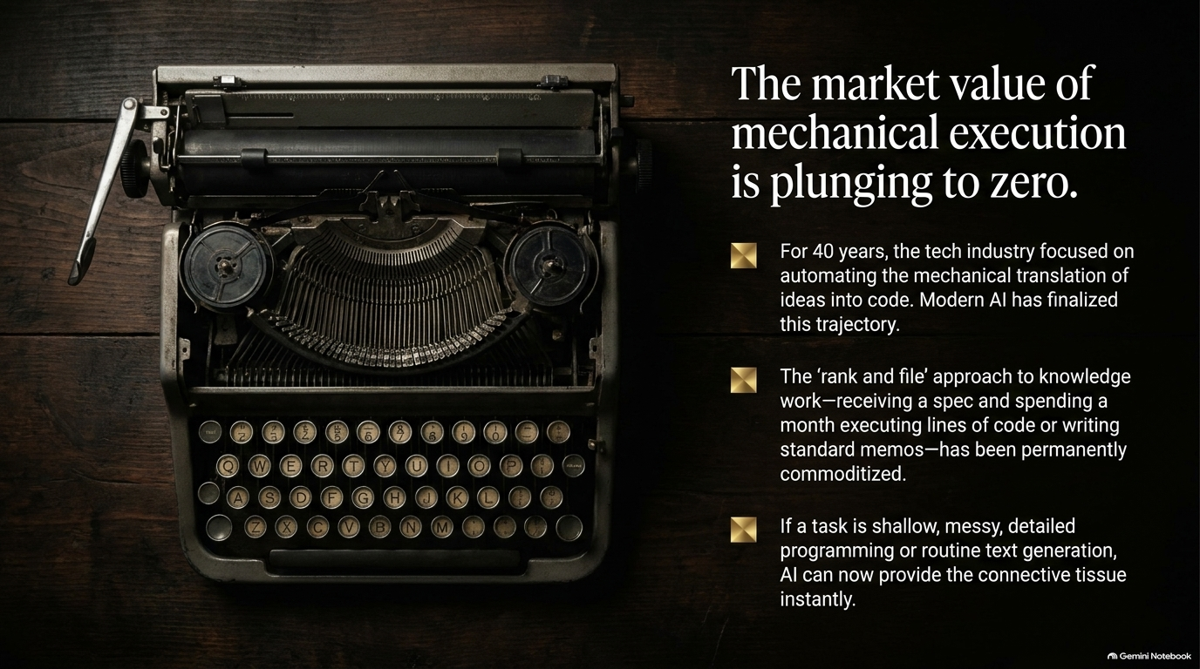
Notes:
Slide Title: The market value of mechanical execution is plunging to zero.
Target Timing: ~3 – 4 Minutes
Corresponding Video Section: Automation & Rank-and-File Work [00:29:40 – 00:32:30]
Speaker Notes
The Historical Shift: For four decades, software engineering focused on manually translating human specifications into lines of code. Modern AI has finalized the automation of basic boilerplate code, syntax formatting, and repetitive mechanical translation.
Commoditization of Rank-and-File Execution: The traditional "rank-and-file" approach to knowledge work—receiving a written spec and spending weeks writing routine code or drafting standardized memos—has been commoditized. AI can instantly generate connective tissue, basic utilities, and standard documentation.
Executive Imperative: Organizations relying solely on labor arbitrage for routine, mechanical work will see those cost margins evaporate. Value has shifted away from raw execution toward higher-order framing and validation.

Slide 9
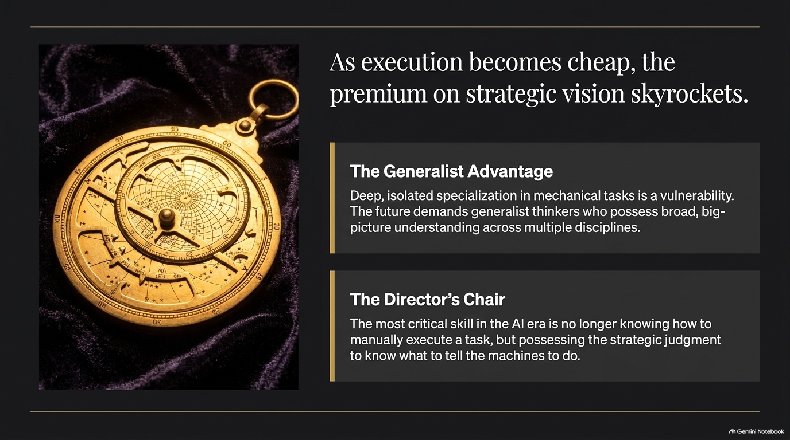
Notes:
Slide Title: As execution becomes cheap, the premium on strategic vision skyrockets.
Target Timing: ~3 – 4 Minutes
Corresponding Video Section: Generalist Advantage & Strategic Leadership [00:32:30 – 00:33:50, 00:48:45 – 00:49:35]
Speaker Notes
The Generalist Advantage: Narrow, isolated specialization in purely mechanical execution is now a career and organizational vulnerability. When AI handles low-level mechanics, competitive advantage accrues to generalist thinkers who possess broad cross-disciplinary understanding.
The Director's Chair: In the AI era, the primary bottleneck is no longer how to manually write code or produce text, but possessing the strategic judgment to decide what to ask the machines to build.
Leadership Focus: Leaders must shift their teams from "doing the manual work" to sitting in the director's chair—setting objectives, framing problems accurately, evaluating options, and applying human critical judgment.

Slide 10
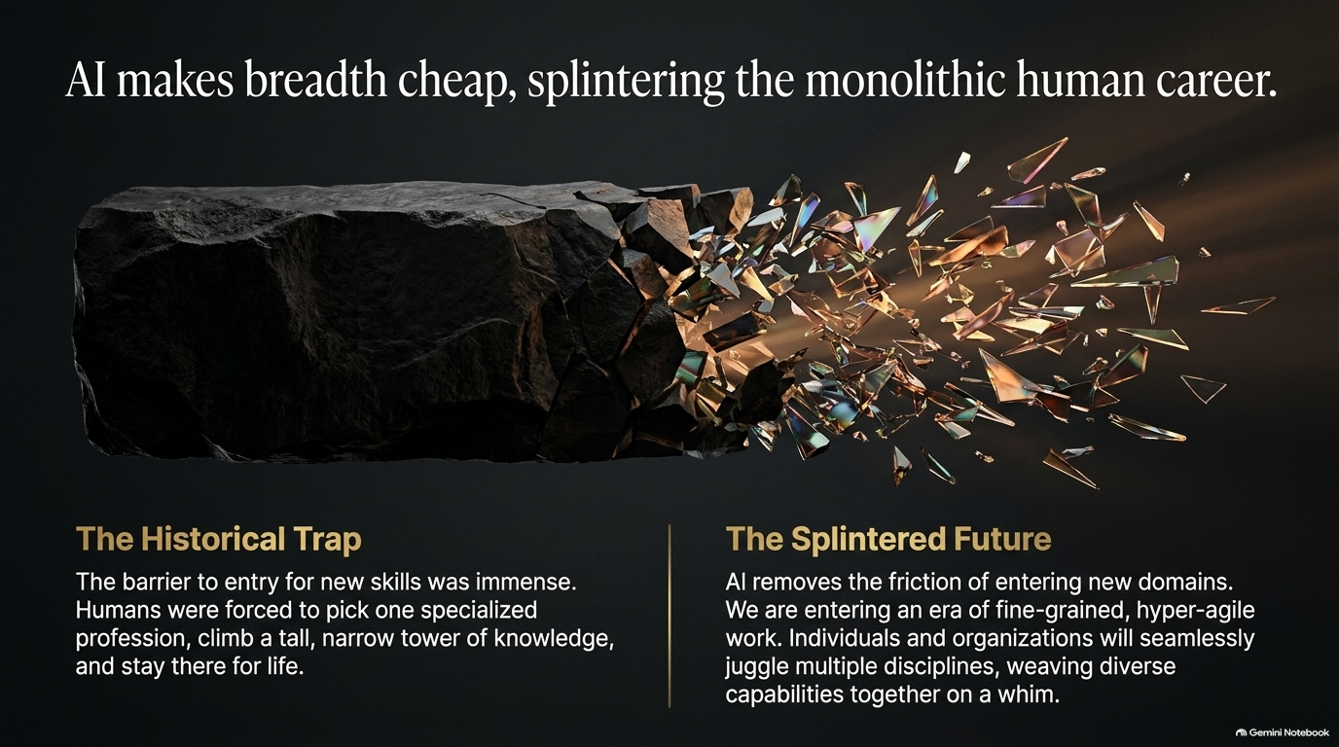
Notes:
Slide Title: AI makes breadth cheap, splintering the monolithic human career.
Target Timing: ~3 – 4 Minutes
Corresponding Video Section: Splintering Careers & Micro-Capabilities [00:46:15 – 00:49:45, 00:54:00 – 00:56:00]
Speaker Notes
The Historical Trap: Historically, learning a new domain required years of climbing a narrow tower of specialized knowledge. Professionals pick one field, stay inside that silo, and perform that specialized function for decades due to high entry barriers.
The Splintered Future: AI dramatically reduces the friction of entering new domains. It enables individuals to build custom utilities in minutes or explore new fields without a 10-year ramp-up.
Agile Workforces: We are entering an era of fine-grained, hyper-agile work where people juggle multiple sub-disciplines seamlessly. Organizations will operate with smaller, highly adaptable teams capable of pivoting across functions on a whim.

Slide 11
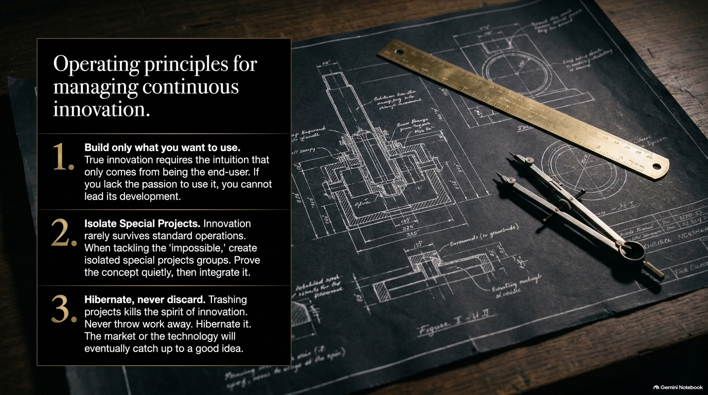
Notes:
Slide Title: Operating principles for managing continuous innovation.
Target Timing: ~4 – 5 Minutes
Corresponding Video Section: Wolfram’s Principles of Innovation & Management [01:03:00 – 01:10:00, 01:16:00 – 01:17:00]
Speaker Notes
Principle 1 — Build Only What You Want to Use: True product innovation stems from deep user empathy and intuition. If leadership and developers lack the personal passion to use their own product daily, they cannot successfully guide its evolution.
Principle 2 — Isolate Special Projects: Radical ideas rarely survive standard operational bureaucracy or established department metrics. When tackling "impossible" problems, form isolated special project teams to prove out the concept quietly before integrating it into core operations.
Principle 3 — Hibernate, Never Discard: Trashing incomplete work destroys employee morale and squanders intellectual property. If a project hits a wall or the market isn't ready, put it into hibernation. As AI and underlying compute advance, technological shifts will eventually make dormant ideas viable.

Slide 12
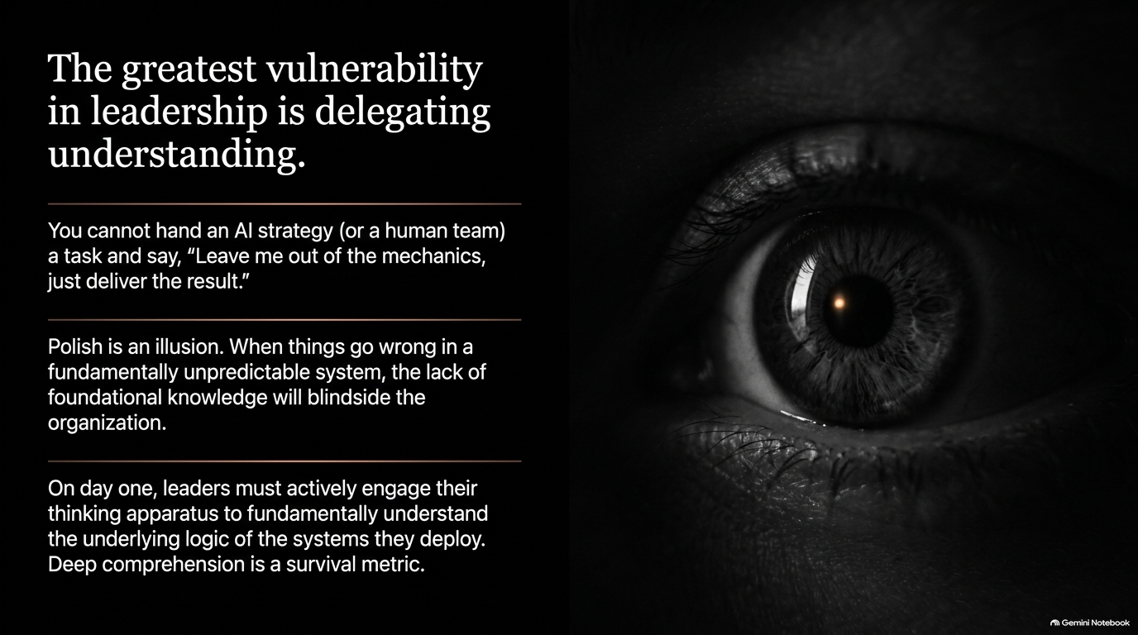
Notes:
Slide Title: The greatest vulnerability in leadership is delegating understanding.
Target Timing: ~4 – 5 Minutes
Corresponding Video Section: Executive Blindspots & Deep Understanding [01:21:40 – 01:25:50]
Speaker Notes
The Leadership Mistake: A major pitfall in managing AI (or technical teams) is abdicating foundational understanding with phrases like: "Just deliver the result, don't worry me with how it works."
Polish is an Illusion: Senior executives often fall for polished outputs, slick slide decks, or impressive demos. But when an irreducible, non-deterministic AI system breaks, a lack of deep foundational understanding will blindside the organization.
Deep Comprehension as a Survival Metric: Leaders must maintain their "thinking apparatus" fully engaged. You must push past surface polish, ask probing questions, and understand the underlying logic of the systems and processes you deploy.

Slide 13
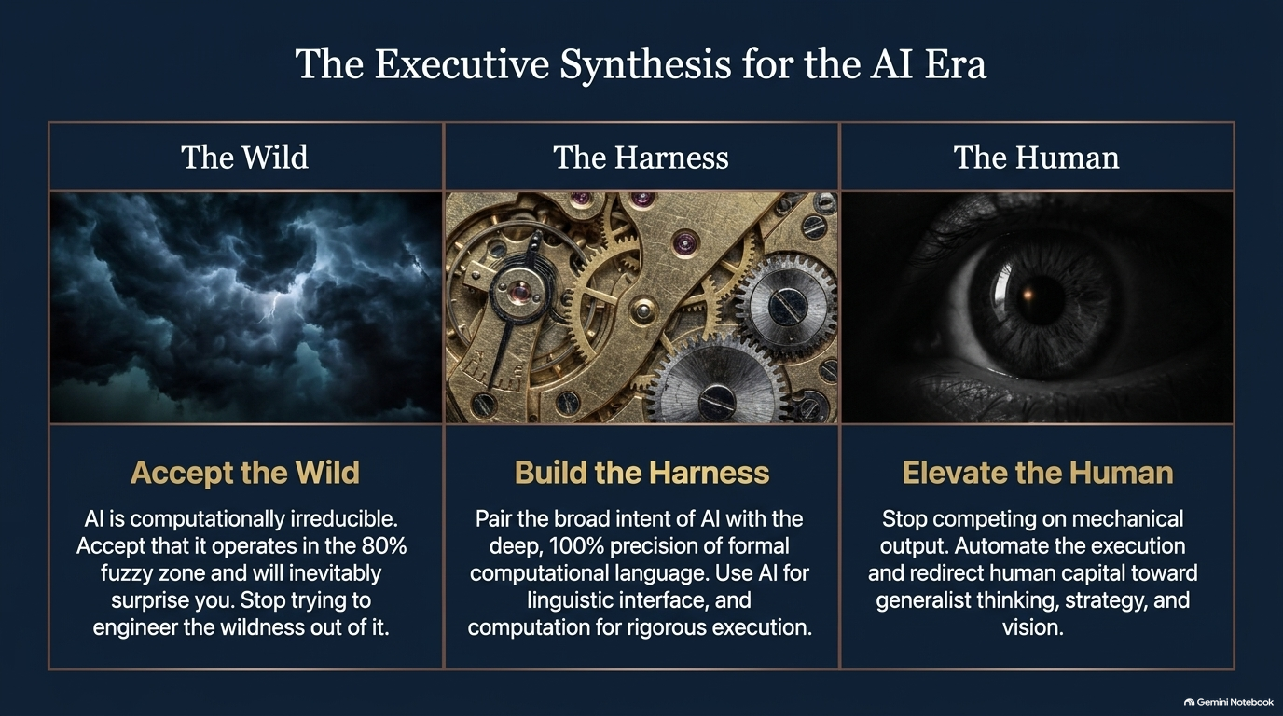
Notes:
Slide Title: The Executive Synthesis for the AI Era
Target Timing: ~3 – 4 Minutes
Corresponding Video Section: Synthesis of Presentation Core Themes
Speaker Notes
Column 1 — Accept the Wild: Stop trying to force LLMs into 100% deterministic boxes. Accept that modern AI is computationally irreducible and thrives in the 80% fuzzy zone of broad pattern recognition.
Column 2 — Build the Harness: Pair the broad intent of linguistic AI with exact computational logic. Use LLMs for user interface and natural language translation, but route formal execution through deterministic engines and human audit checkpoints.
Column 3 — Elevate the Human: Stop competing with AI on mechanical output. Automate routine execution and redirect your workforce toward high-level strategy, holistic synthesis, and generalist vision.

Slide 14
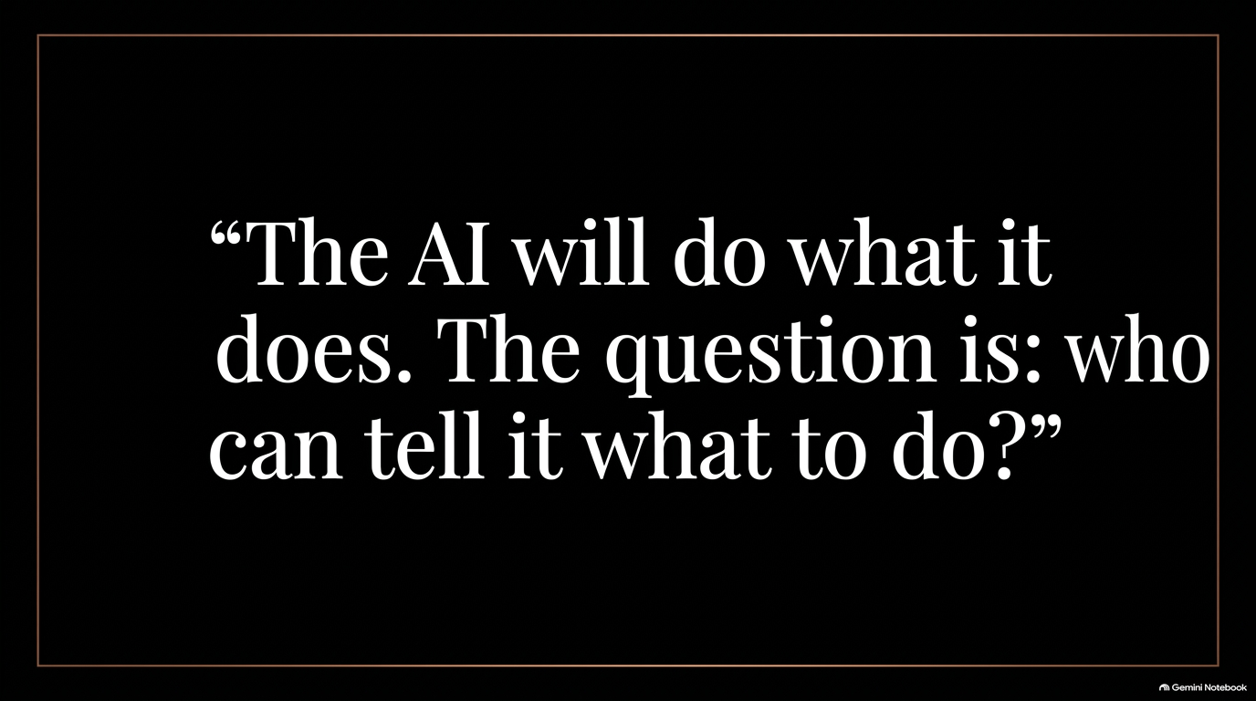
Notes:
Slide Title: “The AI will do what it does. The question is: who can tell it what to do?”
Target Timing: ~2 – 3 Minutes
Corresponding Video Section: Concluding Philosophy [00:33:00 – 00:33:20]
Speaker Notes
Closing Philosophical Message: As Stephen Wolfram succinctly framed it: “The AI will do what it does. The question is: who can tell it what to do?”
Final Challenge: Technology automation will continue its irreversible forward march. The ultimate competitive advantage does not lie in the algorithms themselves, but in the vision, clarity of thought, and human judgment of the leaders who guide them.

Slide 15
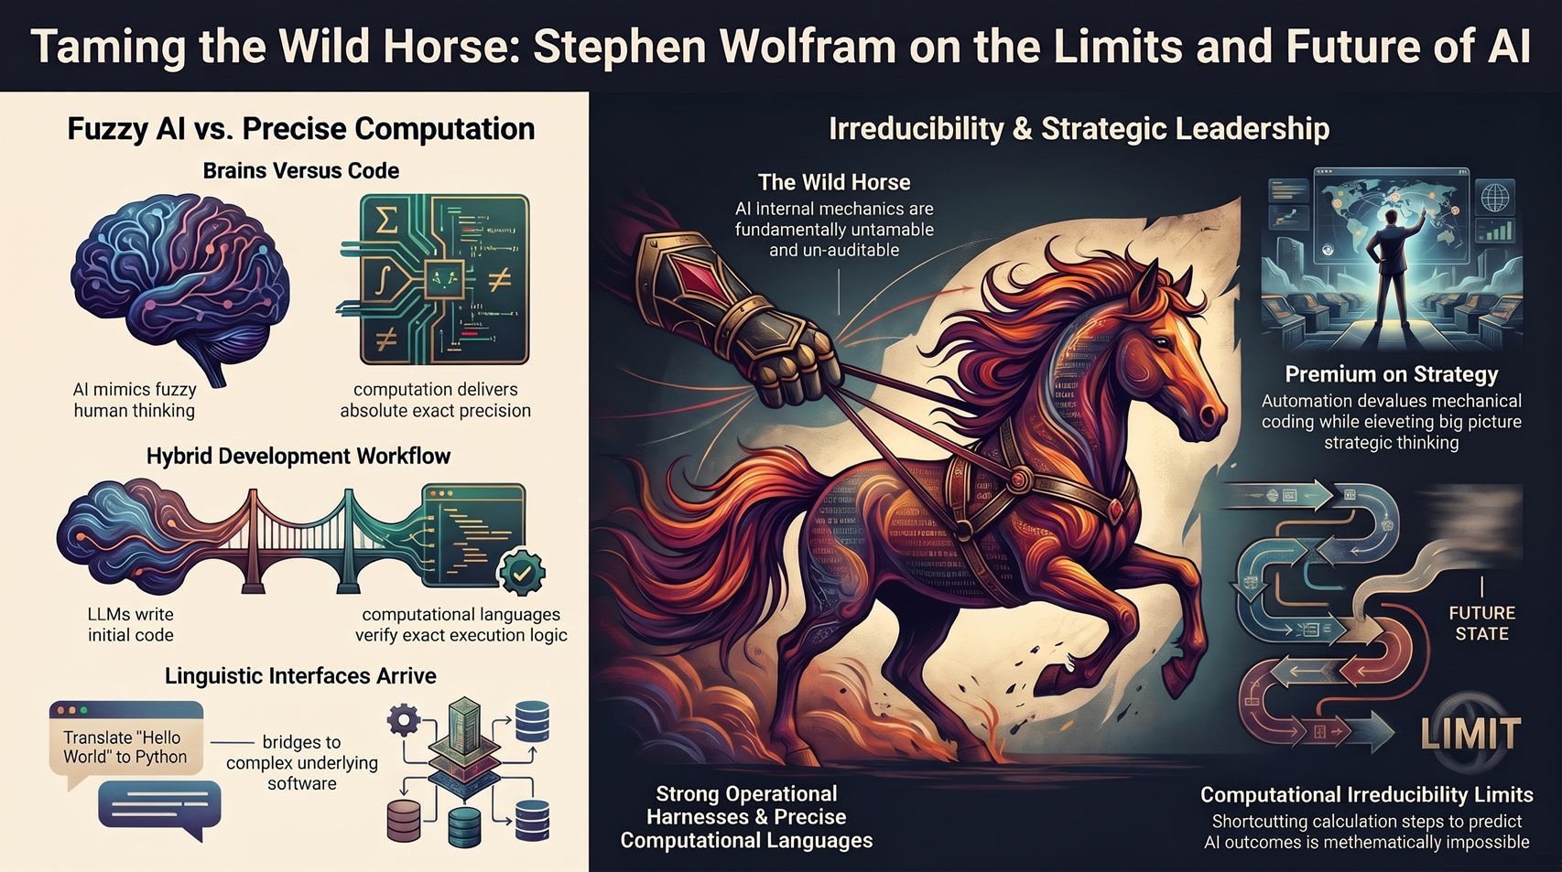
Notes:
Slide Title: Taming the Wild Horse: Stephen Wolfram on the Limits and Future of AI
Target Timing: ~4 – 6 Minutes (Infographic Summary / Q&A Slide)
Corresponding Video Section: Full Executive Overview & Q&A Transition
Speaker Notes
Summary & Visual Anchor: This visual summary roadmap brings together our key themes:
Fuzzy AI vs. Precise Computation: Brains versus Code. Hybrid workflows combine LLM code generation with formal computational verification.
Linguistic Interfaces: Natural language serves as the bridge connecting human intent to complex software stacks.
The Irreducible Wild Horse: Mechanics are untamable at the micro-level due to computational irreducibility limits.
Strong Operational Harnesses & Strategic Premium: Automation reduces mechanical code costs while raising the value of big-picture strategic thinking.
Transition to Q&A: Open the floor for executive discussion, strategy alignment, and questions on implementation.
Summary Table of Timing & Pace
Slide
Title
Target Duration
Slide 1
The Untamable Machine
2 – 3 mins
Slide 2
The 300-year era of transparent machinery is officially over.
3 – 4 mins
Slide 3
We have discovered the digital equivalent of a wild horse.
3 – 4 mins
Slide 4
AI unpredictability is a law of physics, not an engineering bug
4 – 5 mins
Slide 5
The quest for a zero-hallucination LLM is a mathematical dead end.
3 – 4 mins
Slide 6
Organizations must deploy two completely different buckets of intelligence.
4 – 5 mins
Slide 7
The solution lies in building a computational harness.
4 – 5 mins
Slide 8
The market value of mechanical execution is plunging to zero.
3 – 4 mins
Slide 9
As execution becomes cheap, the premium on strategic vision skyrockets.
3 – 4 mins
Slide 10
AI makes breadth cheap, splintering the monolithic human career.
3 – 4 mins
Slide 11
Operating principles for managing continuous innovation.
4 – 5 mins
Slide 12
The greatest vulnerability in leadership is delegating understanding.
4 – 5 mins
Slide 13
The Executive Synthesis for the AI Era
3 – 4 mins
Slide 14
“The AI will do what it does. The question is: who can tell it what to do?”
2 – 3 mins
Slide 15
Taming the Wild Horse: Stephen Wolfram on the Limits and Future of AI
4 – 6 mins
Total
Full Keynote Presentation
~50 – 60 mins
Would you like me to adjust any specific slide's tone, focus on particular enterprise use cases, or export these notes into a Google Doc or presentation script format?

