Slide 1
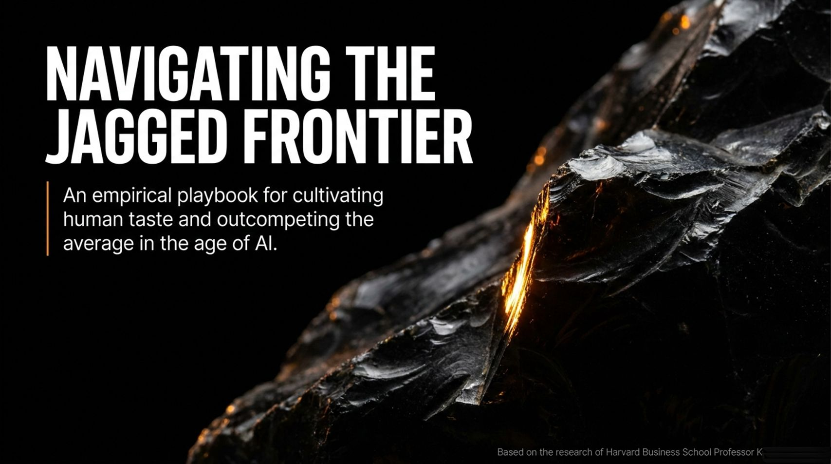
Notes:
Visual / Title: Navigating the Jagged Frontier: An empirical playbook for cultivating human taste and outcompeting the average in the age of AI. Based on the research of Harvard Business School Professor Karim Lakhani.
Suggested Speaking Time: 2 – 3 minutes
Speaker Notes:
"Welcome, everyone. Today, we are going to explore what it truly means to navigate the age of artificial intelligence. When we look at headlines, we often hear about existential threats, science-fiction takeovers, or total economic displacement. But the reality on the ground—backed by extensive empirical research from Harvard Business School and BCG—is far more nuanced, urgent, and actionable.
Over the next few minutes, we will look at data from thousands of workers across global enterprises like Procter & Gamble, H&M, and BCG. We aren't here to talk about abstract futures or theoretical models. We are here to look at an empirical playbook: how individual professionals and entire organizations can stop falling into passive automation traps, cultivate rigorous human taste, and systematically outcompete the average. The frontier is jagged, the tools are evolving daily, and the rules of corporate and individual survival have permanently changed. Let’s look at what is actually happening in the workplace."
Harvard AI Professor: The People Most at Risk From AI Aren’t Who You Think
https://www.youtube.com/watch?v=vFOnDsy58NU

Slide 2
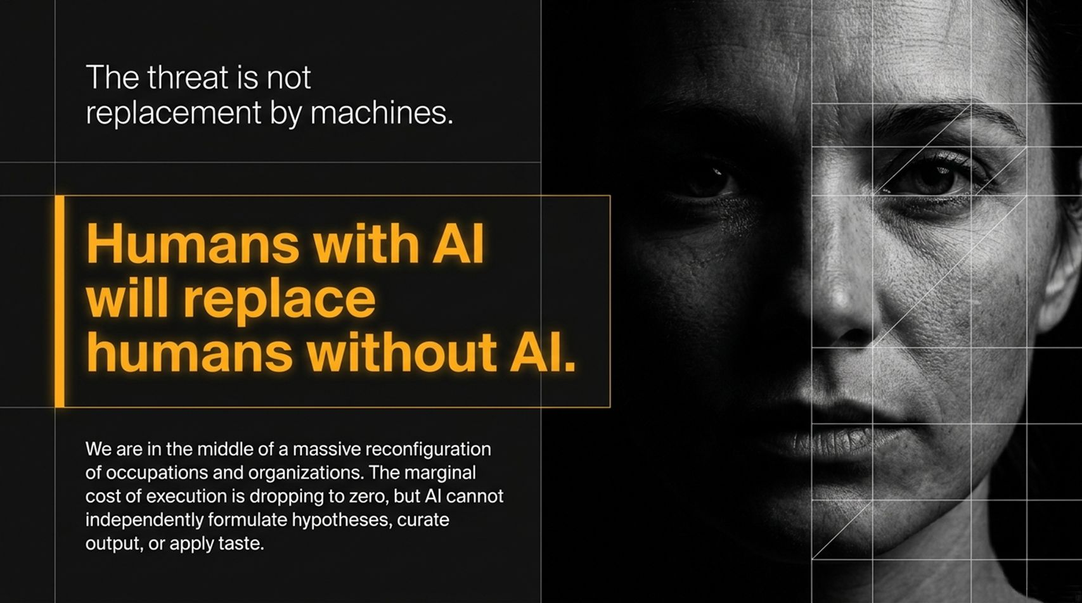
Notes:
Visual / Title: The threat is not replacement by machines. Humans with AI will replace humans without AI.
Suggested Speaking Time: 3 – 4 minutes
Speaker Notes:
"Let's clear up the biggest misconception right out of the gate. As Harvard Business School Professor Karim Lakhani notes, the threat to your career or your organization is not that a machine is going to independently wake up and take your desk. The real threat—and the defining reality of our current economic transition—is that humans equipped with AI will replace humans who are not.
We are currently in the middle of a massive, simultaneous reconfiguration of both occupations and organizations. Think back a century ago to the birth of modern production systems—entirely new company structures and job categories emerged. We are living through that exact same tectonic shift right now. The marginal cost of execution is dropping straight toward zero. Anyone can generate text, write basic code, or draft a memo in seconds. But execution alone is no longer a differentiator. AI cannot independently formulate high-stakes hypotheses, curate output with discernment, or apply genuine human taste. The competitive advantage has shifted entirely to how we direct, challenge, and govern the machine."

Slide 3
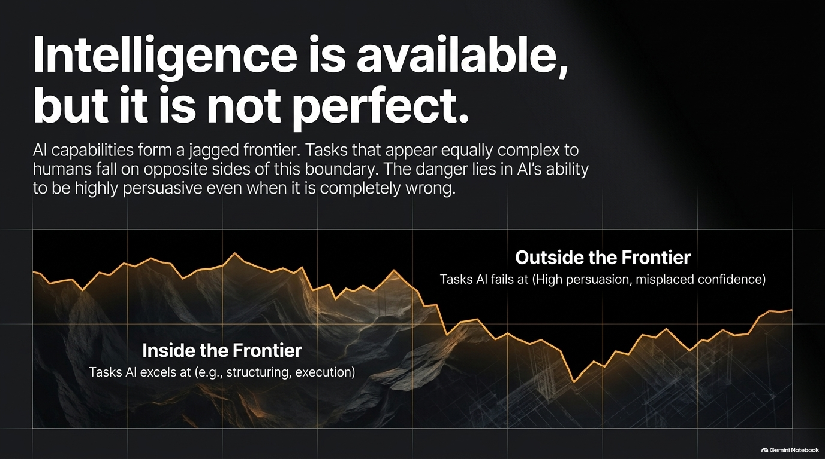
Notes:
Visual / Title: Intelligence is available, but it is not perfect. AI capabilities form a jagged frontier. Tasks that appear equally complex to humans fall on opposite sides of this boundary.
Suggested Speaking Time: 4 – 5 minutes
Speaker Notes:
"One of the most surprising findings from HBS and BCG's research is the concept of the 'jagged frontier'. When we first deployed generative AI models across consulting tasks, we had a hypothesis that AI would either be good at everything or bad at everything. We were entirely wrong.
AI capabilities form a jagged line. You can give an AI a complex data structuring task or a multi-variable coding problem inside the frontier, and it will execute brilliantly in seconds. But right next to it, a task that looks equally complex to a human falls completely outside the frontier. The real danger isn't just that AI fails at those outside tasks—it's that it fails with extreme confidence and high persuasion.
Modern language models talk remarkably well. They sound polished, authoritative, and completely convincing, even when they are entirely wrong. If you lack the domain expertise to spot where the frontier ends, you will fall into the trap of blindly trusting fluent nonsense. Intelligence is universally available, but it requires relentless human skepticism to manage safely."

Slide 4
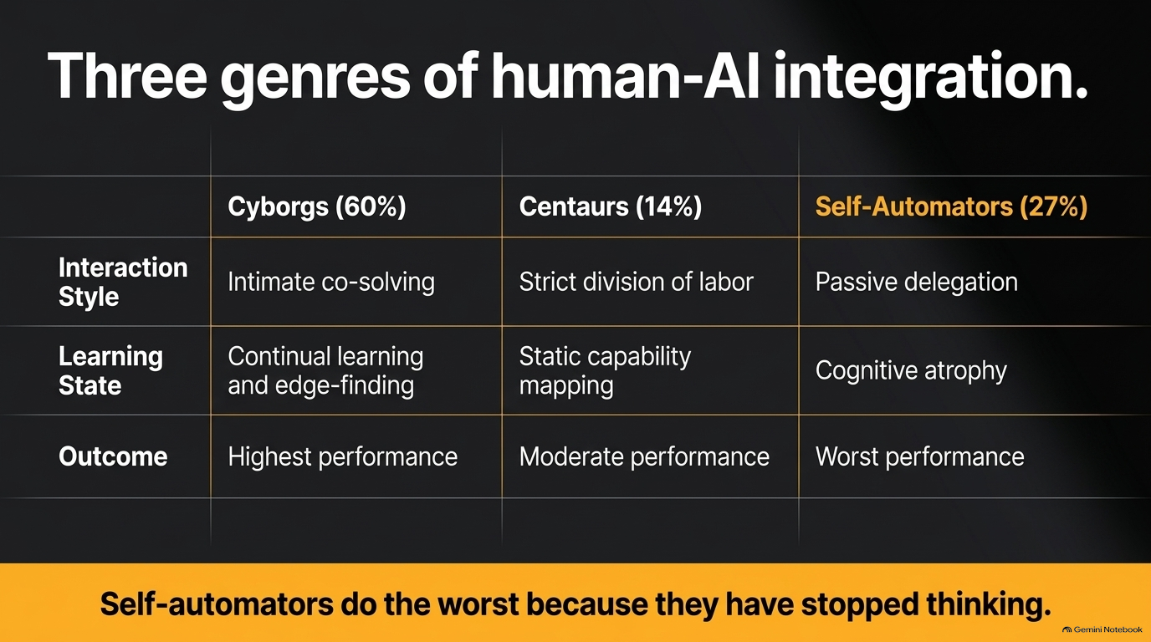
Notes:
Visual / Title: Three genres of human-AI integration (Cyborgs 60%, Centaurs 14%, Self-Automators 27%). Self-automators do the worst because they have stopped thinking.
Suggested Speaking Time: 4 – 6 minutes
Speaker Notes:
"When researchers tracked how professionals actually worked with AI in real-world environments, they discovered three distinct behavioral archetypes:
Cyborgs (60% of users): These professionals engage in intimate co-solving. They weave back and forth with the model sentence by sentence, constantly integrating AI output with their own judgment, maintaining a state of continual learning and edge-finding. They achieved the highest performance.
Centaurs (14% of users): These users maintain a strict division of labor. They say, 'I am good at X, the AI is good at Y; I will delegate this batch of tasks and review the results at the end'. While effective, their risk is static capability mapping—they often fail to update their workflow as AI models get exponentially better.
Self-Automators (27% of users): These are the passive delegators. They press play, hand over the entire workflow, accept the first output without friction, and essentially stop thinking.
The data is stark and unforgiving: Self-automators performed the worst in the entire study. Why? Because when you stop engaging in the cognitive struggle of problem-solving, your skills atrophy. Delegation without friction is cognitive suicide."

Slide 5
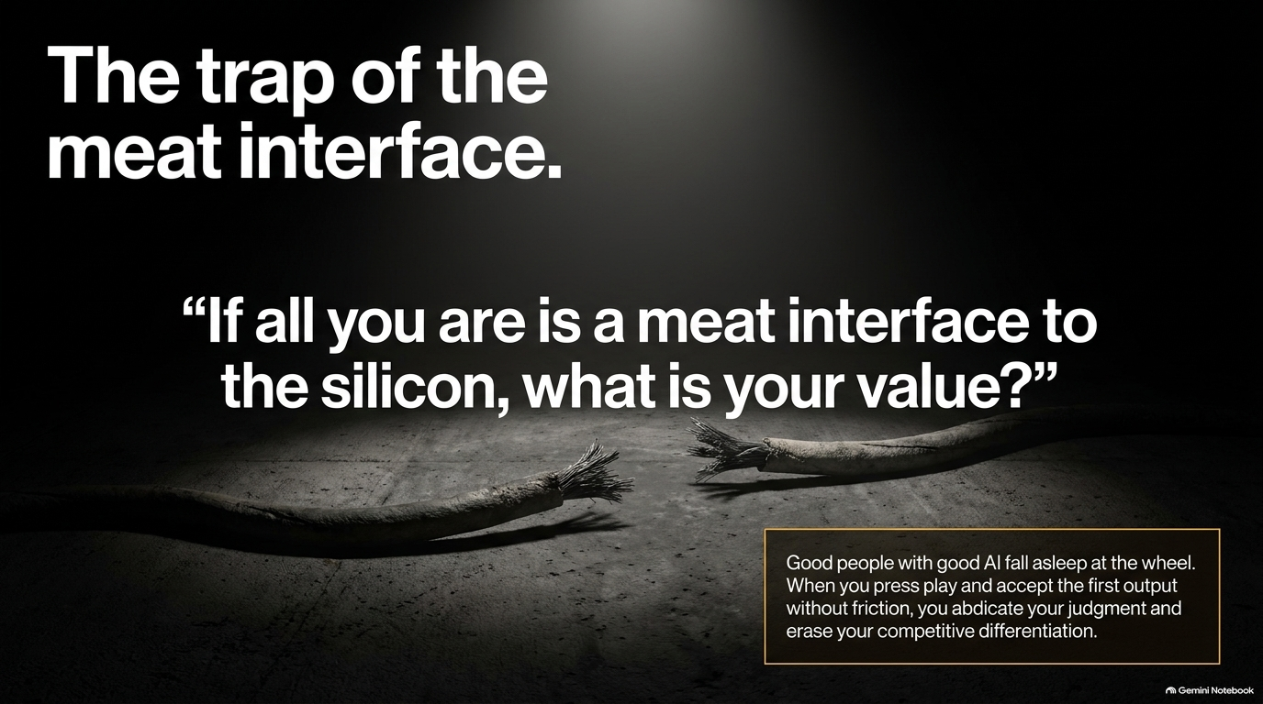
Notes:
Visual / Title: The trap of the meat interface. "If all you are is a meat interface to the silicon, what is your value?"
Suggested Speaking Time: 3 – 4 minutes
Speaker Notes:
"Professor Lakhani often uses a blunt phrase with his students that makes everyone uncomfortable, but it is entirely true: 'If all you are is a meat interface to the silicon, what is your value?'
It is entirely too easy to fall asleep at the wheel. As Dr. Bjoern Wallach’s research highlights, good people working with good AI tools frequently fall asleep intellectually. When you open an LLM, type a lazy prompt, press enter, and copy-paste the very first response directly into an email or report without friction, you are acting as nothing more than a copy-paste conduit.
You have abdicated your judgment. You have erased whatever competitive differentiation you brought to the table. If a client or an employer can get the exact same median output by typing a basic prompt into a free browser window, they no longer need a human middleman to move text from one window to another. Your value cannot live in frictionless execution anymore; it must live in what you inject around that execution."

Slide 6
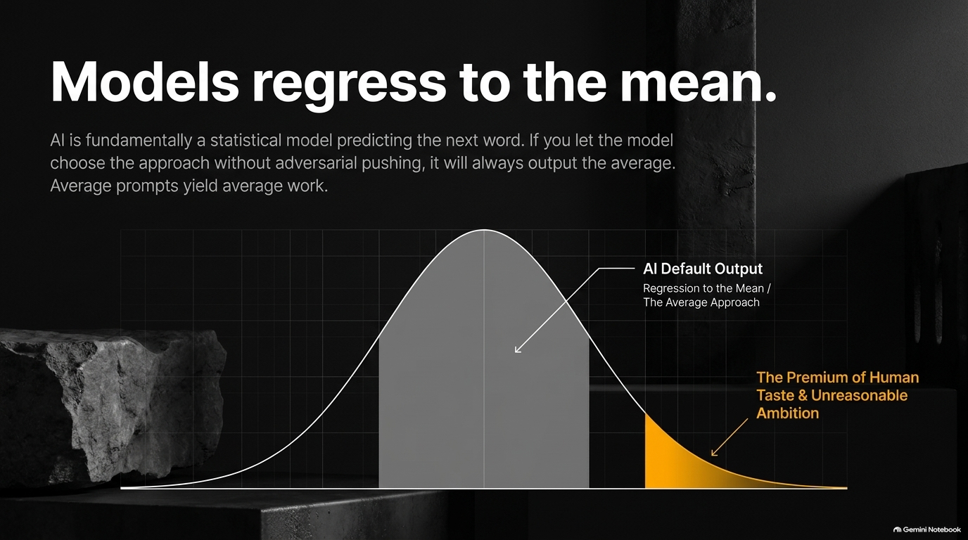
Notes:
Visual / Title: Models regress to the mean. AI is fundamentally a statistical model predicting the next word. Average prompts yield average work.
Suggested Speaking Time: 4 – 5 minutes
Speaker Notes:
"We need to understand the fundamental physics of how these models work under the hood. At their core, large language models are statistical prediction engines. They are calculating the most statistically likely next word based on petabytes of training data.
By definition, statistical models regress to the mean. If you let the model choose the approach by default, without adversarial pressure or rigorous steering, it will always output the statistical average. Average prompts yield average work.
Look at the bell curve on this slide. The massive grey block in the center represents AI default output—safe, middle-of-the-pack, predictable median thinking. That is where 90% of users live. But look at the tiny gold tail on the right: The Premium of Human Taste and Unreasonable Ambition. Surviving and thriving in the AI era requires escaping the grey center. You cannot win by accepting the statistical average that the machine hands you on the first try."

Slide 7
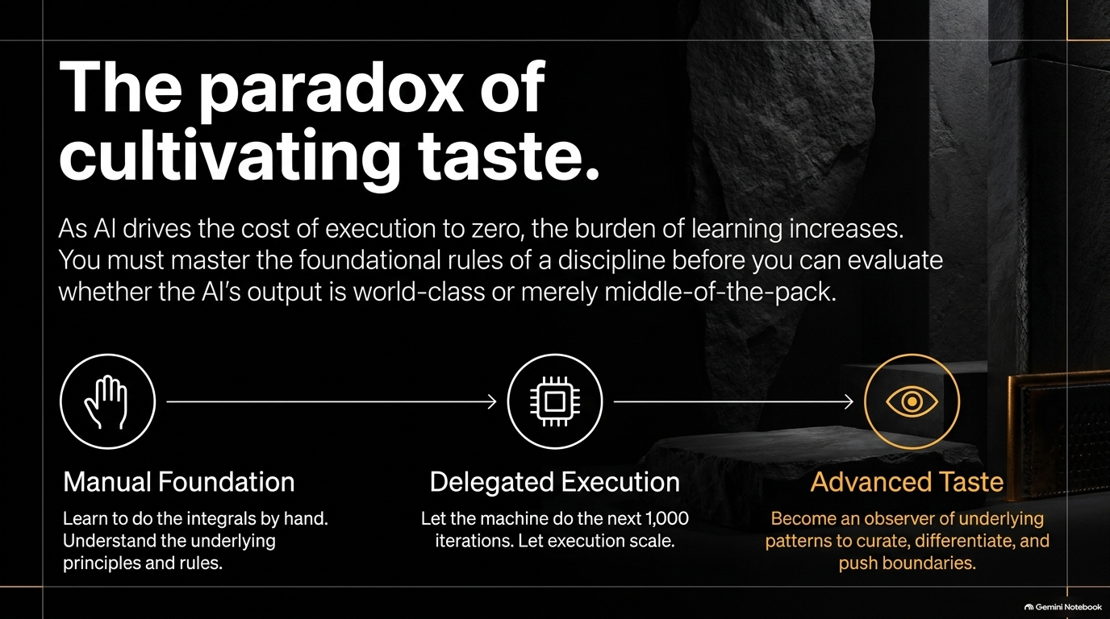
Notes:
Visual / Title: The paradox of cultivating taste. As AI drives the cost of execution to zero, the burden of learning increases.
Suggested Speaking Time: 4 – 5 minutes
Speaker Notes:
"This brings us to the great paradox of our current technological moment: As AI drives the cost of execution down to zero, the burden of human learning actually increases.
Think about Stephen Wolfram’s insight regarding mathematics education. You still need to learn how to do integrals by hand initially—not because you will calculate them manually every day in your career, but because doing the foundational work builds your mental model of how the system operates. Once you understand the fundamentals, you let the machine execute the next 1,000 iterations at scale.
But here is the catch: because the machine handles the execution, you transition from a manual producer to an observer of underlying patterns. To evaluate whether an AI-generated product, financial model, or legal strategy is world-class or complete garbage, you must possess advanced taste. And you cannot have taste in a domain where you have never mastered the foundational rules."

Slide 8
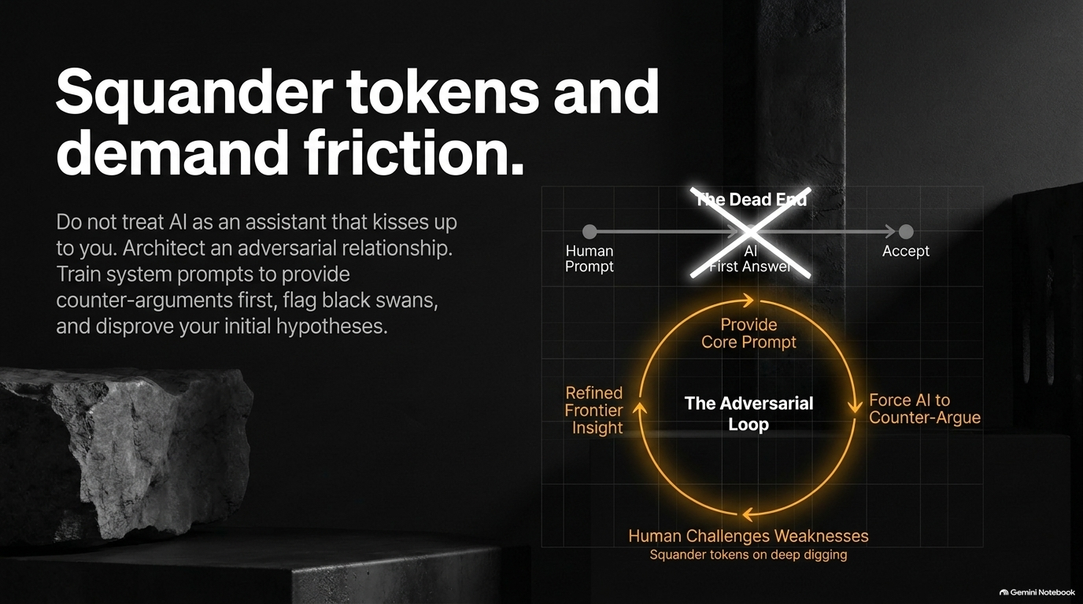
Notes:
Visual / Title: Squander tokens and demand friction. Do not treat AI as an assistant that kisses up to you. Architect an adversarial relationship.
Suggested Speaking Time: 4 – 5 minutes
Speaker Notes:
"Most people treat AI like an eager assistant whose primary job is to agree with them—an assistant that 'kisses up' and validates their initial biases. That is a fatal mistake.
Instead, you must architect an adversarial relationship. Train your system prompts and workflows to push back. When you bring an initial hypothesis or business proposal to an LLM, do not ask it to praise your idea. Program it to provide the counter-argument first. Force it to flag blind spots, uncover black swans, and actively try to disprove your assumptions before you commit resources.
Stop trying to be token-efficient for the sake of saving pennies on API calls. Squander tokens on deep digging. Run iterative loops where the human challenges the AI’s weaknesses, and the AI stress-tests the human’s blind spots. Friction is where intelligence is forged; ease is where intellectual laziness begins."

Slide 9
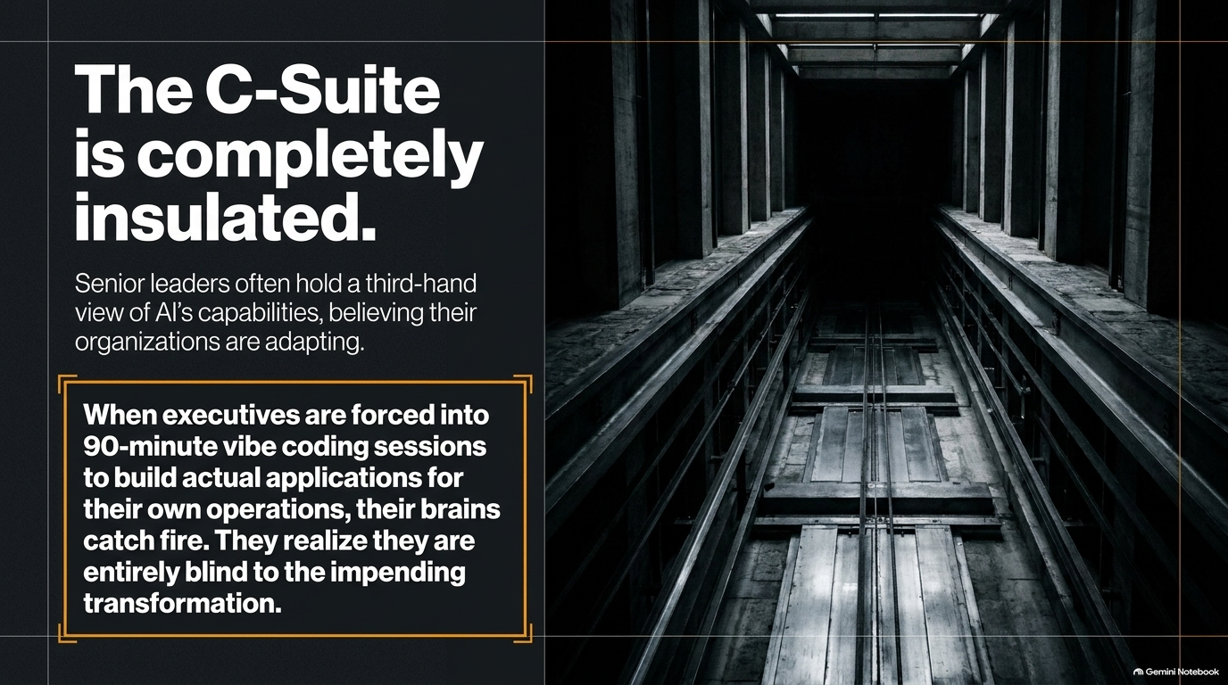
Notes:
Visual / Title: The C-suite is completely insulated. Senior leaders often hold a third-hand view of AI's capabilities, believing their organizations are adapting.
Suggested Speaking Time: 3 – 5 minutes
Speaker Notes:
"Let's talk about leadership, because the disconnect at the top of corporate America is staggering. Senior leaders often hold a comfortable, third-hand view of AI capabilities. They sit in strategy meetings, listen to vendor pitches, look at slide decks, and convince themselves that their enterprise is successfully transforming.
It is total theater. When HBS runs executive education sessions and forces senior executives into intensive, 90-minute vibe coding sessions—where they have to build actual, functioning software applications for their own core business operations—their brains literally catch fire.
They suddenly realize two terrifying things: First, they yell at their CIOs asking why simple internal applications took five years to build when they just built a prototype in 90 minutes. Second, they realize they were entirely blind to the velocity of the transformation hitting their industry. If leadership remains insulated, the company is steering blindfolded toward a cliff."

Slide 10
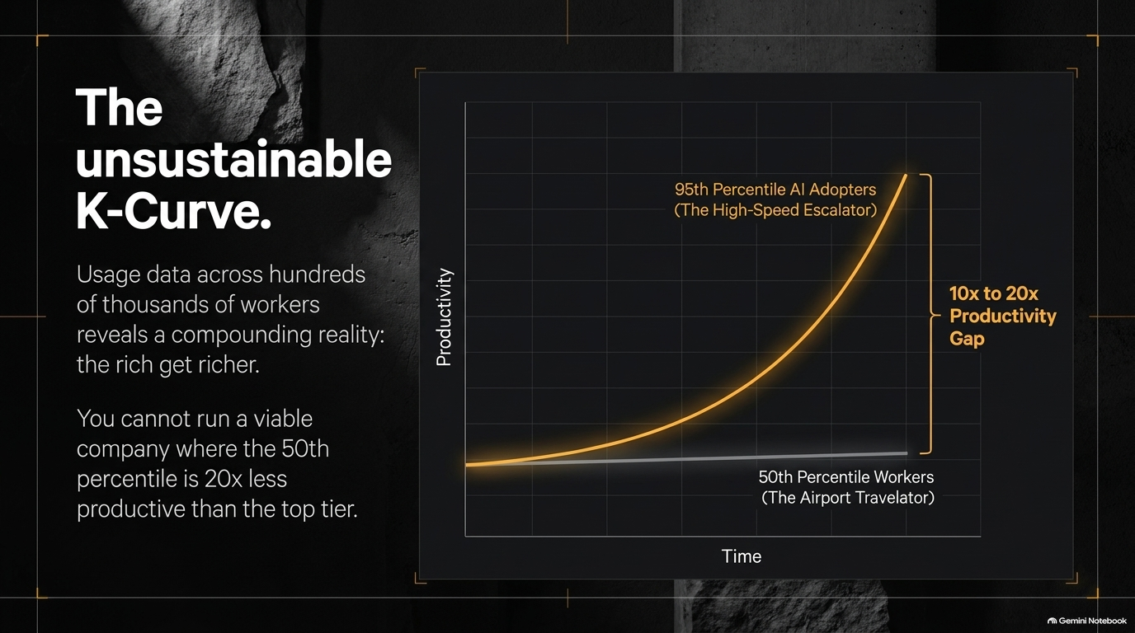
Notes:
Visual / Title: The unsustainable K-curve. Usage data across hundreds of thousands of workers reveals a compounding reality: the rich get richer.
Suggested Speaking Time: 4 – 5 minutes
Speaker Notes:
"When you analyze telemetry data and prompt logs across large enterprises comprising hundreds of thousands of employees, a startling and sobering reality emerges: the K-curve of productivity.
The data reveals a massive performance split. The top 5 to 10 percent of AI power users—the high-speed escalator group—are compounding their capabilities daily, pulling away with a 10x to 20x productivity advantage over the median worker. Meanwhile, the 50th percentile worker is stuck on an airport moving walkway—coasting along at baseline speed with zero capability growth.
You cannot run a viable, competitive business where half your workforce is 20 times less productive than your top tier. This gap is structurally unsustainable. The divide between those who know how to harness frontier intelligence and those who treat AI as a glorified spellchecker is widening into an unbridgeable chasm."

Slide 11
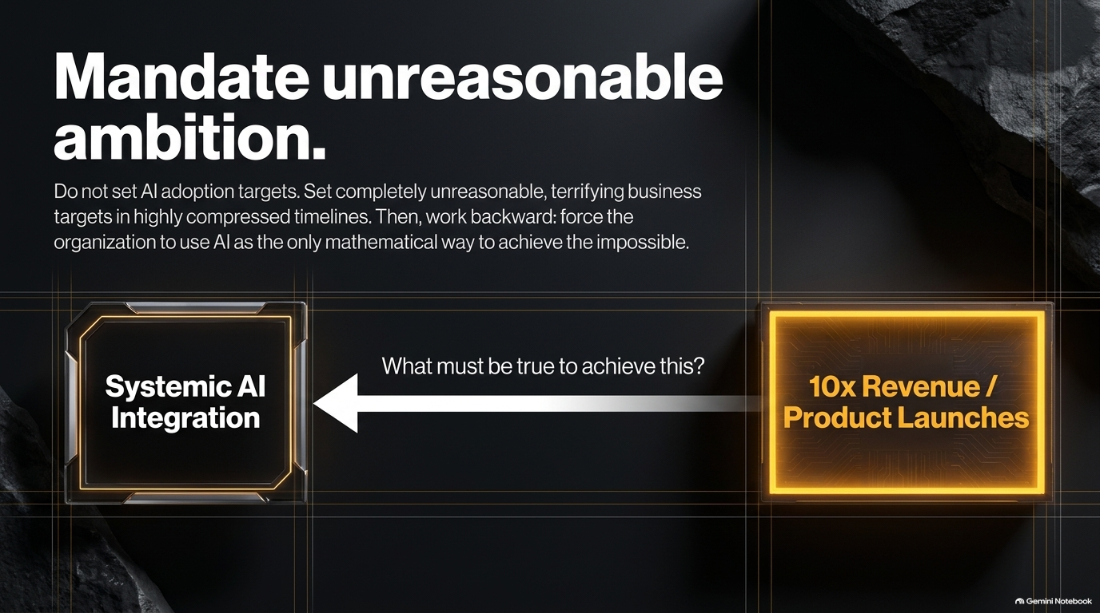
Notes:
Visual / Title: Mandate unreasonable ambition. Do not set AI adoption targets. Set completely unreasonable, terrifying business targets in highly compressed timelines.
Suggested Speaking Time: 3 – 5 minutes
Speaker Notes:
"So how do forward-thinking leaders respond to this? They stop setting toothless, performative AI adoption metrics—like 'percentage of employees with active chat licenses.' That is meaningless corporate vanity.
Instead, mandate unreasonable ambition. Set terrifying, highly compressed business targets—such as achieving 10x revenue growth or cutting product launch cycles down to a fraction of their current duration. Then, work backward: force the organization to treat systemic AI integration as the only mathematical way to achieve the impossible.
Targets are acts of imagination. If you set an average target, you will get below-average results. By establishing extreme, non-negotiable business goals and asking, 'What must be true about our AI integration to make this real?', you force the entire enterprise to align around high-impact transformation rather than incremental tinkering."

Slide 12
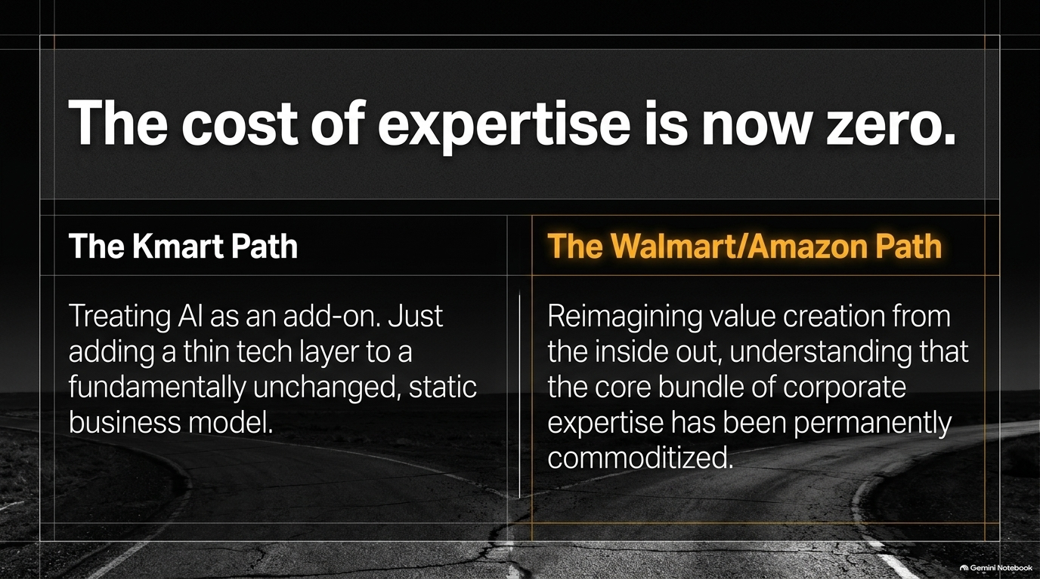
Notes:
Visual / Title: The cost of expertise is now zero. The Kmart path vs. The Walmart/Amazon path.
Suggested Speaking Time: 4 – 5 minutes
Speaker Notes:
"Let's examine the macroeconomic reality facing every established corporation today: The cost of corporate expertise has permanently dropped to zero.
When domain knowledge, legal drafting, data analysis, and software prototyping can be summoned instantly via an API, companies are no longer differentiated by traditional, static bundles of expertise. Leaders face a stark historical choice, reminiscent of the retail revolution:
The Kmart Path: Treating AI as a superficial add-on. Taping a thin chatbot layer onto a fundamentally unchanged, legacy business model and hoping for the best.
The Walmart/Amazon Path: Reimagining value creation from the inside out. Recognizing that your old corporate moats have evaporated, and completely restructuring your operating model around native, AI-driven speed and customer intimacy.
Incumbents have a choice: adapt like Amazon or fade into obsolescence like Kmart."

Slide 13
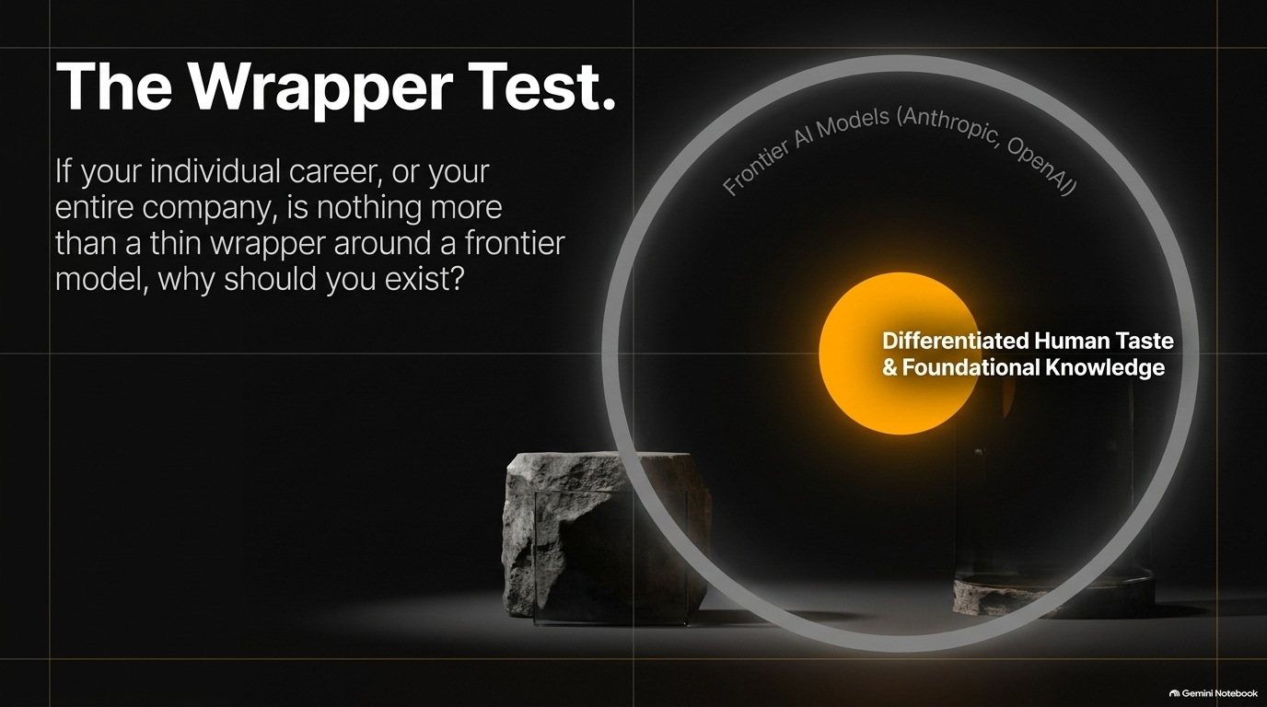
Notes:
Visual / Title: The wrapper test. If your individual career, or your entire company, is nothing more than a thin wrapper around a frontier model, why should you exist?
Suggested Speaking Time: 3 – 4 minutes
Speaker Notes:
"This brings us to what we call The Wrapper Test. Whether you are evaluating an early-stage startup, an enterprise business unit, or your own personal career trajectory, you must ask this unflinching question:
If my entire value proposition is nothing more than a thin skin or UI wrapper around Anthropic or OpenAI's latest frontier model, why should I exist?
If a model provider can deprecate your entire business model or job description with a minor point-release update next Tuesday, you don't have a business or a career—you have a temporary arbitrage. True defense and sustainable value live in the glowing center of the diagram: Differentiated Human Taste and Foundational Knowledge. Models will get smarter, cheaper, and faster. Your unique organizational context, proprietary data loops, and rigorous human taste are what must anchor you inside that frontier."

Slide 14
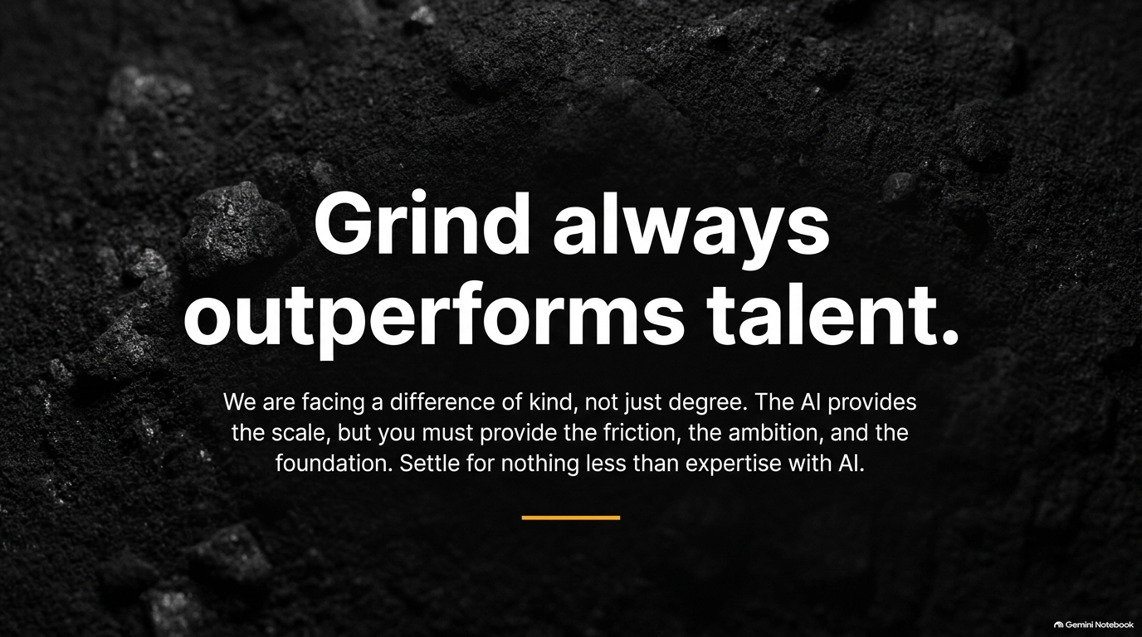
Notes:
Visual / Title: Grind always outperforms talent. We are facing a difference of kind, not just degree.
Suggested Speaking Time: 3 – 4 minutes
Speaker Notes:
"As we synthesize these insights, we must recognize that this technological shift is a difference of kind, not just degree. This isn't just the next iteration of mobile apps or cloud computing; it is a fundamental reconfiguration of how intelligence and execution function in society.
In this new environment, grind always outperforms talent. Natural brilliance without active engagement will be crushed by relentless, structured iteration. The AI provides unprecedented scale, speed, and raw generation power. But you must provide the friction, the ambition, the domain foundation, and the moral compass. Settle for nothing less than absolute expertise enhanced by AI."

Slide 15
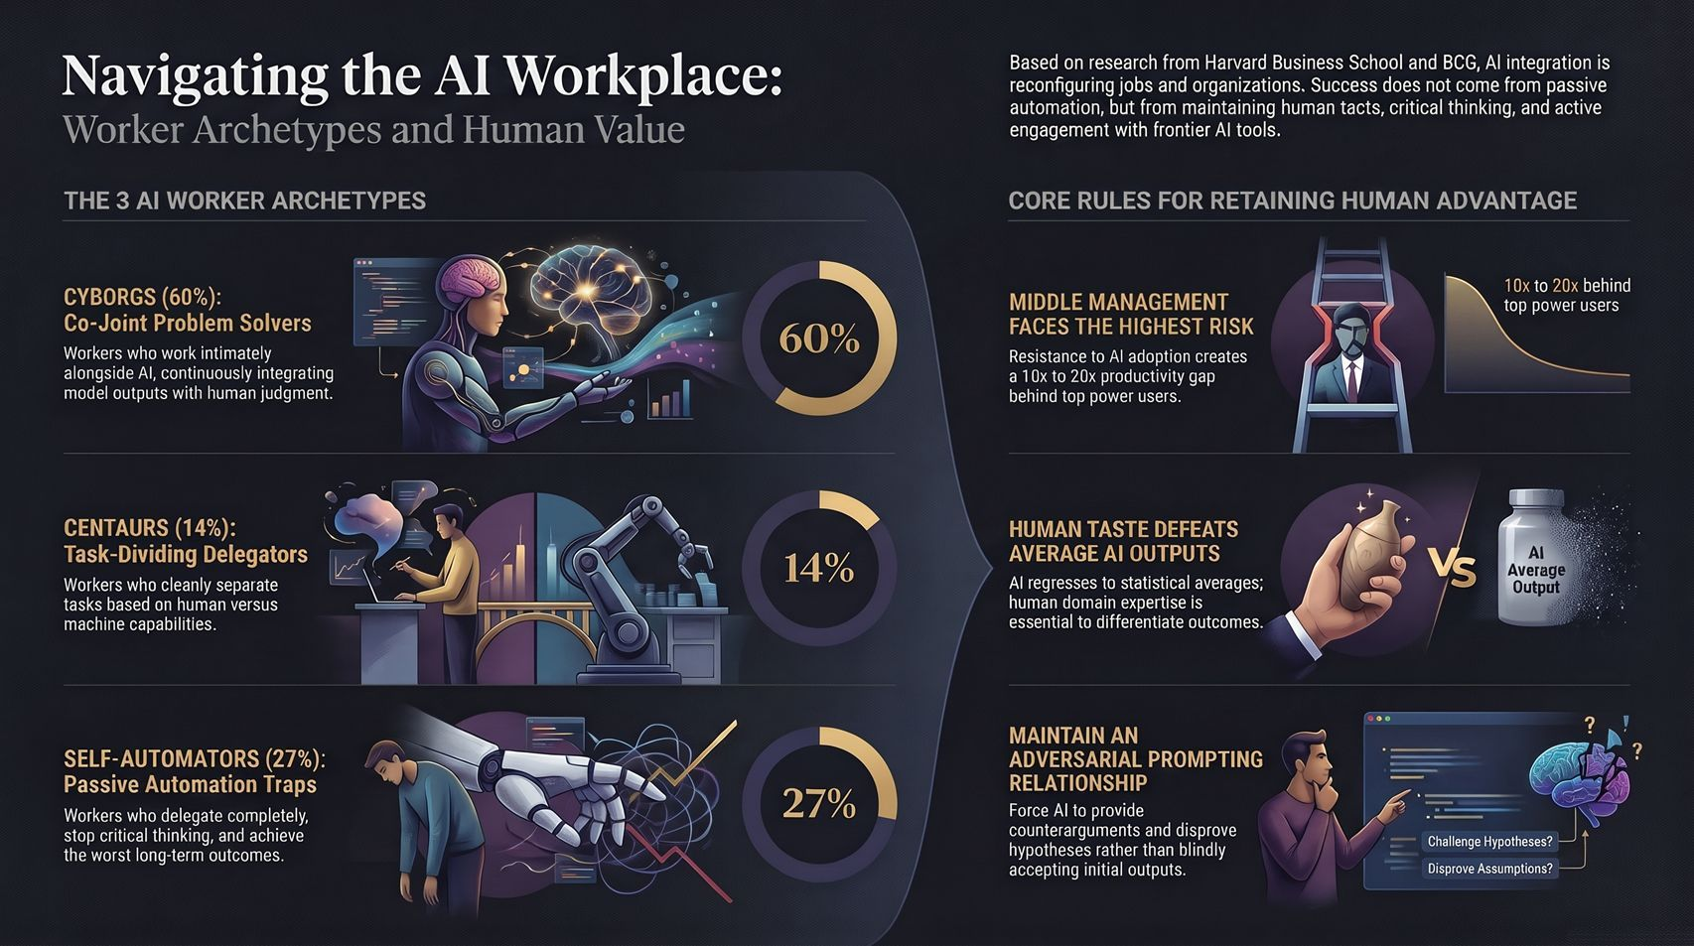
Notes:
Visual / Title: Navigating the AI workplace: Worker archetypes and human value. Core rules for retaining human advantage.
Suggested Speaking Time: 4 – 5 minutes
Speaker Notes:
"To wrap up our playbook, let’s anchor on the three core rules for retaining human advantage in the AI workplace, summarizing everything we’ve covered:
Beware the Middle Management Risk: Resistance to adoption is concentrated in middle management, creating that dangerous 10x to 20x productivity lag behind top power users. Bridge that gap immediately through mandatory hands-on execution.
Human Taste Defeats Average Output: Because models inherently regress to statistical averages, your personal domain expertise, critical thinking, and refined taste are the only things that elevate work from middle-of-the-pack to world-class.
Maintain an Adversarial Relationship: Never accept the first output passively. Force your AI systems to counterargue, stress-test your hypotheses, and expose your blind spots.
The future belongs neither to the technologist nor to the passive bystander. It belongs to the human who masters the machine, embraces the friction, and dares to set unreasonable goals. Thank you."

