Slide 1

Notes:
From Paycheck to Power
Target Timing: 2 – 3 Minutes
Core Topic: Setting the Stage & Reclaiming Agency
Speaker Notes Script:
Welcome everyone. Today, we’re not here to talk about budget spreadsheets that make you feel guilty or strict rules that force you to give up the things you love. Today is about power, freedom, and reclaiming your financial agency.
The presentation you're looking at is titled From Paycheck to Power: A tactical playbook for building a financial buffer, automating wealth, and reclaiming your agency. This playbook is directly inspired by the candid, no-nonsense insights shared by Vivian Tu—founder of Your Rich BFF—and Mel Robbins.
Many of us grew up believing that personal finance is purely a math problem. If you’re living paycheck-to-paycheck, you were probably told it’s because you buy too many lattes or eat too much avocado toast. But as Vivian and Mel point out, the economic landscape today is fundamentally different than it was for previous generations. The old rules don't work the same way anymore.
Over the next 16 slides, we are going to break down the exact mechanics of shifting your mindset, taking control of your current cash flow, setting up automated systems that protect you, negotiating the compensation you actually deserve, and growing wealth through effortless investing. By the end of this session, you won't just have theoretical advice—you will have a concrete, step-by-step roadmap to move from surviving your paycheck to controlling your future.
If You’re Struggling With Money, Watch This
https://www.youtube.com/watch?v=78BsFkDrAr8

Slide 2
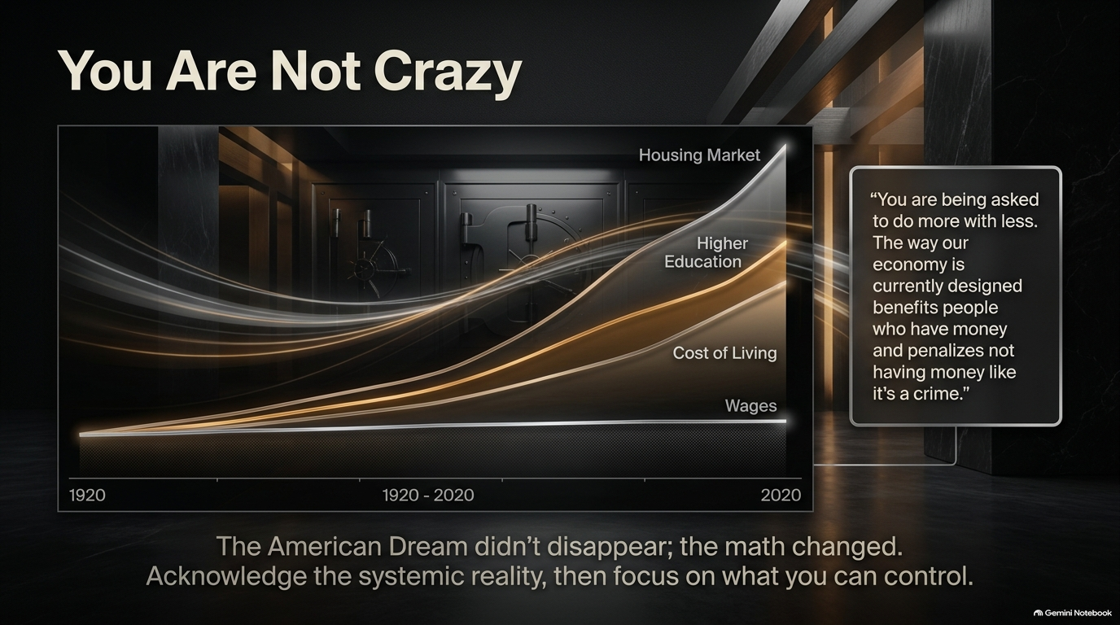
Notes:
You Are Not Crazy (The Macro Realities)
Target Timing: 3 – 4 Minutes
Core Topic: Economic Reality vs. Personal Guilt
Speaker Notes Script:
Let’s start with a truth that far too few financial advisers admit out loud: You are not crazy.
Look at the visual on this slide. Since 1920, and particularly over the last four decades, the cost of the key markers of financial security—housing, higher education, and basic cost of living—has skyrocketed exponentially. Meanwhile, real wage growth has remained virtually flat.
As Vivian Tu highlights, 'You are being asked to do more with less. The way our economy is currently designed benefits people who have money and penalizes not having money like it's a crime.' Think about that for a second. If you have money, you get high-yield interest, rewards, and tax breaks. If you don't have money, you get hit with overdraft fees, high interest rates, and late penalties.
The takeaway here is profound: The American Dream didn't disappear because people got lazy or stopped caring. The math changed.
When you understand this macro reality, you can stop carrying the toxic guilt and shame that usually comes with money struggles. Feeling broke is not a personal character flaw; it is often the direct result of a system built on changing rules. Acknowledge this systemic reality, take a deep breath, and let's focus exclusively on the variables that are within your control.

Slide 3
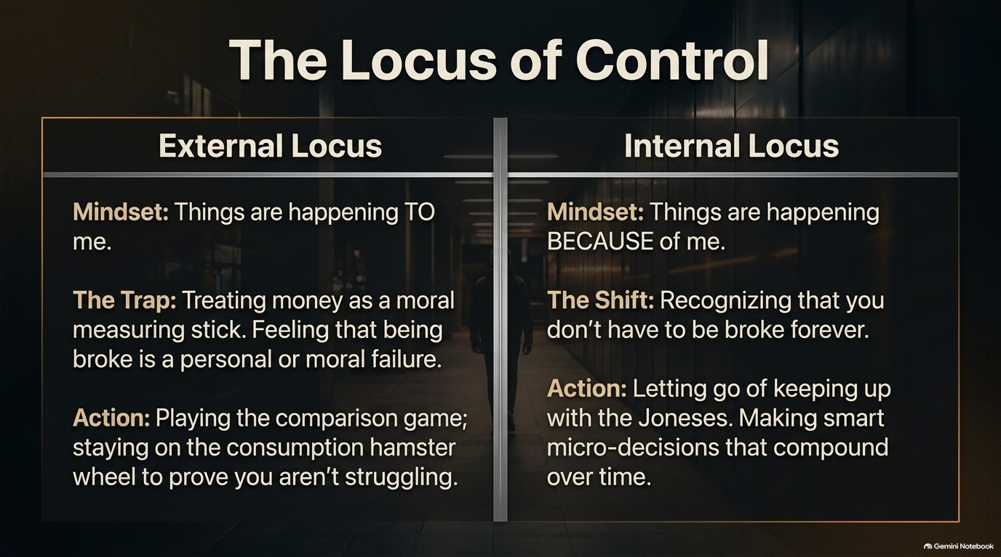
Notes:
The Locus of Control
Target Timing: 3 – 4 Minutes
Core Topic: External vs. Internal Locus of Control
Speaker Notes Script:
Now that we know the game is rigged, how do we play to win? It begins with shifting what psychologists call your Locus of Control.
On the left side of the slide, we have the External Locus. This is where most people get stuck. The mindset here is: 'Things are happening TO me.' You view money as a moral measuring stick. If your account balance is low, you feel like a moral failure. The trap here leads directly to the 'comparison game'—spending money you don't have on things you don't need to prove to people you don't like that you aren't struggling. You stay stuck on the consumption hamster wheel.
On the right side, we have the Internal Locus. The mindset shifts to: 'Things are happening BECAUSE of me.' You recognize that while you didn't create the macro-economy, you don't have to stay broke forever.
Moving to an internal locus means letting go of 'keeping up with the Joneses.' You stop using purchases to validate your worth. Instead, you focus on micro-decisions—small, consistent, smart choices that compound over time into massive financial freedom.

Slide 4
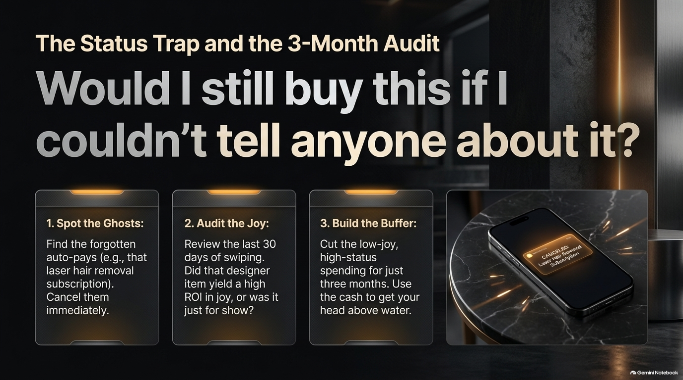
Notes:
The Status Trap and the 3-Month Audit
Target Timing: 4 – 5 Minutes
Core Topic: The Status Filter & Spending Audit
Speaker Notes Script:
To break the External Locus, we must address The Status Trap. Ask yourself this powerful question displayed right here: 'Would I still buy this if I couldn't tell anyone about it?'
Think about your recent purchases. Were they for your actual utility and joy, or were they for the 'curated presentation' of your life to others? To break free from this trap, Vivian recommends a 3-step action plan:
Spot the Ghosts: Search your bank statements for forgotten auto-pays. That unused gym membership, the streaming service you watched once, or the laser hair removal subscription you forgot about. Cancel them immediately.
Audit the Joy: Look at your last 30 days of swiping. Did that designer handbag or expensive night out actually yield a high Return on Investment (ROI) in long-term joy, or was it just a temporary dopamine hit for show?
Build the Buffer: Temporarily pause low-joy, high-status spending for just three months.
You are not committing to a lifetime of deprivation. You are simply creating a temporary 90-day pause to capture that extra cash and get your head above water.

Slide 5
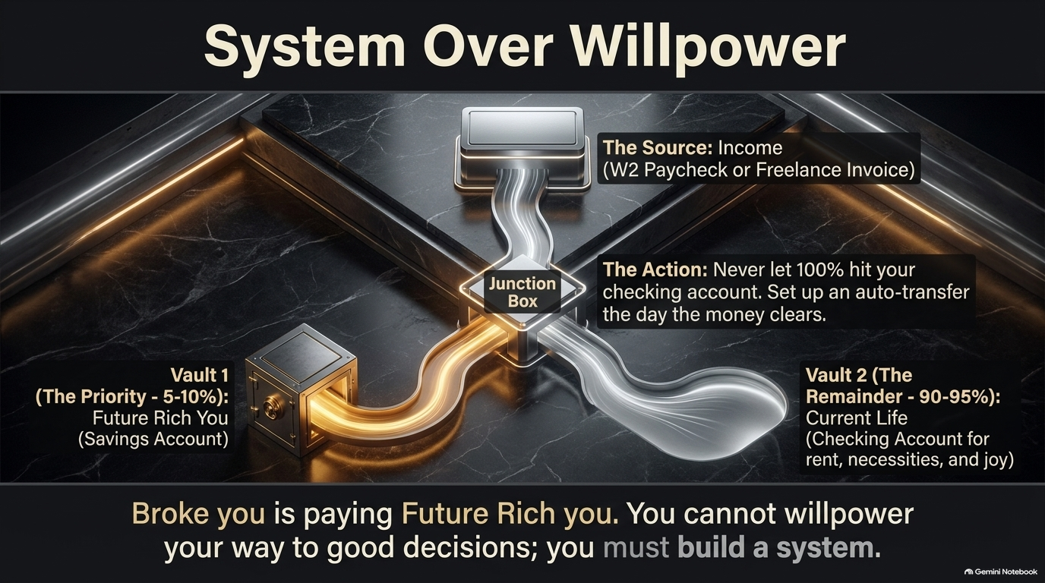
Notes:
System Over Willpower
Target Timing: 4 – 5 Minutes
Core Topic: Automating Pay Yourself First
Speaker Notes Script:
Here is a truth about human psychology: You cannot willpower your way to financial security. Willpower is a finite muscle; by the time you finish a stressful workday, your willpower is depleted. If you rely on willpower to decide how much money to save at the end of the month, the answer will almost always be zero.
You must build a system that makes saving automatic. Look at this visual framework:
The Source: Your incoming W2 paycheck or freelance invoice hits the system.
The Junction Box: The critical rule is that 100% of your paycheck should never hit your primary checking account.
Vault 1 (The Priority): Set up an automatic transfer on the exact day your direct deposit clears, sending 5% to 10% straight into your high-yield savings account. This is 'Future Rich You.'
Vault 2 (The Remainder): The remaining 90% to 95% goes to your checking account for 'Current Life'—your rent, utilities, groceries, and guilt-free fun.
When 'Broke You' pays 'Future Rich You' first, you remove decision fatigue completely. You spend what is left over after saving, rather than saving what is left over after spending.

Slide 6
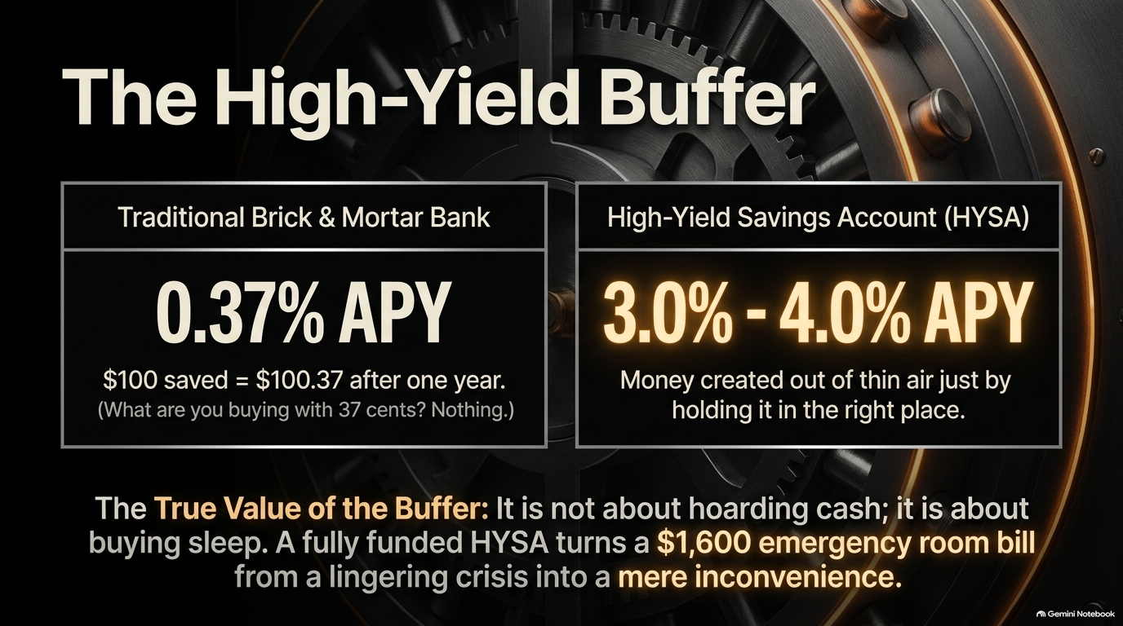
Notes:
The High-Yield Buffer
Target Timing: 3 – 4 Minutes
Core Topic: HYSA vs. Traditional Banks & Peace of Mind
Speaker Notes Script:
Where you store that 5% to 10% matters immensely.
If you leave your cash in a traditional brick-and-mortar bank, you are receiving an average annual percentage yield (APY) of around 0.37%. If you save $100, you earn 37 cents after an entire year. What can you buy with 37 cents? Nothing.
By moving your buffer into a High-Yield Savings Account (HYSA), you earn between 3.0% and 4.0%+ APY. That is free money generated out of thin air simply by picking the right vault for your money. HYSAs are FDIC-insured up to $250,000, meaning your money is just as safe as it is in a traditional bank, but it actually works for you.
But beyond the math, let's talk about the true value of the buffer. An emergency buffer isn't about hoarding wealth or bragging rights; it is about buying sleep.
When you have a fully funded HYSA, a sudden $1,600 emergency room bill or car repair isn't a catastrophic crisis that plunges you into credit card debt. It is simply a minor, temporary inconvenience.

Slide 7
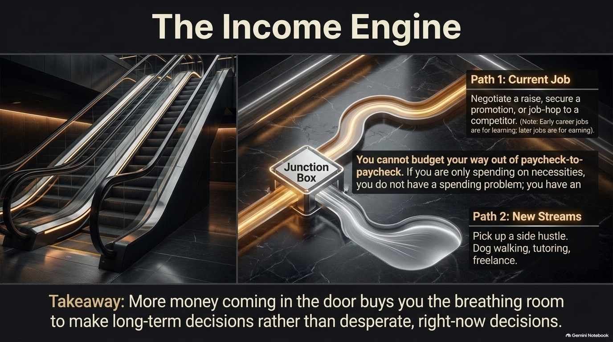
Notes:
The Income Engine
Target Timing: 3 – 4 Minutes
Core Topic: Increasing Cash Flow (Offense)
Speaker Notes Script:
Now that we have set up our defense with an automated buffer, let's talk about offense: The Income Engine.
There is a mathematical limit to how much you can cut from a budget. You can cut netflix, cut dining out, and downsize your apartment, but you cannot cut below zero. However, there is no upper limit on how much you can earn. If you are only spending on basic necessities and still struggling, you don't have a spending problem—you have an income problem.
To fix an income problem, you have two primary paths:
Path 1: Your Current Job. Negotiating a raise, securing a promotion, or strategically job-hopping to a competitor. Remember: early-career jobs are primarily for learning, but mid-to-later jobs are for earning.
Path 2: New Streams. Picking up a targeted side hustle—freelancing, consulting, dog walking, or tutoring.
Increasing the money coming through the door gives you the breathing room to make strategic, long-term decisions rather than desperate, right-now survival decisions.

Slide 8
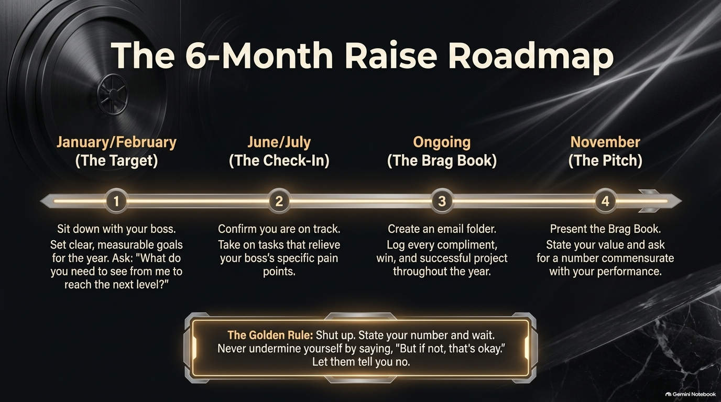
Notes:
The 6-Month Raise Roadmap
Target Timing: 4 – 5 Minutes
Core Topic: Step-by-Step Salary Negotiation Strategy
Speaker Notes Script:
Most people approach salary negotiation completely wrong. They wait until their annual performance review in December, sit down, and say, 'I've worked hard this year and inflation is high, so I'd like a raise.' That almost never works.
To secure real compensation increases, you must use The 6-Month Raise Roadmap:
Step 1 (Jan/Feb - The Target): Sit down with your manager at the beginning of the year. Ask directly: 'What specific, measurable metrics do I need to achieve over the next 6 to 12 months to be performing at the next level?'
Step 2 (June/July - The Check-In): Mid-year, confirm you are on track. Take on projects that solve your manager's specific high-priority pain points.
Step 3 (Ongoing - The Brag Book): Create a dedicated folder. Log every positive email, client compliment, project milestone, and revenue-generating win throughout the year.
Step 4 (November - The Pitch): Present your Brag Book. Show the receipts. State your value based on market data and present your number.
The Golden Rule: Once you state your desired number, shut up and wait. Do not fill the silence with weak statements like 'But if that's not in the budget, it's okay.' Let them respond.

Slide 9
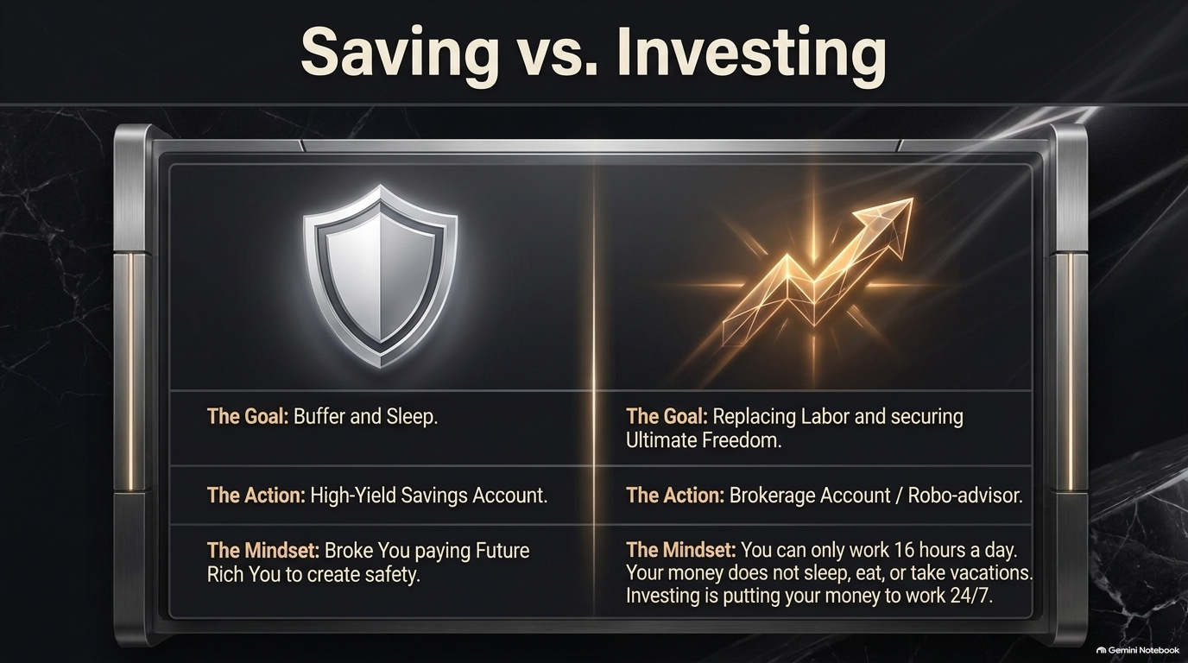
Notes:
Saving vs. Investing
Target Timing: 3 – 4 Minutes
Core Topic: Wealth Accumulation Mechanics
Speaker Notes Script:
To build true wealth, you must understand the distinction between Saving and Investing. They serve entirely different purposes in your financial ecosystem.
Saving (The Shield):
Goal: Short-term security, emergency buffers, and peace of mind.
Action: Placing money in a High-Yield Savings Account.
Mindset: Protection. Broke You paying Future Rich You to guarantee safety.
Investing (The Engine):
Goal: Replacing your physical labor and securing ultimate long-term freedom.
Action: Opening a Brokerage account, Roth IRA, or 401(k).
Mindset: Multiplication. You can physically only work 8 to 16 hours a day. But your money does not sleep, eat, take vacations, or get sick. Investing puts your dollars to work 24 hours a day, 7 days a week, 365 days a year.

Slide 10
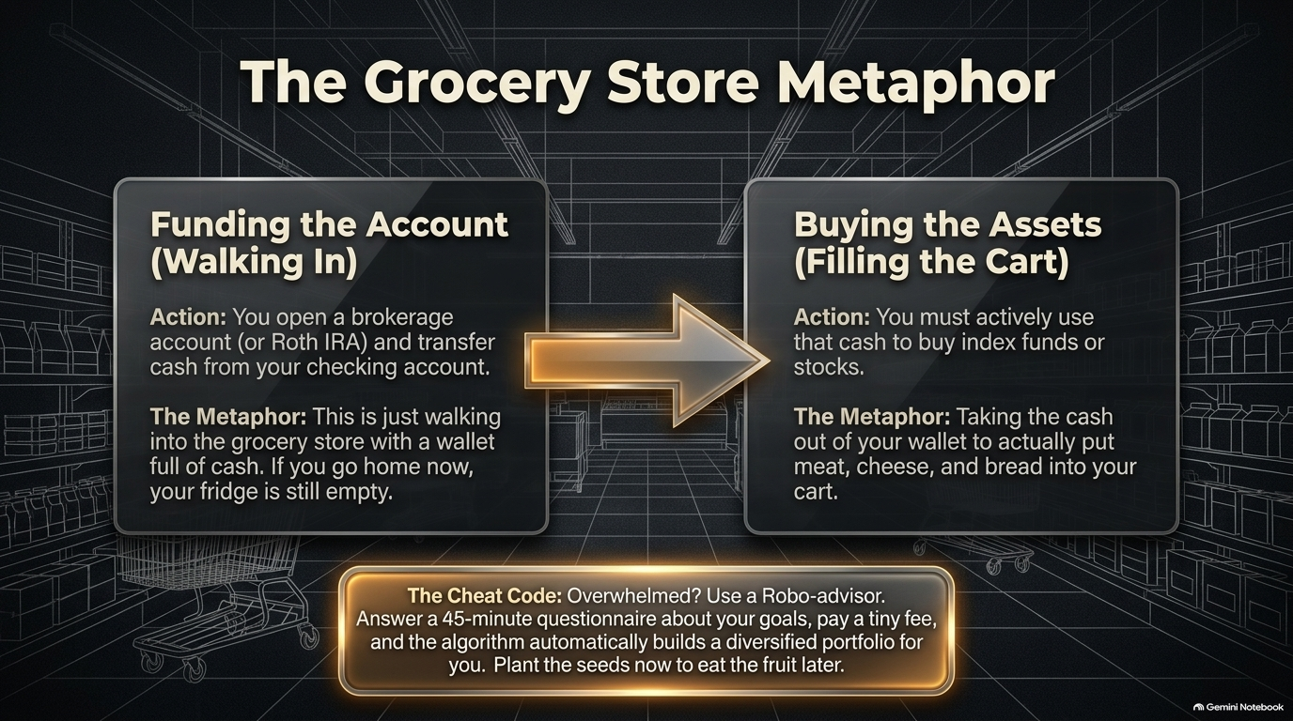
Notes:
The Grocery Store Metaphor
Target Timing: 4 – 5 Minutes
Core Topic: Demystifying How Brokerage Accounts Work
Speaker Notes Script:
One of the single biggest mistakes beginners make when entering the market is misunderstanding how an investment account actually works. Vivian Tu uses The Grocery Store Metaphor to explain this brilliantly:
Funding the Account (Walking In): Opening a Roth IRA or Brokerage account and transferring $500 into it is simply like walking into a grocery store with cash in your wallet. If you stop there, you have not bought any food. Your cash is just sitting inside the store, uninvested.
Buying the Assets (Filling the Cart): You must actively take that cash and use it to purchase assets like index funds, ETFs, or stocks. That is the equivalent of taking cash out of your wallet to buy produce, protein, and bread to fill your fridge.
The Cheat Code: If picking individual stocks or index funds feels overwhelming, use a Robo-advisor. You answer a brief questionnaire about your age, risk tolerance, and goals. For a tiny fee, the automated algorithm buys and rebalances a diversified portfolio for you. Plant the seeds today so you can harvest the fruit later.

Slide 11
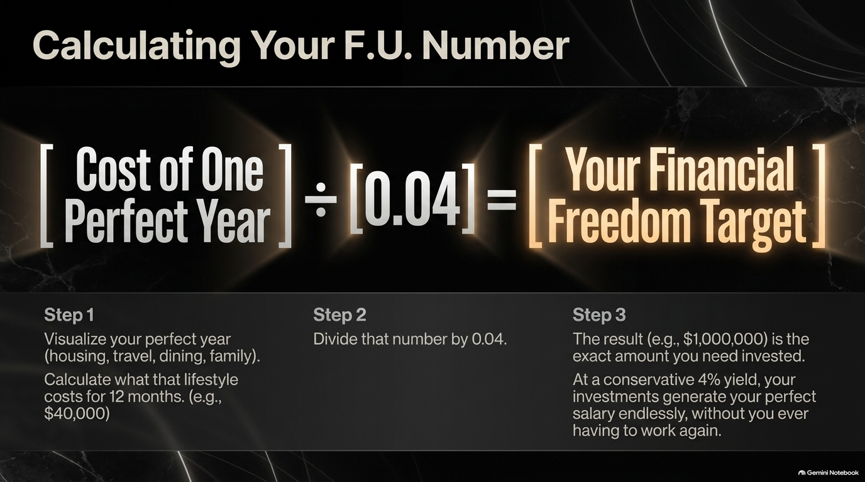
Notes:
Calculating Your F.U. Number
Target Timing: 4 – 5 Minutes
Core Topic: The 4% Rule & Financial Independence Target
Speaker Notes Script:
What is the ultimate goal of investing? It is reaching your F.U. Number—the financial freedom target where work becomes completely optional.
Here is the simple 3-step formula based on the widely tested 4% Rule:
Step 1: Visualize your perfect, comfortable year. Calculate what that lifestyle costs for 12 months (housing, travel, food, family). Let's use $40,000/year as an example.
Step 2: Divide that annual lifestyle number by 0.04 (or multiply it by 25).
Step 3: $40,000 ÷ 0.04 = $1,000,000.
Once you have $1,000,000 invested, a conservative 4% withdrawal rate generates $40,000 every single year in interest and growth indefinitely, without ever touching your core principal. You never have to work for a paycheck again unless you choose to. Demystifying this math turns an abstract dream into a concrete numerical target.

Slide 12

Notes:
The Realities of Modern Housing
Target Timing: 4 – 5 Minutes
Core Topic: Living with Parents & Rethinking Homeownership
Speaker Notes Script:
Housing is typically the largest expense in anyone's budget, so let's address modern housing realities head-on.
1. The New Generational Wealth: Nearly 50% of young adults under 30 in America are currently living with their parents. Social stigma tells you this is a failure. In reality, it is an incredible financial launching pad.
The Rule: Don't set a move-out date; set a move-out number. Stay until your foundation is built on solid ground. Route the money you are saving on rent directly into your HYSA, Roth IRA, or 401(k).
2. Homeownership as a Lifestyle Choice: Stop treating buying a house as an automatic financial requirement. Ask yourself: Do you plan to stay in one location for 5 to 7 years? Do you want to deal with replacing a broken roof or fixing a leaky toilet at 2 AM? If not, renting is not 'throwing money away'—it is buying flexibility and capping your monthly housing costs. If you do want to buy, don't buy into the myth that you need 20% down. Explore FHA loans (3.5% down), Conventional 97s (3% down), or zero-down VA loans.

Slide 13
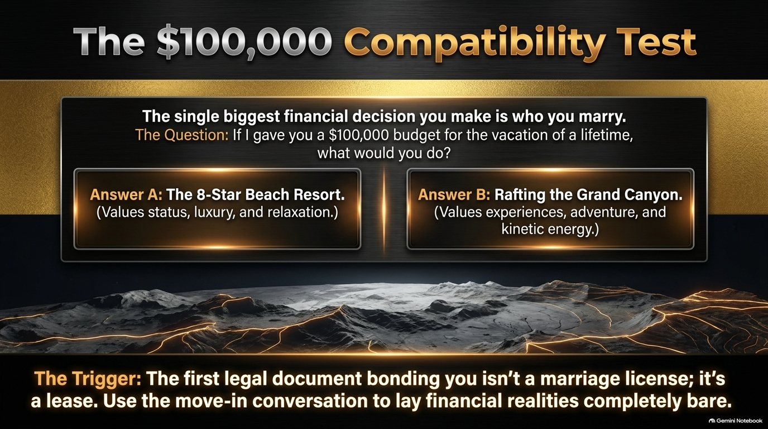
Notes:
The $100,000 Compatibility Test
Target Timing: 3 – 4 Minutes
Core Topic: Relationships and Financial Alignment
Speaker Notes Script:
The single biggest financial decision you will ever make in your life is not what stock you buy or what job you accept—it is who you choose to marry or partner with.
To test financial compatibility early, use The $100,000 Question: Ask your partner: 'If I handed you a $100,000 tax-free check right now to spend on the vacation of a lifetime, what would you do?'
Answer A: Book an all-inclusive 8-star luxury beach resort. (Values status, relaxation, pampering).
Answer B: Go white-water rafting through the Grand Canyon and backpack across continents. (Values kinetic energy, adventure, raw experience).
Neither answer is wrong, but drastically different answers highlight underlying value differences.
Remember: The first legal document bonding you to a partner isn't a marriage license—it's a residential lease or mortgage. Use moving in together as the key opportunity to lay your debt, credit scores, savings, and spending habits completely bare.

Slide 14
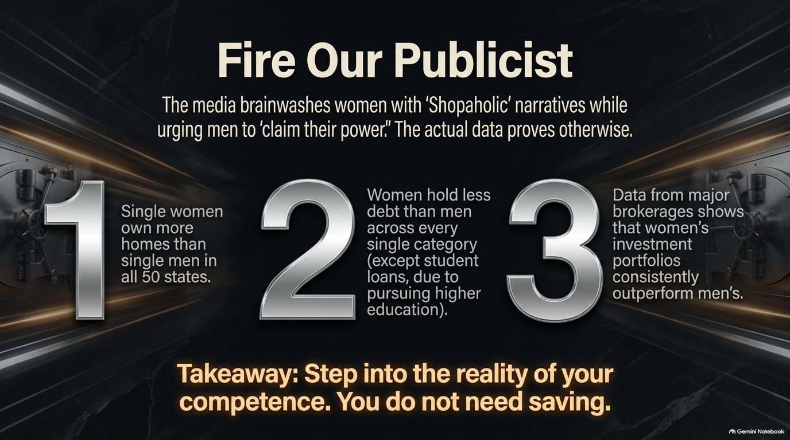
Notes:
Fire Our Publicist
Target Timing: 3 – 4 Minutes
Core Topic: Debunking Gendered Financial Myths
Speaker Notes Script:
Media and pop culture have promoted a harmful narrative for decades: portraying women as impulsive 'shopaholics' who spend money on shoes, while portraying men as savvy financial investors.
It's time to fire that publicist, because hard data proves the exact opposite:
Homeownership: Single women own significantly more homes than single men across all 50 U.S. states.
Debt: Women hold less consumer debt than men across every category, with the sole exception of student loans—which exists because women pursue higher education degrees at significantly higher rates.
Investing Performance: Data from major brokerages like Fidelity shows that when women invest, their investment portfolios consistently outperform men's portfolios over time, largely because women trade less speculatively and hold steady.
Step into the reality of your competence. You do not need saving; you simply need to step into your power and put your money to work.

Slide 15
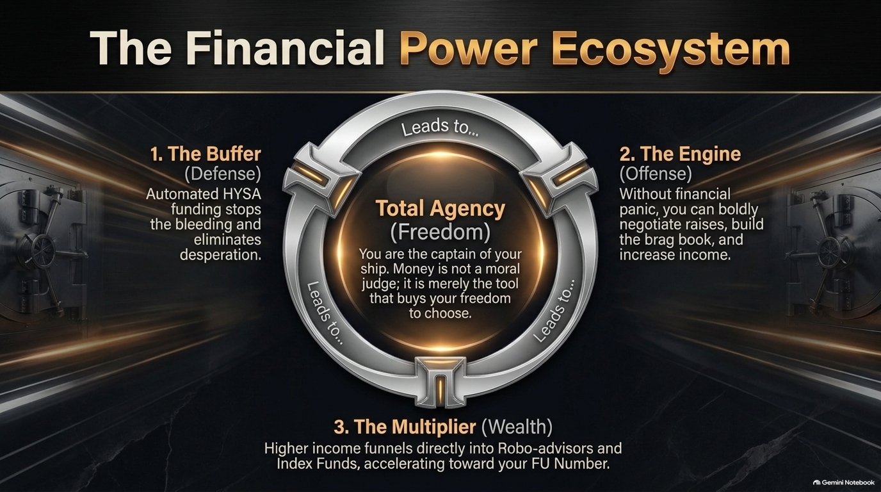
Notes:
The Financial Power Ecosystem
Target Timing: 4 – 5 Minutes
Core Topic: Connecting Defense, Offense, and Wealth Multiplication
Speaker Notes Script:
Let's bring all these pieces together into The Financial Power Ecosystem. Financial independence is not a single action; it is a closed-loop system where each component feeds the next:
The Buffer (Defense): Automated transfers to your High-Yield Savings Account eliminate desperation and keep you out of bad debt.
The Engine (Offense): Because you aren't living in financial panic, you have the leverage to negotiate aggressively, build your brag book, track achievements, and increase your income.
The Multiplier (Wealth): Every dollar earned from your increased income is routed straight past your lifestyle creep and into Robo-advisors, Roth IRAs, and low-cost Index Funds.
At the center of this ecosystem sits Total Agency. Money is not a moral judge or a badge of personal worth; it is simply a neutral tool that buys you choices and freedom.

Slide 16
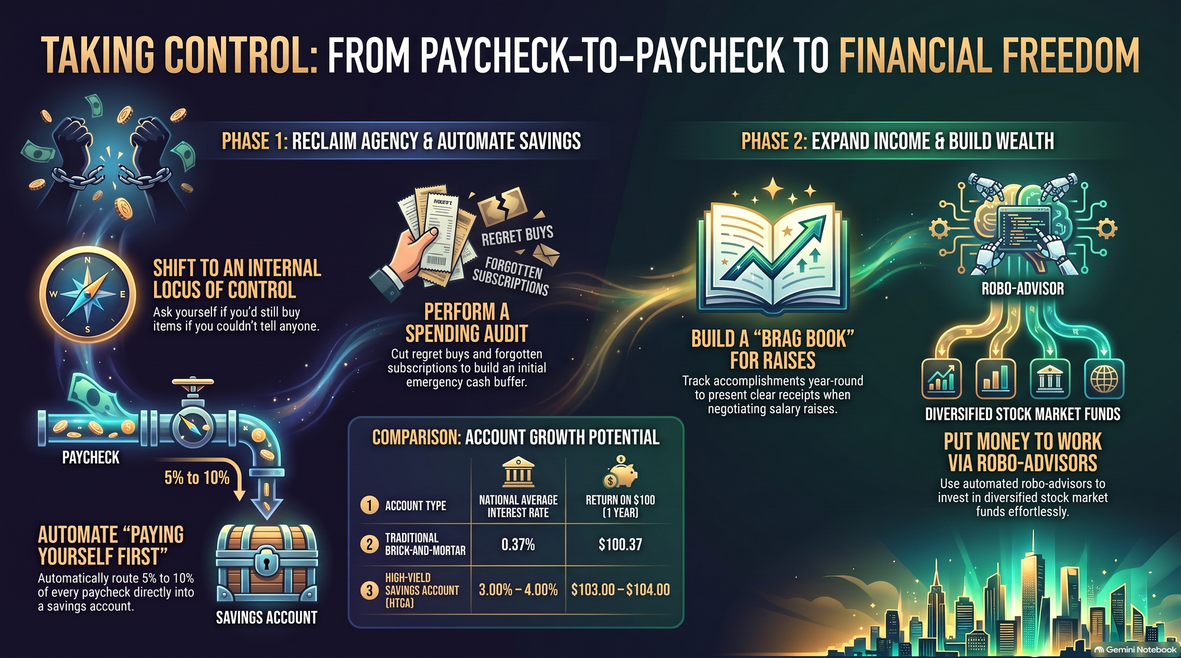
Notes:
Taking Control Roadmap (Phase 1 & Phase 2 Overview)
Target Timing: 4 – 5 Minutes
Core Topic: Summary & Immediate Actionable Steps
Speaker Notes Script:
To conclude our presentation, let me leave you with this complete summary roadmap of your immediate next steps:
Phase 1: Reclaim Agency & Automate Savings
Shift Mindset: Transition to an internal locus of control and apply the status filter to your purchases.
Perform a Spending Audit: Eliminate regret buys and forgotten auto-subscriptions.
Automate First: Set up direct transfers routing 5% to 10% of every paycheck into an HYSA earning 3–4%+ APY before you ever touch the rest.
Phase 2: Expand Income & Build Wealth
Build a Brag Book: Log your professional wins continuously to negotiate raises with cold, hard receipts.
Put Money to Work: Use Robo-advisors or diversified index funds to systematically compound your wealth toward your F.U. Number.
Take control today. Stop letting money happen to you, and start using money to build the exact life you desire. Thank you!
If You’re Struggling With Money, Watch This
https://www.youtube.com/watch?v=78BsFkDrAr8

