Slide 1
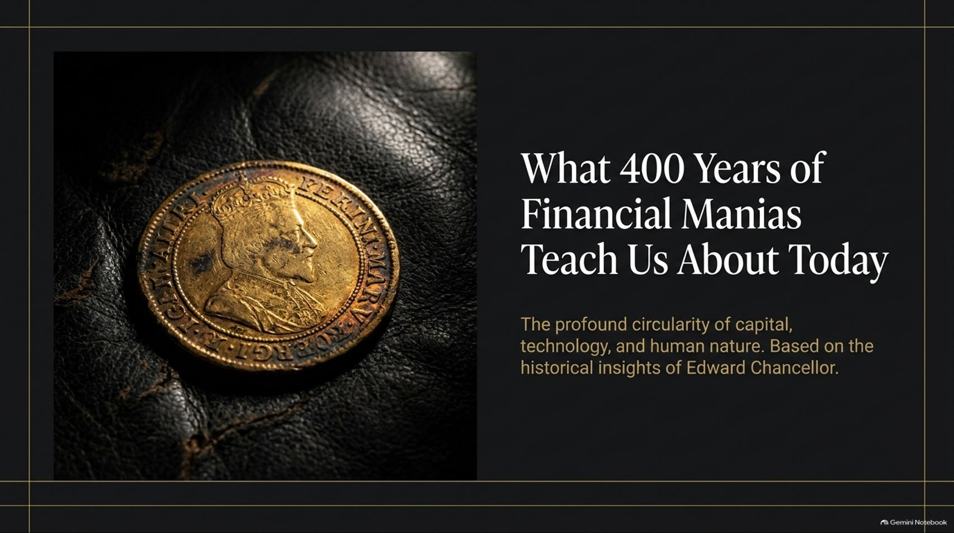
Notes:
Target Timing: 3 – 4 minutes
Tone: Reflective, authoritative, engaging
Speaker Script:
"Good morning, everyone, and welcome. Today, we are taking a step back from the immediate noise of daily market tickers to explore one of the most persistent phenomena in economic history: the speculative mania.
Our talk today is titled: 'What 400 Years of Financial Manias Teach Us About Today.' It draws directly upon the historical framework established by Edward Chancellor—author of Devil Take the Hindmost and The Price of Time—who is widely regarded as one of our generation's premier financial historians.
When we look back over the last four centuries—from the canal booms of the 18th century to the dot-com bubble of 1999, and right into today's frenzy over Artificial Intelligence, crypto, and perpetual leverage—it is tempting to believe that each epoch is fundamentally unique. We like to tell ourselves that new technology, sophisticated algorithms, or modern central banking have changed the rules of the game.
However, history teaches us quite the opposite. What changes across centuries is merely the surface narrative and the technological medium. What remains entirely unchanged is human psychology and the structural mechanics of capital allocation.
Today, we will unpack this circularity. We will look at how financial bubbles are born, how they are nurtured by messianic narratives and easy money, how information velocity actually accelerates irrationality rather than preventing it, and—most importantly—what warning signs we are seeing in today’s current market environment.
By the end of this presentation, my goal is to equip you with a historical compass: a perspective that allows you to distinguish between genuine, long-term wealth creation and speculative, credit-driven illusions."
What 400 Years of Financial Manias Teach Us About Today | Edward Chancellor
https://www.youtube.com/watch?v=bhgiF3nWr7w

Slide 2
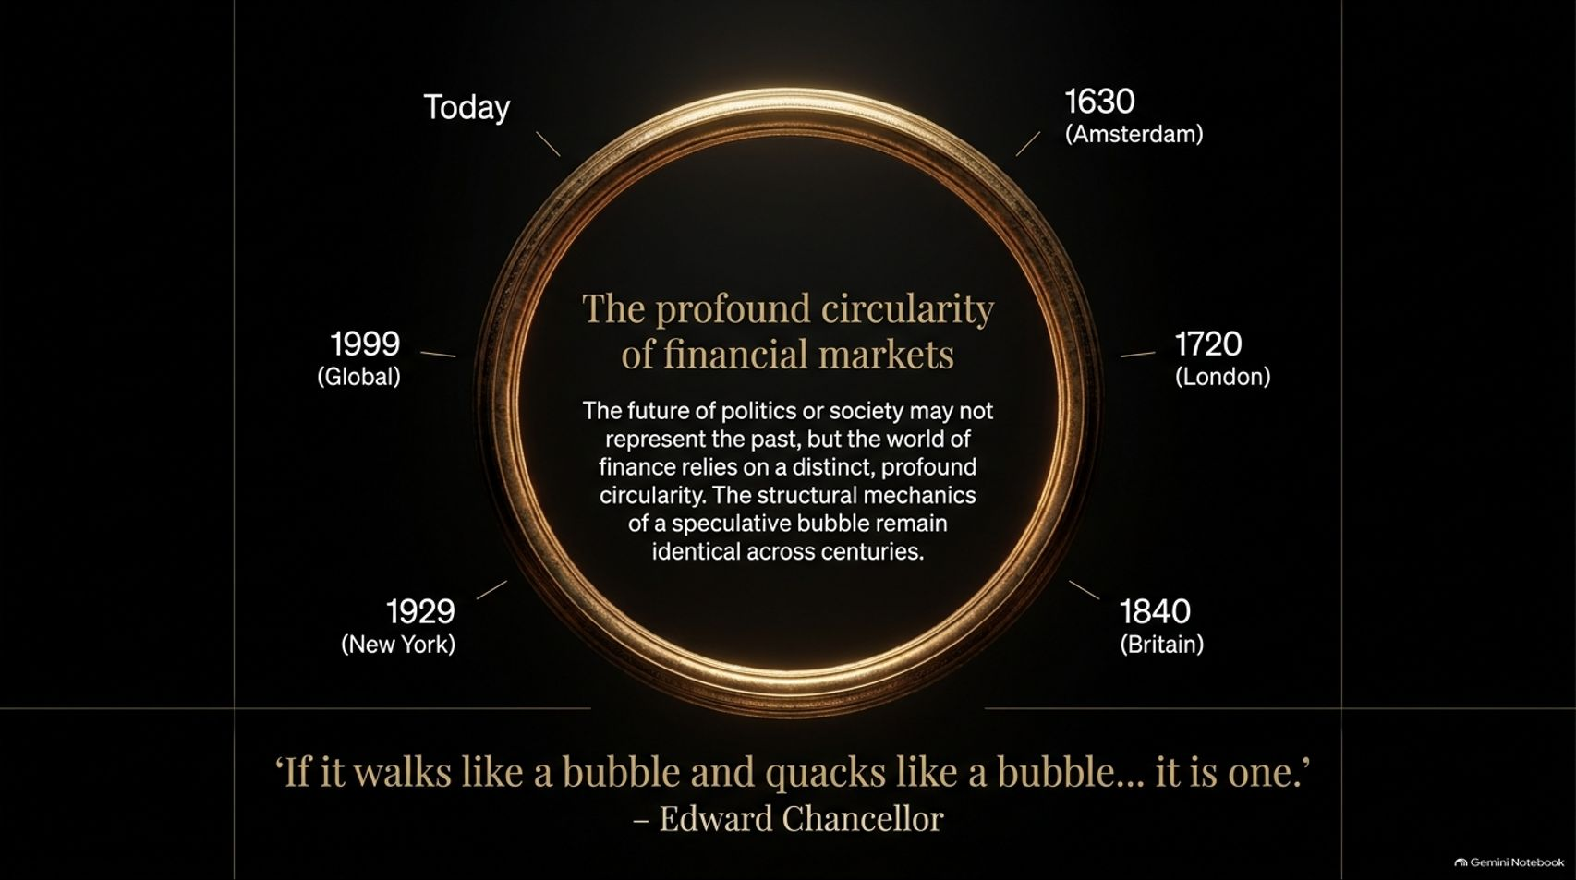
Notes:
Target Timing: 3 – 5 minutes
Tone: Analytical, historical, thesis-building
Speaker Script:
"Let us start with the core thesis of today’s presentation: Financial markets do not move in a straight line of linear progress; they move in cycles of profound circularity.
Look at the timeline displayed on this slide. In 1630, we had Tulip Mania in Amsterdam—the first documented market bubble where exotic flower bulbs were traded on futures contracts at valuations exceeding the price of luxury townhouses. By 1720, the focal point shifted to London with the South Sea Bubble, where public debt conversion schemes led to a frenzy that ruined aristocrats and scientists alike, including Sir Isaac Newton.
Fast forward to 1840, and we see British Railway Mania; move to 1929, and we have the Great Crash in New York; move to 1999, and we witness the global Dot-Com euphoria. And today? We are watching the exact same behavioral patterns play out across AI data centers, speculative tech stocks, and high-frequency retail trading.
Edward Chancellor famously summarized this repeating pattern with a simple, sharp observation: 'If it walks like a bubble and quacks like a bubble... it is one.'
Why does this circularity exist? Because while technology evolves exponentially, human biology and cognitive biases remain static. Fear, greed, FOMO (fear of missing out), the desire for easy wealth, and the suspension of critical reasoning under social proof are identical today to what they were in 17th-century Amsterdam.
Whenever you hear the four most dangerous words in investing—'This time is different'—remember this circular wheel. The assets change, the speed changes, but the structural mechanics of a speculative bubble remain 100% identical across the centuries."

Slide 3
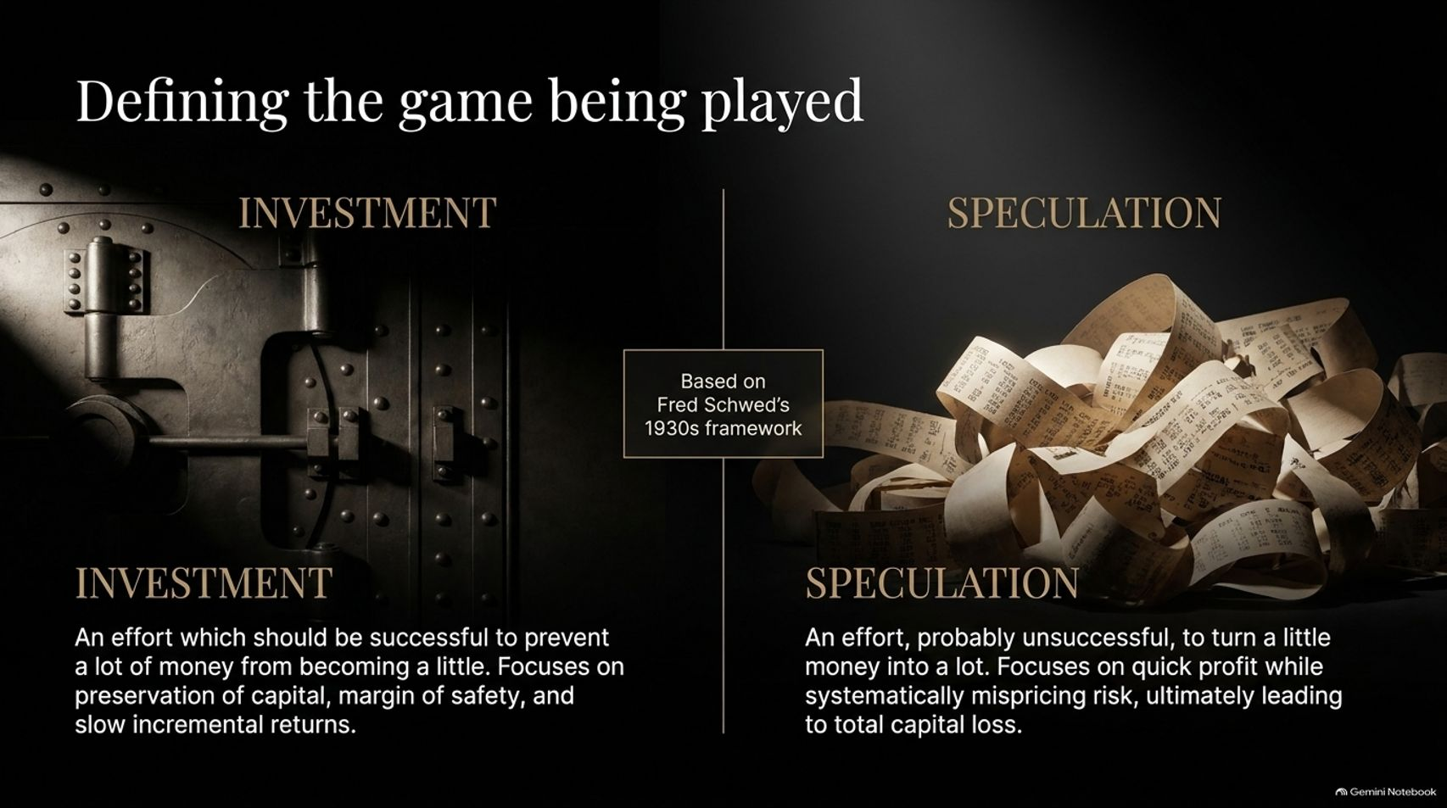
Notes:
Target Timing: 4 – 5 minutes
Tone: Educational, sharp, distinction-focused
Speaker Script:
"To understand where we are in today's cycle, we first need to define the game we are playing. To do that, we look back to the brilliant 1930s framework of Fred Schwed, author of Where Are the Customers' Yachts?
Schwed drew a line in the sand between two fundamental activities that take place in capital markets: Investment and Speculation.
On the left, we have Investment. Schwed humorously—yet accurately—defined investment as 'an effort, which should be successful, to prevent a lot of money from becoming a little.'
Real investment is inherently unsexy. It is grounded in capital preservation, a rigorous requirement for a margin of safety, thorough fundamental analysis, and compounding slow, incremental returns over long time horizons. An investor asks: 'What is the underlying cash flow of this asset relative to the price I am paying today?'
On the right, we have Speculation. Schwed defined speculation as 'an effort, probably unsuccessful, to turn a little money into a lot.'
Speculation is focused on fast capital gains. It relies on the belief that someone else will pay a higher price tomorrow regardless of intrinsic value. It systematically misprices risk, relies heavily on leverage, and historically, almost always culminates in total or near-total capital loss for the late entrants.
The central tragedy of every financial mania is that as asset prices climb, the line between these two activities becomes blurred. Speculators begin calling themselves 'visionary long-term investors,' and true value investors are mocked as dinosaurs or forced out of business because they refuse to buy overvalued assets.
As we examine the rest of these slides, keep asking yourself: Are today's market participants engaged in true investment, or are they playing Schwed’s 'probably unsuccessful' speculative game?"

Slide 4
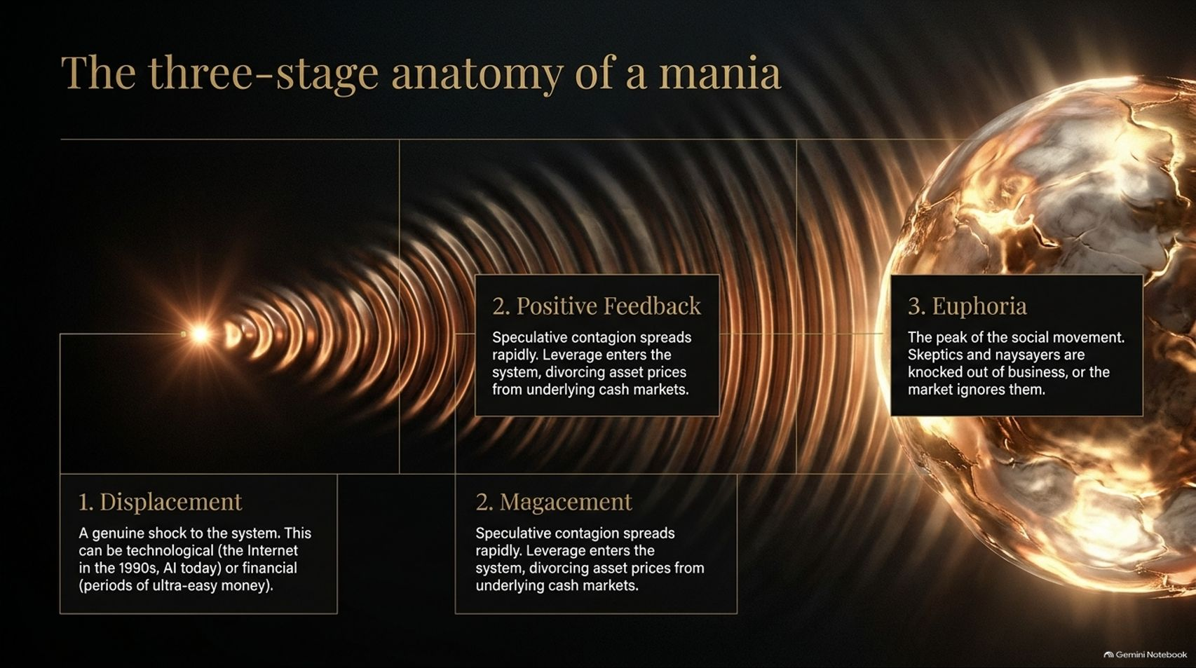
Notes:
Target Timing: 4 – 6 minutes
Tone: Structured, instructional, narrative
Speaker Script:
"Now that we’ve distinguished investment from speculation, let us examine how a speculative mania actually develops. Drawing on the work of economist Charles Kindleberger and Edward Chancellor, we can break every major mania down into three distinct stages.
Stage 1: Displacement.
Every bubble starts with a kernel of truth—a genuine, fundamental shock to the system. This shock can be technological—such as the arrival of steam railways in the 1840s, the commercial Internet in the 1990s, or Generative AI today. Or it can be financial, such as a sudden shift to ultra-low interest rates and credit expansion by central banks. This displacement opens up vast, uncharted economic possibilities, creating a legitimate reason for profit expectations to rise.
Stage 2: Positive Feedback & Management.
As early adopters make real fortunes, stories of sudden wealth spread. Speculative contagion takes root. Price increases reinforce optimism, which attracts more capital, which drives prices higher still. At this stage, credit and leverage enter the system. Financial engineering—whether it was margin loans in 1929, subprime CDOs in 2006, or perpetual futures and 3x leveraged ETFs today—divorces asset prices from underlying cash flows. Narratives replace cash flow models.
Stage 3: Euphoria.
This is the peak of the social movement. At this stage, buying asset classes is no longer an economic decision; it is a cultural phenomenon. Everyone is talking about it—from taxi drivers to corporate executives. Critical thinking is completely suspended. Skeptics and shorts who point out valuation anomalies are either wiped out by margin calls or simply ignored as 'not getting it.'
Notice how continuous the wave effect is in the diagram on your screen. What starts as a small point of true innovation expands continuously until it forms an unsustainable, glowing orb of euphoria. Recognizing which stage you are in is the single most critical asset for capital preservation."

Slide 5
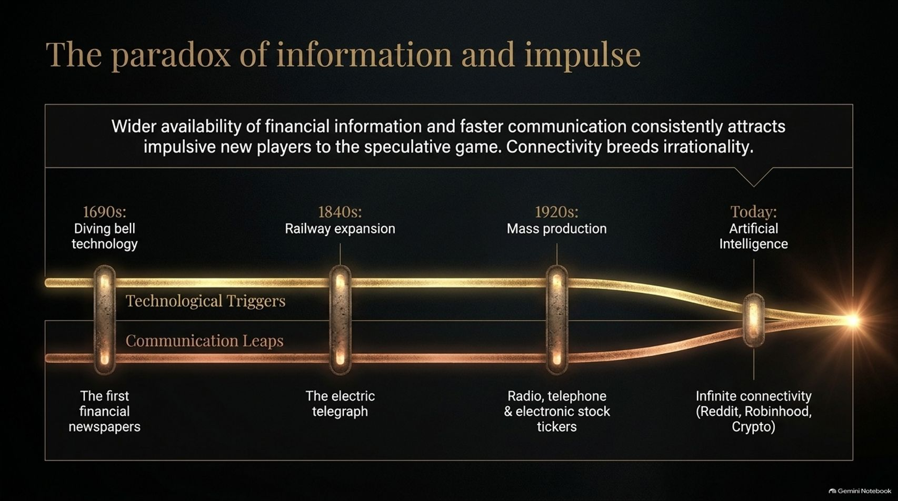
Notes:
Target Timing: 3 – 5 minutes
Tone: Counter-intuitive, thought-provoking
Speaker Script:
"There is a prevailing myth in modern finance that goes like this: 'Because we now have instant access to data, financial news, and real-time analytical tools, modern markets are far more efficient and rational than those of the past.'
History proves the exact opposite. This is what Chancellor calls The Paradox of Information and Impulse.
Wider availability of financial information and faster communication channels do not increase market rationality. Instead, they democratize speculative access, lower the barrier to entry, and dramatically increase the speed at which speculative impulse spreads.
Look at the dual timeline on this slide:
In the 1690s, the emergence of the first financial newspapers coincided with London’s diving-bell and joint-stock company bubble.
In the 1840s, the invention of the electric telegraph arrived right alongside Railway Mania, allowing stock prices to be flashed across cities instantaneously.
In the 1920s, mass production of radios, home telephones, and electronic stock tickers allowed retail investors across America to follow Wall Street minute-by-minute.
And Today, we have infinite connectivity: zero-commission trading apps like Robinhood, algorithmic social media feeds, Reddit forums, and 24/7 crypto markets.
Rather than turning investors into deliberate analysts, faster information feeds our most primitive emotional triggers. It creates herd behavior operating at the speed of light. Today, a tweet or a viral clip can ignite a global speculative rally or a bank run in minutes. Hyper-connectivity does not breed discipline—it supercharges irrationality."

Slide 6

Notes:
Target Timing: 4 – 5 minutes
Tone: Comparative, biographical, psychological
Speaker Script:
"Every great speculative mania requires a story, and every great story requires a protagonist. History shows that speculative booms operate far more efficiently when organized around a charismatic leader who projects an overblown messianic manner and an aura of boundless power.
On the left, you see a portrait representative of figures like John Law during the 1720 Mississippi Scheme, or Sir John Blunt during the South Sea Bubble, or George Hudson—known as the 'Railway King'—in 1840s Britain.
These men did not just promote companies; they promoted visions of society. Hudson promised that railways would abolish poverty and bring universal peace by connecting humanity. John Law promised to eliminate France’s national debt entirely through financial engineering. To maintain their aura, these figures cultivated political relationships, co-opted the ruling class through stock allocations, and silenced critics through sheer force of personality.
On the right, look at today’s parallel: modern tech figureheads like Elon Musk or key leaders in the AI and crypto spaces. They project visions not just of corporate growth, but of civilizational salvation—promising Artificial General Intelligence (AGI), multi-planetary human existence, or decentralized liberation from government money.
Why is the messianic leader necessary? Because the projects being funded—whether laying tens of thousands of miles of redundant iron tracks in 1845 or spending trillions of dollars on unproven AI data centers and GPU clusters today—are so capital-intensive and speculative that traditional cash-flow models cannot justify the investment.
Only a messianic narrative can persuade investors to suspend standard valuation metrics and commit vast amounts of capital to highly speculative, long-horizon infrastructure."

Slide 7
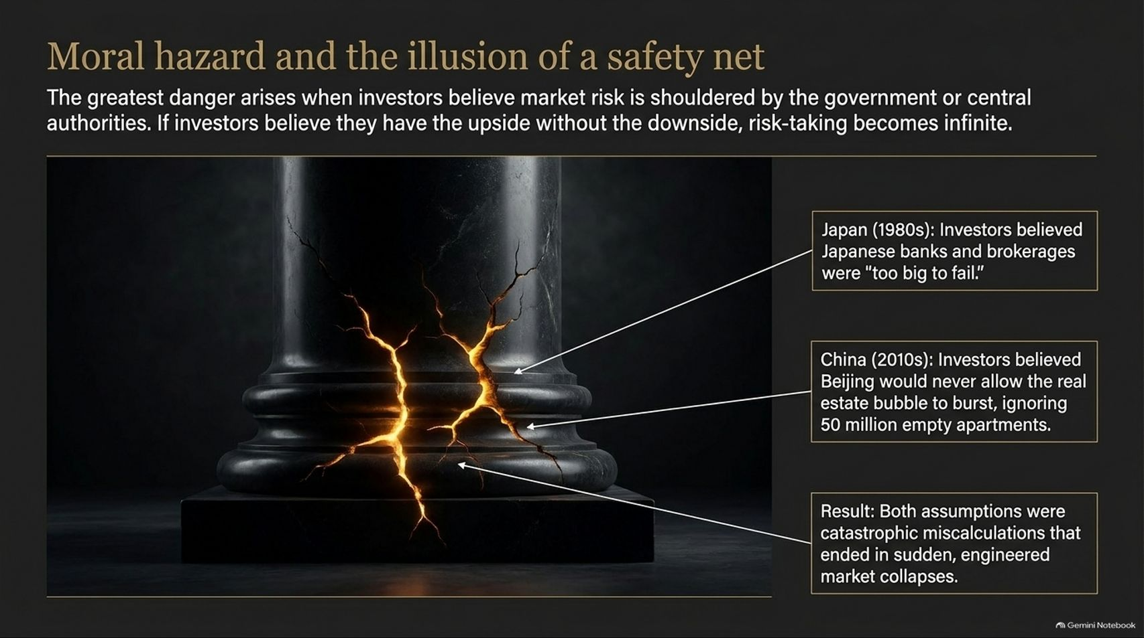
Notes:
Target Timing: 4 – 5 minutes
Tone: Warning, macroeconomic, cautionary
Speaker Script:
"We now turn to one of the most dangerous catalysts in financial history: Moral Hazard.
The greatest speculative excesses do not happen in a vacuum of pure free-market risk. They occur when market participants develop a firm belief that central authorities—whether governments or central banks—will underwrite their downside. When investors believe they have unlimited upside with a guaranteed floor underneath them, risk management disappears and risk-taking becomes infinite.
Consider two historical examples displayed on this slide:
1. Japan in the 1980s: Investors and financial institutions operated under the firm conviction that the Ministry of Finance and Japanese banks were simply 'too big to fail.' Equity and real estate values soared to absurd heights—at one point, the land under the Imperial Palace in Tokyo was valued higher than all the real estate in the state of California. People believed government coordination made a crash impossible.
2. China in the 2010s: For over a decade, domestic and international investors poured capital into Chinese real estate based on the implicit assumption that Beijing would never allow housing prices to decline. They ignored blinding red flags—including an estimated 50 million empty apartments across ghost cities.
The Result? In both cases, the assumption of a permanent government safety net was a catastrophic miscalculation. When the underlying credit structures became unsustainable, both bubbles burst, leading to decades of structural economic drag and balance-sheet stagnation.
Whenever you hear that a government or central bank 'cannot afford to let markets drop,' remember the cracked pillar on this slide. Moral hazard creates a fragile foundation that eventually crumbles."

Slide 8
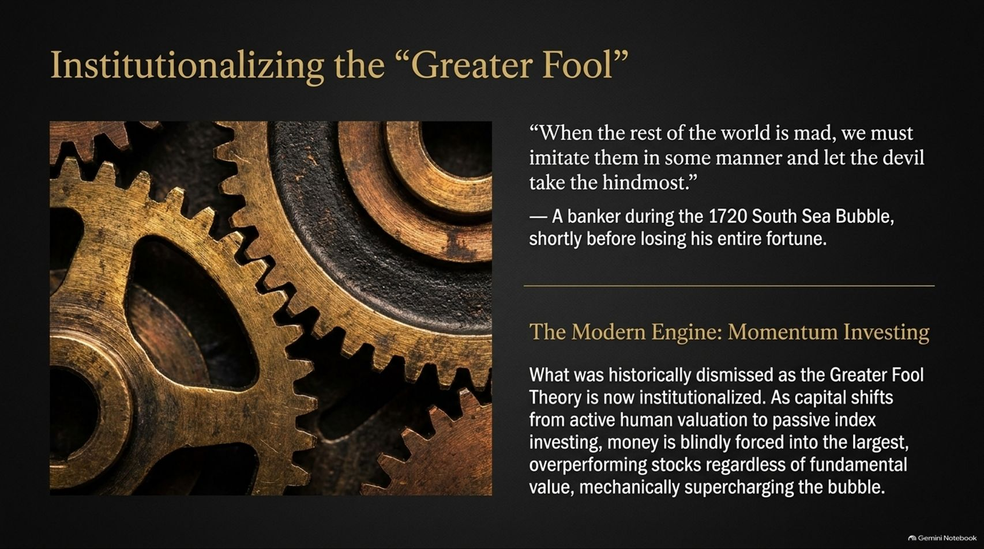
Notes:
Target Timing: 4 – 5 minutes
Tone: Critical, structural, market-mechanics
Speaker Script:
"Historically, the 'Greater Fool Theory' was a derogatory term used to describe naive retail investors who bought overpriced assets hoping an even greater fool would come along and buy them out at a higher price.
Look at the quote on the top right of this slide from a banker during the 1720 South Sea Bubble: 'When the rest of the world is mad, we must imitate them in some manner and let the devil take the hindmost.' That banker knew the market was insane, but he felt forced to participate anyway. He subsequently lost his entire fortune.
What is happening today, however, is even more profound: We have structurally institutionalized the Greater Fool Theory through Momentum Investing and Passive Indexing.
Over the past two decades, trillions of dollars have shifted from active human fund managers—who evaluate balance sheets and price-to-earnings ratios—into passive index funds (like S&P 500 or Nasdaq 100 ETFs).
How does a market-cap weighted index fund allocate capital? It buys stocks strictly in proportion to their market size. The larger and more expensive a stock becomes, the more capital passive index funds are mechanically forced to buy, regardless of whether that company is earning real income or trading at 100 times revenue.
This creates a mechanical feedback loop: money flows into index funds, index funds buy the largest mega-cap tech stocks, their prices rise, their market weighting increases, which forces the next wave of index dollars to buy even more of them.
Modern index investing has converted what used to be irrational individual behavior into a mechanical engine that supercharges speculative momentum."

Slide 9
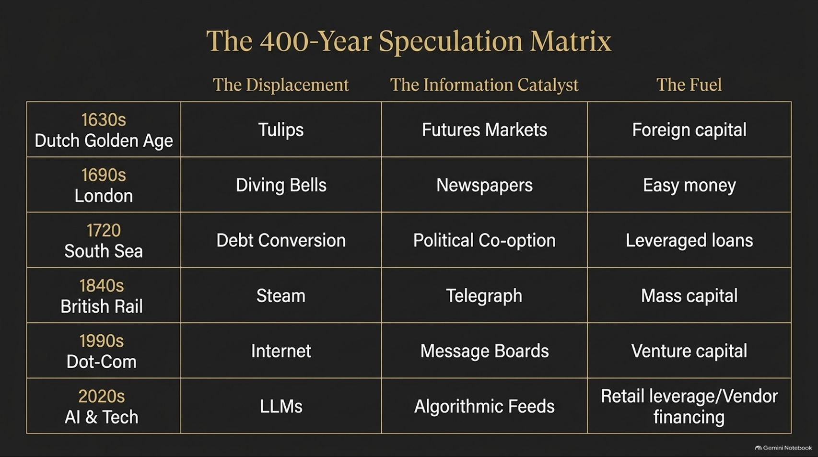
Notes:
Target Timing: 5 – 6 minutes
Tone: Comprehensive, comparative, analytical
Speaker Script:
"To bring all these concepts together, let us examine The 400-Year Speculation Matrix. This table maps the key speculative manias across history along three core structural dimensions: The Displacement (the initial trigger), The Information Catalyst (how the narrative spread), and The Fuel (the financial mechanism driving leverage).
Let's run down the timeline:
1630s Dutch Golden Age: The displacement was exotic rare tulips; the information catalyst was the invention of informal futures markets in taverns; the fuel was an influx of foreign gold and capital into Amsterdam.
1690s London: The displacement was new diving-bell salvage technologies; the catalyst was the birth of financial newspapers; the fuel was easy credit from early joint-stock banks.
1720 South Sea Bubble: The displacement was government debt conversion schemes; the catalyst was political co-option and bribes; the fuel was loans issued by the South Sea Company itself using its own inflated stock as collateral.
1840s British Rail: The displacement was steam power; the catalyst was the electric telegraph; the fuel was mass retail capital participating via low margin deposits ('calls').
1990s Dot-Com: The displacement was the commercialization of the Internet; the catalyst was online message boards and cable financial news; the fuel was abundant venture capital and IPO speculation.
2020s AI & Tech: The displacement is Large Language Models and Generative AI; the catalyst is algorithmic social media feeds and 24/7 news cycles; the fuel is retail leverage, zero-interest legacy capital, and massive corporate vendor financing between tech giants.
Look across these rows: The technology changes, but the matrix structure remains perfectly constant. Every mania requires a compelling spark, an accelerated communication channel, and cheap, leveraged capital to blow the spark into a fire."

Slide 10
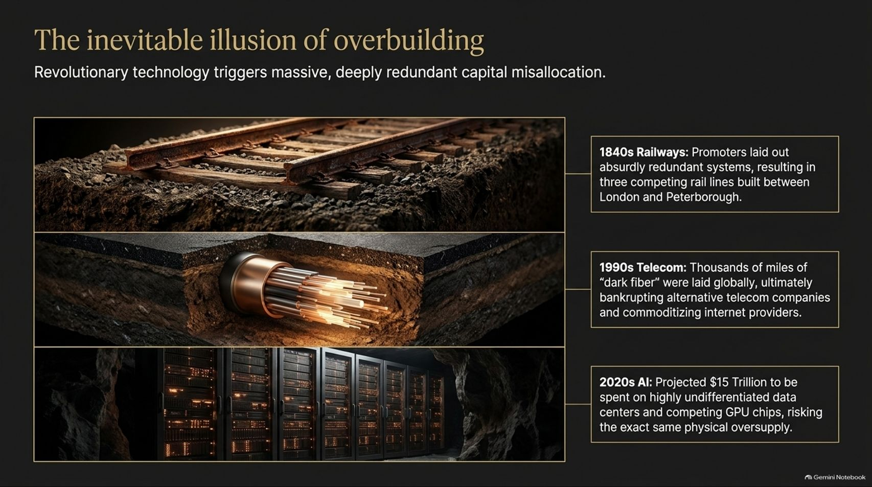
Notes:
Target Timing: 4 – 5 minutes
Tone: Grounded, economic, technological reality-check
Speaker Script:
"One of Edward Chancellor's most crucial insights into technological manias is The Inevitable Illusion of Overbuilding.
When a truly revolutionary technology emerges, it triggers a rush of capital. But because every corporate actor and investor is competing for the same future market share simultaneously, the collective capital committed vastly exceeds what the economy can productively absorb in the short-term. This leads to massive, redundant overbuilding.
Look at the three historical tiers on this slide:
1. 1840s Railways: Promoters laid out absurdly redundant track systems. At the peak of Railway Mania, parliament authorized thousands of miles of redundant routes, including three separate, competing rail lines built concurrently between London and Peterborough. Most rail companies went bankrupt.
2. 1990s Telecom: During the dot-com era, telecom operators spent hundreds of billions laying millions of miles of fiber-optic cable. Over 95% of this cable remained unlit—known as 'dark fiber.' The massive overcapacity bankrupt dozens of telecom giants (like WorldCom and Global Crossing) and commoditized internet data transmission.
3. 2020s AI Data Centers: Today, hyper-scalers and tech companies are projected to spend hundreds of billions—potentially reaching trillions—building specialized data centers and buying GPU chips. Yet, much of this spending is highly undifferentiated and driven by defensive FOMO rather than current end-user revenues.
Here is the grand paradox of technological bubbles: The technology often DOES change the world, but the early investors in its physical buildout almost always lose their shirts. The physical infrastructure gets overbuilt, the bubble bursts, prices collapse, and only then does society build sustainable business models on top of the cheap, overbuilt assets."

Slide 11
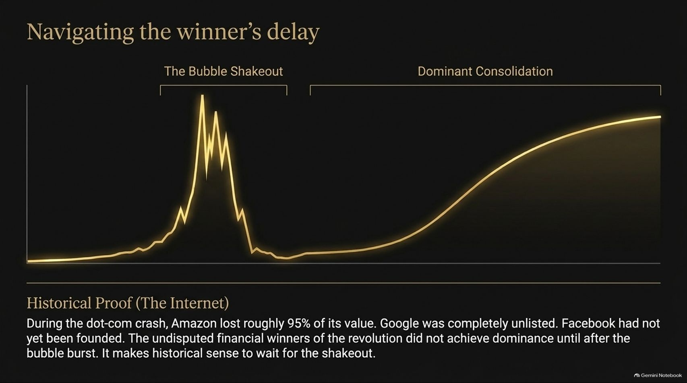
Notes:
Target Timing: 4 – 5 minutes
Tone: Strategic, investment-focused, pragmatic
Speaker Script:
"Building on the idea of overbuilding, let us look at the concept of The Winner's Delay.
Investors often assume that if they correctly identify a revolutionary secular trend—like the Internet in 1995 or AI today—they can simply buy the leading companies in that space and hold them to make vast fortunes. Historical data tells a very different story.
Look at the chart displayed here, which illustrates the classic lifecycle of a technological bubble followed by long-term consolidation:
During the Dot-Com crash of 2000 to 2002:
Amazon—which ultimately became one of the most successful companies in human history—lost 95% of its stock value from its peak.
Google was an unlisted, early-stage private company that hadn't yet gone public.
Meta (Facebook) had not even been founded yet.
The vast majority of market darlings in 1999—companies like Pets.com, Webvan, or Exodus Communications—went completely to zero.
The ultimate financial winners of a technological revolution rarely lead or survive the initial hype cycle unscathed. The real, enduring mega-cap winners emerge after the speculative shakeout, when valuations have collapsed, weak competitors have been liquidated, and real unit economics replace hype.
From a capital allocation standpoint, historical wisdom suggests that you do not need to rush into the initial euphoria. Waiting for the bubble shakeout to clear away the noise and overcapacity is historically the far safer, more profitable strategy."

Slide 12
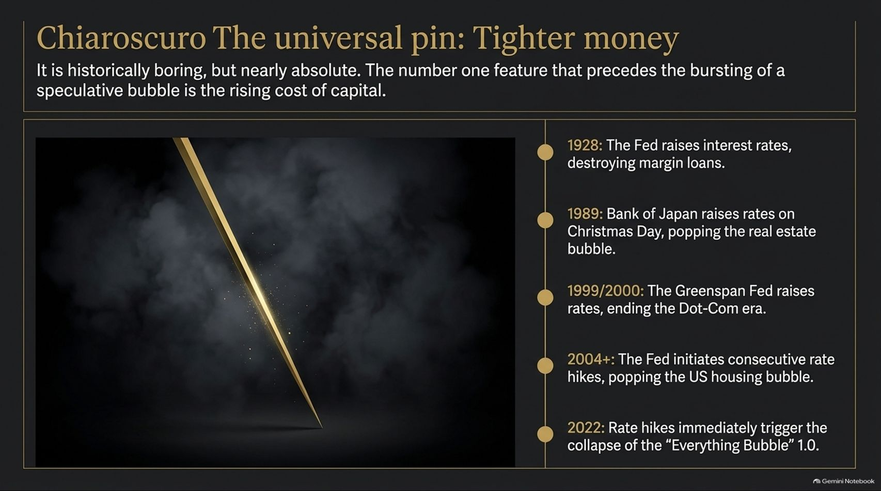
Notes:
Target Timing: 4 – 5 minutes
Tone: Macroeconomic, definitive, sobering
Speaker Script:
"If speculative bubbles are built on cheap credit, narrative energy, and investor optimism, what ultimately pops them?
While every bubble feels like a complex web of unique circumstances, the mechanism that pricks them is historically boring, remarkably simple, and almost absolute: The Rising Cost of Capital.
As Edward Chancellor highlights in The Price of Time, interest rates are the fundamental price of time in a capitalist economy. When central banks artificially depress interest rates, they blow up asset bubbles. When interest rates rise and credit tightens, the speculative pin strikes.
Look at the historical record listed on this slide:
1928: The Federal Reserve raised interest rates to curb stock market speculation, drying up the margin loans that funded retail buying. The crash of October 1929 followed shortly after.
1989: The Bank of Japan initiated aggressive rate hikes on Christmas Day, popping the massive Japanese asset and real estate bubble overnight.
1999/2000: Alan Greenspan's Federal Reserve raised interest rates six times, raising borrowing costs and pulling the rug out from under unprofitable tech startups.
2004–2006: The Fed initiated a cycle of 17 consecutive rate hikes, increasing the federal funds rate from 1% to 5.25%, which triggered the collapse of subprime mortgage resets and the 2008 Global Financial Crisis.
2022: The fastest interest rate tightening cycle in 40 years immediately triggered a sharp downturn across crypto, unprofitable tech, and highly leveraged venture portfolios.
You cannot sustain high valuations when borrowing money becomes expensive. Tighter money is the ultimate pin that brings financial gravity back to markets."

Slide 13
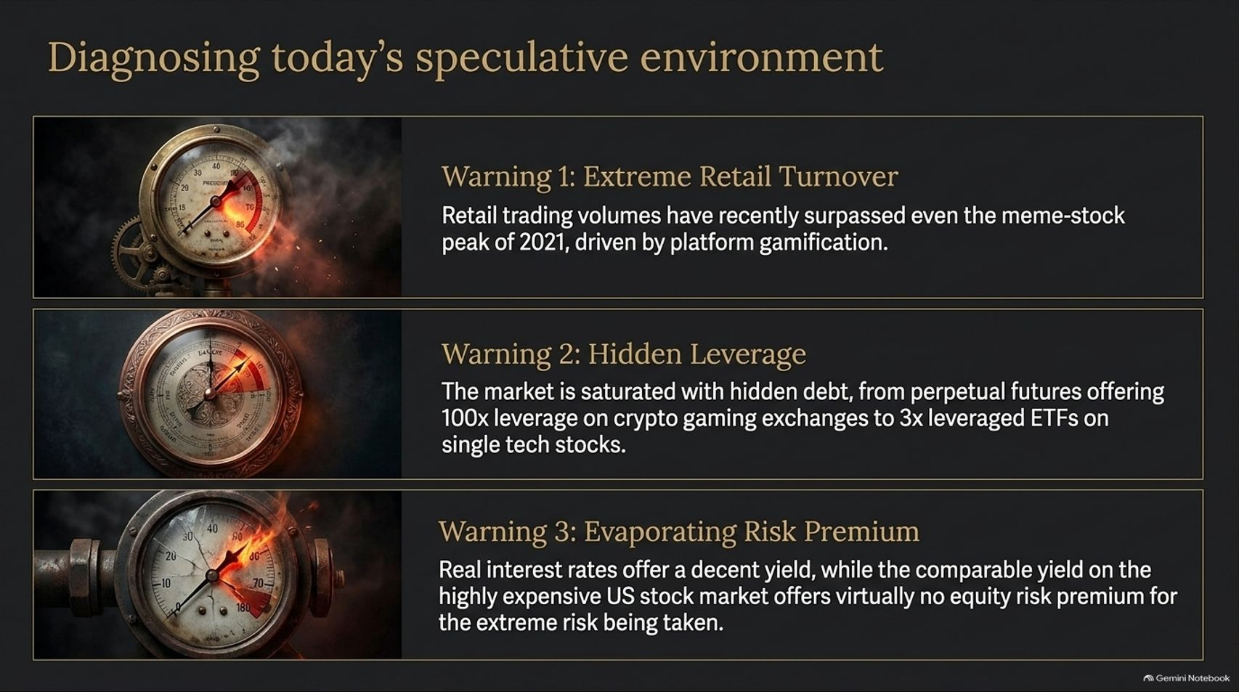
Notes:
Target Timing: 4 – 6 minutes
Tone: Diagnostic, urgent, empirical
Speaker Script:
"Now let us bring all these historical lessons straight into the present moment and diagnose today's speculative environment. Are we seeing the warning signs of a bubble today?
Let us look at three quantitative pressure gauges currently flashing red:
Warning 1: Extreme Retail Turnover.
Retail trading volumes have recently reached levels that surpass even the meme-stock peak of 2021. Driven by mobile app gamification, zero-commission options, and short-dated zero-days-to-expiration (0DTE) contracts, financial trading for a vast segment of the population has transitioned from investment into pure short-term gambling.
Warning 2: Hidden & Off-Balance-Sheet Leverage.
While traditional margin debt looks moderate on paper, the financial system is saturated with opaque leverage. We see offshore crypto exchanges offering 100x leverage on perpetual futures, complex retail derivative products, and 3x single-stock leveraged ETFs tracking individual volatile tech stocks. Furthermore, corporate vendor financing—where large tech giants invest in AI startups which are then contractually obligated to spend that capital buying chips back from the investor—is creating circular revenue loops reminiscent of the late 1990s.
Warning 3: Evaporating Equity Risk Premium.
Today, risk-free real interest rates on government bonds offer a respectable real return. Yet, the price-to-earnings ratios on major US tech indices are so elevated that the Equity Risk Premium—the excess return an investor receives for holding risky equities instead of safe bonds—has evaporated to near-zero, and in some cases, turned negative.
Investors are taking on historically extreme concentration risk while receiving virtually no risk premium in return."

Slide 14
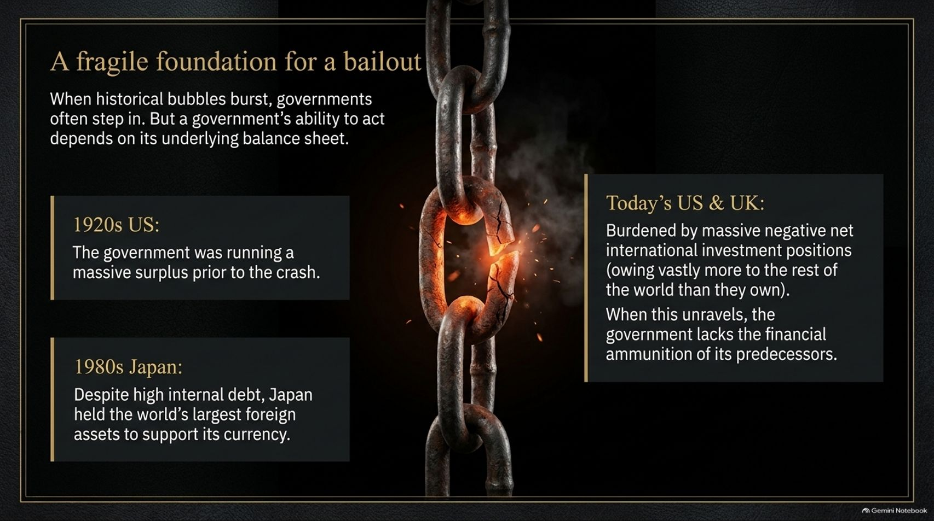
Notes:
Target Timing: 4 – 5 minutes
Tone: Macro-fiscal, solemn, risk-focused
Speaker Script:
"When bubbles burst historically, private investors and financial institutions look to one place for salvation: government bailouts and central bank interventions. But a government’s capacity to cushion a market crash depends entirely on its own underlying balance sheet.
Look at how today’s macroeconomic setup differs dangerously from past crises:
In the 1920s US: Prior to the 1929 crash, the US federal government was running massive budget surpluses and had a very low national debt ratio. It had tremendous fiscal headroom.
In the 1980s Japan: Although Japanese domestic debt was high, Japan was the world’s largest net creditor nation, holding vast overseas foreign reserves that could be repatriated to support its financial sector.
Now look at Today’s US and UK fiscal realities:
Major Western nations are burdened by record public debt levels exceeding 100% of GDP, massive ongoing peacetime fiscal deficits, and severely negative Net International Investment Positions (NIIP)—meaning these nations owe vastly more assets to foreign creditors than they own abroad.
What does this mean for the next market unwinding? It means governments and central banks are severely constrained. If they attempt to print money and issue massive public debt to fund corporate or market bailouts today, they risk accelerating currency debasement, reigniting inflation, and triggering sovereign bond market instability.
The safety net that investors took for granted in 2008 and 2020 is far more fragile today."

Slide 15

Notes:
Target Timing: 4 – 5 minutes
Tone: Constructive, advisory, philosophical
Speaker Script:
"Having diagnosed the risks, what is the path forward for thoughtful capital allocation? What is the antidote to modern speculative manias?
The answer lies in stepping away from the gravitational pull of passive index momentum and returning to active, disciplined, human valuation.
As passive index funds blindly funnel capital into whatever stocks are already the largest and most expensive, they create profound market dislocations. They artificially inflate overvalued market leaders while completely neglecting unloved, cash-generative, value-oriented sectors of the real economy.
This dislocation creates an extraordinary opportunity for the disciplined, long-term investor.
Look at the timeless quote on this slide from Sir Richard Steele, written in the 1690s during the dawn of financial speculation:
'Nothing could be more useful than to be well instructed in man’s hopes and fears: to be diffident when others exalt, and with a secret joy, buy when others think it’s in their interest to sell.'
To navigate today's markets, we must reclaim the discipline of true value investing:
Insisting on a genuine margin of safety.
Focusing on real, tangible cash flows rather than long-horizon hype narratives.
Having the psychological courage to be a contrarian—refusing to buy into over-concentrated themes simply because they are going up today."

Slide 16
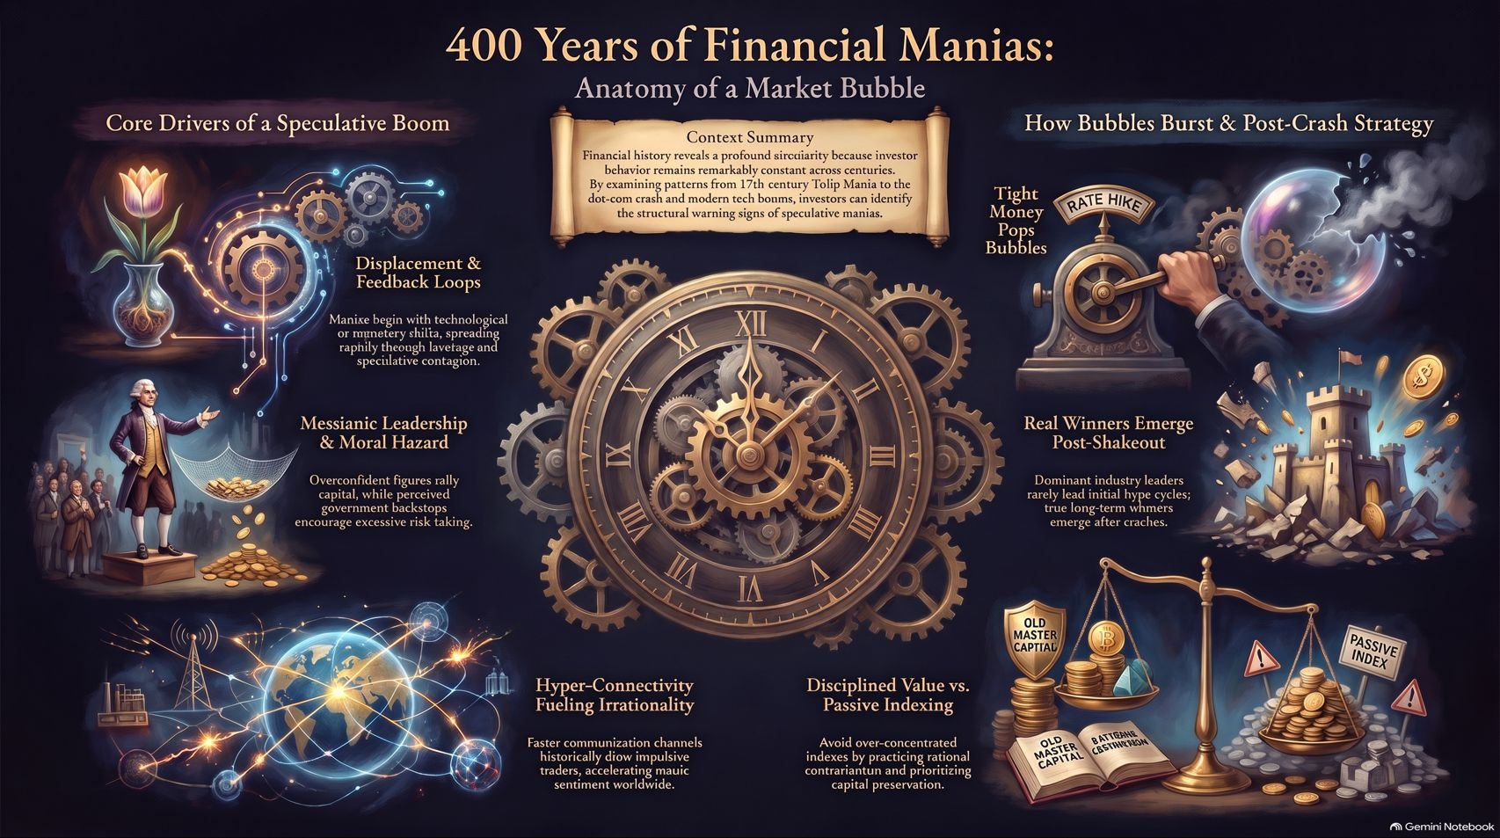
Notes:
Target Timing: 4 – 6 minutes
Tone: Summary, synthesis, powerful closing
Speaker Script:
"To conclude our presentation today, let us look at this comprehensive visual summary that synthesizes our 400-year journey into one unified framework: The Anatomy of a Market Bubble.
If you take away only three core lessons from today’s talk, let them be these:
First: Core Drivers of a Speculative Boom.
Every bubble in history starts with a real displacement—a exciting tech innovation or monetary shift—that gets amplified by speculative contagion, messianic leadership, and cheap credit. Hyper-connectivity and fast information channels do not make markets smarter; they accelerate irrational herd behavior.
Second: How Bubbles Burst.
Rising interest rates and tighter monetary policy remain the universal pin. When capital is repriced, the illusion of overbuilding is exposed. But remember: the real, dominant long-term winners of any industrial revolution rarely lead the hype cycle—they emerge stronger after the speculative shakeout has cleared away overcapacity.
Third: Disciplined Value vs. Passive Indexing.
In an era where passive indexation blindly forces money into over-concentrated speculative themes, true capital preservation requires a return to active valuation, rational contrarianism, and patience.
Financial history is not a dusty record of the past; it is a mirror reflecting human nature. By understanding the structural mechanics of yesterday's manias, we protect our capital today and position ourselves for true, long-term wealth creation tomorrow.
Thank you very much for your time and attention. I would now be glad to open the floor to any questions."

