Slide 1
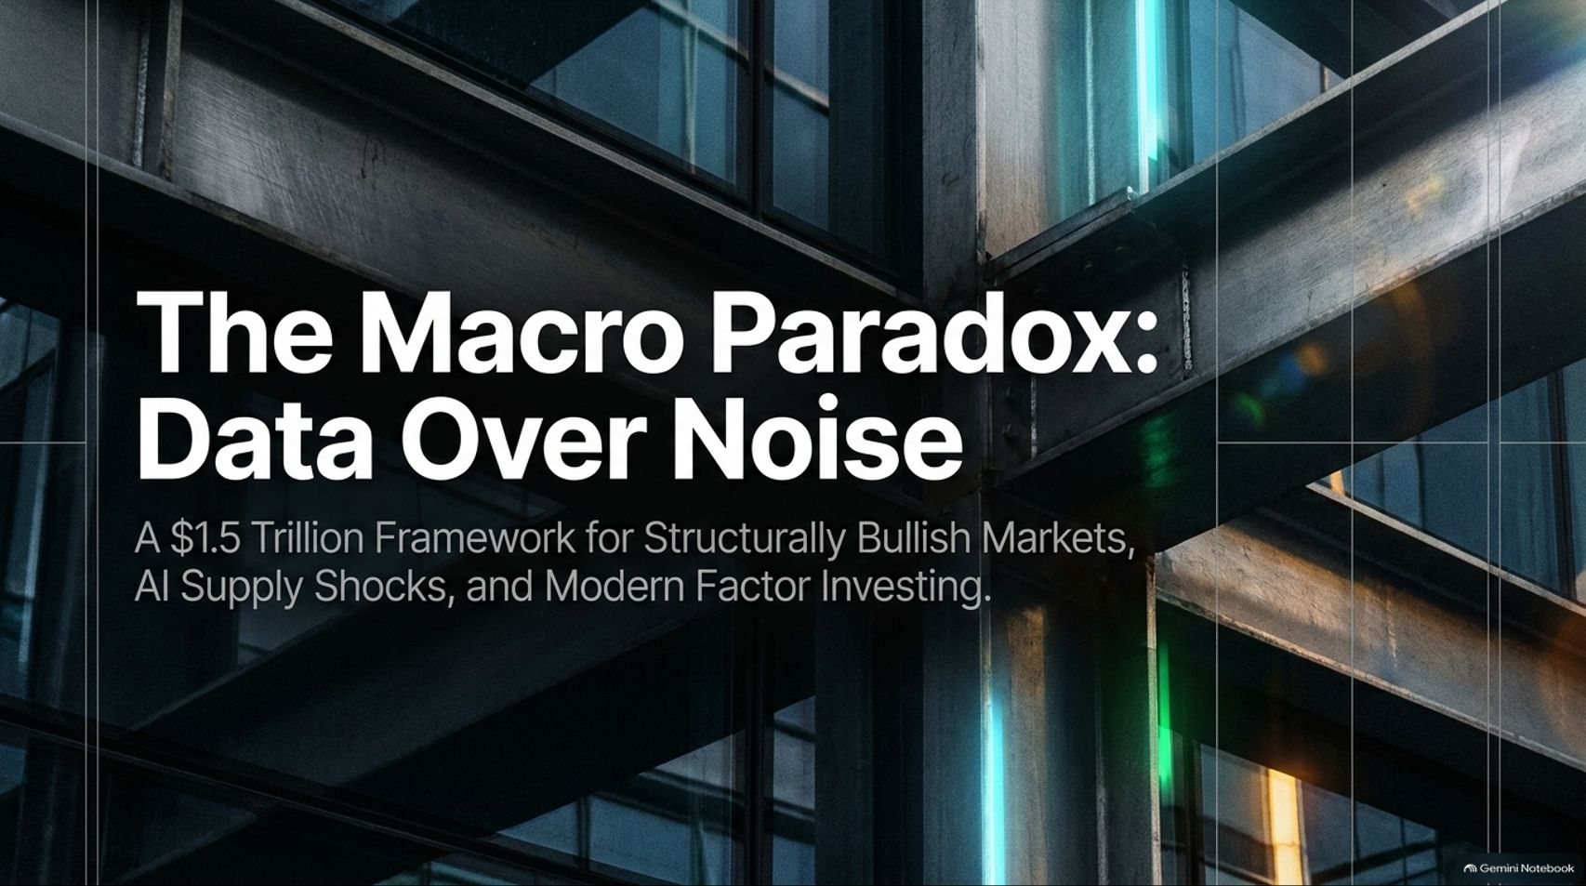
Notes:
Target Timing: 3 – 4 minutes
Tone: Authoritative, professional, forward-looking
Speaker Script:
"Good morning, everyone. Welcome to today's session. We are living through a unique and fascinating period in financial markets—one defined by constant headline turbulence, shifting central bank policies, and the monumental technological wave of artificial intelligence.
Our deck today is titled: 'The Macro Paradox: Data Over Noise—A $1.5 Trillion Framework for Structurally Bullish Markets, AI Supply Shocks, and Modern Factor Investing.'
Throughout this presentation, we will draw directly from institutional insights—including perspectives shared by Mike Hunstad, President of Northern Trust Asset Management, which oversees more than $1.5 trillion in assets. We will explore why the day-to-day market anxiety captured by the financial news media frequently contradicts the robust underlying reality of the real economy.
We will examine why the US economy is experiencing an unprecedented wealth effect, how Artificial Intelligence is functioning as the largest positive supply shock in modern economic history, and how quantitative factor investing has evolved beyond rudimentary metrics like Price-to-Book. By the end of our time together, you will have a clear, data-driven framework to separate actionable economic signals from transient headline noise."
This $1.5 Trillion Manager Expects More Fed Hikes. So Why Is He Still Bullish?
https://www.youtube.com/watch?v=W1a8QjNG8Nc

Slide 2
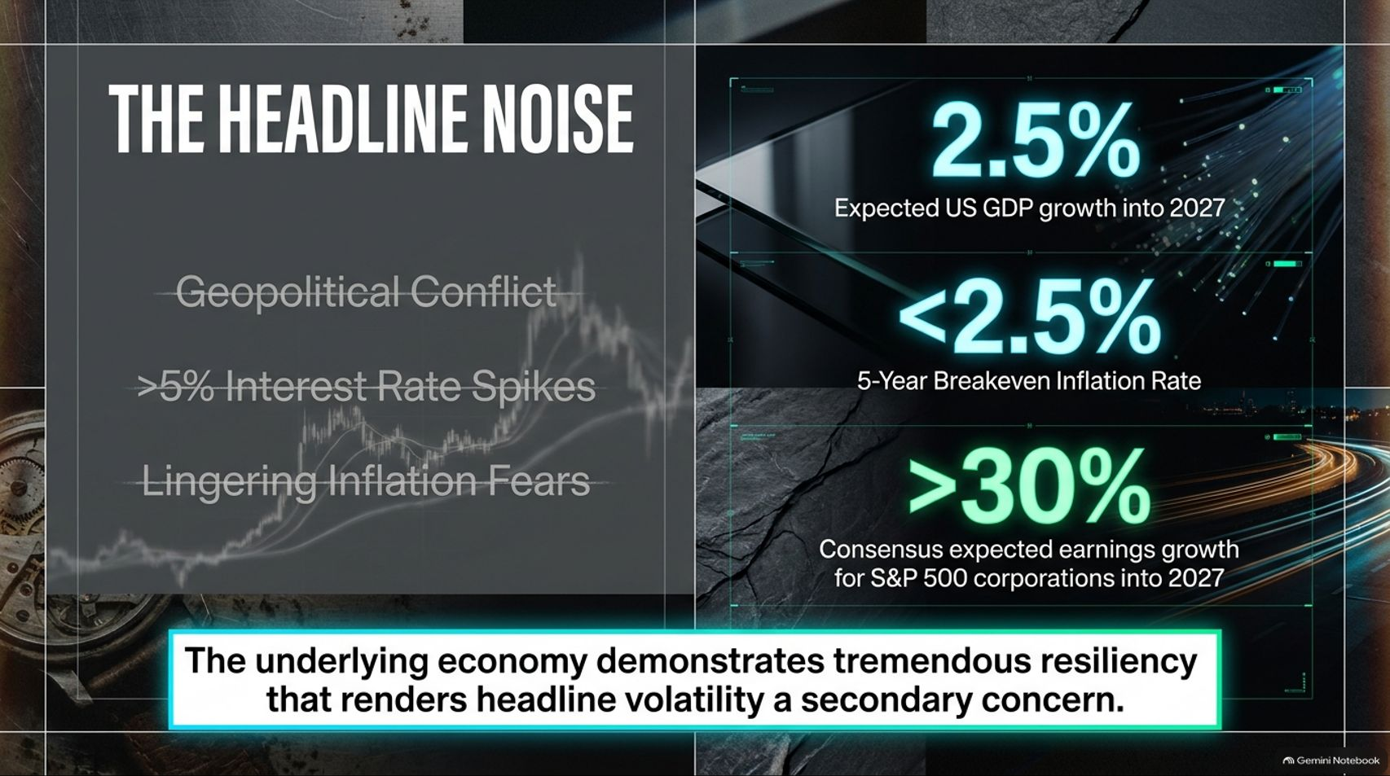
Notes:
Target Timing: 3 – 5 minutes
Tone: Analytical, contrasting, reassuring
Speaker Script:
"Let’s start by addressing the glaring disconnect in today’s financial landscape. If you turn on the news or read financial headlines on any given day, what do you see? Geopolitical tensions, conflicts in the Middle East, persistent fears about sticky inflation, and interest rate spikes hovering above 5%. It sounds like an environment primed for a bear market.
But when you step back from the emotional noise and look strictly at the hard data, a completely different picture emerges.
Look at the core economic metrics displayed on this slide:
Expected US GDP growth heading into 2027 is projected at a resilient 2.5%.
5-Year Breakeven Inflation Rates, despite near-term volatility, remain anchored below 2.5%.
Most importantly, when we look at corporate America, consensus expected earnings growth for S&P 500 corporations into 2027 stands at over 30%.
As Mike Hunstad points out, 'The market from a data perspective is saying one thing, while the headline narrative is saying something else.' This divergence highlights the tremendous underlying resilience of the US economy, rendering headline volatility a secondary concern for long-term investors."

Slide 3
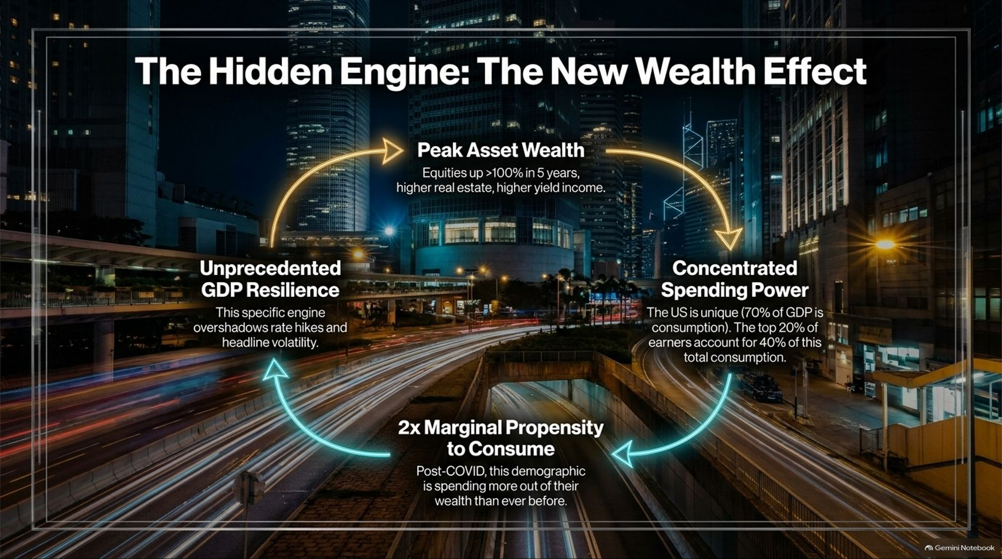
Notes:
Target Timing: 4 – 5 minutes
Tone: Explanatory, macroeconomic, structural
Speaker Script:
"What is actually driving this remarkable market resilience despite high interest rates and constant geopolitical anxiety? The answer lies in The Hidden Engine: The New Wealth Effect.
To understand the US economy, you have to understand its unique structural composition. Globally, consumption makes up roughly 60% of developed market GDP. But in the United States, consumption accounts for approximately 70% of total GDP. As long as American consumers keep spending, the US economy keeps moving forward.
But let’s dive deeper into who is doing the spending. Wealth in America is highly concentrated: The top 20% of wealthiest households account for roughly 40% of total US consumption.
Over the last several years, this demographic has experienced unprecedented wealth accumulation. With equity markets delivering double-digit returns over a multi-year period (up over 100% across a five-year horizon), coupled with higher real estate values and elevated interest income, this segment is wealthier than ever before. Furthermore, post-COVID data shows that their marginal propensity to consume out of that wealth has more than doubled.
Put simply: your biggest spenders have never been wealthier, and they are spending more out of that wealth than ever before. That is the massive fuel tank propelling the US economy forward."

Slide 4
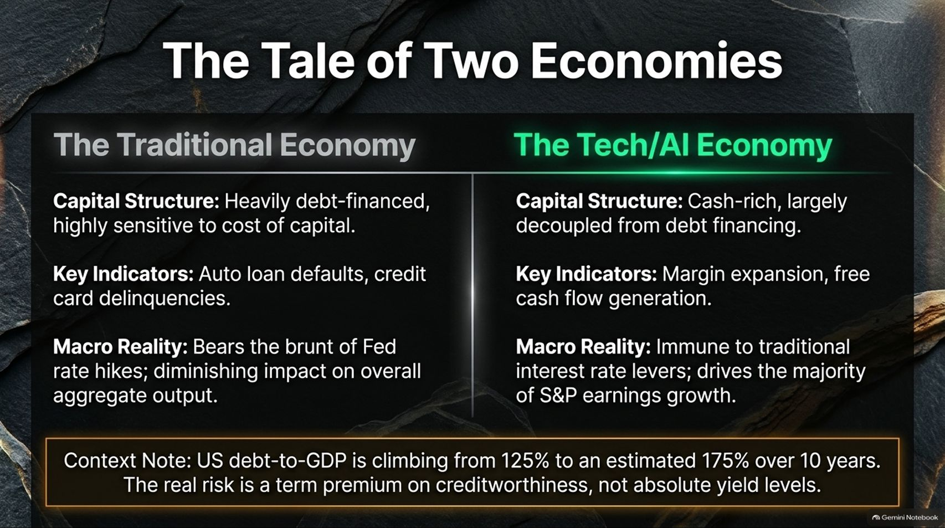
Notes:
Target Timing: 4 – 5 minutes
Tone: Comparative, structural, insightful
Speaker Script:
"When analyzing today's economic environment, it is a mistake to view the market as a monolith. In reality, we are witnessing The Tale of Two Economies.
On the left, we have The Traditional Economy. This sector—comprising smaller businesses, consumer retail, and debt-reliant industries—is heavily debt-financed and highly sensitive to the cost of capital. It bears the absolute brunt of Federal Reserve rate hikes. When analysts look at traditional leading indicators like auto loan defaults, credit card delinquencies, and mortgage stress, they are looking at this traditional economy.
On the right, we have The Tech and AI Economy. This sector is cash-rich, boasts some of the most robust balance sheets in corporate history, and is largely decoupled from debt financing. Key indicators here are margin expansion and free cash flow generation. Because these tech giants do not rely on debt to fund operations, they are largely immune to traditional interest rate levers.
At the same time, national debt levels are climbing—projected to rise from 125% of GDP toward 175% over the coming decade. As Mike Hunstad notes, the real macro risk going forward is not absolute interest rate levels, but rather the term premium associated with sovereign creditworthiness."

Slide 5
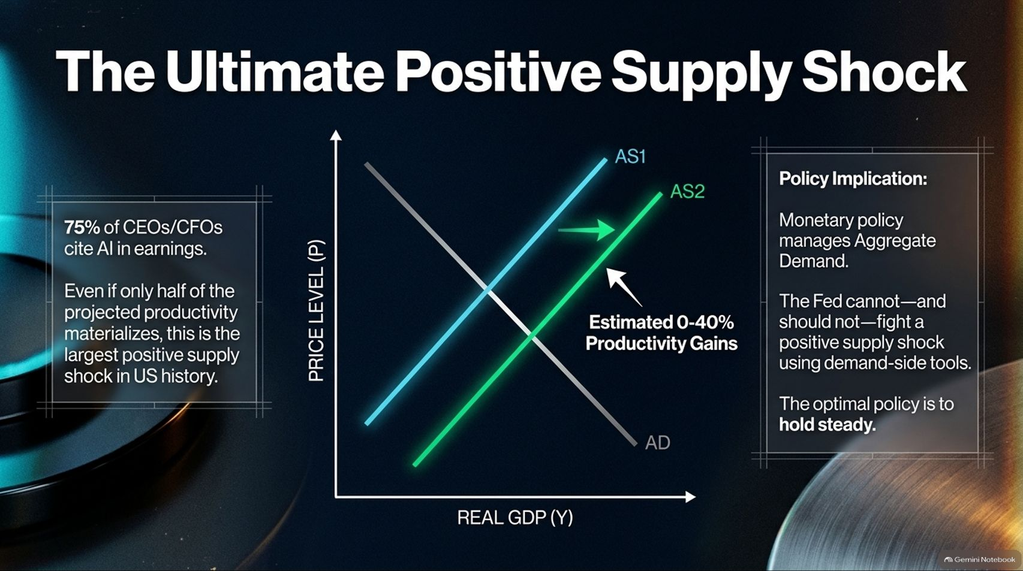
Notes:
Target Timing: 4 – 6 minutes
Tone: Theoretical, policy-focused, analytical
Speaker Script:
"Let's turn to the elephant in the room: Artificial Intelligence. While mainstream commentary often focuses on equity valuations or near-term hype, from a macroeconomic perspective, AI represents The Ultimate Positive Supply Shock.
Look at the supply-and-demand graph on this slide. When a technological innovation fundamentally enhances productivity, it shifts the Aggregate Supply curve outward from AS1 to AS2.
Consider the data: roughly 75% of CEOs and CFOs now cite AI in their earnings calls. Even if we discount those projections heavily and assume only half of the estimated productivity gains materialize—which range from conservative estimates up to 40%—this stands as the largest positive supply shock in US economic history.
This creates a fascinating dilemma for central bankers. Traditional monetary policy is designed exclusively to manage Aggregate Demand (shifting the AD curve). As Mike Hunstad emphasizes, the Federal Reserve cannot—and should not—try to fight a positive supply shock using demand-side tools. Trying to offset productivity-driven supply expansion with tighter monetary policy is counterproductive. The optimal policy response to a massive positive supply shock is simply to hold steady."

Slide 6
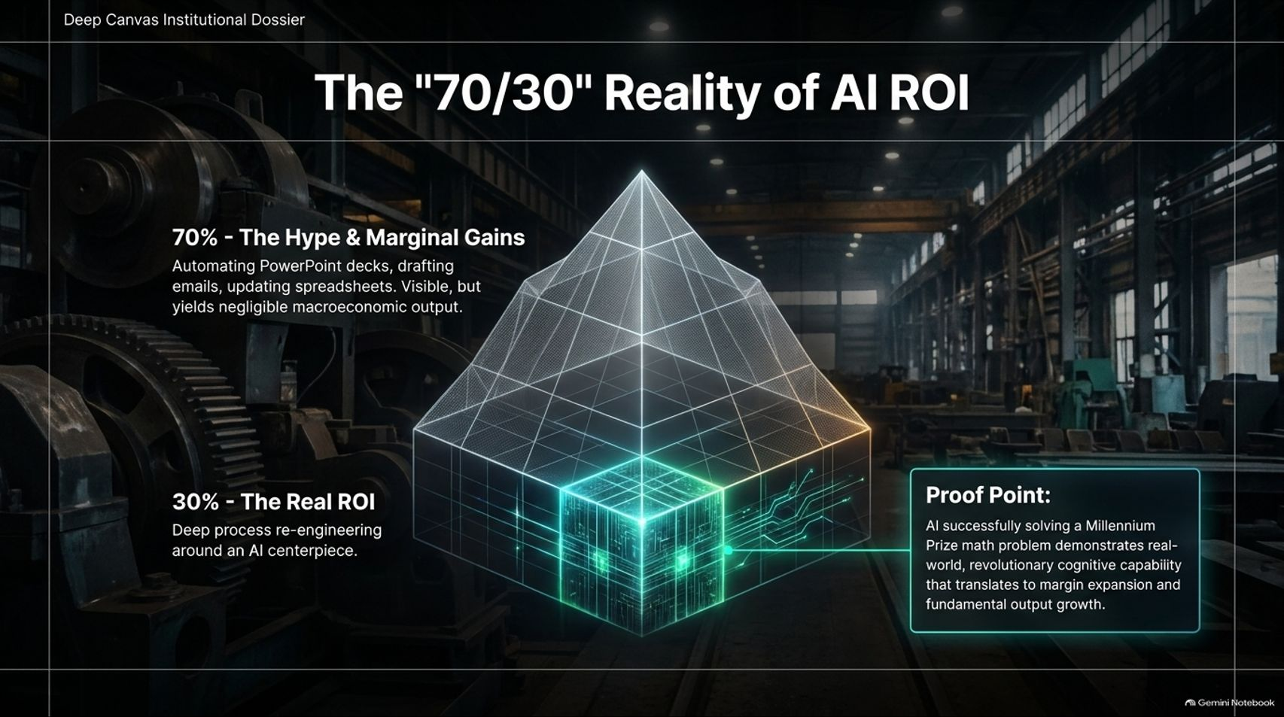
Notes:
Target Timing: 3 – 5 minutes
Tone: Pragmatic, realistic, deep-dive
Speaker Script:
"As investors, how should we evaluate the return on investment (ROI) on the massive amounts of capital flowing into artificial intelligence? We can break market activity down into what we call The '70/30' Reality of AI ROI.
70% of current AI projects represent hype and marginal gains. These are surface-level applications—such as automating PowerPoint decks, drafting routine emails, or tidying up spreadsheets. While visually appealing and convenient, these marginal tasks yield negligible macroeconomic output.
30% of AI activity represents the true, transformative ROI. This involves deep process re-engineering around an AI centerpiece. It is not about doing existing tasks slightly faster; it is about completely rethinking business workflows, software architecture, and scientific research.
As evidence of this true cognitive capability, consider real-world milestones where AI has successfully resolved complex Millennium Prize math problems (administered by the Clay Mathematics Institute). That is not marketing hype; that is revolutionary cognitive capability that translates directly into long-term margin expansion and fundamental output growth."

Slide 7
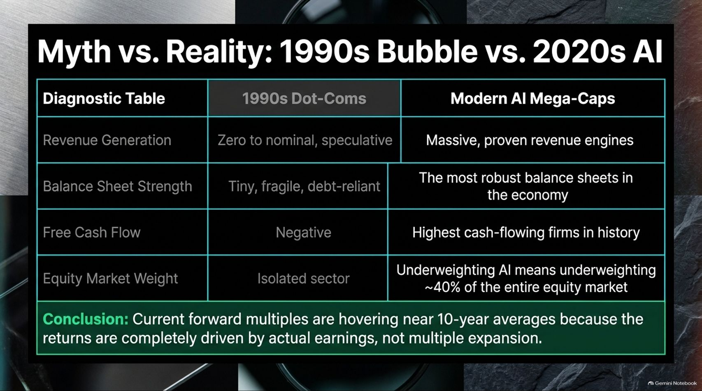
Notes:
Target Timing: 4 – 5 minutes
Tone: Comparative, analytical, debunking
Speaker Script:
"Skeptics frequently draw parallels between today’s AI-driven market and the dot-com bubble of the late 1990s. But when you look under the hood, the diagnostic reality reveals that these two eras are entirely different.
Let’s compare them across four key pillars:
Revenue Generation: In the 1990s dot-com era, revenue was zero to nominal and purely speculative. Today’s AI mega-caps feature massive, proven revenue engines.
Balance Sheet Strength: 90s dot-coms had tiny, fragile, debt-reliant balance sheets. Today’s tech leaders possess some of the most robust, cash-heavy balance sheets in economic history.
Free Cash Flow: Dot-com startups operated with deep negative cash flows. Today’s AI leaders generate the highest cash flows of any firms ever recorded.
Equity Market Weight: In the 1990s, tech speculation was largely an isolated sector. Today, AI and related technology companies account for roughly 40% of the entire equity market. Underweighting AI means effectively underweighting nearly half of the global opportunity set.
Because returns are driven by actual earnings rather than speculative multiple expansion, current forward multiples are hovering right around their 10-year averages."

Slide 8
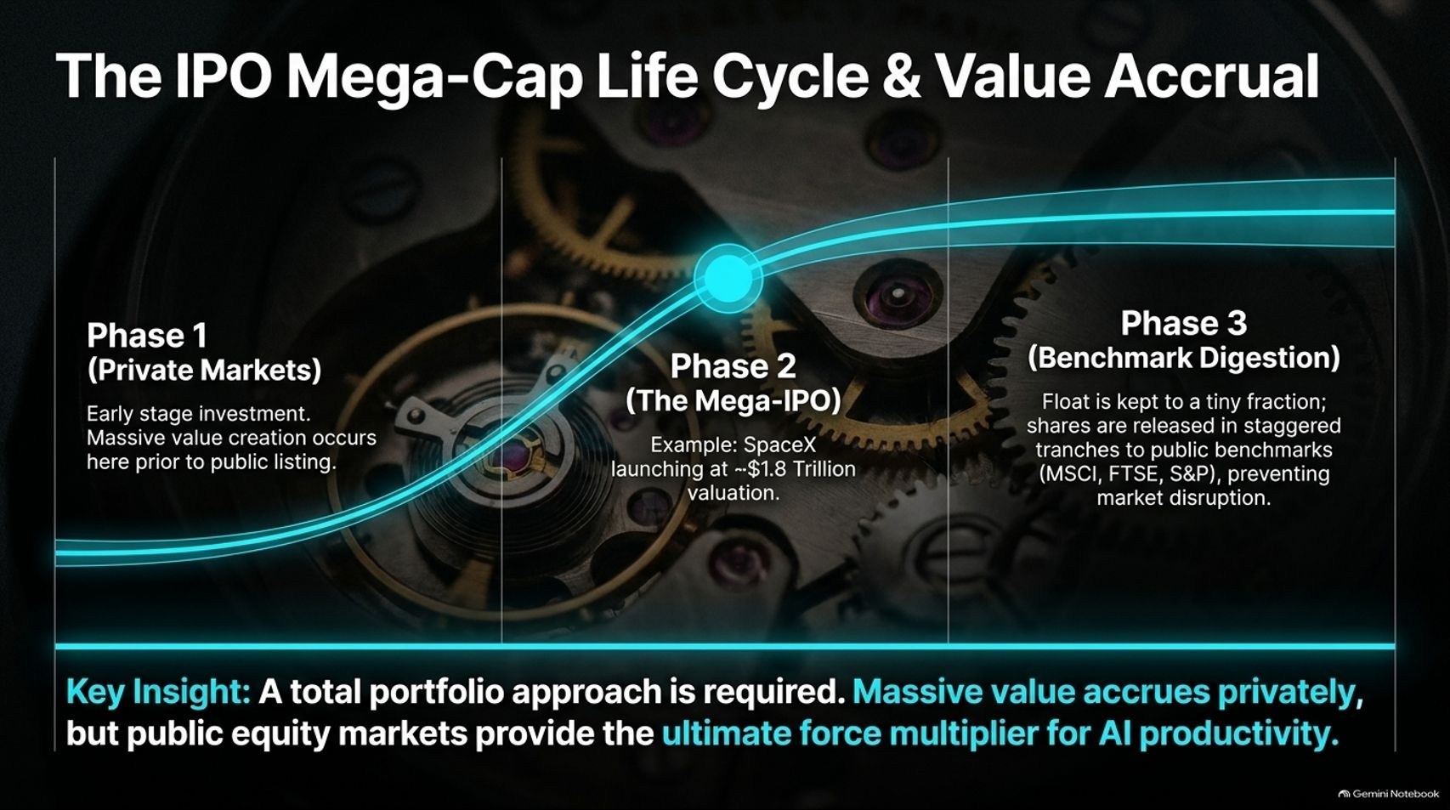
Notes:
Target Timing: 3 – 5 minutes
Tone: Strategic, portfolio-oriented, insightful
Speaker Script:
"Another major topic of discussion in modern markets is the changing nature of equity supply, particularly massive private companies approaching public markets—such as SpaceX launching public tranches at valuations near $1.8 trillion. To understand this, we must examine The IPO Mega-Cap Life Cycle.
Phase 1 (Private Markets): Early-stage investment and massive value creation occur long before a company ever lists publicly.
Phase 2 (The Mega-IPO): The company debuts on public exchanges at an already staggering multi-trillion-dollar valuation.
Phase 3 (Benchmark Digestion): To prevent severe market disruption, the public float is initially kept to a tiny fraction, with shares released in staggered tranches into major benchmarks like MSCI, FTSE, and S&P.
The Key Insight: A total portfolio approach is required today. While a substantial portion of modern value accrues privately before public listing, public equity markets remain the ultimate force multiplier for deploying AI productivity at a global scale."

Slide 9
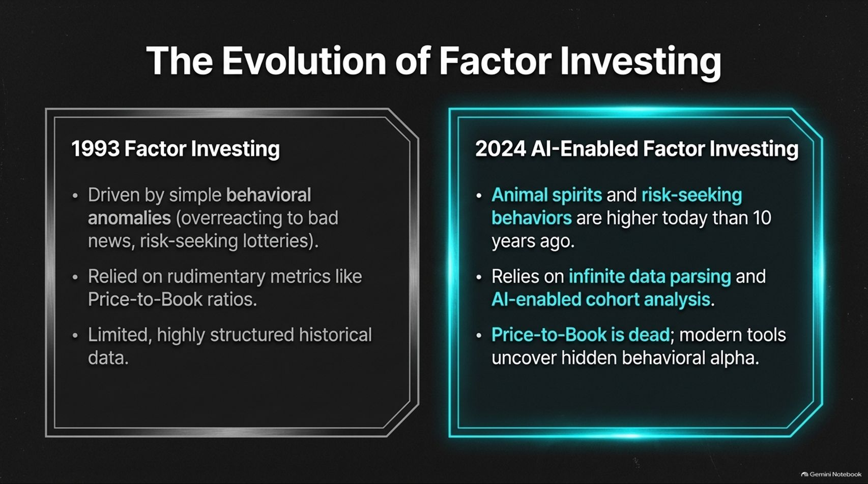
Notes:
Target Timing: 3 – 5 minutes
Tone: Evolutionary, quantitative, educational
Speaker Script:
"As a quantitative discipline, factor investing has undergone a radical transformation over the past three decades. Let’s look at The Evolution of Factor Investing.
Back in 1993, traditional factor investing—pioneered by academics like Fama and French—was driven by simple behavioral anomalies, such as investors overreacting to bad news or chasing lottery-like volatility. It relied on rudimentary, static accounting metrics like Price-to-Book ratios, working within highly structured and limited historical datasets.
Fast forward to 2024 and beyond, and the landscape is entirely different. Animal spirits and risk-seeking behaviors in modern markets are higher than they were a decade ago. Modern factor investing relies on infinite data parsing, Natural Language Processing (NLP), and AI-enabled cohort analysis.
As Mike Hunstad points out: 'Price-to-Book is dead.' Traditional single-metric sorting no longer captures market reality; modern quantitative tools uncover hidden behavioral alpha that legacy models completely miss."

Slide 10
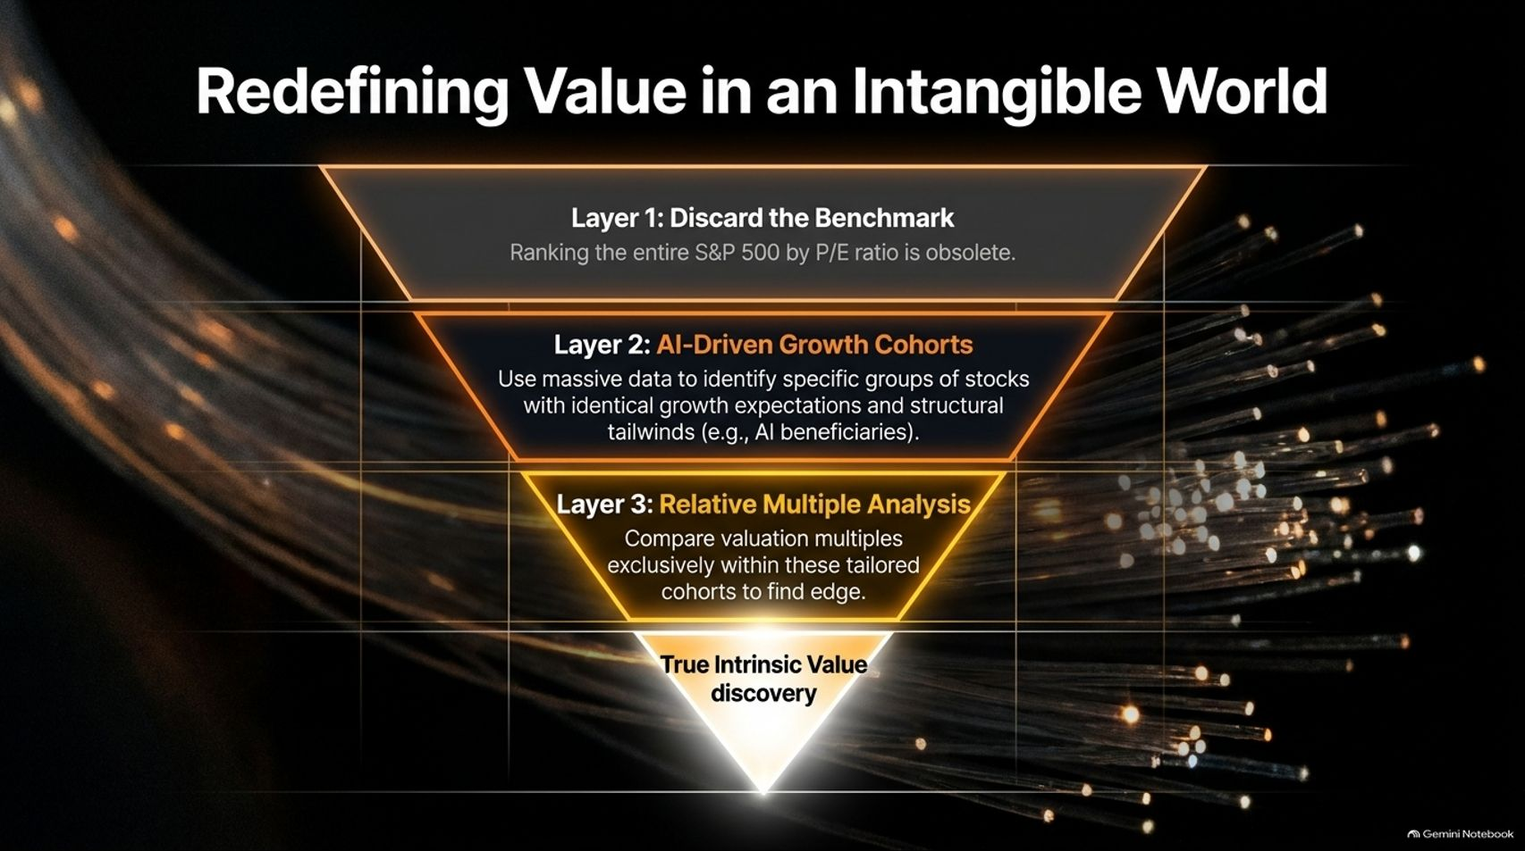
Notes:
Target Timing: 4 – 5 minutes
Tone: Instructional, methodological, forward-looking
Speaker Script:
"Because modern corporate balance sheets are dominated by intangible assets—such as software, intellectual property, algorithms, and brand equity—traditional value investing metrics have broken down. This slide outlines our framework for Redefining Value in an Intangible World using a three-layer funnel:
Layer 1: Discard the Benchmark. Ranking the entire S&P 500 index by a blunt P/E ratio is fundamentally obsolete. A traditional bank and an AI semiconductor designer cannot be evaluated on the same simplistic multiple.
Layer 2: AI-Driven Growth Cohorts. We utilize massive datasets and NLP tools to identify specific groups of stocks sharing identical growth expectations and structural tailwinds—such as distinct AI supply chain beneficiaries.
Layer 3: Relative Multiple Analysis. Once these tailored cohorts are established, we conduct valuation multiple comparisons exclusively within those peer groups to discover true market edge.
By moving away from blunt index-wide sorting, this methodology allows us to uncover true intrinsic value discovery in an economy driven by intangible assets."

Slide 11

Notes:
Target Timing: 4 – 5 minutes
Tone: Analytical, technical, innovative
Speaker Script:
"Let’s look at how quantitative momentum has similarly evolved.
The Old Way of measuring momentum was simplistic: the classic '12 minus 1' model, which tracks a stock's past 12-month price movement while skipping the most recent month. While popular, this crude price-tracking method is notoriously prone to severe, violent momentum crashes when market sentiment reverses.
The Modern Edge utilizes Natural Language Processing (NLP) to map business relationships across millions of documents, transcripts, and global languages. Instead of treating a target company in isolation, NLP maps its entire ecosystem: its suppliers, its customers, its peers, and its regulators.
The Core Takeaway: Supply chain and network relationships persist. If a company’s primary customers are thriving, they pull the target company along, which in turn pulls its suppliers. Momentum operating within these fundamental networks persists over time and provides natural insulation against the classic, destructive momentum crash."

Slide 12
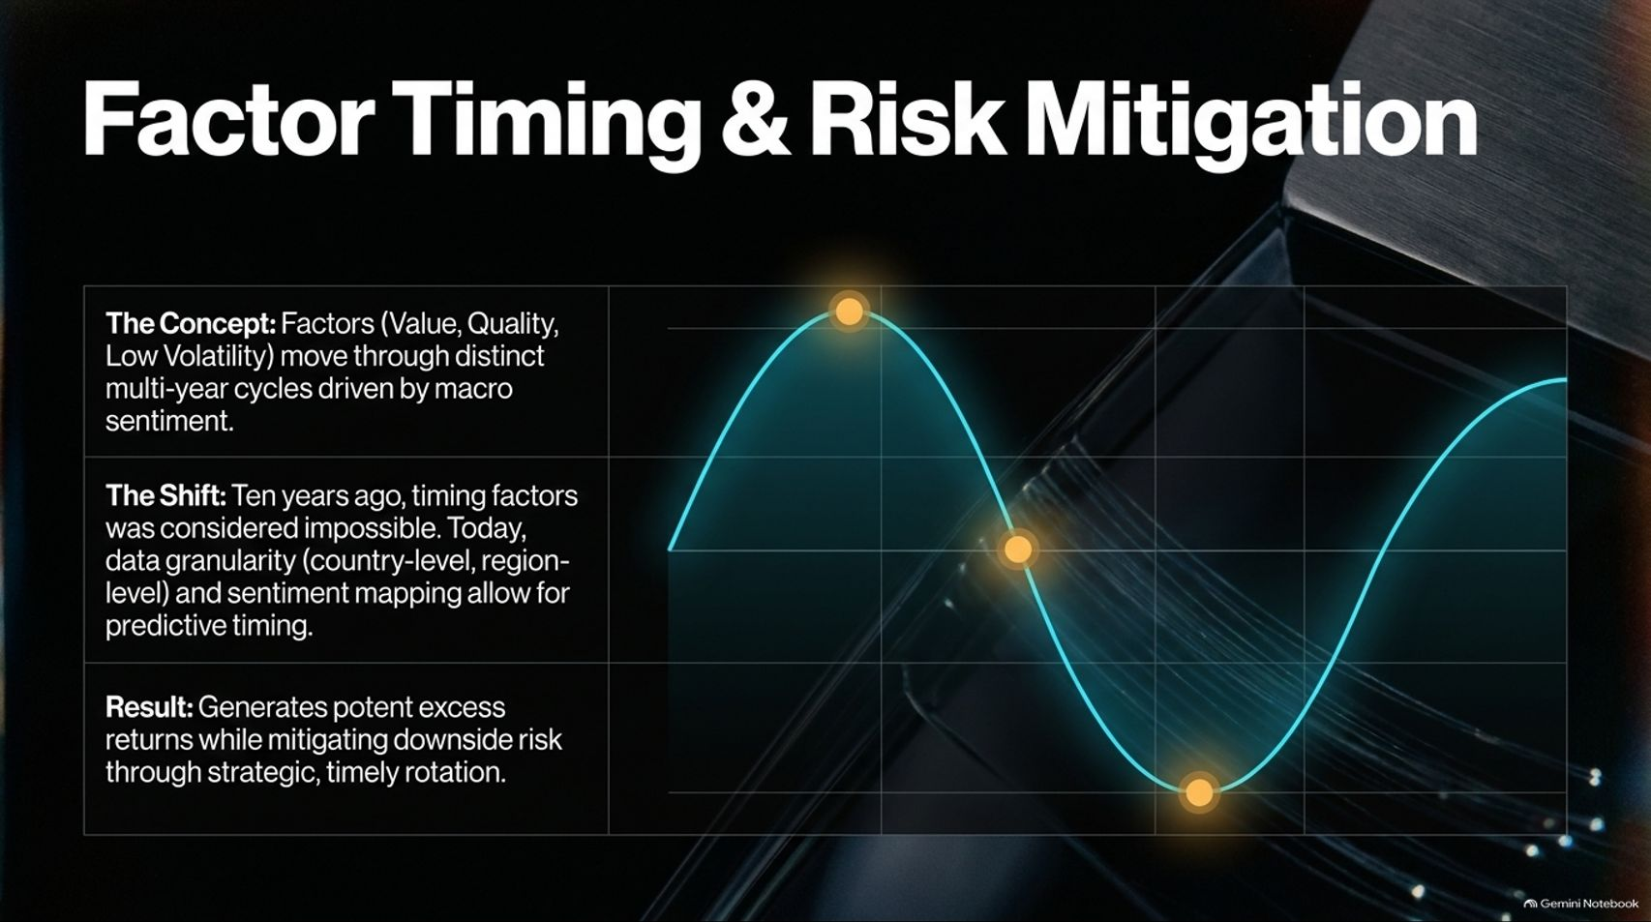
Notes:
Target Timing: 3 – 5 minutes
Tone: Strategic, tactical, risk-aware
Speaker Script:
"Can you successfully time investment factors like Value, Quality, or Low Volatility? Ten years ago, the institutional consensus was an emphatic 'No.'
Today, our view has completely evolved. Factor Timing and Risk Mitigation have become core drivers of alpha generation.
Factors move through distinct, multi-year macro sentiment cycles. Thanks to modern data granularity—spanning country-level, regional, and sentiment metrics—we can now map these cycles with predictive precision.
When executed with granular breadth across regions and sectors, factor timing generates potent excess returns while actively mitigating downside risk through strategic, timely portfolio rotation. Rather than sitting passively in a static factor bucket, dynamic rotation allows portfolios to navigate macro headwinds effectively."

Slide 13
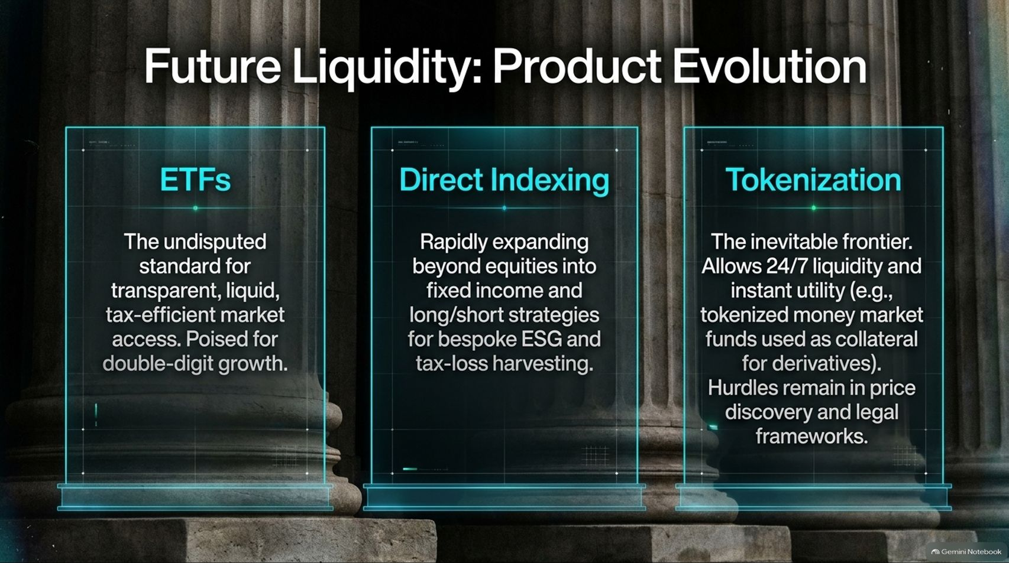
Notes:
Target Timing: 4 – 5 minutes
Tone: Forward-looking, product-focused, visionary
Speaker Script:
"How investors access markets is evolving just as rapidly as the underlying quantitative models. Let’s examine Future Liquidity and Product Evolution across three distinct vehicles:
1. ETFs: ETFs remain the undisputed standard for transparent, liquid, and tax-efficient market access, poised for continued double-digit growth.
2. Direct Indexing: Expanding rapidly beyond equities into fixed income and long/short strategies, direct indexing provides bespoke execution for personalized ESG mandates and sophisticated tax-loss harvesting.
3. Tokenization: This is the inevitable financial frontier. Tokenization enables 24/7 liquidity and instant utility—such as tokenized money market funds utilized directly as collateral for derivatives. While regulatory hurdles and price-discovery frameworks are still being finalized, tokenization represents the next major structural leap in market plumbing."

Slide 14
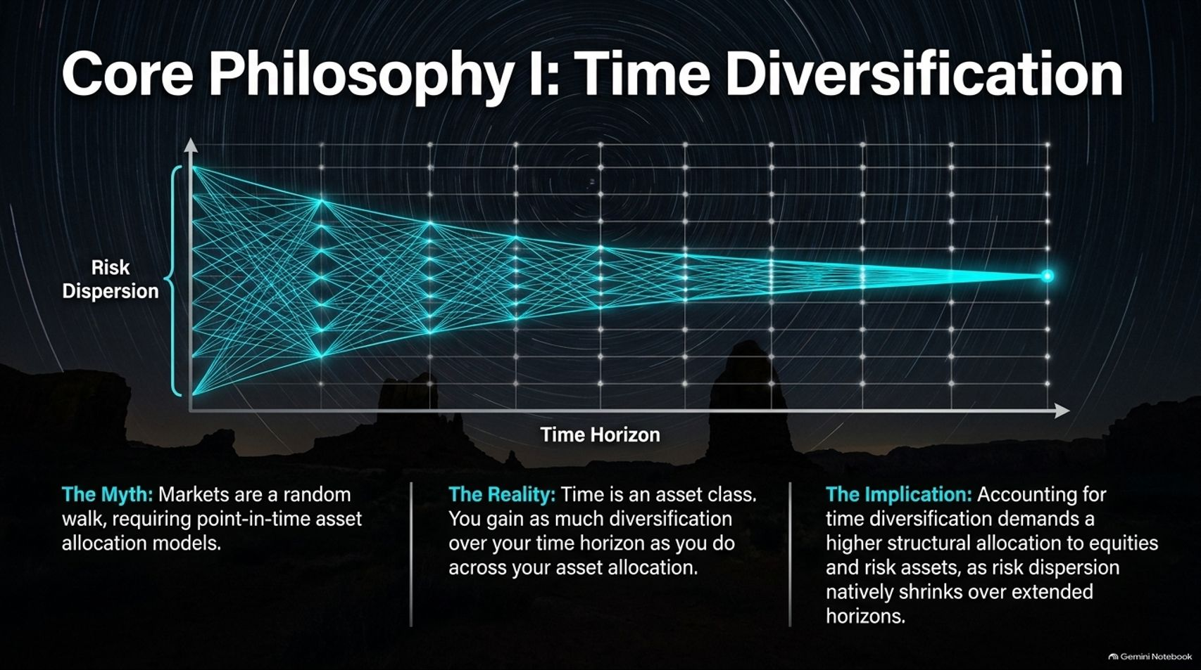
Notes:
Target Timing: 4 – 5 minutes
Tone: Philosophical, foundational, contrarian
Speaker Script:
"As we move into our core investment philosophies, let's address Core Philosophy I: Time Diversification.
The Myth: Conventional financial theory treats markets as a random walk, forcing advisors to rely entirely on static, point-in-time asset allocation models.
The Reality: Time is an asset class in its own right. As the cone chart on this slide illustrates, risk dispersion natively shrinks as your time horizon expands. You gain just as much risk diversification over an extended time horizon as you do across your cross-sectional asset allocation. Equity markets making new all-time highs over long horizons is not a random accident.
The Implication: Accounting for time diversification demands a higher structural allocation to equities and risk assets. If you have a true long-term time horizon, treating risk as a static point-in-time calculation severely underallocates capital to growth."

Slide 15
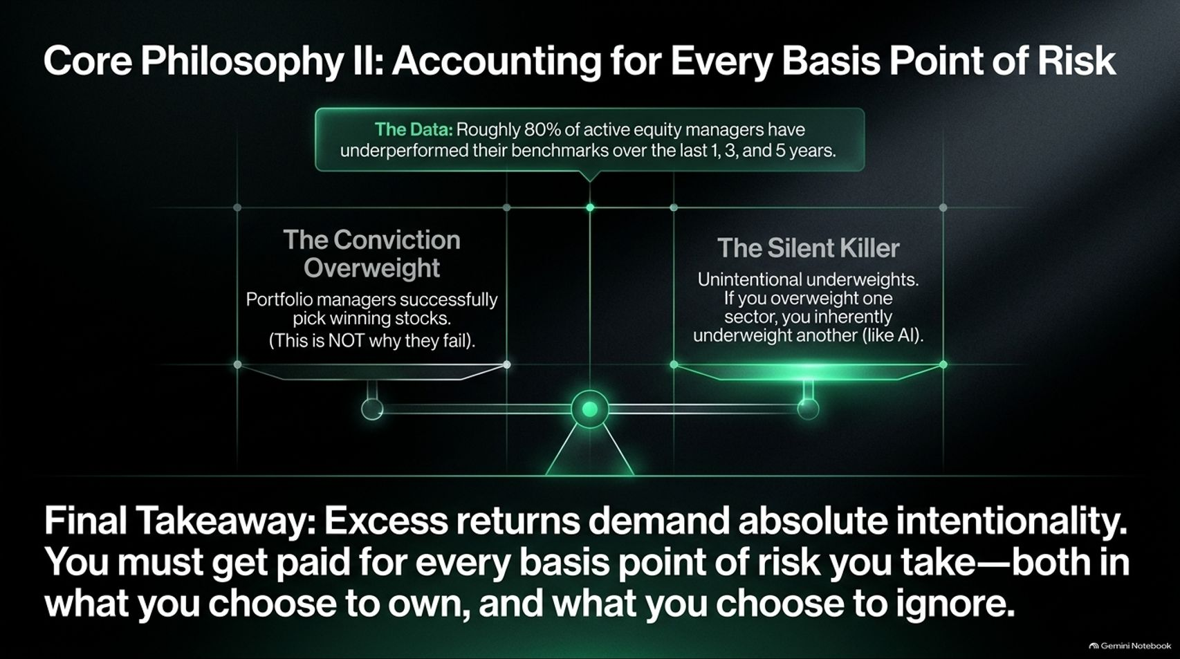
Notes:
Target Timing: 4 – 5 minutes
Tone: Analytical, cautionary, disciplined
Speaker Script:
"Our final core philosophy addresses the fundamental driver of active portfolio management: Accounting for Every Basis Point of Risk.
Consider the institutional data: roughly 80% of active equity managers have underperformed their benchmarks over 1, 3, and 5-year periods. Why do skilled managers fail?
Many assume it’s because portfolio managers pick bad stocks. But empirical data shows that managers are often successful at picking winning stocks—that is not why they fail.
The Silent Killer is the Unintentional Underweight. If you build high conviction in one sector, you inherently take an aggressive underweight in another—such as missing out on the 40% AI weighting of the market. If that unchosen sector outperforms, it overwhelms all your positive stock-picking alpha.
Final Takeaway: Excess returns demand absolute intentionality. You must get paid for every basis point of risk you take—both in what you actively choose to own, and what you choose to ignore."

Slide 16
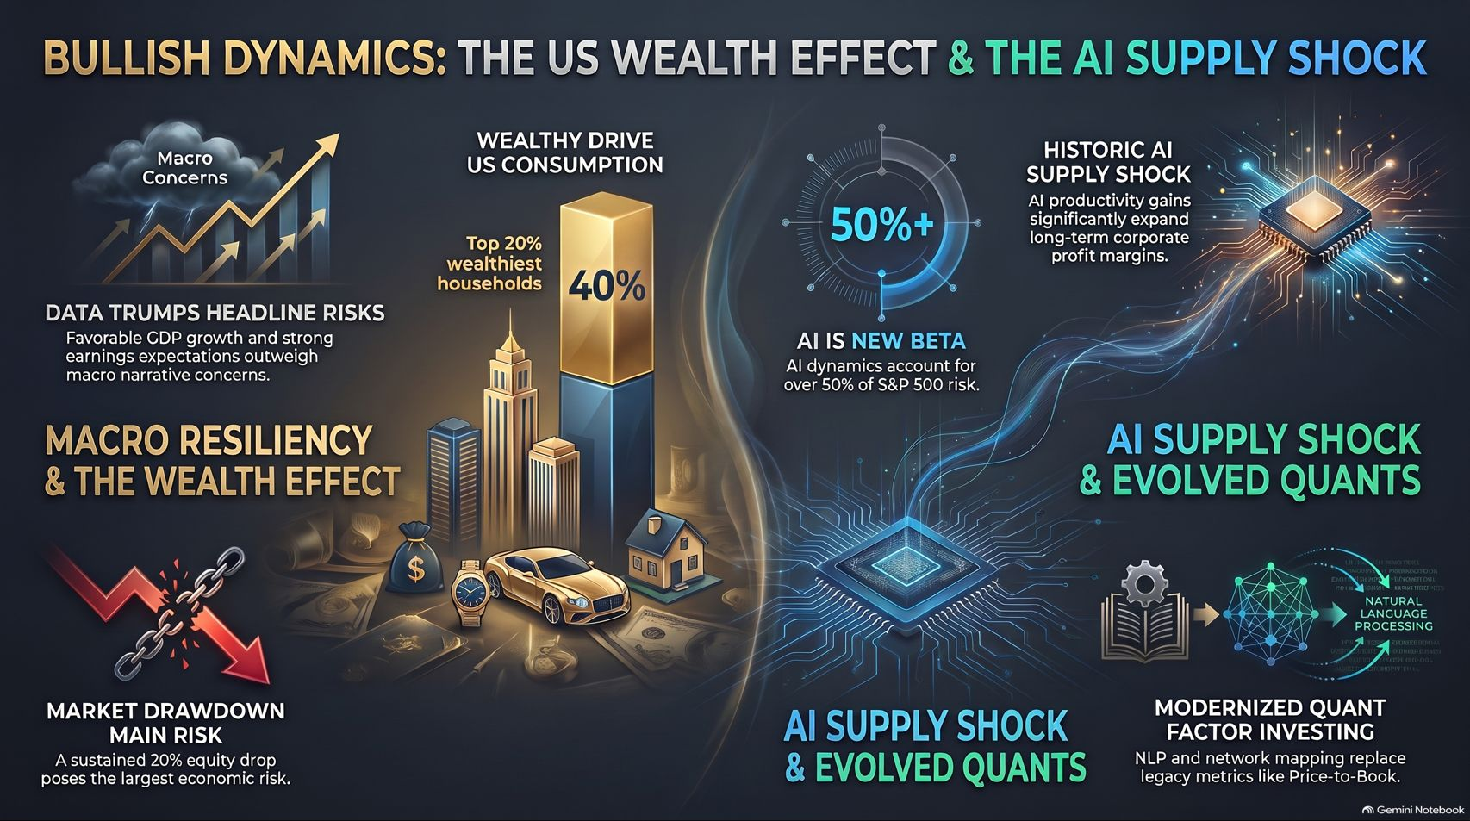
Notes:
Target Timing: 4 – 6 minutes
Tone: Summary, synthesizing, powerful closing
Speaker Script:
"To conclude our presentation today, let us synthesize our entire framework into this comprehensive executive summary.
When we strip away headline noise, the macroeconomic reality rests on three unbreakable pillars:
First: Macro Resiliency and the Wealth Effect. Driven by the top 20% of households commanding 40% of consumption, the US consumer engine remains exceptionally well-capitalized. While equity market drawdowns represent a primary risk, fundamental economic growth projections remain exceptionally robust.
Second: The Historic AI Supply Shock. Artificial Intelligence is not a bubble; it is the largest positive supply shock in economic history. Backed by pristine corporate balance sheets and massive cash flows, AI acts as the new market beta, driving long-term structural corporate margin expansion.
Third: Evolved Quant Investing. Traditional Price-to-Book metrics are obsolete. By leveraging natural language processing for network mapping, dynamic factor timing, and treating time as a true diversifier, modern investors can navigate intangible markets with precision.
In an era of profound technological transition, success belongs to those who prioritize hard data over headline noise, maintain absolute risk intentionality, and align their portfolios with structural economic realities.
Thank you very much for your time. I would now be delighted to open the floor to any questions."

