Slide 1
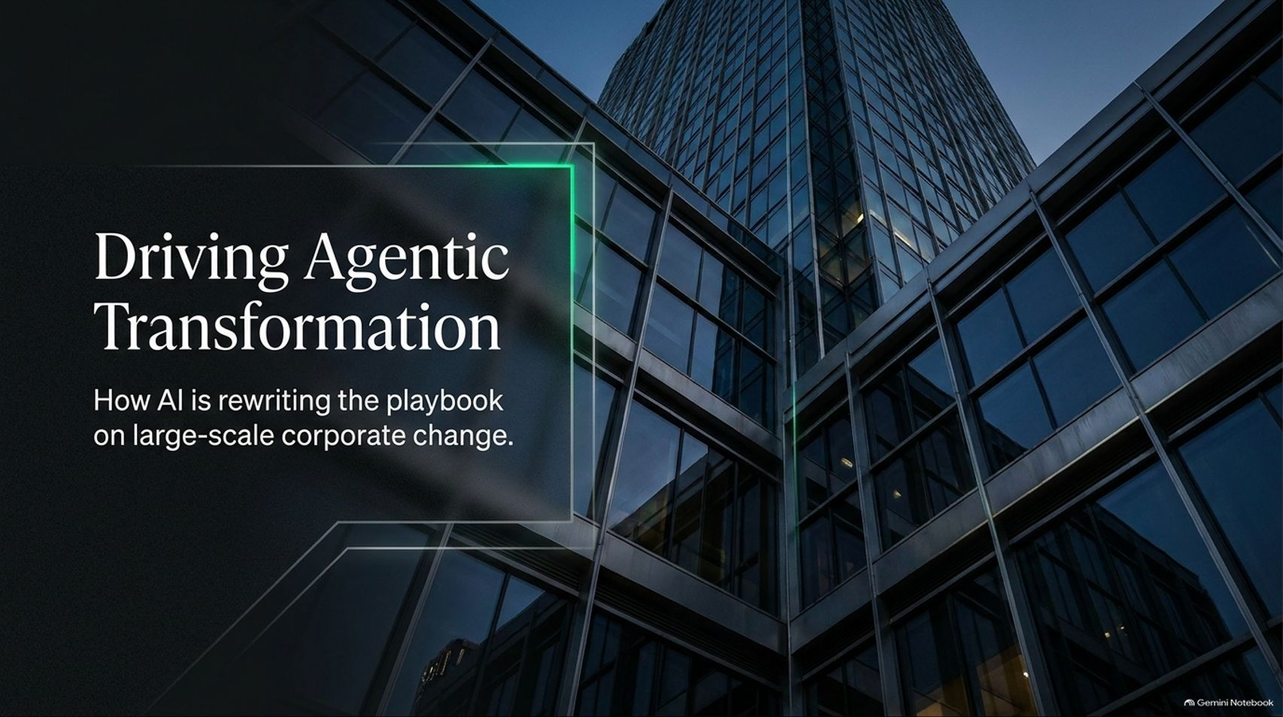
Notes:
Target Timing: 3 – 4 minutes
Tone: Professional, engaging, forward-looking
Speaker Script:
"Good morning, everyone, and welcome. Today, we are examining one of the most vital yet historically traditional functions in modern corporations: the Transformation Office.
Our presentation is titled: 'Driving Agentic Transformation: How AI is Rewriting the Playbook on Large-Scale Corporate Change.'
Drawing from recent insights by McKinsey experts Chase Cington and Tor Laney, we will explore why transformation offices have historically lagged behind in adopting AI, and how integrating AI agents fundamentally transforms how enterprise-wide change is designed, managed, and delivered.
For decades, leading large-scale corporate change has meant drowning in administrative overhead, manual data reconciliation, and slide deck formatting. Today, we will look at how agentifying these workflows rescues the human element of change management, shifting teams away from mindless data crunching and back toward what matters most: coaching people, solving complex business problems, and driving real enterprise value."
Driving Agentic Transformation: How AI Is Rewriting the Playbook on Large-Scale Change
https://www.youtube.com/watch?v=XZcbnO2m9UE

Slide 2
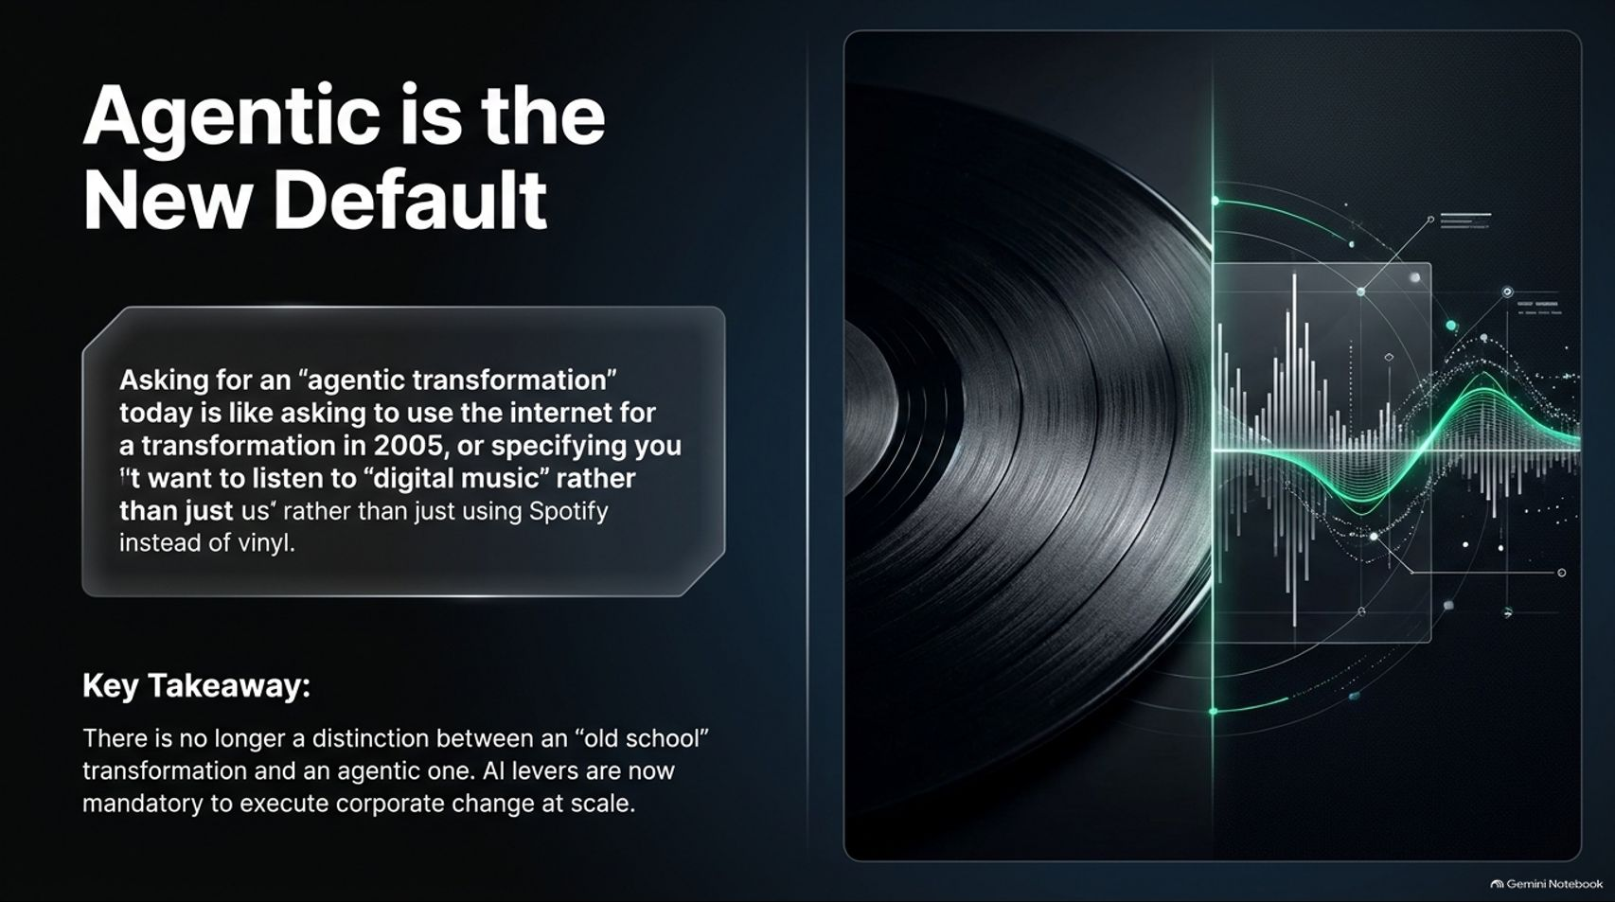
Notes:
Target Timing: 3 – 5 minutes
Tone: Provocative, analytical, modernizing
Speaker Script:
"Let's start with a foundational premise: Agentic is the New Default.
Asking for an 'agentic transformation' today is much like asking to use the internet for a transformation back in 2005, or specifying that you want to listen to 'digital music' rather than just streaming via Spotify instead of playing vinyl.
As Chase Cington notes in our reference video, a year or two ago clients would frequently call asking if they should pursue an 'old-school transformation' or an 'agentic transformation,' treating them as separate strategic choices. But that distinction has completely evaporated.
Key Takeaway: There is no longer a valid separation between a traditional transformation and an agentic one. AI levers are now mandatory, baseline technologies required to execute corporate change at scale. Just as every business process relies on digital connectivity today, every effective transformation office must now be built on an agentic foundation."

Slide 3
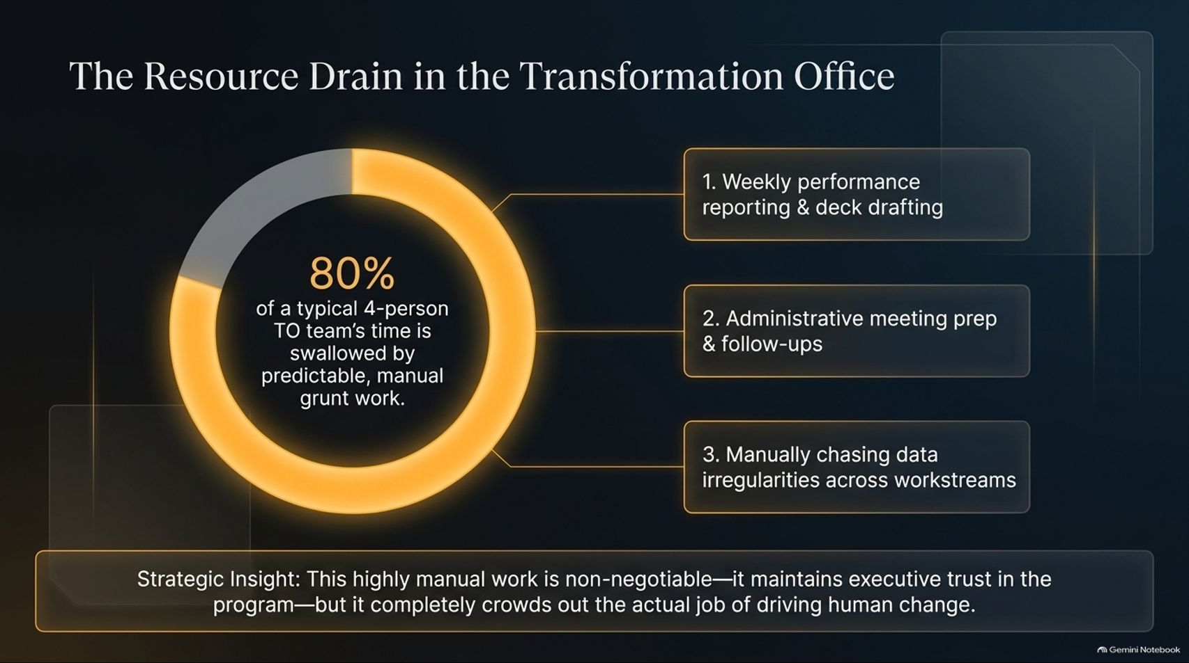
Notes:
Target Timing: 4 – 5 minutes
Tone: Empathetic, diagnostic, eye-opening
Speaker Script:
"Why are transformation offices so ripe for agentification? To answer that, let’s look at where time actually goes. When you audit a typical four-person Transformation Office (TO) team, you find that 80% of their working hours are swallowed by predictable, manual grunt work.
This time drain falls into three major buckets:
Weekly performance reporting and deck drafting: Spending hours copy-pasting data extracts into presentation templates.
Administrative meeting prep and follow-ups: Organizing agendas, coordinating calendars, and chasing action items.
Manually chasing data irregularities: Tracking down why workstream KPIs don't match finance reports across disparate spreadsheets.
Strategic Insight: This highly manual work is non-negotiable—it maintains executive trust and keeps the program structured. But because it consumes 80% of bandwidth, it completely crowds out the actual, high-impact job of driving human change."

Slide 4
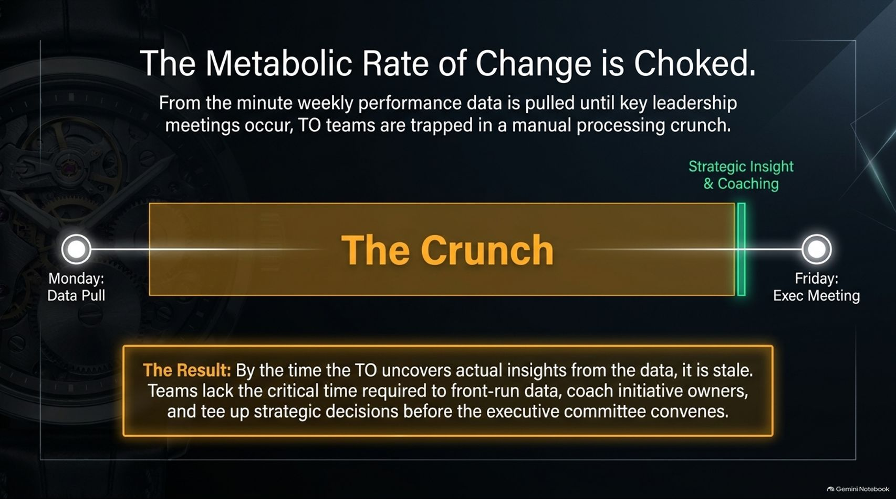
Notes:
Target Timing: 4 – 5 minutes
Tone: Analytical, urgent, structural
Speaker Script:
"This manual drag creates what we call a choked metabolic rate of change. Look at the typical weekly timeline of a Transformation Office:
On Monday, the team pulls raw performance data. Between Monday and Friday's Executive Committee meeting, the TO team is trapped in a brutal processing crunch. They spend every waking hour formatting slides, reconciling numbers, and building reports.
The Result? By the time the TO uncovers actual strategic insights from the data, those insights are already stale. The team lacks the critical time required to front-run data, coach initiative owners, and tee up strategic decisions before the executive committee convenes. Instead of acting as strategic counselors, they are reduced to reactive reporters."

Slide 5
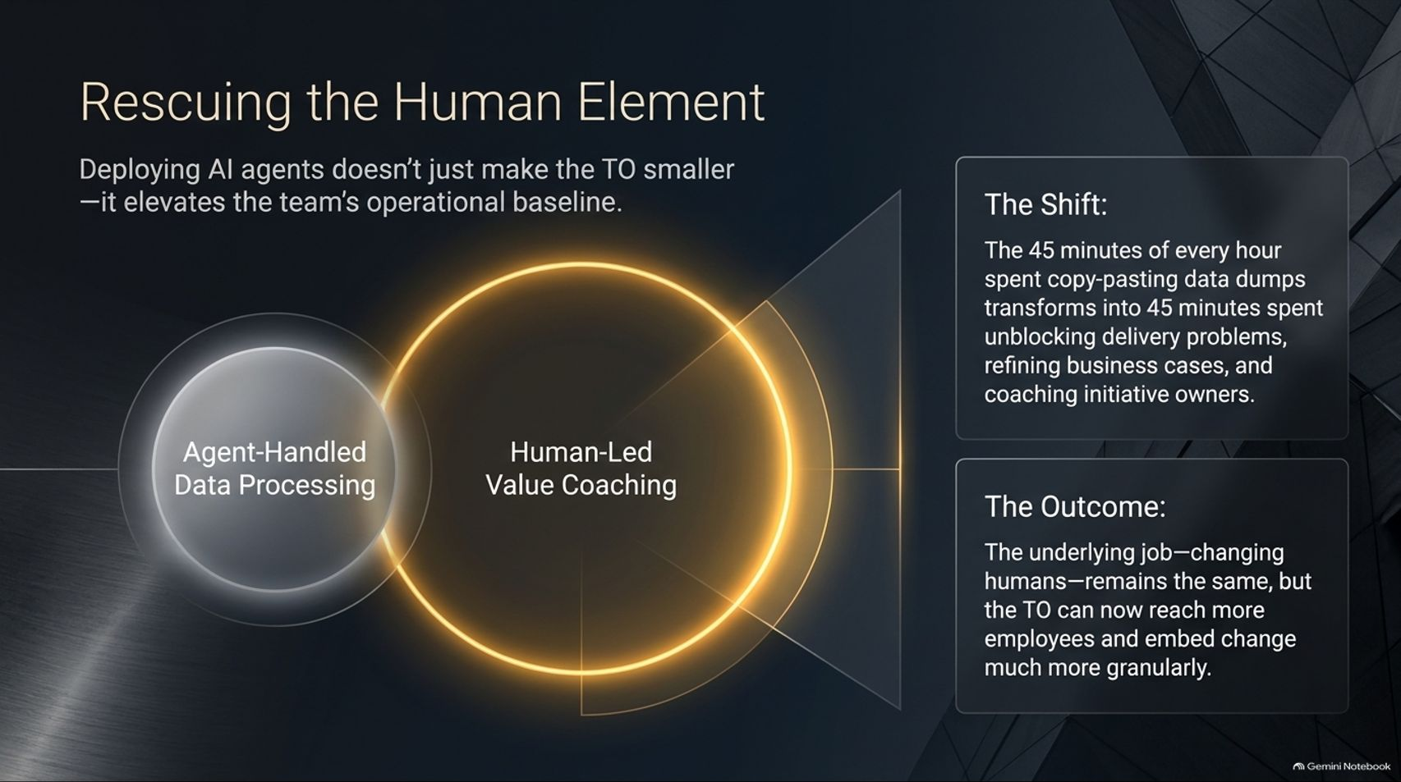
Notes:
Target Timing: 4 – 5 minutes
Tone: Visionary, uplifting, empowering
Speaker Script:
"Deploying AI agents doesn't just make the Transformation Office smaller or faster—it fundamentally elevates the team's operational baseline.
Look at the shift in daily allocation: The 45 minutes of every hour previously spent copy-pasting data dumps transforms into 45 minutes spent unblocking delivery problems, refining business cases, and coaching initiative owners.
The Outcome: The underlying goal of the office remains identical—changing human behavior across the enterprise. But by automating the administrative grind, the TO can now reach more employees and embed change much more granularly throughout the organization."

Slide 6
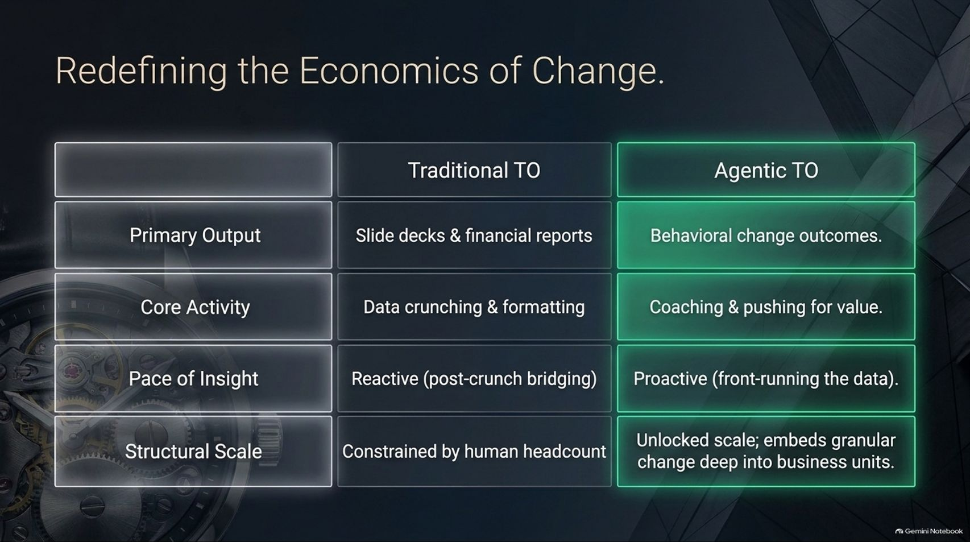
Notes:
Target Timing: 4 – 5 minutes
Tone: Comparative, structural, strategic
Speaker Script:
"Let's compare the operating model side-by-side using the matrix on this slide:
Primary Output: Traditional TOs produce static slide decks and financial reports. Agentic TOs produce measurable behavioral change outcomes.
Core Activity: Traditional teams spend their time on data crunching and formatting. Agentic teams focus on coaching and pushing for value.
Pace of Insight: Traditional models are reactive, constantly bridging post-crunch data gaps. Agentic models are proactive, front-running the data before meetings occur.
Structural Scale: Traditional scale is tightly constrained by human headcount. Agentic models unlock exponential scale, embedding granular change deep into every business unit."

Slide 7
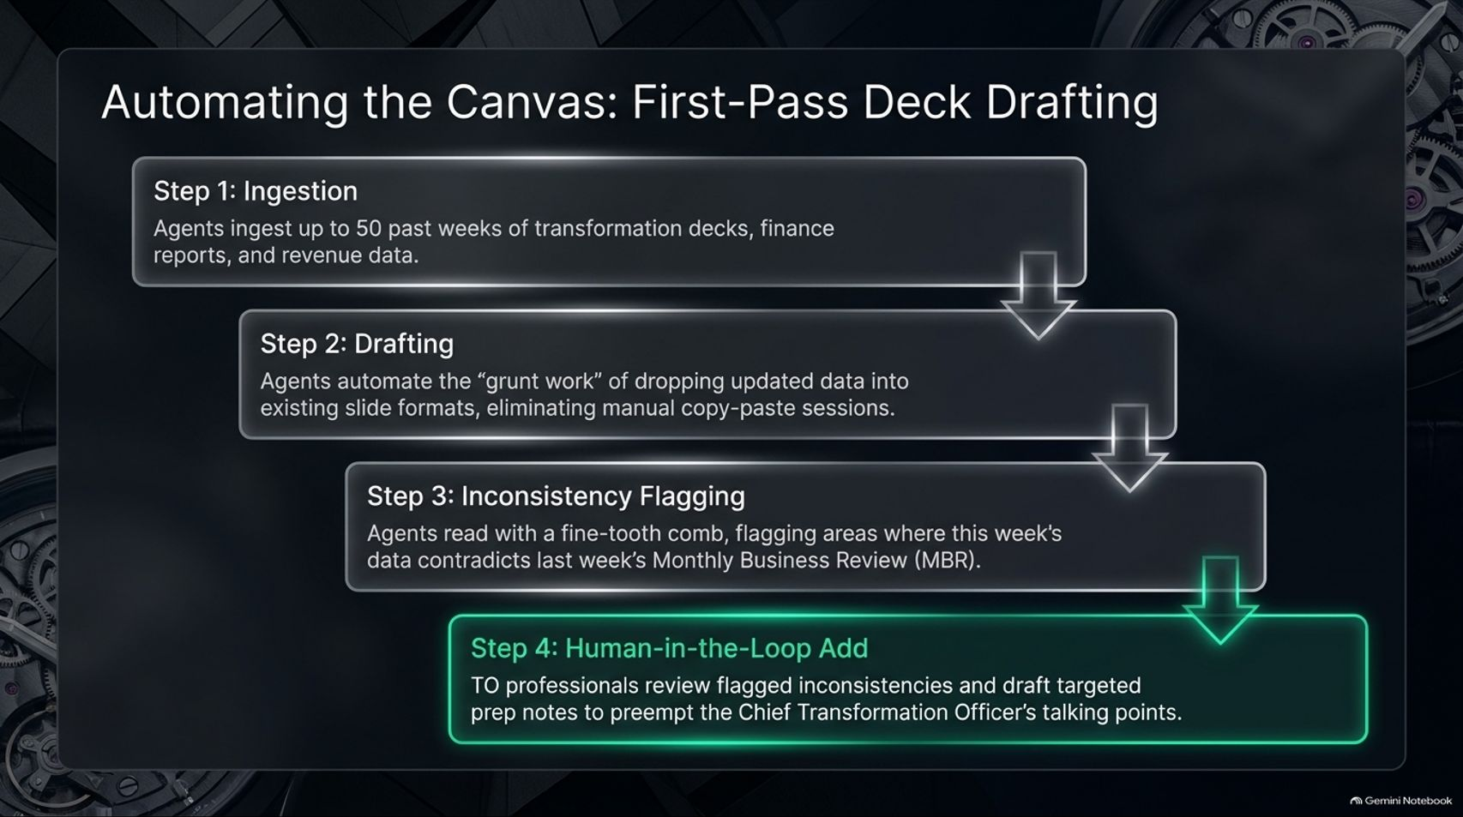
Notes:
Target Timing: 4 – 5 minutes
Tone: Practical, workflow-focused, technical
Speaker Script:
"Let's look at how this works in practice, starting with slide deck creation—the single biggest time sink for any TO team. We automate the canvas across four structured steps:
Step 1 (Ingestion): AI agents ingest up to 50 past weeks of transformation decks, finance reports, and revenue data.
Step 2 (Drafting): Agents automate the grunt work of dropping updated performance data into existing slide formats, eliminating manual copy-paste sessions.
Step 3 (Inconsistency Flagging): Agents read with a fine-tooth comb, flagging areas where this week's data contradicts last week's Monthly Business Review (MBR).
Step 4 (Human-in-the-Loop Add): TO professionals review flagged inconsistencies and draft targeted prep notes to preempt the Chief Transformation Officer’s talking points."

Slide 8
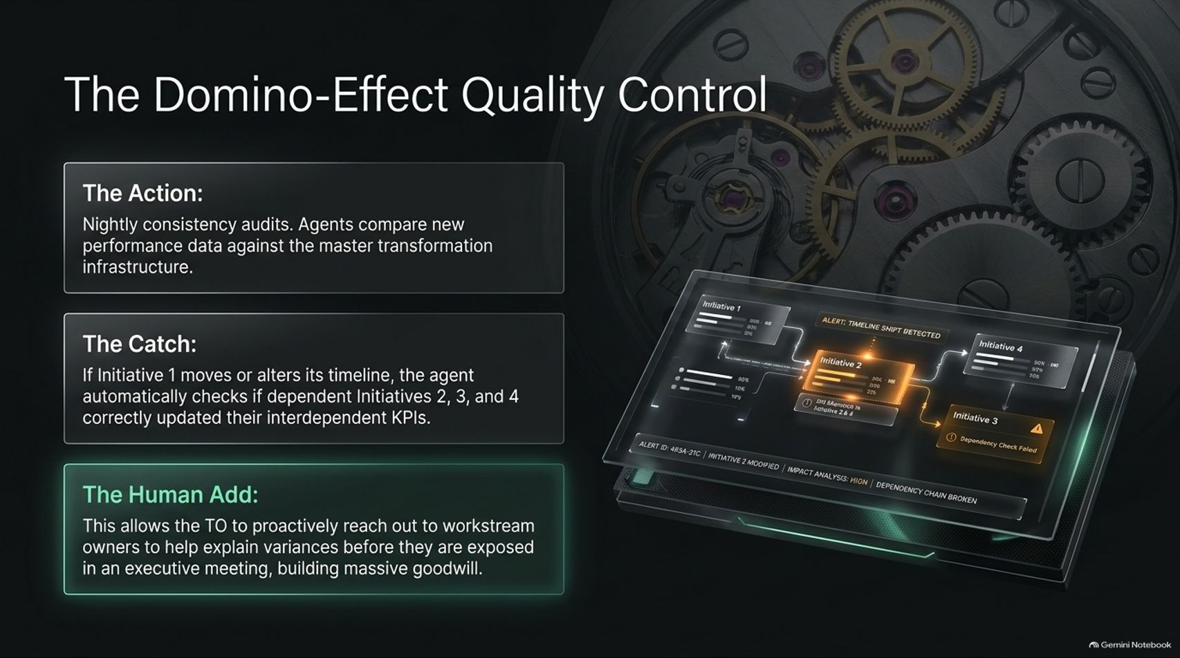
Notes:
Target Timing: 4 – 5 minutes
Tone: Vigilant, protective, system-level
Speaker Script:
"Beyond weekly decks, agents provide powerful quality control through automated auditing.
The Action: Nightly consistency audits run automatically, comparing new performance data against the master transformation infrastructure.
The Catch: If Initiative 1 moves or alters its timeline, the agent automatically checks whether dependent Initiatives 2, 3, and 4 have correctly updated their interdependent KPIs.
The Human Add: This allows the TO to proactively reach out to workstream owners to help explain variances before they are exposed as nasty surprises in an executive meeting, building massive goodwill and trust across the business."

Slide 9
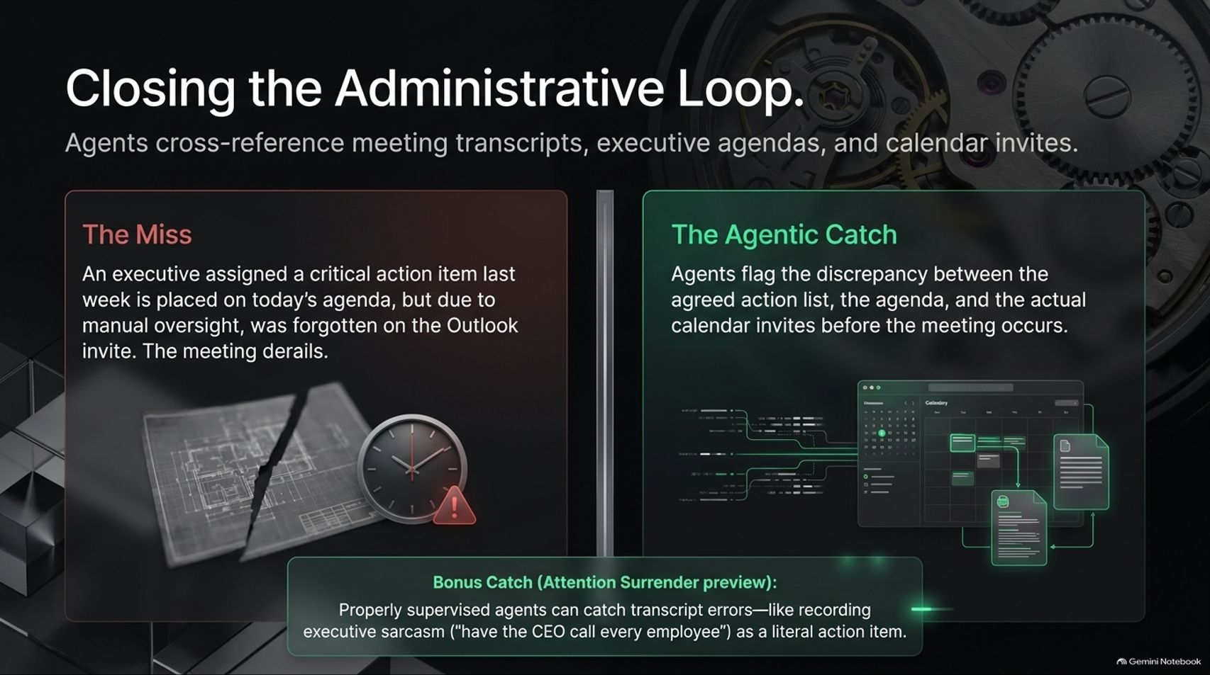
Notes:
Target Timing: 3 – 5 minutes
Tone: Illustrative, cautionary, precise
Speaker Script:
"Administrative oversights can derail executive trust instantly. Consider this common scenario: An executive is assigned a critical action item last week, but due to manual oversight, it gets forgotten on the Outlook invite, and the meeting derails.
The Agentic Catch: Agents cross-reference meeting transcripts, executive agendas, and calendar invites to flag discrepancies before the meeting occurs.
Bonus Catch: Properly supervised agents also catch transcript errors—such as recording executive sarcasm (like an executive asking, 'Do you just want the CEO to call every single employee?') as a literal action item, saving the organization from absurd miscommunications."

Slide 10
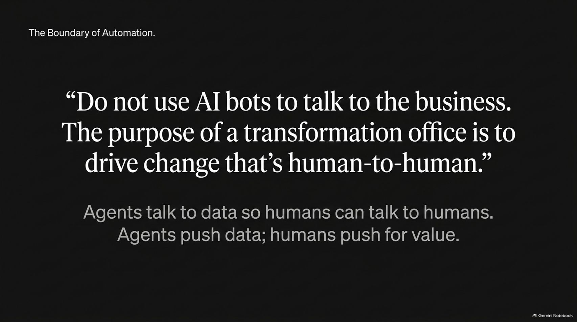
Notes:
Target Timing: 3 – 5 minutes
Tone: Philosophical, principled, firm
Speaker Script:
"As we deploy these powerful tools, we must remember a cardinal rule of transformation. As Chase Cington emphasizes:
“Do not use AI bots to talk to the business. The purpose of a transformation office is to drive change that’s human-to-human.”
Agents talk to data so humans can talk to humans.
AI agents push data, surface insights, and clean up administrative overhead. But humans—TO professionals—must push for value, provide counseling, and coach business leaders. Bots should make your TO people better, not replace human empathy and accountability."

Slide 11
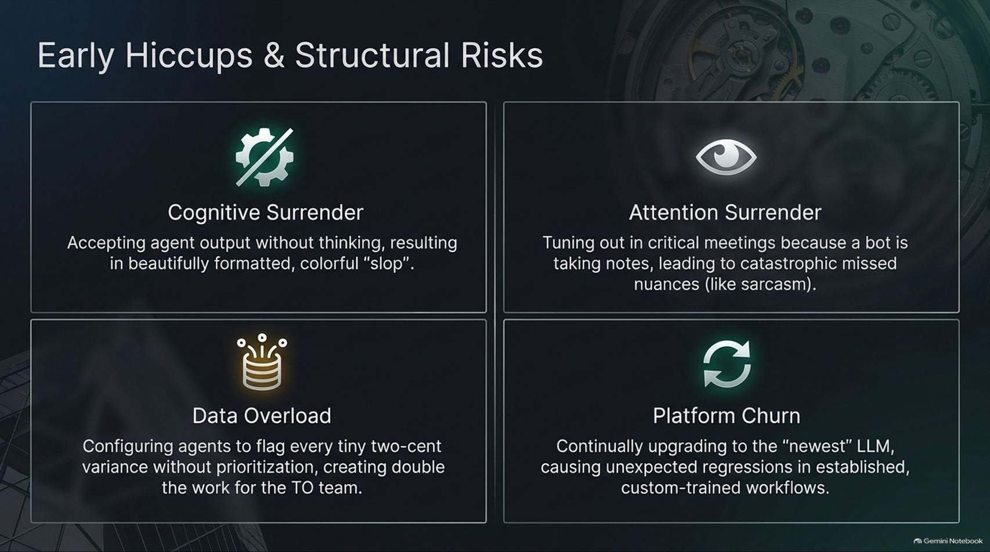
Notes:
Target Timing: 4 – 5 minutes
Tone: Candid, risk-aware, educational
Speaker Script:
"Adopting agentic workflows is not without its hurdles. Teams must actively guard against four major structural risks:
1. Cognitive Surrender: Accepting agent output without thinking, resulting in beautifully formatted, colorful 'slop'.
2. Attention Surrender: Tuning out in critical meetings because a bot is taking notes, leading to catastrophic missed nuances like sarcasm.
3. Data Overload: Configuring agents to flag every tiny two-cent variance without prioritization, creating double the work for the TO team.
4. Platform Churn: Continually upgrading to the 'newest' LLM, causing unexpected regressions in established, custom-trained workflows."

Slide 12
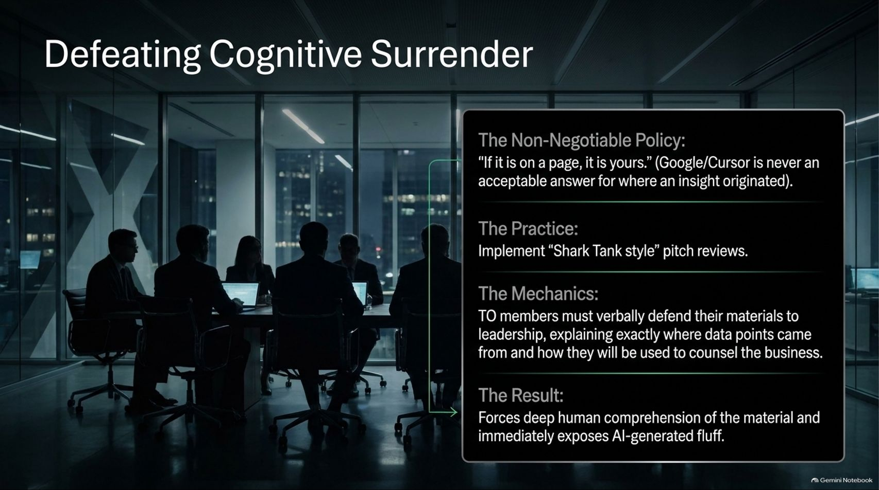
Notes:
Target Timing: 4 – 5 minutes
Tone: Rigorous, disciplined, managerial
Speaker Script:
"How do we defeat cognitive surrender and ensure high quality? We enforce strict institutional practices:
The Non-Negotiable Policy: 'If it is on a page, it is yours.' Saying 'Cursor' or 'ChatGPT' generated this insight is never an acceptable answer for where data originated.
The Practice: Implement 'Shark Tank-style' pitch reviews.
The Mechanics: TO members must verbally defend their materials to leadership, explaining exactly where data points came from and how they will be used to counsel the business.
The Result: This forces deep human comprehension of the material and immediately exposes AI-generated fluff."

Slide 13
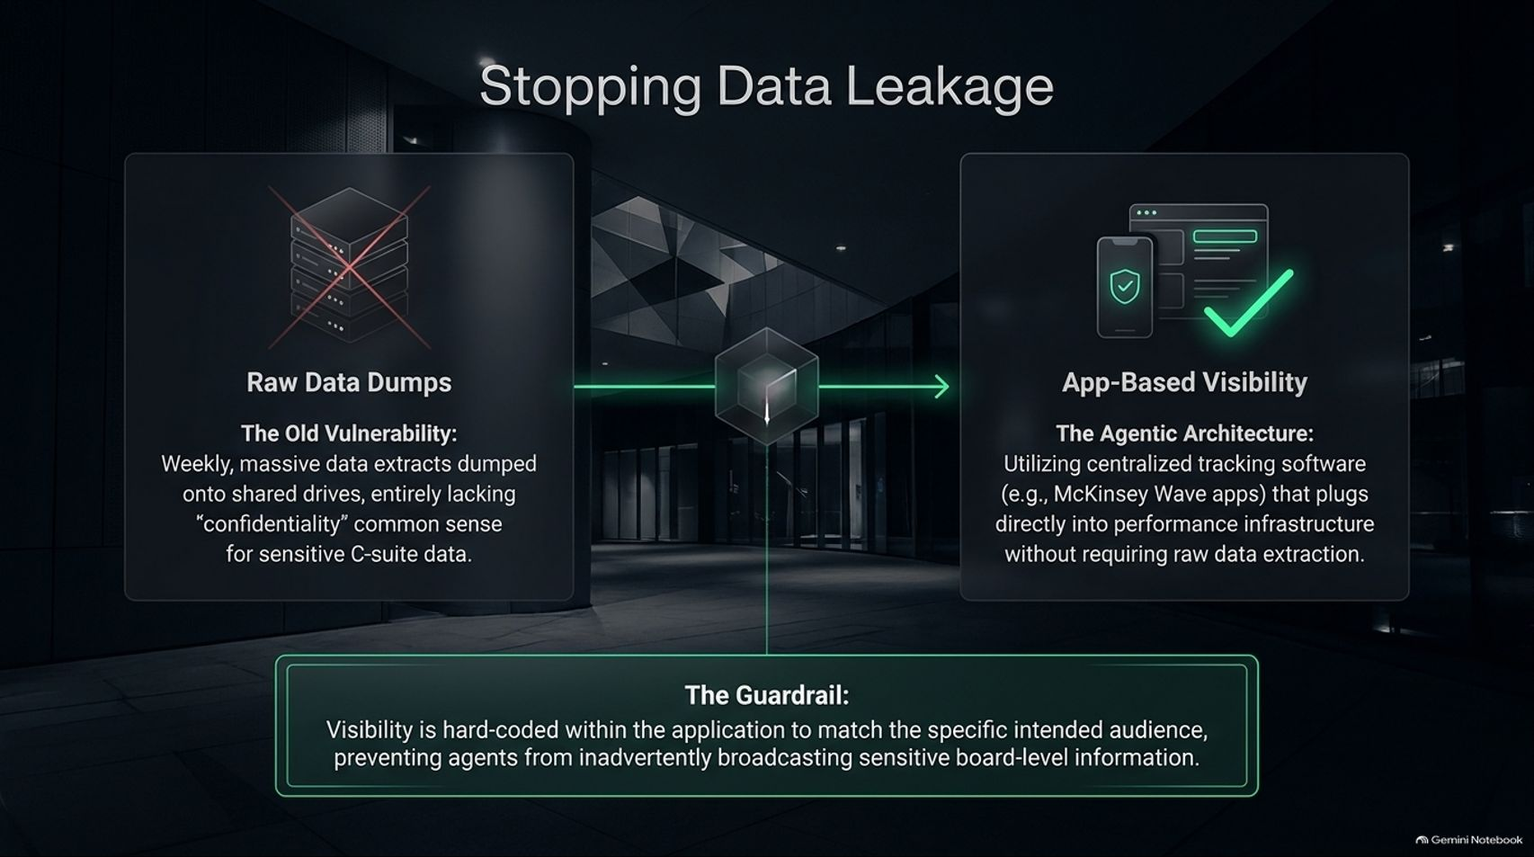
Notes:
Target Timing: 4 – 5 minutes
Tone: Secure, architectural, protective
Speaker Script:
"Data security is paramount when handling sensitive C-suite transformation data.
The Old Vulnerability: Weekly, massive data extracts were dumped onto shared drives, entirely lacking confidentiality common sense.
The Agentic Architecture: We utilize centralized tracking software—such as McKinsey Wave apps—that plugs directly into performance infrastructure without requiring raw data extraction.
The Guardrail: Visibility is hard-coded within the application to match the specific intended audience, preventing agents from inadvertently broadcasting sensitive board-level information across the enterprise."

Slide 14
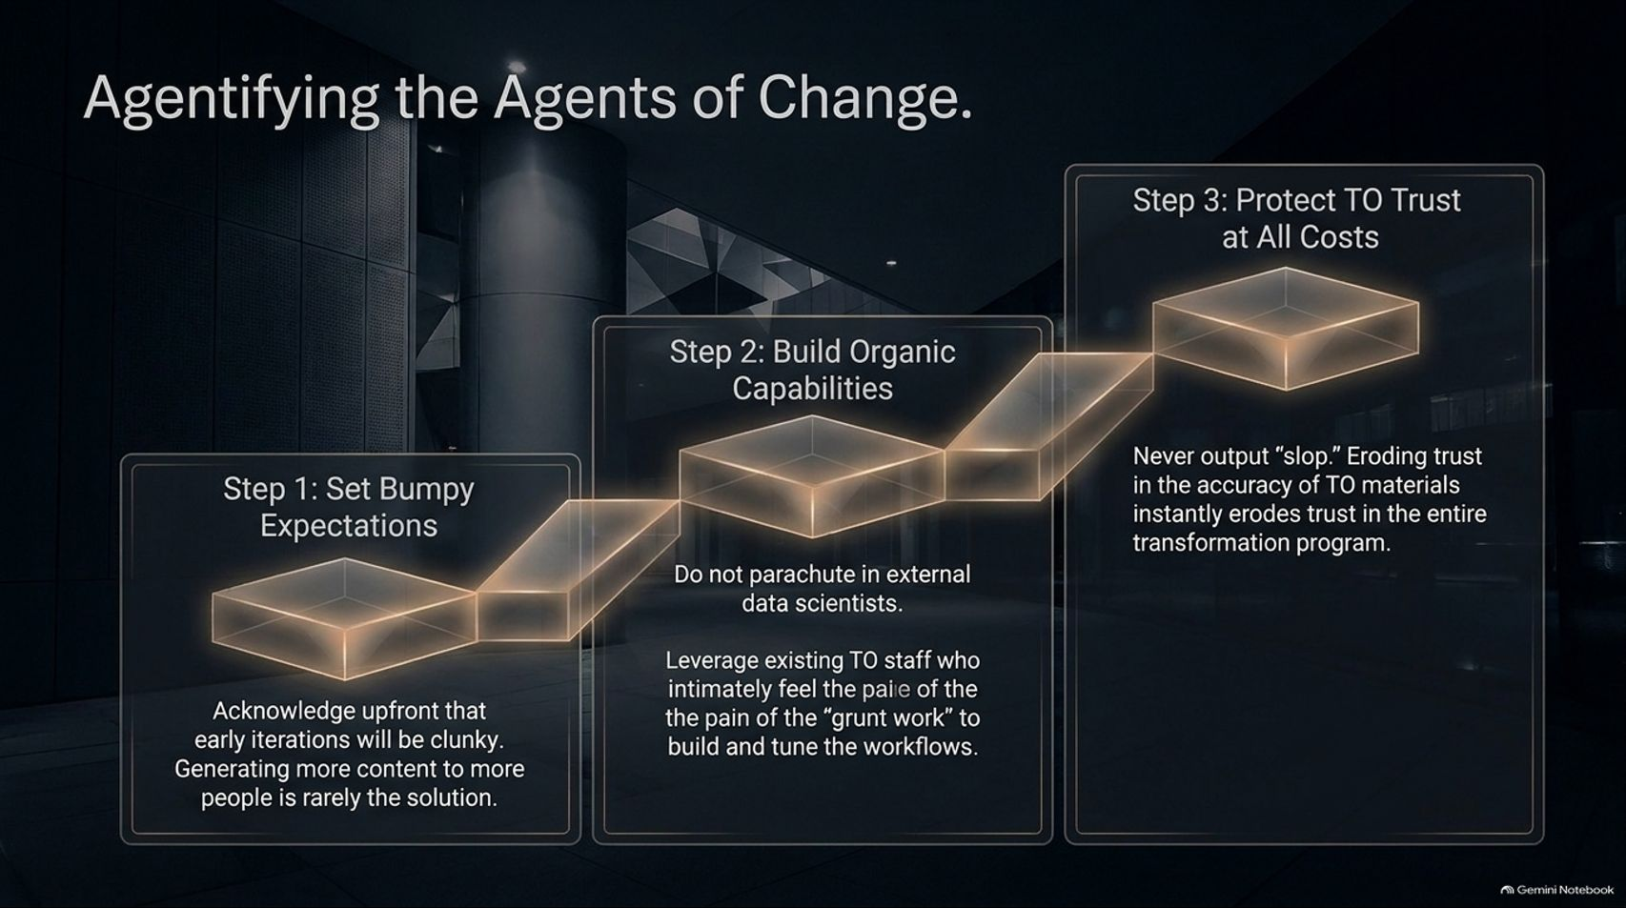
Notes:
Target Timing: 3 – 5 minutes
Tone: Step-by-step, implementation-focused, realistic
Speaker Script:
"How should organizations roll out agentic transformation? Follow these three steps:
Step 1: Set Bumpy Expectations. Acknowledge upfront that early iterations will be clunky. Generating more content to more people is rarely the solution.
Step 2: Build Organic Capabilities. Do not parachute in external data scientists. Leverage existing TO staff who intimately feel the pain of the 'grunt work' to build and tune the workflows.
Step 3: Protect TO Trust at All Costs. Never output slop. Eroding trust in the accuracy of TO materials instantly erodes trust in the entire transformation program."

Slide 15
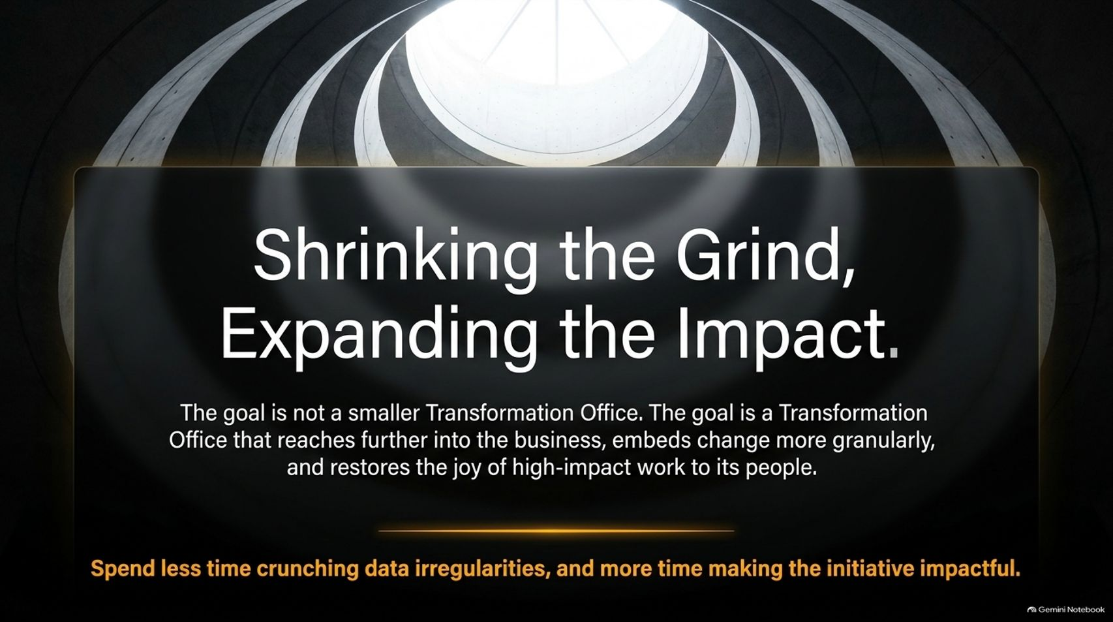
Notes:
Target Timing: 3 – 4 minutes
Tone: Inspiring, synthesizing, encouraging
Speaker Script:
"To wrap up our core philosophy: The goal is not a smaller Transformation Office. The goal is a Transformation Office that reaches further into the business, embeds change more granularly, and restores the joy of high-impact work to its people.
When you spend less time crunching data irregularities and formatting slides, your team can spend more time making every initiative impactful. Transformation team members join to drive meaningful corporate change—not to make reports. Agentification gives them their jobs back."

Slide 16
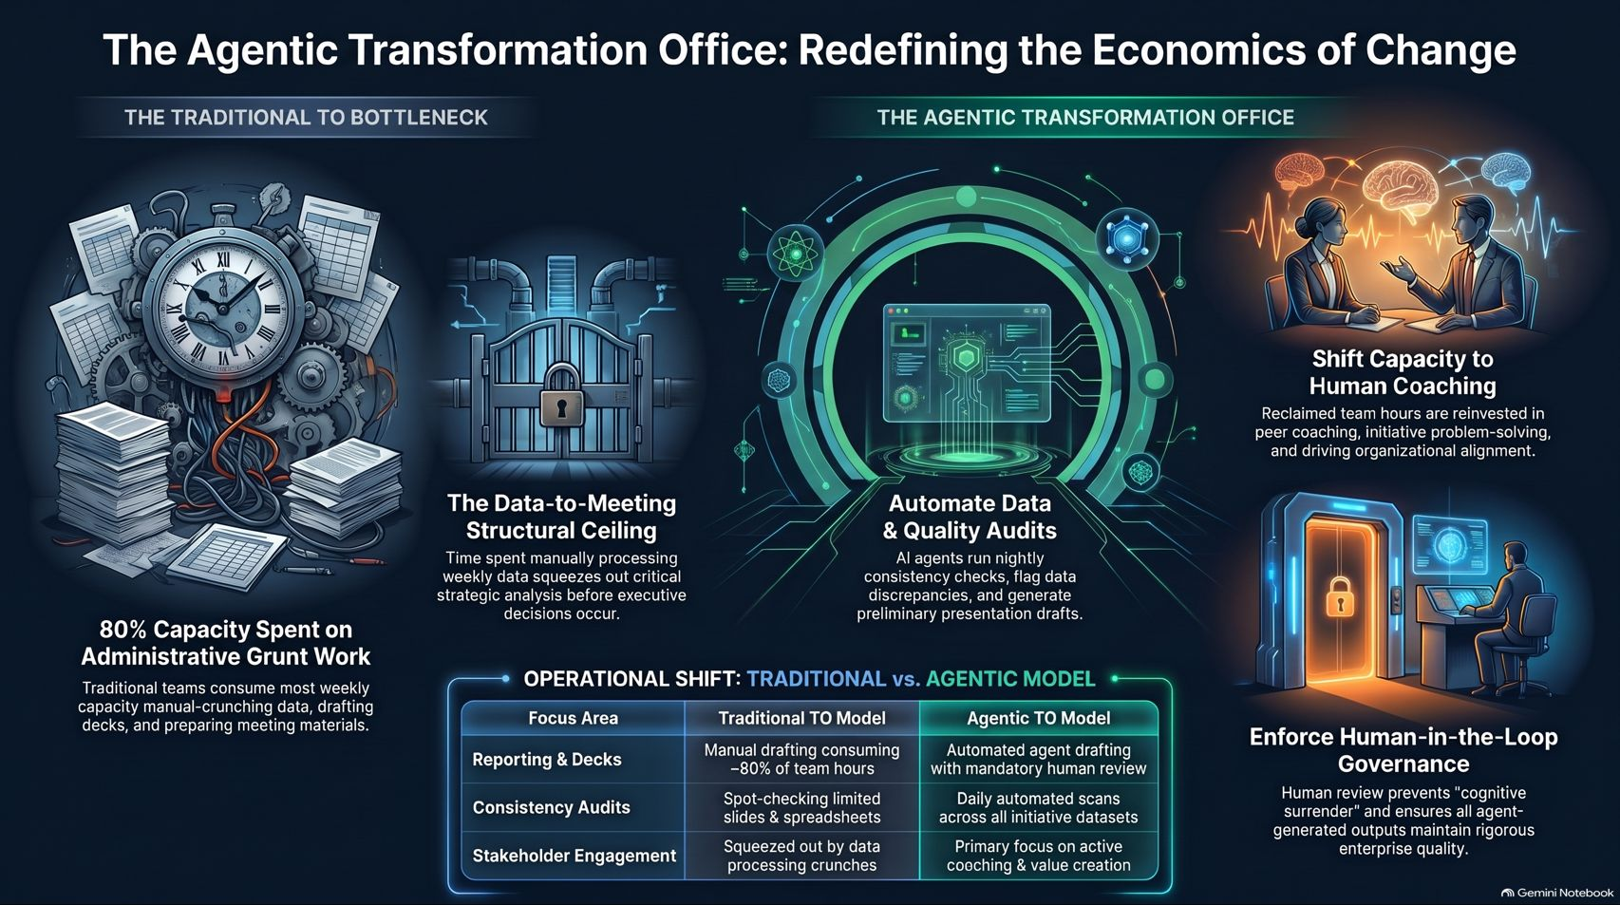
Notes:
Target Timing: 4 – 6 minutes
Tone: Summarizing, powerful closing, strategic
Speaker Script:
"Let us synthesize our entire framework into this executive summary.
Traditionally, transformation offices hit a data-to-meeting structural ceiling, spending 80% of their capacity on administrative grunt work.
By moving to an Agentic TO Model, we achieve three critical outcomes:
Automate Data & Quality Audits: AI agents run nightly consistency checks, flag data discrepancies, and generate preliminary drafts.
Shift Capacity to Human Coaching: Reclaimed team hours are reinvested in peer coaching, solving complex initiative roadblocks, and driving organizational alignment.
Enforce Human-in-the-Loop Governance: Rigorous human review prevents cognitive surrender and ensures all agent outputs maintain flawless enterprise quality.
Agentic transformation is no longer optional—it is the modern standard for executing successful corporate change at scale.
Thank you very much for your time and attention. I would now be delighted to open the floor to any questions."

