Slide 1
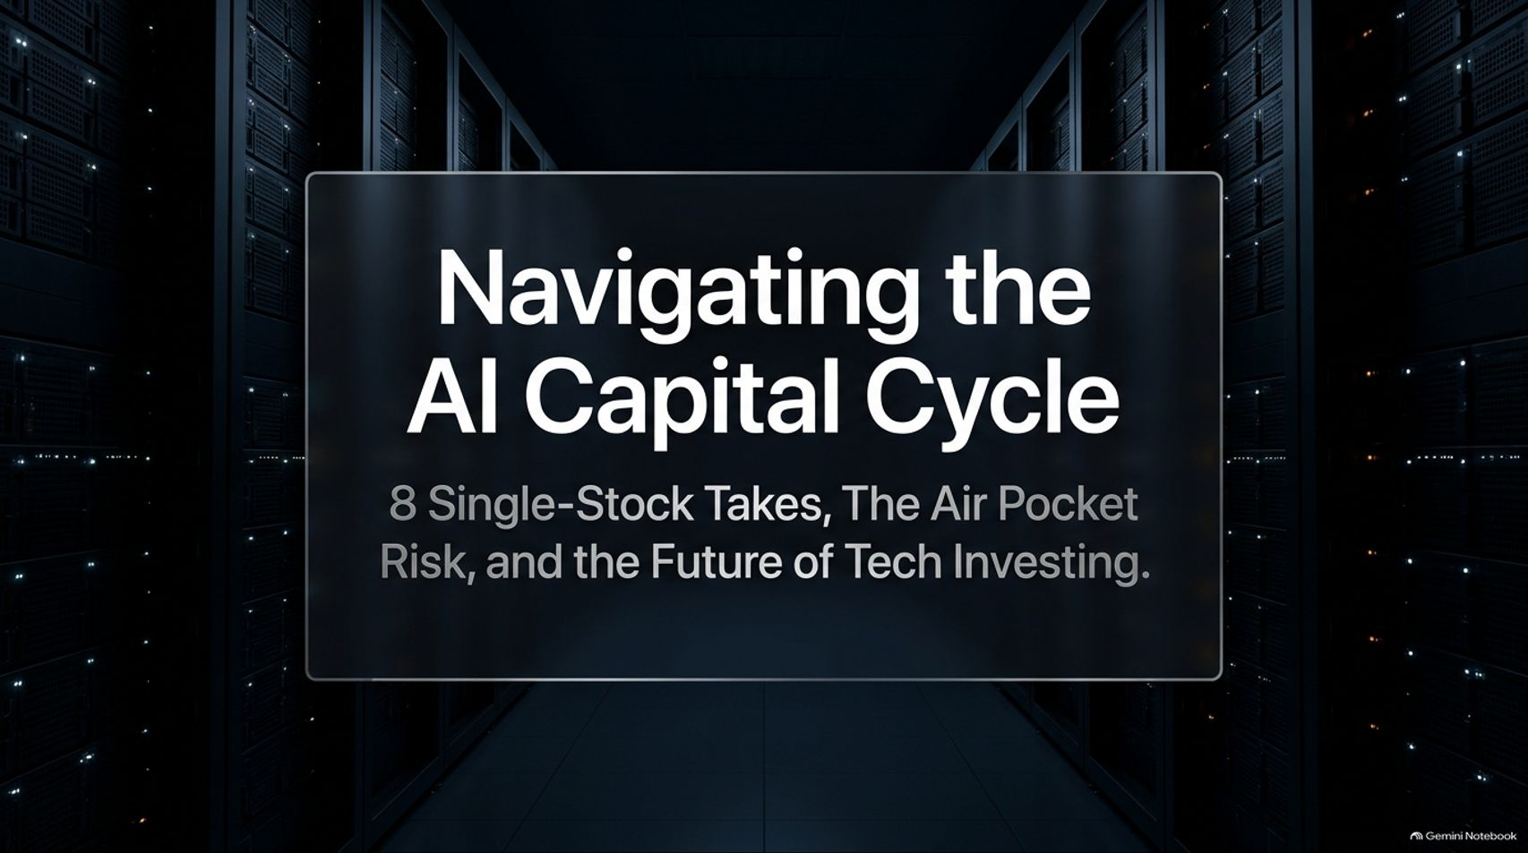
Notes:
Target Timing: 3 – 4 minutes
Tone: Authoritative, strategic, forward-looking
Speaker Script:
"Good morning, everyone, and welcome. Today, we are diving deep into one of the most critical and fast-moving shifts in modern financial history: the intersection of artificial intelligence, capital cycle dynamics, and single-stock execution.
Our presentation is titled: 'Navigating the AI Capital Cycle: 8 Single-Stock Takes, The Air Pocket Risk, and the Future of Tech Investing.'
Over the past few years, the market has been gripped by a singular narrative—that AI will change everything. While that macro premise is true, the way capital flows through this technological revolution follows rigid, historical laws. We are witnessing massive multi-billion-dollar infrastructure buildouts, fierce battles for market share in the Global South, and structural threats to legacy business models like traditional search and generic software.
Today, we are going to look past the superficial media noise. We will examine why extrapolated tech demand creates a dangerous supply-driven 'air pocket,' how frontier AI models face inevitable commoditization, and what specific single-stock takes—from Amazon and Meta to AppLovin, ServiceNow, and MercadoLibre—reveal about winning in today's volatile market.
By the end of this session, my goal is to equip you with a clear, rigorous framework for identifying where true compounding value lies versus where capital traps are waiting."
How AI Will Unfold and 8 Single Stock Takes
https://www.youtube.com/watch?v=OiOMon-wWVs

Slide 2
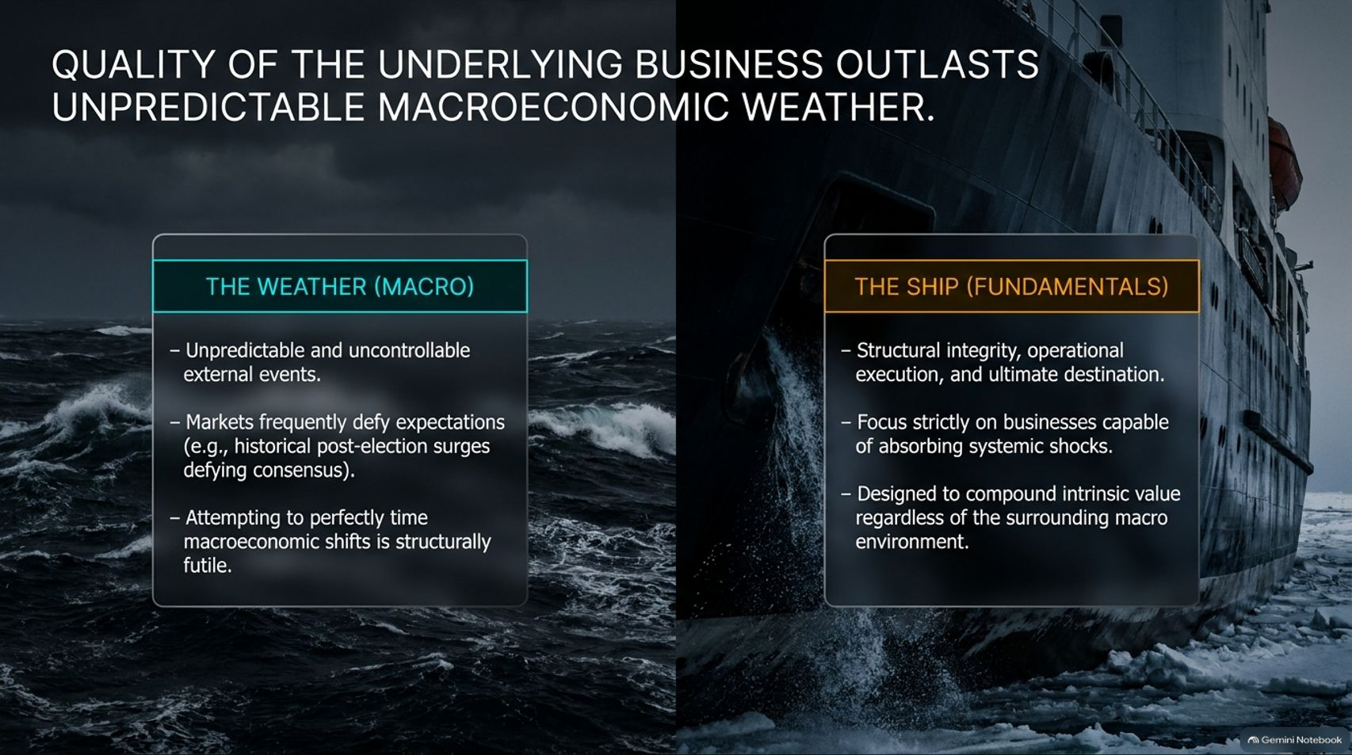
Notes:
Target Timing: 3 – 5 minutes
Tone: Grounded, philosophical, investment-focused
Speaker Script:
"Let us start with a fundamental truth of long-term investing: The quality of the underlying business always outlasts unpredictable macroeconomic weather.
Look at the metaphor on this slide. On the left, we have The Weather (Macro). Macroeconomic forecasting is inherently uncontrollable. Markets routinely defy consensus expectations—whether it is unexpected interest rate trajectories, geopolitical shocks, or post-election market surges that leave consensus forecasters scrambling. Trying to perfectly time macroeconomic shifts is structurally futile.
On the right, we have The Ship (Fundamentals). The ship represents structural integrity, operational execution, and the business's ultimate destination.
As long-term investors, our job is not to predict whether the storm will be a Category 3 or a Category 4. Our job is to own a ship engineered to absorb systemic shocks and compound intrinsic value regardless of the surrounding macro environment. When you focus entirely on business quality, pricing power, and balance sheet strength, macro volatility stops being a threat and simply becomes part of the journey."

Slide 3
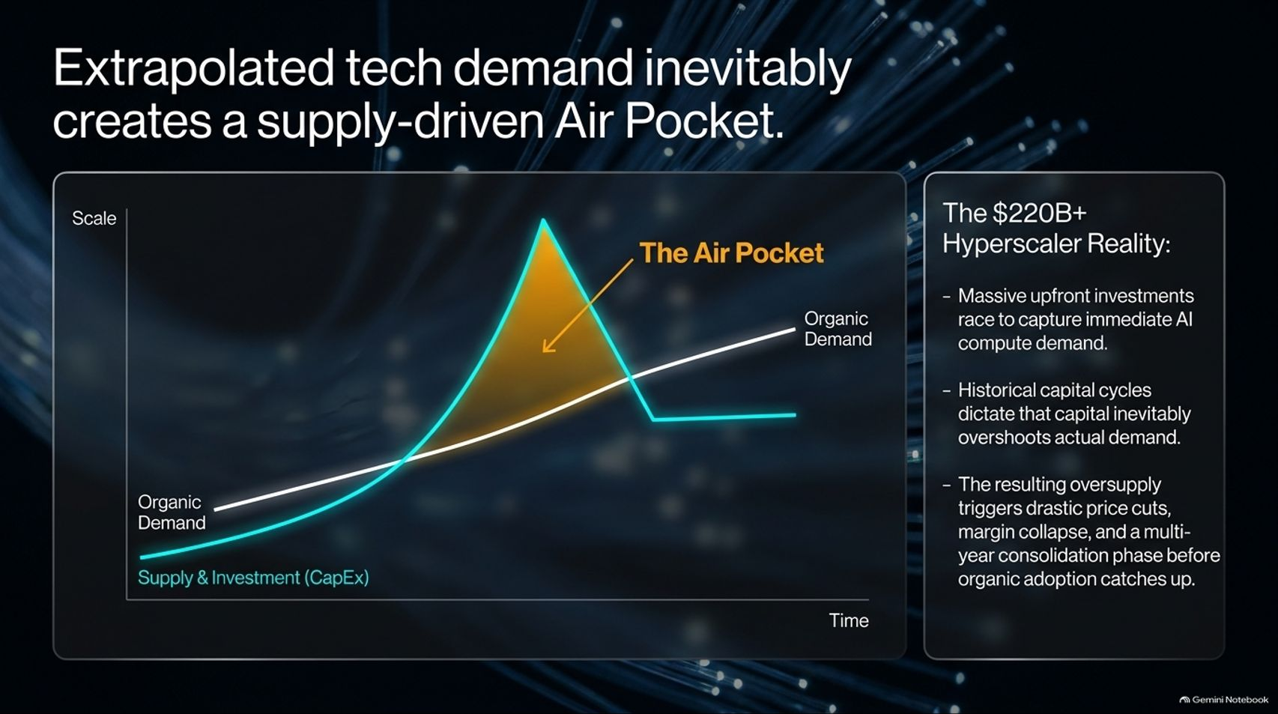
Notes:
Target Timing: 4 – 5 minutes
Tone: Analytical, cautionary, cycle-focused
Speaker Script:
"Now let's examine the core macroeconomic risk facing the AI infrastructure trade today: The Capital Cycle Air Pocket.
Look at the chart on this screen. The white line represents organic, steady demand for AI computing power. The blue line represents supply and capital expenditure (CapEx) commitments.
Right now, across the tech landscape, we are pouring over $220 billion-plus into hyperscaler infrastructure. Massive upfront investments are racing to capture immediate compute demand. But historical capital cycles dictate a rigid law: capital inevitably overshoots actual demand.
When supply spikes past organic demand, it creates what we call The Air Pocket—the shaded orange zone on the chart. During this phase, the resulting oversupply triggers drastic price cuts, severe margin compression, and a multi-year consolidation phase across the semiconductor and hardware supply chain before organic adoption finally catches up to physical capacity. Recognizing where we are in this capital cycle is vital to avoiding the air pocket crash."

Slide 4
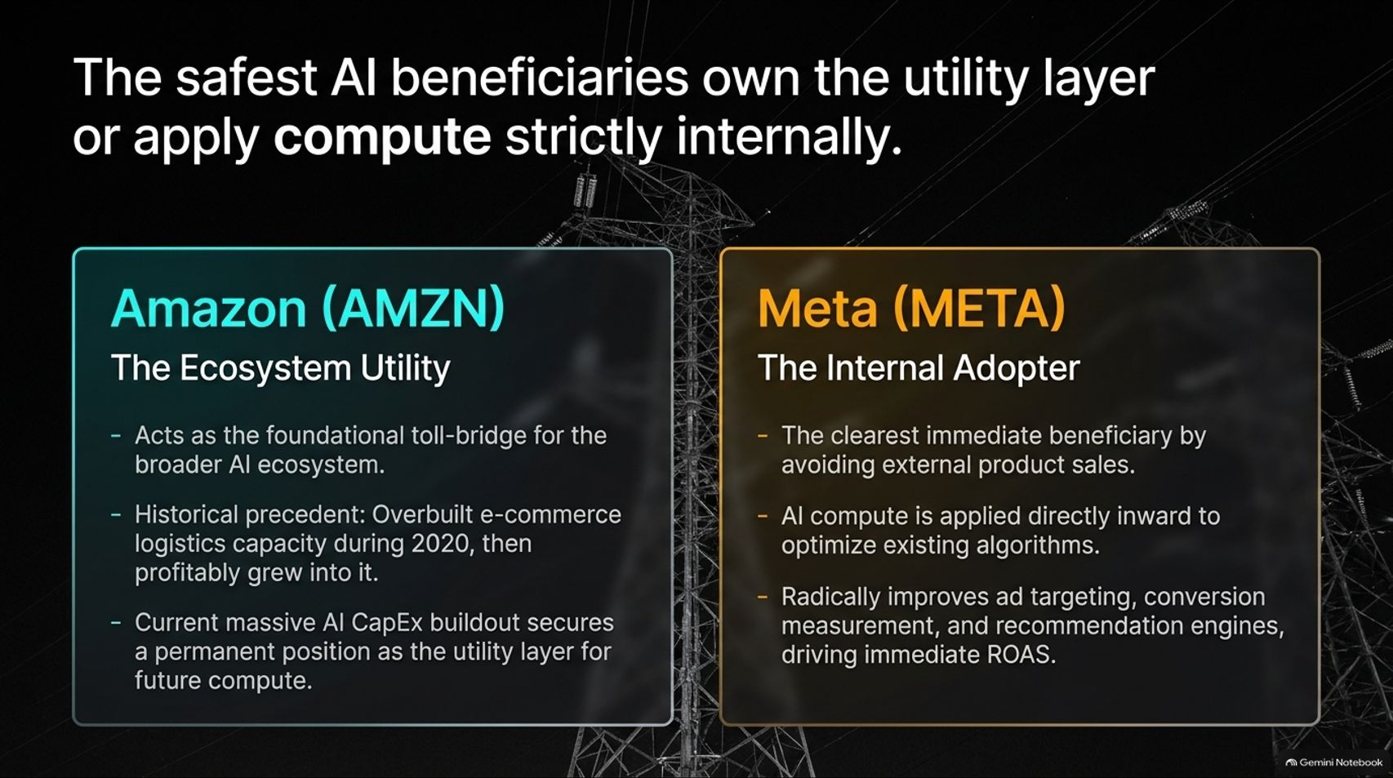
Notes:
Target Timing: 4 – 5 minutes
Tone: Strategic, comparative, stock-specific
Speaker Script:
"Given the risk of the AI air pocket, where are the safest places to deploy capital? History and structural positioning point to two distinct models: companies that own the utility layer or those that apply compute strictly internally.
Look at the two giants featured here:
1. Amazon (AMZN) – The Ecosystem Utility:
Amazon acts as the foundational toll-bridge for the broader digital and AI economy via AWS. Think back to 2020: Amazon heavily overbuilt its e-commerce logistics capacity during the pandemic boom. Wall Street panicked, but Amazon profitably grew into that capacity over subsequent years. Their current massive AI CapEx buildout follows the exact same playbook, securing their permanent position as the indispensable utility layer for future compute.
2. Meta (META) – The Internal Adopter:
Meta is arguably the clearest immediate beneficiary of AI because they do not sell external AI products. Instead, they apply AI compute inward to optimize existing algorithms. By radically improving ad targeting, conversion measurement, and recommendation engines, AI drives immediate return on ad spend (ROAS) and cash flow without taking on consumer pricing risk."

Slide 5
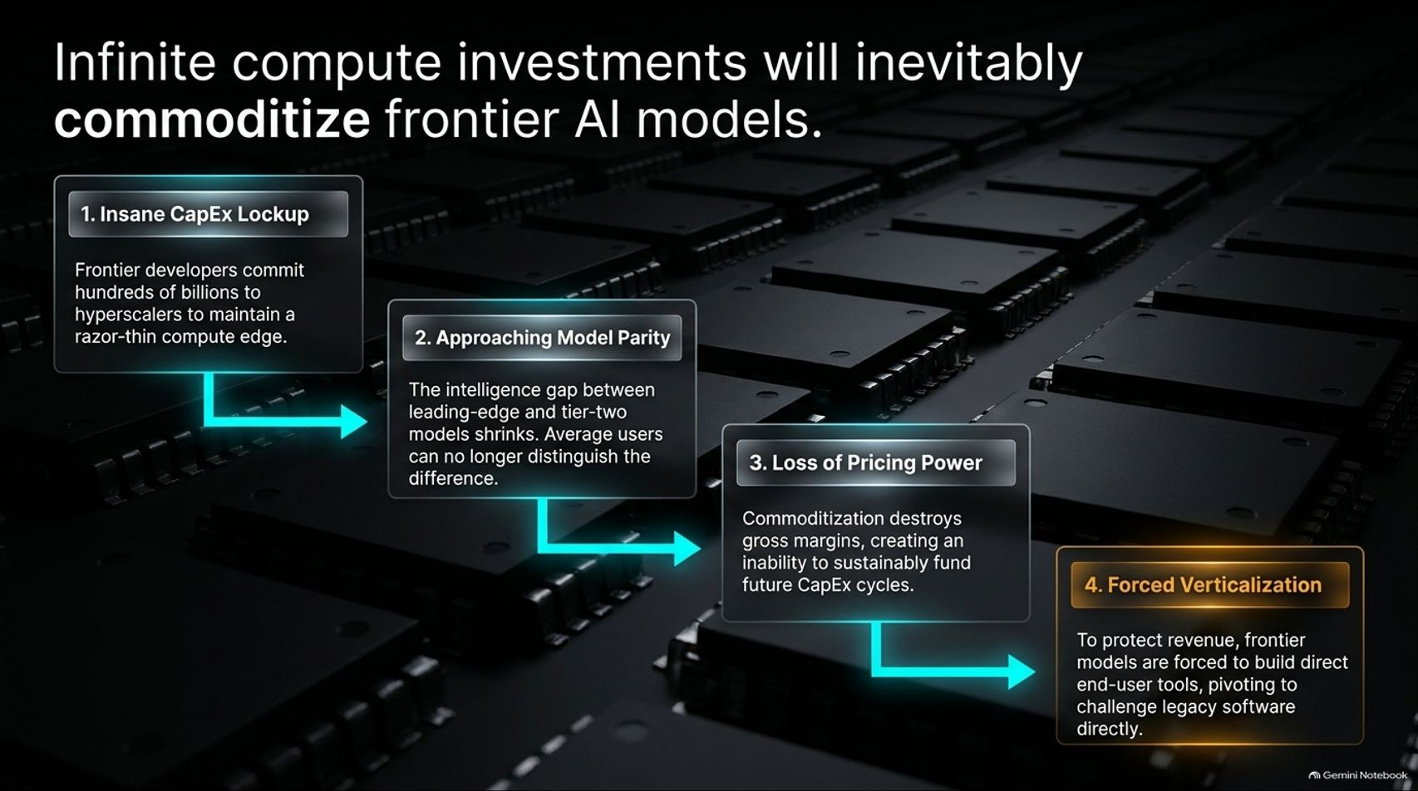
Notes:
Target Timing: 4 – 6 minutes
Tone: Critical, structural, technological reality-check
Speaker Script:
"There is a widespread belief among retail investors that owning the companies building the most advanced frontier AI models is a guaranteed multi-decade compounding machine. But when analyzed through the lens of industrial economics, infinite compute investments will inevitably commoditize frontier AI models.
This process unfolds in four distinct steps:
Step 1: Insane CapEx Lockup. Frontier developers are committing hundreds of billions of dollars to hyperscalers just to maintain a razor-thin compute edge.
Step 2: Approaching Model Parity. As compute scales, the intelligence gap between leading-edge models and tier-two open-source models rapidly shrinks. Average enterprise users can soon no longer distinguish the difference.
Step 3: Loss of Pricing Power. Once models achieve parity, commoditization sets in. Gross margins collapse, destroying the ability of model developers to sustainably fund future CapEx cycles.
Step 4: Forced Verticalization. To protect their revenue, frontier model developers are forced to pivot and build end-user software tools directly, putting them into direct, brutal competition with legacy software giants. Model creation is becoming a commodity; workflow ownership is where the real moat lives."

Slide 6
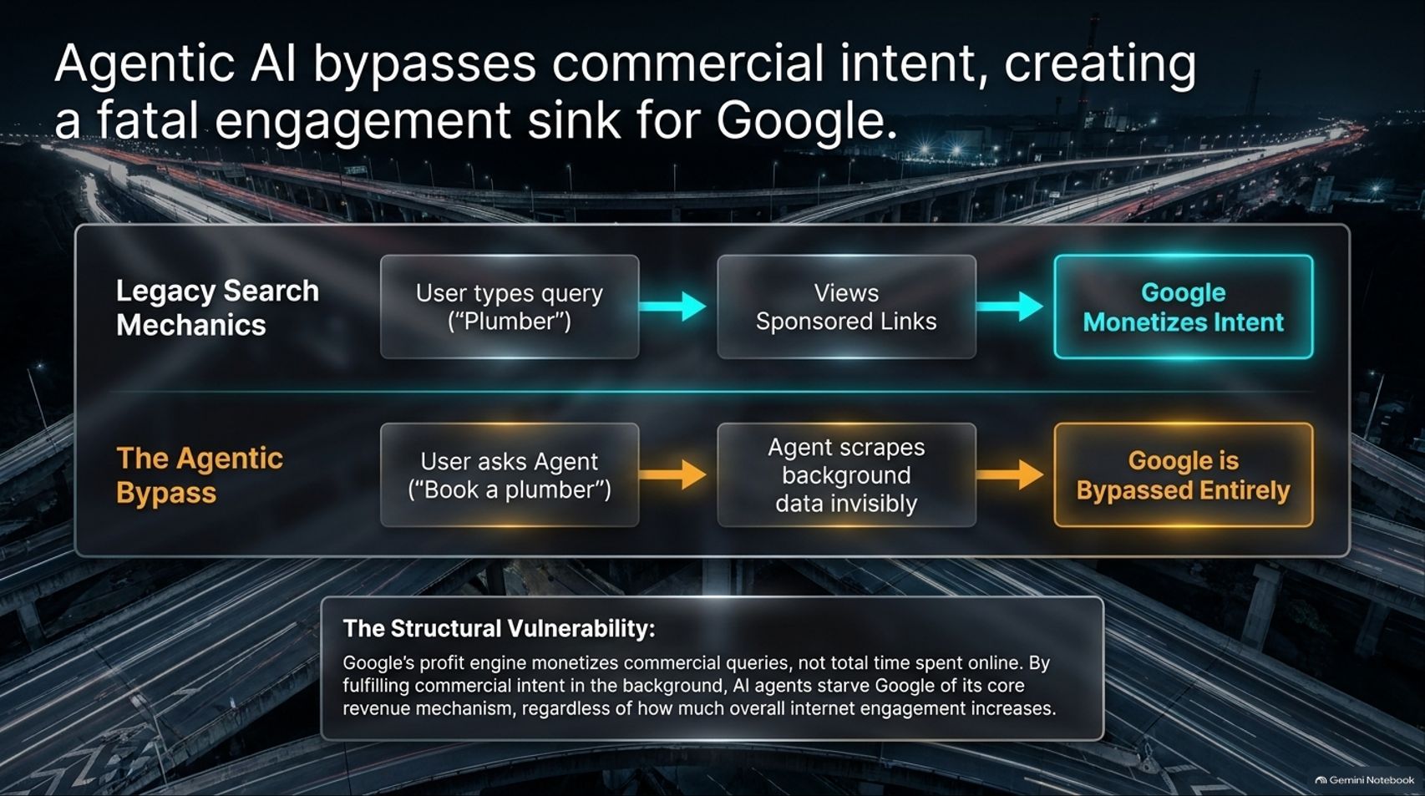
Notes:
Target Timing: 4 – 5 minutes
Tone: Disruption-focused, urgent, analytical
Speaker Script:
"Nowhere is the threat of agentic AI more pronounced than in the traditional search and advertising business model—most notably for Google.
Look at the structural comparison on this slide:
Legacy Search Mechanics: A user types a commercial query like 'Plumber' into a search engine. They view sponsored links, click through, and Google monetizes that commercial intent.
The Agentic Bypass: A user asks an AI agent: 'Book a plumber for Tuesday morning.' The agent silently scrapes background data, coordinates the schedule, and executes the transaction invisibly. Google is bypassed entirely.
The Structural Vulnerability: Google’s profit engine monetizes commercial queries and user attention on search pages—not total time spent online. By fulfilling commercial intent in the background, autonomous AI agents starve Google of its core revenue mechanism, regardless of how much overall internet activity increases. That is a profound structural risk."

Slide 7
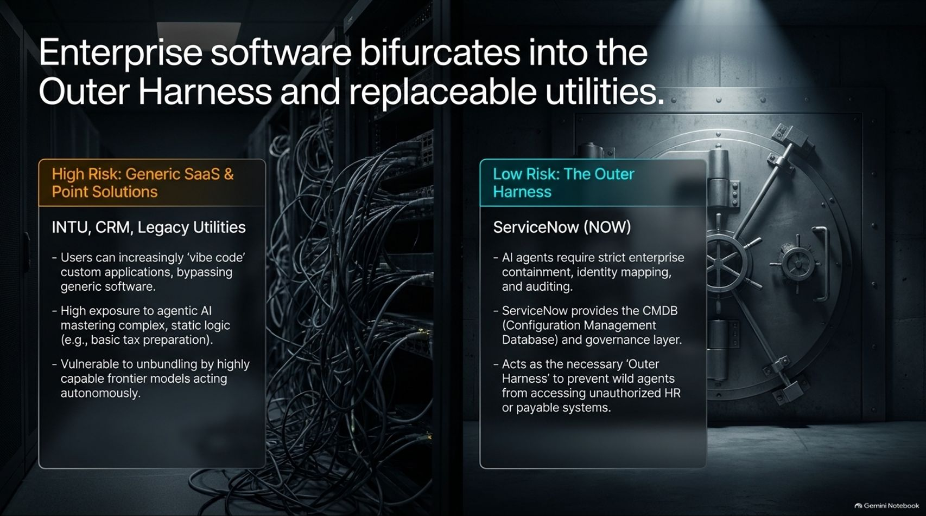
Notes:
Target Timing: 4 – 5 minutes
Tone: Software-focused, strategic, defensive
Speaker Script:
"The software sector is undergoing a massive structural bifurcation. It is splitting cleanly into two categories: High Risk (Generic SaaS) and Low Risk (The Outer Harness).
High Risk (INTU, CRM, Legacy Utilities): Companies offering generic SaaS or static point solutions are highly vulnerable. Enterprise users can increasingly 'vibe code' custom applications or rely on agentic AI to master static logic (such as basic tax preparation). These legacy utilities face severe unbundling by autonomous agents.
Low Risk – The Outer Harness (ServiceNow - NOW): Conversely, companies like ServiceNow occupy an indispensable position. AI agents require strict enterprise containment, identity mapping, security governance, and auditing. ServiceNow provides the Configuration Management Database (CMDB) and governance layer that acts as the necessary 'Outer Harness', preventing wild AI agents from accessing unauthorized HR or payable systems."

Slide 8
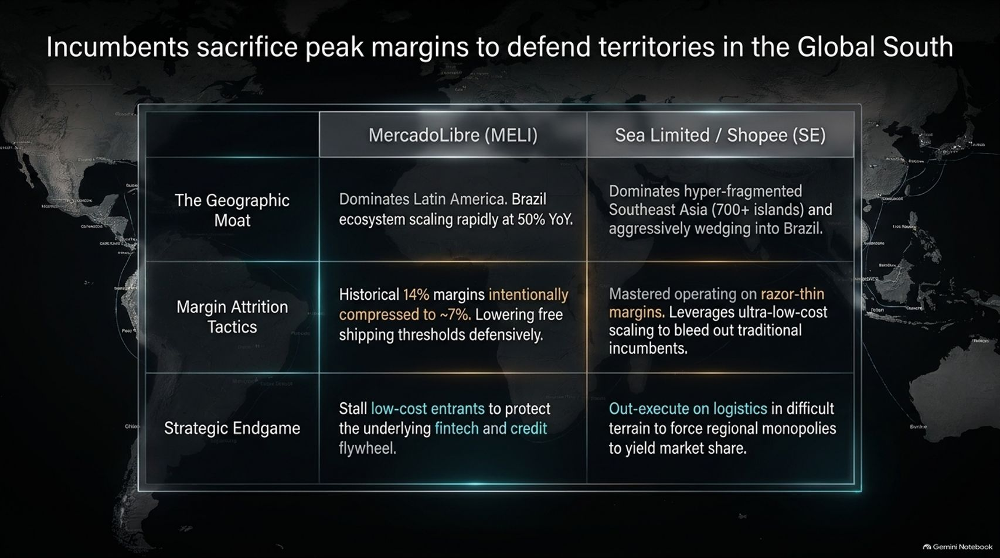
Notes:
Target Timing: 4 – 5 minutes
Tone: International, competitive, comparative
Speaker Script:
"Looking across emerging markets, we see an intense, high-stakes battle between e-commerce behemoths. This slide contrasts two titans: MercadoLibre (MELI) and Sea Limited / Shopee (SE).
MercadoLibre (MELI): Dominates Latin America, with its Brazilian ecosystem scaling rapidly at 50% year-over-year. To fend off low-cost entrants, MercadoLibre has intentionally compressed its historical 14% margins down to roughly 7% by lowering free shipping thresholds defensively. Their strategic endgame is to stall competitors in retail to protect their highly lucrative fintech and credit flywheel.
Sea Limited (SE): Dominates the hyper-fragmented islands of Southeast Asia and is aggressively wedging into Brazil. Sea Limited has mastered operating on razor-thin margins, leveraging ultra-low-cost scaling to bleed out traditional incumbents. Their endgame is ruthless logistics execution in difficult terrain to force regional monopolies to yield market share."

Slide 9
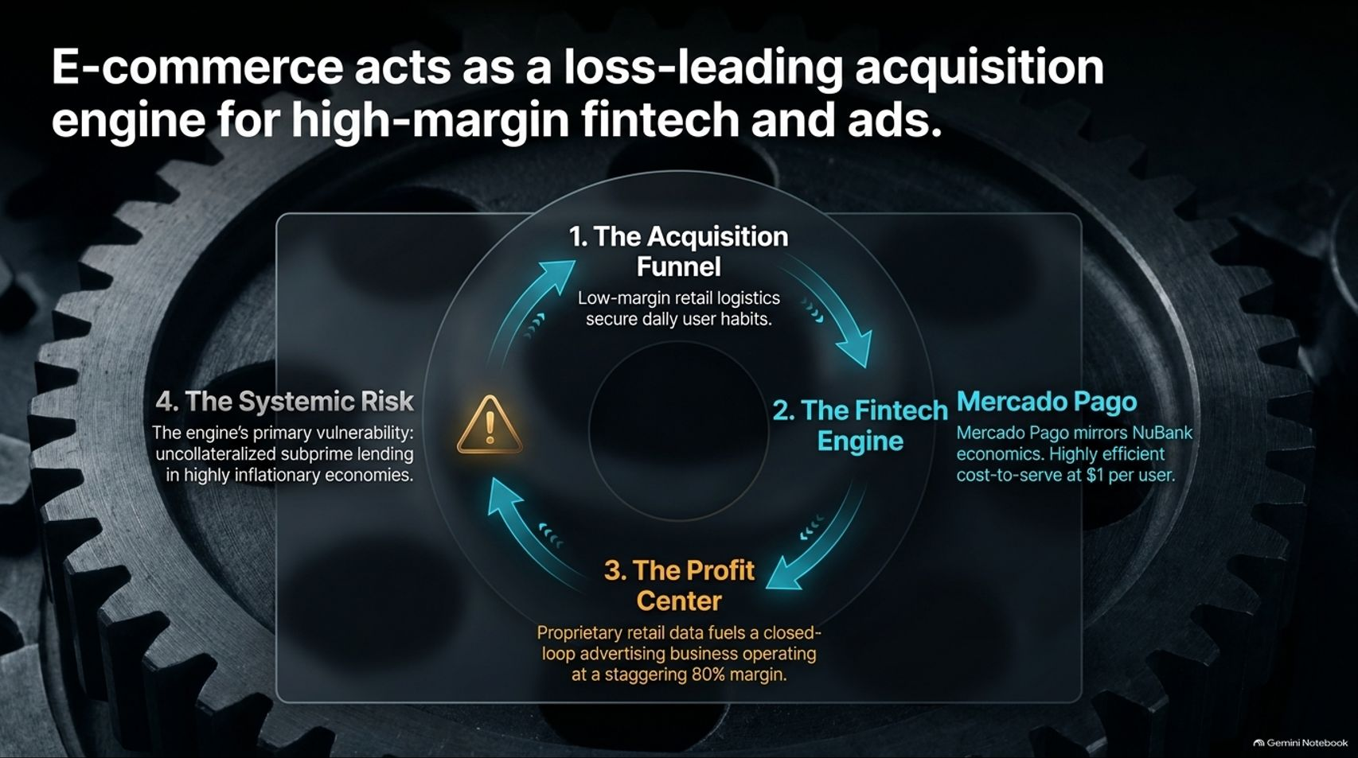
Notes:
Target Timing: 4 – 5 minutes
Tone: Financial, structural, deep-dive
Speaker Script:
"To truly understand companies like MercadoLibre, we must look past retail revenue and understand their economic engine. E-commerce acts as a loss-leading acquisition engine for high-margin fintech and advertising.
Look at the four-step flywheel on this slide:
The Acquisition Centimeter: Low-margin retail logistics secure daily user habits.
The Fintech Engine: Mercado Pago mirrors NuBank economics, achieving a highly efficient cost-to-serve of just $1 per user.
The Profit Center: Proprietary retail shopping data fuels a closed-loop digital advertising business operating at a staggering 80% operating margin.
The Systemic Risk: Every engine has a vulnerability. Here, the primary risk is uncollateralized subprime lending inside highly inflationary Latin American economies. Retail brings them in; fintech and ads make them rich."

Slide 10
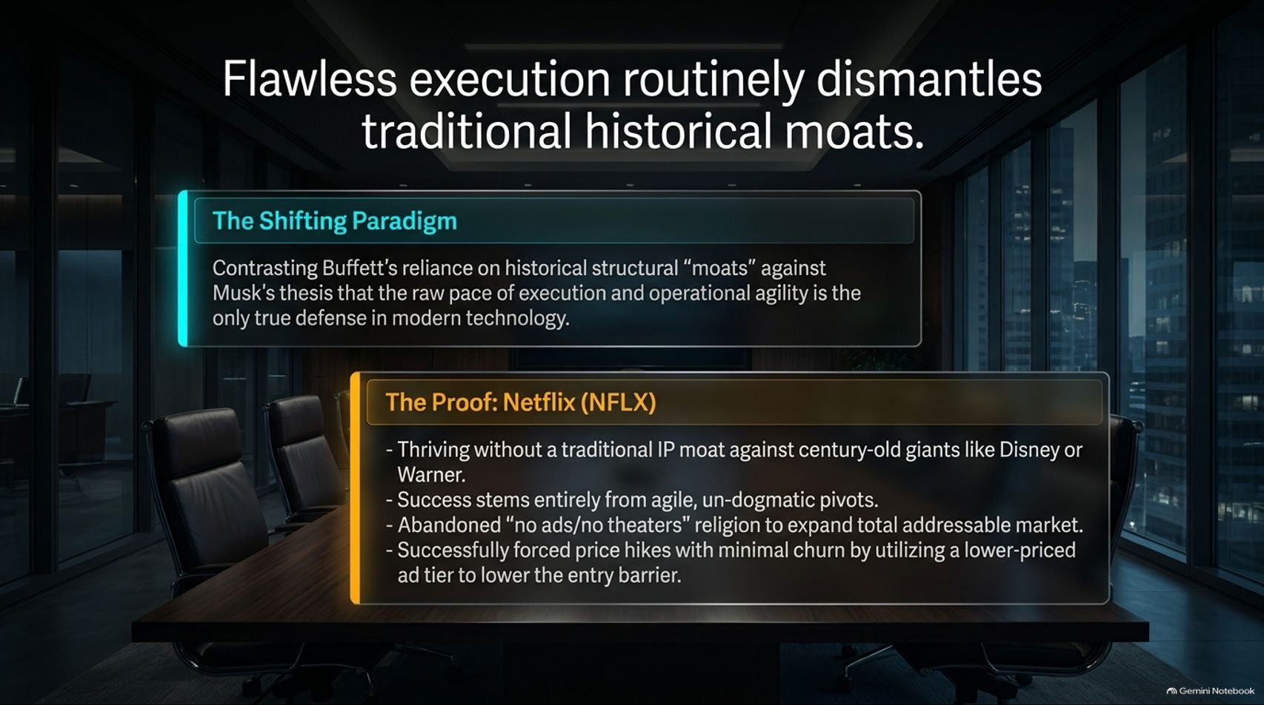
Notes:
Target Timing: 4 – 5 minutes
Tone: Disruptive, managerial, case-study
Speaker Script:
"Let's challenge a sacred dogma of traditional investing: Warren Buffett’s reliance on permanent, structural 'economic moats.' In modern technology, flawless execution routinely dismantles traditional historical moats.
Consider the proof in Netflix (NFLX): Netflix thrives today without a traditional intellectual property (IP) moat against century-old entertainment giants like Disney or Warner Bros. Its success stems entirely from agile, undogmatic operational pivots.
When growth slowed, Netflix abandoned its strict 'no ads, no theaters' religion to dramatically expand its total addressable market. Furthermore, they successfully implemented price hikes with minimal subscriber churn by introducing a lower-priced ad-supported tier to lower the barrier to entry. Operational agility beats a static moat every single time."

Slide 11
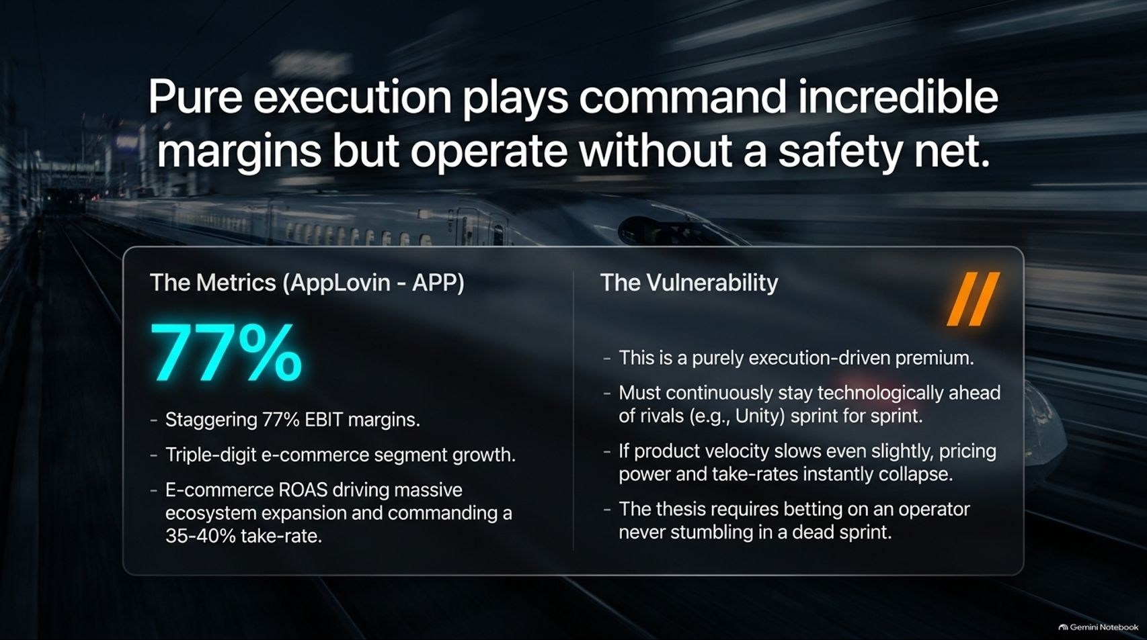
Notes:
Target Timing: 4 – 5 minutes
Tone: Quantitative, risk-aware, intense
Speaker Script:
"While pure execution can build extraordinary businesses, it comes with a catch: Pure execution plays command incredible margins but operate without a safety net.
Look at AppLovin (APP):
The Metrics: AppLovin boasts staggering 77% EBIT margins, triple-digit e-commerce segment growth, and an advertising take-rate of 35% to 40% driven by massive ecosystem expansion.
The Vulnerability: This is a purely execution-driven premium. AppLovin must stay technologically ahead of rivals sprint-for-sprint. If product velocity slows even slightly, pricing power and take-rates instantly collapse. Investing here requires betting that an operator will never stumble in a dead sprint."

Slide 12
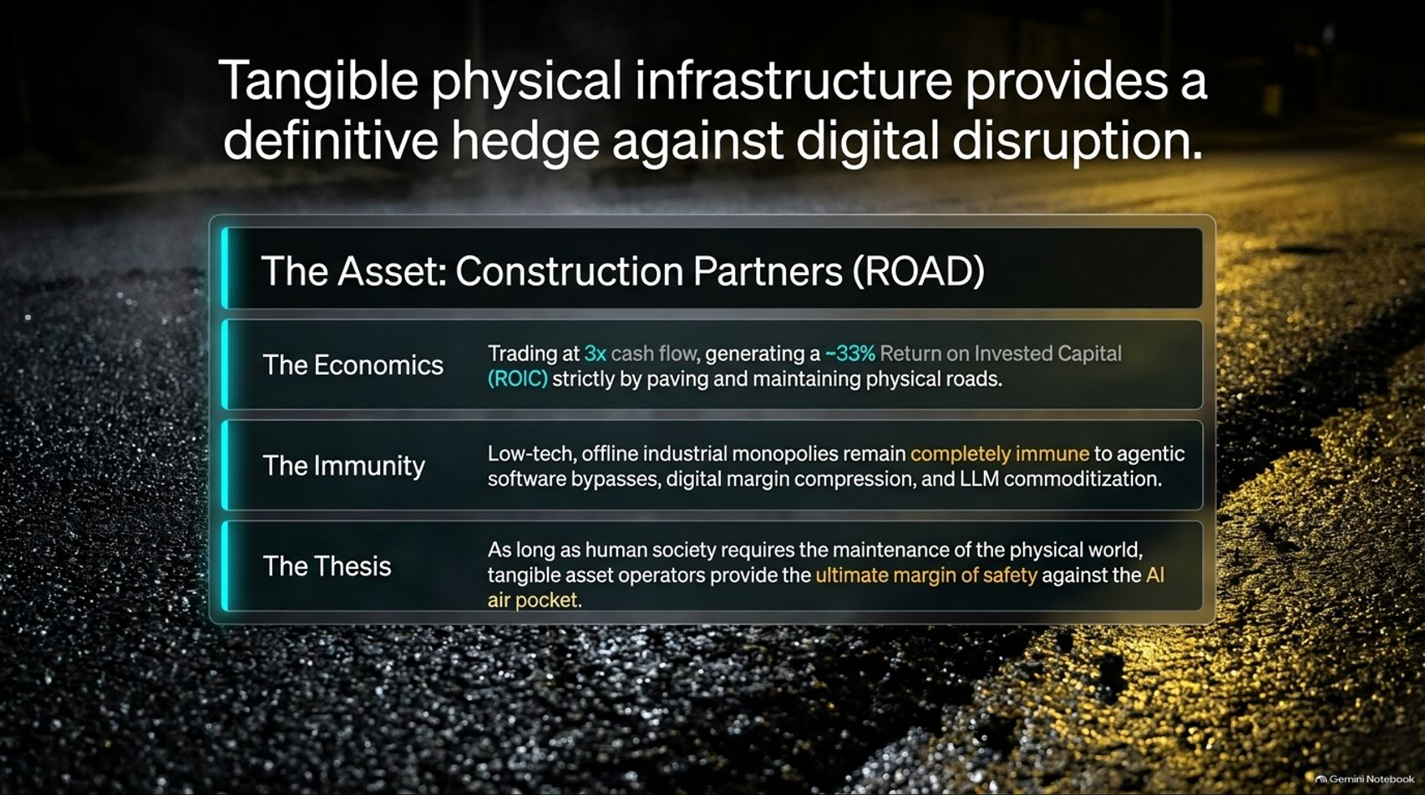
Notes:
Target Timing: 4 – 5 minutes
Tone: Reassuring, tangible, tactical
Speaker Script:
"In a world terrified of digital disruption and AI air pockets, where do you find absolute safety? Tangible physical infrastructure provides a definitive hedge against digital disruption.
Look at Construction Partners (ROAD):
The Economics: ROAD trades at roughly 3x cash flow while generating an extraordinary 33% Return on Invested Capital (ROIC) strictly by paving and maintaining physical asphalt roads.
The Immunity: As a low-tech, offline industrial monopoly, ROAD is completely immune to agentic software bypasses, digital margin compression, and LLM commoditization.
The Thesis: As long as human society requires the maintenance of the physical world, tangible asset operators provide the ultimate margin of safety against the AI air pocket."

Slide 13
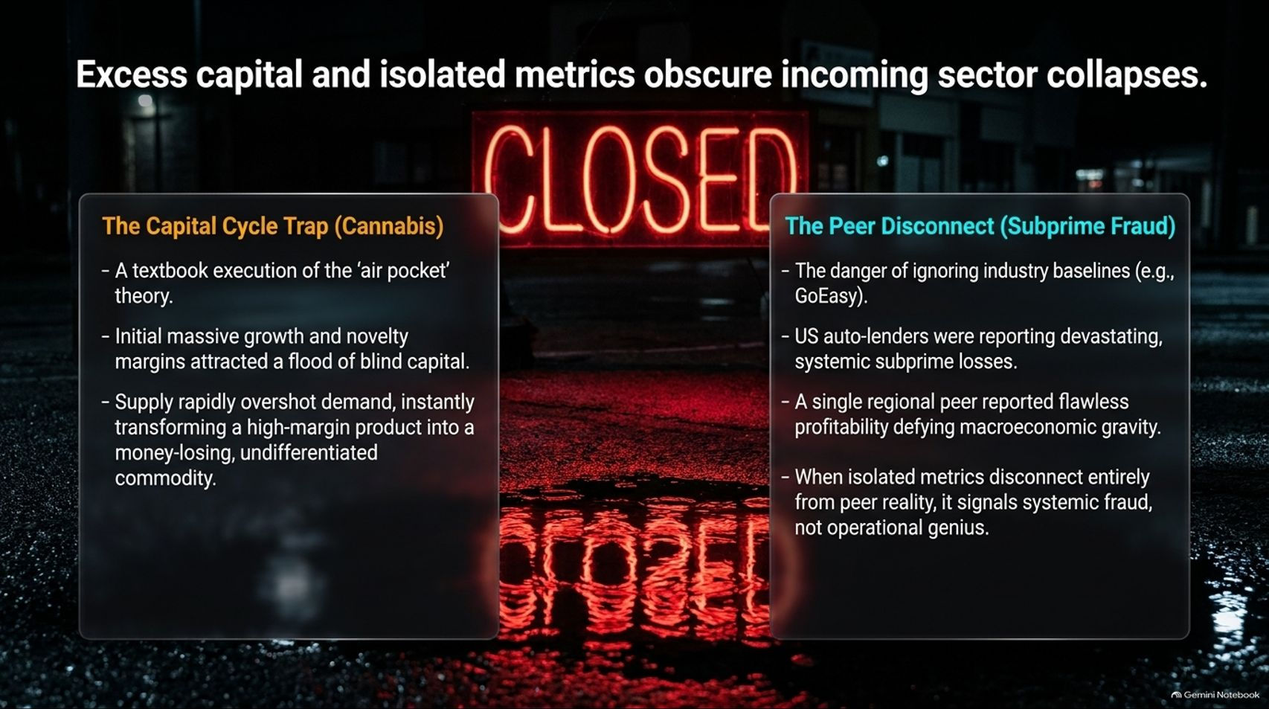
Notes:
Target Timing: 4 – 5 minutes
Tone: Investigative, cautionary, forensic
Speaker Script:
"When capital floods into a nascent trend, excess liquidity and isolated metrics routinely obscure incoming sector collapses. Look at two historical cautionary tales on this slide:
The Capital Cycle Trap (Cannabis): A textbook execution of the 'air pocket' theory. Initial massive growth and novelty margins attracted a flood of blind capital. Supply rapidly overshot demand, instantly transforming a high-margin agricultural product into a money-losing, undifferentiated commodity.
The Peer Disconnect (Subprime Fraud): This highlights the danger of ignoring industry baselines. While US auto-lenders and financial peers were reporting devastating systemic subprime losses, isolated regional peers occasionally reported 'flawless' profitability defying macroeconomic gravity. When isolated metrics disconnect entirely from peer reality, it signals systemic fraud, not operational genius."

Slide 14
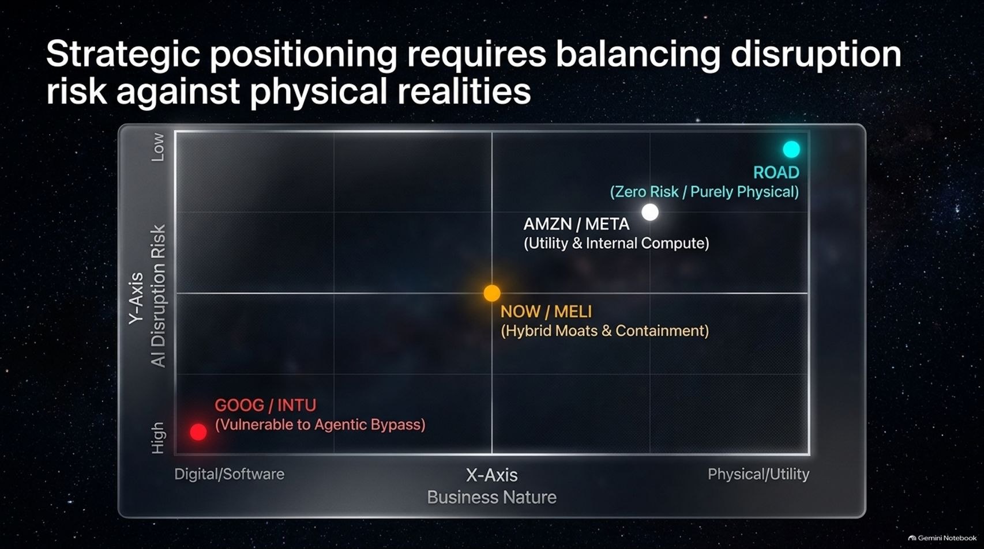
Notes:
Target Timing: 4 – 5 minutes
Tone: Visual, synthesis, analytical
Speaker Script:
"Let's put this entire universe into a single framework. As shown in this matrix, strategic positioning requires balancing disruption risk against physical realities.
Look at the axes:
X-Axis (Business Nature): Moving from pure Digital/Software on the left to Physical/Utility on the right.
Y-Axis (AI Disruption Risk): Moving from Low disruption risk at the top to High disruption risk at the bottom.
Notice where companies land:
Top Right (ROAD, AMZN/META): Zero risk or utility-backed infrastructure.
Middle (NOW, MELI): Hybrid moats and enterprise containment layers.
Bottom Left (GOOG, INTU): High vulnerability to agentic software bypass.
Mapping your portfolio across this grid is essential for surviving the AI transition."

Slide 15
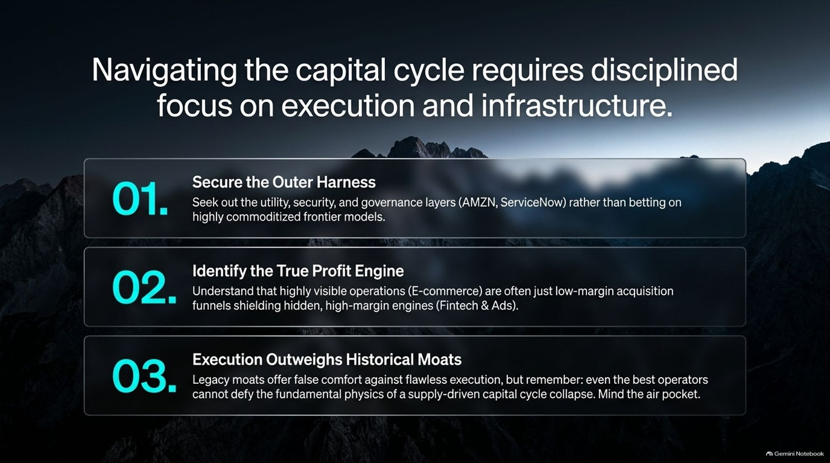
Notes:
Target Timing: 4 – 5 minutes
Tone: Summarizing, tactical, guiding
Speaker Script:
"To successfully navigate this capital cycle, investors must maintain a disciplined focus across three operational pillars:
1. Secure the Outer Harness: Seek out the utility, security, and governance layers—such as Amazon and ServiceNow—rather than betting blindly on highly commoditized frontier models.
2. Identify the True Profit Engine: Understand that highly visible consumer operations like retail e-commerce are often just low-margin acquisition funnels shielding hidden, high-margin profit centers like fintech and digital advertising.
3. Execution Outweighs Historical Moats: Legacy moats offer false comfort against flawless execution. But remember: even the best operators cannot defy the fundamental physics of a supply-driven capital cycle collapse. Always mind the air pocket."

Slide 16
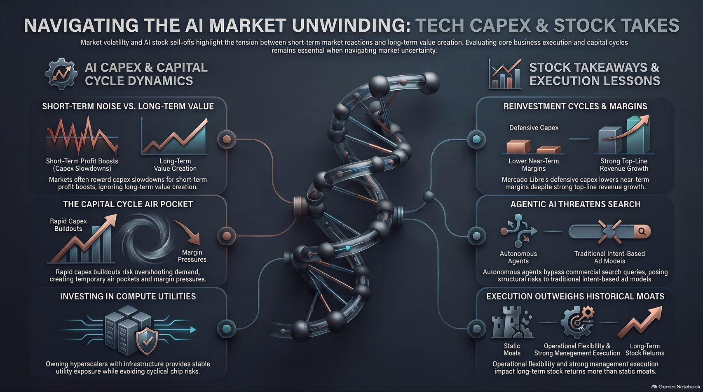
Notes:
Target Timing: 4 – 6 minutes
Tone: Powerful closing, synthesis, comprehensive
Speaker Script:
"Let us synthesize our entire journey into this executive summary.
Market volatility and AI stock sell-offs highlight the ongoing tension between short-term market reactions and long-term value creation. As we navigate this unwinding, three core lessons stand out:
First, Capital Cycle Dynamics: Rapid CapEx buildouts in AI infrastructure risk overshooting organic demand, creating temporary air pockets and margin pressures. Owning compute utilities with established infrastructure provides stable exposure while avoiding cyclical chip risks.
Second, Stock Takeaways & Execution Lessons: MercadoLibre's defensive CapEx demonstrates how companies sacrifice near-term margins to secure long-term market dominance. Meanwhile, agentic AI threatens traditional ad models, making operational flexibility and strong management execution far more important than static historical moats.
Third, The Ultimate Hedge: Balancing high-margin pure execution plays against tangible, physical asset operators like Construction Partners ensures your portfolio maintains a robust margin of safety against digital disruption.
Master the capital cycle, respect the air pocket, and focus on fundamental business quality.
Thank you very much for your time and attention. I would now be delighted to open the floor to any questions."

