Slide 1
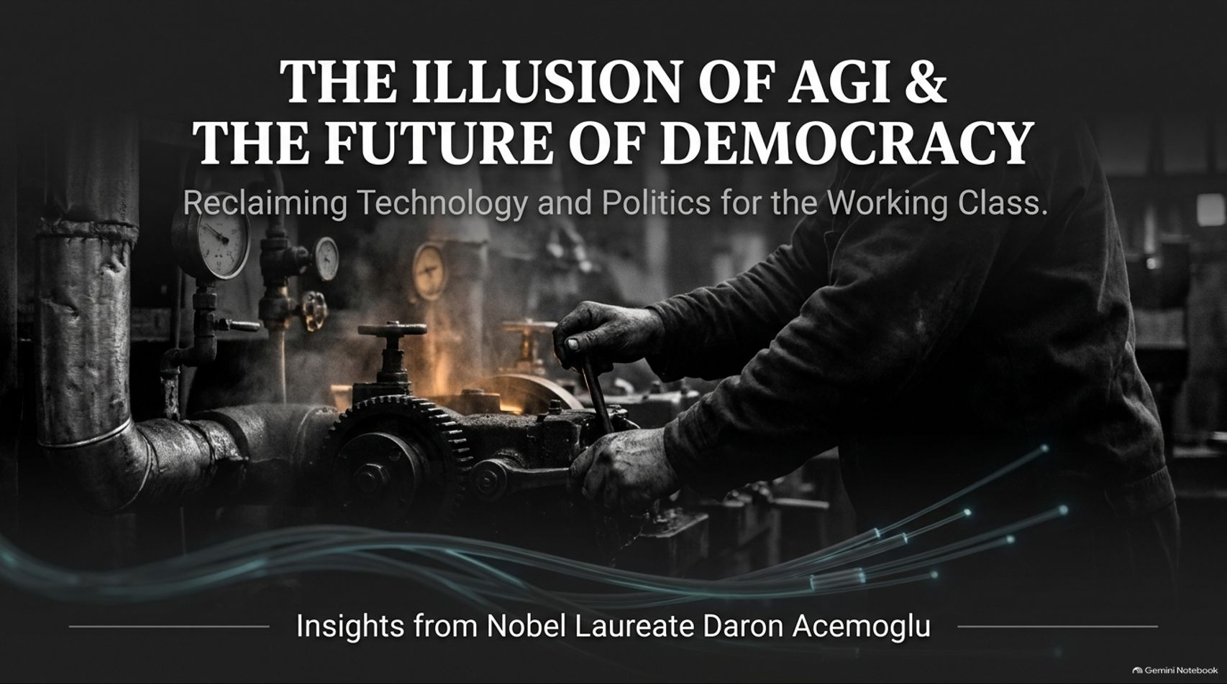
Notes:
Target Timing: 3 – 4 minutes
Tone: Authoritative, reflective, urgent
Speaker Script:
"Good morning, everyone. Welcome to today’s session. We are standing at a unique and precarious inflection point in human history, where two massive, compounding forces are colliding: the deep crisis of modern liberal democracy and the runaway, uncritical hype surrounding Artificial Intelligence.
Our presentation today is titled: 'The Illusion of AGI & The Future of Democracy: Reclaiming Technology and Politics for the Working Class.'
This deck draws directly from the profound economic and political insights of Nobel Laureate Daron Acemoglu—author of Why Nations Fail and What Happened to Liberal Democracy.
For the past several decades, we have been fed a comforting technological and political myth: that market-driven globalization and exponential tech advancement will naturally lift all boats, and that the disruption of the working class is simply an unavoidable side effect of progress. Professor Acemoglu’s work shatters this illusion. He demonstrates that technology is not an autonomous, predetermined force of nature. It is a human choice.
Over the next 15 slides, we will unpack why liberal democracy has lost its foundational mandate, why the elite obsession with Artificial General Intelligence (AGI) threatens both our economy and our freedom, and how we can consciously redirect technology toward a pro-worker, democratic future. Let’s begin."
Nobel Laureate Daron Acemoglu on How China Is Outpacing US in Tech | Nvidia | Jensen Huang
https://www.youtube.com/watch?v=GxfLcAm0fbs

Slide 2
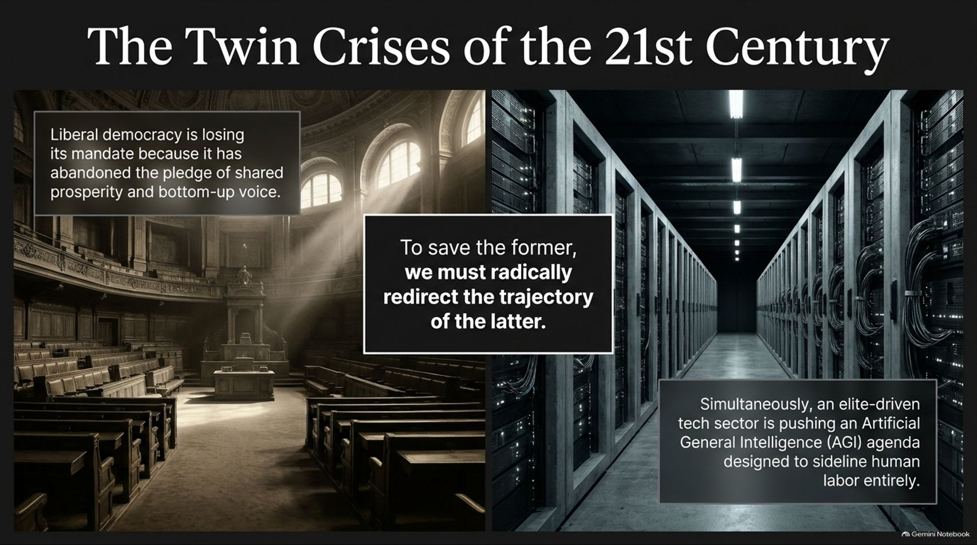
Notes:
Target Timing: 3 – 5 minutes
Tone: Analytical, sober, structural
Speaker Script:
"To understand where we are going, we must first diagnose the present. We are living through The Twin Crises of the 21st Century.
Look at the dual realities on this slide. On the left, our political pillar: Liberal democracy is losing its mandate because it has abandoned its core pledge of shared prosperity and bottom-up voice. For forty years, political institutions have catered primarily to educated elites, leaving the working class economically stagnant and politically disenfranchised.
On the right, our technological pillar: An elite-driven tech sector is pushing an Artificial General Intelligence (AGI) agenda designed to sideline human labor entirely.
Notice the stark contrast. While democratic institutions are crumbling from a lack of popular trust, a tiny, highly concentrated tech oligarchy is funneling hundreds of billions of dollars into algorithms meant to mimic and replace human workers.
Professor Acemoglu argues that these two crises are deeply intertwined. To save liberal democracy, we cannot merely tinker at the edges; we must radically redirect the trajectory of technology. If we allow technology to destroy working-class livelihoods, political populism and authoritarianism will inevitably fill the vacuum."

Slide 3
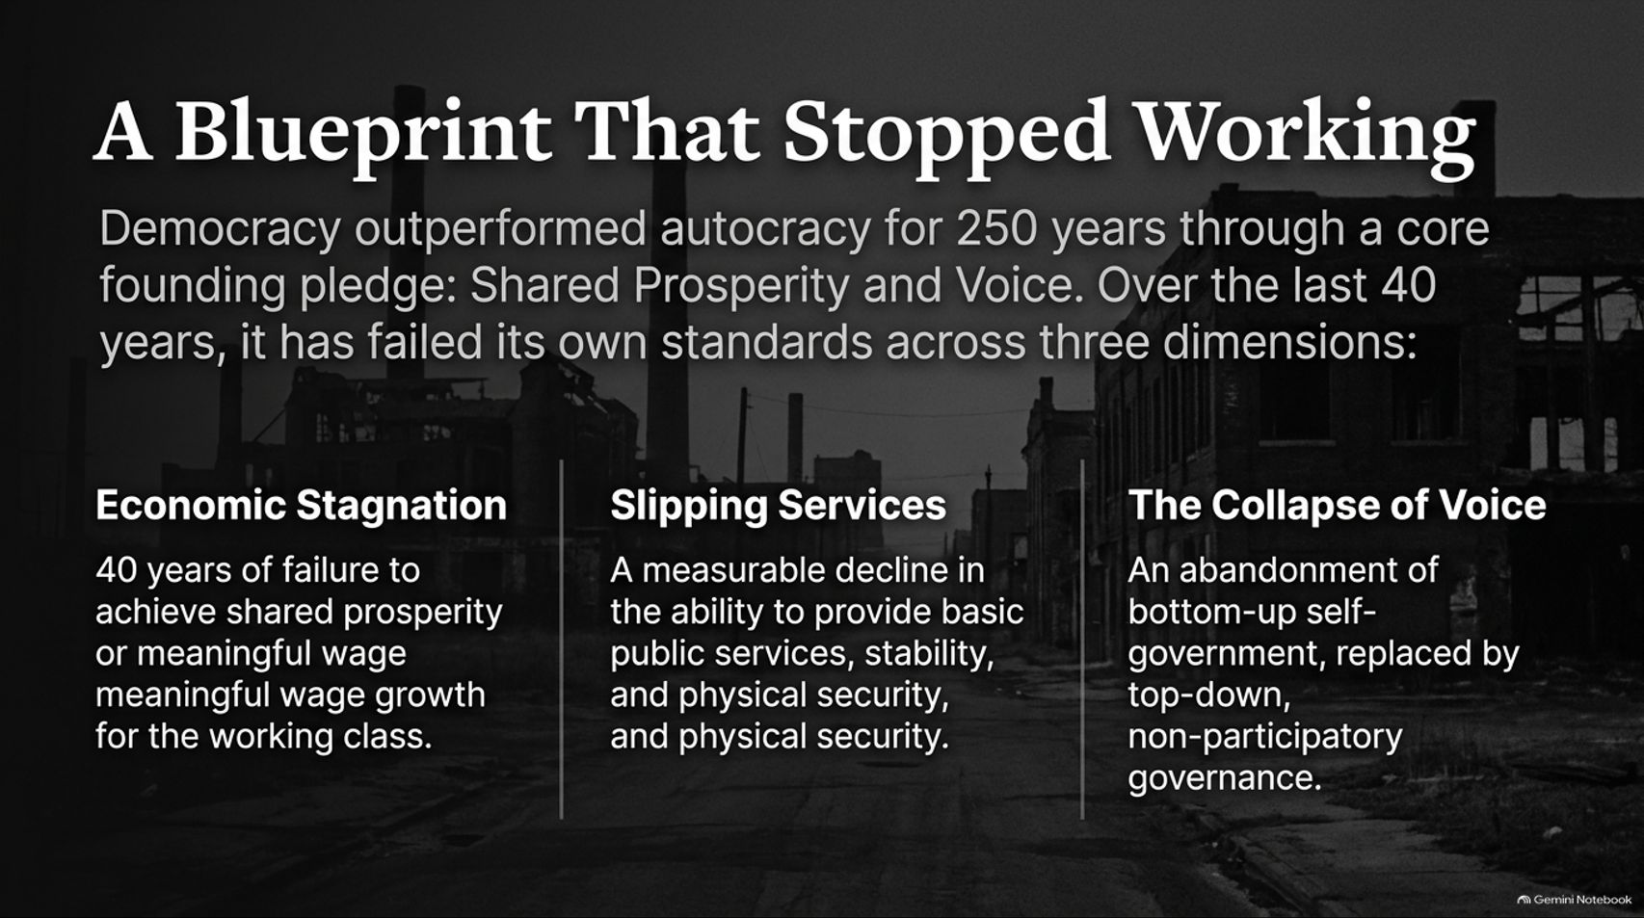
Notes:
Target Timing: 4 – 5 minutes
Tone: Historical, critical, diagnostic
Speaker Script:
"Why has the western political model faltered? Because the blueprint that powered democracy for 250 years has stopped working.
Historically, democracy outperformed autocracy because of a foundational social contract: the promise of Shared Prosperity and Voice. As economies grew, the fruits of that growth were distributed widely across the working population, and ordinary citizens had genuine mechanisms of self-government through labor unions, local associations, and responsive political parties.
Over the last 40 years, however, liberal democracy has failed its own standards across three critical dimensions:
1. Economic Stagnation: A four-decade failure to achieve meaningful wage growth for workers without elite college degrees. Productivity went up; working-class wages flatlined.
2. Slipping Services: A measurable decline in the state's ability to provide basic public goods, physical security, and economic stability.
3. The Collapse of Voice: An abandonment of bottom-up self-government, replaced by top-down, technocratic governance run by insulated elites.
When a political system stops delivering economic security and political voice to the majority, it invites its own dismantling."

Slide 4
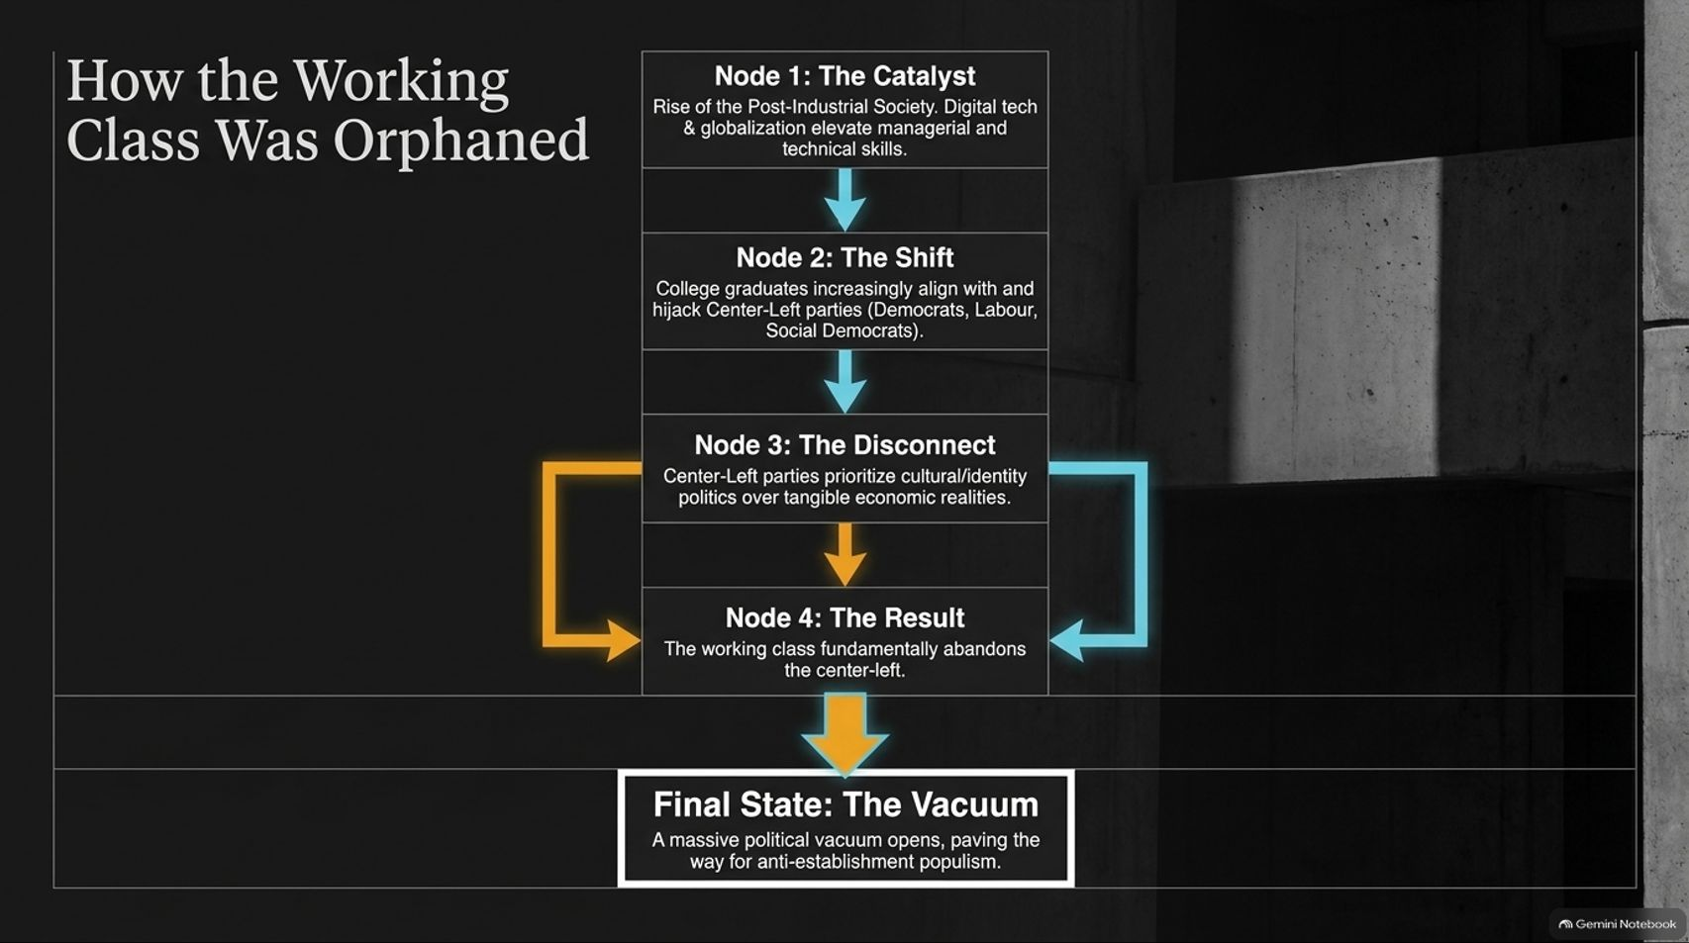
Notes:
Target Timing: 4 – 6 minutes
Tone: Sociological, explanatory, structural
Speaker Script:
"How did we reach this political breaking point? Let’s trace the causal chain of How the Working Class Was Orphaned:
Node 1: The Catalyst. The rise of the post-industrial society. Digital technologies and globalization fundamentally elevated managerial, financial, and technical skills while devaluing manual and routine labor.
Node 2: The Shift. As higher education expanded, college graduates increasingly aligned with and eventually hijacked center-left parties—such as the Democrats in the US, Labour in the UK, and Social Democrats across Europe.
Node 3: The Disconnect. Center-left parties, once anchored by labor unions and working-class economics, shifted their focus toward elite cultural priorities and identity politics, losing touch with tangible economic realities.
Node 4: The Result. Recognizing that mainstream center-left parties no longer spoke for their material interests, the working class fundamentally abandoned them.
Final State: The Vacuum. This created a massive political vacuum, paving the way for hard-right and hard-left anti-establishment populism.
This systemic realignment explains why traditional working-class strongholds across the democratic world turned their backs on the political establishment."

Slide 5
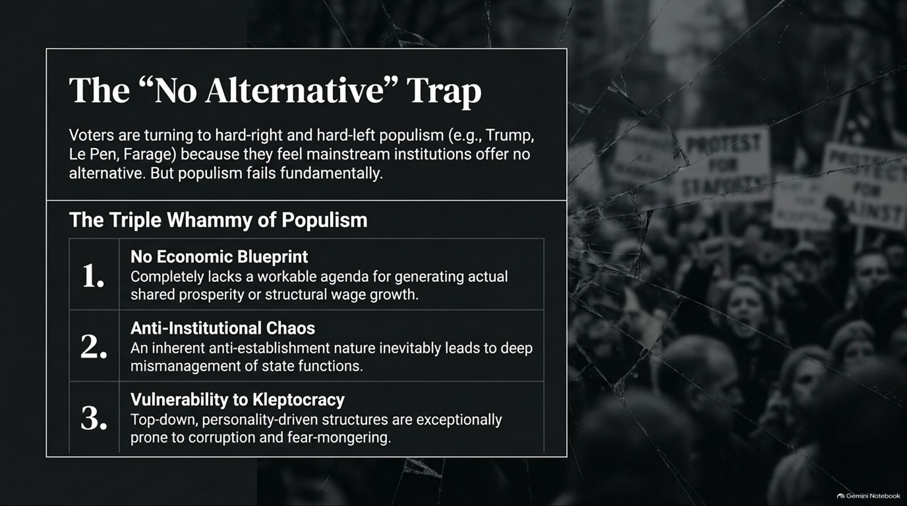
Notes:
Target Timing: 4 – 5 minutes
Tone: Warning, analytical, uncompromising
Speaker Script:
"Voters are turning in droves to populist figures—whether Trump, Le Pen, or Farage—because establishment figures told them a dangerous lie: 'There is no alternative.' When voters feel mainstream institutions offer no economic breathing room, they lash out.
But Professor Acemoglu warns that populism is a trap because it relies on a Triple Whammy of failure:
1. No Economic Blueprint: Populist movements completely lack a workable agenda for generating actual shared prosperity or structural wage growth. Their economic nationalism is largely performative.
2. Anti-Institutional Chaos: Their inherent anti-establishment nature inevitably leads to deep mismanagement of complex state functions. Tearing down institutions doesn't solve problems; it blinds the pilot.
3. Vulnerability to Kleptocracy: Top-down, personality-driven political structures are exceptionally prone to corruption, cronyism, and fear-mongering.
Populism diagnoses real pain, but its prescription is poison. Defeating populism at the ballot box by simply returning to the pre-2016 status quo is a fool's errand; without structural reform, the crisis will only deepen."

Slide 6
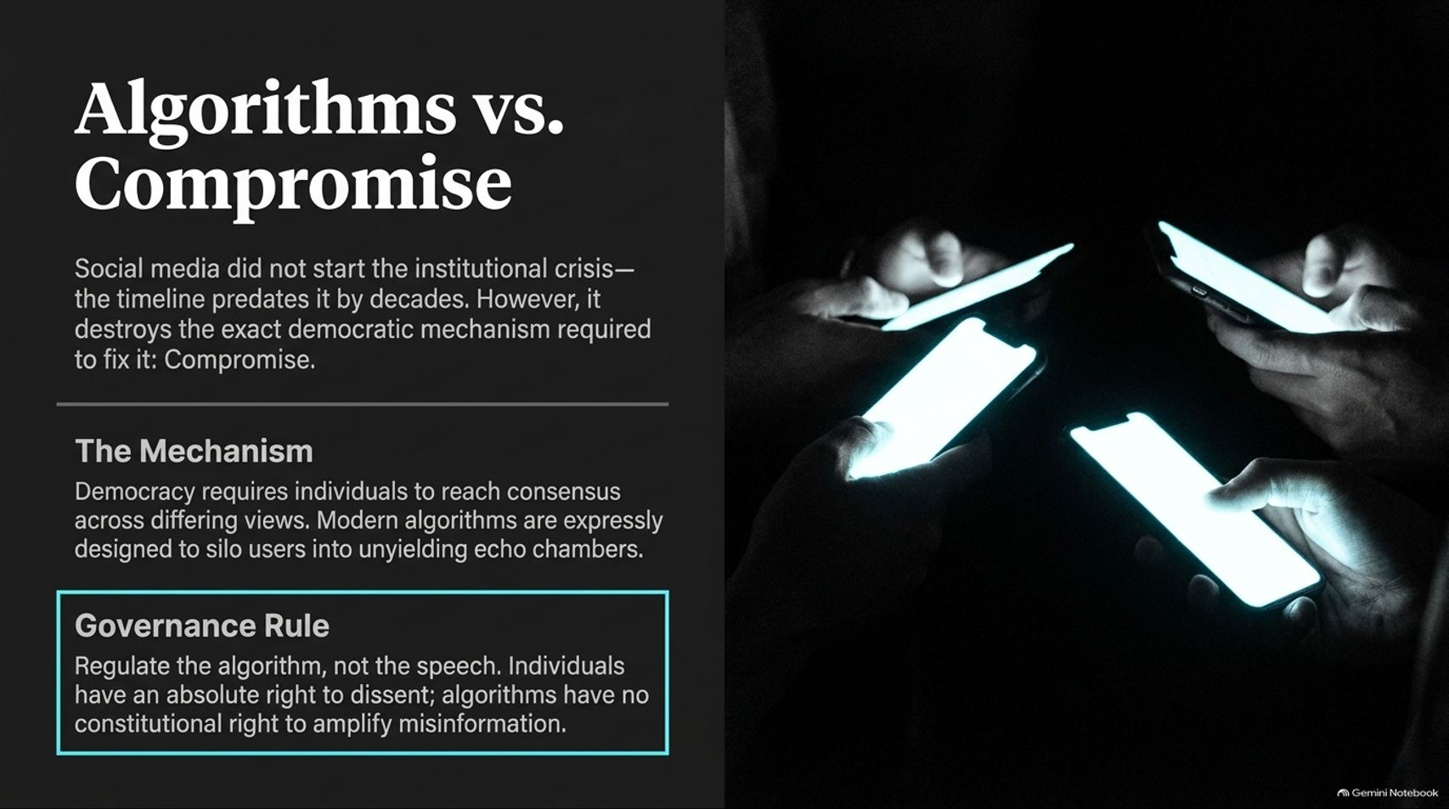
Notes:
Target Timing: 4 – 5 minutes
Tone: Media-critical, technological, uncompromising
Speaker Script:
"While political institutional decay started decades before social media, digital platforms have poured gasoline on the fire. Algorithms are fundamentally incompatible with political compromise.
Healthy democracy requires individuals with differing views to reach pragmatic compromises within a shared framework. But modern social media algorithms are expressly engineered to achieve the exact opposite: maximizing engagement through outrage, thereby siloing users into unyielding echo chambers.
Notice the governance principle highlighted on this slide: Regulate the algorithm, not the speech.
Citizens have an absolute constitutional right to dissent, no matter how radical or unpopular their views are. But algorithms—the corporate lines of code designed to amplify sensationalism and misinformation—have no constitutional rights. Reverting social media architectures back to chronological feeds rather than algorithmic outrage engines is a vital first step to restoring national sanity."

Slide 7
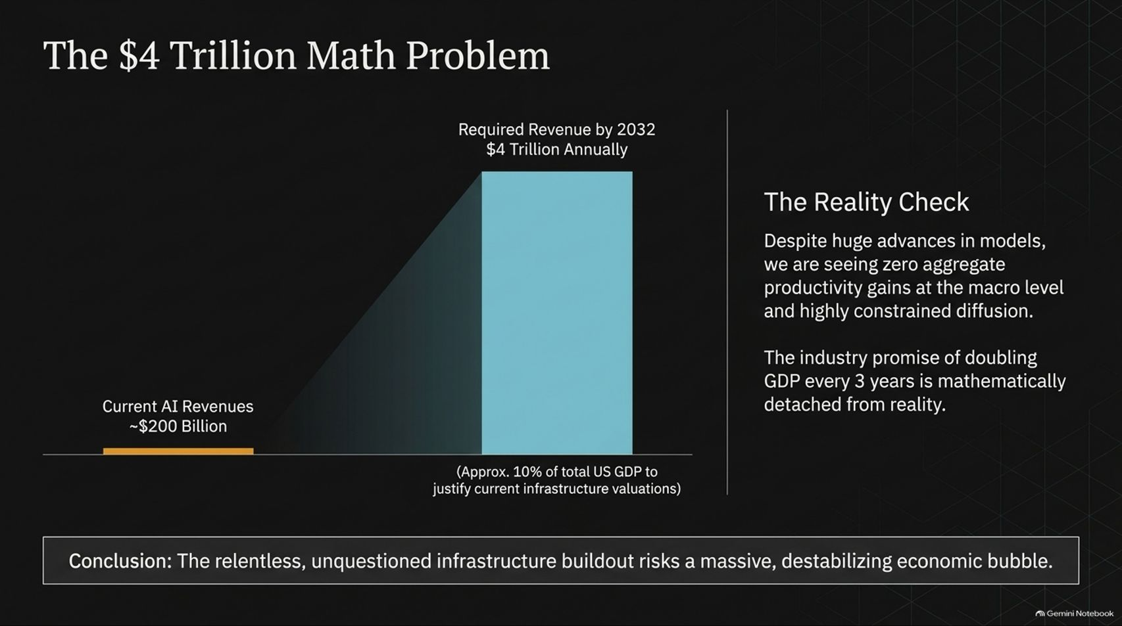
Notes:
Target Timing: 4 – 6 minutes
Tone: Financial, skeptical, macroeconomic
Speaker Script:
"Let us pivot from politics to economics and examine the staggering valuation of today’s artificial intelligence boom. Welcome to The $4 Trillion Math Problem.
Current global AI revenues hover around $200 billion. Yet, based on the monumental capital expenditures currently being poured into data centers, chips, and energy infrastructure, Brookings-backed economic models estimate that AI frontier labs and leading tech firms will need to generate $3.7 to $4 trillion in annual revenues by 2032 just to justify their current valuations. That is roughly 10% of total US GDP.
The Reality Check: Despite breathtaking demos from AI labs, macroeconomic data shows near-zero aggregate productivity gains at the macro level and highly constrained diffusion across traditional industries. The industry promise of doubling global GDP every three years is mathematically detached from reality.
Conclusion: The relentless, unquestioned infrastructure buildout risks triggering a massive, destabilizing economic bubble. When the hype crashes against the wall of cold revenue math, the fallout will be severe."

Slide 8

Notes:
Target Timing: 4 – 5 minutes
Tone: Critical, governance-focused, provocative
Speaker Script:
"Perhaps the most alarming aspect of the current AI boom is not just the financial math, but the governance vacuum. As Professor Acemoglu points out: We have roughly 20 people deciding the future of 8 billion.
Let's break down this core critique:
The Concentration of Power: The development of a technology intended to alter every single aspect of human life is driven by an unprecedentedly concentrated group of tech leaders in Silicon Valley.
The Unquestioned Ideology: This elite shares an identical, largely unscrutinized ideology: the relentless, messianic pursuit of Artificial General Intelligence (AGI).
The Existential Risk: They are pushing aggressively forward without ever pausing to ask whether mimicking and ultimately surpassing human intelligence is actually the optimal, safest, or most desirable direction for human society.
No democratic electorate voted for this transition. A handful of unelected tech monopolists are unilaterally steering humanity's destination."

Slide 9
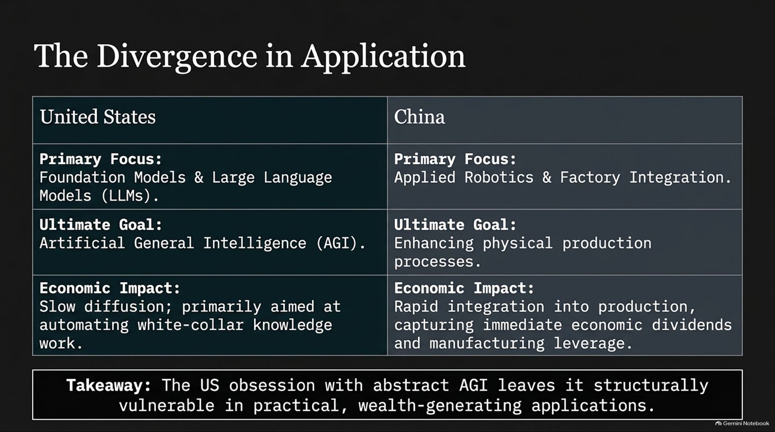
Notes:
Target Timing: 4 – 5 minutes
Tone: Geopolitical, comparative, strategic
Speaker Script:
"How different regions approach AI is creating a profound geopolitical divergence. Let’s compare the United States and China:
Primary Focus: The US focuses obsessively on foundational models and Large Language Models (LLMs). China focuses heavily on applied robotics and factory integration.
Ultimate Goal: US tech leaders chase abstract AGI. China’s goal is enhancing physical production processes and manufacturing efficiency.
Economic Impact: In the US, AI diffusion has been slow, primarily aimed at automating white-collar knowledge work. In China, AI and robotics are rapidly integrated into physical production, capturing immediate economic dividends and manufacturing leverage.
Takeaway: The American obsession with abstract AGI leaves it structurally vulnerable in practical, wealth-generating applications. While Silicon Valley debates chatbot consciousness, Chinese industry is quietly automating the physical world."

Slide 10
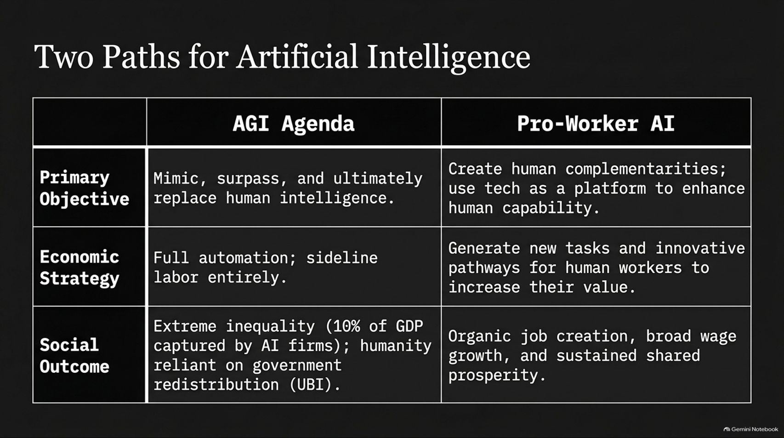
Notes:
Target Timing: 4 – 6 minutes
Tone: Philosophical, visionary, foundational
Speaker Script:
"We are not locked into a single technological destiny. There are Two Distinct Paths for Artificial Intelligence, and society must choose between them:
Path 1: The AGI Agenda. Its primary objective is to mimic, surpass, and ultimately replace human intelligence. Its economic strategy is full automation—sideline labor entirely. Its social outcome? Extreme inequality, with up to 10% of GDP captured by AI firms, leaving humanity reliant on government handouts like Universal Basic Income (UBI).
Path 2: Pro-Worker AI. Its primary objective is to create human complementarities—using technology as a platform to enhance human capability rather than erase it. Its economic strategy is generating new tasks and innovative pathways for human workers to increase their value. Its social outcome? Organic job creation, broad wage growth, and sustained shared prosperity.
Automation is a choice. We can choose to build tools that empower workers, or toys that replace them."

Slide 11
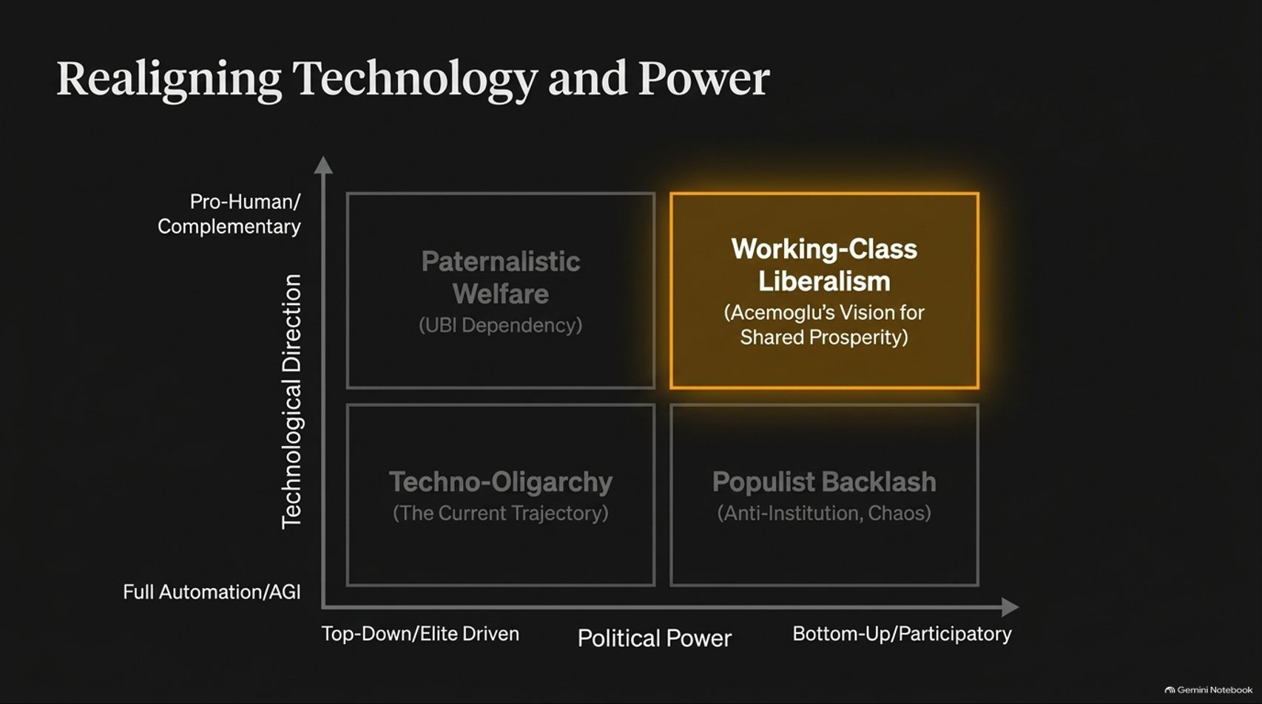
Notes:
Target Timing: 3 – 5 minutes
Tone: Strategic, matrix-analysis, explanatory
Speaker Script:
"Let's map these choices onto a strategic matrix: Realigning Technology and Power.
Look at the two axes:
Y-Axis (Technological Direction): Ranging from Full Automation/AGI at the bottom to Pro-Human/Complementary technology at the top.
X-Axis (Political Power): Ranging from Top-Down/Elite Driven on the left to Bottom-Up/Participatory on the right.
This creates four quadrants:
Bottom Left: Techno-Oligarchy—our current trajectory of elite-driven AGI.
Top Left: Paternalistic Welfare—where tech automates everything, and elites placate the masses with UBI.
Bottom Right: Populist Backlash—anti-institutional chaos driven by economic desperation.
Top Right: Working-Class Liberalism—Professor Acemoglu’s vision, combining pro-human technological direction with bottom-up political empowerment.
That top-right quadrant is where we must direct our policy efforts."

Slide 12

Notes:
Target Timing: 4 – 5 minutes
Tone: Political, actionable, inspiring
Speaker Script:
"To achieve Working-Class Liberalism, we must execute three core solution pillars. Pillar 1: Rebuilding the Democratic Tent.
The Prescription: Liberal democracy must structurally re-center on the working class—embracing both blue-collar workers and non-urban white-collar workers.
The Mechanism: Political parties must shift away from elite cultural signaling and identity politics, returning to the hard work of delivering tangible economic outcomes.
The Metric of Success: Focus on aggressive job creation and wage growth across all skill levels, rather than lazily relying on post-facto wealth redistribution and safety nets.
A political coalition cannot claim to represent working people while ignoring their economic security."

Slide 13
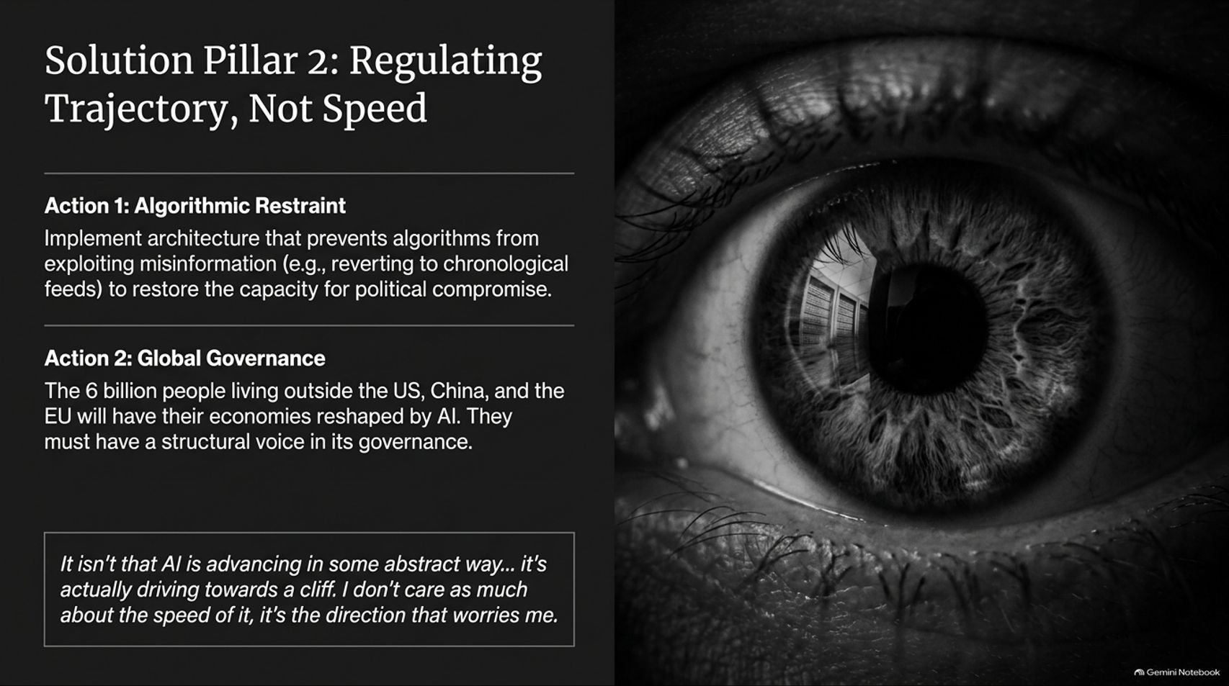
Notes:
Target Timing: 4 – 5 minutes
Tone: Regulatory, forward-thinking, urgent
Speaker Script:
"Our second solution pillar focuses on technology governance: Regulating Trajectory, Not Speed.
Action 1: Algorithmic Restraint. Implement architectural rules that prevent social media algorithms from exploiting misinformation—such as returning to chronological feeds—to restore society's capacity for political compromise.
Action 2: Global Governance. Over 6 billion people live outside the US, China, and the EU. Their economies will be profoundly reshaped by AI, yet they have zero voice in its current development. They must be granted structural representation in global AI governance.
As Professor Acemoglu famously notes: 'It isn’t that AI is advancing in some abstract way... it’s actually driving towards a cliff. I don’t care as much about the speed of it, it’s the direction that worries me.' Steering away from the cliff is more urgent than racing over it."

Slide 14
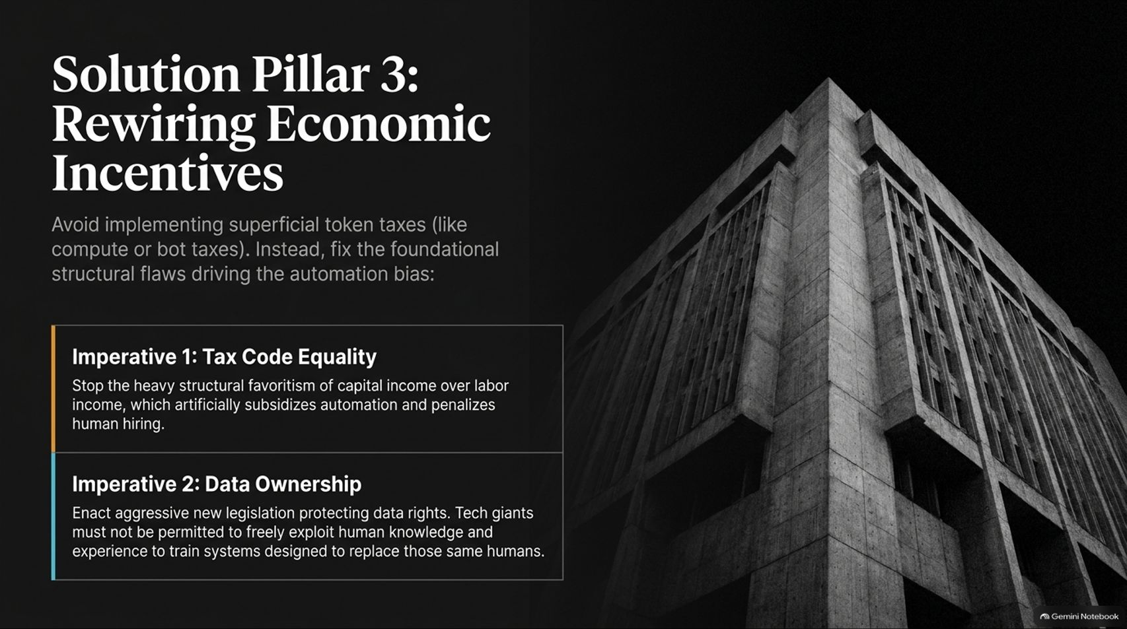
Notes:
Target Timing: 4 – 5 minutes
Tone: Economic, structural, policy-driven
Speaker Script:
"Our third solution pillar tackles the financial architecture of automation: Rewiring Economic Incentives.
We must avoid superficial token taxes, such as compute or bot taxes, which fail to address root causes. Instead, we must fix the foundational structural flaws driving the automation bias:
Imperative 1: Tax Code Equality. Stop the heavy structural favoritism of capital income over labor income. For decades, tax codes have artificially subsidized corporate automation and penalized human hiring. Leveling the tax playing field is essential.
Imperative 2: Data Ownership. Enact aggressive new legislation protecting data rights. Tech giants must no longer be permitted to freely exploit human knowledge, writing, and labor to train systems explicitly designed to replace those same humans."

Slide 15
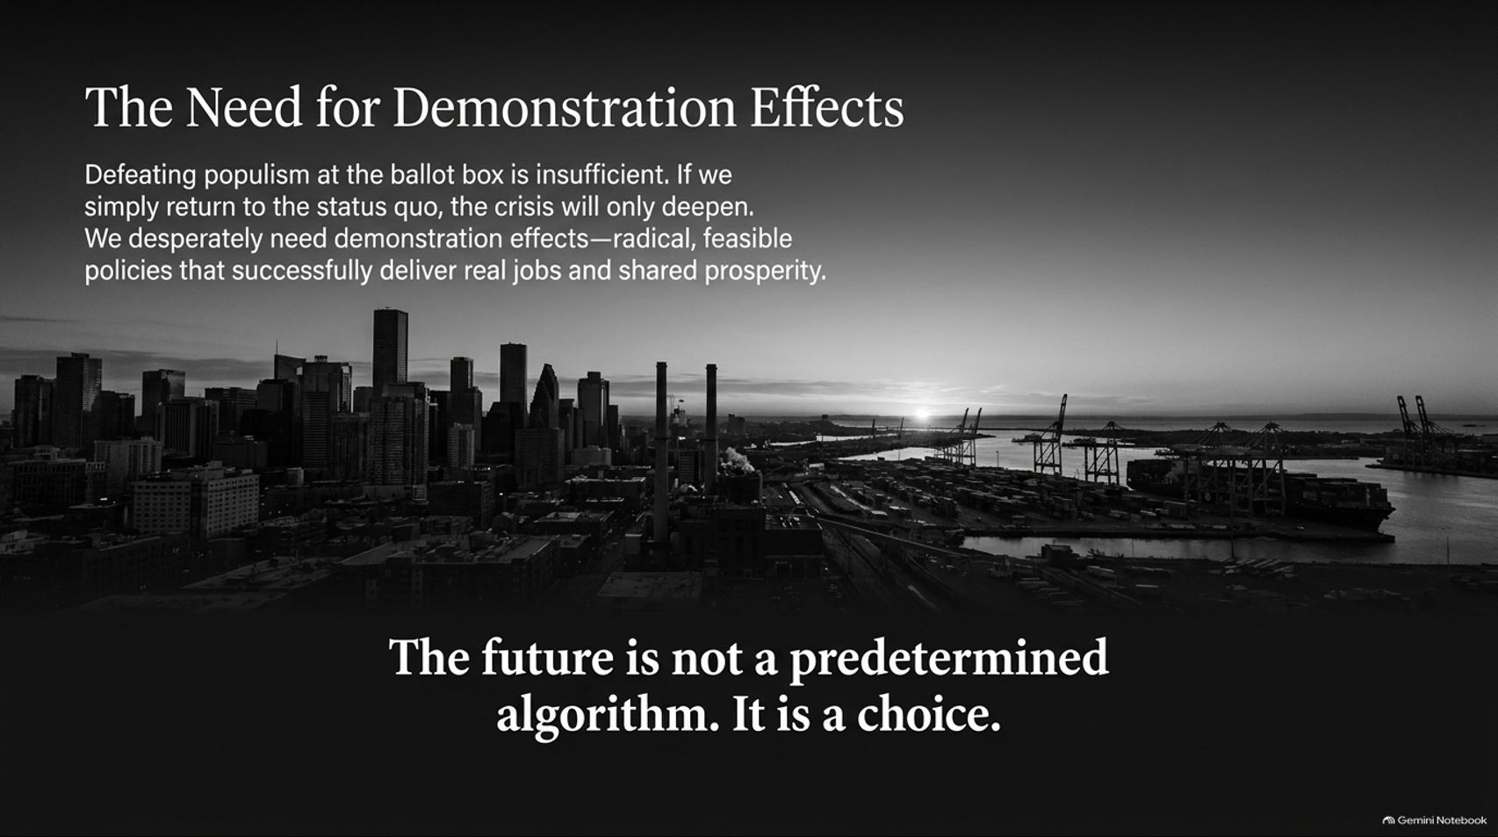
Notes:
Target Timing: 4 – 6 minutes
Tone: Inspiring, powerful closing, call-to-action
Speaker Script:
"To conclude our presentation, let us reflect on what it takes to enact real change. Defeating populism at the ballot box is insufficient. If we simply return to the pre-crisis status quo, the political rot will only deepen.
We desperately need Demonstration Effects—radical, feasible policies that successfully deliver real jobs, wage growth, and shared prosperity. We need political leaders who can prove that democratic governance can build a flourishing, inclusive economy.
Leave with this final thought displayed on our screen:
'The future is not a predetermined algorithm. It is a choice.'
Technology does not master us; we master technology. By rejecting the illusion of AGI, reclaiming our political institutions, and championing pro-worker innovation, we can rescue liberal democracy and secure a prosperous future for the working class.
Thank you very much for your time and attention. I would now be delighted to open the floor to questions."

