Slide 1
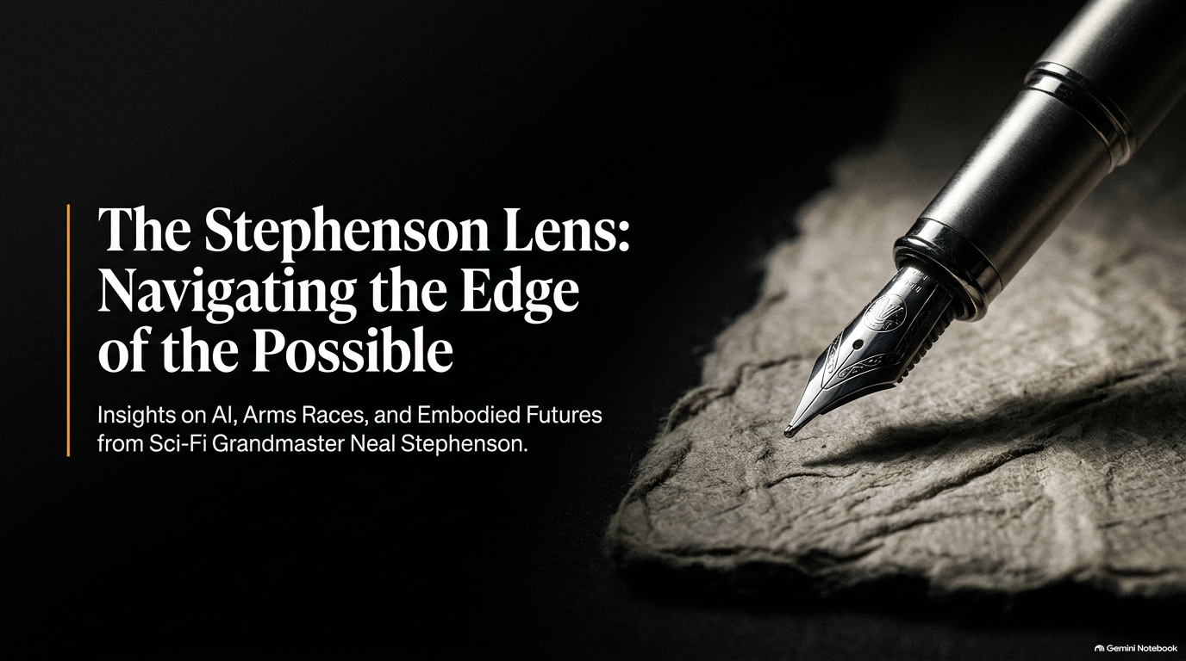
Notes:
Target Duration: 2–3 minutes
Speaker Notes:
Opening Hook: Welcome everyone. Today, we are exploring the world through what we call "The Stephenson Lens"—named after Neal Stephenson, one of the defining science fiction grandmasters and visionary thinkers of our time.
Setting the Stage: Stephenson doesn't write about magic floating castles or convenient space-faring handwaves. He writes about the precise, gritty intersection of engineering, human psychology, economic pressure, and geopolitical anxiety.
Connecting to Reality: As we look at the rapid pace of technological change today—from artificial intelligence to aerospace and embodied human futures—we often fall into the trap of either breathless techno-utopianism or paralyzed techno-dystopianism.
Core Objective: Over the next few minutes, we’re going to use Stephenson’s intellectual framework to stress-test our realities, strip away the hype, and look at how true innovation actually happens when governed by physics, human biology, and market economics. Let’s dive in.
Even Neal Stephenson Felt Blindsided By AI
https://www.youtube.com/watch?v=Ii-aeW5pHPQ

Slide 2
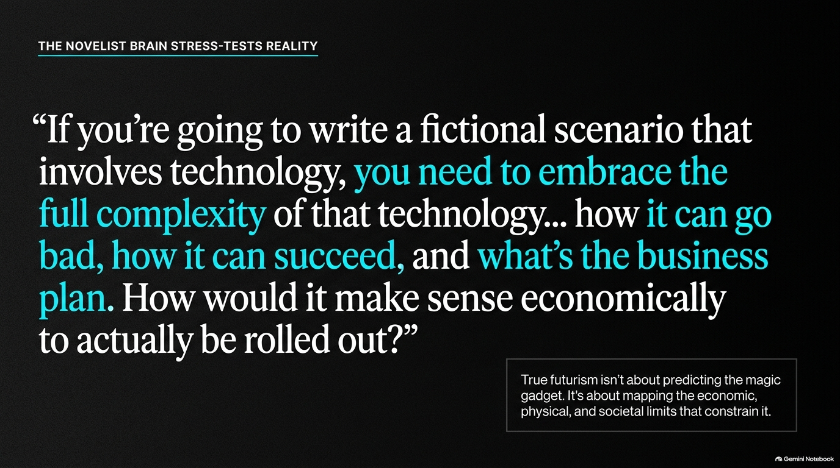
Notes:
Target Duration: 3–4 minutes
Speaker Notes:
Unpacking the Quote: Look closely at Stephenson's core philosophy on world-building: "If you’re going to write a fictional scenario that involves technology, you need to embrace the full complexity of that technology... how it can go bad, how it can succeed, and what’s the business plan."
The Fallacy of the "Magic Gadget": Amateurs think futuristic writing is about inventing a cool gadget. Real futurism—and real business strategy—is about mapping the structural limits that constrain it.
The Economic and Physical Constraint: In the podcast, Stephenson emphasizes that a novelist’s brain is constantly running background checks: How does this scale? Who pays for it? What happens when people misuse it?
Audience Takeaway: When we evaluate modern tech breakthroughs—whether it's large language models, quantum computing, or energy grids—we cannot just look at the code or the lab demo. We have to look at the economic survival of the entities deploying it and the societal friction it creates. If the business model or the physical reality breaks down, the technology stays a toy.

Slide 3
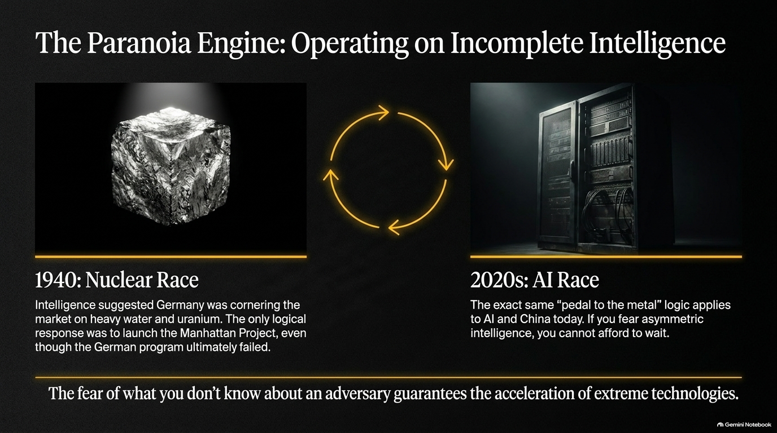
Notes:
Target Duration: 3–5 minutes
Speaker Notes:
The Historical Parallel (1940): Stephenson’s recent historical fiction work (Bomb Light and Polostan) dives deep into the pre-history of the Manhattan Project. In 1940, intelligence suggested Germany was cornering the market on heavy water from Norway and uranium from the Belgian Congo.
The Logic of Fear: Did Germany actually have a working bomb program? Looking back with historical hindsight, no—their physics calculations were flawed, and Heisenberg’s team wasn't close. But intelligence in real-time is incomplete. The Allies didn't know that. The only logical, rational response to perceived existential asymmetry was to launch the Manhattan Project.
The 2020s AI Race: We are living through an exact mirror image today. When people ask whether we should "hit the pause button" on AI, Stephenson highlights the geopolitical trap: If you fear what you don't know about an adversary (like China), you cannot afford to wait.
The Driving Force: The fear of what an adversary might achieve in secret guarantees the acceleration of extreme technologies, bypassing ethical comfort zones because the cost of falling behind feels infinitely higher than the risk of moving too fast.

Slide 4
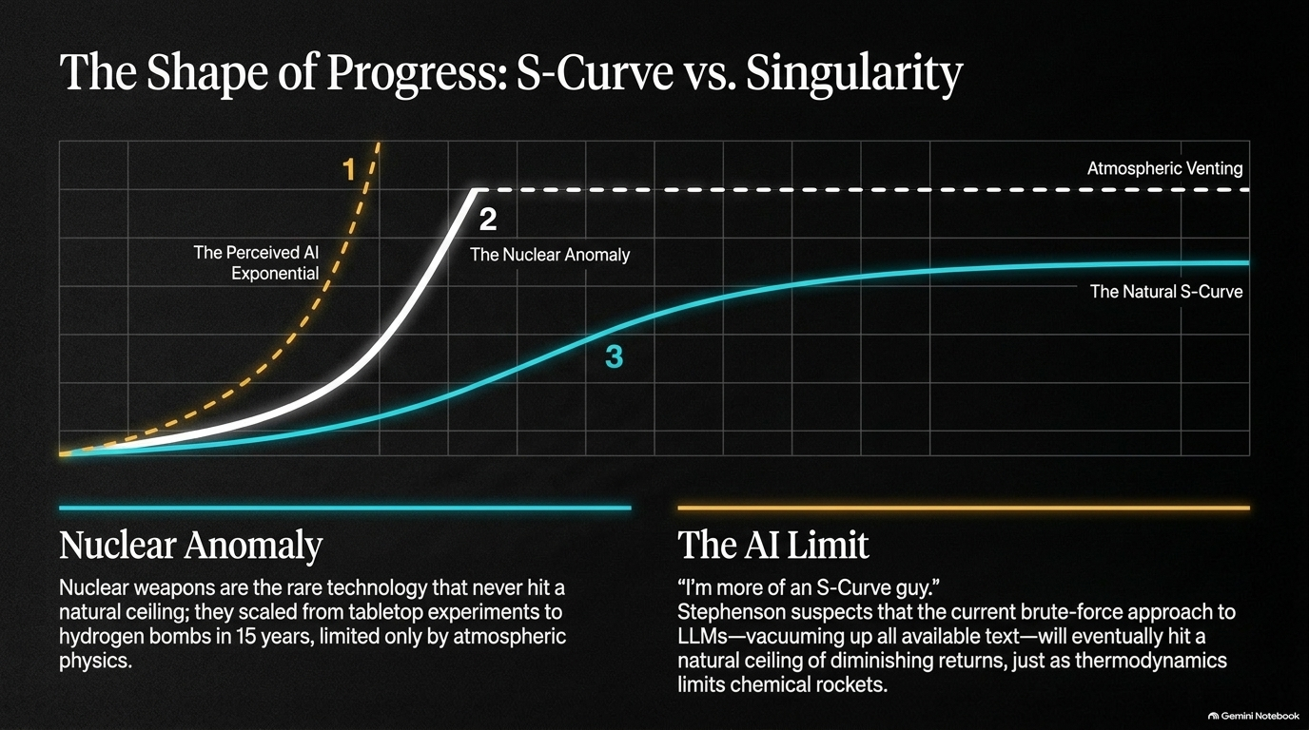
Notes:
Target Duration: 4–6 minutes
Speaker Notes:
Challenging the Singularity: Many Silicon Valley tech figures look at exponential curves and assume an endless, vertical takeoff straight into the technological singularity. Stephenson offers a sobering reality check: "I'm more of an S-curve guy."
The Nuclear Anomaly: Nuclear weapons are essentially the only major modern technology that never hit a natural thermodynamic ceiling. They scaled from tabletop lab experiments to 50-megatons (like the Tsar Bomba) in 15 years, limited only by atmospheric venting.
The AI Ceiling: Stephenson suspects that our current brute-force approach to LLMs—vacuuming up all available human text and scaling compute—will eventually hit a natural ceiling of diminishing returns, just as thermodynamics limits chemical rockets.
Navigating the Anxiety: Even if an S-curve awaits us at the top, the steepness of the current curve is what causes widespread economic disruption, job anxiety, and the palpable sense that society is being upended overnight.

Slide 5
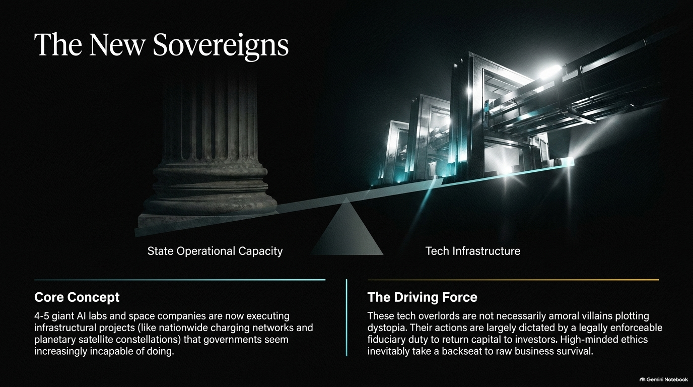
Notes:
Target Duration: 4–5 minutes
Speaker Notes:
Shift in Power: Look at the modern balance of power. Governments used to build transcontinental railways, highway systems, and atomic arsenals. Today, 4 to 5 giant AI labs and private space companies are executing planetary-scale infrastructural projects that sovereign governments seem increasingly incapable of tackling.
Scale and Compute: If the U.S. government wanted to build data centers of the scale, power draw, and compute capacity currently deployed by private tech giants, it's doubtful bureaucratic red tape and operational speed would even allow it.
The Driving Force (Fiduciary Duty): Why are these tech overlords racing forward? Stephenson notes they aren't necessarily mustache-twirling cartoon villains plotting dystopia. Their actions are dictated by a legally enforceable fiduciary duty to return capital to investors.
Survival over Ethics: When you run a multi-billion dollar enterprise, raw business survival and board mandates take precedence over high-minded philosophical ethics. High-minded ideals take a backseat when capital markets demand growth.

Slide 6
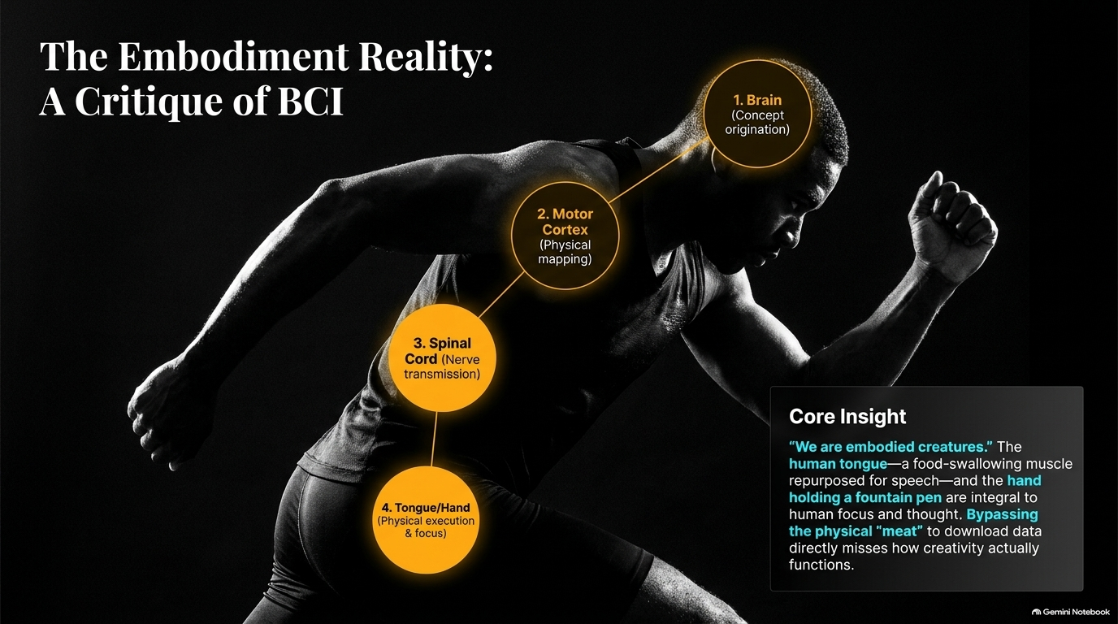
Notes:
Target Duration: 3–5 minutes
Speaker Notes:
The Value of "Meat": While Brain-Computer Interfaces (BCIs) offer miraculous medical solutions for patients with ALS or locked-in syndrome, Stephenson expresses deep skepticism toward the transhumanist fantasy of bypassing the physical body altogether.
Writing with a Fountain Pen: Stephenson famously writes using a fountain pen on paper. To him, thinking isn't an abstract disembodied cloud sitting in the skull; it involves the full neurological pathway—the motor cortex, the spinal cord, down to the hand and the pen.
The Tongue and Athletic Flow: In the podcast, Stephenson notes fascinating biological details, like elite athletes (Michael Jordan, Caitlin Clark) sticking their tongues out during moments of maximum concentration. The human tongue is a food-swallowing machine repurposed for speech—an evolutionary marvel that allowed humans to rapidly outpace other primates.
The Core Insight: Bypassing the physical "meat" to download data directly misses how creativity and human focus actually function. True thought is deeply rooted in physical, biological embodiment.

Slide 7
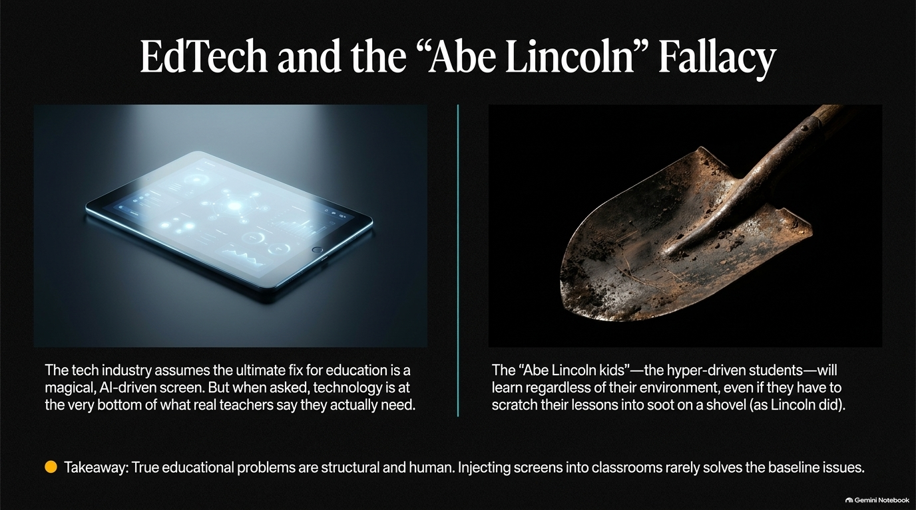
Notes:
Target Duration: 3–5 minutes
Speaker Notes:
The Tech Industry Illusion: The tech sector constantly assumes that the ultimate fix for broken educational systems is a magical, AI-driven screen or tablet. But when you talk to real classroom teachers, technology is at the very bottom of what they actually need to survive their daily environments.
The "Abe Lincoln" Kids: Hyper-driven, brilliant students will learn regardless of their environment. Lincoln didn't have iPads or notebooks; as a child, he scratched his lessons out on a dirty shovel using soot from a fire, wiping it clean and starting over.
Structural vs. Superficial Fixes: True educational crises are human, structural, and institutional. Throwing expensive screens and generic edtech software into classrooms rarely solves baseline socio-economic and structural problems. Edtech must serve real teachers, not Silicon Valley marketing narratives.

Slide 8
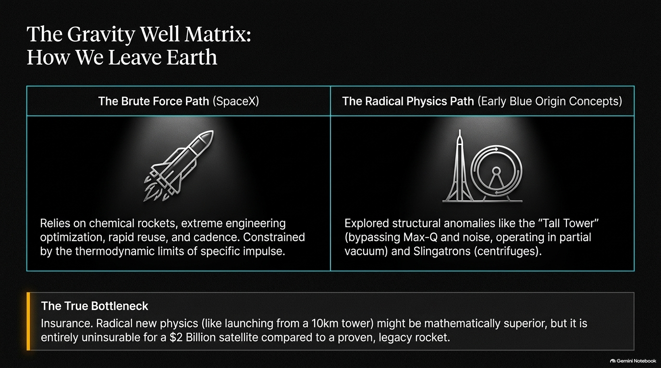
Notes:
Target Duration: 3–5 minutes
Speaker Notes:
Two Paths to Space: On one side, we have SpaceX's Brute Force Path—relying on chemical rockets, extreme engineering optimization, rapid reuse, and cadence, constrained only by the thermodynamic limits of specific impulse. On the other side, we have Radical Physics Paths—such as early Blue Origin concepts exploring 10km "Tall Towers" (bypassing Max-Q and atmospheric noise) or Slingatrons (centrifugal mass accelerators).
The Brute Force Winner: While radical physics ideas like launching from a towering megastructure are mathematically elegant, they run straight into the ultimate bottleneck: Insurance.
The Risk Profile: If you are launching a $2 billion commercial satellite, underwriters will not insure an unproven, radical new physics concept. They demand a proven, legacy rocket family. This economic reality is why brute-force chemical reuse won out over exotic launch concepts for decades.

Slide 9
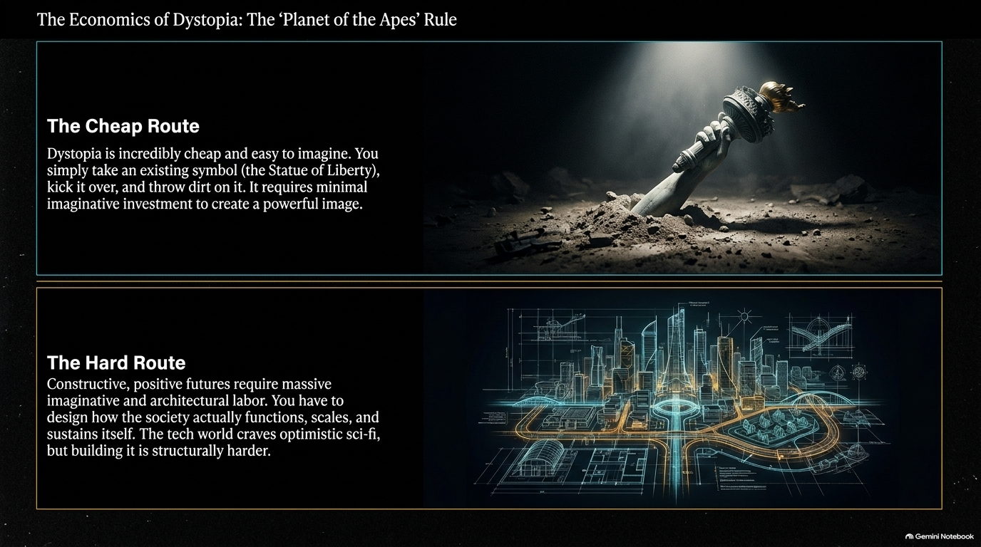
Notes:
Target Duration: 3–4 minutes
Speaker Notes:
The Cheap Route to Fiction: Why is pop culture saturated with grim, dystopian futures? Because dystopia is cheap and easy to imagine. You take an existing symbol—like the Statue of Liberty half-buried in sand from Planet of the Apes—kick it over, throw some dirt on it, and instantly evoke a powerful, melancholy image with minimal imaginative investment.
The Hard Route (Optimistic Sci-Fi): Constructive, positive, high-function futures require massive imaginative and architectural labor. You have to design how a thriving society actually functions at scale, how it sustains itself economically, and how humans cooperate.
Industry Craving vs. Execution: The tech world constantly craves optimistic sci-fi that inspires engineers to build cool things, but Hollywood defaults to the lazy, post-apocalyptic tropes because building a believable, thriving future is structurally much harder.

Slide 10
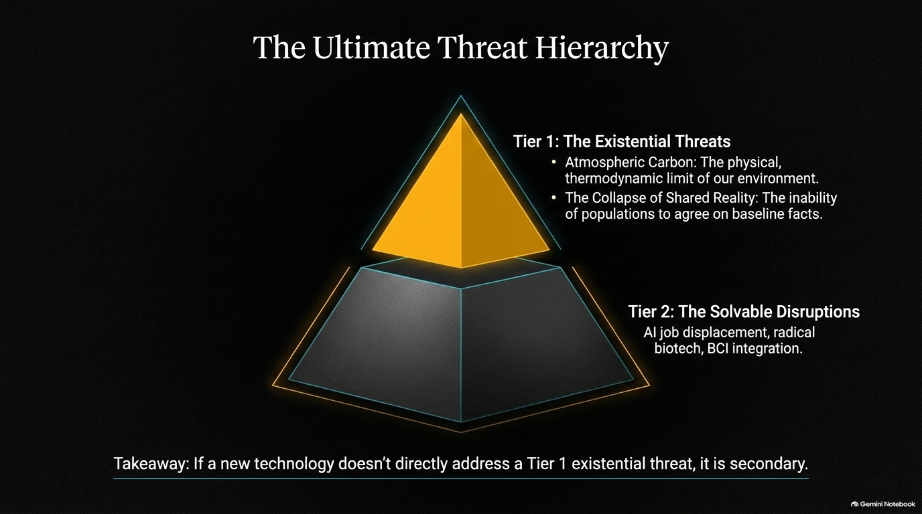
Notes:
Target Duration: 3–4 minutes
Speaker Notes:
Sorting Real Risks from Noise: As a society, we panic over endless disruptions—AI job displacement, biotech debates, and synthetic media. But Stephenson draws a clear line between primary existential threats and secondary solvable disruptions.
Tier 1 (The Existential Threats):
Atmospheric Carbon: The hard, unyielding thermodynamic limit of our planetary environment.
The Collapse of Shared Reality: The dangerous inability of modern populations to agree on baseline facts.
Tier 2 (The Solvable Disruptions): AI job displacement, BCI integration, and rapid biotech shifts are profound, but they are downstream operational challenges.
The Core Takeaway: If an emerging technology or corporate venture does not directly help humanity address Tier 1 existential threats—climate and shared truth—it remains secondary.

Slide 11
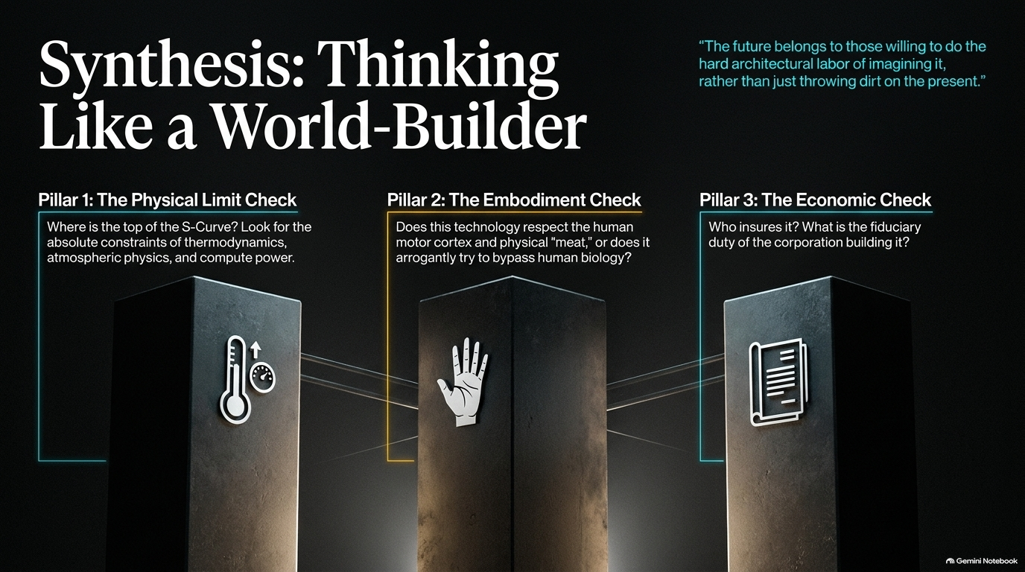
Notes:
Target Duration: 3–5 minutes
Speaker Notes:
The Three Pillars of World-Building: To think clearly about the future without falling for hype or despair, we must adopt the three checklist pillars derived from Stephenson's life work:
The Physical Limit Check: Where is the top of the S-curve? Look past the marketing hype to absolute thermodynamic, atmospheric, and compute constraints.
The Embodiment Check: Does a technology respect the human motor cortex and biological "meat," or does it arrogantly try to bypass human reality?
The Economic Check: Who insures it? What is the fiduciary duty and business survival plan of the corporation building it?
Closing Thought: As Stephenson reminds us: "The future belongs to those willing to do the hard architectural labor of imagining it, rather than just throwing dirt on the present." Let's build wisely.

