Slide 1
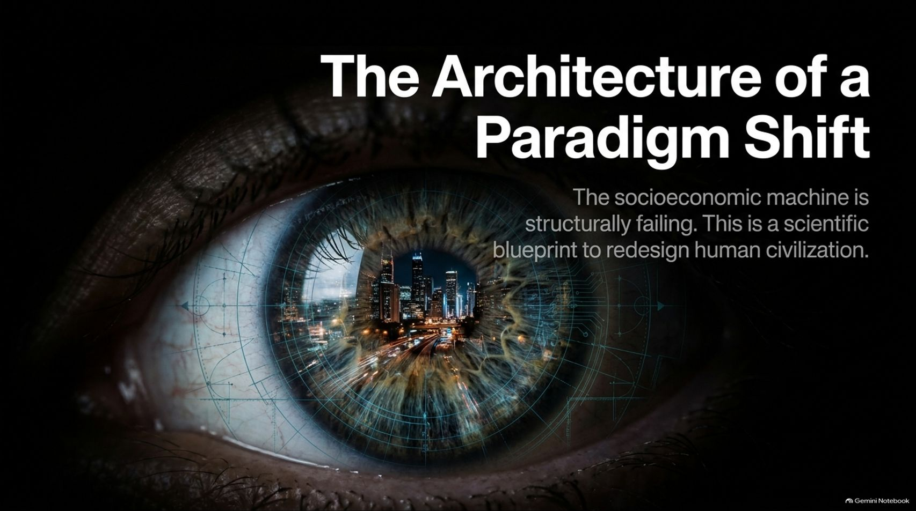
Notes:
Estimated Speaking Time: 2 – 3 minutes
Speaker Script & Talking Points
Welcome everyone. Today we are addressing the most critical conversation of our era: "The Architecture of a Paradigm Shift."
If we look around at our global institutions, financial systems, public health indices, and ecological boundaries, a sobering reality becomes impossible to ignore: the socioeconomic machine is structurally failing. We are not dealing with temporary policy missteps or isolated political failures; we are confronting an obsolete operating system that governs human civilization.
As explored in depth in films like Zeitgeist: Moving Forward, our current model is built on principles of artificial scarcity, monetary competition, and endless debt. This presentation is a scientific blueprint to redesign human civilization—transitioning away from a failing monetary market paradigm toward a fully integrated, science-guided, Resource-Based Economy.
Over the next 16 slides, we will examine why our biological reality clashes with market structures, how current economic metrics reward destruction, and how we can apply scientific methodology to achieve planetary sustainability and human well-being.
Zeitgeist - Moving Forward | What If Money Is the Problem | 4K
https://www.youtube.com/watch?v=PexFCfc69e4

Slide 2
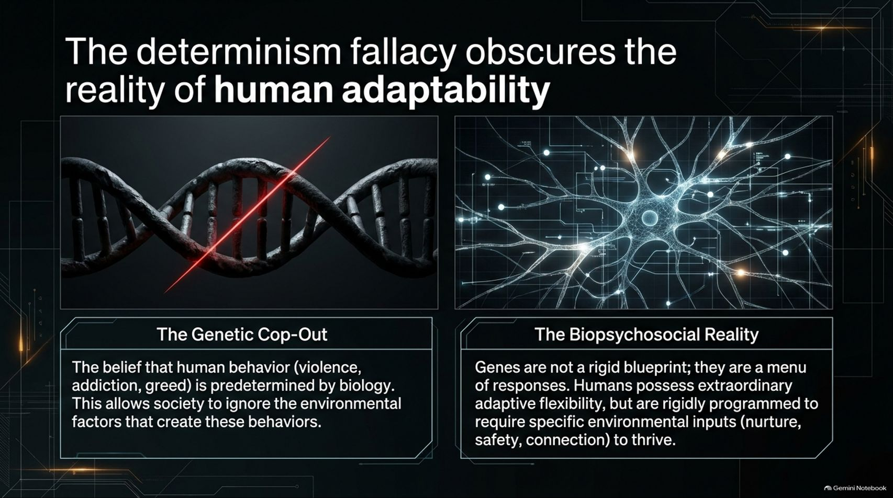
Notes:
Estimated Speaking Time: 3 – 4 minutes
Speaker Script & Talking Points
To understand how we redesign civilization, we must first dismantle a foundational myth: the determinism fallacy.
The Genetic Cop-Out: For generations, conventional reductionist thinking has argued that complex human behaviors—such as violence, greed, poverty, and addiction—are rigidly predetermined by biology. This view acts as a convenient excuse for society. If humans are biologically hardwired for cutthroat competition, then inequality and war are inevitable, and we are absolved from changing the underlying system.
The Biopsychosocial Reality: Modern biology and epigenetics completely refute this. As experts emphasize, genes are not a rigid blueprint; they are a menu of responses. Humans possess extraordinary adaptive flexibility, but we are also programmed to require specific environmental inputs—such as safety, nurture, connection, and proper nutrition—to thrive. When the environment is toxic, stressed, or deprived, it triggers pathological expressions in our biology.
Blaming human nature for the flaws of our civilization is scientifically bankrupt; human behavior is largely a reflection of environmental design.

Slide 3
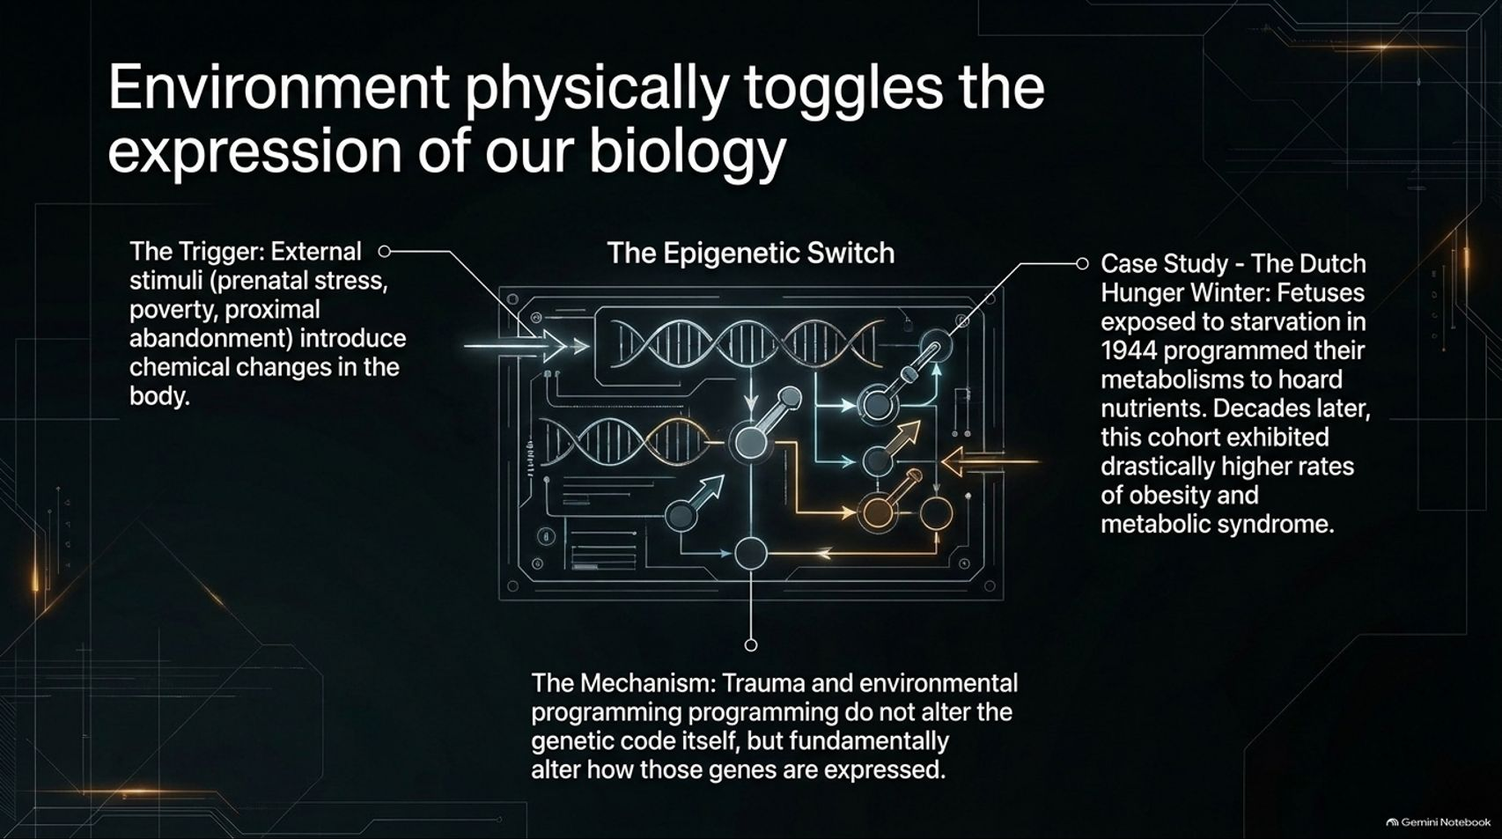
Notes:
Estimated Speaking Time: 4 – 5 minutes
Speaker Script & Talking Points
Slide 3 dives deeper into the mechanism of epigenetics: Environment physically toggles the expression of our biology.
The Trigger: External stimuli—such as prenatal stress, poverty, trauma, or neglect—introduce chemical changes in the body.
The Mechanism: Traumatic experiences and environmental programming do not alter the base DNA sequence itself; rather, they fundamentally alter how those genes are expressed.
Case Study — The Dutch Hunger Winter: A prime historical example is the Dutch Hunger Winter of 1944, when occupying forces cut off food supplies in Holland, causing widespread starvation. Fetuses exposed to starvation in utero underwent epigenetic reprogramming, causing their metabolisms to permanently hoard nutrients. Decades later, this cohort exhibited drastically higher rates of obesity, cardiovascular disease, and metabolic syndrome.
Environment does not begin at birth; it begins in utero. If we want healthy human beings, we must design a social environment that provides security and proper nourishment from conception onward.

Slide 4
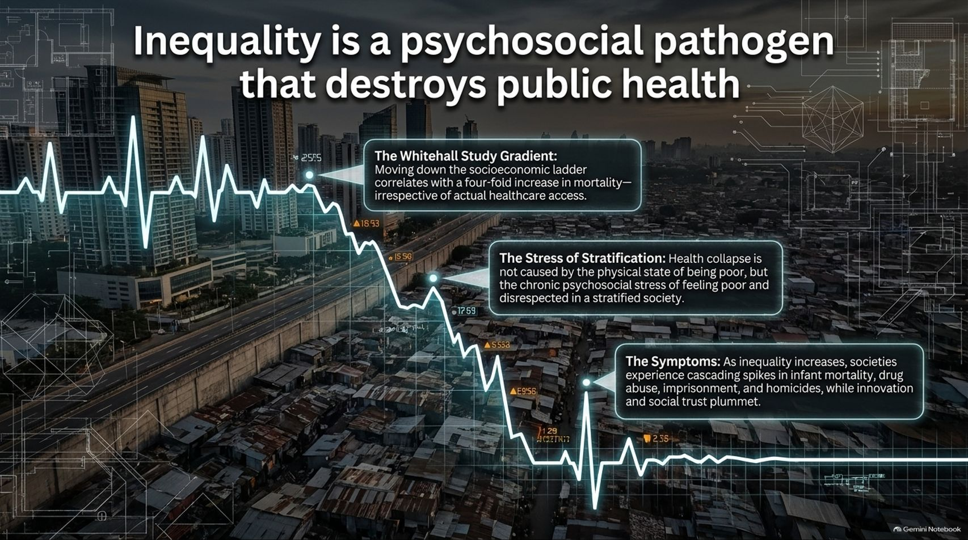
Notes:
Estimated Speaking Time: 4 – 5 minutes
Speaker Script & Talking Points
When a society is stratified by extreme economic inequality, it generates a profound public health crisis. Inequality is not merely an accounting imbalance; it is a psychosocial pathogen.
The Whitehall Study Gradient: Landmark epidemiological research, such as the Whitehall studies, demonstrates that moving down the socioeconomic ladder correlates with a dramatic increase in mortality—irrespective of actual healthcare access.
The Stress of Stratification: Health collapse is not caused solely by absolute physical deprivation, but by the chronic psychosocial stress of feeling poor, undervalued, and disrespected in a hyper-stratified society.
The Systemic Symptoms: As inequality widens, societies experience cascading spikes in infant mortality, drug abuse, imprisonment, and homicides, while innovation, social trust, and community cohesion plummet.
A culture built on winner-take-all competition literally makes its population sick.

Slide 5
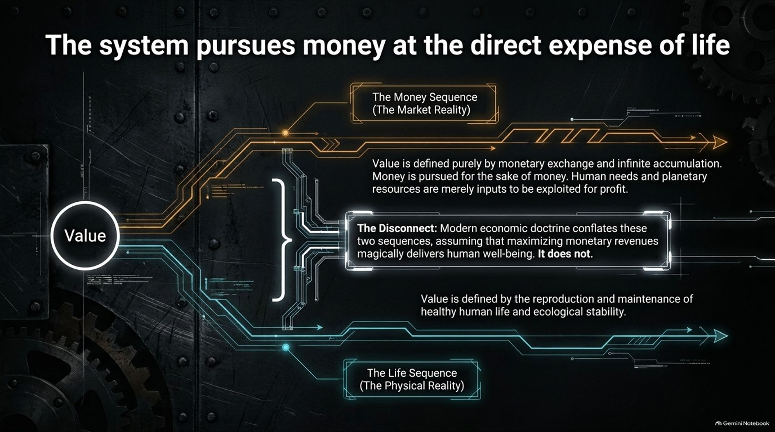
Notes:
Estimated Speaking Time: 4 – 5 minutes
Speaker Script & Talking Points
Why do our institutions tolerate widespread deprivation while ecological life-support systems collapse? Because the system pursues money at the direct expense of life.
The Money Sequence (Market Reality): In a monetary market, value is defined purely by monetary exchange and infinite accumulation. Money is pursued for its own sake, and both human needs and planetary resources are treated merely as disposable inputs to be exploited for profit.
The Life Sequence (Physical Reality): True value is defined by the reproduction and maintenance of healthy human life and ecological stability.
The Fundamental Disconnect: Modern economic doctrine conflates these two sequences, assuming that maximizing monetary revenues magically delivers human well-being. It does not.
When financial profit diverges from human survival, the market will cheerfully monetize destruction as long as someone pays for it.

Slide 6
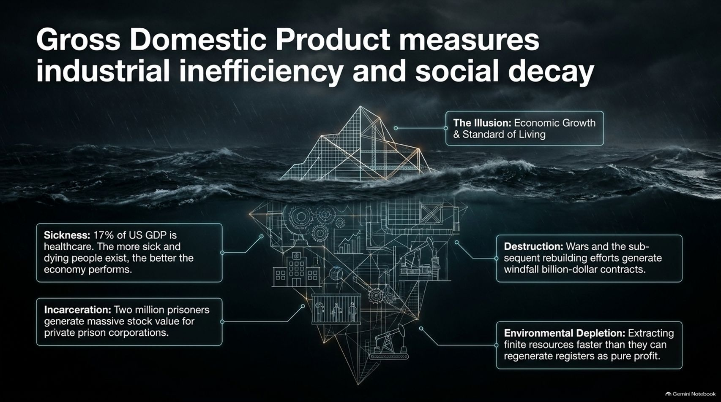
Notes:
Estimated Speaking Time: 3 – 4 minutes
Speaker Script & Talking Points
Look at the iceberg graphic on Slide 6. Above the surface lies The Illusion: Gross Domestic Product (GDP) growth represents rising standards of living. But beneath the surface lies the grim reality: GDP measures industrial inefficiency and social decay.
Sickness: Healthcare systems capture massive amounts of GDP. From a market perspective, a chronically sick and dying population generates high economic activity.
Incarceration: Millions of prisoners generate lucrative stock value and revenue streams for private prison corporations.
Destruction and Depletion: Wars, weapons manufacturing, and post-disaster rebuilding efforts generate windfall billion-dollar contracts. Furthermore, extracting finite resources faster than ecosystems can regenerate registers as pure financial profit.
A metric that treats environmental destruction and human misery as economic growth is structurally insane.

Slide 7
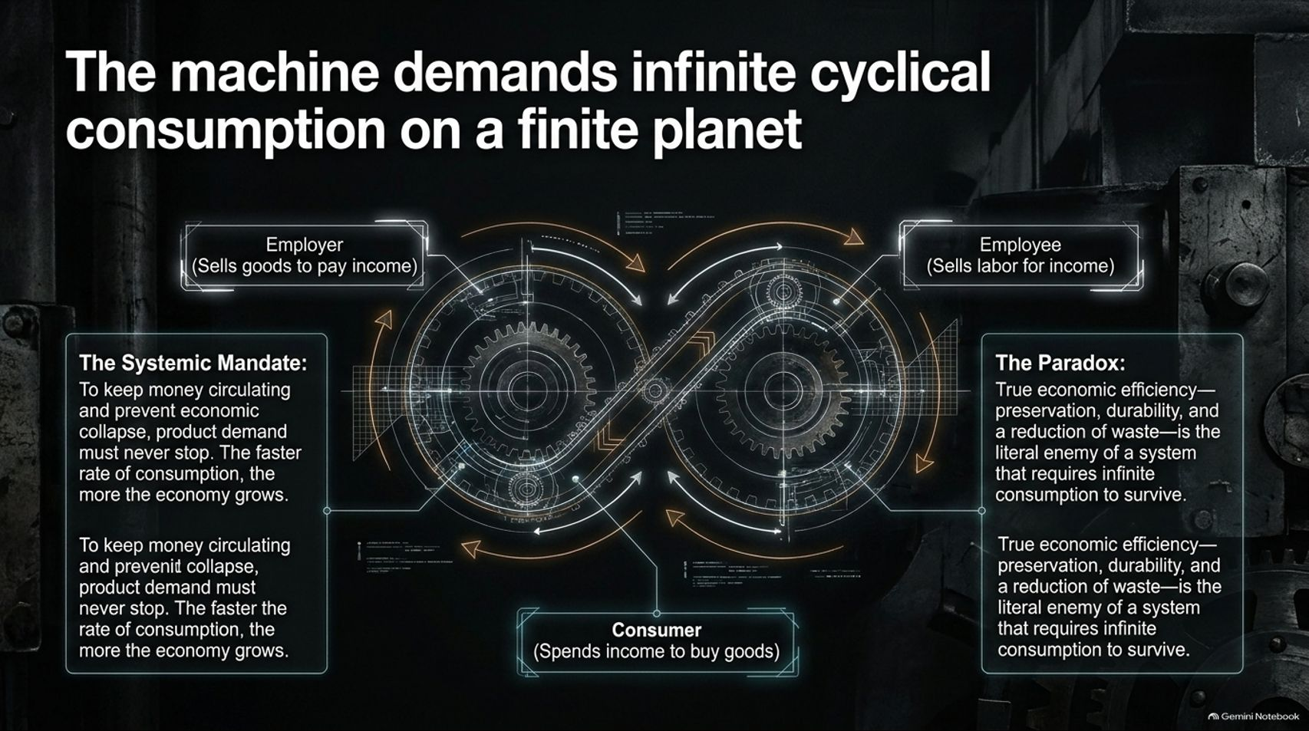
Notes:
Estimated Speaking Time: 4 – 5 minutes
Speaker Script & Talking Points
Slide 7 illustrates the structural treadmill of our economy: The machine demands infinite cyclical consumption on a finite planet.
The Systemic Mandate: To keep money circulating and prevent economic collapse, product demand must never stop. Employees work to earn income, consumers spend income to buy goods, and employers sell goods to pay incomes. The faster the rate of consumption, the more the economy "grows".
The Paradox: True economic efficiency—defined by preservation, durability, and a reduction of waste—is the literal enemy of a system that requires infinite consumption to survive.
If manufacturers built products that lasted forever, replacement markets would vanish, companies would go bankrupt, and employment would collapse. Our economic model requires waste to function.

Slide 8
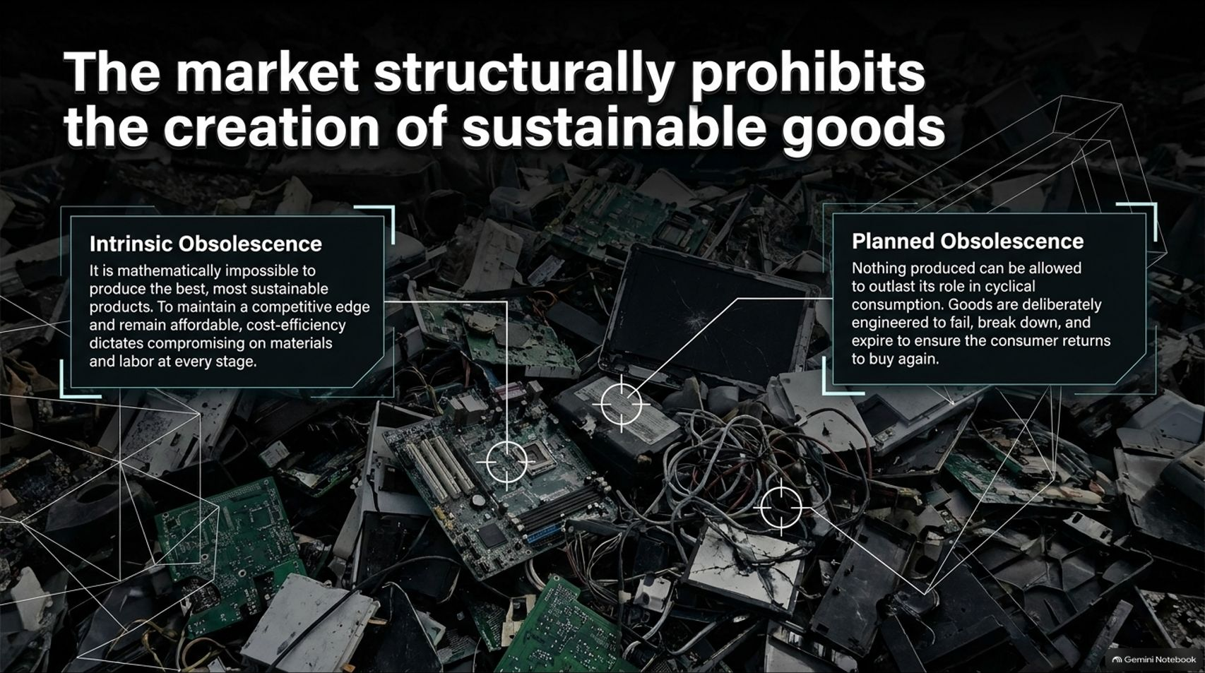
Notes:
Estimated Speaking Time: 4 – 5 minutes
Speaker Script & Talking Points
Because of this systemic requirement for consumption, the market structurally prohibits the creation of sustainable goods.
Intrinsic Obsolescence: It is mathematically impossible under market competition to produce the absolute best, most sustainable products. To maintain a competitive edge and remain affordable to consumers squeezed by wages, companies are forced to compromise on materials and labor at every stage.
Planned Obsolescence: Nothing produced can be allowed to outlast its role in cyclical consumption. Goods are deliberately engineered to fail, break down, or become obsolete within a few years, ensuring the consumer is forced to return to buy again.
Landfills filled with electronics and consumer goods are not accidental design flaws; they are the intended output of a market that profits from replacement.

Slide 9
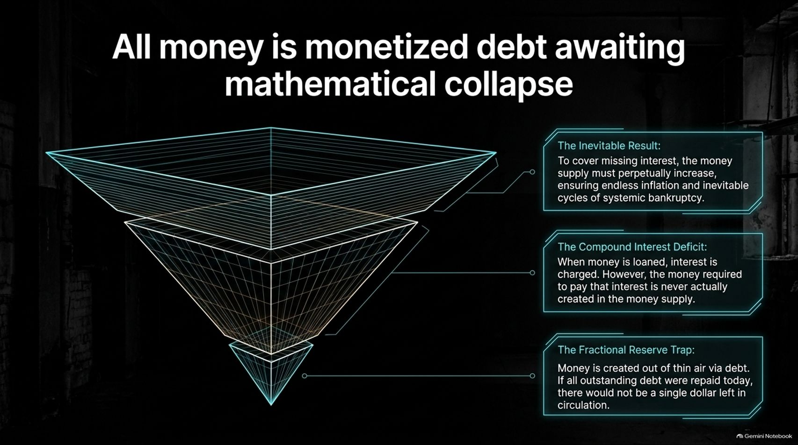
Notes:
Estimated Speaking Time: 4 – 5 minutes
Speaker Script & Talking Points
At the root of this machinery is our monetary architecture: All money is monetized debt awaiting mathematical collapse.
The Fractional Reserve Trap: Money is created out of thin air via bank lending. If all outstanding debt were magically repaid today, there would not be a single dollar left in circulation. Every dollar is someone else's liability.
The Compound Interest Deficit: When money is loaned into existence, interest is charged. However, the money required to pay that accumulated interest is never created in the initial money supply.
The Inevitable Result: To cover missing interest and keep the ledger balanced, the money supply must perpetually expand. This structural requirement guarantees endless inflation, asset bubbles, and recurrent cycles of systemic bankruptcy.
A debt-based monetary system is a giant global pyramid scheme heading toward a mathematical wall.

Slide 10
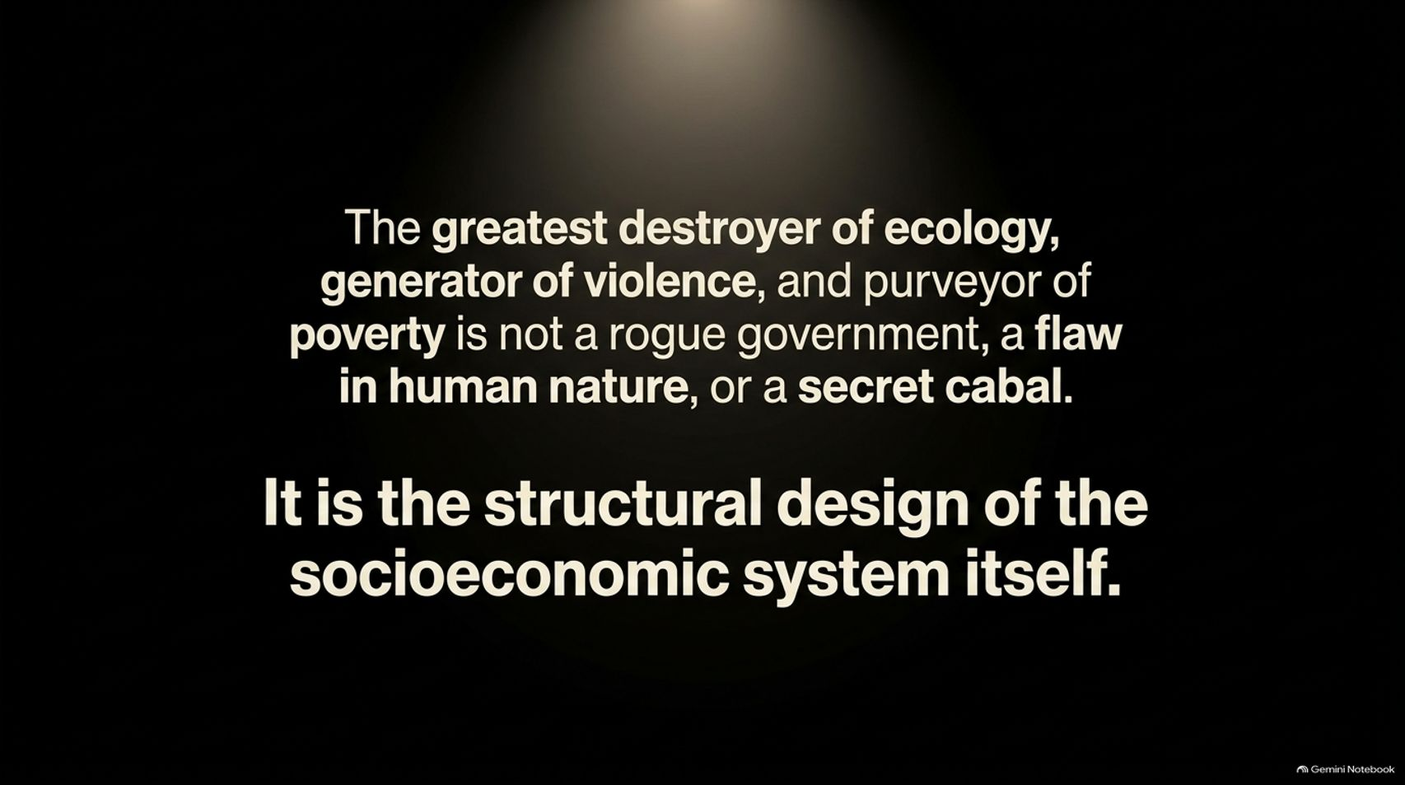
Notes:
Estimated Speaking Time: 3 – 4 minutes
Speaker Script & Talking Points
Slide 10 delivers the core conclusion of our systemic critique:
"The greatest destroyer of ecology, generator of violence, and purveyor of poverty is not a rogue government, a flaw in human nature, or a secret cabal. It is the structural design of the socioeconomic system itself."
We can change politicians, protest corrupt administrations, or preach moral restraint, but as long as we retain a monetary market framework driven by debt, profit maximization, and scarcity, the outcomes will remain identical. To fix the symptoms, we must redesign the container.

Slide 11
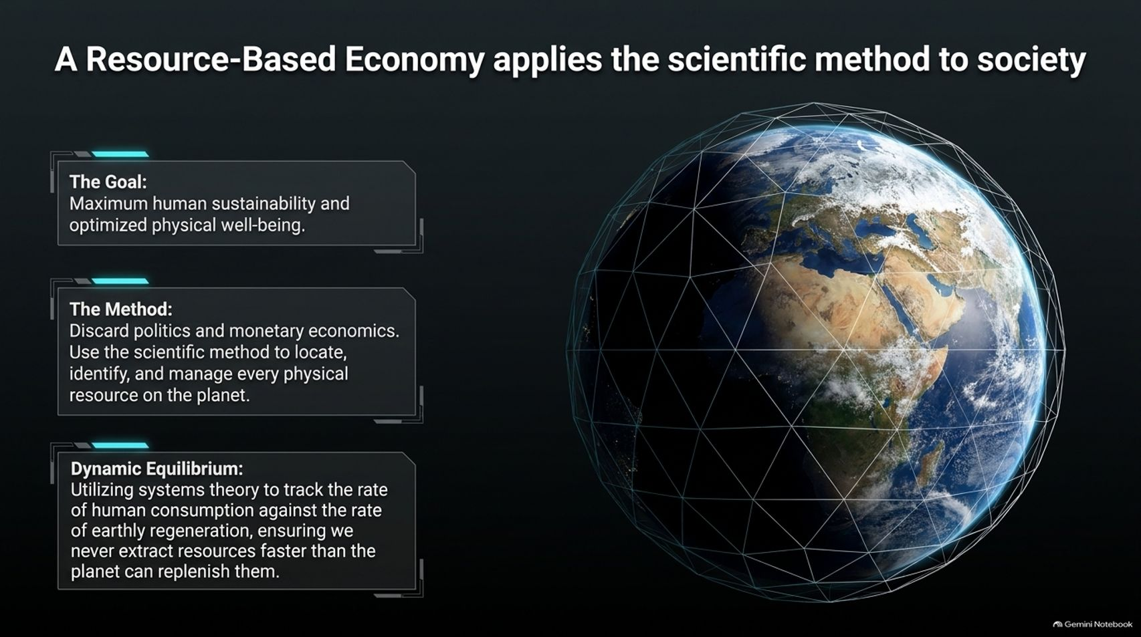
Notes:
Estimated Speaking Time: 4 – 5 minutes
Speaker Script & Talking Points
What is the alternative? A Resource-Based Economy applies the scientific method to society.
The Goal: Maximum human sustainability and optimized physical well-being.
The Method: We discard politics, monetary economics, and property laws. Instead, we use the scientific method to locate, identify, and manage every physical resource on the planet as the common heritage of all people.
Dynamic Equilibrium: Utilizing systems theory, we track the rate of human consumption against the rate of earthly regeneration. We ensure that we never extract resources faster than the planet can replenish them.
Instead of managing society through financial incentives and price tags, we manage it through technological stewardship and empirical data.

Slide 12
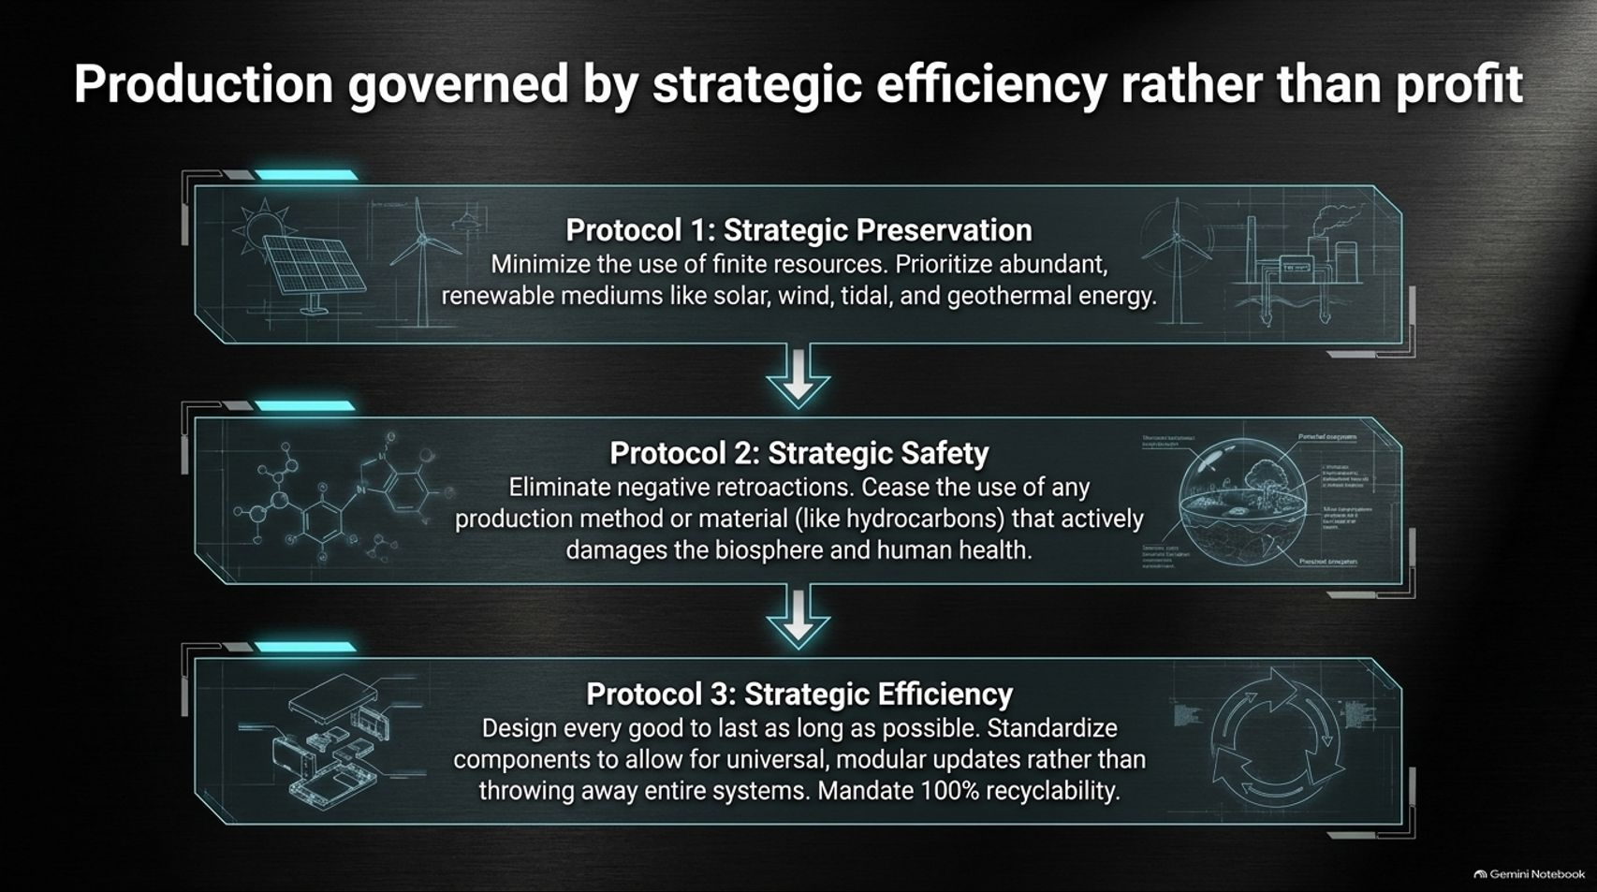
Notes:
Estimated Speaking Time: 4 – 5 minutes
Speaker Script & Talking Points
In a Resource-Based Economy, industrial production is governed by three protocols of strategic efficiency:
Protocol 1 — Strategic Preservation: Minimize the use of finite resources. Prioritize abundant, renewable mediums like solar, wind, tidal, and geothermal energy.
Protocol 2 — Strategic Safety: Eliminate negative retroactions. Cease the use of any production method or material—such as hydrocarbons or toxic chemicals—that actively damages the biosphere and human health.
Protocol 3 — Strategic Efficiency: Design every good to last as long as possible. Standardize components to allow for universal, modular updates rather than throwing away entire systems, and mandate 100% recyclability.
By removing the profit motive, we eliminate the incentive for waste and planned obsolescence.

Slide 13
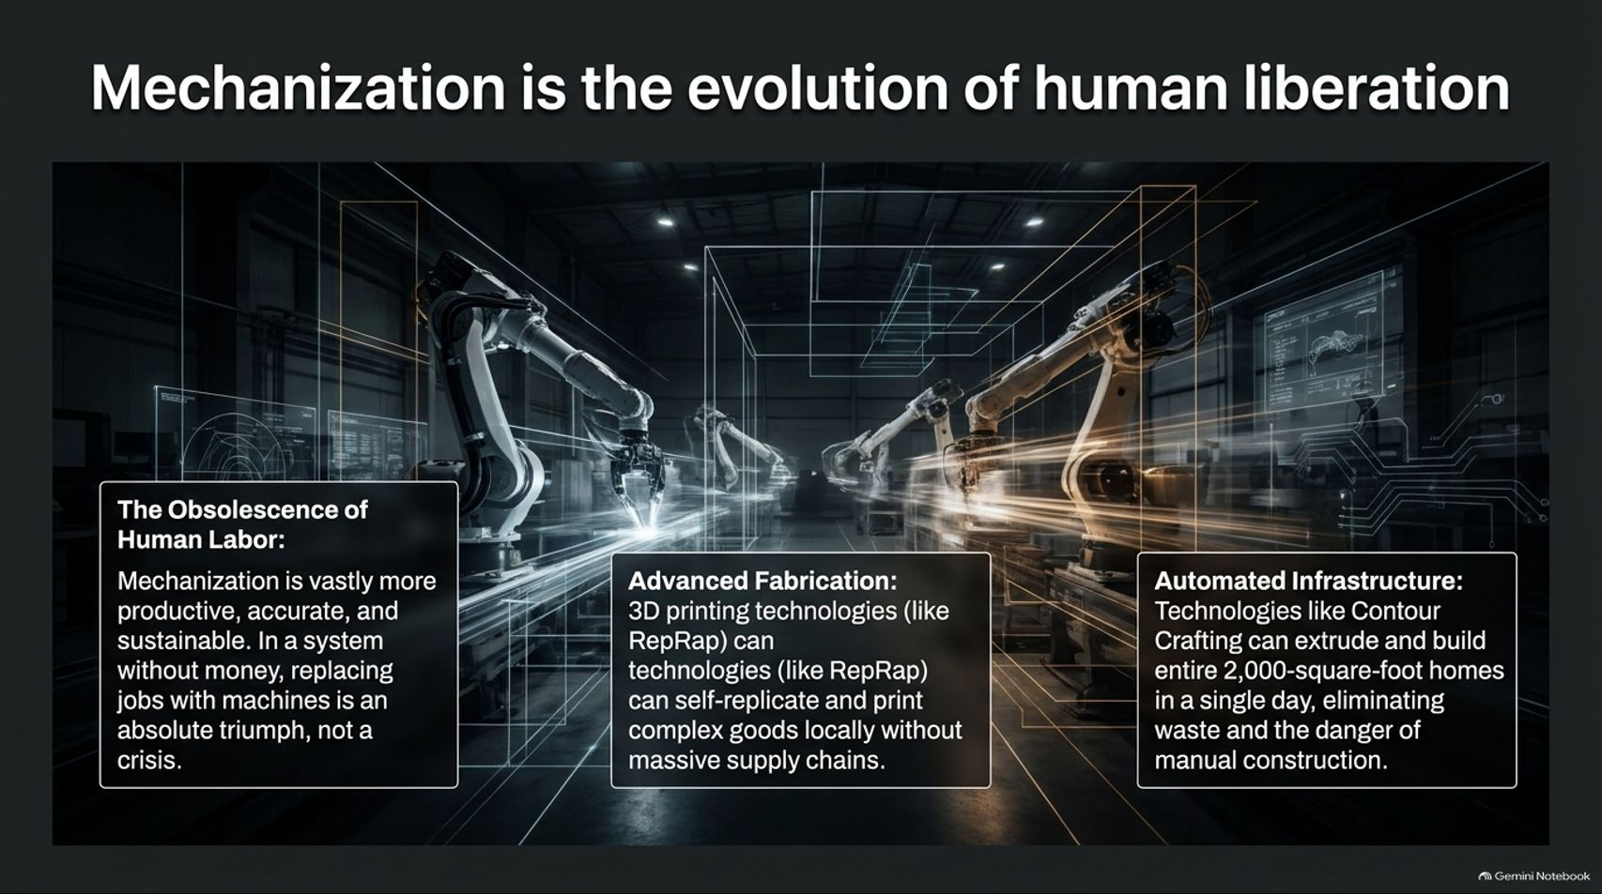
Notes:
Estimated Speaking Time: 4 – 5 minutes
Speaker Script & Talking Points
Technological automation is often feared today because in a monetary system, losing your job means losing your right to survive ("technological unemployment"). But in a Resource-Based Economy, mechanization is the evolution of human liberation.
The Obsolescence of Human Labor: Machines are vastly more productive, accurate, and sustainable than humans in repetitive tasks. Replacing drudgery with automation in a system without money is an absolute triumph.
Advanced Fabrication: Open-source 3D printing technologies (like RepRap) can self-replicate and print complex goods locally, eliminating massive global supply chains.
Automated Infrastructure: Technologies like Contour Crafting can build entire 2,000-square-foot homes in a single day, eliminating industrial waste and dangerous manual labor.
Automation frees humanity from forced labor, dedicating our lives to creative expression, education, and exploration.

Slide 14
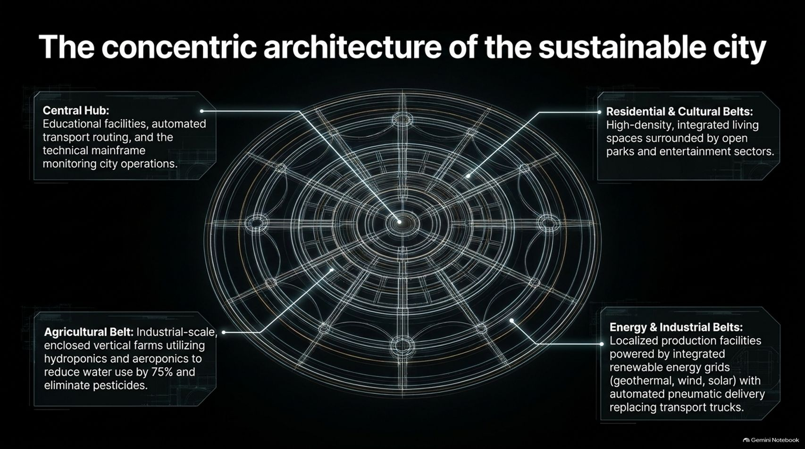
Notes:
Estimated Speaking Time: 4 – 5 minutes
Speaker Script & Talking Points
Slide 14 outlines the physical blueprint of sustainable urban design: The concentric architecture of the sustainable city.
Central Hub: Educational facilities, automated transport routing systems, and the technical mainframe monitoring city operations.
Residential & Cultural Belts: High-density, integrated living spaces surrounded by open parks, recreational areas, and entertainment sectors.
Energy & Industrial Belts: Localized production facilities powered by integrated renewable energy grids (geothermal, wind, solar) equipped with automated pneumatic delivery systems replacing polluting transport trucks.
Agricultural Belt: Industrial-scale, enclosed vertical farms utilizing hydroponics and aeroponics to reduce water use by 75% and eliminate pesticides entirely.
This circular city layout minimizes transit energy, maximizes local self-sufficiency, and integrates human habitation seamlessly into nature.

Slide 15
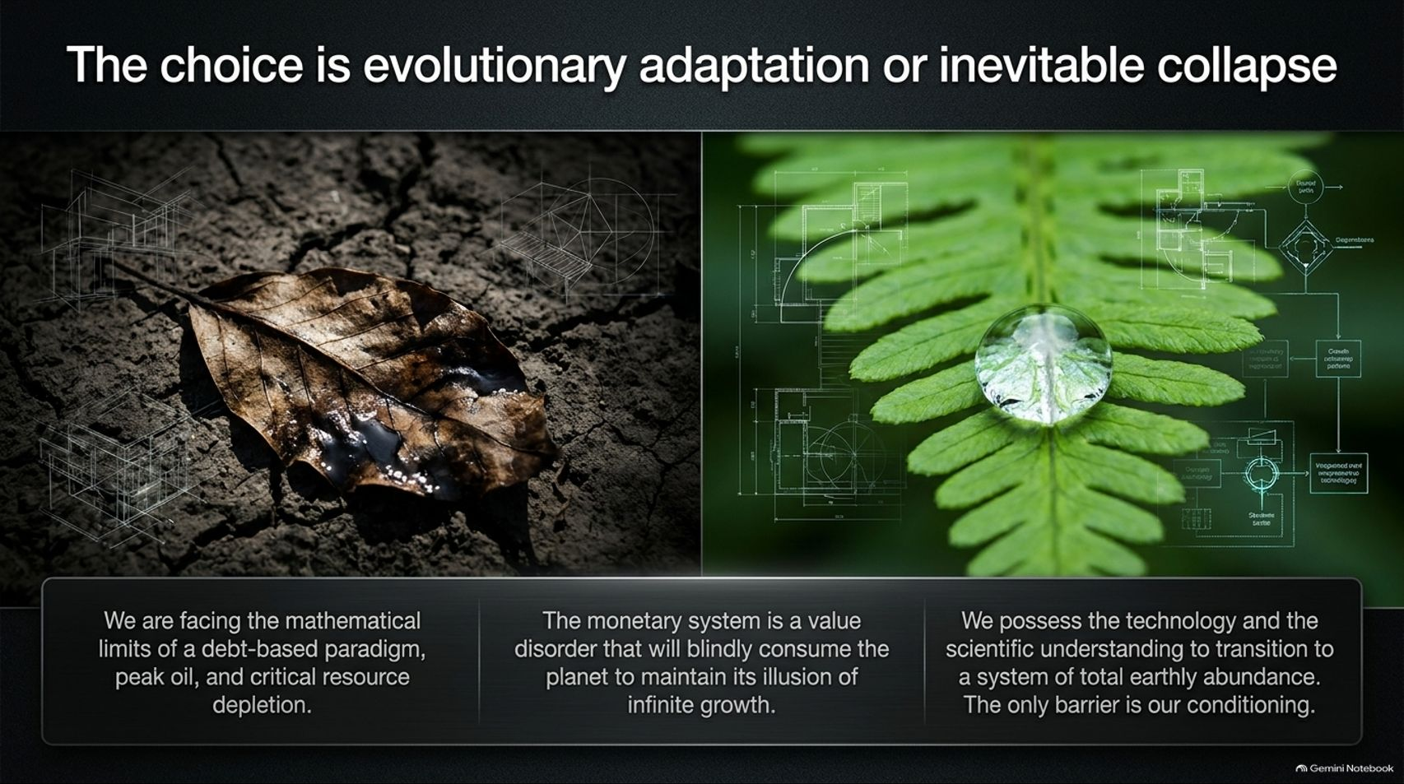
Notes:
Estimated Speaking Time: 3 – 4 minutes
Speaker Script & Talking Points
We stand at a definitive fork in the road of human history: The choice is evolutionary adaptation or inevitable collapse.
On one side, we face the mathematical limits of a debt-based paradigm, peak resource extraction, and ecological destabilization. The monetary system is a value disorder that will blindly consume the planet to maintain its illusion of infinite growth.
On the other side, we possess the technology, scientific understanding, and ecological awareness required to transition to a system of total earthly abundance.
As the concluding text highlights, the only barrier standing between our current misery and a sustainable future is our own cultural and psychological conditioning.

Slide 16
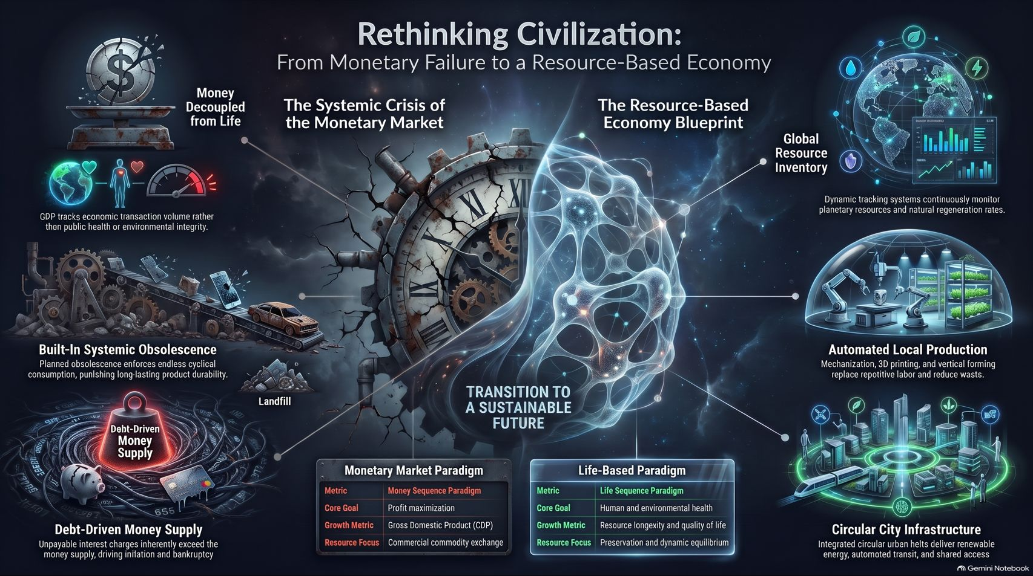
Notes:
Estimated Speaking Time: 4 – 5 minutes
Speaker Script & Talking Points
To summarize our journey across this paradigm shift (Slide 16):
The Crisis of the Monetary Market: We have de-coupled money from life. GDP tracks financial transactions rather than human health. Built-in obsolescence forces endless waste, and debt-driven money supplies drive inflation and bankruptcy.
The Resource-Based Economy Blueprint: We replace monetary metrics with life-based metrics. We use global resource inventories and dynamic tracking systems to monitor planetary regeneration rates. We deploy automated local production, vertical farming, and circular city infrastructure to deliver material security to every human being on Earth.
We no longer need to fight over scarce resources. We have the intelligence, the tools, and the science to build a thriving civilization. Thank you.

