Slide 1
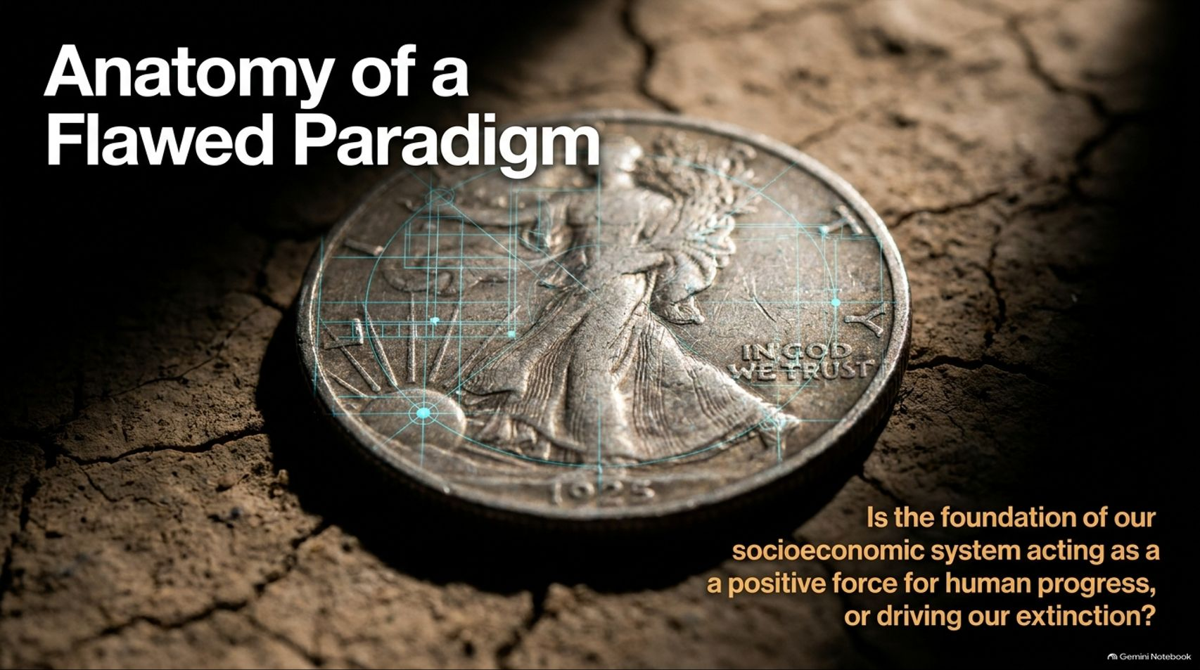
Notes:
Estimated Speaking Time: 2 – 3 minutes
Speaker Script & Talking Points
Welcome everyone. Today we are addressing the foundational architecture of human civilization. Our opening slide asks a piercing question: "Is the foundation of our socioeconomic system acting as a positive force for human progress, or driving our extinction?"
When we look around the globe today, we witness staggering technological prowess alongside deepening systemic crises—ecological collapse, widening inequality, chronic financial instability, and widespread social distress. Most people treat these problems as isolated issues or political failures.
As explored in depth in films like Zeitgeist: Moving Forward, these crises are not anomalies; they are the predictable, mathematical outputs of an obsolete operating system. Our monetary-market paradigm is built on principles of artificial scarcity, competition, and endless debt. Today, we will examine the anatomy of this flawed paradigm and explore a scientific blueprint to transition toward a sustainable, Resource-Based Economy.
Zeitgeist - Moving Forward | What If Money Is the Problem | 4K
https://www.youtube.com/watch?v=PexFCfc69e4

Slide 2
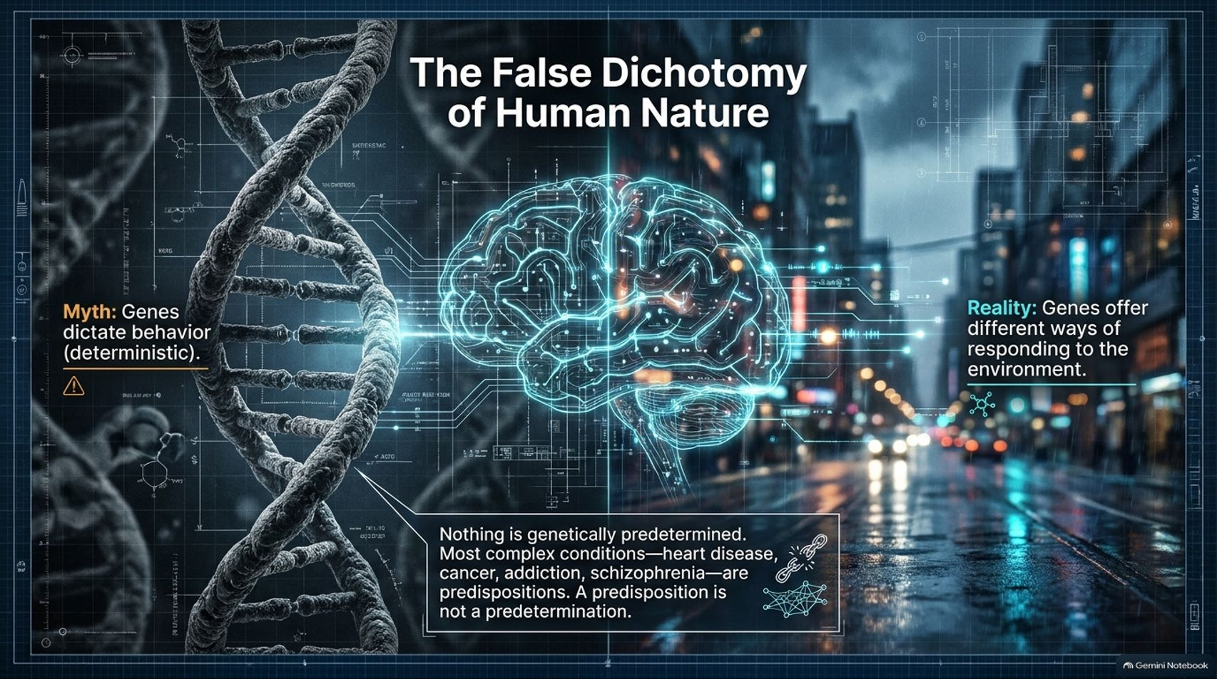
Notes:
Estimated Speaking Time: 3 – 4 minutes
Speaker Script & Talking Points
To understand why our society is structured the way it is, we must first dismantle a pervasive myth: the false dichotomy of human nature.
The Deterministic Myth: Traditional reductionist thinking argues that human behavior—greed, violence, selfishness, and addiction—is strictly hardwired into our genes. This view acts as a convenient excuse for existing power structures. If humans are inherently vicious, then inequality and warfare are inevitable, and we are absolved from changing the system.
The Biological Reality: Modern science completely refutes this. Nothing complex is purely genetically predetermined. Conditions like heart disease, cancer, addiction, and mental illness represent genetic predispositions, not predeterminations. Genes do not dictate a rigid script; they offer a menu of responses to environmental cues.
Blaming human nature for the pathologies of modern civilization is scientifically invalid. Human behavior is largely a reflection of environmental design.

Slide 3
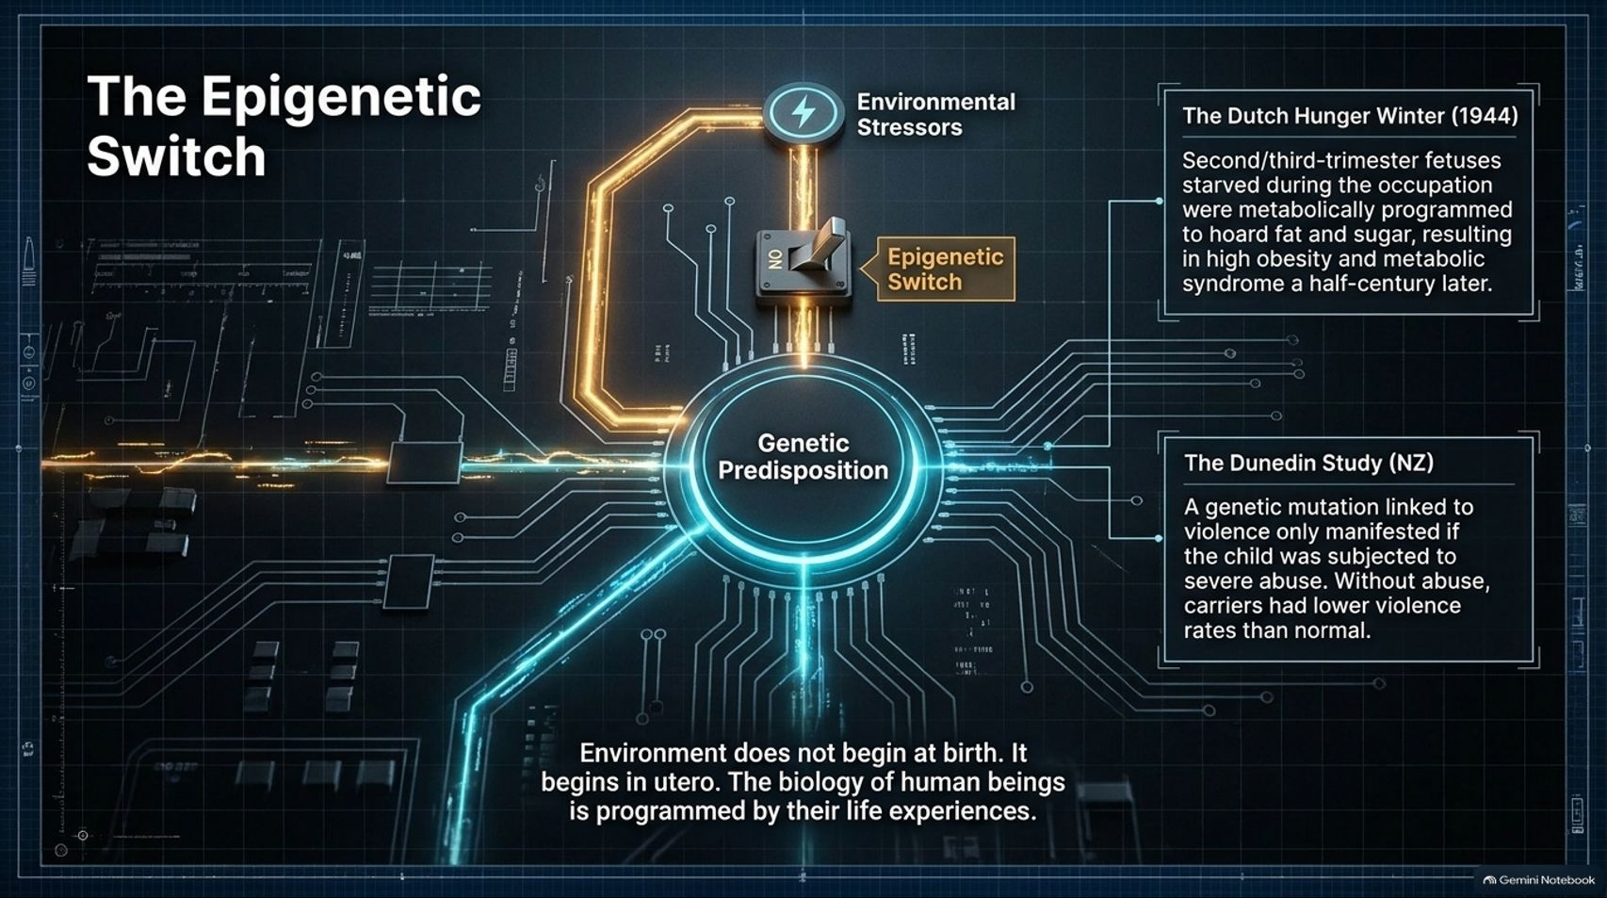
Notes:
Estimated Speaking Time: 4 – 5 minutes
Speaker Script & Talking Points
Slide 3 dives deeper into how biology interacts with our surroundings through The Epigenetic Switch.
Environmental Stressors: External stimuli—such as trauma, poverty, chronic stress, or nutritional deprivation—act as chemical switches that toggle how our genes are expressed. Environment does not begin at birth; it begins in utero. The biology of human beings is programmed by their lived experiences from conception onward.
Case Study — The Dutch Hunger Winter (1944): During the Nazi occupation of Holland, second- and third-trimester fetuses experienced severe starvation. These individuals were metabolically programmed to hoard fat and sugar, resulting in drastically higher rates of obesity and metabolic syndrome half a century later.
The Dunedin Study (New Zealand): Research demonstrated that a specific genetic marker linked to violent behavior only manifested if the child was subjected to severe abuse. Without abuse, carriers of the gene exhibited lower violence rates than normal.
If we want healthy, cooperative human beings, we must engineer a social environment that provides security, safety, and proper nourishment from the womb onward.

Slide 4
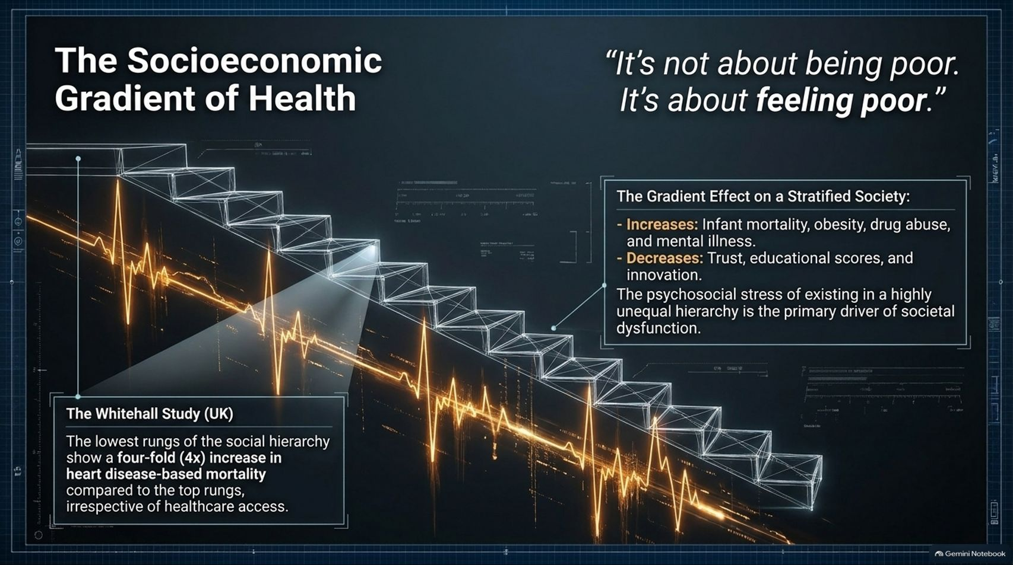
Notes:
Estimated Speaking Time: 4 – 5 minutes
Speaker Script & Talking Points
When a society is structured around hyper-competition and extreme stratification, it produces a devastating public health crisis. As the famous epidemiological maxim states: "It’s not about being poor. It’s about feeling poor."
The Whitehall Study (UK): Landmark research on British civil servants revealed that individuals on the lowest rungs of the social hierarchy experience a four-fold ($4\times$) increase in heart disease-based mortality compared to top rungs—irrespective of actual healthcare access.
The Gradient Effect: In highly unequal societies, infant mortality, obesity, drug abuse, and mental illness scale upward, while social trust, educational scores, and innovation scale downward.
Health collapse is not merely a product of absolute deprivation, but of the chronic psychosocial stress of navigating an unequal hierarchy. A system that breeds insecurity makes its population physically sick.

Slide 5
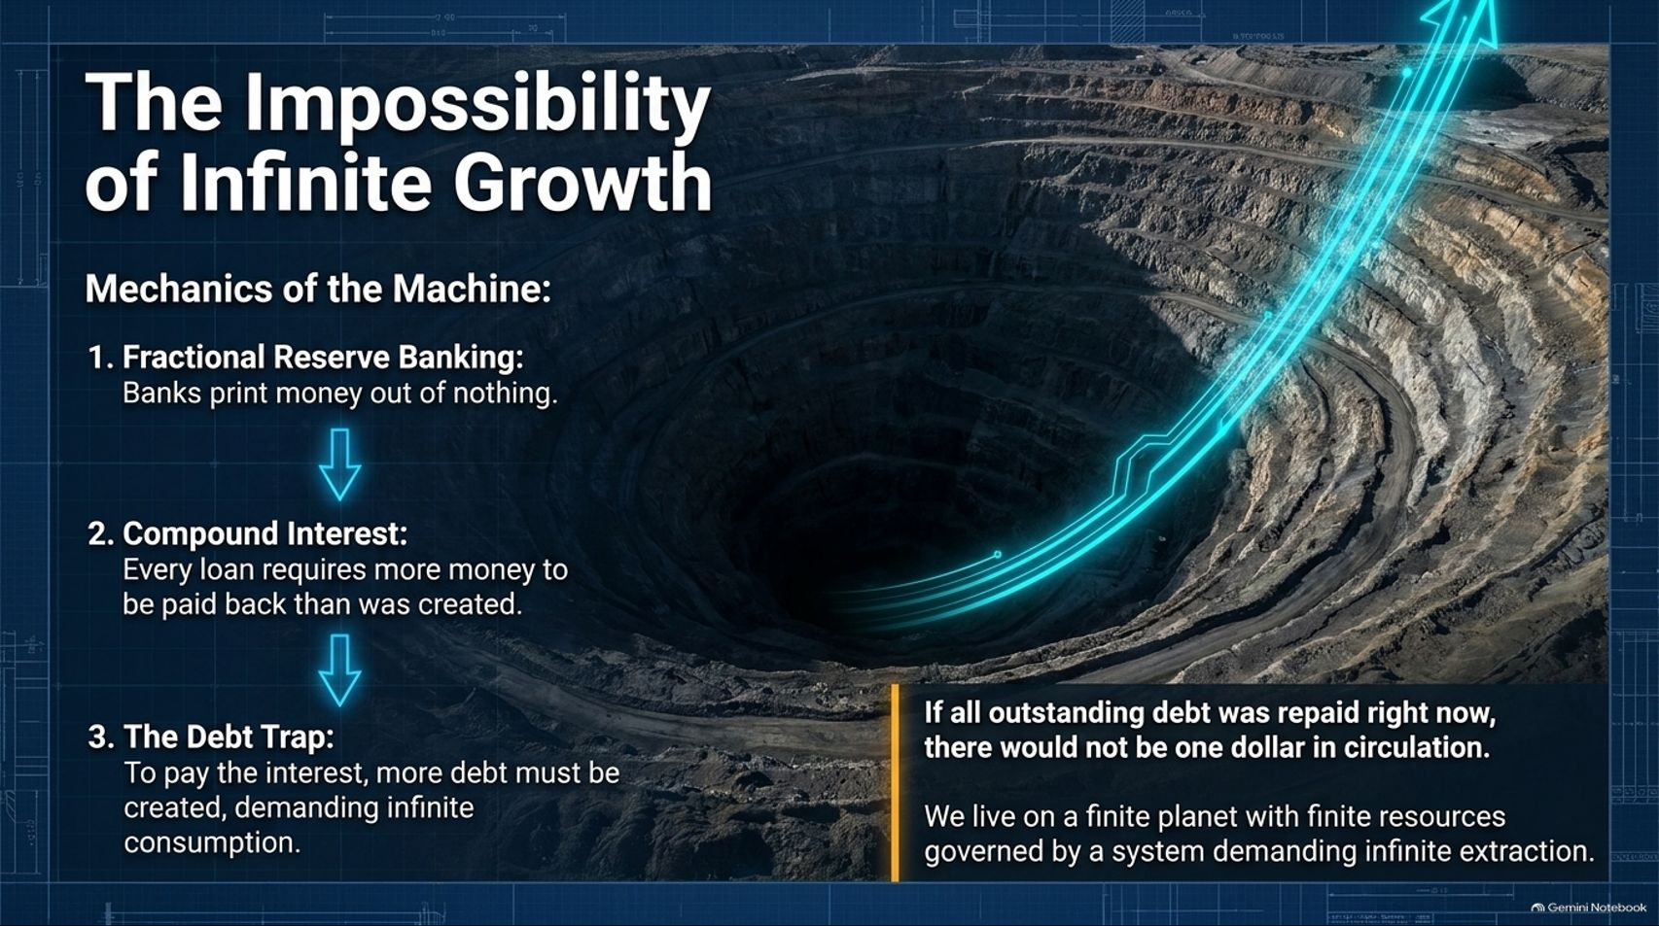
Notes:
Estimated Speaking Time: 4 – 5 minutes
Speaker Script & Talking Points
At the core of our economic engine lies a fatal mathematical contradiction: The Impossibility of Infinite Growth.
Let’s trace the mechanics of the machine:
Fractional Reserve Banking: Commercial banks create money out of nothing through lending.
Compound Interest: Every loan carries interest. However, the money required to pay back that accumulated interest is never created in the initial money supply.
The Debt Trap: To cover missing interest and prevent total collapse, the money supply must perpetually expand. This demands endless borrowing and endless consumption.
As Slide 5 highlights: If all outstanding debt was repaid right now, there would not be one dollar in circulation. We live on a finite planet with finite ecological boundaries, governed by a monetary system demanding infinite extraction. This is a mathematical impossibility heading toward inevitable collapse.

Slide 6
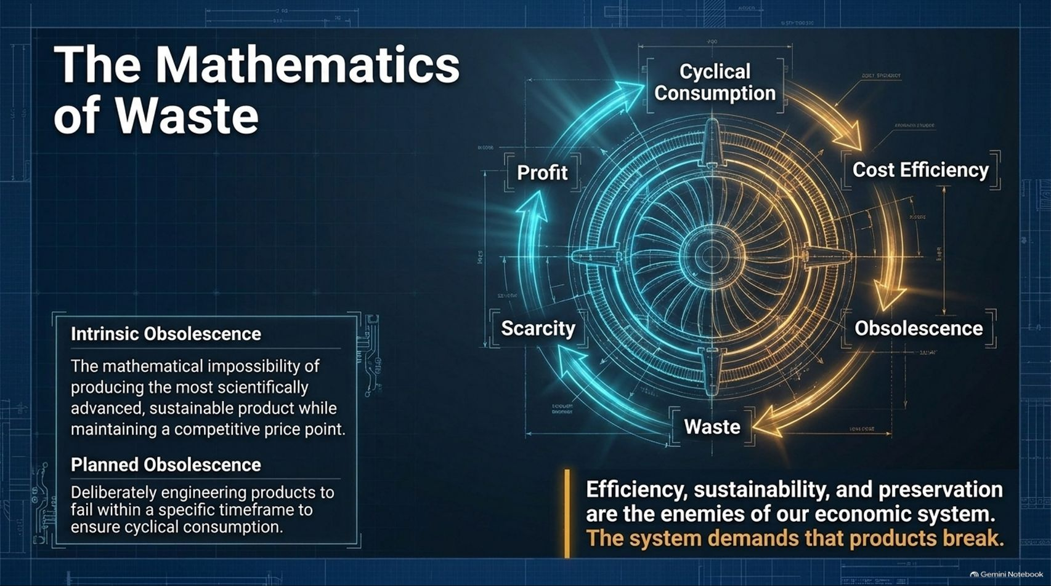
Notes:
Estimated Speaking Time: 4 – 5 minutes
Speaker Script & Talking Points
Because our economic model requires continuous turnover to survive, efficiency, sustainability, and preservation are the literal enemies of our economic system.
Intrinsic Obsolescence: Under market competition, it is mathematically impossible to produce the most scientifically advanced, durable product while maintaining a competitive price point. Companies must compromise on materials and labor.
Planned Obsolescence: Goods are deliberately engineered to fail, break down, or become outdated within a specific timeframe to ensure cyclical consumption and repeat purchases.
The endless wheel of scarcity, profit, cost efficiency, obsolescence, and waste is not an accidental glitch. The system demands that products break. Landfills overflowing with consumer electronics are the logical output of a market that profits from replacement.

Slide 7
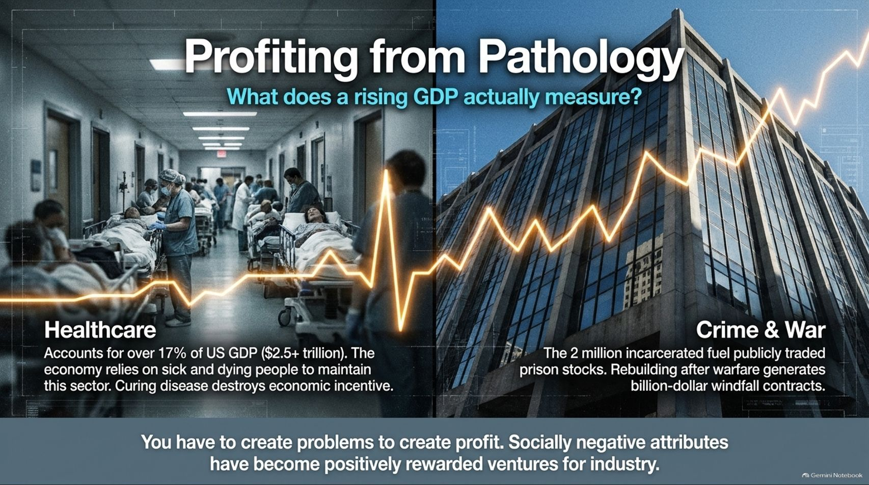
Notes:
Estimated Speaking Time: 4 – 5 minutes
Speaker Script & Talking Points
Slide 7 exposes a disturbing economic reality: What does a rising GDP actually measure?
Healthcare: Healthcare accounts for over 17% of U.S. GDP—over $2.5 trillion. In our current economic model, the market relies on a sick, declining population to maintain this massive sector. Curing disease permanently destroys the economic incentive and revenue stream.
Crime and War: The two million incarcerated individuals in the U.S. generate lucrative stock value for private prison corporations. Meanwhile, geopolitical conflict and post-war rebuilding efforts generate windfall billion-dollar contracts.
In a monetary-market paradigm, you have to create problems to generate profit. Socially negative attributes—sickness, conflict, decay, and incarceration—have become positively rewarded business ventures.

Slide 8
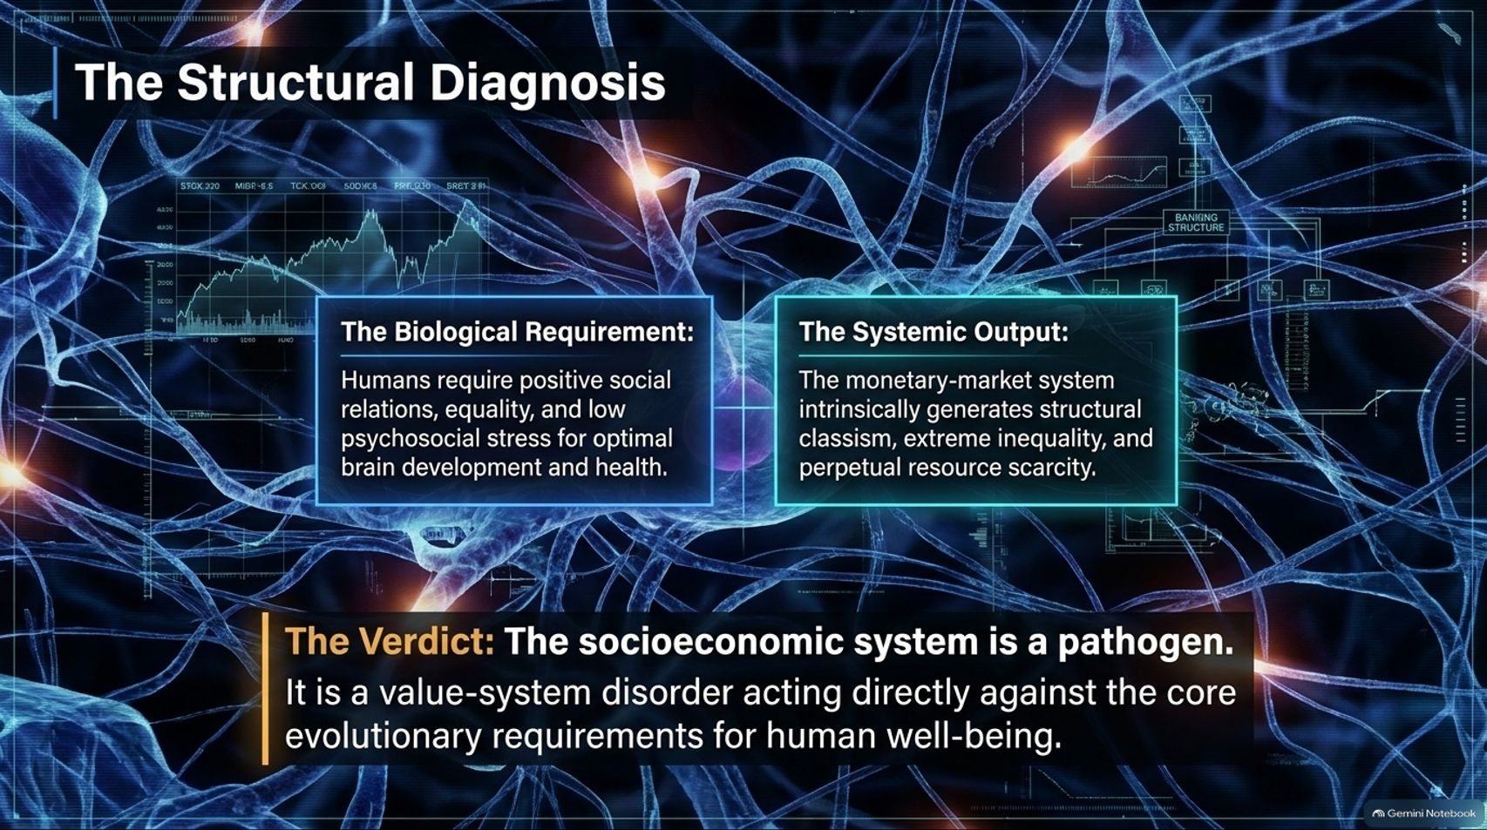
Notes:
Estimated Speaking Time: 3 – 4 minutes
Speaker Script & Talking Points
Let’s review the structural diagnosis of our civilization (Slide 8):
The Biological Requirement: Humans require positive social relations, equality, low psychosocial stress, and ecological security for optimal brain development and health.
The Systemic Output: The monetary-market system intrinsically generates structural classism, extreme inequality, and perpetual resource scarcity.
The Verdict: The socioeconomic system is a pathogen. It is a value-system disorder acting directly against the core evolutionary requirements for human well-being. We cannot fix a system designed to exploit life by simply applying moral band-aids; we must change the container.

Slide 9
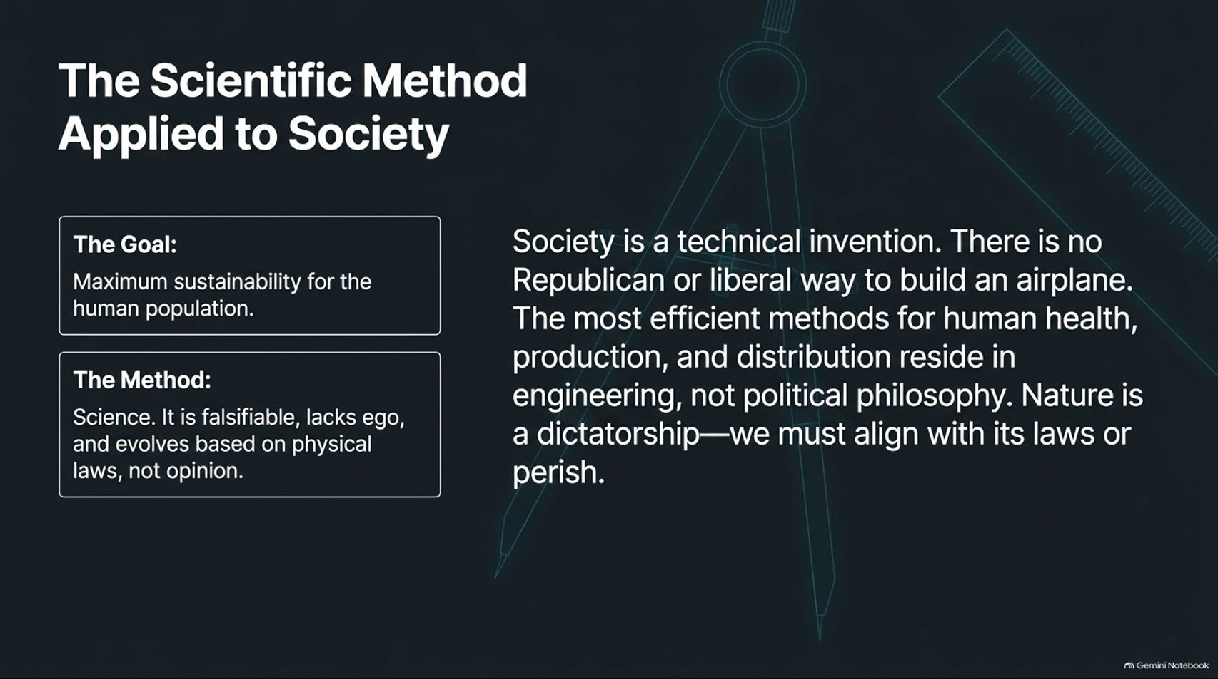
Notes:
Estimated Speaking Time: 4 – 5 minutes
Speaker Script & Talking Points
How do we design a functional alternative? By applying The Scientific Method to Society.
The Goal: Maximum sustainability and optimized physical well-being for the entire human population.
The Method: Science. It is falsifiable, lacks ego, and evolves based on empirical physical laws rather than subjective opinion or political ideology.
Society is a technical invention. There is no Republican or Democratic way to build an airplane, and there is no capitalist or socialist way to manage a freshwater watershed. The most efficient methods for human health, production, and distribution reside in engineering and systems science, not political philosophy. Nature is an absolute dictatorship—we must align with its physical laws or perish.

Slide 10
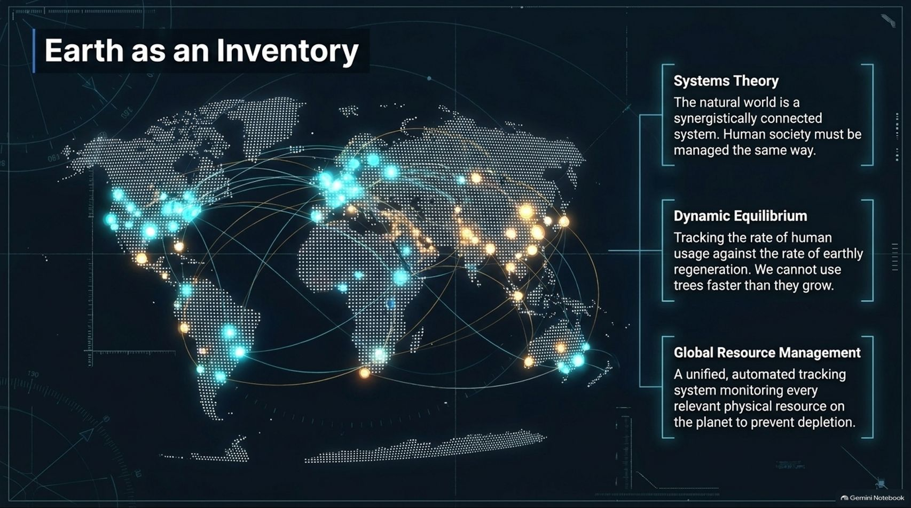
Notes:
Estimated Speaking Time: 4 – 5 minutes
Speaker Script & Talking Points
In a Resource-Based Economy, governance is replaced by technical management. We treat Earth as an Inventory:
Systems Theory: The natural world is a synergistically connected system. Human society must be managed using the same holistic principles.
Dynamic Equilibrium: We track the rate of human consumption against the rate of earthly regeneration. Just as a prudent forester cannot log trees faster than they grow, human industry cannot extract resources faster than ecosystems can replenish them.
Global Resource Management: A unified, automated tracking system monitors every relevant physical resource on the planet in real time to prevent depletion and ensure abundance.

Slide 11
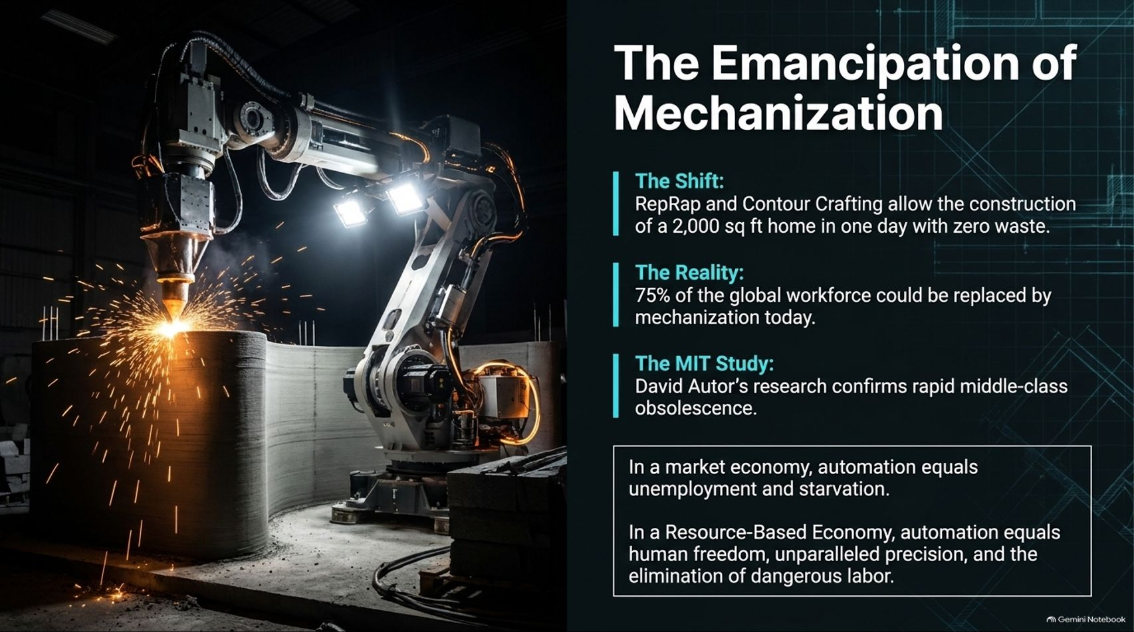
Notes:
Estimated Speaking Time: 4 – 5 minutes
Speaker Script & Talking Points
Slide 11 addresses the technological revolution: The Emancipation of Mechanization.
The Shift: Advanced manufacturing technologies, such as open-source 3D printers (RepRap) and automated construction systems (Contour Crafting), allow the construction of a 2,000-square-foot home in a single day with zero waste.
The Reality & MIT Study: Research by economists like MIT's David Autor confirms rapid middle-class obsolescence due to automation. Up to 75% of the global workforce could be replaced by mechanization.
In a market economy, automation equals unemployment, poverty, and starvation. But in a Resource-Based Economy, automation equals human freedom, unparalleled precision, and the complete elimination of dangerous, repetitive toil. Machines free humanity to pursue education, art, and scientific exploration.

Slide 12
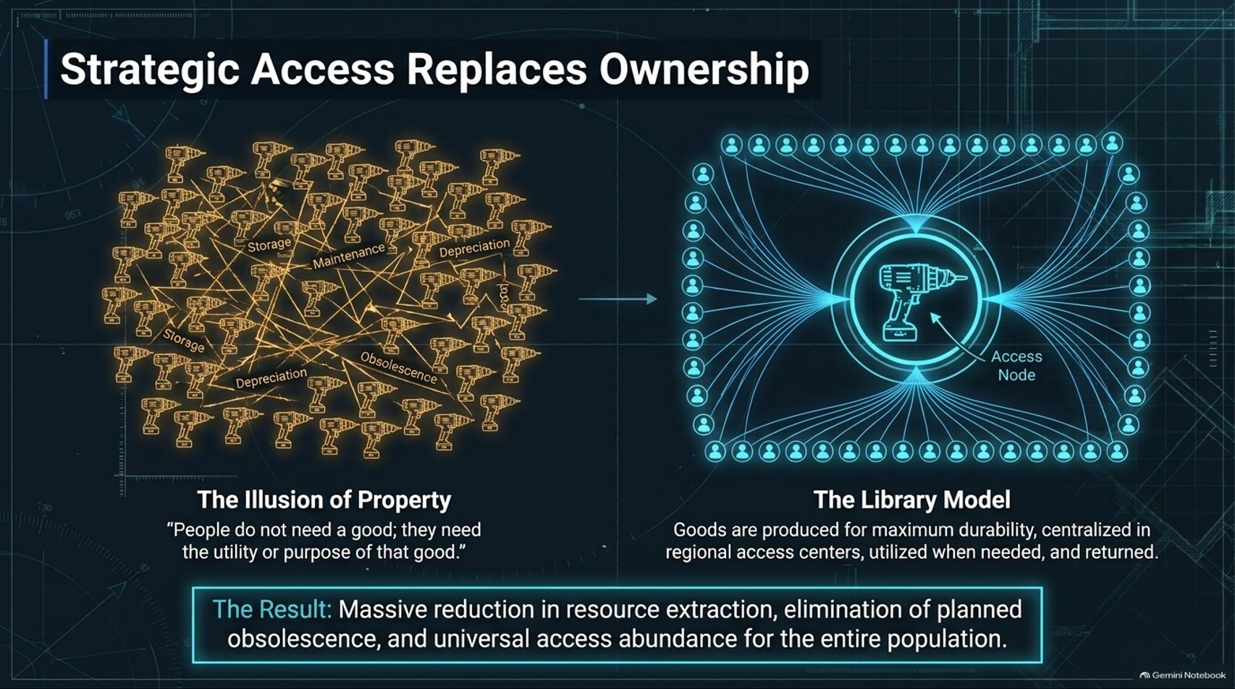
Notes:
Estimated Speaking Time: 4 – 5 minutes
Speaker Script & Talking Points
One of the most profound shifts in a Resource-Based Economy is that Strategic Access Replaces Ownership.
The Illusion of Property: In our current system, millions of people own individual power tools, cars, and appliances that sit unused 95% of the time, resulting in massive redundancy, storage costs, maintenance overhead, and depreciation. As Jacque Fresco noted: "People do not need a good; they need the utility or purpose of that good."
The Library Model: Goods are produced for maximum durability, centralized in regional access centers, utilized when needed, and returned.
The Result: This model achieves a massive reduction in resource extraction, completely eliminates planned obsolescence, and guarantees universal access to high-quality goods for the entire population.

Slide 13
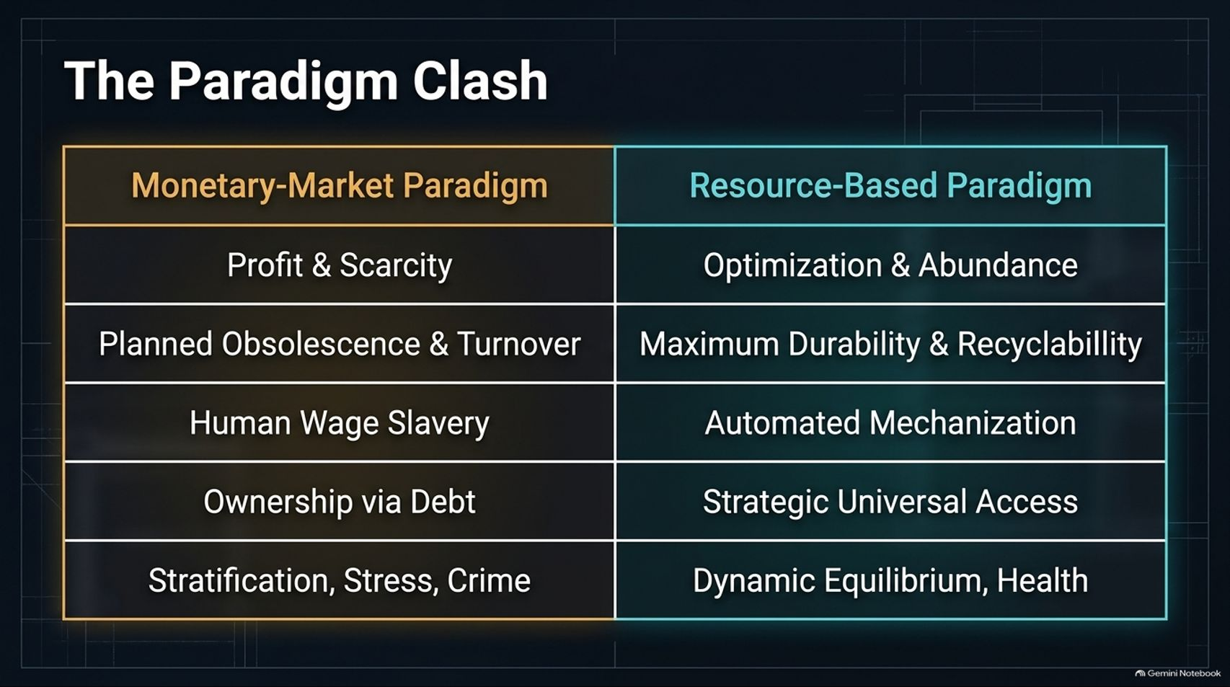
Notes:
Estimated Speaking Time: 3 – 4 minutes
Speaker Script & Talking Points
Slide 13 provides a direct comparative matrix contrasting our two paradigms:
Monetary-Market Paradigm: Driven by Profit & Scarcity, Planned Obsolescence & Turnover, Human Wage Slavery, Ownership via Debt, and resulting in Stratification, Stress, and Crime.
Resource-Based Paradigm: Driven by Optimization & Abundance, Maximum Durability & Recyclability, Automated Mechanization, Strategic Universal Access, and resulting in Dynamic Equilibrium & Health.
We are moving from a system that monetizes artificial scarcity to one that optimizes natural abundance.

Slide 14
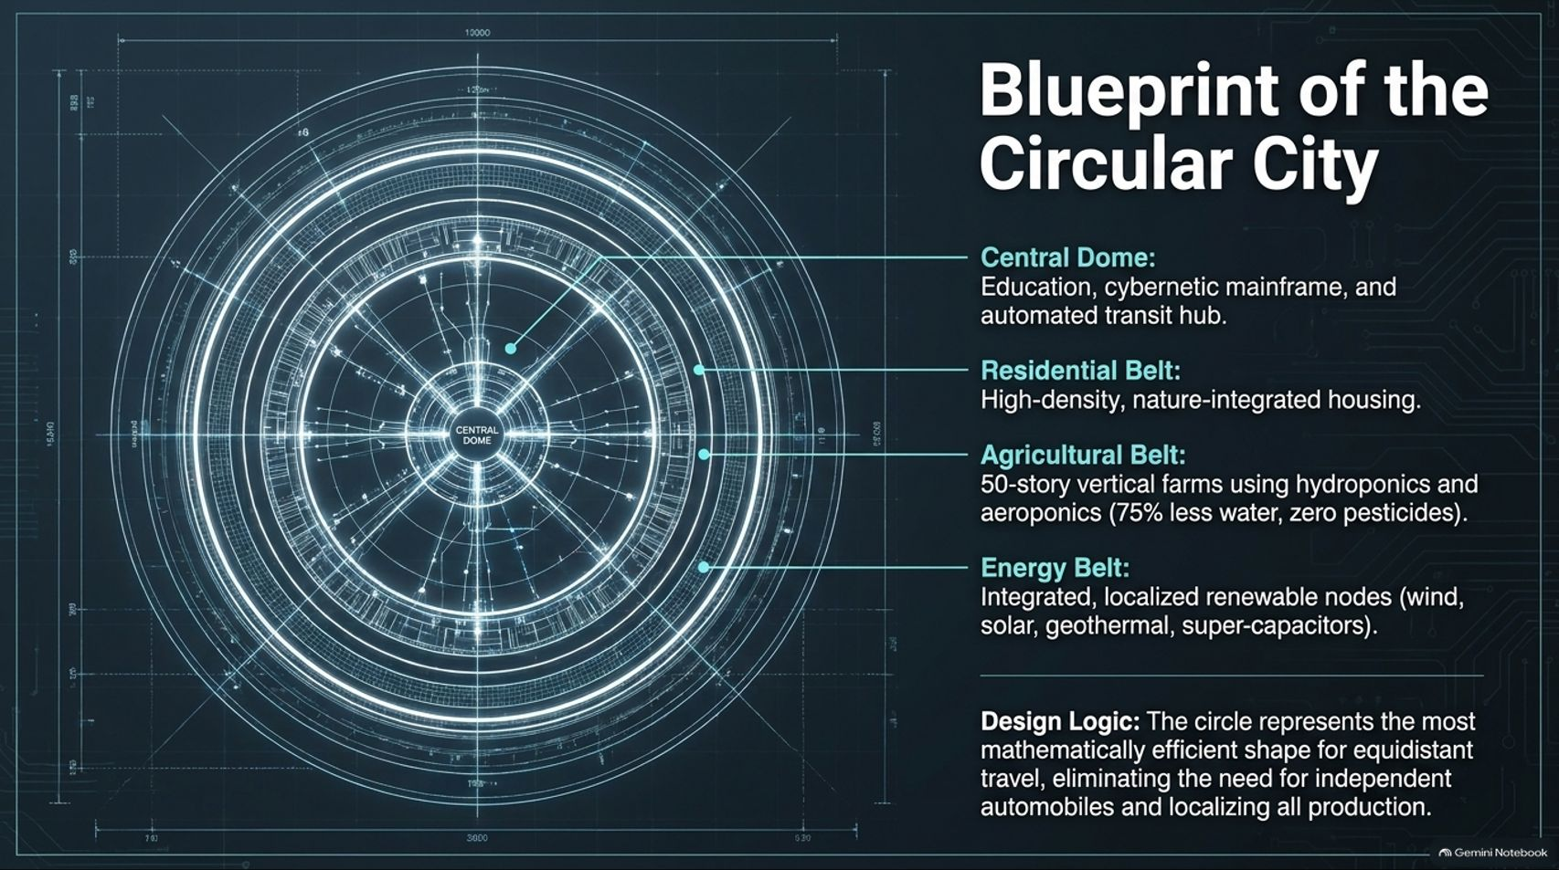
Notes:
Estimated Speaking Time: 4 – 5 minutes
Speaker Script & Talking Points
Slide 14 outlines the physical architecture of a sustainable habitat: The Blueprint of the Circular City:
Central Dome: Houses educational facilities, the cybernetic mainframe for resource tracking, and automated transit hubs.
Residential Belt: High-density, nature-integrated housing designed for comfort and community.
Agricultural Belt: 50-story vertical farms utilizing advanced hydroponics and aeroponics, reducing water usage by 75% while eliminating pesticides entirely.
Energy Belt: Integrated, localized renewable nodes harnessing wind, solar, geothermal energy, and advanced super-capacitors.
Design Logic: The circular layout represents the most mathematically efficient shape for equidistant travel, eliminating the need for independent polluting automobiles and localizing all production.

Slide 15
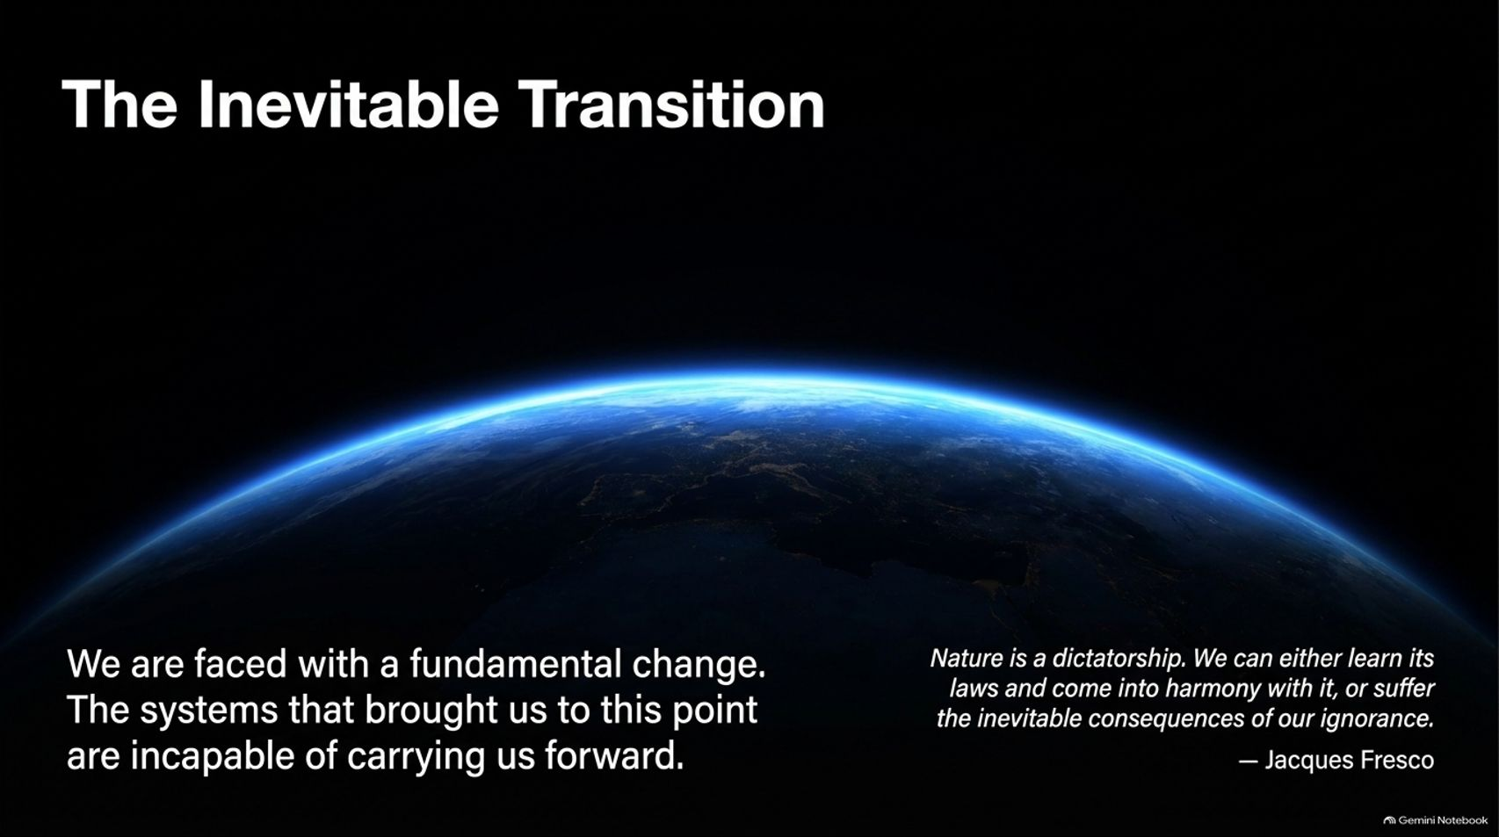
Notes:
Estimated Speaking Time: 3 – 4 minutes
Speaker Script & Talking Points
As we reach Slide 15, we confront the reality of our historical juncture: The Inevitable Transition.
"We are faced with a fundamental change. The systems that brought us to this point are incapable of carrying us forward."
As futurist Jacque Fresco famously stated: "Nature is a dictatorship. We can either learn its laws and come into harmony with it, or suffer the inevitable consequences of our ignorance." We can no longer negotiate with the laws of physics and ecology.

Slide 16
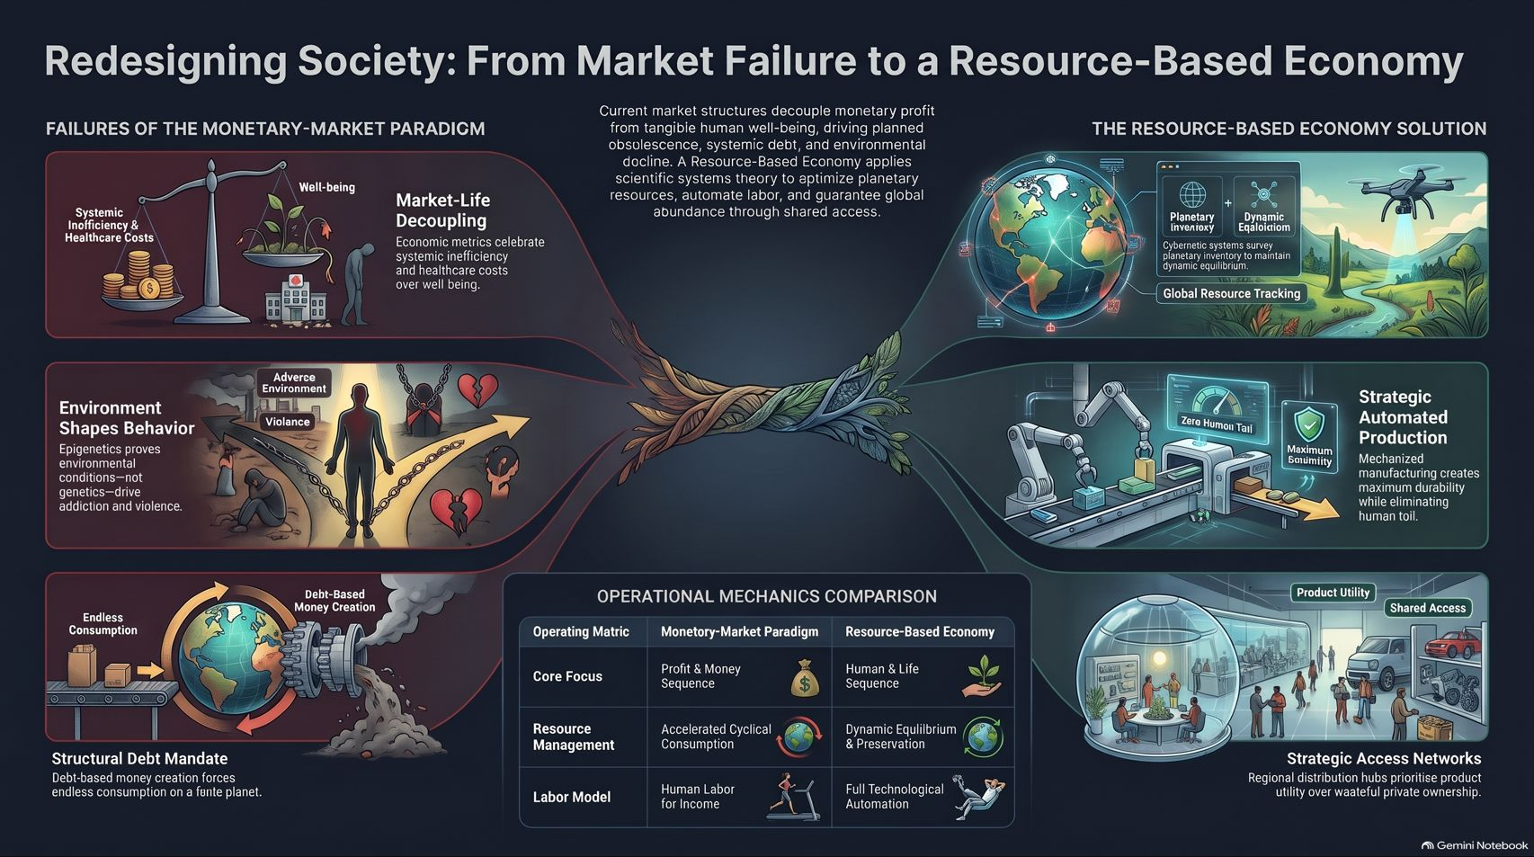
Notes:
Estimated Speaking Time: 4 – 5 minutes
Speaker Script & Talking Points
To summarize our comprehensive roadmap (Slide 16):
Failures of the Monetary-Market Paradigm: We suffer from market-life decoupling where GDP rewards inefficiency, epigenetic trauma driven by toxic environments, and debt-driven money supplies mandating endless extraction and consumption.
The Resource-Based Economy Solution: We replace profit with global resource tracking and dynamic equilibrium. We substitute human toil with automated production and replace wasteful private ownership with strategic access networks.
We possess the technology, the science, and the ecological awareness to eliminate poverty and scarcity. The only remaining barrier is our willingness to outgrow an obsolete system. Thank you.

