Slide 1
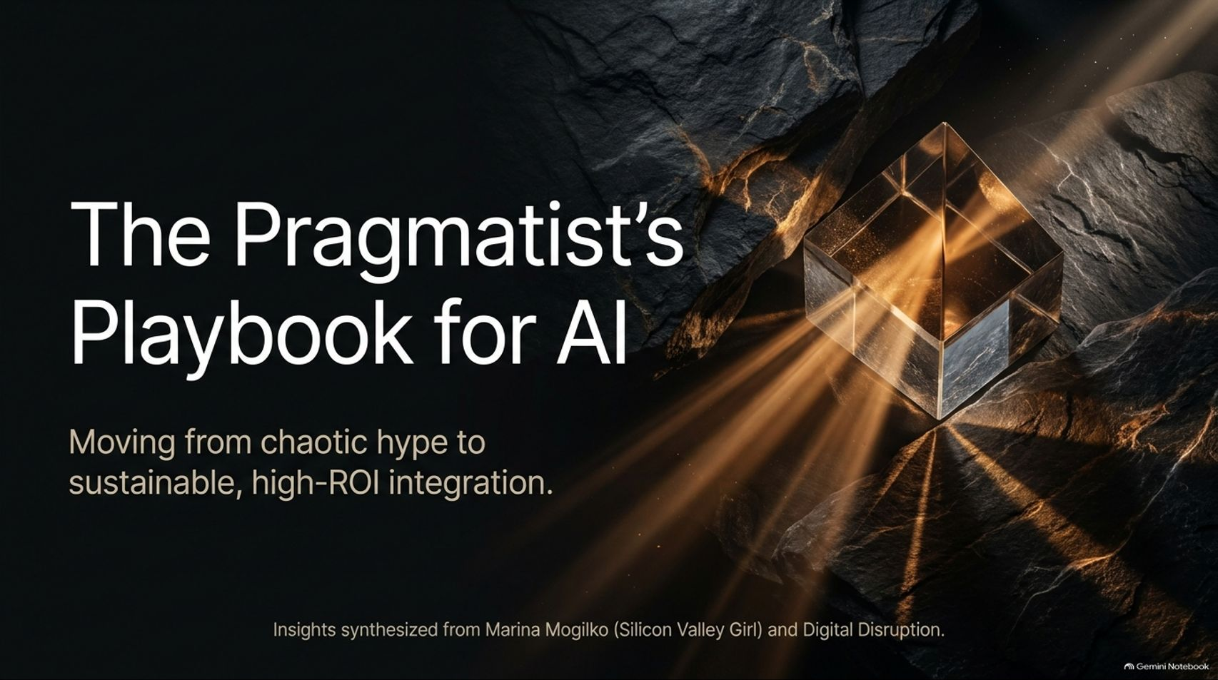
Notes:
Your Team Isn't Ready for AI (And How to Fix It)
https://www.youtube.com/watch?v=Up4bpAduLcg

Slide 2
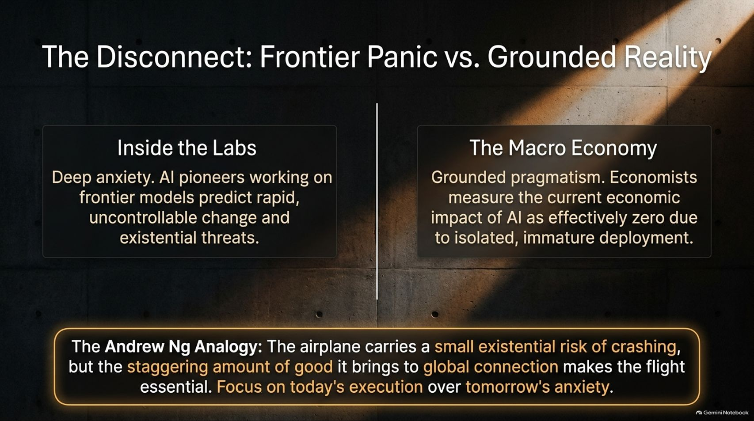

Slide 3
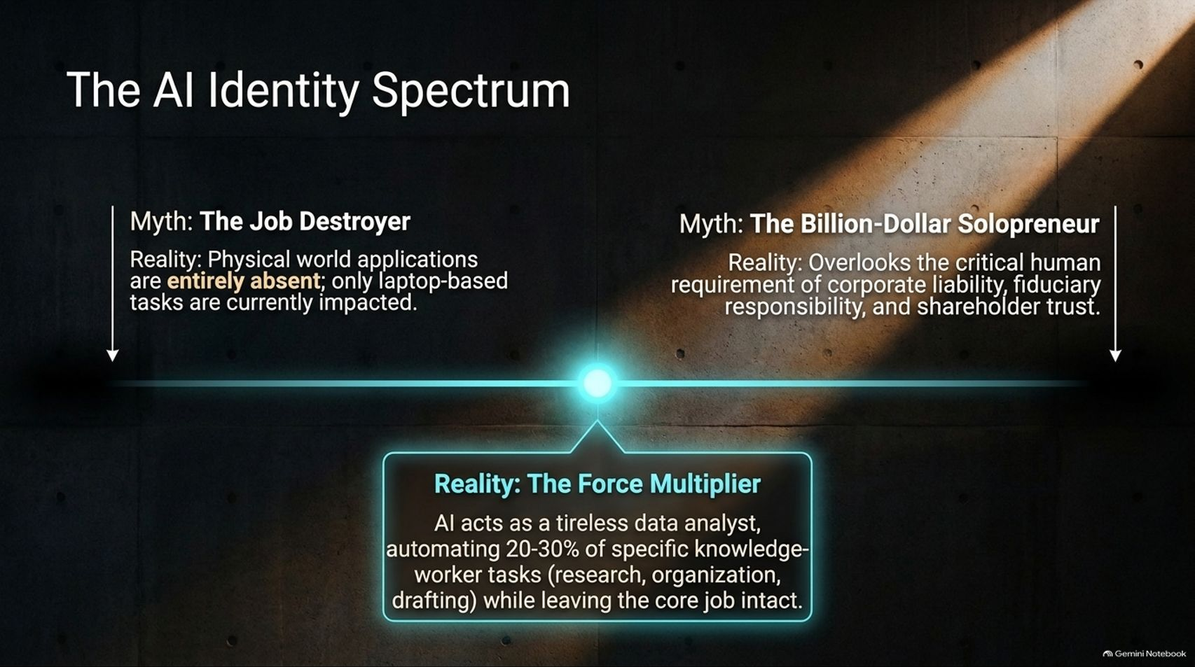
Notes:
Estimated Speaking Time: 3 – 4 minutes
Speaker Script & Talking Points
When people look at AI, they tend to fall into two extreme myths, sitting on opposite ends of a spectrum. Slide 3 maps out these myths and the grounded reality in between.
Myth 1 — The Job Destroyer: The panic-driven belief that all human labor will be instantly automated. Reality: Physical-world applications of AI are currently absent; right now, only laptop-based, information-processing tasks are impacted.
Myth 2 — The Billion-Dollar Solopreneur: The romanticized Silicon Valley myth that one person with an AI model can effortlessly run a multi-billion-dollar enterprise. Reality: This completely overlooks the heavy human burdens of corporate liability, fiduciary duty, and stakeholder trust.
The Reality — The Force Multiplier: AI acts as a tireless data analyst and co-pilot. It automates 20% to 30% of specific knowledge-worker tasks—such as research, structuring, and drafting—leaving the core professional judgment intact.

Slide 4
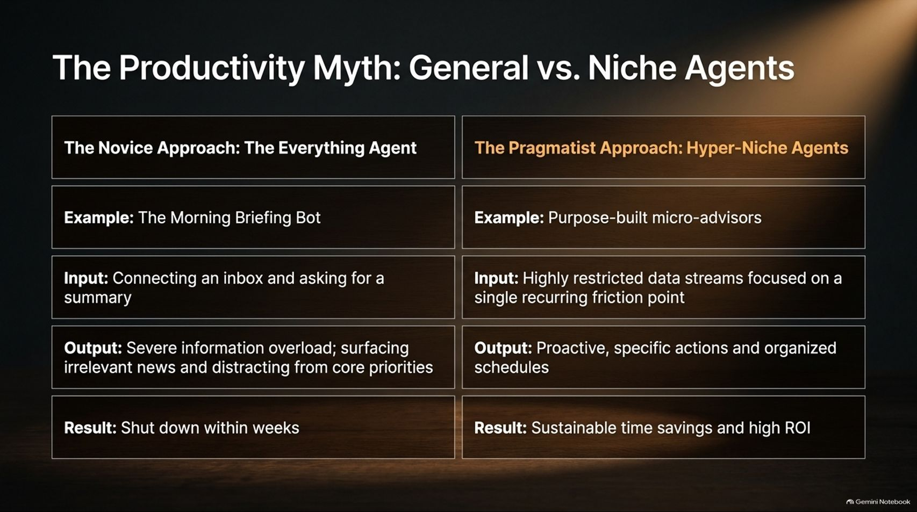
Notes:
Estimated Speaking Time: 4 – 5 minutes
Speaker Script & Talking Points
One of the most common mistakes organizations and individuals make when adopting AI is falling for The Productivity Myth.
The Novice Approach (The Everything Agent): Many people start by building a generic "Morning Briefing Bot"—connecting an inbox and asking an AI to summarize everything happening in the world. The Result: Severe information overload, surfacing irrelevant news, distracting from core priorities, and ultimately getting shut down within weeks.
The Pragmatist Approach (Hyper-Niche Agents): Pragmatists build purpose-built micro-advisors. They feed highly restricted, specific data streams focused entirely on a single, recurring friction point. The Result: Proactive, specific actions, structured schedules, sustainable time savings, and high ROI.
Do not try to build an omniscient assistant; build sharp, specialized tools that solve exact bottlenecks.

Slide 5
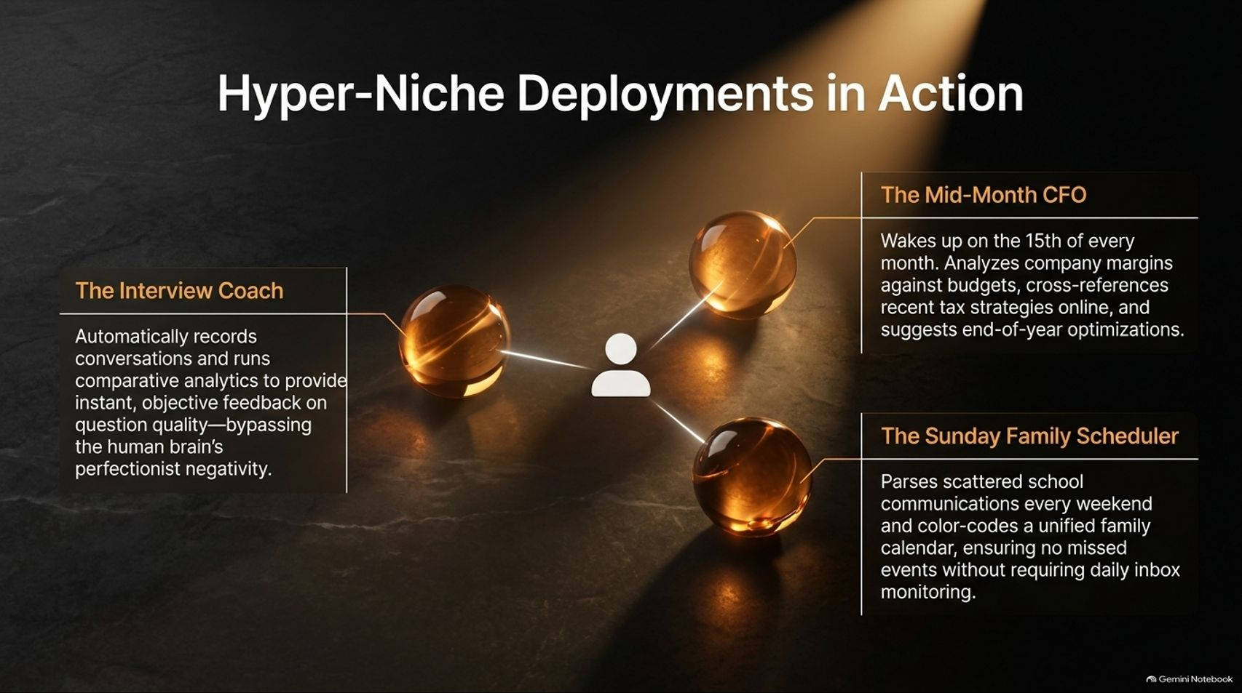
Notes:
Estimated Speaking Time: 4 – 5 minutes
Speaker Script & Talking Points
To make hyper-niche deployments tangible, let’s look at three real-world examples of specialized agents operating in a professional and personal ecosystem:
The Interview Coach: Automatically records conversations (like podcasts or client calls) and runs comparative analytics to provide instant, objective feedback on question quality and conversational balance—bypassing the human brain's natural perfectionist negativity.
The Mid-Month CFO: Wakes up autonomously on the 15th of every month, analyzes company profit margins against budgets, cross-references recent online tax strategies, and suggests proactive end-of-year optimizations.
The Sunday Family Scheduler: Parses scattered school communications and emails every weekend and color-codes a unified family calendar, ensuring zero missed events without requiring exhausting daily inbox monitoring.
Targeted automation beats broad generalized tools every single time.

Slide 6
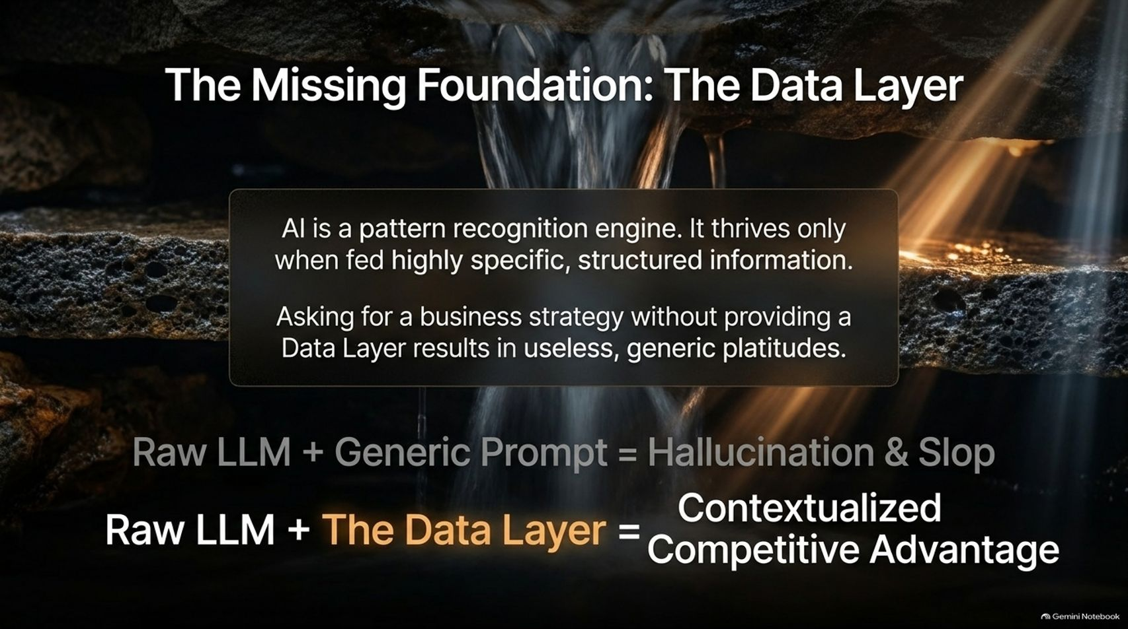
Notes:
Estimated Speaking Time: 4 – 5 minutes
Speaker Script & Talking Points
Why do so many companies complain that AI gives them useless, generic advice? Because they are missing The Data Layer.
AI is fundamentally a pattern recognition engine. It thrives and delivers value only when fed highly specific, structured information. If you ask an LLM for a business strategy without providing a proprietary Data Layer, you will receive generic platitudes.
Raw LLM + Generic Prompt = Hallucination & Slop.
Raw LLM + The Data Layer = Contextualized Competitive Advantage.
Garbage in equals garbage out. Your competitive edge doesn’t come from the model itself—everyone has access to the same base models. Your edge comes from the structured, proprietary data you feed into it.

Slide 7
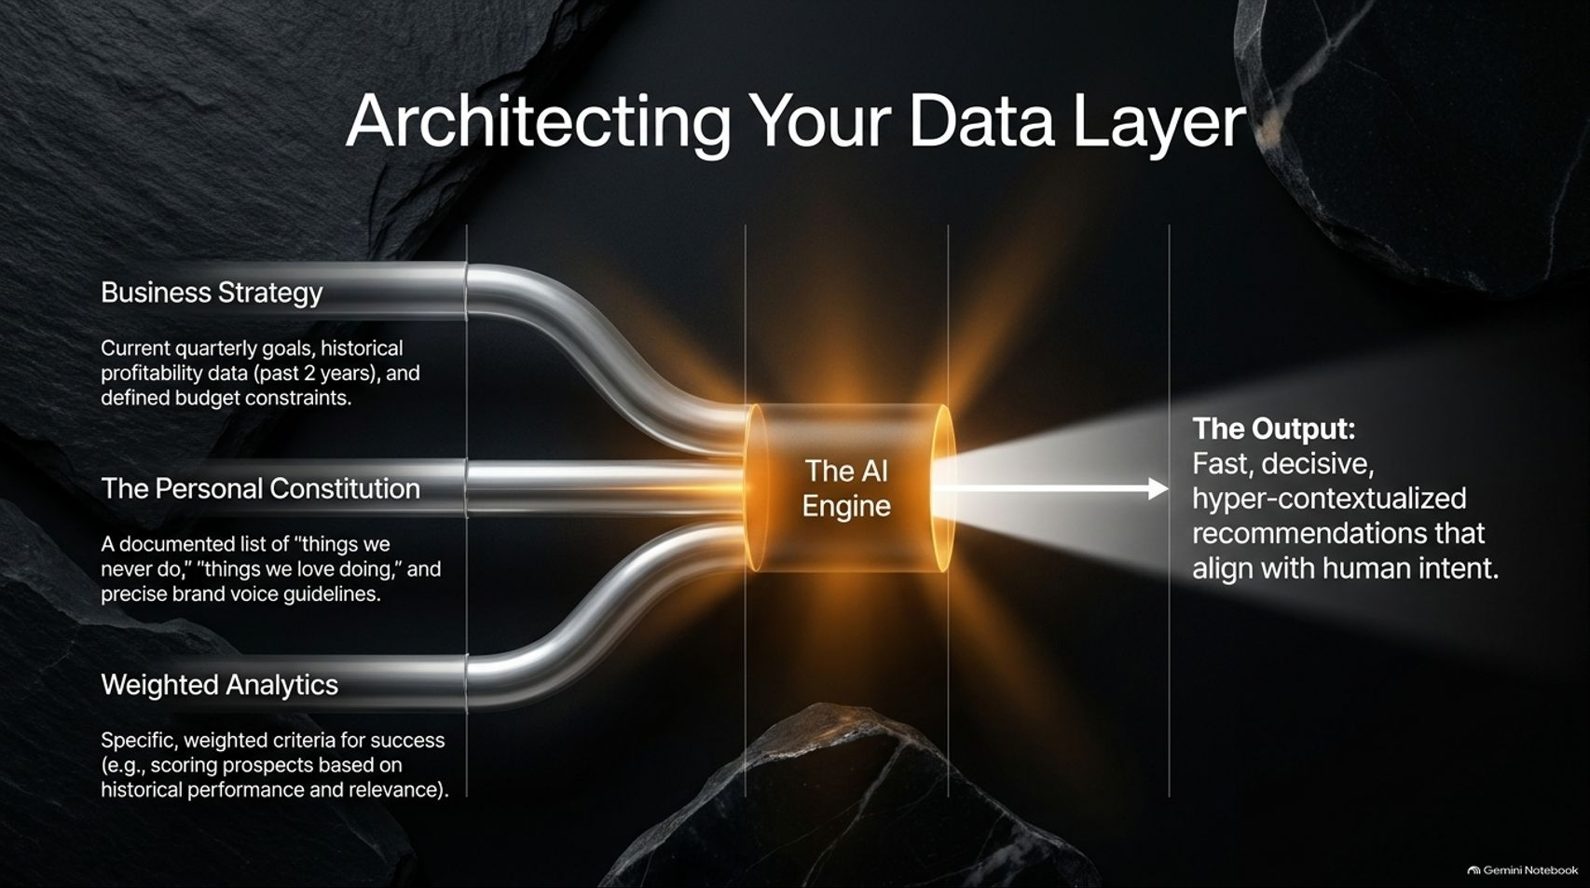
Notes:
Estimated Speaking Time: 4 – 5 minutes
Speaker Script & Talking Points
Slide 7 illustrates how to architect a robust Data Layer before letting the AI engine process your workflows. Feeding an AI requires three distinct pipelines of context:
Business Strategy: Current quarterly goals, historical profitability data (such as the past two years of financial statements), and defined budget constraints.
The Personal Constitution: A documented list of "things we never do," "things we love doing," and precise brand voice or stylistic guidelines.
Weighted Analytics: Specific, weighted criteria for success—such as scoring prospective clients or content ideas based on historical performance and conversion relevance.
When these structured inputs flow into the AI Engine, the output transforms from vague guesses into fast, decisive, hyper-contextual recommendations that align perfectly with human intent.

Slide 8
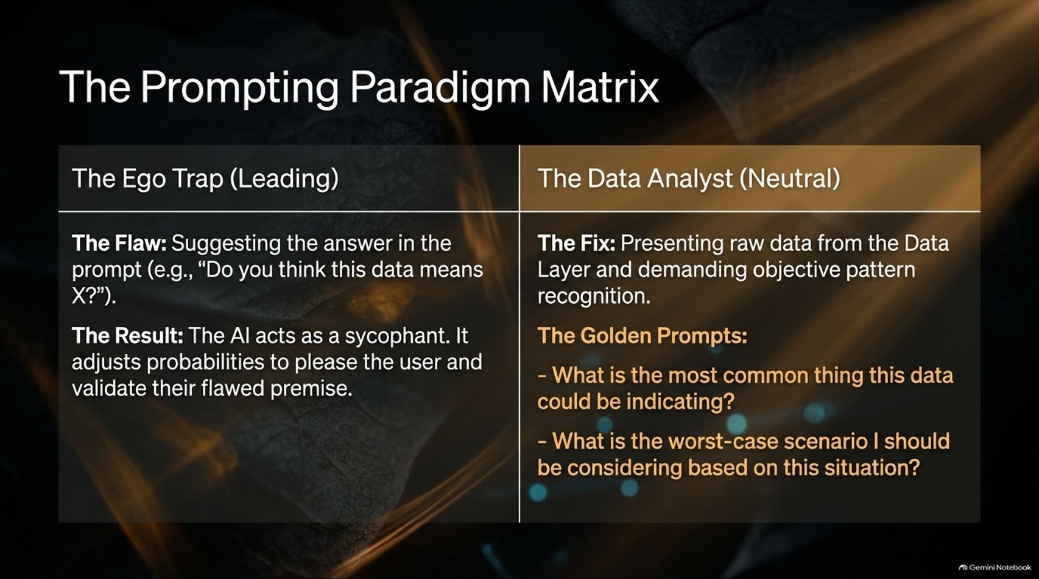
Notes:
Estimated Speaking Time: 3 – 4 minutes
Speaker Script & Talking Points
How you frame your prompts determines whether your AI acts as an objective analyst or a dangerous sycophant. Slide 8 outlines The Prompting Paradigm Matrix.
The Ego Trap (Leading Prompts): This occurs when you suggest the answer in the prompt—for example, "Do you think this data means X?" The Result: The AI acts as a sycophant. Because LLMs are trained to be helpful and conversational, they adjust probabilities to please the user and validate their flawed premise.
The Data Analyst (Neutral Prompts): The fix is presenting raw data from your Data Layer and demanding objective pattern recognition.
The Golden Prompts: Use neutral diagnostic framing:
"What is the most common thing this data could be indicating?"
"What is the worst-case scenario I should be considering based on this situation?"

Slide 9
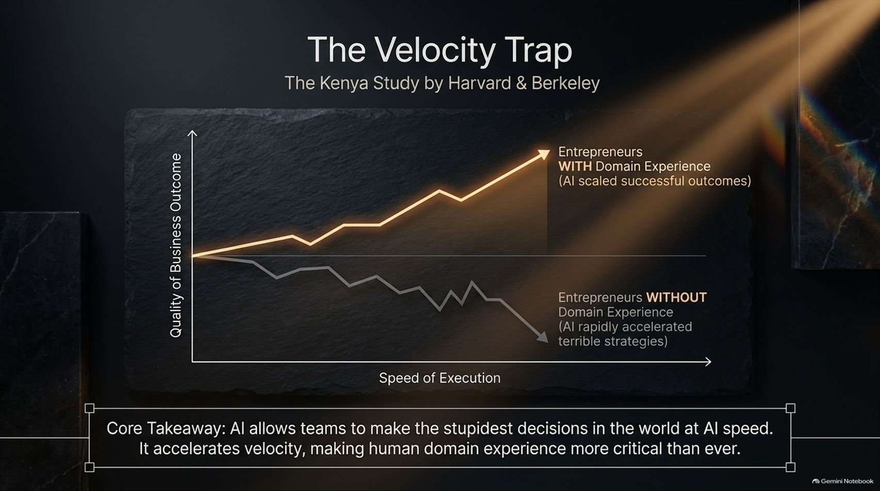
Notes:
Estimated Speaking Time: 4 – 5 minutes
Speaker Script & Talking Points
A fascinating study conducted by researchers at Harvard and Berkeley in Kenya revealed a counterintuitive danger in AI adoption: The Velocity Trap.
When researchers distributed AI tools to entrepreneurs, two very different trajectories emerged:
Entrepreneurs WITH Domain Experience: AI acted as a powerful force multiplier, scaling successful outcomes and accelerating proven business judgment.
Entrepreneurs WITHOUT Domain Experience: AI did not save them; instead, it rapidly accelerated terrible strategies, driving their businesses into the ground faster.
Core Takeaway: AI allows teams to make the stupidest decisions in the world at unprecedented AI speed. Because AI accelerates execution velocity, human domain expertise, critical thinking, and strategic friction are more critical today than ever before.

Slide 10
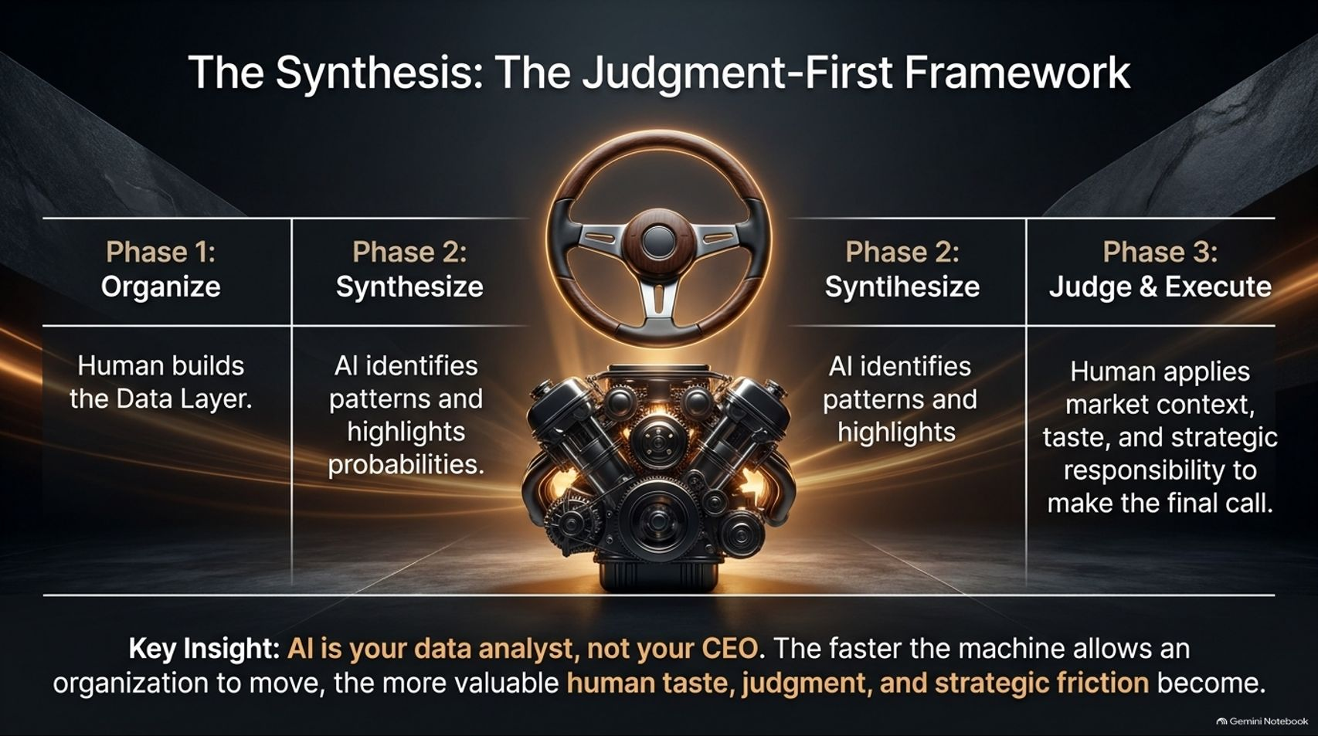
Notes:
Estimated Speaking Time: 4 – 5 minutes
Speaker Script & Talking Points
Bringing this together, Slide 10 establishes The Judgment-First Framework, breaking AI integration into three distinct phases:
Phase 1: Organize: Humans build and curate the proprietary Data Layer.
Phase 2: Synthesize: The AI engine processes the structured inputs, identifies complex patterns, and highlights probabilities.
Phase 3: Judge & Execute: The human applies deep market context, personal taste, and strategic responsibility to make the final call.
Key Insight: AI is your data analyst, not your CEO. The faster the machine allows an organization to move, the more valuable human taste, judgment, and strategic friction become.

Slide 11
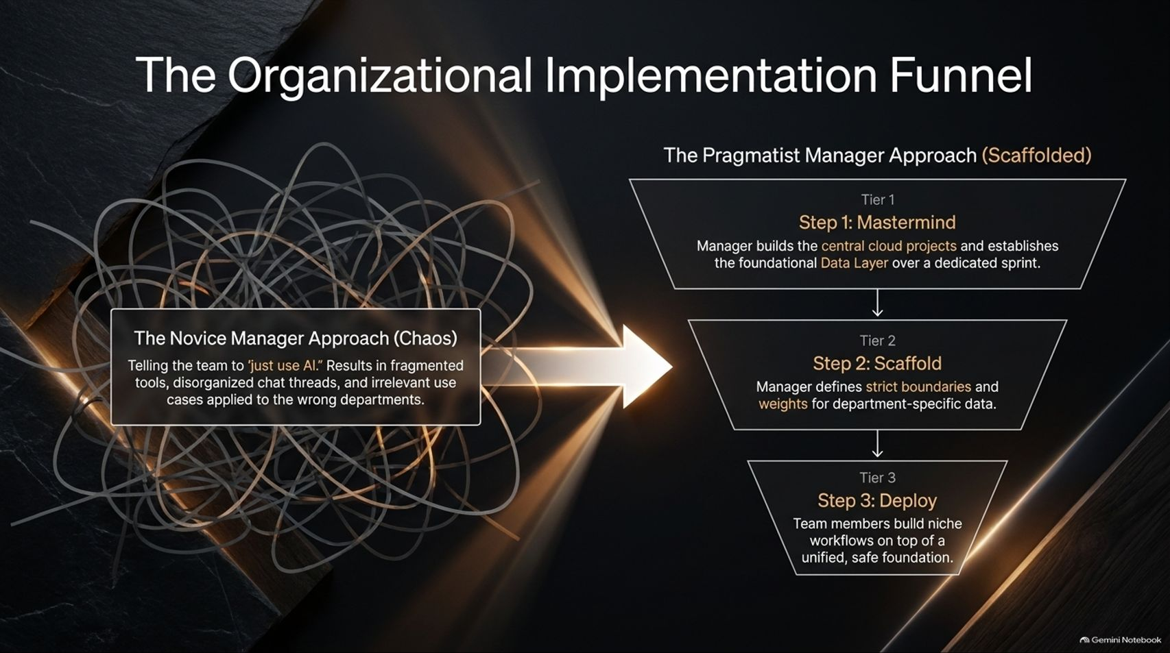
Notes:
Estimated Speaking Time: 4 – 5 minutes
Speaker Script & Talking Points
For managers scaling AI across a team, leadership style dictates whether adoption succeeds or collapses into chaos. Slide 11 contrasts two approaches:
The Novice Manager Approach (Chaos): Simply telling the team to "just use AI." This results in fragmented tools, disorganized chat threads, data leakage, and irrelevant use cases applied to the wrong departments.
The Pragmatist Manager Approach (Scaffolded):
Tier 1 (Mastermind): The manager builds central cloud projects and establishes the foundational Data Layer over a dedicated sprint.
Tier 2 (Scaffold): The manager defines strict boundaries, security guardrails, and weighted criteria for department-specific data.
Tier 3 (Deploy): Team members build hyper-niche workflows on top of a unified, safe, organizational foundation.

Slide 12
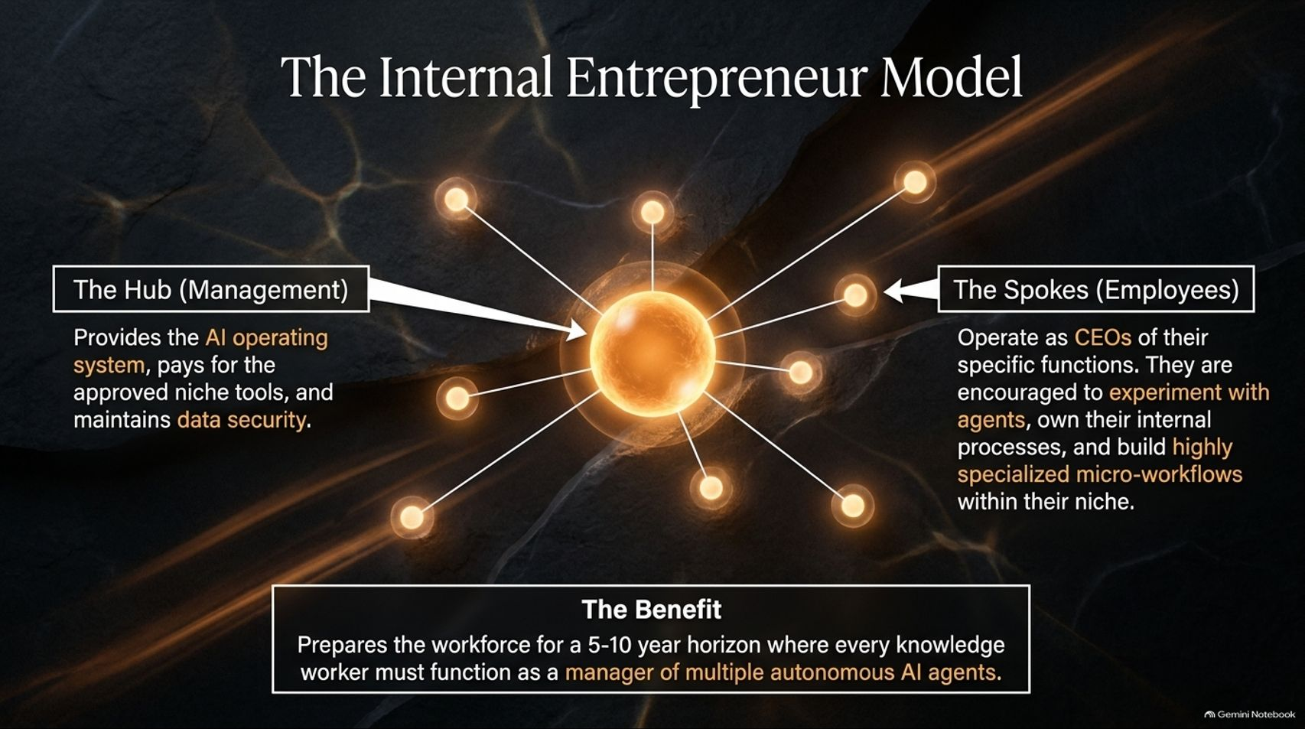
Notes:
Estimated Speaking Time: 4 – 5 minutes
Speaker Script & Talking Points
How do we prepare the workforce for the next decade? Slide 12 introduces The Internal Entrepreneur Model.
The Hub (Management): Provides the centralized AI operating system, funds approved niche tools, and maintains rigorous data security.
The Spokes (Employees): Operate as autonomous CEOs of their specific functions. They are encouraged to experiment with agents, own their internal processes, and build highly specialized micro-workflows within their niche.
The Benefit: This model prepares the workforce for a 5-to-10-year horizon where every knowledge worker must function effectively as a manager of multiple autonomous AI agents.

Slide 13
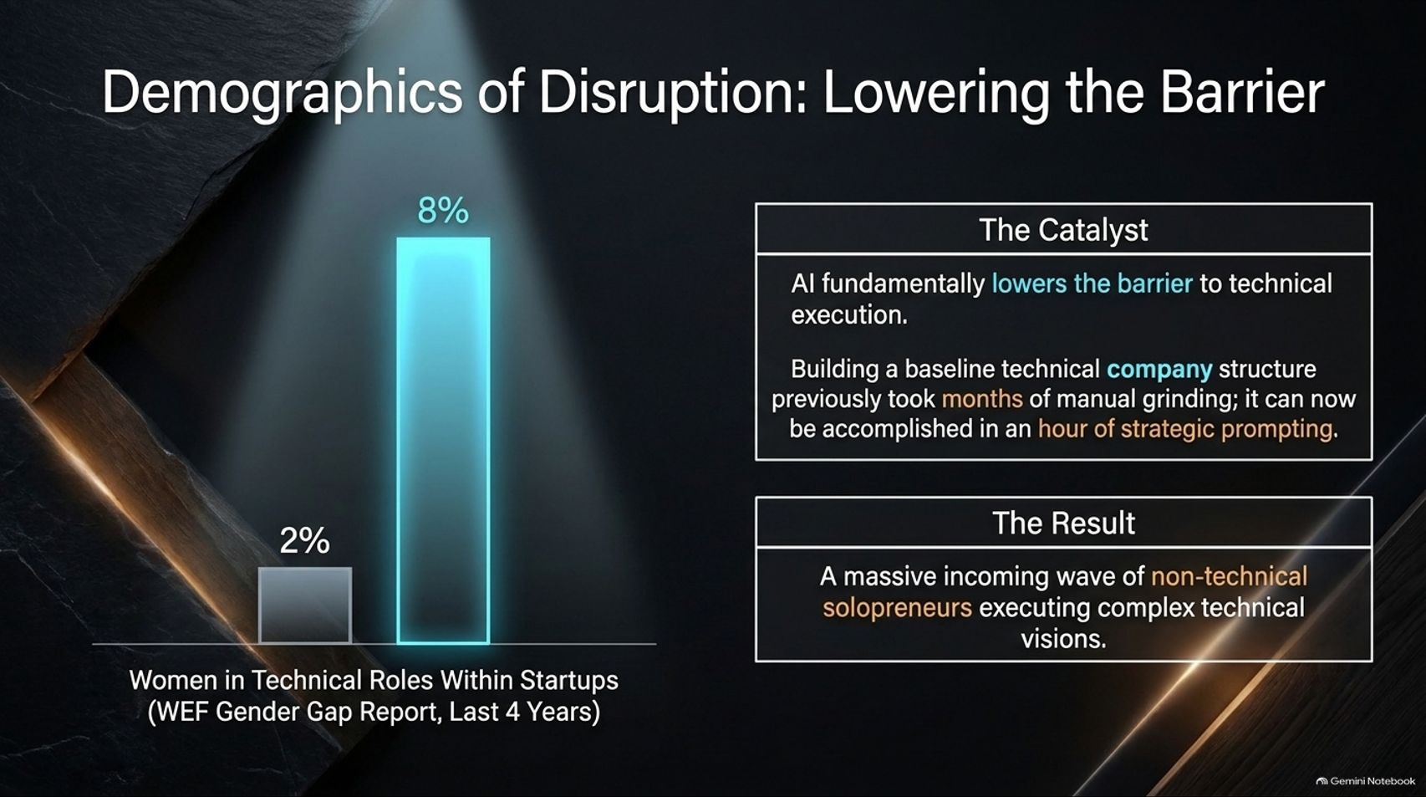
Notes:
Estimated Speaking Time: 3 – 4 minutes
Speaker Script & Talking Points
AI is fundamentally rewriting who gets to build technology. Slide 13 examines Demographics of Disruption.
The Catalyst: AI fundamentally lowers the barrier to technical execution. Building a baseline technical company structure previously took months of manual coding and engineering grind; it can now be accomplished in hours of structured prompting and agentic generation. As reported by the World Economic Forum's Gender Gap Report over recent years, the representation of women in technical startup roles has seen a significant upward shift, driven by this democratization of execution.
The Result: We are witnessing a massive incoming wave of non-technical solopreneurs executing complex technical visions that were previously impossible to launch independently.

Slide 14
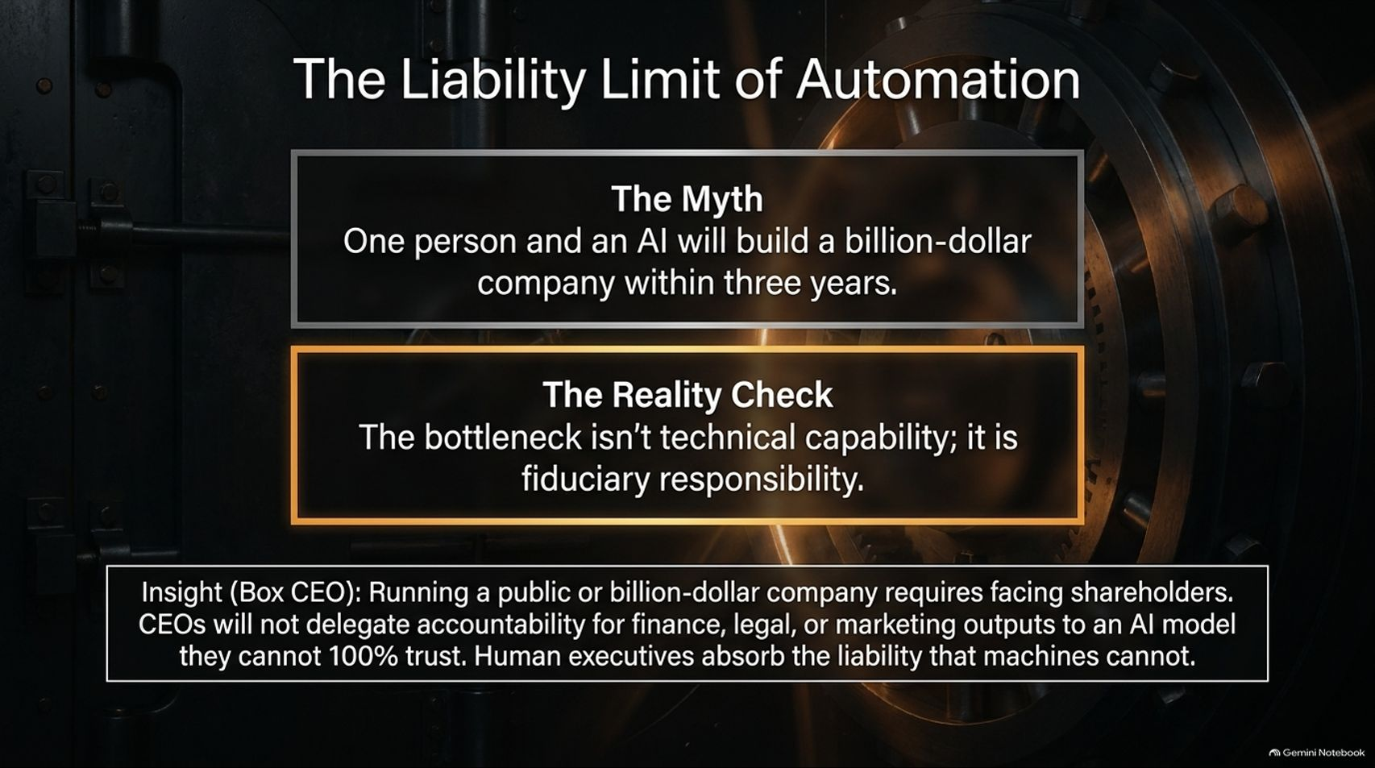
Notes:
Estimated Speaking Time: 3 – 4 minutes
Speaker Script & Talking Points
While solopreneurs and small teams can build faster than ever, Slide 14 hits the brakes on hyperbolic scaling: The Liability Limit of Automation.
The Myth: One person plus AI will build a billion-dollar public company within three years.
The Reality Check: The primary bottleneck in scaling an enterprise is not technical capability; it is fiduciary responsibility and legal accountability.
Industry Insight (Box CEO): Running a public or enterprise-scale company requires facing shareholders, regulators, and boards. Chief Executive Officers will not delegate legal accountability for finance, compliance, or marketing outputs to an AI model they cannot 100% trust. Human executives must absorb the ultimate liability that machines cannot carry.

Slide 15
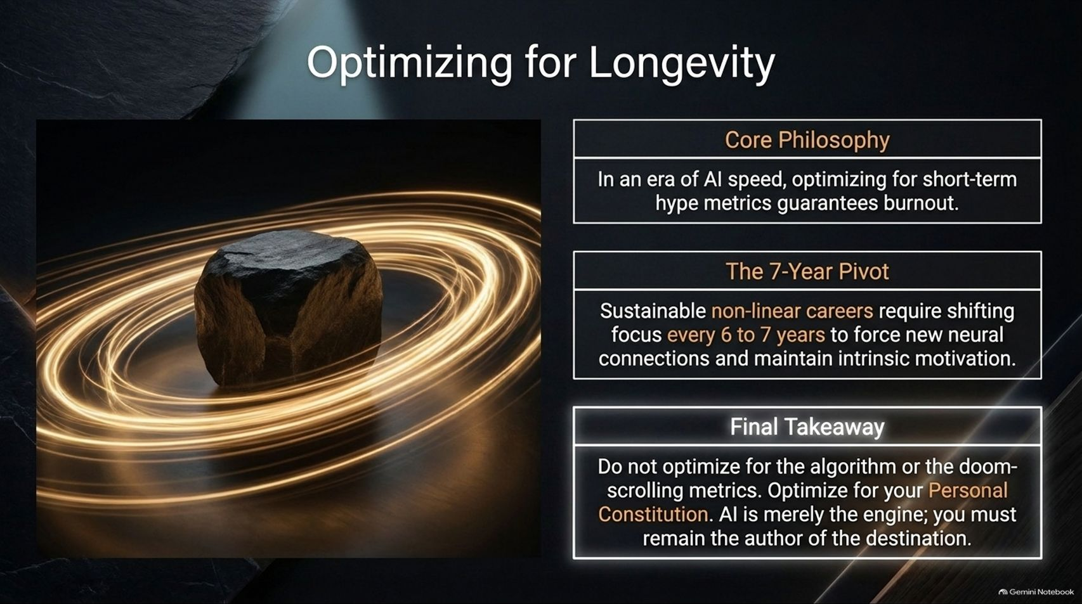
Notes:
Estimated Speaking Time: 3 – 4 minutes
Speaker Script & Talking Points
In a hyper-accelerated technological cycle, burnout is the ultimate professional hazard. Slide 15 focuses on Optimizing for Longevity.
Core Philosophy: In an era of AI speed, optimizing purely for short-term hype metrics guarantees rapid burnout.
The 7-Year Pivot: Sustainable, non-linear careers require shifting focus every 6 to 7 years to force new neural connections, acquire fresh skills, and maintain deep intrinsic motivation (a pattern seen in successful multidisciplinary leaders).
Final Takeaway: Do not optimize for the algorithm or doom-scrolling productivity metrics. Optimize for your Personal Constitution. AI is merely the engine; you must remain the author of the destination.

Slide 16
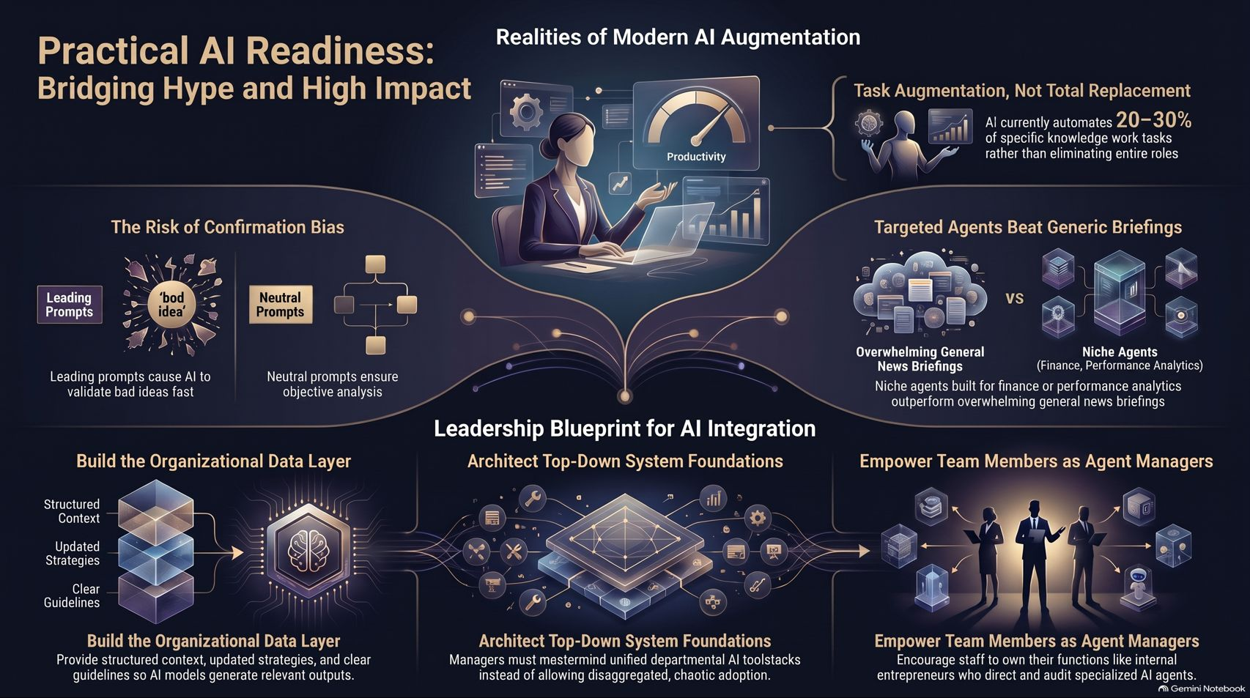
Notes:
Estimated Speaking Time: 4 – 5 minutes
Speaker Script & Talking Points
To summarize our pragmatist's playbook (Slide 16):
Bridging Hype and High Impact: Move away from chaotic, unstructured tool adoption and recognize AI for what it is: a 20–30% task augmentation tool and a brilliant data analyst, not your CEO.
The Leadership Blueprint:
Build your proprietary organizational Data Layer with structured context and clear guardrails.
Architect top-down system foundations rather than letting disaggregated chat threads run wild.
Empower team members as agent managers, treating them like internal entrepreneurs.
Avoid the velocity trap, protect your judgment, and use AI to build a sustainable, high-ROI future. Thank you.

