Slide 1
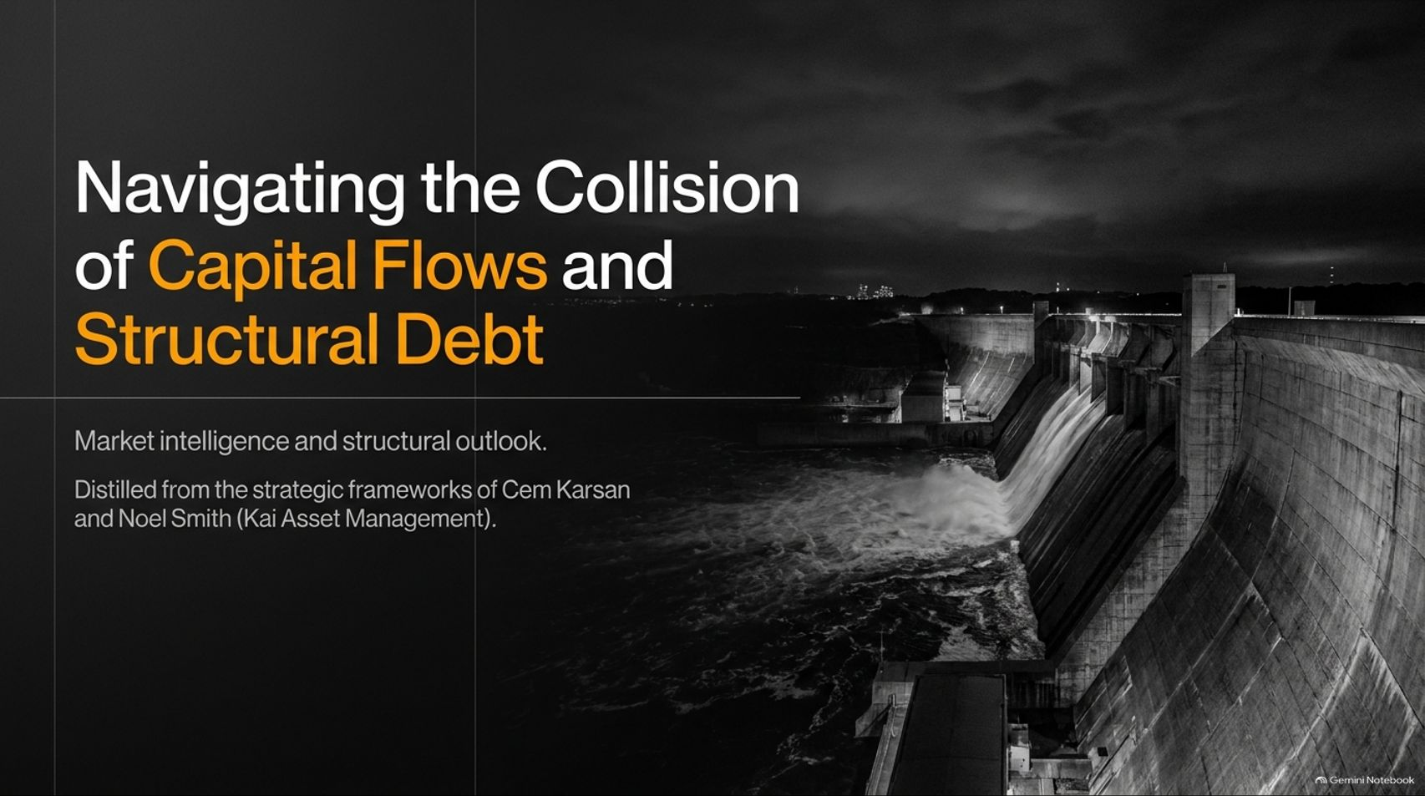
Notes:
Estimated Speaking Time: 2 – 3 minutes
Speaker Script & Talking Points
Welcome, everyone. Today we are addressing one of the most critical structural crosscurrents in modern financial history: "Navigating the Collision of Capital Flows and Structural Debt."
Financial markets today are caught between two massive, opposing forces. On one side, short-term positioning, capital flows, and volatility compression can create powerful, deceptive liquidity rallies that mask severe underlying decay. On the other side, a multi-trillion-dollar maturity wall, inelastic commodity pricing, and unrelenting debt-funded capital expenditures are pushing the macro system toward a hard wall.
Distilled from the strategic frameworks of market mechanics expert Cem Karsan and veteran options trader Noel Smith of Kai Asset Management, this presentation provides a masterclass in reading both the macro tides and the flow navigation required to survive and thrive through the coming market dislocations. Let’s dive in.
Crisis Is Coming In Early 2027 | Cem Karsan
https://www.youtube.com/watch?v=VMi5kby6YFA

Slide 2
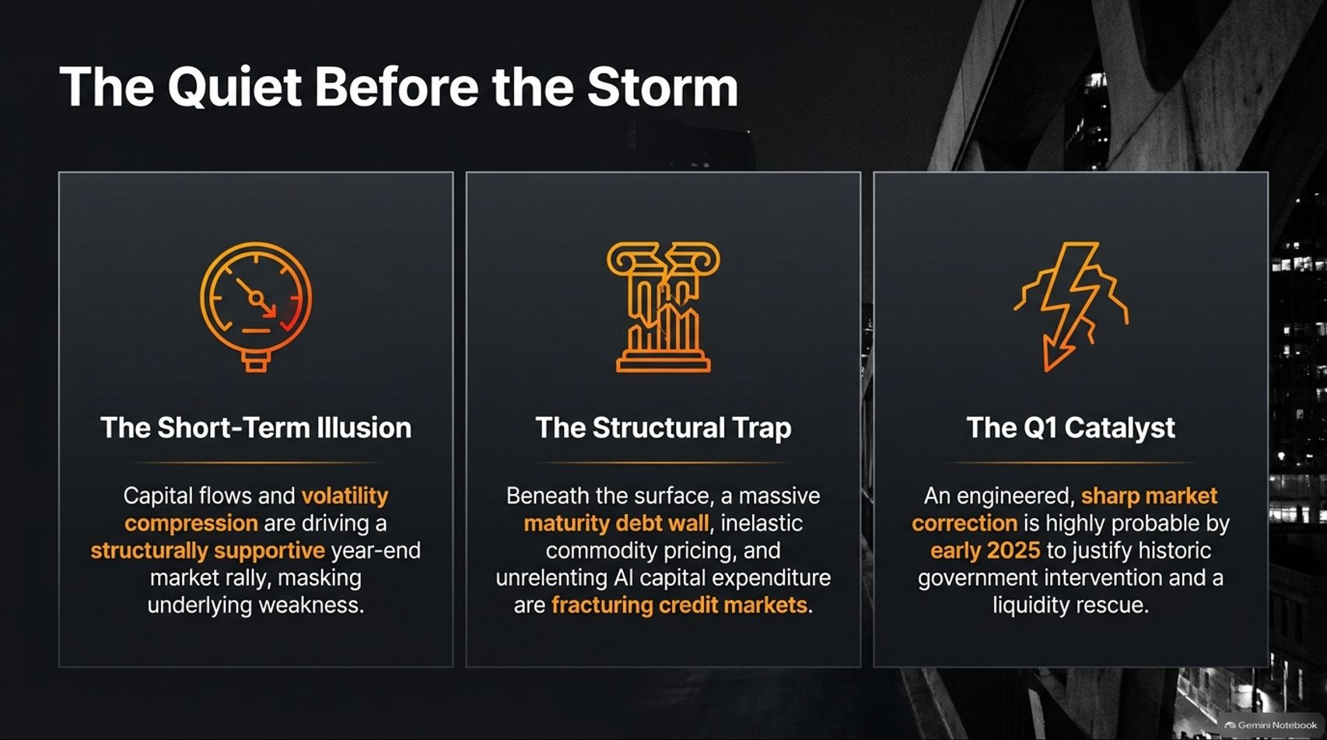
Notes:
Estimated Speaking Time: 3 – 4 minutes
Speaker Script & Talking Points
Slide 2 sets the overarching premise of our outlook. We are currently living in the quiet before a structural storm, characterized by three distinct phases:
The Short-Term Illusion: Capital flows and volatility compression drive structurally supportive year-end market rallies, lulling investors into complacency and masking deep underlying vulnerabilities.
The Structural Trap: Beneath the surface price action, a massive maturity debt wall, inelastic commodity pricing, and relentless artificial intelligence capital expenditure commitments are fracturing credit markets.
The Q1 Catalyst: Rather than a slow, chaotic bleed, an engineered, sharp market correction is highly probable by early 2025 (or early 2027 cycle context) to provide the necessary political and psychological cover for historic government intervention and liquidity rescues.

Slide 3
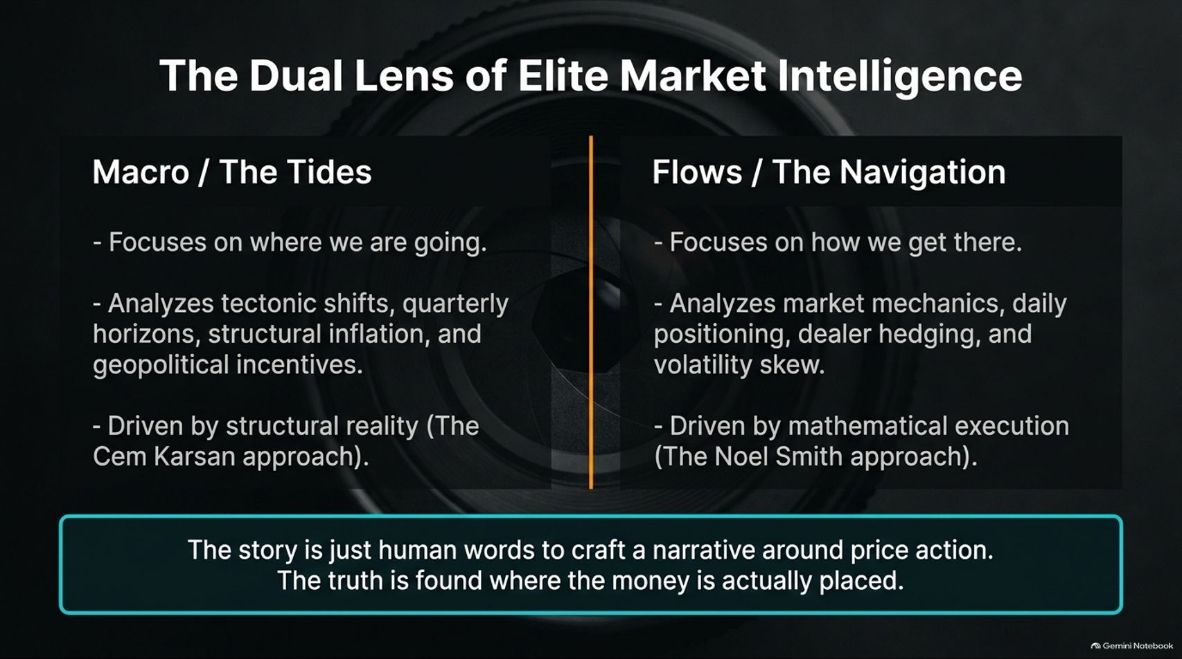
Notes:
Estimated Speaking Time: 3 – 4 minutes
Speaker Script & Talking Points
To navigate modern markets successfully, you cannot rely on traditional financial media narratives. You need a dual lens, combining macro analysis with pure market mechanics.
Macro / The Tides (The Cem Karsan Approach): Focuses on where we are going. It analyzes tectonic shifts, quarterly horizons, structural inflation, geopolitical incentives, and the ultimate reality of sovereign debt and monetary policy.
Flows / The Navigation (The Noel Smith Approach): Focuses on how we get there. It analyzes market mechanics, daily positioning, dealer hedging, options skew, and volatility decay.
The Core Truth: Stories and headlines are merely human words crafted to explain price action after the fact. True market edge is found where money is actually positioned and executed.

Slide 4
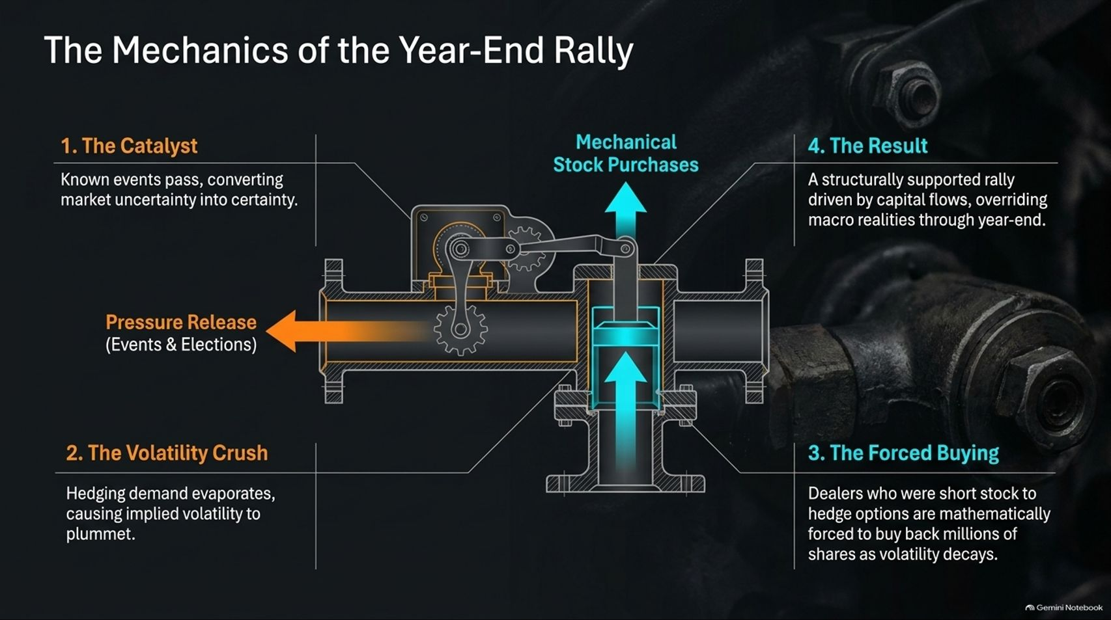
Notes:
Estimated Speaking Time: 4 – 5 minutes
Speaker Script & Talking Points
Why do markets consistently experience strong year-end and post-election rallies even when fundamental clouds loom large? Slide 4 breaks down the mechanical plumbing:
The Catalyst: Major known binary events (like elections or policy announcements) pass, converting market uncertainty into clarity.
The Volatility Crush: Because investors heavily hedge against downside risk ahead of events, implied volatility spikes. Once the event resolves, hedging demand evaporates, causing implied volatility to plummet.
The Forced Buying: Market makers and options dealers who were short stock to hedge their short-option books are mathematically forced to buy back millions of shares of underlying stock as volatility decays.
The Result: A structurally supported, flow-driven rally that overrides broader macro realities through the end of the year.

Slide 5
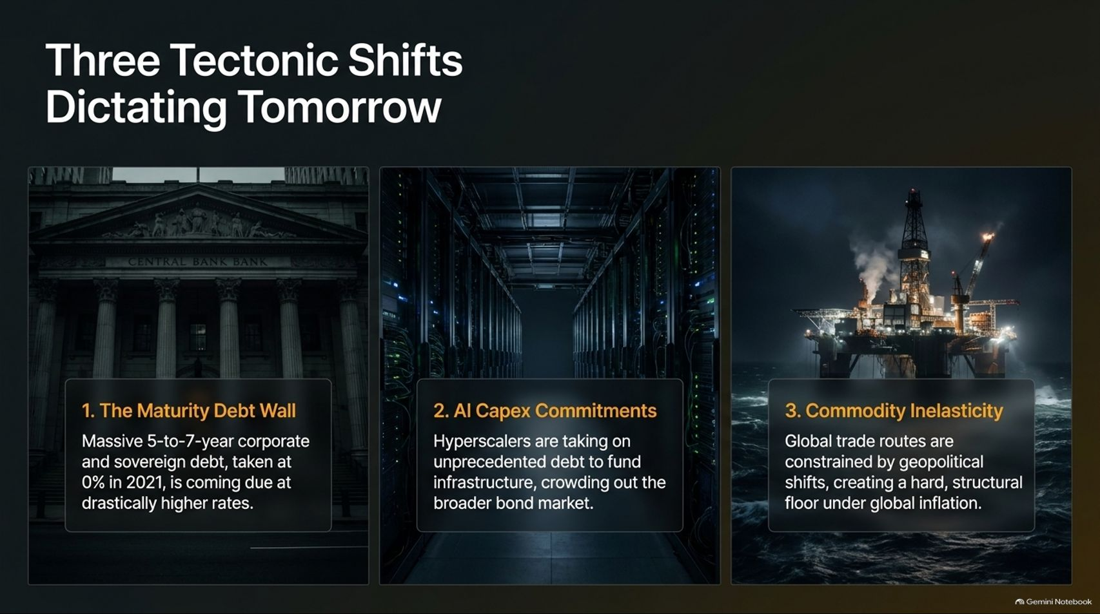
Notes:
Estimated Speaking Time: 4 – 5 minutes
Speaker Script & Talking Points
While flows dictate the short-term path, three massive tectonic macro shifts dictate the medium-term destination:
The Maturity Debt Wall: Massive 5-to-7-year corporate and sovereign debt packages that were locked in at near-zero interest rates in 2021 are now rolling over and coming due at drastically higher interest rates.
AI Capex Commitments: Hyperscalers and mega-corporations are taking on unprecedented debt loads to fund infrastructure and data center expansion, aggressively crowding out the broader bond market.
Commodity Inelasticity: Global trade routes and supply chains are severely constrained by geopolitical shifts (such as tensions in key shipping lanes and energy corridors), creating a hard, structural floor under global inflation.

Slide 6
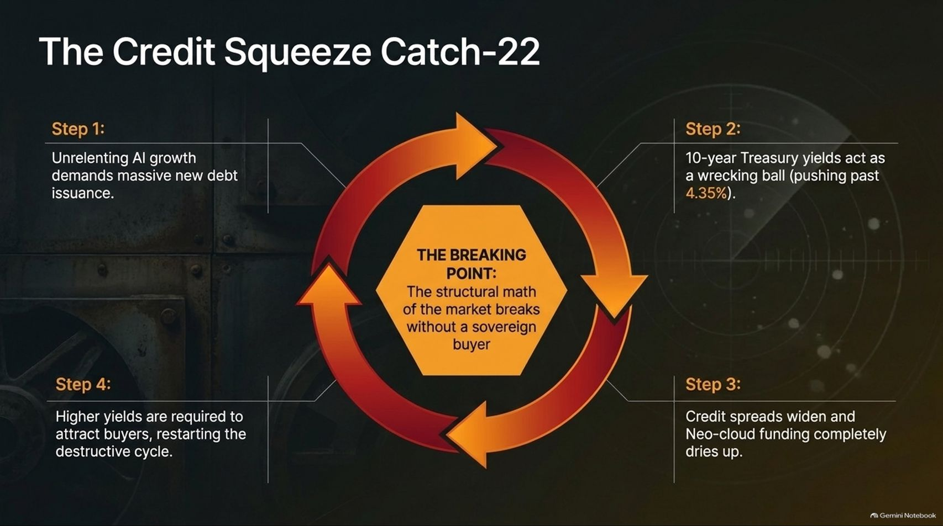
Notes:
Estimated Speaking Time: 4 – 5 minutes
Speaker Script & Talking Points
Slide 6 maps out the vicious feedback loop currently strangling the credit markets—The Credit Squeeze Catch-22:
Step 1: Unrelenting technology and infrastructure growth demand massive new debt issuance.
Step 2: This relentless supply acts as a wrecking ball on the long end of the curve, pushing 10-year Treasury yields upward.
Step 3: As yields rise, credit spreads widen significantly, and alternative funding sources (such as neo-clouds and speculative corporate credit) completely dry up.
Step 4: Higher yields and tighter spreads require even more expensive debt issuance to attract buyers, restarting the destructive cycle.
The Breaking Point: The mathematical reality of the debt market breaks completely without a massive sovereign buyer stepping in.

Slide 7
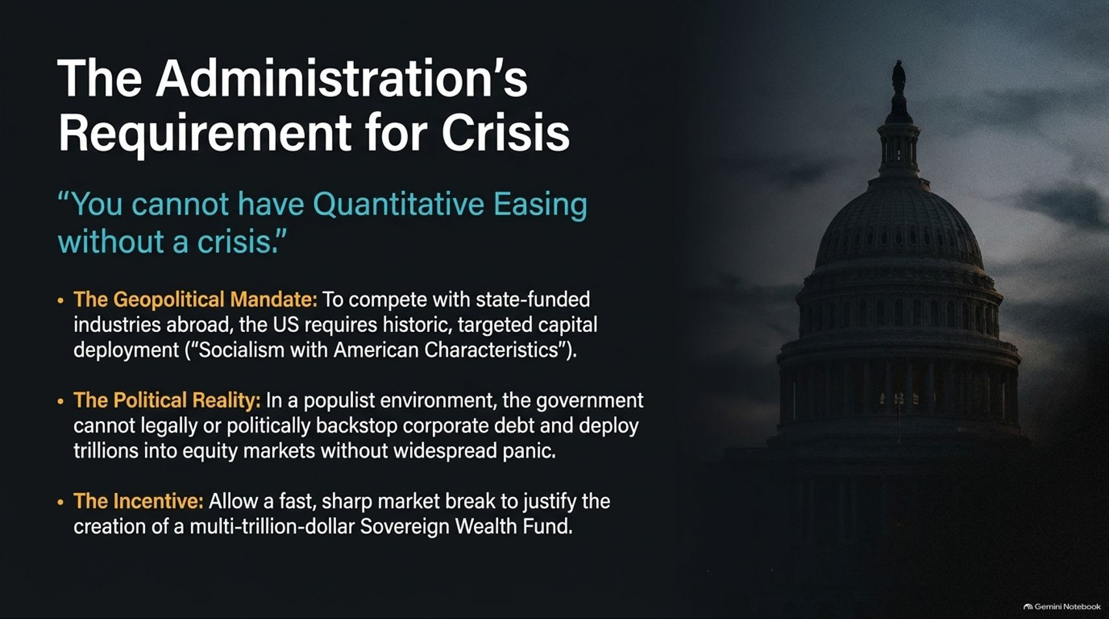
Notes:
Estimated Speaking Time: 4 – 5 minutes
Speaker Script & Talking Points
A provocative but essential market truth: "You cannot have Quantitative Easing without a crisis." Slide 7 examines the political and economic incentives driving modern policy:
The Geopolitical Mandate: To successfully compete with state-funded industrial models abroad, the United States requires historic, targeted capital deployment—effectively implementing "Socialism with American Characteristics".
The Political Reality: In a polarized, populist environment, the government cannot legally or politically backspace corporate debt and deploy trillions into equity markets without widespread public and political panic.
The Incentive: Allowing a fast, sharp market break provides the necessary justification for sweeping emergency measures, including the creation of a multi-trillion-dollar Sovereign Wealth Fund.

Slide 8
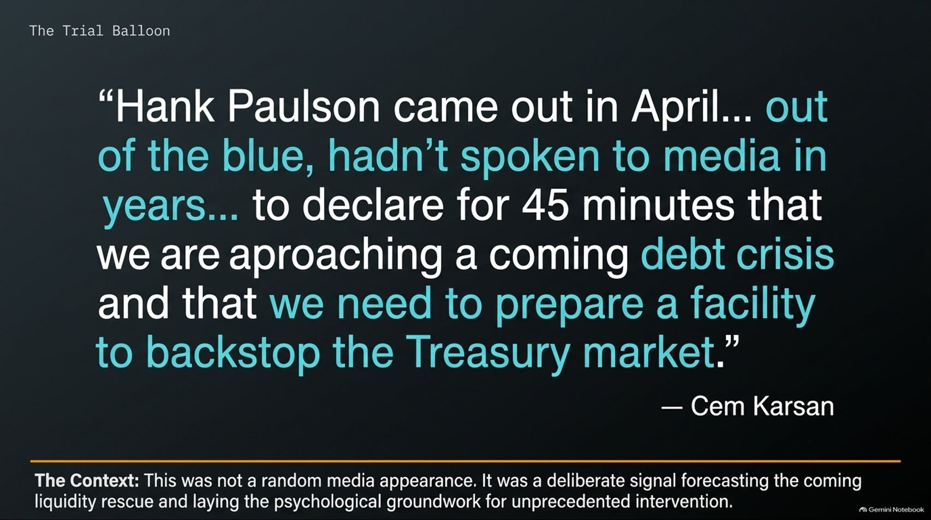
Notes:
Estimated Speaking Time: 3 – 4 minutes
Speaker Script & Talking Points
Was high-level signaling about debt stress accidental? Slide 8 highlights a telling precursor discussed by Cem Karsan: Former Treasury Secretary Hank Paulson’s sudden, uncharacteristic media blitz:
"Hank Paulson came out in April... out of the blue, hadn't spoken to media in years... to declare for 45 minutes that we are approaching a coming debt crisis and that we need to prepare a facility to backstop the Treasury market." — Cem Karsan
The Context: This was not a random media appearance. It was a calculated trial balloon and deliberate signal forecasting an upcoming liquidity rescue, laying the psychological and political groundwork for unprecedented state intervention.

Slide 9
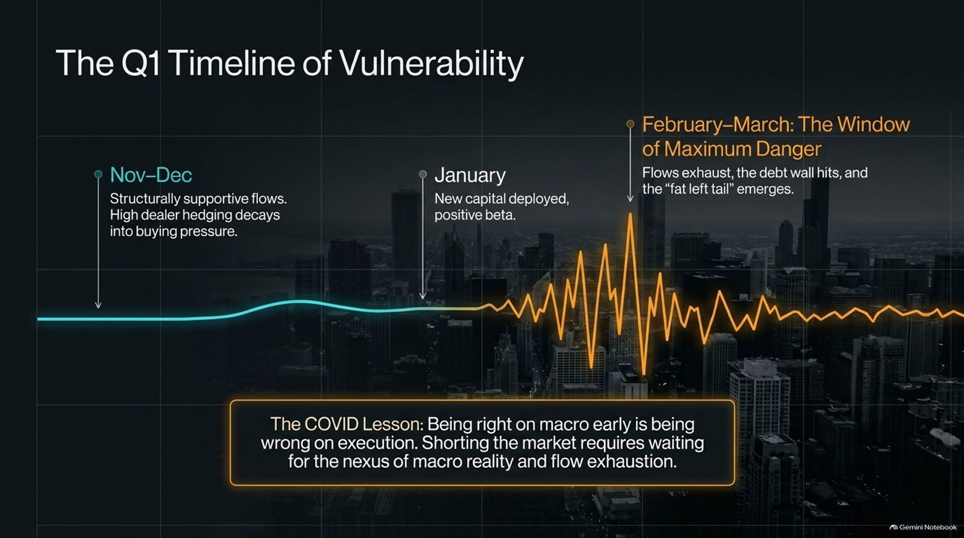
Notes:
Estimated Speaking Time: 4 – 5 minutes
Speaker Script & Talking Points
Timing is everything in trading. Slide 9 maps out the expected timeline of vulnerability leading into early next year:
Nov–Dec: Structurally supportive flows dominate. High dealer hedging decays into steady buying pressure, creating a resilient tape.
January: New capital is deployed with positive market beta, maintaining the illusion of stability.
February–March (The Window of Maximum Danger): Capital flows exhaust themselves, the refinancing debt wall hits full force, and a "fat left tail" market shock emerges.
The COVID Lesson: Being right on the macro thesis early is functionally identical to being wrong on execution. Shorting the market prematurely destroys capital; you must wait for the exact nexus of macro reality and flow exhaustion.

Slide 10
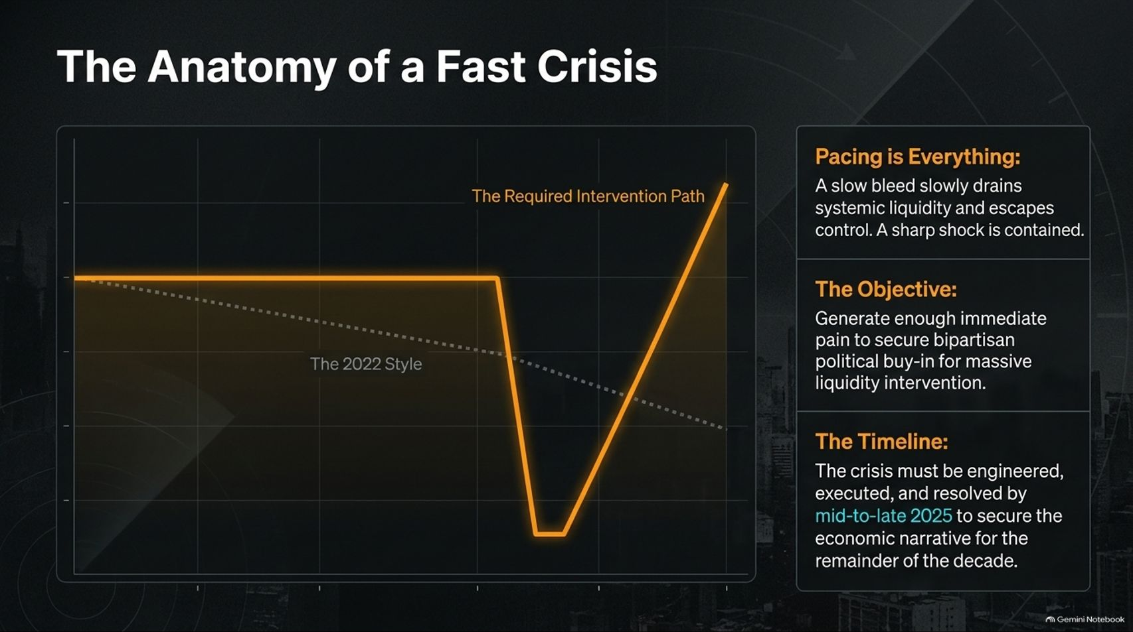
Notes:
Estimated Speaking Time: 4 – 5 minutes
Speaker Script & Talking Points
Why do policymakers prefer a fast, sharp crisis over a slow bleed? Slide 10 contrasts market crash dynamics:
Pacing is Everything: A slow, grinding bear market (like 2022) drains systemic liquidity slowly, creates political paralysis, and ultimately escapes control. In contrast, a sharp, violent shock is contained, captured, and easily blamed on external events.
The Objective: Generate enough immediate, undeniable pain to secure bipartisan political buy-in for massive, unprecedented liquidity intervention.
The Timeline: If a crisis is engineered or permitted to happen, it must execute and resolve within a compressed window to secure the economic narrative for the remainder of the decade.

Slide 11
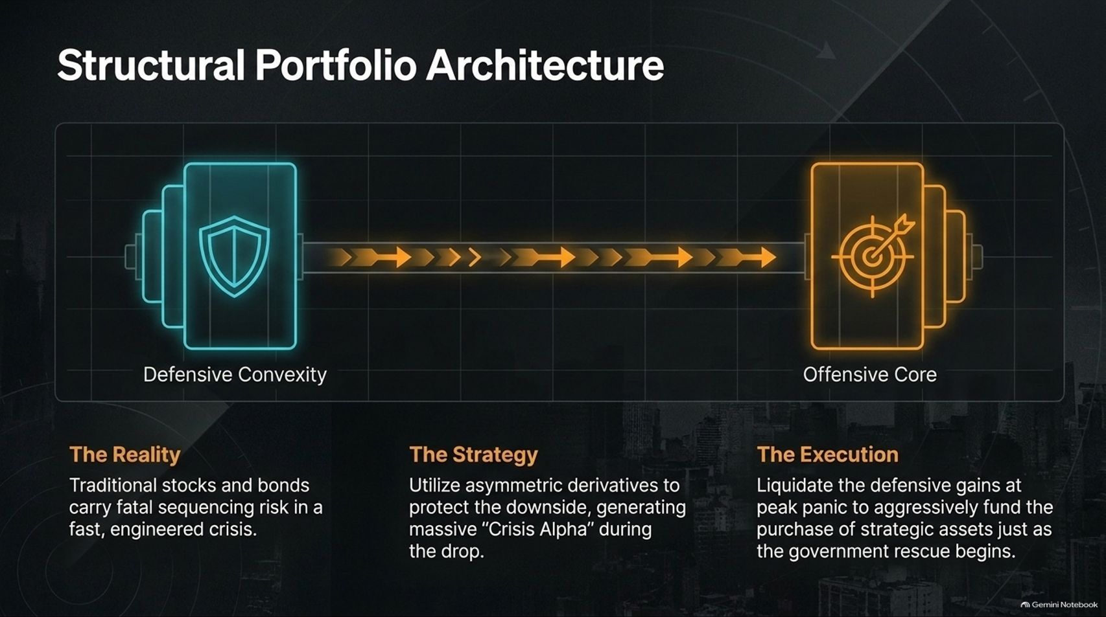
Notes:
Estimated Speaking Time: 4 – 5 minutes
Speaker Script & Talking Points
Given this volatile backdrop, how should institutional and high-net-worth capital be structured? Slide 11 outlines a barbell portfolio architecture:
Defensive Convexity: Traditional stocks and bonds carry fatal sequencing risk in a fast, engineered crisis. You need asymmetric derivatives to protect the downside and generate massive "Crisis Alpha" during the drop.
Offensive Core: Once the market reaches peak panic and government rescues begin, you liquidate defensive convexity gains at peak valuation to aggressively snap up strategic, hard, and sovereign assets.

Slide 12
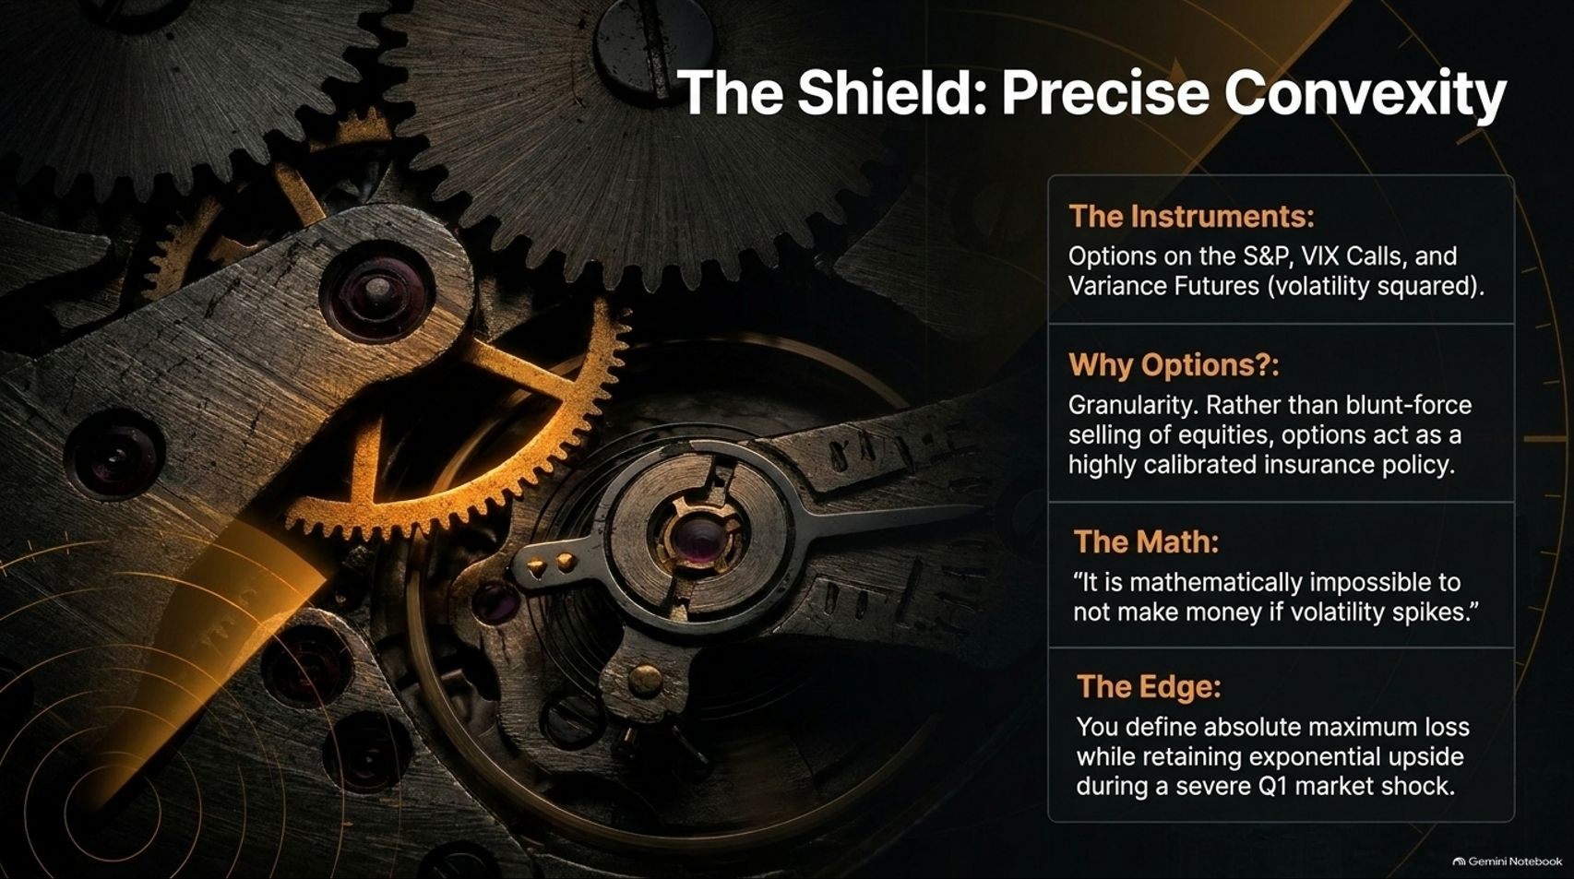
Notes:
Estimated Speaking Time: 4 – 5 minutes
Speaker Script & Talking Points
Slide 12 details the mechanics of the portfolio shield—Precise Convexity:
The Instruments: Options on the S&P 500, VIX Calls, and Variance Futures (volatility squared).
Why Options?: Granularity. Rather than engaging in blunt-force, indiscriminate selling of equities, options act as a highly calibrated insurance policy tailored to exact timeframes.
The Math: As Noel Smith notes, "It is mathematically impossible not to make money if volatility spikes."
The Edge: You define your absolute maximum known loss (the option premium) while retaining exponential, uncapped upside during a severe market shock.

Slide 13
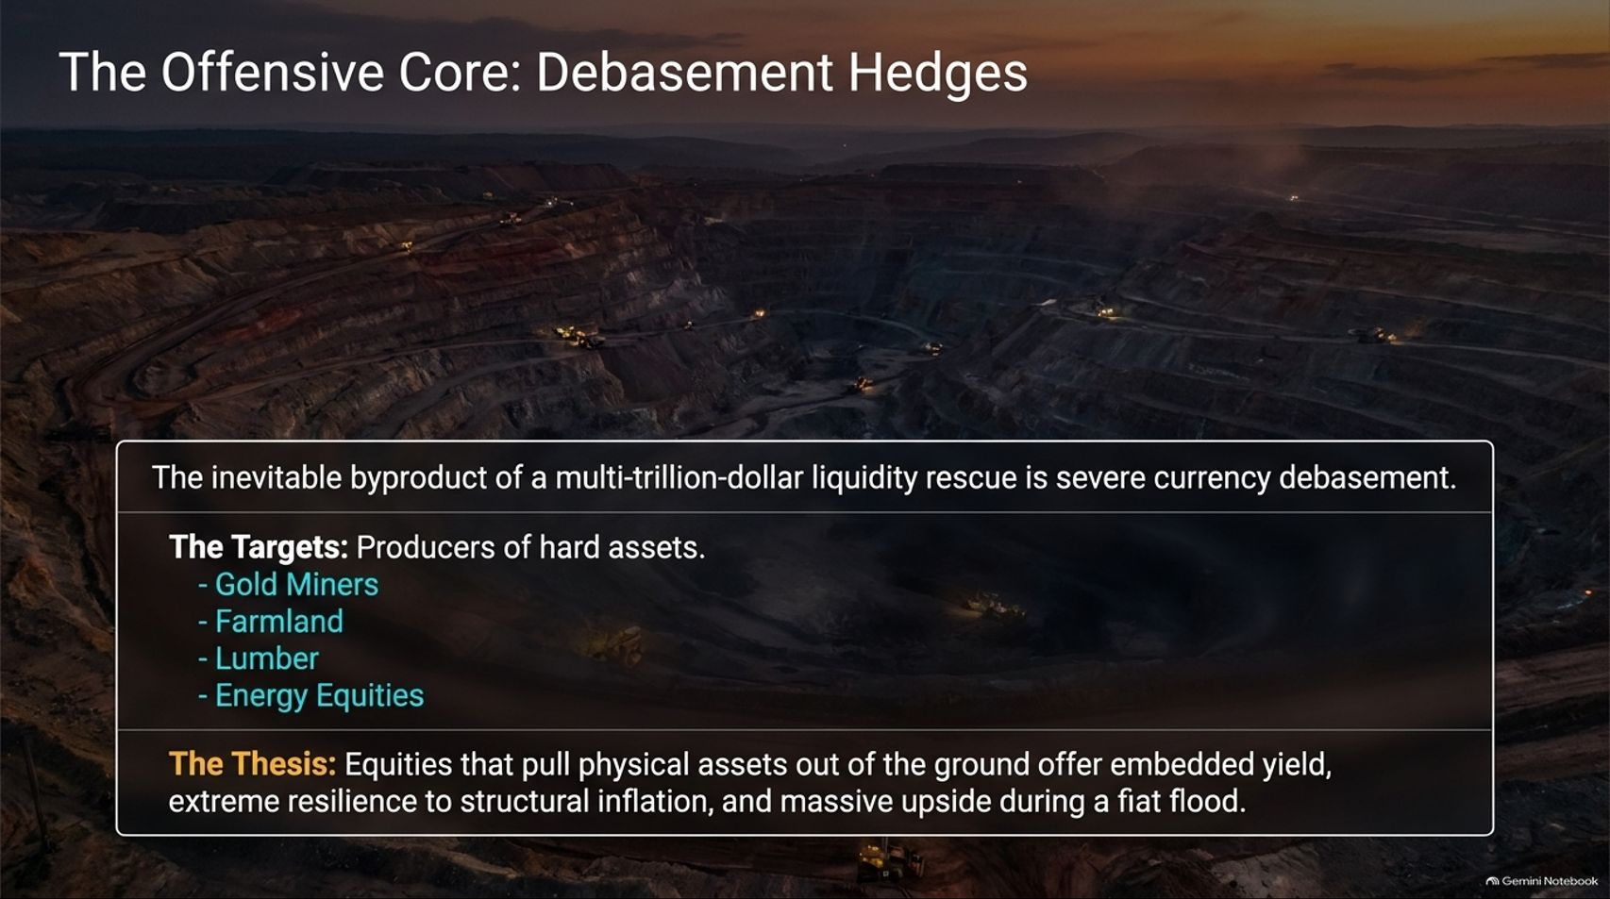
Notes:
Estimated Speaking Time: 4 – 5 minutes
Speaker Script & Talking Points
The inevitable byproduct of multi-trillion-dollar liquidity rescues and sovereign debt monetization is severe currency debasement. Slide 13 focuses on the first half of our offensive core:
The Targets: Producers of hard physical assets—specifically Gold Miners, Farmland, Lumber, and Energy Equities.
The Thesis: Equities that pull scarce physical assets out of the ground offer embedded cash yield, extreme resilience against structural inflation, and massive nominal upside when fiat liquidity floods the system.

Slide 14
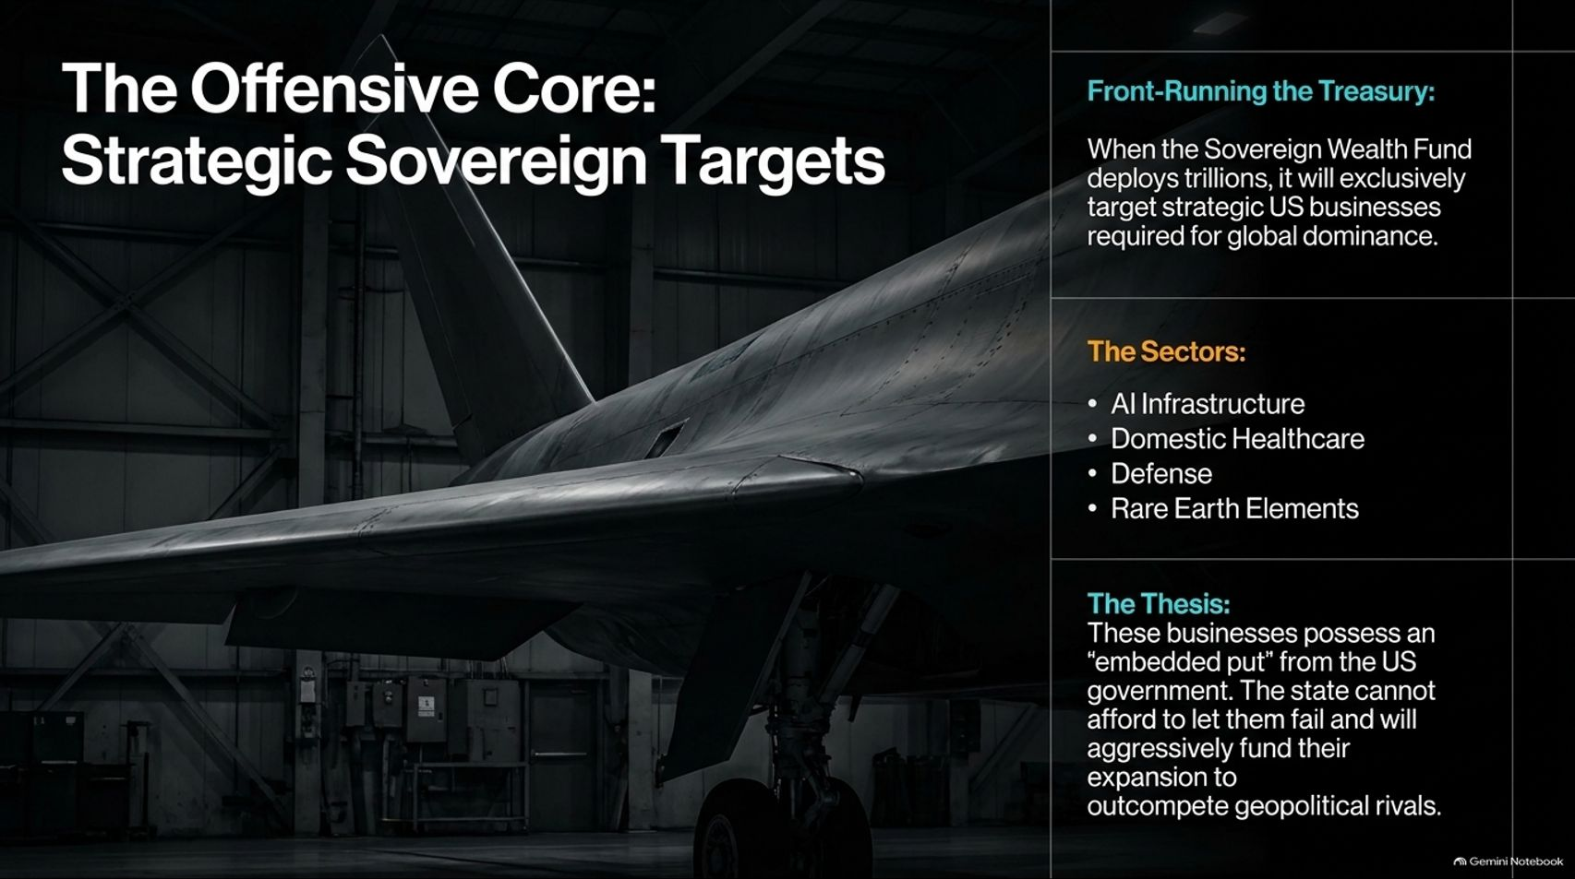
Notes:
Estimated Speaking Time: 4 – 5 minutes
Speaker Script & Talking Points
The second half of the offensive core involves front-running state intervention. Slide 14 outlines Strategic Sovereign Targets:
Front-Running the Treasury: When a Sovereign Wealth Fund deploys trillions of dollars, it will exclusively target critical US businesses required for absolute global dominance.
The Sectors: AI Infrastructure, Domestic Healthcare, Defense, and Rare Earth Elements.
The Thesis: These businesses possess an "embedded put" from the US government. The state cannot afford to let them fail and will aggressively fund and subsidize their expansion to outcompete geopolitical rivals, regardless of traditional valuation metrics.

Slide 15
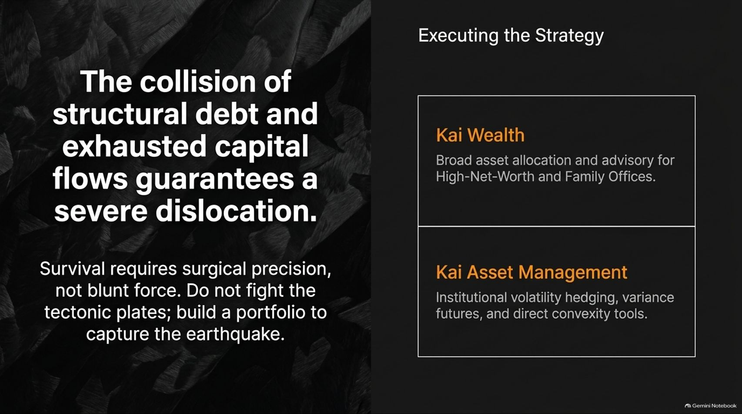
Notes:
Estimated Speaking Time: 3 – 4 minutes
Speaker Script & Talking Points
The collision of structural debt and exhausted capital flows guarantees severe market dislocation. Survival and outperformance require surgical precision, not brute force.
Do not fight the macro tectonic plates head-on; build a portfolio structured to capture the earthquake. This dual-engine strategy is executed through specialized channels:
Kai Wealth: Providing broad asset allocation, wealth advisory, and customized multi-family office solutions for high-net-worth clients.
Kai Asset Management: Delivering institutional volatility hedging, variance futures management, and direct convexity tools for professional allocators.

Slide 16
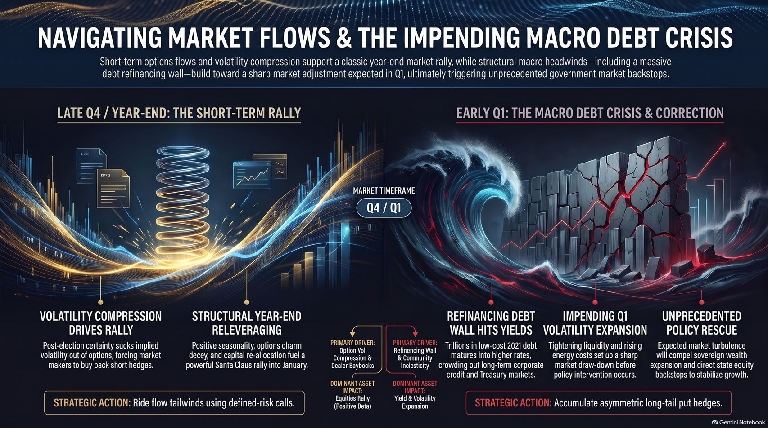
Notes:
Estimated Speaking Time: 4 – 5 minutes
Speaker Script & Talking Points
To summarize our strategic framework (Slide 16):
Late Q4 / Year-End: Volatility compression and structural releveraging support a classic year-end and post-election rally. Ride these flow tailwinds with defined risk.
Early Q1: The refinancing debt wall, inelastic energy costs, and exhausted liquidity converge into a high-risk window for a sharp market correction. Accumulate asymmetric long-tail put hedges ahead of time.
The Resolution: Expect unprecedented policy rescues, sovereign wealth interventions, and subsequent currency debasement—making hard assets and sovereign-backed equities the ultimate destination for capital preservation and growth.
Thank you for your time, and let’s open the floor to questions.

