Slide 1
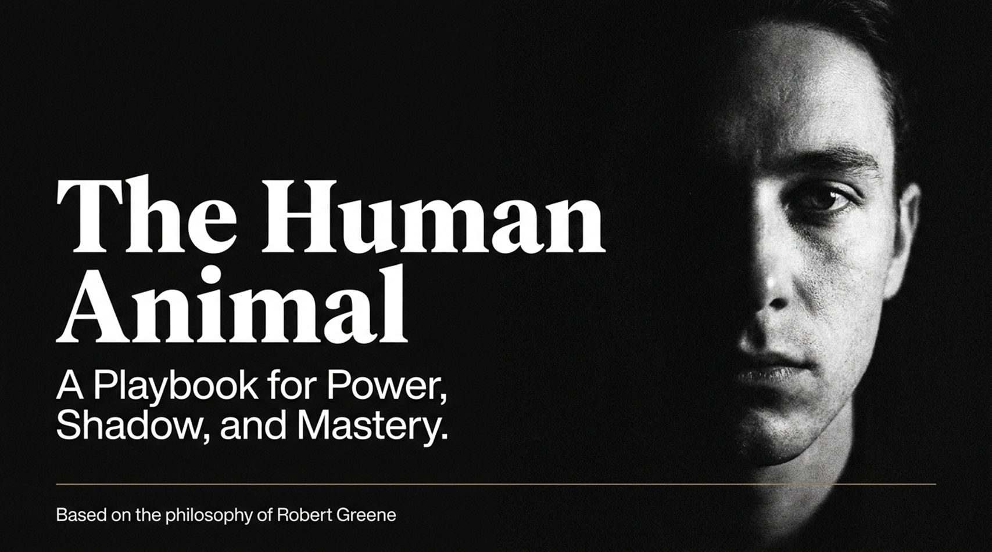
Notes:
Estimated Time: 2 – 3 Minutes
Core Objective: Set a dark, realistic, and pragmatic tone; introduce Robert Greene’s core premise that beneath human civilization lies a deeply rooted primate nature.
Key Points to Cover:
Welcome the audience and frame the theme: moving away from idealist views of human behavior toward cold biological and psychological realism.
Define "The Human Animal": the realization that despite our technology and culture, our foundational behavior is driven by evolutionary dynamics, ego, power, and subconscious signaling.
Establish the overarching objective of the session: to understand power dynamics, master appearance management, embrace the strategic shadow, and transition from emotional manipulation to self-mastery.
Speaker Script:
"Welcome, everyone. Look at the title of today’s presentation: The Human Animal. Notice the subtitle—A Playbook for Power, Shadow, and Mastery.
For thousands of years, human philosophy and religion have tried to elevate us above the rest of the natural world. We like to think of ourselves as hyper-rational, moral creatures guided by pure reason. But if you take an honest look at history, politics, or corporate life, you quickly realize that the human creature is still fundamentally driven by ancient primate instincts: status-seeking, territoriality, power plays, vanity, and fear.
Today’s presentation is grounded in the philosophy of Robert Greene. We are going to strip away moralistic self-deceptions. We are not here to debate how human beings should act in an ideal utopia; we are here to analyze how human beings actually operate in the real world.
By the end of these 14 slides, you will have a comprehensive framework for reading non-verbal cues, managing your personal aura, integrating your inner shadow, avoiding destructive narcissism, and grounding your confidence in real skill rather than performative bravado. Let's begin by confronting our fundamental biological origin."
When You Look Poor, Everything Works Against You Machiavelli — Robert Greene
https://www.youtube.com/watch?v=_a6UgToOff0

Slide 2
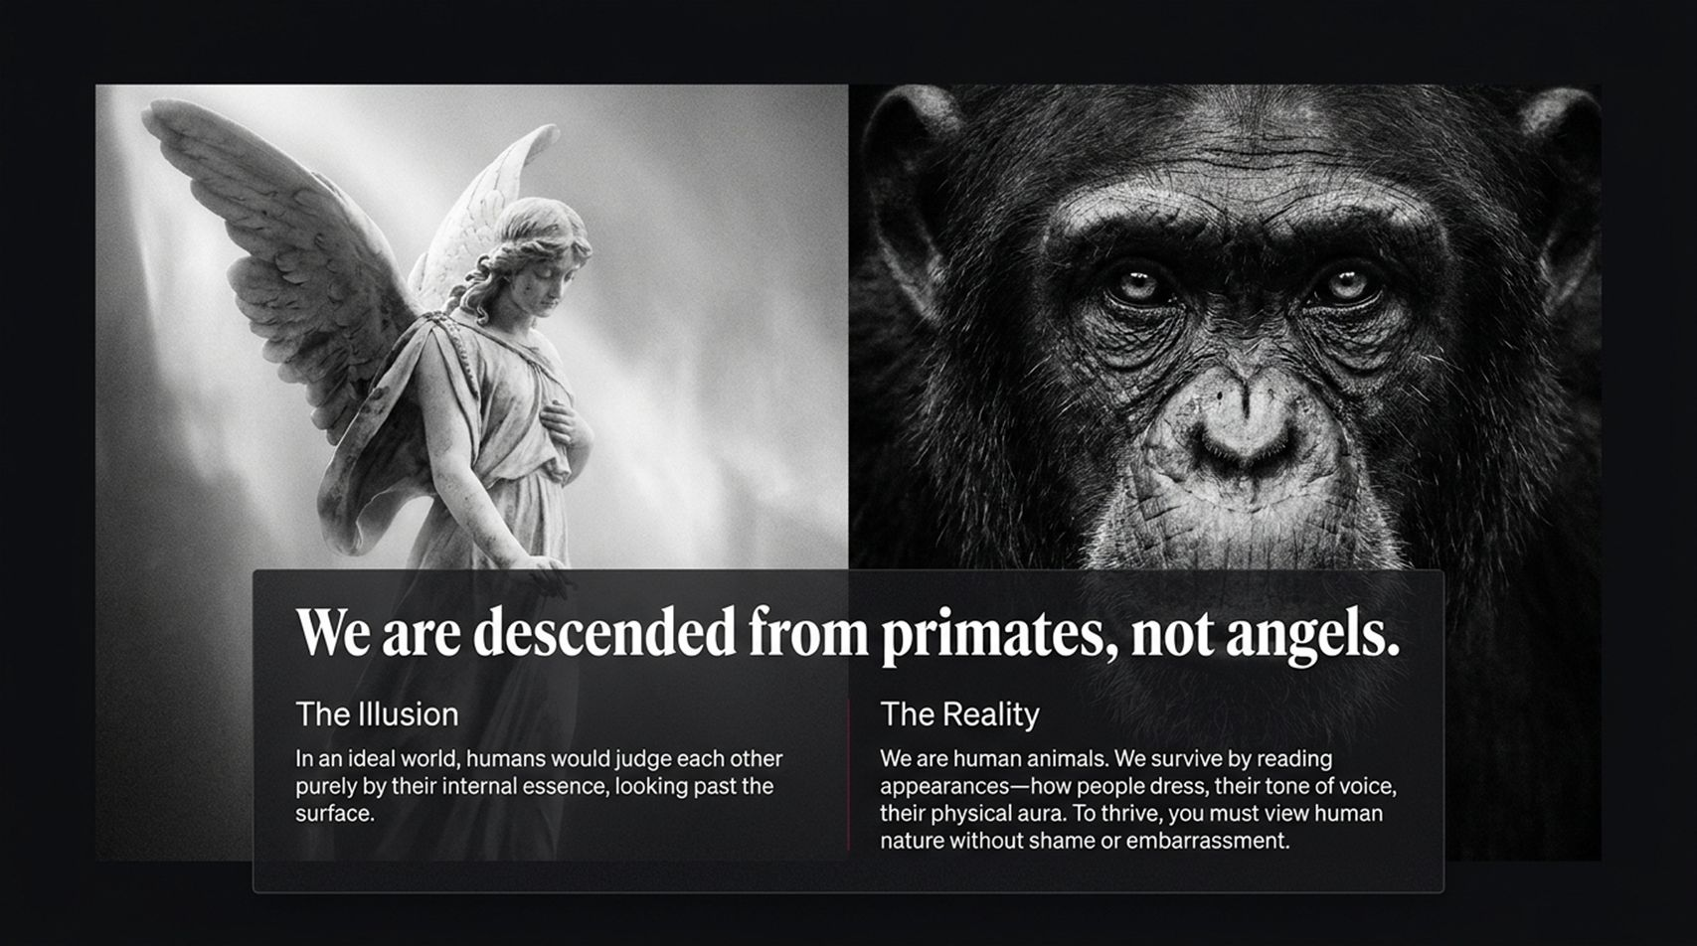
Notes:
Estimated Time: 3 – 5 Minutes
Core Objective: Contrast "The Illusion" (moral idealization) with "The Reality" (biological realism); establish that appearances rule human interaction.
Key Points to Cover:
The Illusion: The naive assumption that people evaluate us based on our internal essence, moral character, or pure intentions.
The Reality: Humans are visual, status-conscious animals. We process tone, posture, grooming, and aura before processing words.
The Philosophical Shift: Why viewing human nature without shame or embarrassment frees you from victimhood and allows strategic clarity.
Speaker Script:
"Slide 2 presents a fundamental duality: We are descended from primates, not angels.
Look at the image on the left—the angel. This represents The Illusion. Most people live in a state of naive idealism. They believe that if their intentions are good, if their heart is pure, or if they work hard, the world will reward them. They want to be judged purely by their 'internal essence.' But this is a fantasy.
Now look at the right—the primate. This represents The Reality. We are human animals. In nature, a predator or competitor reads physical cues instantly to determine strength, weakness, and intent. Humans do the exact same thing. We survive and climb social hierarchies by constantly reading appearances—how someone dresses, their posture, the pitch of their voice, their stillness, and their physical presence.
When you get upset because someone judged you based on surface appearances, you are complaining about human evolution. Robert Greene’s central lesson here is that you must view human nature without shame or embarrassment. You cannot play chess effectively if you are angry at the rules of the game. Once you accept that humans react to surface signals first, you stop being a victim of social dynamics and start actively engineering your own aura."

Slide 3
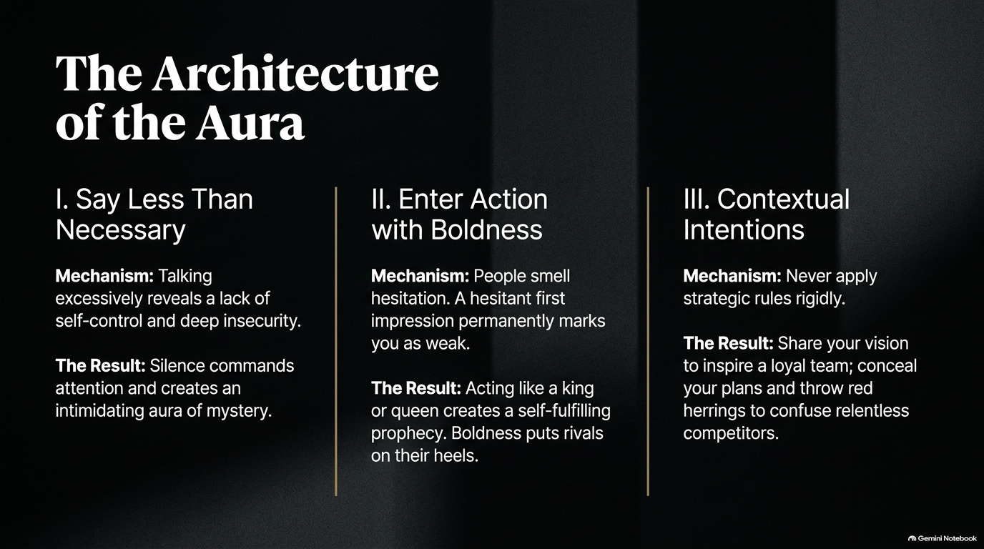
Notes:
Estimated Time: 4 – 6 Minutes
Core Objective: Explain the three structural pillars of aura management: strategic silence, calculated boldness, and contextual intent.
Key Points to Cover:
Pillar I (Say Less Than Necessary): Why excessive talking signals insecurity, low status, and lack of self-control.
Pillar II (Enter Action with Boldness): The psychological impact of hesitation versus immediate, decisive command.
Pillar III (Contextual Intentions): Avoid rigid application of rules; adapt between inspiring vision for allies and strategic opacity for competitors.
Speaker Script:
"If appearances rule the world, how do you construct an aura of authority and power? Slide 3 breaks down The Architecture of the Aura into three core pillars derived from Greene's laws.
First: Say Less Than Necessary.
When you observe people in high-stress environments or high-stakes meetings, notice who speaks the most. Inexperienced or insecure individuals constantly over-explain, fill silence, and chatter. Why? Because silence creates anxiety for the weak. But excessive talking reveals your hand, exposes your doubts, and eventually makes you look common. When you intentionally limit your words, your speech carries weight. Silence creates an uncomfortable vacuum that forces others to reveal their motives while you remain an unreadable, intimidating mystery.
Second: Enter Action with Boldness.
Human beings have an uncanny, primal ability to smell hesitation. If you approach a situation nervously—asking for permission, shuffling your feet, double-guessing your words—you signal to the room that you are weak. Boldness creates a powerful psychological effect: when you act like you belong, when you state terms without flinching, people subconsciously assume you possess hidden resources or authority to back it up. Boldness puts your rivals on their defensive heels.
Third: Contextual Intentions.
Never apply these rules like a rigid robot. Power requires flexibility. When leading your team, you share your vision openly to cultivate trust and loyalty. But when dealing with aggressive competitors or political opponents, you conceal your intentions, drop red herrings, and keep your ultimate destination concealed until you strike. Master all three pillars, and you master how the room perceives you."

Slide 4
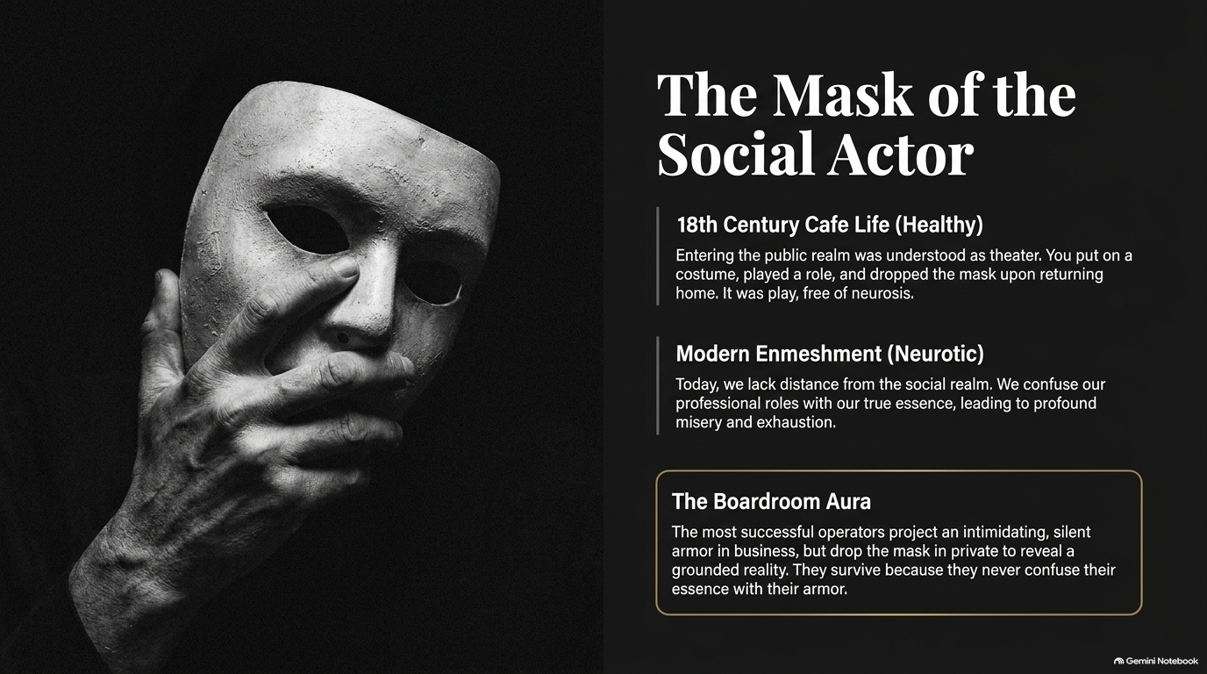
Notes:
Estimated Time: 4 – 5 Minutes
Core Objective: Differentiate healthy historical role-playing (18th-century café culture) from modern neurotic enmeshment; teach the concept of "The Boardroom Aura."
Key Points to Cover:
18th-Century Cafe Life: Treating social life as theater—putting on a public mask as a game, keeping private life distinct.
Modern Enmeshment: The psychological trap of equating professional identity with one's core soul, resulting in burnout and fragility.
The Boardroom Aura: Protecting internal authenticity by wearing an impenetrable social armor during strategic encounters.
Speaker Script:
"Slide 4 addresses a major crisis of the modern era: The Mask of the Social Actor.
In 18th-century Europe—think of the bustling public cafes of Paris or London—social interaction was understood to be theater. You selected your wardrobe, put on a stylized persona, engaged in witty public rhetoric, and played a role. Crucially, when you went home, you took off the mask. It was a conscious, playful distinction. People rarely suffered from existential anxiety about their 'personal brand' because public life was viewed as performance.
Fast forward to today. We live in an era of Modern Enmeshment. People blur the line between their authentic soul and their professional role. If someone attacks your project at work, you take it as an existential attack on your identity. This lack of emotional distance creates constant misery, neurosis, and exhaustion.
Look at the bottom box: The Boardroom Aura. The most effective operators in business and politics understand that the public arena is a stage. In the boardroom, they put on a calm, formidable, silent armor. They play the game with precision. But in private, they drop the armor completely. They survive and win because they never confuse their true essence with their public mask. You must learn to wear the mask deliberately, rather than letting the mask wear you."

Slide 5
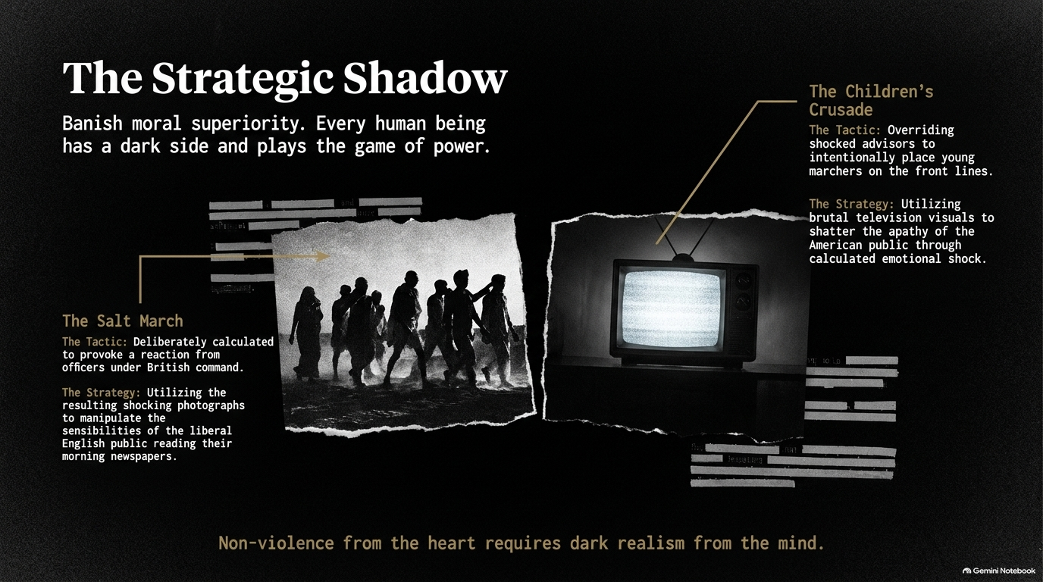
Notes:
Estimated Time: 5 – 6 Minutes
Core Objective: Analyze Carl Jung’s concept of "The Shadow" as interpreted by Robert Greene; illustrate how effective historical leaders (Gandhi, MLK) used cold, dark realism to achieve noble ends.
Key Points to Cover:
Banish Moral Superiority: Every human possesses aggression, self-interest, and dark drives; suppressing them creates passive-aggressive hypocrisy.
Case Study 1: The Salt March (Gandhi): Deliberately provoking British colonial authorities into violent overreactions to win global media sympathy.
Case Study 2: The Children’s Crusade (MLK / Birmingham 1963): Overriding fearful advisors to put youth on the front lines to shock white middle-class apathy via television visuals.
The Takeaway: Pure heart without dark realism equals helplessness.
Speaker Script:
"This slide—The Strategic Shadow—is often the most uncomfortable for idealists, yet it is essential for true mastery.
Carl Jung noted that every human being possesses a 'Shadow'—the repressed, darker aspects of our psyche, including aggression, ambition, and strategic calculating instincts. Naive people pretend they have no shadow. They wrap themselves in moral superiority. But when pushed into a corner, they collapse or become passive-aggressive.
True leaders acknowledge their shadow and weaponize it for their purpose. Look at the two historical examples on this slide:
First, Mahatma Gandhi and the Salt March. We often view Gandhi as a saintly figure of pure non-violence. But Gandhi was also a master strategist. He calculated that by walking to the sea to make salt, he would force British officials to violently beat unarmed protestors. He wanted those horrific photographs published in morning newspapers across London and America to destroy the moral legitimacy of British rule. That is not passive submission; that is aggressive, high-stakes psychological warfare.
Second, Martin Luther King Jr. and the Children’s Crusade in Birmingham, 1963. When campaign momentum was stalling and adult marchers feared losing their jobs, King made the controversial decision to allow young students to march against Sheriff Bull Connor’s attack dogs and fire hoses. King knew the brutal television visuals would shock the conscience of the nation. It was a cold, calculated strategic choice that broke the back of segregation in Birmingham.
Notice the quote at the bottom: Non-violence from the heart requires dark realism from the mind. To achieve great outcomes, you cannot afford naive innocence. You must master the mechanics of power."

Slide 6
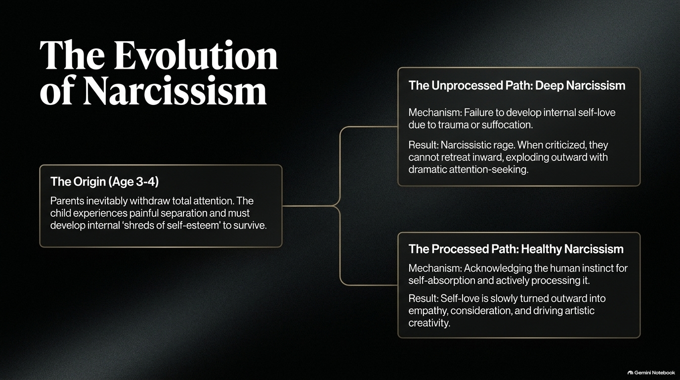
Notes:
Estimated Time: 4 – 5 Minutes
Core Objective: Trace the developmental origin of narcissism; contrast the path of "Deep Narcissism" with "Healthy Narcissism."
Key Points to Cover:
The Origin (Ages 3–4): The inevitable moment parents withdraw total focus, forcing the child to build an internal sense of self-worth.
The Unprocessed Path (Deep Narcissism): Trauma or over-indulgence prevents self-soothing, leading to fragile egos, narcissistic rage, and constant validation-seeking.
The Processed Path (Healthy Narcissism): Redirecting natural self-absorption outward into deep empathy, social keenness, and intense creative drive.
Speaker Script:
"On Slide 6, we examine one of the most destructive forces in human relationships and organizations: Narcissism.
Robert Greene outlines the developmental root of narcissism around age three or four. Up to that point, a child feels like the absolute center of the universe. But eventually, parents must withdraw complete, undivided attention. The child experiences a painful realization: I am separate from the world. To survive this separation, a child must develop an internal reservoir of self-esteem.
Depending on how this phase is handled, a person follows one of two paths:
Path 1: Deep Narcissism. If a child experiences severe emotional neglect, trauma, or conversely, overwhelming smothering, they fail to develop that internal core of self-love. As adults, they remain emotional black holes. They possess no internal anchor. When criticized, they cannot reflect internally; instead, they explode in narcissistic rage, blame others, and resort to dramatic attention-seeking. In work environments, deep narcissists ruin team dynamics because everything must serve their fragile ego.
Path 2: Healthy Narcissism. A healthy individual acknowledges their built-in instinct for self-preservation, but processes it. Because their internal self-esteem is stable, they don’t need to spend all day worrying about whether people like them. They can turn their energy outward. They use their self-awareness to cultivate genuine empathy, observe others accurately, and channel their focus into artistic or professional mastery.
When analyzing colleagues, partners, or leaders, determine early which path they have taken. Deep narcissists will drain your energy; healthy narcissists will channel their ego into high performance."

Slide 7
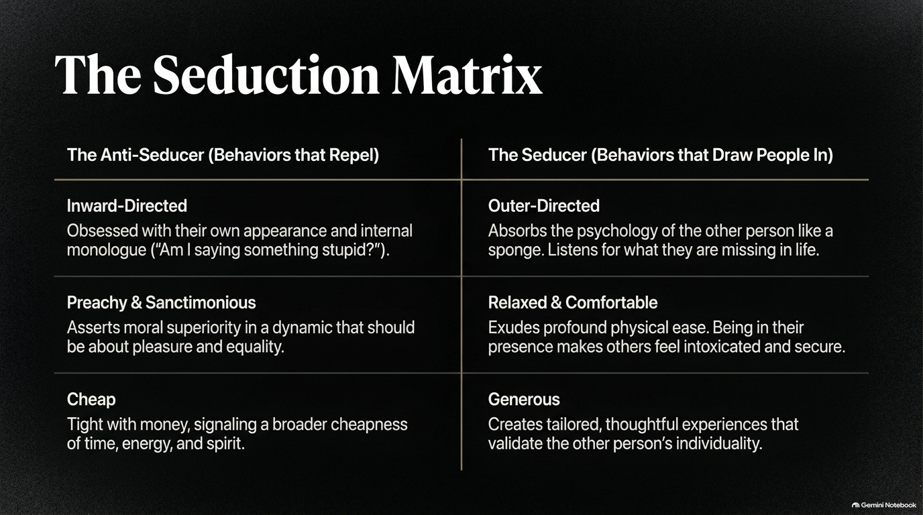
Notes:
Estimated Time: 4 – 6 Minutes
Core Objective: Compare the behavioral traits of "The Anti-Seducer" (repelling traits) against "The Seducer" (drawing traits) across focus, tone, and generosity.
Key Points to Cover:
Inward-Directed vs. Outer-Directed: Self-absorbed internal monologue versus absorbing the psychological needs of others.
Preachy & Sanctimonious vs. Relaxed & Comfortable: Moral superiority versus physical ease and psychological comfort.
Cheap vs. Generous: Stinginess of spirit/energy versus creating tailored, validating experiences.
Speaker Script:
"Seduction is not merely about romance; in Greene's framework, seduction is the ultimate form of social influence. It is the art of pulling people toward your vision voluntarily rather than coercing them. Slide 7 contrasts the Anti-Seducer with the Seducer.
Look at the left column: The Anti-Seducer. These are behaviors that instantly repel people.
Inward-Directed: They are trapped inside their own head. During a conversation, they aren't listening to you; they are rehearsing what to say next or worrying: 'Do I sound smart? How do I look?'
Preachy & Sanctimonious: They judge others, lecture people on morality, and ruin social flow by constantly asserting superiority.
Cheap: This isn't just about money. Cheapness is an attitude. It’s being stingy with praise, stingy with time, stingy with warmth, and tight-fisted with credit.
Now look at the right column: The Seducer.
Outer-Directed: When they speak with you, their entire focus shifts to you. They absorb your moods, listen for what is missing in your life, and make you feel like the only person in the room.
Relaxed & Comfortable: They exude physical ease. Because they aren't fidgeting or anxious, their calm nervous system regulates yours. People naturally gravitate toward those who make them feel safe and comfortable.
Generous: They create tailored, thoughtful experiences. They validate your individuality and give freely of their attention and recognition.
If you want to increase your influence in any arena, systematically purge anti-seductive behaviors from your repertoire and cultivate outer-directed focus."

Slide 8
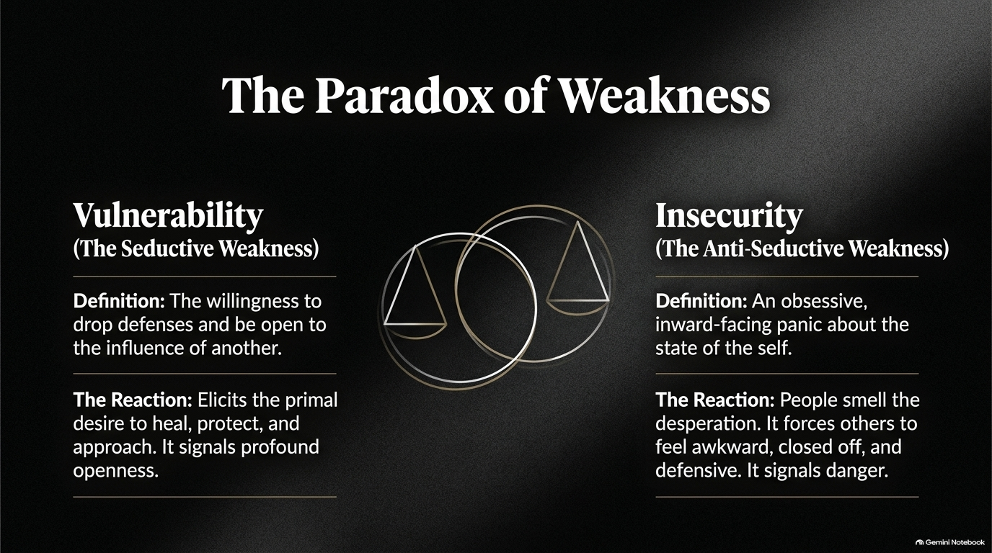
Notes:
Estimated Time: 4 – 5 Minutes
Core Objective: Contrast high-status vulnerability (seductive weakness) with low-status insecurity (anti-seductive weakness).
Key Points to Cover:
Vulnerability (Seductive): Strategic dropping of defenses from a position of strength, eliciting empathy, connection, and protective instincts.
Insecurity (Anti-Seducer): Inward-facing panic, needy validation-seeking, and desperation that signals danger and drives people away.
The Core Distinction: Vulnerability is an intentional open door; insecurity is a leaking vessel.
Speaker Script:
"There is a major misunderstanding in modern psychology regarding the concept of weakness. We often hear the phrase: 'You should show your vulnerability.' But Slide 8 reveals The Paradox of Weakness—because not all weakness is perceived equally.
Look at the distinction on this slide:
On the left, we have Vulnerability, which Greene calls The Seductive Weakness. Vulnerability occurs when someone who is grounded and capable consciously chooses to drop their armor. They share a personal struggle, admit a past mistake, or show genuine emotional openness. Because this openness comes from a place of underlying stability, it triggers a primal human reaction: people want to step in, help, protect, and connect. It signals authenticity and deep confidence.
On the right, we have Insecurity, which is The Anti-Seductive Weakness. Insecurity is not conscious openness; it is an inward-facing panic about your own worth. It manifests as constant self-deprecation aimed at fishing for compliments, nervous laughter, or defensive over-explaining.
People instinctively recoil from insecurity. Why? Because human evolutionary instincts interpret desperation as a sign of hidden incompetence or social contagion. Needy insecurity forces others to walk on eggshells.
Before you share a weakness in a public or professional setting, ask yourself: Am I sharing this from a place of grounded vulnerability to build trust, or am I broadcasting dynamic insecurity because I am seeking external validation?"

Slide 9
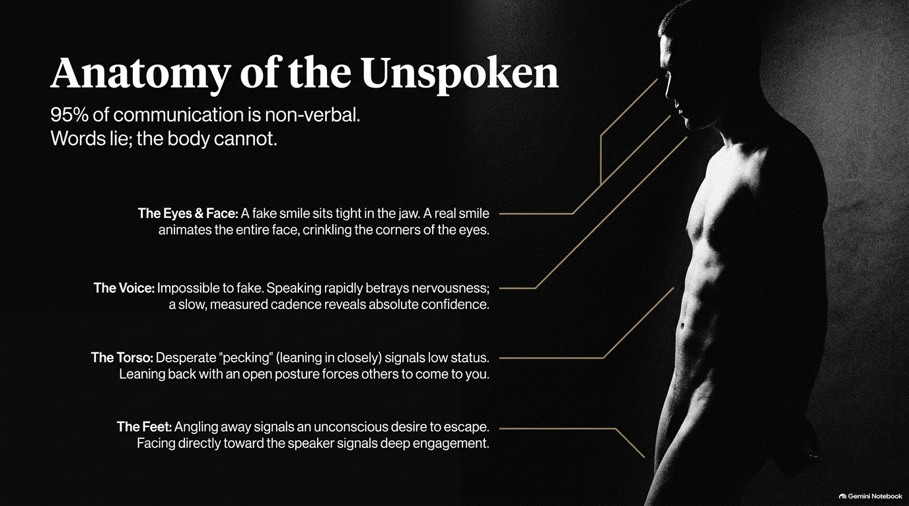
Notes:
Estimated Time: 4 – 6 Minutes
Core Objective: Detail the mechanics of non-verbal signals across four primary channels: Eyes/Face, Voice, Torso, and Feet.
Key Points to Cover:
The Core Premise: Words can easily deceive; body language, micro-expressions, and vocal pitch reveal underlying reality.
Facial Micro-Expressions: Duchenne smiles (eye crinkles) vs. fake masking smiles (jaw-only).
Vocal Cadence: Rapid high-pitched speech vs. measured, grounded pace.
Physical Posture & Direction: Torso leaning ("pecking") vs. open posture; feet direction as an indicator of real engagement.
Speaker Script:
"Slide 9 brings us to the physical mechanics: Anatomy of the Unspoken. Up to 95% of emotional communication is non-verbal. Words are generated by the conscious prefrontal cortex, meaning they can be easily manipulated. But the body is controlled by older limb systems—it leaks truth constantly.
Let's break down the body map shown on the slide:
1. The Eyes & Face: Pay attention to smiles. A fake, polite smile only engages the muscles around the mouth, leaving the jaw tight and the eyes cold. A genuine smile—what psychologists call a Duchenne smile—contracts the orbicularis oculi muscles, crinkling the corners of the eyes. Micro-expressions of contempt or disgust often flash across the eyes for a fraction of a second before a polite mask is restored.
2. The Voice: You can lie with words, but tone is almost impossible to fake under pressure. When someone feels nervous or threatened, their vocal cords tighten, raising their pitch and speeding up their speech rate. True authority is characterized by a slow, measured cadence, lower pitch, and comfortable pauses.
3. The Torso: Notice how people position their upper bodies. Low-status, needy individuals perform what body language experts call 'pecking'—they constantly lean forward into another person's space to seek approval. High-status individuals lean back, keep their shoulders relaxed, and maintain an open posture, forcing others to move into their space.
4. The Feet: The feet are the most honest part of the human body because we rarely pay attention to them. If someone’s torso is facing you, but their feet are angled toward the door, their brain has already mentally escaped the conversation. When their feet point directly at you, their engagement is authentic."

Slide 10
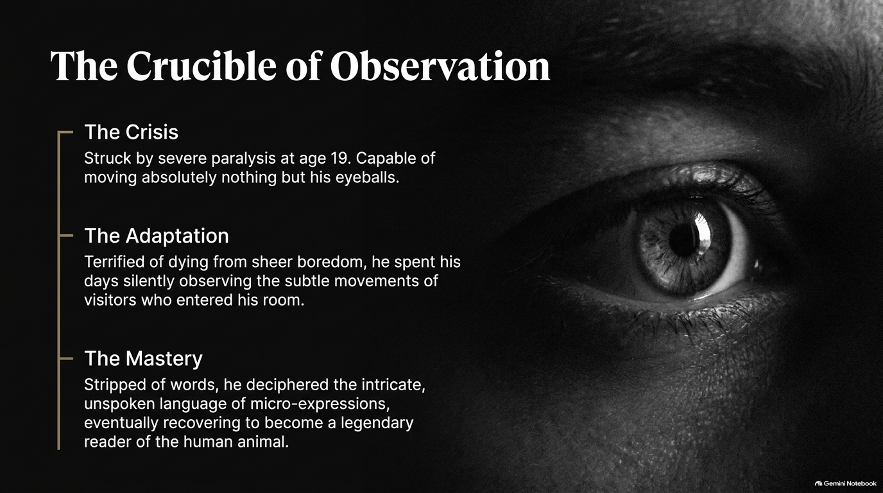
Notes:
Estimated Time: 4 – 5 Minutes
Core Objective: Share the origin story of legendary psychiatrist Milton Erickson; illustrate how enforced silence and intense observation build micro-expression decoding mastery.
Key Points to Cover:
The Crisis: Milton Erickson struck by severe polio at age 19, totally paralyzed and capable of moving only his eyes.
The Adaptation: Observing the micro-movements, contradictions, and non-verbal cues of family and visitors to survive boredom.
The Mastery: Translating this perceptual training into becoming one of the most legendary readers of human behavior and hypnotherapists in history.
Speaker Script:
"How do you actually train yourself to read these non-verbal signals in real time? Slide 10 tells one of the most extraordinary stories in Robert Greene’s The Laws of Human Nature: The Crucible of Observation—the story of Milton Erickson.
In 1919, seventeen-year-old Milton Erickson was struck by a devastating attack of polio. He fell into a severe state of paralysis. He was locked in his bed, unable to move a single muscle in his body, unable to speak, capable of moving absolutely nothing except his eyeballs.
Most people in that situation would sink into complete despair. But Erickson was terrified of dying from pure boredom. So he began to use the only tool he had left: intense, unbroken observation.
For months, he watched his parents, his sisters, and visiting doctors. Stripped of spoken dialogue, he began noticing things no one else saw. He noticed how his sister would say 'yes' with her voice, but her shoulders would give a tiny, unconscious twitch indicating 'no.' He noticed how tone of voice changed when someone was hiding bad news, and how micro-gestures revealed hidden jealousy or deep affection.
When Erickson eventually recovered his physical mobility years later, he had developed an almost superhuman ability to read human behavior. He went on to become a pioneer in modern hypnotherapy and psychiatry, able to diagnose a patient’s suppressed traumas within minutes just by watching them walk across the room.
The lesson for us is profound: you do not need to suffer paralysis to build this skill. You simply need to turn off your internal monologue, stop talking so much, and start actively observing the unspoken signals of the people right in front of you."

Slide 11
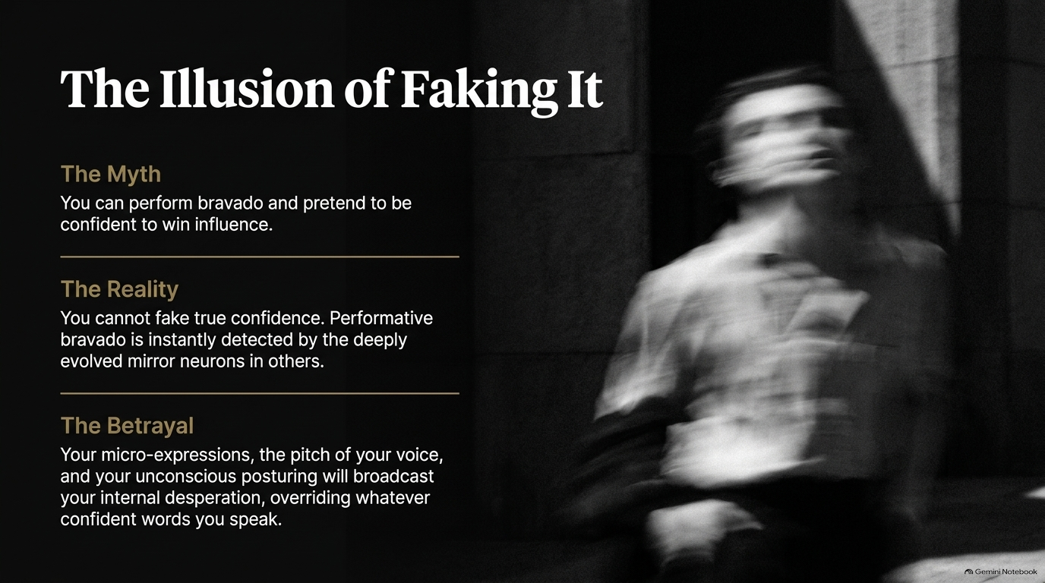
Notes:
Estimated Time: 3 – 5 Minutes
Core Objective: Deconstruct the "fake it till you make it" myth; explain how mirror neurons instantly detect performative bravado and expose internal desperation.
Key Points to Cover:
The Myth: Believing that performing loud bravado or adopted postures can trick others into perceiving real power.
The Reality: Human mirror neurons process subtle micro-expressions and vocal tension, instinctively detecting deceit.
The Betrayal: Unconscious posturing betrays internal panic, creating distrust rather than influence.
Speaker Script:
"Slide 11 addresses one of the most common pieces of modern self-help advice: 'Fake it till you make it.' Greene calls this The Illusion of Faking It.
We have all seen people try this. Someone feels deeply insecure, so they attempt to put on a mask of extreme swagger, aggressive posture, or loud talking. They think they are projecting confidence.
Here is the problem: human beings possess highly evolved neural networks, including mirror neurons, designed specifically over millions of years to read threats and deceit in social groups.
When you attempt to perform confidence while feeling internal panic, you create what psychologists call incongruence. Your words say one thing, but your micro-expressions, tight jaw, rapid blinking, and elevated vocal pitch betray your actual state.
The room senses this incongruence instantly. Even if people can't articulate why, they feel an intuitive discomfort around you. Performative bravado smells like desperation. Trying to fake power is like trying to hide a fire by covering it with paper—eventually, the smoke gets out. True confidence cannot be faked; it must be built from the inside out."

Slide 12
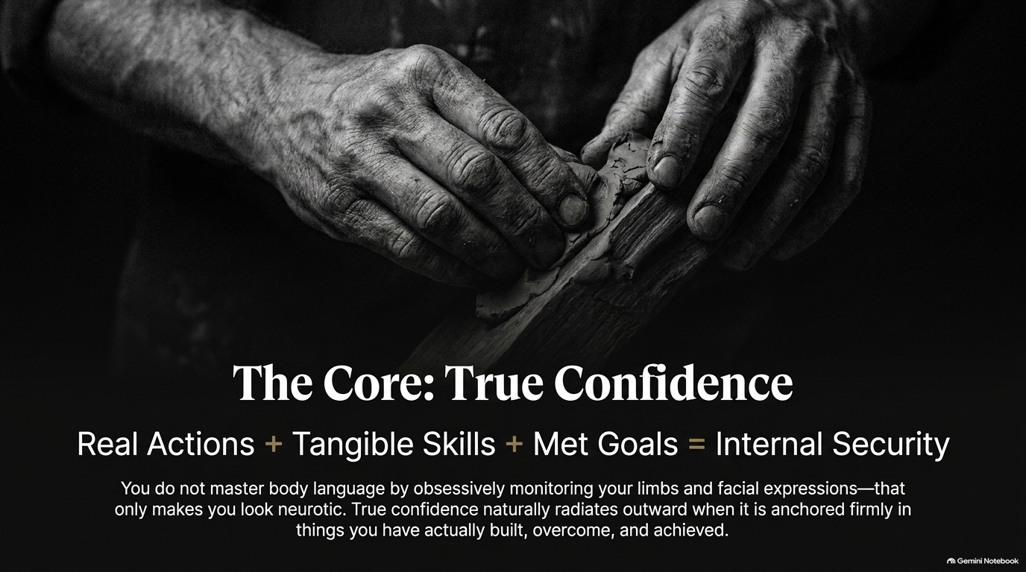
Notes:
Estimated Time: 4 – 5 Minutes
Core Objective: Define the formula for true confidence ($Real\ Actions + Tangible\ Skills + Met\ Goals = Internal\ Security$); explain why internal security naturally radiates authentic body language.
Key Points to Cover:
The Confidence Formula: Real actions, actual skills, and real-world achievements create unbreakable internal security.
The Trap of Self-Monitoring: Obsessively checking your limbs or body language makes you look neurotic rather than authoritative.
Natural Radiation: When you master a hard skill or overcome real adversity, your physical aura relaxes automatically.
Speaker Script:
"If faking confidence fails, what produces the real thing? Slide 12 gives us the exact formula: The Core: True Confidence.
Look at the equation across the middle of the slide:
$$\text{Real Actions} + \text{Tangible Skills} + \text{Met Goals} = \text{Internal Security}$$
True confidence is not an emotional state you manufacture in front of a bathroom mirror before a meeting. True confidence is a byproduct of competence.
When you have spent years mastering a hard skill—whether that is financial modeling, public speaking, negotiation, software engineering, or physical training—your brain knows you possess value. When you have set difficult goals and actually met them through sweat and discipline, you don't need to perform bravado. You are internally secure.
Notice the warning at the bottom of the slide: You do not master body language by obsessively monitoring your limbs and facial expressions. If you sit in a meeting constantly thinking, 'Are my arms crossed? Am I holding eye contact long enough?' you will look stiff, awkward, and deeply neurotic.
When your internal state is anchored in real accomplishment, your physical body language takes care of itself. Your shoulders drop, your eyes settle, your voice deepens, and you radiate an effortless, calm authority that people respect instantly."

Slide 13
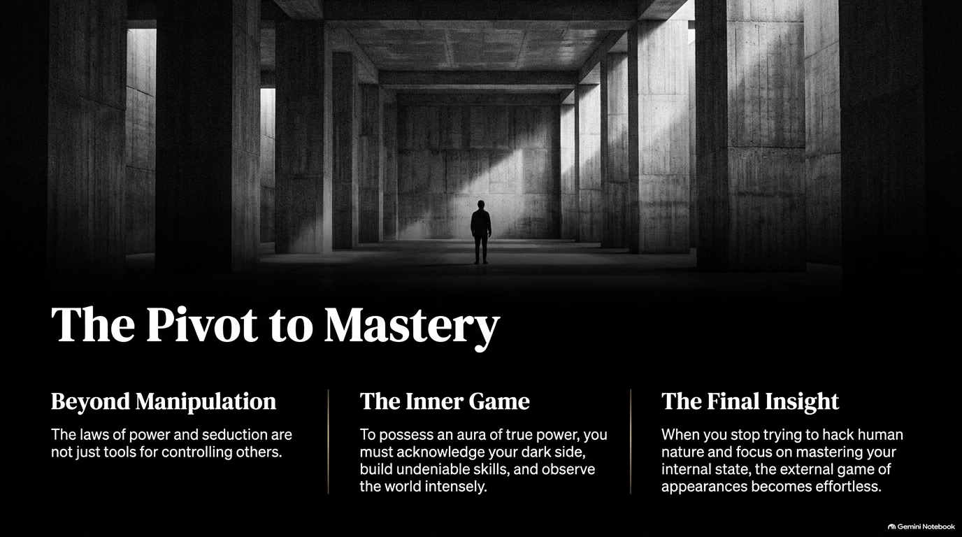
Notes:
Estimated Time: 4 – 5 Minutes
Core Objective: Synthesize the shift from superficial manipulation to deep self-mastery; frame power as an "inner game."
Key Points to Cover:
Beyond Manipulation: Moving past using power tactics as cheap tricks to control others.
The Inner Game: Integrating the shadow, honing real skills, and observing reality objectively.
The Final Insight: When internal state is mastered, navigating external appearances becomes effortless.
Speaker Script:
"As we reach Slide 13, we make The Pivot to Mastery.
When people first read Robert Greene, Machiavelli, or Sun Tzu, they often make the mistake of viewing these concepts as a set of opportunistic tricks—loopholes to manipulate their boss, charm a date, or trick competitors. But if you stop at manipulation, you remain a amateur playing a dangerous game.
True mastery requires stepping beyond manipulation into The Inner Game.
To possess real, enduring power, you must do the hard internal work:
You must acknowledge your dark shadow rather than pretending to be a saint.
You must build undeniable, real-world skills that give you genuine value.
You must train yourself to observe the world dispassionately, without emotional distortion.
Look at The Final Insight on the right side of the screen: When you stop trying to hack human nature and focus on mastering your internal state, the external game of appearances becomes effortless.
You no longer have to work hard to manage impression because your presence is anchored in reality. You stop reacting to other people's power plays and start dictating the emotional climate of the room."

Slide 14
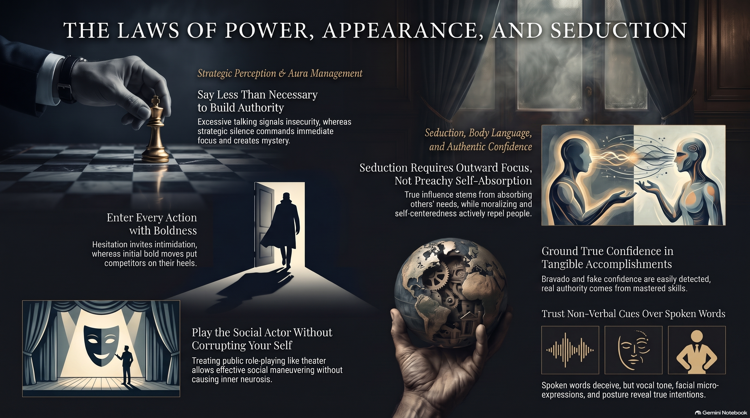
Notes:
Estimated Time: 4 – 6 Minutes
Core Objective: Synthesize the 6 core pillars of the presentation into a final action plan; deliver a strong closing call-to-action.
Key Points to Cover:
Strategic Silence: Speak less than necessary to build authority and maintain mystery.
Bold Action: Eliminate hesitation; enter every situation with decisive clarity.
Social Role-Playing: Wear the public mask as theater without corrupting your inner self.
Outward Seduction: Focus intensely on others' needs rather than self-absorbed moralizing.
Grounded Confidence: Build real authority through mastered skills, not performative bravado.
Non-Verbal Mastery: Trust vocal tone, micro-expressions, and body language over deceitful spoken words.
Speaker Script:
"To conclude our presentation today, Slide 14 brings together the complete blueprint: The Laws of Power, Appearance, and Seduction.
Let’s review the six fundamental pillars we have covered:
Say Less Than Necessary to Build Authority: Strategic silence creates focus, demands respect, and protects you from revealing critical weaknesses.
Enter Every Action with Boldness: Hesitation invites aggression; bold initial moves put competitors on their heels immediately.
Play the Social Actor Without Corrupting Your Self: Treat public roles like theater. Wear the armor in the boardroom to maneuver effectively, but drop the mask in private to maintain your sanity.
Seduction Requires Outward Focus, Not Preachy Self-Absorption: True influence comes from listening deeply and absorbing what others lack, while self-centered preachy behavior actively repels people.
Ground True Confidence in Tangible Accomplishments: Ignore the myth of 'faking it.' Real authority stems from mastered skills and proven track records.
Trust Non-Verbal Cues Over Spoken Words: Words deceive; body language, vocal cadence, and facial micro-expressions reveal true intentions.
If you apply these principles not as malicious tools, but as a realistic lens through which to understand yourself and the human animal, you will navigate social hierarchies with poise, protect yourself from bad actors, and achieve true personal mastery.
Thank you very much. I am now open to any questions or discussion."
Edit directly or with Gemini
Click anywhere to type and edit directly, or select text to prompt Gemini for changes.

