Slide 1

Notes:
The Bear Market Has Already Started (Most Just Don’t See It Yet) | Vincent Deluard
https://www.youtube.com/watch?v=CH6rqNVSJJw

Slide 2
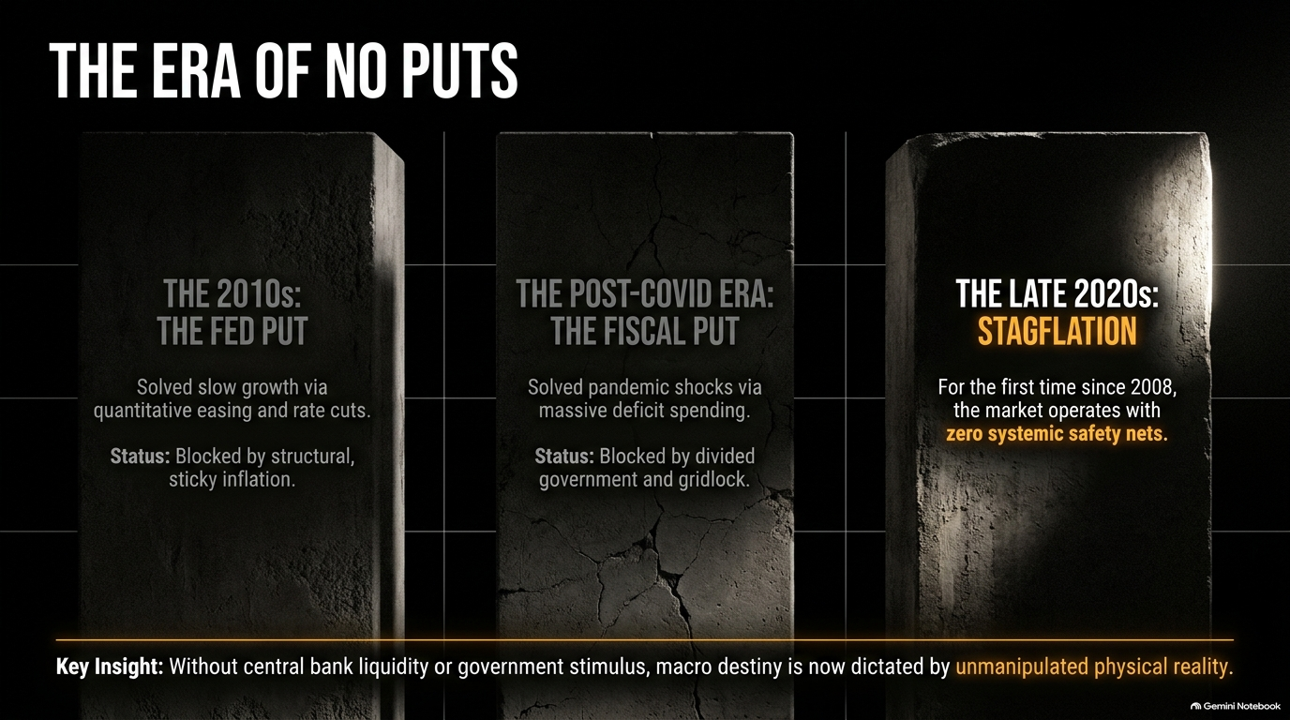

Slide 3
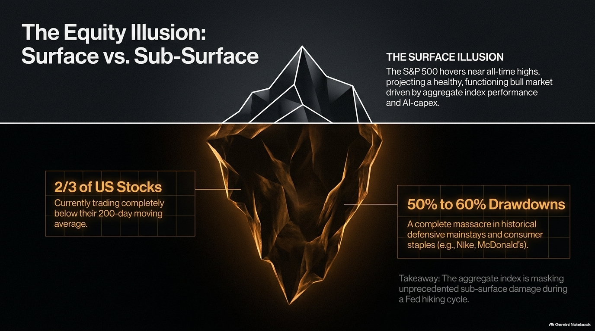

Slide 4
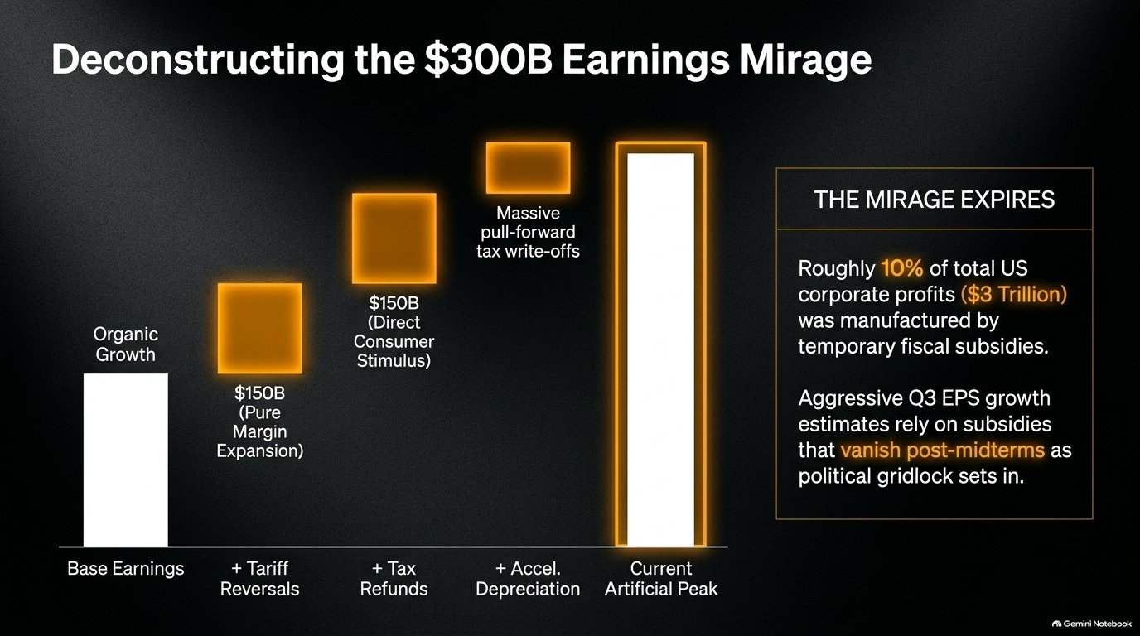

Slide 5
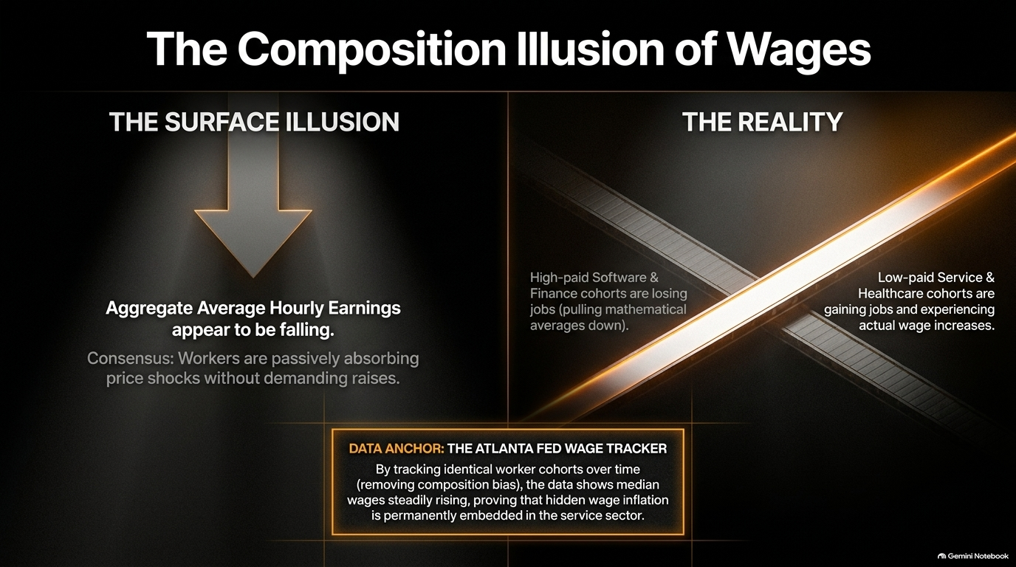

Slide 6


Slide 7
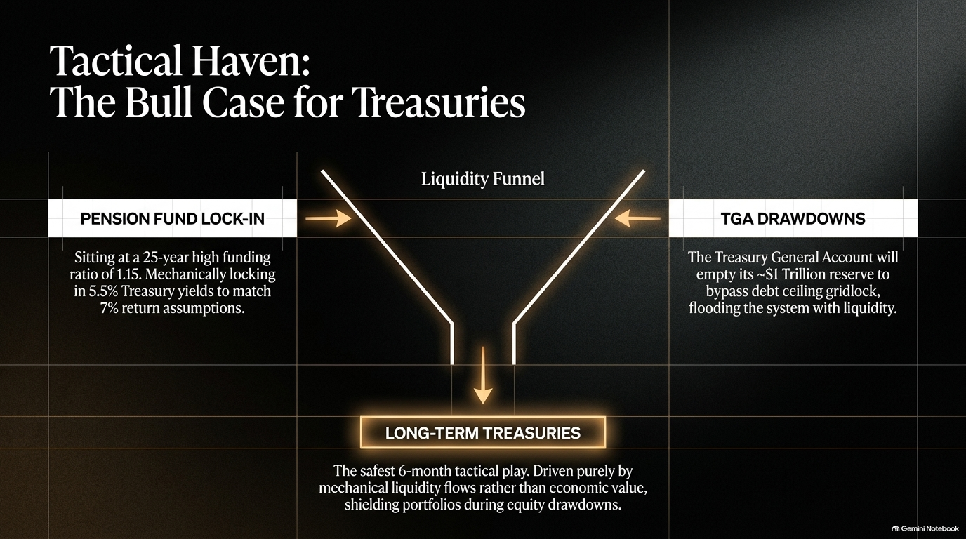

Slide 8
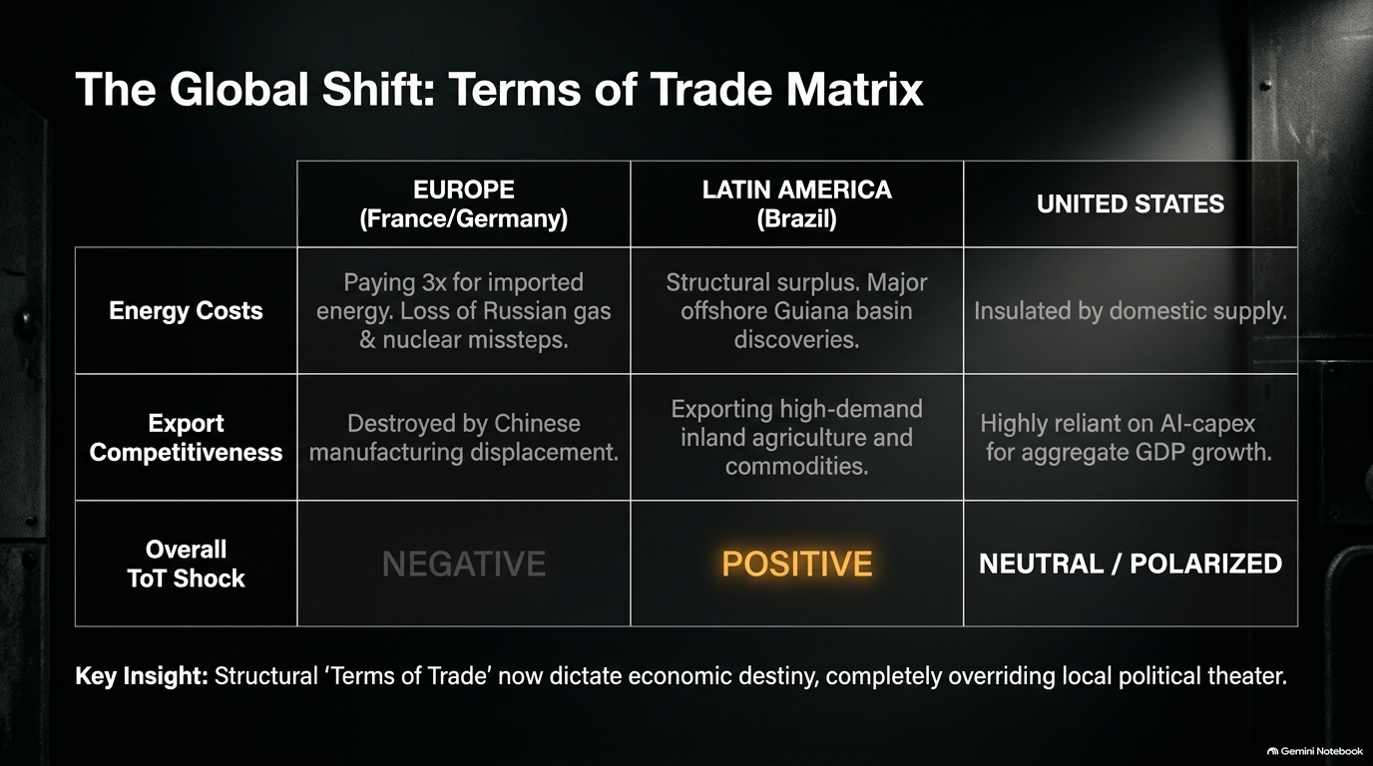

Slide 9


Slide 10
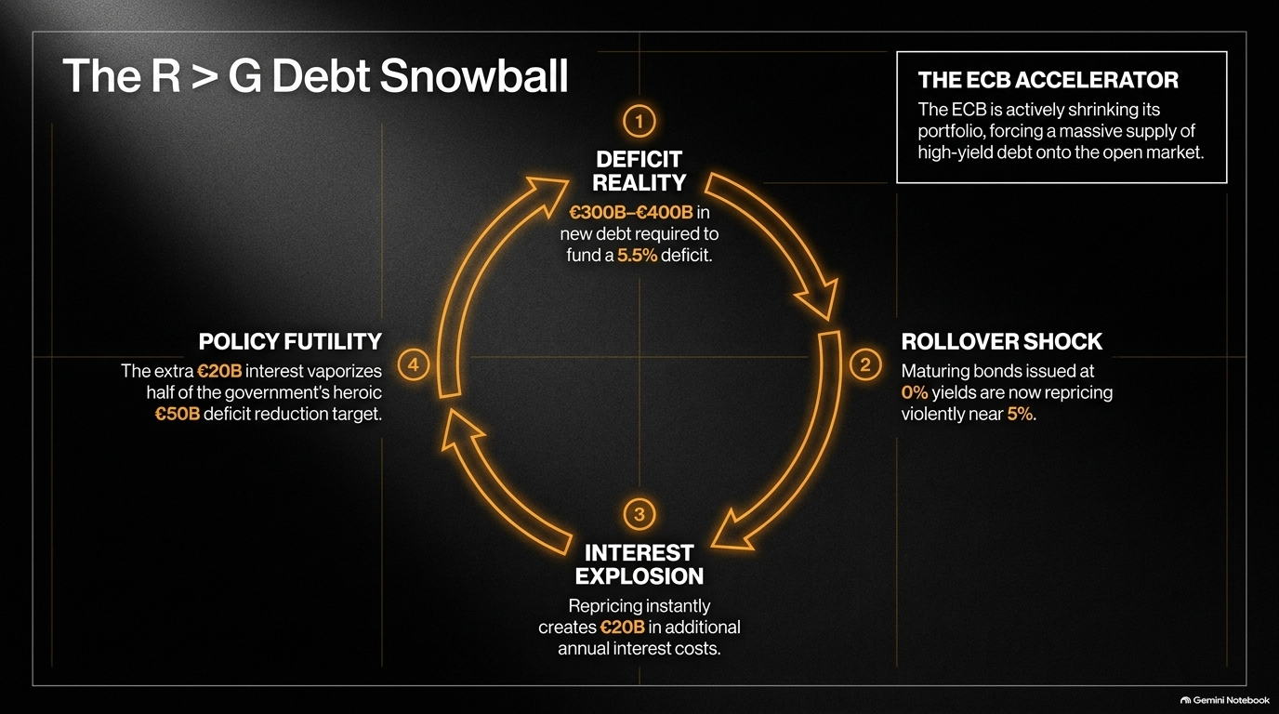

Slide 11


Slide 12
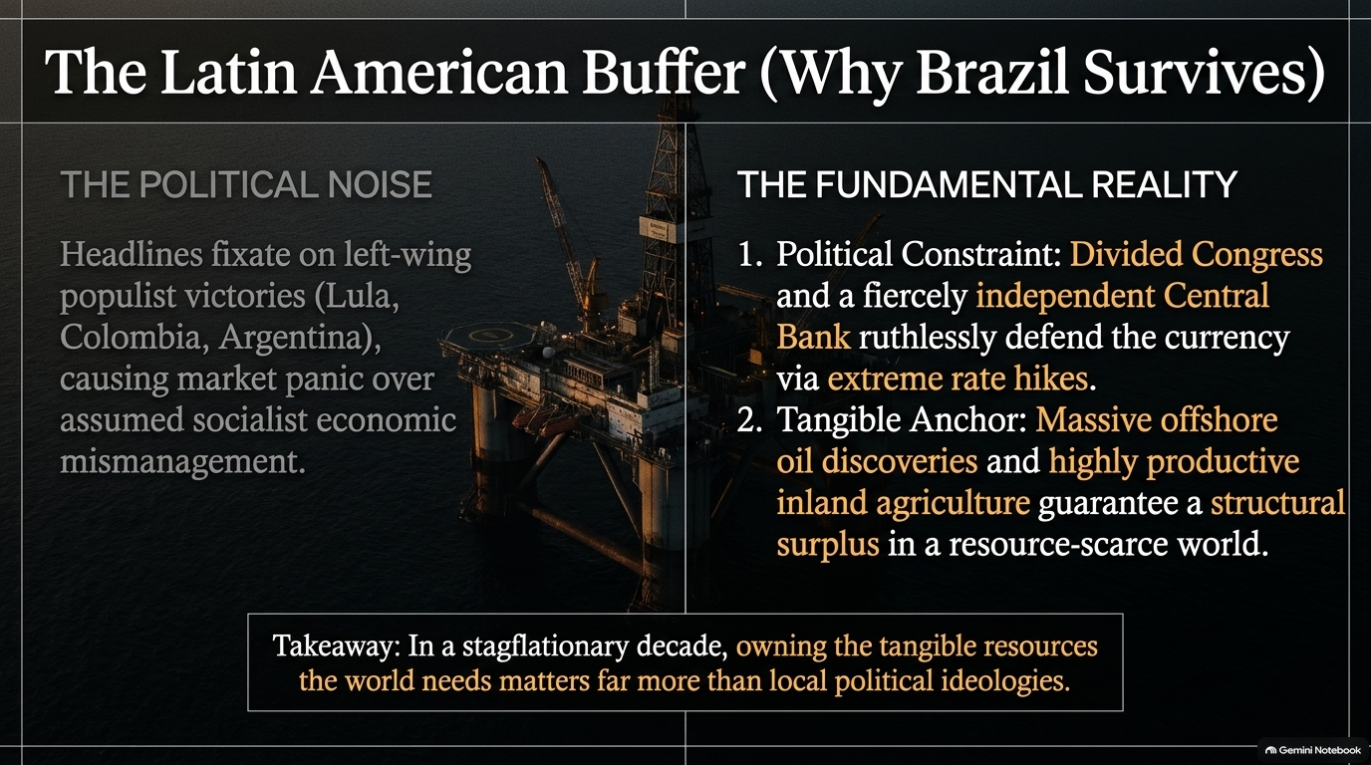

Slide 13
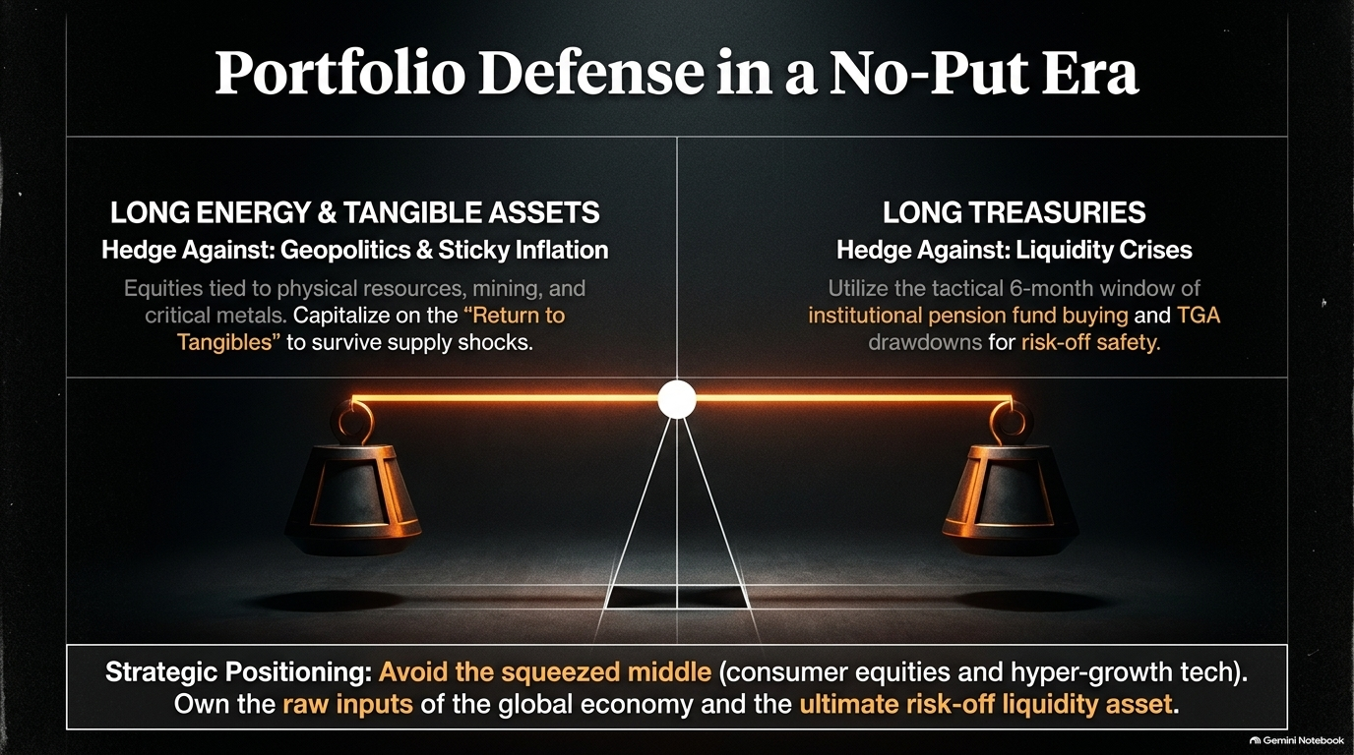

Slide 14
