Slide 1
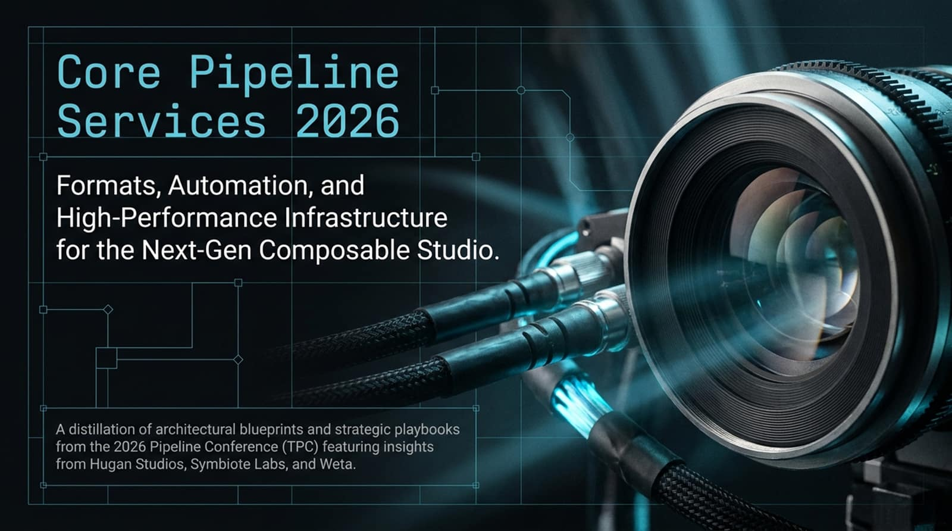
Notes:
Visual Reference: Title slide featuring a macro view of camera lenses, fiber-optic inputs, and structured blueprints.
Estimated Speaking Duration: 2–3 minutes
Speaker Notes:
"Welcome, everyone, to today's deep-dive session on Core Pipeline Services for 2026. As we gather—whether live or streaming later via our conference channels—we are looking at a pivotal inflection point in digital content creation. This presentation represents a careful distillation of architectural blueprints and strategic playbooks gathered from the 2026 Pipeline Conference (TPC), integrating frontline insights from industry leaders at Hugan Studios, Symbiote Labs, and Weta.
Over the next few minutes, we aren't just talking about abstract tech trends; we are examining the raw survival mechanics of modern studios. The tools we rely on—spanning visual effects, animation, high-end game development, and cross-industry real-time XR—are undergoing a massive structural overhaul. We are dealing with exploding data densities, rising infrastructure costs, and a fundamental shift toward agentic automation.
Today, we will unpack how top-tier studios are standardizing data structures through OpenUSD, deploying intelligent micro-agents to handle cross-tool dependencies, and breaking free from legacy storage bottlenecks by shifting to composable, high-performance bare metal. Let's dive straight into the mandate driving this industry evolution."
TPC 2026 Day Two: Core Pipeline Services
https://www.youtube.com/watch?v=u6NRNxPXdTo

Slide 2
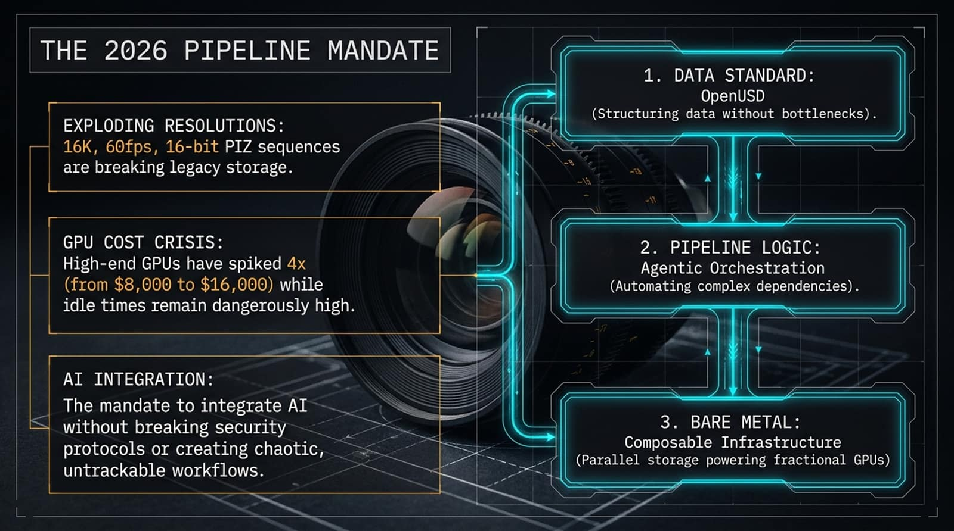
Notes:
Visual Reference: Overview slide outlining exploding resolutions, the GPU cost crisis, AI integration, and the three-part mandate (OpenUSD, Agentic Orchestration, Composable Infrastructure).
Estimated Speaking Duration: 3–4 minutes
Speaker Notes:
"To understand where our industry is heading, we first have to confront the harsh economic and technical realities defining the 2026 pipeline mandate. Studios today are being squeezed from multiple directions simultaneously.
First, look at Exploding Resolutions: we are routinely handling 16K workflows at 60 frames per second using 16-bit PIZ image sequences. Legacy storage systems simply cannot breathe under this kind of throughput pressure.
Second, we face a severe GPU Cost Crisis. High-end production GPUs have spiked dramatically—jumping fourfold from roughly $8,000 to $16,000 per unit—while idle times across workstations remain dangerously high. We are buying bleeding-edge silicon only to watch it starve for data.
Finally, there is the rush toward AI Integration. The mandate commands us to integrate AI deeply into our workflows, but we cannot afford to compromise security protocols or create chaotic, untrackable, 'wild-west' pipelines.
To solve this, the 2026 mandate breaks down into three non-negotiable pillars:
Data Standardization via OpenUSD, structuring data to eliminate pipeline silos.
Pipeline Logic via Agentic Orchestration, using intelligent agents to automate complex multi-tool dependencies.
Bare Metal via Composable Infrastructure, deploying parallel storage that can power fractional GPUs dynamically.
Let's look at how we actually execute the first pillar without getting bogged down in 'planning purgatory'."

Slide 3
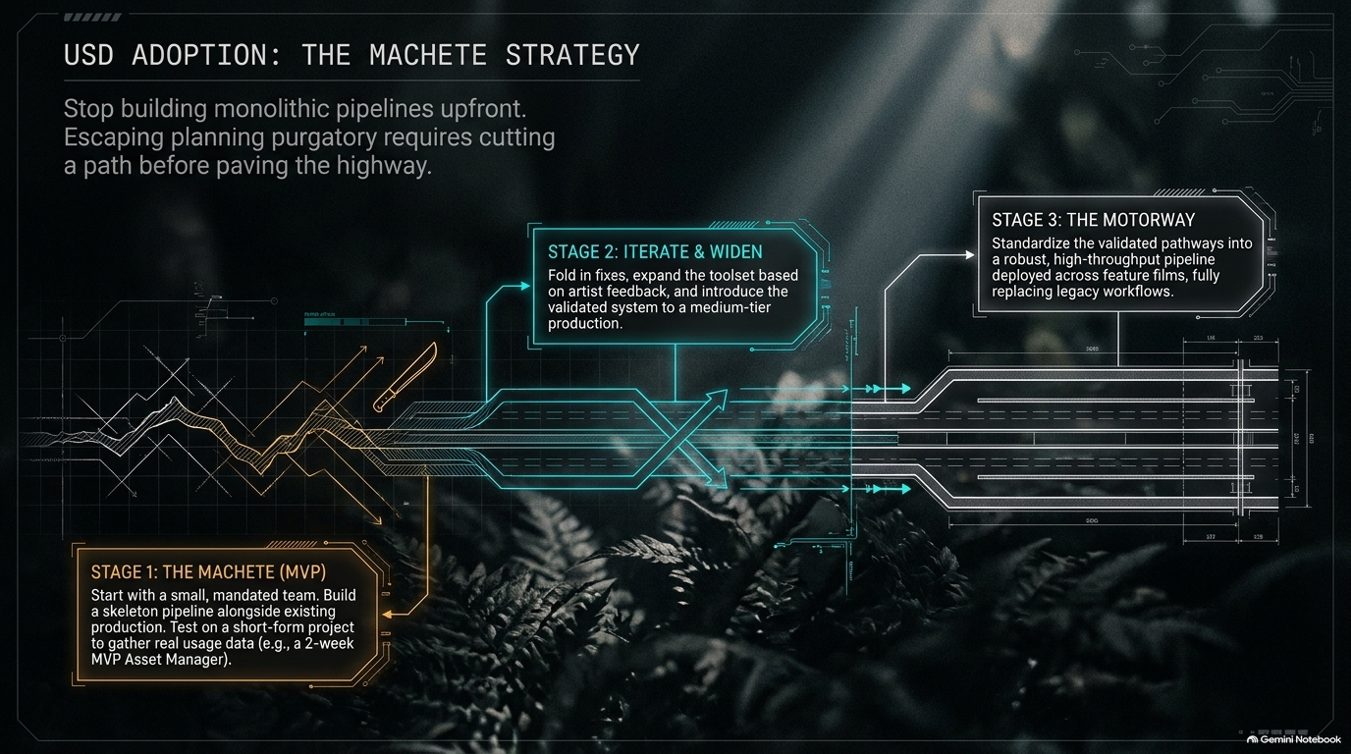
Notes:
Visual Reference: Diagram comparing a chaotic jagged path (The Machete MVP) against a streamlined motorway (Stage 3).
Estimated Speaking Duration: 3–5 minutes
Speaker Notes:
"One of the biggest mistakes studios make when transitioning to OpenUSD is trying to build a monolithic pipeline upfront. They spend months or years in planning purgatory trying to design the ultimate, all-encompassing highway before laying down a single brick. The 'Machete Strategy'—a core playbook from Hugan Studios—tells us to stop doing that.
Instead, we break adoption down into three distinct stages:
Stage 1: The Machete (MVP). You start with a small, mandated team. You don't try to rewrite the studio's entire core; you build a skeleton pipeline right alongside existing production. You test it on a short-form project to gather real usage data—such as building a functional asset manager in just two weeks.
Stage 2: Iterate and Widen. Once the MVP proves itself, you fold in fixes, expand the toolset based directly on artist feedback, and introduce the validated system to a medium-tier production.
Stage 3: The Motorway. Only then do you standardize these validated pathways into a robust, high-throughput pipeline deployed across feature films, fully replacing legacy workflows.
By cutting your path with a machete before trying to pave a six-lane highway, you ensure that your architecture is shaped by real production pain points, not theoretical boardrooms."

Slide 4
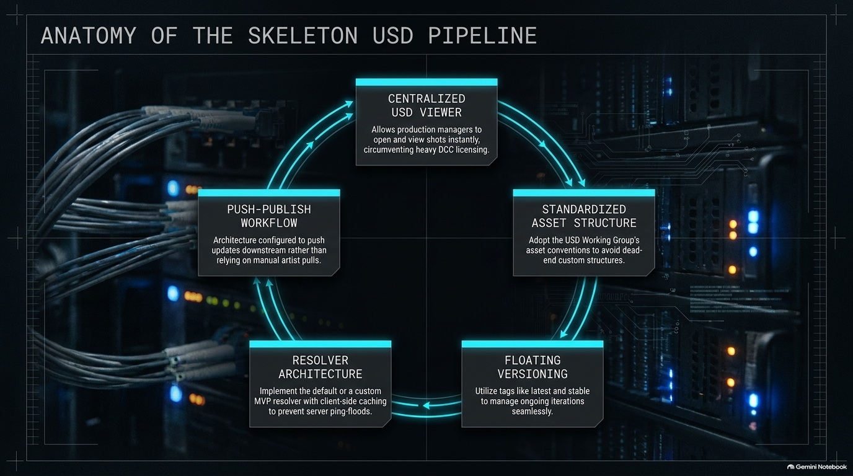
Notes:
Visual Reference: Circular schematic showing Centralized USD Viewer, Standardized Asset Structure, Floating Versioning, Resolver Architecture, and Push-Publish Workflow.
Estimated Speaking Duration: 3–4 minutes
Speaker Notes:
"When you are building that initial skeleton USD pipeline (Stage 1), what does its internal anatomy actually look like? It consists of five tightly integrated core components that work in harmony:
Centralized USD Viewer: This allows production managers and supervisors to open and view shots instantly, completely circumventing heavy, expensive Digital Content Creation (DCC) software licensing just to look at a frame.
Standardized Asset Structure: You must adopt the USD Working Group's established asset conventions from day one to avoid falling into dead-end, custom directory structures.
Floating Versioning: Utilizing tags like latest and stable allows teams to manage ongoing asset iterations seamlessly without breaking downstream links.
Resolver Architecture: Implementing a default or custom MVP resolver with client-side caching prevents server ping-floods and keeps network traffic lean.
Push-Publish Workflow: The entire architecture is configured to push updates downstream automatically, rather than relying on manual artist pulls.
This closed-loop system is lightweight, fast, and gives artists immediate confidence in the data they are consuming."

Slide 5
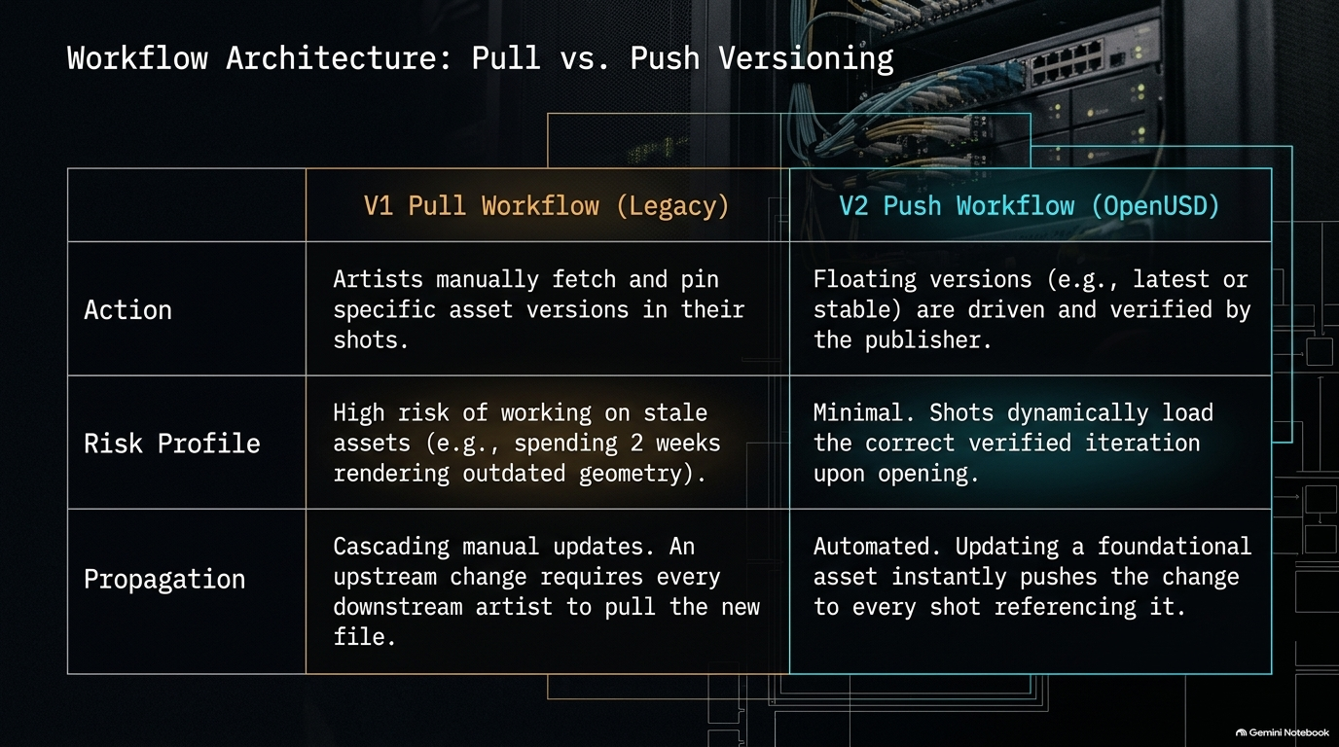
Notes:
Visual Reference: Comparison table contrasting V1 Pull Workflow (Legacy) with V2 Push Workflow (OpenUSD).
Estimated Speaking Duration: 2–4 minutes
Speaker Notes:
"Let's zoom in on the operational heart of this change: the shift from legacy pull workflows to modern push versioning.
In the V1 Pull Workflow, artists are burdened with manually fetching and pinning specific asset versions inside their shots. The risk profile here is dangerously high. It's entirely common for an artist to spend two weeks rendering out a sequence using stale geometry simply because an upstream asset changed and they forgot to pull the latest version. Furthermore, propagation requires cascading manual updates—meaning every single downstream artist has to be notified and manually pull the new file.
In the V2 Push Workflow powered by OpenUSD, this entire paradigm is automated. Floating versions like latest or stable are driven and verified directly by the publisher. The risk drops to near zero because shots dynamically load the correct, verified iteration the moment they are opened. If an upstream asset changes, that update instantly pushes through to every single shot referencing it. It removes human error from version tracking entirely."

Slide 6
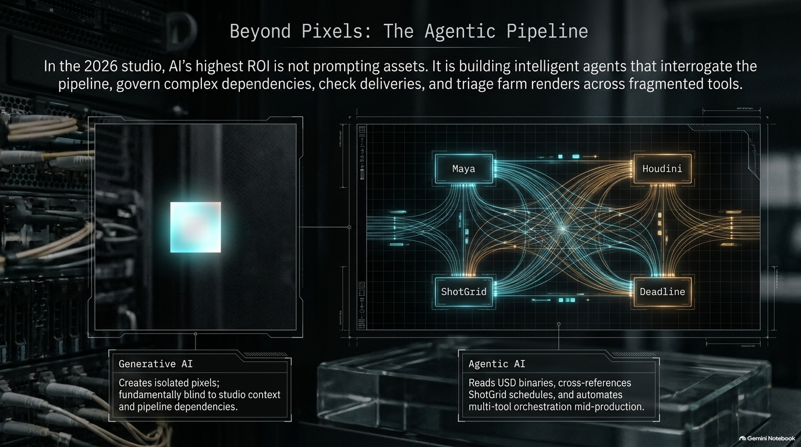
Notes:
Visual Reference: Concept split showing Generative AI (isolated pixels) vs. Agentic AI (orchestrating Maya, Houdini, ShotGrid, and Deadline).
Estimated Speaking Duration: 3–5 minutes
Speaker Notes:
"As we look at AI integration in the 2026 studio, we need to clear away a major misconception. In many organizations, leadership thinks AI's highest ROI is prompting pretty background pixels or generating concept art. But generative AI creates isolated pixels; it is fundamentally blind to studio context, naming conventions, and pipeline dependencies.
True pipeline ROI comes from Agentic AI. In the modern studio, we build intelligent agents that actively interrogate the pipeline, govern complex dependencies, check multi-tool deliveries, and triage farm renders across fragmented software.
Look at the orchestration web on the screen: our agents sit at the center, reading USD binary files, cross-referencing ShotGrid schedules, talking to Houdini and Maya, and managing Deadline render nodes. They don't replace the artist's creative touch; they automate the tedious, error-prone glue work that traditionally requires armies of pipeline technical directors to maintain."

Slide 7
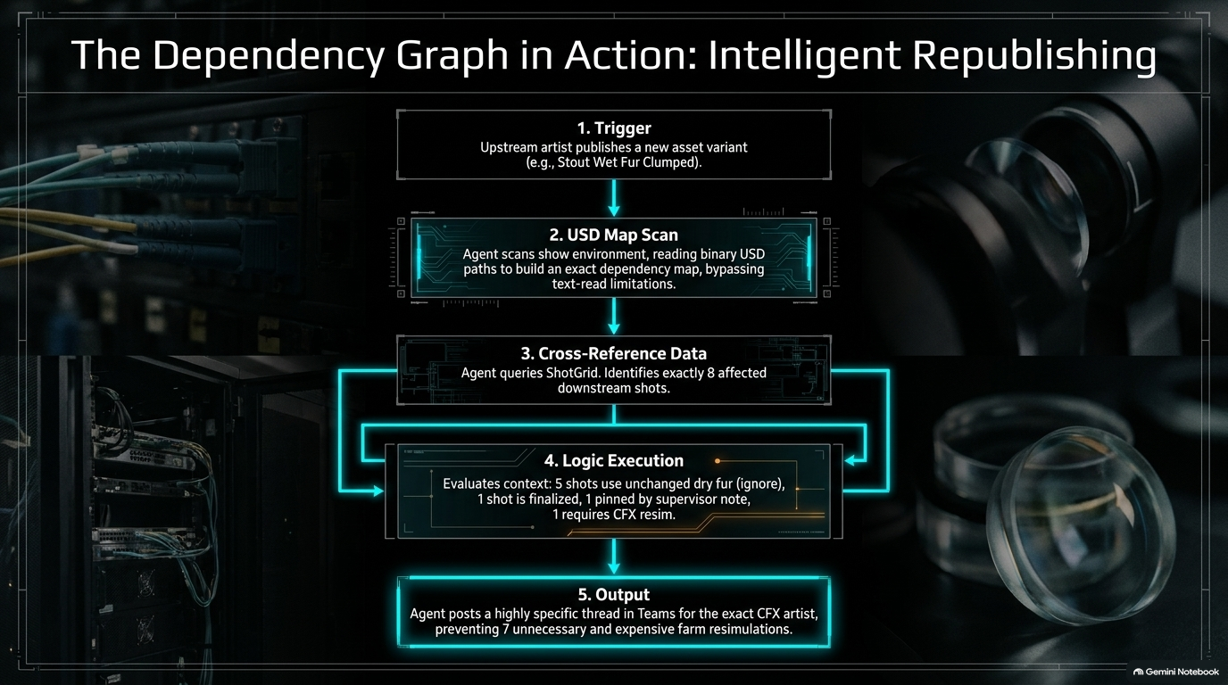
Notes:
Visual Reference: Step-by-step flowchart showing an upstream publish triggering a USD map scan, ShotGrid lookup, dependency evaluation, and targeted Teams notification.
Estimated Speaking Duration: 3–5 minutes
Speaker Notes:
"Let's trace a real-world scenario to see how agentic orchestration functions in practice. Imagine an upstream groom artist publishes a new asset variant: Stout Wet Fur Clumped.
Here is what happens autonomously in seconds:
The Trigger: The publish event fires.
USD Map Scan: The agent scans the environment, reading binary USD paths directly to build an exact dependency map, bypassing slow text-read limitations.
Cross-Reference Data: The agent queries ShotGrid to identify precisely which downstream shots are affected—in this case, exactly 8 shots.
Logic Execution: The agent evaluates context intelligently. It notices that 5 shots use unchanged dry fur and can be ignored; 1 shot is already finalized; 1 is pinned by a supervisor note; and exactly 1 shot requires a CFX re-simulation.
Output: Instead of blindly triggering a massive, expensive farm re-render for all 8 shots, the agent posts a highly specific, targeted thread in Teams to the exact CFX artist responsible for that single shot, preventing 7 unnecessary and expensive farm re-simulations. That is high-leverage pipeline automation."

Slide 8
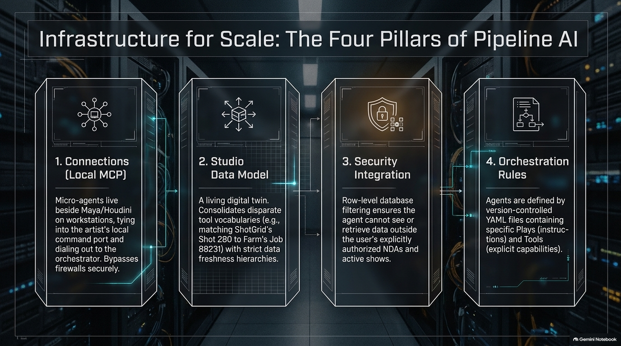
Notes:
Visual Reference: Four server racks detailing Local MCP, Studio Data Model, Security Integration, and Orchestration Rules.
Estimated Speaking Duration: 3–5 minutes
Speaker Notes:
"To run these intelligent agents reliably at scale without creating security nightmares or system instability, you need four foundational pillars of infrastructure:
Connections (Local MCP): Micro-agents live directly on artist workstations alongside Maya and Houdini, tying into local command ports and dialing out to the orchestrator securely without opening dangerous inbound firewall ports.
Studio Data Model: A living digital twin that consolidates disparate tool vocabularies—for example, matching ShotGrid's Shot 280 to the farm's Job 88231 while maintaining strict data freshness hierarchies.
Security Integration: Row-level database filtering ensures that an AI agent never sees or retrieves data outside the user's explicitly authorized active shows and NDAs.
Orchestration Rules: Agents are not guessing; they are strictly defined by version-controlled YAML files containing specific plays, instructions, and explicit tool capabilities."

Slide 9
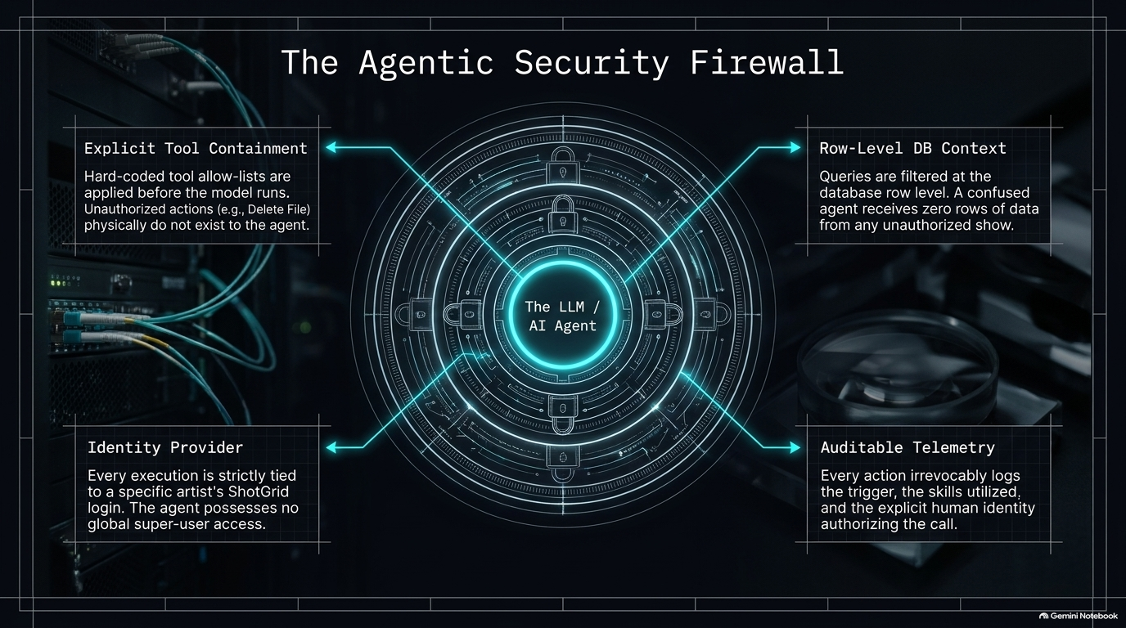
Notes:
Visual Reference: Concentric security diagram highlighting Tool Containment, Row-Level DB Context, Identity Provider, and Auditable Telemetry.
Estimated Speaking Duration: 3–4 minutes
Speaker Notes:
"Security is always the number one concern when executives hear 'AI agents with pipeline access.' How do we prevent an LLM from hallucinating and accidentally deleting a project directory or leaking unreleased content? We build a rigorous, multi-layered Agentic Security Firewall.
It rests on four ironclad controls:
Explicit Tool Containment: Hard-coded tool allow-lists are enforced before the model ever runs. Unauthorized actions—like a Delete File command—literally do not exist in the agent's functional vocabulary.
Row-Level DB Context: Queries are filtered at the database row level. A confused or compromised agent receives zero rows of data from any unauthorized show.
Identity Provider: Every single execution is strictly tied to a specific artist's verified ShotGrid login. The agent possesses zero global super-user privileges.
Auditable Telemetry: Every action irrevocably logs the trigger, the specific skills utilized, and the exact human identity authorizing the call. Total accountability is built into the architecture."

Slide 10
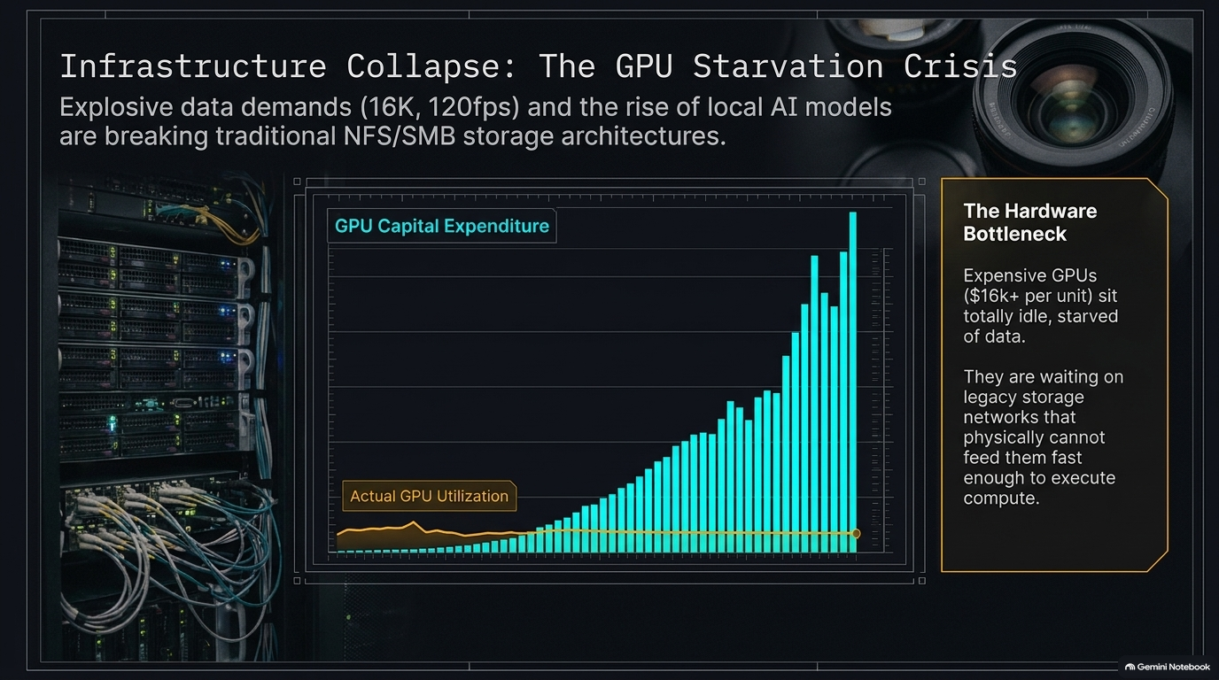
Notes:
Visual Reference: Graph contrasting skyrocketing GPU capital expenditure against flat, stagnant actual GPU utilization, alongside hardware bottleneck notes.
Estimated Speaking Duration: 3–4 minutes
Speaker Notes:
"Now let's look at the hardware layer and the crisis happening in server rooms across our industry. Studios are spending record amounts of capital on hardware, yet our actual GPU utilization remains stubbornly, flatly low. Why?
We are facing a severe Hardware Bottleneck. We are deploying enterprise GPUs costing $16,000+ per unit, only to watch them sit totally idle, starved of data. They are waiting on legacy storage networks that physically cannot feed them fast enough to execute compute.
Explosive data demands—like 16K at 120fps—combined with the immense data transfer requirements of local AI inference models, are literally breaking traditional NFS and SMB storage architectures. When your storage network acts like a garden hose trying to feed a fire hydrant, your expensive silicon sits idle, wasting millions of dollars in capital expenditure."

Slide 11
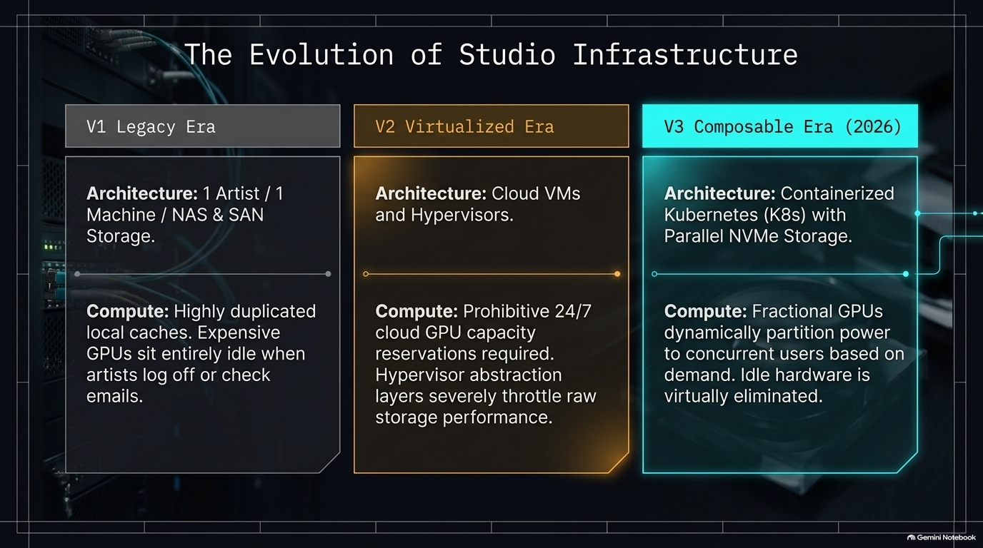
Notes:
Visual Reference: Three-column architectural evolution comparing V1 Legacy Era, V2 Virtualized Era, and V3 Composable Era (2026).
Estimated Speaking Duration: 3–5 minutes
Speaker Notes:
"To understand how we fix this starvation crisis, we have to look at how studio infrastructure has evolved across three distinct eras:
V1 Legacy Era: The classic model of one artist, one machine, and local NAS/SAN storage. It featured highly duplicated local caches, where expensive workstation GPUs sat entirely idle whenever artists logged off to go home or check their email.
V2 Virtualized Era: Studios shifted to cloud VMs and hypervisors. This required prohibitive 24/7 cloud GPU capacity reservations, and the heavy hypervisor abstraction layers severely throttled raw storage performance.
V3 Composable Era (2026): Where we operate today. We utilize containerized Kubernetes with parallel NVMe storage. Compute is handled via Fractional GPUs, which dynamically partition power to concurrent users on demand. Idle hardware is virtually eliminated because compute and storage are fully disaggregated and elastic."

Slide 12
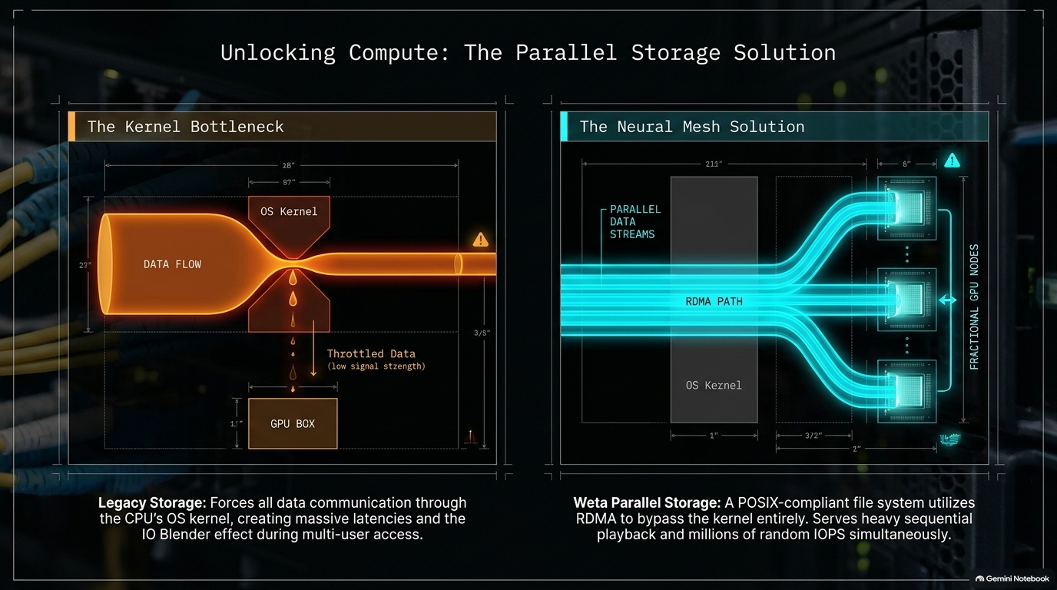
Notes:
Visual Reference: Side-by-side technical diagram contrasting the legacy OS Kernel bottleneck against the Weta Parallel Storage RDMA mesh solution.
Estimated Speaking Duration: 3–5 minutes
Speaker Notes:
"Let's examine the physics of why legacy storage fails and how modern parallel storage solves it.
On the left, The Kernel Bottleneck: Legacy storage forces all data communication straight through the CPU's operating system kernel. When multiple users hit the storage at once, it creates massive latencies and the notorious 'IO Blender' effect, throttling data flow down to a trickle before it ever reaches the GPU box.
On the right, The Neural Mesh Solution (pioneered by advanced facilities like Weta): A POSIX-compliant file system utilizes Remote Direct Memory Access (RDMA) to bypass the OS kernel entirely. Data streams directly from parallel storage straight into GPU memory. This enables heavy sequential playback and millions of random IOPS simultaneously, keeping those expensive GPUs fully fed and active."

Slide 13
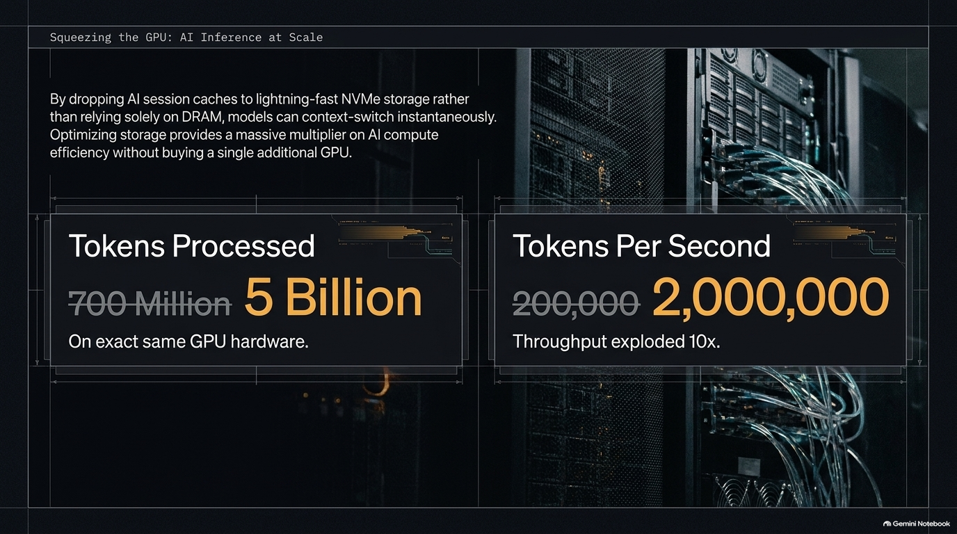
Notes:
Visual Reference: Metrics comparison showing tokens processed exploding from 700 million to 5 billion, and throughput jumping from 200,000 to 2,000,000 tokens per second.
Estimated Speaking Duration: 3–4 minutes
Speaker Notes:
"When you fix your storage layer, the performance multiplier across AI inference is staggering. Look at these production metrics on the screen, achieved on the exact same physical GPU hardware.
By dropping AI session caches onto lightning-fast NVMe parallel storage rather than relying solely on slow DRAM, models can context-switch instantaneously. Look at the results:
Tokens Processed jumped from 700 million to 5 billion.
Tokens Per Second (throughput) exploded tenfold, surging from 200,000 to 2,000,000 tokens per second.
Optimizing your storage layer delivers a massive compute efficiency multiplier without forcing you to purchase a single additional GPU. It's about squeezing every drop of performance out of the hardware you already own."

Slide 14
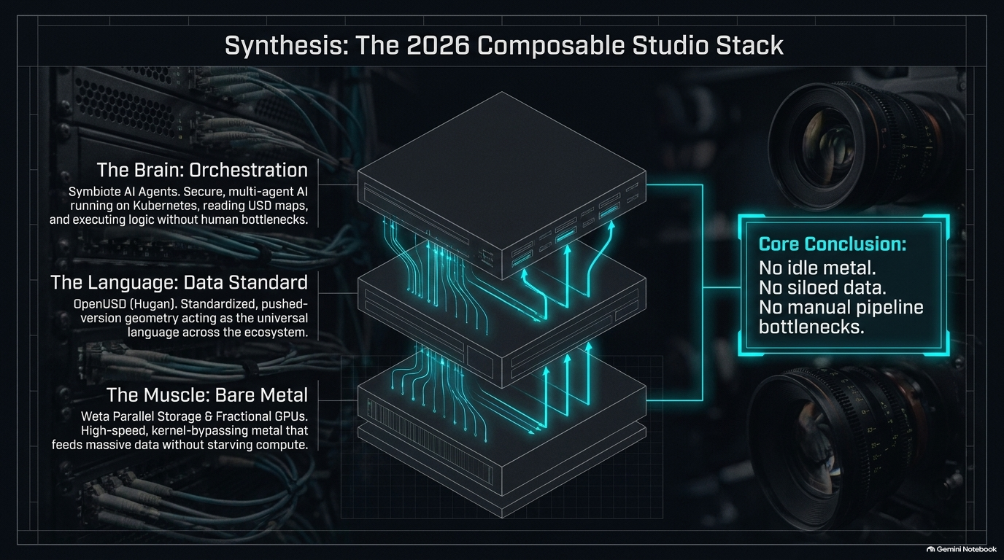
Notes:
Visual Reference: Three-tier architectural stack breakdown (Orchestration, Data Standard, Bare Metal) with core conclusions.
Estimated Speaking Duration: 3–4 minutes
Speaker Notes:
"Let's synthesize everything we've covered into the complete 2026 Composable Studio Stack. The architecture rests on three perfectly synchronized layers:
The Brain (Orchestration): Symbiote AI agents running securely on Kubernetes, reading USD maps, and executing logic without human bottlenecks.
The Language (Data Standard): OpenUSD. Standardized, pushed-version geometry acting as the universal language across the entire studio ecosystem.
The Muscle (Bare Metal): Weta Parallel Storage and Fractional GPUs. High-speed, kernel-bypassing metal that feeds massive data streams without starving compute.
The core conclusion of this entire architecture is simple: No idle metal. No siloed data. No manual pipeline bottlenecks. Everything flows as a unified, intelligent organism."

Slide 15
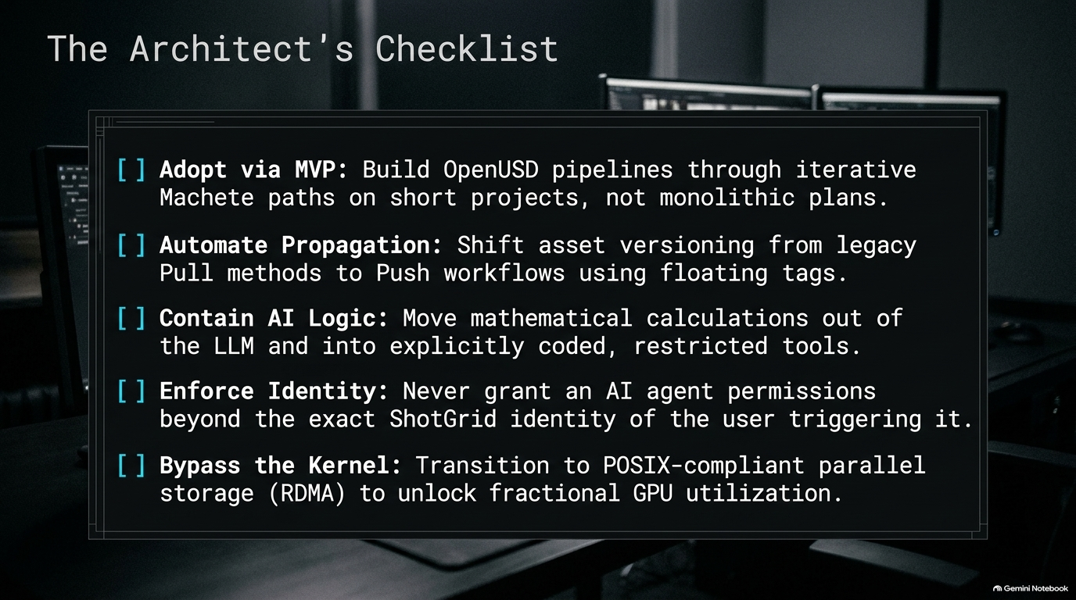
Notes:
Visual Reference: Actionable checklist summarizing MVP adoption, automated propagation, tool containment, identity enforcement, and kernel bypassing.
Estimated Speaking Duration: 3–4 minutes
Speaker Notes:
"As you leave this conference and return to your respective studios, I want you to take this Architect's Checklist with you. Here are your five immediate action items to modernize your pipeline services:
[ ] Adopt via MVP: Build OpenUSD pipelines through iterative machete paths on short projects, not monolithic, multi-year plans.
[ ] Automate Propagation: Shift asset versioning away from legacy pull methods to automated push workflows using floating tags.
[ ] Contain AI Logic: Move complex mathematical calculations and execution out of the LLM and into explicitly coded, restricted tools.
[ ] Enforce Identity: Never grant an AI agent permissions beyond the exact ShotGrid identity and permissions of the user triggering it.
[ ] Bypass the Kernel: Transition to POSIX-compliant parallel storage utilizing RDMA to unlock true fractional GPU utilization.
Tackle these one by one, and your studio will be fully prepared for the demands of modern production."

Slide 16
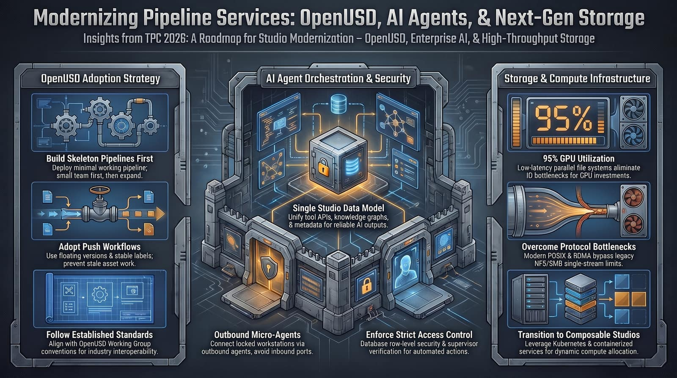
Notes:
Visual Reference: Comprehensive summary dashboard integrating OpenUSD adoption strategy, AI agent orchestration & security, and storage & compute infrastructure.
Estimated Speaking Duration: 3–4 minutes
Speaker Notes:
"To wrap up our session today, this summary dashboard brings together the entire roadmap we've explored from TPC 2026.
Modernizing your pipeline isn't about adopting one shiny tool; it's a triad of transformation:
On the left, we standardize our formats by building skeleton OpenUSD pipelines and enforcing push workflows.
In the center, we govern our AI workloads through secure data models, outbound micro-agents, and strict database access controls.
On the right, we eliminate hardware starvation by modernizing our storage protocols, bypassing the kernel, and moving toward fully composable Kubernetes clusters.
Thank you all for joining us for Day Two of the Pipeline Conference. Be sure to cast your votes for the Pipeline Awards, check out our upcoming sessions, and let's build the next generation of studios together! Have a fantastic rest of the conference!"

