Slide 1

Navigating the 2026 Crosscurrents
Progress, Peril, and the New Systemic Nexus
A strategic synthesis of the Bls Annual Economic Report 2026
Source: https://www.bis.org/publ/arpdf/ar2026e.pdf

Slide 2
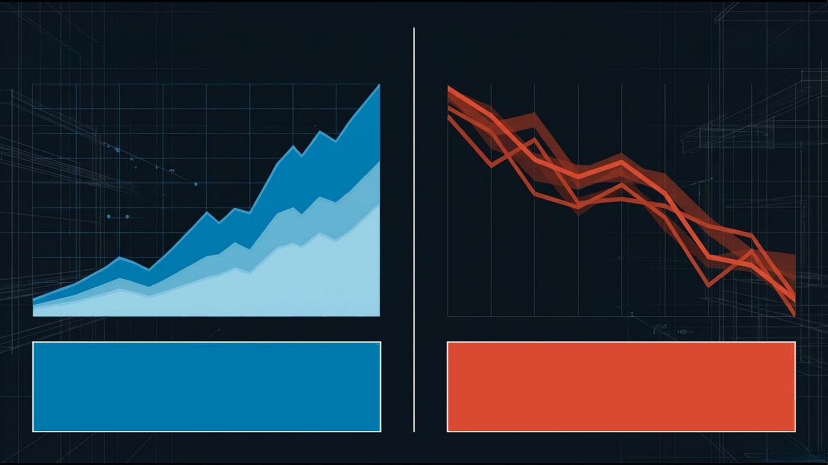
The AI Capital Expenditure Boom
The Strait of Hormuz Energy Shock
Animal spirits driving stock valuations
Synchronized monetary easing
Capital expenditure surging across global supply chains
12-million-barrel-per-day supply shut-in (late Feb 2026)
Surging g input costs for manufacturing and agriculture
Immediate threat of an inflation comeback

Slide 3
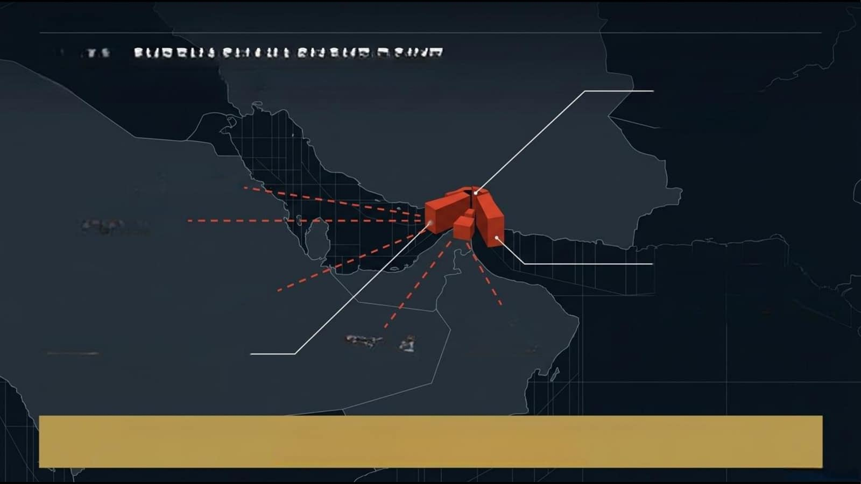
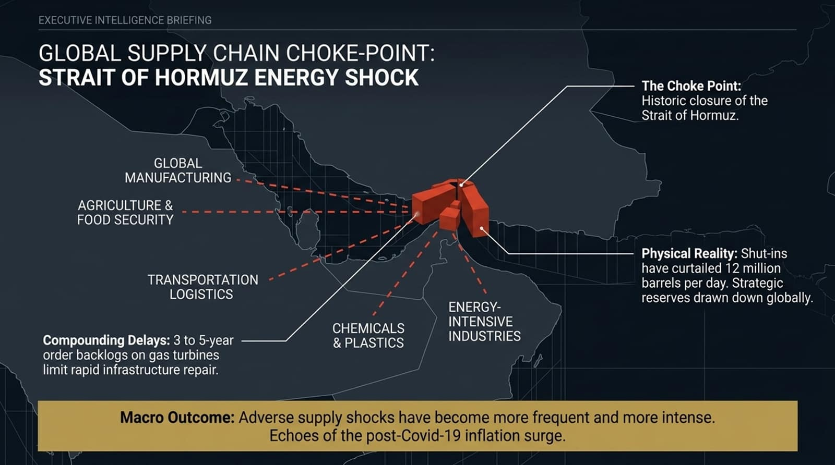
EXECUTIVEINTELLIGENCEBRIEFING
GLOBAL
SUPPLYCHAINCHOKE-POINT:
STRAIT
OF
HORMUZ
ENERGY SHOCK
The Choke Point:
Historic closure of the
Strait of Hormuz.
GLOBAL
MANUFACTURING
AGRICULTURE&
FOODSECURITY
Physical Reality: Shut-ins
have curtailed12 million
TRANSPORTATION
barrels per day. Strategic
LOGISTICS
reserves drawn down globally.
ENERGY-
CHEMICALS
INTENSIVE
Compounding Delays: 3 to 5-year
&PLASTICS
INDUSTRIES
order backlogs on gas turbines
limit rapid infrastructure repair.
Macro Outcome: Adverse supply shocks have become more frequent and more intense.
Echoes of the post-Covid-19 inflation surge.

Slide 4
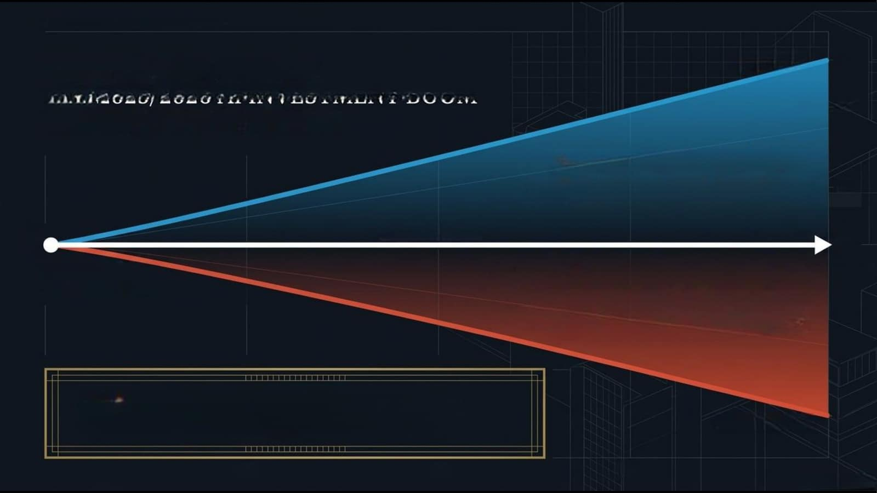
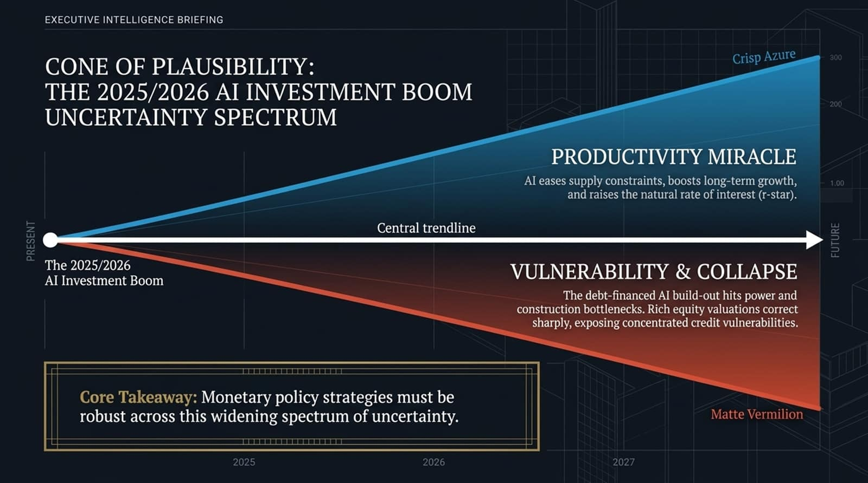
EXECUTIVEINTELLIGENCEBRIEFING
CONE
OF
PLAUSIBILITY:
Crisp Azure
300
THE
2025/2026.ALINVESTMENTBOOM
UNCERTAINTY
SPECTRUM
200
PRODUCTIVITYMIRACLE
AI eases supply constraints, boosts long-term growth,
1.00
and raises the natural rate of interest (r-star.
Central trendline
PRESENT
FUTURE
The 2025/2026
VULNERABILITY& COLLAPSE
AI Investment Boom
The debt-financed AI build-out hits power and
construction bottlenecks. Rich equity
valuationscorrect
sharply, exposing concentrated credit
vulnerabilities.
Core Takeaway: Monetary policy strategies must be
robust across this widening spectrum of uncertainty.
Matte Vermilion
2025
2026
2027

Slide 5
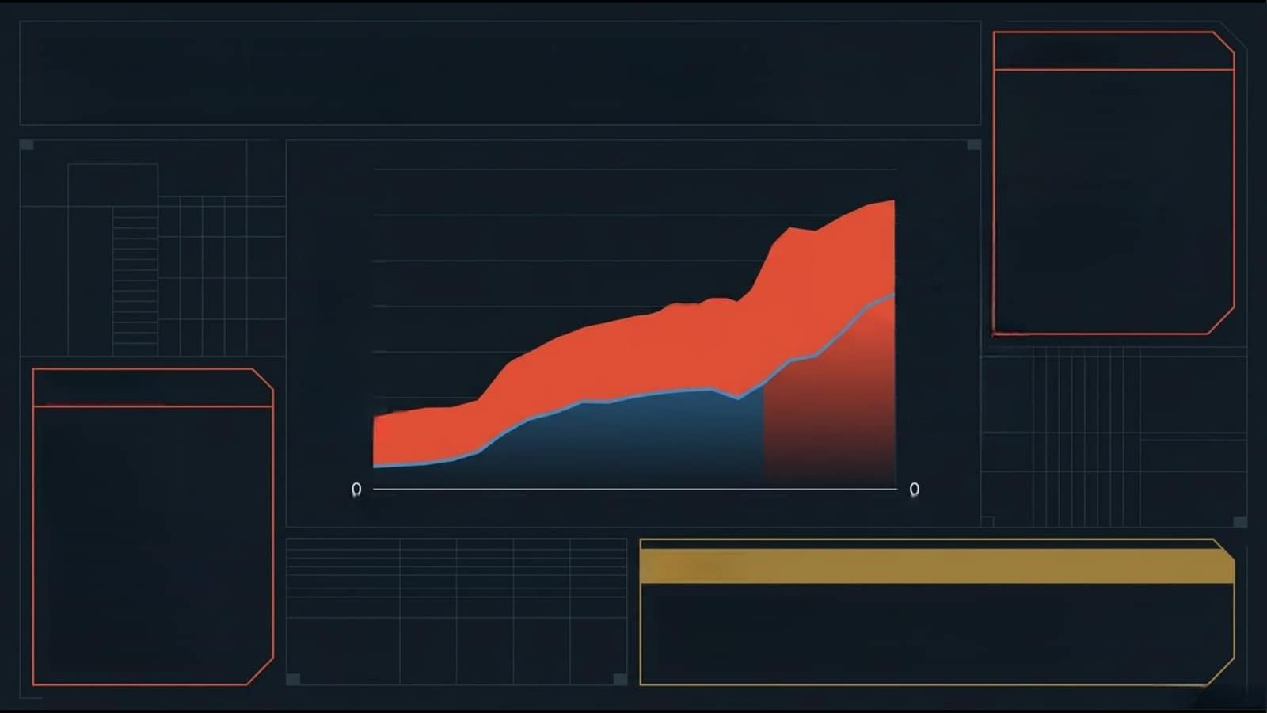
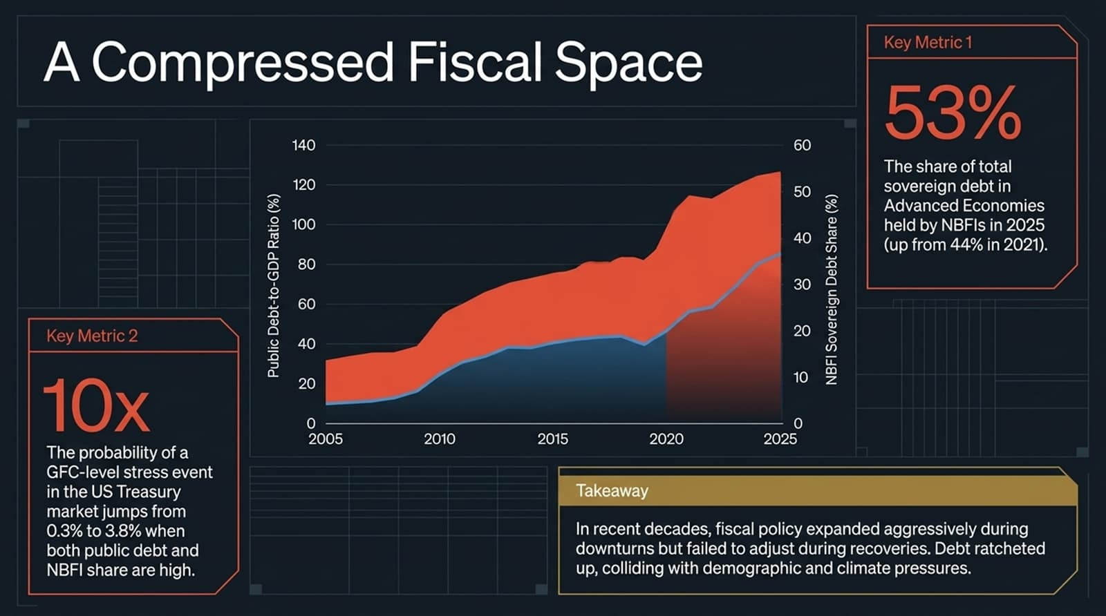
A Compressed Fiscal Space
Key Metric 1
53%
140
09
The share of total
120
50
sovereign debt in
Advanced Economies
100
40
held by NBFIs in 2025
(up from 44% in 2021).
80
Public Debt-to-GDP Ratio (%)
30
09
NBFI Sovereign Debt Share(%)
Key Metric 2
20
40
10x
20
10
2005
2010
2015
2020
2025
The probability of a
GFC-level stressevent
in the US Treasury
Takeaway
market jumps from
0.3% to 3.8% when
In recent decades,fiscal policy expanded aggressively during
both public debt and
downturns but failed to adjust during recoveries.Debt ratcheted
NBFI share are high.
up, colliding with demographic and climate pressures.

Slide 6
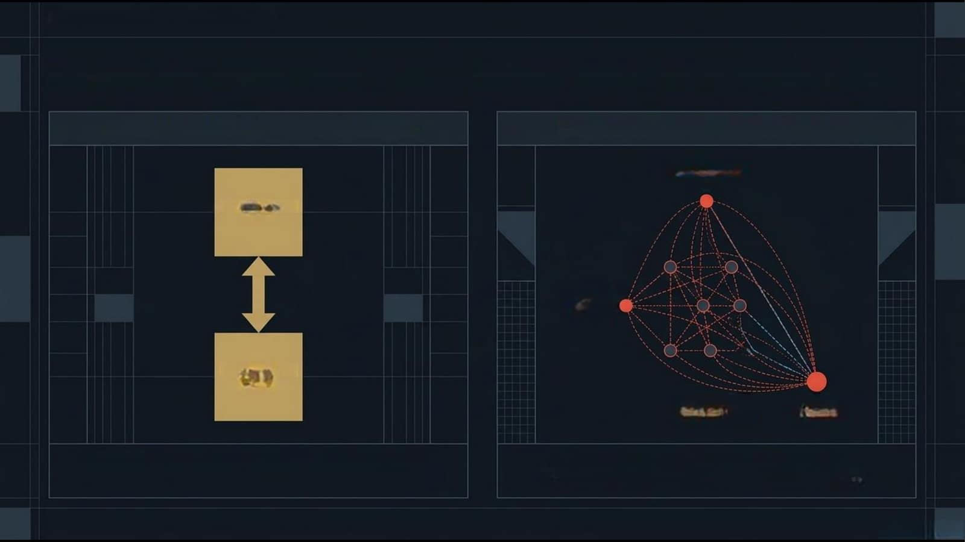
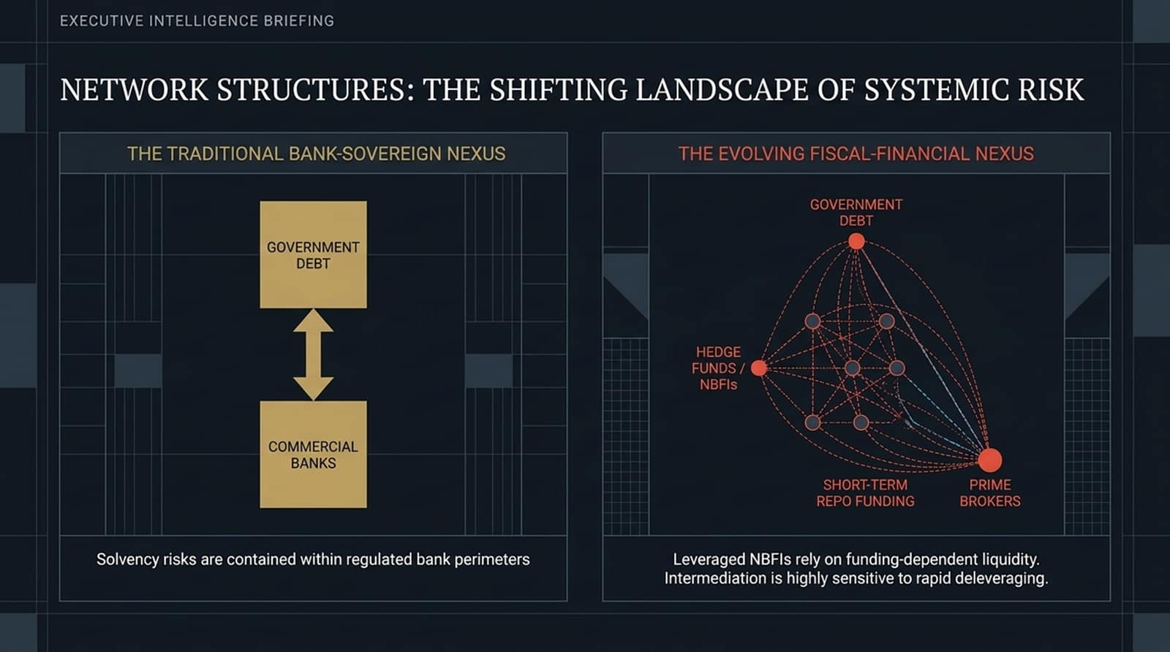
EXECUTIVE INTELLIGENCEBRIEFING
NETWORK STRUCTURES: THESHIFTING LANDSCAPEOF SYSTEMIC RISK
THE TRADITIONAL BANK-SOVEREIGN NEXUS
THE EVOLVINGFISCAL-FINANCIAL NEXUS
GOVERNMENT
DEBT
GOVERNMENT
DEBT
HEDGE
FUNDS/
NBFIs
COMMERCIAL
BANKS
SHORT-TERM
PRIME
REPOFUNDING
BROKERS
Solvency risks are contained within regulated bank perimeters
Leveraged NBFls rely on funding-dependent liquidity.
Intermediation is highlysensitive to rapid deleveraging

Slide 7
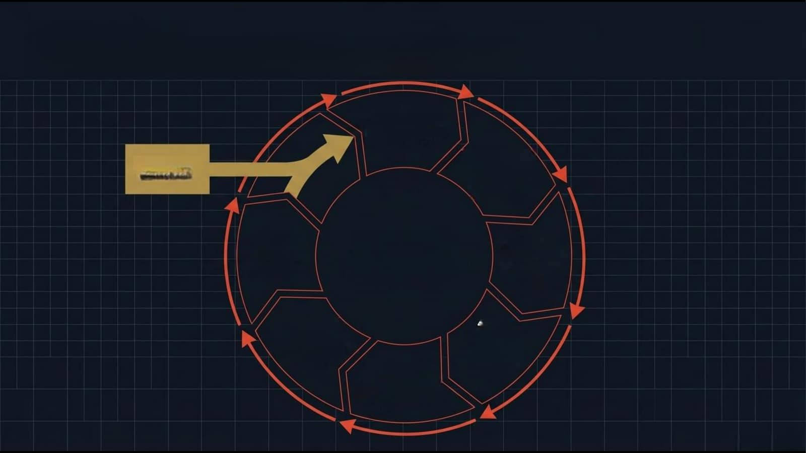
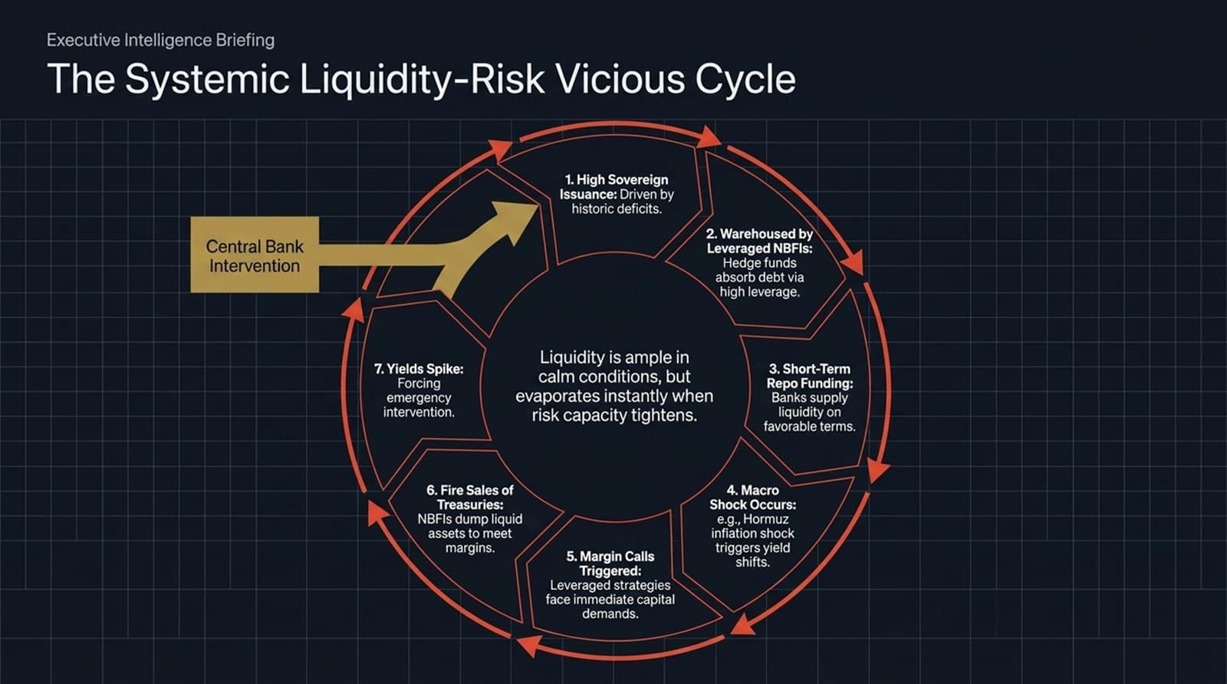
Executive Intelligence Briefing
The Systemic Liquidity-Risk Vicious Cycle
1. High Sovereign
Issuance: Driven by
historic deficits.
Central Bank
2. Warehoused by
Leveraged NBFIs:
Intervention
Hedge funds
absorb debt via
high leverage.
7. Yields Spike:
Liquidity is ample in
3.
Short-Term
Forcing
calm conditions,but
Repo Funding:
emergency
evaporates instantly when
Banks supply
intervention.
risk capacity tightens.
liquidity
on
favorable
terms.
6.Fire Sales of
Macro
Treasuries:
Shock
Occurs:
NBFIs dump liquid
e.g.,
Hormuz
assets to meet
infiation
shock
margins.
5.Margin Calls
triggers
yield
Triggered:
shifts.
Leveraged strategies
face immediate capital
demands.

Slide 8
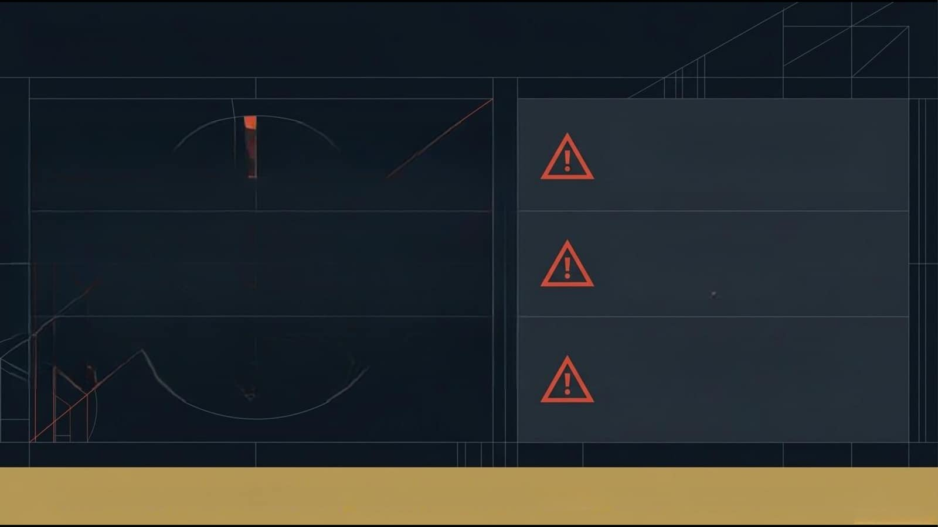
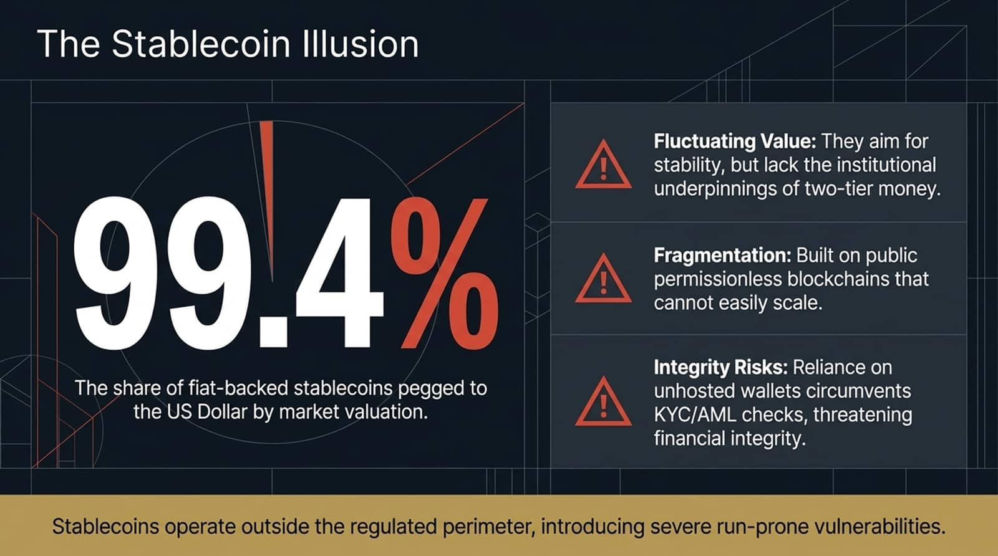
The Stablecoin Ilusion
Fluctuating Value: They aim for
stability, but lack the institutional
underpinnings of two-tiermoney.
99.4%
Fragmentation: Built on public
permissionless blockchains that
cannot easily scale.
Integrity Risks: Reliance on
The share of fiat-backed stablecoins pegged to
unhosted walletscircumvents
the US Dollar by market valuation.
KYC/AMLchecks,threatening
financial integrity.
Stablecoinsoperateoutsidetheregulatedperimeterintroducing severerun-prone vulnerabilities.

Slide 9
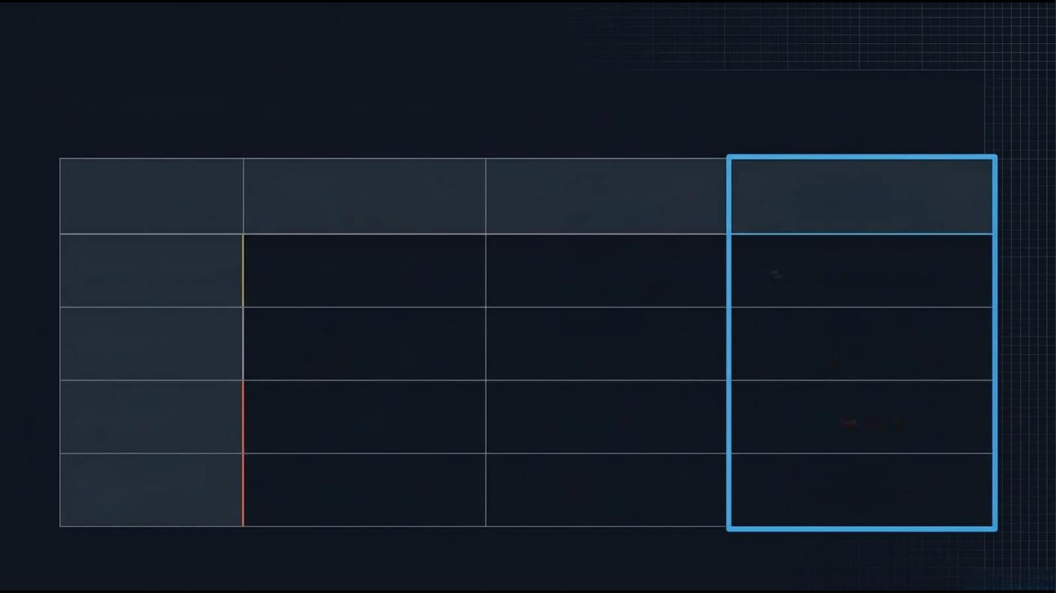
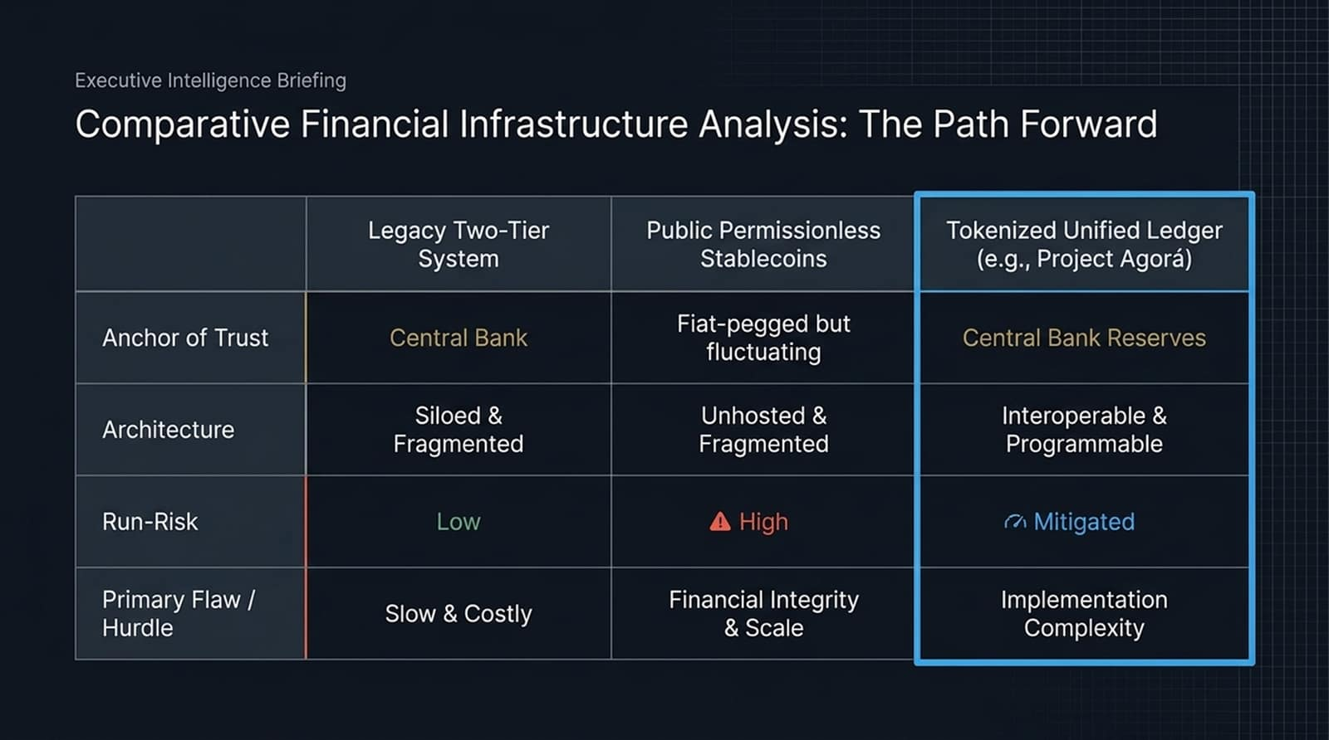
Executive Intelligence Briefing
Comparative Financial Infrastructure Analysis: The Path Forward
Legacy Two-Tier
Public Permissionless
Tokenized Unified Ledger
System
Stablecoins
(e.g., Project Agorá)
Anchor of Trust
Central Bank
Fiat-peggedbut
Central Bank Reserves
fluctuating
Architecture
Siloed &
Unhosted &
Interoperable &
Fragmented
Fragmented
Programmable
Run-Risk
Low
A High
Mitigated
Primary Flaw /
Slow& Costly
Financial Integrity
Implementation
Hurdle
& Scale
Complexity

Slide 10
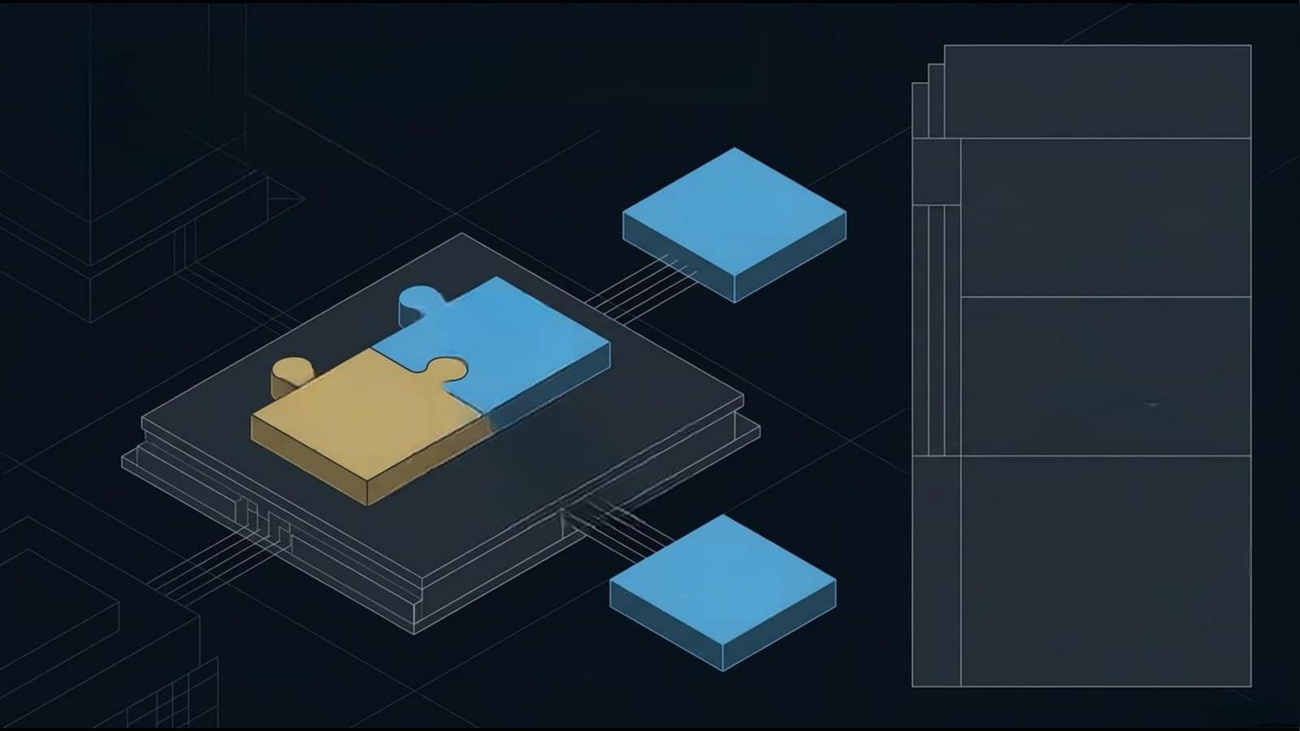
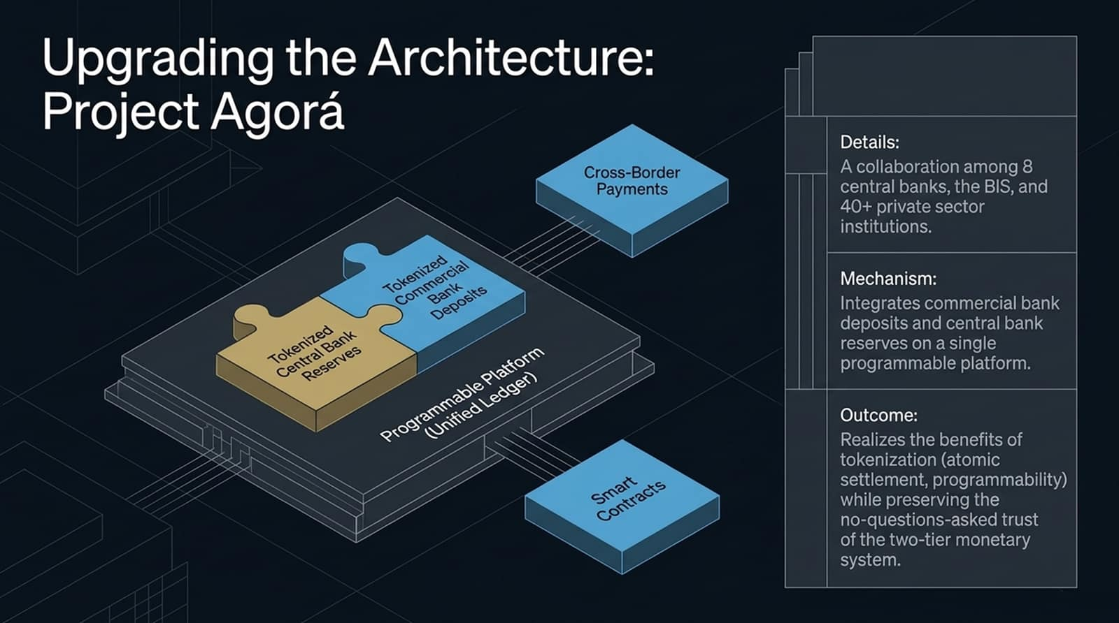
Upgrading
g the Architecture:
Project
Agorá
Details:
Cross-Border
Acollaboration among 8
Payments
central banks,the BiS,and
40+ private sector
institutions.
Tokenized
Mechanism:
Commercial
Bank
Integrates commercial bank
Deposits
deposits and central bank
Tokenized
reserves on a single
Central Bank
programmable platform.
Reserves
ProgrammablePlatform
(Unified Ledger)
Outcome:
Realizes the benefits of
tokenization(atomic
Smart
settlement,programmability)
Contracts
while preserving the
no-questions-asked trust
of the two-tier monetary
system.

Slide 11
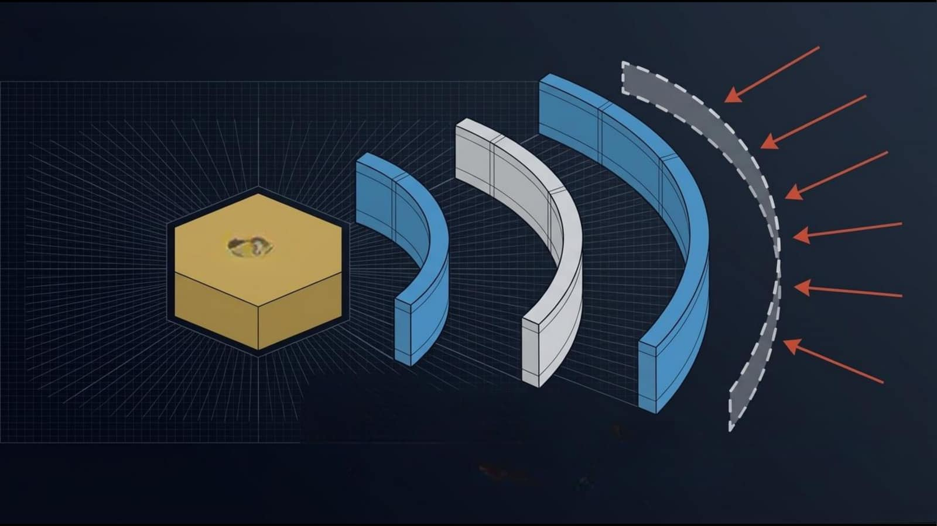
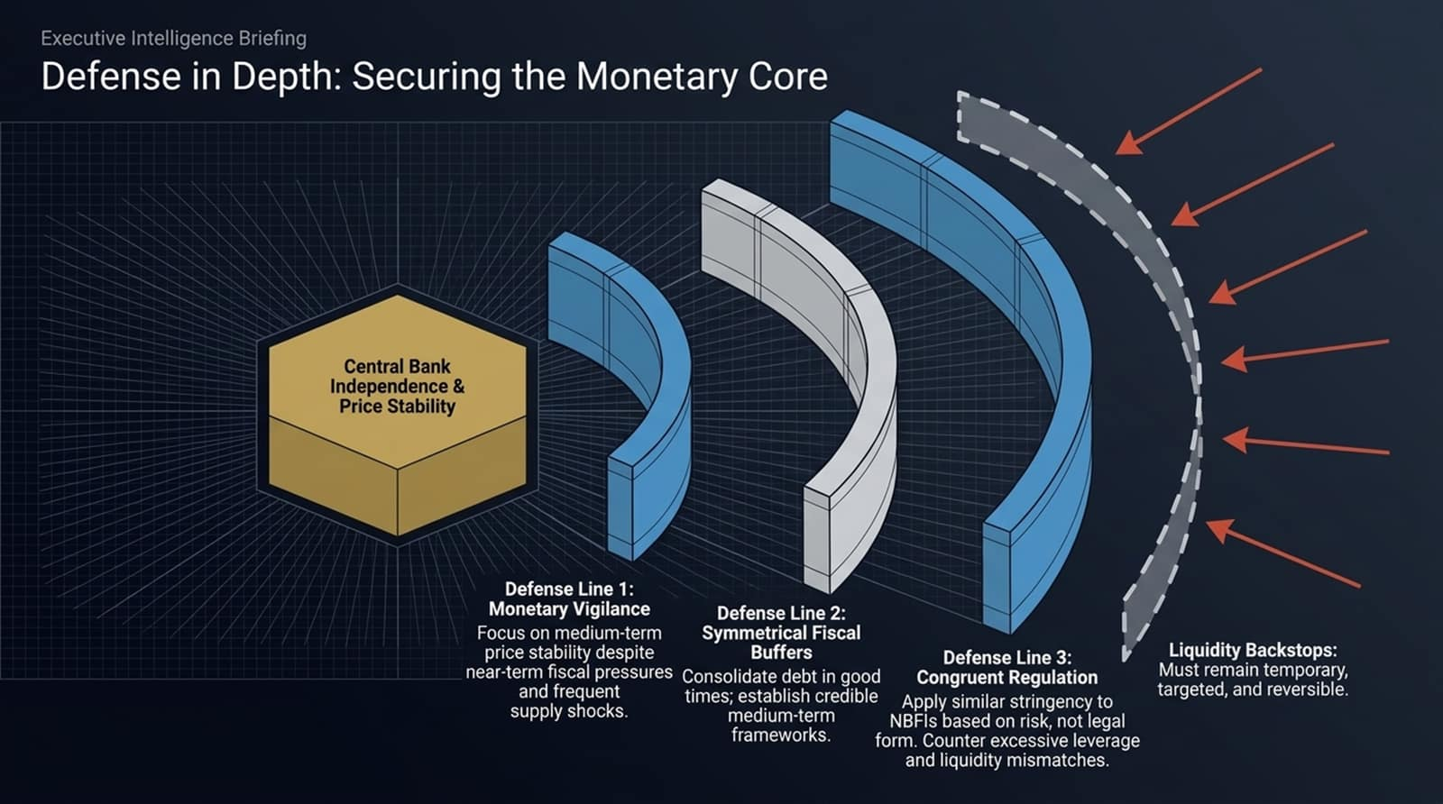
Executive Intelligence Briefing
Defense in Depth: Securing the Monetary Core
Central Bank
Independence&
Price Stability
Defense Line 1:
Monetary Vigilance
Defense Line2:
Focus
on
medium-term
Symmetrical Fiscal
price
stability despite
Buffers
Defense
eLine3:
Liquidity Backstops:
near-term
fiscalp
pressures Consolidate debt in good
Congruent
Regulation
Must remain temporary,
and frequent
times; establish credible
Apply
similar
rstringencyto
targeted, and reversible.
supply
shocks.
medium-term
NBFIs
based
on risk,not legal
frameworks.
form.
Counter
excessive leverage
andI
liquidity
mismatches.

Slide 12
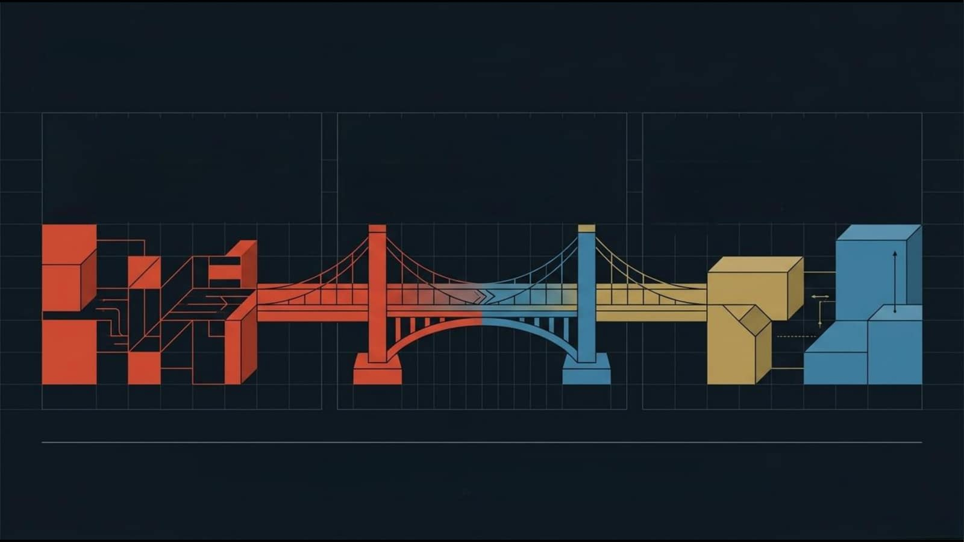
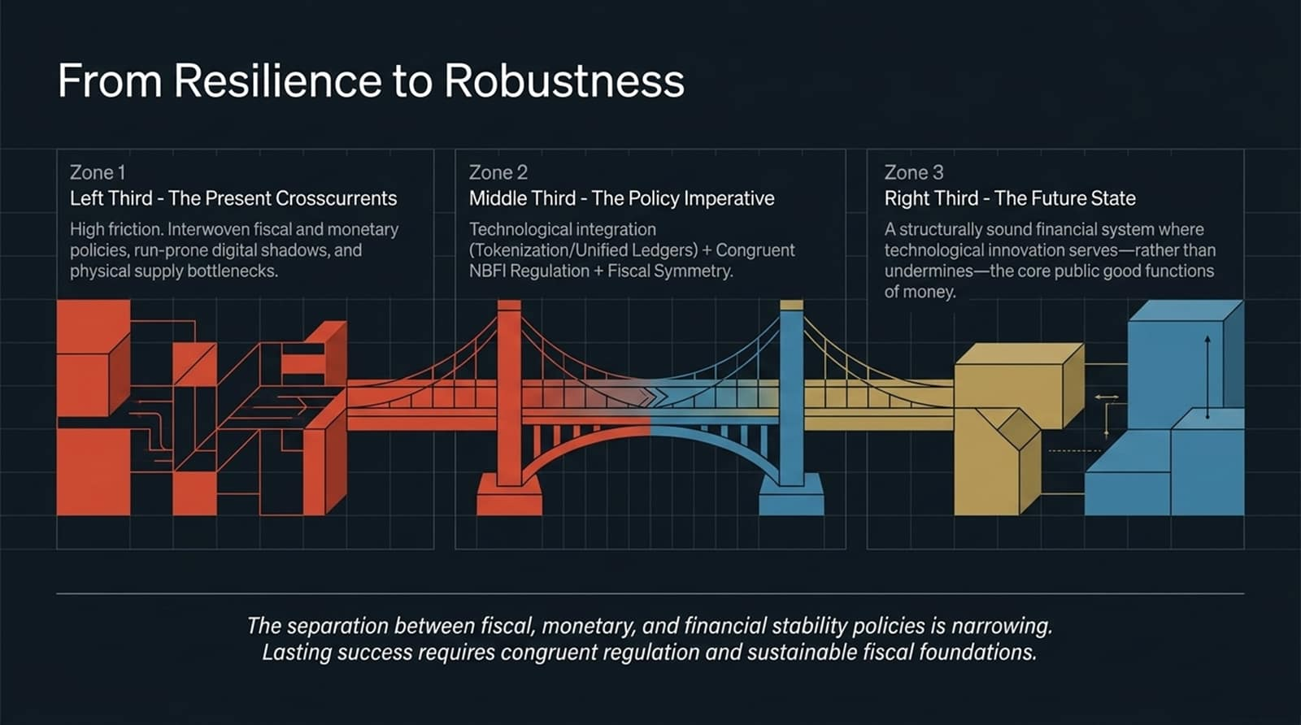
From Resilience to Robustness
Zone1
Zone2
Zone 3
Left Third - The Present Crosscurrents
MiddleThird-ThePolicyImperative
Right Third - The Future State
High friction. Interwoven fiscal and monetary
Technological integration
A structurally sound financial system where
policies,run-prone digital shadows,and
(Tokenization/UnifiedLedgers)+Congruent
technological innovation serves—rather than
physical supply bottlenecks.
NBFIRegulation+Fiscal Symmetry
undermines—the core public good functions
of money.
The separation betwenfiscal,monetary,andinancialstabilitypoliciesis narrowing.
Lasting successrequirescongruentregulationand sustainablefiscal foundations.

Slide 13
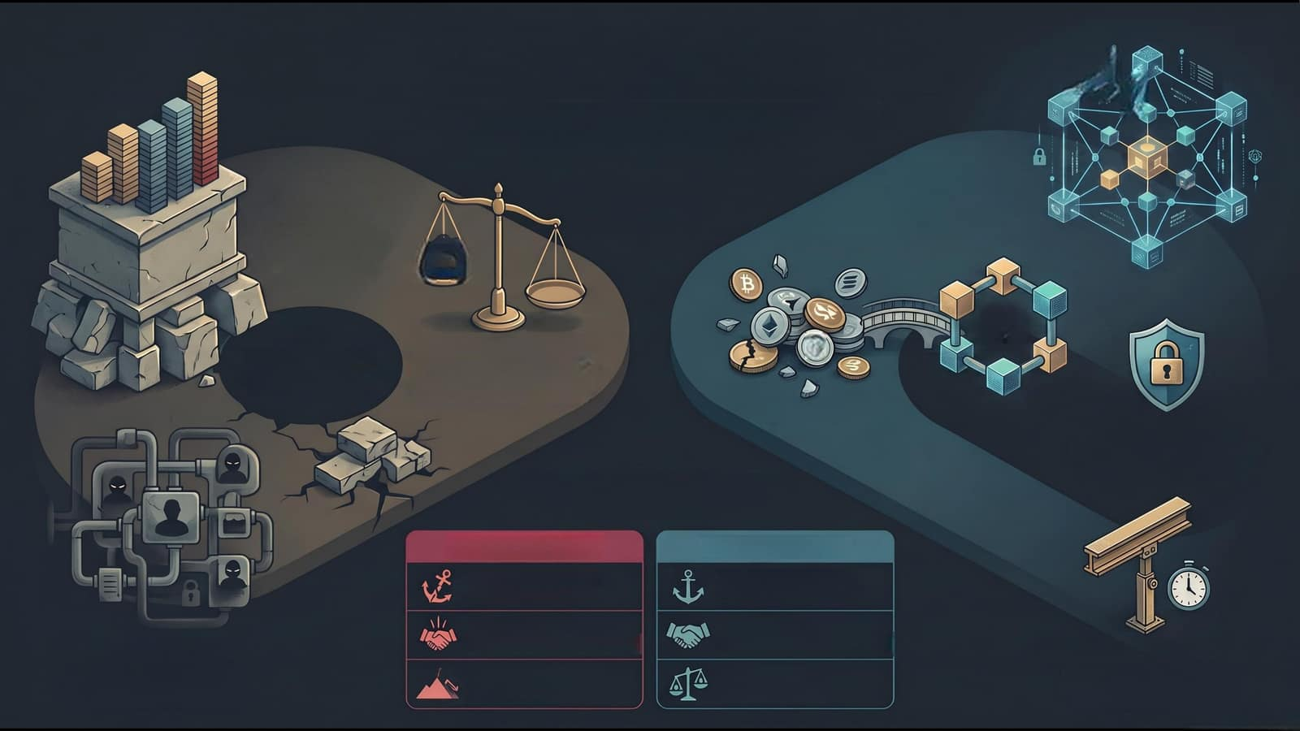
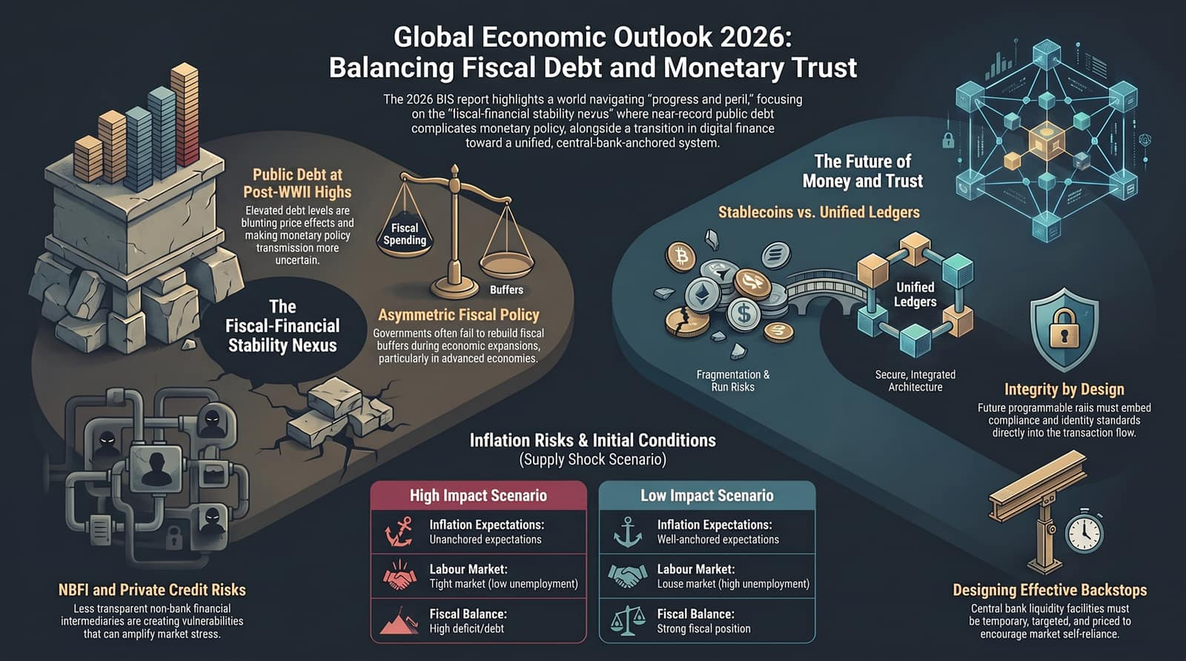
GlobalE
Economic Outlook 2026:
li
Balancing
Fiscal Debt and Monetary
Trust
The
2026
BIS
reporthighlightsaworldnaviatingprogressand peril,"focusing
on
the"fiscal-financial stabilitynevus"wherenear-record
dpublicdebt
complicatesmonetarypolicyalongsideatransitionindiitalfinance
toward a unified, central-bank-anchored system.
Public
The Future of
Debt
at
Money and Trust
Post-WWIl
Highs
Elevated
debt
levels
are
Stablecoins vs. Unified Ledgers
blunting price
effects
and
Fiscal
making monetary
policy
Spending
transmission
more
uncertain.
Buffers
Unified
The
Asymmetric
Fiscal
Policy
$
Ledgers
Fiscal-Financial
Governments
often
fail
to
rebuild
fiscal
Stability Nexus
buffers
during
economic
expansions,
particularly
in
advanced
economies.
Fragmentation &
Secure, Integrated
Run Risks
Architecture
Integrity by Design
Future programmable raiismustembed
compliance and identity standards
Inflation Risks & Initial Conditions
directlyintothetransactionflow.
(Supply Shock Scenario)
High Impact Scenario
Low Impact Scenario
Inflation Expectations:
Inflation Expectations:
Unanchored expectations
Well-anchored expectations
Labour Market:
Labour Market:
NBFI and Private Credit Risks
Tightmarket(lowunemployment)
Louse market (high unemployment)
Designing Effective Backstops
Less transparent non-bank financial
Fiscal Balance:
Fiscal Balance:
Central bank liquidityfacilitiesmust
intermediaries are creating vulnerabilities
High deficit/debt
Strong fiscal position
be temporary, targeted, and priced to
that can amplify market stress.
encourage market self-reliance.

