Slide 1

Notes:
Target Delivery Time: 3:00 – 4:00 minutes
Key Talking Points & Concepts
Performance Benchmark: Back-to-back victories in the World Trading Championship ($1M Real Money Division) with 350% return in 2024 and >250% return in 2025.
Philosophy of Asymmetry: Moving away from guessing market directions to engineering mathematical asymmetry.
Data-Driven Evolution: Edge built on auditing thousands of logged trades, psychological self-audits, and multi-AI cross-examination workflows.
Speaker Script
"Welcome, everyone. Today, we are opening the playbook to 16 years of hard-earned, professional trading knowledge—distilled from back-to-back World Trading Championship victories in the $1 Million Real Money Division.
When people look at returns like 350% in 2024 and over 250% in 2025, the common assumption is that it requires high-risk gambling or predicting every minor market turn. The reality is radically different. As Jay Law emphasizes, world-class trading is not about being right 90% of the time; it’s about the mathematical asymmetry of your returns when you are right, coupled with strict capital protection.
Over the next hour, we are going to break down how to blend technical precision with macroeconomic context, how to engineer personal rules that bypass human emotional flaws, and how to harness cutting-edge AI workflows to gain an unshakeable conviction in your open positions. Let’s dive in."
16 Years Of Professional Trading Knowledge In Under 60 Minutes (2X World Trading Champion)
https://www.youtube.com/watch?v=1NhqL2i5WkM

Slide 2
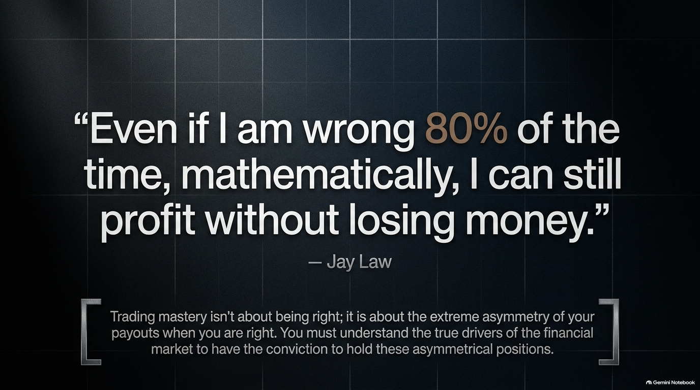
Notes:
Target Delivery Time: 3:30 – 5:00 minutes
Key Talking Points & Concepts
The Asymmetry Axiom: "Even if I am wrong 80% of the time, mathematically, I can still profit without losing money."
Conviction vs. Forecast: You do not need high accuracy if your reward-to-risk ratio is $4:1$ or $5:1$.
True Market Drivers: Real holding conviction comes from knowing the underlying macro catalyst driving price, not just drawing lines on a chart.
Speaker Script
"Let’s start with a quote from Jay Law that completely flips retail trading wisdom on its head: 'Even if I am wrong 80% of the time, mathematically, I can still profit without losing money.'
Most retail traders spend years hunting for a 'holy grail' setup with an 80% or 90% win rate. Champion-level traders focus entirely on payout asymmetry. If your average winning trade generates 4 to 5 times the risk you take, your win rate can drop to 20% or 30%, and you will still generate massive, steady portfolio growth over time.
But here is the catch: to capture a 5x reward, you have to hold positions through normal market noise and temporary pullbacks. And as Jay points out, if you don't understand the real macroeconomic and thematic drivers behind why a stock is moving, you will lack the conviction to sit on your hands and hold those asymmetric positions to their full potential."

Slide 3
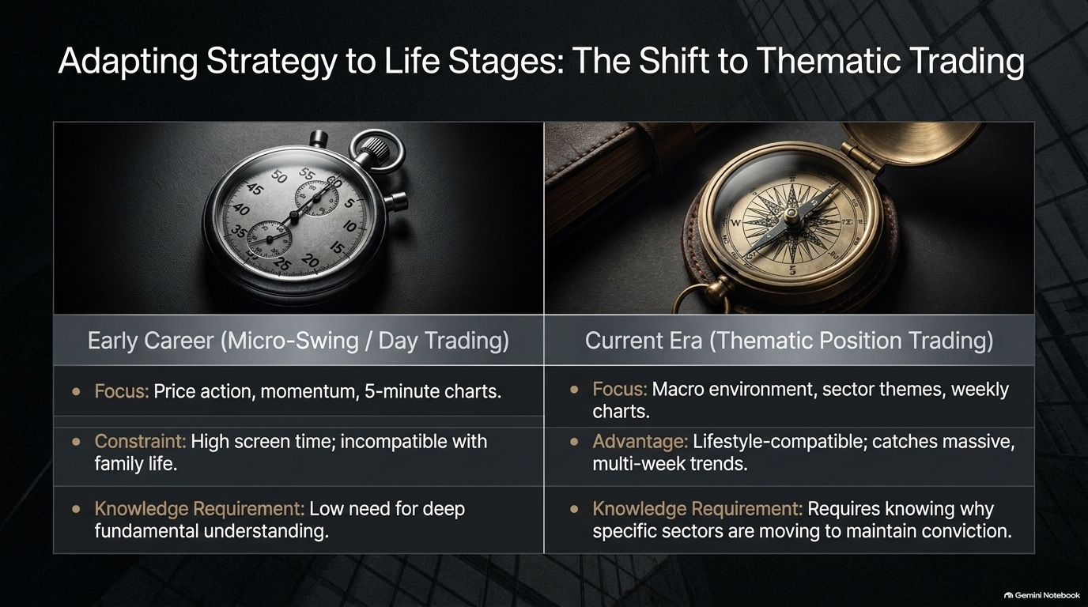
Notes:
Target Delivery Time: 4:00 – 5:30 minutes
Key Talking Points & Concepts
Evolution of a Trader: Transitioning from early-career micro-swing/day trading (5-minute charts) to thematic position trading (weekly charts).
Life-Stage Alignment: Adapting time horizons to lifestyle constraints (e.g., family commitments, children).
Depth of Knowledge Shift: Day trading requires fast reaction to price action; position trading requires deep comprehension of macro sector themes.
Speaker Script
"Slide 3 addresses an vital factor that almost no trading book discusses: strategy longevity relative to your life stage.
In his early career, Jay was a high-frequency day trader and short-term swinger staring at 5-minute charts. Day trading demands intense screen time, rapid order execution, and constant psychological energy. It doesn't require deep fundamental research, but it is deeply exhausting and incompatible with family life once you have children.
As Jay transitioned in his career, he evolved his style into Thematic Position Trading using higher-timeframe structures. Instead of glued-to-the-screen scalping, he shifted to identifying macro sector trends on weekly charts. The trade-off? You must understand why specific sectors are moving to maintain conviction across multi-week trends. Your trading style must complement your lifestyle—not destroy it."

Slide 4
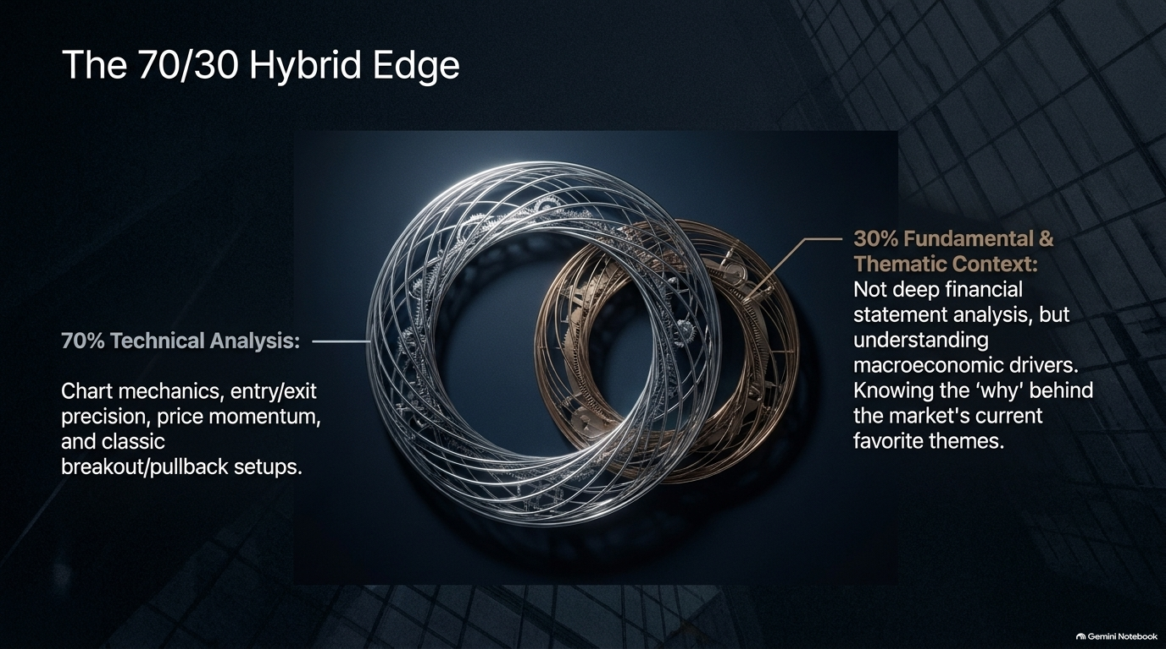
Notes:
Target Delivery Time: 3:30 – 5:00 minutes
Key Talking Points & Concepts
70% Technical Analysis: Precise entry/exit mechanics, chart structures, price momentum, breakout/pullback setups.
30% Fundamental & Thematic Context: Not deep balance sheet auditing, but recognizing macroeconomic drivers and market narratives.
Symbiosis: Technicals tell you when and where to buy; fundamentals and themes tell you why and how long to hold.
Speaker Script
"This slide illustrates Jay's exact formula: The 70/30 Hybrid Edge.
70% of the framework relies on classical Technical Analysis. Charts are the universal language of price momentum, entry timing, and stop placement whether you look at a 5-minute chart or a weekly chart. Technicals give you execution precision.
However, technicals alone often result in getting chopped up during extended moves. The remaining 30% is Fundamental & Thematic Context. Jay explicitly notes that this does NOT mean reading 100-page corporate financial reports or DCF valuation models. It means grasping the 'market narrative'—understanding why capital is flowing into a specific sector right now. When a tight technical breakout aligns with a hot market theme, you have the ultimate high-probability setup."

Slide 5
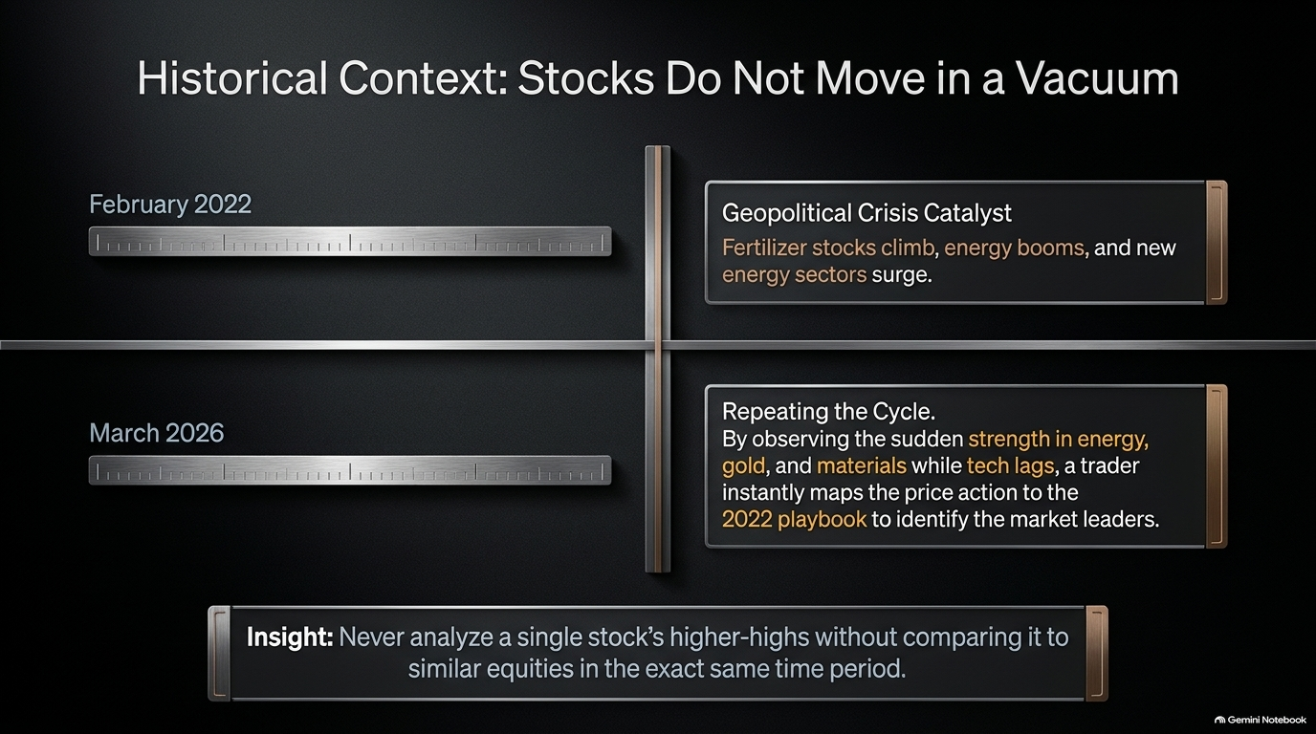
Notes:
Target Delivery Time: 4:30 – 6:00 minutes
Key Talking Points & Concepts
Macro Pattern Recognition: Markets repeat structural behavior across cycles.
2022 vs. 2026 Comparison: Comparing the February 2022 geopolitical shock (Russia-Ukraine war driving fertilizer, energy, materials) to March 2026 market behaviors.
Relative Strength Context: Never analyze a stock in isolation; evaluate it relative to broader index behavior and sector peers.
Speaker Script
"One of Jay Law’s most profound insights is that stocks do not move in a vacuum.
When analyzing market leaders, amateurs just look at an individual stock chart making higher highs. Champions compare that stock to its sector peers and the broader market context. For instance, looking back at February 2022 when the Russia-Ukraine war broke out, fertilizer stocks, traditional oil, and clean energy surged while technology stocks struggled.
Fast forward to March 2026: when we see tech lagging while energy, gold, and materials suddenly break out on strong relative volume, a trained trader immediately references the 2022 historical playbook. By placing individual stock action within broader historical macro cycles, you instantly recognize which sectors are accumulating institutional capital."

Slide 6
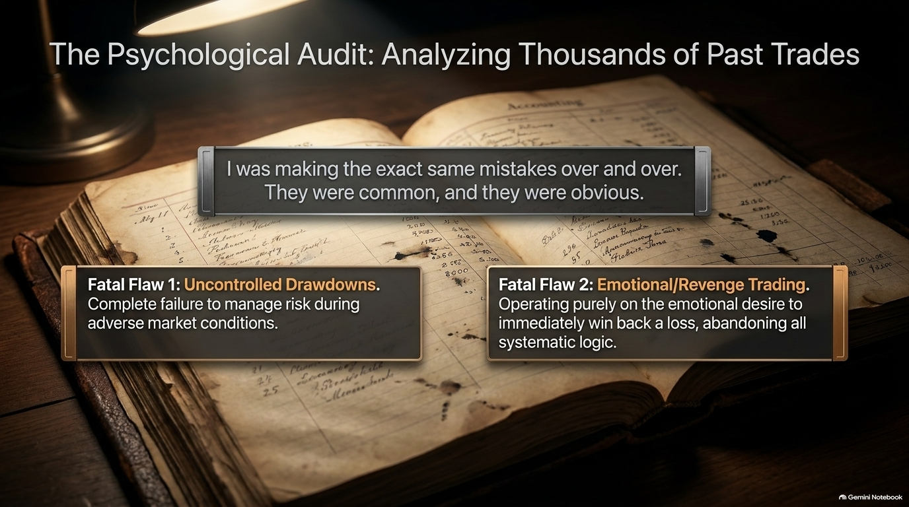
Notes:
Target Delivery Time: 4:00 – 5:30 minutes
Key Talking Points & Concepts
Self-Audit Methodology: Logged and audited over 1,000 personal trades to identify systemic errors.
Fatal Flaw 1 – Uncontrolled Drawdowns: Allowing small losses to compound due to poor stop management or holding losing trades.
Fatal Flaw 2 – Emotional/Revenge Trading: Trading on the desire to immediately win back lost capital rather than executing systematic edge.
Speaker Script
"Before Jay Law became a two-time world champion, he struggled for years. How did he unlock consistent performance? Through a brutal psychological audit of over 1,000 of his own past trades.
What he discovered was shocking: he wasn't making complex technical errors. He was making the exact same simple, obvious mistakes repeatedly. They boiled down to two primary fatal flaws:
Uncontrolled Drawdowns: Failing to cut losses quickly during adverse market conditions.
Emotional/Revenge Trading: Trying to win back losses immediately on tilt, abandoning rational analysis.
Recognizing that human flaws cannot be cured by willpower alone was his turning point. He realized he needed external, structural rules to protect him from his own psychology."

Slide 7
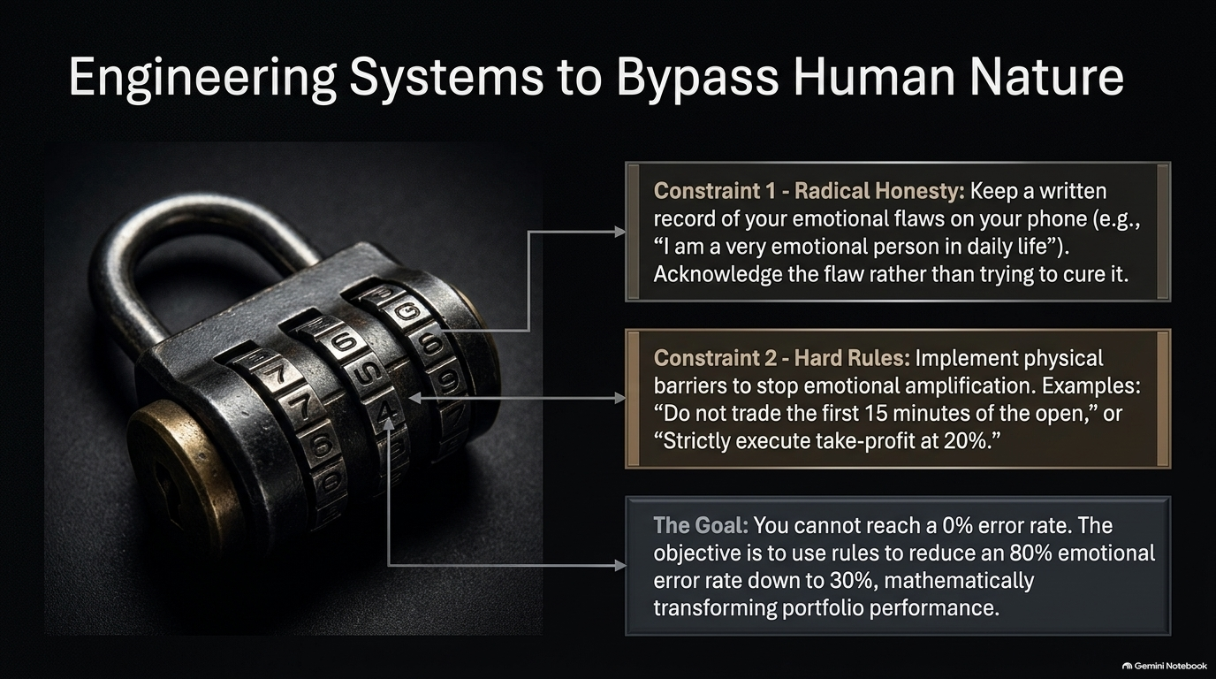
Notes:
Target Delivery Time: 4:00 – 5:30 minutes
Key Talking Points & Concepts
Constraint 1 – Radical Honesty: Keeping explicit mobile notes acknowledging core emotional traits (e.g., "I am a very emotional person in daily life").
Constraint 2 – Hard Rules: Establishing physical barriers (e.g., no trading in the first 15 minutes of market open, taking partial profits strictly at 20%).
The Error Reduction Goal: Lowering an 80% human error frequency down to 20-30% transforms account results.
Speaker Script
"You cannot eliminate human emotion from trading, but you can build rules that bypass it.
On his phone, Jay keeps a note that begins with radical honesty: 'I am a very emotional person in daily life.' Rather than pretending to be an emotionless robot, he accepts his nature and engineers hard operational constraints to protect his portfolio:
Time Guardrails: For example, refraining from entering trades during the chaotic first 15 minutes of the market open.
Profit Lock Rules: Enforcing systematic partial profit-taking when a position hits a 20% gain.
The goal is not a 0% error rate. If you can reduce your emotional mistakes from 80% down to 30%, the mathematical impact on your portfolio compounding will be dramatic."

Slide 8
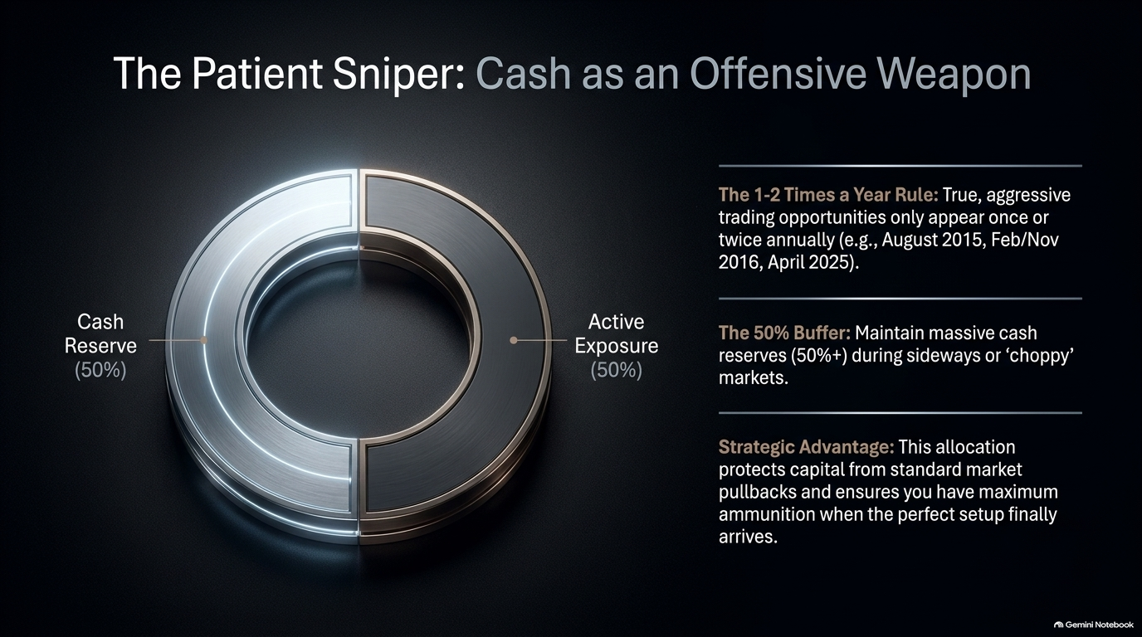
Notes:
Target Delivery Time: 4:30 – 6:00 minutes
Key Talking Points & Concepts
The 1-2 Times a Year Rule: Prime, high-conviction trading windows occur rarely (e.g., August 2015, Feb/Nov 2016, April 2025).
The 50%+ Cash Buffer: Maintaining 50%+ cash reserves during sideways or choppy market environments.
Offensive Ammunition: Cash is not passive; holding cash keeps you solvent and capitalized to strike aggressively when true market pivots occur.
Speaker Script
"Most traders suffer from an obsession with being 100% invested at all times. On Slide 8, we explore Jay Law’s concept of Cash as an Offensive Weapon.
In real markets, aggressive, high-probability window opportunities only appear once or twice a year. Jay points to historical windows like August 2015, November 2016, or April 2025. During choppy, range-bound periods (like 8 months of 2015), over-trading destroys account capital through endless paper cuts.
Jay regularly keeps 50% or more of his portfolio in cash during off-peak market environments. This cash buffer acts as a shield against drawdowns and ensures that when a major thematic market pivot arrives, he has maximum liquid ammunition to go all-in with aggressive position size."

Slide 9
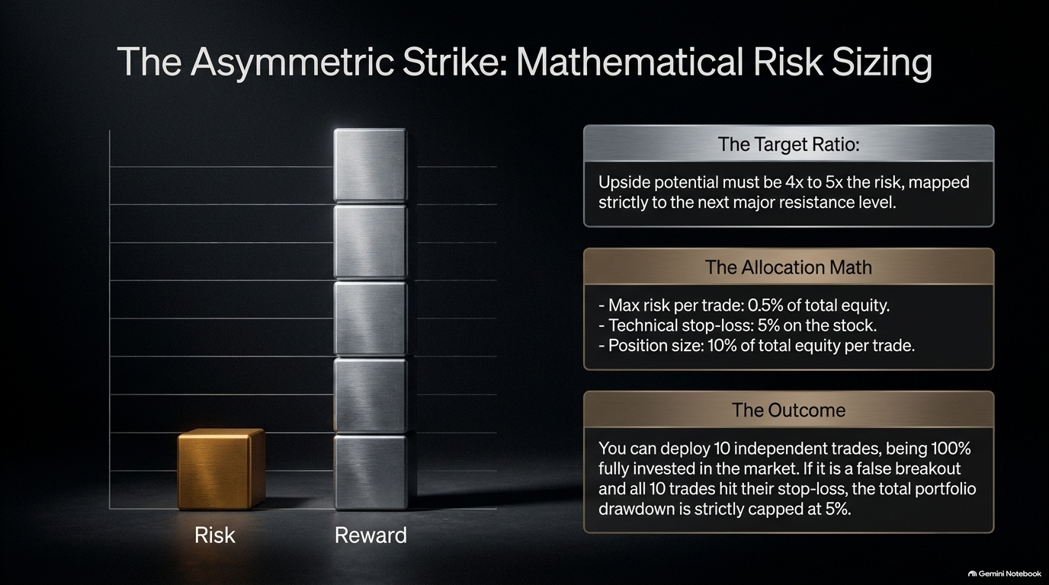
Notes:
Target Delivery Time: 4:30 – 6:00 minutes
Key Talking Points & Concepts
Target Reward-to-Risk: Potential profit must reach $4x$ to $5x$ the risk, mapped to clear resistance levels.
The Risk Sizing Math: Max 0.5% account equity risk per trade; 5% technical stop-loss on stock = 10% portfolio position allocation.
Total Portfolio Insulation: Deploying 10 simultaneous trades (100% invested) capped at a max total drawdown of only 5% if every single trade fails.
Speaker Script
"How do you trade with maximum market exposure while strictly limiting total account risk? Slide 9 breaks down Jay Law's exact position-sizing formula.
Assume your account accumulated a 10% profit buffer. Your risk model sets a strict 0.5% max equity risk per trade with a 5% technical stop-loss on the underlying stock.
Doing the math: a 5% loss on a 10% position allocation equals exactly 0.5% loss of total account capital. This means you can enter 10 separate trades, putting 100% of your capital to work in the market. If the breakout fails entirely and all 10 positions hit their stops simultaneously, your total portfolio drawdown is strictly capped at 5%. You preserve half your accumulated profit and remain fully solvent for the real pivot."

Slide 10
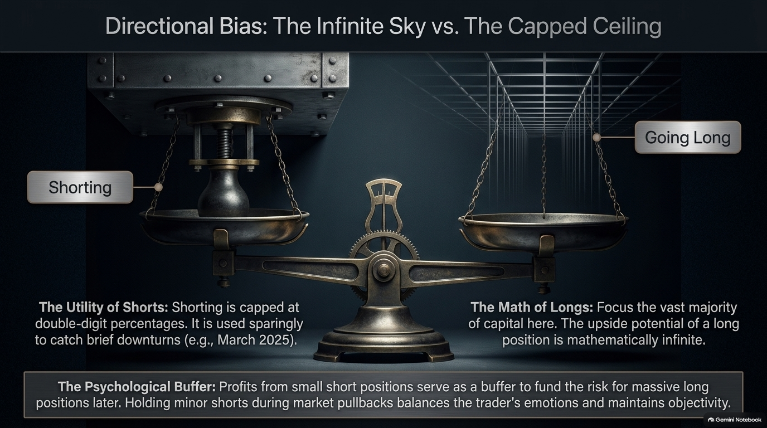
Notes:
Target Delivery Time: 4:00 – 5:30 minutes
Key Talking Points & Concepts
Math of Longs: Upside potential on long equity positions is theoretically infinite.
Utility of Shorts: Short gains are mathematically capped at double-digit percentages (<100%) and carry high friction/borrow risks.
The Shorting Buffer: Short positions are used sparingly during market pullbacks to generate modest profit cushions that fund subsequent aggressive long positions.
Speaker Script
"Slide 10 details Jay Law’s structural stance on Longs vs. Shorts.
While many retail traders attempt to short every market top, Jay focuses the vast majority of his energy on the long side. Why? Simple math. On a short position, your gain is strictly capped at under 100%, while holding a stock long offers theoretically infinite upside potential. Furthermore, holding strong short biases creates severe psychological friction when it’s time to flip long.
Jay uses shorting purely as a temporary tactical buffer. For example, taking minor short positions during a pullback (like March 2025) builds a profit cushion. That cushion is then used as 'house money' to fund aggressive long entries when the market bottoms in April."

Slide 11
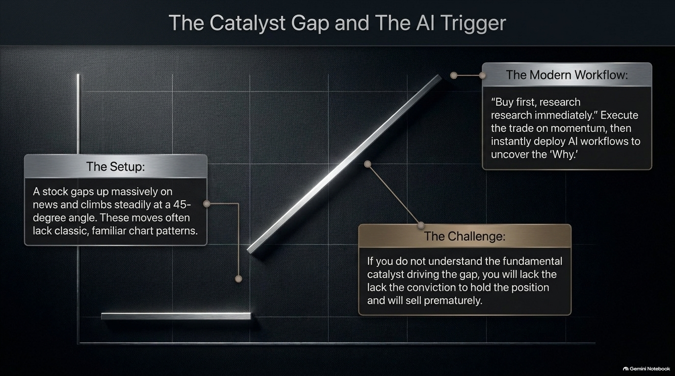
Notes:
Target Delivery Time: 4:00 – 5:30 minutes
Key Talking Points & Concepts
The Modern Market Anomaly: Powerful stocks gap up on catalysts and grind upward at 45-degree angles without forming traditional chart pullbacks.
The Execution Dilemma: Hesitating on momentum gaps means missing out on top-performing stocks.
The Modern Execution Workflow: "Buy first, research immediately." Enter price action momentum instantly, then deploy AI workflows to evaluate the fundamental catalyst.
Speaker Script
"In today's algorithmic market, major market leaders frequently gap up on earnings or structural news and trend steadily at a 45-degree angle without ever giving a classic technical entry pullback.
If you wait hours to manually read through corporate press releases and earnings transcripts, the stock moves away without you. On the flip side, if you buy without understanding the catalyst, you will panic and sell prematurely on the first minor tick down.
Jay Law solved this dilemma with a modern hybrid workflow: Buy first on technical momentum, then immediately deploy AI to research the catalyst. AI provides instant fundamental clarity, giving you the conviction needed to hold the trade through volatility."

Slide 12
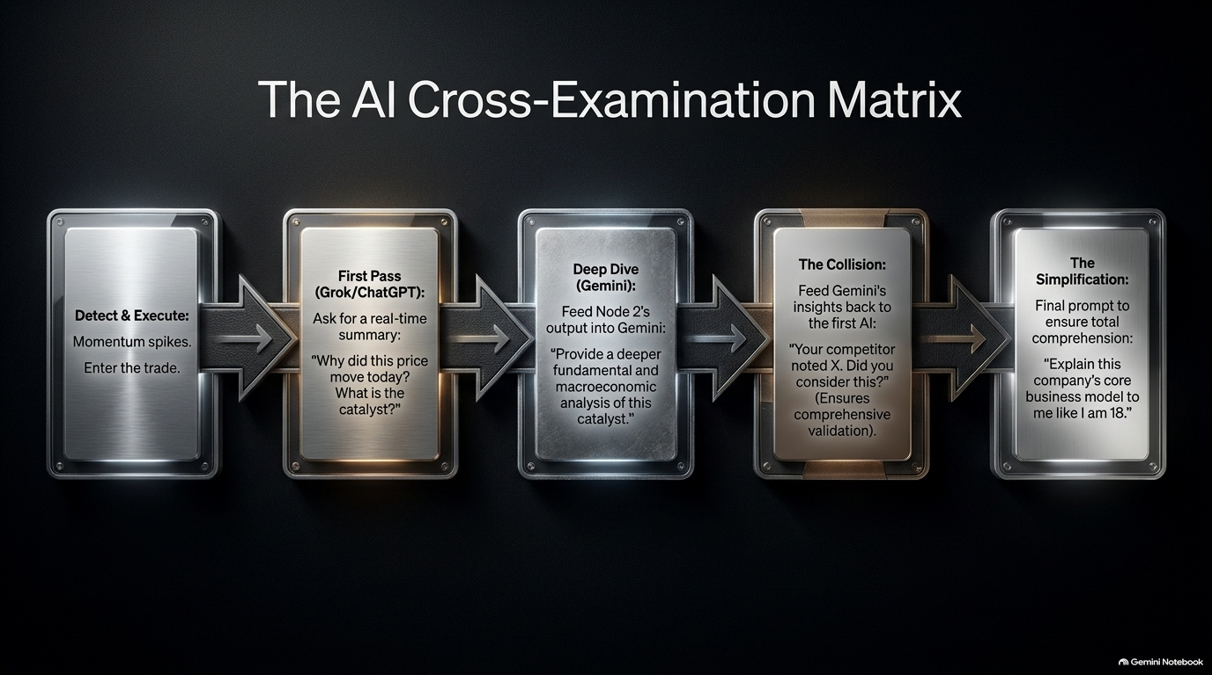
Notes:
Target Delivery Time: 5:00 – 6:00 minutes
Key Talking Points & Concepts
Multi-LLM Workflow: Leveraging distinct strengths of different AI models (Grok, Gemini, ChatGPT).
Node 1 (Grok/Real-time X): Instant real-time catalyst lookup for rapid price momentum.
Node 2 (Gemini/Deep Analysis): Comprehensive macro and fundamental validation.
Node 3 (Adversarial Collision): Pitting AI models against each other to uncover blind spots.
Node 4 (Jensen Huang Technique): "Explain this business model like I am 18 years old" to ensure complete operational clarity.
Speaker Script
"Slide 12 unveils Jay Law’s secret weapon: The AI Cross-Examination Matrix. Asking a single AI tool a simple question yields generic answers. Jay uses a 4-step multi-AI validation pipeline:
Detection & Real-Time Pass (Grok): Grock pulls instant real-time data from X/social feeds to explain why a stock is spiking right now.
Deep-Dive Analysis (Gemini): Feed Grok’s summary into Gemini for deep macroeconomic analysis.
Adversarial Collision: Feed Gemini’s output back into ChatGPT/Grok and ask: 'Your competitor highlighted X. What blind spots or risks did they miss?' This forces the models to cross-examine each other.
Simplification: Finally, prompt the AI using Jensen Huang’s technique: 'Explain this company's core business model to me like I am 18 years old.'
In under 3 minutes, you achieve complete fundamental clarity."

Slide 13
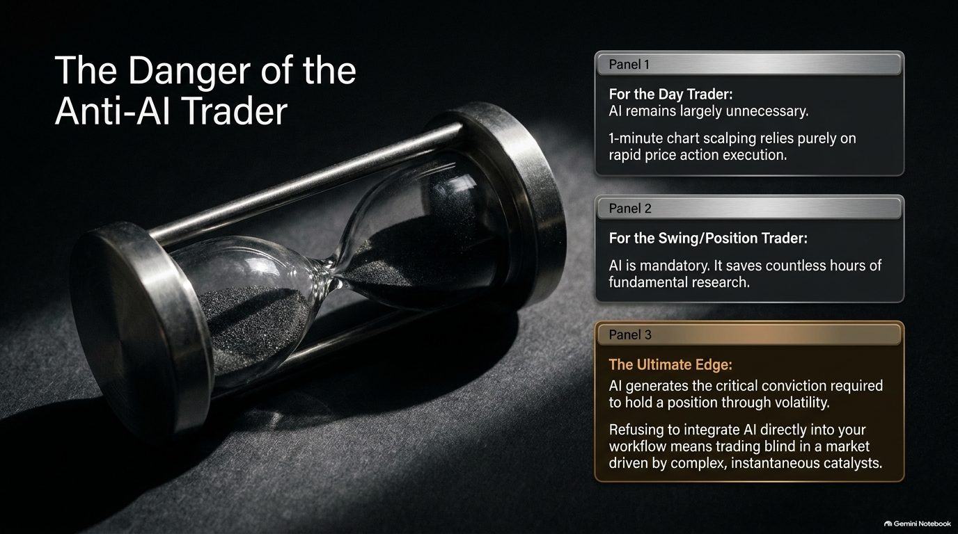
Notes:
Target Delivery Time: 3:30 – 5:00 minutes
Key Talking Points & Concepts
Timeframe Distinction: Day traders/scalpers don't need AI (pure 1-minute price action).
Mandatory for Swing/Position Traders: AI acts as a research assistant, compressing hours of analysis into minutes.
The Conviction Gap: Traders who reject AI risk trading blind against complex, fast-moving market catalysts.
Speaker Script
"Is AI mandatory for all traders? Jay Law makes a clear distinction based on holding timeframes.
If you are a 1-minute order-flow scalper, AI is unnecessary—you are purely trading speed and price action. But if you are a swing or position trader holding positions for days, weeks, or months, refusing to integrate AI into your workflow is financial suicide.
Modern catalysts move markets instantaneously. AI gives you the research speed of an institutional analyst team. It saves hundreds of hours of manual reading and provides the deep conviction needed to ride winning positions through multi-week pullbacks. Without AI, swing traders are essentially operating blind in a hyper-fast market."

Slide 14
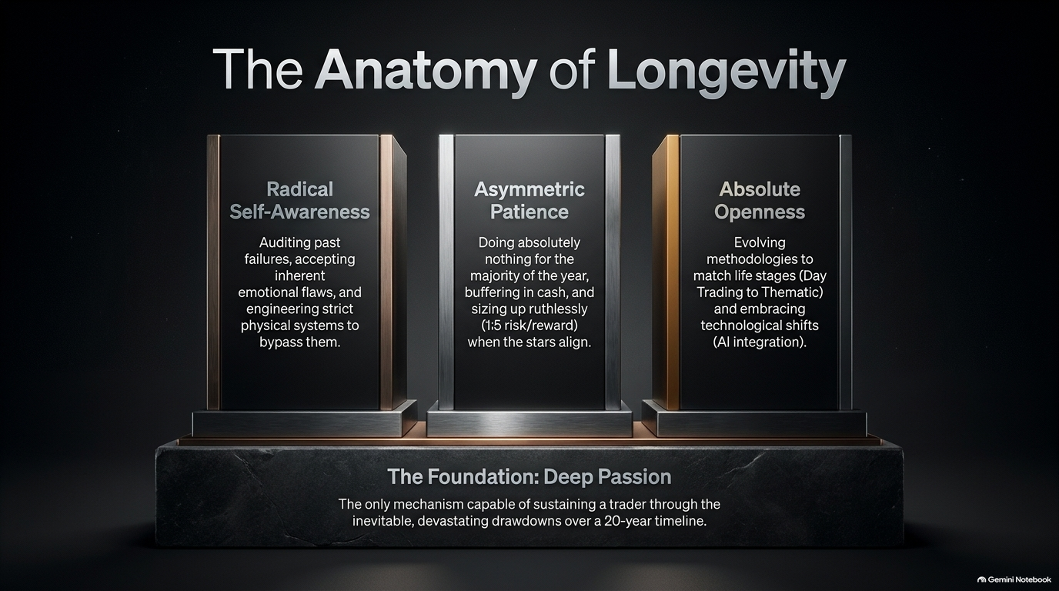
Notes:
Target Delivery Time: 4:30 – 6:00 minutes
Key Talking Points & Concepts
Pillar 1 – Radical Self-Awareness: Auditing failures and building strict rule systems around personal flaws.
Pillar 2 – Asymmetric Patience: Sitting in cash for months, executing high risk-reward setups when conditions align.
Pillar 3 – Absolute Openness: Continuously evolving methodologies (Day Trading $\rightarrow$ Thematic Trading $\rightarrow$ AI Workflows).
The Core Foundation – Deep Passion: Genuine love for the game as the sole fuel to survive 10-20+ years of inevitable drawdowns.
Speaker Script
"Slide 14 summarizes the core pillars required for 16+ years of survival and champion-level consistency.
Longevity rests on three pillars anchored by one foundation:
Radical Self-Awareness: Accepting your emotional traits and building guardrails to protect your capital.
Asymmetric Patience: Sitting quietly in cash for months until high R:R opportunities arrive.
Absolute Openness: Willingness to upgrade your methods—moving from day trading to thematic position trading, or adopting AI workflows when technology shifts.
Supporting all of this is Deep Passion. As Jay emphasizes in his closing thoughts, trading will bring brutal drawdowns and frustrating dry spells. Capital alone won't keep you grinding through off-hours research; only a genuine passion for the market will sustain you across decades."

Slide 15
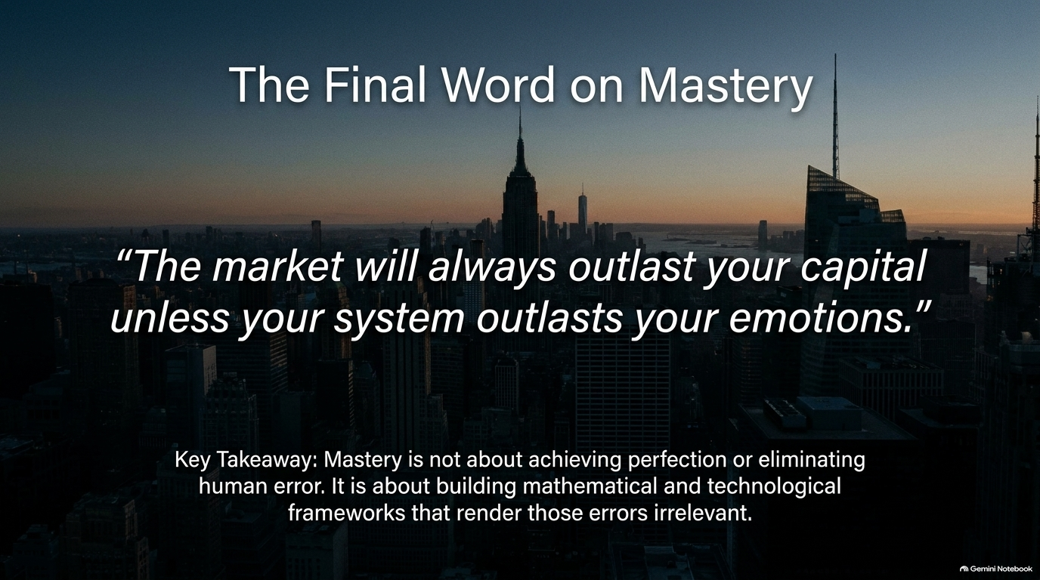
Notes:
Target Delivery Time: 3:00 – 4:30 minutes
Key Talking Points & Concepts
The Core Thesis Quote: "The market will always outlast your capital unless your system outlasts your emotions."
Systemic Insulation: Mastery is not about human perfection; it is about building mathematical and rule-based guardrails.
Process vs. Outcome: Focus on flawless system execution rather than short-term trade outcomes.
Speaker Script
"We conclude with Jay Law’s defining quote on market mastery: 'The market will always outlast your capital unless your system outlasts your emotions.'
Financial markets are designed to exploit human impatience, greed, and fear. If you rely on willpower, discipline alone will eventually break during a drawdown.
True mastery is not about achieving flawless human execution. It is about designing mathematical risk sizing, cash buffer rules, and AI cross-examination workflows that make human error irrelevant. Protect your downside, respect market themes, and let the math of asymmetry do the heavy lifting."

Slide 16
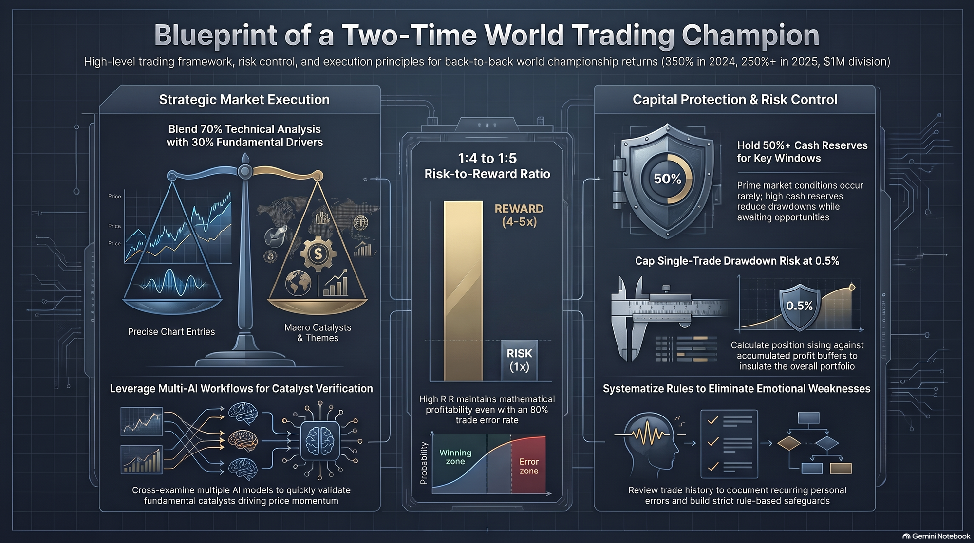
Notes:
Target Delivery Time: 4:30 – 6:00 minutes
Key Talking Points & Concepts
Strategic Execution: Combining 70% Technical Analysis with 30% Macro Catalysts.
Risk Engine: Targeting $4:1$ to $5:1$ R:R ratios; capping individual trade risk at 0.5% equity.
Capital Protection: Maintaining 50%+ cash reserves; utilizing multi-account structures.
Modern Workflows: Cross-examining multi-AI models (Grok, Gemini, ChatGPT) for instant research validation.
Speaker Script
"Slide 16 brings together the complete visual blueprint of a Two-Time World Trading Champion:
Strategic Execution: We blend precise technical chart entries with macroeconomic momentum drivers.
Multi-AI Verification: We accelerate fundamental research using Grok for speed, Gemini for depth, and adversarial prompts for truth.
Mathematical Risk Engine: We strictly enforce a 4x to 5x reward-to-risk requirement. By limiting individual trade risk to 0.5% of total capital, we can hold 10 full positions while keeping maximum portfolio drawdown capped at 5%.
Capital Reserves: We hold 50%+ cash buffers during quiet periods, preserving capital for high-probability market windows.
Apply these four pillars systematically, and you build a trading operation that survives any market environment. Thank you very much, and let's open the floor to questions."

