Slide 1
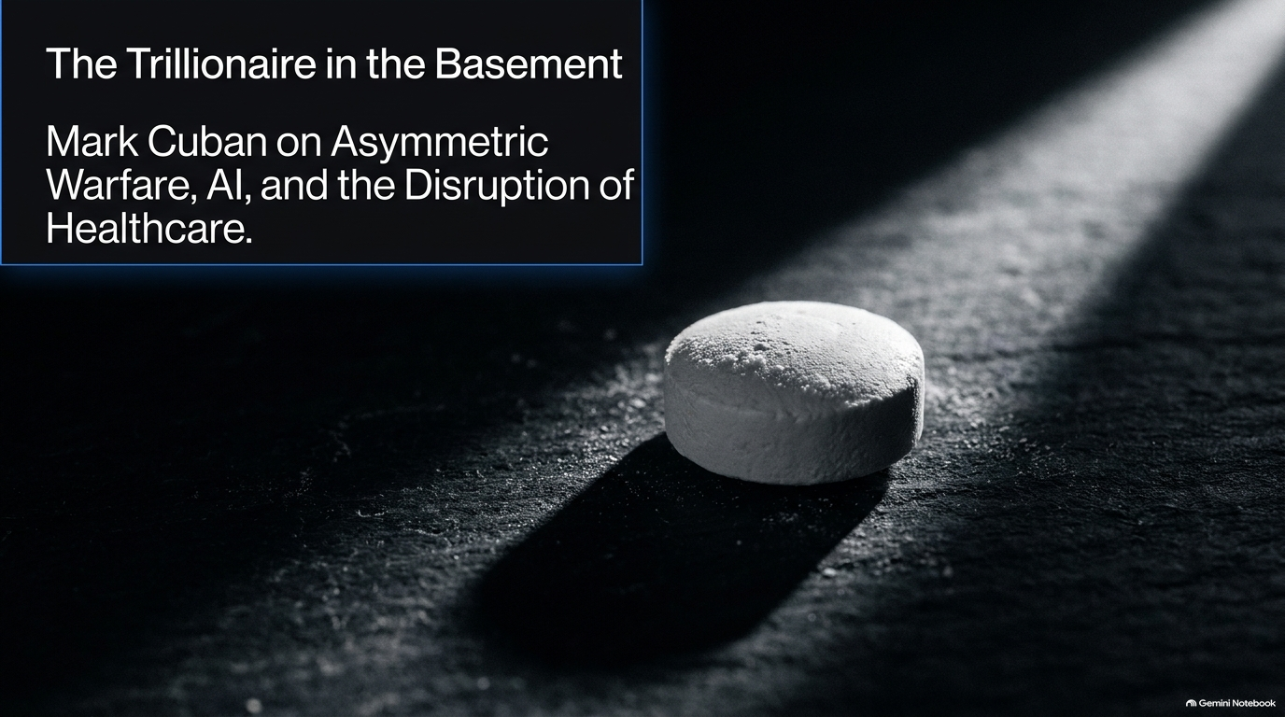
Notes:
Mark Cuban on Why AI Could Turn Solo Founders Into Trillionaires
https://www.youtube.com/watch?v=5UWDUD6qaM4

Slide 2
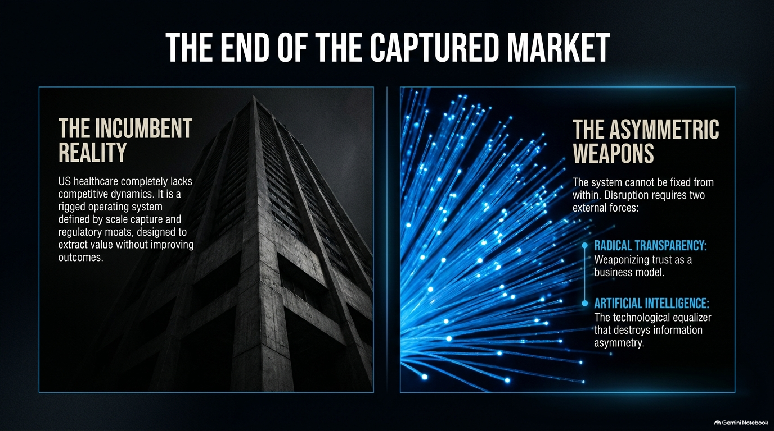
Notes:
Target Duration: 4–6 minutes
Key Talking Points:
Dive deep into the structural flaws of legacy healthcare.
Discuss how vertical integration among major incumbents has created massive conglomerates with thousands of subsidiaries and billions in intercompany transfers.
Explain how premiums and deductibles continually rise while pushing patients and providers into rigid, non-competitive relationships.
Video Connection: Highlight the reality of administrative bloat and opaque supply chains. Emphasize that the system is set up to benefit middlemen rather than patients or employers.

Slide 3
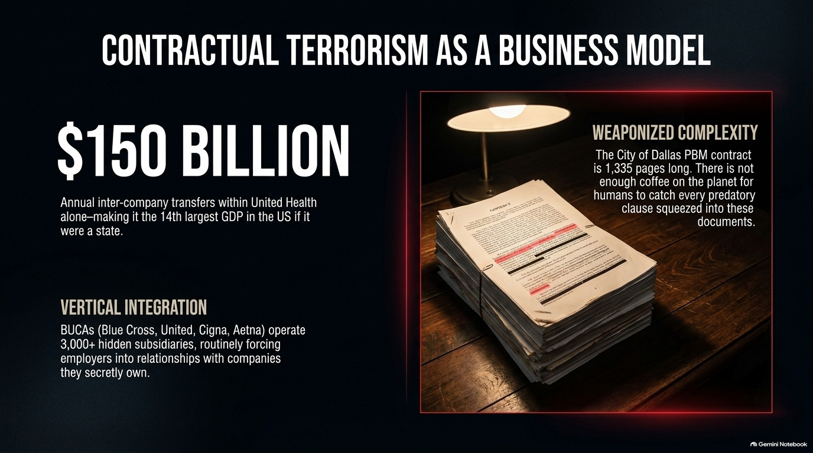
Notes:
Target Duration: 3–5 minutes
Key Talking Points:
Contrast healthcare with other consumer industries where free-market competition drives innovation and lower costs.
Address the information asymmetry: patients and self-insured employers have virtually zero visibility into actual pricing or underlying contract terms.
Discuss the role of price discovery as the ultimate safeguard of a functioning market—and how its absence in healthcare drives costs through the roof.

Slide 4
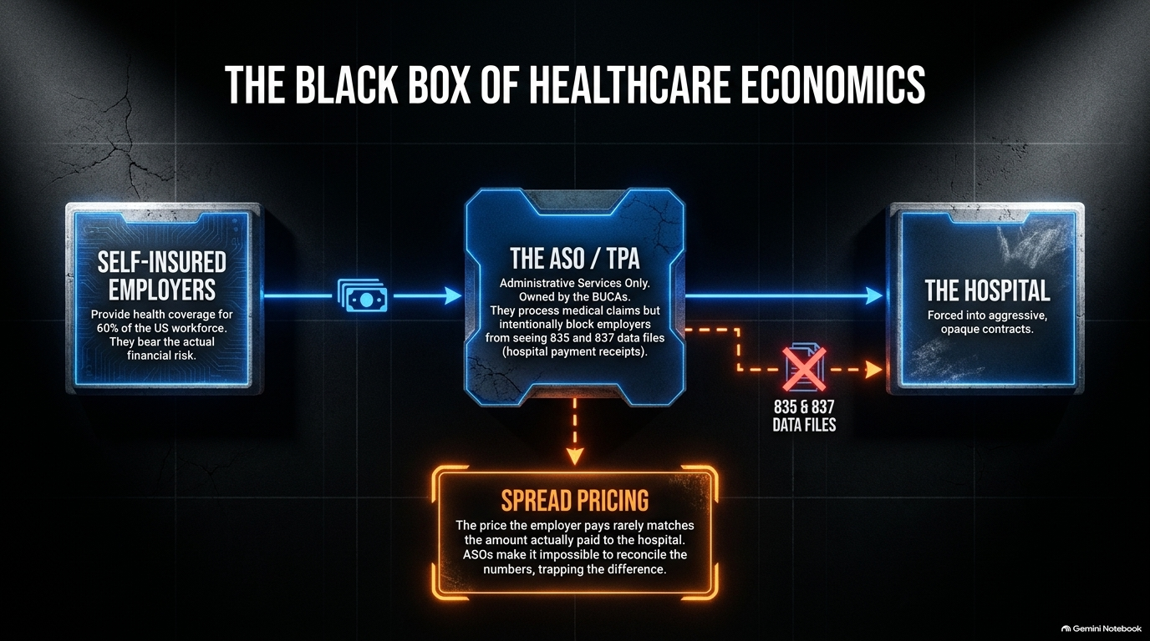
Notes:
Target Duration: 4–6 minutes
Key Talking Points:
Examine the scale of legacy insurance giants, Pharmacy Benefit Managers (PBMs), and Third-Party Administrators (TPAs).
Explain how these entities control multiple touchpoints of care—from insurance and administration to pharmacy fulfillment—creating closed loops that extract maximum profit.
Video Connection: Reference the sheer scale of major conglomerates (comparable to state-level GDPs) and how intercompany transfers mask true costs from self-insured employers.

Slide 5
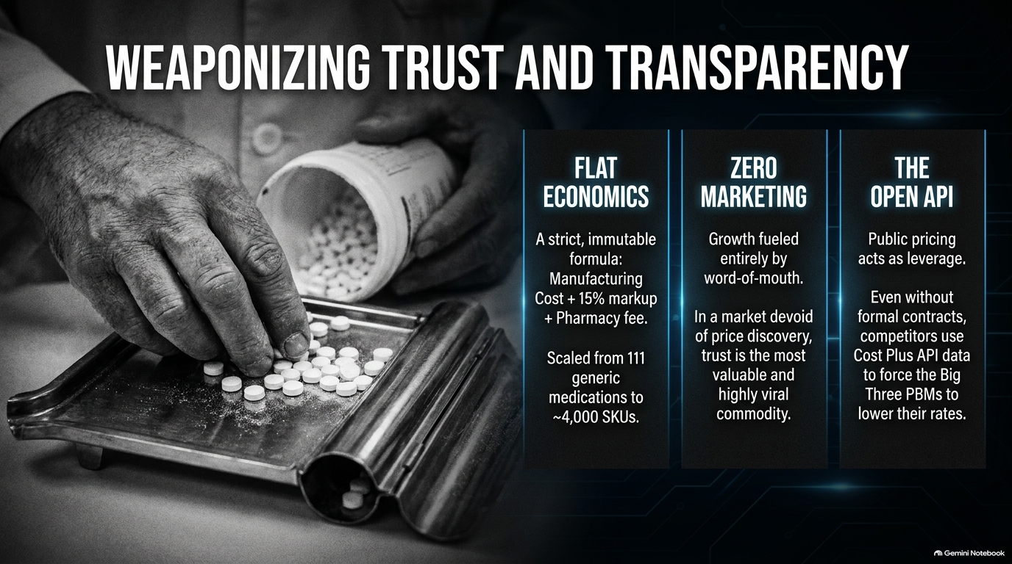
Notes:
Target Duration: 3–5 minutes
Key Talking Points:
Explore how transparent pricing models and direct-to-consumer alternatives have proven that incumbents can be challenged.
Discuss the psychological shift: when pricing is made public, even competitors are forced to adjust their benchmarks downward.
Video Connection: Highlight how the presence of disruptive models (such as transparent drug pricing APIs) serves as an external benchmark that corporate buyers use to negotiate better rates, even without direct contracts.

Slide 6
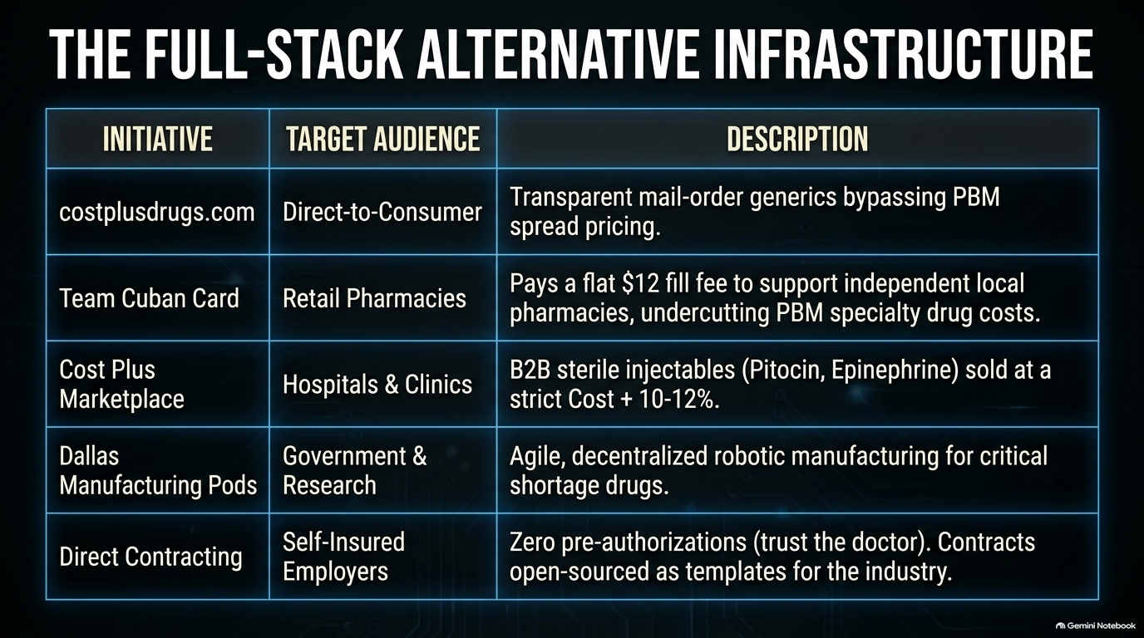
Notes:
Target Duration: 4–6 minutes
Key Talking Points:
Discuss the evolution from mail-order solutions to local community integration.
Emphasize the importance of supporting independent pharmacies to ensure local accessibility for critical medications, cold-chain products, and specialty generics.
Video Connection: Outline the tiered approach to distribution—combining low-cost mail-order options with local discount cards and affiliate pharmacy networks to balance affordability with community support.

Slide 7
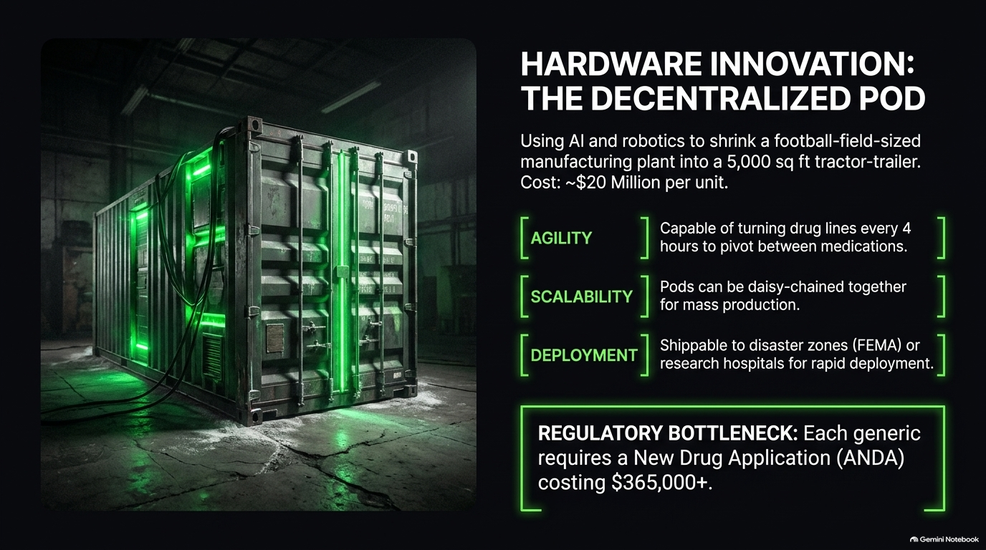
Notes:
Target Duration: 4–6 minutes
Key Talking Points:
Address the vulnerabilities of global supply chains, particularly regarding FDA-approved drug shortages (e.g., essential hospital injectables and pediatric oncology drugs).
Introduce advanced manufacturing innovations: using robotics and AI to shrink traditional manufacturing footprints down to compact, agile production units ("pods").
Video Connection: Explain how these units can rapidly switch production runs (e.g., turning over every few hours) and scale to meet emergency needs, disaster relief, or decentralized clinical trials.

Slide 8
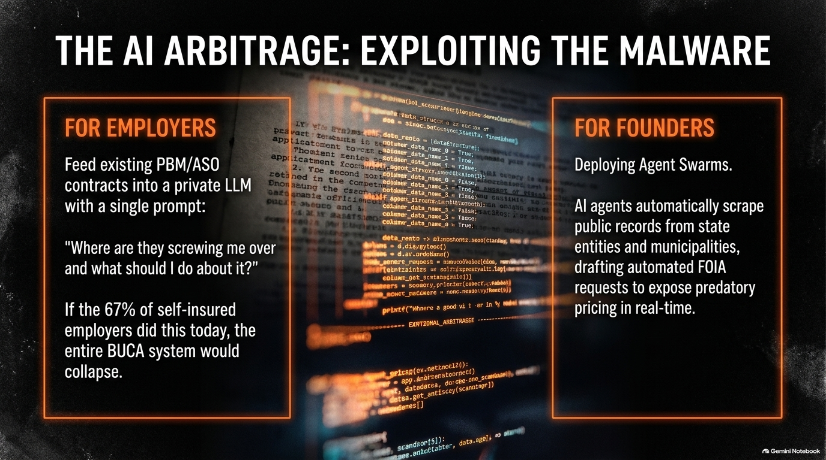
Notes:
Target Duration: 3–5 minutes
Key Talking Points:
Analyze the friction in hospital procurement where CEOs want cost savings, but entrenched purchasing departments stick to legacy vendor habits.
Discuss how transparent marketplace models for sterile injectables and clinical supplies can save hospital systems millions of dollars annually.
Video Connection: Emphasize the challenge of shifting enterprise mindset from status-quo purchasing to cost-plus efficiency.

Slide 9
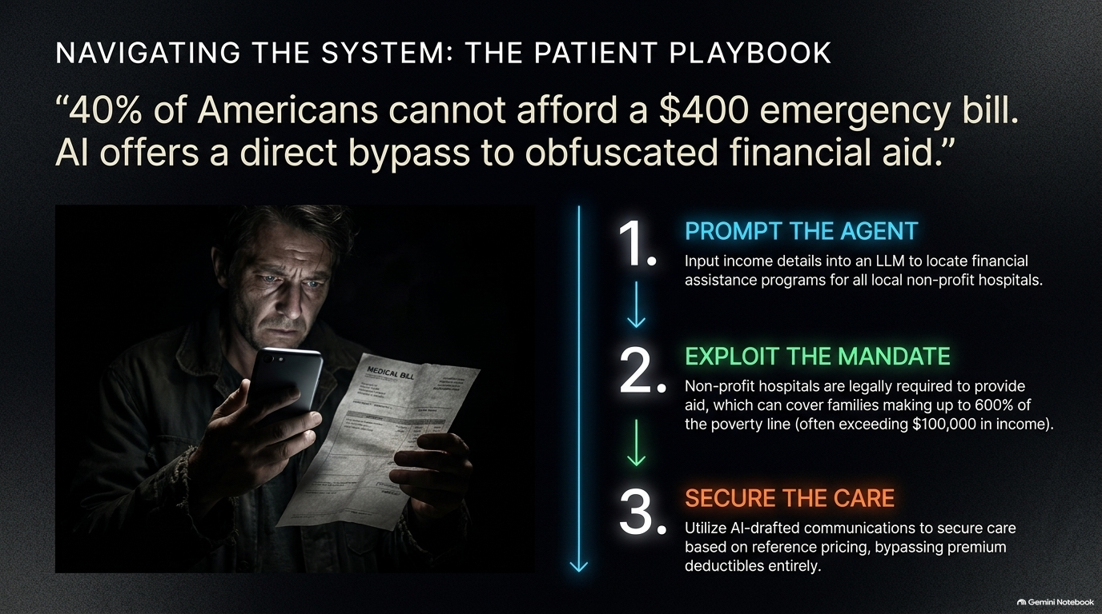
Notes:
Target Duration: 4–6 minutes
Key Talking Points:
Focus on self-insured employers who cover the majority of working Americans and are suffering under double-digit annual premium hikes.
Break down the hidden traps in Administrative Services Only (ASO) and PBM contracts—such as spread pricing, hidden fees, and restricted access to raw claims data.
Video Connection: Detail the concept of "contractual terrorism"—massive, multi-thousand-page agreements designed to obscure financial extraction.

Slide 10
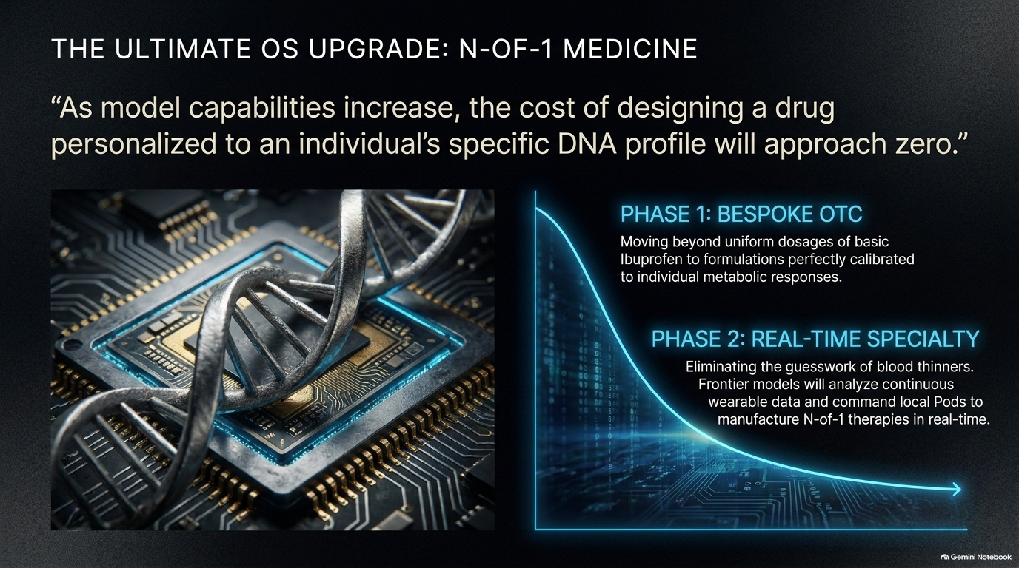
Notes:
Target Duration: 4–6 minutes
Key Talking Points:
Shift focus to practical, immediate applications of Artificial Intelligence in enterprise operations.
Explain how AI agents and Large Language Models (LLMs) can ingest complex vendor contracts in seconds to expose hidden penalty clauses and unfavorable terms.
Video Connection: Share the practical prompt strategy: running existing healthcare and vendor contracts through AI with the explicit query, "Where are they taking advantage of us, and what should we do about it?"

Slide 11
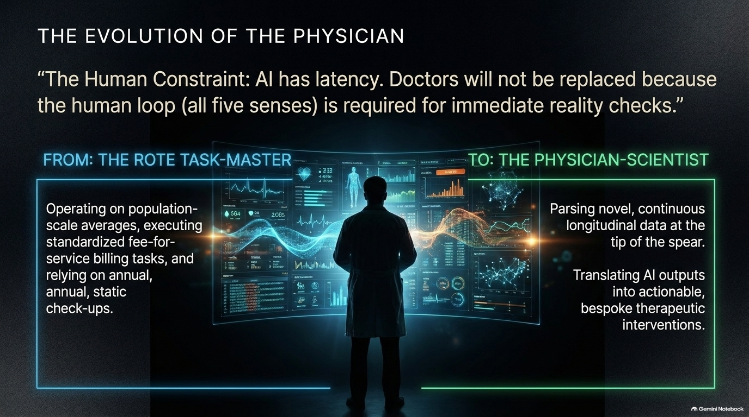
Notes:
Target Duration: 3–5 minutes
Key Talking Points:
Propose a radical alternative to traditional insurance webs: direct agreements between self-insured employers and healthcare providers.
Outline the core pillars: honoring clinical judgment (eliminating burdensome pre-authorizations), guaranteeing on-time payments, and absorbing patient out-of-pocket credit risk.
Video Connection: Emphasize open-sourcing these direct contracts so other employers and providers can use them as templates to bypass legacy insurers entirely.

Slide 12
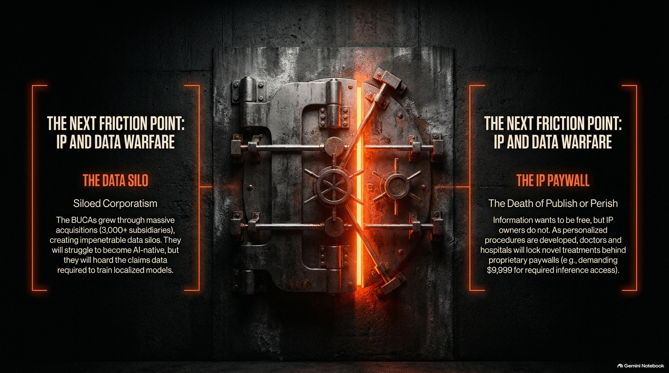
Notes:
Target Duration: 4–6 minutes
Key Talking Points:
Look ahead at how frontier AI and genetic sequencing are transforming drug design and personal treatment efficacy.
Discuss the shift from generalized population-level treatments (where one-size-fits-all drugs fail significant portions of patients) to true $N \text{ of } 1$ precision medicine.
Video Connection: Explain how marginal costs for advanced genetic analysis and custom formulations will trend toward zero, integrating personalized health into routine subscriptions.

Slide 13
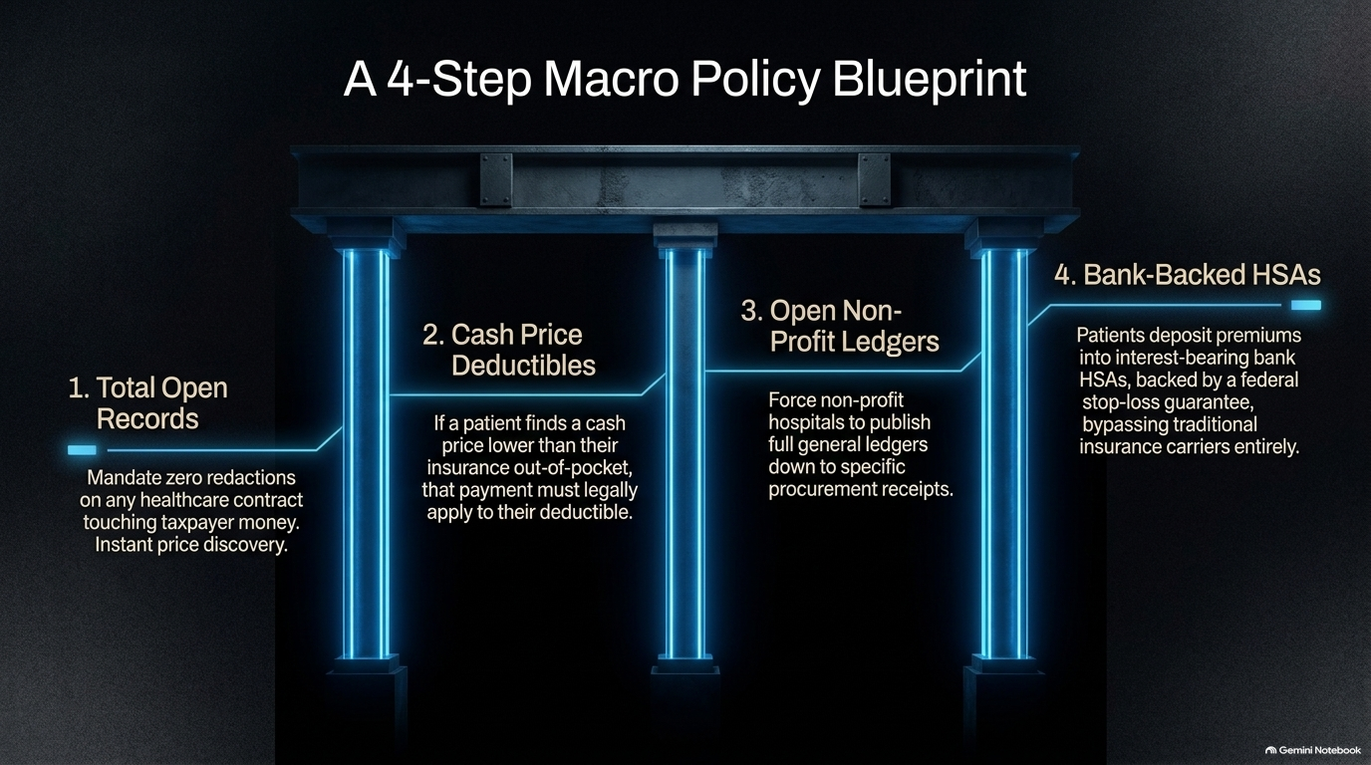
Notes:
Target Duration: 3–5 minutes
Key Talking Points:
Address workforce anxieties surrounding automation and AI in clinical settings.
Reframe the doctor's role: moving away from rote administrative tasks, coding, and box-checking toward higher-order clinical science, novel data generation, and human empathy.
Video Connection: Emphasize that while AI handles data synthesis and pattern matching, the human-in-the-loop (with all five senses and emotional intelligence) remains irreplaceable for patient reassurance and complex care delivery.

Slide 14
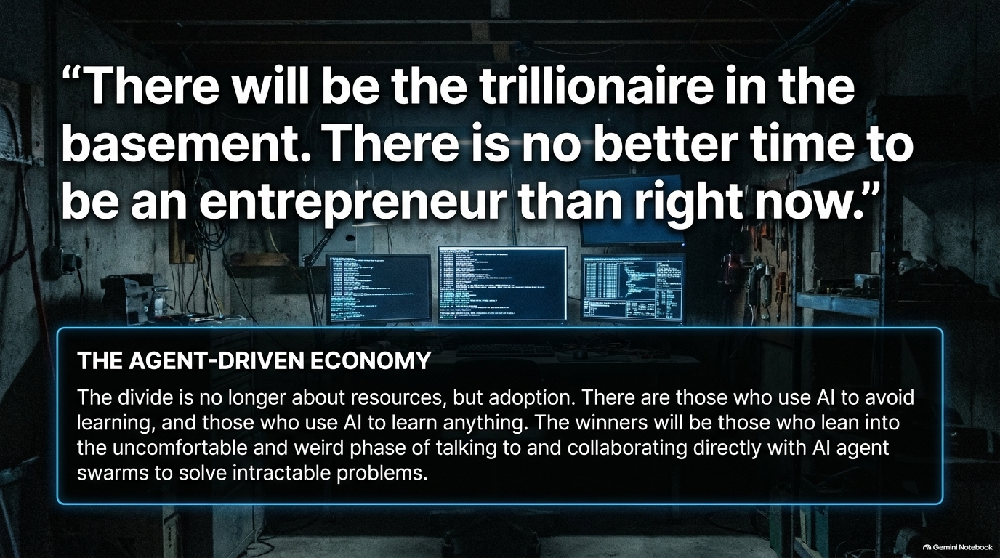
Notes:
Target Duration: 4–6 minutes
Key Talking Points:
Address the anxiety and financial terror consumers face regarding medical debt and emergency bills.
Empower patients and families to use AI tools to understand their Explanation of Benefits (EOB), research nonprofit hospital financial assistance policies, and explore alternative funding models.
Video Connection: Highlight that patient education and proactive navigation are the ultimate keys to breaking reliance on broken institutional gatekeepers.

Slide 15
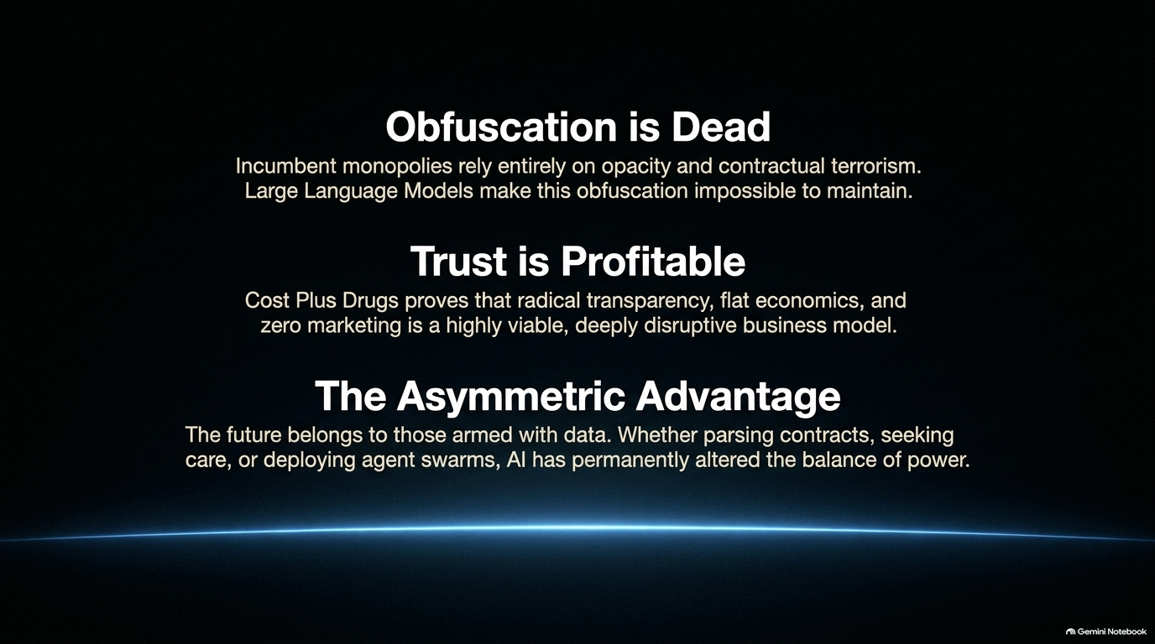
Notes:
Target Duration: 3–5 minutes
Key Talking Points:
Outline actionable policy recommendations for lawmakers: mandating transparency on all government-funded contracts with zero redactions, allowing out-of-pocket savings to apply toward deductibles, and making nonprofit hospital ledgers fully open to the public.
Propose structural alternatives to legacy insurance, such as personal health savings accounts backed by government safety-net stop-loss programs.
Video Connection: Summarize that true reform requires removing regulatory capture and scale-based monopolies.

Slide 16
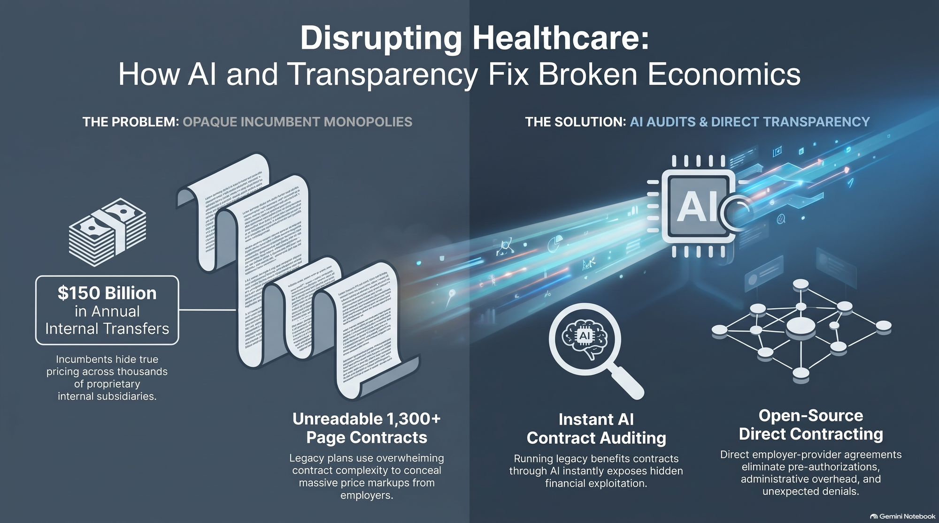
Notes:
Target Duration: 3–5 minutes
Key Talking Points:
Deliver an inspiring closing call to action for entrepreneurs, business leaders, and innovators.
Reiterate that despite regulatory hurdles, there has never been a better time to build solutions that fix foundational economic problems.
Video Connection: Conclude with the core mindset shift: embrace uncomfortableness, leverage AI not just to avoid learning but to master any subject, and build the future of healthcare with uncompromising trust and transparency.

