Slide 1
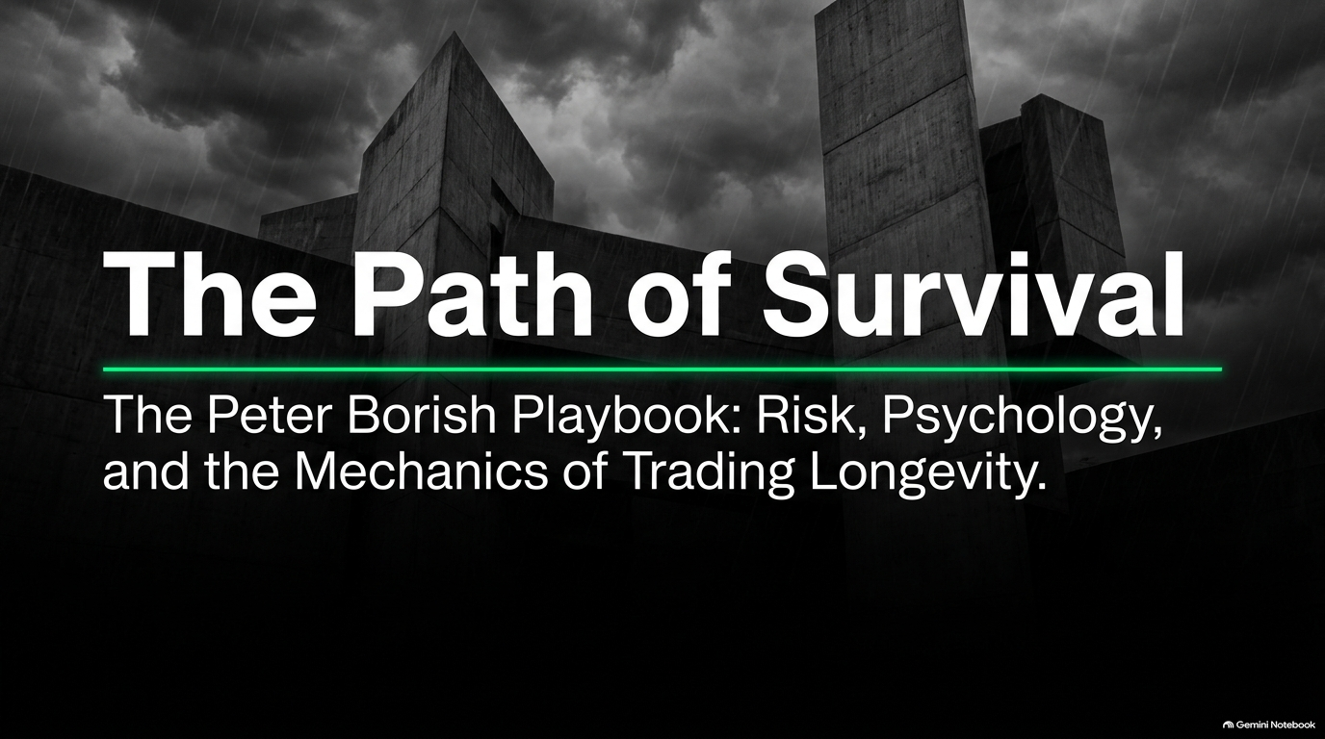
Notes:
Estimated Speaking Time: 2 – 3 minutes.
Speaker Notes:
Opening Hook: "Welcome, everyone. Today, we are diving deep into The Path of Survival: The Peter Borish Playbook. When people enter the world of trading, they are usually obsessed with finding the holy grail of entries—the perfect indicator, the exact tip, or the secret formula. But veteran market architects like Peter Borish—who served as Paul Tudor Jones’s second-in-command, scaling capital to billions and helping build the quantitative foundation behind the 1987 crash and George Soros’s The Alchemy of Finance—know a starker truth."
Core Theme: "Trading longevity has almost nothing to do with how smart you are or how often you are right. It is entirely about risk, psychology, and survival mechanics. Over the next several minutes, we are going to break down how to stop fighting the market, how to decouple your ego from execution, and how to stay at the table long enough to catch the few outlier days that define a trading career."
Paul T.Jones Partner: All Your Money Comes From 10 Days A Year. The Rest Is Where You Die!
https://www.youtube.com/watch?v=l9x3xs83QG4

Slide 2
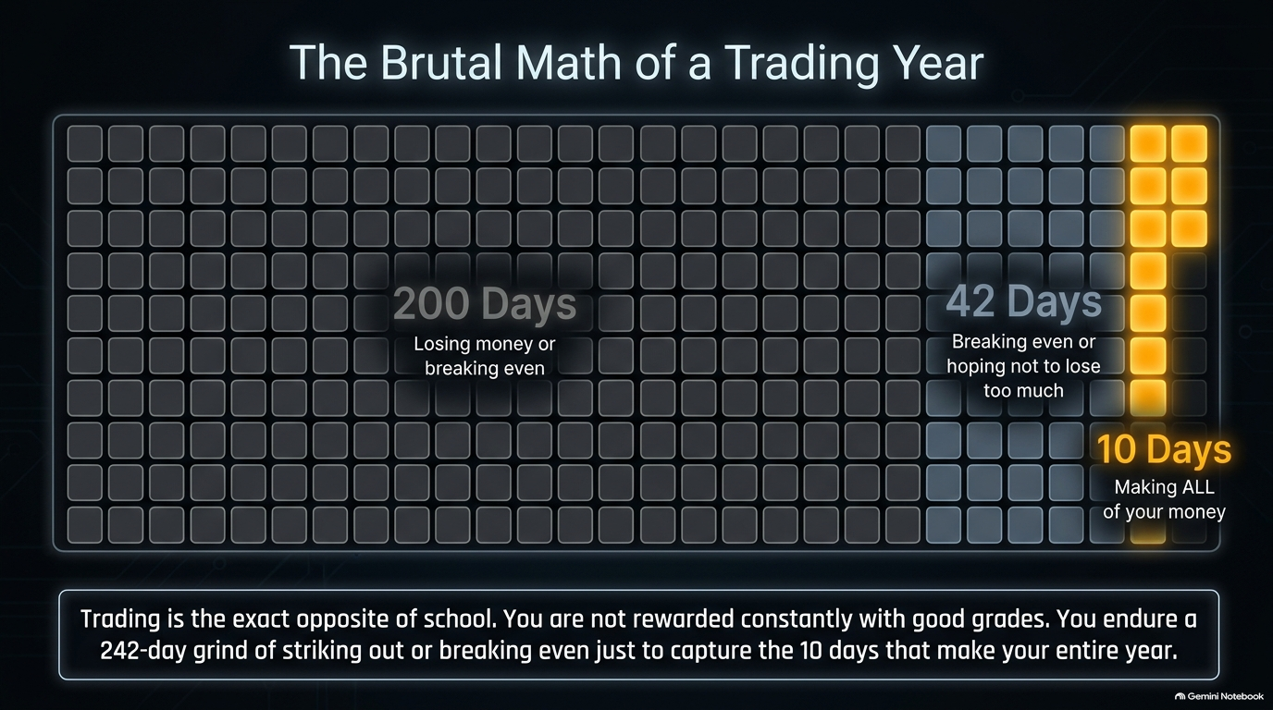
Notes:
Estimated Speaking Time: 3 – 5 minutes.
Speaker Notes:
The School Paradigm Trap: "Let’s start with a hard psychological pill to swallow: trading is the exact opposite of school. In school, you are conditioned for constant positive reinforcement. You hand in homework, you get an A, you get a pat on the back, and you are rewarded consistently."
The Reality of the 252-Day Grid: "Markets don’t care about your grades. Out of a standard 252-day trading year, Peter Borish points out a brutal mathematical reality: roughly 200 days are a relentless grind of striking out, losing money, or just breaking even. Another 42 days are spent treading water, hoping you don't lose too much. Your entire annual performance—all your profits—happen in roughly 10 outlier trading days."
The Baseball Analogy: "If you walk up to the plate expecting to hit a home run on every single pitch, you will strike out emotionally and blow up your account. You have to endure the grind, accept the strikeouts with zero memory like a major league batter, and preserve your capital so that when those 10 golden days arrive, you are fully funded and ready to capture them."

Slide 3
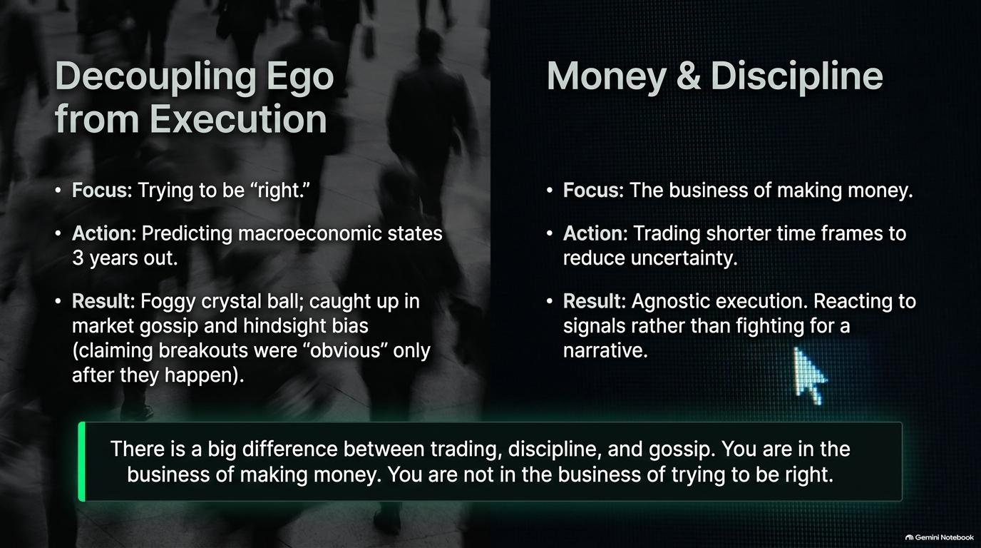
Notes:
Estimated Speaking Time: 3 – 4 minutes.
Speaker Notes:
Ego vs. Profit: "One of the most dangerous psychological flaws in trading is the desire to be 'right.' Borish emphasizes a monumental distinction: You are in the business of making money; you are not in the business of trying to be right."
The Foggy Crystal Ball: "Amateurs love to gaze into a three-year crystal ball, gossiping about macroeconomic states and geopolitical narratives they cannot possibly predict. They claim breakouts were 'obvious' only after they happen, playing Monday-morning quarterback on television. Professionals, conversely, operate on shorter time frames to reduce uncertainty. They are agnostic executioners."
Actionable Takeaway: "If the market gives you a signal, you react to it. You don't fight the tape just to prove your political or economic narrative is correct. Drop the ego, check your opinions at the door, and focus strictly on P&L."

Slide 4
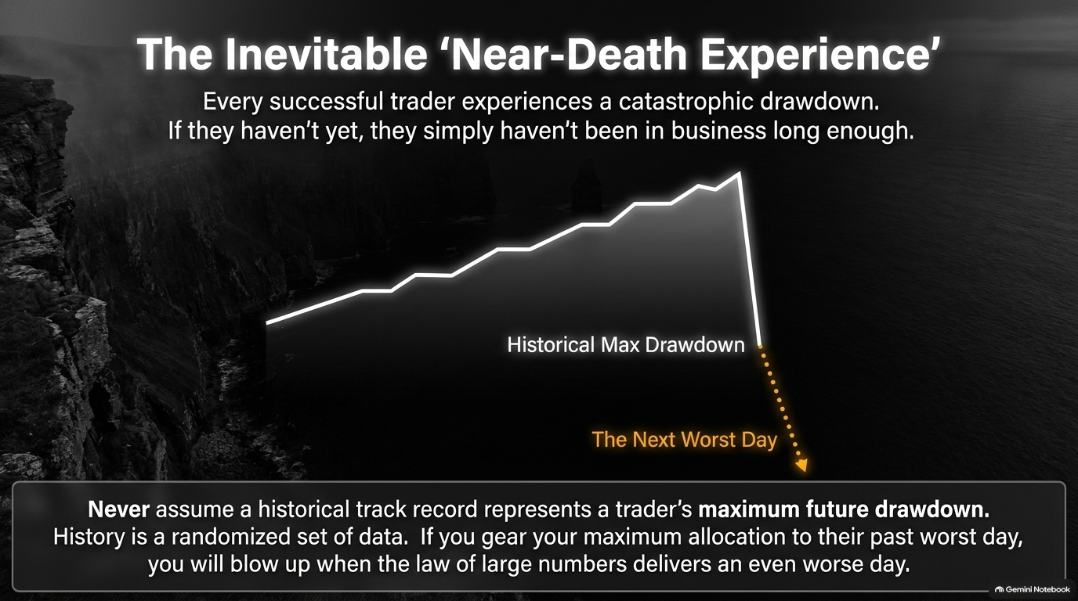
Notes:
Estimated Speaking Time: 3 – 5 minutes.
Speaker Notes:
Borish’s Office Rule: "Peter Borish loves to share what happens when young traders walk into his office after a disaster. They sit down and say, 'Pete, I can’t believe it. I just had the worst day of my life.' Borish gives them the good news and the bad news: The good news is you haven't reached your absolute kickout level, so you're still in business. The bad news? If you are in business long enough, you are going to have a worse day."
The Illusion of Historical Track Records: "Never assume a historical track record represents a trader's maximum future drawdown. History is merely a randomized set of data. If you size your maximum allocation based on someone's past worst day, you are guaranteed to blow up when the law of large numbers delivers a day that is twice as bad."

Slide 5
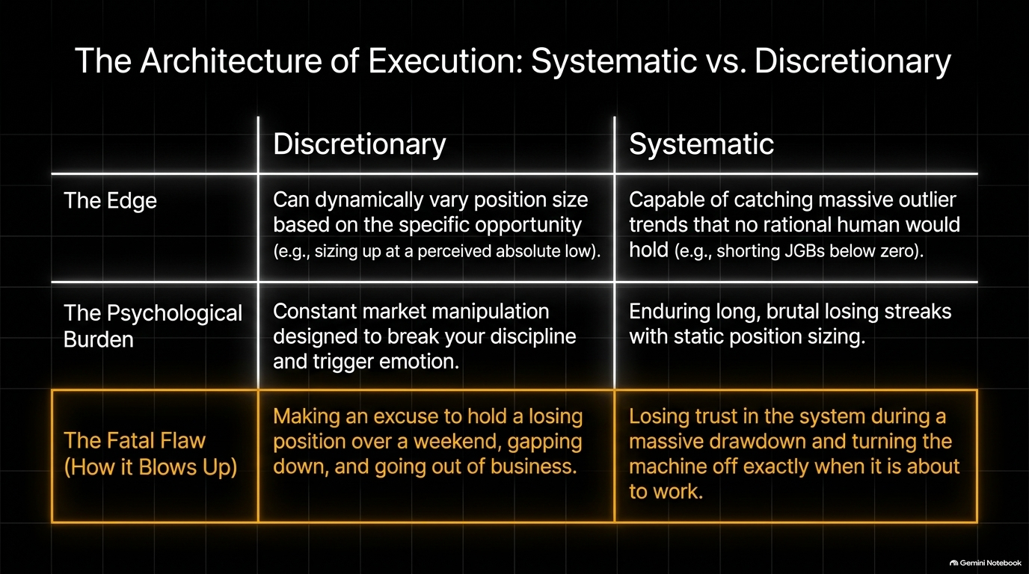
Notes:
Estimated Speaking Time: 4 – 6 minutes.
Speaker Notes:
Two Paths to Rome: "Every trader must choose their architecture, and each comes with its own psychological burden. Discretionary traders have the flexibility to dynamically vary position size based on perceived opportunities—like sizing up at an absolute low. Their fatal flaw? Making excuses to hold a losing position over the weekend, gapping down, and going out of business."
The Systematic Machine: Systematic traders, on the other hand, use static sizing and can endure long, brutal losing streaks. Because their system is cold and mechanical, it is capable of catching massive outlier trends that no rational human would hold—such as shorting Japanese Government Bonds (JGBs) all the way below zero. Their fatal flaw? Losing trust in the system during a drawdown and turning the machine off exactly when it is about to work."
The Transparency Test: "Borish notes that you could put a systematic trader's signals up in Times Square for everyone to see, and they still wouldn't execute them correctly during a drawdown without strict discipline."

Slide 6
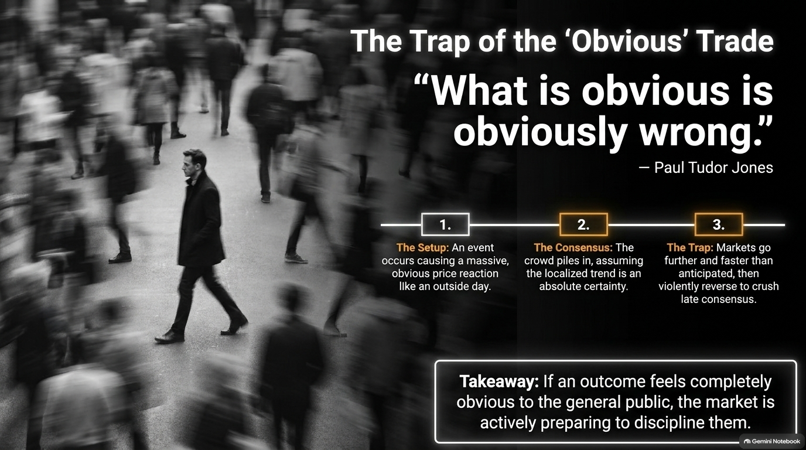
Notes:
Estimated Speaking Time: 3 – 5 minutes.
Speaker Notes:
Paul Tudor Jones’s Wall Sign: "Behind Paul Tudor Jones’s desk hung a famous handwritten sign: 'What is obvious is obviously wrong.' When a market event occurs that triggers an overwhelming, uniform price reaction—like a massive outside day—the general public piles in, assuming the localized trend is an absolute certainty."
The Reversal Mechanism: "Markets love to go further and faster than anticipated precisely to trap and crush the late consensus. If an outcome feels entirely obvious to the mainstream media and general public, the market is actively preparing to discipline them. As a professional, you must look past the obvious gossip and locate the hidden technical reality."

Slide 7
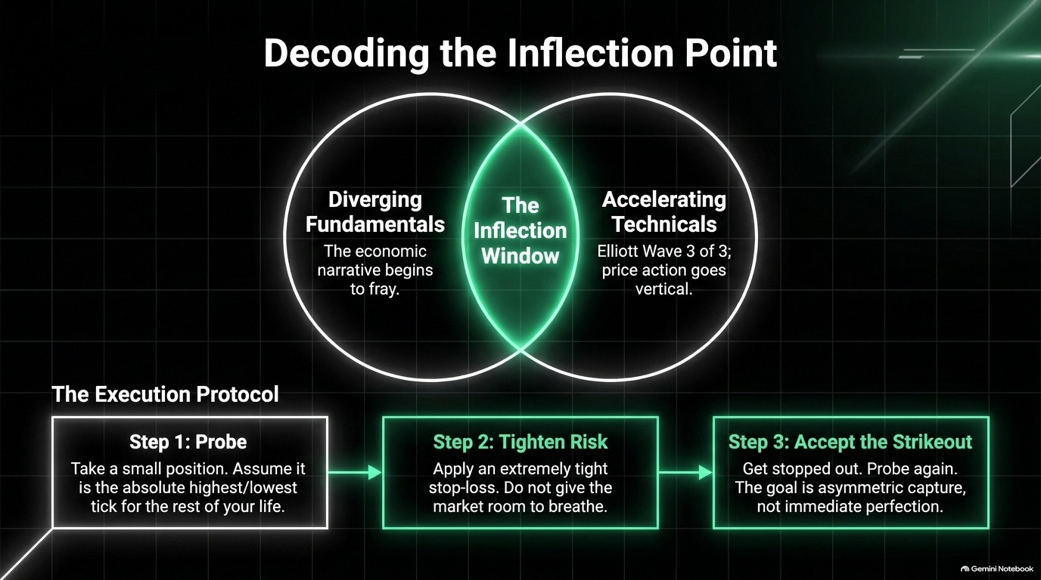
Notes:
Estimated Speaking Time: 4 – 6 minutes.
Speaker Notes:
Finding the Sweet Spot: "Where do major market turns happen? At the intersection of Diverging Fundamentals (where the economic narrative begins to fray) and Accelerating Technicals (such as an Elliott Wave 3 of 3 where price action goes vertical)."
The 3-Step Execution Protocol:
Step 1: Probe. Take a small position. Assume every time you sell or buy, you are picking the absolute highest or lowest tick for the rest of your life (even if that mindset only lasts 30 seconds).
Step 2: Tighten Risk. Apply an extremely tight stop-loss. Do not give the market room to breathe when you are probing an inflection point.
Step 3: Accept the Strikeout. If you get stopped out, accept it. Probe again. The goal is asymmetric capture, not immediate perfection.

Slide 8
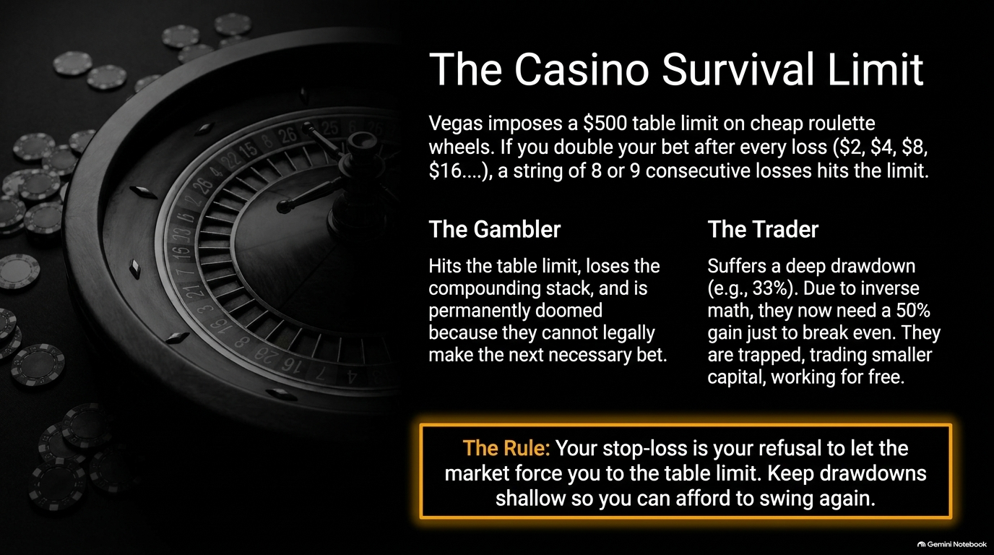
Notes:
Estimated Speaking Time: 3 – 5 minutes.
Speaker Notes:
The Martingale Fallacy: "Think about how a cheap roulette wheel works in Vegas. If you use a doubling strategy after every loss ($2, $4, $8, $16...), a string of 8 or 9 consecutive losses hits the $500 table limit. The gambler hits that limit, loses their compounding stack, and is permanently doomed because they can legally no longer make the next necessary bet."
The Trader’s Inverse Math Trap: "Traders face the exact same limit through drawdowns. If you suffer a 33% drawdown, inverse math dictates that you now need a staggering 50% gain just to break even. You become trapped, trading smaller capital, and essentially working for free. Your stop-loss is your refusal to let the market force you to the table limit. Keep drawdowns shallow so you can always afford to swing again."

Slide 9
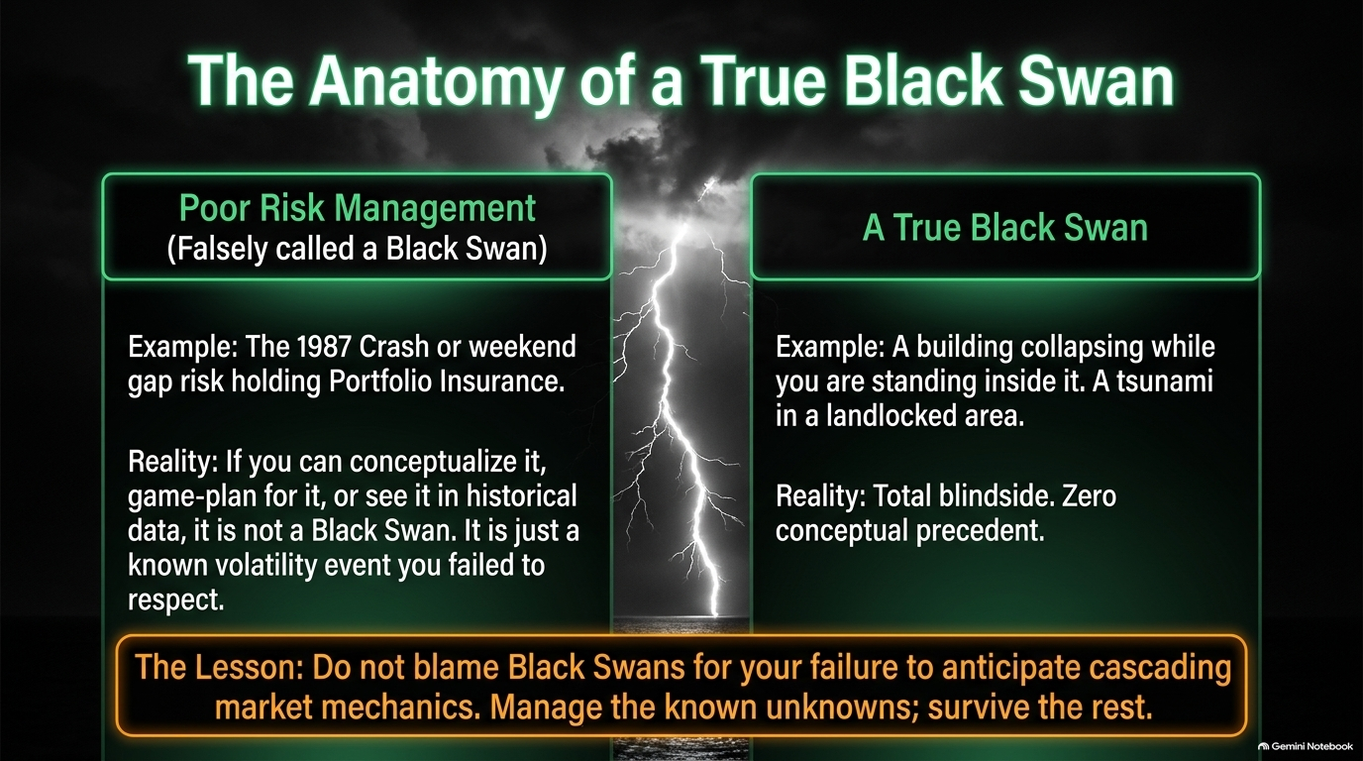
Notes:
Estimated Speaking Time: 3 – 4 minutes.
Speaker Notes:
Mislabeling Disasters: "Traders love to blame 'Black Swans' for their blowups, but Peter Borish draws a sharp distinction. Events like the 1987 Crash or weekend gap risks while holding portfolio insurance are not Black Swans—they are failures of risk management. If you can conceptualize it, game-plan for it, or see historical precedents for it, it is simply a known volatility event you failed to respect."
The True Definition: "A true Black Swan is a total blindside with zero conceptual precedent—like a building collapsing while you stand inside it, or a tsunami in a completely landlocked area. Do not blame Black Swans for cascading market mechanics you failed to anticipate. Manage the known unknowns, and survive the rest."

Slide 10
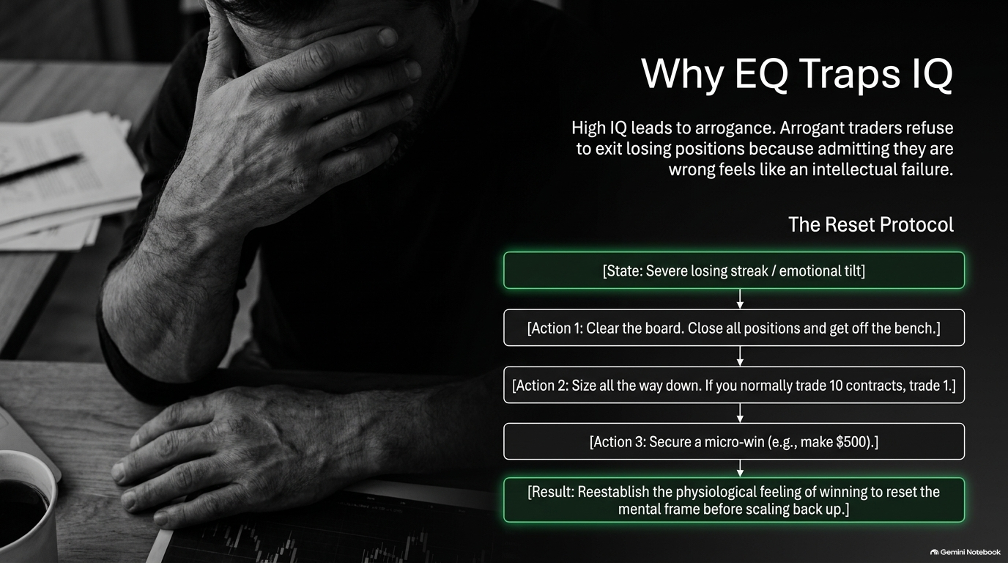
Notes:
Estimated Speaking Time: 4 – 6 minutes.
Speaker Notes:
The Intellectual Trap: "High IQ is often a trader's worst enemy. Arrogant, highly intelligent traders refuse to exit losing positions because admitting they are wrong feels like an intellectual failure. Emotional Quotient (EQ)—the ability to accept losses and move forward—matters far more than IQ in the markets."
The Reset Protocol: When you hit a severe losing streak or emotional tilt, execute this immediate reset:
Clear the board: Close all positions and get off the bench.
Size all the way down: If you normally trade 10 contracts, trade 1.
Secure a micro-win: Make a small, easy gain (e.g., $500) to re-establish the physiological feeling of winning, resetting your mental frame before scaling back up.

Slide 11
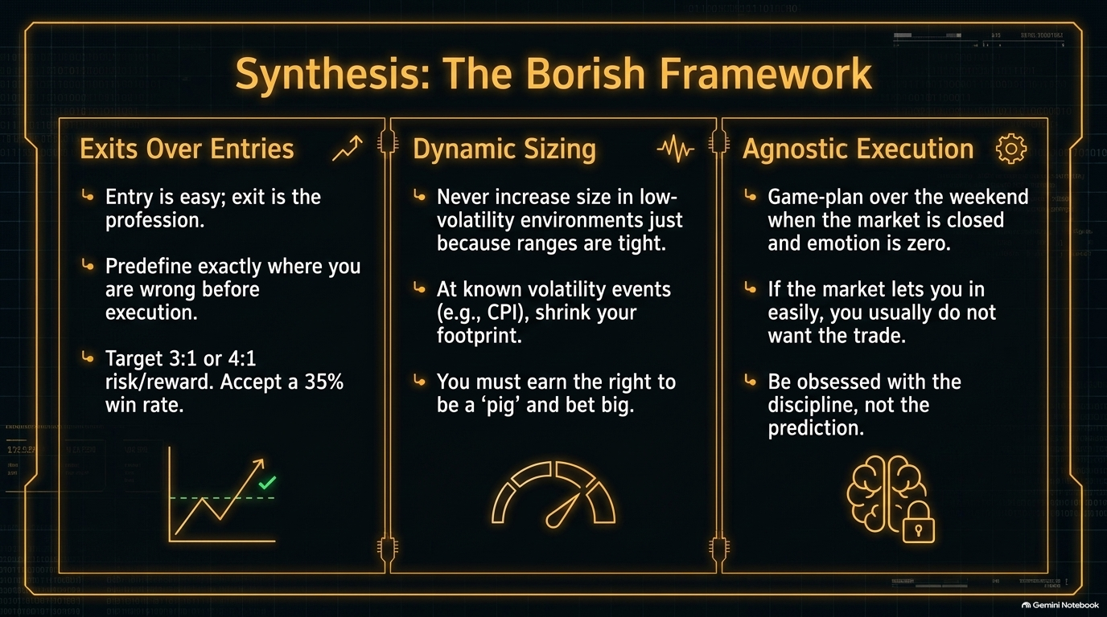
Notes:
Estimated Speaking Time: 4 – 5 minutes.
Speaker Notes:
Pillar 1: Exits Over Entries: "Entry is easy; exit is the profession. Predefine exactly where you are wrong before you execute. Target 3:1 or 4:1 risk-to-reward ratios so you can comfortably accept a 35% win rate."
Pillar 2: Dynamic Sizing: "Never increase size in low-volatility environments just because ranges are tight. At known volatility events like CPI releases, shrink your footprint. You must earn the right to be a 'pig' and bet big."
Pillar 3: Agnostic Execution: "Do your game-planning over the weekend when the market is closed and emotion is zero. If the market lets you in too easily, you usually don't want the trade. Be obsessed with the discipline, not the prediction."

Slide 12
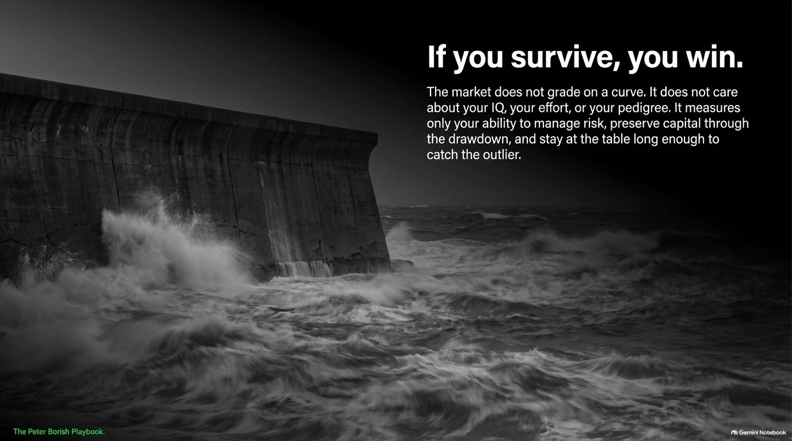
Notes:
Estimated Speaking Time: 2 – 3 minutes.
Speaker Notes:
The Ultimate Market Rule: "The market does not grade on a curve. It does not care about your IQ, your university pedigree, or how hard you tried. It measures only one thing: your ability to manage risk, preserve capital through the drawdown, and stay at the table long enough to catch the outlier."
Closing Thought: "If you stay in business, if you protect your downside, and if you respect the brutal math of the grid—you win."

Slide 13
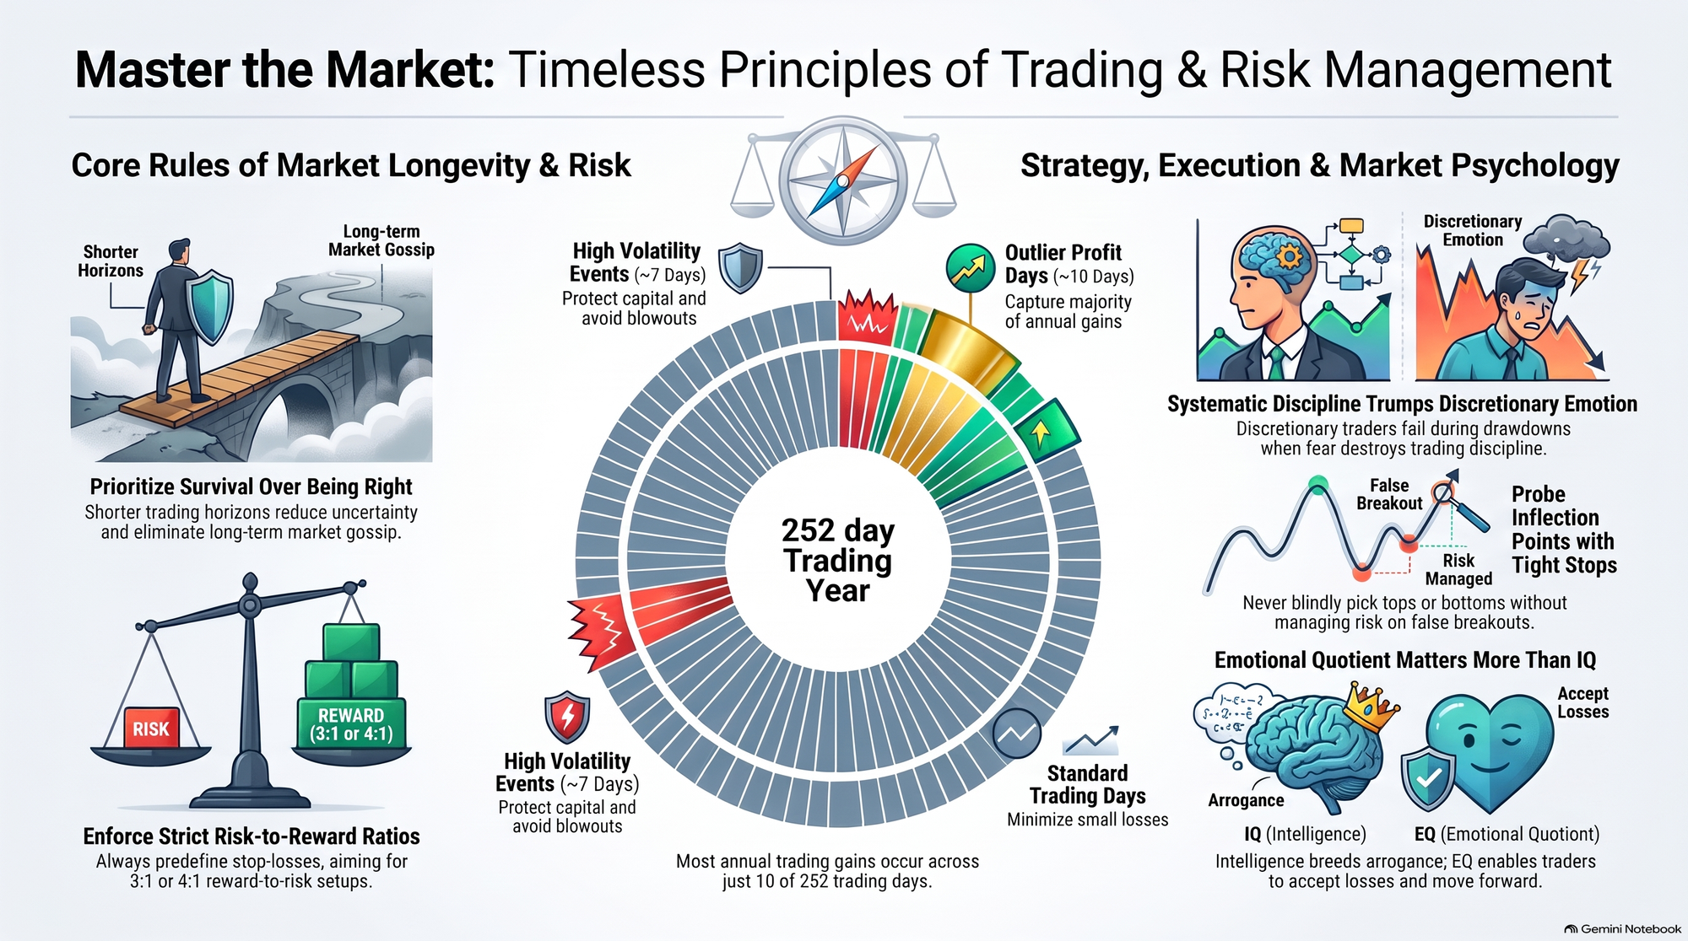
Notes:
Estimated Speaking Time: 3 – 5 minutes.
Speaker Notes:
Summary and Integration: "As we bring this playbook together, look at how all these pieces interlock. Shorter horizons eliminate market gossip. Strict 3:1 risk-to-reward ratios protect your capital. Respecting high-volatility events keeps you solvent. And superior emotional intelligence trumps raw intellect every single time."
Final Charge: "Take these principles back to your desks. Master your exits, size your risk dynamically, respect the 252-day grind, and remember: If you survive, you win. Thank you."

