Slide 1
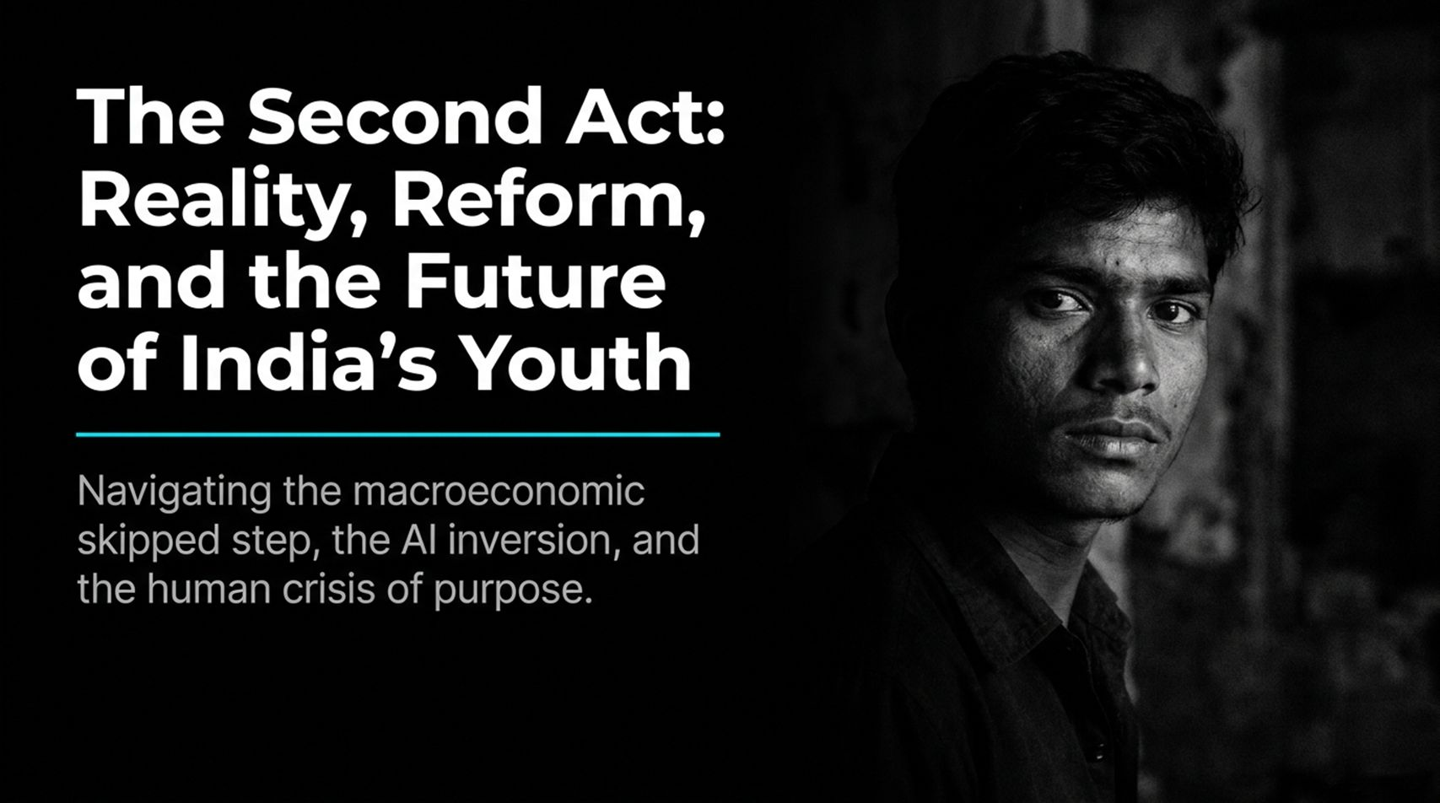
Notes:
Reality About India’s Growth, Job Crisis, AI & Manufacturing | Gurcharan Das | The Second Act
https://www.youtube.com/watch?v=uvLIxE8wNY4

Slide 2
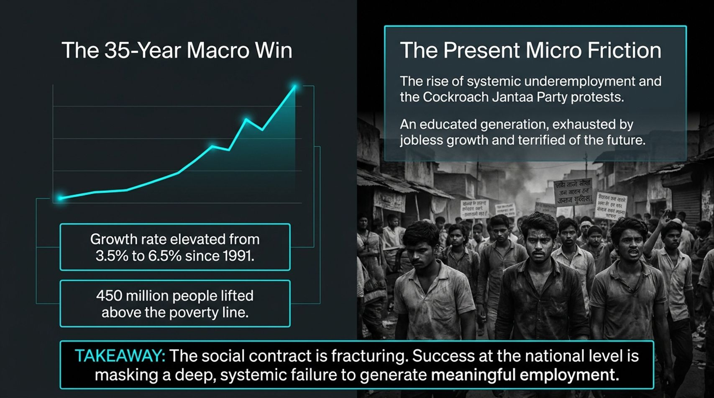

Slide 3
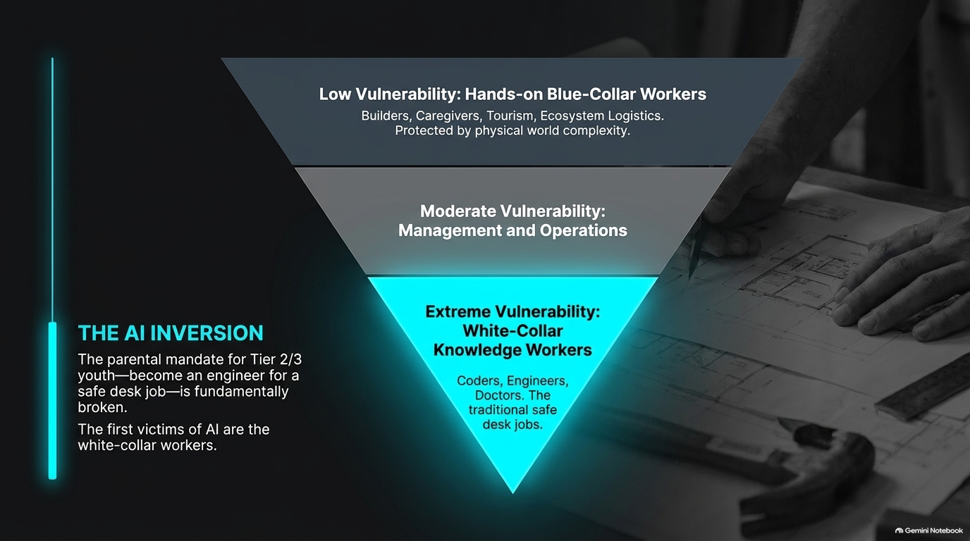

Slide 4
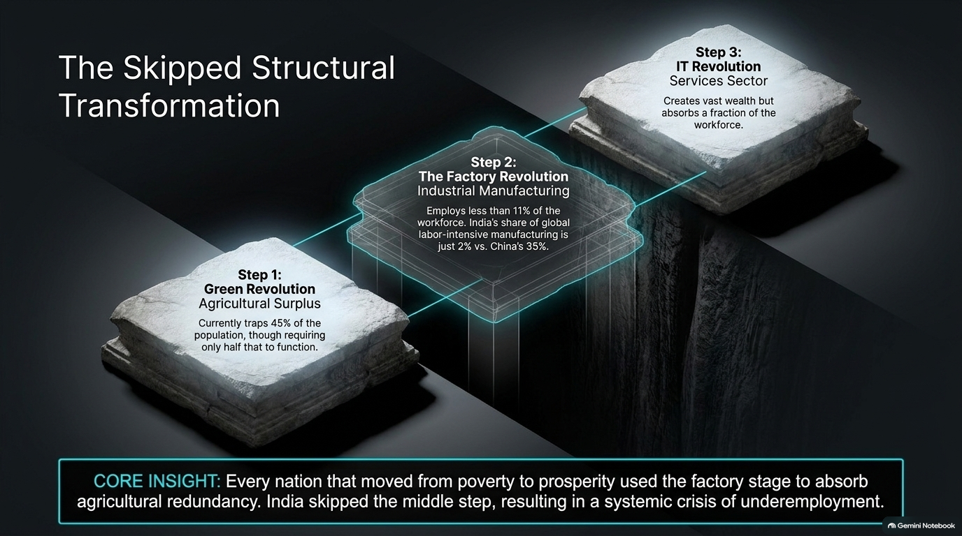

Slide 5


Slide 6
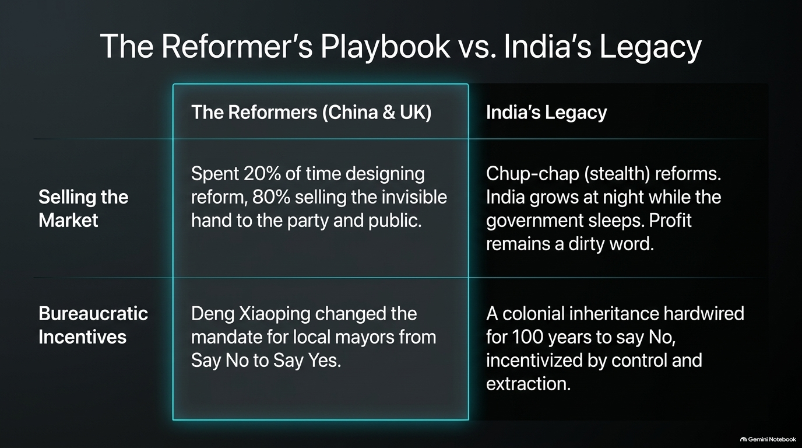

Slide 7
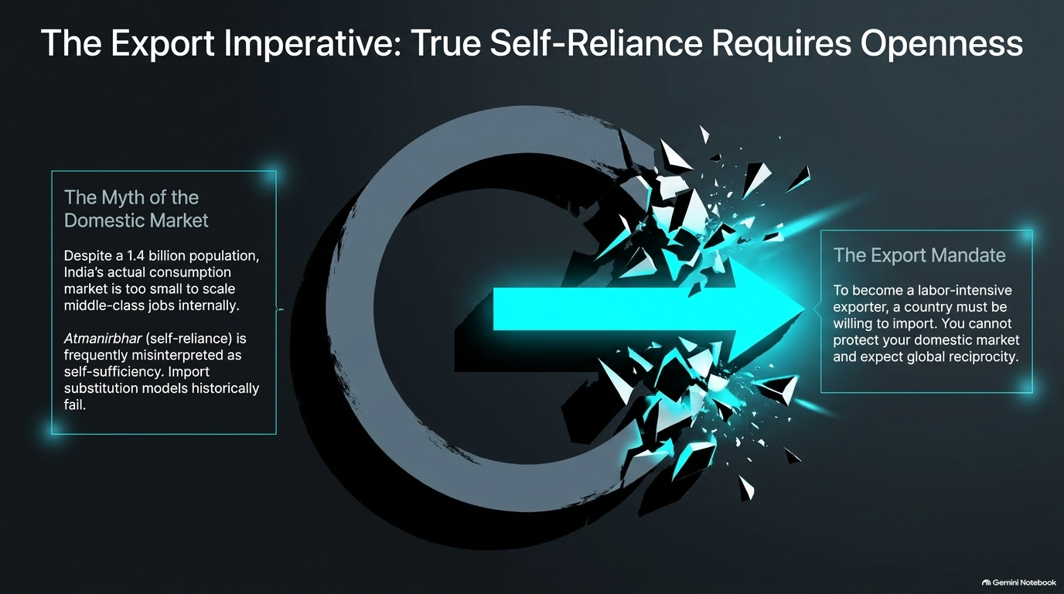

Slide 8
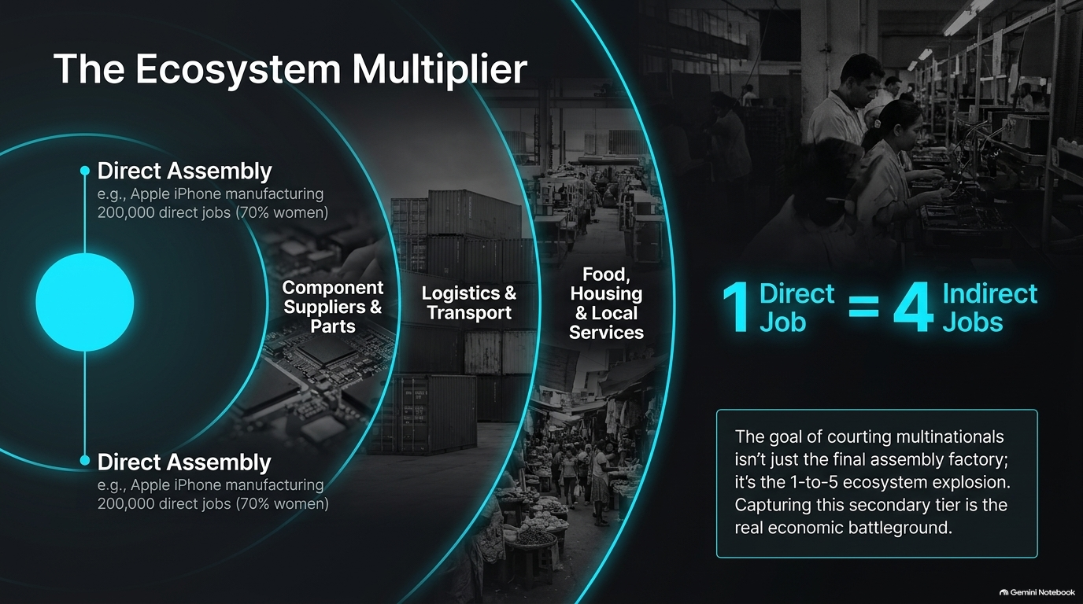

Slide 9
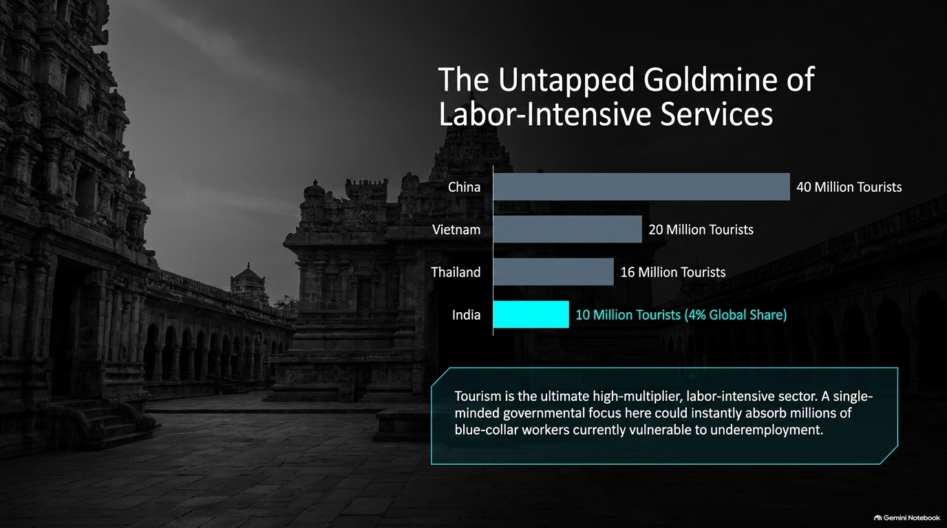

Slide 10
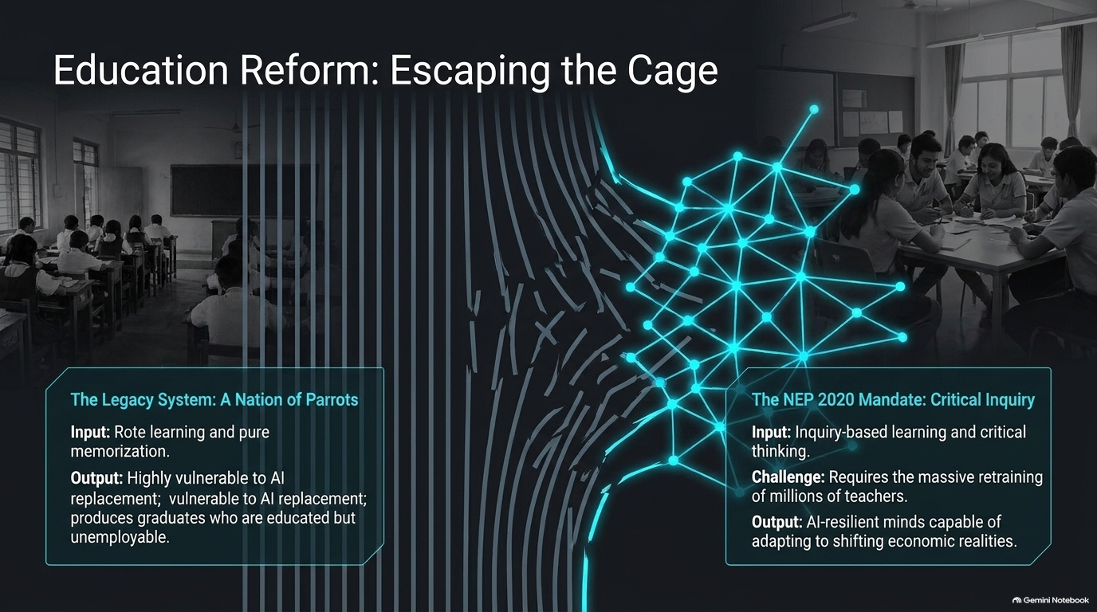

Slide 11
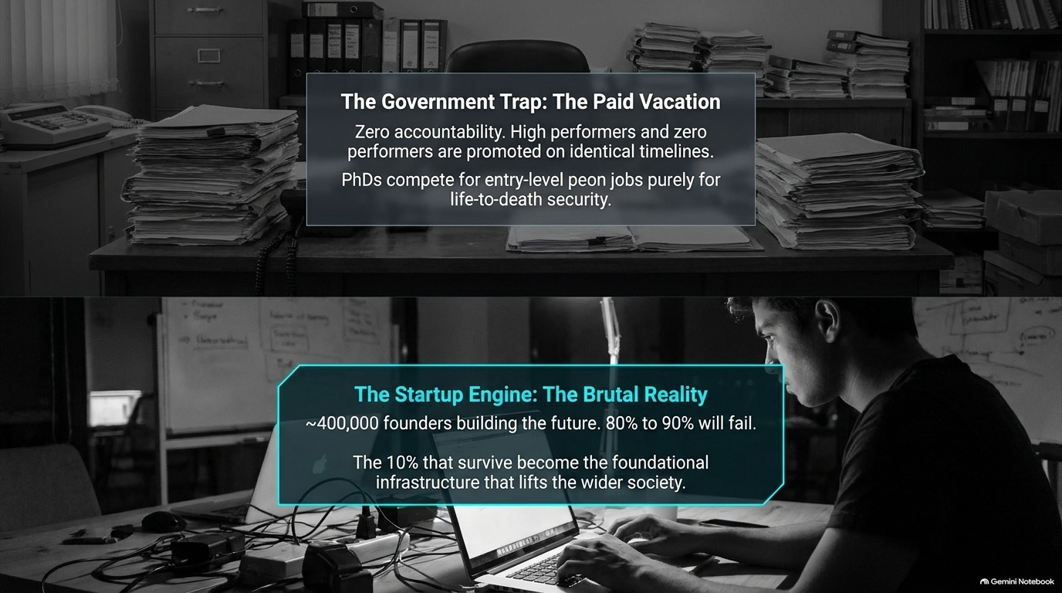

Slide 12
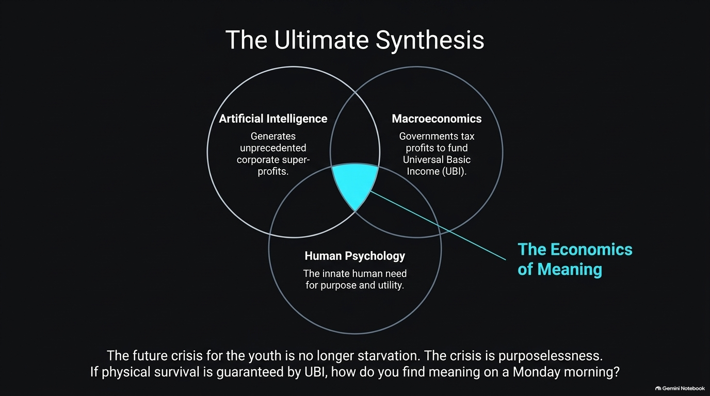

Slide 13


Slide 14


Slide 15


Slide 16
