Slide 1
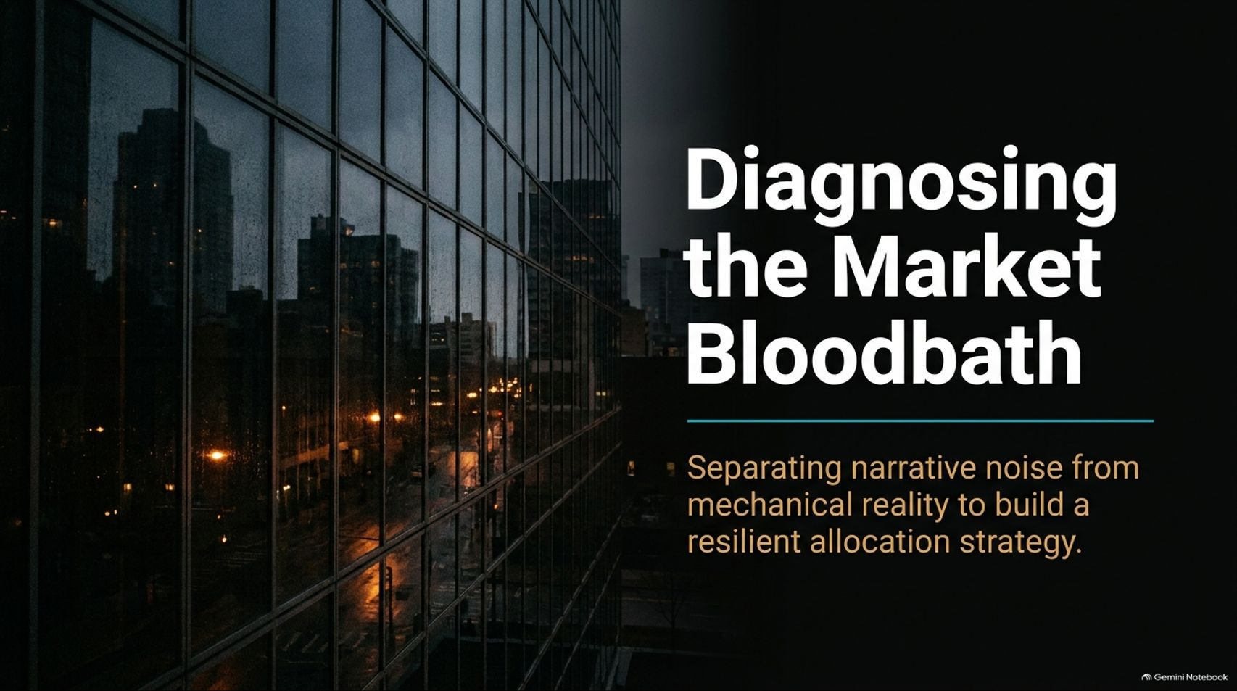
Notes:
Target Speaking Time: ~3–4 Minutes
Speaker Script:
"Welcome, everyone. Today we are addressing a critical market moment: diagnosing the recent market bloodbath.
When markets experience sudden, violent sell-offs, human psychology instinctively scrambles for a catastrophic narrative to explain the pain. But as professional portfolio managers and analytical investors, our job is to strip away political noise and emotional panic to expose the underlying market mechanics.
Over the next few minutes, we will separate headline noise from structural reality, examining why passive index stability is an illusion, how credit plumbing is behaving, and how to construct a resilient allocation strategy that survives volatility."
Is The Worst Of The Sell-off Over? | Michael Lebowitz
https://www.youtube.com/watch?v=S0p0HMazP44

Slide 2
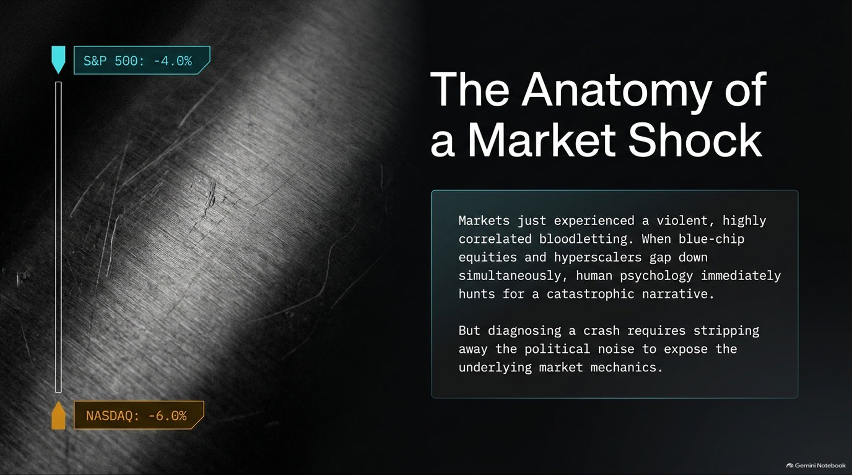
Notes:
Target Speaking Time: ~4 Minutes
Speaker Script:
"Let's look at the anatomy of what just happened. Markets recently went through a violent, highly correlated bloodletting where blue-chip equities and hyperscalers gapped down simultaneously. The S&P 500 tumbled over 4%, while the Nasdaq dropped nearly 6%.
Whenever you see broad-based drops of this magnitude, the media rushes to assign apocalyptic headlines. But diagnosing a crash requires looking past the panic. It requires understanding how institutional positioning, pre-election hedging, and margin liquidations actually drive prices in the short term, independent of long-term fundamentals."

Slide 3
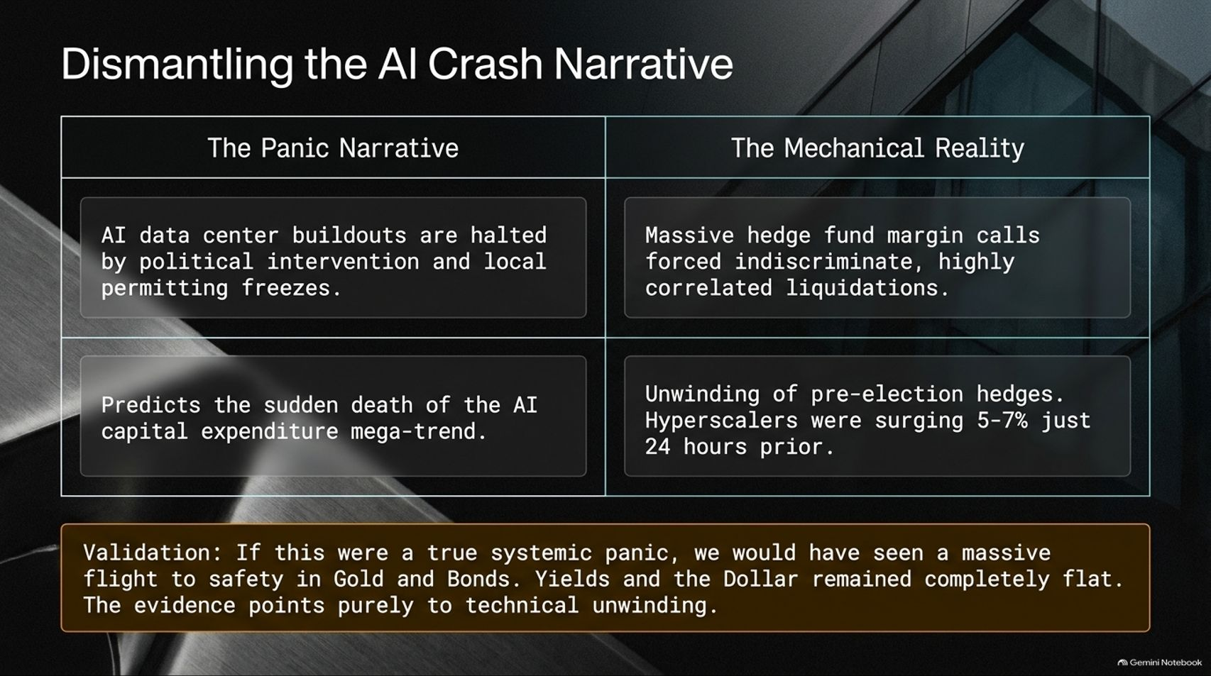
Notes:
Target Speaking Time: ~4–5 Minutes
Speaker Script:
"Let's contrast The Panic Narrative with The Mechanical Reality.
The panic narrative claims that AI data center buildouts are suddenly screeching to a halt due to local permitting freezes or political intervention, signaling the sudden death of the AI capital expenditure mega-trend.
But the mechanical reality is entirely different. What we witnessed was massive hedge fund margin calls forcing indiscriminate, highly correlated liquidations following an intense pre-election hedging cycle. Remember, just 24 hours prior, these same hyperscalers were surging 5% to 7%. Furthermore, if this were a true systemic panic, capital would have rushed into traditional safe havens like Gold and Bonds. Instead, yields and the US dollar remained completely flat. The evidence points purely to technical unwinding."

Slide 4
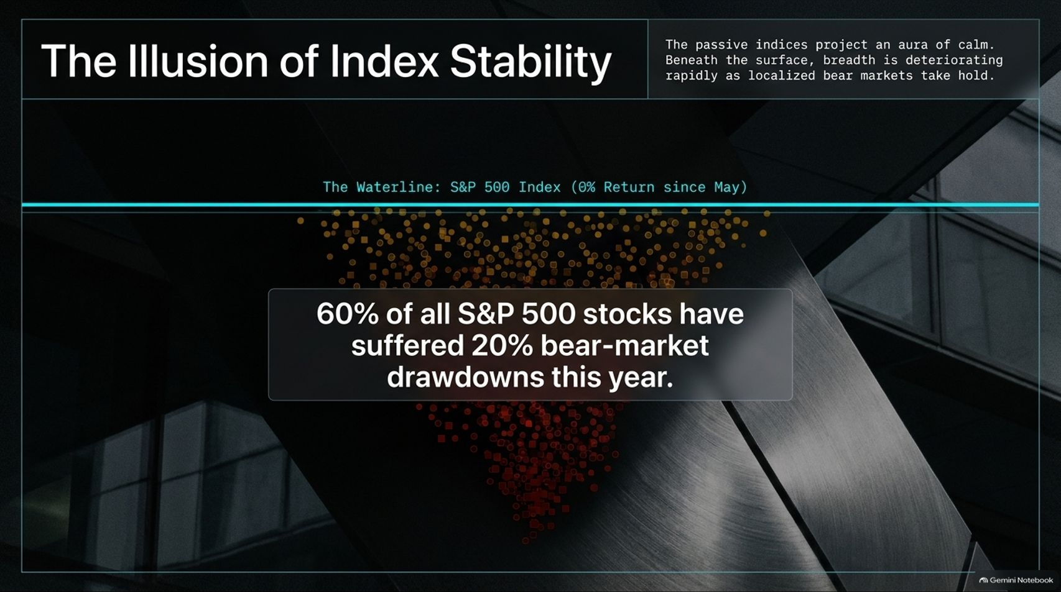
Notes:
Target Speaking Time: ~4 Minutes
Speaker Script:
"One of the most dangerous traps for investors this year has been The Illusion of Index Stability.
Passive indices project a comforting aura of calm, hovering around a flat waterline with 0% return since May. But beneath that surface calm, market breadth has been deteriorating rapidly as localized bear markets take hold.
In fact, 60% of all S&P 500 stocks have suffered 20% bear-market drawdowns this year. If you rely strictly on passive, buy-and-hold index tracking, you are sitting completely still while underlying components undergo massive turbulence."

Slide 5
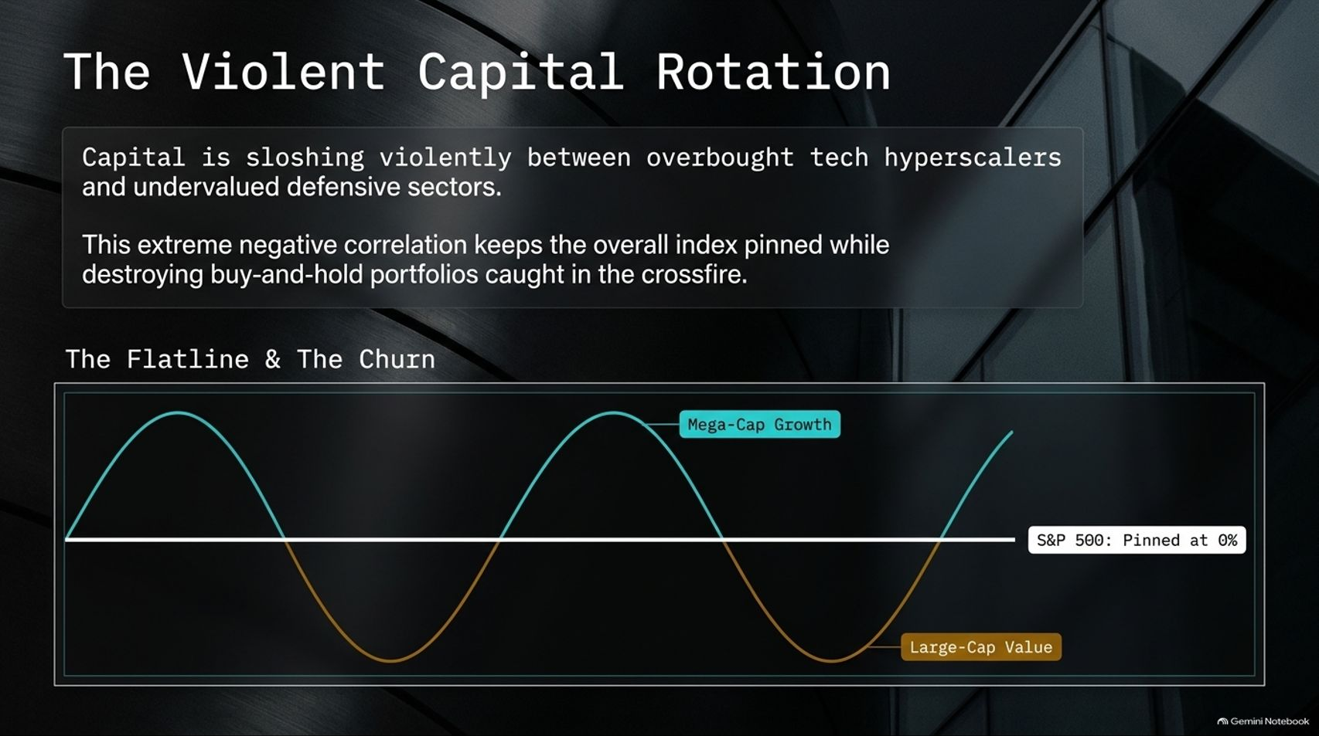
Notes:
Target Speaking Time: ~4–5 Minutes
Speaker Script:
"That stability at the index level is driven by a Violent Capital Rotation.
Capital is sloshing aggressively between overbought tech hyperscalers and undervalued defensive sectors. This extreme negative correlation keeps the overall index pinned flat in a churn, while systematically punishing buy-and-hold portfolios caught in the crossfire.
When mega-cap growth surges, value dips; when growth corrects, defensive value steps in. Understanding this cyclical churn is essential for navigating modern market regimes."

Slide 6
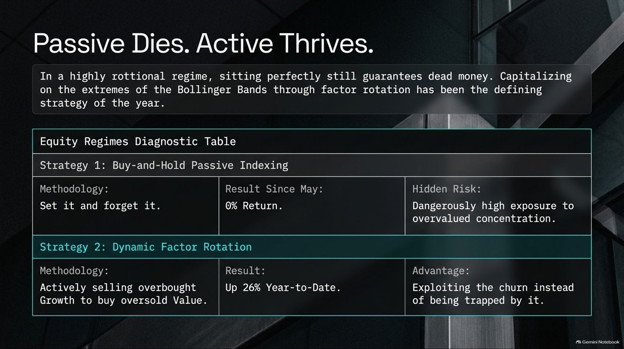
Notes:
Target Speaking Time: ~4–5 Minutes
Speaker Script:
"In this highly rotational regime, sitting perfectly still with a 'set-it-and-forget-it' mindset guarantees dead money.
Look at our Equity Regimes Diagnostic Table:
Strategy 1 (Passive Indexing): Yields a 0% return since May, exposing portfolios to dangerously high concentration risk.
Strategy 2 (Dynamic Factor Rotation): Actively selling overbought growth to buy oversold value has outperformed significantly, capturing strong year-to-date gains.
The advantage lies in exploiting the churn rather than being trapped underneath it."

Slide 7
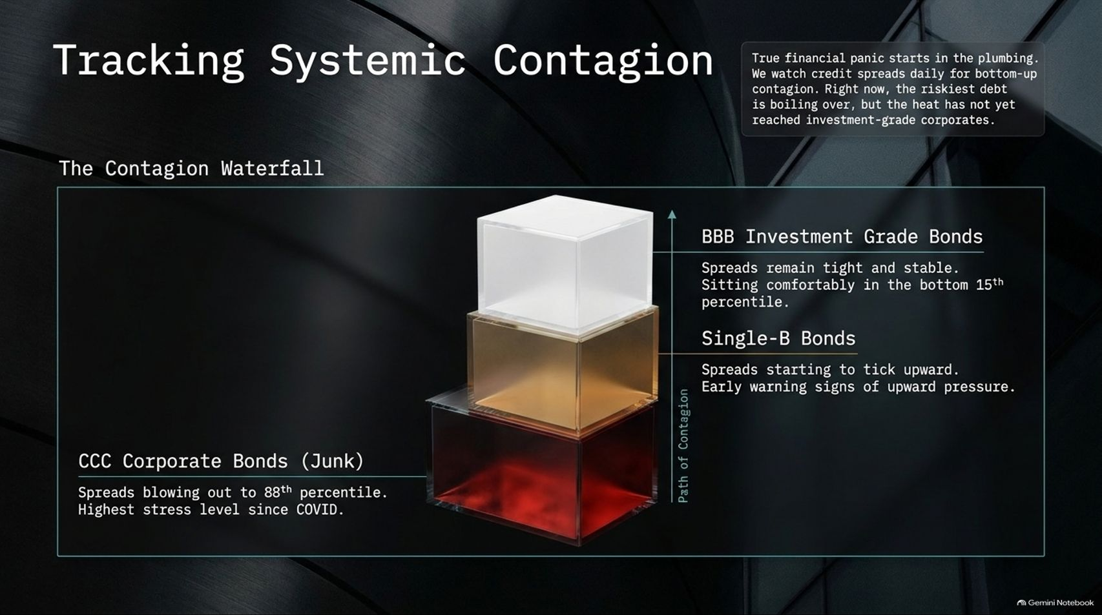
Notes:
Target Speaking Time: ~4–5 Minutes
Speaker Script:
"True financial panic starts in the plumbing. We must track credit spreads daily to watch for bottom-up contagion.
Looking at our Contagion Waterfall:
BBB Investment Grade Bonds: Spreads remain tight, stable, and comfortable in the bottom 15th percentile.
Single-B Bonds: Spreads are starting to tick upward, serving as early warning signs.
CCC Corporate Junk Bonds: Spreads are blowing out to the 88th percentile, reaching stress levels not seen since COVID.
While stress is boiling over in the riskiest debt, the heat has not yet fully infected investment-grade corporates—a boundary we monitor daily."

Slide 8
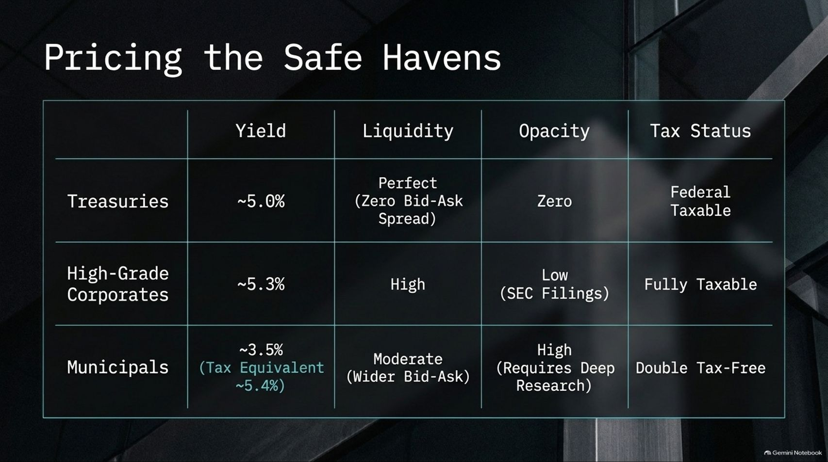

Slide 9
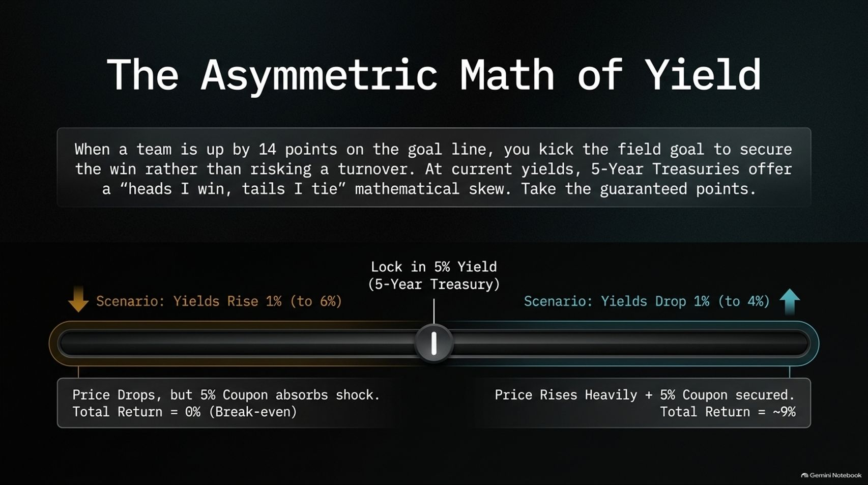

Slide 10
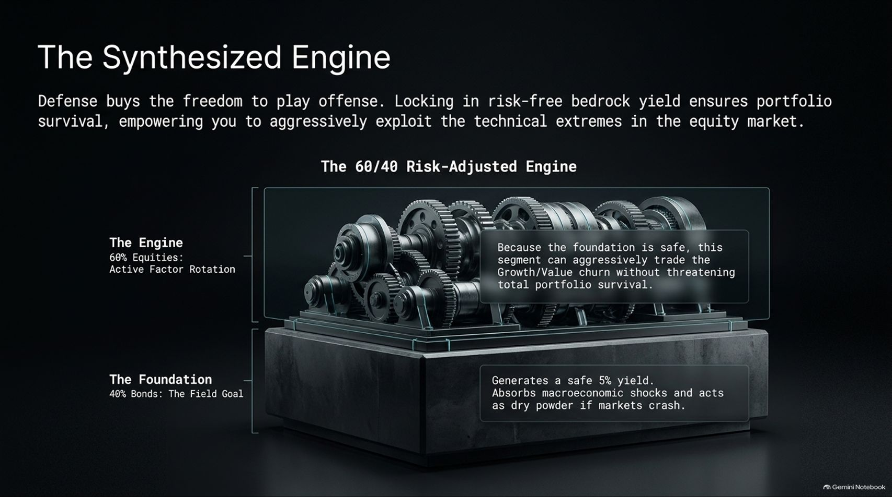
Notes:
Target Speaking Time: ~4–5 Minutes
Speaker Script:
"Defense buys you the freedom to play offense. Locking in risk-free bedrock yield ensures portfolio survival and provides the dry powder needed to aggressively exploit equity market extremes.
Our 60/40 Risk-Adjusted Engine operates on two levels:
The Foundation (40% Bonds): Generates a safe 5% yield, absorbs macroeconomic shocks, and acts as dry powder if markets crash.
The Engine (60% Equities): Utilizes active factor rotation to trade the growth-value churn without threatening total portfolio survival.
You achieve market-like returns, but with significantly less risk."

Slide 11
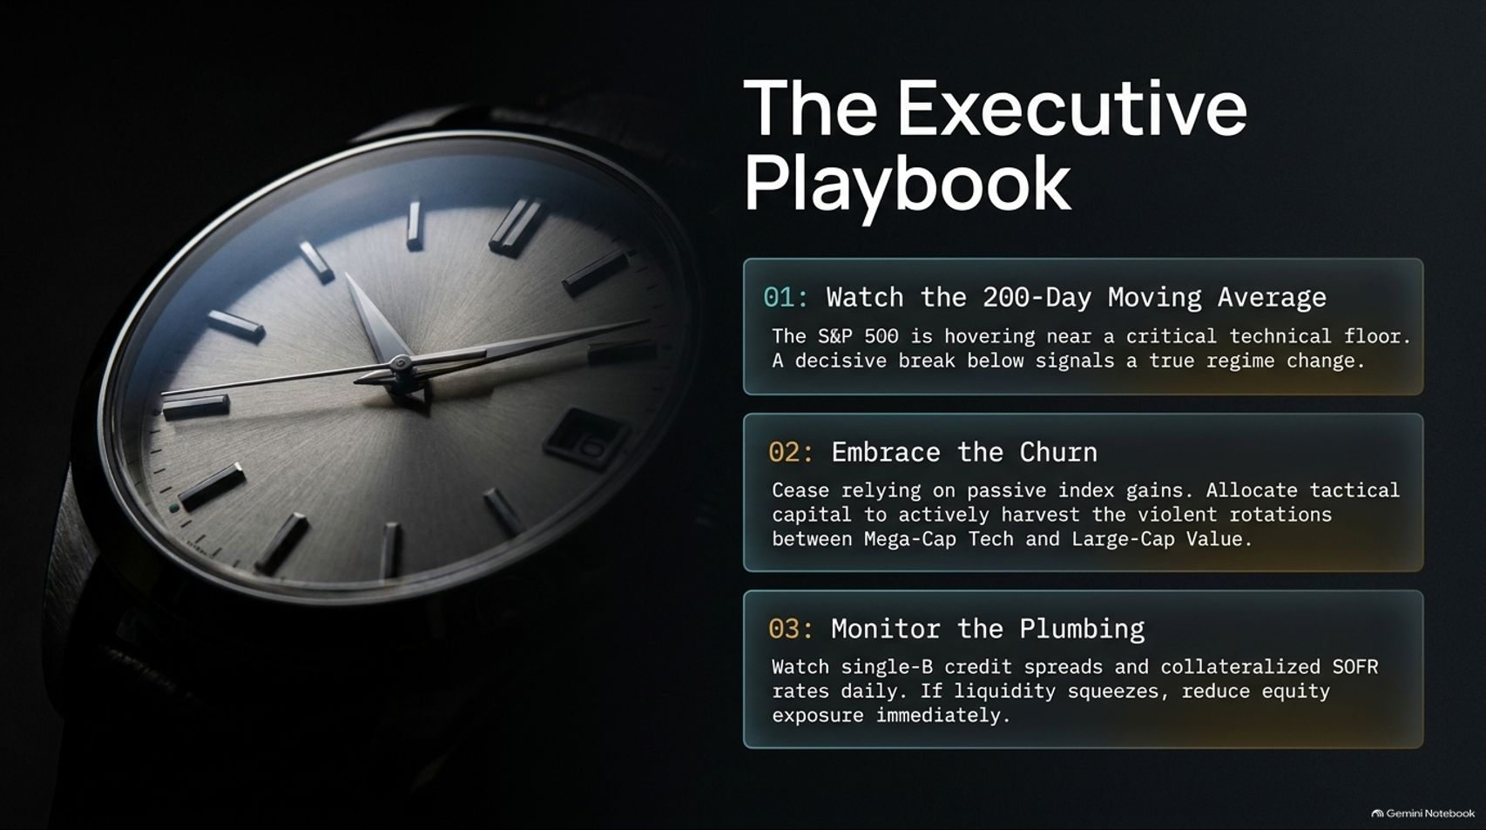
Notes:
Target Speaking Time: ~3–4 Minutes
Speaker Script:
"To execute this strategy successfully, follow our Executive Playbook:
Watch the 200-Day Moving Average: The S&P 500 is hovering near a critical technical floor; a decisive break below signals a true macro regime change.
Embrace the Churn: Stop relying on passive index gains and allocate tactical capital to actively harvest rotations between mega-cap tech and large-cap value.
Monitor the Plumbing: Keep a daily eye on single-B credit spreads and collateralized SOFR rates. If liquidity tightens severely, reduce equity exposure immediately."

Slide 12

Notes:
Target Speaking Time: ~3–4 Minutes
Speaker Script:
"Financial markets are mechanisms, not mandates. The ultimate purpose of securing yield and managing risk is not to obsess over daily technical charts, but to fund a life well-lived.
True wealth is measured entirely in the currency of quality relationships, engaged purpose, and physical health. Secure your financial field goal, protect your peace of mind, and go live your life."

Slide 13
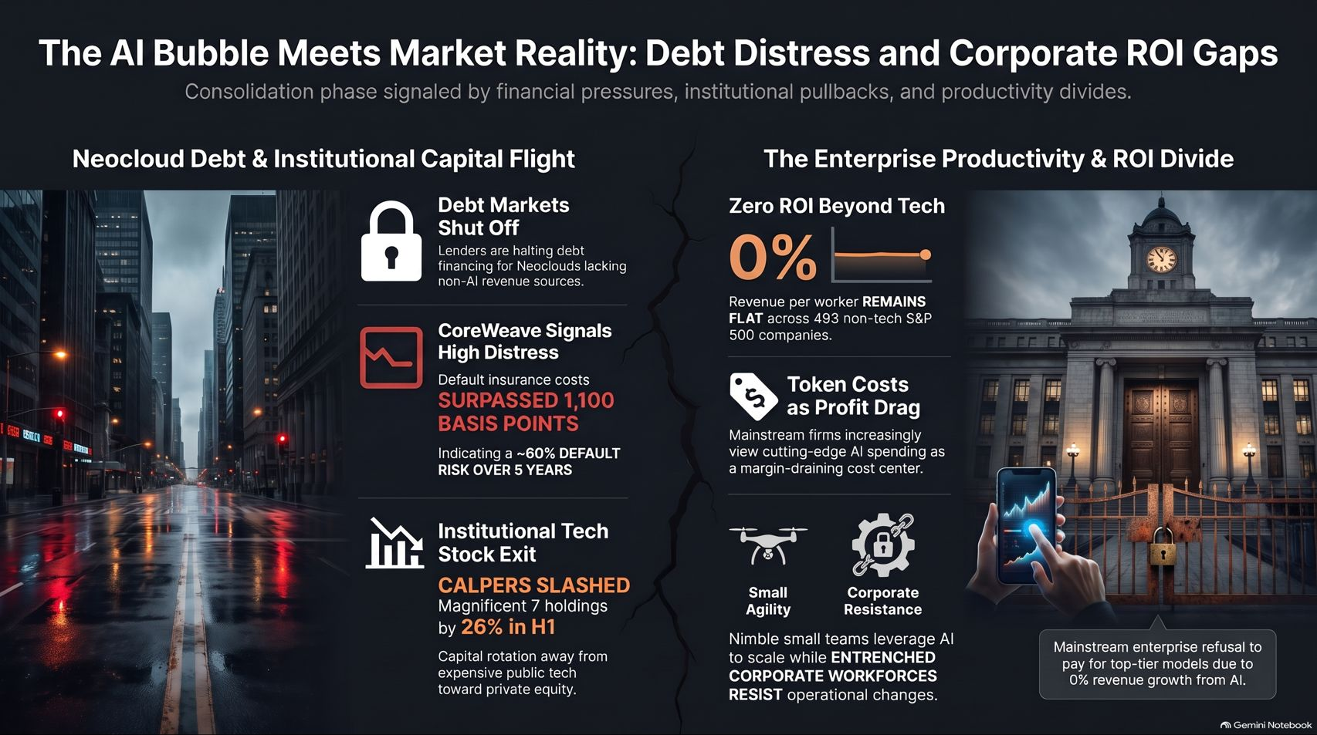
Notes:
Target Speaking Time: ~4 Minutes
Speaker Script:
"As we conclude, let's address the structural divide between Neocloud Debt and Enterprise Productivity.
On the left, debt markets are tightening for Neoclouds lacking non-AI revenue, and distress signals are rising. On the right, enterprise productivity metrics show a 0% ROI gain across hundreds of non-tech S&P 500 companies, as cutting-edge AI spending increasingly acts as a margin-draining cost center rather than an immediate profit driver.
By maintaining disciplined factor rotation, monitoring credit plumbing, and prioritizing bedrock yield, we insulate our portfolios against these structural disconnects. Thank you."

