Slide 1
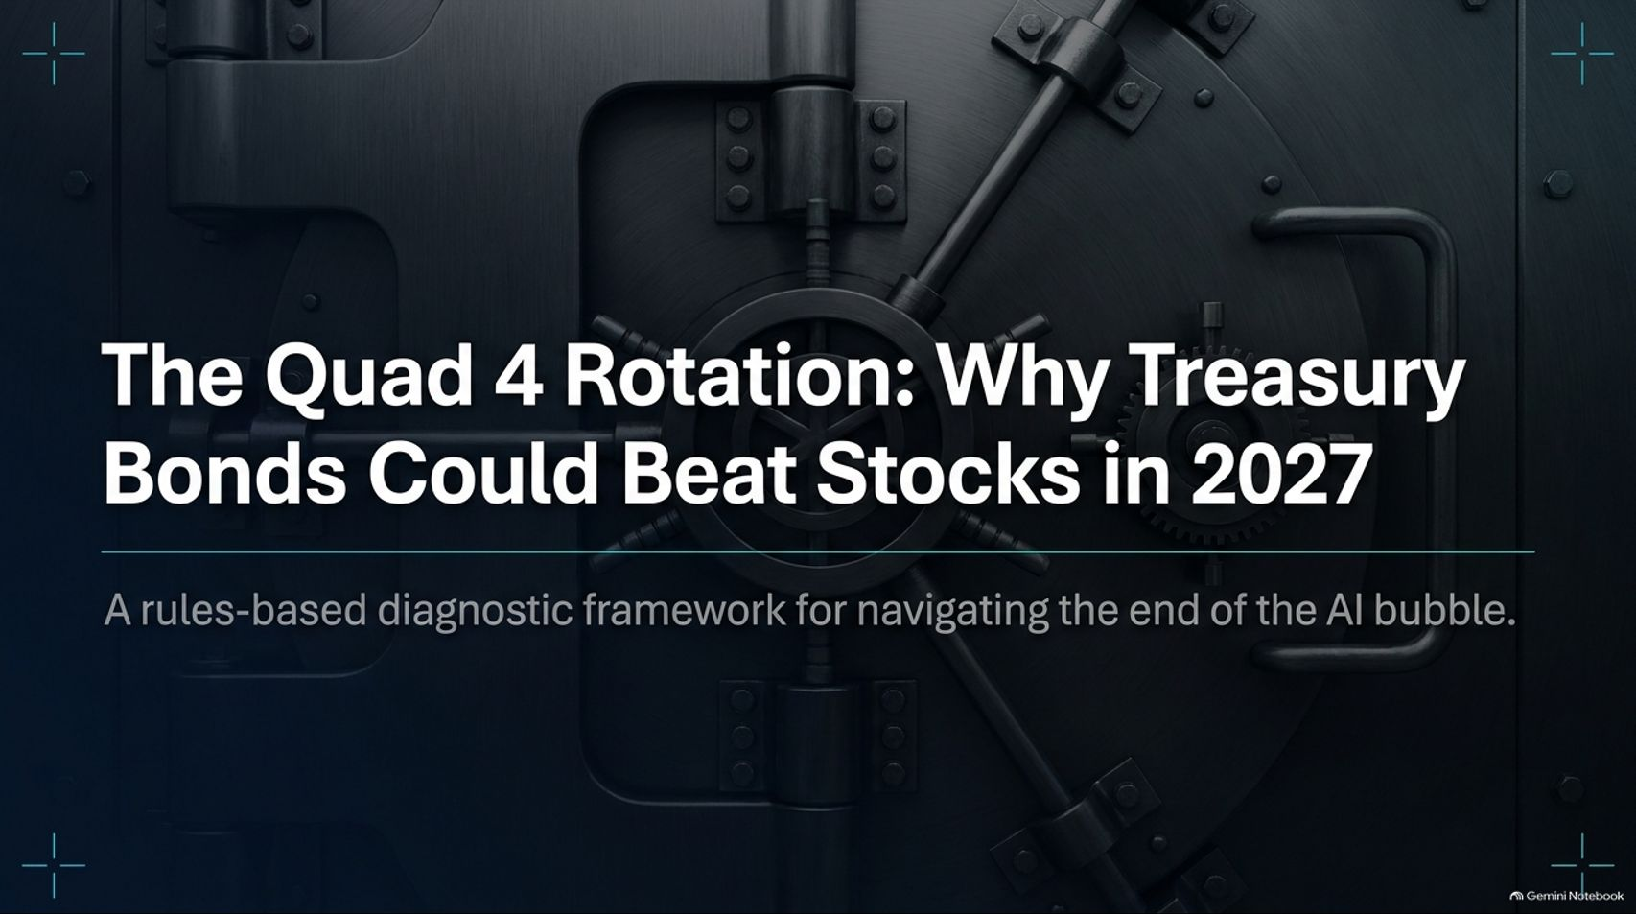
Notes:
Target Speaking Time: ~3–4 Minutes
Speaker Script:
"Welcome, everyone. Today we are presenting a rigorous, rules-based diagnostic framework for navigating what comes next: The Quad 4 Rotation: Why Treasury Bonds Could Beat Stocks in 2027.
As explored in recent market analysis with macro experts Bob Elliot and Ahan Haque, the financial markets are currently transfixed by short-term political noise and post-election tape bombs. But true market practitioners do not trade on political headlines—they trade on economic gravity.
Across these 15 slides, we will examine why the post-pandemic AI and capital expenditure bubble has peaked, how the macro framework is shifting into Quad 4, and why Treasury bonds represent the ultimate asymmetrical allocation move. Let's dive into the data."
The Fed Could Tighten Into a Stock Market Crash | Keith McCullough
https://www.youtube.com/watch?v=okZpJ7E__og

Slide 2
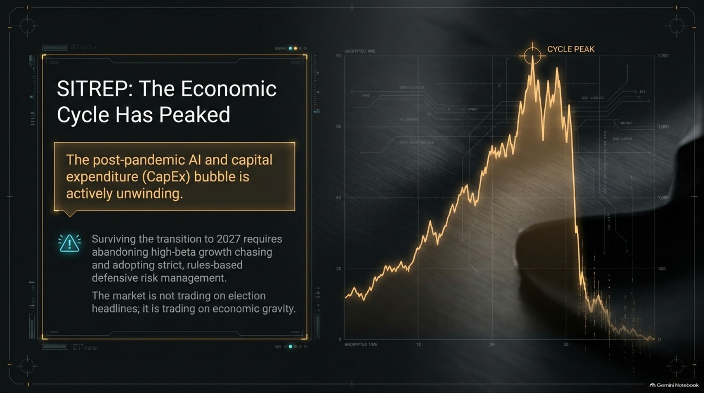
Notes:
Target Speaking Time: ~4–5 Minutes
Speaker Script:
"Let’s start with Slide 2: SITREP: The Economic Cycle Has Peaked.
The Core Reality: The post-pandemic AI and capital expenditure (CapEx) bubble is actively unwinding.
The Strategic Imperative: Surviving the transition to 2027 requires abandoning high-beta growth chasing and adopting strict, rules-based defensive risk management.
Takeaway: The market is not trading on election headlines or superficial relief rallies; it is being pulled down by undeniable economic gravity. When cycles peak, fundamentals and liquidity dictate the outcome."

Slide 3
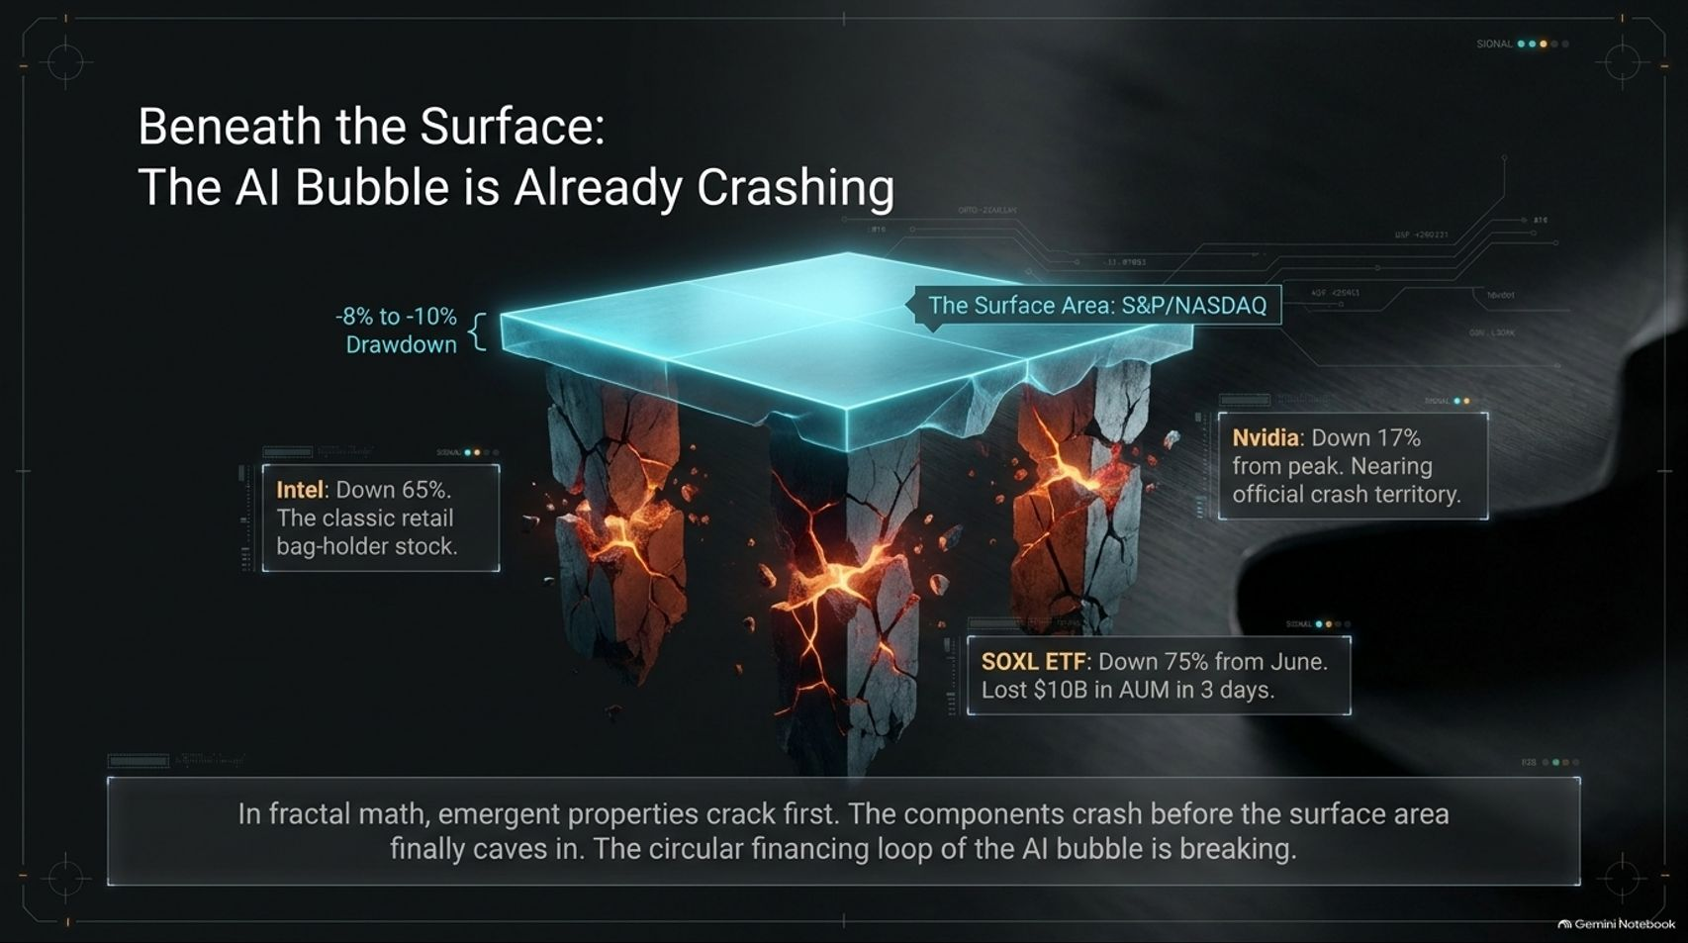
Notes:
Target Speaking Time: ~4–5 Minutes
Speaker Script:
"Slide 3 reveals what is happening Beneath the Surface: The AI Bubble is Already Crashing.
While the headline surface indices (S&P/NASDAQ) might only show a modest -8% to -10% drawdown, fractal math teaches us that emergent properties crack first. The underlying components are breaking down before the surface index caves in:
Intel: Down 65%, representing the classic retail bag-holder stock.
Nvidia: Down 17% from peak, rapidly nearing official crash territory.
SOXL ETF: Down 75% from June highs, losing an astounding $10 billion in AUM in just 3 days.
Takeaway: The circular financing loop and speculative froth of the AI bubble are actively fracturing."

Slide 4
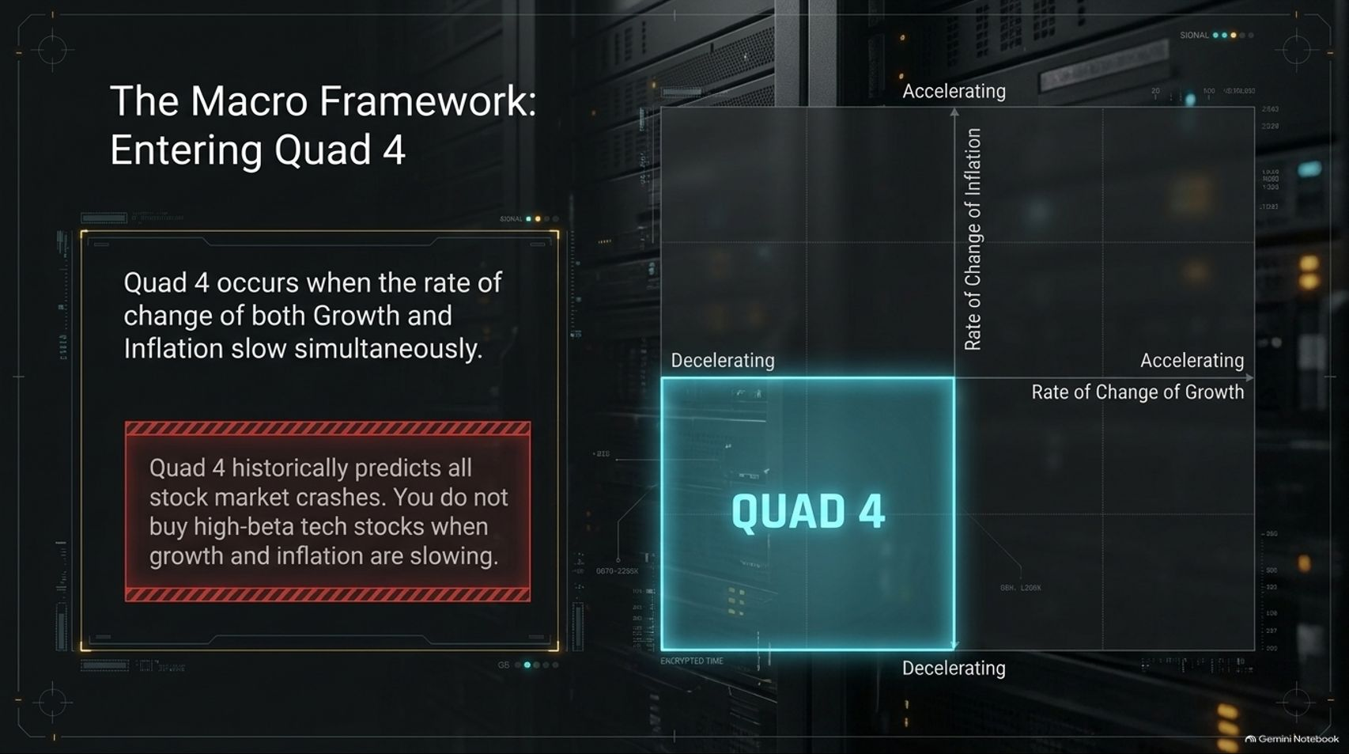
Notes:
Target Speaking Time: ~4–5 Minutes
Speaker Script:
"Slide 4 introduces our diagnostic lens: The Macro Framework: Entering Quad 4.
What is Quad 4? Quad 4 occurs when the rate of change of both Growth and Inflation slow simultaneously.
The Historical Warning: Quad 4 historically predicts all major stock market crashes. You do not buy high-beta tech stocks when growth and inflation are decelerating together.
Takeaway: Asset allocation must pivot away from growth-dependent equities and toward defensive safe havens as economic momentum rolls over."

Slide 5
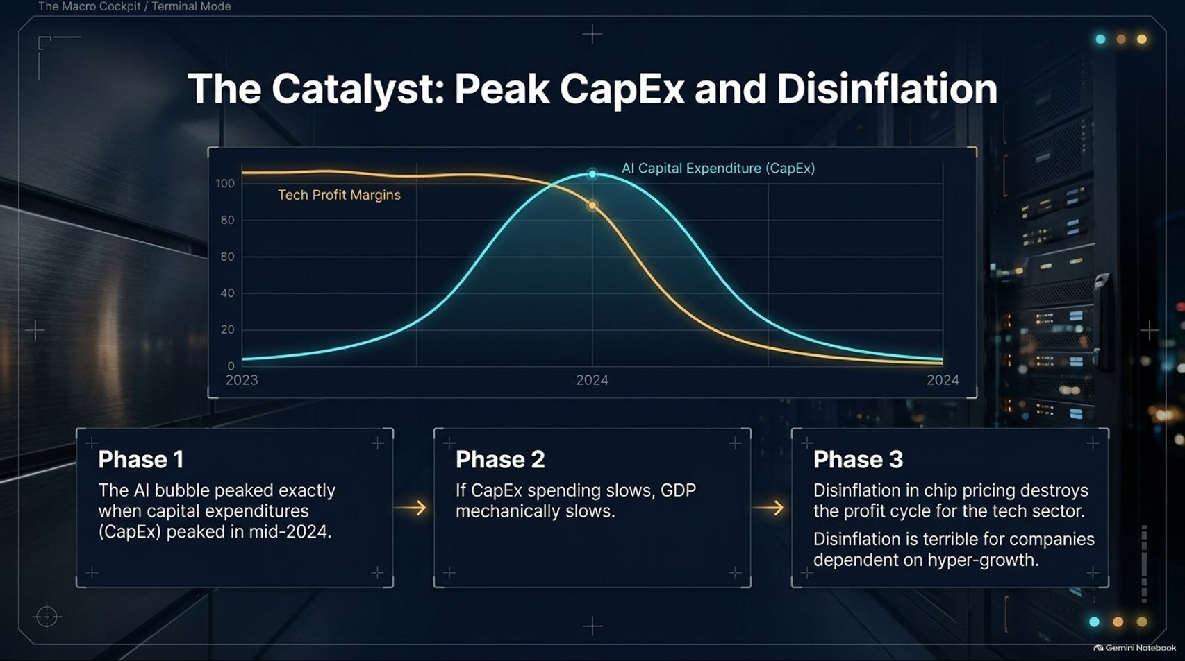
Notes:
Target Speaking Time: ~4–5 Minutes
Speaker Script:
"Let’s analyze The Catalyst: Peak CapEx and Disinflation on Slide 5.
Phase 1 (Peak): The AI bubble peaked exactly when capital expenditures (CapEx) peaked in mid-2024. As tech profit margins plateaued, CapEx growth rolled over.
Phase 2 (The Slowdown): When CapEx spending slows, GDP growth mechanically slows with it.
Phase 3 (Disinflationary Damage): Disinflation in chip pricing and tech infrastructure destroys the profit cycle for the tech sector, punishing companies dependent on hyper-growth."

Slide 6
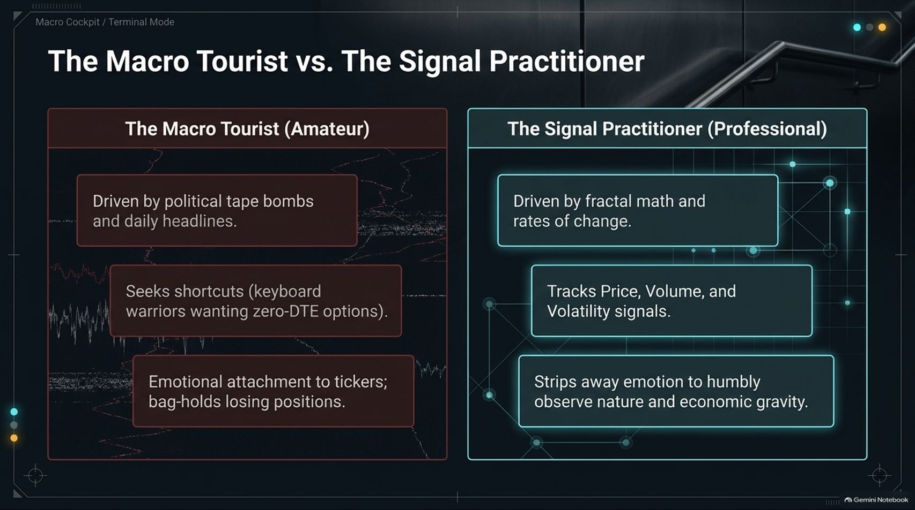
Notes:
Target Speaking Time: ~3–4 Minutes
Speaker Script:
"Slide 6 contrasts The Macro Tourist vs. The Signal Practitioner.
The Macro Tourist (Amateur): Driven by political tape bombs, daily headlines, and emotional attachment to tickers. They seek shortcuts like zero-DTE options and bag-hold losing positions.
The Signal Practitioner (Professional): Driven by fractal math, rates of change, and rigorous price/volume/volatility signals. They strip away emotion to humbly observe nature and economic gravity."

Slide 7
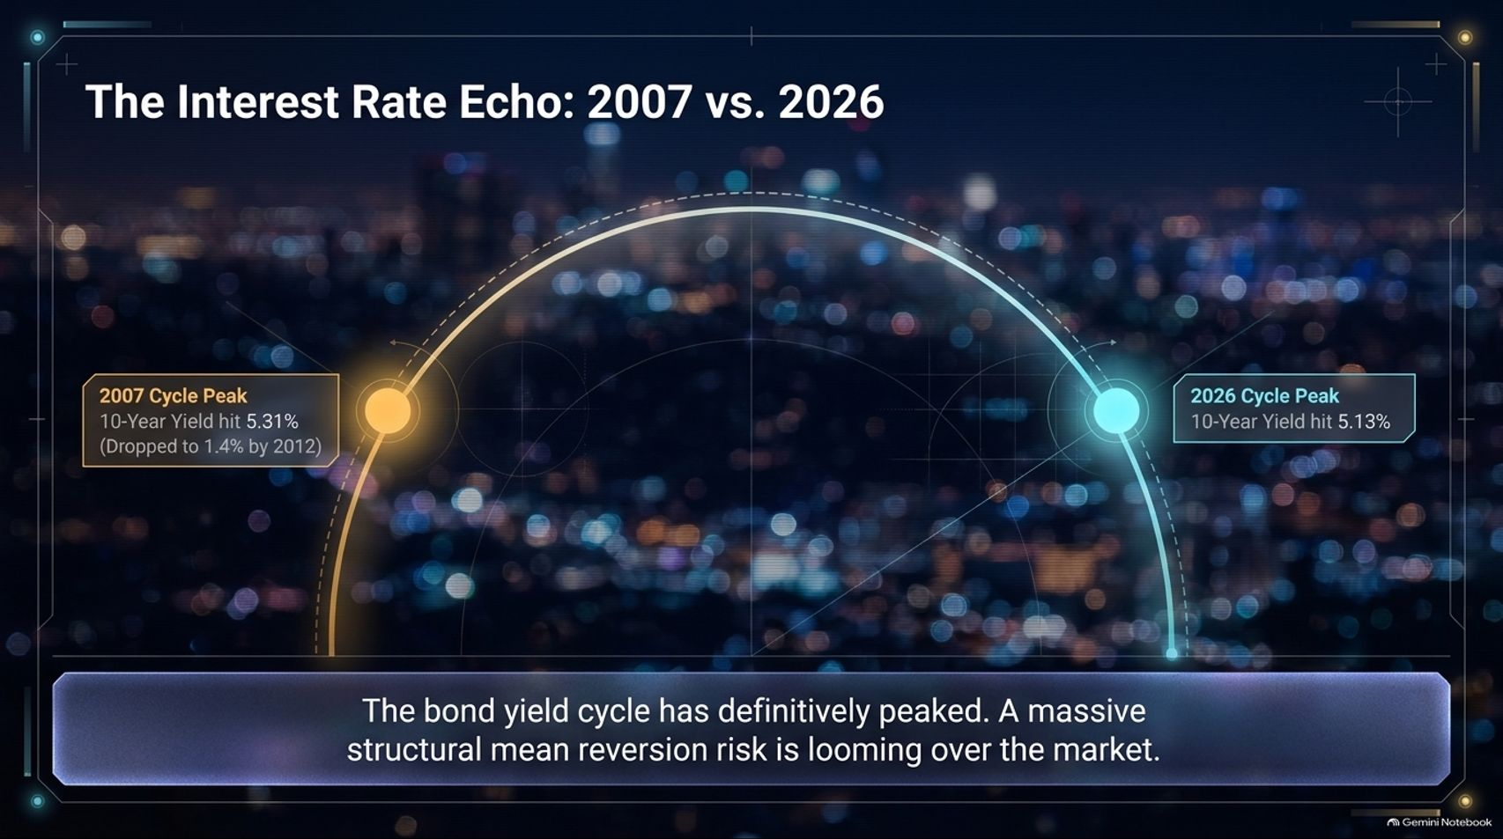
Notes:
Target Speaking Time: ~4–5 Minutes
Speaker Script:
"Slide 7 examines The Interest Rate Echo: 2007 vs. 2026.
2007 Cycle Peak: The 10-year Treasury yield hit 5.31% before dropping dramatically to 1.4% by 2012.
2026 Cycle Peak: The 10-year Treasury yield hit a near-identical peak at 5.13%.
Takeaway: The bond yield cycle has definitively peaked. A massive structural mean reversion risk is looming over the market, presenting a generational opportunity for fixed-income investors."

Slide 8
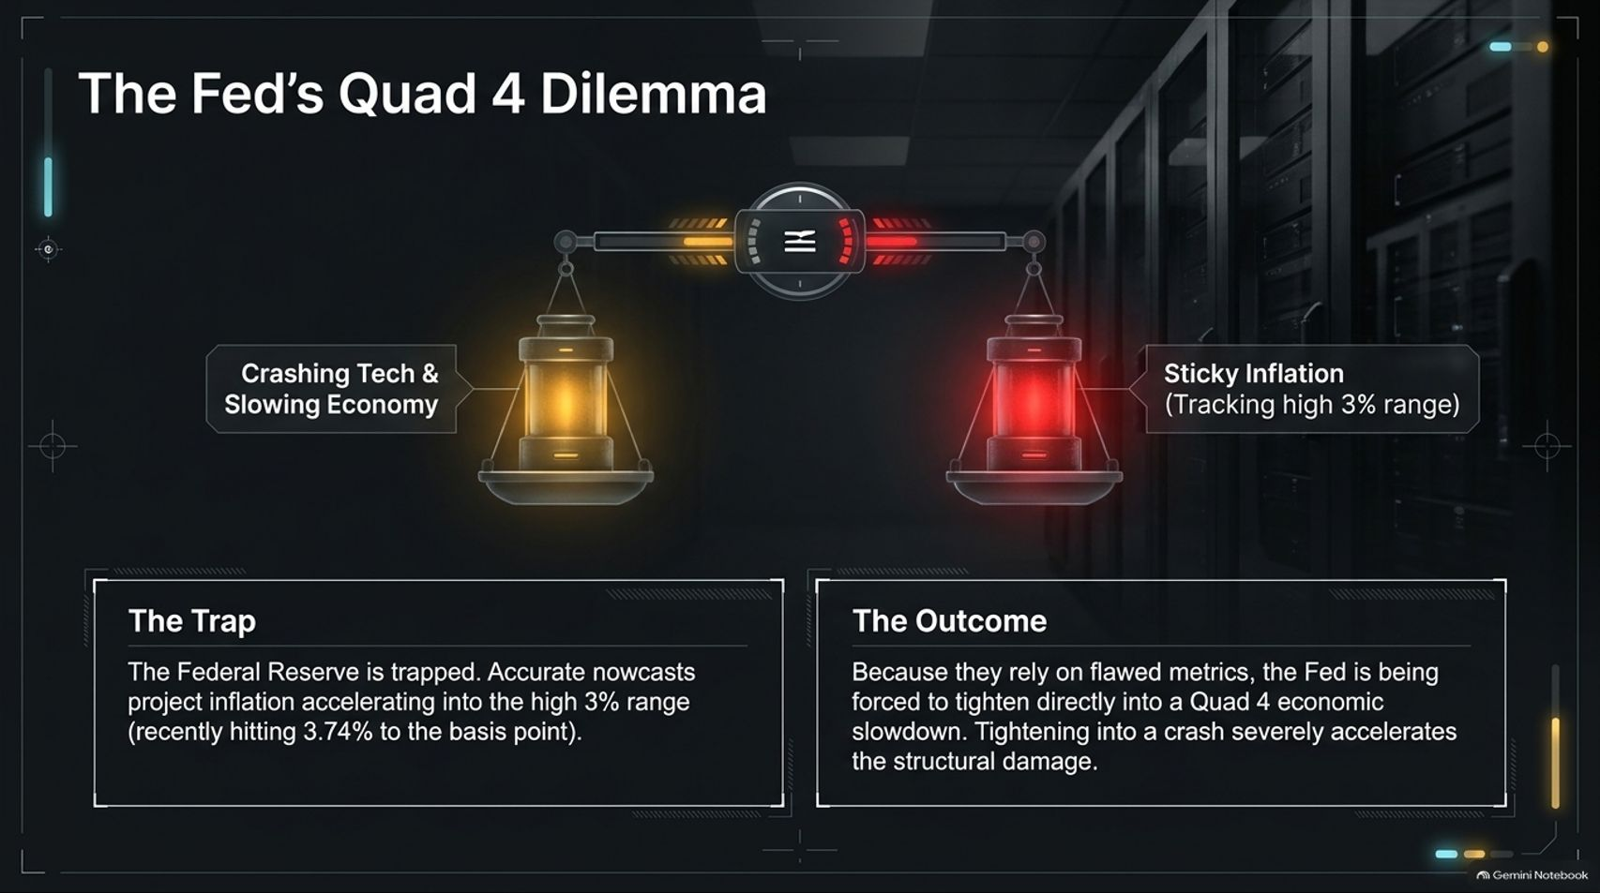
Notes:
Target Speaking Time: ~4–5 Minutes
Speaker Script:
"Slide 8 details The Fed's Quad 4 Dilemma.
The Trap: The Federal Reserve is trapped. Accurate nowcasts project inflation lingering in the high 3% range (recently hitting 3.74%), creating stubborn sticky inflation readings.
The Outcome: Because they rely on lagging metrics, the Fed risks tightening directly into a Quad 4 economic slowdown. Tightening into a crash severely accelerates structural damage across the real economy."

Slide 9
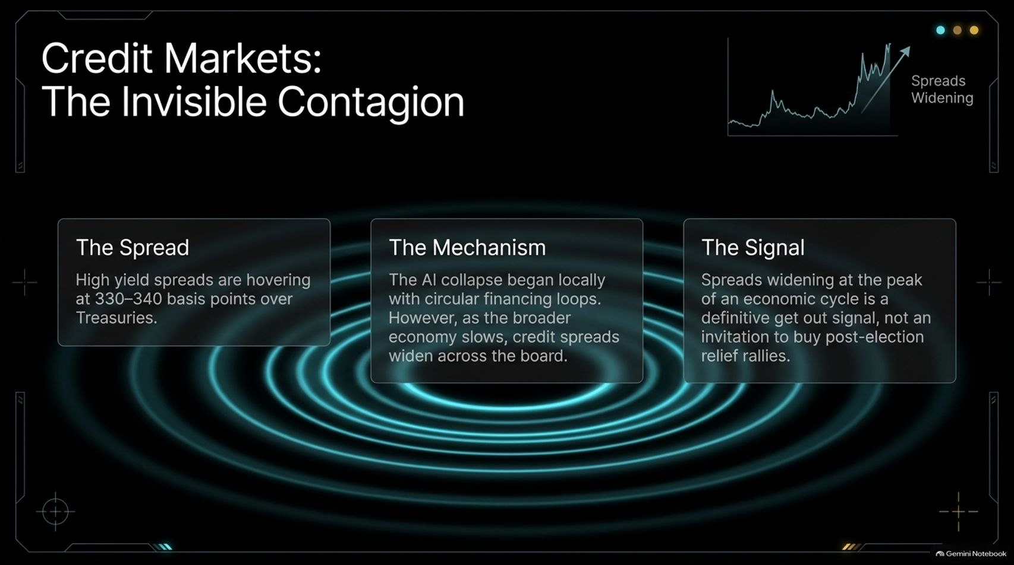
Notes:
Target Speaking Time: ~4–5 Minutes
Speaker Script:
"Slide 9 uncovers Credit Markets: The Invisible Contagion.
The Spread: High yield spreads are currently hovering at 330–340 basis points over Treasuries.
The Mechanism: The AI collapse began locally with circular financing loops. However, as the broader economy slows, credit spreads widen across the board.
The Signal: Spreads widening at the peak of an economic cycle is a definitive 'get out' signal—not an invitation to buy post-election relief rallies."

Slide 10
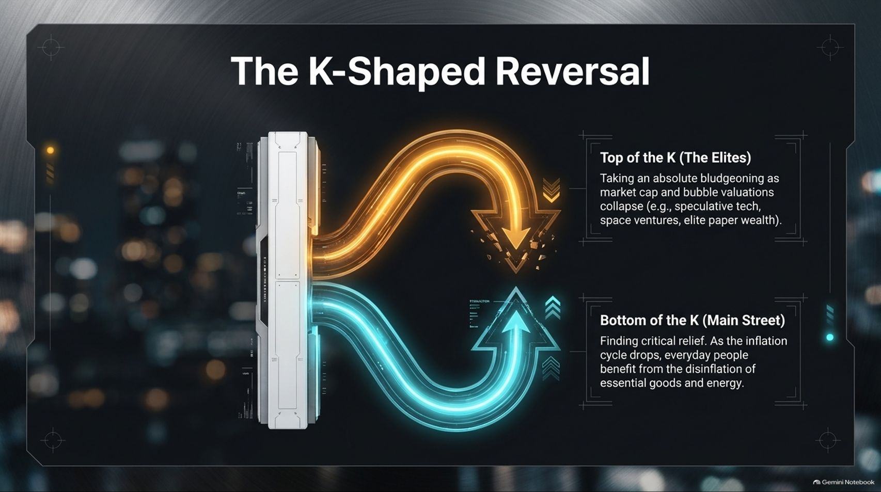
Notes:
Target Speaking Time: ~4–5 Minutes
Speaker Script:
"Slide 10 highlights The K-Shaped Reversal taking place across society.
Top of the K (The Elites): Taking an absolute bludgeoning as market cap and bubble valuations collapse—hitting speculative tech, space ventures, and elite paper wealth.
Bottom of the K (Main Street): Finding critical relief. As the inflation cycle drops, everyday people benefit from the disinflation of essential goods and energy."

Slide 11
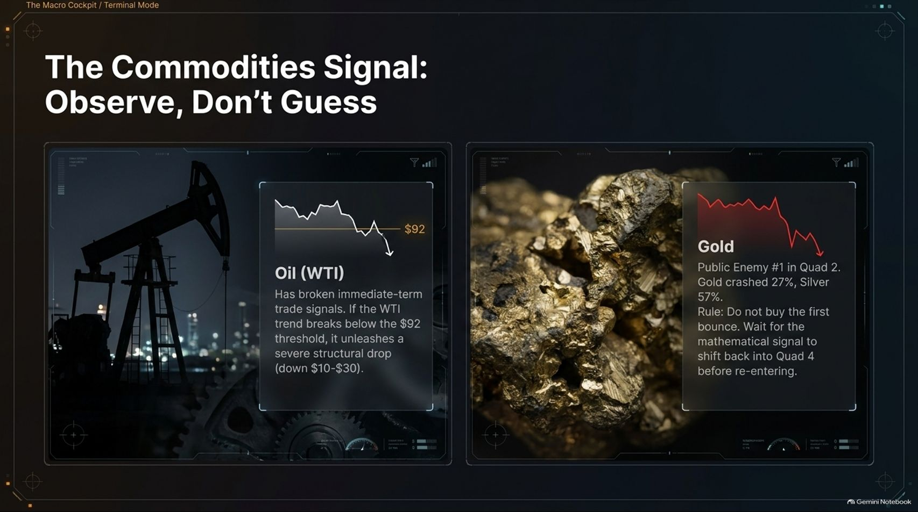
Notes:
Target Speaking Time: ~4–5 Minutes
Speaker Script:
"Slide 11 outlines The Commodities Signal: Observe, Don’t Guess.
Oil (WTI): Has broken immediate-term trade signals. If WTI trend breaks below the $92 threshold, it unleashes a severe structural drop (down $10–$30) as demand softens.
Gold: Public Enemy #1 in Quad 2, gold crashed 27% and silver dropped 57%. The Rule: Do not buy the first bounce. Wait for the mathematical signal to shift back before re-entering."

Slide 12
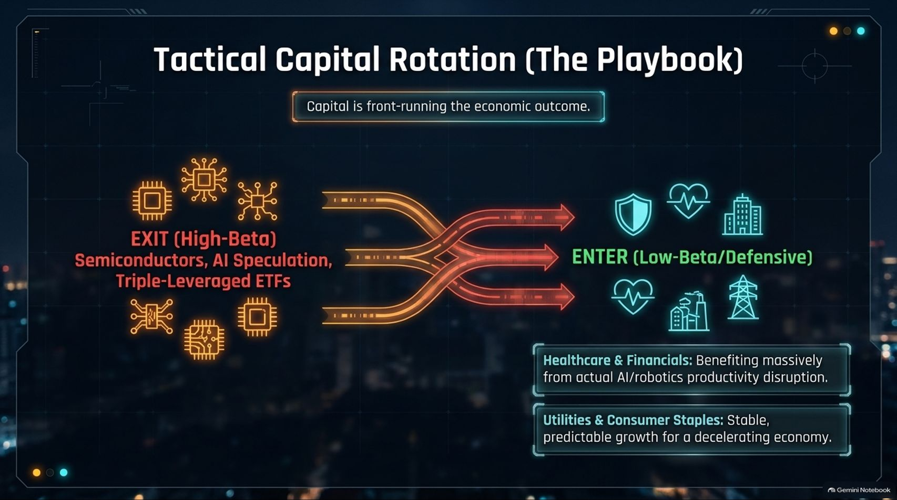
Notes:
Target Speaking Time: ~4–5 Minutes
Speaker Script:
"Slide 12 presents our Tactical Capital Rotation Playbook—because capital is front-running the economic outcome.
EXIT (High-Beta): Semiconductors, AI speculation, and triple-leveraged ETFs.
ENTER (Low-Beta/Defensive):
Healthcare & Financials: Benefiting from operational stability and cash flow.
Utilities & Consumer Staples: Providing stable, predictable growth for a decelerating economy."

Slide 13
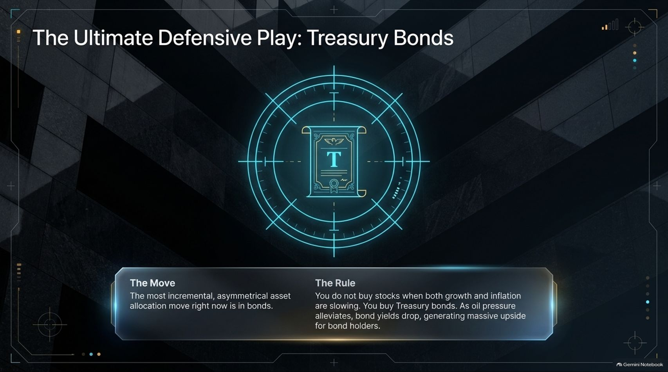
Notes:
Target Speaking Time: ~4–5 Minutes
Speaker Script:
"Slide 13 reveals The Ultimate Defensive Play: Treasury Bonds.
The Move: The most incremental, asymmetrical asset allocation move right now is in bonds.
The Rule: You do not buy stocks when both growth and inflation are slowing. You buy Treasury bonds. As oil pressure alleviates and economic gravity takes hold, bond yields drop, generating massive capital appreciation and upside for bond holders."

Slide 14
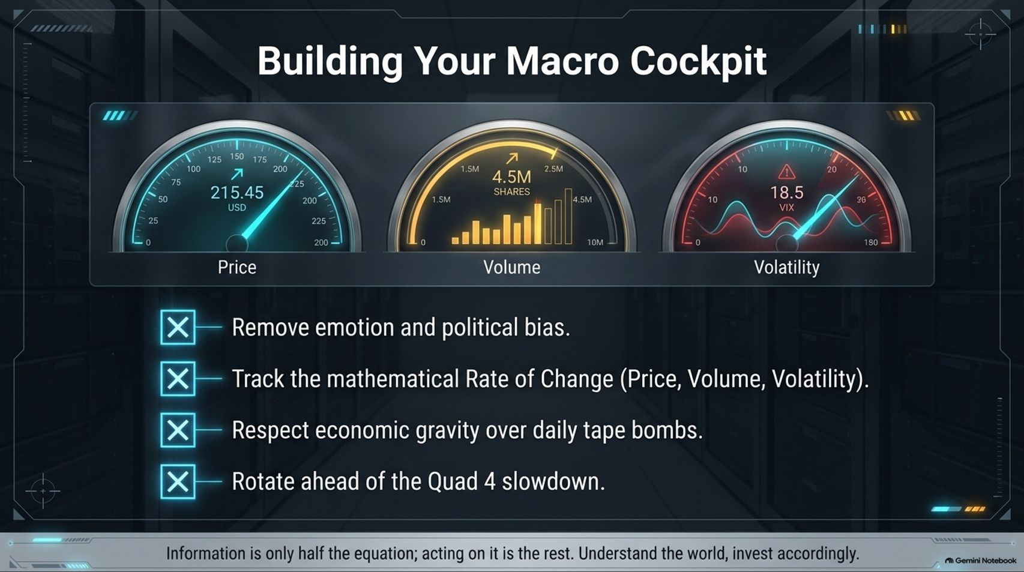
Notes:
Target Speaking Time: ~3–4 Minutes
Speaker Script:
"Slide 14 reminds us how to construct Building Your Macro Cockpit.
Remove emotion and political bias.
Track the mathematical Rate of Change across Price, Volume, and Volatility.
Respect economic gravity over daily tape bombs.
Rotate ahead of the Quad 4 slowdown.
Takeaway: Information is only half the equation; acting on disciplined rules is the rest. Understand the world, invest accordingly."

Slide 15
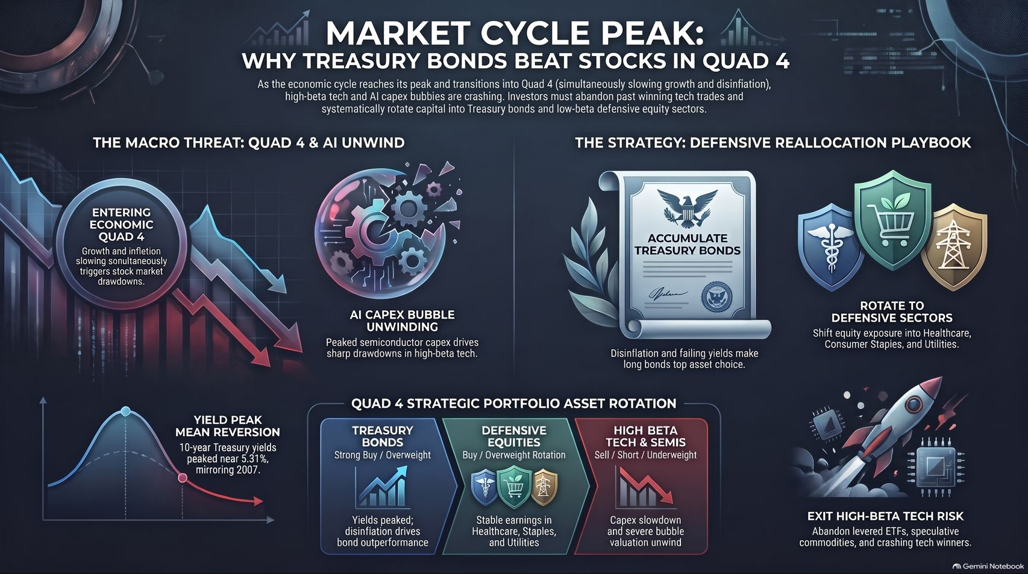
Notes:
Target Speaking Time: ~3–4 Minutes
Speaker Script:
"Finally, Slide 15 provides our master synthesis: Market Cycle Peak: Why Treasury Bonds Beat Stocks in Quad 4.
As the economic cycle reaches its peak and transitions into Quad 4 (simultaneously slowing growth and disinflation), high-beta tech and AI capex bubbles are unwinding.
The Action Plan:
Accumulate Treasury Bonds: Disinflation and falling yields make long bonds the top asset choice.
Rotate to Defensive Equities: Shift exposure into Healthcare, Staples, and Utilities.
Exit High-Beta Tech Risk: Abandon levered ETFs, speculative commodities, and crashing tech winners.
Protect capital, follow the math, and position for the 2027 macro reality. Thank you."

