Slide 1
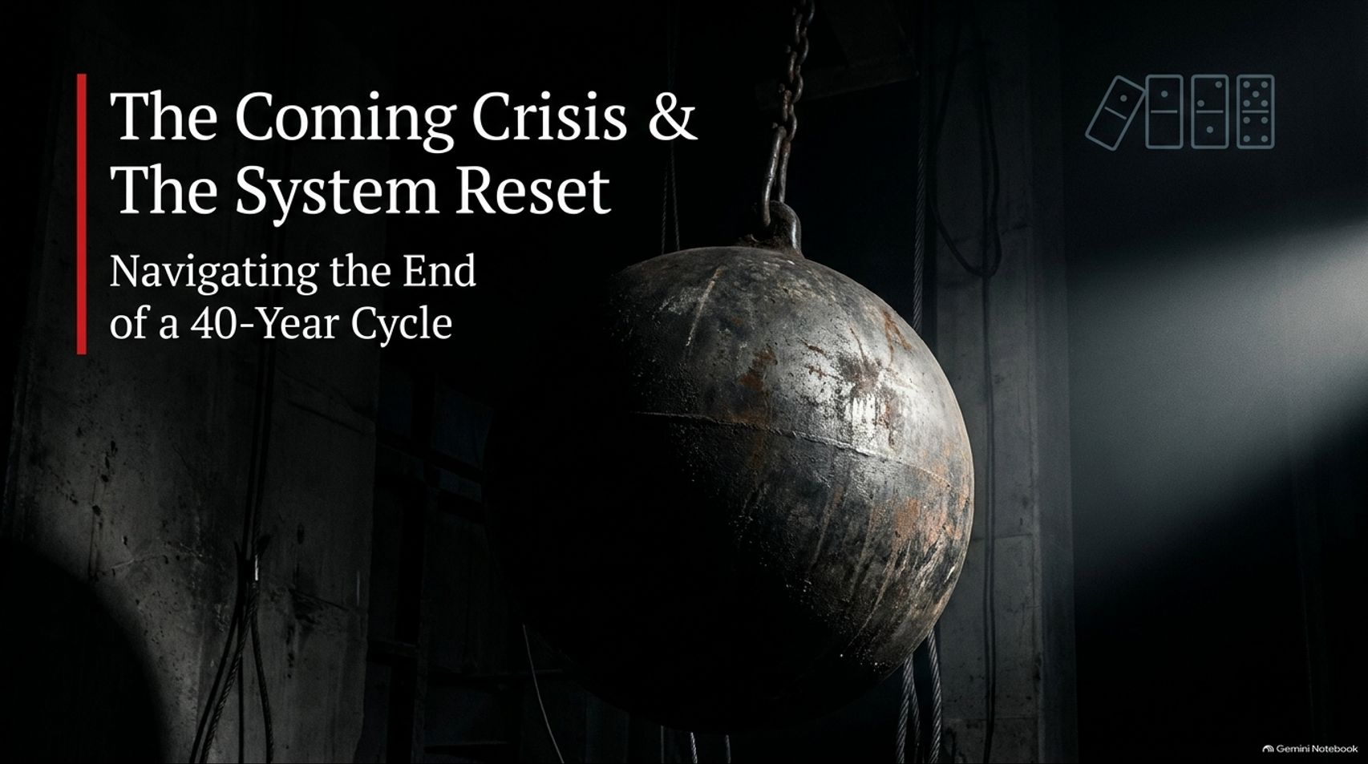
Notes:
Visual Anchor: A heavy, rusted iron wrecking ball hanging in a dark, industrial space with a row of dominoes tipping in the upper right.
Core Theme: Introducing the monumental structural shift occurring at the conclusion of a 40-year macroeconomic cycle.
Speaker Notes & Script:
"Welcome, everyone. Today, we are standing at one of the most critical structural junctures in modern economic history. For the past forty years, the global financial architecture has operated under a very specific, deeply entrenched set of rules. We have lived through an era defined by free-market globalization, relentless supply-side optimization, falling interest rates, and an unwavering belief that central banks could seamlessly smooth out every business cycle.
But as we look around the world today—at escalating geopolitical friction, structural sovereign debt cliffs, intense societal polarization, and shifting economic superpowers—it becomes clear that this 40-year cycle has reached its absolute mathematical and structural limit.
The title of our presentation today is The Coming Crisis and the System Reset. This is not just another cyclical downturn or a routine bear market; it is the systemic unwinding of a multi-decade paradigm. Over the course of our session today, we are going to dissect the underlying pressures compressing our global system, examine the playbook that ruling powers must deploy to prevent a catastrophic collapse, and—most importantly—look at how you can engineer true resilience into your portfolios before the pendulum completes its violent swing. Let's begin by looking at the battlefield we now inhabit."
Why It May Take a Crisis to Change the System feat. Cem Karsan | Systematic Investor | Ep.425
https://www.youtube.com/watch?v=ytXZBUIrd2Q

Slide 2
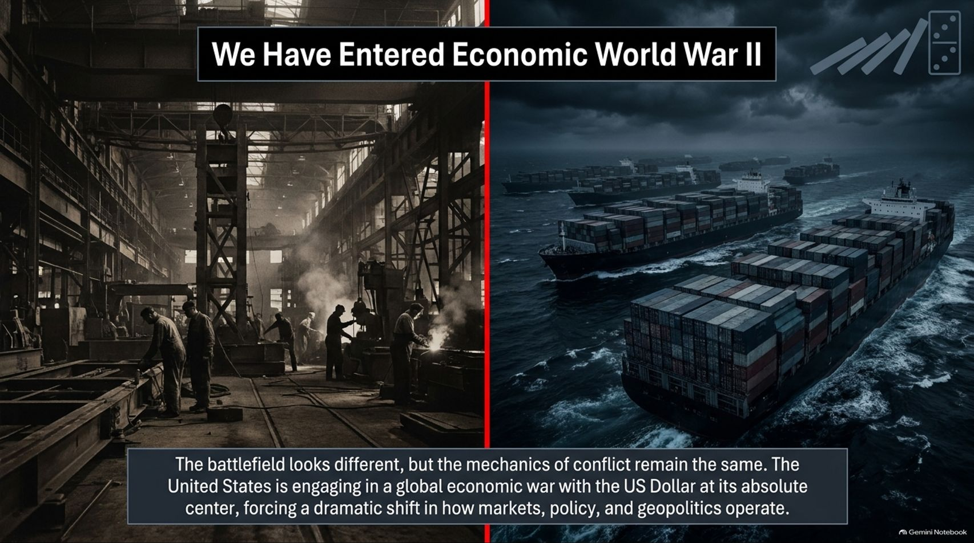
Notes:
Visual Anchor: Split-screen comparing a 1940s industrial war-production factory floor on the left with a modern dark-sea cargo fleet carrying shipping containers on the right.
Core Theme: Reframing modern geopolitical and economic conflict as a de facto world war fought through industrial policy, trade routes, and currency dominance rather than traditional kinetic battlefields.
Speaker Notes & Script:
"To understand why markets are behaving with such unprecedented volatility, we first have to discard our traditional peacetime mentalities and confront a stark reality: We have entered Economic World War II.
Now, when people hear the phrase 'World War II,' their minds immediately drift to historical images of mass mobilization, artillery, and trench warfare. But the mechanics of conflict evolve alongside technology and global integration. Today, the battlefield looks entirely different, yet the fundamental objective remains identical: the complete subjugation or out-competing of rival economic and geopolitical systems. At the absolute center of this modern global conflict is the United States Dollar.
The US is currently engaged in a high-stakes, multi-front economic war. Because direct great-power military conflict carries mutually assured nuclear destruction, the primary arenas of confrontation have shifted. They are fought through trade restrictions, technological embargoes, resource chokepoints, currency weaponization, and aggressive state-directed industrial policies. This reality is forcing a tectonic shift in how markets operate, how policy is enacted, and how geopolitical stability is maintained. If you analyze today's headlines through a peacetime lens, nothing makes sense. But when you view them through the lens of wartime economic survival, everything falls sharply into place."

Slide 3
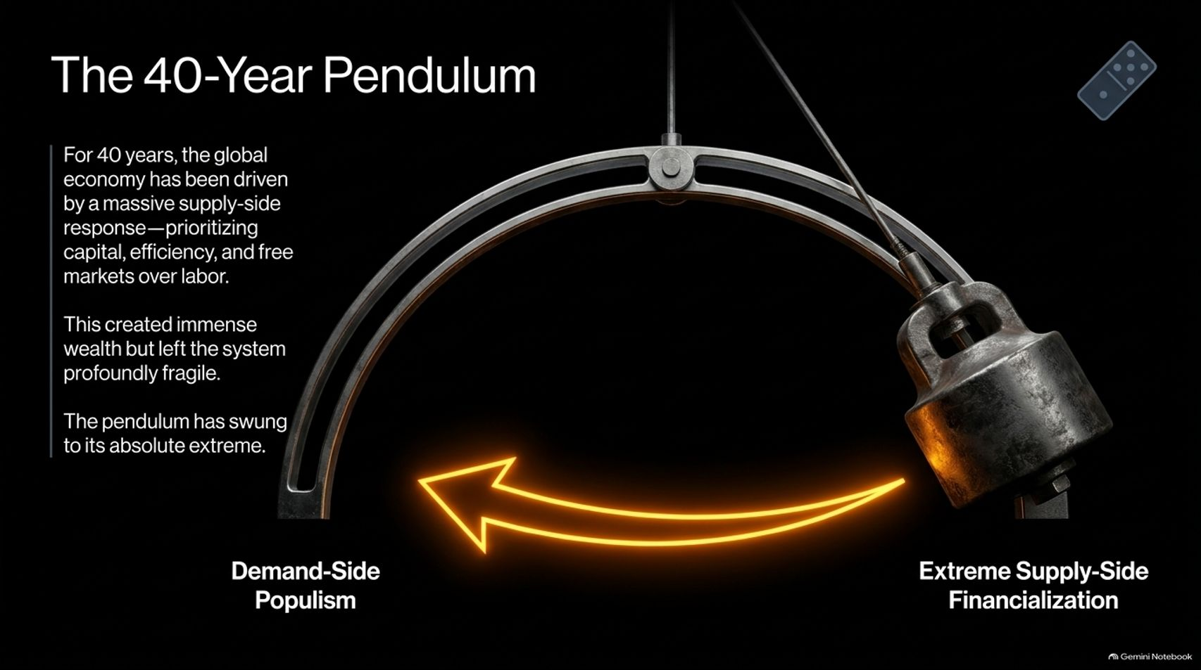
Notes:
Visual Anchor: A large mechanical pendulum swinging dynamically from 'Extreme Supply-Side Financialization' toward 'Demand-Side Populism'.
Core Theme: Tracing the 40-year swing of the generational and economic pendulum from capital-friendly supply-side dominance toward labor-backed populism.
Speaker Notes & Script:
"Let’s look closer at the mechanism driving this transition: The 40-Year Pendulum.
For the last four decades—roughly starting in the early 1980s—the global economy has been driven by a massive, uninterrupted supply-side response. The core philosophy of this era was simple: prioritize capital, maximize corporate efficiency, champion free markets, and systematically suppress the costs of labor. By tapping into globalized labor pools—most notably integrating an agrarian China into the global trading system—corporations achieved unprecedented profit margins. Capital owners grew fabulously wealthy, and asset prices soared.
However, this incredible wealth creation came with a devastating hidden cost: it left the entire global system profoundly fragile. By prioritizing capital over labor and pushing financialization to its absolute extreme, we hollowed out domestic industrial bases, widened wealth inequality to breaking points, and concentrated systemic risk inside financial markets.
Now, the pendulum has reached its outer limit. The extreme supply-side era is colliding with an irresistible force: a massive, generational swing toward demand-side populism. The system can no longer sustain the tension between capital accumulation and social equity. The pendulum is swinging back, and the momentum of that reversal is going to reshape every asset class on Earth."

Slide 4
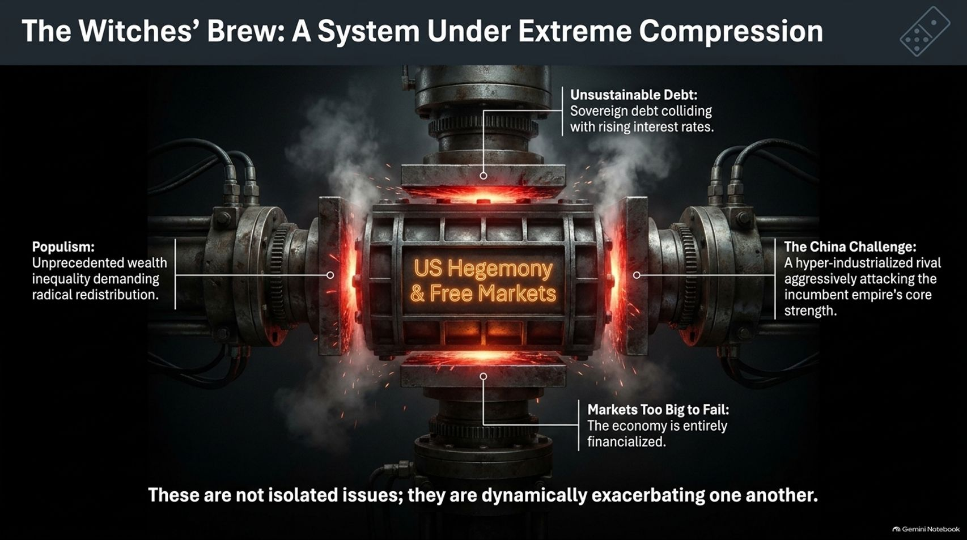
Notes:
Visual Anchor: A heavy industrial vise crushing a central core labeled 'US Hegemony & Free Markets' from four distinct directions under immense heat and sparks.
Core Theme: Detailing the four interlocking systemic pressures—unsustainable debt, runaway populism, markets too big to fail, and the China challenge—that are actively crushing traditional free markets.
Speaker Notes & Script:
"When economists look at the fragility of our current financial architecture, they often make the mistake of treating problems in isolation. They look at inflation separately from sovereign debt, or geopolitics separately from domestic politics. But as you can see on this slide, we are dealing with what can only be described as a Witches' Brew: a system under extreme compression.
At the center of this industrial vise is traditional US hegemony and free-market capitalism. And it is being squeezed simultaneously from four distinct directions:
Unsustainable Debt: Sovereign debt levels across the developed world are exploding, colliding head-on with structurally higher interest rates that make servicing that debt exponentially more expensive.
Rising Populism: Decades of stagnant median wages and soaring asset inequality have created intense political pressure demanding radical wealth redistribution and protectionism.
Markets Too Big to Fail: Decades of central bank intervention have entirely financialized the economy. Markets are no longer a barometer of economic health; they are the literal foundation upon which the entire financial system rests. A sharp drop in equities threatens systemic collapse.
The China Challenge: A hyper-industrialized, state-directed rival has spent over twenty years methodically eroding the incumbent empire's core manufacturing, technological, and supply-chain strengths.
Crucially, these are not isolated issues. They are dynamically exacerbating one another in real-time. You cannot solve the debt crisis without angering populist voters; you cannot protect domestic labor without crushing financial market multiples; and you cannot compete with China's state capitalism using pure, hands-off free-market principles."

Slide 5
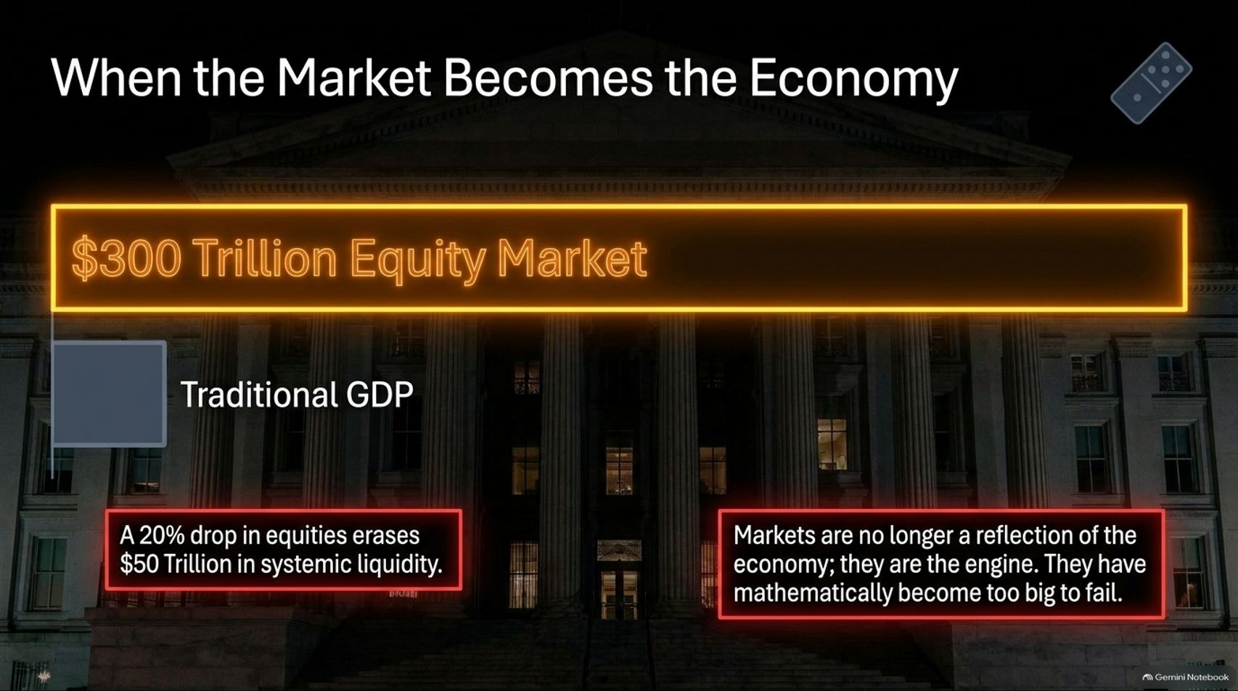
Notes:
Visual Anchor: A glowing overlay showing a massive $300 Trillion Equity Market towering over a diminutive traditional GDP building facade, highlighting systemic risk metrics.
Core Theme: Illustrating how the financialization of the economy has created a $300 trillion equity market where asset price movements dictate macroeconomic survival.
Speaker Notes & Script:
"To truly grasp why central banks and policy makers are trapped, we must examine a profound structural mutation: When the Market Becomes the Economy.
Historically, the stock market was a secondary reflection of the underlying real economy—corporate revenues, Main Street commerce, and consumer spending drove the markets. But over the last forty years of financialization, that relationship has entirely inverted. Today, the equity, private, and public debt markets combined represent a staggering $300 trillion edifice.
Think about the mathematics of this vulnerability. A routine 20% correction in global equities doesn't just bruise investor sentiment—it instantly obliterates roughly $50 trillion in systemic liquidity from the global financial ecosystem. When $50 trillion vanishes, the wealth effect goes into reverse, credit locks up, municipal funding freezes, and corporate capex grinds to a halt.
Because the economy has become entirely financialized, markets are mathematically too big to fail. Central banks and fiscal authorities understand that they no longer have the luxury of allowing a natural, unhedged market clearing event. Any sustained plunge in asset prices threatens an immediate, cascading systemic default. Consequently, the state is forced to intervene continuously to keep the asset-price plates spinning, trapping themselves in an ever-escalating cycle of intervention."

Slide 6
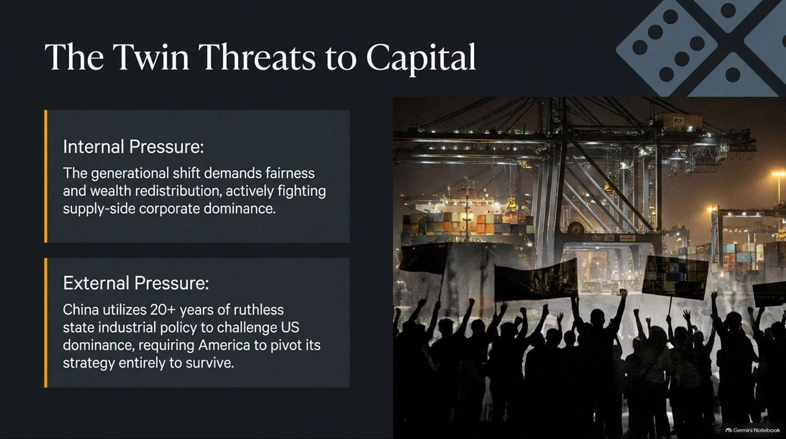
Notes:
Visual Anchor: Dual information panels outlining internal populist pressure versus external geopolitical pressure, juxtaposed against a silhouetted crowd of protesters beneath massive shipping port cranes.
Core Theme: Analyzing the dual pincer movement of internal generational demands for fairness and external state-directed challenges from foreign competitors.
Speaker Notes & Script:
"Capital today faces a vicious pincer movement—what we define as The Twin Threats to Capital.
On the internal front, we are experiencing an unstoppable generational shift. Younger demographics—millennials and Gen Z—are entering political dominance with a worldview shaped by financial crises, housing unaffordability, and immense wealth disparity. They are demanding fairness, institutional accountability, and aggressive wealth redistribution. This internal populist wave is actively hostile to supply-side corporate dominance. It views traditional corporate profit margins as a societal rent extraction and is pushing for heavy taxation, regulatory crackdowns, and anti-trust enforcement.
On the external front, capital faces an equally severe existential threat from abroad. China has spent over two decades deploying ruthless, patient, state-directed industrial policy. While Western corporations optimized solely for short-term shareholder return and stock buybacks, Beijing systematically captured global supply chains in solar, electric vehicles, batteries, rare earths, and advanced manufacturing.
To survive this external assault, the United States can no longer rely on passive, free-market laissez-faire capitalism. It is forced to completely pivot its national strategy toward state intervention. Capital is thus being squeezed between the anvil of internal socialist/populist redistribution and the hammer of external state-capitalist competition."

Slide 7
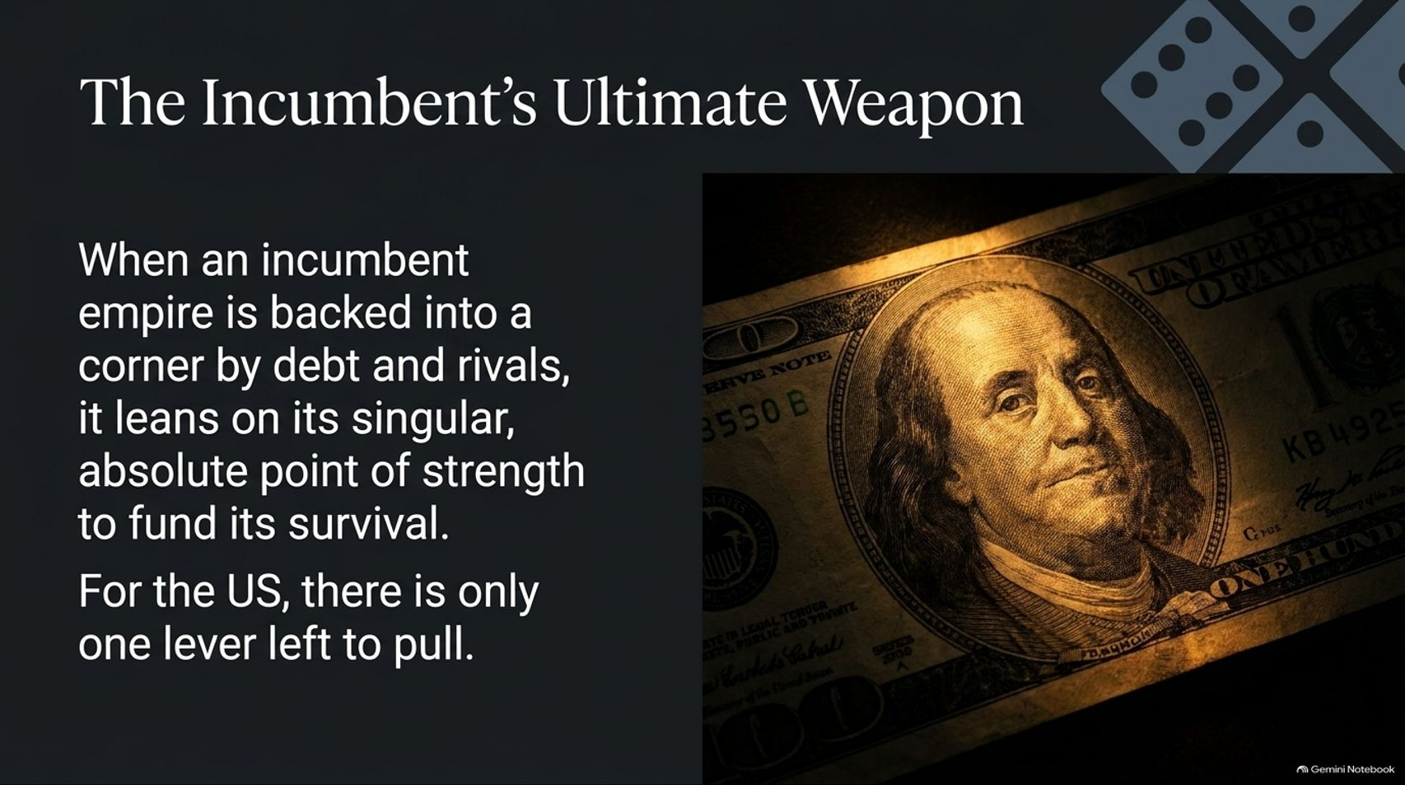
Notes:
Visual Anchor: A dramatic, high-contrast close-up of a US hundred-dollar bill illuminated by a harsh spotlight, symbolizing absolute financial power and sovereign leverage.
Core Theme: Examining how a cornered incumbent empire falls back on its singular, unmatched point of structural leverage: global dominance of the US dollar.
Speaker Notes & Script:
"When an incumbent global empire is backed into a corner by compounding sovereign debt, domestic political fracturing, and aggressive rising rivals, history shows it does not go quietly into the night. It leans heavily on its singular, absolute point of strength to fund its survival.
For the United States, facing the twilight of its unipolar dominance, there is ultimately only one sovereign lever left to pull: the exorbitant privilege and global ubiquity of the US Dollar.
The entire global financial system is denominated, settled, and anchored in US dollars. Every foreign central bank, every international trade contract, and every emerging-market debtor relies on dollar liquidity to function. When you control the global reserve currency, you possess the ultimate financial weapon. You can essentially tax the rest of the world through inflation export, compel foreign nations to finance your debt by purchasing Treasuries, and unilaterally cut off adversaries from global commerce through the SWIFT network and sanctions. As domestic pressures mount and traditional fiscal room-to-manoeuvre vanishes, the incumbent power will inevitably centralize its defense around protecting and weaponizing this monetary monopoly. Understanding this dynamic explains why geopolitics, energy corridors, and currency diplomacy are converging right now with such astonishing ferocity."

Slide 8
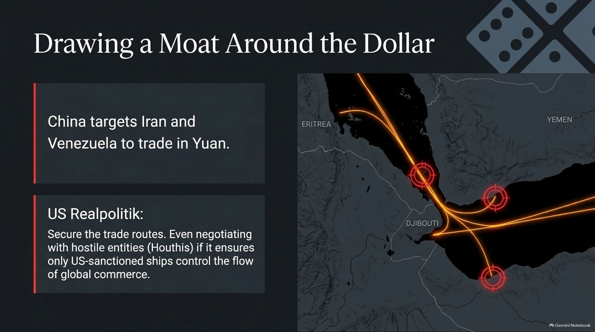

Slide 9
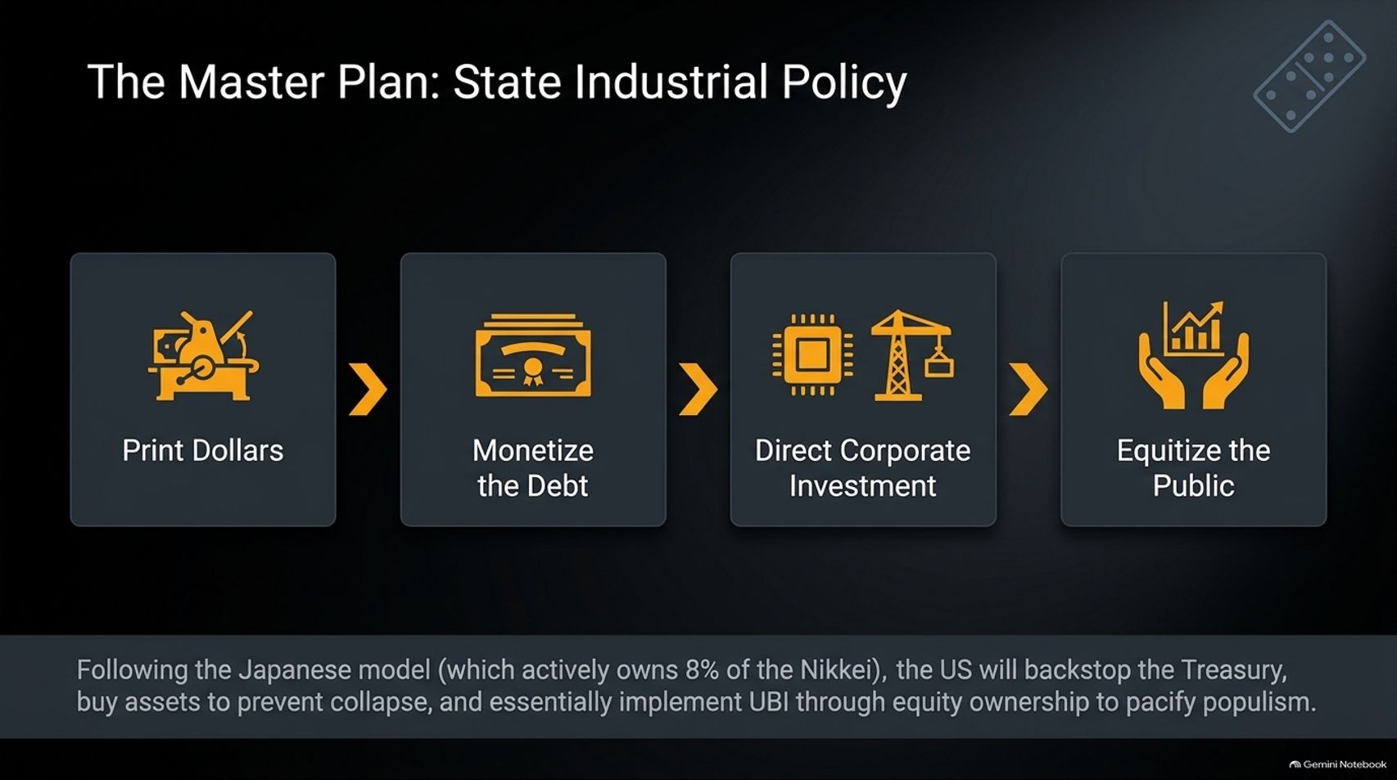
Notes:
Visual Anchor: A four-step linear workflow graphic with professional vector icons: Print Dollars $\rightarrow$ Monetize the Debt $\rightarrow$ Direct Corporate Investment $\rightarrow$ Equitize the Public.
Core Theme: Outlining the four-stage macroeconomic master plan: printing currency, monetizing sovereign debt, directing industrial investments (following the Japanese model), and equitizing citizens to pacify populism.
Speaker Notes & Script:
"So, what is the actual macroeconomic roadmap for the United States as it attempts to bridge this transition? It is a four-step master plan of State-Directed Capitalism.
Print Dollars: When fiscal deficits explode and traditional buyers of Treasuries pull back, the monetary taps must open. The state relies on liquidity expansion to fund its operational survival.
Monetize the Debt: Through central bank facilities and backstop mechanisms, the state absorbs its own sovereign issuance, effectively financing government spending directly through balance-sheet expansion.
Direct Corporate Investment: Moving away from pure free-market allocation, the state pours capital directly into strategic domestic industries—semiconductors, critical minerals, defense technology, and advanced energy—just as China has done for decades.
Equitize the Public: To pacify domestic populism and bridge the wealth gap without triggering a catastrophic socialist revolution, the state must find a way to give citizens a stake in asset appreciation.
This mirrors the structural evolution seen in Japan—where the central bank and public funds actively own a massive percentage of domestic equities (such as nearly 8% of the Nikkei). The US is quietly heading toward a model where it backstops the Treasury market, props up strategic corporate assets, and ultimately implements a form of equity-backed universal basic income to pacify social unrest."

Slide 10
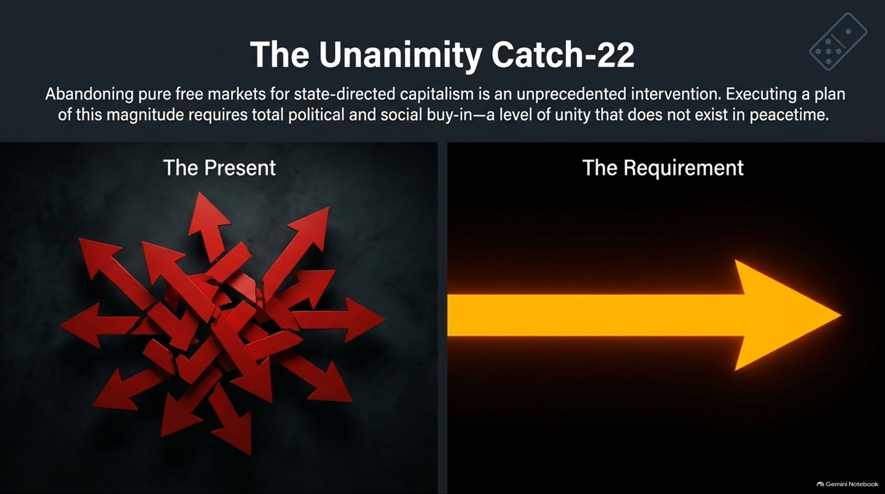
Notes:
Visual Anchor: Split graphic contrasting 'The Present' (a chaotic explosion of red arrows pointing in random directions) with 'The Requirement' (a single, massive, glowing golden arrow pointing forward).
Core Theme: Highlighting the political impossibility of executing massive state intervention in peacetime due to extreme societal polarization and lack of unified buy-in.
Speaker Notes & Script:
"However, executing this master plan comes with a massive structural roadblock: The Unanimity Catch-22.
Abandoning forty years of pure free-market capitalism in favor of heavy, state-directed industrial policy is an unprecedented intervention in Western peacetime history. To successfully overhaul supply chains, nationalize debt management, and restructure the social contract requires an extraordinary level of political and social alignment—a national unity that simply does not exist today.
As our graphic illustrates, The Present state is characterized by total fragmentation. Society is deeply polarized, political parties are at war, corporate lobbies fight for narrow self-interests, and the public distrusts institutional authority. Red arrows are pointing in every direction, tearing the policy apparatus apart.
Yet, The Requirement for surviving Economic World War II is a single, laser-focused vector of national purpose. How do you force a deeply divided, partisan democracy to accept massive economic restructuring, capital controls, and systemic monetary inflation? History tells us that societies do not embrace radical transformation during periods of calm and prosperity. They cling to the status quo until circumstances leave them no alternative."

Slide 11
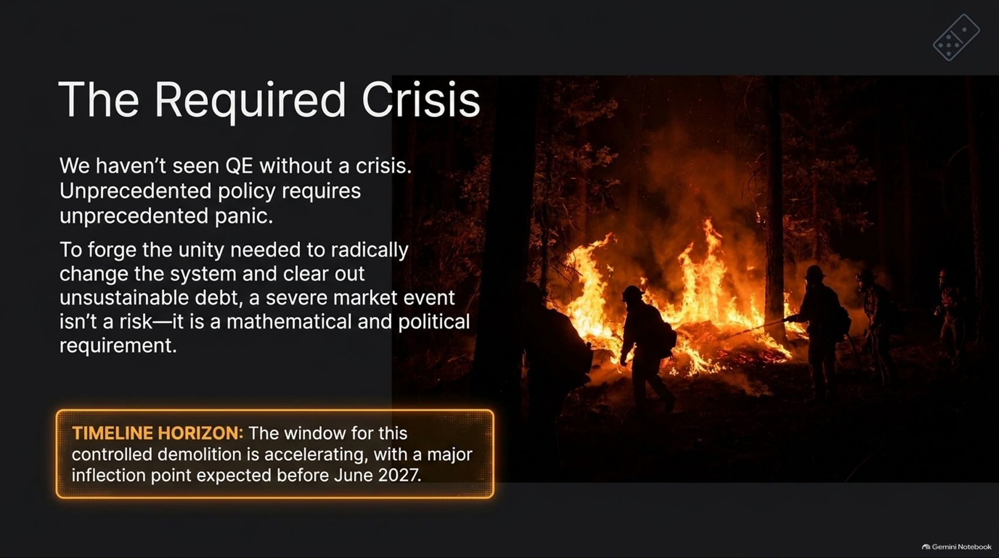
Notes:
Visual Anchor: A dramatic photograph of firefighters battling a controlled wildfire in a dark forest at night, symbolizing necessary destruction to clear dead brush.
Core Theme: Arguing that a severe market or economic crisis is not merely a risk, but a mathematical and political prerequisite to forge the unity needed for system restructuring.
Speaker Notes & Script:
"This brings us to one of the most provocative yet essential realizations of our macro thesis: The Required Crisis.
Look back through financial history. We have never seen massive quantitative easing or radical state intervention introduced without a profound crisis. Unprecedented policy requires unprecedented panic to justify its implementation.
To forge the political unity needed to restructure unsustainable debt, break entrenched institutional inertia, and pivot the nation onto a wartime economic footing, a severe market event is not a tail-risk—it is a mathematical and political requirement. Without a catalyst of immense proportion, the political friction is simply too high to push through radical reform.
Notice our timeline horizon: The window for this controlled demolition is accelerating, with a major systemic inflection point expected before June 2027. The underlying mathematical pressures are simply too heavy to maintain the illusion of stability much longer. A cleansing crisis is coming because the system requires a fire to clear out the dead underbrush before anything new can grow."

Slide 12
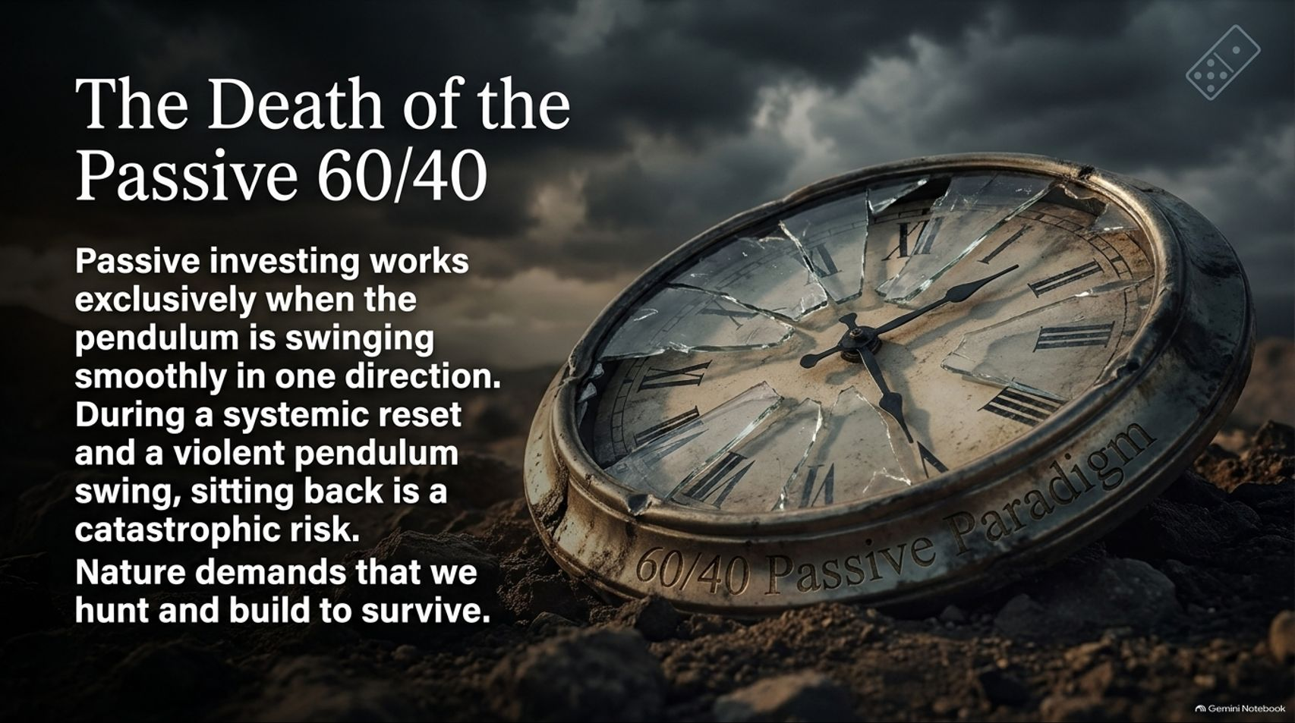
Notes:
Visual Anchor: A cracked, weathered antique pocket watch lying in dry dirt, with the words '60/40 Passive Paradigm' etched into its metallic casing under stormy skies.
Core Theme: Explaining why traditional passive index investing and the classic 60/40 portfolio model fail during violent macroeconomic regime shifts and systemic resets.
Speaker Notes & Script:
"For decades, retail investors and institutional pension funds alike have relied on a comfortable, autopilot investment strategy: The Passive 60/40 Portfolio. Put 60% in equities, 40% in long-term bonds, set it and forget it, and let compounding do the rest.
But today, we are witnessing The Death of the Passive 60/40.
Passive indexing and static asset allocation work exceptionally well under one specific condition: when the macroeconomic pendulum is swinging smoothly and predictably in a single direction, supported by falling inflation and declining interest rates. In that benign environment, bonds act as a reliable equity hedge, and beta does all the heavy lifting.
But during a systemic reset—when the pendulum swings violently, inflation becomes structural, and asset correlations break down—sitting back passively is a catastrophic risk. When bonds and stocks crash simultaneously due to unified inflation shocks, your primary portfolio insurance vanishes. Nature and markets demand that in times of volatility, you cannot simply be a passive harvester of beta; you must actively hunt, build, and protect your capital."

Slide 13
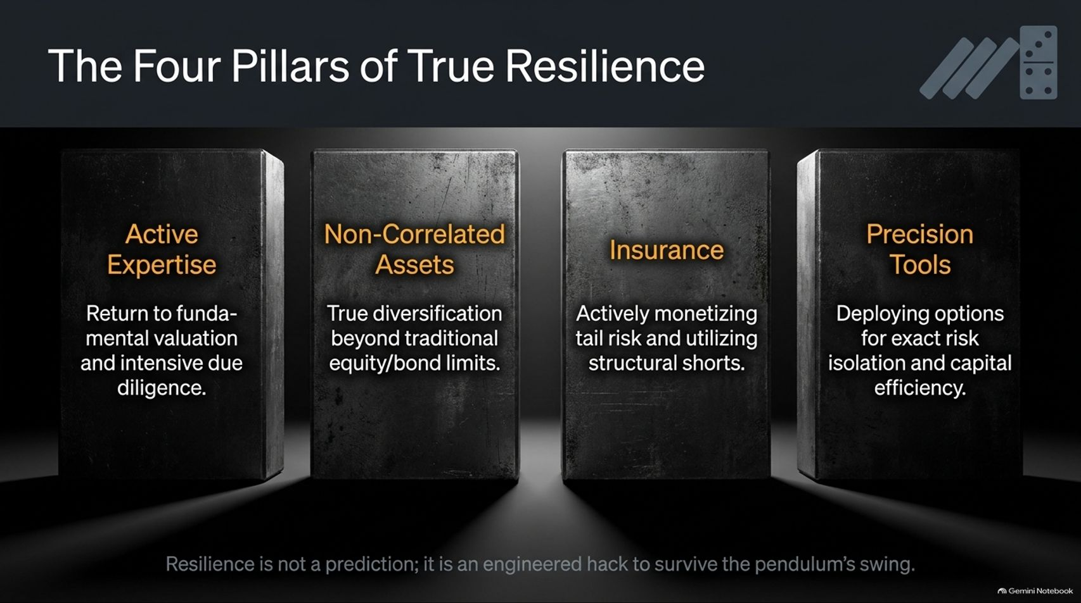
Notes:
Visual Anchor: Four massive, industrial steel monoliths standing side-by-side in a dark vault, each engraved with one of the four core pillars of resilient portfolio construction.
Core Theme: Presenting an actionable, engineered blueprint for portfolio survival based on active expertise, non-correlated assets, deliberate insurance, and precision capital tools.
Speaker Notes & Script:
"If passive investing is dead and traditional diversification has failed, how do we position ourselves for the violent swing of the pendulum? We must build our portfolios upon The Four Pillars of True Resilience:
Active Expertise: Return to fundamental valuation and intensive due diligence. Stop buying blind index weights and start understanding the granular health of what you own.
Non-Correlated Assets: True diversification goes far beyond splitting money between US stocks and US bonds. You must incorporate asset classes that behave independently during systemic liquidations.
Insurance: Actively monetize tail risk and utilize structural options protection. Just as you insure your home against fire, your portfolio must hold dedicated hedges that pay out precisely when markets fracture.
Precision Tools: Deploy modern financial instruments—such as defined-risk options and derivatives—to isolate exact risks and achieve maximum capital efficiency without unnecessary exposure.
As our footer notes: Resilience is not a prediction; it is an engineered hack to survive the pendulum’s swing. You do not need to predict the exact day of the crisis; you simply need to engineer a structure that survives it."

Slide 14
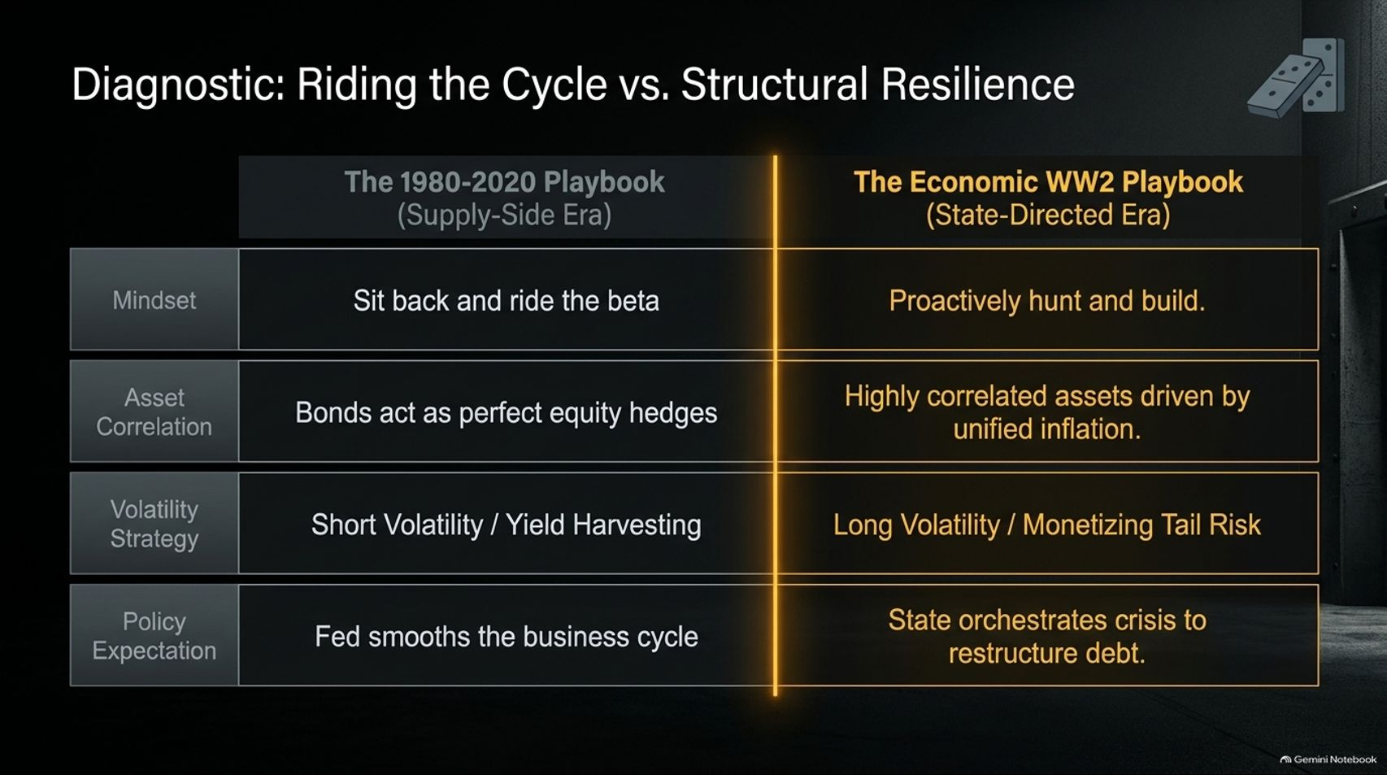
Notes:
Visual Anchor: A clean, structured comparative matrix contrasting the old '1980–2020 Playbook' against the new 'Economic WW2 Playbook' across four operational dimensions.
Core Theme: Summarizing the strategic pivot required by institutional and private investors moving from a supply-side passive mindset to a state-directed structural resilience framework.
Speaker Notes & Script:
"Let’s do a quick diagnostic comparison to test your current portfolio positioning. This matrix contrasts the playbook that worked for the last forty years against the playbook required for the era we have now entered.
Mindset: The old playbook told you to sit back and ride market beta. The new playbook demands that you proactively hunt and build.
Asset Correlation: In the past, bonds acted as perfect equity hedges during downturns. Today, assets are increasingly correlated and driven by unified structural inflation.
Volatility Strategy: The old environment rewarded short volatility and yield harvesting. The new environment requires long volatility exposure and the monetization of tail risk.
Policy Expectation: Previously, investors assumed the Federal Reserve would always step in and smooth the business cycle. Today, we recognize that the state will orchestrate or tolerate crisis conditions to restructure unsustainable sovereign debt.
If your portfolio is still optimized for the 1980–2020 playbook, you are dangerously mispositioned for the economic reality of the late 2020s."

Slide 15

Notes:
Visual Anchor: A solitary figure standing on a rocky shore beneath a dramatic storm cloud pierced by a powerful, vertical shaft of golden sunlight.
Core Theme: Delivering the final strategic call to action: recognizing that the timeline is accelerating, the inflection point has arrived, and preparation is urgently required.
Speaker Notes & Script:
"We have covered a tremendous amount of ground today—from global industrial warfare and currency moats to debt compressions, political catch-22s, and portfolio architecture. The overarching takeaway is simple: The Inflection Point is Here.
The macro timeline is actively accelerating. The underlying fiscal and monetary pressures we’ve mapped out are mathematically unsustainable without a hard, structural reset. You can ignore these signals, you can hope for a return to the comfortable normalcy of the 2010s, but the laws of economics and human nature will not be negotiated with.
Prepare for the required crisis, build structural resilience into every layer of your wealth, and position your capital to not only survive the violence of the pendulum’s swing, but to thrive on the other side. The window to adjust your positioning is closing rapidly."

Slide 16
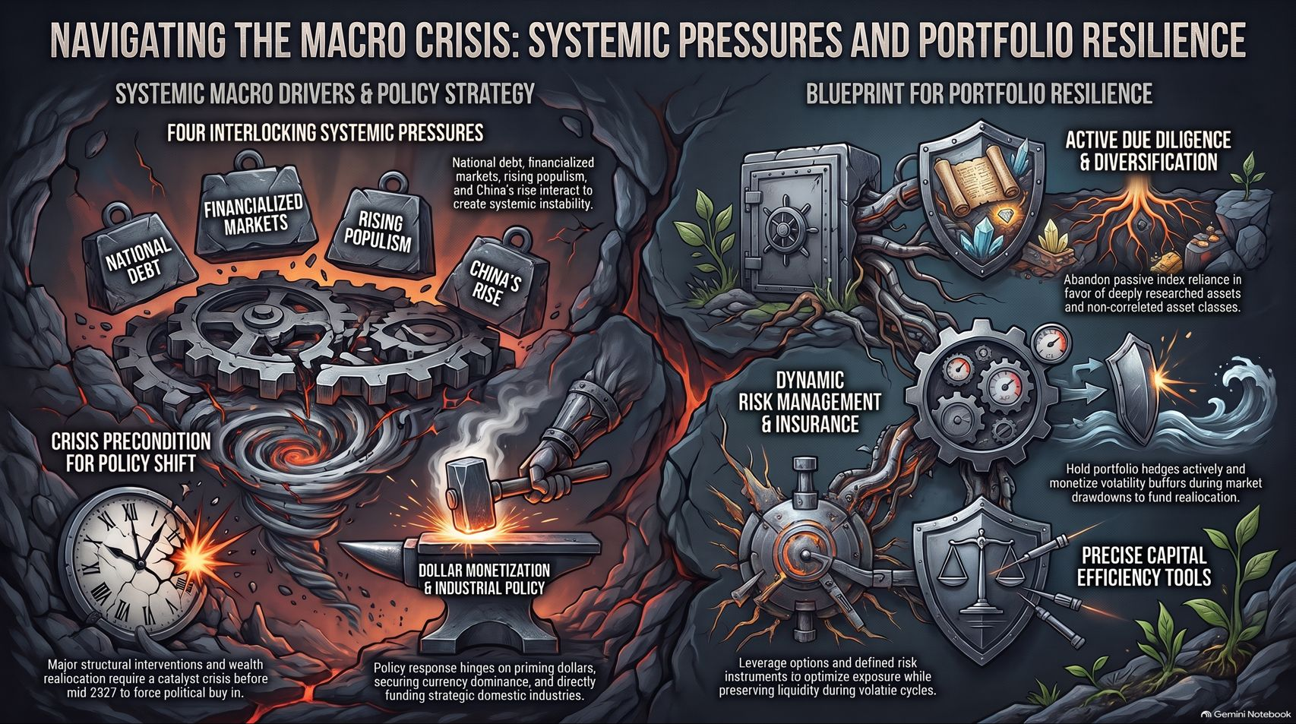
Notes:
Visual Anchor: A comprehensive, highly detailed summary infographic synthesizing both halves of the presentation—left side showing interlocking macro pressures and policy anvils, right side illustrating the secure vault, shields, and precision tools of portfolio resilience.
Core Theme: Providing a final, unified executive summary of the entire master class for lasting audience retention.
Speaker Notes & Script:
"As we conclude our session today, this final visual map brings together our entire thesis in a single, comprehensive framework.
On the left side, we see the macro drivers: the colossal weight of national debt, overly financialized markets, explosive populist pressure, and the unstoppable rise of China combining into a systemic pressure cooker. We see the ticking clock of our crisis precondition pushing toward our 2027 horizon, and the heavy anvil of dollar monetization and industrial policy shaping the state's response.
On the right side, we have our blueprint for survival: abandoning passive index reliance for active due diligence, holding dynamic risk management hedges and volatility buffers, and leveraging precision capital tools to preserve liquidity through volatile cycles.
Navigating this macro crisis requires clear eyes, disciplined preparation, and a rejection of comfortable illusions. Thank you for your time, your attention, and your commitment to thinking deeper about the future of wealth and power. Let’s open the floor for your questions."

