Slide 1

Notes:
Visual Anchor: A sleek, dark mechanical keyboard under a soft studio spotlight, with bold typography highlighting the 32,000% return milestone and 60 years of market mastery.
Core Theme: Introducing the extraordinary profit potential—and hidden dangers—of leveraging high-beta technology vehicles using systematic intraday rules.
Speaker Notes & Script:
"Welcome, everyone. Today, we are exploring one of the most powerful, high-performance trading strategies in modern quantitative finance: 32,000% in a Decade: The TQQQ Trading Playbook.
When people first hear about leveraged exchange-traded funds like TQQQ—which delivers three times the daily performance of the Nasdaq-100—they are naturally captivated by the astronomical upside. Over specific backtested bull market windows, compounding 3x daily exposure can produce generational wealth creation, scaling up over 32,000%. But there is a monumental catch: leverage is a double-edged sword. As we will uncover today, holding leveraged instruments blindly through a major bear market will mathematically destroy your capital twice over.
Drawing from over six decades of market mastery—specifically the wisdom of veteran trader Les Masonson, who has been trading since 1957—this playbook strips away the noise of external news, Wall Street opinions, and emotional decision-making. We are going to look at a rigorous, rules-based architecture combining intraday technical confluence, relative strength sector rotation, strict risk management, and multi-AI backtesting verification. Let's dive into the core mandate that governs this entire system."
32,000% in 10 Years - The TQQQ Trading Strategy of a 60 Year Trader | Les Masonson
https://www.youtube.com/watch?v=HMu4w60FuZ8

Slide 2
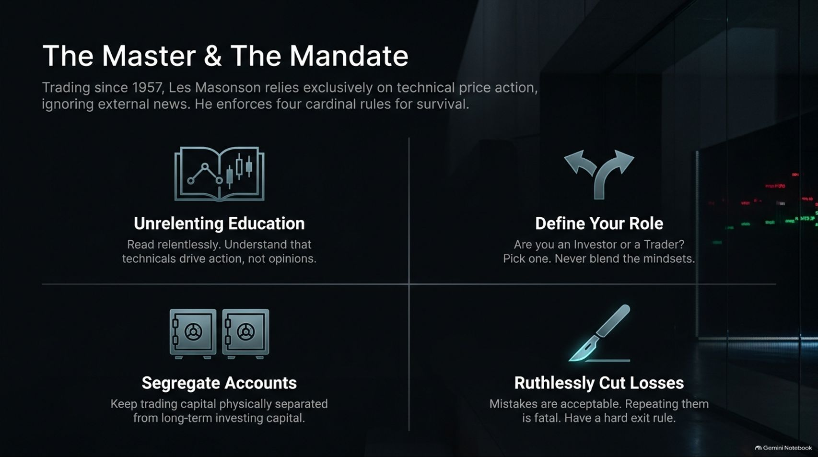
Notes:
Visual Anchor: A clean four-quadrant grid featuring vector icons representing education, role definition, segregated accounts, and loss cutting.
Core Theme: Establishing the four cardinal rules for market survival laid down by veteran trader Les Masonson, emphasizing technical price action over external noise.
Speaker Notes & Script:
"To survive and thrive in the markets for over six decades—as Les Masonson has done since 1957—you cannot rely on luck, gut feelings, or financial media chatter. Masonson operates entirely on technical price action, ignoring external news because noise creates emotional paralysis. Survival requires strict adherence to four cardinal rules:
Unrelenting Education: You must read relentlessly and study technical mechanics. Understand deeply that price action drives market reality, not analyst opinions.
Define Your Role: Are you a long-term investor or a short-term day trader? Pick one lane and never blend the mindsets. Mixing them is a recipe for disaster.
Segregate Accounts: Keep your high-risk trading capital physically separated from your long-term retirement and investing capital. Never let a trading drawdown compromise your life savings.
Ruthlessly Cut Losses: Making mistakes in trading is completely acceptable and inevitable. Repeating them or refusing to exit is fatal. You must have hard, non-negotiable exit rules.
These four pillars form the protective armor every trader needs before touching leveraged instruments."

Slide 3
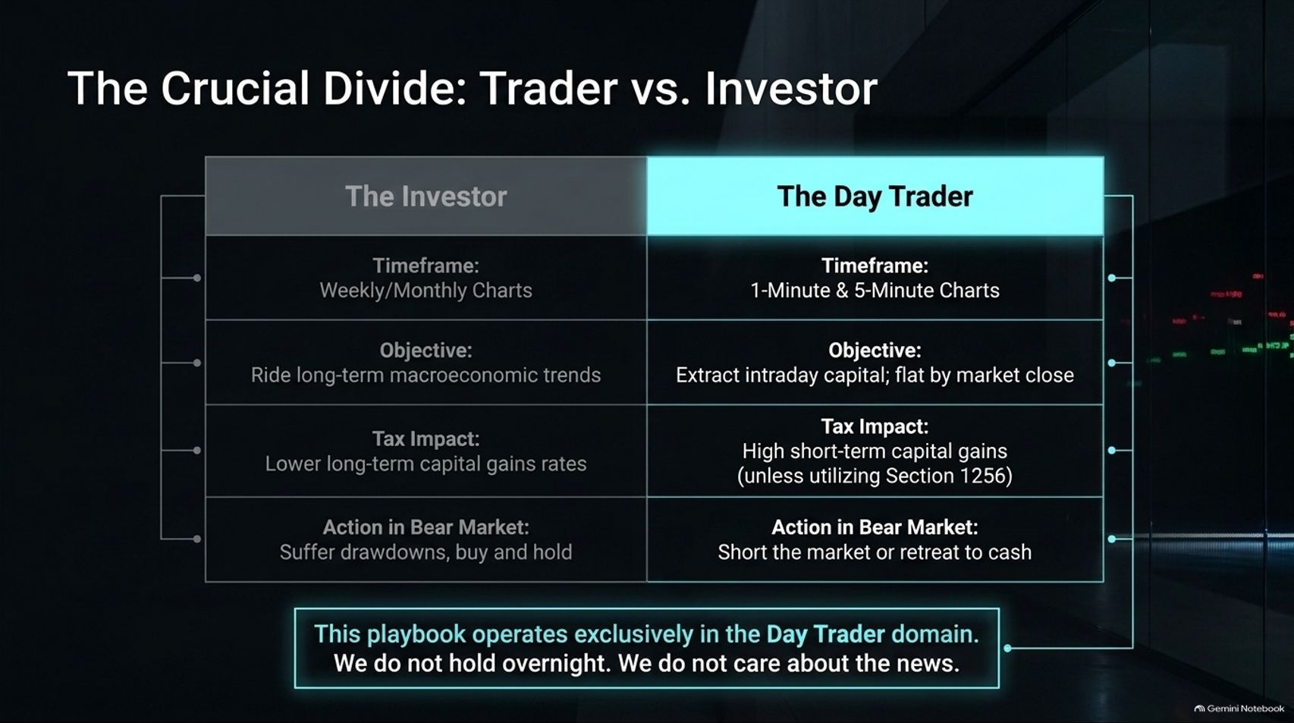
Notes:
Visual Anchor: A structured comparative table contrasting 'The Investor' (weekly charts, macroeconomic focus, long-term capital gains) against 'The Day Trader' (1-minute/5-minute charts, intraday extraction, strict cash-flat by close).
Core Theme: Establishing the strict operational boundary of the playbook: operating exclusively in the intraday day-trader domain with zero overnight holding.
Speaker Notes & Script:
"One of the most common pitfalls in retail trading is identity confusion: trying to be an investor on Tuesday and a day trader on Friday. This slide highlights The Crucial Divide.
Look at the structural differences. An investor utilizes weekly and monthly charts, focuses on macroeconomic trends, holds positions through painful bear market drawdowns, and targets long-term capital gains tax rates. A day trader operates on 1-minute and 5-minute charts, aims to extract intraday capital, and is flat by market close.
This playbook operates exclusively in the Day Trader domain. We do not hold leveraged products overnight, and we do not care about macroeconomic news or corporate earnings reports. Why? Because holding leveraged ETFs overnight exposes you to devastating gap-downs and severe volatility decay. By closing all trades before the closing bell, we eliminate overnight tail risk entirely. Decide right now which side of the divide you are on."

Slide 4
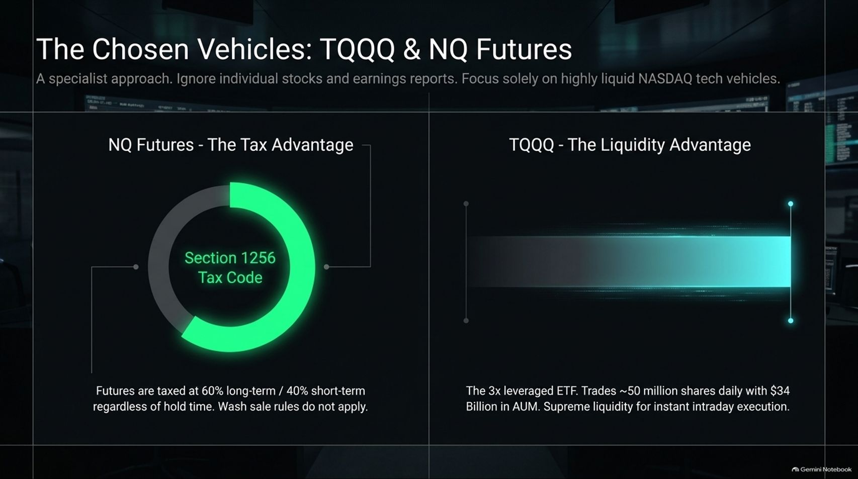
Notes:
Visual Anchor: Side-by-side graphic contrasting a glowing green Section 1256 tax code circle chart for NQ Futures against a supreme liquidity volume bar for TQQQ.
Core Theme: Selecting specialized trading vehicles—NQ Futures for tax advantages and TQQQ for intraday liquidity—while completely ignoring individual stocks.
Speaker Notes & Script:
"When executing a high-frequency, leveraged strategy, vehicle selection is everything. We ignore individual stocks, earnings surprises, and sector noise entirely. Instead, we focus solely on highly liquid Nasdaq technology vehicles: NQ Futures and TQQQ.
Each vehicle offers a distinct strategic advantage:
NQ Futures (The Tax Advantage): Governed by Section 1256 of the US tax code, futures contracts are taxed at a blended rate of 60% long-term and 40% short-term capital gains—regardless of how long you hold them. Furthermore, wash sale rules do not apply, making it an exceptional vehicle for active accounts.
TQQQ (The Liquidity Advantage): As a 3x leveraged ETF tracking the Nasdaq-100, TQQQ routinely trades around 50 million shares daily with massive assets under management. It provides supreme, frictionless liquidity for instant intraday execution.
By mastering these two instruments, you gain the precise leverage and liquidity needed to execute rapid, high-probability setups."

Slide 5
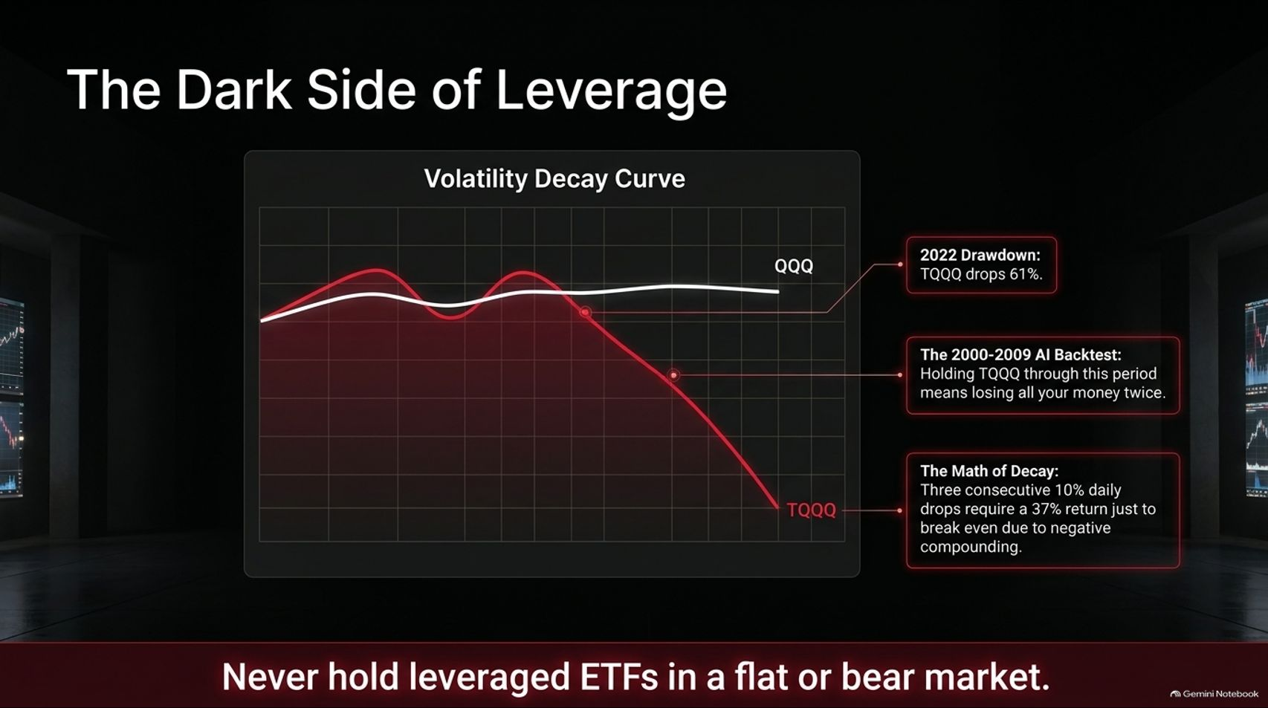
Notes:
Visual Anchor: A sharp downward-sloping red curve illustrating volatility decay for TQQQ compared to a flat white line for QQQ, backed by backtest data from the 2000–2009 dot-com bust.
Core Theme: Exposing the mathematical danger of volatility decay and proving why leveraged ETFs must never be held long-term in flat or bear markets.
Speaker Notes & Script:
"Before anyone gets blinded by the 32,000% bull market gains, we must shine a harsh spotlight on The Dark Side of Leverage.
Look at the volatility decay curve on this slide. The white line represents the baseline QQQ index; the aggressive red line represents 3x leveraged TQQQ. When Les Masonson ran AI-driven backtests simulating how TQQQ would have performed during the brutal dot-com crash between 2000 and 2009, the result was staggering: Holding TQQQ through that secular bear market would have wiped out all your capital twice over.
Why does this happen? It’s the brutal math of negative compounding and volatility decay. If an underlying index suffers three consecutive 10% daily drops, it requires much more than a simple recovery bounce just to break even. During the 2022 bear market, TQQQ suffered a brutal 61% drawdown.
The golden rule here is absolute: Never hold leveraged ETFs in a flat or bear market. They are precision scalpels for bull trends and intraday momentum, not long-term buy-and-hold investments."

Slide 6
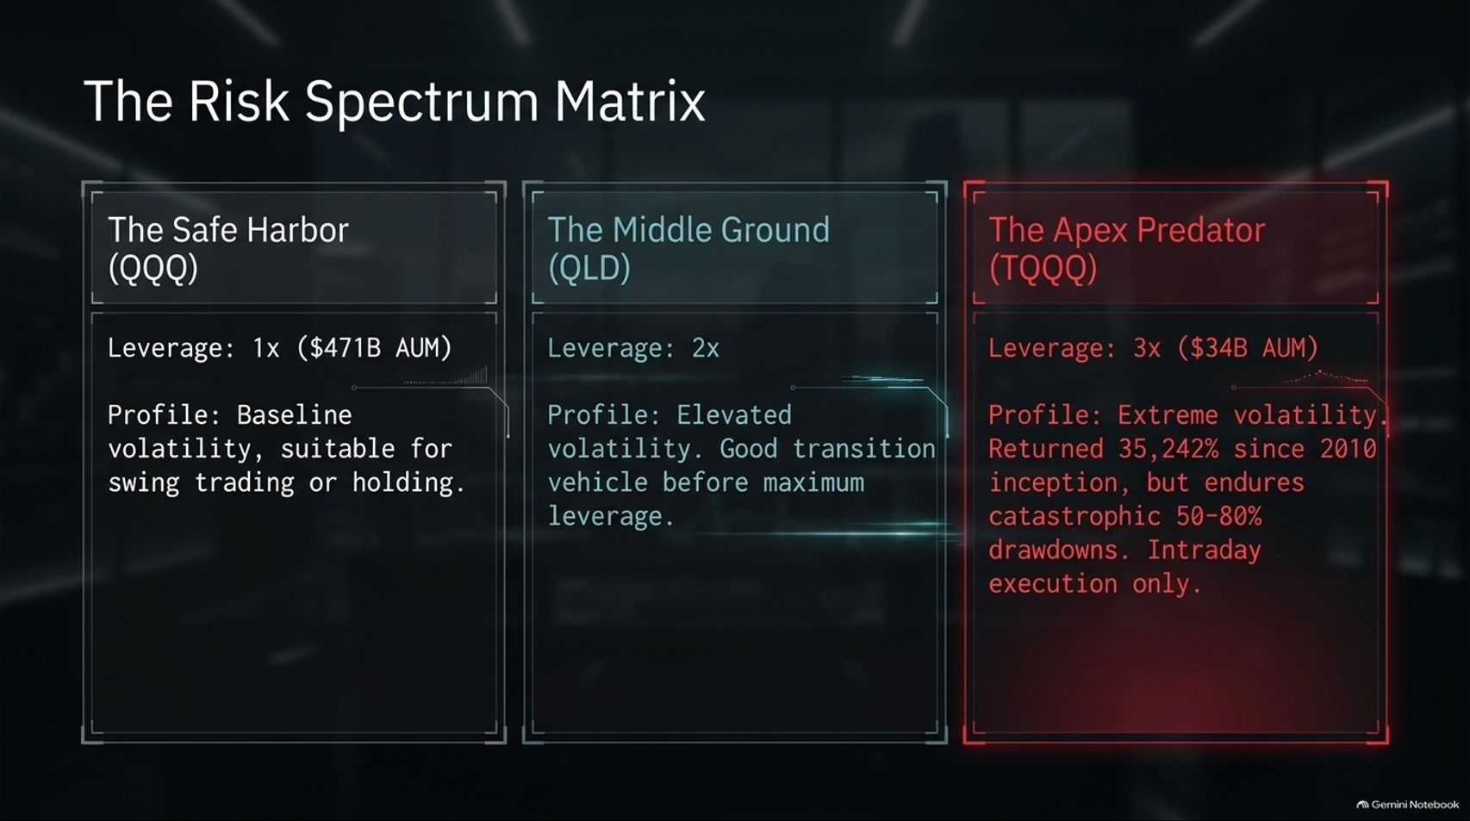
Notes:
Visual Anchor: Three distinct vertical columns grading risk from left to right: QQQ (Safe Harbor, 1x), QLD (Middle Ground, 2x), and TQQQ (Apex Predator, 3x).
Core Theme: Categorizing market vehicles across a risk spectrum from baseline safety to extreme 3x volatility, reinforcing the need for intraday discipline on TQQQ.
Speaker Notes & Script:
"To manage risk effectively, you must understand where your vehicle sits on the volatility spectrum. We call this The Risk Spectrum Matrix.
The Safe Harbor (QQQ - 1x): Managing baseline volatility with hundreds of billions in AUM. This is the standard vehicle suitable for swing trading or traditional long-term holding.
The Middle Ground (QLD - 2x): Offering elevated volatility at 2x leverage. It serves as a transitional vehicle for traders looking to step up in aggression before handling maximum leverage.
The Apex Predator (TQQQ - 3x): Operating at 3x leverage with extreme volatility. While it has returned tens of thousands of percentage points during powerful secular bull runs, it routinely endures catastrophic 50% to 80% drawdowns during market corrections.
Because TQQQ is an apex predator, it demands elite execution. That is why our playbook restricts it strictly to intraday timeframes."

Slide 7
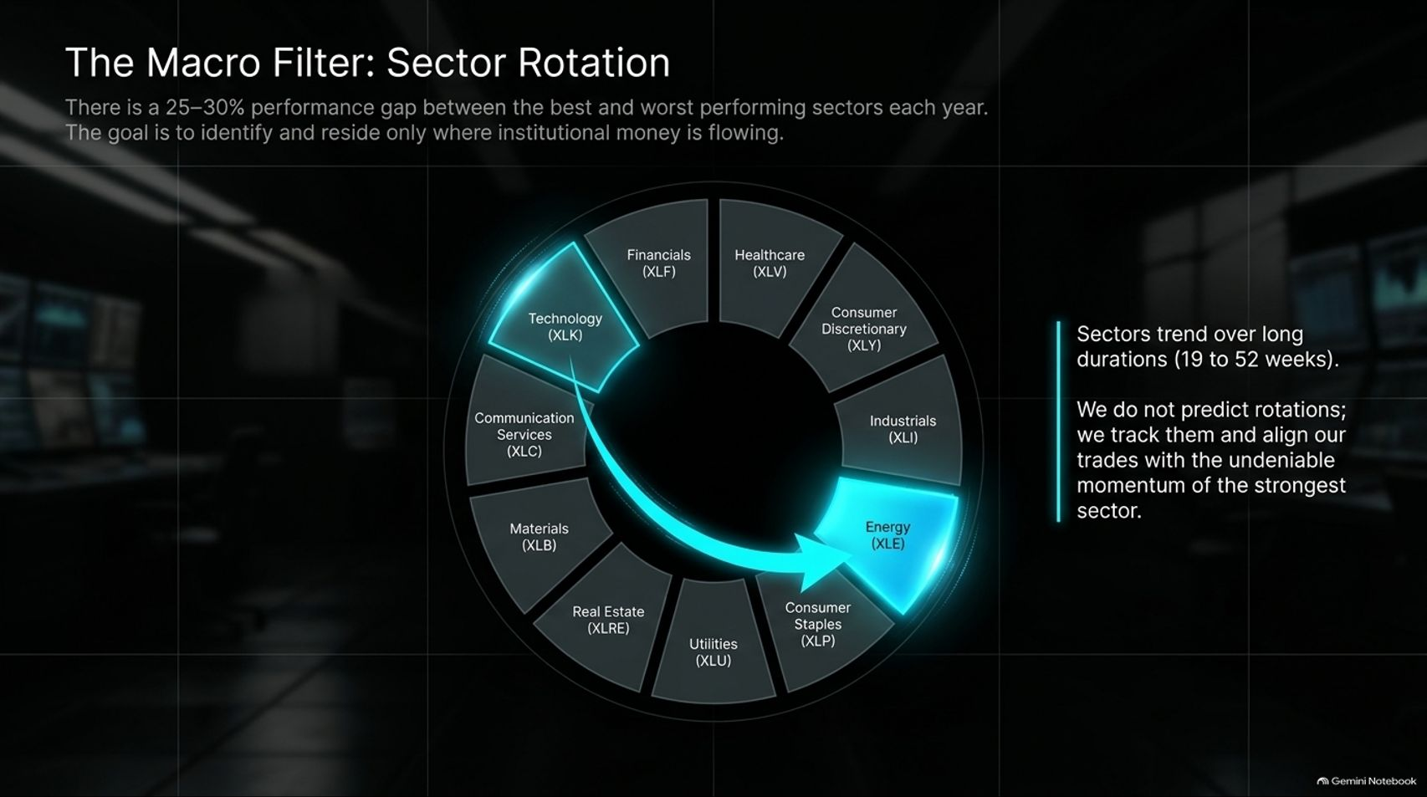
Notes:
Visual Anchor: A circular sector rotation wheel highlighting Technology (XLK) and Energy (XLE) against other market sectors, emphasizing institutional capital flow.
Core Theme: Tracking 19-to-52-week sector trends to ensure trades are aligned with the strongest institutional momentum rather than guessing market directions.
Speaker Notes & Script:
"Even within a powerful bull market, capital does not flow evenly. There is a staggering 25% to 30% performance gap between the best and worst-performing sectors every single year. Our goal as systematic traders is to identify and reside exclusively where institutional money is actively flowing.
This is The Macro Filter: Sector Rotation. Sectors do not rotate randomly; they trend over very long institutional durations—typically lasting anywhere from 19 to 52 weeks.
We do not waste energy trying to predict macroeconomic rotations or guess tops and bottoms. Instead, we track sector momentum objectively and align our trades with the undeniable strength of the leading sector. If Technology or Semiconductors are leading the relative strength rankings, that is where our focus remains. We trade with the institutional wind at our back."

Slide 8
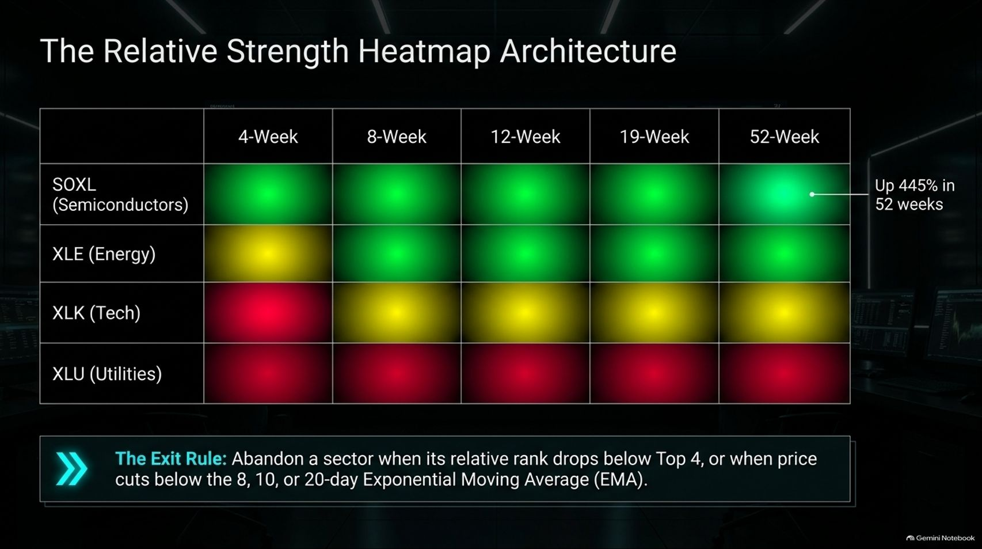
Notes:
Visual Anchor: A multi-timeframe grid (4-week, 8-week, 12-week, 19-week, 52-week) using green, yellow, and red status blocks to rank sector momentum.
Core Theme: Utilizing multi-timeframe relative strength heatmaps to rank sectors and establishing strict exit rules when sector rank drops out of the top tier.
Speaker Notes & Script:
"To operationalize sector rotation, we use The Relative Strength Heatmap Architecture.
As shown in this matrix, we track sector performance across multiple time horizons—from short-term 4-week lookbacks all the way to structural 52-week trends. For example, during strong secular runs, leading sectors like Semiconductors (SOXL) or Energy (XLE) light up solid green across every single time column, signaling massive institutional accumulation.
But momentum shifts. That is why we enforce a strict Exit Rule: You must immediately abandon a sector when its relative performance rank drops below the Top 4, or when price action breaches key exponential moving averages (such as the 8, 10, or 20-day EMA). By letting the heatmap dictate our sector selection, we eliminate emotional attachment to lagging assets."

Slide 9
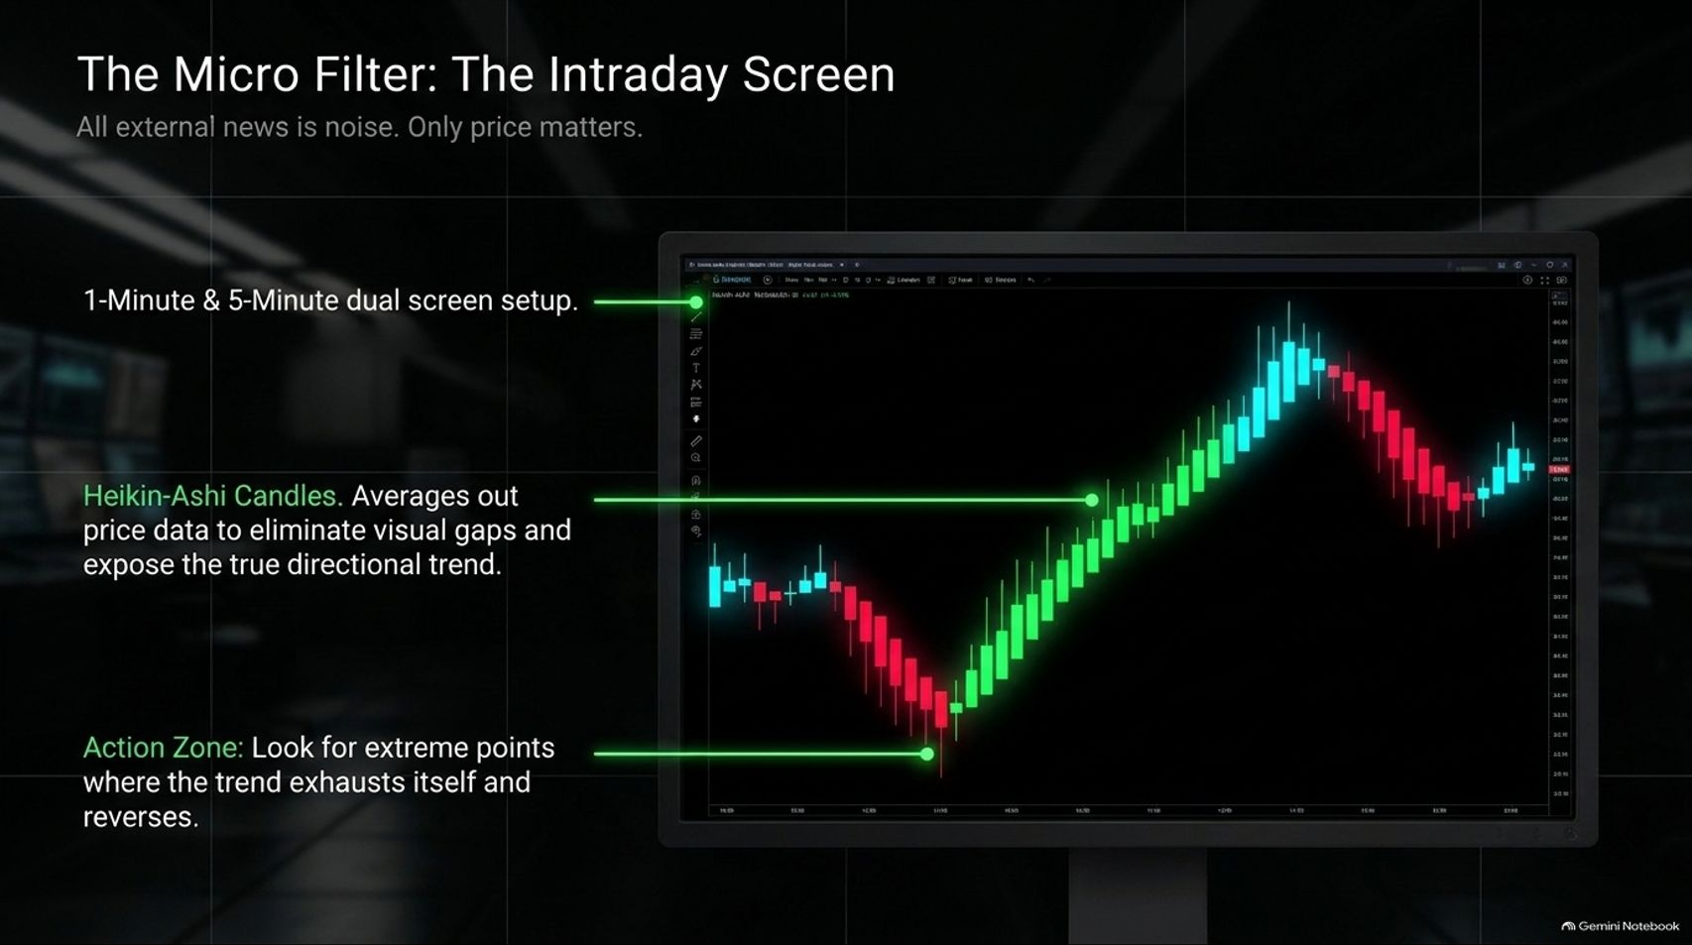
Notes:
Visual Anchor: A dual-screen 1-minute and 5-minute trading workstation displaying Heikin-Ashi candlestick charts filtering out price noise to reveal clean trend direction.
Core Theme: Utilizing dual-timeframe Heikin-Ashi charts on 1-minute and 5-minute intervals to eliminate visual market noise and identify trend exhaustion points.
Speaker Notes & Script:
"Once our macro filter identifies the strongest sector, we zoom into the execution level using The Micro Filter: The Intraday Screen.
External news is pure noise; only price pays. To execute clean intraday trades, we set up a dual-screen workstation featuring 1-minute and 5-minute charts.
Standard candlestick charts can be choppy and filled with false breakouts. To solve this, we rely heavily on Heikin-Ashi Candles. Heikin-Ashi averages out price data mathematically, eliminating visual gaps and smoothing out intraday noise. This transformation exposes the true directional trend with crystal clarity.
When looking at our intraday screen, we hunt for specific Action Zones—extreme market inflection points where intraday selling or buying pressure exhausts itself, setting the stage for a violent, high-probability reversal."

Slide 10
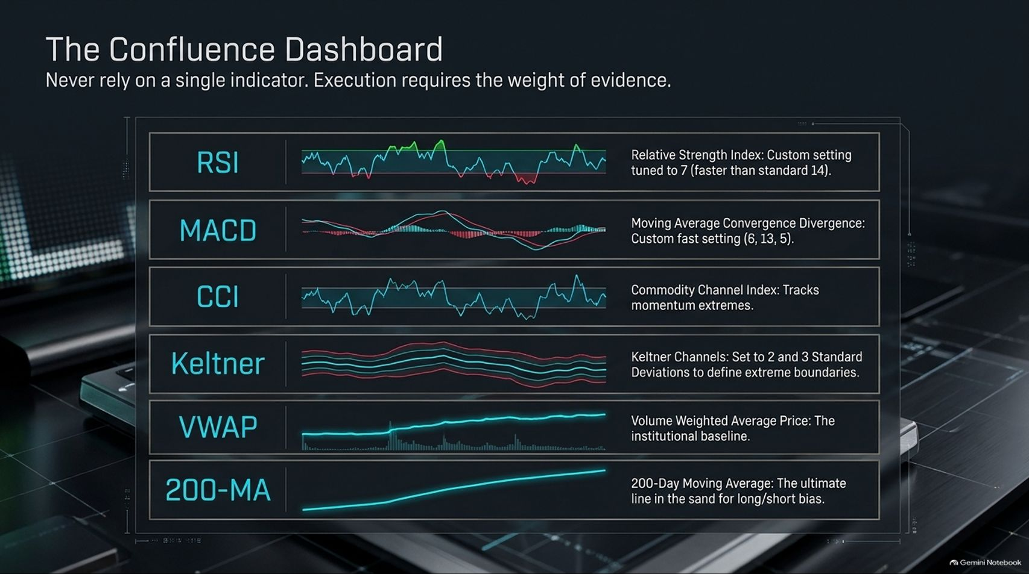
Notes:
Visual Anchor: A comprehensive indicator panel displaying customized RSI (7), MACD (6,13,5), CCI, Keltner Channels (2 & 3 SD), VWAP, and the 200-Day Moving Average.
Core Theme: Combining multiple technical indicators into a weight-of-evidence dashboard to ensure trades are never taken on a single isolated signal.
Speaker Notes & Script:]
"Never rely on a single technical indicator. In professional trading, high-probability execution requires an overwhelming weight of evidence. This is our Confluence Dashboard.
We layer specific, finely tuned indicators to cross-verify market extremes:
RSI (7): A custom, faster-tuned Relative Strength Index (setting of 7 instead of the standard 14) to catch oversold and overbought extremes rapidly.
MACD (6, 13, 5): A custom fast-setting Moving Average Convergence Divergence to spot momentum shifts instantly.
CCI: Commodity Channel Index to measure cyclical momentum extremes.
Keltner Channels: Set to 2 and 3 Standard Deviations to define statistical price boundaries.
VWAP: Volume Weighted Average Price, serving as our primary institutional baseline.
200-Day MA: The ultimate line in the sand establishing long and short structural bias.
When these indicators synchronize at statistical extremes, the statistical edge swings heavily in our favor."

Slide 11
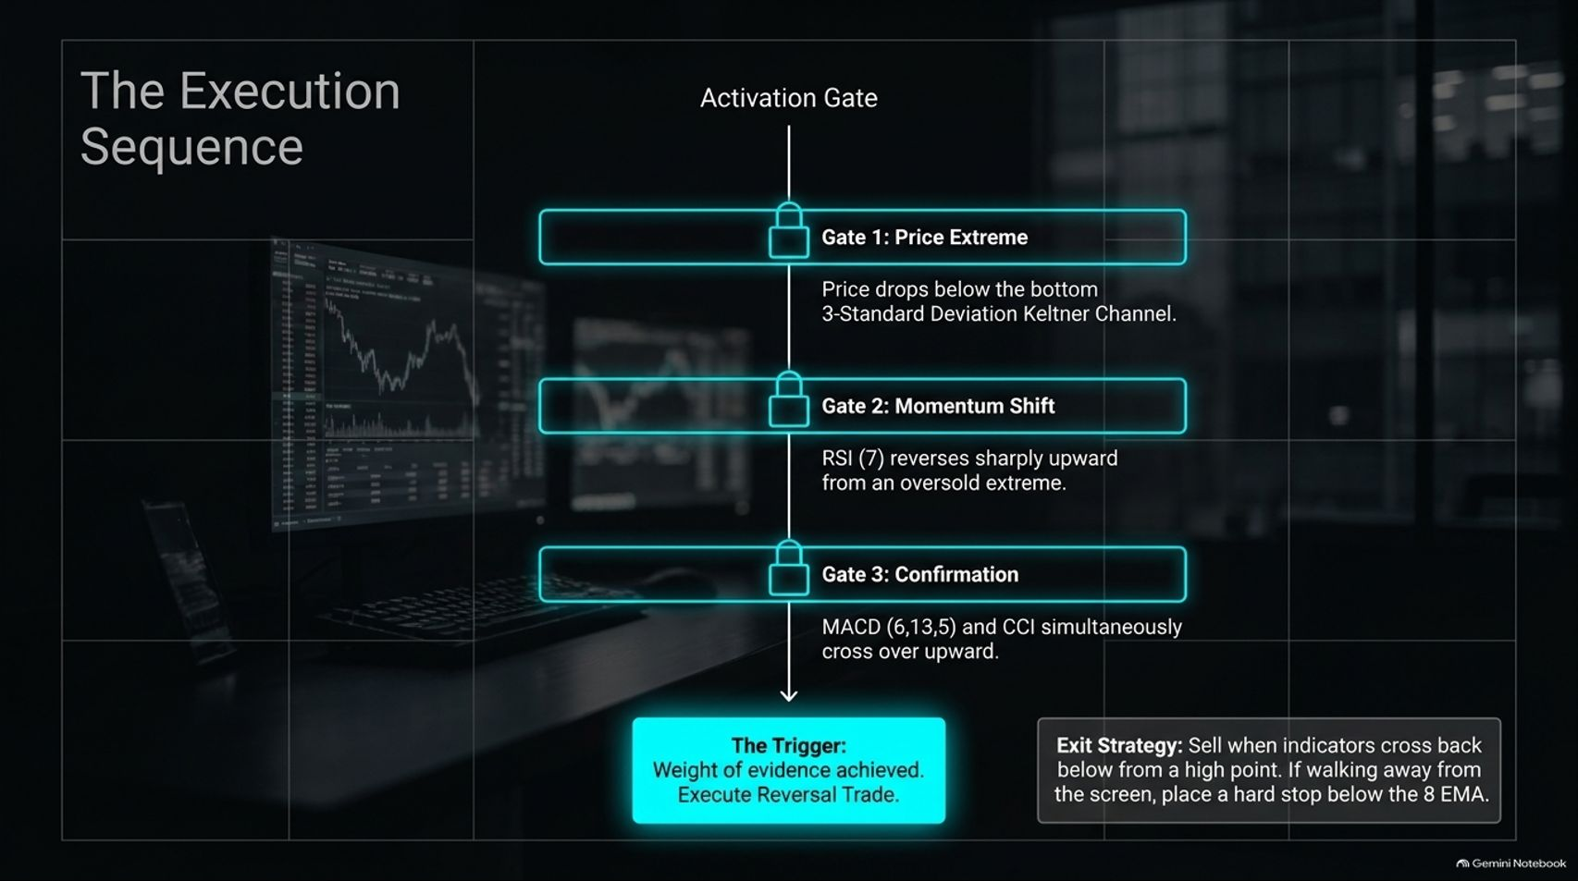
Notes:
Visual Anchor: A three-gate security flowchart illustrating the progression from Keltner channel extremes to momentum shifts and confirmation crossovers, leading to trade execution.
Core Theme: Executing trades through a mandatory three-gate activation sequence (price extreme, momentum shift, indicator confirmation) backed by strict exit rules.
Speaker Notes & Script:
"Executing a trade in this playbook is not a guess; it is passing through a strict Activation Gate sequence. You must clear three distinct gates before pressing the buy button:
Gate 1 (Price Extreme): Price must drop below the bottom 3-Standard Deviation Keltner Channel, signaling an overextended exhaustion move.
Gate 2 (Momentum Shift): The custom RSI (7) must reverse sharply upward from an oversold extreme, showing that buyers are stepping in.
Gate 3 (Confirmation): The fast MACD (6,13,5) and CCI indicators must simultaneously cross upward, confirming momentum alignment.
Once the weight of evidence is achieved, we execute the reversal trade. If we are stepping away from the screen, a hard stop is immediately placed below the 8 EMA to protect capital."

Slide 12
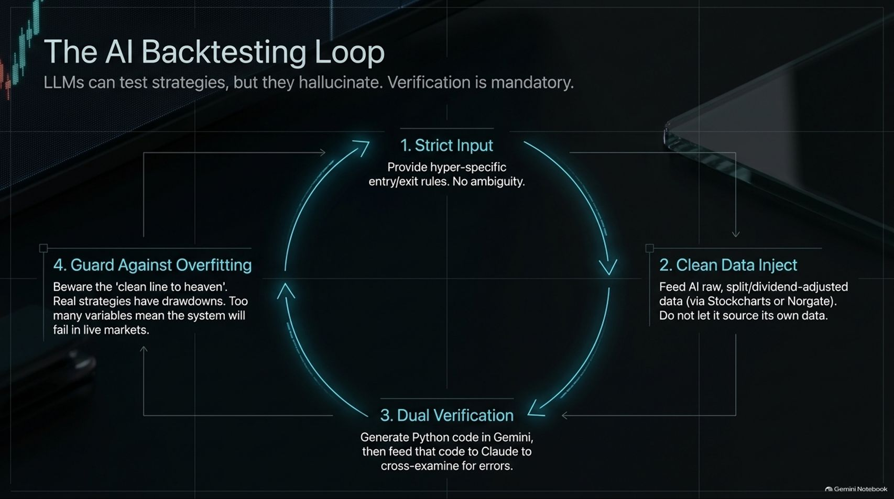
Notes:
Visual Anchor: A circular four-stage workflow diagram highlighting strict inputs, clean data injection, dual AI model verification (Gemini and Claude), and guarding against overfitting.
Core Theme: Leveraging AI models like Gemini and Claude to backtest trading strategies while maintaining rigorous data hygiene and guarding against curve-fitting.
Speaker Notes & Script:
"In today's technological landscape, artificial intelligence is an incredible asset for strategy testing, but LLMs can hallucinate; verification is mandatory. That is why we follow a rigorous AI Backtesting Loop:
Strict Input: Feed the AI hyper-specific entry and exit rules with zero ambiguity.
Clean Data Inject: Always feed AI raw, split- and dividend-adjusted price data sourced reliably from platforms like Stockcharts or Norgate. Never let an LLM source its own financial data.
Dual Verification: Generate Python backtesting code in Gemini, then cross-examine that exact code in Claude to audit for logic errors or discrepancies.
Guard Against Overfitting: Beware the 'clean line to heaven.' Real trading strategies experience drawdowns. If your model has too many optimized variables, it will fail catastrophically in live markets."

Slide 13
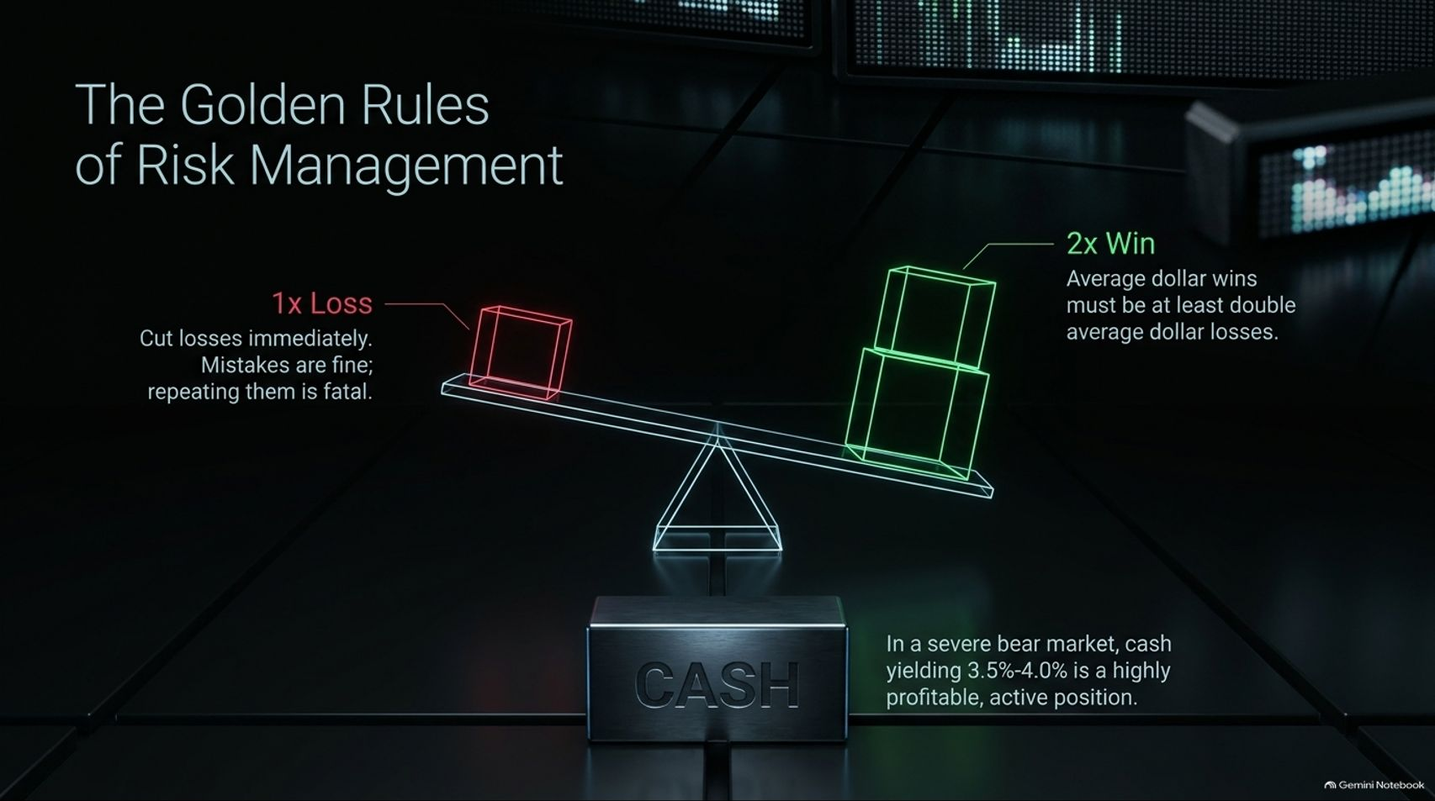
Notes:
Visual Anchor: A financial scale balancing a 1x Loss cube against a 2x Win block, underpinned by a solid foundation labeled 'CASH' yielding 3.5%–4.0%.
Core Theme: Enforcing a strict 2-to-1 win-loss dollar ratio, cutting losses instantly, and recognizing that holding cash during severe bear markets is a highly profitable position.
Speaker Notes & Script:]
"At the end of the day, elite trading is not about being right on every single trade; it is about mathematical risk asymmetry. These are The Golden Rules of Risk Management.
Rule number one: Cut losses immediately. Mistakes are completely fine as long as they remain small; repeating them or hoping a loser will bounce is fatal.
Rule number two: Maintain a 2-to-1 Win-Loss Ratio. Your average dollar wins must be at least double your average dollar losses. If you maintain a 2:1 payout ratio with a solid win rate, profitability takes care of itself.
Furthermore, remember that cash is a position. In a severe bear market where leveraged ETFs are decaying, sitting in risk-free cash yielding 3.5% to 4.0% is not 'doing nothing'—it is a highly profitable, defensive masterclass in capital preservation."

Slide 14
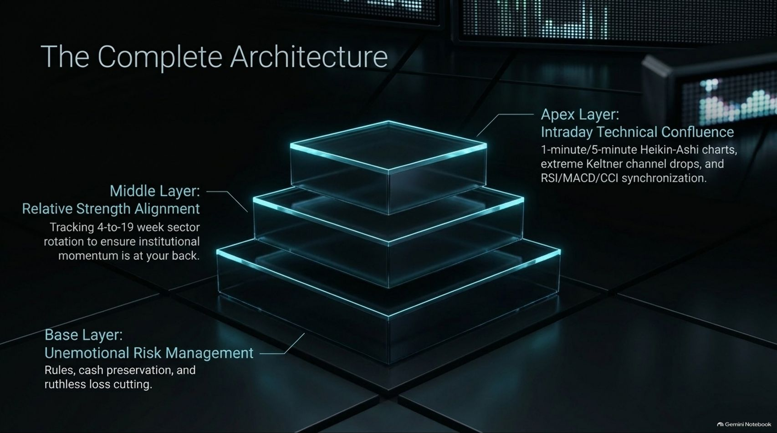

Slide 15
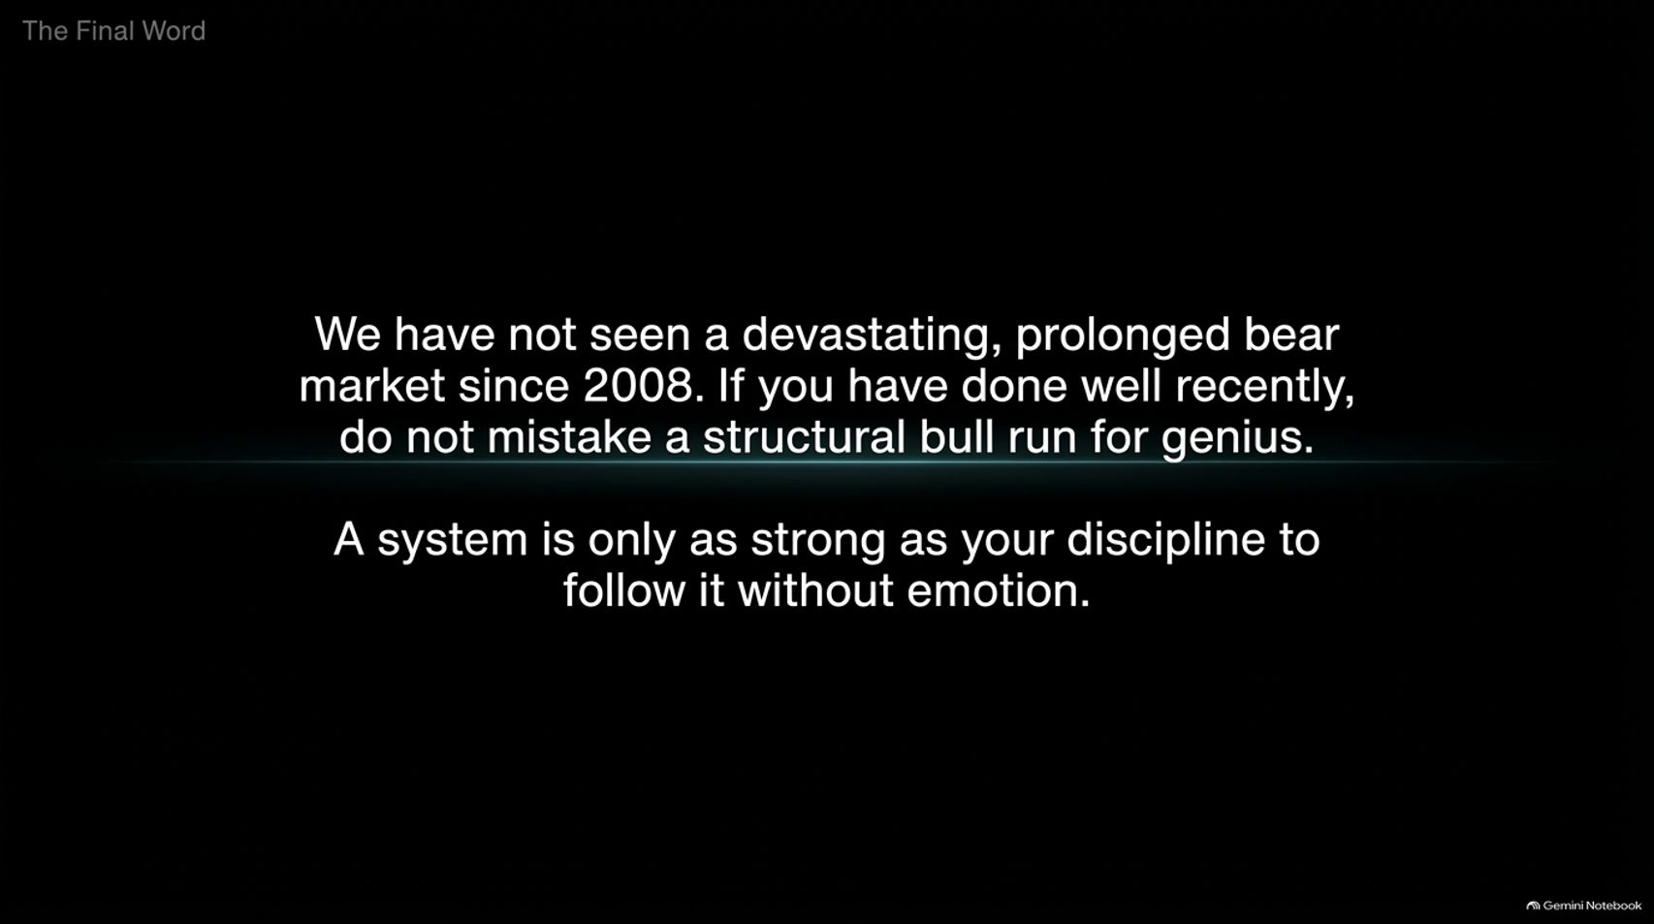
Notes:
Visual Anchor: Clean, stark typography on a deep dark background emphasizing market humility and the vital importance of emotional discipline.
Core Theme: Reminding traders that no prolonged bear market has occurred since 2008, warning against mistaking a bull run for genius, and stressing emotional discipline.
Speaker Notes & Script:]
"As we arrive at The Final Word of our playbook, we must end with a sobering reality check.
We have not seen a devastating, prolonged secular bear market since 2008. An entire generation of traders has grown up in an environment where every dip is aggressively bought and central banks rush to rescue asset prices. If you have done exceptionally well trading leveraged products recently, do not mistake a structural, liquidity-fueled bull run for personal genius.
Markets are humbling, cyclical, and unforgiving. A trading system is only ever as strong as your personal discipline to follow its rules without emotion when fear and greed take over. Respect the risk, master the architecture, and protect your capital above all else."

Slide 16
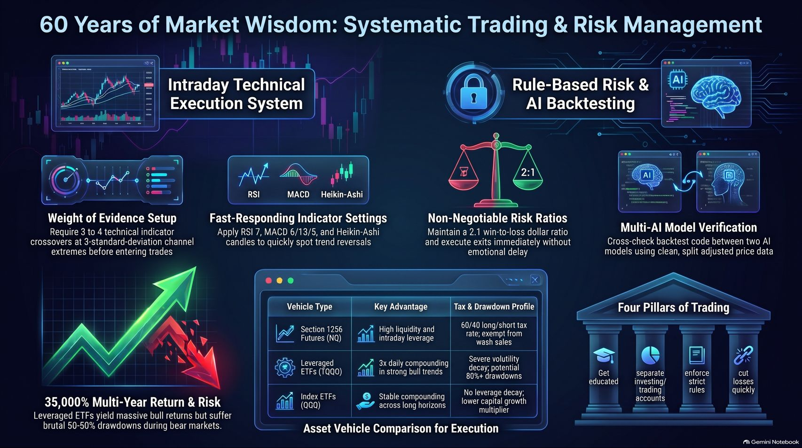
Notes:
Visual Anchor: A rich, executive summary dashboard integrating all key visual elements from the deck—risk scales, technical indicator panels, asset comparison tables, and architectural pillars.
Core Theme: Providing a comprehensive executive summary synthesizing decades of market wisdom, systematic execution protocols, and risk frameworks.
Speaker Notes & Script:
"To wrap up our deep dive into 32,000% in a Decade: The TQQQ Trading Playbook, this summary dashboard encapsulates six decades of hard-won market wisdom.
We have reviewed the essential pillars: segregating your accounts, respecting the dark side of leverage, filtering institutional momentum through relative strength heatmaps, timing entries via rigorous technical confluence gates, and backtesting safely with multi-AI verification.
Trading high-beta, 3x leveraged products like TQQQ is not for the faint of heart. It requires professional discipline, mechanical execution, and an unwavering commitment to cutting losses. Apply these rules rigorously, treat your trading like a disciplined business, and you will be equipped to navigate whatever the markets bring next. Thank you for your time, and trade with discipline."

Slide 17


