Slide 1
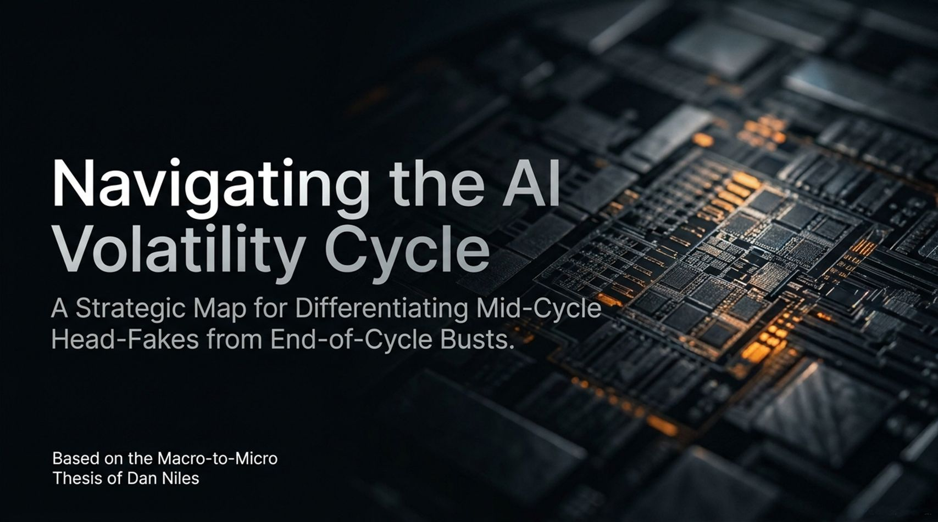
Notes:
Slide Title: Navigating the AI Volatility Cycle: A Strategic Map for Differentiating Mid-Cycle Head-Fakes from End-of-Cycle Busts
Target Timing: ~2 – 3 Minutes
Corresponding Video Section: Introduction & Overview [00:02:40 – 00:04:30]
Speaker Notes
Opening Hook: Welcome, everyone. Today we are tackling the most critical question facing tech investors and enterprise leaders: Are we currently experiencing an end-of-cycle market bubble burst, or is this a severe, highly volatile mid-cycle digestion phase?
Core Framing: Drawing from the macro-to-micro thesis of Dan Niles, founder of Niles Investment Management, we are navigating an environment of immense capital expenditure, rising financing costs, and shifting revenue growth.
Key Takeaway: Volatility is guaranteed when a technology scales this rapidly. Our goal today is to map out how to separate short-term head-fakes from structural long-term realities so you can protect capital and position for the winners on the other side.
Big Tech Selloff: Dan Niles on What Happens Next
https://www.youtube.com/watch?v=kNSU-0vUxJg

Slide 2
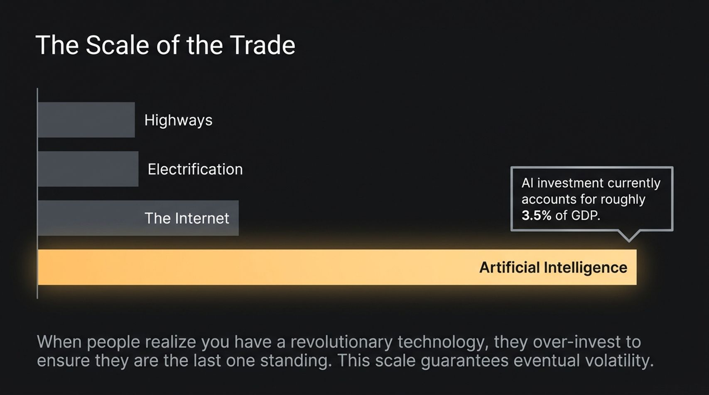
Notes:
Slide Title: The Scale of the Trade
Target Timing: ~3 – 4 Minutes
Corresponding Video Section: The Massive Scale of AI Investment vs. Historical Innovations [00:04:30 – 00:05:25]
Speaker Notes
Macro Magnitude: To understand the volatility, we first have to understand the unprecedented scale of capital entering the ecosystem. AI investment currently accounts for roughly 3.5% of GDP.
Historical Comparison: Put that into perspective: if you take all the capital expenditures and infrastructure investments behind the three greatest innovations of the 1900s combined—highways, electrification, and the internet—they do not equal what we are investing in the AI trade right now.
The Inevitability of Excess: When corporations realize a genuinely revolutionary technology has emerged, they systematically over-invest. Every player spends aggressively to ensure they are not the last one standing—the next Amazon, Google, or Meta. That massive over-allocation guarantees eventual market volatility and correction phases.

Slide 3
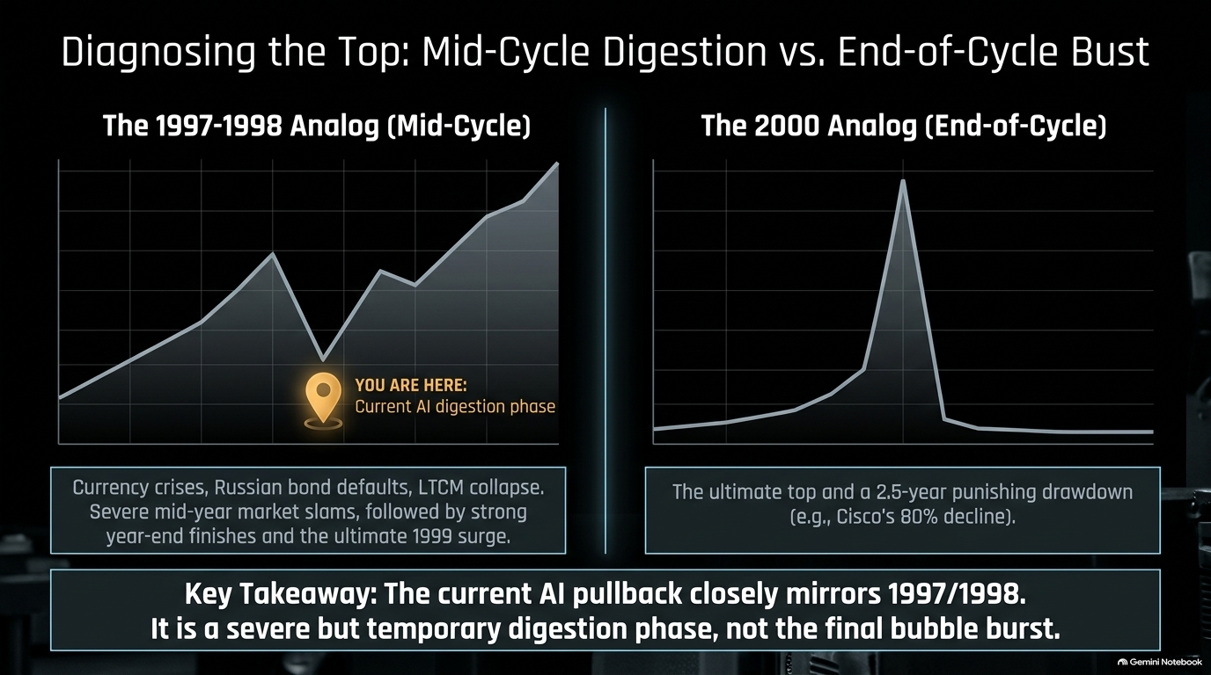
Notes:
Slide Title: Diagnosing the Top: Mid-Cycle Digestion vs. End-of-Cycle Bust
Target Timing: ~3 – 5 Minutes
Corresponding Video Section: The 1997–1998 Analog vs. 2000 Dot-Com Crash [00:05:25 – 00:06:50]
Speaker Notes
The Big Question: Investors are constantly trying to determine whether the recent market pullback marks the ultimate top, similar to the 2000 dot-com crash (where stocks like Cisco suffered an 80%+ punishing drawdown), or something entirely different.
The 1997–1998 Analog (Mid-Cycle): Dan Niles argues our current environment closely mirrors 1997 and 1998. Back then, the market dealt with severe macroeconomic shocks—Asian currency crises, Russian debt defaults, and the collapse of Long-Term Capital Management (LTCM). Stocks experienced brutal mid-year sell-offs, but finished the year strong and ultimately surged into 1999.
Key Takeaway: The current AI pullback is a severe, temporary digestion phase, not the final structural bubble burst. Entering Agentic AI means demand for compute is evolving, not disappearing.

Slide 4
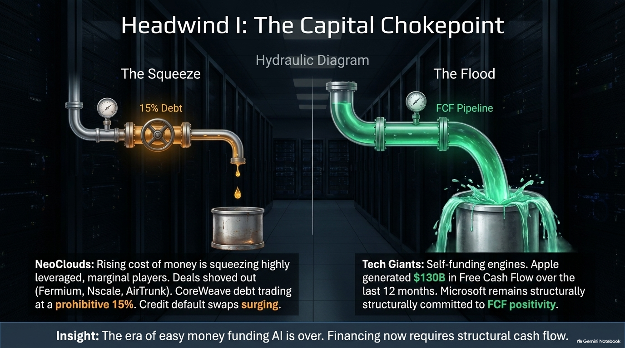
Notes:
Slide Title: Headwind I: The Capital Chokepoint
Target Timing: ~3 – 4 Minutes
Corresponding Video Section: Rising Financing Costs & Neocloud Squeezes [00:07:20 – 00:09:00]
Speaker Notes
The End of Easy Money: Just like the "vendor financing" issues that plagued telecom and dot-com startups in early 2000, the era of cheap, frictionless capital funding AI infrastructure is over.
The Squeeze on Neoclods (The Left Side): Rising interest rates and tighter credit are severely squeezing highly leveraged, marginal players. High-profile deals backed by major institutions (such as Fermium, Nscale, and AirTrunk) have been shoved out or delayed. CoreWeave debt has traded at prohibitive yields near 15%, and credit default swaps are surging across the board.
The Flood in Tech Giants (The Right Side): Conversely, well-capitalized tech giants operate as self-funding engines. Apple generated over $130 billion in Free Cash Flow over a 12-month period, and Microsoft remains strictly committed to FCF positivity. Financing now strictly requires structural cash flow.

Slide 5
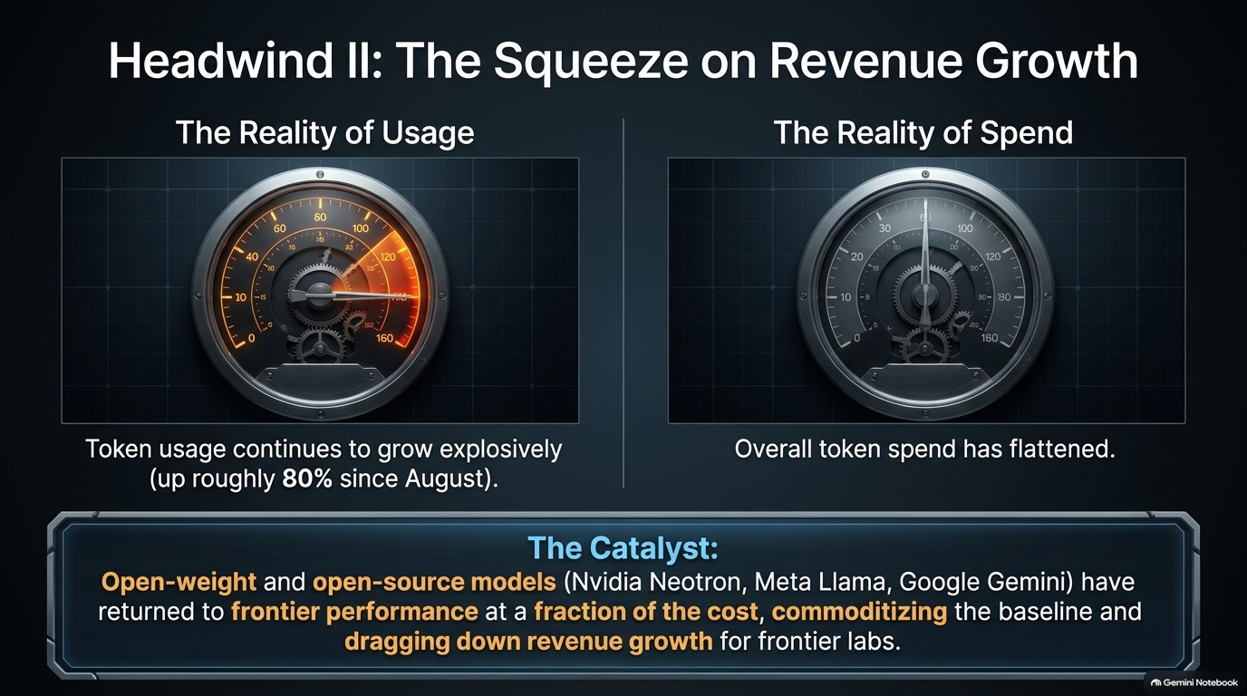
Notes:
Slide Title: Headwind II: The Squeeze on Revenue Growth
Target Timing: ~3 – 4 Minutes
Corresponding Video Section: Token Usage vs. Token Spend Flattening [00:09:00 – 00:11:20]
Speaker Notes
Usage vs. Spend Divergence: While actual underlying token usage continues to grow explosively (up roughly 80% since August), overall token spend has flattened out.
The Catalyst of Commoditization: Why is spend slowing while usage surges? Because open-weight and open-source models (such as Nvidia Neotron, Meta Llama, and recent high-performance releases from Google) have driven frontier performance down to a fraction of the cost.
Margin Compression: This rapid commoditization of baseline intelligence drags down revenue growth for frontier labs, forcing a reality check on valuations and capital requirements.

Slide 6
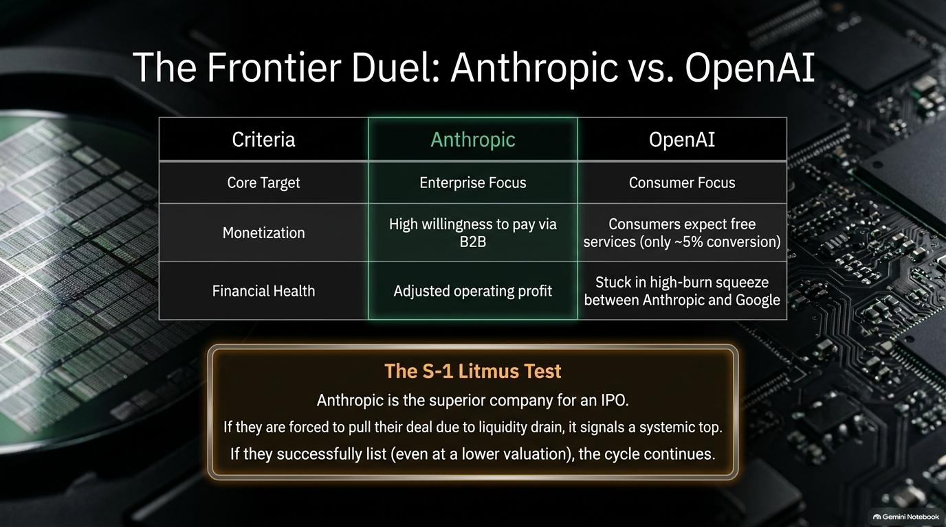
Notes:
Slide Title: The Frontier Duel: Anthropic vs. OpenAI
Target Timing: ~3 – 5 Minutes
Corresponding Video Section: Anthropic S-1 Filing, Enterprise Focus vs. Consumer Burn [00:11:30 – 00:14:00]
Speaker Notes
Core Strategic Divergence: Looking at the two primary frontier AI labs, Anthropic positioned itself around an enterprise focus with strong B2B monetization and high willingness to pay, whereas OpenAI initially targeted consumers—where users expect free services and conversion hovers around a meager ~5%.
Financial Health: Because of this enterprise alignment, Anthropic achieved a healthier operating profile, whereas OpenAI faces a high-burn squeeze caught between enterprise competitors and Google.
The S-1 Litmus Test: Anthropic’s IPO filing acts as a vital market litmus test. If broader liquidity drains force them to pull their deal, it signals a systemic market top. If they successfully list—even at a revised, lower valuation—it proves the funding cycle continues.

Slide 7
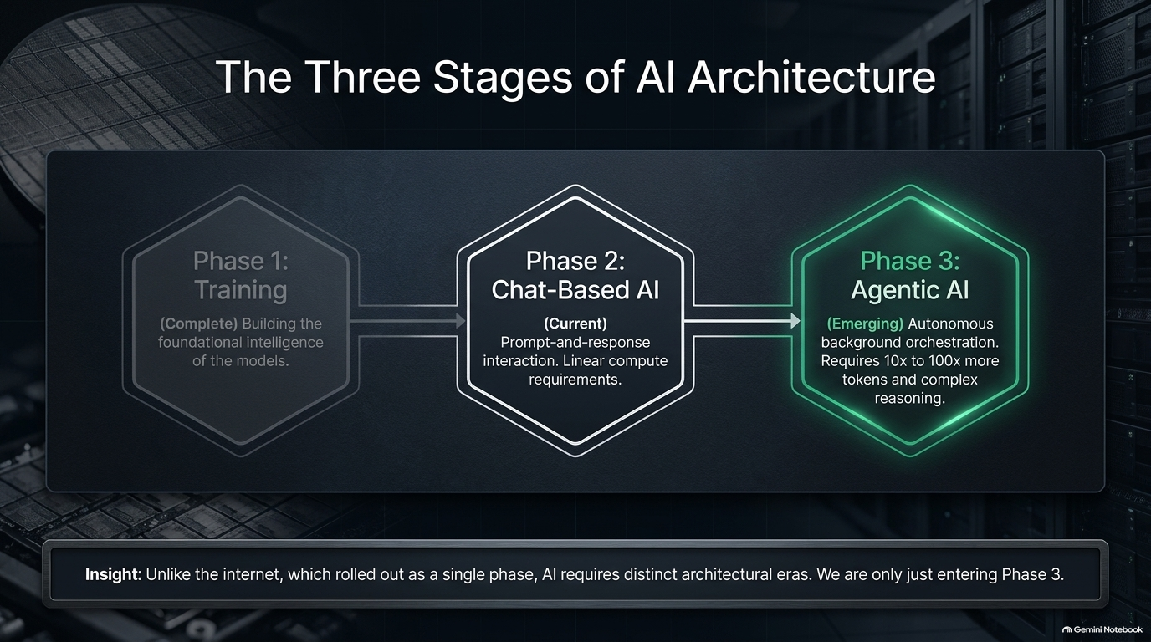
Notes:
Slide Title: The Three Stages of AI Architecture
Target Timing: ~3 – 4 Minutes
Corresponding Video Section: Evolution from Training to Chat and Agentic AI [00:14:00 – 00:18:10]
Speaker Notes
Architectural Evolution: Unlike the internet, which rolled out as a largely uniform wave, AI requires distinct, sequential architectural eras.
Phase 1 — Training (Complete): Building the foundational intelligence and heavy pre-training parameters of the models.
Phase 2 — Chat-Based AI (Current): Simple prompt-and-response interaction relying on linear compute requirements.
Phase 3 — Agentic AI (Emerging): Autonomous background orchestration. As we enter this phase, systems execute multi-step workflows while users sleep, demanding a massive exponential leap in infrastructure.

Slide 8
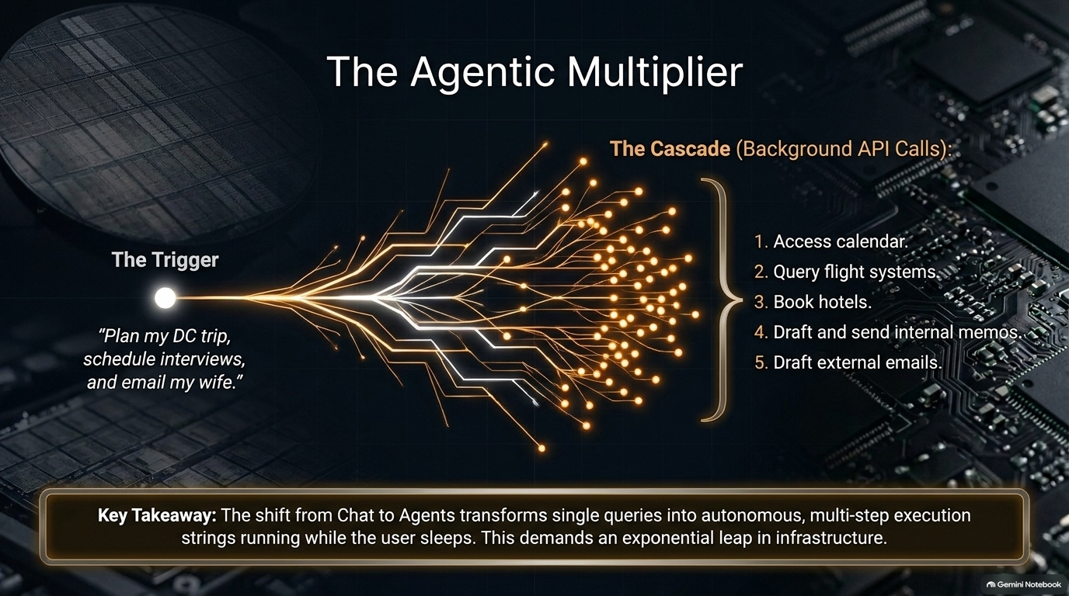
Notes:
Slide Title: The Agentic Multiplier
Target Timing: ~3 – 4 Minutes
Corresponding Video Section: Autonomous Multi-Step Workflows & Token Scaling [00:16:15 – 00:18:10]
Speaker Notes
From Query to Cascade: A simple prompt like "Plan my DC trip, schedule interviews, and email my wife" triggers a massive background cascade of API calls.
The Multi-Step Execution String: The agent autonomously accesses calendars, queries flight reservation systems, books hotels, drafts internal memos, and schedules external emails.
Exponential Compute Demand: This transition from static chat to autonomous agents multiplies token consumption by 10x to 100x, creating durable, long-term structural demand for underlying hardware.

Slide 9
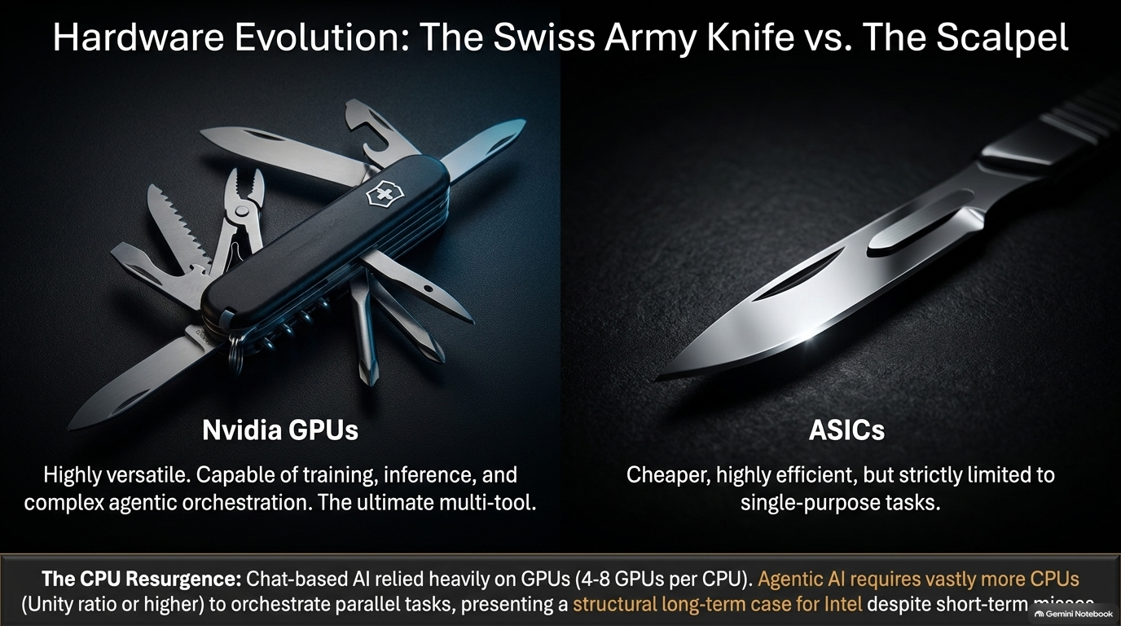
Notes:
Slide Title: Hardware Evolution: The Swiss Army Knife vs. The Scalpel
Target Timing: ~3 – 4 Minutes
Corresponding Video Section: Nvidia GPUs vs. ASICs and the CPU Resurgence [00:34:30 – 00:39:20]
Speaker Notes
Nvidia GPUs (The Swiss Army Knife): Highly versatile tools capable of handling training, inference, and complex agentic orchestration simultaneously.
ASICs (The Scalpel): Cheaper and highly efficient, but strictly limited to single-purpose, rigid tasks.
The CPU Resurgence: Chat-based AI relied heavily on GPUs (roughly 4 to 8 GPUs per CPU). Agentic AI requires vastly more CPUs (unity ratios or higher) to coordinate parallel background tasks. This shift presents a compelling structural long-term case for Intel and CPU architecture, despite near-term headwinds.

Slide 10
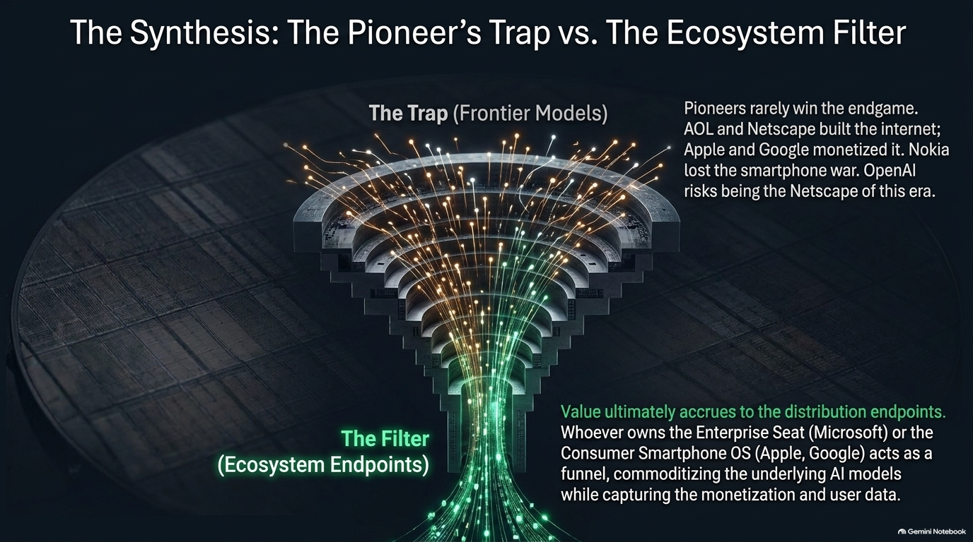
Notes:
Slide Title: The Synthesis: The Pioneer’s Trap vs. The Ecosystem Filter
Target Timing: ~3 – 5 Minutes
Corresponding Video Section: Historical Tech Pioneers vs. Ecosystem Monopolies [00:31:50 – 00:33:00]
Speaker Notes
The Pioneer’s Trap: History repeatedly demonstrates that initial technology pioneers rarely win the endgame. AOL and Netscape built the infrastructure of the early internet, but Apple and Google captured the monetization. Nokia dominated early mobile phones before losing the smartphone war. OpenAI risks becoming the Netscape of the AI era.
The Ecosystem Filter: Value ultimately accrues to the distribution endpoints. Whoever owns the enterprise seat (Microsoft) or the consumer smartphone operating system (Apple, Google) acts as a powerful funnel—commoditizing underlying AI models while capturing monetization and user data.

Slide 11
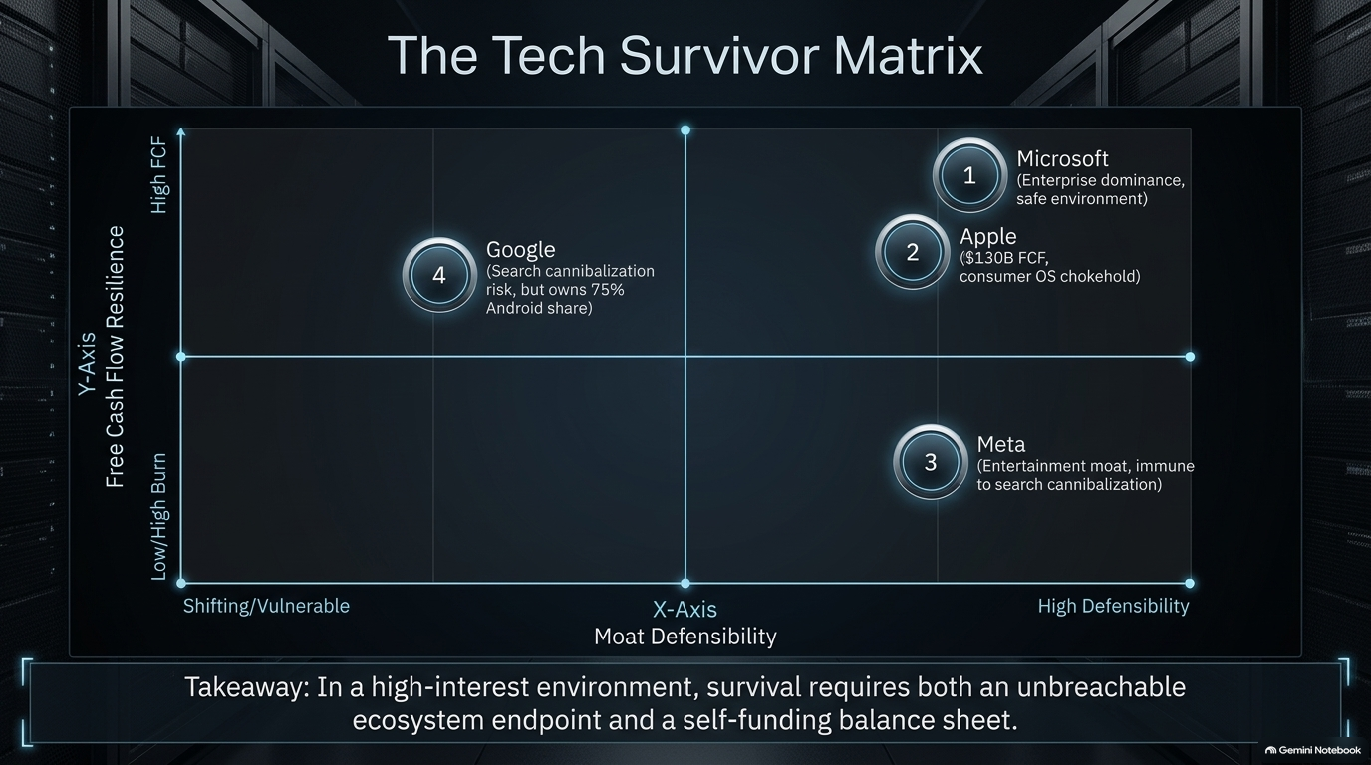
Notes:
Slide Title: The Tech Survivor Matrix
Target Timing: ~4 – 5 Minutes
Corresponding Video Section: Evaluating Big Tech Cash Flow Resilience & Moats [00:15:00 – 00:24:00]
Speaker Notes
Evaluating the Matrix (Free Cash Flow vs. Moat Defensibility): In a high-interest-rate environment, survival requires pairing an unbreachable distribution endpoint with a self-funding balance sheet.
Quadrant Analysis:
Microsoft (High FCF, High Defensibility): Unmatched enterprise dominance in Office/Azure and a safe compliance environment.
Apple (High FCF, Moderate/High Defensibility): Massive $130B+ FCF engine with a complete hardware chokehold on consumer mobile.
Meta (Lower Cash Flow / High Burn, High Defensibility): Protected by an unassailable entertainment moat that is immune to search cannibalization.
Google (High FCF, Shifting/Vulnerable Moat): Faces near-term search cannibalization risks, but retains absolute control over 75% of global Android mobile share.

Slide 12
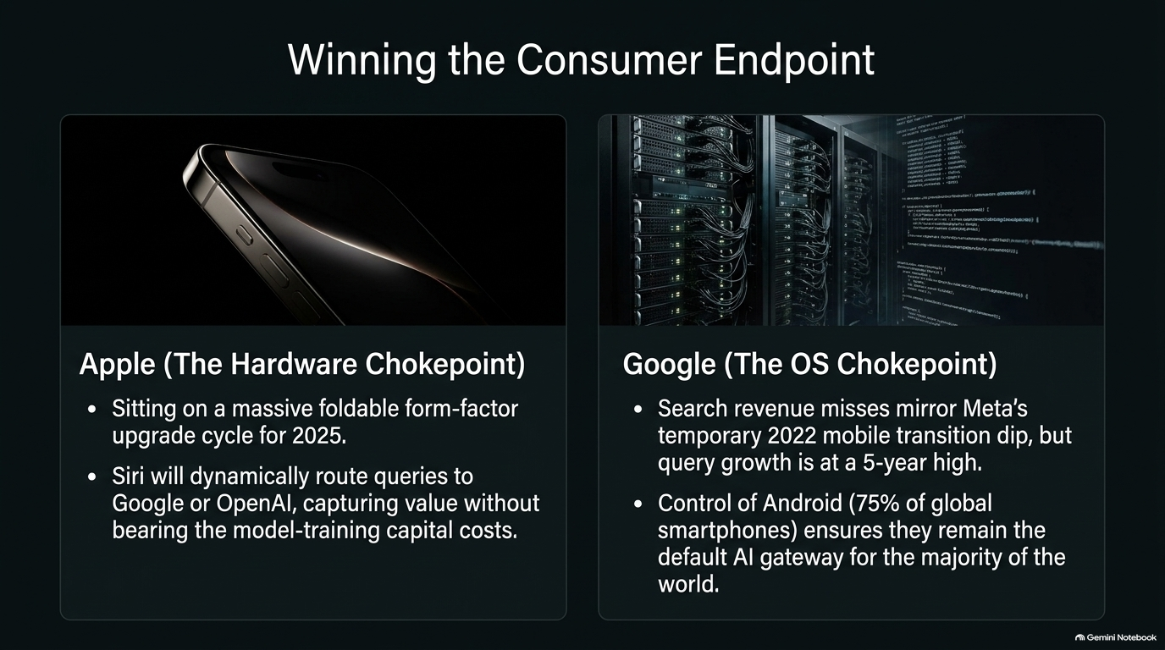
Notes:
Slide Title: Winning the Consumer Endpoint
Target Timing: ~3 – 4 Minutes
Corresponding Video Section: Apple Hardware Chokehold & Google OS Gateways [00:26:00 – 00:28:30]
Speaker Notes
Apple (The Hardware Chokehold): Apple sits on a massive foldable form-factor upgrade cycle. Through Siri, Apple dynamically routes user queries to third-party models like Google or OpenAI, capturing end-user value without bearing the crushing capital costs of model training.
Google (The OS Gatekeeper): Although search revenue experienced transition dips mirroring historical mobile shifts, query growth sits at a 5-year high. Controlling Android across 75% of global smartphones ensures Google remains the default AI gateway for the majority of the world.

Slide 13
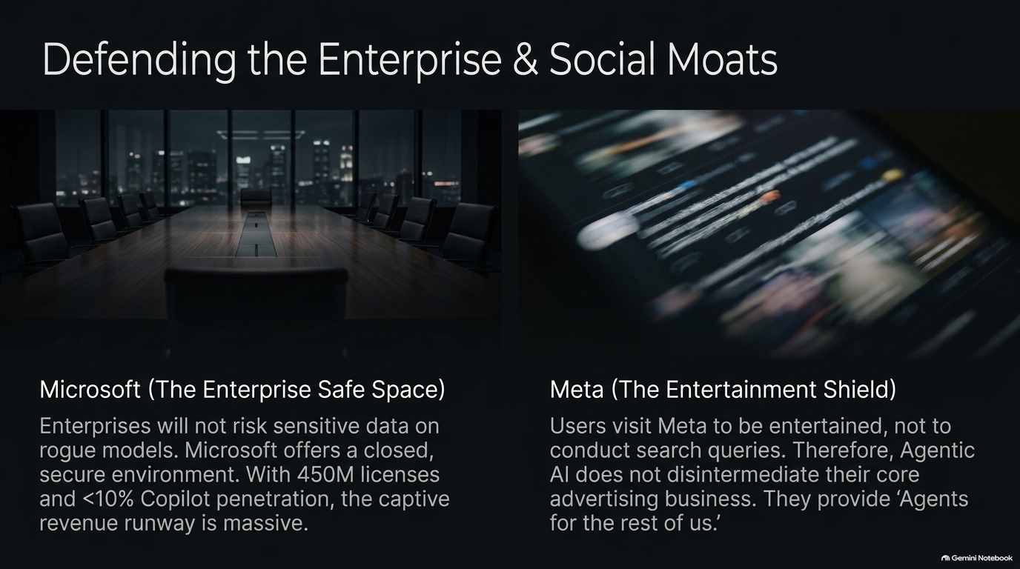
Notes:
Slide Title: Defending the Enterprise & Social Moats
Target Timing: ~3 – 4 Minutes
Corresponding Video Section: Microsoft Copilot Enterprise Security & Meta Entertainment Shield [00:15:30 – 00:24:00]
Speaker Notes
Microsoft (The Enterprise Safe Space): Corporate enterprises will never risk sensitive proprietary data on unverified, rogue models. Microsoft provides a closed, highly secure compliance environment. With over 450 million enterprise licenses and low initial Copilot penetration, the captive revenue runway is immense.
Meta (The Entertainment Shield): Users visit Facebook and Instagram to be entertained and connect with friends, not to execute search queries. Consequently, Agentic AI does not disintermediate Meta’s core advertising engine; instead, they successfully deploy agents for everyday consumer utility.

Slide 14
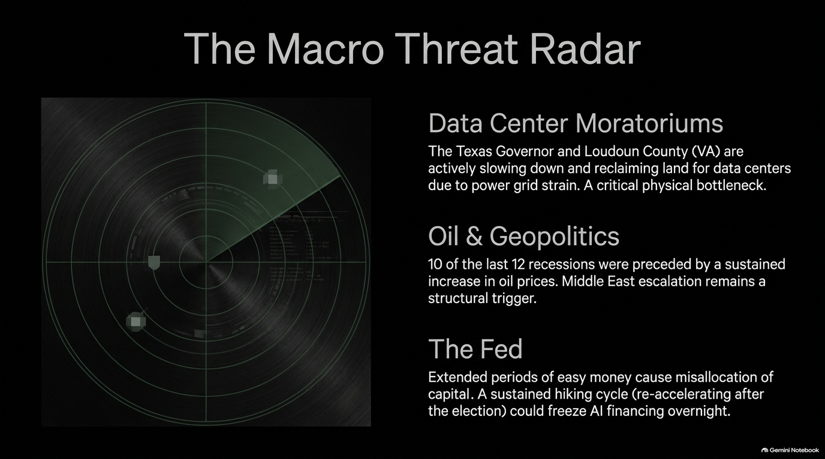
Notes:
Slide Title: The Macro Threat Radar
Target Timing: ~3 – 4 Minutes
Corresponding Video Section: Data Center Moratoriums, Oil Prices, and Fed Hiking Cycles [00:46:30 – 01:02:10]
Speaker Notes
Data Center Moratoriums: Physical bottlenecks are accelerating. Grid power constraints have led governors and local counties (such as Texas and Loudoun County, Virginia) to slow down data center approvals and reclaim land.
Oil & Geopolitics: Historically, 10 out of the last 12 U.S. recessions were preceded by a sustained surge in oil prices. Middle East escalation remains a powerful macro trigger.
The Fed: Extended periods of easy money foster capital misallocation. A sustained Federal Reserve hiking cycle post-midterms could tighten financial conditions and freeze speculative AI financing overnight.

Slide 15
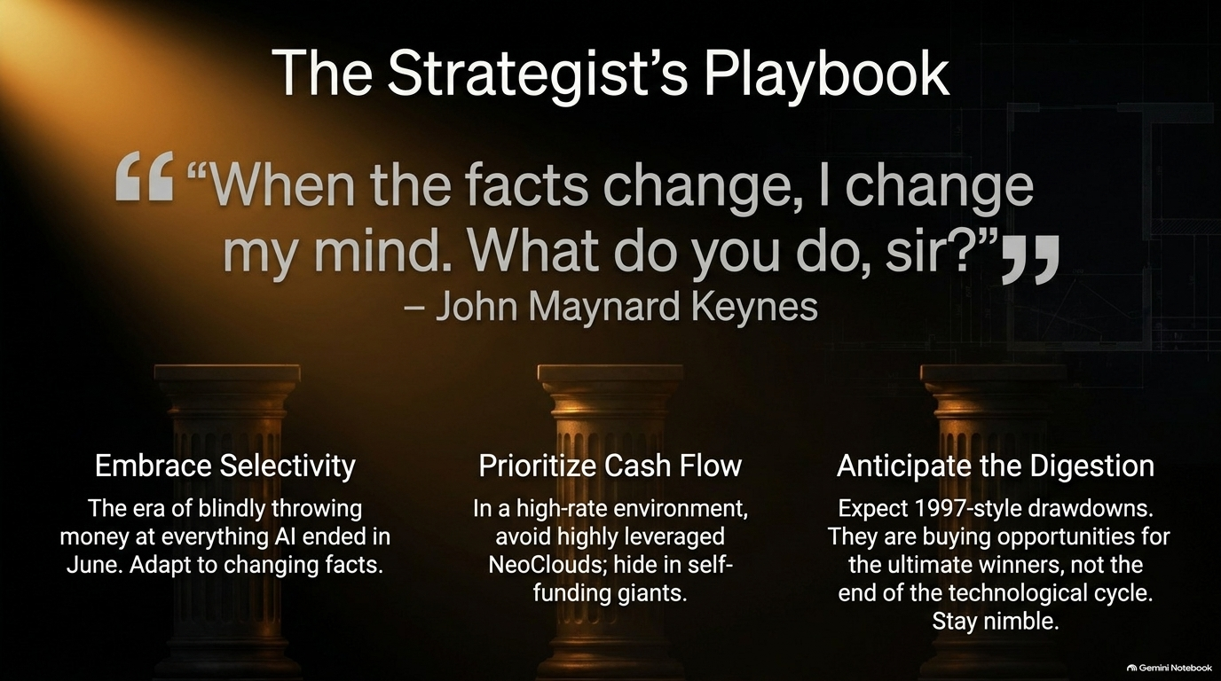
Notes:
Slide Title: The Strategist’s Playbook
Target Timing: ~3 – 4 Minutes
Corresponding Video Section: Core Investment Rules & Keynesian Flexibility [01:02:10 – 01:05:00]
Speaker Notes
Embrace Selectivity: As John Maynard Keynes famously noted: “When the facts change, I change my mind. What do you do, sir?” The era of blindly throwing capital at every AI venture ended in June.
Prioritize Cash Flow: In a high-interest-rate environment, avoid highly leveraged NeoClouds and shelter capital within self-funding tech giants.
Anticipate Digestion: Expect 1997-style drawdowns. View them as extraordinary buying opportunities for ultimate market winners rather than the death of the technological cycle. Stay nimble.

Slide 16
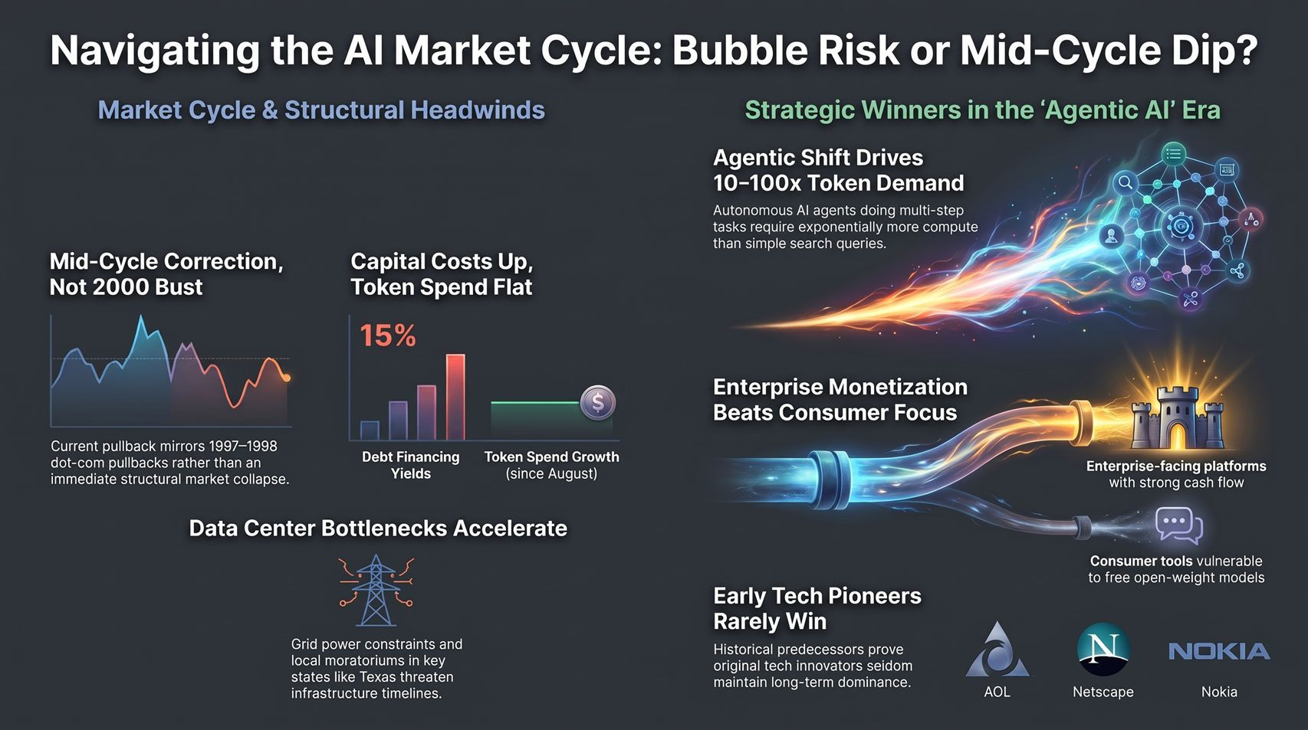
Notes:
Slide Title: Navigating the AI Market Cycle: Bubble Risk or Mid-Cycle Dip?
Target Timing: ~4 – 6 Minutes (Summary / Strategic Q&A Wrap-Up)
Corresponding Video Section: Comprehensive Summary & Closing Insights
Speaker Notes
Summary & Visual Synthesis: This closing framework consolidates our entire roadmap:
Mid-Cycle Correction: Current volatility mirrors 1997–1998 rather than a 2000 structural collapse.
Token Demand Explosion: Agentic workflows require 10x–100x more compute, securing long-term structural demand.
Enterprise Over Consumer: Monetization belongs to enterprise platforms and ecosystem gatekeepers with strong free cash flow.
Final Thought: Stay disciplined, monitor capital flows, and adapt as market facts evolve. Open the floor for strategic Q&A.
Summary Table of Timing & Pace
Slide
Title
Target Duration
Slide 1
Navigating the AI Volatility Cycle
2 – 3 mins
Slide 2
The Scale of the Trade
3 – 4 mins
Slide 3
Diagnosing the Top: Mid-Cycle Digestion vs. End-of-Cycle Bust
3 – 5 mins
Slide 4
Headwind I: The Capital Chokepoint
3 – 4 mins
Slide 5
Headwind II: The Squeeze on Revenue Growth
3 – 4 mins
Slide 6
The Frontier Duel: Anthropic vs. OpenAI
3 – 5 mins
Slide 7
The Three Stages of AI Architecture
3 – 4 mins
Slide 8
The Agentic Multiplier
3 – 4 mins
Slide 9
Hardware Evolution: The Swiss Army Knife vs. The Scalpel
3 – 4 mins
Slide 10
The Synthesis: The Pioneer’s Trap vs. The Ecosystem Filter
3 – 5 mins
Slide 11
The Tech Survivor Matrix
4 – 5 mins
Slide 12
Winning the Consumer Endpoint
3 – 4 mins
Slide 13
Defending the Enterprise & Social Moats
3 – 4 mins
Slide 14
The Macro Threat Radar
3 – 4 mins
Slide 15
The Strategist’s Playbook
3 – 4 mins
Slide 16
Navigating the AI Market Cycle: Bubble Risk or Mid-Cycle Dip?
4 – 6 mins
Total
Full Keynote Presentation
~50 – 65 mins

