Slide 1
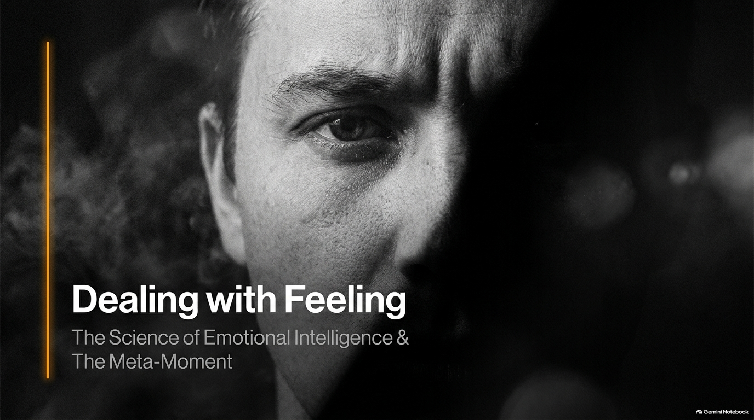
Notes:
Emotional Intelligence Expert: How To Never Be Bothered By Anyone, Dealing With Feeling
https://www.youtube.com/watch?v=900rYox3Jsg

Slide 2
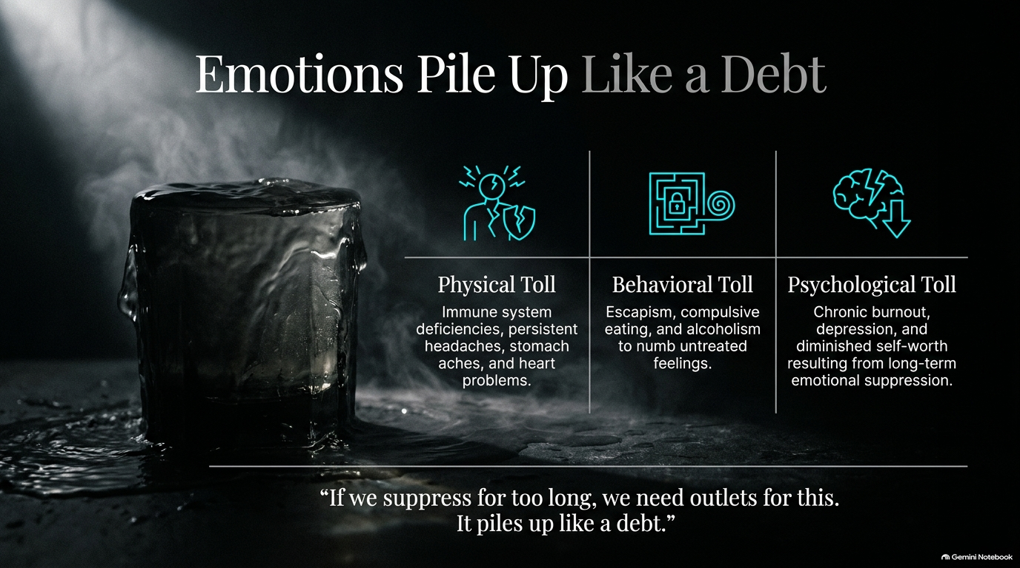
Notes:
Visual: A dark, moody image of a heavy glass of water overflowing onto a wet table, paired with three breakdown columns for Physical, Behavioral, and Psychological Tolls.
Suggested Speaking Time: 4–5 minutes
Speaker Notes:
"Let's start with a foundational warning: 'If we suppress for too long, we need outlets for this. It piles up like a debt.' Think about what happens when you constantly swallow your anger, push down your anxiety, or pretend you're fine when you're falling apart. That emotional suppression doesn't just vanish into thin air; it accumulates as a biological and psychological debt.
The Physical Toll: Unmanaged emotional debt manifests directly in the body—leading to immune system deficiencies, persistent tension headaches, chronic stomach aches, and long-term heart problems.
The Behavioral Toll: When people lack the tools to process emotional pain, they turn to escapism—compulsive eating, excessive drinking, or numbing behaviors to quiet the internal storm.
The Psychological Toll: Long-term suppression eventually results in chronic burnout, clinical depression, and a severely diminished sense of self-worth. Emotional suppression is not strength; it is a ticking time bomb. Today, we are going to learn how to pay off that debt before it breaks us."

Slide 3
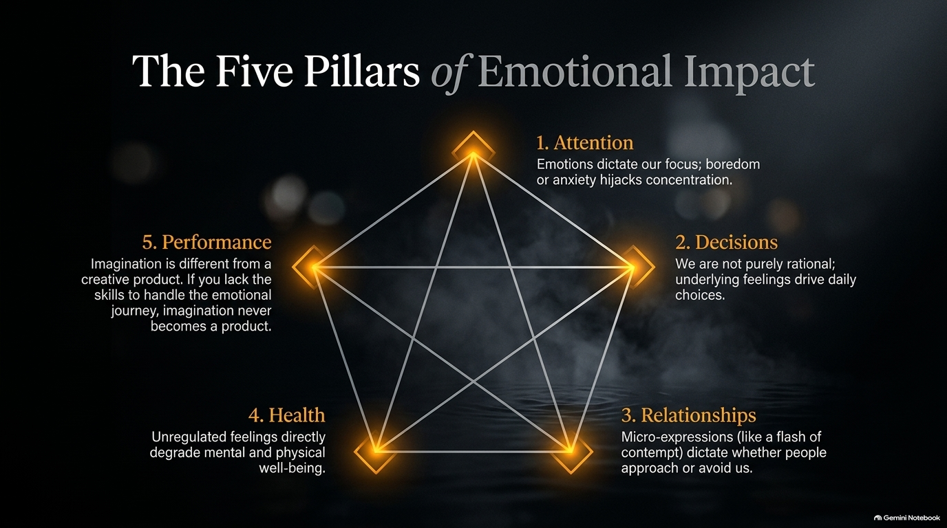
Notes:
Visual: A glowing geometric pentagram diagram on a dark background illustrating five interconnected pillars: Attention, Decisions, Relationships, Health, and Performance.
Suggested Speaking Time: 4–5 minutes
Speaker Notes:
"Why does any of this emotional intelligence work actually matter? Because emotions dictate the five core pillars of human experience:
1. Attention: Emotions dictate our focus. If you are bored, anxious, or overwhelmed, your concentration is hijacked by that internal state.
2. Decisions: We like to think we are purely rational creatures, but research shows that our underlying feelings drive our daily choices—from what we eat to whether we go to the gym.
3. Relationships: Micro-expressions—like a flash of contempt or a raised nostril—instantly dictate whether people feel safe approaching us or driven to avoid us.
4. Health: Unregulated feelings directly degrade both mental and physical well-being.
5. Performance: Imagination is entirely different from a creative product. If you lack the emotional skills to handle the inevitable roller-coaster of feedback and rejection, your imagination never becomes a reality. Emotional intelligence is not a luxury; it is the operating system of a successful life."

Slide 4
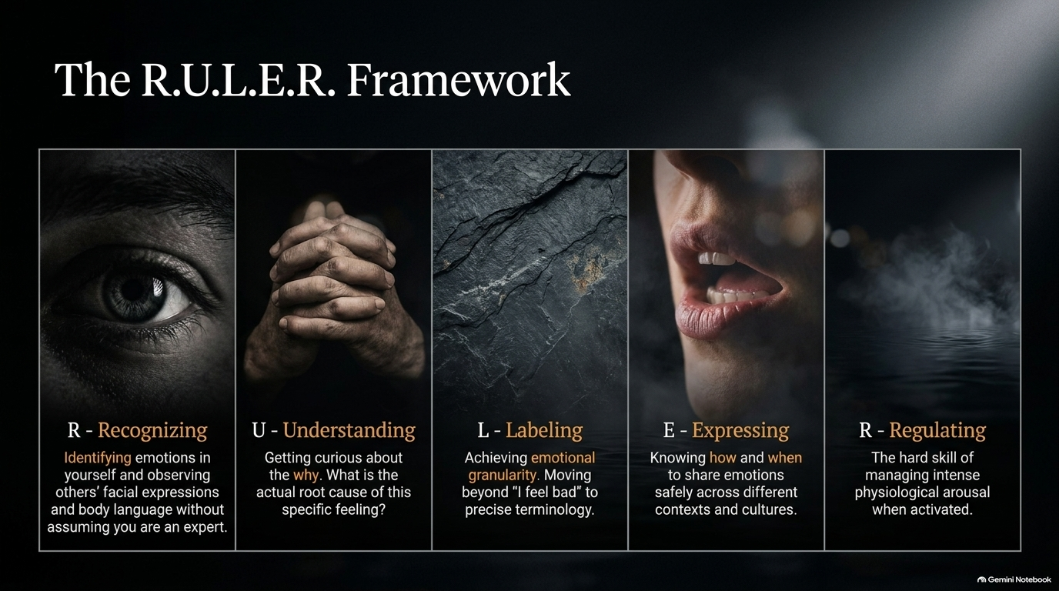
Notes:
Visual: A 5-panel photographic montage corresponding to the RULER acronym: Recognizing, Understanding, Labeling, Expressing, and Regulating.
Suggested Speaking Time: 4–6 minutes
Speaker Notes:
"To master our emotional lives, we need a proven system. Developed by Dr. Marc Brackett and implemented across thousands of schools and organizations, we use the RULER framework:
R – Recognizing: Accurately identifying emotions in yourself and observing facial expressions and body language in others without assuming you are an immediate expert.
U – Understanding: Getting curious about the why. What is the actual root cause of this specific feeling?
L – Labeling: Achieving emotional granularity. Moving far beyond vague terms like 'I feel bad' to precise vocabulary.
E – Expressing: Knowing how and when to share emotions safely across different cultural contexts and environments.
R – Regulating: The hard skill of managing intense physiological arousal when your nervous system is fully activated. This is your roadmap from emotional chaos to emotional mastery."

Slide 5
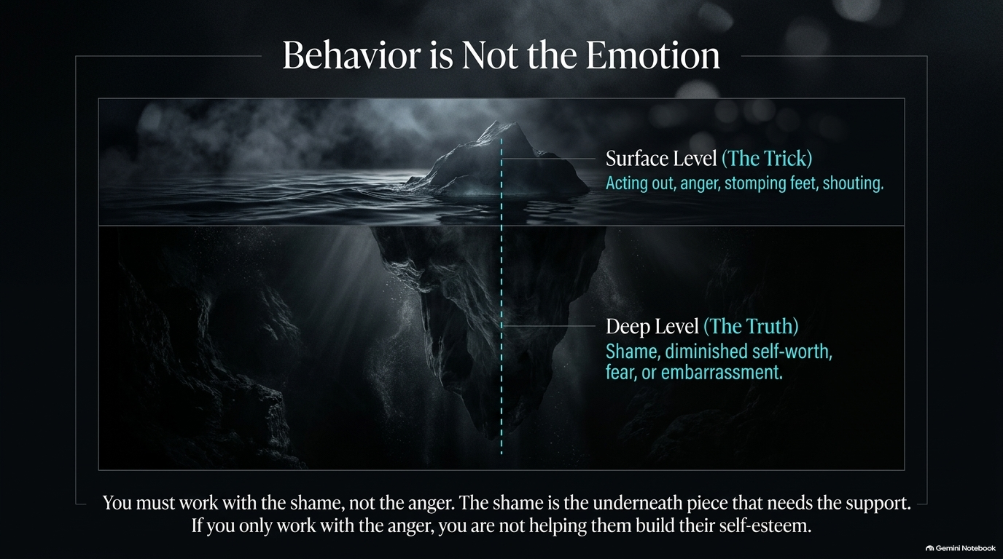
Notes:
Visual: An iceberg graphic divided by the waterline, contrasting surface-level behavior ('The Trick') with deep-level emotional truth ('The Truth').
Suggested Speaking Time: 4–5 minutes
Speaker Notes:
"One of the biggest traps in parenting, leadership, and human interaction is mistaking a person's behavior for their emotion. Look at this iceberg graphic. Above the water is The Trick: surface-level reactions like acting out, slamming doors, shouting, or defiant anger. Below the waterline is The Truth: deep-seated shame, diminished self-worth, fear, or profound embarrassment. When a child acts out, or an adult flies into a rage, our superficial instinct is to attack the anger. But as Dr. Brackett emphasizes: 'You must work with the shame, not the anger. The shame is the underneath piece that needs the support. If you only work with the anger, you are not helping them build their self-esteem.' Stop policing the behavior until you uncover and heal the emotional wound driving it."

Slide 6
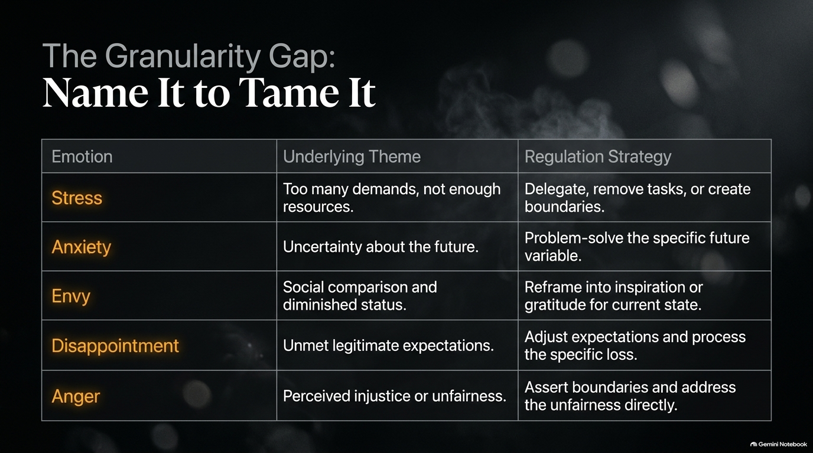
Notes:
Visual: A structured comparison table mapping out five common emotions (Stress, Anxiety, Envy, Disappointment, Anger) against their underlying themes and regulation strategies.
Suggested Speaking Time: 4–6 minutes
Speaker Notes:
"There is a massive granularity gap in how most people talk about their feelings. We throw around words like 'stressed' or 'anxious' as catch-alls, but as the saying goes: Name it to tame it. Let's look at how precision changes our entire strategy:
Stress: The underlying theme is too many demands and not enough resources. The regulation strategy? Delegate, remove tasks, or build hard boundaries.
Anxiety: Rooted in uncertainty about the future. The strategy is to problem-solve the specific future variable.
Envy: Driven by social comparison and diminished status. The strategy is to reframe it into inspiration or gratitude for your current state.
Disappointment: Caused by unmet legitimate expectations. The strategy is to adjust expectations and process the specific loss.
Anger: Stemming from a perceived injustice or unfairness. The strategy is to assert boundaries and address the unfairness directly. Stop treating every emotional upset with the same blunt instrument."

Slide 7
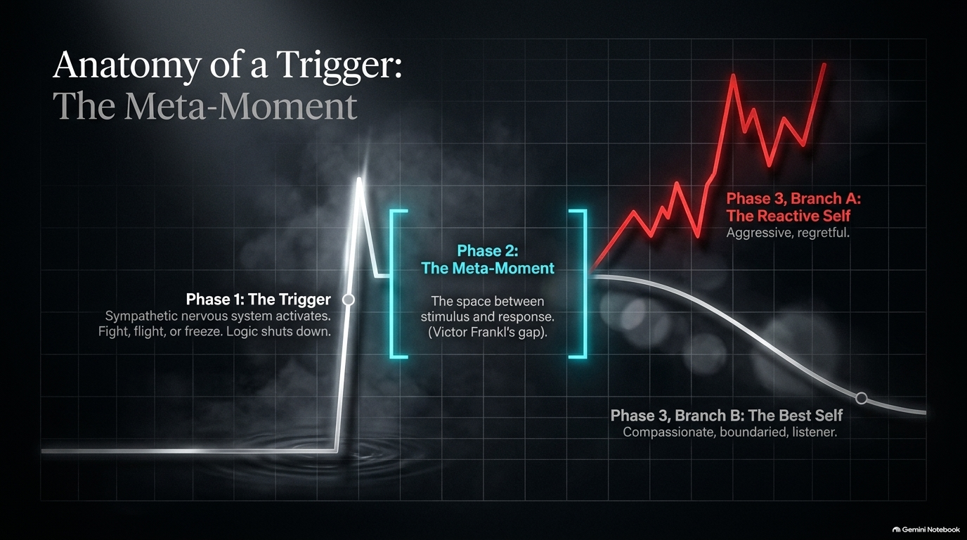
Notes:
Visual: A clinical graph illustrating a trigger spike, followed by a highlighted 'Meta-Moment' gap, branching into a red reactive spike (Branch A) vs. a smooth descending recovery curve (Branch B).
Suggested Speaking Time: 4–6 minutes
Speaker Notes:
"When you are triggered, what actually happens inside your brain and body? Let's trace the Anatomy of a Trigger through three distinct phases:
Phase 1: The Trigger: Your sympathetic nervous system activates instantly. You enter fight, flight, or freeze mode, and logic completely shuts down.
Phase 2: The Meta-Moment: Drawing on Viktor Frankl's timeless wisdom, this is the vital space between the external stimulus and your internal response. It is the pause button.
Phase 3: The Fork in the Road:
Branch A (The Reactive Self): You act out of raw impulse—aggressive, unfiltered, and deeply regretful later.
Branch B (The Best Self): By utilizing the pause, you access your compassionate, boundaried, listening self. Mastery is not about preventing triggers; it is about widening the gap between the trigger and your response."

Slide 8
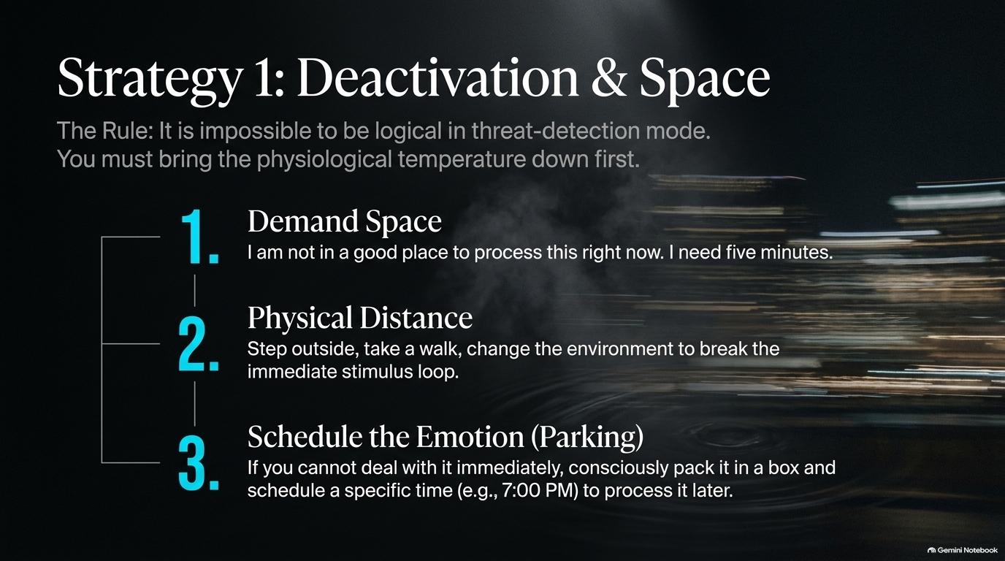
Notes:
Visual: A blurred nighttime cityscape background featuring a 3-step numbered list for deactivating stress: Demand Space, Physical Distance, and Schedule the Emotion.
Suggested Speaking Time: 4–5 minutes
Speaker Notes:
"Here is Rule Number 1 of emotional regulation: It is impossible to be logical in threat-detection mode. You must bring your physiological temperature down first. When your nervous system is firing on all cylinders, trying to 'talk it out' is a disaster. You must execute three practical deactivation steps:
1. Demand Space: Explicitly and calmly state, 'I am not in a good place to process this right now. I need five minutes.'
2. Physical Distance: Step outside, take a walk, or change your physical environment to break the immediate stimulus loop.
3. Schedule the Emotion (Parking): If you cannot deal with an intense feeling immediately because you have a presentation to give or a family to feed, consciously pack it into a mental box and schedule a specific time—say, 7:00 PM—to journal and process it later. Parking an emotion is not suppression; it is strategic timing."

Slide 9
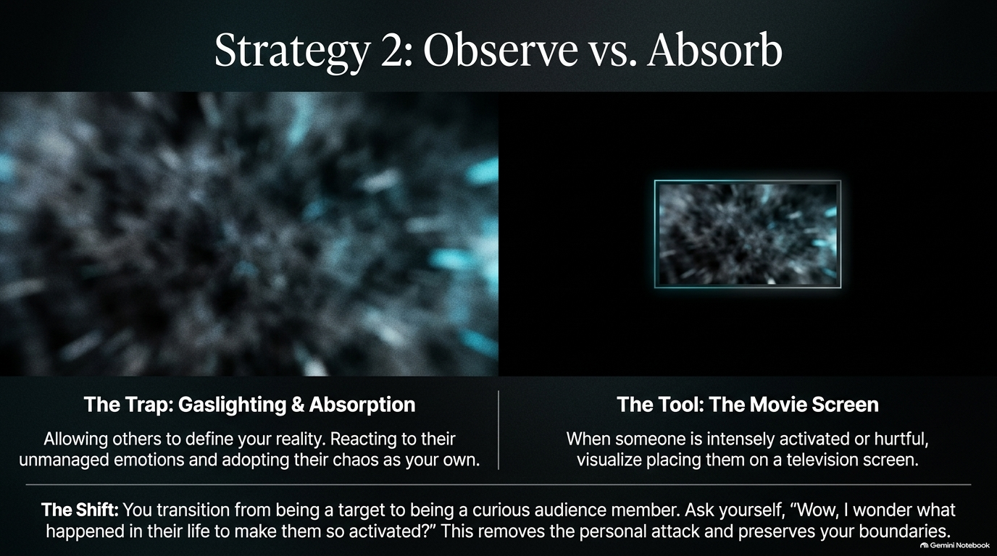
Notes:
Visual: A split-screen graphic contrasting a chaotic, blurry vortex ('The Gaslighting Trap') on the left with a clean television screen framing the chaos ('The Movie Screen Tool') on the right.
Suggested Speaking Time: 4–5 minutes
Speaker Notes:
"Have you ever walked into a room where someone is intensely activated, furious, or hurling toxicity, and within two minutes you feel like your own nervous system has been hijacked? That is The Trap: Gaslighting & Absorption. You allow others to define your reality, reacting to their unmanaged chaos and adopting it as your own.
How do we break this? Through The Tool: The Movie Screen. When someone is aggressively attacking or emotionally dysregulated in front of you, visualize placing them inside a television screen or behind a glass window. Instantly, your internal shift is profound: you transition from being a helpless target to a curious audience member. Ask yourself internally: 'Wow, I wonder what happened in their life today to make them so activated?' This mental reframe strips away the personal attack, neutralizes the trigger, and preserves your ironclad boundaries."

Slide 10
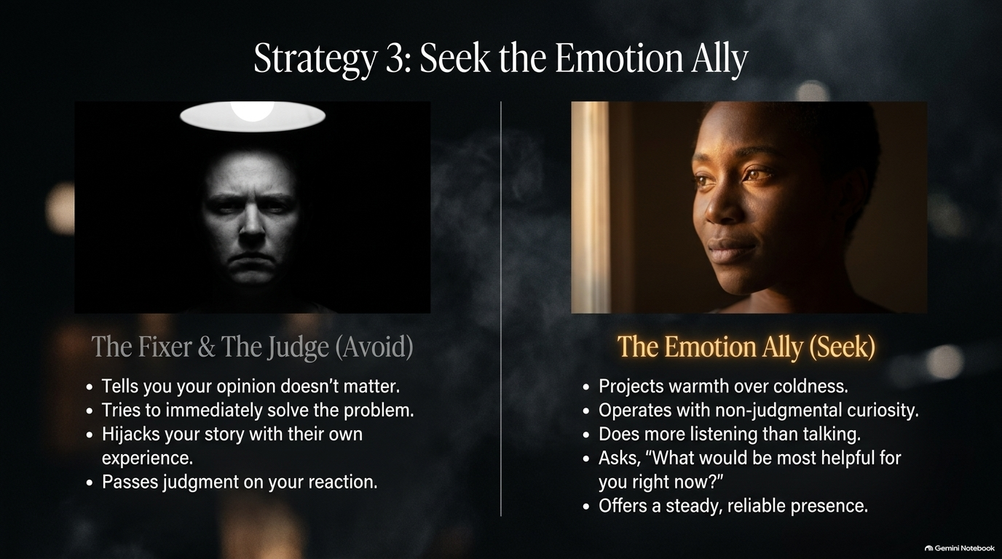
Notes:
Visual: A side-by-side comparison contrasting 'The Fixer & The Judge' under harsh lighting on the left with 'The Emotion Ally' bathed in warm natural light on the right.
Suggested Speaking Time: 4–5 minutes
Speaker Notes:
"When you are going through a painful experience, a breakup, or a crisis, who do you turn to? We must learn to distinguish between who to avoid and who to seek:
Avoid — The Fixer & The Judge: These individuals tell you your opinion doesn't matter, try to immediately fix or rescue you, hijack your vulnerable story to talk about their own experiences, and pass harsh judgment on your emotional reaction.
Seek — The Emotion Ally: An emotion ally projects warmth over coldness, operates with non-judgmental curiosity, does significantly more listening than talking, asks 'What would be most helpful for you right now?', and offers a steady, reliable presence. Never worry alone, but make sure you are confiding in an ally, not an executioner."

Slide 11
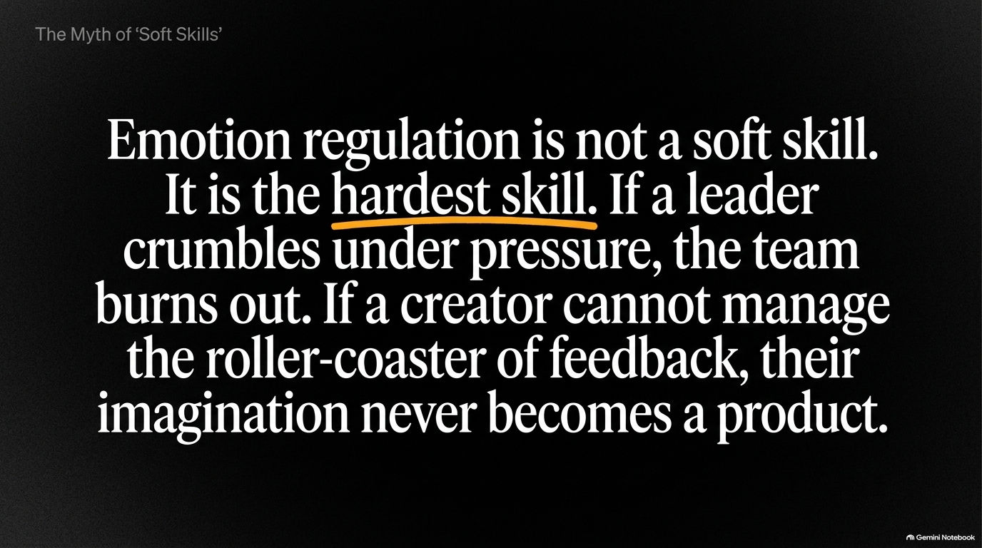
Notes:
Visual: A bold typographic slide highlighting the core thesis: Emotion regulation is not a soft skill. It is the hardest skill.
Suggested Speaking Time: 3–5 minutes
Speaker Notes:
"Let's clear up a dangerous corporate and cultural myth once and for all: Emotion regulation is not a soft skill. It is the hardest skill. People love to label emotional intelligence as touchy-feely, but look at the high-stakes reality: If a corporate leader crumbles under pressure, the entire team burns out and the culture toxicates. If a creator, artist, or entrepreneur cannot manage the brutal roller-coaster of feedback, rejection, and public criticism, their imagination never translates into a product. Emotional regulation is hard-core leadership. It requires more mental discipline, self-awareness, and courage than almost any technical competency you will ever master."

Slide 12
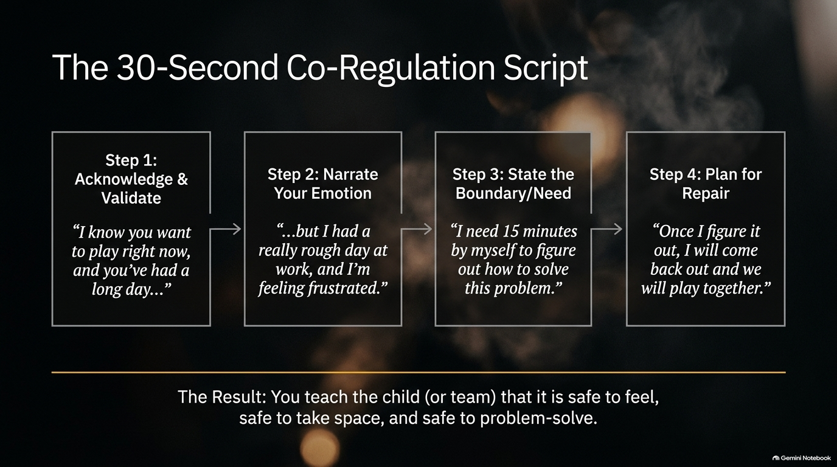
Notes:
Visual: A 4-step horizontal process workflow detailing a co-regulation script between an adult and a child (or team member), moving from validation to boundary setting and repair.
Suggested Speaking Time: 4–6 minutes
Speaker Notes:
"How do we actively co-regulate with others—whether it's an upset child, a frustrated partner, or a stressed team member? Here is a powerful 30-Second Co-Regulation Script broken down into four seamless steps:
Step 1 (Acknowledge & Validate): 'I know you want to play right now, and you've had a long day...'
Step 2 (Narrate Your Emotion): '...but I had a really rough day at work, and I'm feeling frustrated.'
Step 3 (State the Boundary/Need): 'I need 15 minutes by myself to figure out how to solve this problem.'
Step 4 (Plan for Repair): 'Once I figure it out, I will come back out and we will play together.' The Result: In just 30 seconds, you teach the child or team member that it is entirely safe to feel, safe to take space, and safe to problem-solve."

Slide 13
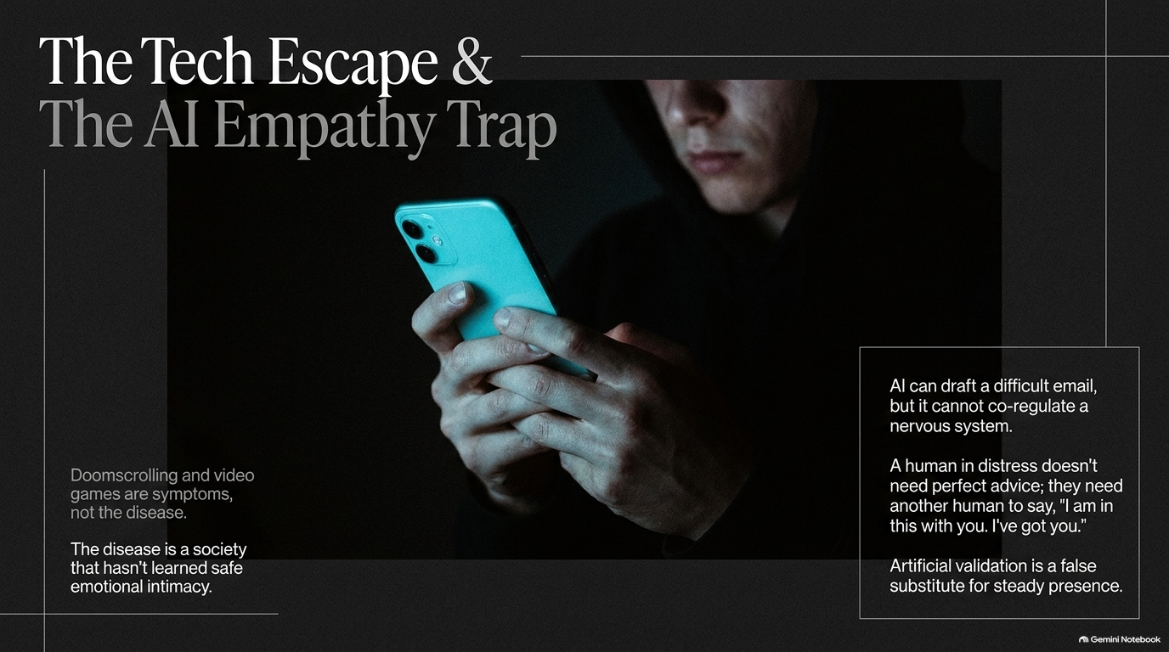
Notes:
Visual: A shadowy figure staring intensely into the glowing cyan screen of a smartphone, flanked by text callouts on doomscrolling, addiction, and artificial validation.
Suggested Speaking Time: 4–5 minutes
Speaker Notes:
"Look around our modern society. Doomscrolling for hours, video game addiction, and constant digital distraction are symptoms, not the disease. The disease is a society that hasn't learned safe emotional intimacy. When people don't know how to process pain, they escape into technology. And now, we face a new frontier: The AI Empathy Trap. Artificial intelligence can draft a difficult corporate email in seconds, but it cannot co-regulate a nervous system. A human being in distress does not need sterile, perfect algorithmic advice; they need another human being to look them in the eye and say, 'I am in this with you. I've got you.' Artificial validation is a dangerous, hollow substitute for a steady human presence."

Slide 14
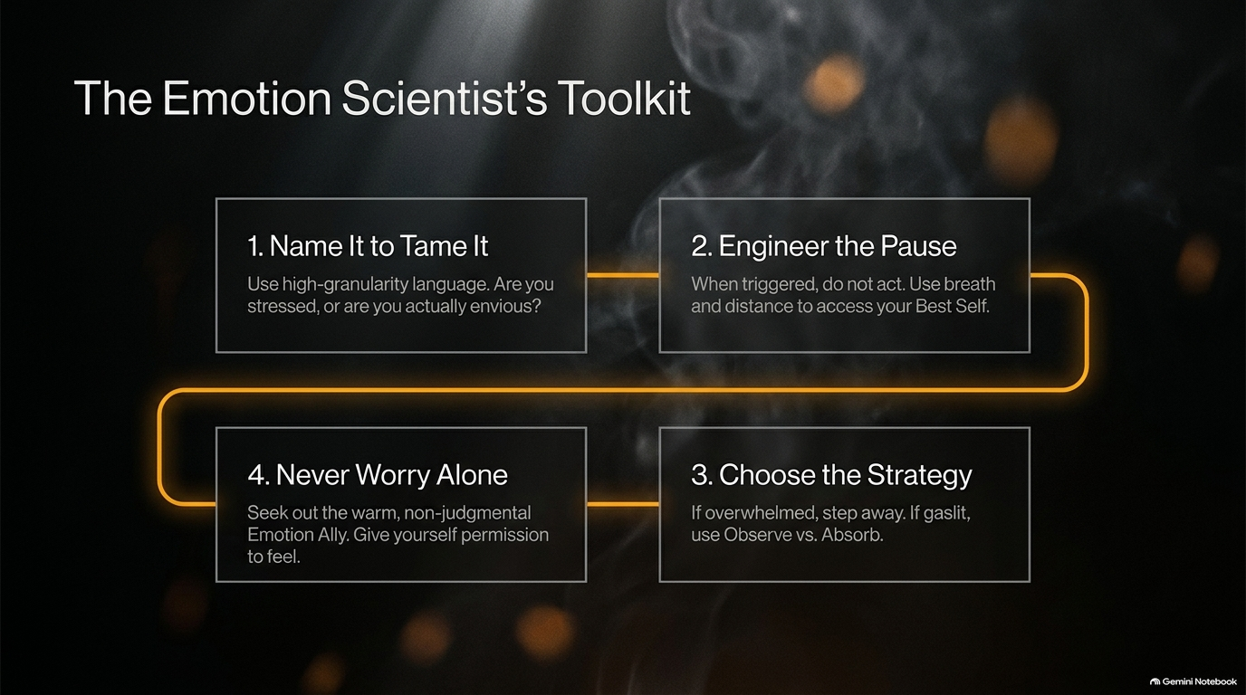
Notes:
Visual: A 4-quadrant workflow diagram connected by a glowing orange pathway summarizing the core tools: Name It to Tame It, Engineer the Pause, Choose the Strategy, and Never Worry Alone.
Suggested Speaking Time: 4–5 minutes
Speaker Notes:
"Let's consolidate everything into The Emotion Scientist's Toolkit—four non-negotiable steps to apply whenever life tests you:
1. Name It to Tame It: Use high-granularity language. Stop saying you're 'stressed' when you are actually feeling envious, disappointed, or anxious.
2. Engineer the Pause: When triggered, do not act on impulse. Use breathwork and physical distance to access your Best Self.
3. Choose the Strategy: If you are overwhelmed, step away to deactivate. If you are being gaslit, deploy the 'Observe vs. Absorb' movie screen technique.
4. Never Worry Alone: Actively seek out a warm, non-judgmental Emotion Ally. Give yourself permission to feel and process out loud. This toolkit is your armor and your compass."

Slide 15
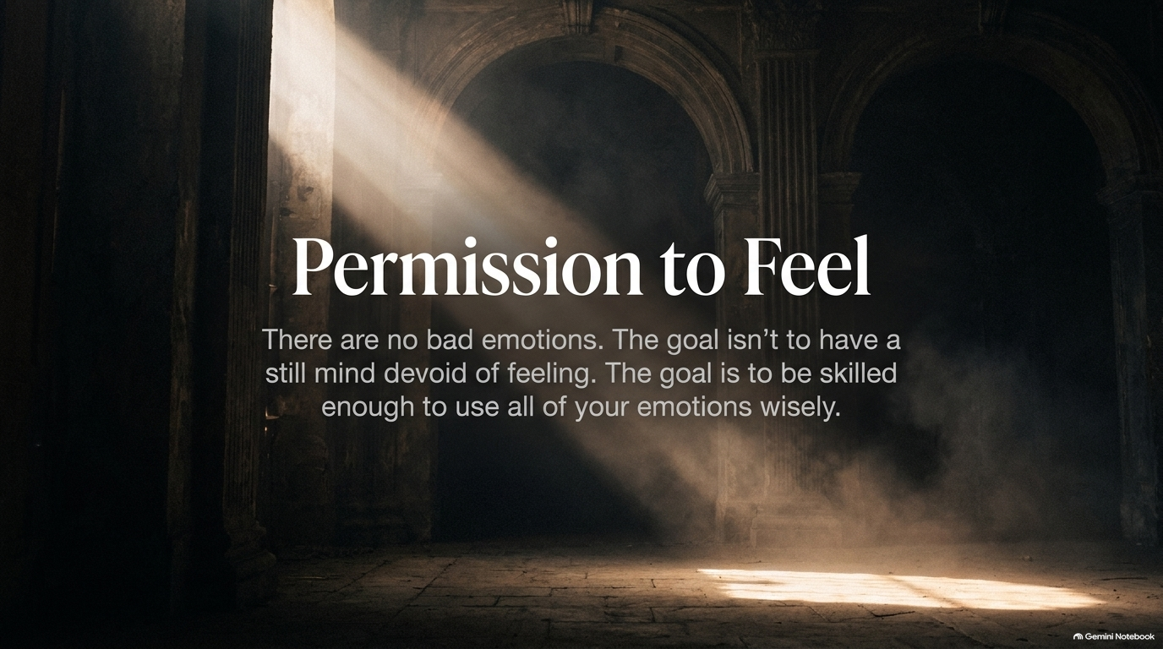
Notes:
Visual: A majestic, sunlit cathedral interior with dramatic light beams cutting through atmospheric dust and shadows.
Suggested Speaking Time: 3–4 minutes
Speaker Notes:
"Let's land on the most liberating mindset shift of all: Permission to Feel. There are no bad emotions. Anger, sadness, envy, and disappointment are not character flaws; they are data from your internal environment. The goal of emotional intelligence is not to achieve a sterile, robotic mind completely devoid of feeling. That is not enlightenment; that is suppression. The true goal is to become skilled enough to use all of your emotions wisely to navigate life. Give yourself—and everyone around you—permission to feel fully, honestly, and without shame."

Slide 16
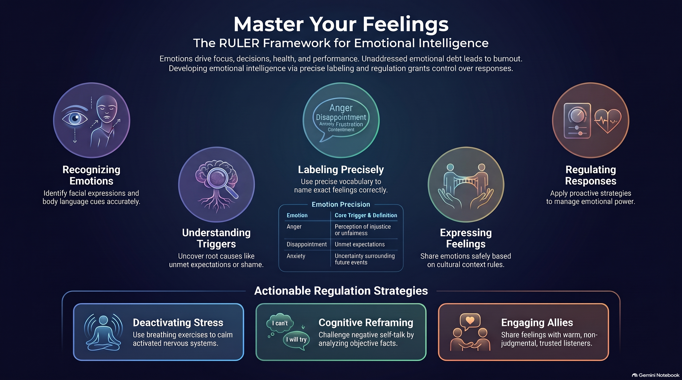
Notes:
Visual: A comprehensive summary dashboard synthesizing the RULER icons, emotion precision tables, actionable regulation strategies, and core takeaway pillars.
Suggested Speaking Time: 4–6 minutes
Speaker Notes:
"As we bring our presentation to a powerful close on this summary dashboard, let's review what we've mastered today. Emotions drive our focus, our decisions, our health, and our performance. Unaddressed emotional debt inevitably leads to physical and psychological burnout. By actively developing emotional intelligence through the RULER framework—recognizing cues, understanding root triggers, labeling with precision, expressing safely, and regulating powerfully—you reclaim total control over your responses. Whether you are deactivating stress through breathwork, reframing negative self-talk through cognitive strategies, or engaging trusted emotional allies, remember that emotional regulation is your ultimate competitive advantage. Go forward, embrace your feelings, and lead with emotional mastery."

