Slide 1

Notes:
Target Delivery Time: ~3 minutes
Speaker Script:
Welcome, everyone. Today, we are exploring what it truly means to cultivate a strategic mind—or what we refer to here as becoming "dangerously intelligent".
When we talk about high-stakes environments, whether in executive leadership, complex negotiations, or navigating rapid change, standard intelligence is simply not enough. The word "dangerously" isn't about malice or manipulation; it's about developing a level of cognitive discipline, clarity, and foresight that renders you nearly impossible to mislead, distract, or disarm.
Look at the imagery on this opening slide: precision clockwork gears moving in exact synchronization. High-level strategic thinking functions much like a finely tuned mechanical watch. Behind every visible action or decision lies an interconnected architecture of internal discipline, observation, and deliberate execution.
Over the course of this presentation, we will dismantle the reactive patterns that trap most decision-makers and replace them with a systematic, step-by-step cognitive framework to govern your focus, decode human behavior, and execute under intense pressure.
Strategic Mindset: How to Become Dangerously Intelligent | Full Audiobook
https://www.youtube.com/watch?v=I9oUrTT9_XQ

Slide 2
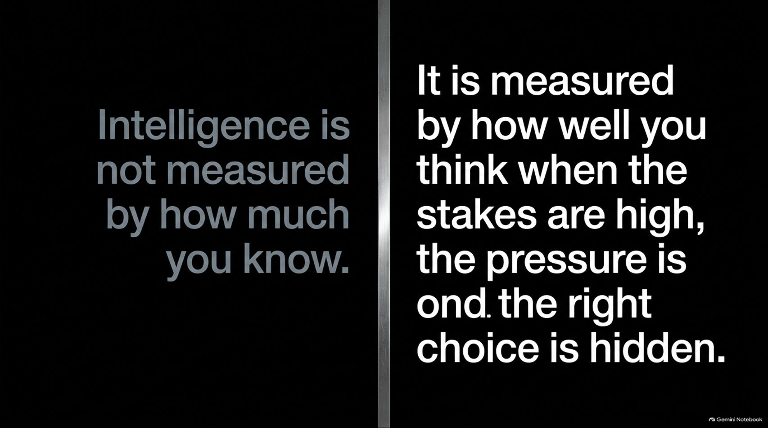
Notes:
Target Delivery Time: ~3–4 minutes
Speaker Script:
Let's start by challenging a fundamental myth about intelligence. In traditional settings, we often equate intelligence with memory—how much data you store, how many books you’ve read, or how quickly you can cite facts.
But as this slide highlights: "Intelligence is not measured by how much you know. It is measured by how well you think when the stakes are high, the pressure is on, and the right choice is hidden."
In the real world, information is cheap and ubiquitous. What is rare is clarity under stress. When chaos hits, panic sets in, or incomplete information threatens to derail a project, passive knowledge offers zero protection if your emotions hijack your judgment.
Real strategic intelligence is tested in moments of uncertainty. Can you stay composed when everyone around you is reacting impulsively? Can you see through the noise to find the non-obvious solution? That is the exact capability we are building today.

Slide 3
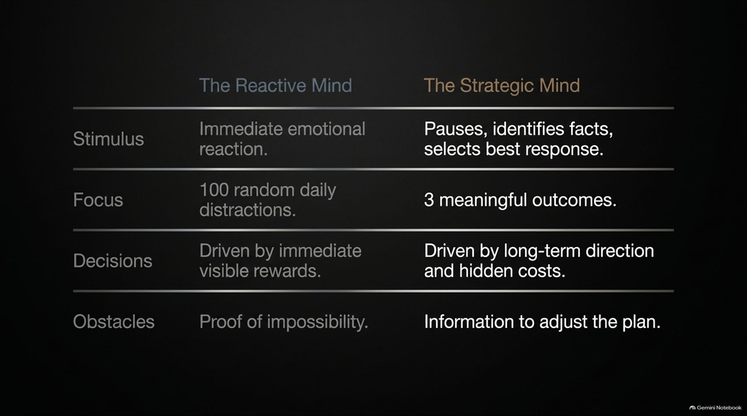

Slide 4
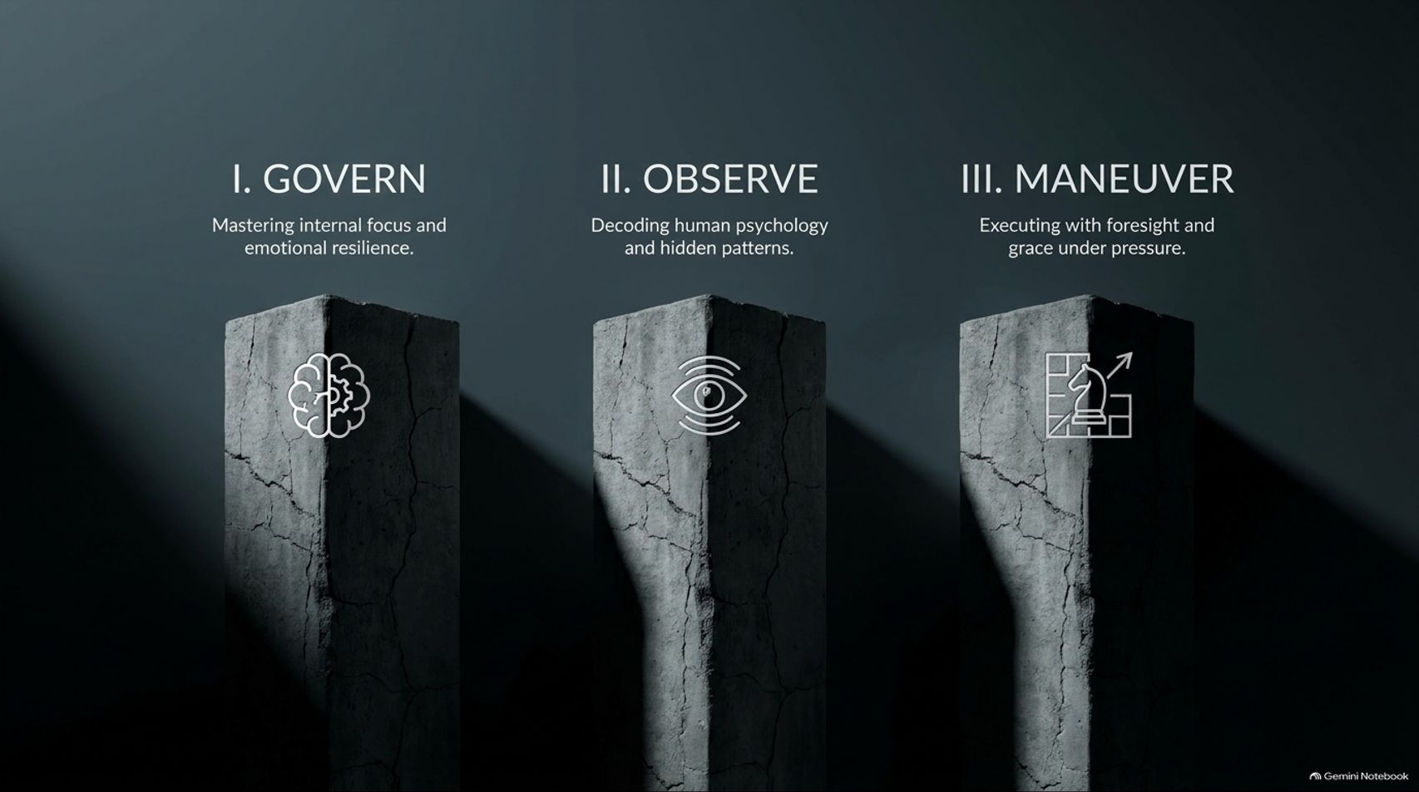
Notes:
Target Delivery Time: ~4 minutes
Speaker Script:
Our core framework is structured around three foundational pillars:
Pillar I: GOVERN – Mastering internal focus and emotional resilience. Before you can lead others or manage external strategy, you must achieve self-command. If you cannot master your own attention and nervous system under stress, your strategic plans will collapse at the first sign of friction.
Pillar II: OBSERVE – Decoding human psychology and hidden patterns. Once internal control is established, you turn your focus outward. Strategic intelligence requires reading people beyond their verbal promises—understanding underlying incentives, systemic loops, and leading indicators.
Pillar III: MANEUVER – Executing with foresight and grace under pressure. Finally, strategy requires action. But not reckless action—deliberate, high-leverage execution using small experiments, risk management, and second-order thinking.

Slide 5
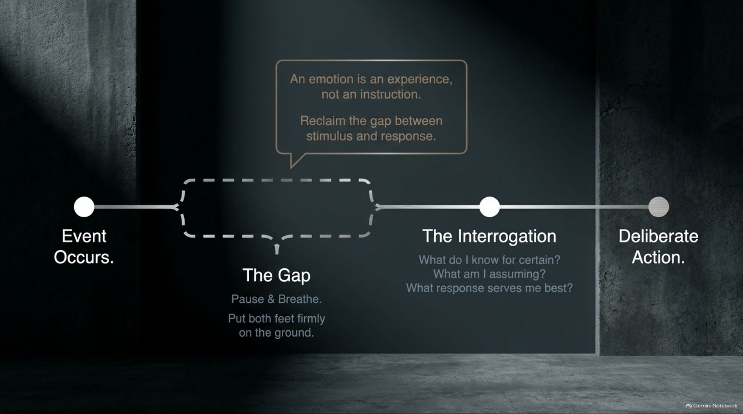

Slide 6
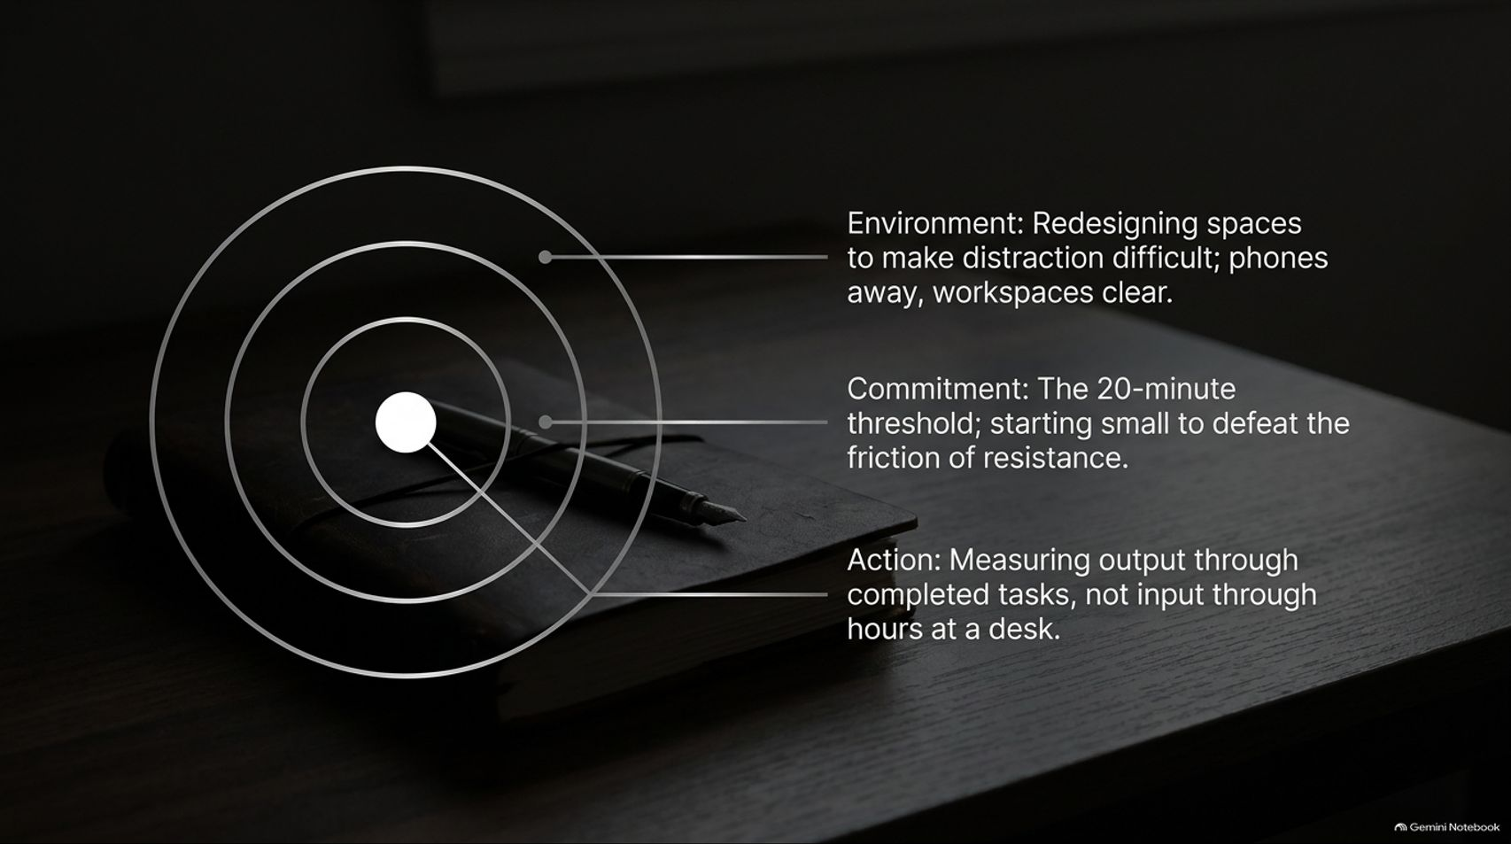
Notes:
Target Delivery Time: ~4 minutes
Speaker Script:
How do we operationalize internal discipline in our day-to-day environments? We structure focus into three concentric layers:
1. Environment (Outer Ring): Strategic minds don't rely purely on willpower; they design environments where distraction is difficult. Put phones away, clear physical workspaces, and block notification streams.
2. Commitment (Middle Ring): Defeat friction using the 20-minute threshold. When resistance to a complex task is high, commit to working on it for just 20 minutes. Starting small lowers cognitive friction and builds momentum.
3. Action (Center Core): Shift how you measure productivity. Never measure input (hours sitting at a desk); measure tangible output through completed, high-leverage tasks.

Slide 7
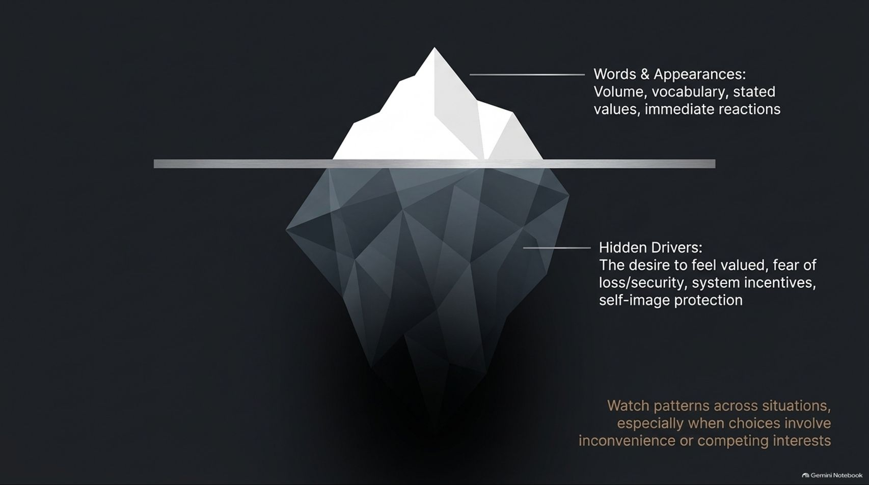
Notes:
Target Delivery Time: ~4–5 minutes
Speaker Script:
Moving to Pillar II: Observe, we look at how to read people accurately.
Most people judge others by the tip of the iceberg: Words & Appearances—volume, impressive vocabulary, stated values, and polished presentations.
A strategic mind looks below the waterline at the Hidden Drivers:
The desire to feel valued or recognized.
Fear of loss, failure, or personal insecurity.
Systemic incentives (how people are actually compensated or evaluated).
Protection of self-image and ego.
Pay attention to actions when choices involve inconvenience or competing interests. That is where true incentives and character are revealed.

Slide 8
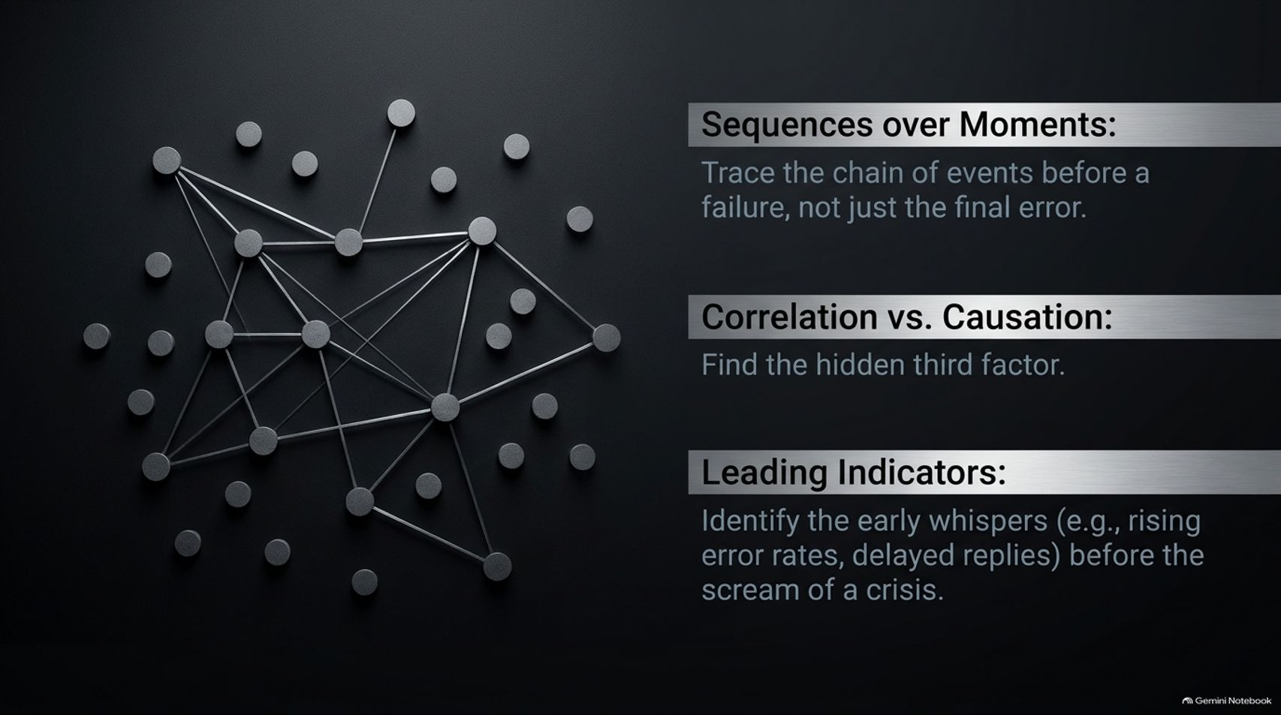
Notes:
Target Delivery Time: ~4–5 minutes
Speaker Script:
To observe clearly, you must train your mind to detect systemic connection patterns.
Sequences over Moments: Don't just analyze a final failure or sudden mistake in isolation. Trace the entire sequence of events leading up to it. Strategic errors rarely happen in a vacuum; they compound over time.
Correlation vs. Causation: Avoid superficial assumptions. Look for the "hidden third factor" driving simultaneous events.
Leading Indicators: Identify early signals long before a crisis occurs. Watch for rising error rates, delayed response times, or subtle shifts in team morale—the early whispers before the loud scream of a systemic breakdown.

Slide 9
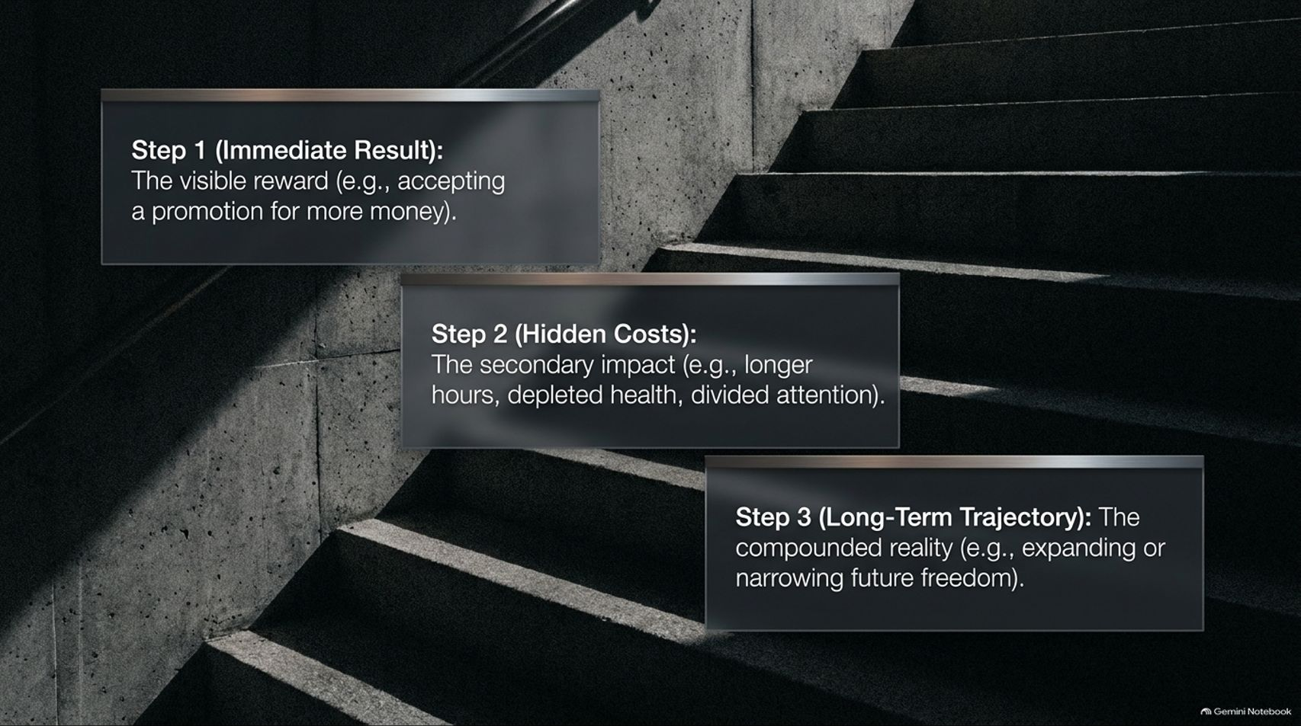
Notes:
Target Delivery Time: ~4–5 minutes
Speaker Script:
Entering Pillar III: Maneuver, strategic execution demands multi-step foresight. Most people only think about Step 1.
Step 1 (Immediate Result): The visible, immediate reward—such as accepting a high-paying promotion.
Step 2 (Hidden Costs): The secondary consequences—longer working hours, depleted health, divided attention, and less time for strategic personal projects.
Step 3 (Long-Term Trajectory): The compounded reality—does this path expand your overall future freedom and capability, or trap you in a golden handcuff scenario?
Before committing resources or accepting opportunities, map out the 2nd and 3rd order impacts.

Slide 10
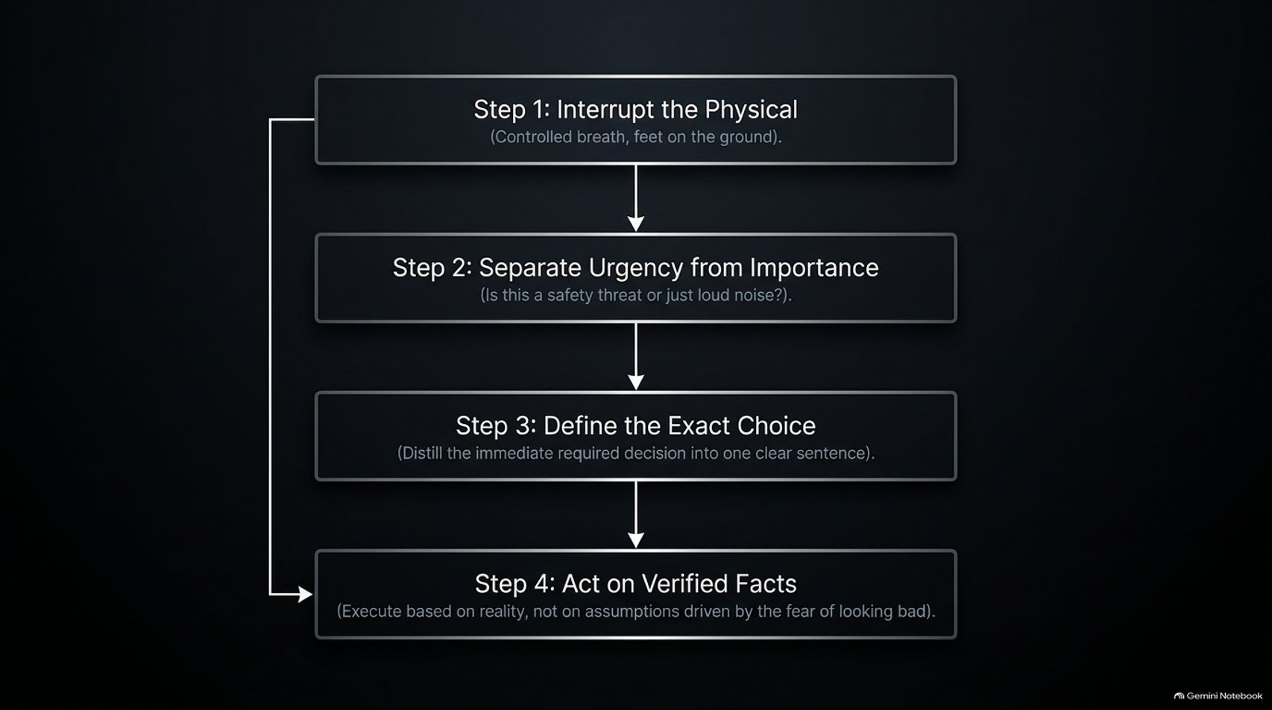
Notes:
Target Delivery Time: ~4–5 minutes
Speaker Script:
When a crisis strikes and pressure builds, follow this 4-step decision protocol:
Step 1: Interrupt the Physical. Reset your body's stress response with controlled breathing and physical grounding.
Step 2: Separate Urgency from Importance. Ask directly: Is this an actual threat to safety/core objectives, or just loud noise?
Step 3: Define the Exact Choice. Distill the immediate decision into a single, unambiguous sentence. Clarity reduces paralysis.
Step 4: Act on Verified Facts. Execute based on cold reality, not on emotional assumptions or the fear of looking bad to peers.

Slide 11
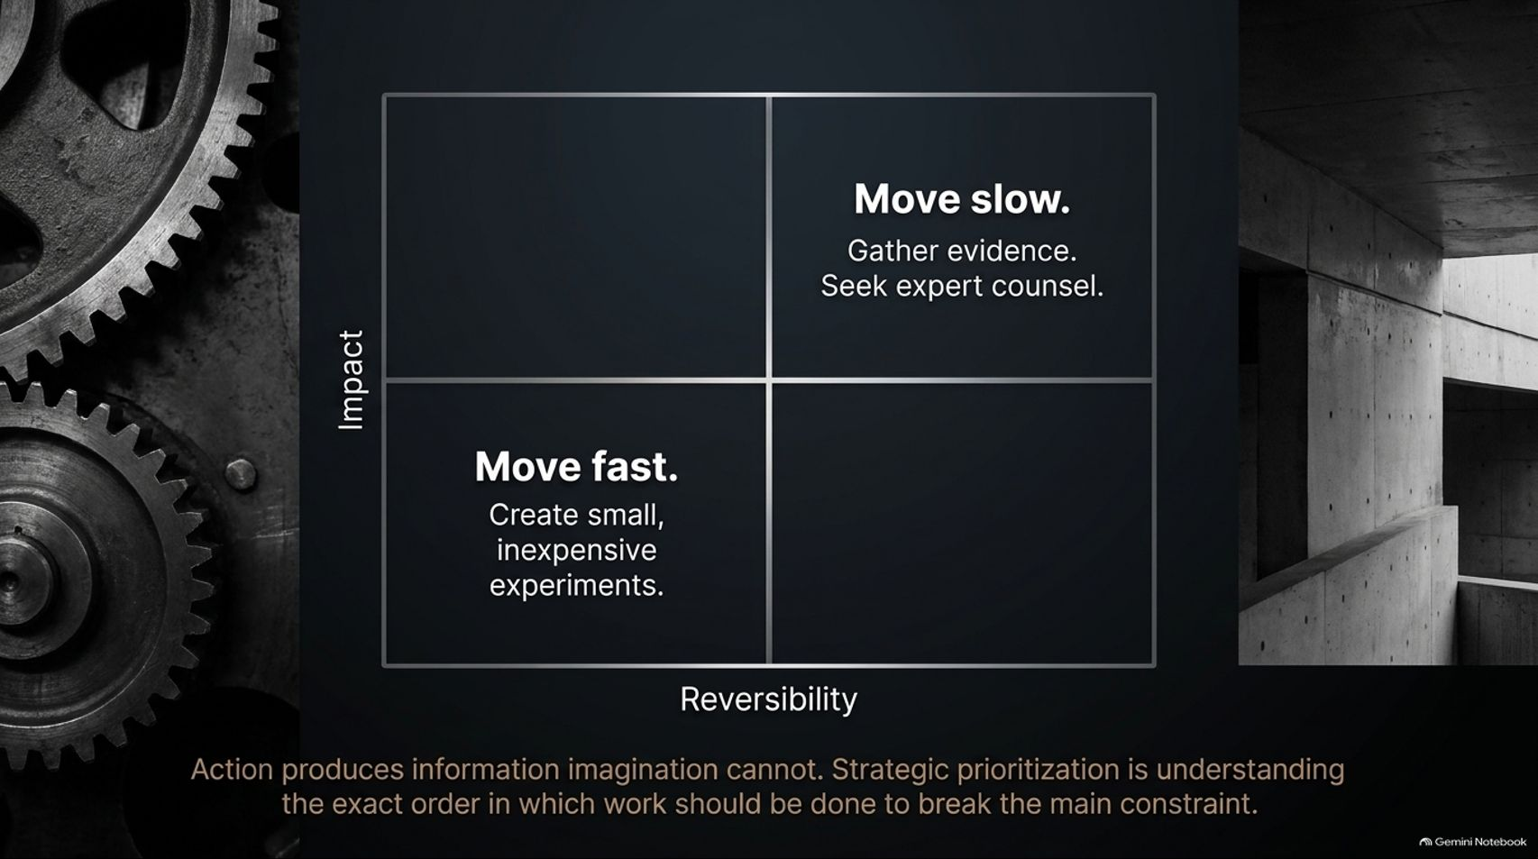
Notes:
Target Delivery Time: ~4–5 minutes
Speaker Script:
High-stakes decision-making requires evaluating two vectors: Impact vs. Reversibility.
High Impact / High Irreversibility (Move Slow): When decisions are costly and impossible to undo (e.g., major acquisitions or core structural pivots), slow down. Gather evidence, stress-test assumptions, and seek expert counsel.
Low Impact / High Reversibility (Move Fast): When risk is low and decisions are easily reversible, move fast. Run small, inexpensive experiments to generate real-world data.
As noted on the slide: "Action produces information imagination cannot." Strategic prioritization means doing work in the exact order required to break your primary constraint.

Slide 12
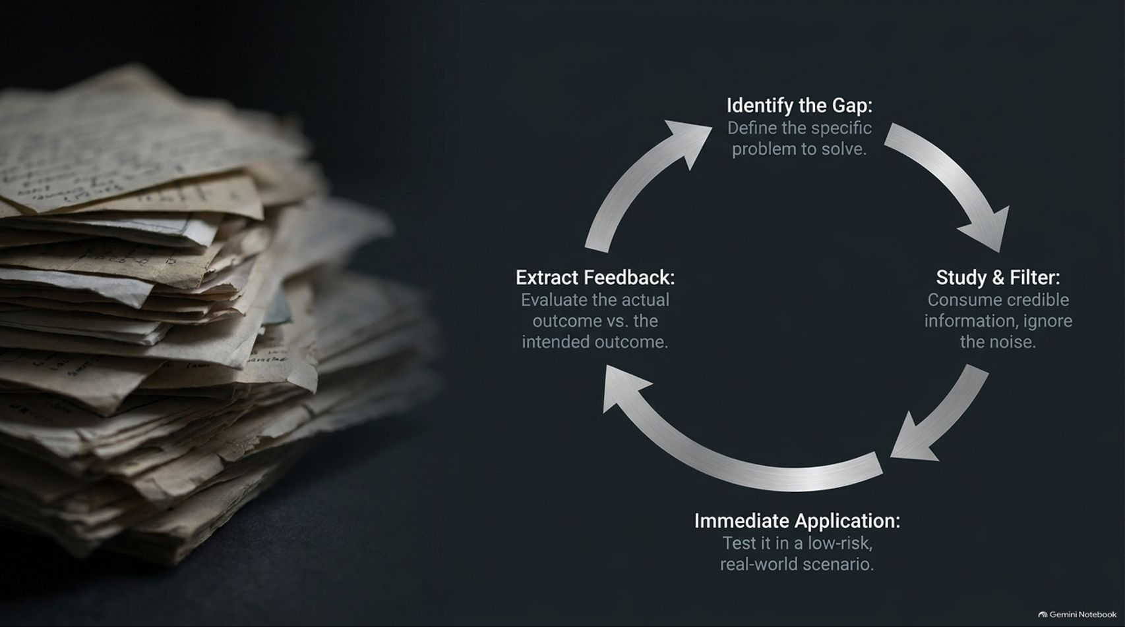
Notes:
Target Delivery Time: ~4 minutes
Speaker Script:
Strategy is an evolving loop. To maintain an advantage, you must turn raw experience into actionable intelligence through a continuous learning cycle:
Identify the Gap: Pinpoint the exact problem or skill deficit you need to solve.
Study & Filter: Consume high-credibility information while filtering out commentary noise.
Immediate Application: Test the new insight immediately in a low-risk, real-world setting.
Extract Feedback: Evaluate actual results against your intended outcome, extract lessons, and refine the loop.

Slide 13
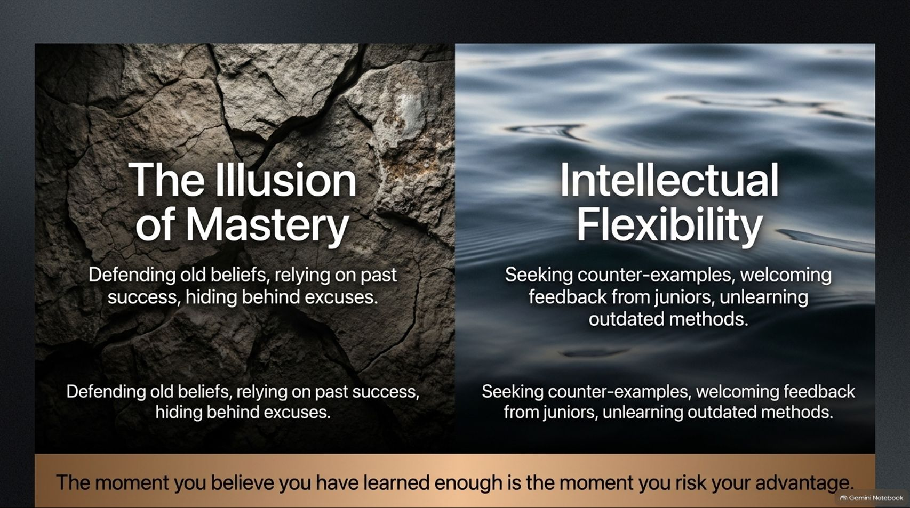
Notes:
Target Delivery Time: ~4–5 minutes
Speaker Script:
The greatest danger to an experienced leader is the Illusion of Mastery.
When you fall into the Illusion of Mastery, you defend outdated beliefs, rely blindly on past successes, and hide behind excuses when strategies fail.
Conversely, Intellectual Flexibility requires:
Actively seeking out counter-examples that challenge your worldview.
Welcoming candid feedback from junior colleagues.
Unlearning legacy methods when the operating environment shifts.
Always remember: The moment you believe you have learned enough is the exact moment you risk losing your advantage.

Slide 14
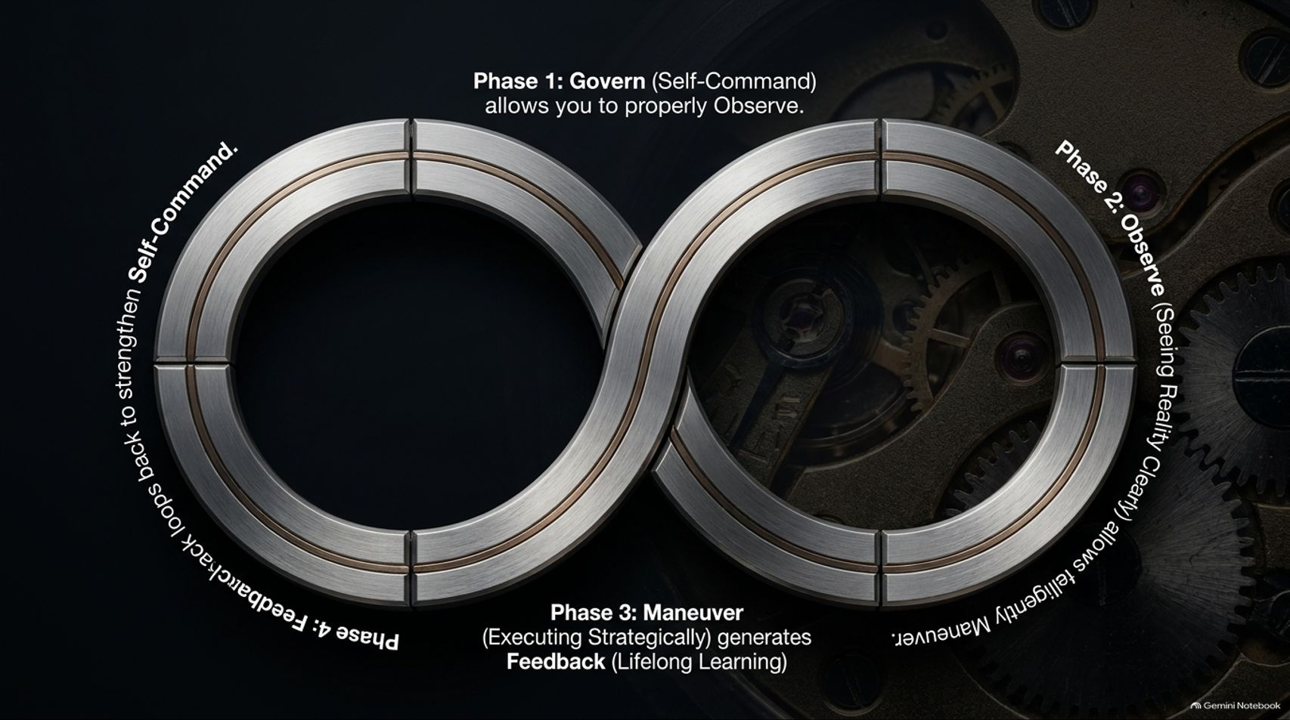

Slide 15

Notes:
Target Delivery Time: ~3 minutes
Speaker Script:
As we conclude the core presentation, reflect on this image of the solitary chess piece illuminated under a spotlight.
"Your future will be shaped by countless ordinary decisions, most of them made when nobody is watching. Make them with care. Keep moving toward what genuinely matters."
Strategic intelligence isn't about grand cinematic moments; it's about keeping small promises to yourself on quiet mornings when motivation is gone. It is built through daily, disciplined habits.

Slide 16
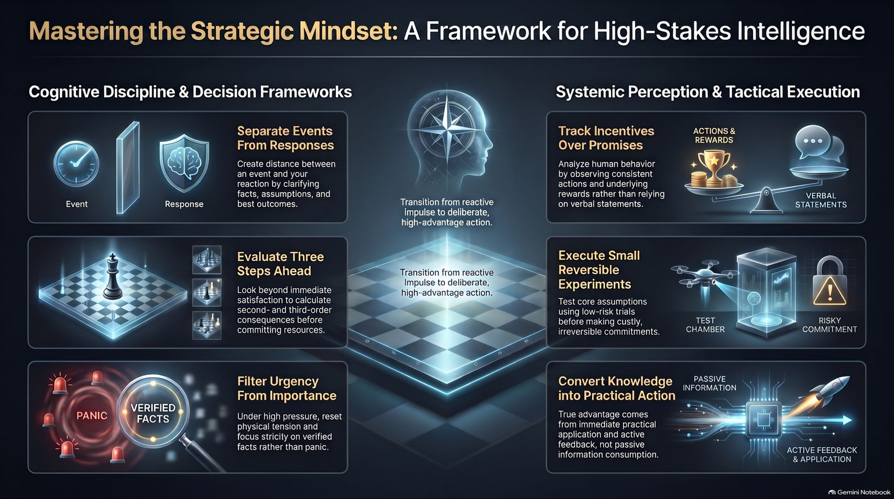
Notes:
Target Delivery Time: ~5–6 minutes
Speaker Script:
To leave you with an actionable reference card, Slide 16 consolidates our 6 core executive takeaways:
Separate Events From Responses: Create cognitive distance between trigger and action.
Track Incentives Over Promises: Analyze underlying rewards rather than relying strictly on verbal statements.
Evaluate Three Steps Ahead: Look past immediate gratification to weigh 2nd and 3rd order impacts.
Execute Small Reversible Experiments: Test high-risk assumptions with low-cost trials before making large commitments.
Filter Urgency From Importance: Reset physical stress under pressure and lock focus onto verified facts.
Convert Knowledge into Practical Action: Real advantage comes from rapid real-world application and active feedback loops.

