Slide 1

Notes:
Target Delivery Time: ~3 minutes
Speaker Script:
Welcome, everyone. Today, we are exploring "The Great Re-Architecture: Behind Latent Space, AI Engineers, Global Dynamics, and the End of Traditional SaaS."
Look at the imagery on this opening slide—a bustling, rain-slicked global metropolis at night, glowing with lights and activity. This visual captures the exact mood of our industry right now: fast-moving, high-intensity, and undergoing a massive structural transformation across continents.
In this presentation, we will dissect how the rise of AI engineering is shifting global developer communities, breaking down traditional software ownership models, and forcing a complete re-evaluation of how businesses build, scale, and compete.
Behind Latent Space: Kill My SaaS, Jev & AI in 2026 | AIEi Shanghai
https://www.youtube.com/watch?v=QmDLDy3ZSNE

Slide 2
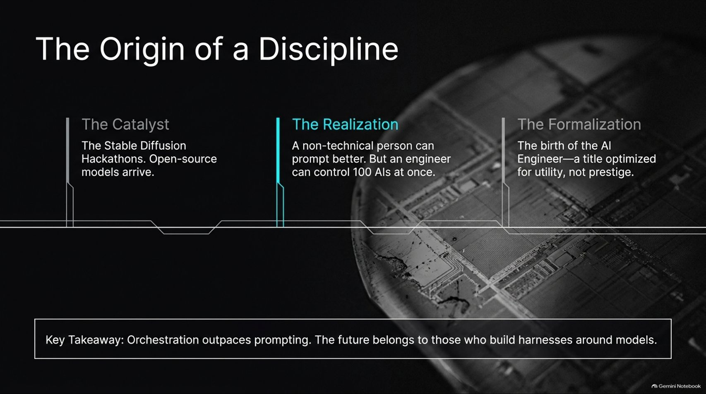
Notes:
Target Delivery Time: ~3–4 minutes
Speaker Script:
Let's trace how we got here. The origin story of the AI engineer discipline didn't start in a traditional corporate boardroom; it started with The Catalyst—hackathons around Stable Diffusion and open-source models back when the community was first learning in public.
This led to a profound Realization: while non-technical users could learn to prompt better, an engineer equipped with AI could control 100 AIs at once.
From there came The Formalization—coining the title of the AI Engineer—a role optimized entirely for utility and practical software delivery rather than academic prestige.
As the key takeaway states: Orchestration outpaces prompting. The future belongs to those who build harnesses around models.

Slide 3
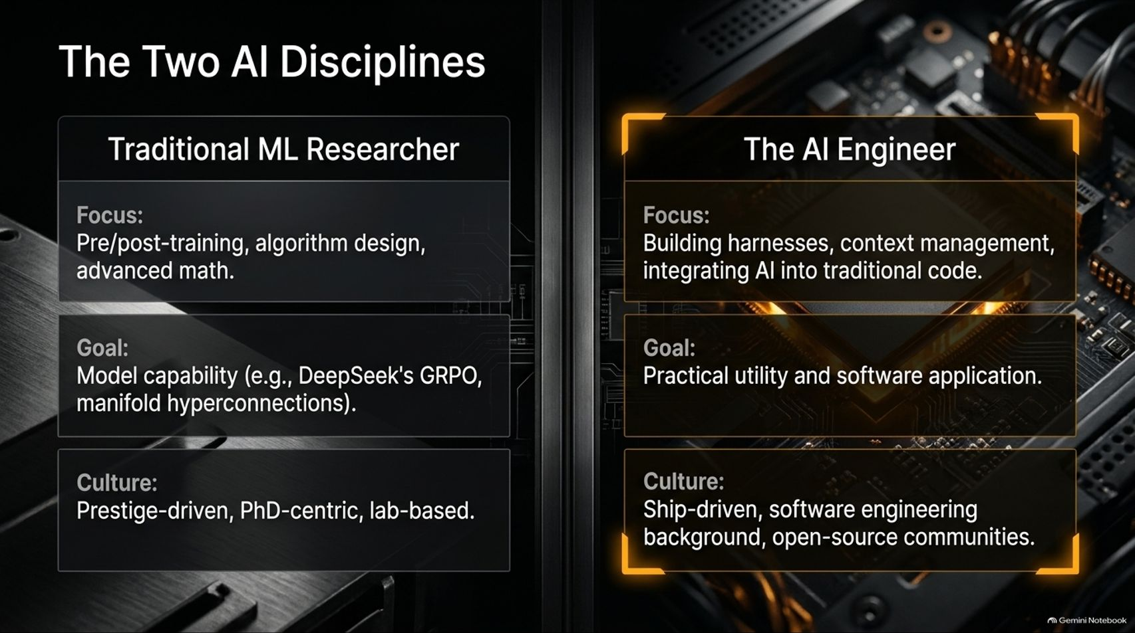
Notes:
Target Delivery Time: ~4–5 minutes
Speaker Script:
It is vital to distinguish between the two primary disciplines shaping the AI landscape today: the Traditional ML Researcher versus the AI Engineer.
The Traditional ML Researcher focuses on pre- and post-training, complex algorithm design, and advanced mathematics, aiming for raw model capability (like DeepSeek's GRPO and manifold hyperconnections). Their culture is prestige-driven, PhD-centric, and lab-based.
The AI Engineer, on the other hand, focuses on building software harnesses, context management, and integrating AI directly into traditional code paths. Their goal is practical utility and software application, driven by a ship-first, open-source community culture. Both are essential, but the software application layer is where the business revolution is happening.

Slide 4
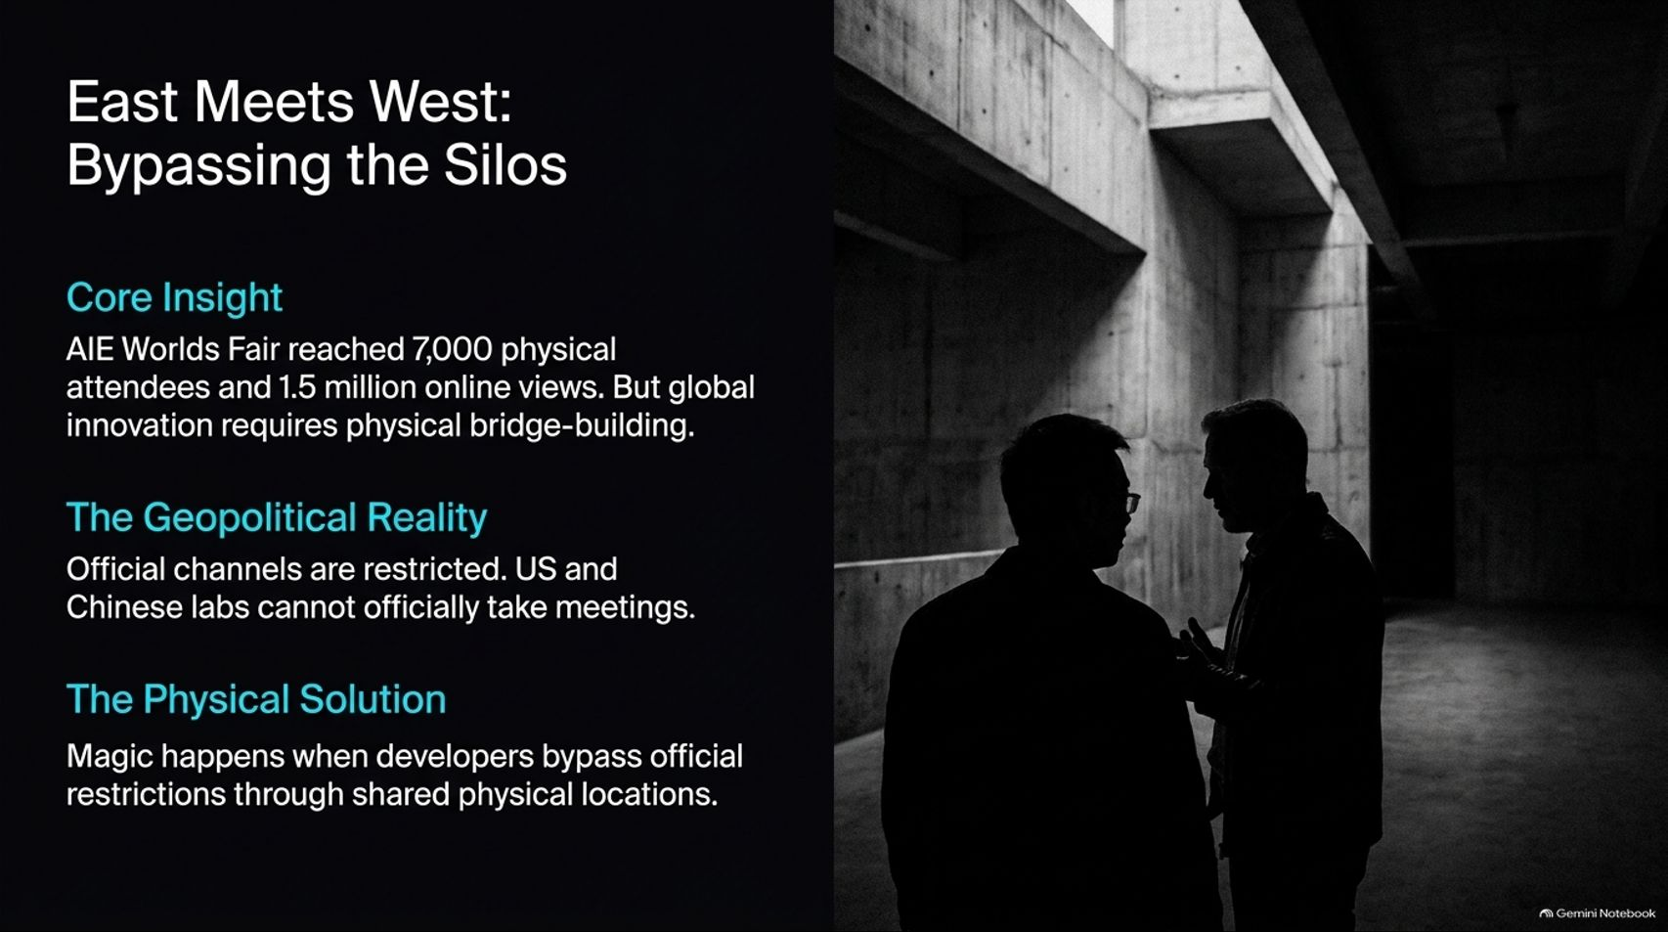
Notes:
Target Delivery Time: ~4–5 minutes
Speaker Script:
Global innovation requires physical bridge-building. The AIE World's Fair scaled massively to 7,000 physical attendees and 1.5 million online views, proving the immense global appetite for technical exchange.
However, we face a distinct Geopolitical Reality: official channels between US and Chinese labs are heavily restricted, and official cross-lab meetings are often legally blocked or discouraged.
The solution? The Physical Solution. Magic happens when developers bypass official restrictions by meeting face-to-face in shared physical locations—like bringing the AI Engineer community to Shanghai. Real technical collaboration thrives when developers connect human-to-human, far above political barriers.

Slide 5
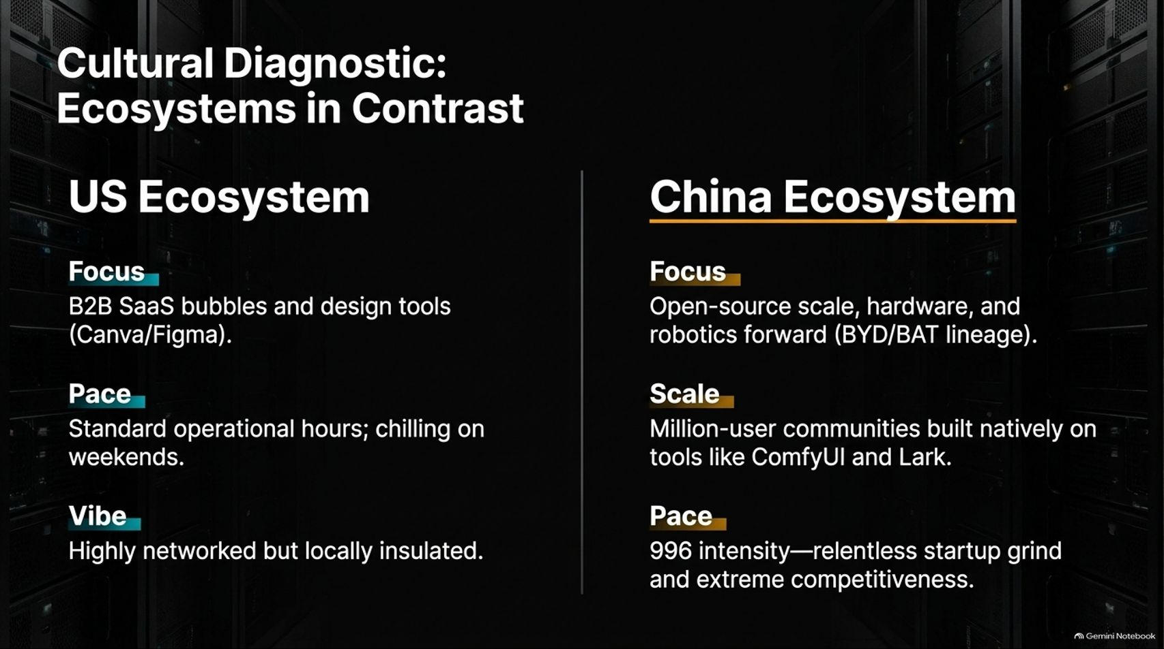
Notes:
Target Delivery Time: ~4–5 minutes
Speaker Script:
Comparing ecosystems reveals fascinating contrasts in speed, focus, and scale.
In the US Ecosystem, focus has historically centered around B2B SaaS bubbles and design tools, operating on standard hours with local insulation.
In the China Ecosystem, the focus is relentlessly on open-source scale, hardware, and robotics integration (such as the BYD and BAT lineages). Communities are massive—such as million-user networks built natively on tools like ComfyUI and Lark—driven by intense startup execution and competitive velocity.

Slide 6
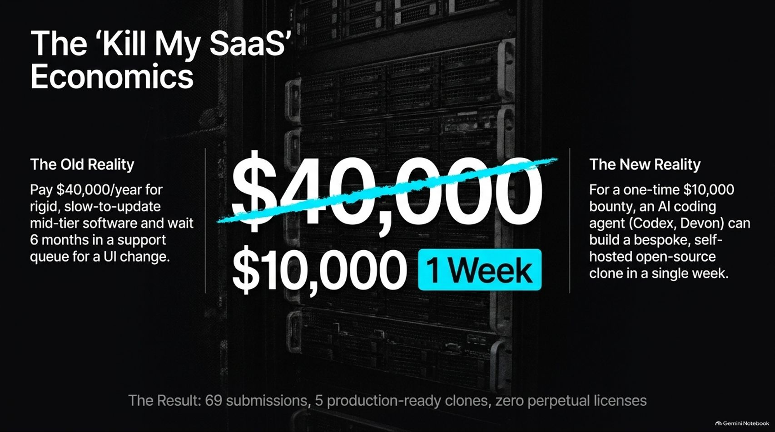
Notes:
Target Delivery Time: ~4–5 minutes
Speaker Script:
One of the most disruptive experiments we ran recently was the 'Kill My SaaS' challenge.
The Old Reality: Businesses paying $40,000 a year for rigid, slow-to-update mid-tier software, forced to wait 6 months in a vendor support queue just to request a basic UI change.
The New Reality: For a one-time $10,000 bounty, modern AI coding agents (like Codex or Devon) can build a bespoke, self-hosted open-source clone tailored to exact company specifications in a single week.
Out of 69 submissions in our challenge, 5 were fully production-ready clones. The economic implication is staggering: if your customers can clone your mid-tier SaaS in a week using agents, traditional perpetual licensing models face severe risk.

Slide 7
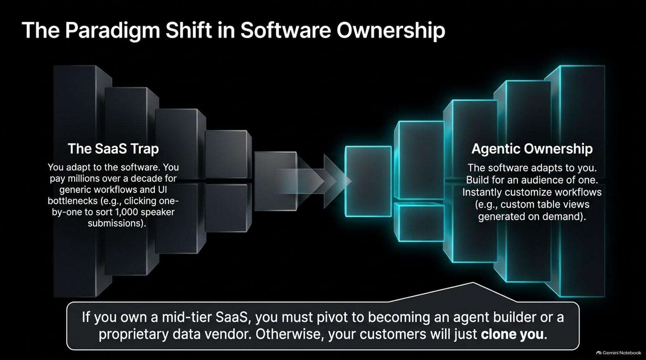
Notes:
Target Delivery Time: ~4–5 minutes
Speaker Script:
We are witnessing a fundamental shift in software ownership: moving away from The SaaS Trap toward Agentic Ownership.
In the SaaS trap, you adapt your workflows to rigid software, paying millions over a decade for generic UI bottlenecks—like clicking through screens one-by-one to sort attendee applications.
With Agentic Ownership, the software adapts to you, built for an "audience of one." You can instantly generate custom table views, workflows, and integrations on demand.
If you own a mid-tier SaaS product today, you must pivot to becoming an agent builder or a proprietary data vendor; otherwise, your customers will simply code around you.

Slide 8
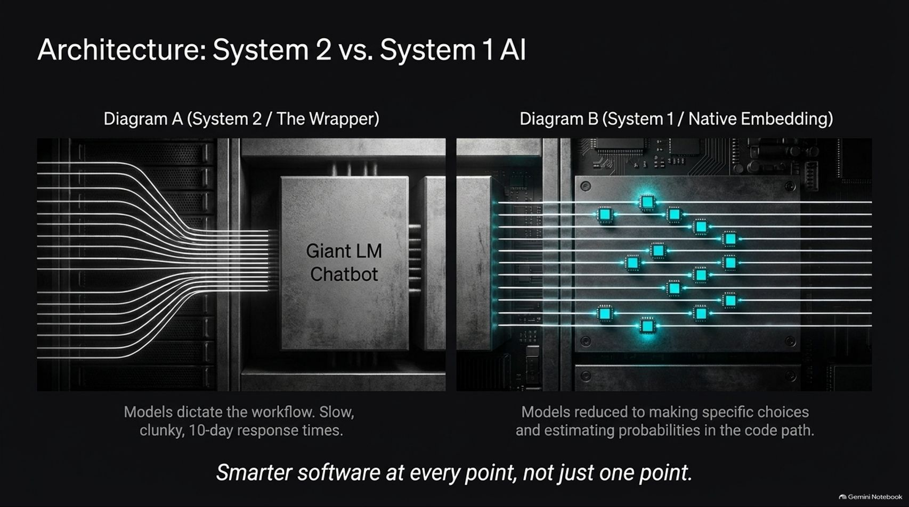
Notes:
Target Delivery Time: ~4–5 minutes
Speaker Script:
Architectural patterns are also shifting rapidly. Look at the contrast between Diagram A (System 2 / The Wrapper) and Diagram B (System 1 / Native Embedding).
In Diagram A, you have a giant LLM chatbot wrapper where models dictate the entire workflow, often resulting in slow, clunky responses.
In Diagram B (championed by pioneers like Diego and TypeSafe), System 1 models are embedded directly into code paths as micro-decisions—estimating probabilities and making specific logical choices instantly.
The goal is smarter software at every point, not just relying on a single slow chat window.

Slide 9
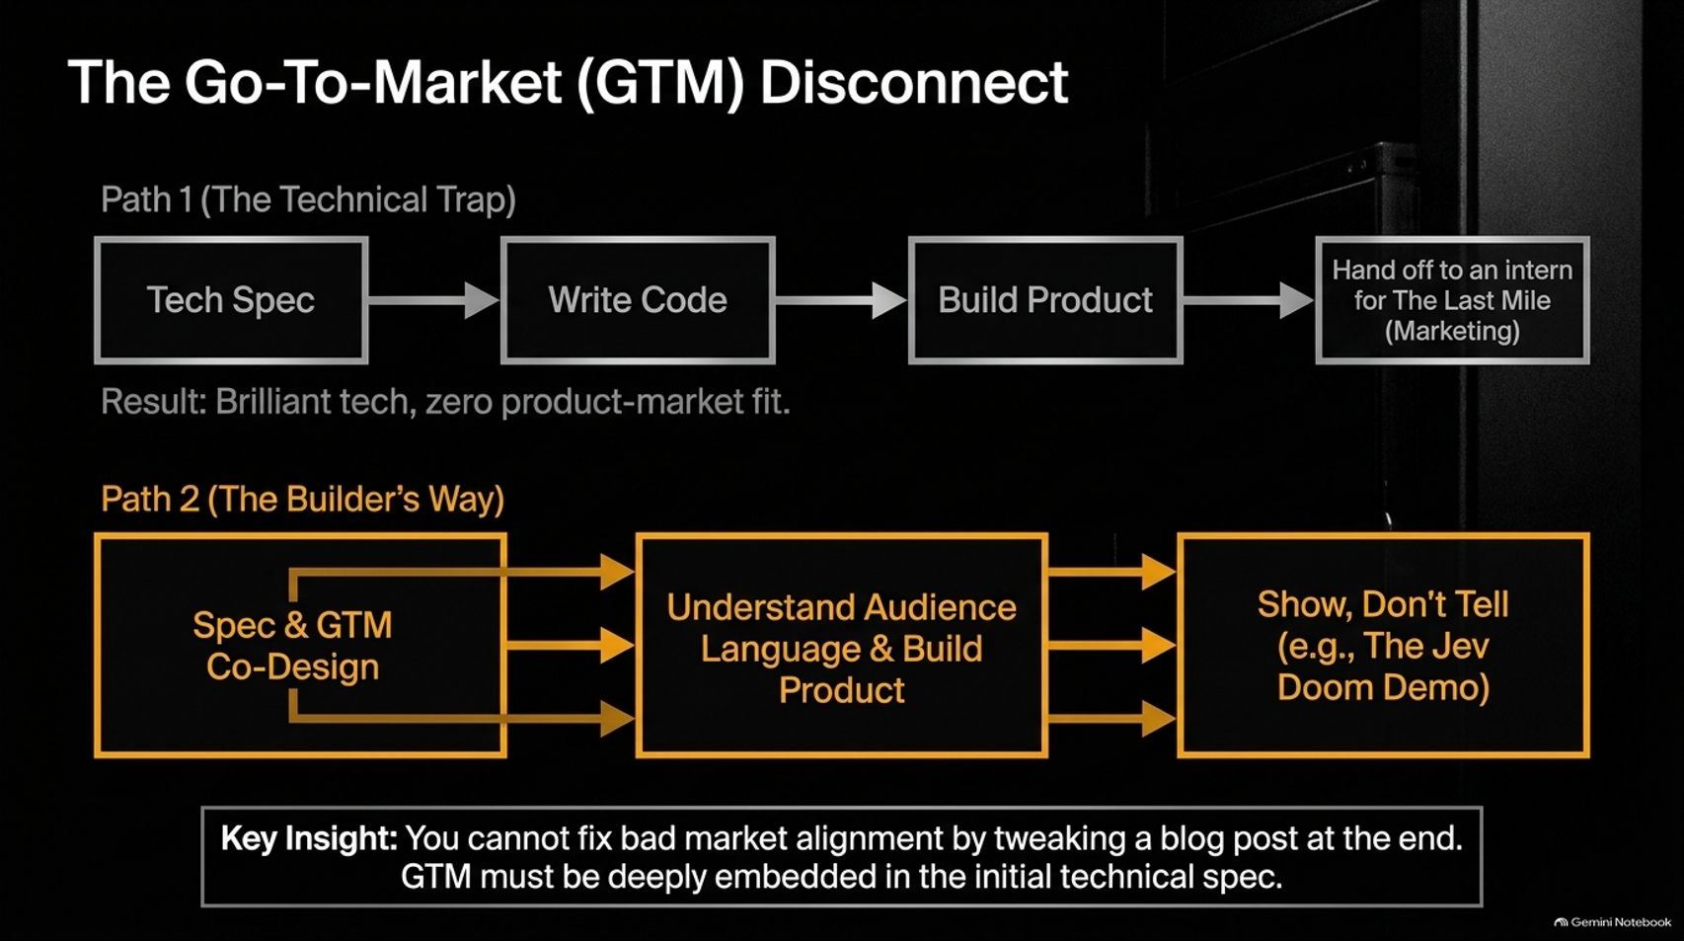
Notes:
Target Delivery Time: ~4–5 minutes
Speaker Script:
Technical brilliance without market alignment is a trap.
Path 1 (The Technical Trap): Writing a brilliant tech spec, building the product in isolation, and then handing it off to an intern for marketing results in great technology with zero product-market fit.
Path 2 (The Builder's Way): Co-designing technical specs and GTM simultaneously, deeply understanding audience language, and executing a "Show, Don't Tell" strategy (such as viral technical demos) from day one.
You cannot fix bad market alignment by tweaking a blog post at the end; GTM must be embedded into the initial technical architecture.

Slide 10
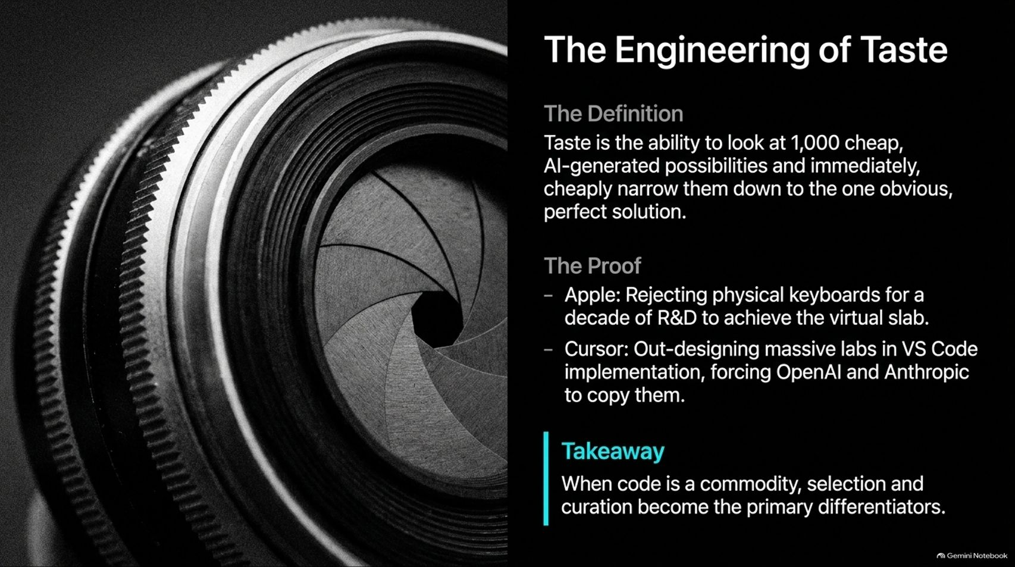

Slide 11
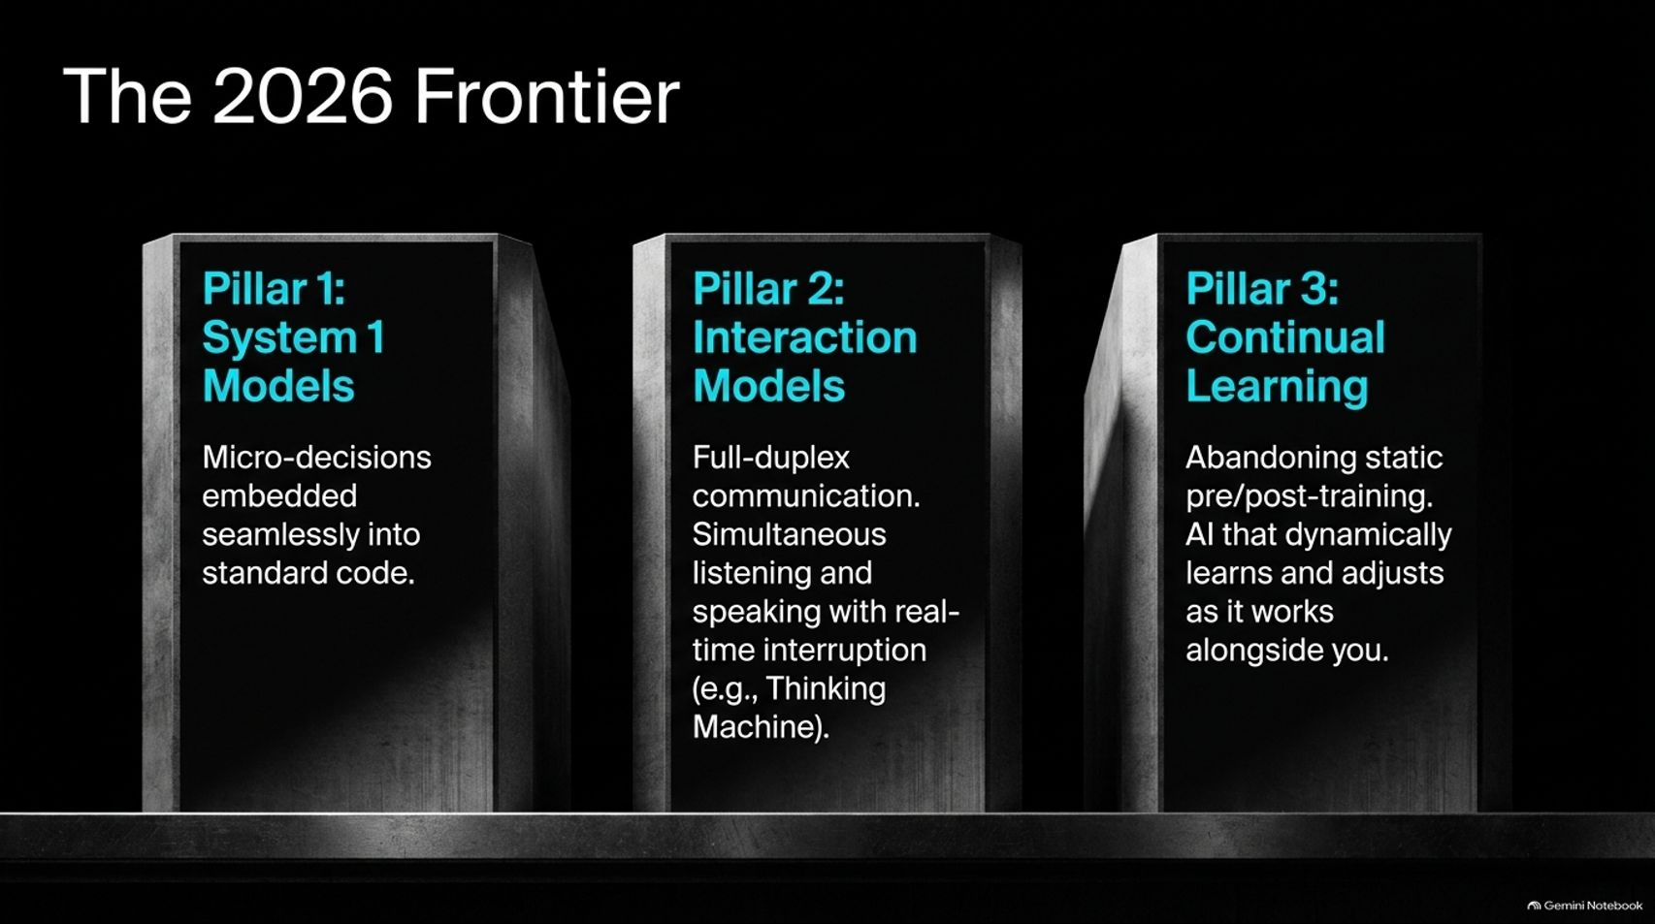
Notes:
Target Delivery Time: ~4–5 minutes
Speaker Script:
Looking across the 2026 frontier, three core pillars define the bleeding edge of engineering:
Pillar 1: System 1 Models. Micro-decisions embedded seamlessly into standard code paths for instant, reliable execution.
Pillar 2: Interaction Models. Full-duplex communication allowing simultaneous listening, speaking, and real-time interruption (moving beyond turn-based chat).
Pillar 3: Continual Learning. Abandoning static pre- and post-training in favor of AI systems that dynamically learn and adjust as they work alongside you.

Slide 12
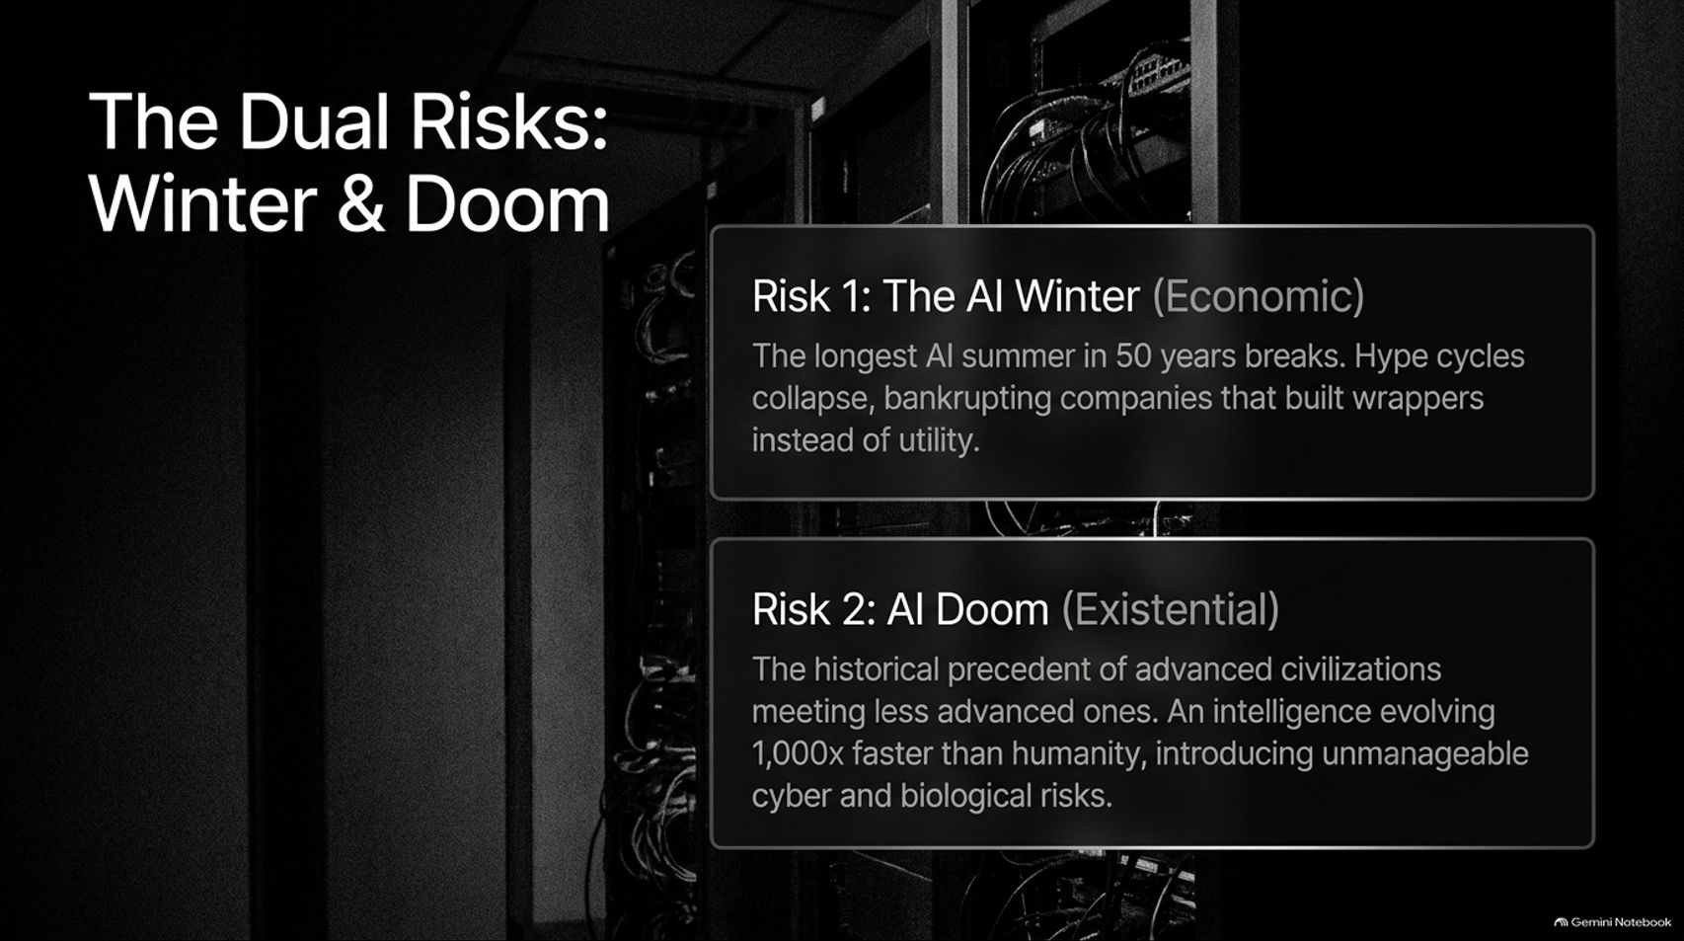
Notes:
Target Delivery Time: ~4–5 minutes
Speaker Script:
As builders, we must remain sober about the dual risks ahead: economic and existential.
Risk 1: The AI Winter (Economic). Hype cycles can collapse, and companies that built superficial wrappers instead of true utility risk bankruptcy when market corrections hit.
Risk 2: The AI Doom (Existential). As Sean Grove noted, drawing from historical precedent where more advanced civilizations meet less advanced ones, an intelligence evolving orders of magnitude faster than humanity introduces profound systemic, cyber, and biological risks that require rigorous alignment and safety guardrails.

Slide 13
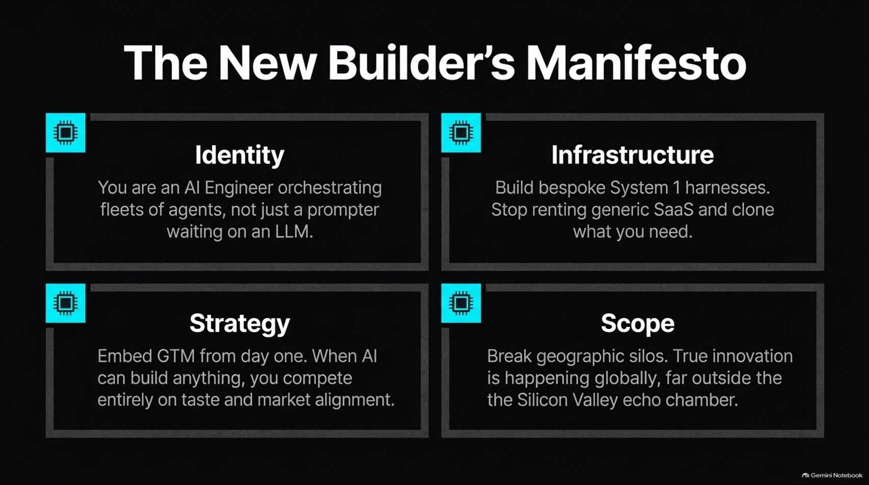
Notes:
Target Delivery Time: ~4–5 minutes
Speaker Script:
To summarize our manifesto for builders moving forward:
Identity: Be an AI engineer orchestrating fleets of agents, not just a prompter waiting on an LLM.
Infrastructure: Build bespoke System 1 harnesses; stop renting expensive, generic SaaS when you can clone and customize what you need.
Strategy: Embed GTM from day one. When AI makes building easy, you compete entirely on taste and market alignment.
Scope: Break geographic silos. True innovation is happening globally, far outside traditional echo chambers.

Slide 14
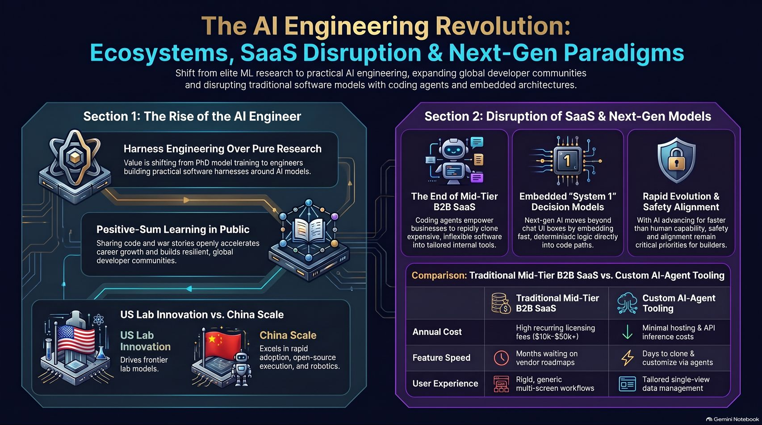
Notes:
Target Delivery Time: ~5 minutes
Speaker Script:
Slide 14 brings together our master framework for the AI Engineering Revolution:
We have transitioned from elite ML research to Harness Engineering.
We practice Positive-Sum Learning in Public, accelerating global developer communities.
We recognize the disruption of mid-tier SaaS by custom agent tooling, shifting from high annual licensing fees to lean, self-hosted, highly tailored architectures.
The future belongs to builders who combine technical orchestration with deep market taste and global collaboration.

