Slide 1
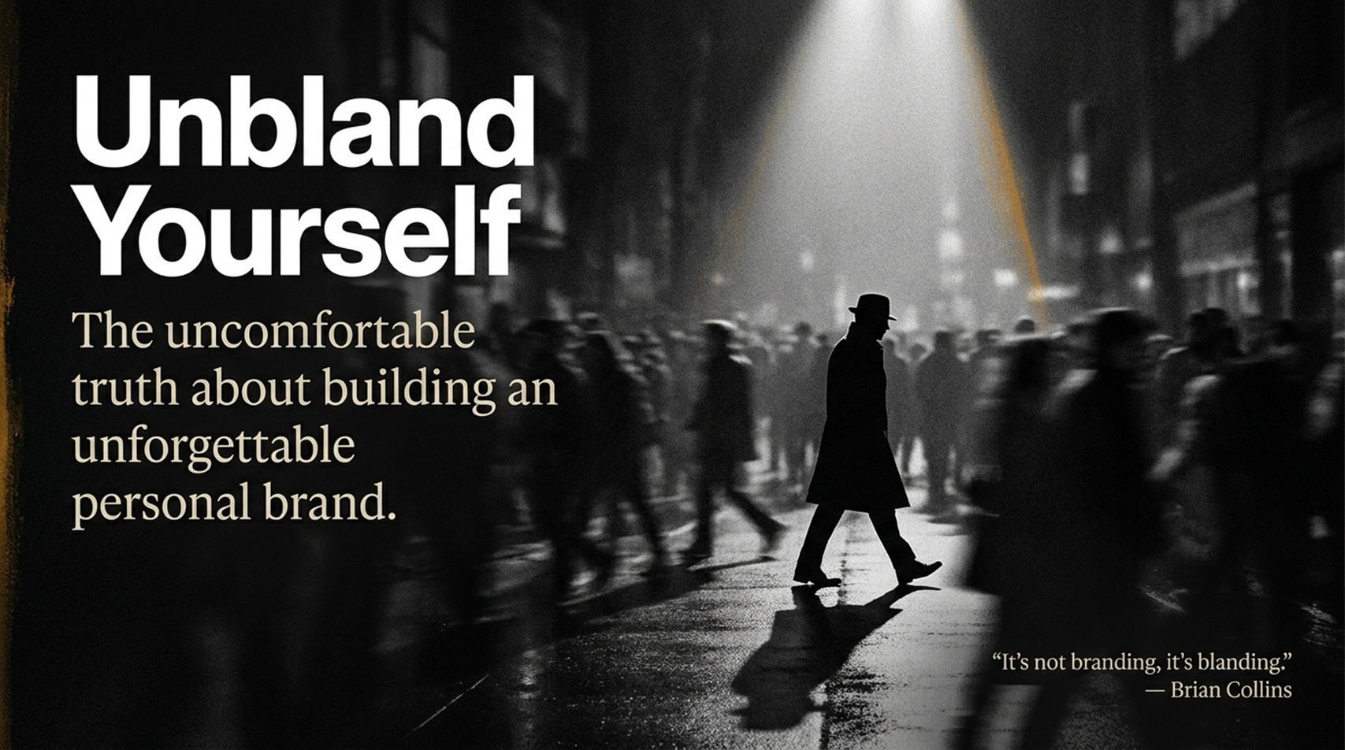
Notes:
Visual: A moody black-and-white street scene at night with a single spotlight illuminating a lone figure in a hat walking through a crowd of blurred people, featuring a Brian Collins quote: "It's not branding, it's blanding."
Suggested Speaking Time: 2–3 minutes
Speaker Notes:
"Welcome, everyone. Let's start with an uncomfortable truth right out of the gate. Look at this room, look at the digital landscape, and look at how most creators and professionals show up online. A brilliant design luminary, Brian Collins, coined a phrase that completely reframes our industry: 'It's not branding, it's blanding.' Think about that. Multimillion-dollar agencies and polished creators spend thousands of dollars trying to fit in, sounding safe, looking sterile, and ultimately blending into a gray sea of sameness. Today, we are going to tear down the templates, stop hiding behind corporate polish, and learn how to unbland ourselves. If you want to build an unforgettable personal brand, you have to stop trying to blend in with the crowd and start having the courage to stand alone."
Visual: Clean, bold minimalist cover title: Unbland Yourself: Stop Performing. Start Being.
Speaking Time: 2–3 minutes
Speaker Notes:
"Welcome, everyone. Take a look around at today’s professional landscape. Everywhere you look, people are trying to fit in. They use the same buzzwords, wear the same safe corporate style, and publish sanitized, risk-free content. They’ve built a 'beige' brand.
Today, we are going to talk about what it means to Unbland Yourself. Personal branding isn't a marketing vehicle or a corporate mask you put on to sell something—it’s an excavation. It’s a reunion with the person you were before the world told you how you were 'supposed' to act. By the end of this session, you're going to learn how to drop the performance, leverage your shadow self, and build a brand that is unmistakably, powerfully you."
How to Build an Unforgettable Personal Brand | Chris Do
https://www.youtube.com/watch?v=uAsAs8MoW9U

Slide 2
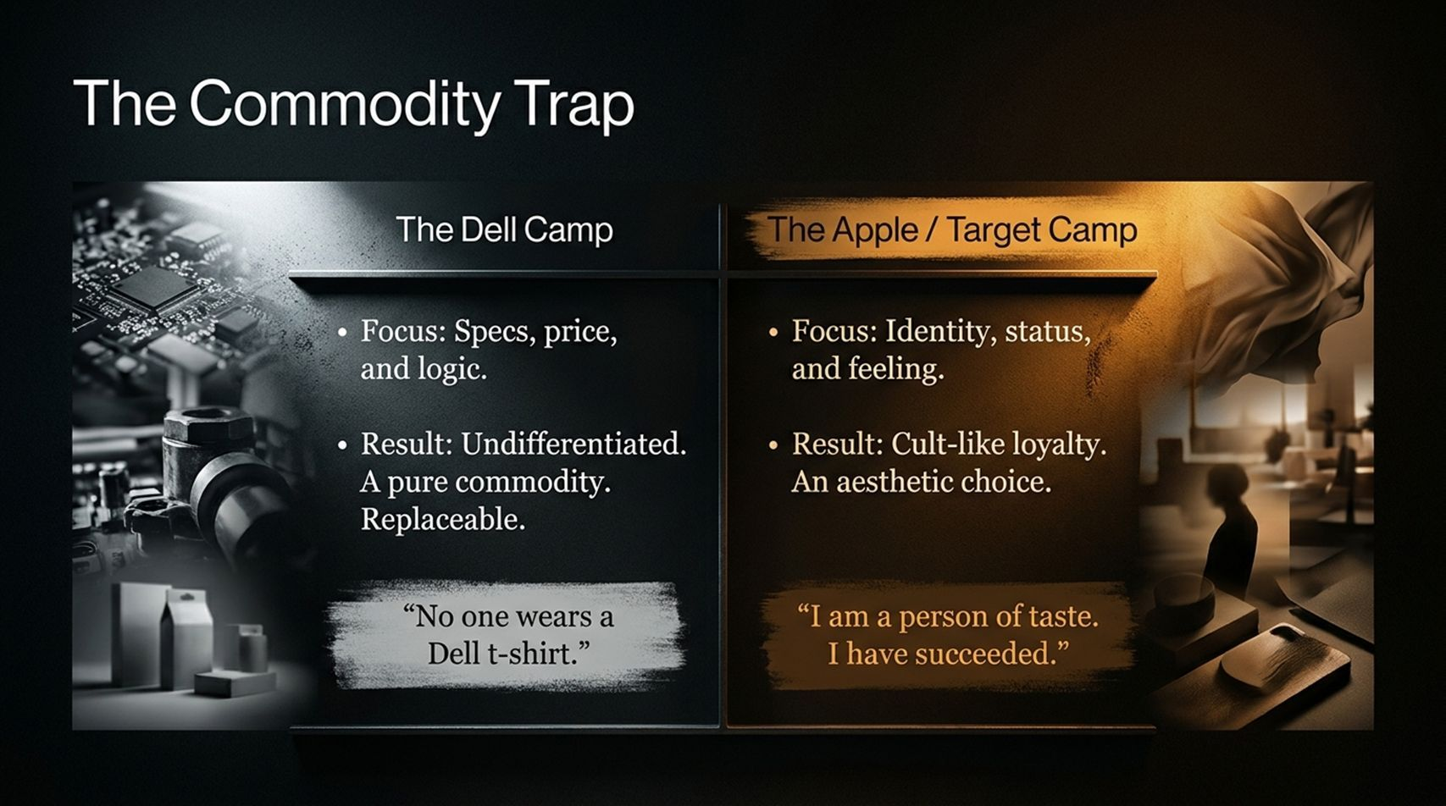
Notes:
Visual: A split-screen comparison contrasting 'The Dell Camp' (specs, price, logic) against 'The Apple / Target Camp' (identity, status, feeling).
Suggested Speaking Time: 4–5 minutes
Speaker Notes:
"Let's look at the ultimate danger of a bland presence: The Commodity Trap. In business and content creation, if people cannot tell the difference between you and your competitors, you are no longer a person or a brand—you are a pure commodity, entirely replaceable. Let's look at the two camps on this slide:
The Dell Camp: Focuses purely on specs, technical features, price, and logic. It's a great machine at a fair price, but as the quote says, 'No one wears a Dell t-shirt.' No one tattoos the Dell logo on their arm or defends them at a dinner party. You buy it because the specs make sense, and the moment a cheaper alternative shows up, you switch.
The Apple or Target Camp: Focuses entirely on identity, status, and feeling. The result is cult-like loyalty and an aesthetic choice. People buy Apple not because of RAM specs, but because it signals: 'I am a person of taste. I have succeeded.' If your personal brand only talks about features and how-tos, you are trapped in the Dell camp. You must cross over into identity and feeling."

Slide 3
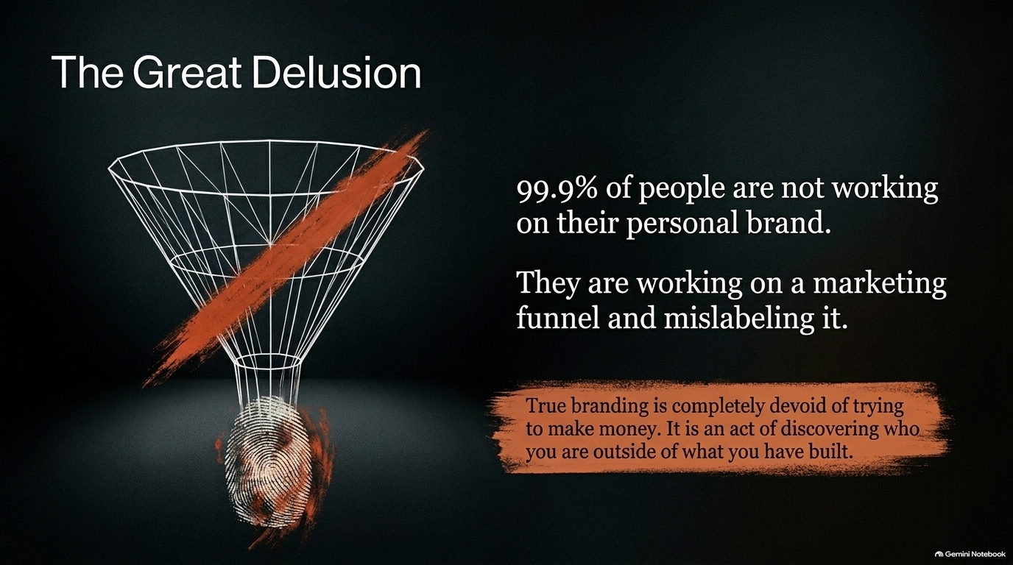
Notes:
Visual: A wireframe marketing funnel with a red X slashing through it, pointing down to a glowing fingerprint at the bottom, paired with Chris Do's quote on true branding.
Suggested Speaking Time: 4–5 minutes
Speaker Notes:
"Here is The Great Delusion that plagues 99.9% of creators online today. Most people think they are working hard on their personal brand, when in reality, they are working on a marketing funnel and mislabeling it. Every piece of content they post is just a poorly disguised ad, a constant pitch for a lead magnet, a course, or a masterclass. They are using buzzwords like 'personal branding' because marketing and funnels don't sound sexy enough right now. But true branding has nothing to do with trying to make money. As Chris Do points out, 'True branding is completely devoid of trying to make money. It is an act of discovering who you are outside of what you have built.' If your entire brand collapses the moment you stop selling, you don't have a brand—you have a sales funnel."

Slide 4
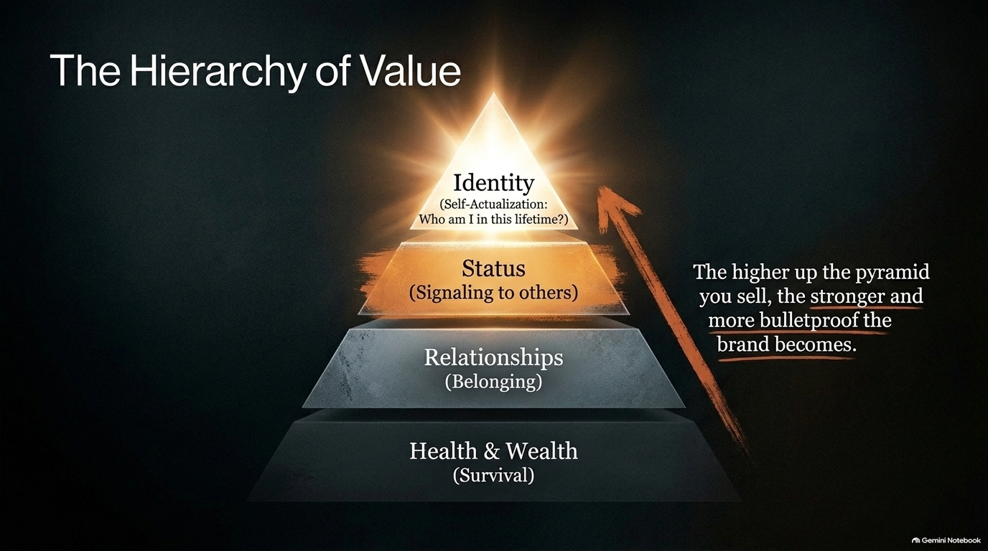
Notes:
Visual: A glowing golden pyramid representing Maslow’s hierarchy adapted for modern value creation, moving from Health & Wealth up to Identity.
Suggested Speaking Time: 4–5 minutes
Speaker Notes:
"To understand why some brands command cult-like loyalty while others struggle, we have to look at The Hierarchy of Value, built on the framework of Maslow's hierarchy of needs.
At the base, we have Health & Wealth (Survival): The domain of making money, staying fit, and basic security.
Moving up, we find Relationships (Belonging): Connecting with community and finding our tribe.
Higher still is Status (Signaling to others): Using possessions, design, and choices to signal who we are to the world.
And at the blazing peak of the pyramid is Identity (Self-Actualization): 'Who am I in this lifetime? Did I matter?' Notice the golden arrow on the right: The higher up the pyramid you sell and communicate, the stronger and more bulletproof the brand becomes. If you only compete at the bottom tier of price and wealth, you are easily undercut. When you connect at the level of identity, you become irreplaceable."

Slide 5
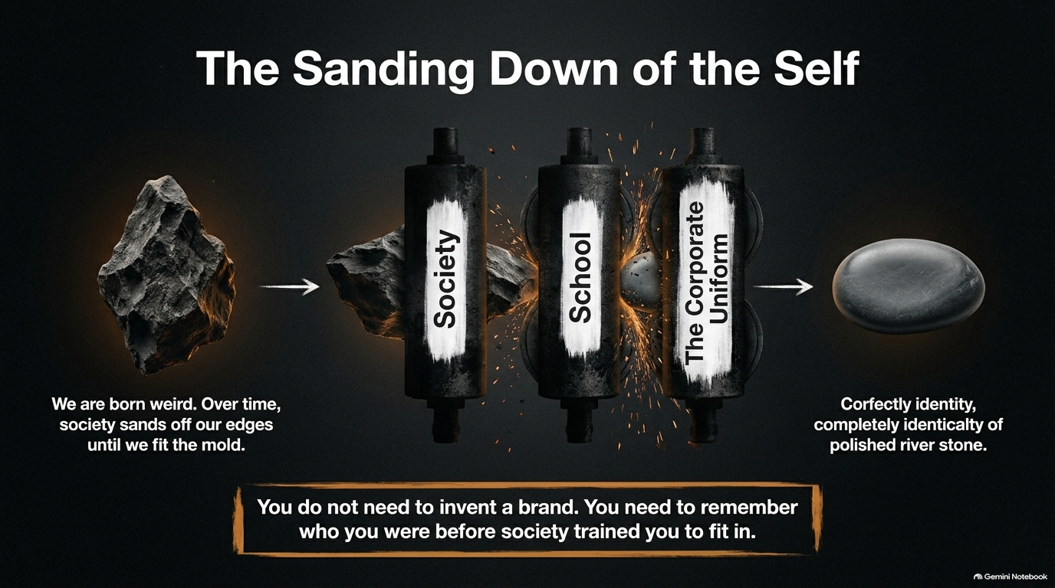
Notes:
Visual: A sequence showing a jagged, raw rock passing through industrial rollers labeled 'Society,' 'School,' and 'The Corporate Uniform,' emerging as a smooth, generic river stone.
Suggested Speaking Time: 4–6 minutes
Speaker Notes:
"Why are we so afraid of showing up authentically? Because of The Sanding Down of the Self. We are all born weird. Children are wonderfully unique, unfiltered, and eccentric. But over time, society systematically sands off our edges until we fit the mold. Think about it: Between ages three and nine, you were who you truly were. Then society stepped in. You talked too loud—'Use your inside voice!' You did something unconventional—'Don't be weird, fit in!' Then you went through school, where non-conformity got you labeled a loser or an outcast. Finally, you entered the professional world and put on The Corporate Uniform—the jacket, the tie, the acceptable corporate speak. You spent decades polishing yourself into a smooth, completely identical river stone so you wouldn't offend anyone. Listen to this mandate: You do not need to invent a brand. You need to remember who you were before society trained you to fit in."

Slide 6
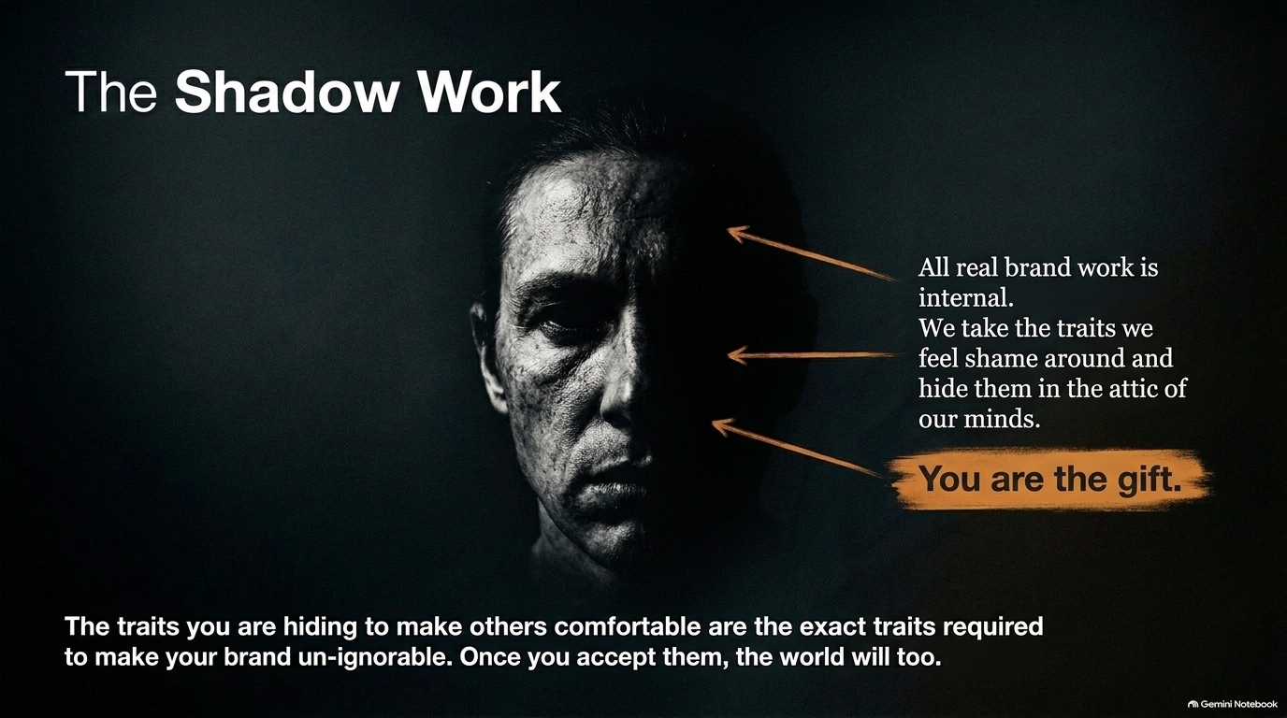
Notes:
Visual: A striking portrait of a face partially obscured in deep shadow, with annotations pointing to hidden traits and the core message: You are the gift.
Suggested Speaking Time: 4–5 minutes
Speaker Notes:
"This brings us to The Shadow Work. All real brand work is fundamentally internal. We take the traits, quirks, and intensities that we feel shame around—the things we were teased for—and we lock them away in the dark attic of our minds. We spend our entire lives pretending not to be those things. But here is the profound truth: The traits you are hiding to make others comfortable are the exact traits required to make your brand un-ignorable. Once you accept your true self, the world will too. You are not a collection of corporate talking points; You are the gift. Stop hiding the very things that make you uniquely powerful."

Slide 7
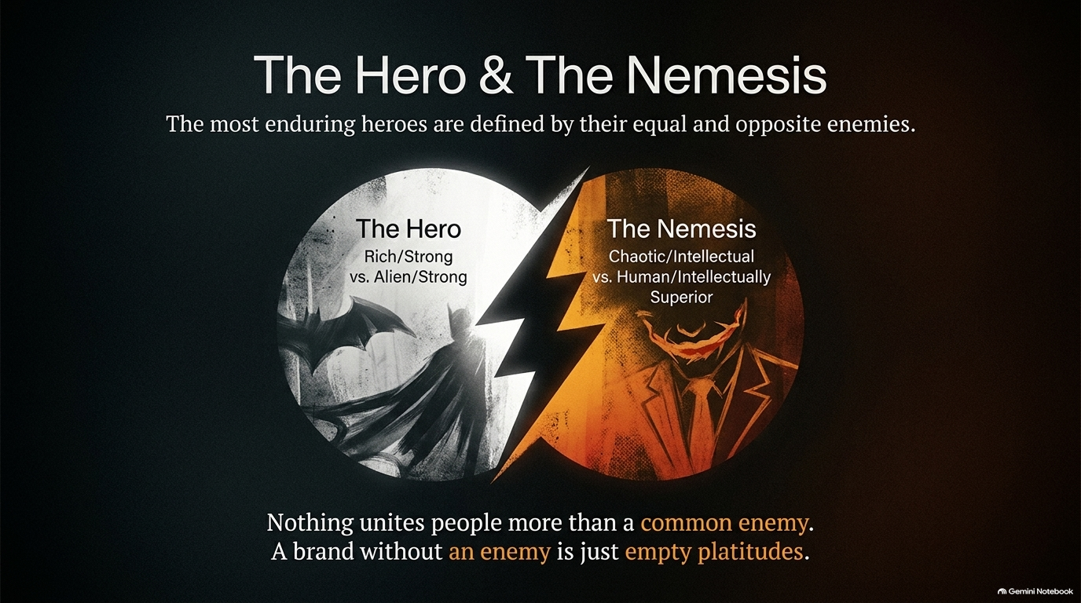
Notes:
Visual: A dual-circle diagram contrasting Batman (rich, strong, hero) with The Joker (chaotic, superior, nemesis), divided by a lightning bolt.
Suggested Speaking Time: 4–5 minutes
Speaker Notes:
"Every enduring hero is defined by their equal and opposite enemy. Look at storytelling and world-building: Batman has the Joker; Superman has Lex Luthor. The hero and the nemesis are two sides of the same coin, perfectly balanced. Why does this matter for your personal brand? Because nothing unites people more than a common enemy. A brand without an enemy is just a collection of empty platitudes. If you only talk about what you love, you create fans. But when you clearly define what you stand against—the broken system, the bad advice, the lazy thinking in your industry—you create a movement. What is the enemy keeping you and your audience awake at night? Name it."

Slide 8
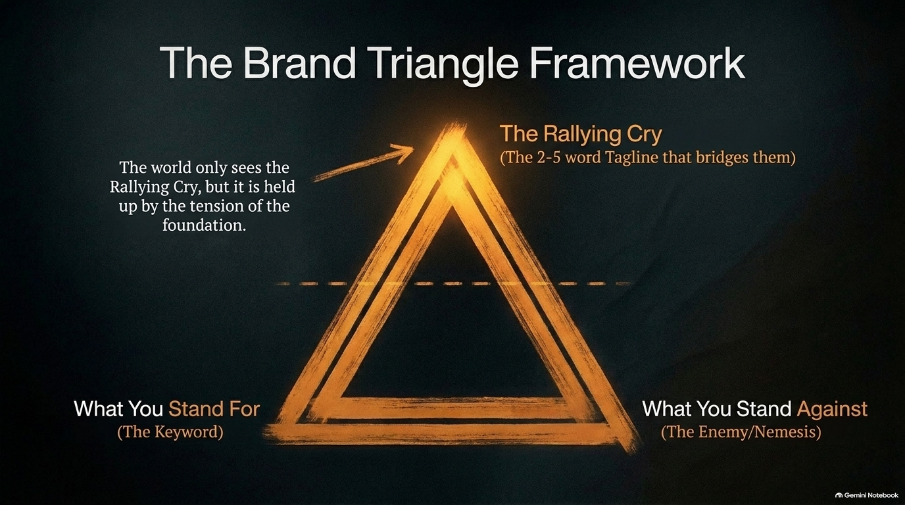
Notes:
Visual: A glowing golden triangle detailing the three pillars: What You Stand For, What You Stand Against, and The Rallying Cry across the top.
Suggested Speaking Time: 4–5 minutes
Speaker Notes:
"How do we structure this? Meet The Brand Triangle Framework. While the world only sees your catchy tagline at the top, that rallying cry is held up by the profound tension of your foundation.
Corner 1 (What You Stand For): Your core keyword, value, or mission (e.g., Longevity, Authentic Identity).
Corner 2 (What You Stand Against): Your nemesis—the system, flaw, or enemy you are fighting (e.g., Death, Corporate Sameness, Masking).
The Apex (The Rallying Cry): The concise, 2-to-5 word tagline that bridges them both together. When these three points lock into place, your brand messaging stops being confusing and becomes an unshakeable anchor."

Slide 9
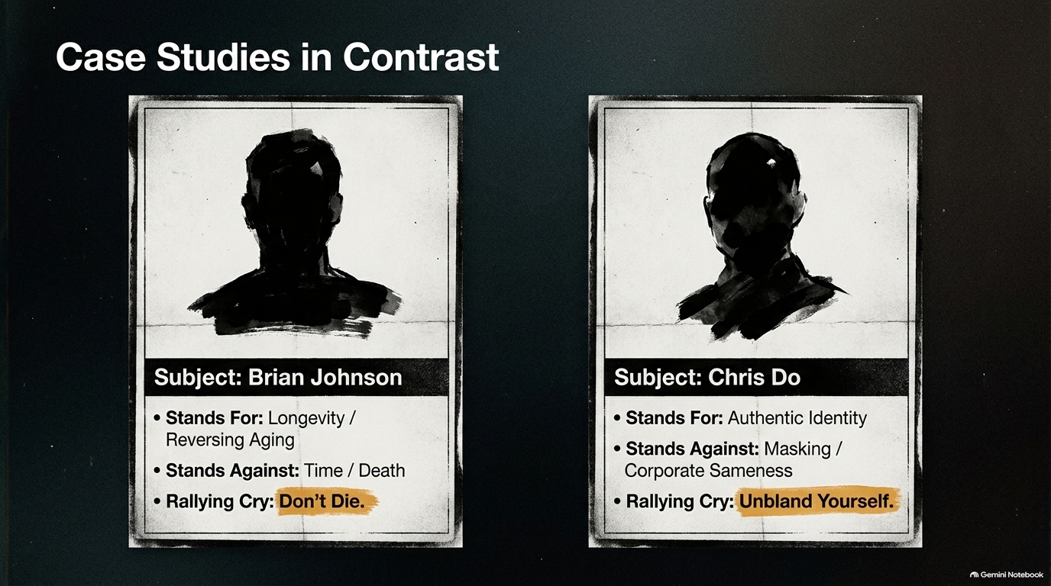
Notes:
Visual: Two dossier-style case study cards comparing Brian Johnson (Don't Die) and Chris Do (Unbland Yourself).
Suggested Speaking Time: 3–5 minutes
Speaker Notes:
"Let's look at two clear case studies in the wild to see how this framework operates in practice.
Subject 1: Brian Johnson (Blueprint / Bryan Johnson): What does he stand for? Longevity and reversing aging. What does he stand against? Time and death. What is his punchy rallying cry? 'Don't die.' Every video, every protocol, and every headline flows directly from that triangle.
Subject 2: Chris Do: What does he stand for? Authentic identity and creative truth. What does he stand against? Masking and corporate sameness. What is his rallying cry? 'Unbland Yourself.' Notice how simple, visceral, and uncompromising these positions are. They don't try to appeal to everyone; they appeal fiercely to the right people."

Slide 10
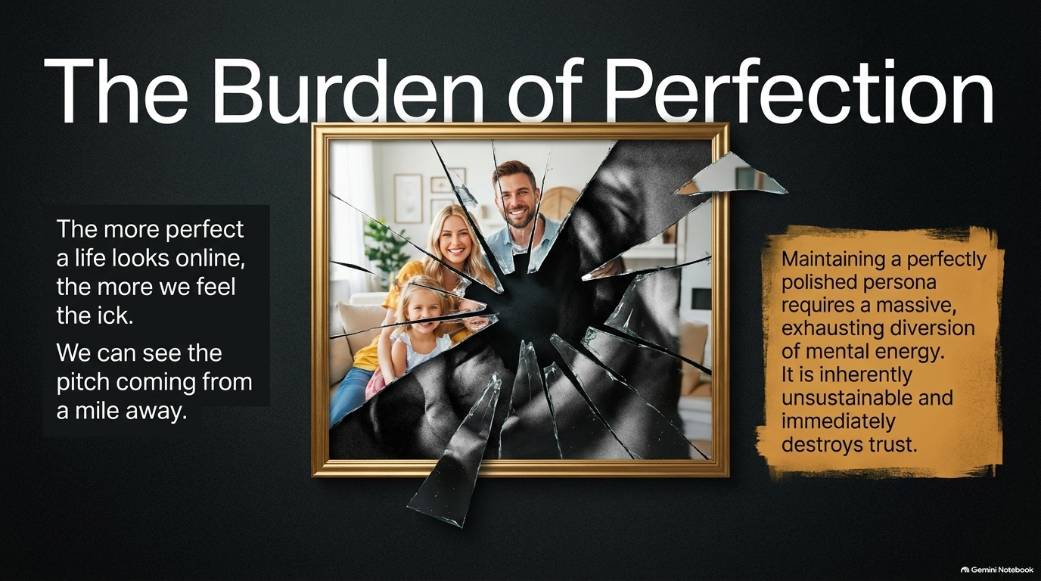
Notes:
Visual: A cracked, shattered gold picture frame revealing a dark, fractured reflection behind a seemingly perfect family photo.
Suggested Speaking Time: 3–5 minutes
Speaker Notes:
"Let's talk about The Burden of Perfection. Have you ever noticed that the more perfect a life looks online, the more we feel the 'ick'? We can smell a manufactured pitch from a mile away. Maintaining a perfectly polished, flawless persona online requires a massive, exhausting diversion of your mental and spiritual energy. You spend all your time cleaning the house before guests arrive, filtering every photo, and censoring every real thought. It is inherently unsustainable, and worse—it immediately destroys trust. People don't connect with perfection; perfection creates distance. People connect with humanity, flaws, and struggle."

Slide 11
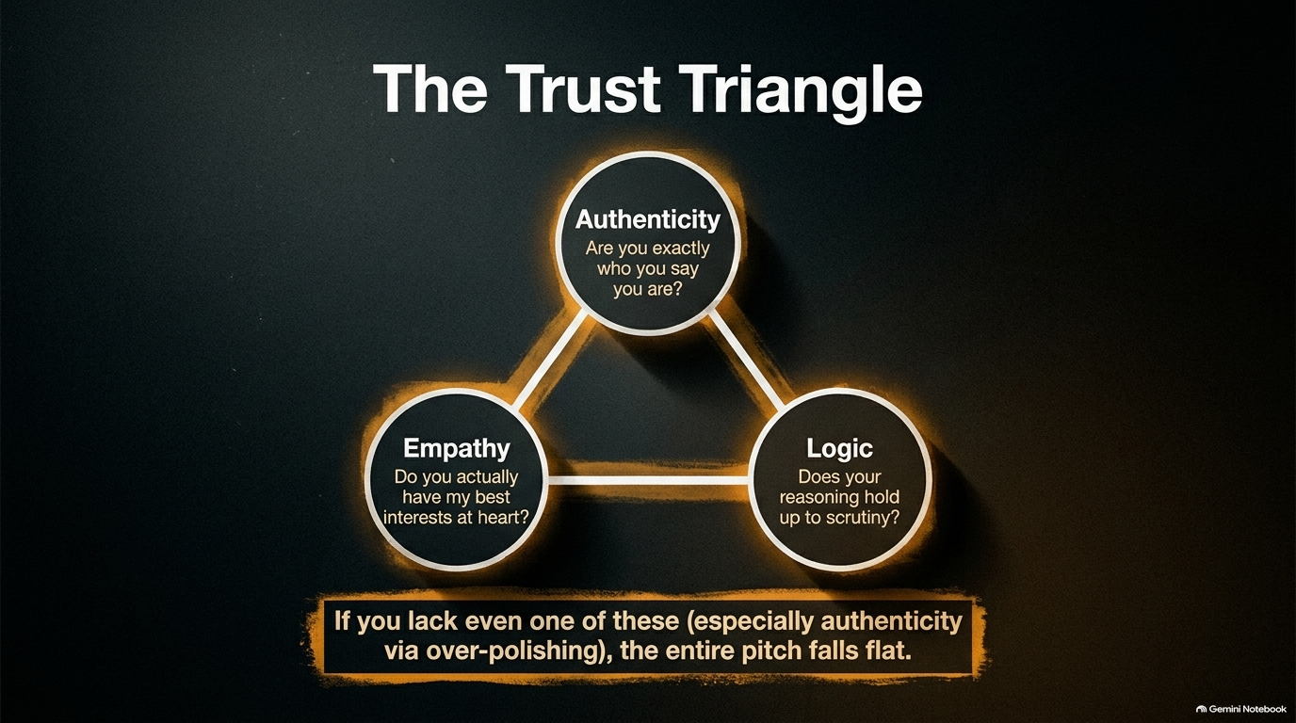
Notes:
Visual: A glowing triangular diagram connecting Authenticity, Empathy, and Logic, with a warning banner at the base.
Suggested Speaking Time: 4–5 minutes
Speaker Notes:
"Harvard Business Review research highlights what they call The Trust Triangle—the three elements people evaluate subconsciously before they trust you:
Authenticity: Are you exactly who you say you are? (Closing the gap between your public persona and your true self).
Empathy: Do you actually have my best interests at heart? (Proving you care about the audience more than your transaction).
Logic: Does your reasoning hold up to scrutiny? Here is the critical takeaway: If you lack even one of these—especially authenticity via over-polishing—your entire pitch falls flat. When you try too hard to look flawless, you break authenticity and empathy simultaneously."

Slide 12
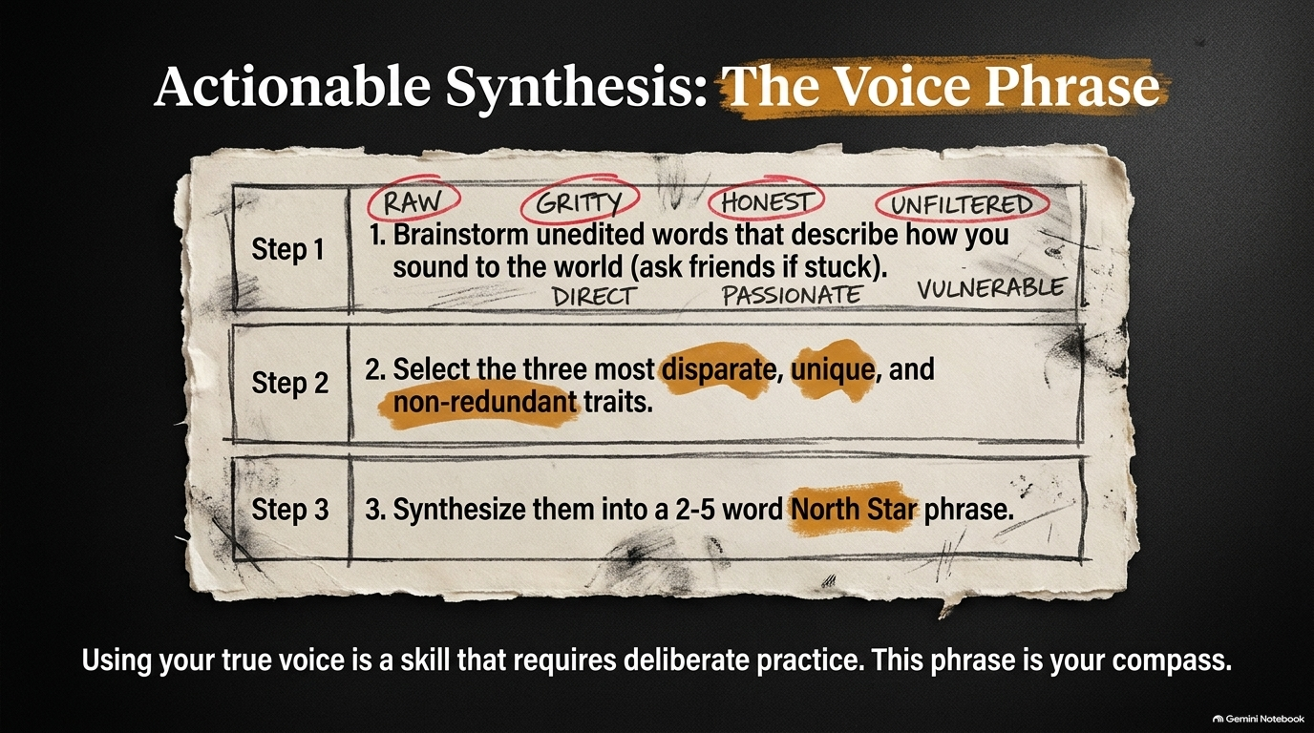
Notes:
Visual: An aged parchment sheet outlining a 3-step actionable exercise to brainstorm raw traits and synthesize a North Star voice phrase.
Suggested Speaking Time: 4–6 minutes
Speaker Notes:
"Let's make this actionable right now. How do you find your true voice? Through The Voice Phrase Exercise:
Step 1: Brainstorm unedited words that describe how you sound to the world—words like raw, gritty, honest, unfiltered, direct, or passionate. Ask friends if you get stuck.
Step 2: Select the three most disparate, unique, and non-redundant traits. (If two words mean the exact same thing, toss one out).
Step 3: Synthesize those three traits into a concise, 2-to-5 word North Star phrase. Using your true voice is a skill that requires deliberate, daily practice. This phrase becomes your permanent compass when creating content or building your brand."

Slide 13
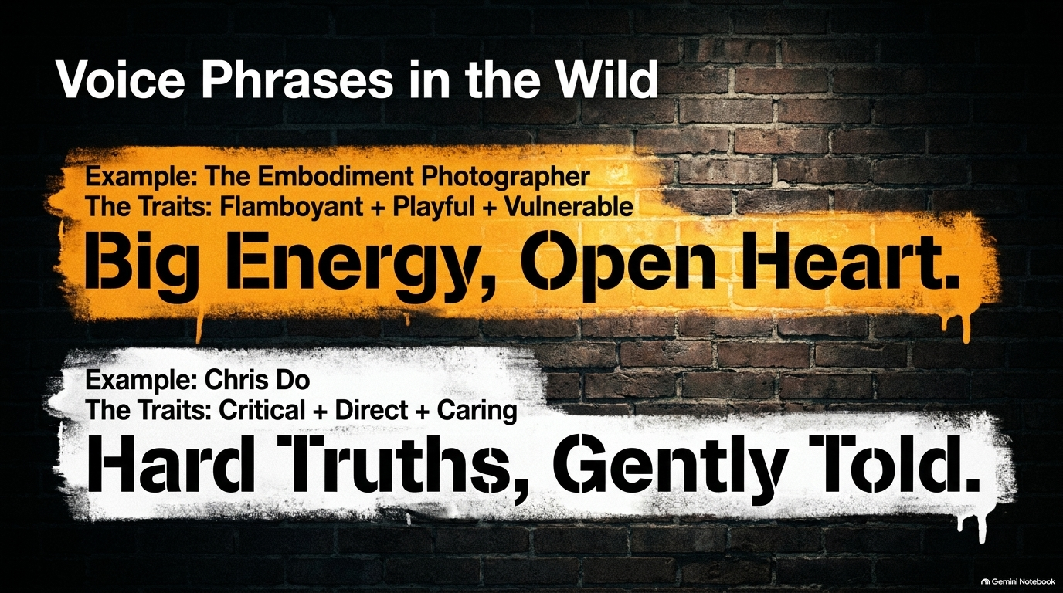
Notes:
Visual: Two bold graffiti-style text callouts on a brick wall displaying real examples: 'Big Energy, Open Heart' and 'Hard Truths, Gently Told.'
Suggested Speaking Time: 3–5 minutes
Speaker Notes:
"Let's look at how this manifests in the real world.
Take an embodiment photographer whose core traits are flamboyant, playful, and vulnerable. Synthesized into a voice phrase, it becomes: 'Big Energy, Open Heart.' When he steps in front of a camera or client, that phrase dictates his exact energy.
Take Chris Do, whose traits are critical, direct, and caring. His voice phrase is: 'Hard Truths, Gently Told.' Notice the brilliant tension in that phrase: it has to be a hard truth, otherwise it's just empty flattery; but it must be gently told, otherwise it's just aggressive and cruel. Your voice phrase keeps you honest to your core."

Slide 14
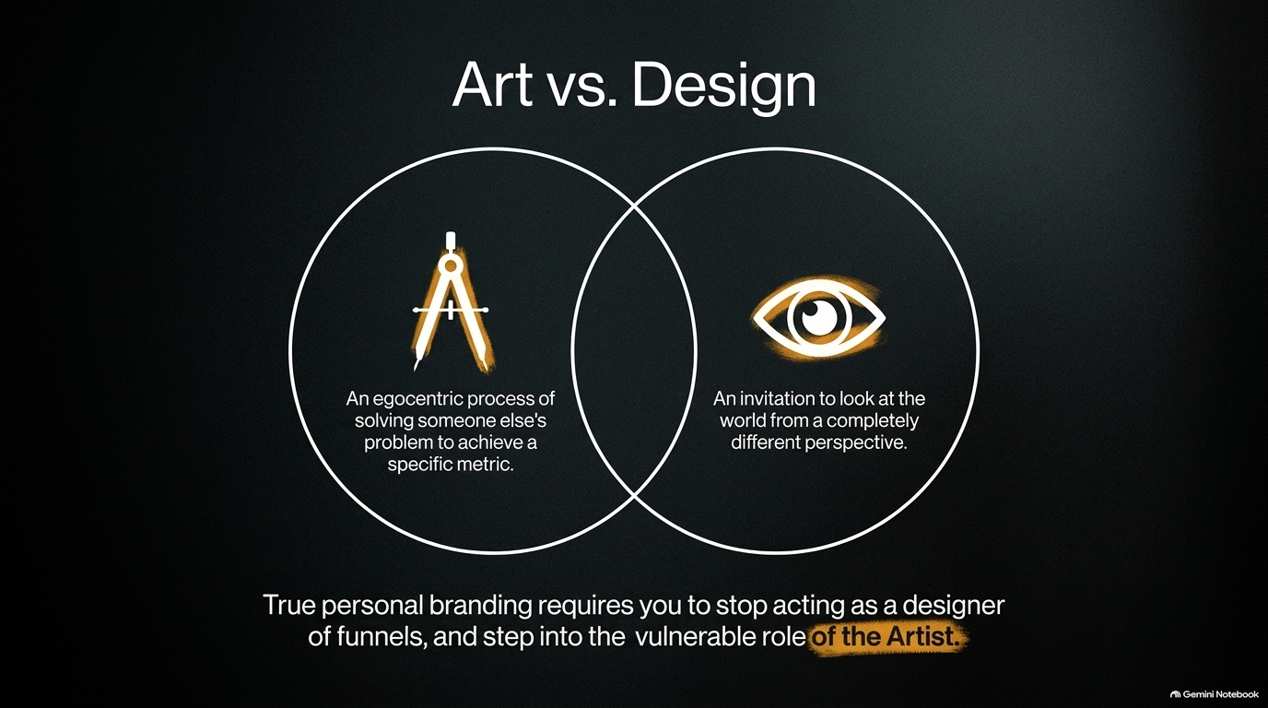
Notes:
Visual: Venn diagram contrasting 'Design' (egocentric problem solving for a metric) with 'Art' (an invitation to look at the world from a different perspective).
Suggested Speaking Time: 4–5 minutes
Speaker Notes:
"As we mature in our work, we must understand the fundamental difference between Art and Design.
Design is an egocentric process of solving someone else's problem to achieve a specific financial metric. It's functional, client-driven, and pragmatic.
Art, on the other hand, is an invitation to look at the world from a completely different perspective. It stems from personal truth, emotion, and vulnerability. The trap for many creators is that they act like corporate designers of marketing funnels, optimizing for clicks and conversions, while completely starving their inner artist. True personal branding requires you to step out of the funnel machine and step into the vulnerable role of the artist."

Slide 15
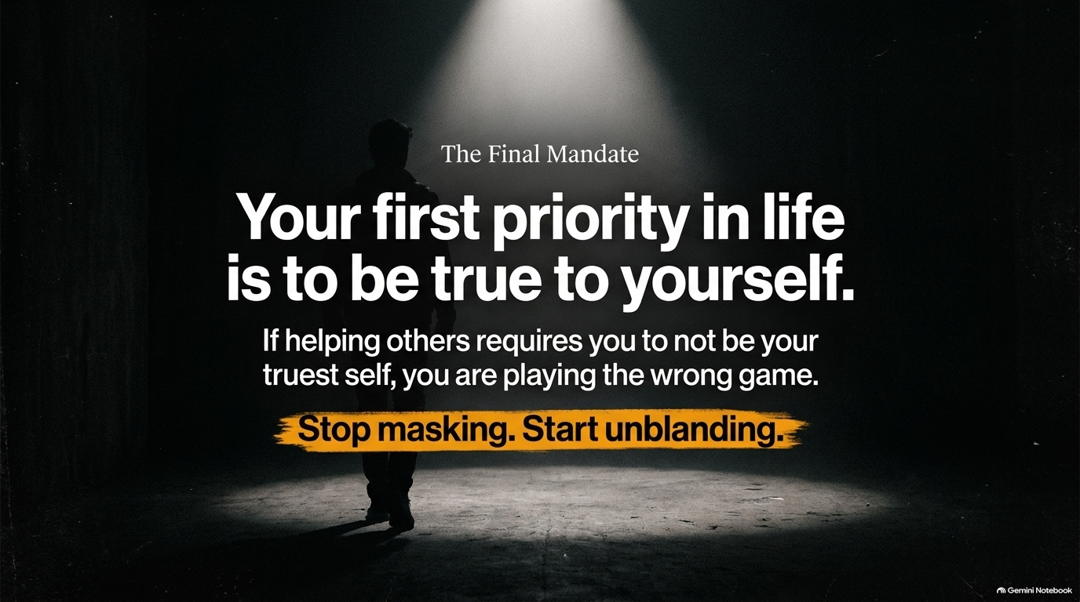
Notes:
Visual: A powerful closing slide with stark white typography over a dark, moody hallway silhouette, emphasizing the ultimate priority of self-truth.
Suggested Speaking Time: 3–4 minutes
Speaker Notes:
"Let's land on The Final Mandate. Your absolute first priority in life is to be true to yourself. Your second priority is to refer back to priority number one. If helping others, pleasing clients, or building a business requires you to sacrifice your truest self and wear a mask, you are playing the wrong game. Success built on a fake identity is just an elaborate prison. Stop masking. Start unblanding. The world doesn't need another polished carbon copy; the world needs the unvarnished, authentic truth of who you are."

Slide 16
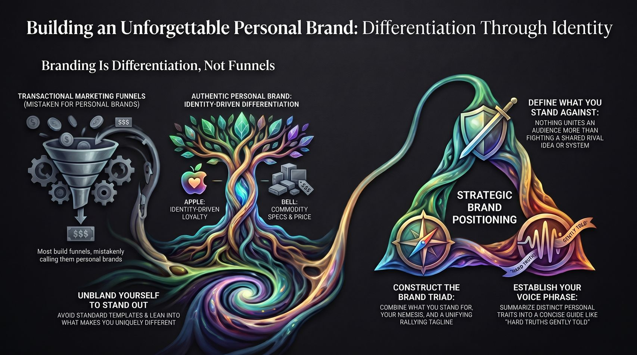
Notes:
Visual: A grand synthesis master slide tying together the marketing funnel vs. tree of identity, the brand triad, the voice phrase, and strategic positioning.
Suggested Speaking Time: 3–5 minutes
Speaker Notes:
"To wrap up our entire journey today, look at this master architecture map. Building an unforgettable personal brand is not about tricking an algorithm or building a sleeker sales funnel. It is about differentiation through identity. Remember to unbland yourself to stand out, construct your Brand Triad by nailing what you stand for and what you stand against, establish your unique voice phrase to guide your communication, and drop the burden of perfection. Step out of the commodity trap, do the deep internal shadow work, and bring your true, unmasked self to the world. Thank you."

