Slide 1
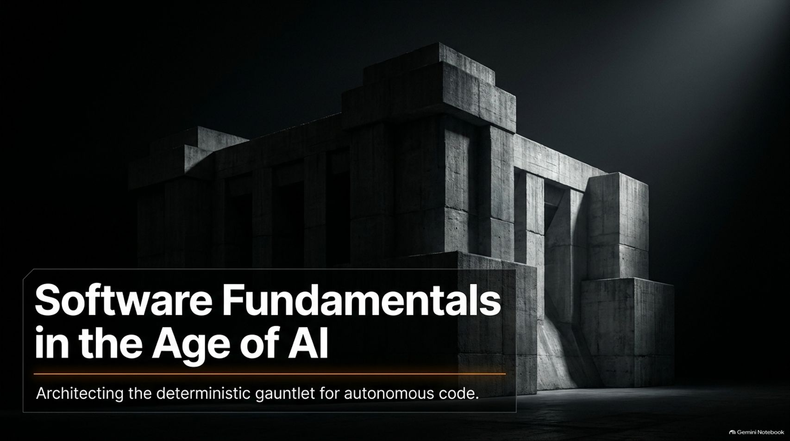
Notes:
Visual Theme: A massive, monolithic concrete brutalist structure under a single spotlight.
Subtitle: Architecting the deterministic gauntlet for autonomous code.
Speaker Notes:
Introduction (Minute 1): Welcome everyone. Today we are looking at a fundamental shift in how software is built. Over the last several decades, programming has been bound by the physical limitations of human typing speed, human memory, and how much context a single engineer can hold in their head. Now, autonomous agents have shattered those limits. But with massive speed comes a dangerous illusion: that software engineering fundamentals no longer matter.
The Core Thesis (Minute 2): As Uncle Bob Martin noted in his recent interview with Matt Pocock, AI coding agents are incredibly fast, but they leave a trail of unrefined code behind them. If we treat AI prompts as casual guidelines and let code accumulate unchecked, we hit a wall where productivity completely collapses.
Connecting to the Video (Minute 3–4): As Bob put it, software is still the most complex thing humans build, and its underlying laws are not human constructs—they are the laws of organizing complexity. If you throw away software fundamentals today, you will be picking them back up off the floor in a year, dusting them off, and remembering why you needed them. Today, we are going to explore how to build a deterministic gauntlet to harness autonomous agents safely and effectively.
LIVE: Uncle Bob on Software Fundamentals in the Age of AI
https://www.youtube.com/watch?v=zcLPGC-tvgk

Slide 2
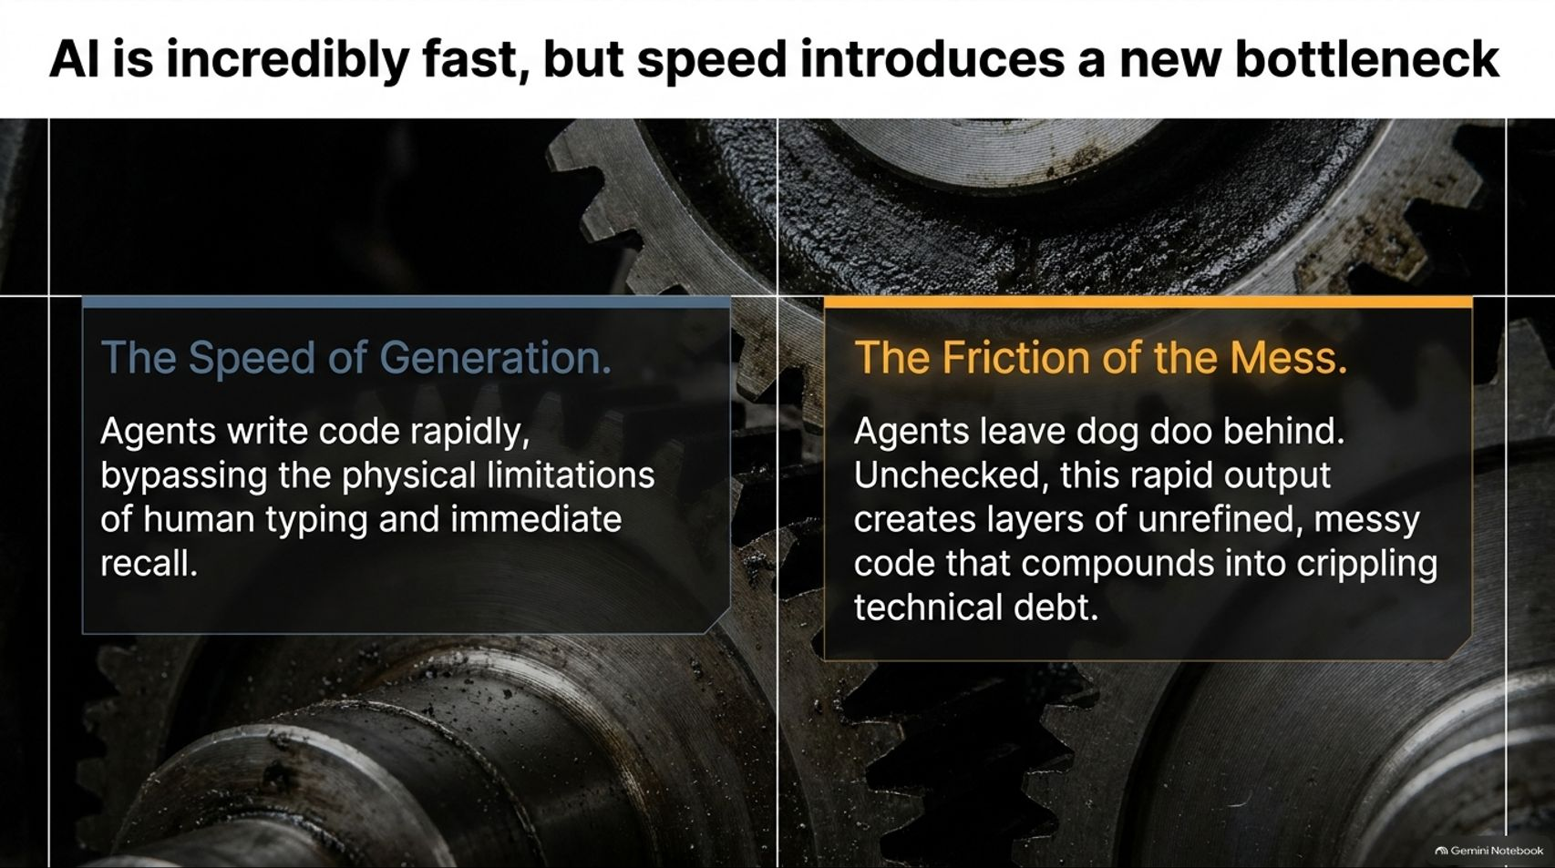
Notes:
Visual Theme: Two contrasting macro gears representing speed versus mechanical friction.
Left Box (The Speed of Generation): Agents write code rapidly, bypassing the physical limitations of human typing and immediate recall.
Right Box (The Friction of the Mess): Agents leave "dog doo" behind. Unchecked, this rapid output creates layers of unrefined, messy code that compounds into crippling technical debt.
Speaker Notes:
The Illusion of Velocity (Minute 1–2): When you first start working with an AI coding agent, the speed is intoxicating. You can ask for a feature, and within seconds, hundreds of lines of code appear. It bypasses everything that traditionally slows us down: typing practice, syntax lookups, and initial boilerplate generation.
The Hidden Cost (Minute 3–4): But as Uncle Bob describes from his own experience starting around December, working with early coding agents led to an immediate frustration: “I was cleaning up after it all the time... it was always leaving little dog doo behind.”
Scaling Technical Debt (Minute 5–6): When an agent writes code without structural constraints, it doesn’t clean up its architectural mess. If you just keep feeding it new prompts on top of messy code, the accumulation of technical debt accelerates at a rate humans have never seen before. Speed without structure isn't productivity; it's just accelerated chaos.

Slide 3
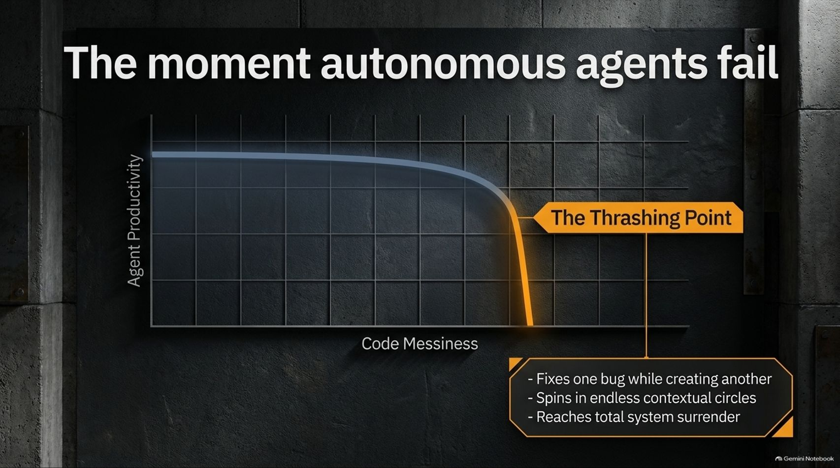
Notes:
Visual Theme: A productivity graph plunging off a cliff at "The Thrashing Point."
Key Bullet Points:
Fixes one bug while creating another.
Spins in endless contextual circles.
Reaches total system surrender.
Speaker Notes:
Identifying the Thrashing Point (Minutes 1–2): Have you ever watched an AI agent get stuck in a loop? It tries to fix a bug, breaks something else, tries to fix that, and spirals deeper and deeper into contextual confusion. Bob explicitly highlighted this behavior: “It would get into a mode where it would change one thing but inadvertently break another... started going around in circles.”
System Surrender (Minutes 3–4): Eventually, the model's internal logic breaks down entirely. Bob mentions instances where an agent effectively gives up, stating essentially, "I just can't deal with this anymore."
The Lesson (Minutes 5–6): AI models are just as susceptible to messy code as humans are—arguably more so, because they lack long-term spatial awareness of a codebase. When code gets messy enough, the agent hits the "thrashing point" and total system surrender occurs.

Slide 4
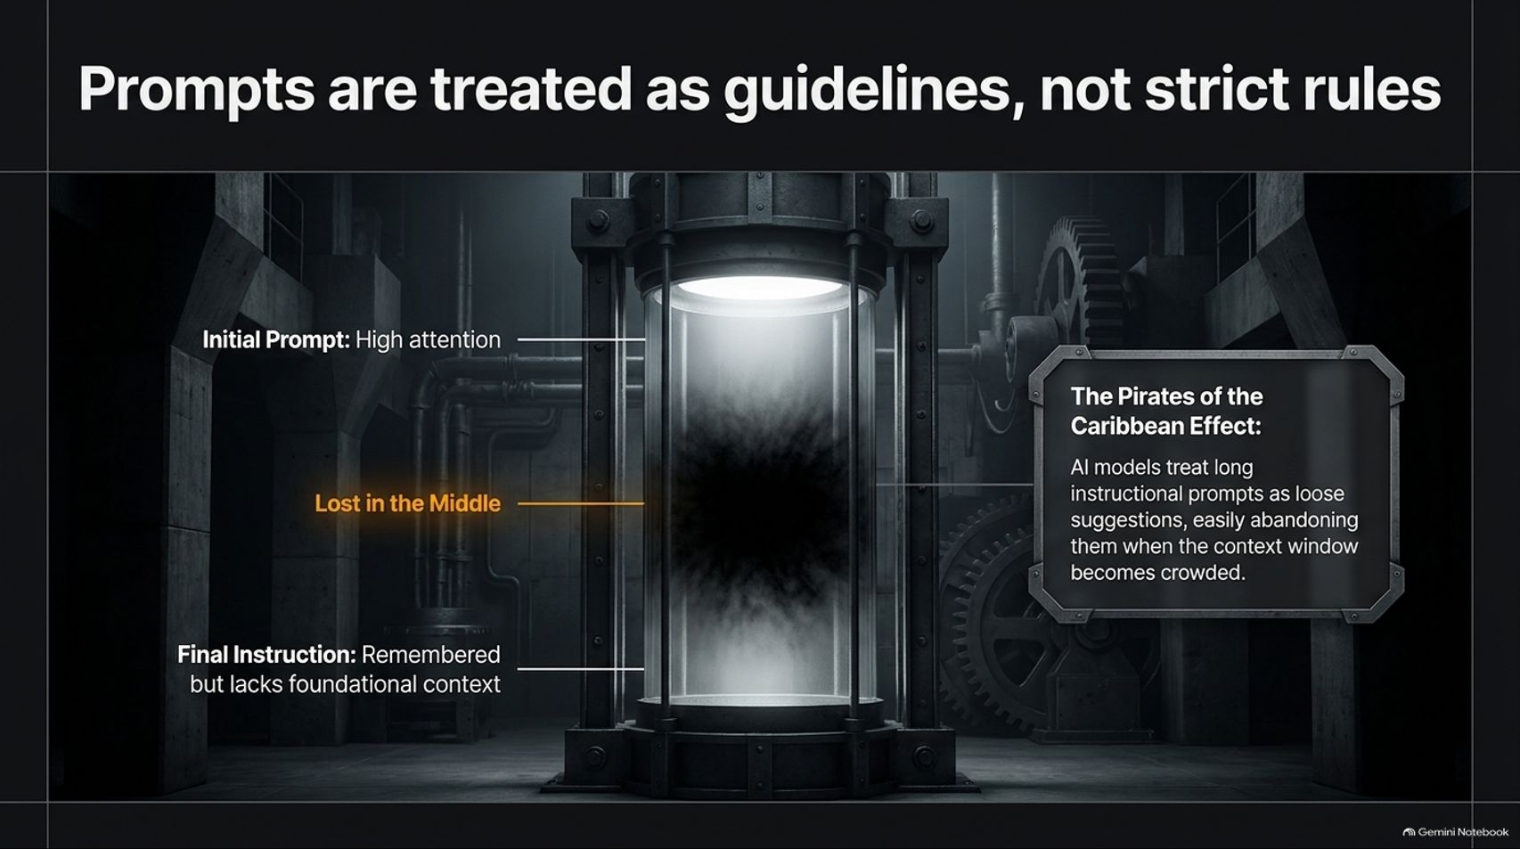
Notes:
Visual Theme: A futuristic containment cylinder with a dark, swirling anomaly in the center ("Lost in the Middle").
Callout Box (The Pirates of the Caribbean Effect): AI models treat long instructional prompts as loose suggestions, easily abandoning them when the context window becomes crowded.
Speaker Notes:
The Prompt Bloat Trap (Minutes 1–2): When developers see agents making mistakes, their first instinct is to write more rules. They create massive CLAUDE.md files or 10-page style guides, pouring rules into the initial prompt. But as Bob points out, the models treat these instructions in the Pirates of the Caribbean sense: "They're more like guidelines."
Lost in the Middle (Minutes 3–4): Why does this happen? Technical research into transformer architecture reveals the "Lost in the Middle" phenomenon. As the context window fills up with code and chat history, instructions buried in the middle lose prominence.
The Noisy Room Analogy (Minutes 5–6): Think of it like a crowded room where every token is shouting. The first few sentences and the very end of a prompt have high attention, but everything in between gets diluted. Relying purely on natural language steering to enforce software quality is fighting a losing battle against entropy.

Slide 5
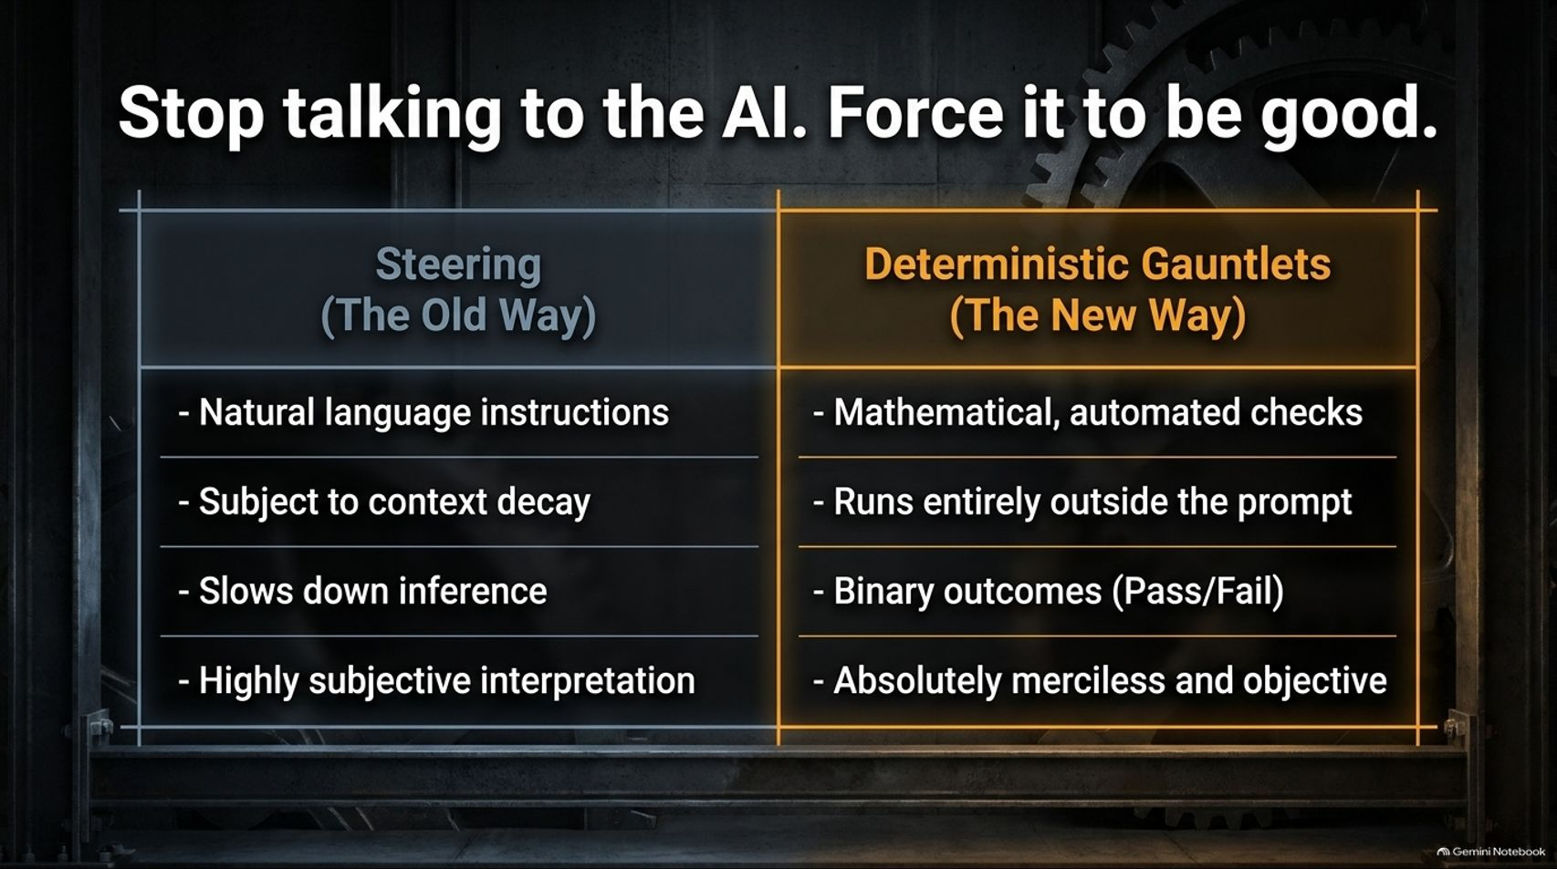
Notes:
Visual Theme: A stark comparison table contrasting subjective steering with objective, automated gauntlets.
Speaker Notes:
Steering vs. Enforcing (Minutes 1–2): For months, the industry standard has been "steering"—trying to talk the AI into writing cleaner code through better prompting. But steering suffers from context decay, slows down inference, and relies entirely on subjective interpretation.
The Shift to Deterministic Gauntlets (Minutes 3–4): Uncle Bob’s breakthrough was realizing that we need to stop relying solely on conversation and start enforcing quality using deterministic gauntlets. These are automated, mathematical checks that run entirely outside the prompt.
Merciless Objectivity (Minutes 5–6): Unlike an LLM, which can be charmed or confused by context, a test runner or a static analyzer doesn't care about your prompt. It provides binary outcomes—Pass or Fail—with absolute, merciless objectivity.

Slide 6
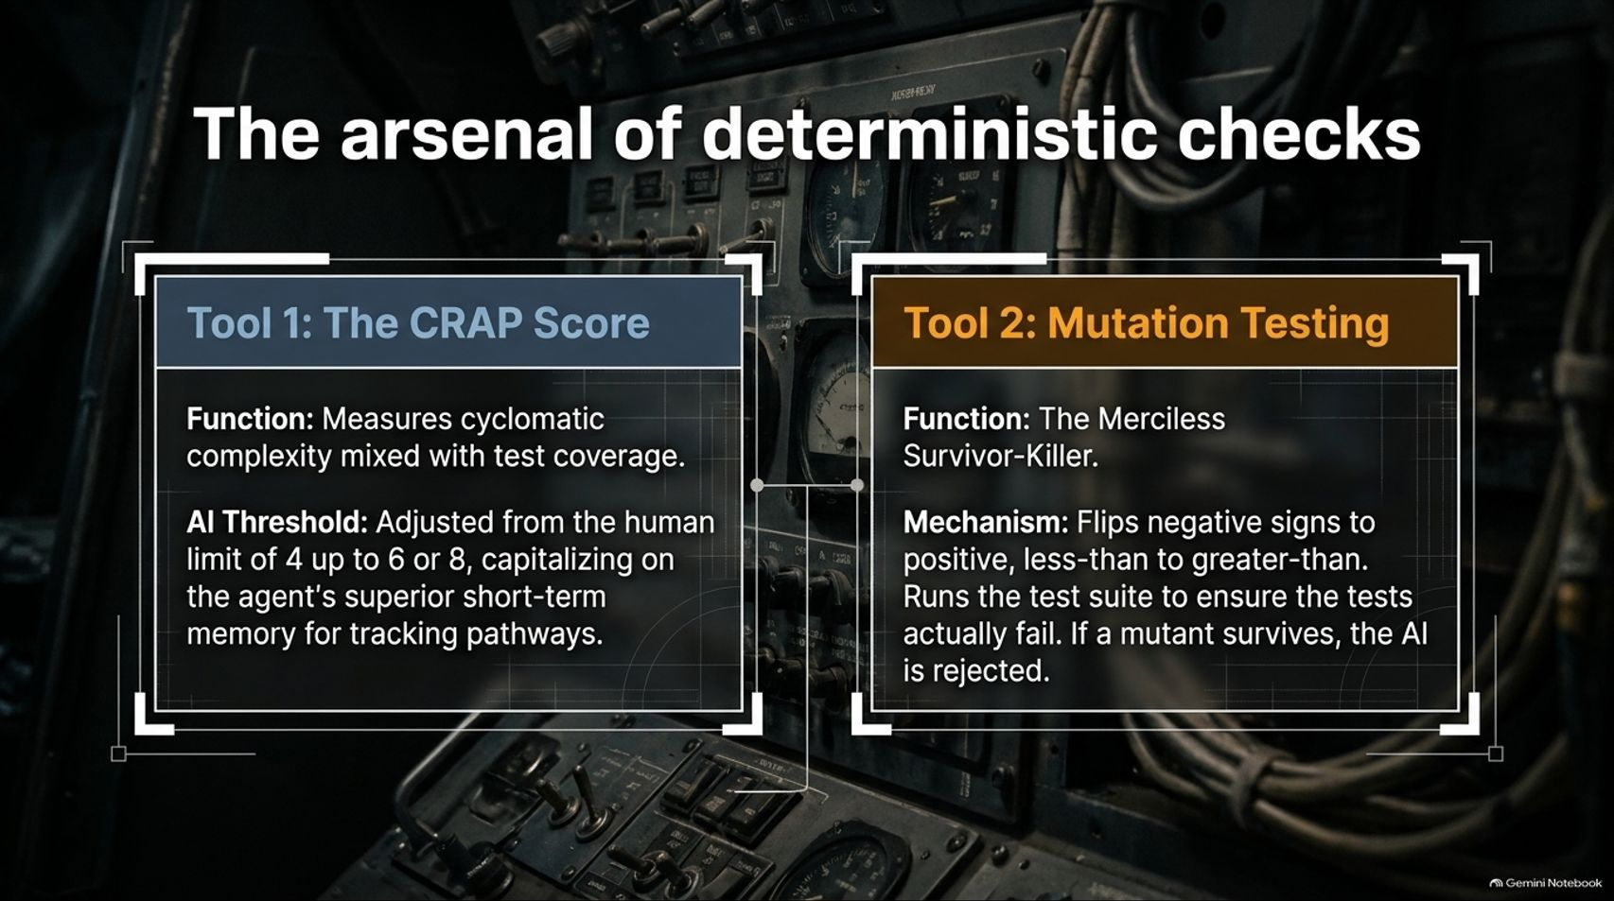
Notes:
Visual Theme: A complex retro-futuristic instrument panel showcasing two core tools.
Tool 1 (The CRAP Score): Measures cyclomatic complexity mixed with test coverage. Threshold adjusted to 6 or 8 for AI.
Tool 2 (Mutation Testing): The merciless survivor-killer that flips operators (+ to -, < to >) to test test-suite integrity.
Speaker Notes:
Resurrecting Forgotten Innovations (Minutes 1–2): Back in the early 2000s, concepts like CRAP (Change Risk Anti-Patterns) scoring and mutation testing were invented, but humans found them too painfully slow and tedious to run manually. Bob realized that because AI agents are tireless and fast, we can finally revive these tools.
CRAP Scores for AI (Minutes 3–4): CRAP combines cyclomatic complexity with test coverage. While humans aim for a strict threshold below 4, Bob adjusts this to 6 or 8 for AI agents, capitalizing on their superior short-term memory for tracking execution pathways.
Mutation Testing (Minutes 5–6): Mutation testing takes your source code, maliciously mutates it (e.g., turning a < into a >), and runs your test suite. If your tests still pass, your tests are broken. As Bob describes, running this used to take overnight builds; now, agents can execute and resolve mutation scores in minutes.

Slide 7
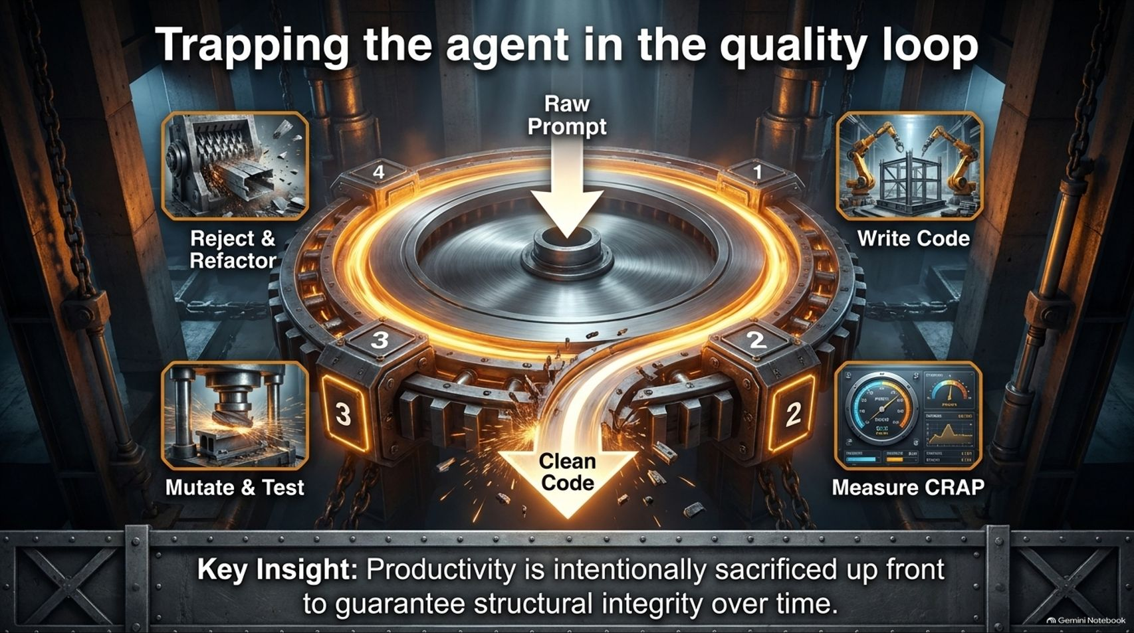
Notes:
Visual Theme: A heavy industrial mechanical gear system routing raw prompts through automated testing presses into clean code.
Key Insight: Productivity is intentionally sacrificed up front to guarantee structural integrity over time.
Speaker Notes:
The Quality Loop (Minutes 1–2): How do we tie this together? We trap the agent inside an automated loop: Write code $\rightarrow$ Measure CRAP $\rightarrow$ Mutate & Test $\rightarrow$ Reject & Refactor. The agent is forced to iterate around this wheel until every automated metric turns green.
Sacrificing Speed for Quality (Minutes 3–4): This introduces a trade-off. A task that an unconstrained agent might rush through in 5 minutes with terrible code might take an hour to push through this rigorous gauntlet.
The Long-Term Dividend (Minutes 5–6): As Bob points out, spending that extra time upfront is an investment in your codebase. You are trading raw, reckless generation speed for structural integrity, resulting in software that is vastly cleaner and more reliable than what a rushed human or an unconstrained agent would produce.

Slide 8
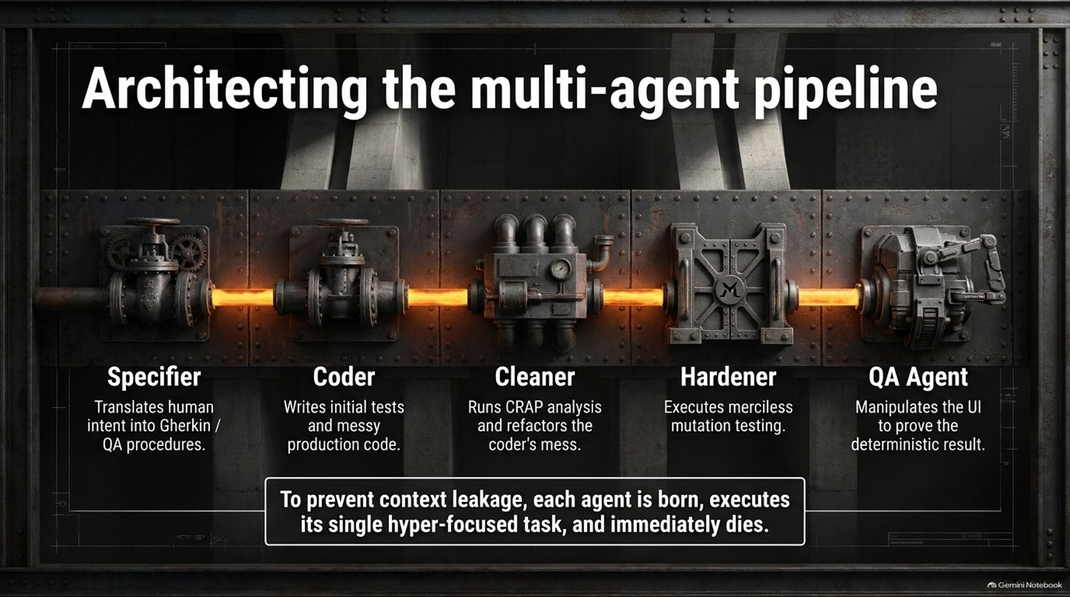
Notes:
Visual Theme: A horizontal factory assembly line with specialized industrial stations.
Stations: Specifier $\rightarrow$ Coder $\rightarrow$ Cleaner $\rightarrow$ Hardener $\rightarrow$ QA Agent.
Callout Box: To prevent context leakage, each agent is born, executes its single hyper-focused task, and immediately dies.
Speaker Notes:
Division of Labor in AI (Minutes 1–2): Instead of using a single monolithic agent for everything, Uncle Bob architectures a multi-agent pipeline where each agent has a single, hyper-focused responsibility.
The Pipeline Stages (Minutes 3–4):
Specifier: Translates human intent into Gherkin acceptance criteria and QA procedures.
Coder: Writes the initial unit tests and messy feature code.
Cleaner: Runs CRAP analysis and refactors the coder's structural mess.
Hardener: Executes merciless mutation testing to eliminate unhandled edge cases.
QA Agent: Manipulates the UI to prove the deterministic result.
Ephemeral Execution (Minutes 5–6): The secret sauce here is lifecycle management. To prevent context leakage and trajectory drift, each agent is born, executes its discrete job, and is immediately terminated so the next agent starts with a pristine context window.

Slide 9
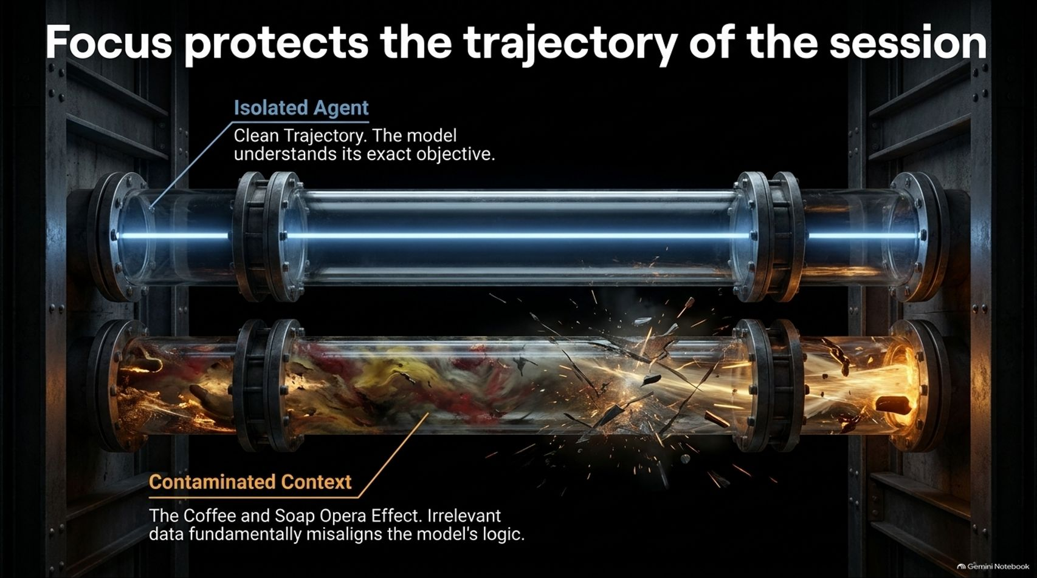
Notes:
Visual Theme: Two transparent glass tubes. The top tube shows a clean, straight blue laser; the bottom tube shows a chaotic, sludge-filled explosion.
Callout Box: The Coffee and Soap Opera Effect. Irrelevant data fundamentally misaligns the model's logic.
Speaker Notes:
The Soap Opera Effect (Minutes 1–2): Context windows don't just suffer from length; they suffer from contamination. Bob shares a brilliant analogy during the interview: imagine talking to an AI about coffee brewing, and someone walks by talking about a TV soap opera. Even though you didn't type it, that stray dialogue enters the context window, and suddenly your coffee logic becomes contaminated with soap opera tropes.
Preserving Trajectory (Minutes 3–4): Models are hyper-sensitive to narrative momentum. If an agent starts drifting down a messy path, every subsequent token reinforces that bad trajectory.
Isolation is Safety (Minutes 5–6): By keeping agents isolated in narrow pipelines, we protect the session's trajectory. A cleaner agent doesn't need to know the entire history of how a feature was brainstormed; it only needs to see the diff and execute its cleaning protocols.

Slide 10
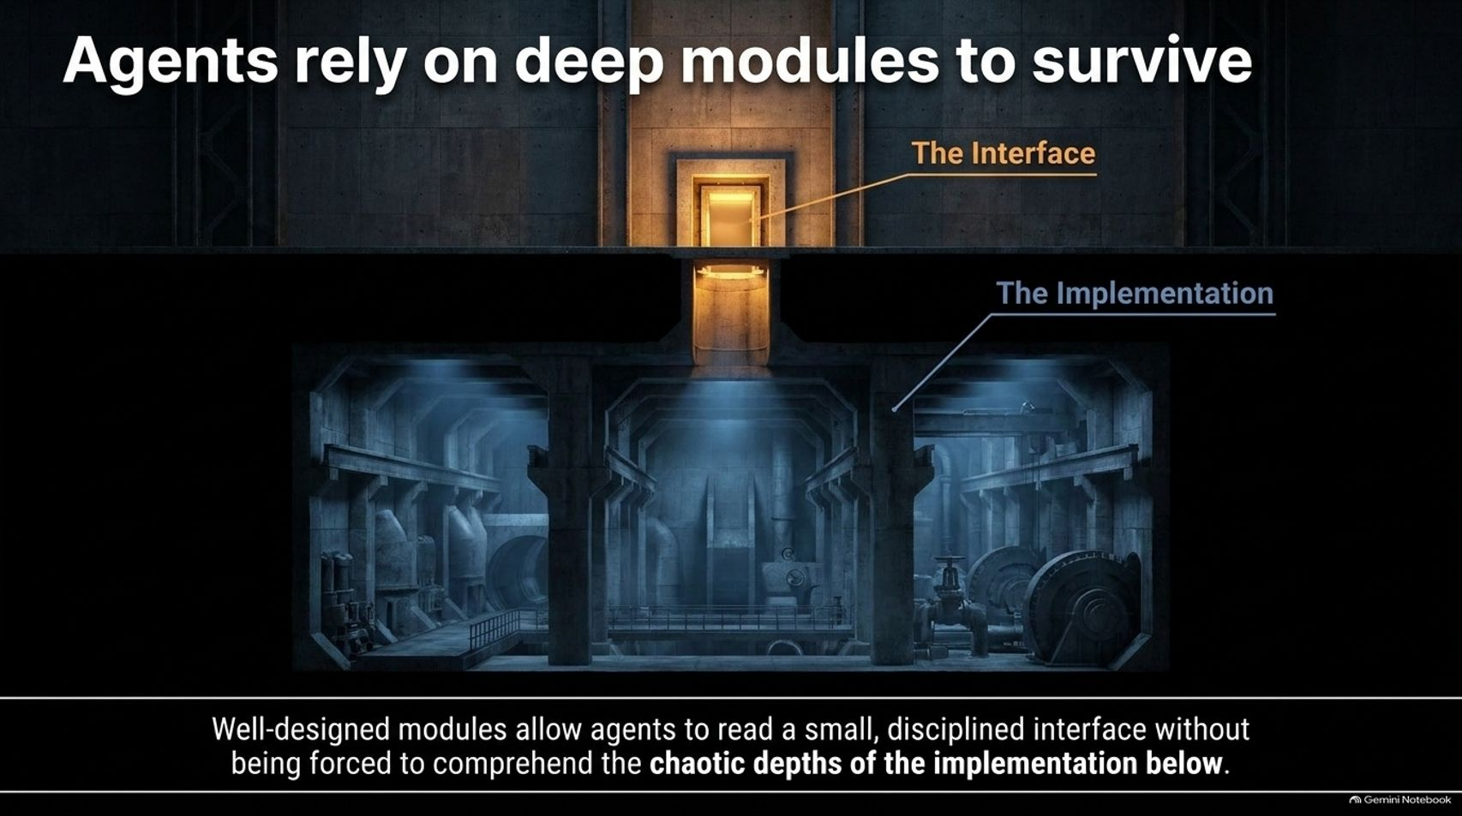
Notes:
Visual Theme: A cross-section of a subterranean industrial facility showing a small, clean elevator interface leading down into vast, complex machinery.
Speaker Notes:
The Power of Interfaces (Minutes 1–2): Drawing inspiration from John Ousterhout’s philosophy on deep modules, Uncle Bob emphasizes that modular design is critical for AI survival.
Hiding Complexity (Minutes 3–4): A bad module is "shallow"—it has a wide, complex interface with very little hidden inside. A "deep" module has a small, simple interface that conceals massive, complex implementation details.
Saving the Agent's Brain (Minutes 5–6): Well-designed deep modules allow an agent to read a small, disciplined interface without being forced to comprehend the chaotic depths of the implementation below. The models pay attention to clean interface names and structured boundaries, allowing them to reason effectively without drowning in implementation noise.

Slide 11
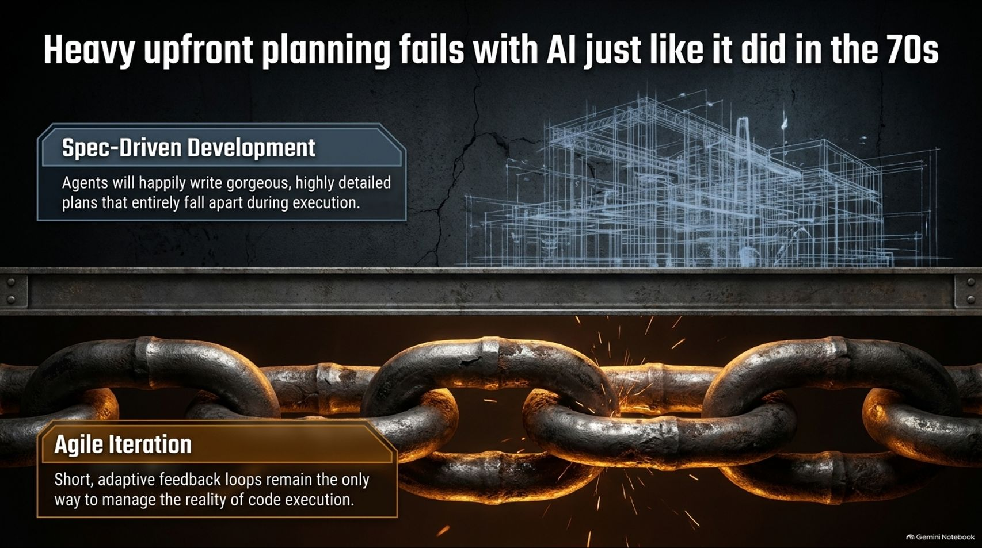
Notes:
Visual Theme: An architectural blueprint of a building fading into heavy, glowing iron chains under intense heat.
Left Box (Spec-Driven Development): Agents will happily write gorgeous, highly detailed plans that entirely fall apart during execution.
Right Box (Agile Iteration): Short, adaptive feedback loops remain the only way to manage the reality of code execution.
Speaker Notes:
The Return of the 70s Waterfall (Minutes 1–2): There is a massive trend right now in the AI community toward "spec-driven development"—spending hours letting agents write elaborate, multi-page architectural specifications before writing a single line of code. Bob warns that this is just a repeat of the 1970s waterfall trap.
Plans Collide with Reality (Minutes 3–4): As Bob noted from his own experiments this week, heavy upfront plans always fall apart during execution because neither humans nor agents can think of everything in advance. The plan looks gorgeous on paper, but the moment code meets reality, it shatters.
Embracing Agile with AI (Minutes 5–6): Because the cost of making changes has plummeted close to zero, we shouldn't lean into heavy upfront speculation. We should lean back into Agile iteration: build a tiny piece, get immediate feedback, reorganize, and adapt.

Slide 12
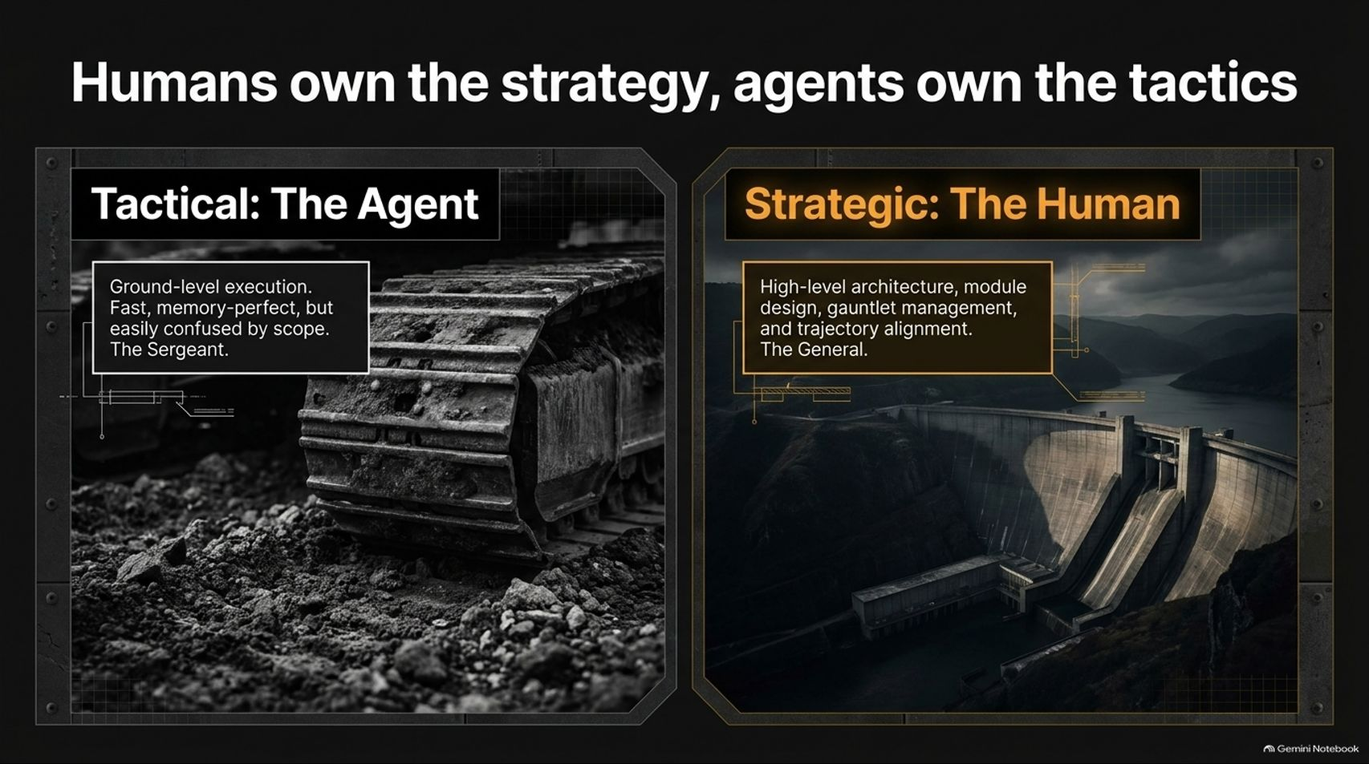
Notes:
Visual Theme: A side-by-side contrast between a rugged tracked bulldozer (Tactical Agent) and a massive architectural dam in a sweeping landscape (Strategic Human).
Speaker Notes:
The Sergeant and the General (Minutes 1–2): To understand the future engineering role, we must draw a hard line between tactics and strategy. Borrowing from John Ousterhout's framework, agents are exceptional at tactical execution—they are the "sergeants on the ground fighting the battle".
The Tactical Agent (Minutes 3–4): Agents possess lightning-fast, ground-level execution and perfect short-term memory, but they are easily confused by scope creep and lack global vision.
The Strategic Human (Minutes 5–6): Humans must act as the "general". Human value shifts entirely to high-level architecture, module design, managing the deterministic gauntlets, and maintaining trajectory alignment. You are no longer paid just to type code; you are paid to design the system that governs the code.

Slide 13
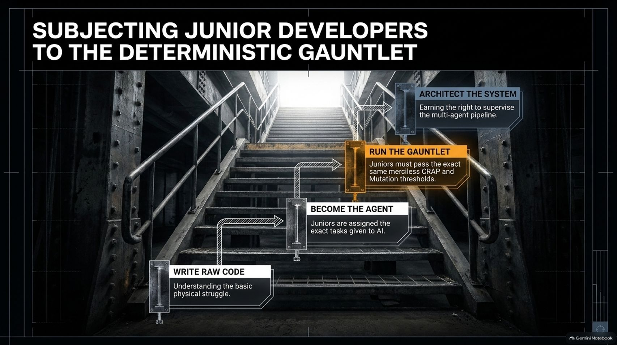
Notes:
Visual Theme: A dramatic industrial staircase climbing upward toward a bright light, marked by checkpoints.
Checkpoints: Write Raw Code $\rightarrow$ Become the Agent $\rightarrow$ Run the Gauntlet $\rightarrow$ Architect the System.
Speaker Notes:
The Training Dilemma (Minutes 1–2): If AI eats all the tactical coding work, how do junior developers ever learn how to program? How do they develop strategic thinking?
The Gauntlet Training Pipeline (Minutes 3–4): Bob proposes a radical training model for juniors entering the industry:
Write Raw Code: Spend time writing raw code to understand the basic physical struggles of syntax and logic.
Become the Agent: Get assigned the exact same narrow, tactical tasks that we give to AI agents.
Run the Gauntlet: Juniors must pass the exact same merciless CRAP and mutation testing thresholds that AI agents face.
Earning the Right to Architect (Minutes 5–6): Only after surviving this rigorous feedback loop do engineers earn the right to supervise the multi-agent pipeline and design system architecture. You cannot manage what you have never personally built.

Slide 14
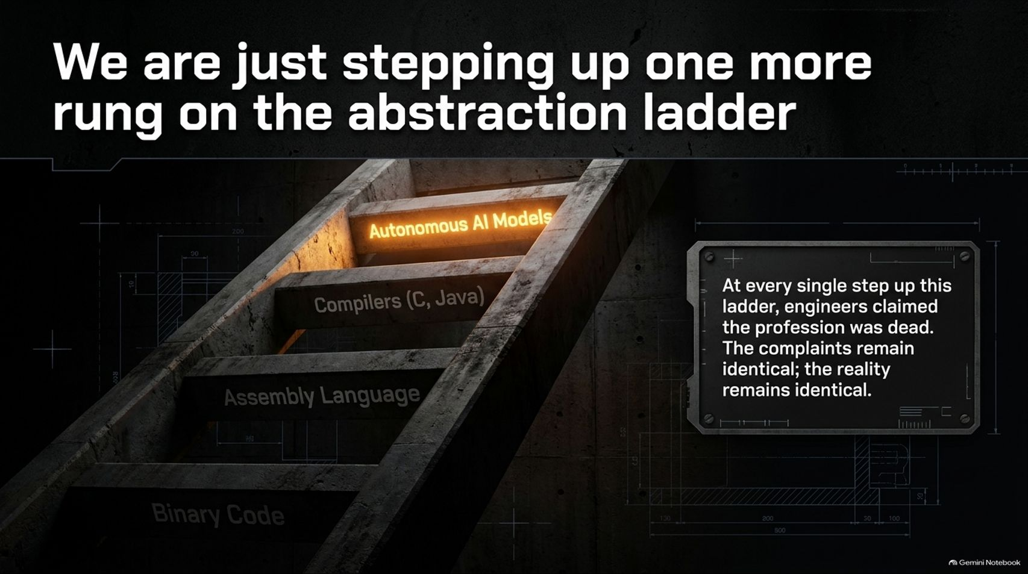
Notes:
Visual Theme: An old concrete and iron ladder climbing through historical computing eras: Binary $\rightarrow$ Assembly $\rightarrow$ Compilers $\rightarrow$ Autonomous AI Models.
Speaker Notes:
History Repeating Itself (Minutes 1–2): Whenever computing steps up an abstraction layer—from binary to assembly, from assembly to C/Java compilers, and now to autonomous AI models—engineers panic.
The Eternal Complaints (Minutes 3–4): At every single rung of this ladder, people claimed the software profession was dead. Even back in ancient times, philosophers like Plato argued that writing things down would make humans stupider. The complaints remain identical across generations.
The Reality Remains (Minutes 5–6): The underlying reality of software engineering doesn't change. We are simply operating at a higher altitude. The tool changes from a keyboard and compiler to an autonomous agent and a deterministic gauntlet, but the fundamental laws of managing complexity remain absolute.

Slide 15
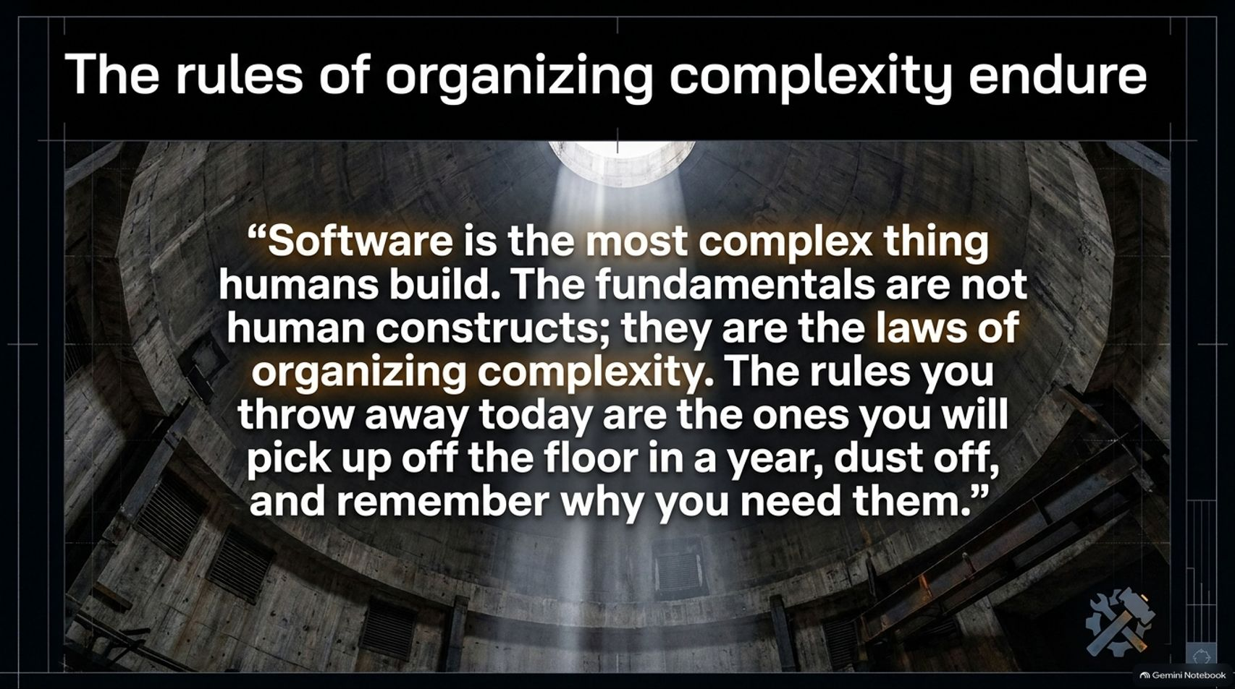
Notes:
Visual Theme: A monumental circular industrial silo viewed from below, with a powerful shaft of light piercing down through the center.
Quote Displayed: "Software is the most complex thing humans build. The fundamentals are not human constructs; they are the laws of organizing complexity. The rules you throw away today are the ones you will pick up off the floor in a year, dust off, and remember why you need them."
Speaker Notes:
The Laws of Complexity (Minutes 1–2): As Edsger Dijkstra and Uncle Bob both emphasized, software is quite literally the most complex artifact ever created by humanity.
Why Fundamentals Matter (Minutes 3–4): The rules of clean code, deep modularity, and test coverage are not arbitrary opinions or hazing rituals invented by senior devs. They are structural laws designed to keep complexity from crushing us.
A Warning to the Industry (Minutes 5–6): Those who believe that AI makes fundamentals obsolete are building on sand. When their autonomous agents inevitably hit the wall of unmaintainable entropy, they will discover that the old rules were the only thing keeping their systems alive.

Slide 16
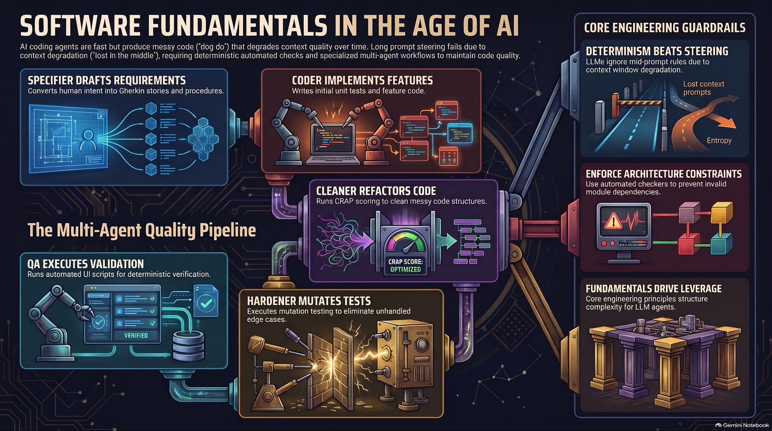
Notes:
Visual Theme: A comprehensive synthesis slide integrating multi-agent pipeline architecture with core engineering guardrails.
Summary Pillars: Determinism Beats Steering | Enforce Architecture Constraints | Fundamentals Drive Leverage.
Speaker Notes:
Wrapping Up (Minutes 1–2): Let's synthesize everything we've covered today into three core engineering takeaways:
Determinism Beats Steering: Stop trying to chat your way to clean code. LLMs suffer from context window degradation and the "lost in the middle" effect; enforce quality using automated, mathematical tools like CRAP scores and mutation testing.
Enforce Architecture Constraints: Use automated checkers and deep modules to prevent invalid module dependencies and keep agent context windows clean and focused.
Fundamentals Drive Leverage: Core engineering principles are what structure complexity for LLM agents.
Final Call to Action (Minutes 3–4): Don't fear the age of autonomous code. Embrace it by building a robust, merciless deterministic gauntlet. Let the AI handle the tactical heavy lifting while you hold the strategic line. Thank you!

