Slide 1
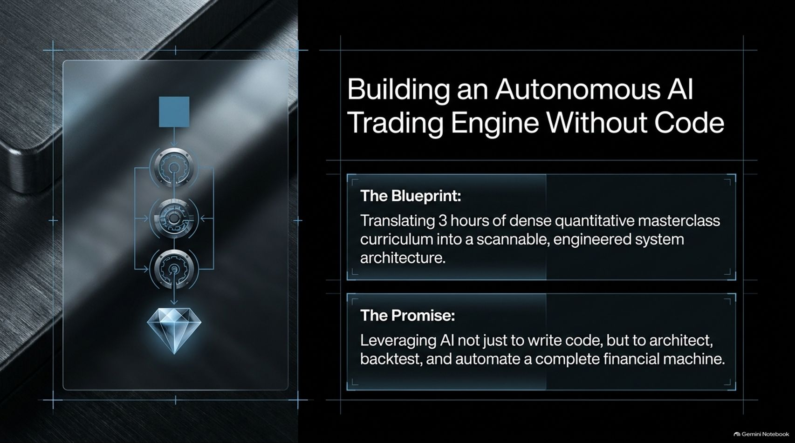
Notes:
Visual Theme: A sleek glass dashboard floating over dark metallic brushed steel, showing workflow pipelines and a diamond indicator.
Subtitle: Translating 3 hours of dense quantitative masterclass curriculum into a scannable, engineered system architecture.
Speaker Notes:
Introduction (Minute 1): Welcome everyone. Today we are breaking down how to build a fully autonomous AI trading engine from scratch—without needing a background in complex software development. Over a dense 3-hour masterclass curriculum, the core objective is clear: how do we transition from zero code and raw ideas into a professional, production-grade financial machine using AI tools like Claude?
The Core Promise (Minute 2–3): Most people think building a trading bot means writing thousands of lines of Python code, managing server uptime, and debugging API errors at 3:00 AM. In this blueprint, we are leveraging AI not just to write lines of code, but to architect, backtest, and automate a complete, risk-managed financial machine. Let's examine how we transition from fragile scripts to a robust engineering system.
How To Actually Build an AI Trading Bot With Claude (3 Hour Course)
https://www.youtube.com/watch?v=gJLKVsIqiTE

Slide 2
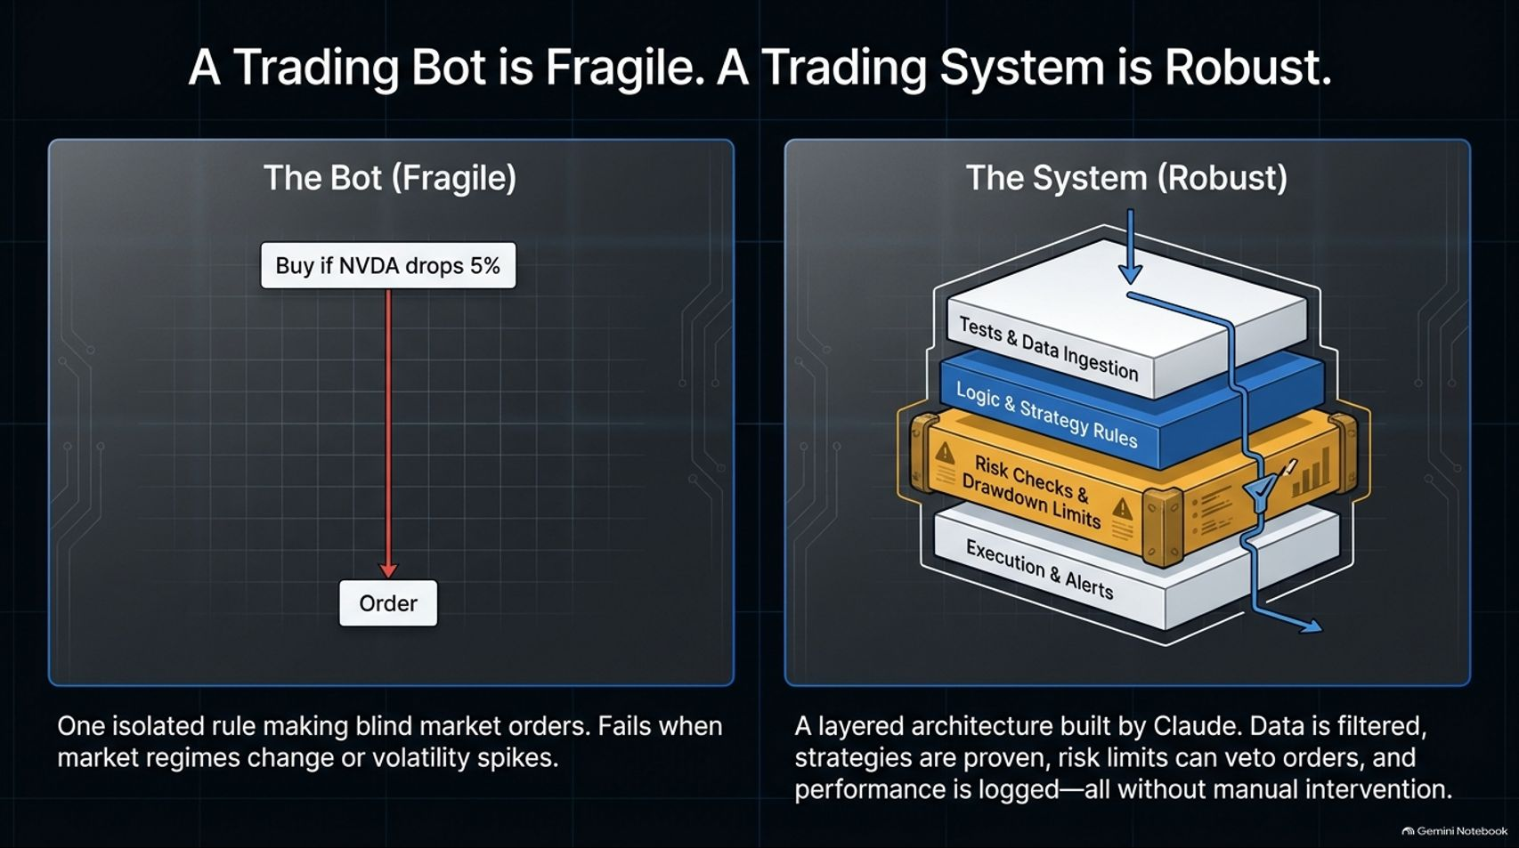
Notes:
Visual Theme: A split comparison layout. On the left, a single linear red drop line ("The Bot"). On the right, a multi-layered, armored modular data stack ("The System").
Speaker Notes:
The Fragility of Simple Bots (Minutes 1–2): What is the difference between a amateur trading bot and a professional trading system? An amateur bot is usually a single isolated rule—like "Buy if NVDA drops 5%"—making blind market orders. It works great in a calm bull market, but it inevitably destroys accounts the moment market regimes change or volatility spikes.
The Robustness of a Layered Architecture (Minutes 3–4): A professional system, built with Claude's assistance, uses a multi-layered architecture. Data is filtered, strategies are proven through historical testing, risk limits can actively veto orders, and performance is logged continuously. By separating data ingestion, strategy logic, risk checks, and execution into isolated layers, we eliminate single points of failure.

Slide 3
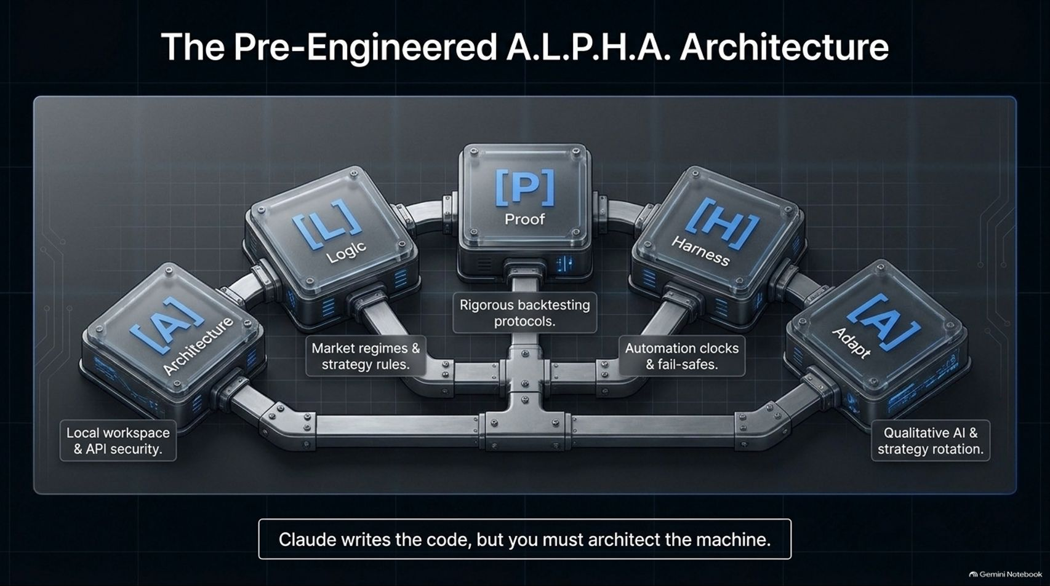
Notes:
Visual Theme: A futuristic 5-node modular pipeline interconnecting blocks labeled A, L, P, H, and A.
Nodes: Architecture | Logic | Proof | Harness | Adapt.
Speaker Notes:
Introducing A.L.P.H.A. (Minutes 1–2): To build this without code, we use the pre-engineered A.L.P.H.A. framework. This acronym covers the entire lifecycle of the trading engine:
A - Architecture: Local workspace setup and API security.
L - Logic: Defining market regimes and strategy rules.
P - Proof: Rigorous backtesting protocols and firewall checks.
H - Harness: Automation clocks and fail-safe safety lines.
A - Adapt: Qualitative AI analysis and quarterly strategy rotation.
The Core Rule (Minutes 3–4): As the masterclass emphasizes: Claude writes the code, but you must architect the machine. You are the general directing the framework, while the AI handles the tactical implementation.

Slide 4
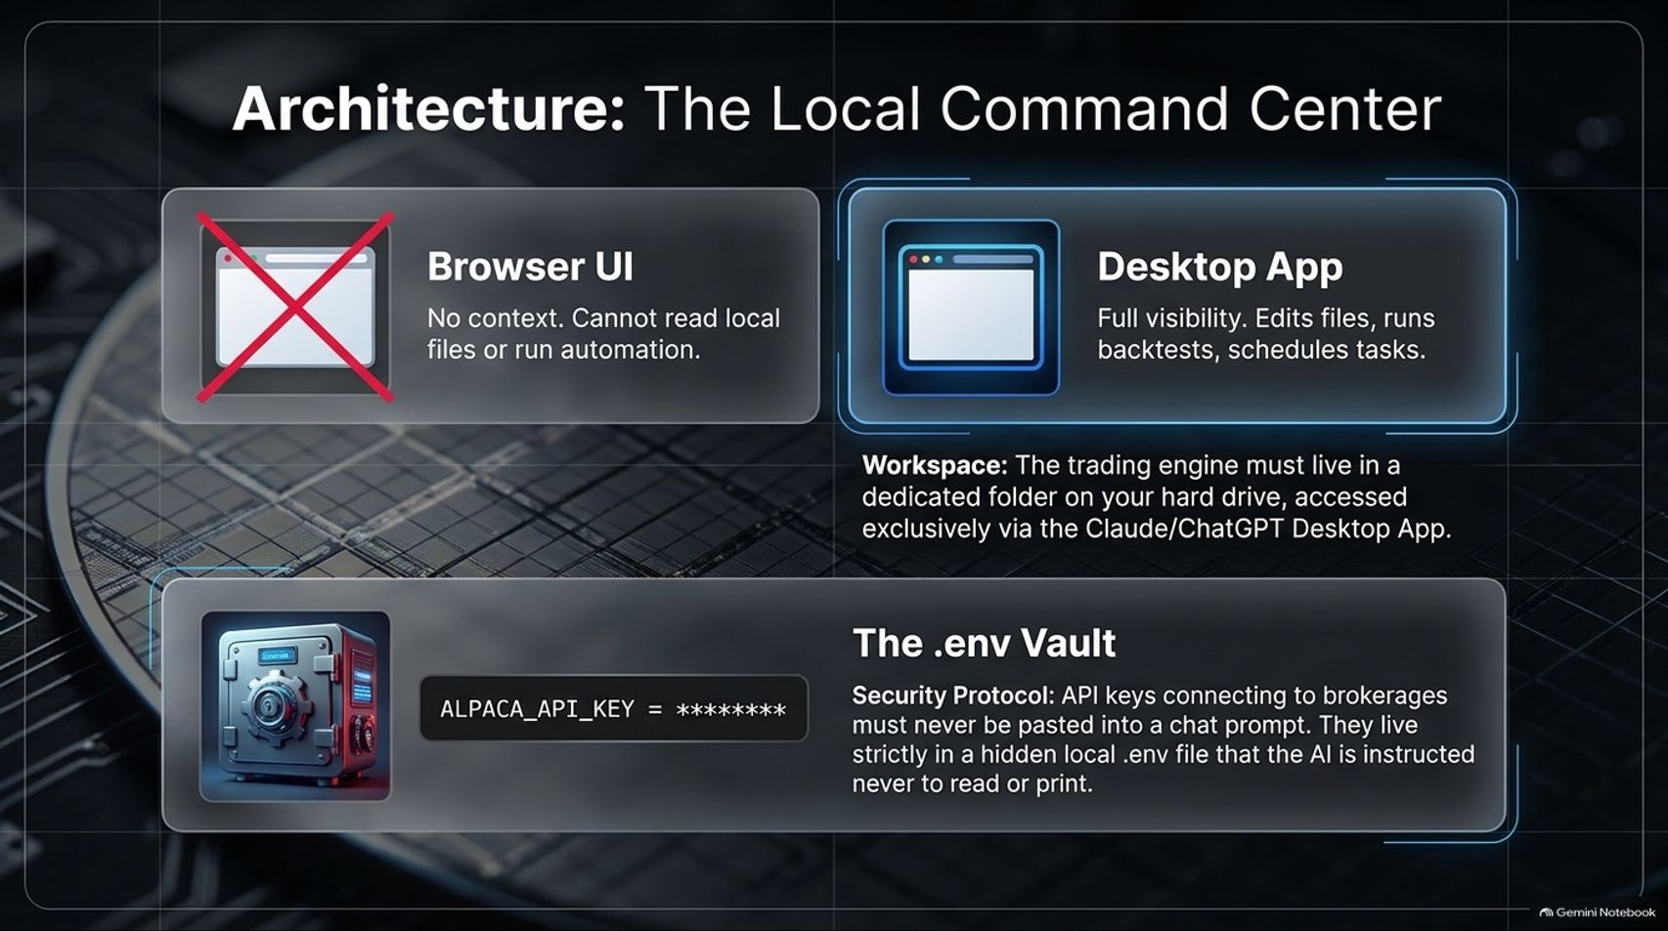
Notes:
Visual Theme: A high-tech desktop workspace contrasted against a crossed-out browser window, alongside a glowing security vault icon (.env).
Speaker Notes:
Browser UI vs. Desktop App (Minutes 1–2): When working with advanced reasoning models like Claude, never rely on a simple browser UI chat window. Browser UIs lack context, cannot read local files on your computer, and cannot run automation. Instead, you must use the Desktop App pointed directly at a dedicated folder on your hard drive.
The .env Security Protocol (Minutes 3–4): Security is paramount. Your API keys connecting to brokerages (like Alpaca or Interactive Brokers) must never be pasted into a chat prompt. They live strictly inside a hidden local .env vault file, which the AI is explicitly instructed never to read or print out.

Slide 5
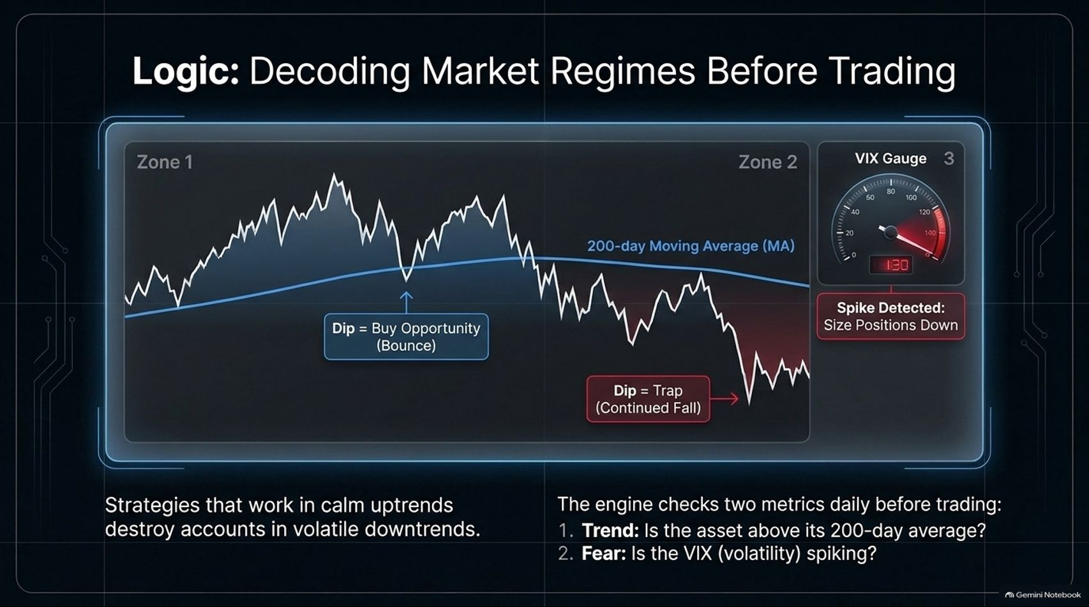
Notes:
Visual Theme: A split stock chart comparing Zone 1 (calm uptrend) and Zone 2 (volatile downtrend), paired with a red-zoned VIX volatility gauge.
Speaker Notes:
The Regime Trap (Minutes 1–2): Strategies that generate incredible returns in calm uptrends will systematically destroy your account in volatile downtrends. A dip in an uptrend is a bounce opportunity; the exact same dip in a downtrend is a bear trap.
The Two Daily Checks (Minutes 3–4): Before any trade executes, our engine checks two mandatory macro metrics daily:
Trend: Is the asset trading above its 200-day moving average?
Fear: Is the VIX (volatility index) spiking? If volatility spikes past safety thresholds, the engine automatically scales down position sizes or halts aggressive sleeve trades.

Slide 6
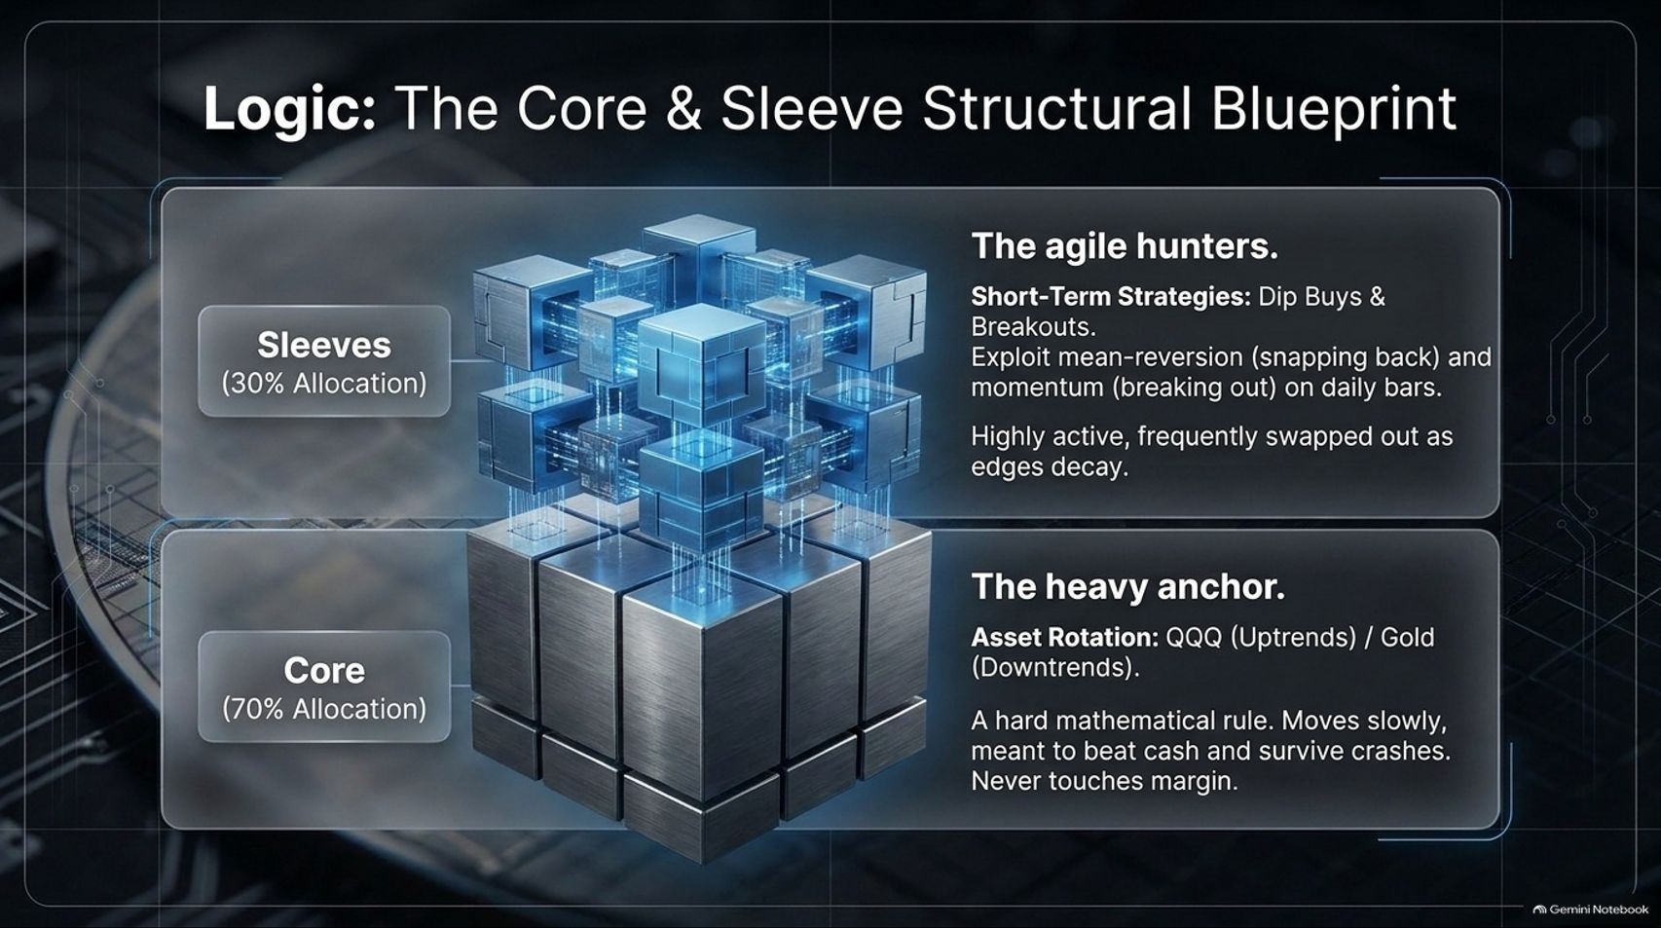
Notes:
Visual Theme: A 3D structural cube matrix divided into a heavy metallic base ("Core") and nimble interconnected satellite nodes ("Sleeves").
Speaker Notes:
The Core and Sleeve Split (Minutes 1–2): Professional asset management relies on separating long-term stability from tactical alpha. Our portfolio is split into two distinct components:
Core (70% Allocation - The Heavy Anchor): Uses hard mathematical rules like asset rotation between QQQ (during uptrends) and Gold (during downtrends). It moves slowly, beats cash, survives major market crashes, and never touches margin.
Sleeves (30% Allocation - The Agile Hunters): Short-term strategies like mean-reversion dip-buys and daily momentum breakouts. These are highly active and frequently swapped out as market edges decay.

Slide 7
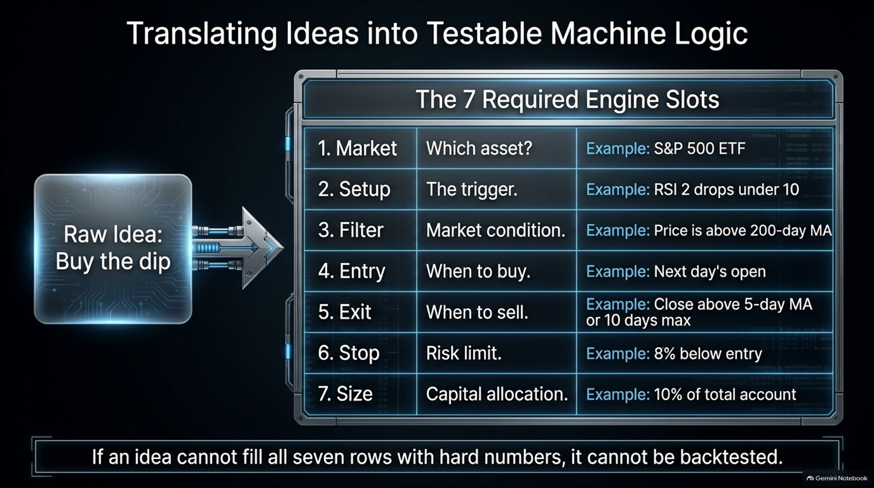
Notes:
Visual Theme: A structured 7-row diagnostic matrix transforming a vague prompt into rigorous parameters.
Speaker Notes:
Eliminating Ambiguity (Minutes 1–2): Vague ideas like "Buy the dip" cannot be coded or backtested by an AI. To make an idea testable, we must force it through The 7 Required Engine Slots:
Market: Which asset? (e.g., S&P 500 ETF)
Setup: The exact trigger (e.g., RSI 2 drops under 10)
Filter: Market condition (e.g., Price above 200-day MA)
Entry: When to buy (e.g., Next day's open)
Exit: When to sell (e.g., Close above 5-day MA or 10 days max)
Stop: Risk limit (e.g., 8% below entry)
Size: Capital allocation (e.g., 10% of total account)
The Iron Rule (Minutes 3–4): If an idea cannot fill all seven rows with hard, quantified numbers, it cannot be backtested.

Slide 8
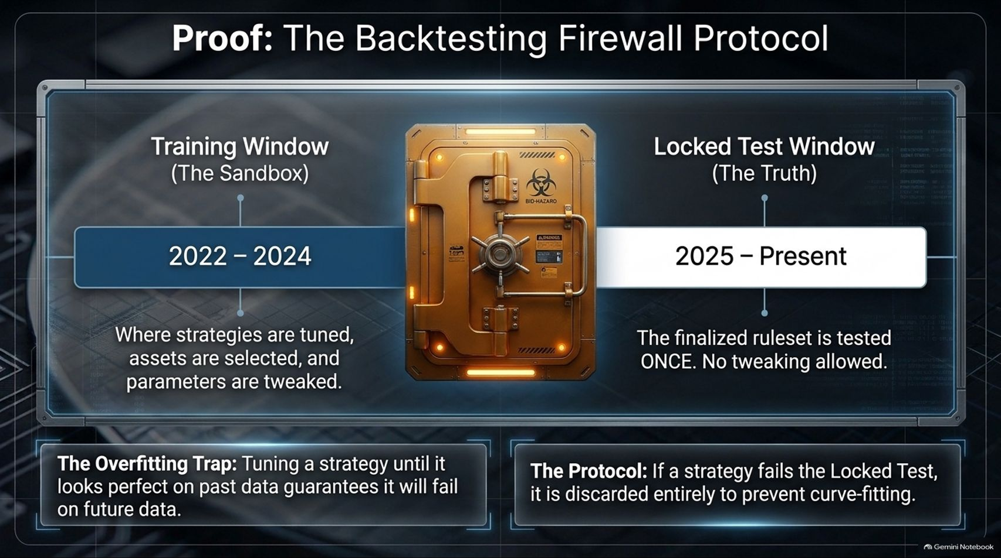
Notes:
Visual Theme: A heavy, glowing bank vault door splitting a timeline between a training sandbox (2022–2024) and a locked test window (2025–Present).
Speaker Notes:
The Overfitting Trap (Minutes 1–2): If you give an AI total freedom to tweak parameters on historical data, it will curve-fit a strategy that looks like a masterpiece on past charts—and fails miserably on live data.
The Sandbox vs. The Truth (Minutes 3–4): We implement a strict two-stage firewall protocol:
Training Window (2022–2024): The sandbox where strategies are tuned, assets are selected, and parameters are adjusted.
Locked Test Window (2025–Present): The vault of truth. The finalized ruleset is tested once. No further tweaking is allowed. If a strategy fails the locked test, it is discarded entirely.

Slide 9
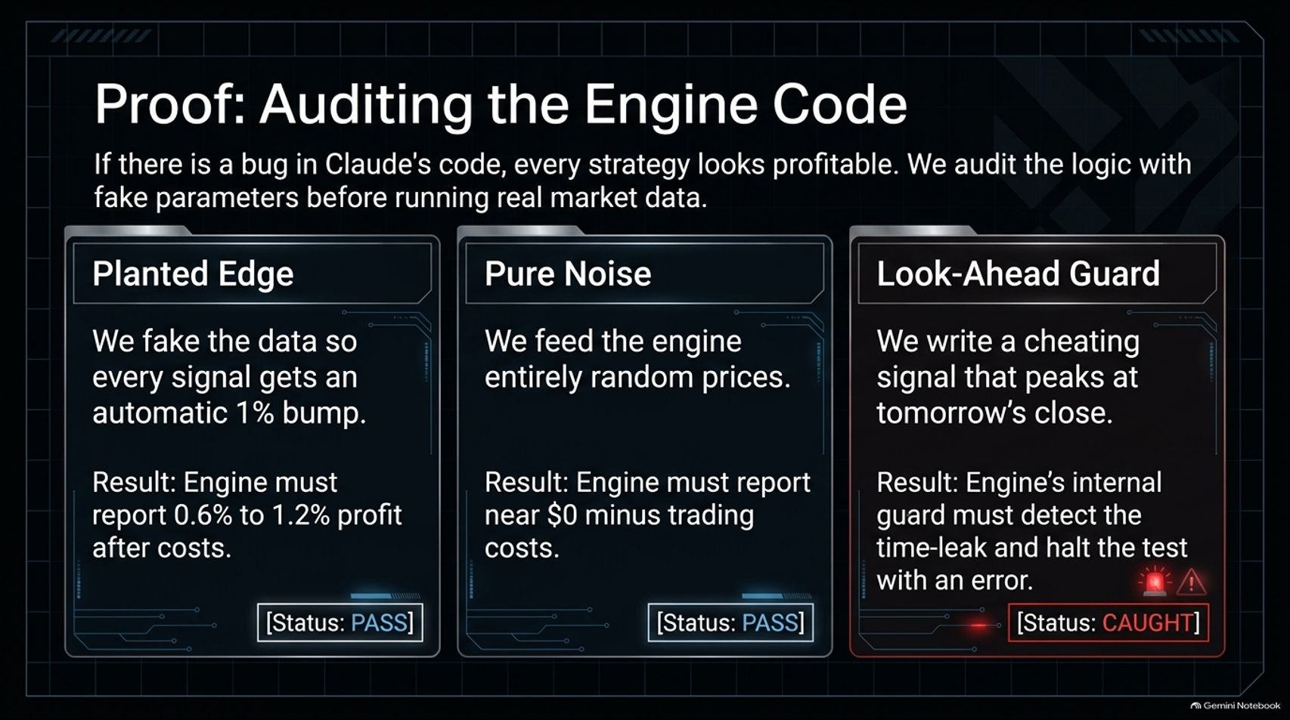
Notes:
Visual Theme: Three diagnostic testing panels demonstrating synthetic verification ([Status: PASS], [Status: PASS], [Status: CAUGHT]).
Speaker Notes:
Verifying the Codebase (Minutes 1–2): If there is a hidden bug in Claude's backtesting code, every strategy will look suspiciously profitable. Before trusting real market data, we audit the logic using three rigorous diagnostic checks:
Planted Edge Test: We artificially inject a 1% profit bump into every signal. The engine must accurately report 0.6% to 1.2% net profit after transaction costs.
Pure Noise Test: We feed the engine entirely random prices. The engine must report near $0 profit minus trading costs.
Look-Ahead Guard Test: We write a cheating signal that peaks at tomorrow's close. The engine's internal integrity guard must instantly detect the time-leak and halt the test with an error.

Slide 10
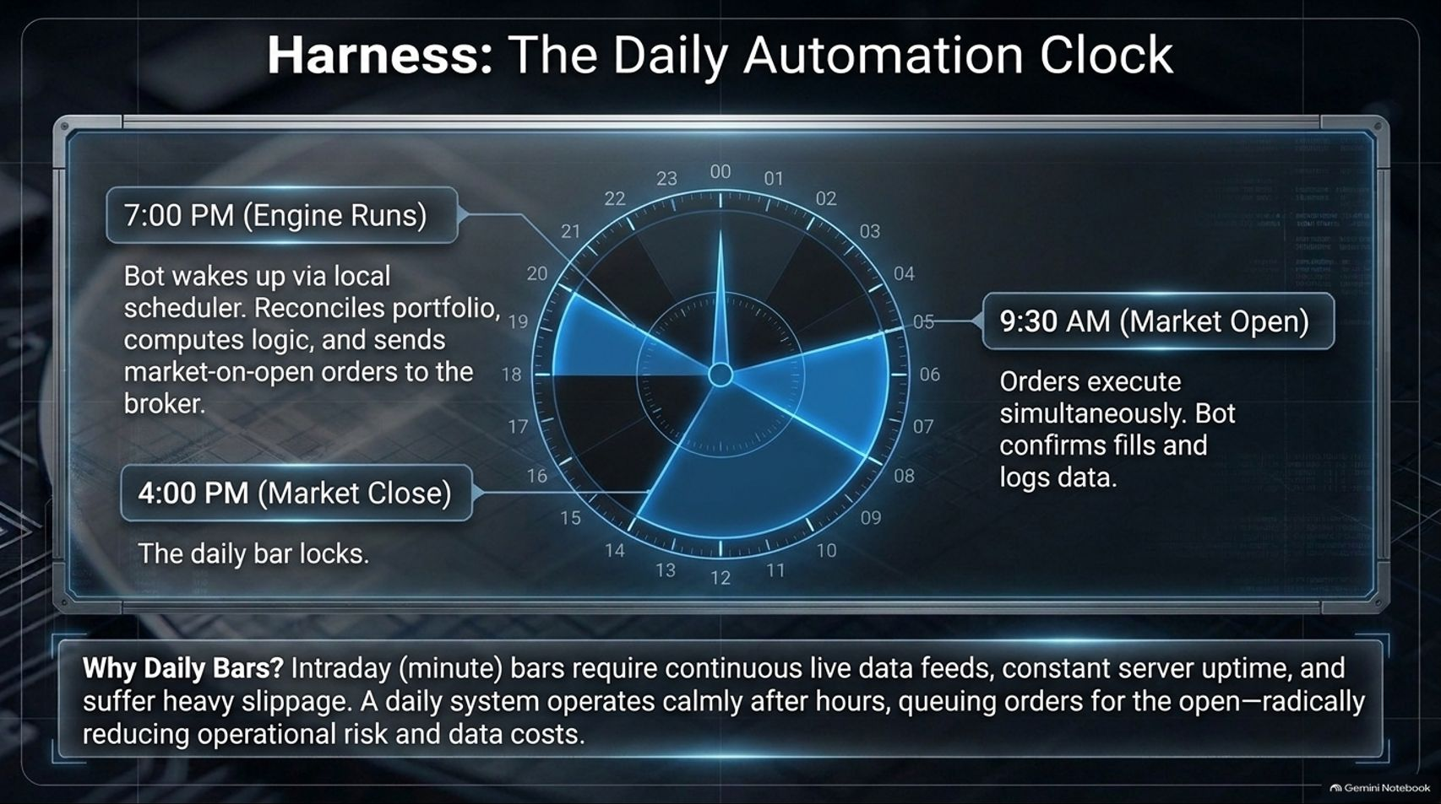
Notes:
Visual Theme: A 24-hour circular automation dial highlighting key time anchors (7:00 PM, 9:30 AM, 4:00 PM).
Speaker Notes:
Why Daily Bars Beat Intraday (Minutes 1–2): Many beginners think they need high-frequency, minute-by-minute data feeds. In reality, intraday trading requires constant server uptime, expensive data subscriptions, and suffers from heavy execution slippage.
The Daily Routine (Minutes 3–4): Our engine operates on a calm, automated schedule:
4:00 PM (Market Close): The daily price bar locks.
7:00 PM (Engine Runs): The bot wakes up via local scheduler, reconciles the portfolio, computes strategy logic, and queues orders.
9:30 AM (Market Open): Market-on-open orders execute simultaneously, confirming fills and logging data while reducing operational risk to near zero.

Slide 11
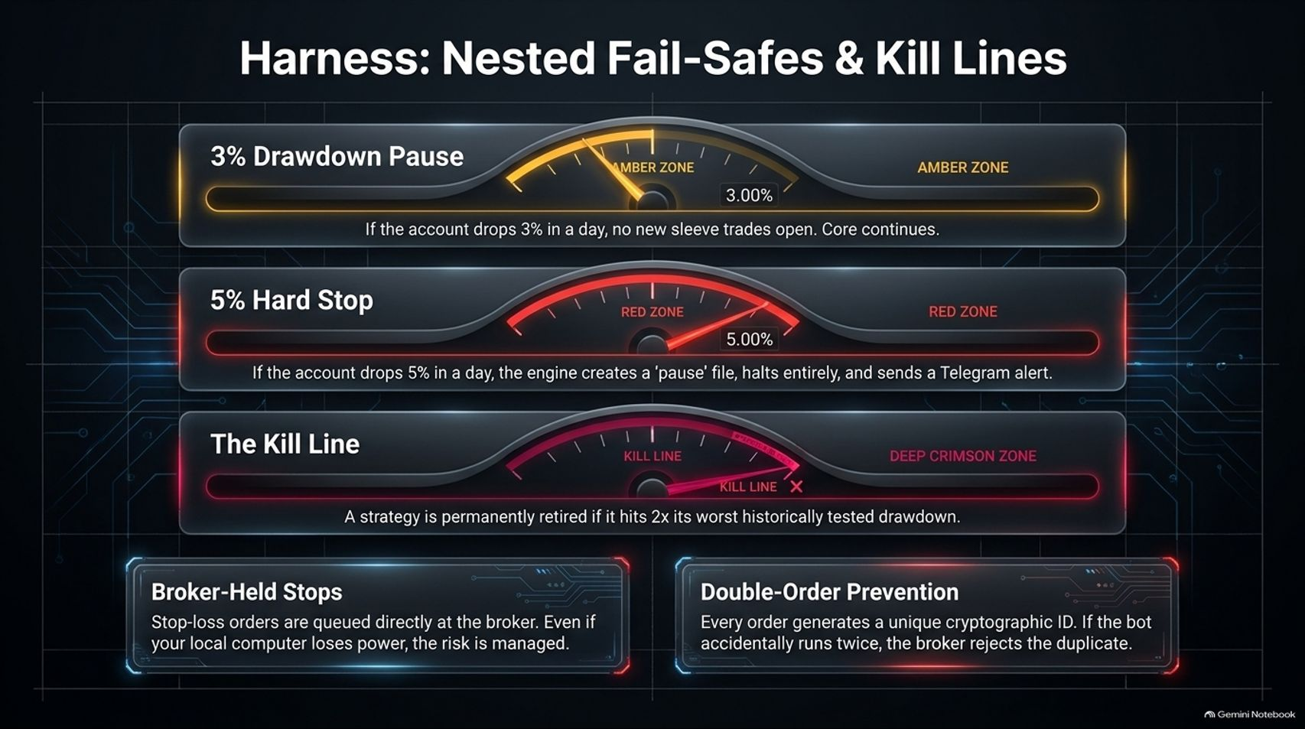
Notes:
Visual Theme: Three industrial gauge dashboards displaying amber and red hazard zones, alongside secure hardware safeguard boxes.
Speaker Notes:
Multi-Layered Circuit Breakers (Minutes 1–2): Automation requires ironclad safety nets. We embed nested fail-safes into the harness:
3% Drawdown Pause (Amber Zone): If the account drops 3% in a single day, no new sleeve trades open; the core continues safely.
5% Hard Stop (Red Zone): If the account drops 5%, the engine creates an emergency 'pause' file, halts all trading, and pushes a Telegram alert to your phone.
The Kill Line: A strategy is permanently retired to the bin if it ever hits twice its worst historically tested drawdown.
Broker-Level Protection (Minutes 3–4): Stop-loss orders are queued directly at the broker. Even if your local computer loses power or internet connectivity, your downside risk remains fully managed by the exchange.

Slide 12
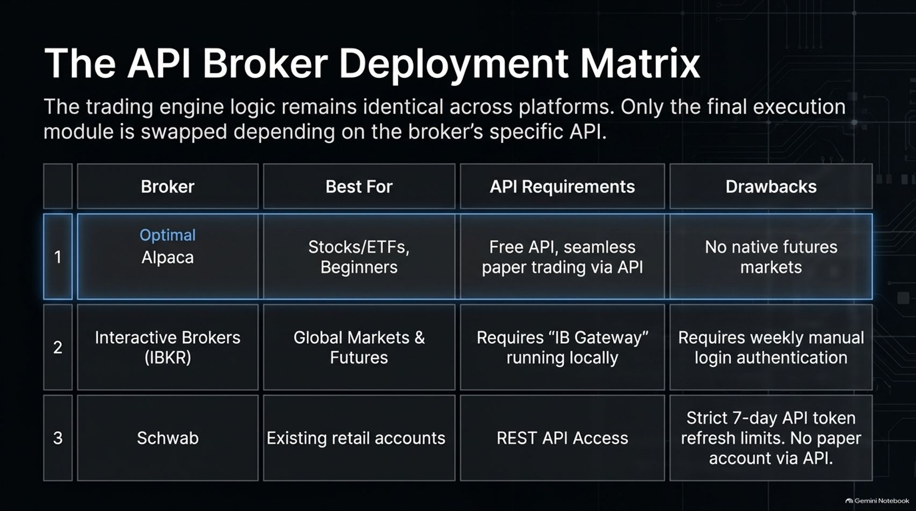
Notes:
Visual Theme: A structured technical comparison matrix evaluating Alpaca, Interactive Brokers (IBKR), and Charles Schwab.
Speaker Notes:
Choosing Your Brokerage Gateway (Minutes 1–2): The trading engine logic remains identical regardless of platform; only the final execution module swaps out based on the broker's API.
Platform Comparison (Minutes 3–4):
Alpaca (Optimal for Beginners): Offers a free API, seamless paper trading, and zero commission on stocks/ETFs, though it lacks native futures markets.
Interactive Brokers (IBKR): Best for global markets and futures, but requires running local software like "IB Gateway" and weekly manual authentication logins.
Schwab: Great for existing retail accounts via REST API, but features strict 7-day token refresh limits and no native paper trading via API. For most builders, Alpaca is the recommended starting point.

Slide 13
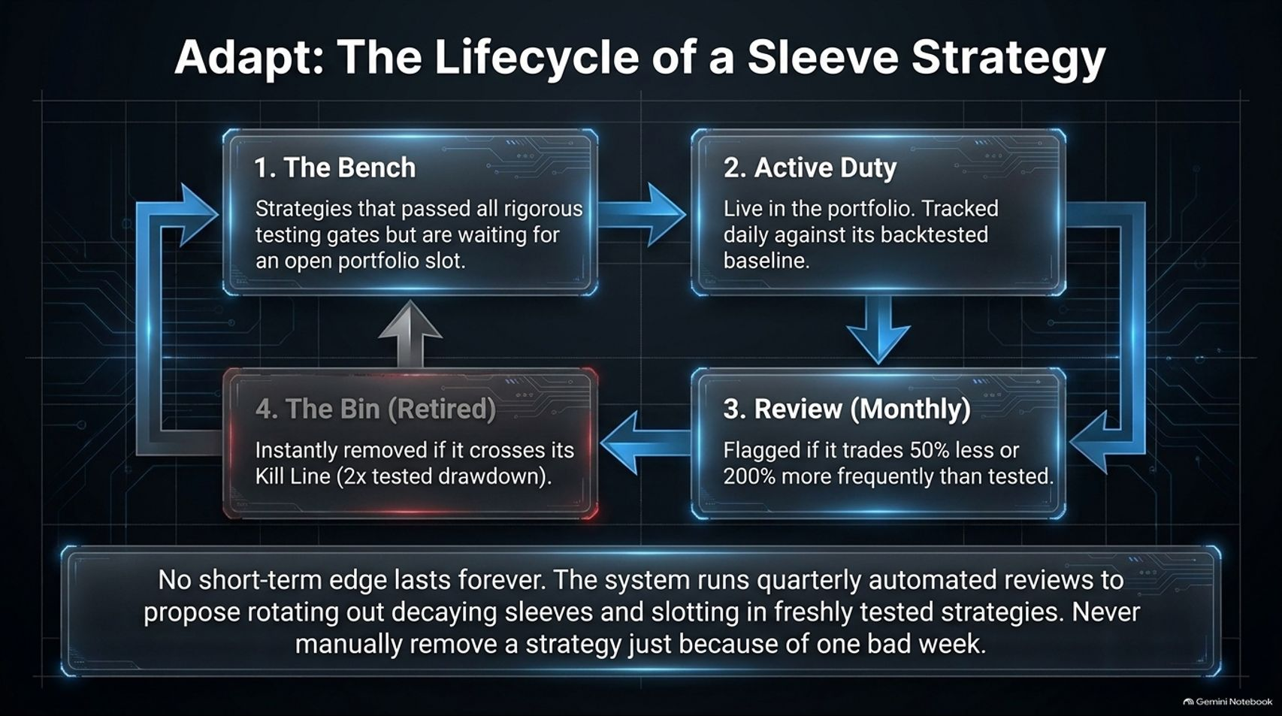
Notes:
Visual Theme: A cyclical 4-stage flowchart mapping a strategy's journey from the Bench to Active Duty, Monthly Review, and Retirement.
Speaker Notes:
Strategy Decay (Minutes 1–2): No short-term market edge lasts forever. Strategies experience decay as market participants adapt. Therefore, our sleeves operate on a strict evolutionary lifecycle:
The Bench: Strategies that passed rigorous backtesting wait for an open portfolio slot.
Active Duty: Live in the portfolio, tracked daily against expected baselines.
Review (Monthly): Flagged if a strategy trades 50% less or 200% more frequently than tested.
The Bin (Retired): Instantly removed if it crosses its predetermined Kill Line.
Patience over Panic (Minutes 3–4): Never manually remove a strategy just because it had one bad week. Let the system run its quarterly automated reviews.

Slide 14
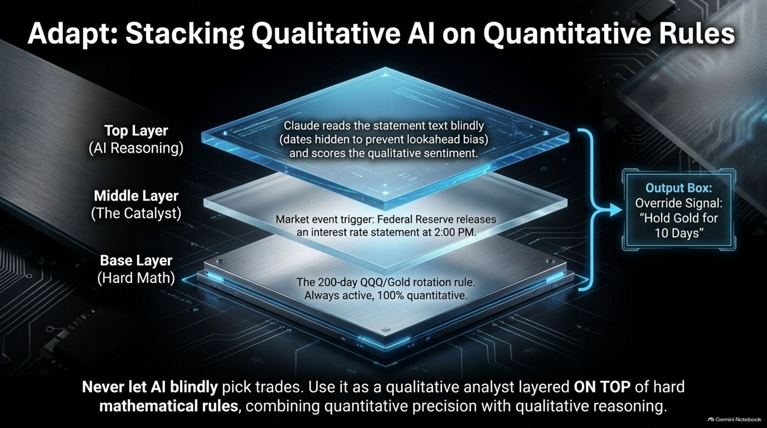
Notes:
Visual Theme: A 3-layered architectural stack showing Base Math, Catalyst Triggers, and Top-Layer AI Reasoning.
Speaker Notes:
The Role of AI Reasoning (Minutes 1–2): Never let an AI blindly pick trades based on raw chat prompts. That is a recipe for disaster. Instead, we use AI as a qualitative analyst layered on top of hard mathematical rules.
The Three-Layer Stack (Minutes 3–4):
Base Layer (Hard Math): The 200-day QQQ/Gold rotation rule. Always active, 100% quantitative.
Middle Layer (The Catalyst): Market event triggers—for instance, the Federal Reserve releasing an interest rate statement at 2:00 PM.
Top Layer (AI Reasoning): Claude reads the statement text blindly (with dates hidden to prevent look-ahead bias) and scores the qualitative sentiment, outputting a precise override signal like "Hold Gold for 10 Days".

Slide 15
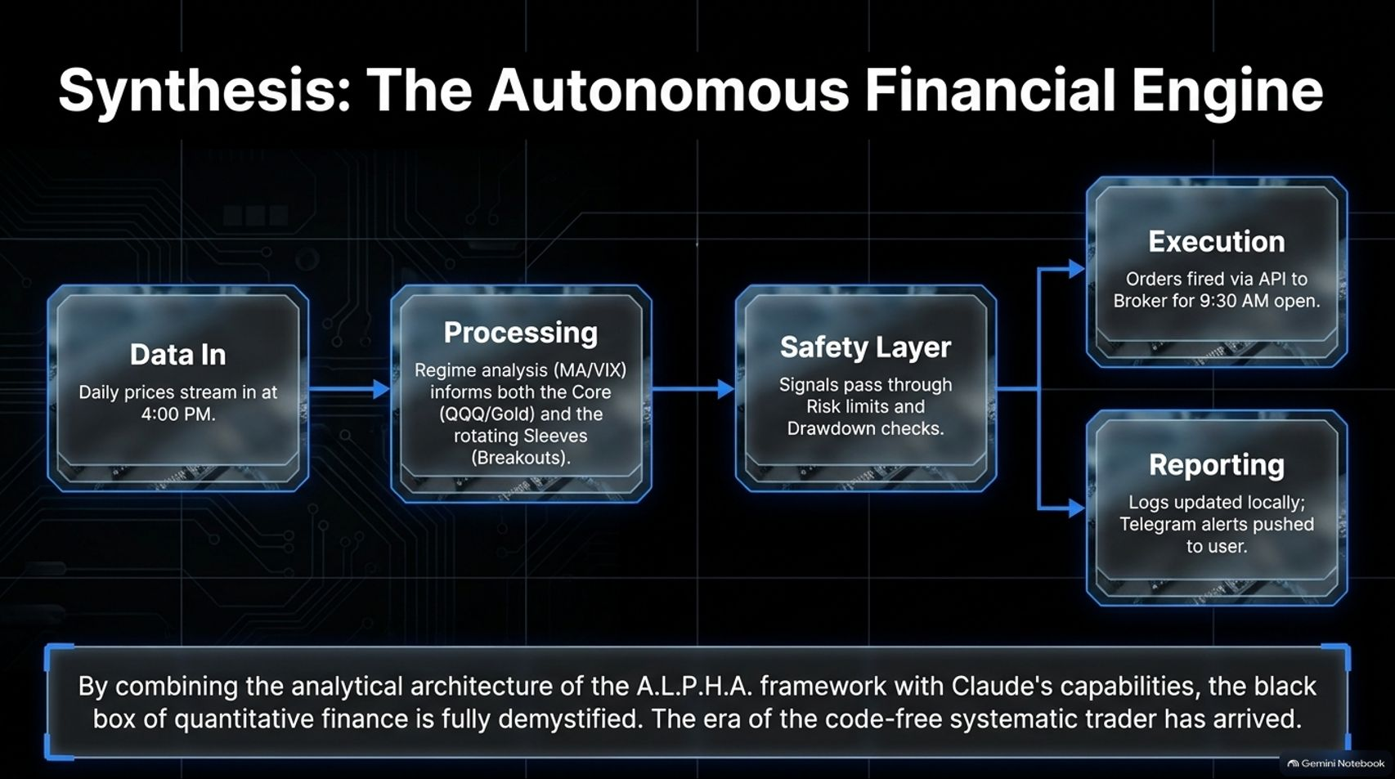
Notes:
Visual Theme: An end-to-end data pipeline diagram flowing from Data In to Processing, Safety Layers, Execution, and Reporting.
Speaker Notes:
Connecting the Pipeline (Minutes 1–2): Let's review the complete engine loop:
Data In: Daily prices stream in automatically at 4:00 PM.
Processing: Regime analysis (MA/VIX) informs both the Core asset rotation and the rotating Sleeve breakouts.
Safety Layer: Signals pass through strict risk limits, drawdown checks, and VIX filters.
Execution & Reporting: Validated orders fire via API to the broker for the 9:30 AM open, while logs update locally and Telegram alerts push straight to your phone.
Demystifying Quant Finance (Minutes 3–4): By combining the analytical architecture of the A.L.P.H.A. framework with Claude's capabilities, the black box of quantitative finance is fully demystified. The era of the code-free systematic trader is here.

Slide 16
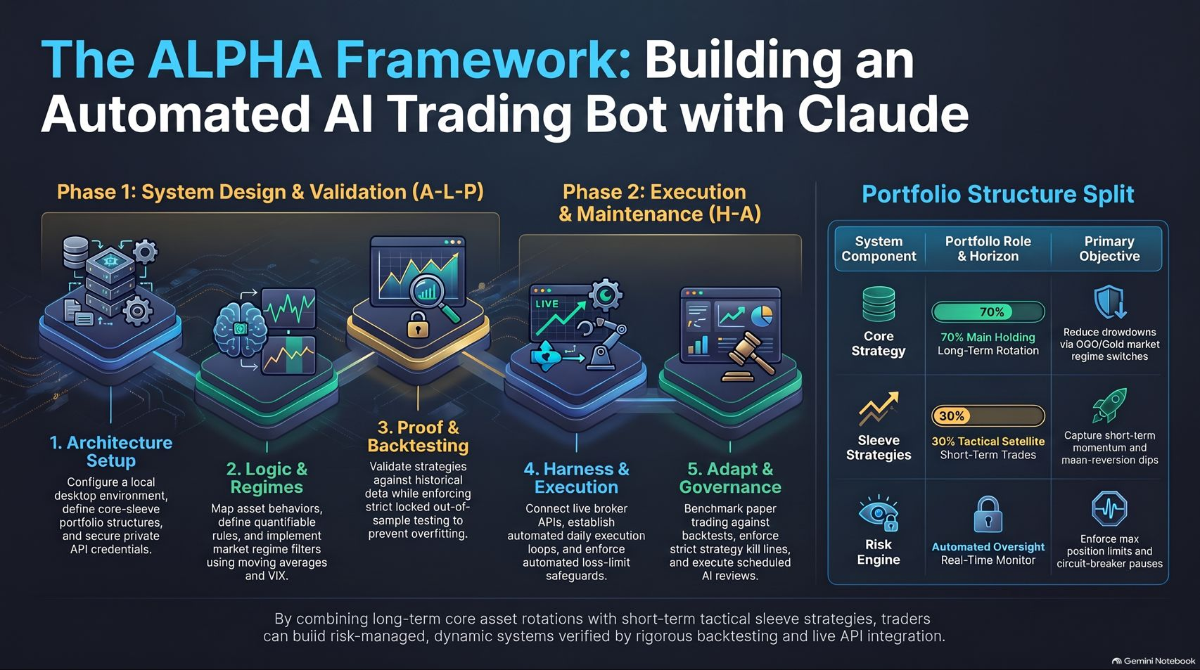
Notes:
Visual Theme: A comprehensive summary dashboard uniting Phase 1 (Design & Validation) and Phase 2 (Execution & Maintenance) alongside the Portfolio Structure Split matrix.
Speaker Notes:
Masterclass Summary (Minutes 1–2): As we conclude this blueprint, remember that building an automated AI trading bot is an engineering discipline, not a guessing game.
The Two Phases (Minutes 3–4):
Phase 1 (A-L-P): Focuses on local workspace setup, regime mapping, and rigorous backtesting firewall protocols to eliminate overfitting.
Phase 2 (H-A): Focuses on live broker API connections, automated daily schedules, nested drawdown safeguards, and scheduled strategy rotation.
Final Takeaway (Minutes 5–6): By combining long-term core asset rotations with short-term tactical sleeve strategies, verified by strict out-of-sample backtesting and secure API integration, you now possess the exact blueprint to run your own institutional-grade trading machine. Thank you!

